Slide 1
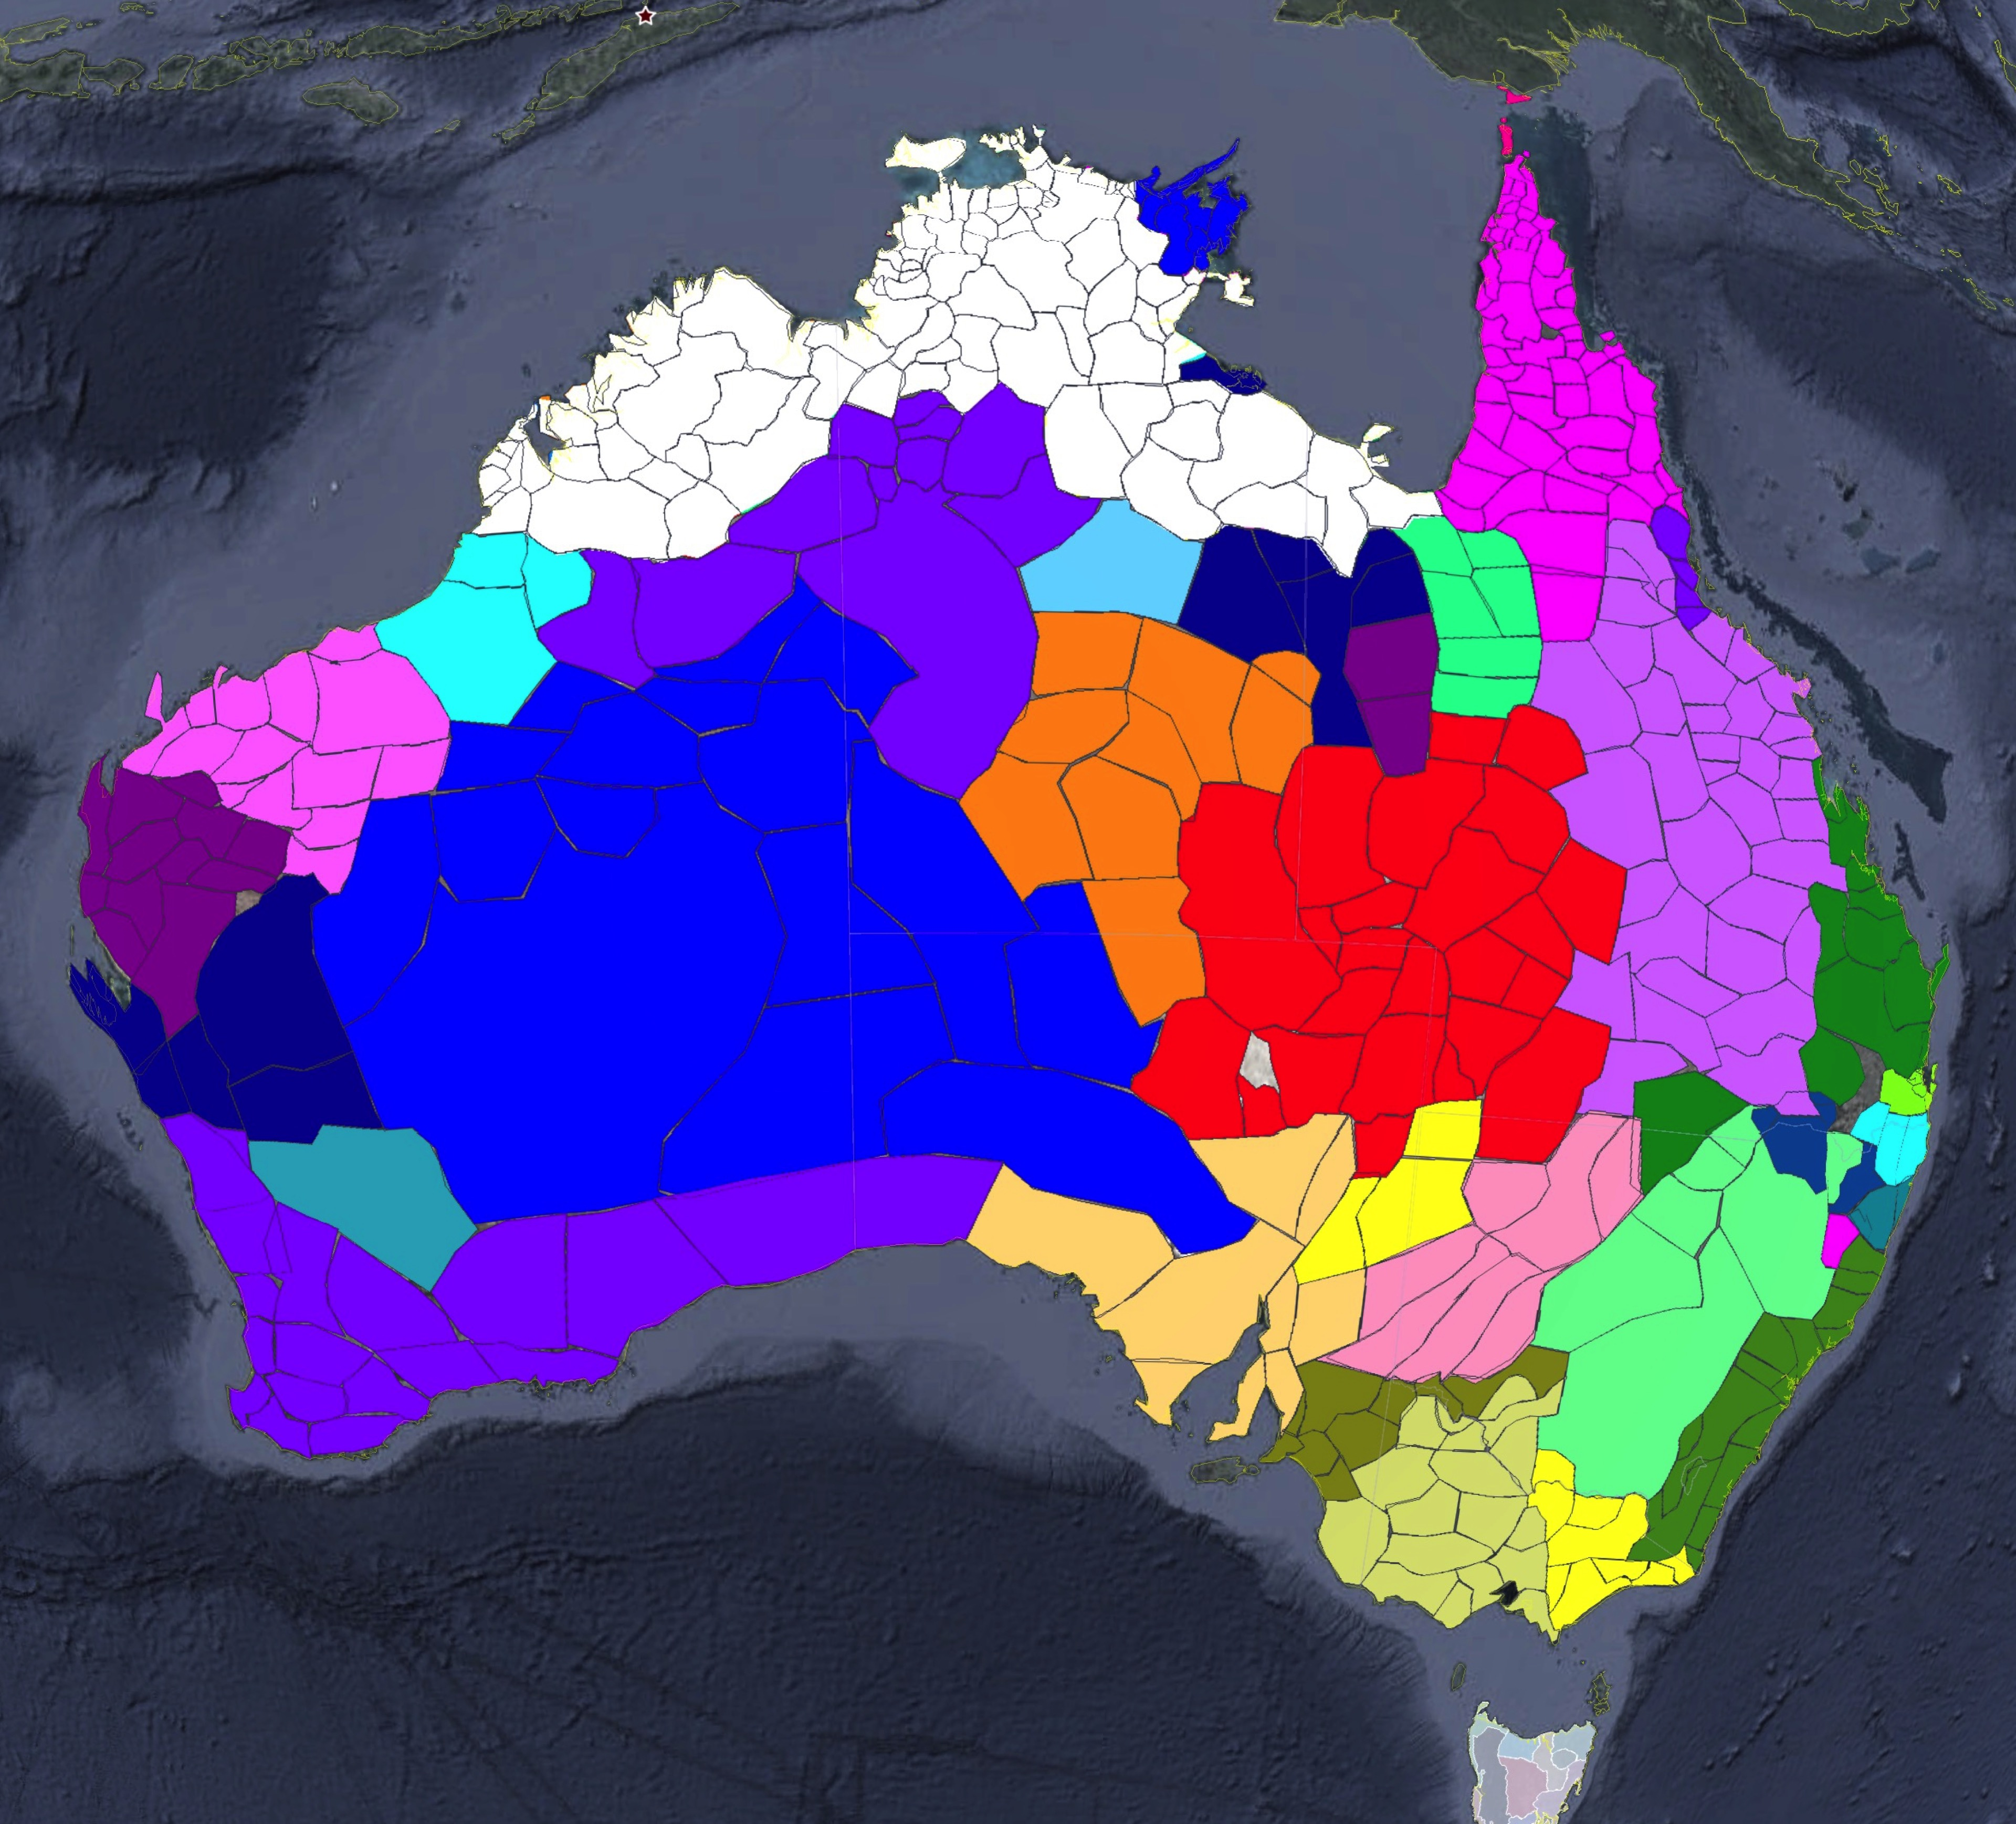


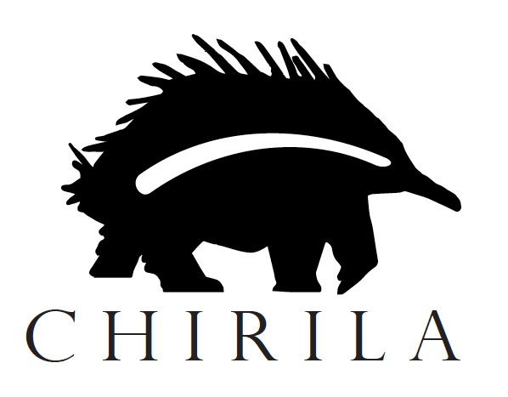
Standard Average Australian
Claire Bowern, Yale University
(full text of paper currently in prep for Linguistic Typology; comments very welcome!)
claire.bowern@yale.edu

Slide 2
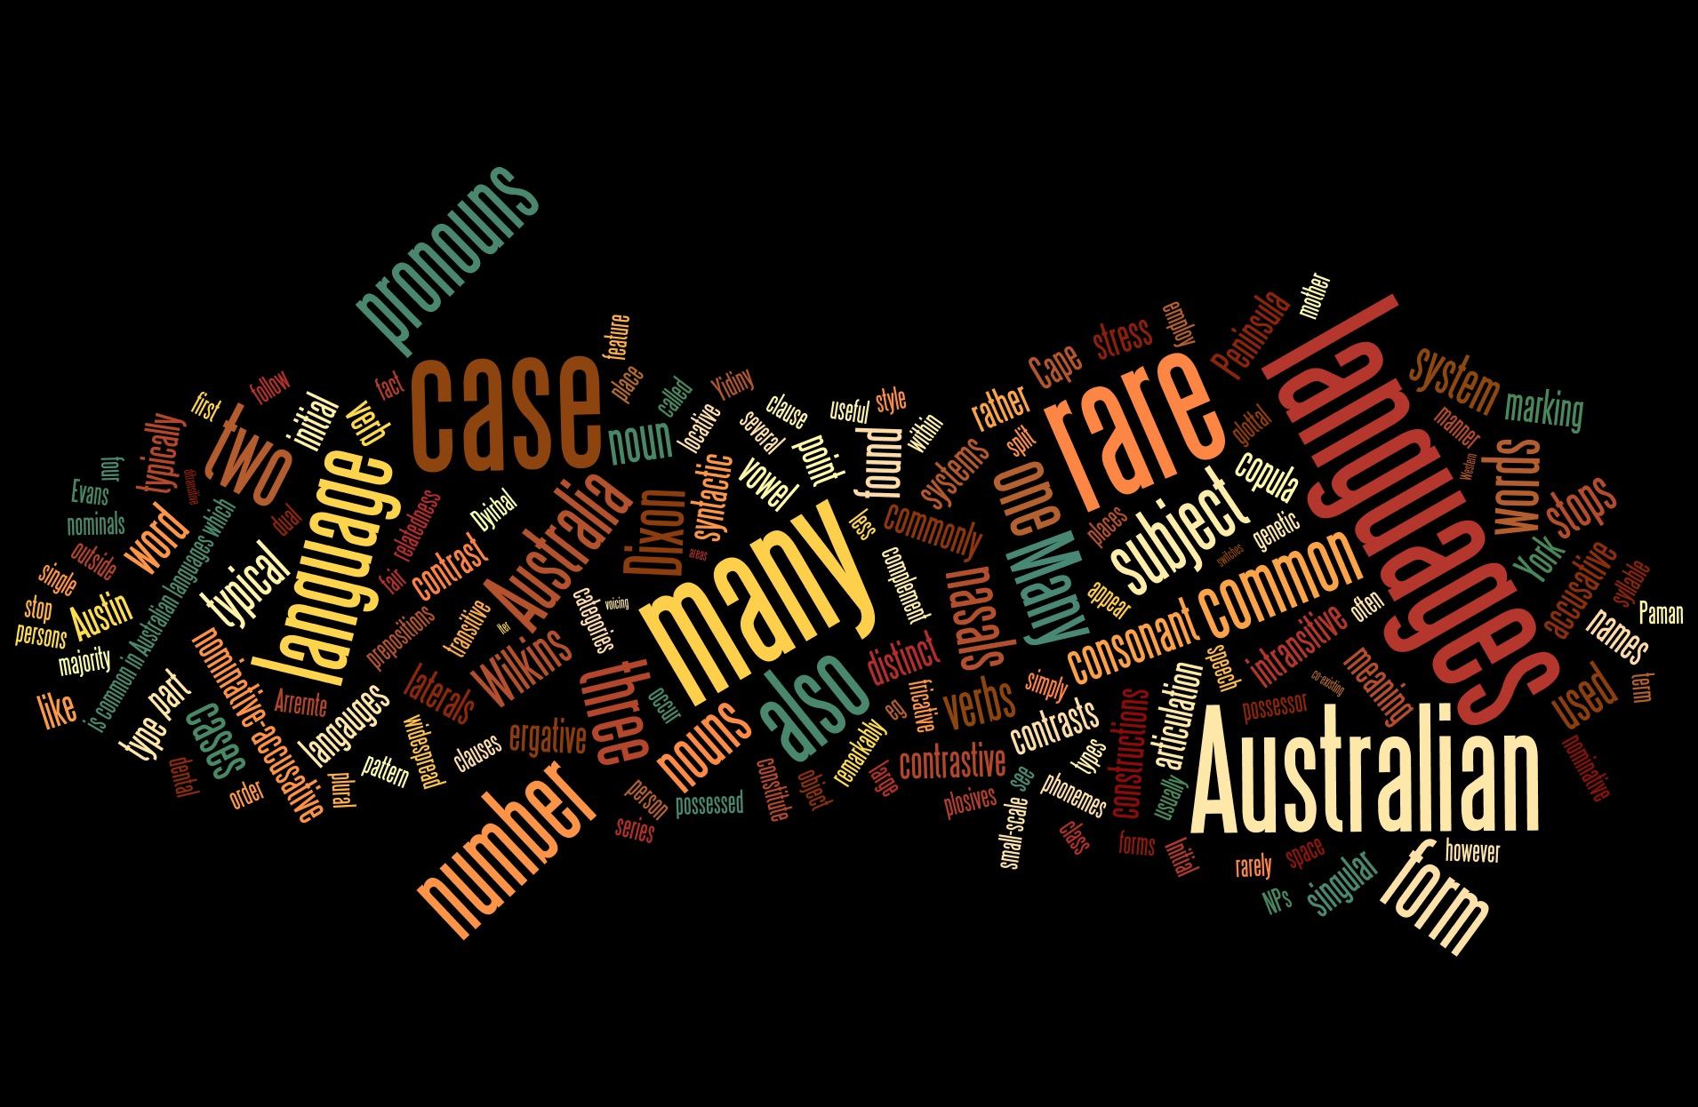
cf. Gasser and Bowern (2014); Bowern (2016)
Notes:
This paper was borne from many years of reading grammars of Australian languages, noticing claims about typicality, commonality, or rarity of features, and then doing typology and reconstruction and noticing some exceptions, and then wondering whether the claims of typicality and rarity were really true. In 2013 I taught a class on Australian languages and we collected some claims as part of that class. Grace Brody graduated recently and tested some of them, I then recently updated the database and wrote this paper.

Slide 3
Today
Examining our assumptions about
  widespread features
  typological profiles and ‘typical’ languages
  and how we talk about them
Implications for
  generalizations about Australian languages
  language documentation
  what to study and how to study it

Slide 4
tl;dr [aka conclusions]
We talk about similarities a lot more than we talk about differences.
Half the claims in the literature about frequency of features are either wrong or impossible to verify because the data are un-knowable or unobtainable.
This is a problem.

Slide 5
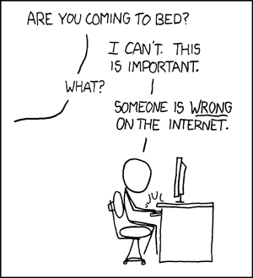
NOT this:

Slide 6
Also not ...
Australian languages generally lack a part of speech with typical determiner features such as obligatory use, competition for a specific position in the noun phrase and specialization in this function. This study uses a sample of 100 languages to investigate whether Australian languages can be said to have any kind of determiner system, and if so, what it looks like in structural terms. I show that there is structural evidence for a determiner slot or zone in half of the languages. (Louagie 2016)
Notes:
ie focusing not on the results of well constructed typological surveys across the country,

Slide 7
But rather
  “Pama-Nyungan languages are fairly homogeneous in grammatical structure, but lexical sharings are often geographically uncoordinated, and there is much semantic flux in word meanings.” (Bellwood 2013:117)

Slide 8
“Mantjiltjara, along with other languages of the Wati Subgroup, has a great concentration of Common Australian characteristics” (Marsh 1992:11)

Slide 9
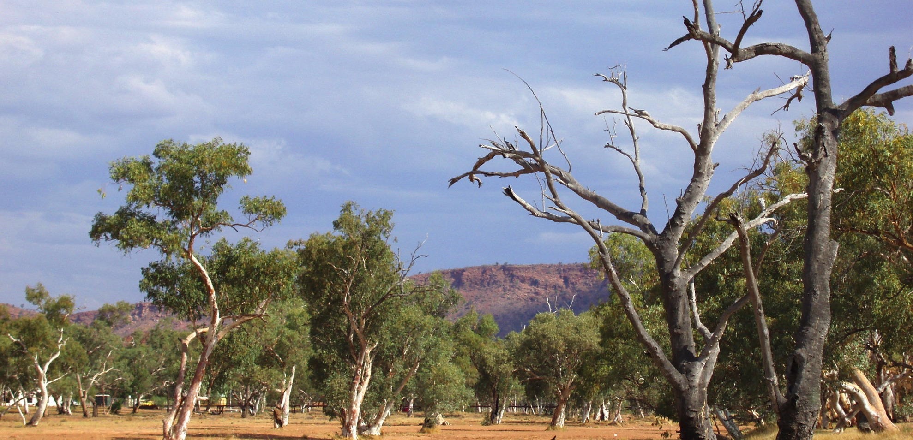
Methods

Slide 10
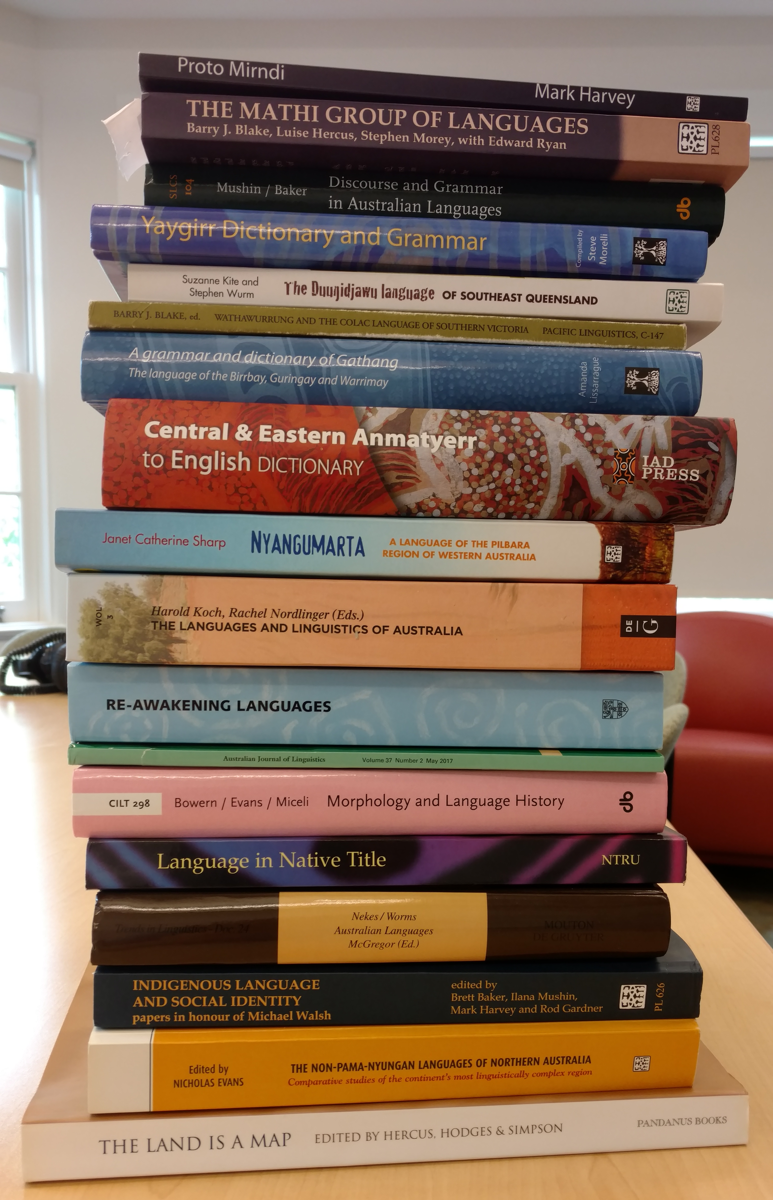
Searching
Google scholar and pdf search
for key terms, including:
  ‘common (in)’, homogeneous,
  ‘rare (in)’
  ‘unusual’
  ‘typical’ [Australian language]
(plus noting terms in other reading)
Not comprehensive of sources (but close to comprehensive by term)
Notes:
concentrated on published and samizdat/grey lit sources; full terms list is below

Slide 11
Coding
Author (+ other demographics)
Year
Type of claim
Common/typical/rare/etc [categorizing the claim]
testable?
  is the evidence in principle available?
  can we test it with the sample we already have?
verified?
  does our data support the claim?

Slide 12
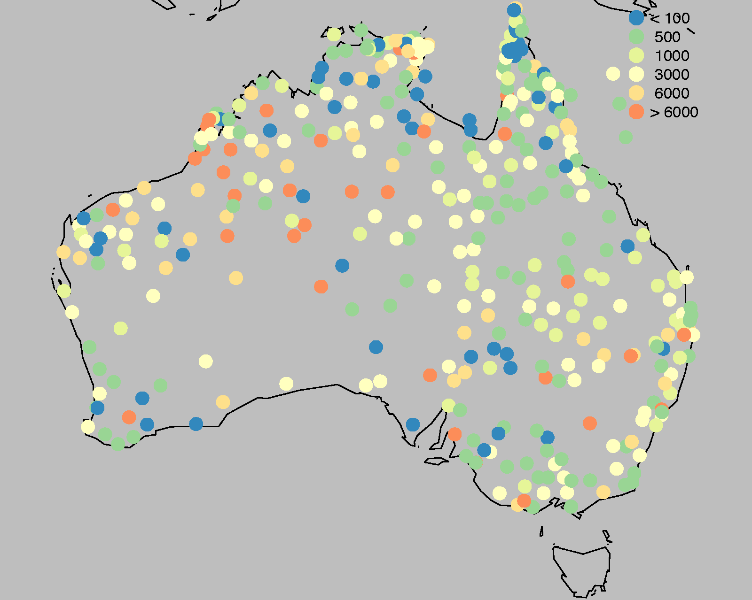
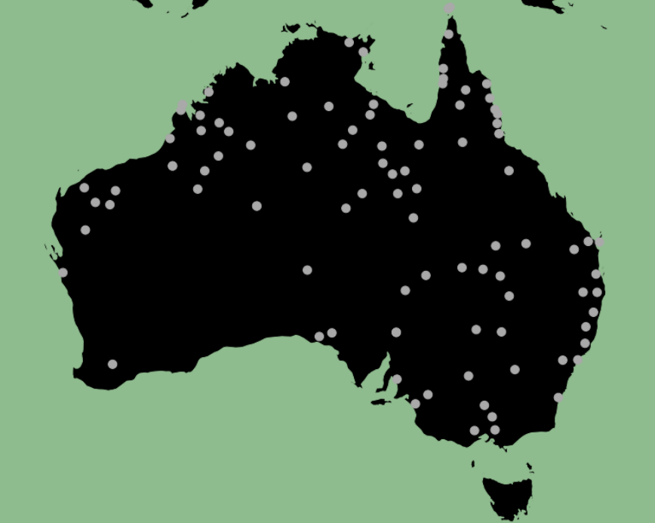
Testing
Test against Chirila (lexical data) for semantics (e.g. polysemy
Test against phonological inference (e.g. as reported in Gasser and Bowern 2014)
Sample of grammatical data (compiled under NSF HSD grant; c. 90 languages from across Australia)
Bowern (2016)
Notes:
Archival work + fieldwork

Slide 13
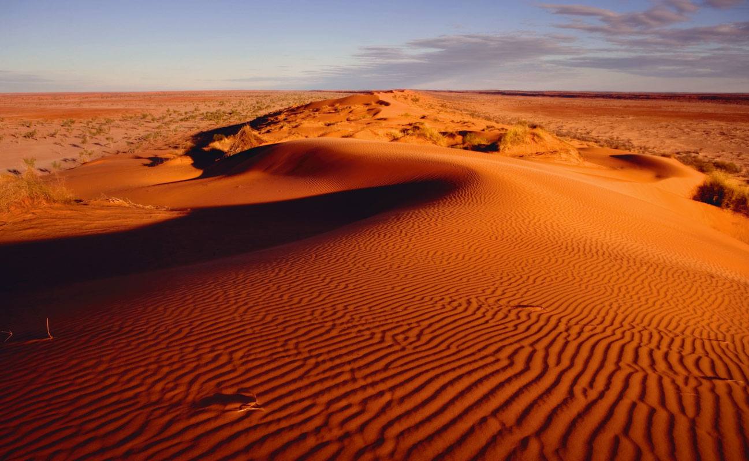
Results

Slide 14
Summary
89 claims
from 48 different authors
1937-2017 in current sample
across phonetics, phonology, morphology, syntax, semantics, discourse

Slide 15
Authors
Notes:
Lots of different authors; top people are Dixon, Goddard, Evans, Capell, Austin (repeated everything that follows, leaving out Dixon, and the results are very similar)

Slide 16
Chronology of claims

Slide 17
Universities of origin
Notes:
(source of claims vs source of authors)

Slide 18
Australianist?
Notes:
That is, these are claims being made by Australianists about the languages we work on.

Slide 19
Subfield

Slide 20
Terms used

Slide 21
Terms used, (condensed)
Notes:
we’re talking a lot more about how the languages of Australia have stuff in common than how different they are.

Slide 22
Terms, by subfield
Notes:
relatively more of the claims about rarity are in phonology (usually in the context of Arandic and Paman, though). Syntax and morphology overwhelmingly are about what the languages have in common.

Slide 23
Are the claims testable?
Yes: Multi-level case marking is widespread in Australian languages (Dench and Evans 1988:1)
Hard: Many Australian languages have a term that is at first glossed as "camp" or hut but in fact has a very general meaning. (Dixon 2002: 58)
No: In all Australian languages ‘point time’ words then have interval reference rather than strict point or punctual specification. (Austin 1988:5)

Slide 24
Testable claims?
Notes:
ost claims testable with data already collected for other purposes; harder to test some of the claims in syntax.

Slide 25
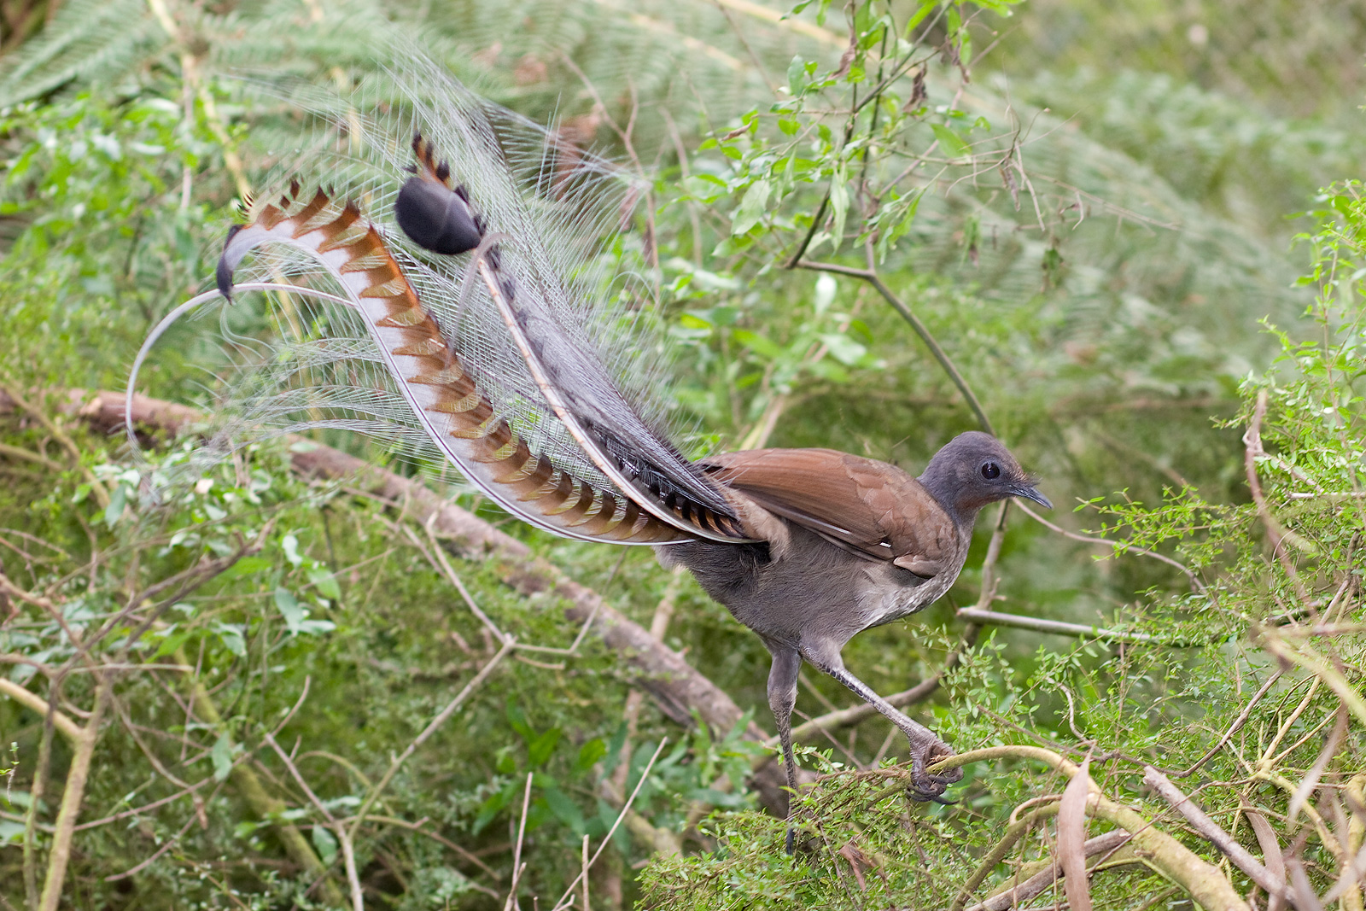
Are the claims true?
Notes:
lyrebird pic, for pun??

Slide 26
Overall
(excludes 20 claims not yet tested, but in principle testable)
Notes:
this based on 69 out of the 89 claims; the remaining 20 are testable in principle but we haven’t got the data to test them yet.

Slide 27
By subfield:

Slide 28
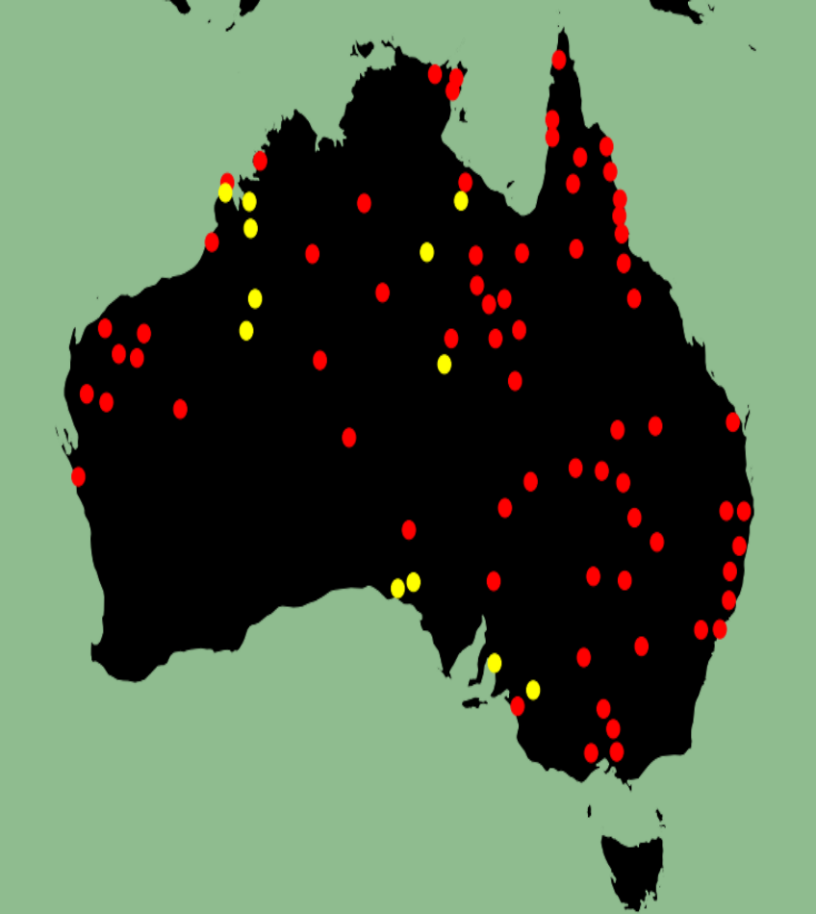
Verified claims:
Most Australian languages have distinct forms for 'who' and 'what' (only in a minority of languages is there a single form covering two meanings). (Dixon 2001:88)
  one term: 12 languages
  distinct terms: 70 languages
Notes:
examples

Slide 29
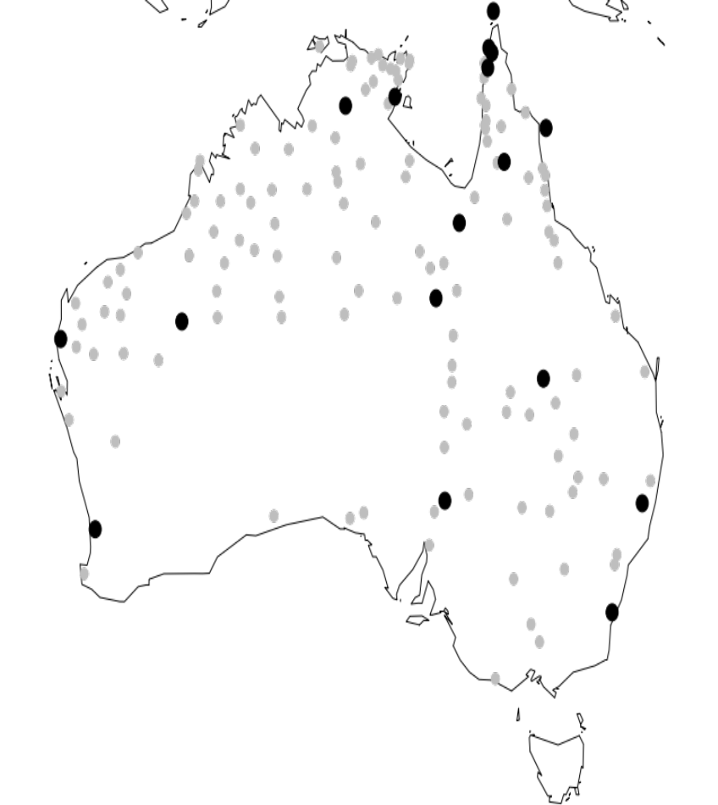
Verified claims
As in many Australian languages, there is no phonemic manner of articulation contrast between stops and fricatives. (Fletcher & Evans 2002: 124)
(Map from Gasser & Bowern 2014)

Slide 30
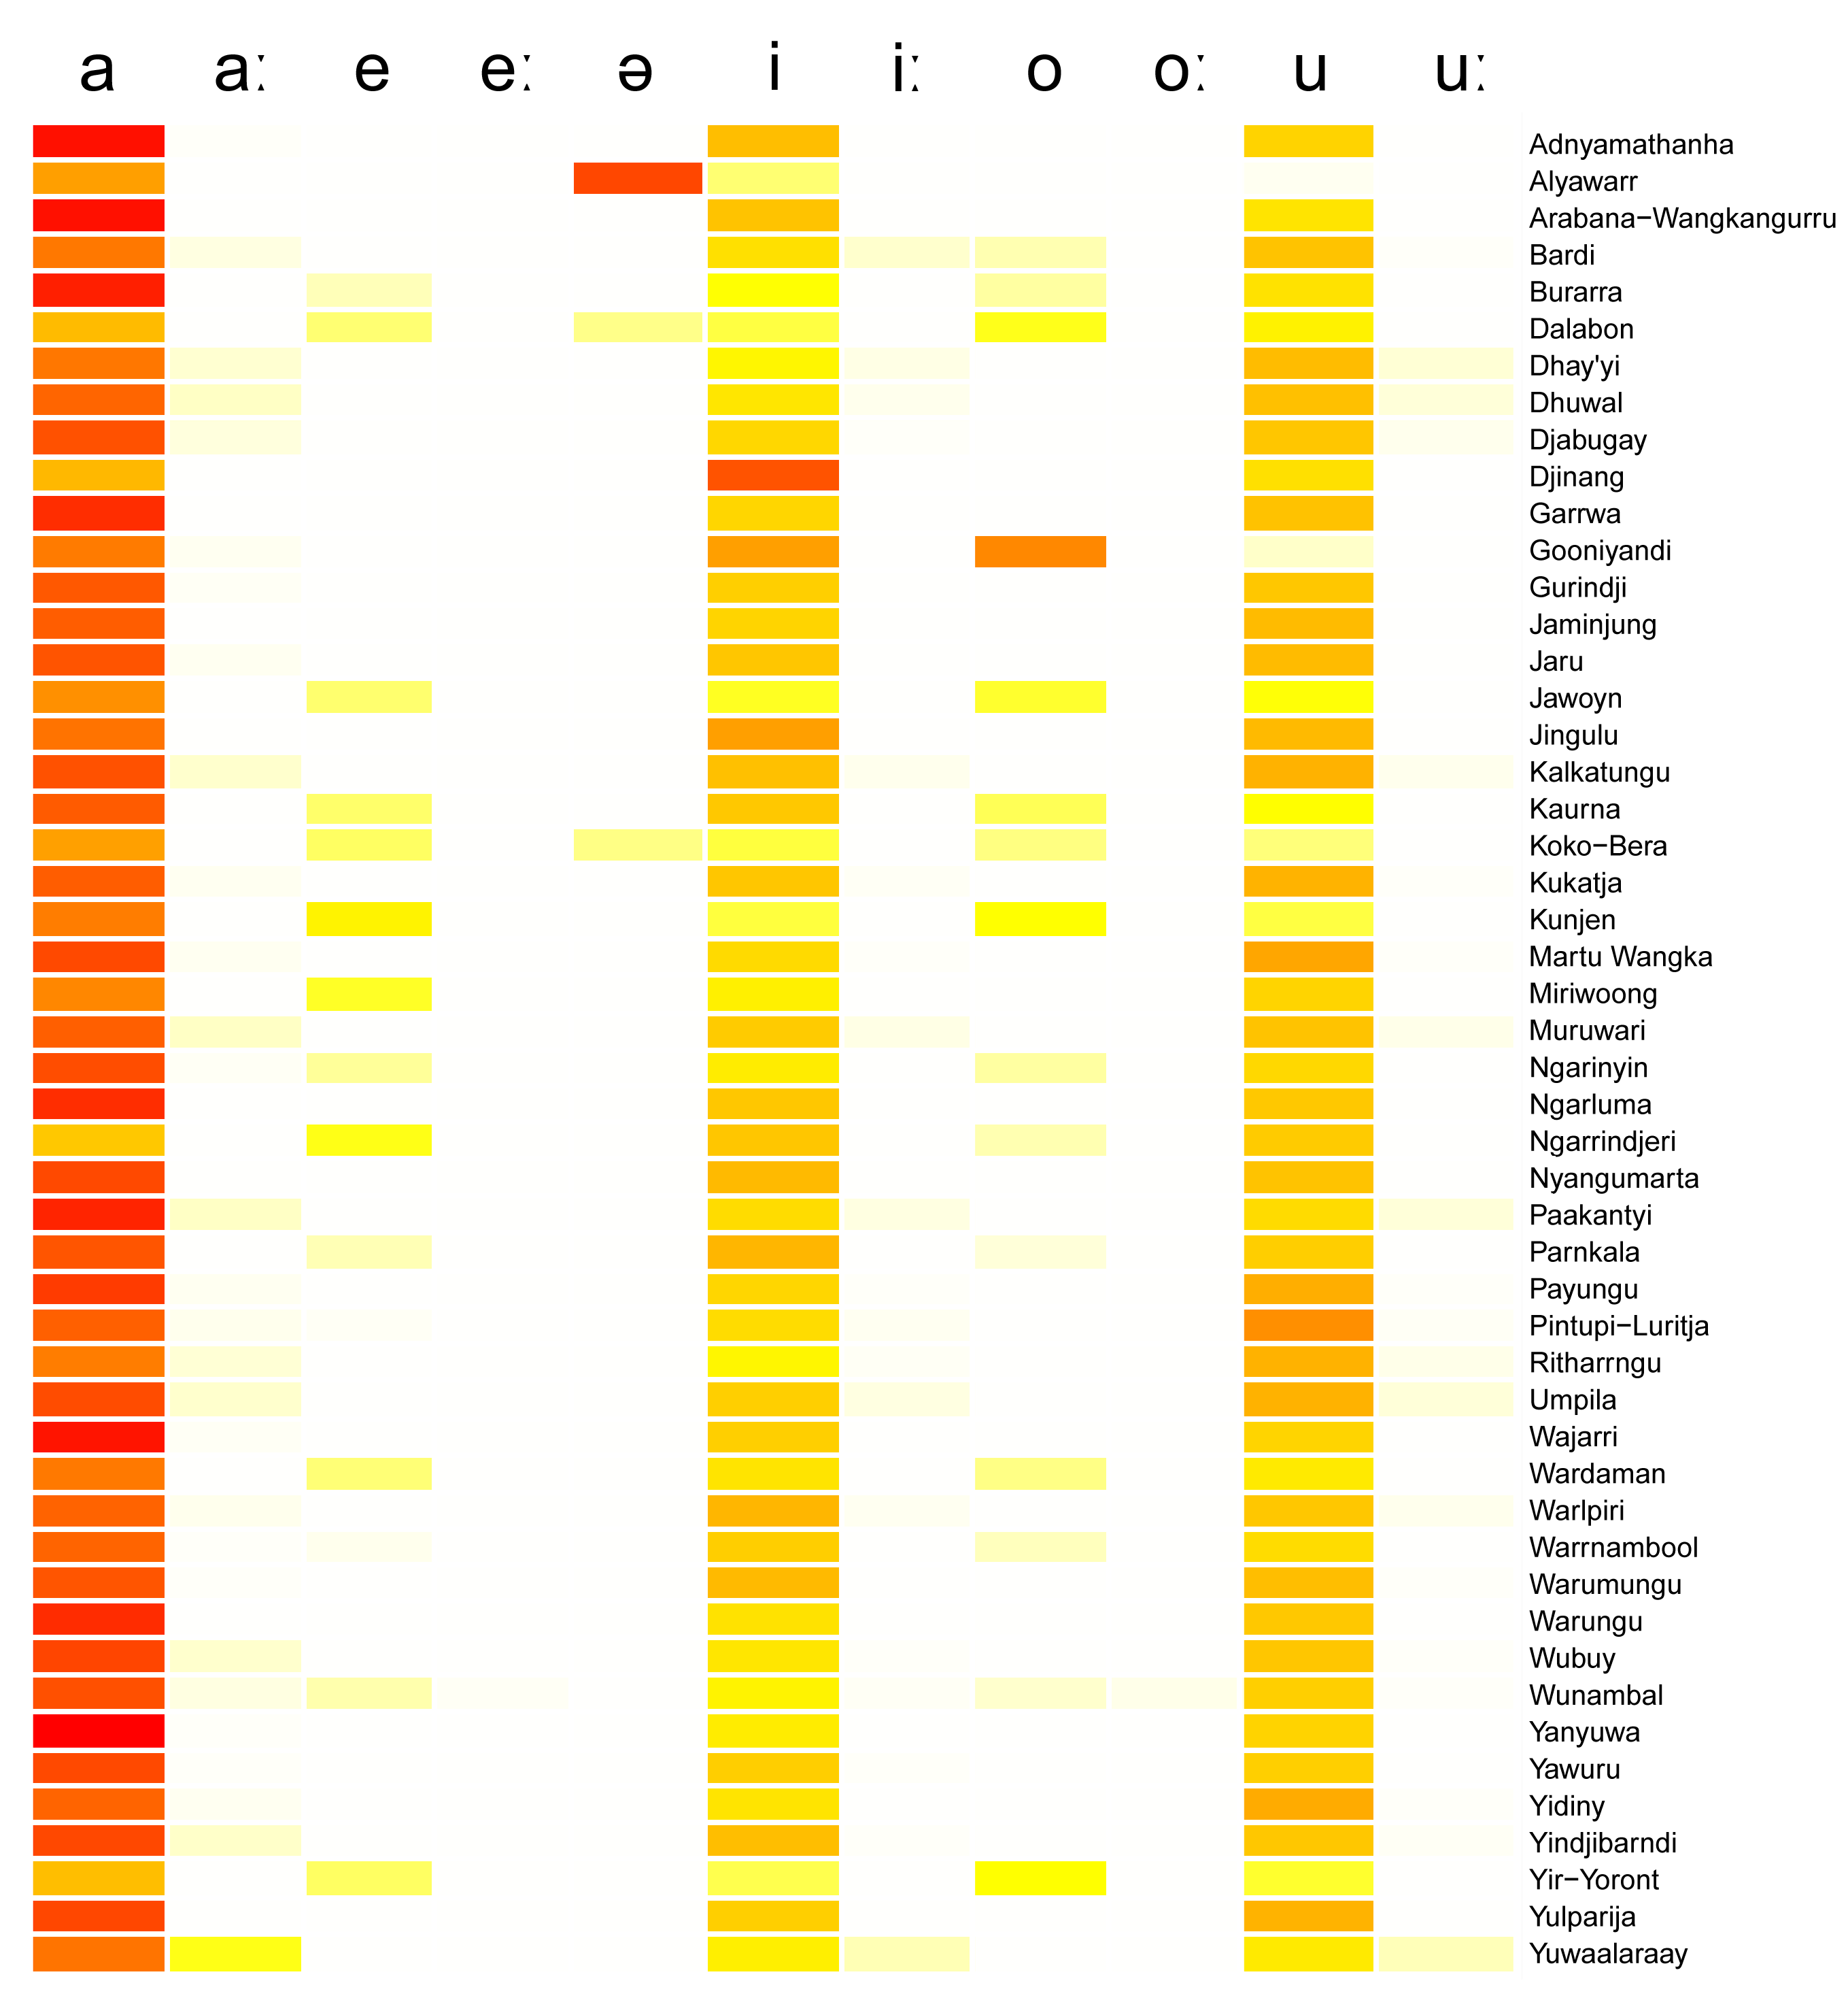
Refining claims
Australian languages usually have 3 vowels

Slide 31
Contested Claims:
In several Australian languages, it is possible for nominals to carry more than one inflectional case marker. (Schweiger 2000:256)
Multi-level case marking is widespread in Australian languages (Dench & Evans 1988:1)
Schweiger 2000, Dench & Evans 1988, and Nordlinger 1997 refer to 20 languages.
We can’t find any others.

Slide 32
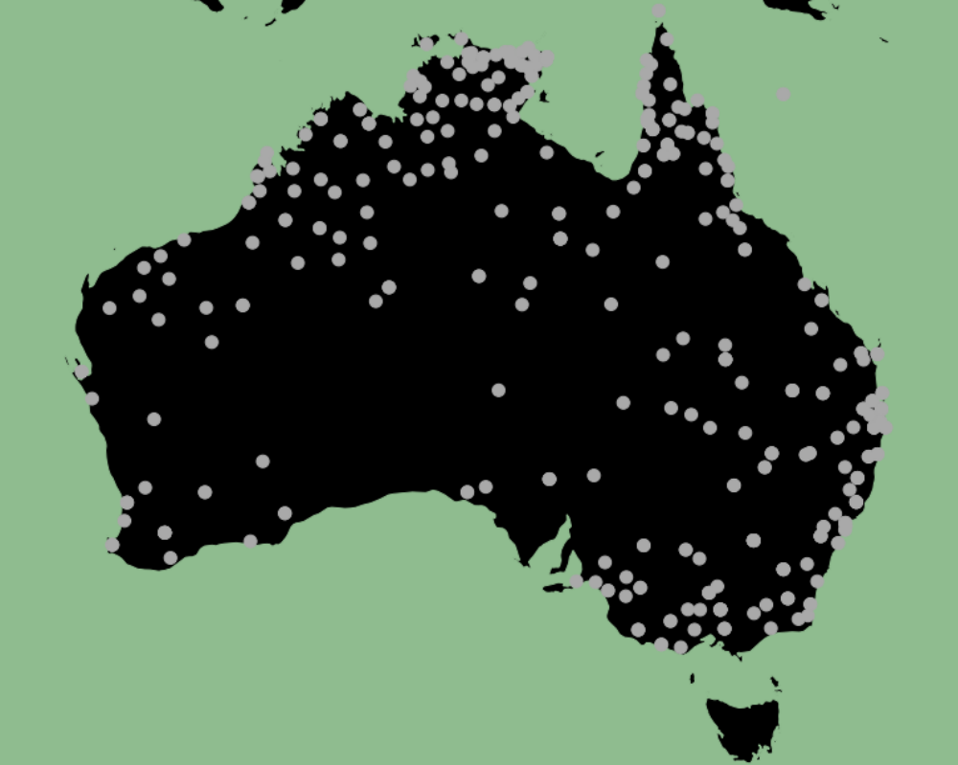
Negated claims:
Dixon (1977:103) “It is unusual in an Australian language to have words ending in ng.”
Languages with words ending in
-ŋ in Chirila; Tasmanian data not
included
Notes:
words with final ŋ recorded in Chirila

Slide 33


Negated (cont.)
Australian languages place it [the adjective] after [the noun]. (Capell 1937:34)
Red : Noun-Adj order
Blue: Adj-Noun order
Notes:
BUT substantial number of languages allow Adj noun order, and some have both.

Slide 34
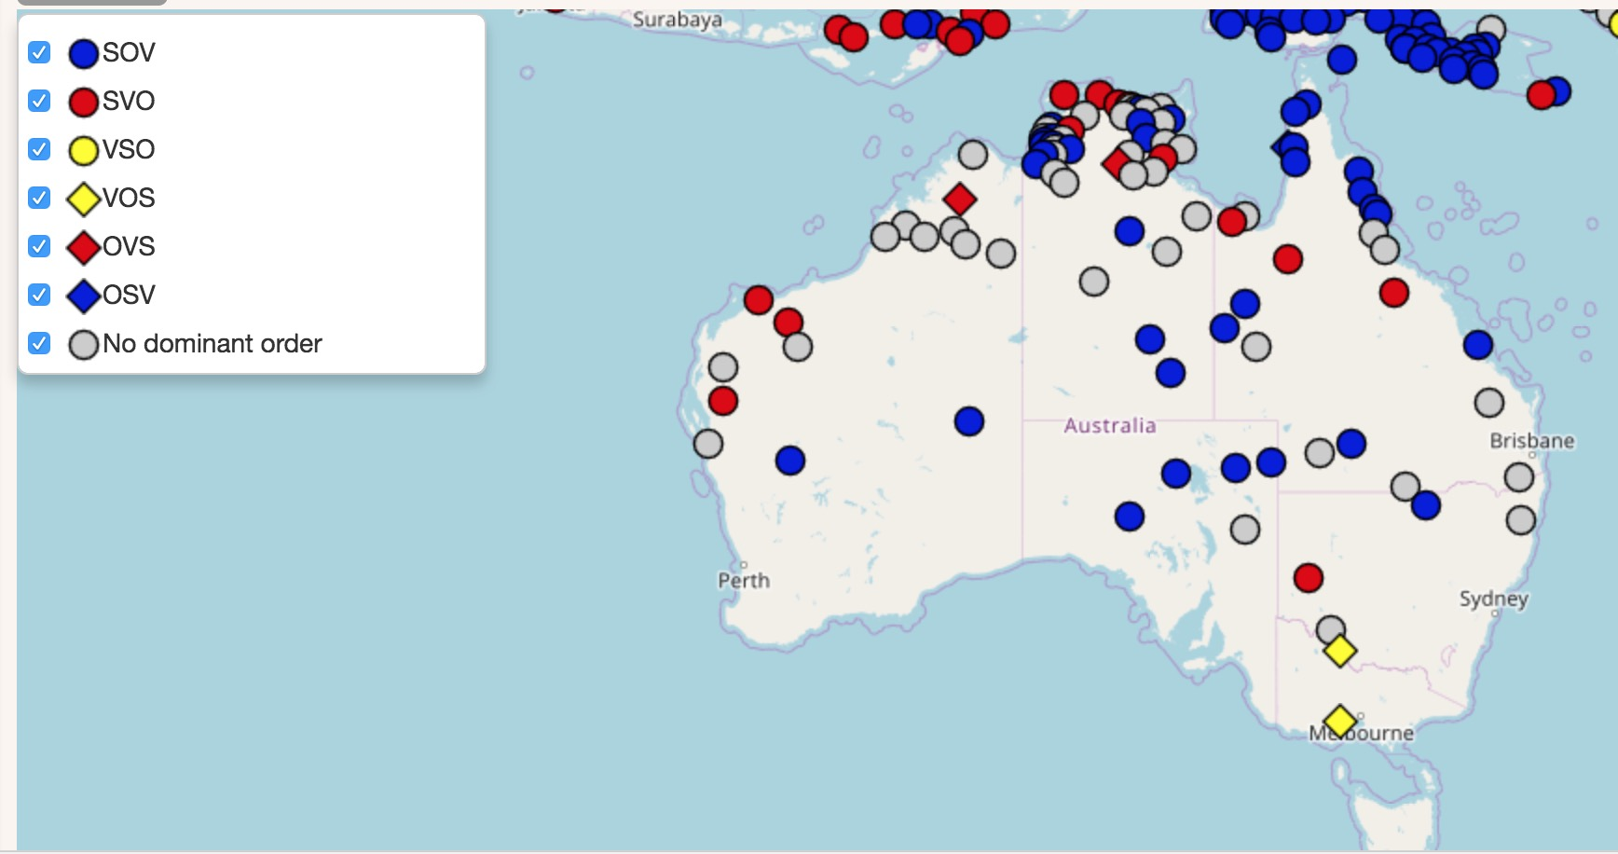
Negated claims
Dominant word order:
Wals feature 81A

Slide 35
Other claims
Confirmed
Negated
Monosyllables are rare (in 50 languages)
Australian languages have postpositions
‘mother’ ≠ ‘mother’s brother’
Initial clusters are rare
Australian languages tend to have split ergative systems
Voicing contrasts are not common
many Australian languages [have] a single phonological word for their complex predicates
Most Australian languages have singular, dual, and plural (56%)
Many have no numeral system

Slide 36
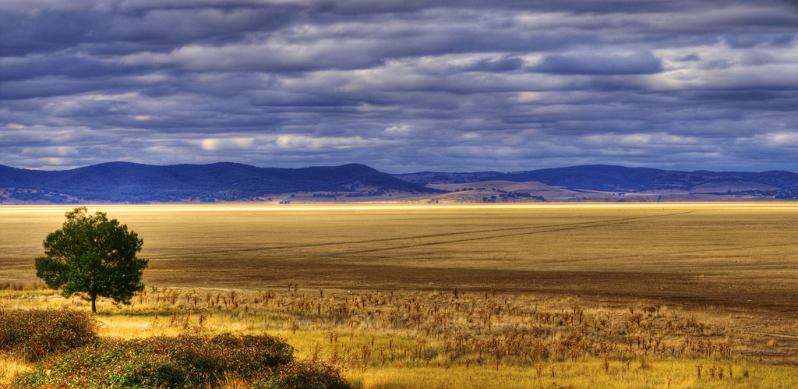
Further discussion

Slide 37
Further discussion
When is a feature no longer rare? (10% of languages in sample? 20%? 30%?; cf. Wohlgemuth & Cysouw 2010)
“Most” = 56%; technically true, but also true that almost half the languages do something else.
Assumptions of uniformity stop us doing good fieldwork and comparative work.
Notes:
could propose some cutoff, but the point isn’t so much about precise numbers (that’s what numbers are for), and more about how the imprecision of these quantifiers reinforces assumptions of uniformity. [sg, dl, pl]. Questions example if time.

Slide 38
Are we refining our generalisations over time? Not really.
Notes:
not really... – volume of claims isn’t going up, and number of errors is about the same, or rising.

Slide 39
The “single language as exemplar” problem
Claims that a feature is widespread that references single language(s), not the claim for frequency.
  Ladd (2017): uses Tabain et al (on Pitjantjatjara) to suggest that all metric stress in Australian languages is stress ghosting.
  Franco (2010): Compound verbs are common in Australian languages (Heath 1976; Schultze-Berndt 2000, 2001; McGregor 2002; Bowern 2008; among many others)
Notes:
reinforced by idea that the languages are similar in morphological profile and inventory (and are genealogically related), and so are probably similar in other ways as well.

Slide 40
Overlooked generalisations?
Productive verbalizing morphology (67 langs have it, 8 don’t), yet ‘received’ view that roots in Australian languages don’t usually change word class.
Verbal reflexive/reciprocal marking (65:17)
marked future (63:22)
marked reality status (48:25)
(20 Pama-Nyungan languages have agreement marking on the verb [out of 70])

Slide 41
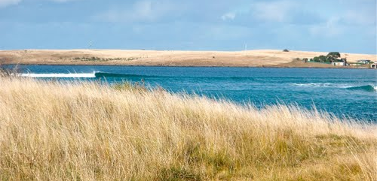
Conclusions

Slide 42
Conclusions/recommendations
We can test a lot of these claims now.
We should be testing them, because our “received wisdom” is only half right.
This is a problem across subfields.
It runs the risk of leading to confirmation bias, attention bias, and recording bias.
Write more papers on rarity, like Evans (2000).
Call out papers when you’re reviewing them.

Slide 43

Acknowledgments
NSF grants BCS-0844550 and BCS-1423711.
The Aboriginal and Torres Strait Islander people
who have given permission for their
languages to be included in the database,
and made data available.
Student grammar coders, especially Amalia Skilton.
Emily Gasser (Swarthmore).
Data from this paper began in a class, with claim sourcing by Patrick Killian and Grace Brody, and testing of morphology claims by Grace Brody.

Slide 44
References
Austin, Peter. 1988. Classification of southern Pilbara languages. Papers in Australian Linguistics 17. A-17.1–17.
Bowern, Claire. 2016. Chirila: Contemporary and Historical Resources for the Indigenous Languages of Australia. Language Documentation & Conservation 10. http://scholarspace.manoa.hawaii.edu/handle/10125/24685.
Capell, A. 1937. The structure of Australian languages. Oceania 8.
Dench, Alan.; and Nicholas Evans. 1988. Multiple case‐marking in Australian languages. Australian Journal of Linguistics 8.1–47. doi:10.1080/07268608808599390.
Dixon, R. M. W. 1979. The Nature and Development of Australian Languages. Annual Review of Anthropology 8.431–443.
Dixon, R. M. W. 1997. The Rise and Fall of Languages. Cambridge: Cambridge University Press.
Dixon, R. M. W. 2001. The Australian linguistic area. Areal diffusion and genetic inheritance: Problems in comparative linguistics, ed. by Alexandra Y. Aikhenvald and R. M. W. Dixon, 64–104. Oxford / New York: Oxford University Press.
Dixon, R. M. W. 2002. Australian languages: Their nature and development. Cambridge Language Surveys. Cambridge: Cambridge University Press.
Fletcher, Janet.; Nick Evans.; and Erich R. Round. 2002. Left-edge tonal events in Kayardild (Australian): a typological perspective. Proceedings of the First International Conference on Speech Prosody 2002, ed. by B. Bel and I. Marlien, 299–303.
Gasser, Emily.; and Claire Bowern. 2014. Revisiting Phonological Generalizations in Australian Languages. Proceedings of the Annual Meetings on Phonology 2013.
Marsh, Jim. 1992. Martu Wangka dictionary. Aboriginal Studies Electronic Data Archive (ASEDA) 0210, ms.
Nordlinger, Rachel. 1997. Constructive case: Dependent-marking nonconfigurationality in Australia. Stanford University.
Tabain, Marija.; Janet Fletcher.; and Andrew Butcher. 2014. Lexical stress in Pitjantjatjara. Journal of Phonetics 42.52–66. doi:10.1016/j.wocn.2013.11.005.

