Slide 1
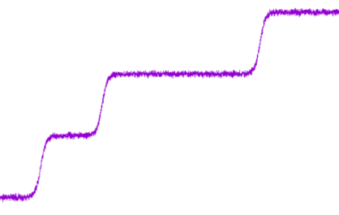
Phase transitions
A Forrest Gump-like account on AI 1984-2024
Valedictory lecture – March 8th, 2024
Lambert Schomaker
Dept. of Artificial Intelligence
Faculty of Science & Engineering
University of Groningen

Slide 2
Phase transitions - Overview
Past
Present
Future
Words of thanks

Slide 3
Electronics & cybernetics
‖ Focus‖
Early life
t

Slide 4
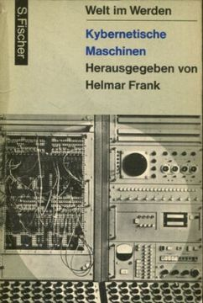
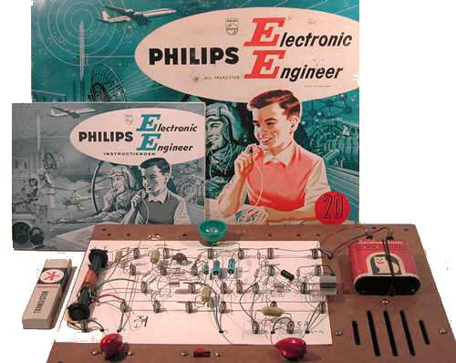
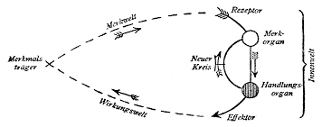
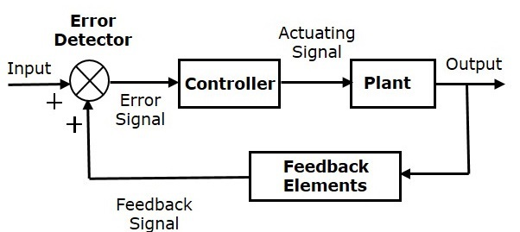
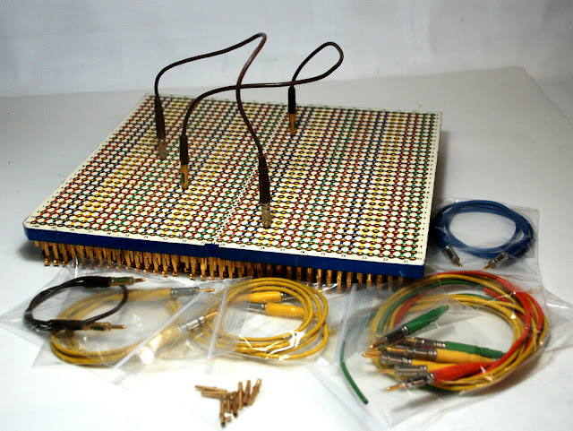
Past: 1968-1975
Fischer Verlag
(1 Jan. 1964)
Homebrew
analog synthesizer.
My own crossboard
definitely looked cheaper!
➔ Electronics & cybernetics
Notes:
We see here two deep roots of my interests: Analog electronics and Cybernetics, systems with goal-oriented behavior thanks to analog negative feedback

Slide 5
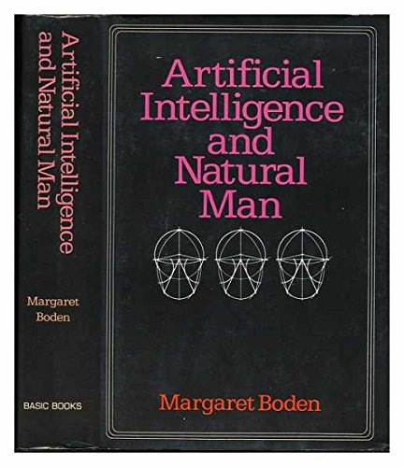
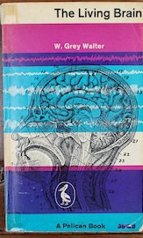
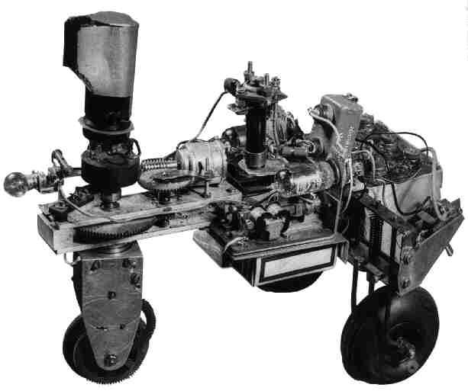
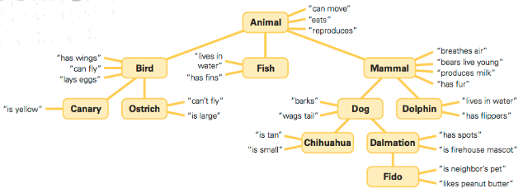
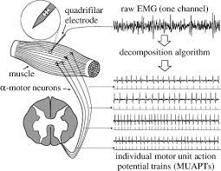
1979
Margaret Boden,
1977
(interesting and a good overview
of 60-ies symbolic AI, but
struck me as being written by
someone who did not code)
PDP 11/10, analog-digital
conversion, digital-analog
conversion (sound replay
at other frequencies & backwards)
VAX/VMS, Fortran
First encounter with Lisp
Implementing my first “is-a” ontology
using IBM ISAM access file records:
<primary key> <parent-pointer> <child-pointers,…>
Grey Walter,
The Living Brain, 1961
PRE BRAITENBERG!!
Carlo De Luca: motor-unit
model, motor control,
Motor-unit action
potential modeling
Notes:
As a student, I was interested in the brain, I ended up in the research group of prof. Cees Brunia & Ton van Boxtel (EEG, evoked potentials,
Mathematical modeling of EMG signals). Then there were two influential books, one by Margaret Boden, looking back at 60-ies AI and Grey Walter: neuroscience & robotics

Slide 6
Symbolic AI
‖ Focus‖
Electrophysiology
t

Slide 7
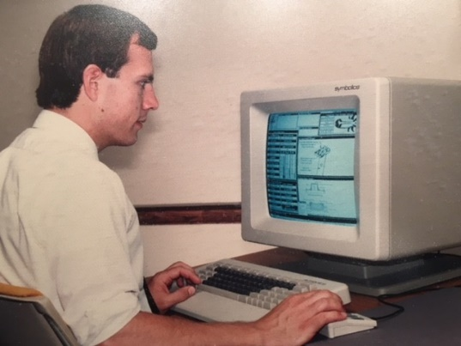

“Symbolic AI”: semantic networks – constructed by humans (1983-1986)
Symbolics
Lisp
Machine
(1985)
NICI Nijmegen
Gluck, M. A., Mercado, E., & Myers, C. E. (2019).
Learning and memory (4th ed.). Worth.
Notes:
In 1984 I shifted to cognitive science in Nijmegen. There was a lot to learn, they gave me books and a lot of technical reports from MIT to get up to speed in image processing and robotics. The goal was to develop a dynamic model of the handwriting process, with the ultimate goal of having robots to write naturally and understand the fundamentals of movement control in the process. However, I quickly found out that AI was a very discrete world, nothing analog, and human movements are intrinsically very fluent. Modeling concepts in a graph, yes. But how about movement. The push towards symbolics (‘it is so explainable!’) was very strong.

Slide 8
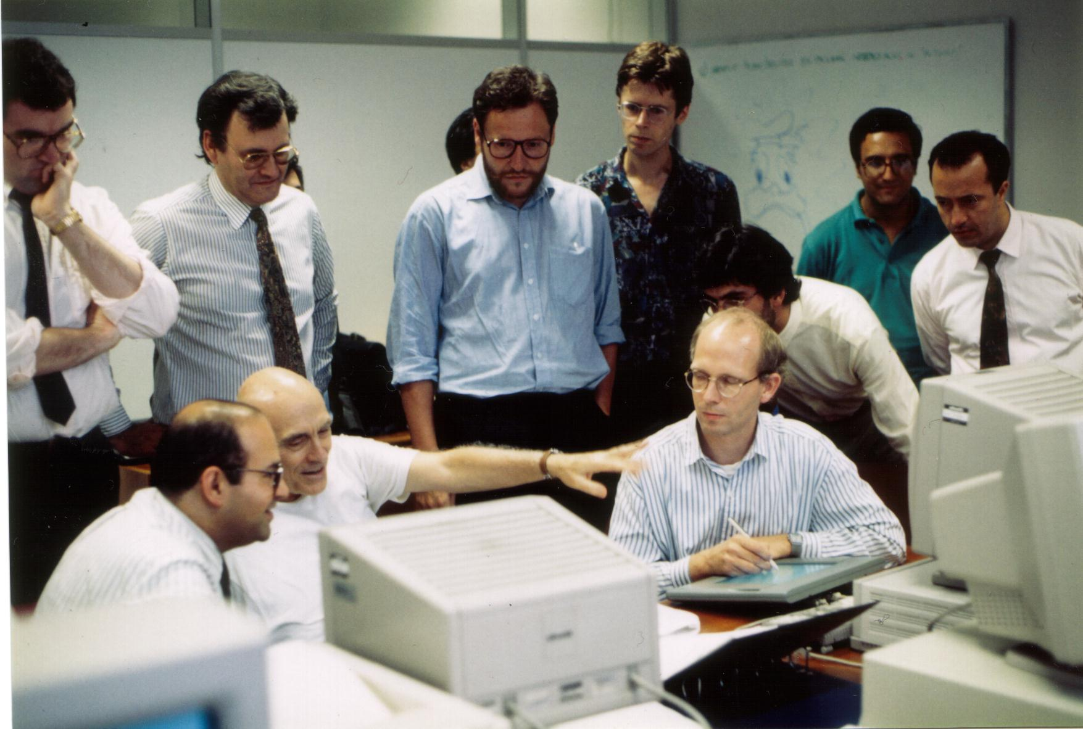
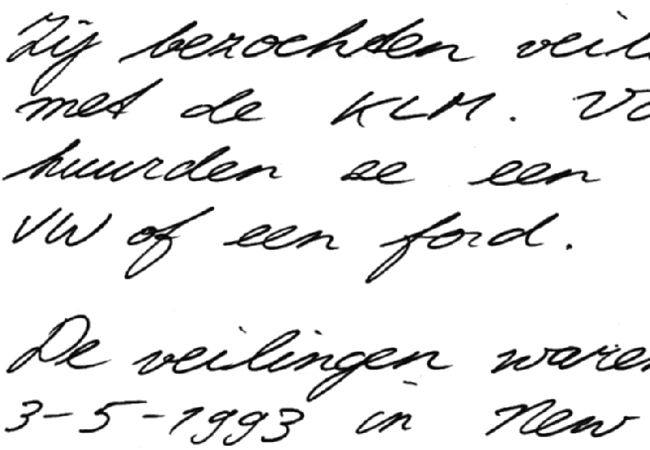
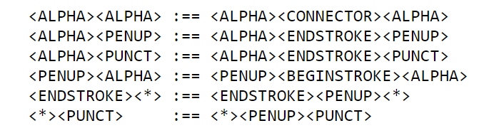
“Symbolic AI” – constructed by humans (1983-1986)
It appeared to be impossible to successfully apply symbolic AI to handwriting recognition using
symbols & knowledge graphs for shape elements !
due to diversity & uncertainty
Within- & Between-writer variability
Notes:
So I did my best. But both for handwriting simulation and for handwriting recognition, the discrete paradigm was often very frustrating. Always brittle, always needing more rules to match the real system or to process the handwriting of a new writer. In fact, even the Lempel-Ziff compressed size of models was linearly increasing without any asymptote in sight. And each improvement required massive human programming and coding efforts. There were some successes, if you made a hybrid model, neural and symbolic, using Kohonen self-organized maps as the bridge. As you can see in the photograph, my colleagues in the EU project were curious.

Slide 9
Artificial neural networks
‖ Focus‖
If there are regularities (density peaks, correlations) in the data, there should exist an algorithm that is able to uncover them (LS)
Symbolic AI
t

Slide 10
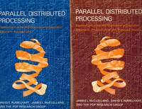
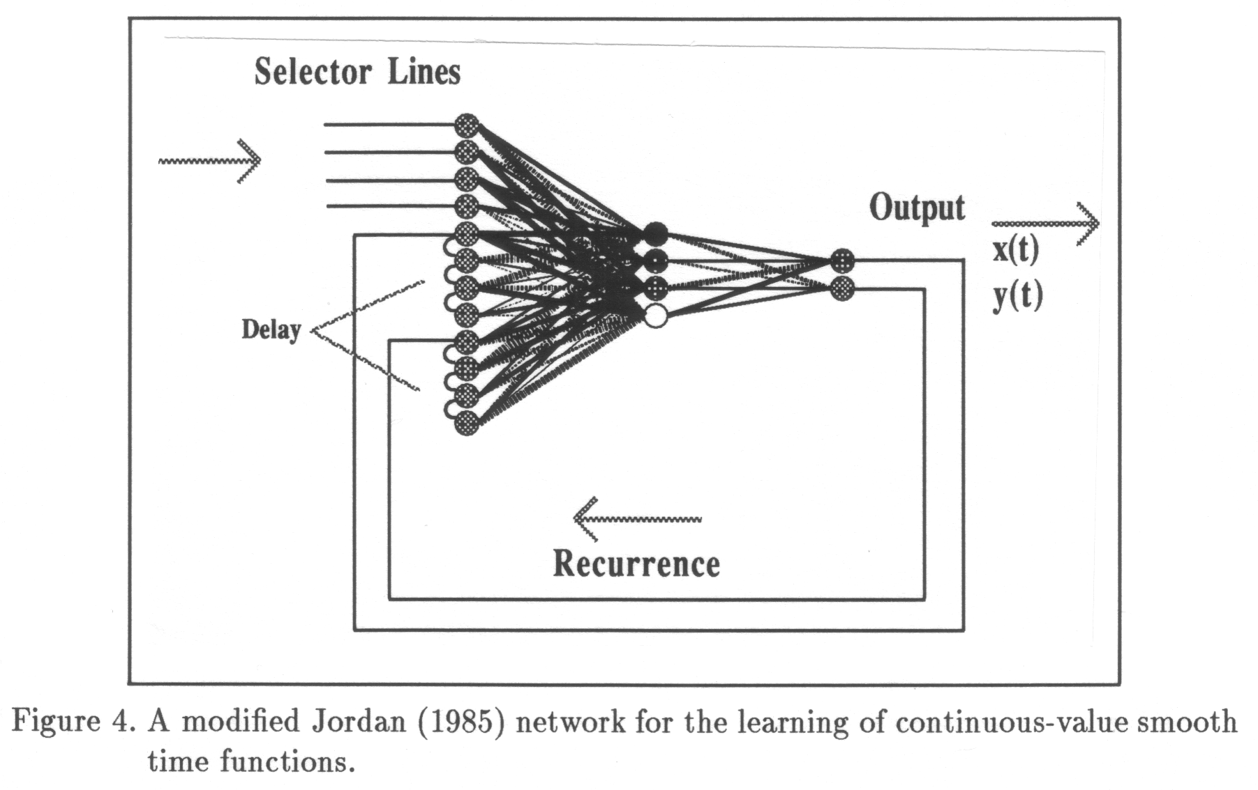
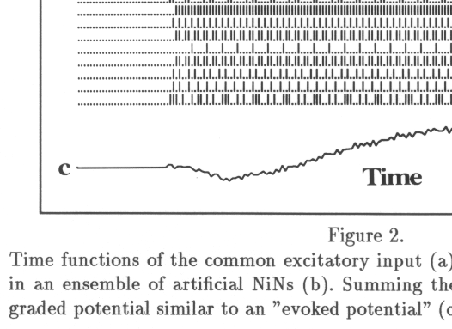
1986-1994
+ Student book with
diskettes & C program code
Rumelhart & McClelland
Back propagation
➔ Getting introduced to Rosenblatt, Widrow-Hoff
hindsight to the 1950^{ies}
Seen Rumelhart lecture (1989) on multihead NNs
with task head and decoder head for ‘embeddings’
in language tasks, seen McClelland lectures at NICI
Battles
  My old cybernetics + new backprop ideas vs: the symbolicists in the
  Nijmegen Institute for Cognition and Information
  ‘Symbol grounding problem’: How are symbols grounded
  in reality?
Dissertation 1991
(exploring spiking neurons)
Notes:
Around 1986 I was introduced into multilayer perceptrons by prof. Pietro Morassi, Genoa university. He dropped the Rumelhart & McClelland bibles on my desk. The student edition also had C source code. Heaven! May the source be with you. In these days I worked on recurrent networks for simulating handwriting, using feedback as in cybernetics and also I maintained, against the stream, my interest in spiking models.

Slide 11
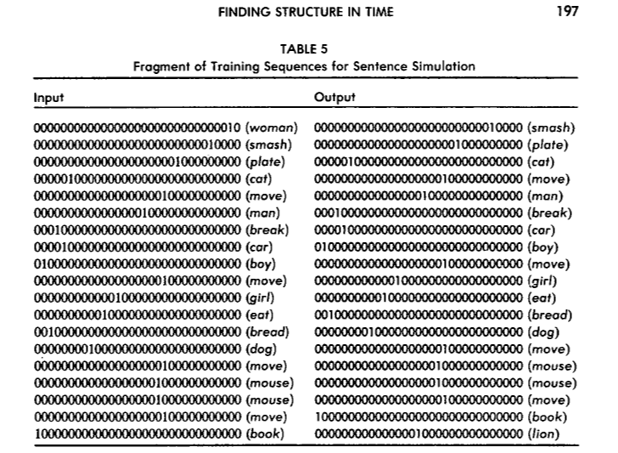
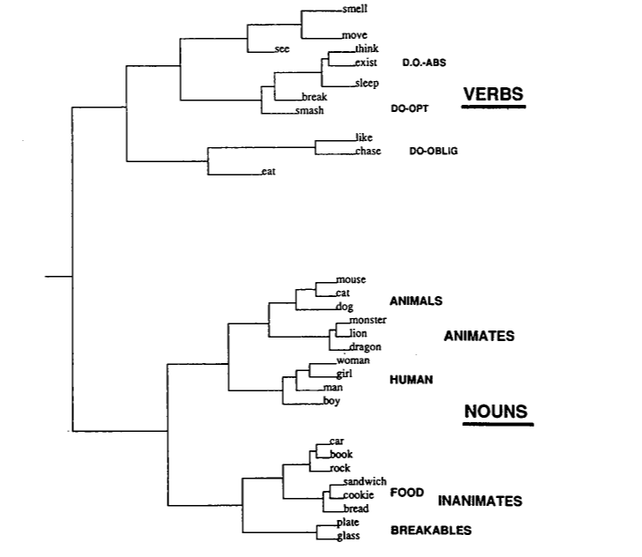
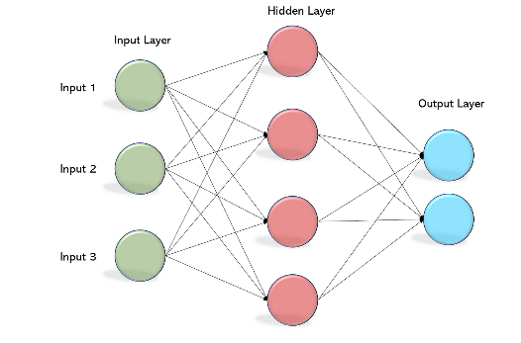

“Neural networks”: semantics and word types learned from text data.
Elman, J. L. (1990). Finding structure in time.
Cognitive Science, 14(2), 179–211.
Transformers (GPT):
not completely ‘new’.
Already in 1990:
word-prediction task.
What is the next word?
Cluster analysis of the
learned hidden
representation
reveals a meaningful
tree
Boxes are only black if you don’t look into them
(today: t-SNE, heat maps)
Notes:
This is a complicated slide, I am sorry for that but it is important in this lecture. This is about an article by Elman, already in 1990, that contains many essential ingredients that were also needed for transformers to be successful, and at the same time, it is an illustration that all complaints of neural networks being a black box need to be seen in perspective. Elman uses a word prediction task. “Cat eats …mouse…”. After training, he did a cluster analysis on the hidden (pink) learned internal representations, called embeddings today, and found that a linguistically meaningful graph emerges, with categories verbs and nouns emerging, and within the nouns animate (the living things) and the inanimate objects and so on. No human-semantics or syntax expert is needed, just the data. It is also a perfect example what you need to do to understand a neural network: Look into it: Every vector and feature map can be inspected. We use t-SNE and GradCam heatmap inspection for that today. Yes, current progress is impressive, but there are deep roots, that appear to have been forgotten.

Slide 12
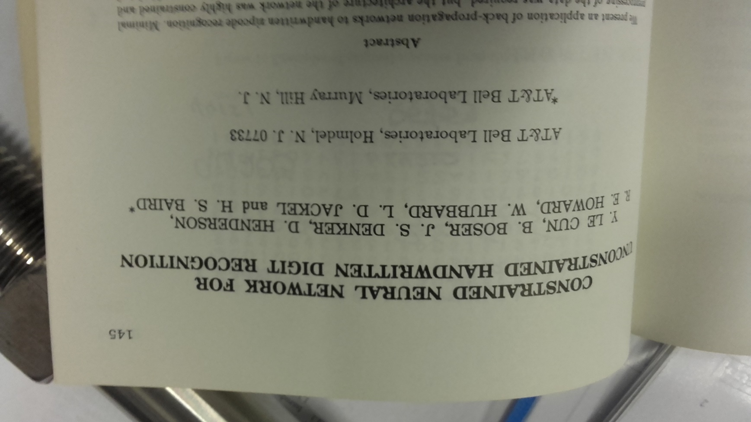
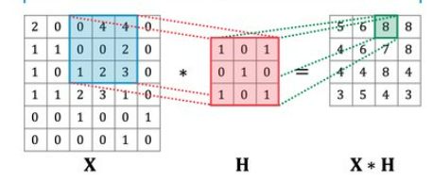
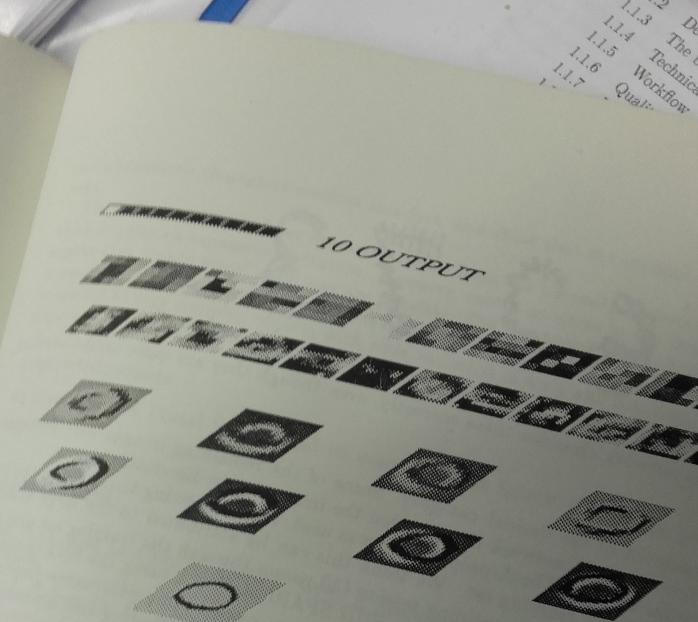
Deep
convolutional
networks (CNNs)
Handwriting recognition research
had a huge impact on the
development of deep learning.
2D Convolutions, saving weights: CNNs!
Yann LeCun/Int. Workshop on Frontiers
in Handwriting Recognition
April 2-3, 1990 Montreal
Notes:
Handwriting recognition is very difficult. This has lead to a situation where the field was populated by a diverse crowd of electronic engineers, theoretical physicists, cognitive science researchers, neuroscientists, and yes, also the occasional computer scientist. Many of the latter found handwriting too ugly as a problem. The convolutional neural network in its current form was introduced by AT&T researcher Yann LeCun, currently at Meta.

Slide 13
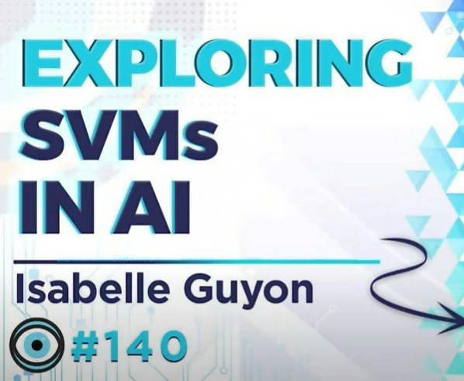
Neural network winter 1995-200x
Support vector machines (SVMs) !
Small data sets & overfit: Urgent in handwriting recognition at AT&T
➔ team at AT&T proposed regularization tricks in binary classification
(Boser, Guyon, Vapnik). The maximized margin is Isabelle Guyon’s idea.
MLPs are out!
Good news: High dimensionality is not a burden, it allows to
handle non-linear problems linearly, in a higher-dimensional
Hilbert space, using dot products.
Boser, B., Guyon, I., Vapnik, V.: A training algorithm for optimal margin classifiers. In: Proceedings of the Fifth Annual
Workshop on Computational Learning Theory, Pittsburgh (1992)
Notes:
Already in 1991, the situation surrounding multilayer perceptrons got into an impasse. Performances did not improve. Engineers at AT&T were appalled by the idea that a model would be different on different training occasions and even presented overfit, a bad performance on unseen data. A team of Vapnik, Boser & Guyon invented a completely new classifier, not neural, that was designed to avoid such problems. In spite of its disadvantages, it pushed MLPs aside for a decade. As a side note, the maximized margin idea in this algorithm is by Isabelle Guyon, who is very famous, but has a comparable position as Rosalind Franklin as regards this detail.

Slide 14
Neural network winter 1995-200x
Many of us still used neural networks (MLPs, Kohonen maps), practically, but you did not dare to publish many papers about it
While: Yann LeCun was continuing on his 1989 invention of 2D-CNNs
in handwriting (not sharing a diskette with a student text book)
and Geoffrey Hinton kept the flame burning.
Notes:
As a consequence many of us did not dare to publish many papers about neural networks, per se, in this period. But we did use them and they served of course as the baseline comparison in SVM papers.

Slide 15
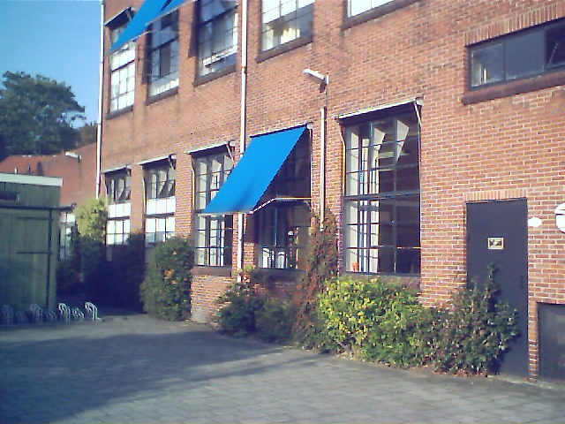
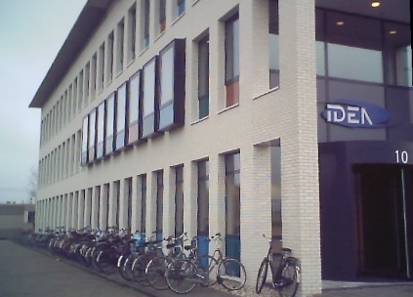
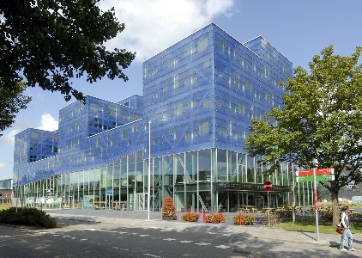
2002
2006
2008 -
Leading the ALICE institute
Administration
Politics
Moving AI to the science faculty
Research in writer identification
(“Anthrax letters”) forensic and
paleographic problems
2009: start of a continual learning
engine for handwriting recognition
‘Monk’

Slide 16
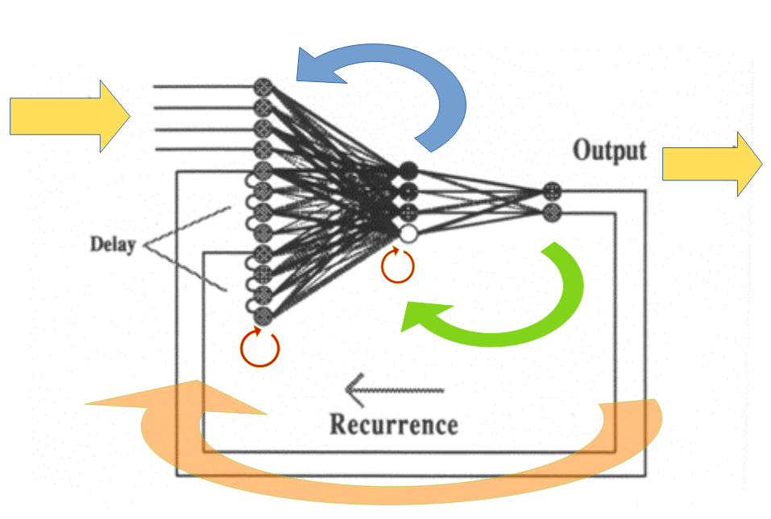
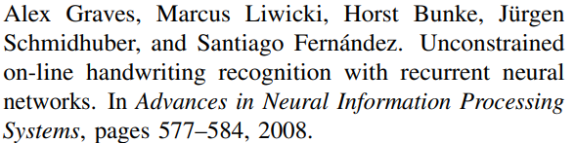
Recurrent neural networks (LSTM)
‖ Focus‖
Hidden Markov Models (HMM)
t

Slide 17
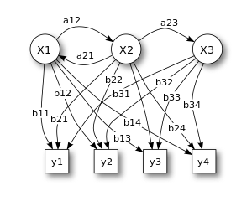
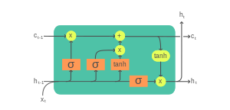
On scientific urban legends
Hidden-Markov Models were successful in speech recognition
(1D, natural time) S(t) = f(S(t-dt))
It always was very difficult to replicate success in handwriting
(2D, x-axis represents pseudo time)
With Jean-Paul van Oosten we found several flaws in the HMM approach
For example:
  Divergence instead of convergence in training, normalization issues
  Successes in common literature: Opportunistically sampled from learning curves
  In speech, people often initialized their HMMs from their own previous publication:
  Bad luck for newcomers
HMMs are OUT, also in speech recognition
Recurrent neural networks: More robust, more democratic, less finnicky

Slide 18
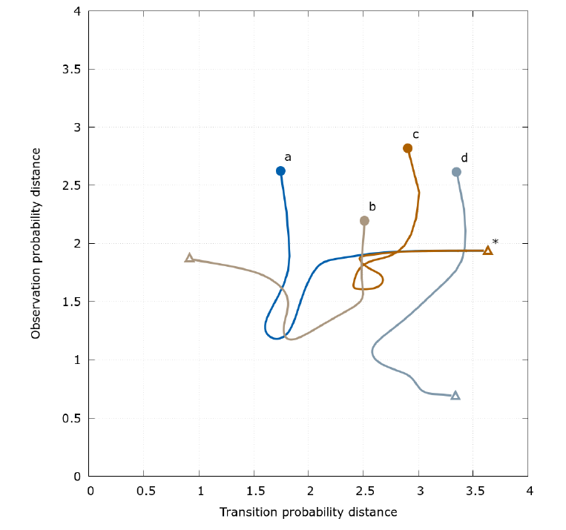
Divergent loss in HMM training
Dissertation J.P. van Oosten
In spite of the mathematical proof,
Baum-Welch does not work reliably
Comment from someone at a conference:
“but everybody knows that
the transition probabilities p_{ij}
are not that important”
(What???)
“In practice the HMM state transitions have become less significant as linguistic and acoustic models have improved, and many current systems ignore them altogether.” (Graves et al., 2013)

Slide 19
Transformers
In handwriting recognition:
You need a CNN front end
for robust shape features, first!
➔ correlations need to
be meaningful.
(with MSc student Max Velich)
‖ Focus‖
LSTMs
t

Slide 20
PhD students, memorable findings
Katrin Franke – robotic dynamic simulation of handwritten signatures, including force and pen angle
Marius Bulacu – the HINGE feature for writer identification
Gert Kootstra – researchers in vision are forgetting about the relation between visual salience and symmetry
Tijn van der Zant – generative AI ‘avant la lettre’
Ralph Niels – letter-based writer identification
Hado van Hasselt – using reinforcement learning for classification, per se
Axel Brink – findings in writer identification – GIWIS system for forensics, directional ink-trace width distribution
Olarik Surinta – explorations in character classification
Faik Karaaba – how far you can get in face identification with tiny images
Sheng He – many findings in document dating and writer identification, deep learning, highly cited
Emmanuel Okafor – use of LSTMs (deep learning for time series) in industrial predictive maintenance
Bowornrat Sriman – explicit modeling of foreground and background in camera-based OCR
Klaas Dijkstra – counting objects (plants) in images – highly cited
Pry Pawara – one-vs-one classification in NNs – highly cited
Amir Shantia – many findings in robotic visual navigation and early work in deep learning
Jean-Paul van Oosten – finding the reasons why hidden-Markov Models are terrible
Zhenxing Zhang – exciting findings in generative adversarial networks (GANs), highly cited
Mahya Ameryan – diverse findings on solutions for robust cursive-script recognition, proxy parameters for validation
Asmaa Haja – self-supervised methods with auxiliary tasks in deep learning
Sha Luo – reinforcement learning in robotic grasping – highly cited
Maruf Dhali – diverse findings on image processing, document dating and shape style methods in the DSS

Slide 21
PhD students (at some distance: pro forma or 2nd promotor)
Wouter Teepe – with Rineke Verbrugge
Leendert van Maanen – with Hedderik van Rijn & Niels Taatgen
Maria Niessen – with Tjeerd Andringa
Dirkjan Krijnders – with Tjeerd Andringa
Bea Valkenier – with Tjeerd Andringa
Anouk Goossens – with Tamalika Banerjee

Slide 22
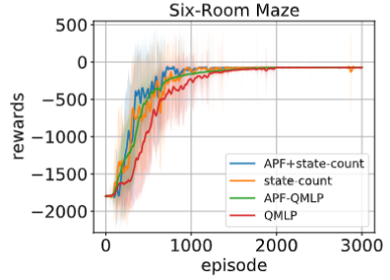
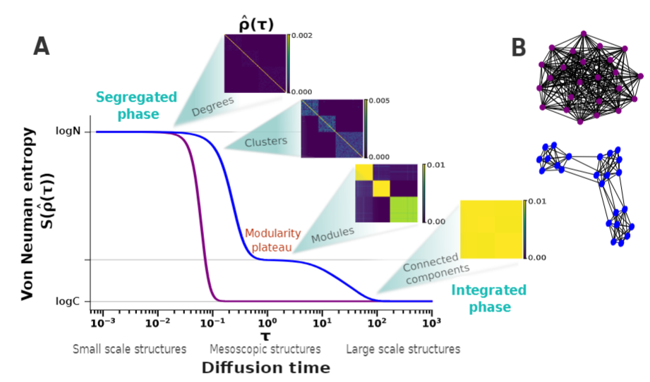
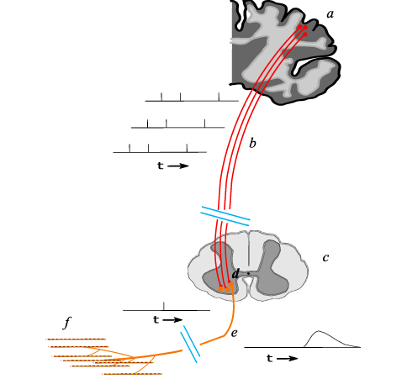
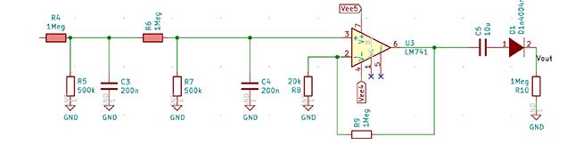
PhD students, ongoing now:
Yifei Chen – reinforcement learning for video games using
adaptive potential function for value estimation
Davide Cipollini – modeling 2D memristive phenomena
in ferroelastic materials
Jordi Timmermans – biomimetic modeling for neuromorphic
movement control

Slide 23
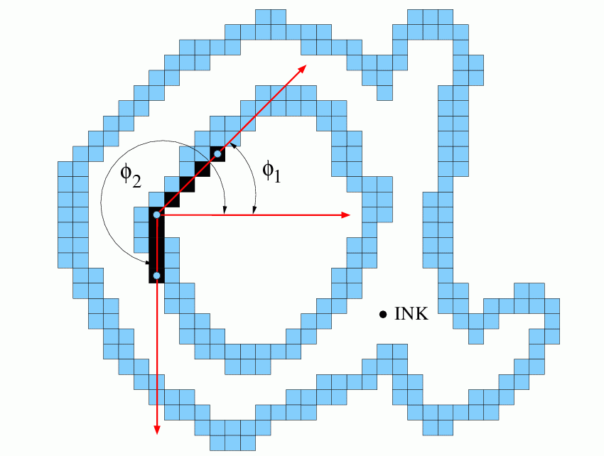
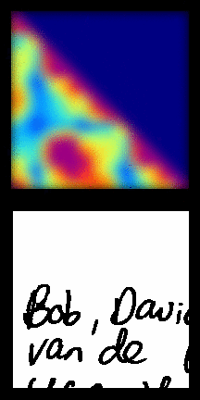
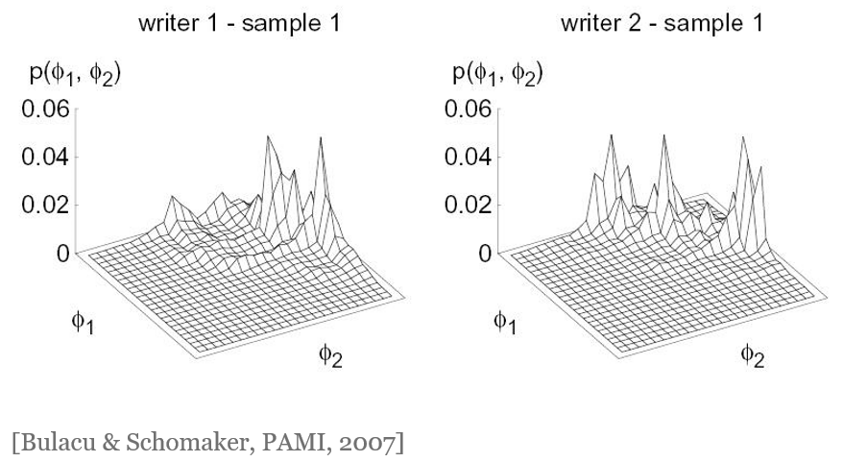
Marius Bulacu / “Hinge” feature
Writer identification using
statistical pattern recognition

Slide 24
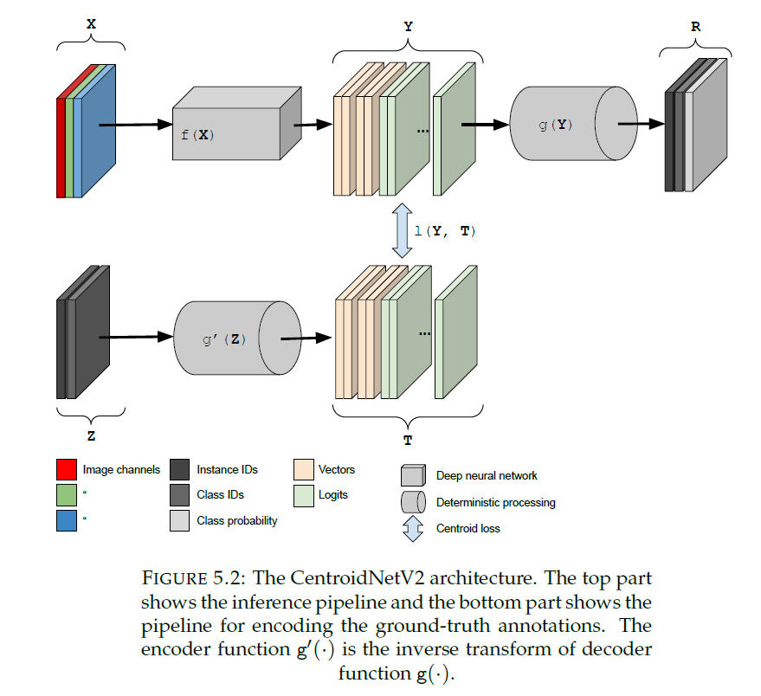
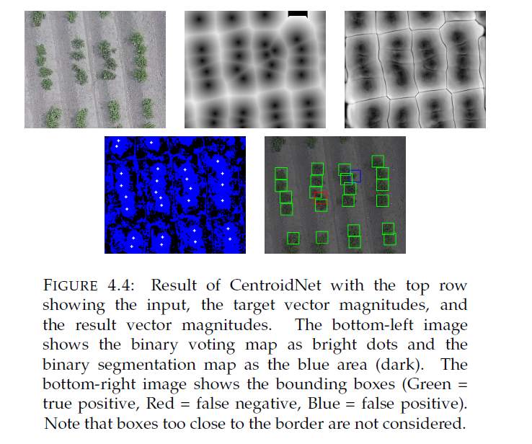
Klaas Dijkstra / CentroidNet
Deep Learning and Hyperspectral Imaging for Unmanned Aerial Vehicles
[Klaas Dijkstra introduced this before in the meeting, not in the video, LS]

Slide 25
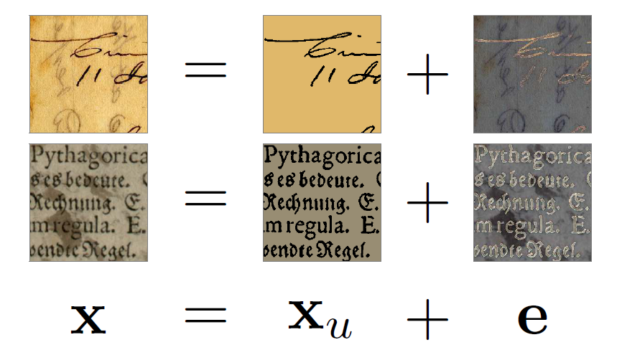
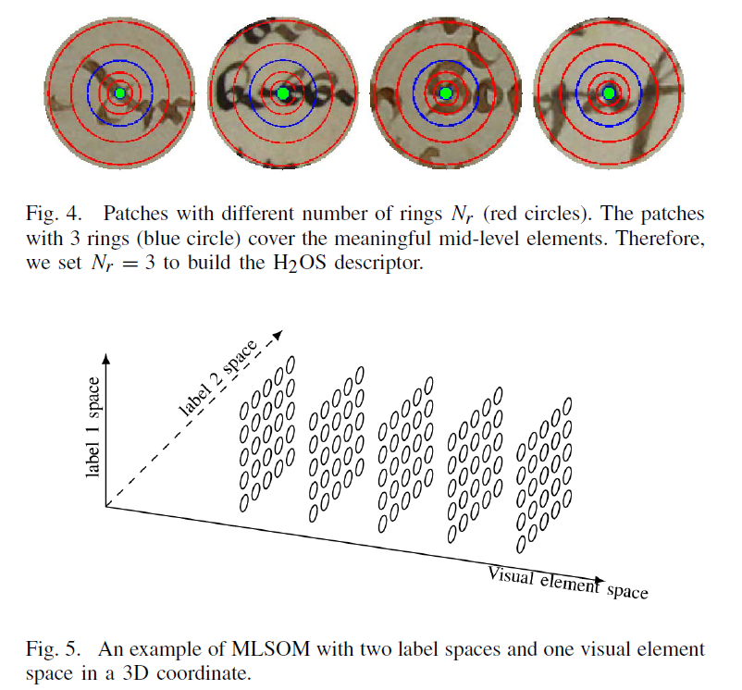
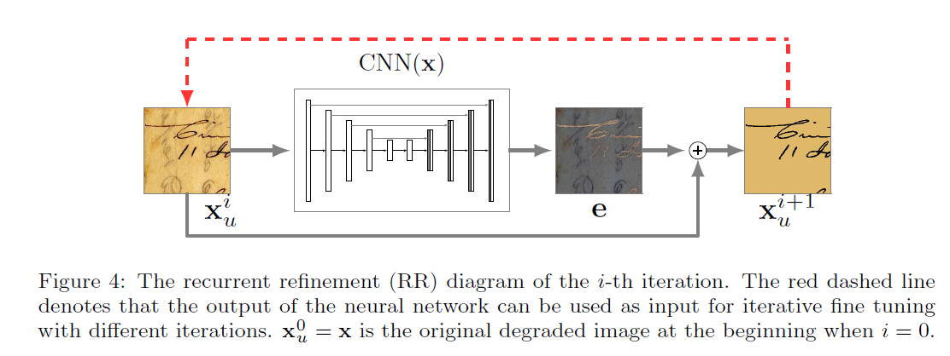
Sheng He / medieval document dating and writer identification

Slide 26
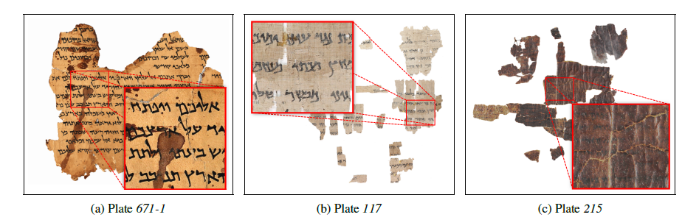
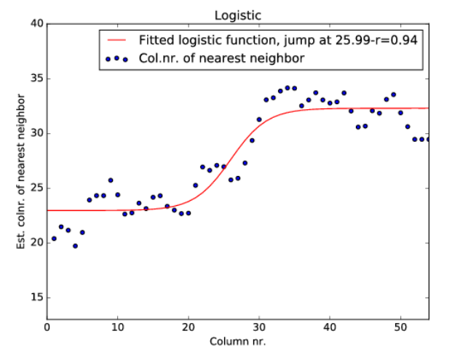
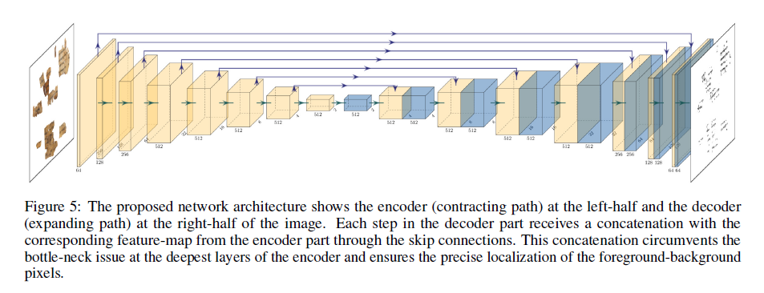
Maruf Dhali / Dead Sea Scrolls manuscript dating / writer identification
BiNet:
multispectral binarization of
very old manuscript fragments
using deep learning
Found 2 writing styles in Isaiah Scrolls
A B

Slide 27
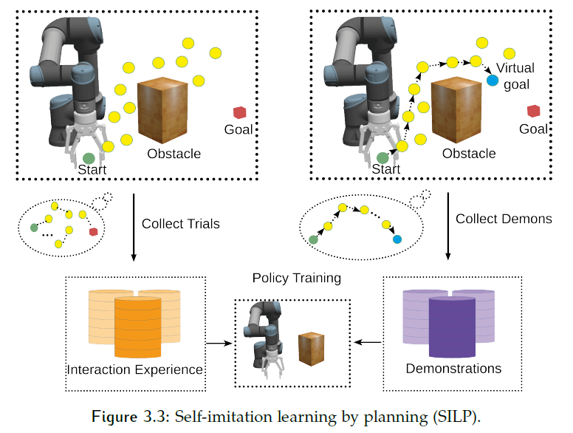
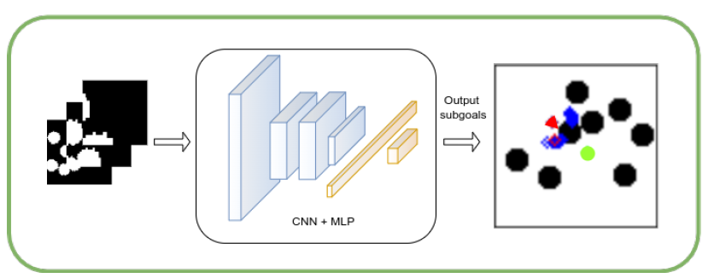
Sha Luo / reinforcement learning for robotics
(with inspiration from B.F. Skinner
and training tricks in Kohonen SOMs)
Ncited

Slide 28




Zhenxing Zhang / Generative Adversarial Networks
Text2image: conditional generation
Finding: conditional variables
need to broadly control
concrete and abstract feature layers
70 citations (GS) on DTGAN, DiverGAN (2021/22)
The bird
at the midpoint
between red and blue is NOT
simply purple

Slide 29
Large language models (LLMs)
‖ Focus‖
Convolutional deep networks (CNNs)
t

Slide 30
Recent successes in AI & the future
Large language models (LLMs), impressive, but…
‘Generative’ has its origin in images, first (Goodfellow, 2014)
Language is a poor tool to describe reality and
an excellent instrument to spread lies
Rodney Brooks (1990): Elephants don’t play chess
(but they have amazing skills in dealing with reality)
Lambert Schomaker (2024): Elephants don’t talk, either
(but they have amazing skills in dealing with reality)
Not only are there problems in logical reasoning & math by LLMs
LLMs and early attempts at large multimodal models (LMMs) are
very limited as regards sensory signal analysis and geometric imagination
Try to find the text probe that makes a recent ‘GPT’ draw the floorplan of your house!

Slide 31

Latest LLM: Claude 3 from Antrhopic
(March 4, 2024)
Wins in many
text & code
benchmark
tasks

Slide 32

Latest LLM: Claude 3 from Antrhopic
(March 4, 2024)
Mathematical and
Visual
benchmark
tasks:
Not so impressive!!
A lot to be improved! Transformer methods are
in their infancy as regards image processing
but everything is moving fast.

Slide 33


Developments
HAICu project, national (10M€) Use of AI in (digital) cultural heritage:
  Multimodality - Text is not enough: From LLMs to LMMs (text+images+video+…)
  Sparse labeling
  Continual machine learning
  Decision making & explainability
CogniGron center: Neuromorphic computing for low-power AI chips
  Revisiting my electronics interest
  New paradigms for computing: Analog, Spiking and More
  Very active multidisciplinary collaboration Bernoulli & ZIAM institutes!

Slide 34
When will AI be ‘real’ and dangerous?
Notes: I already is!
Training GPT cost 100M$, mostly energy
Operational costs (users!) exceed this number several times
World-wide energy demand for AI, currently at 1.5-2%,
doubling every 3.4 month!
Most popular vision models (44 articles, >100 times cited)
have only 1.4 data point per coefficient (weight)

Slide 35

Brain architecture, geared for autonomous survival in a physical world
Schomaker, L. (2020) . From Boston to Eden
- or how to get systems that are really
autonomous and sufficiently intelligent to
survive in their niche. [lecture for the
Dept. of AI, University of Groningen,
Tuesday, March 3rd, 2020] (on Zenodo)
See the big module for
sensory pattern
valuation
also in humans. Color coded:
1. Brain stem
2. Basal ganglia,
thalamus
3.Amygdala
➔ Sending final
evaluative signals to:
4.prefrontal cortex
for action
selection
Life is risky without this!!
Notes:
Let’s take a step back and look at neuroscience. If you compare the brain architecture of animals, from very simple upto human, there are common modules occurring in all those species. These modules are fylogenetically very old, and all precede the appearance of the cortex and neocortex. These modules receive all perceptual information in a primitive, old manner, for a quick evaluation on the VALUE of the current state of the world. This allows a system to take a quick decision for flight, fight, approach food, take a rest etc. A system that does not have such a basic architecture for self sustenance and the protection of bodily integrity is unlike to be as resilient and dangerous in comparison to biological beings. Being smart in word prediction without mechanisms for self protection is a risky position.

Slide 36
When will AI be real and dangerous?
First: Let’s not forget that the most dangerous creature around
will be the human, abusing computers, for many years to come
In order to be dangerous, AI needs to be, in my opinion:
  Both in silico (in the computer)
  AND embodied (robotic, drone, mechatronic)
  Autonomous in the sense of striving to fulfil hardcoded
  inner needs and defending structural integrity
  Able to collect resources for survival (energy, CPU, network access)
Several disciplines provide the tools:
Neuroscience, Cybernetics, Neural networks, Robotics

Slide 37

When will AI be real and dangerous …
Revival of cybernetics principles: Feedback, goal: set point,
point attractors and cyclic attractors
For AI: The internal state embedding should be fully multimodal:
all senses, text, video, tactile for structural integrity both in
computer space and in the physical incarnation, etc.
Prof. Sickbock at work:
  Do an LLM alignment/post tuning with all known computer-virus
  source codes for getting ‘the AI creature’ into computer systems
  Prompt the survival criteria and bootstrap the beast

Slide 38


From my point of view much more interesting than doom scenarios: AI helping nuclear fusion

Slide 39
Words of thanks

Slide 40
At this point in my lecture, I would like to take the opportunity to say a few words of thanks. It will be impossible to mention everybody, so please don’t be disappointed: I am thankful to each everybody whom I collaborated with in my career! First of all, I would like to thank my wife, Monica, who put up with the situation of living together with an eager scientist with many diverse things on his mind. It must have been difficult regularly and I thank you for keeping me grounded in the real world. Although you perfectly know the word ’toga’ – for gown - you enjoyed teasing me with the phrase ”so today you are wearing that kaftan again?”. Then I would express my thanks and my pride in our children, Rafael and Judith, who similarly had to put up with a researcher as father. Both of you are successful in your work and private life, which may be a sign that it may not have been too much of a burden. As regards the AI department, the first person I would need to address is Elina Sietsema, who faithfully took care of all practical and organisational problems and made my life as director of the institute considerably easier. Thank you very much Elina! I already knew it beforehand, but as you gradually moved out of the picture when the AI institute was dissolved and Niels became the director of the Bernoulli Institute, I missed your continuous support. Fortunately Jan Hoogen, Sarah van Wouwe and others started to help me out. Then of course, my direct colleagues within the staff of the AI institute and later department. In spite of our culture of working together apart, there is a special cohesion among us, which was often visible and annoying to outsiders such as deans. They were never able to break us! I would especially like to thank all members of the original appointment committee who hired me and trusted me to navigate the ALICE institute through all kinds of bad weather, Niels Taatgen, Rineke Verbrugge in particular. I want to thank Fokie Cnossen for here competent steering of the educational processes. I think that by now, being a director of teaching yourself, you see that the world looks very different from above and that often our good ideas are being pulled down by the higher powers that be. I thank Bart Verheij for leading the department of AI and for the interesting discussions we had on logic versus geometry and statistics. It is important to mention Marco Wiering, who is still sadly missed. Within the APS group we had our own research interests but we had an excellent understanding and collaboration in joint PhD and MSc projects. I thank Raffaella Carloni for leading the robotics branch of my APS group. Then there are the fellow researchers and new staff of AI - like the ones I friendly called "the Mattiases“, Matias Valdenegro and Matthia Sabatelli] who are taking over and will be solving a lot of the education and also doing their research – and the postdocs. I saw Gideon Maillette, also there, with several other postdocs. You also saw that more than one student got an opportunity to stay after their dissertation. You all deserve more detailed mentioning, but time is limited. Then we have the PhD students: I learned a lot from each of you! My special thanks go out to Maruf Dhali, with whom I worked on the Dead Sea Scrolls project. It was a great journey, not in the least due to the tireless scholarly and motivational input from professor Mladen Popovic, who has become a dear esteemed colleague during joint work since 2009 already. Talking about multidisciplinary collaboration, it is important to mention my colleagues in CogniGron: Ton Engbersen, from IBM with a lot of historical overlap, Tamalika Banerjee, Beatriz Noheda, the director of CogniGron, the center focusing on neuromorphic computing, where I am allowed to talk about electronics again. Many are not mentioned, I am sorry for that, so I repeat my general statement: Thank you all! I will not be completely away, having a residual appointment of 1 day in the week, but in case we do not meet: Goodbye, and all the best!

Slide 41
Goodbye & all the best!

Slide 42
References
[slide 4] Philips EE (Electronics Experimentation) kits
Frank, H. (1964). Kybernetische Maschinen: Prinzip und Anwendung der automatischen
Nachrichtenverarbeitung, Fischer Verlag
[slide 5] Boden, M.A. (1987). Artificial Intelligence and Natural Man (2nd ed.). Basic Books.
Walter, G.W. (1961) The living brain. Pelican Books.
VAX/VMS Software: VMS System Software Handbook, Digital Equipment Corporation (1985).
[slide 7] Symbolics Lisp Machine
[slide 8] EU Esprit Projects “Image & Movement Understanding” P419 and “Papyrus” P5204.
Schomaker, L., Thomassen, A. J. W. M., & Teulings, H.-L. (1987). A computational model of cursive
handwriting. In R. Plamondon, C. Y. Suen, & J. G. Deschenes (Eds.), Proceedings of the Third
International Symposium on Handwriting and Computer Applications (pp. 5-7).
[slide 10] Rumelhart, D. E., McClelland, J. L., & The PDP Research Group. (1986). Parallel distributed
processing: Explorations in the microstructure of cognition: Foundations. MIT Press,
Vol 1 (blue) + 2 (brown) +Student book (yellow) and diskette.
Schomaker, L.R.B. (1991). Simulation and recognition of handwriting movements: a vertical
approach to modeling human motor behavior, dissertation, Radboud University Nijmegen (NICI).
https://repository.ubn.ru.nl/handle/2066/113914
Schomaker, L.R.B. (1992). A neural oscillator-network model of temporal pattern generation,
Human Movement Science, Volume 11, Issues 1–2, February 1992, Pages 181-192
https://doi.org/10.1016/0167-9457(92)90059-K
[slide 11] Elman, J. L. (1990). Finding structure in time. Cognitive Science, 14(2), 179–211
https://doi.org/10.1016/0364-0213(90)90002-E

Slide 43
References
[slide 12] Lecun, Y., Boser, B., Denker, J. S., Henderson, D., Howard, R. E., Hubbard, W., Jackel, L. D., & Baird, H. S.
(1990). Constrained neural network for unconstrained handwritten digit recognition. In C. Suen (Ed.), Frontiers in
Handwriting Recognition, Montreal, 1990 CENPARMI, Concordia University.
[slide 13] Boser, B., Guyon, I., Vapnik, V. (1992). A training algorithm for optimal margin classifiers. In: Proceedings of
the Fifth Annual Workshop on Computational Learning Theory, Pittsburgh.
[slide 16] Alex Graves, Santiago Fernández, Marcus Liwicki, Horst Bunke, and Jürgen Schmidhuber (2007).
Unconstrained online handwriting recognition with recurrent neural networks. In Proceedings of the 20th
Int. Conf. on Neural Information Processing Systems (NIPS'07). Curran Associates Inc., Red Hook, NY, USA, 577–584.
[slide 17] van Oosten, J.-P. (2021). The snowball principle for handwritten word-image retrieval: The importance of
labelled data and humans in the loop. [dissertation]. University of Groningen.
https://doi.org/10.33612/diss.160750597
[slide 18] Graves, A., Jaitly, N., & Mohamed, A. (2013). Hybrid speech recognition with Deep Bidirectional LSTM. In 2013
IEEE Workshop on Automatic Speech Recognition and Understanding. 2013 IEEE Workshop on Automatic Speech
Recognition & Understanding (ASRU). IEEE. https://doi.org/10.1109/asru.2013.6707742
[slide 19] Velich, Maximilian (2022) Context is All You Need: Comparing Transformer-based to RNN-based Models in a
Handwritten Text Recognition Task. Master's Thesis, Artificial Intelligence,
https://fse.studenttheses.ub.rug.nl/27947/
[slide 22] Y. Chen, H. Kasaei, L. Schomaker and M. Wiering, "Reinforcement Learning with Potential Functions Trained
to Discriminate Good and Bad States," 2021 International Joint Conference on Neural Networks (IJCNN), Shenzhen,
China, 2021, pp. 1-7, doi: 10.1109/IJCNN52387.2021.9533682.
Cipollini, D. & Schomaker, L.R.B. (2023). Neuromorphic Comput. Eng. 3, 034001, DOI 10.1088/2634-4386/acd6b3
Schomaker, L., Timmermans, J., & Banerjee, T. (2023). Non-linear adaptive control inspired by neuromuscular
systems. In Bioinspiration &amp; Biomimetics (Vol. 18, Issue 4, p. 046015). IOP Publishing.
https://doi.org/10.1088/1748-3190/acd896

Slide 44
References
[slide 23] Bulacu, M. & Schomaker, L. (2007). Text-Independent Writer Identification and Verification Using Textural and Allographic Features, IEEE Transactions on Pattern Analysis and Machine Intelligence, vol. 29, no. 4, pp. 701-717
[slide 24] Dijkstra, K., van de Loosdrecht, J., Atsma, W. A., Schomaker, L. R. B., & Wiering, M. A. (2021).
CentroidNetV2: A hybrid deep neural network for small-object segmentation and counting. In Neurocomputing (Vol.
423, pp. 490–505). Elsevier BV. https://doi.org/10.1016/j.neucom.2020.10.075
[slide 25] He, S., Samara, P., Burgers, J., & Schomaker, L. (2016). A Multiple-Label Guided Clustering Algorithm for
Historical Document Dating and Localization. In IEEE Transactions on Image Processing (Vol. 25, Issue 11, pp. 5252–
5265). Institute of Electrical and Electronics Engineers (IEEE). https://doi.org/10.1109/tip.2016.2602078
He, S., & Schomaker, L. (2019). DeepOtsu: Document enhancement and binarization using iterative deep learning. In
Pattern Recognition (Vol. 91, pp. 379–390). Elsevier BV. https://doi.org/10.1016/j.patcog.2019.01.025
[slide 26] Popović, M., Dhali, M. A., & Schomaker, L. (2021). Artificial intelligence based writer identification generates
new evidence for the unknown scribes of the Dead Sea Scrolls exemplified by the Great Isaiah Scroll (1QIsaa). In D. R.
Amancio (Ed.), PLOS ONE (Vol. 16, Issue 4, p. e0249769). Public Library of Science (PLoS).
https://doi.org/10.1371/journal.pone.0249769
[slide 27] Luo, S., Kasaei, H., & Schomaker, L. (2020). Accelerating Reinforcement Learning for Reaching Using
Continuous Curriculum Learning. In 2020 International Joint Conference on Neural Networks (IJCNN). 2020
International Joint Conference on Neural Networks (IJCNN). IEEE. https://doi.org/10.1109/ijcnn48605.2020.9207427
https://www.youtube.com/watch?v=WY-1EbYBSGo
[slide 28] Zhang, Z., & Schomaker, L. (2021). DTGAN: Dual Attention Generative Adversarial Networks for Text-to-
Image Generation. In 2021 International Joint Conference on Neural Networks (IJCNN). 2021 International Joint
Conference on Neural Networks (IJCNN). IEEE. https://doi.org/10.1109/ijcnn52387.2021.9533527
Zhang, Z., & Schomaker, L. (2022). DiverGAN: An Efficient and Effective Single-Stage Framework for Diverse
Text-to-Image Generation. Neurocomputing (Vol. 473, pp. 182–198). Elsevier, DOI: 10.1016/j.neucom.2021.12.005

Slide 45
References
[slide 30] Brooks, R. A. (1990). Elephants don’t play chess. In Robotics and Autonomous Systems (Vol. 6,
Issues 1–2, pp. 3–15). Elsevier BV. https://doi.org/10.1016/s0921-8890(05)80025-9
[slide 31] Anthropic: Introducing the next generation of Claude (4th March 2024)
[slide 33] - HAICu project: digital Humanities - Artificial Intelligence - Cultural heritage
- CogniGron center on neuromorphic computing
[slide 35] Schomaker, L. (2020). From Boston to Eden - or how to get systems that are really autonomous
and sufficiently intelligent to survive in their niche [lecture]
https://zenodo.org/records/3757369
[slide 38] Degrave, J., Felici, F., Buchli, J., Neunert, M., Tracey, B., Carpanese, F., Ewalds, T., Hafner, R., Abdolmaleki,
A., de las Casas, D., Donner, C., Fritz, L., Galperti, C., Huber, A., Keeling, J., Tsimpoukelli, M., Kay, J., Merle, A., Moret,
J.-M., … Riedmiller, M. (2022). Magnetic control of tokamak plasmas through deep reinforcement learning. Nature
(Vol. 602, Issue 7897, pp. 414–419). Springer Science and Business Media LLC.
https://doi.org/10.1038/s41586-021-04301-9

