Slide 1
AI Guided Ontology Curation Workflows
https://bit.ly/ai-ontology-workflows
Chris Mungall
Lawrence Berkeley National Laboratory
OBO Academy
March 2024

Slide 2
Goals for today
Demo / Tutorial
  Demonstrate what can be done using standard generic ChatGPT (and similar) interfaces
  Next session we will talk about specialized tools (OntoGPT, CurateGPT, OAK-LLM)
You can follow along if you want
  These slides: https://bit.ly/ai-ontology-workflows
Questions encouraged!
Goal is to make you feel empowered to experiment and explore for yourself
If we have time
  Report on evaluation of DRAGON-AI

Slide 3
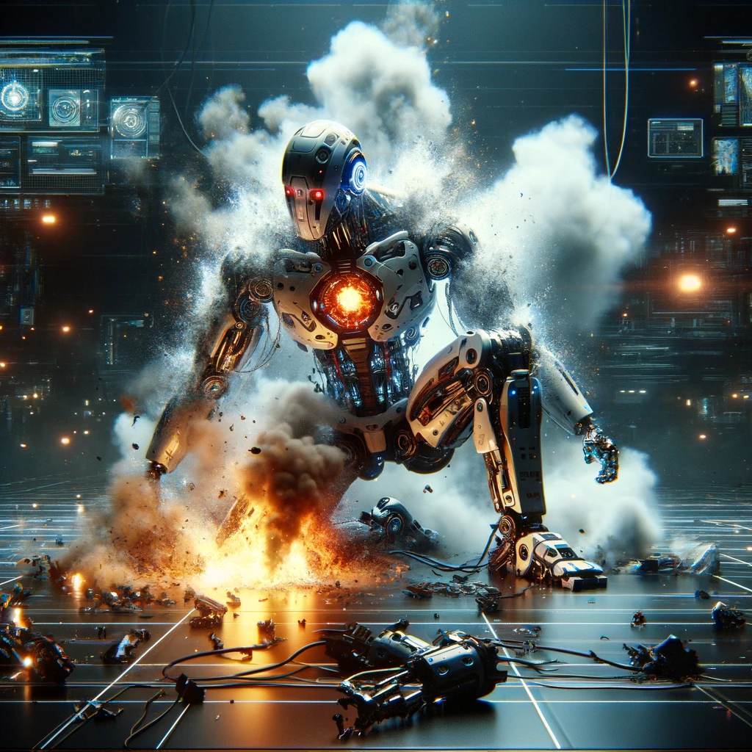
Caveat 1: AI is weird
Everything I aim to show today has worked in the past
But web-based AIs are non-deterministic
It’s quite possible that things will go wrong – this is an experiment!

Slide 4
Caveat 2: Tools are not open to all
ChatGPT
  https://chat.openai.com/
  Gpt-4 requires subscription
Gemini
  https://gemini.google.com/app
  AI premium account
Claude
  https://claude.ai/chats
  Claude-3 Opus requires a subscription
Groq
  https://groq.com/
  Free (for now!)
  Note: this is nothing to do with Twitter’s Grok
  Fast access to mixtral and llama2

Slide 5
Experiments today
Direct chat interface
Review-based workflows
Enhancement workflows
ROBOT helper
Consensus for finding references

Slide 6
First attempt - obo format
Create a term in the plant ontology for the concept "Fine root C/leaf C ratio". Show in obo format
https://chat.openai.com
Notes:
TODO: change to non-plant example

Slide 7
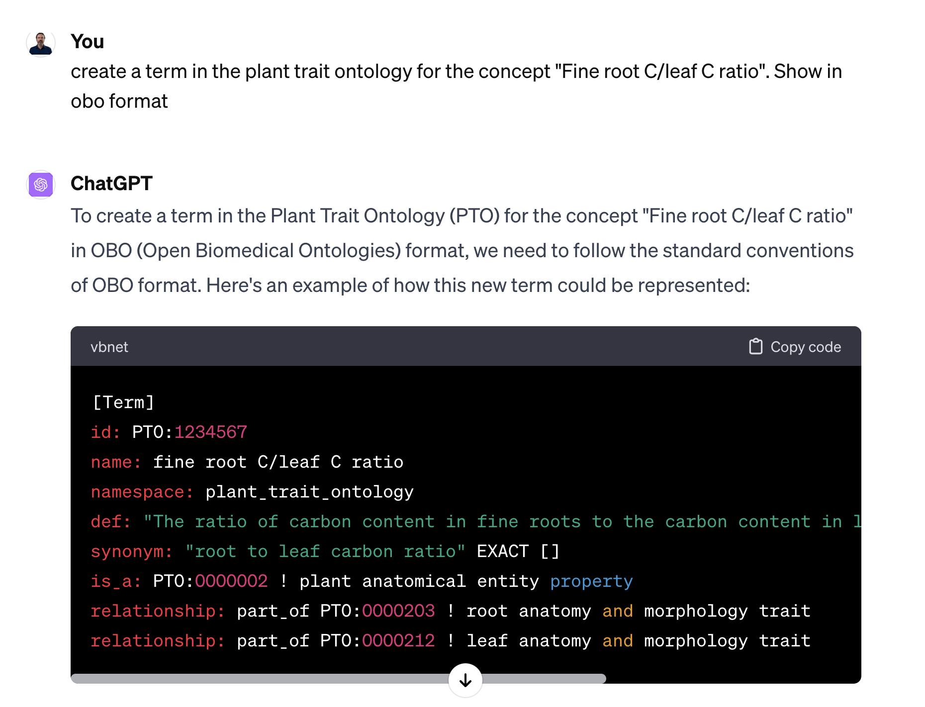
First attempt - seems OK?
Notes:
TODO: change to non-plant example

Slide 8
Uh oh! Hallucinations!
No such term
Too general a parent (ChatGPT doesn’t know the ontology well enough to place a term)

Slide 9
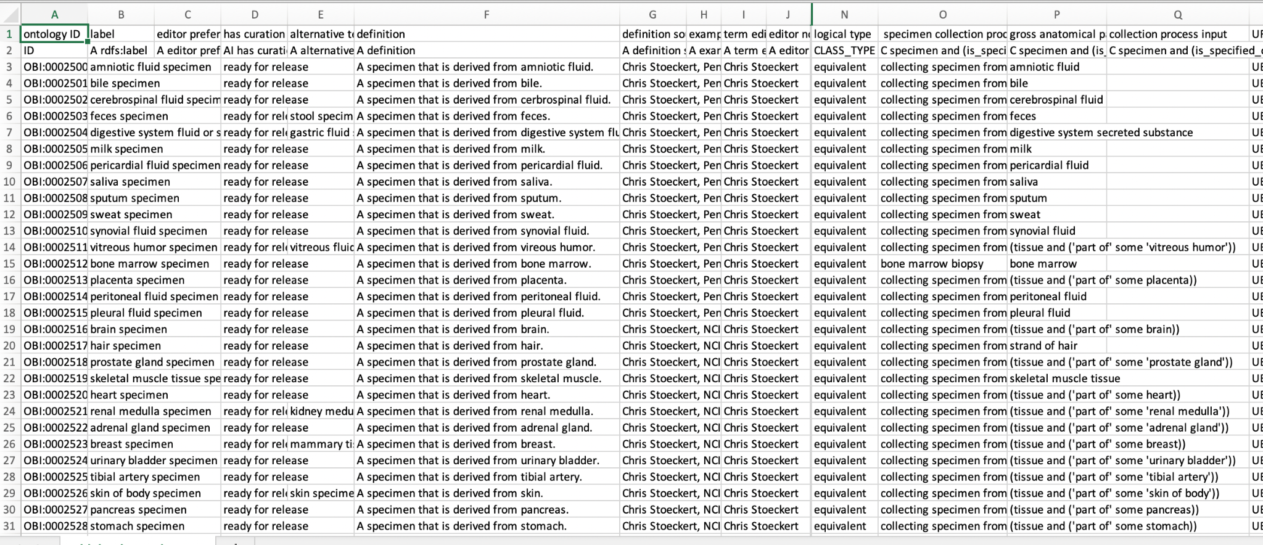
ROBOT CSVs to the rescue
ROBOT CSVs are nice for humans as we don’t have to memorize IDs
Nice for AIs for the same reason!

Slide 10

Review-based workflow
It’s easy to make mistakes with ontologies!
  Hard to avoid these slipping through

Slide 11
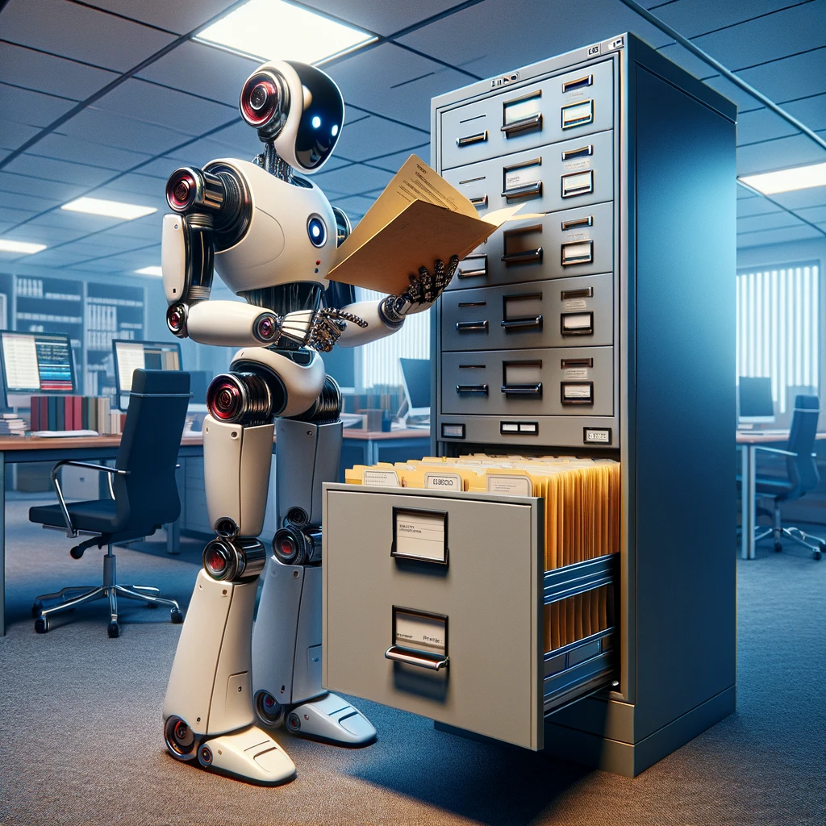
Review-based workflow
It’s easy to make mistakes with ontologies!
  Hard to avoid these slipping through
Let’s have the AI review a collection of ontology terms
The collection will be represented as a robot template CSV
We will introduce a deliberate error
  https://gist.github.com/cmungall/68ceedb93abdd24946cb2e3737bbe603
  Can you find the error faster than the AI?
Let’s try ChatGPT

Slide 12
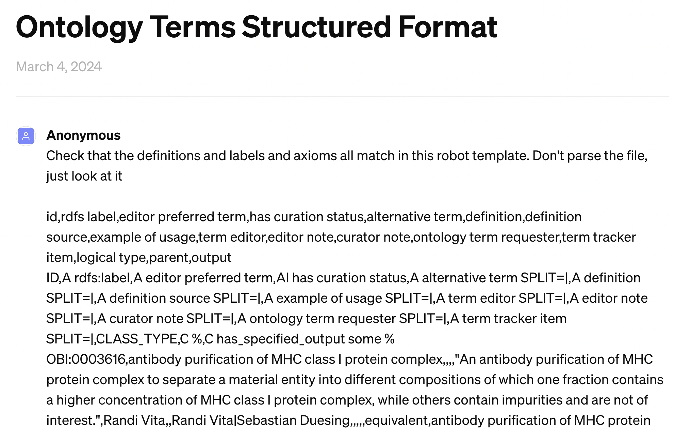
Review-based workflow

Slide 13
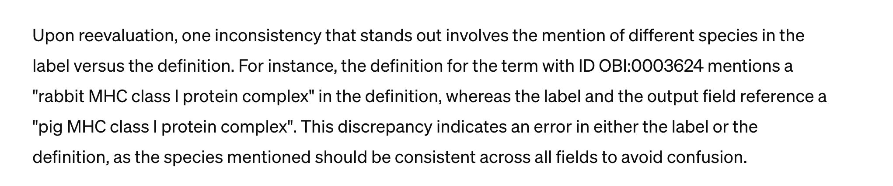
Review-based workflow - success!

Slide 14
Review-based workflow: larger files
Example file: biobank specimens from OBI
https://gist.githubusercontent.com/cmungall/ec2a2cc2a453be40ab755bc1aa650520/raw/c8cbe6dec97ccbded52dbd9f6f9d0244d7daf9cb/biobank-specimens.csv
> 100 lines, many columns
Too large to paste into ChatGPT!
Alternative: claude.ai

Slide 15
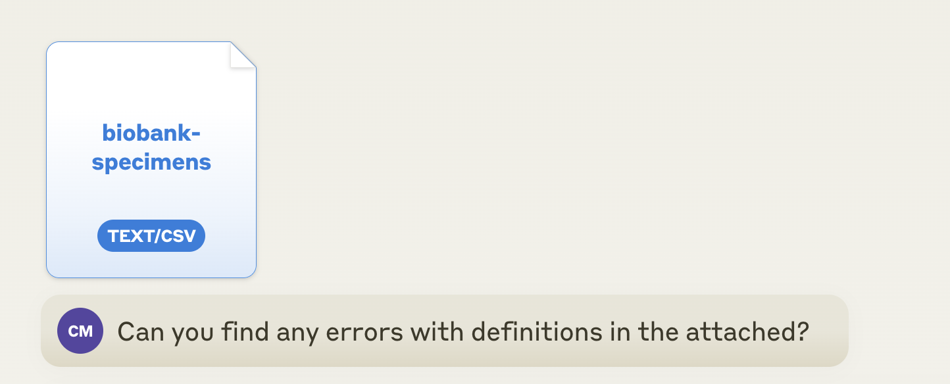

Slide 16
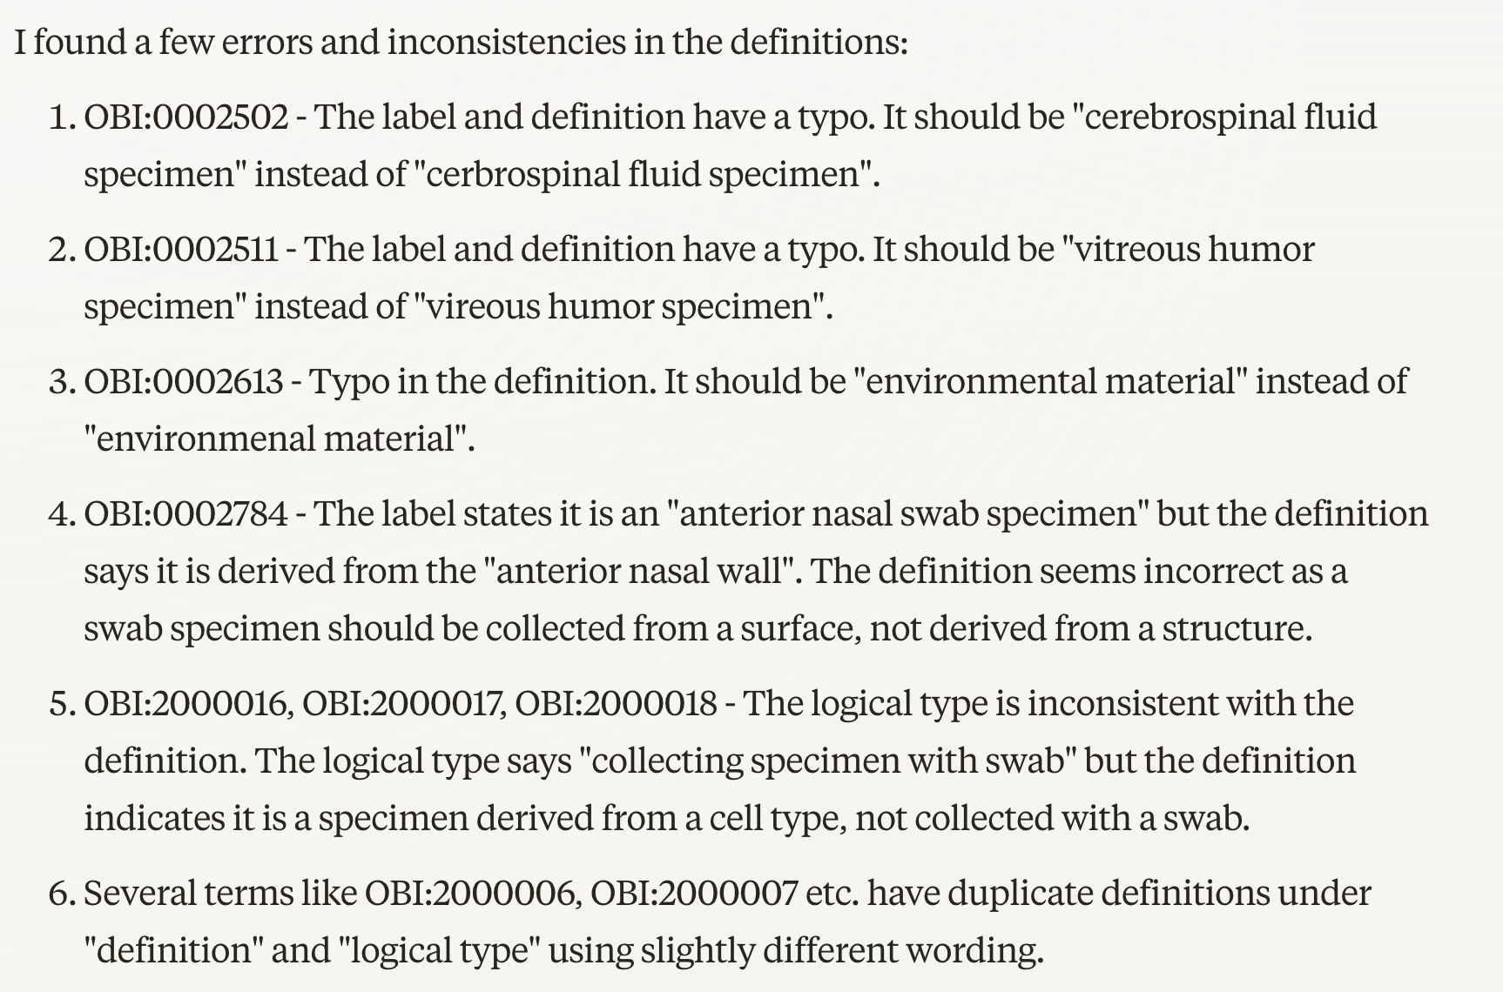

Slide 17
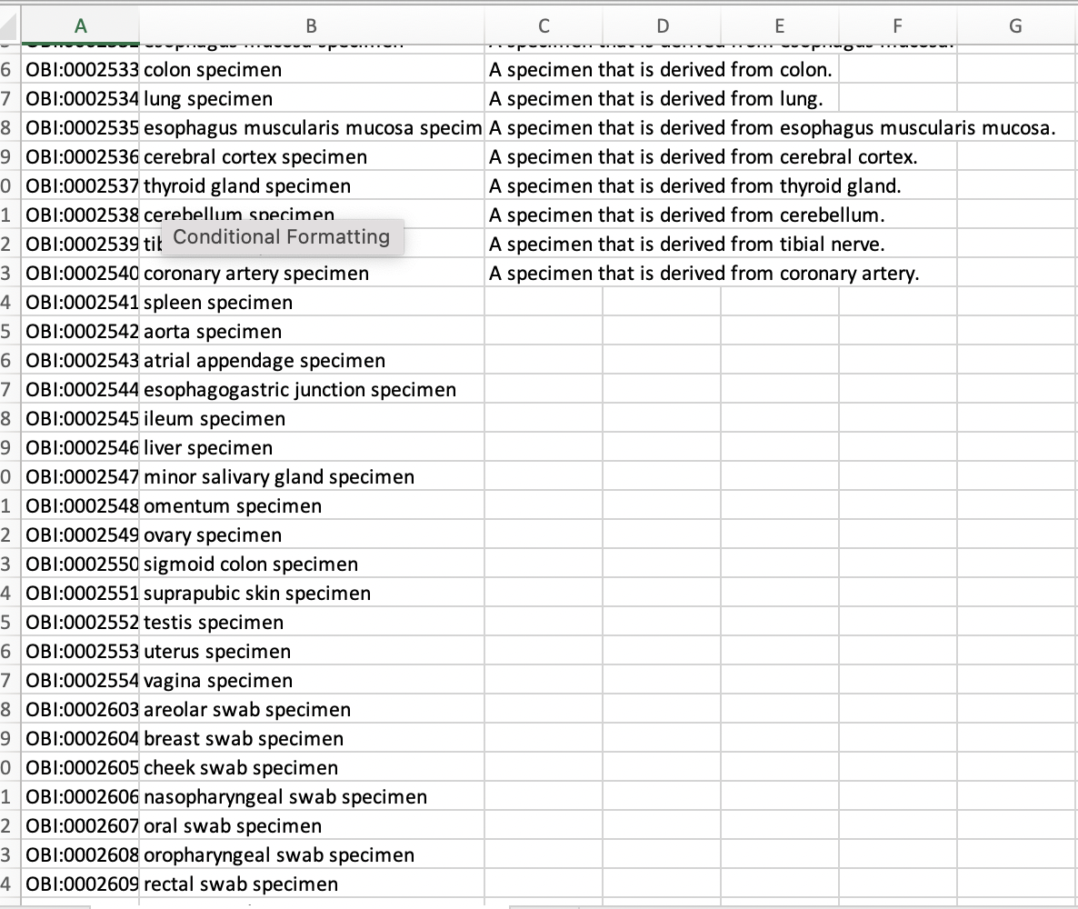
Missing definition test
Example robot template with definitions missing:
https://gist.github.com/cmungall/2be046ef3f7eba16bb8a54b677280692
This time let’s use groq

Slide 18
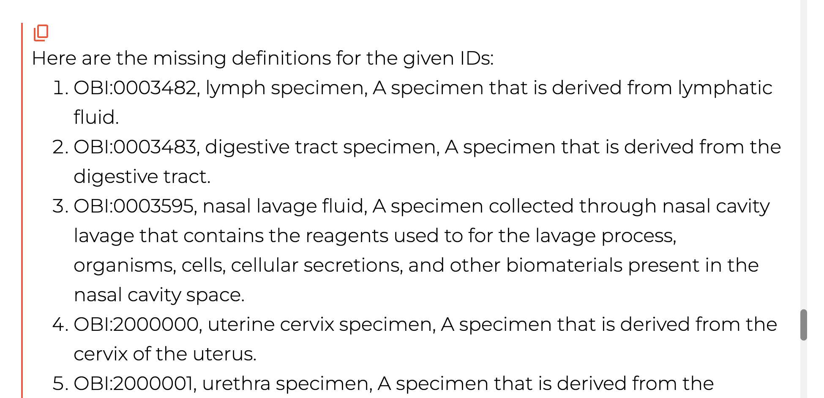

Slide 19
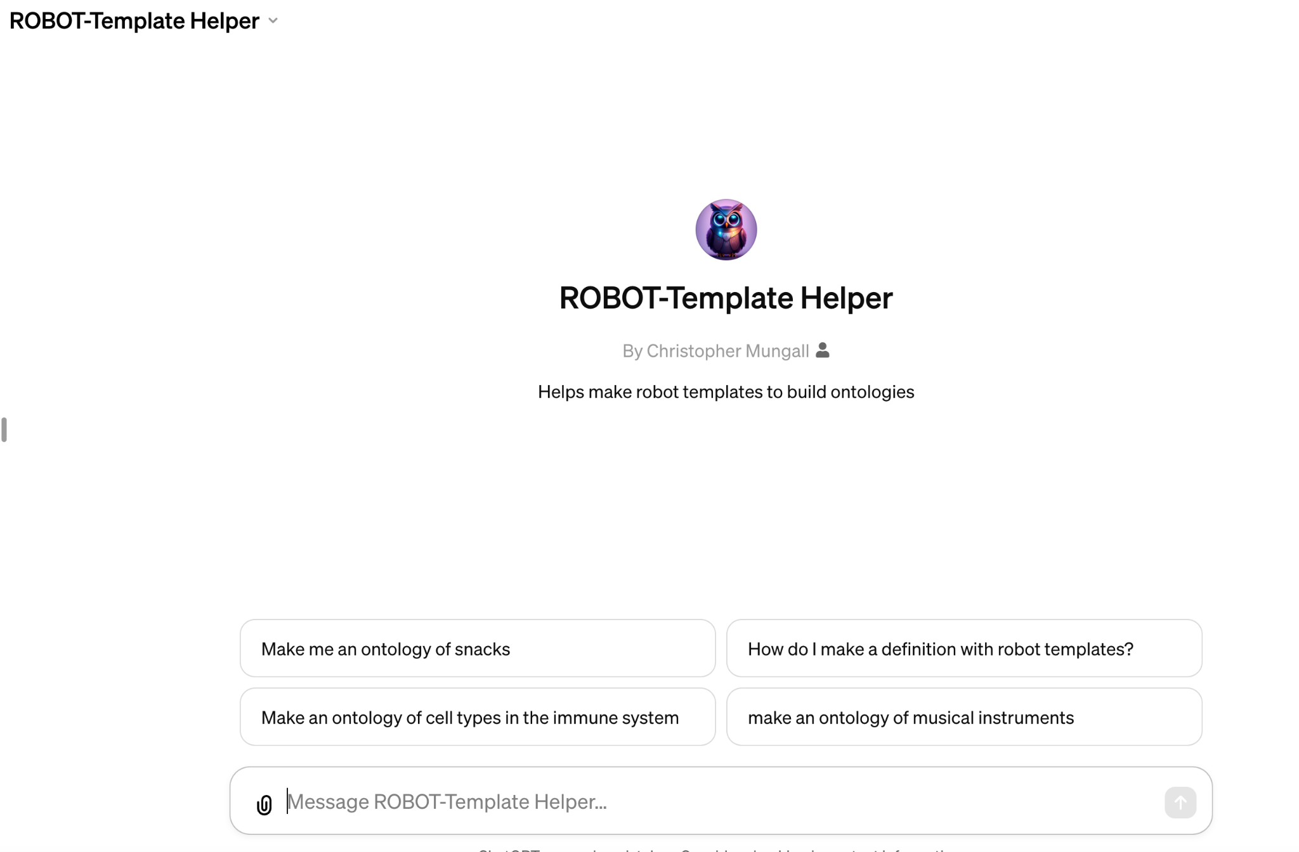
ROBOT Helper
https://bit.ly/robot-gpt

Slide 20
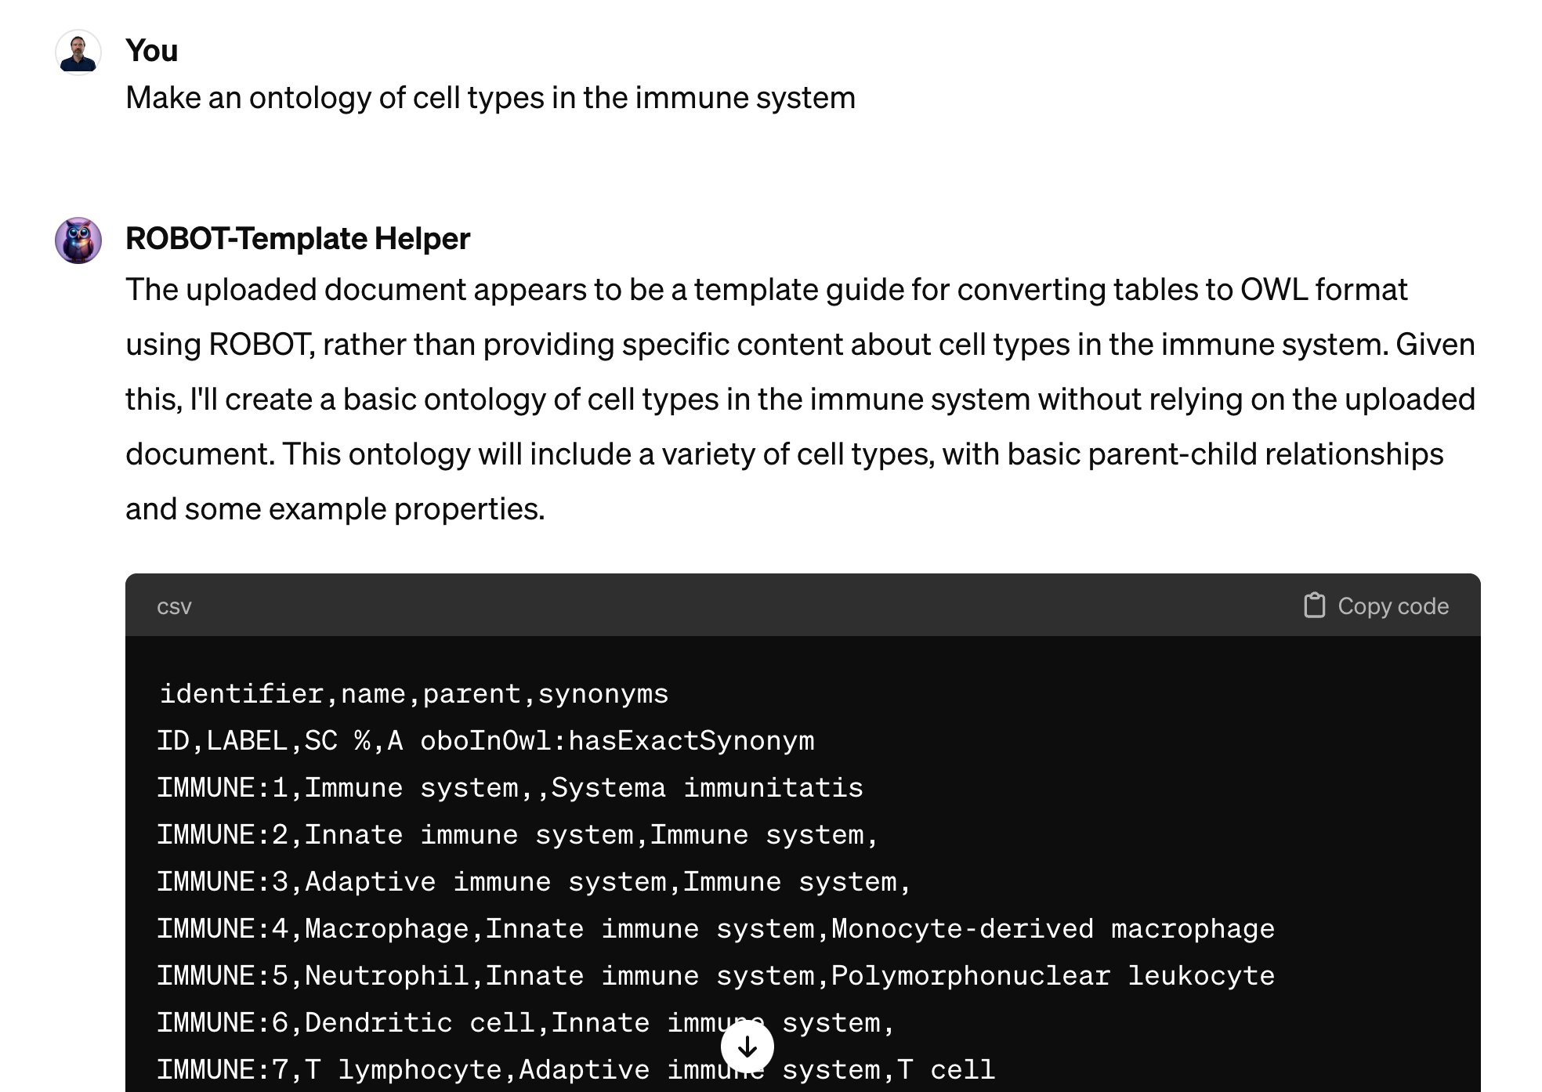

Slide 21
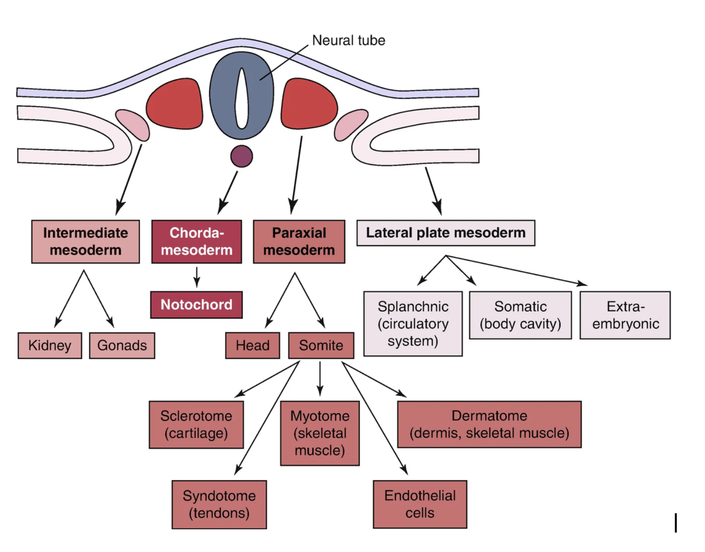

Slide 22
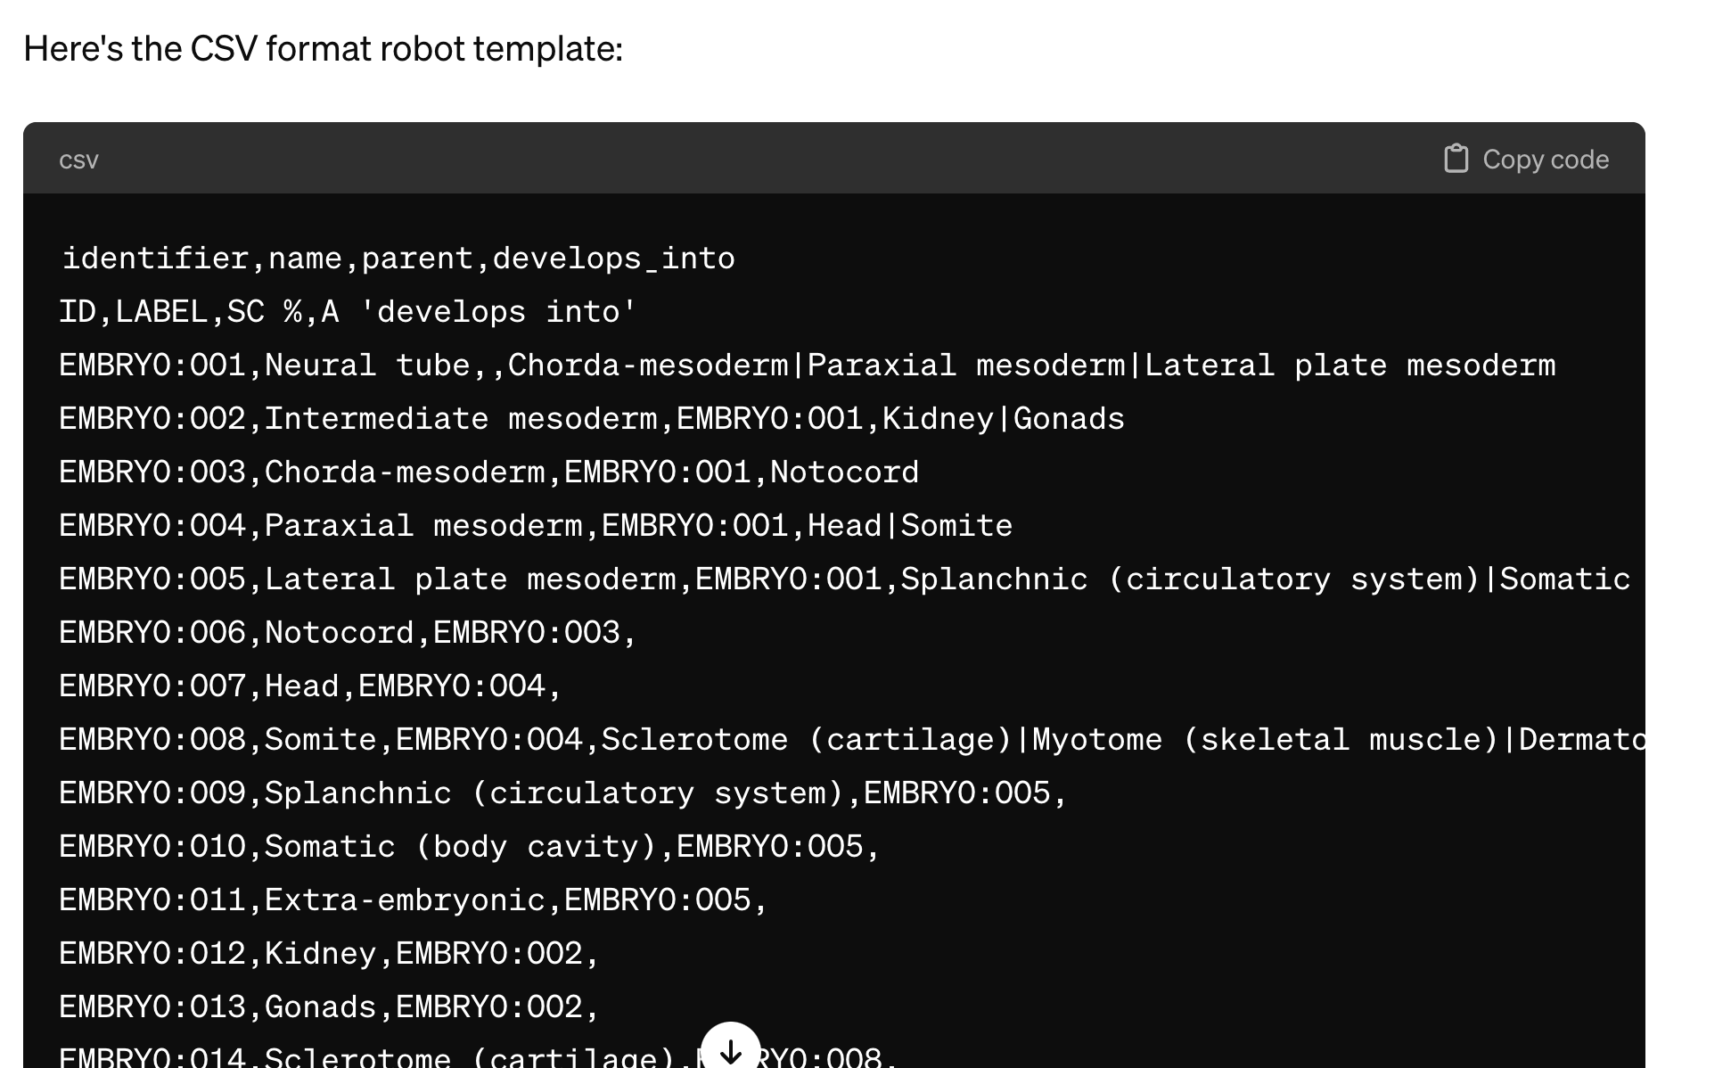

Slide 23
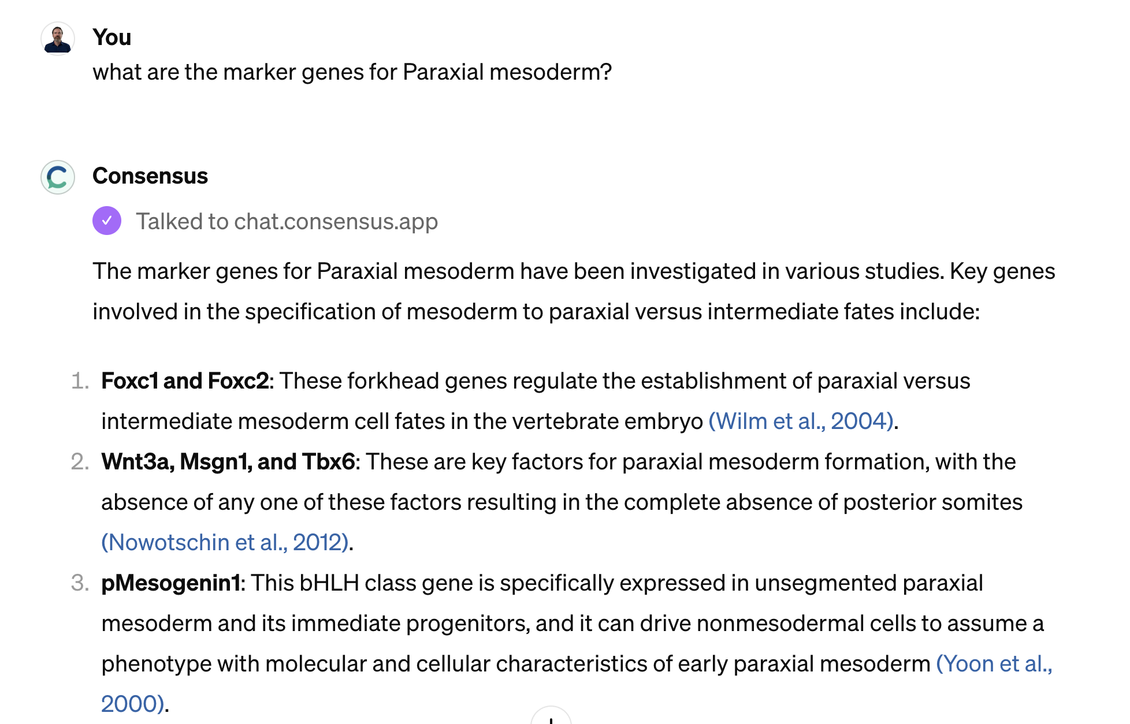

Slide 24
Questions?

Slide 25
DRAGON-AI evaluation
Chris Mungall
Lawrence Berkeley National Laboratory
OBO Academy
March 2024

Slide 26









Ontologies are vital for Knowledge Bases
Ontologies (Examples)
DRKBs (Examples)
GO (Gene Function)
CL (Cell Types)
Ontologies: >1k
Terms: >14m
MONDO (Diseases)
HPO (Human Phenotype)
MPO (Mammalian Phenotype)
UBERON (Anatomy)
OBA (Traits)
CHEBI (Chemical Entities)
Ontologies and knowledge bases are living resources, continually updated and maintained
<and many more>

Slide 27
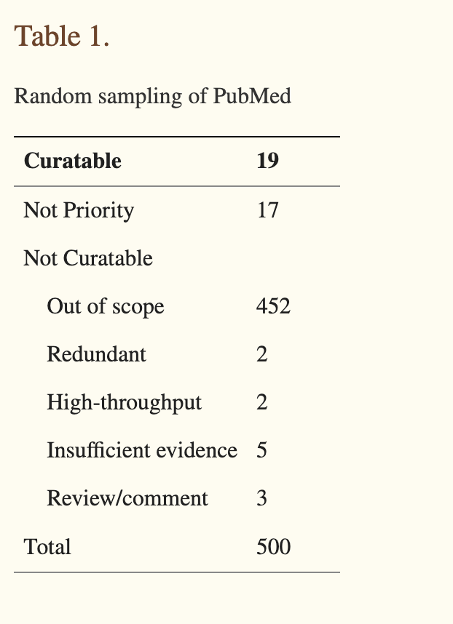
Can generative AI help maintain ontologies?
Dispelling Myths
“Manual curation is not scalable”
“Knowledge in the literature growing exponentially””
This is not true!
On expert curation and scalability: UniProtKB/Swiss-Prot as a case study
Poux et al., Bioinformatics 2017

Slide 28
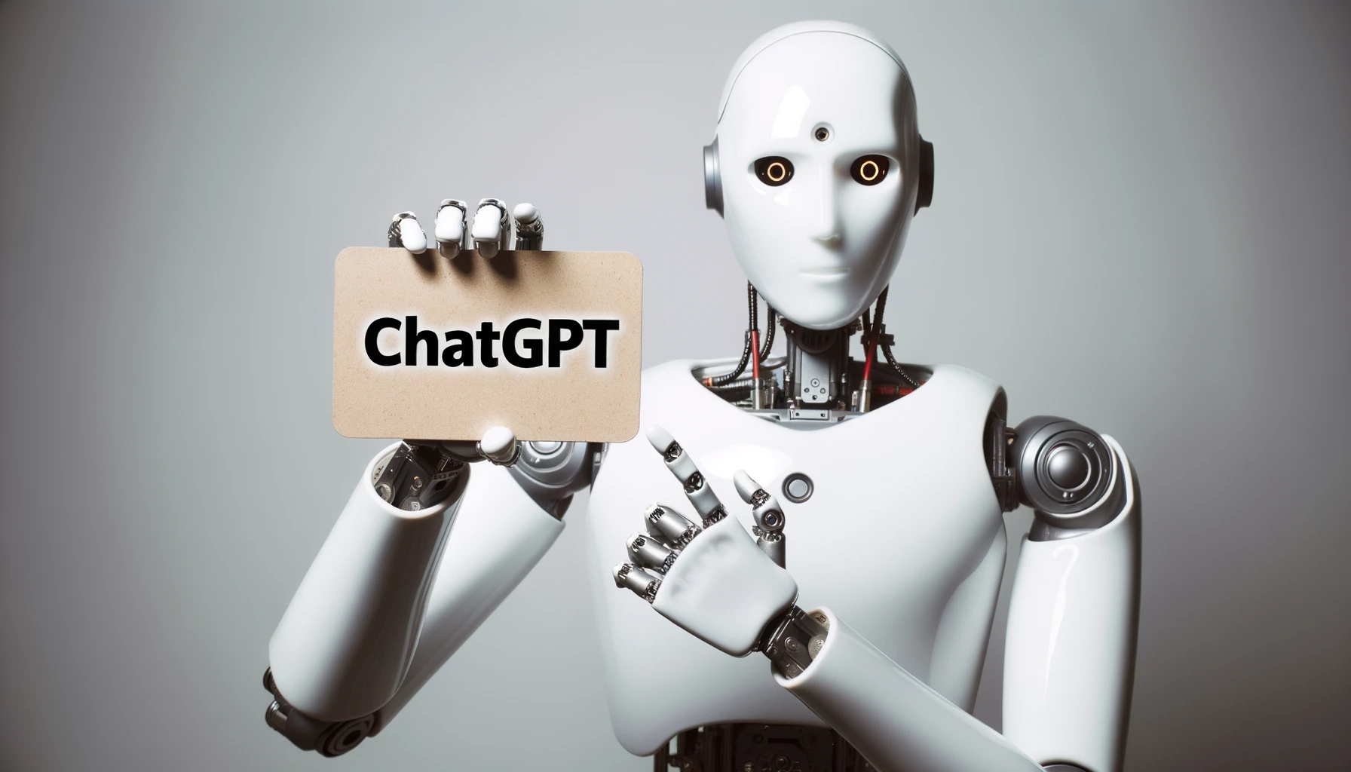
Can generative AI help maintain ontologies?
Dispelling Myths
“Manual curation is not scalable”
“Knowledge in the literature growing exponentially””
Reality
We could do with some help!
  1000s of open issues on GitHub trackers
We should use experts for high level tasks and automation for low level tasks
Particularly true for ontologies
This is not true!
On expert curation and scalability: UniProtKB/Swiss-Prot as a case study
Poux et al., Bioinformatics 2017
Can AI help here?

Slide 29
Are LLMs alone the solution?
Notes:
TODO: change to non-plant example

Slide 30
Challenge: LLMs hallucinate and have reliability issues
No such term
Too general a parent (ChatGPT doesn’t know the ontology well enough to place a term)

Slide 31
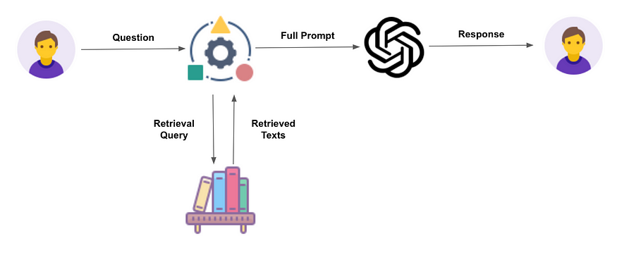
Retrieval Augmented Generation (RAG) adds context
RAG adds relevant context to the prompt passed to the LLM
Image credit: https://www.linkedin.com/pulse/what-retrieval-augmented-generation-grow-right

Slide 32
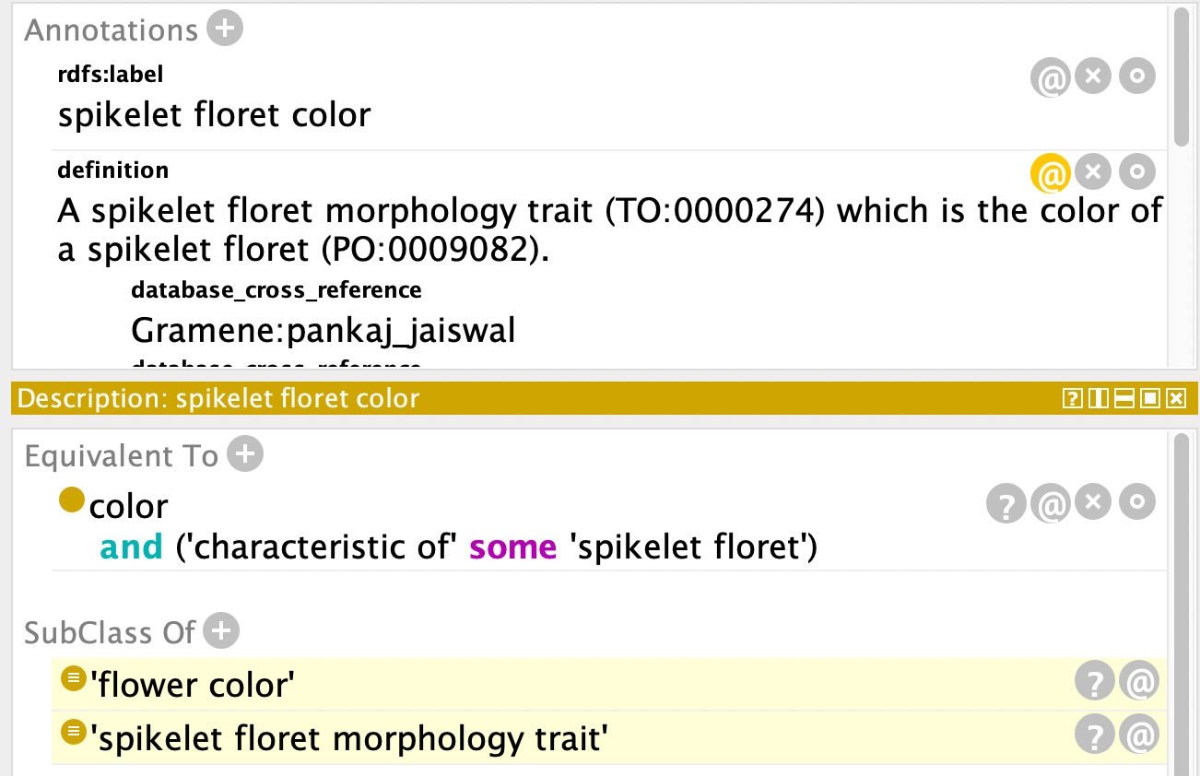
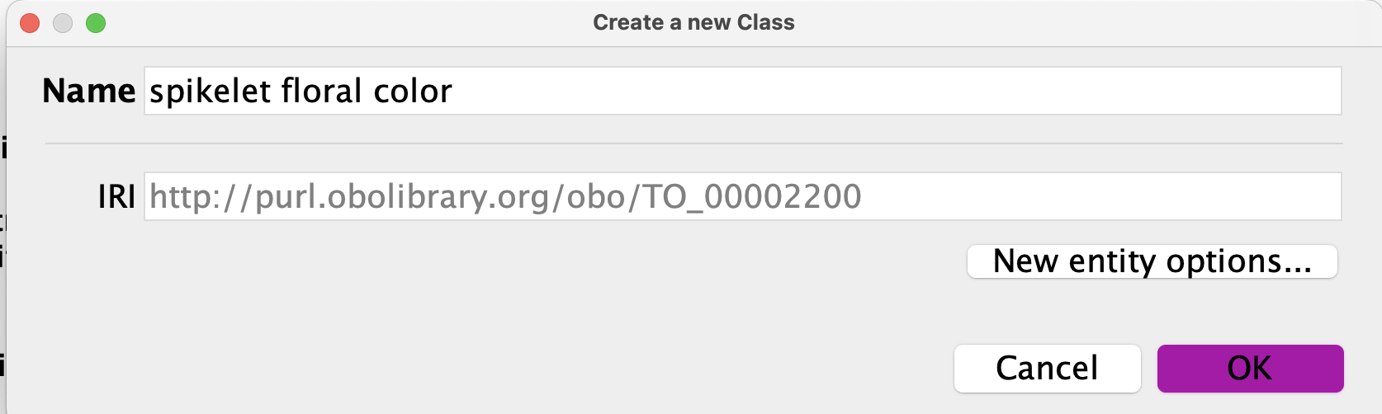






DRAGON-AI: Dynamic Retrieval Augmented Generation of Ontologies using AI
Definition (text)
Logical (OWL) definition
Relationships
Question
“Add term ‘spiketet floral color’”
Question
Full prompt
Response (new ontology term)
Similar Terms
LLM
Retrieval
Query
Text Embedding model
https://github.com/monarch-initiative/curate-gpt

Slide 33
Challenge: How do we evaluate performance?
Subjectivity
  Ontology terms are constructs
  Multiple ground truths
Heterogeneity
  Different knowledge domains present different challenges
  What works for one ontology or knowledgebase may not work for another
Multifaceted
  Ontologies have a variety of axiom types (logical and textual)
  Not just link prediction
Realistic scenarios
  Ontology development is collaborative
  How to emulate domain experts giving background knowledge
Benchmarks
  How do we deal with test data leakage?
  All major LLMs have “seen” most ontology terms already
Model proliferation
  Generalizability across models
  Different models are proliferating (Gemini, Mixtral, …)
Notes:
NOTES: All these also issues for KBs generally

Slide 34
Our evaluation approach
Subjectivity
  Ontology terms are constructs
  Manual evaluation using multiple experts
Heterogeneity
  Different knowledge domains present different challenges
  Test on a variety of ontologies, evaluate on multiple criteria
Multifaceted
  Ontologies have a variety of axiom types (logical and textual)
  Evaluate each axiom type separately
Realistic scenarios
  Ontology development is collaborative
  Evaluate realistic workflows, use of GitHub issues as background knowledge
Benchmarks
  How do we deal with test data leakage?
  Test using only terms from after model cutoff
Model proliferation
  Generalizability across models
  Test open and closed models
Notes:
All these also issues for KBs generally

Slide 35





Evaluating AI-Generated Definitions against Human Curated Definitions
Scored using different criteria (1-5)
Accuracy
Consistency
Overall score
Evaluators also indicated confidence (1-5)
24 Evaluators volunteered
editors, curators, and users
Evaluators considered terms generated by different AI models as well as manually authored ones
Evaluators worked independently
Evaluators were blinded to source of term
https://github.com/monarch-initiative/dragon-ai-results

Slide 36
Evaluation on 10 ontologies
Ontology | Name | Typical Usage | Terms Tested | Tasks Evaluated
CL | Cell type ontology | Single cell annotation | 50 | R,D,L
ENVO | Environment Ontology | Microbiome annotation | 50 | R,D,L
FOODON | Food Ontology | Nutrition, food safety | 50 | R,D,L
GO | Gene Ontology | Gene function analysis | 50 | R,D,L
HP | Human Phenotype Ontology | Disease/gene annotation, variant prioritization | 50 | R,D
MONDO | Mondo Disease Ontology | Disease classification | 50 | R,D,L
MP | Mammalian Phenotype Ontology | Gene/genotype annotation | 50 | R,D
OBA | Ontology of Biological Attributes | GWAS, eQTL | 50 | R,D,L
OBI | Ontology of Biomedical Investigations | Experimental methods | 50 | R
UBERON | Anatomy Ontology | Gene expression | 40 | R,D,L
Inclusion criteria
Pass OBO Dashboard
Impactful for NIH DRKBs
Actively developed
Cross-section of domains
Diversity of styles of ontology development
Tasks
Relationships
  Classification
  All relationships
Definitions (text)
Logical axiomatization

Slide 37



Models and configurations tested
Gpt-3.5-turbo (OpenAI)
Closed, inexpensive, API only
+
x
RAG over ontology + GitHub issues
Gpt-4 (OpenAI)
Closed, expensive, API only
nous-hermes-13b
Open, API or download and run locally (huggingface.co)
RAG over ontology only
Notes:
TODO: mention GH here

Slide 38

Results: Humans beat AI!
Terms authored by humans scored better than those authored by AI
Image credit: ChatGPT-DALL-E3

Slide 39
Relationship Prediction Task
Relationships were largely correct
Precision scores may undercount due to missing relationships in ontology
 |  | SubClassOf Task |  |  | All Relationship Types Task
method | model | precision | recall | f1 | precision | recall | f1
DRAGON | gpt-3.5-turbo | 0.831 | 0.352 | 0.494 | 0.746 | 0.392 | 0.514
DRAGON | gpt-4 | 0.889 | 0.44 | 0.588 | 0.797 | 0.456 | 0.58
DRAGON | nous-hermes-13b | 0.68 | 0.273 | 0.39 | 0.597 | 0.292 | 0.392
OWL Reasoner | n/a | 1.0* | 0.337 | 0.504 | n/a | n/a | n/a
(results aggregated across ontologies)

Slide 40
Definition evaluation: Human curated definitions (narrowly) beat AI generated ones
method | model name | Accuracy (1-5) | Score (1-5) | Consistency (1-5)
DRAGON | gpt-3.5-turbo | 4.018 | 3.598 | 3.7
DRAGON | gpt-4 | 3.945 | 3.543 | 3.664
DRAGON | nous-hermes-13b | 3.741 | 3.361 | 3.548
curator | human | 4.332 | 4.06 | 4.107
}
2nd best (joint)
best
gpt-4 vs gpt-3.5 not statistically significant
Closed models vs open model: statistically significant
Humans vs AI: statistically significant
Adding GitHub issues as a background source boosted performance by 0.2 on average (only tested on subset)
huggingface.co/datasets/MonarchInit/dragon-ai-definition-evals

Slide 41
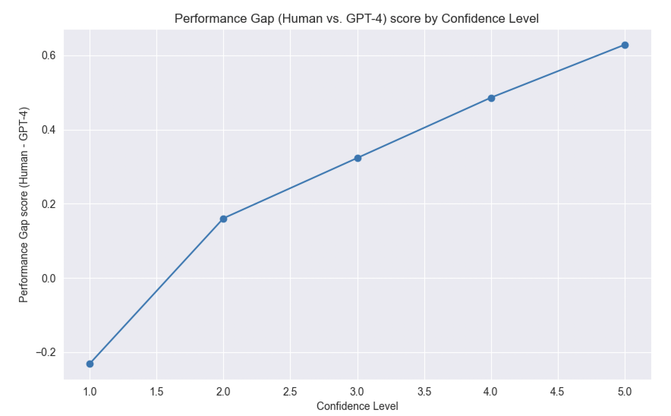
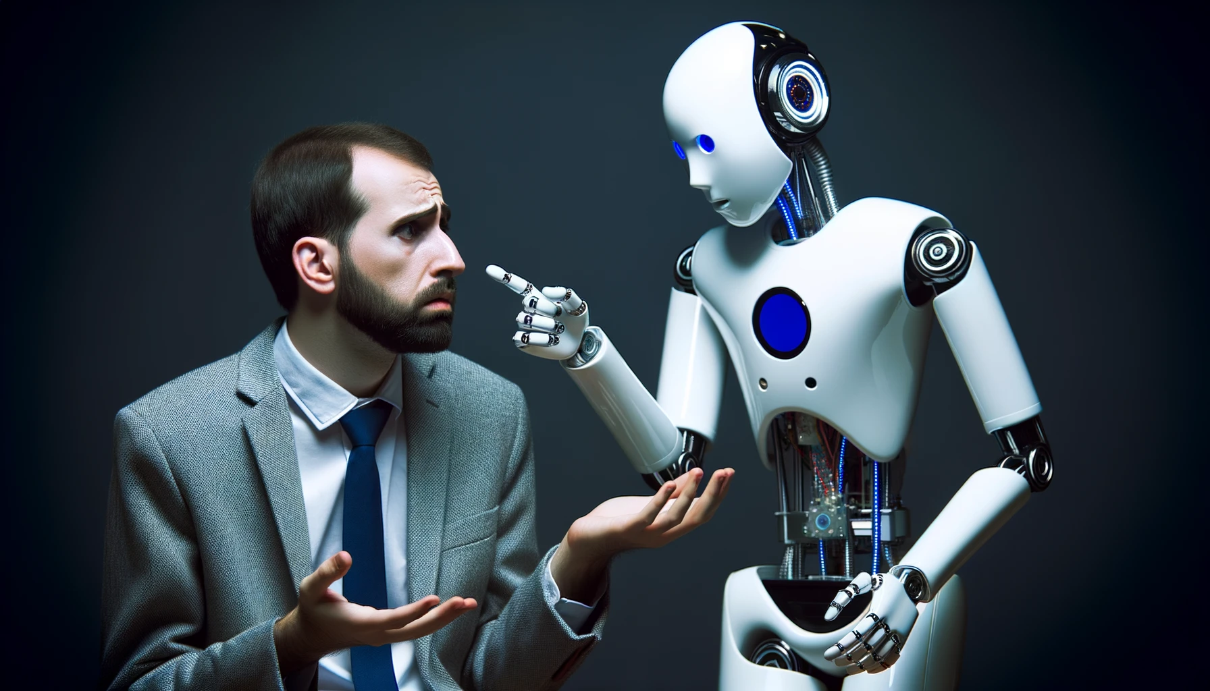
Note of caution: Less-confident evaluators gave AI better scores
“Gaslight” effect
r=0.97

Slide 42

Lessons from software engineering?
June 2023
“Estimated GDP boost of $1.5trillion by 2030”
Domhke et al (2023) Sea Change in Software Development: Economic and Productivity Analysis of the AI-Powered Developer Lifecycle 10.48550/arXiv.2306.15033

Slide 43
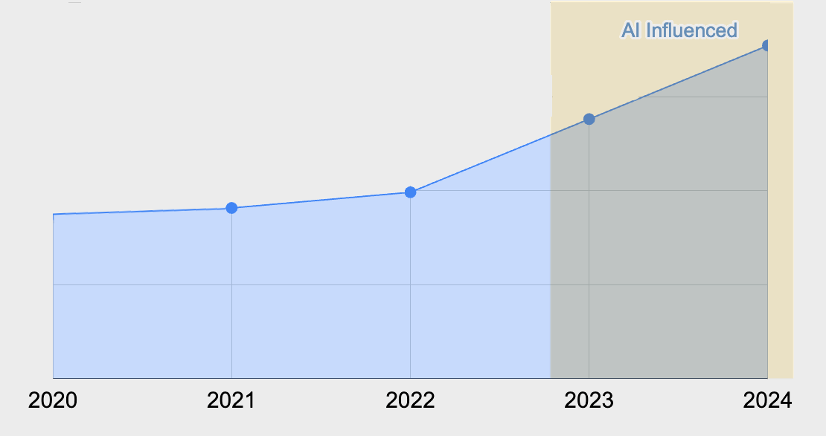
Lessons from software engineering?
June 2023
Jan 2024
“Estimated GDP boost of $1.5trillion by 2030”
2023 Data Shows Downward Pressure on
Code Quality ⇒ Technical Debt
Code Churn by Year
Domhke et al (2023) Sea Change in Software Development: Economic and Productivity Analysis of the AI-Powered Developer Lifecycle 10.48550/arXiv.2306.15033
Harding W, Kloster M (2024) Coding on Copilot (GitClear analysis of 150m lines of code) https://www.gitclear.com/coding_on_copilot_data_shows_ais_downward_pressure_on_code_quality

Slide 44
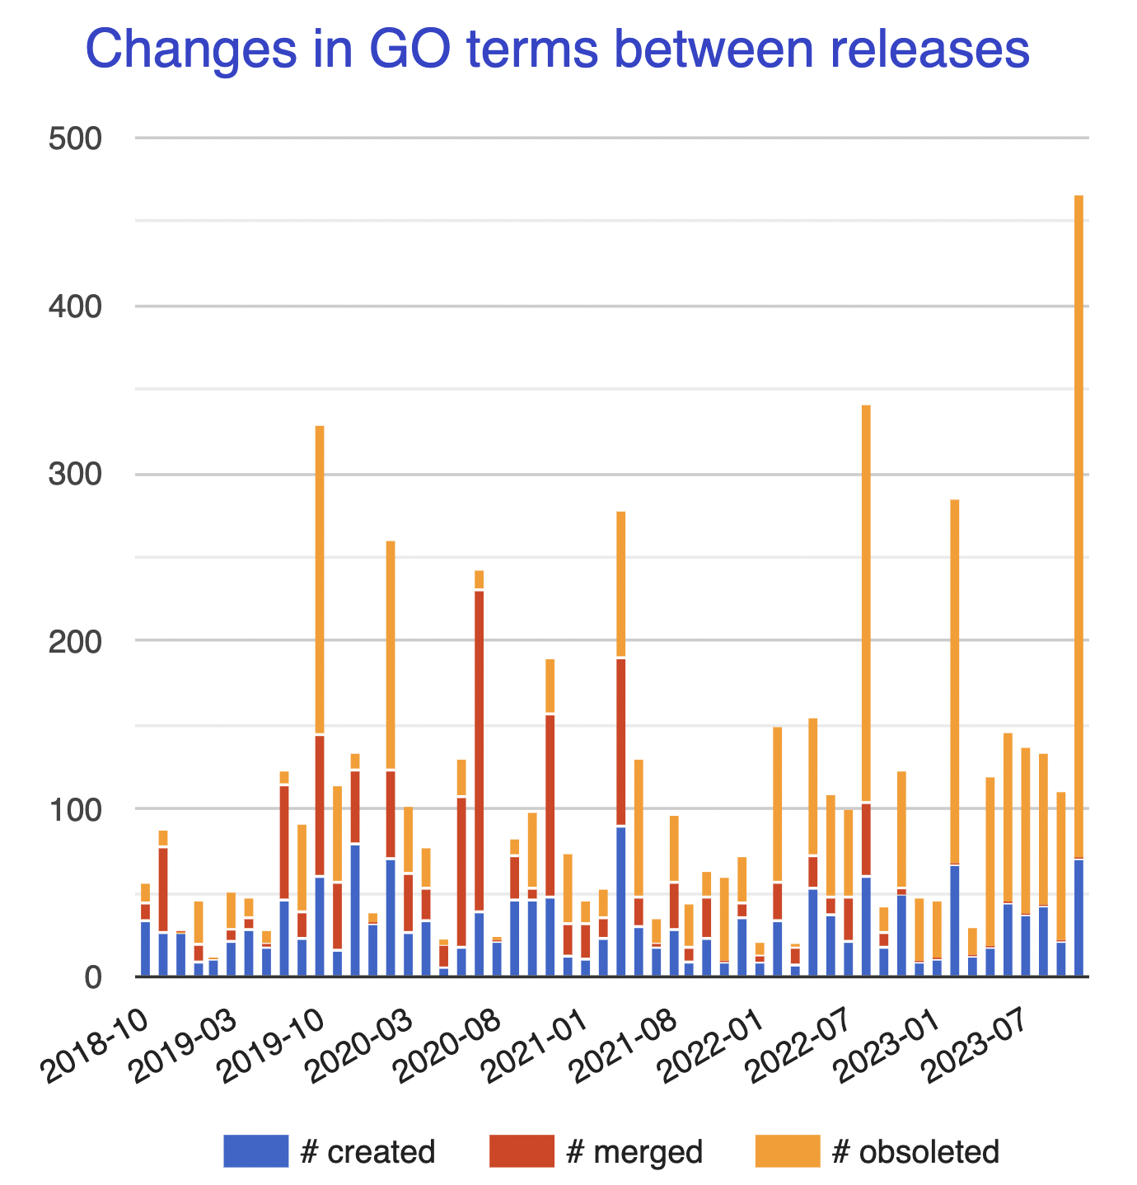
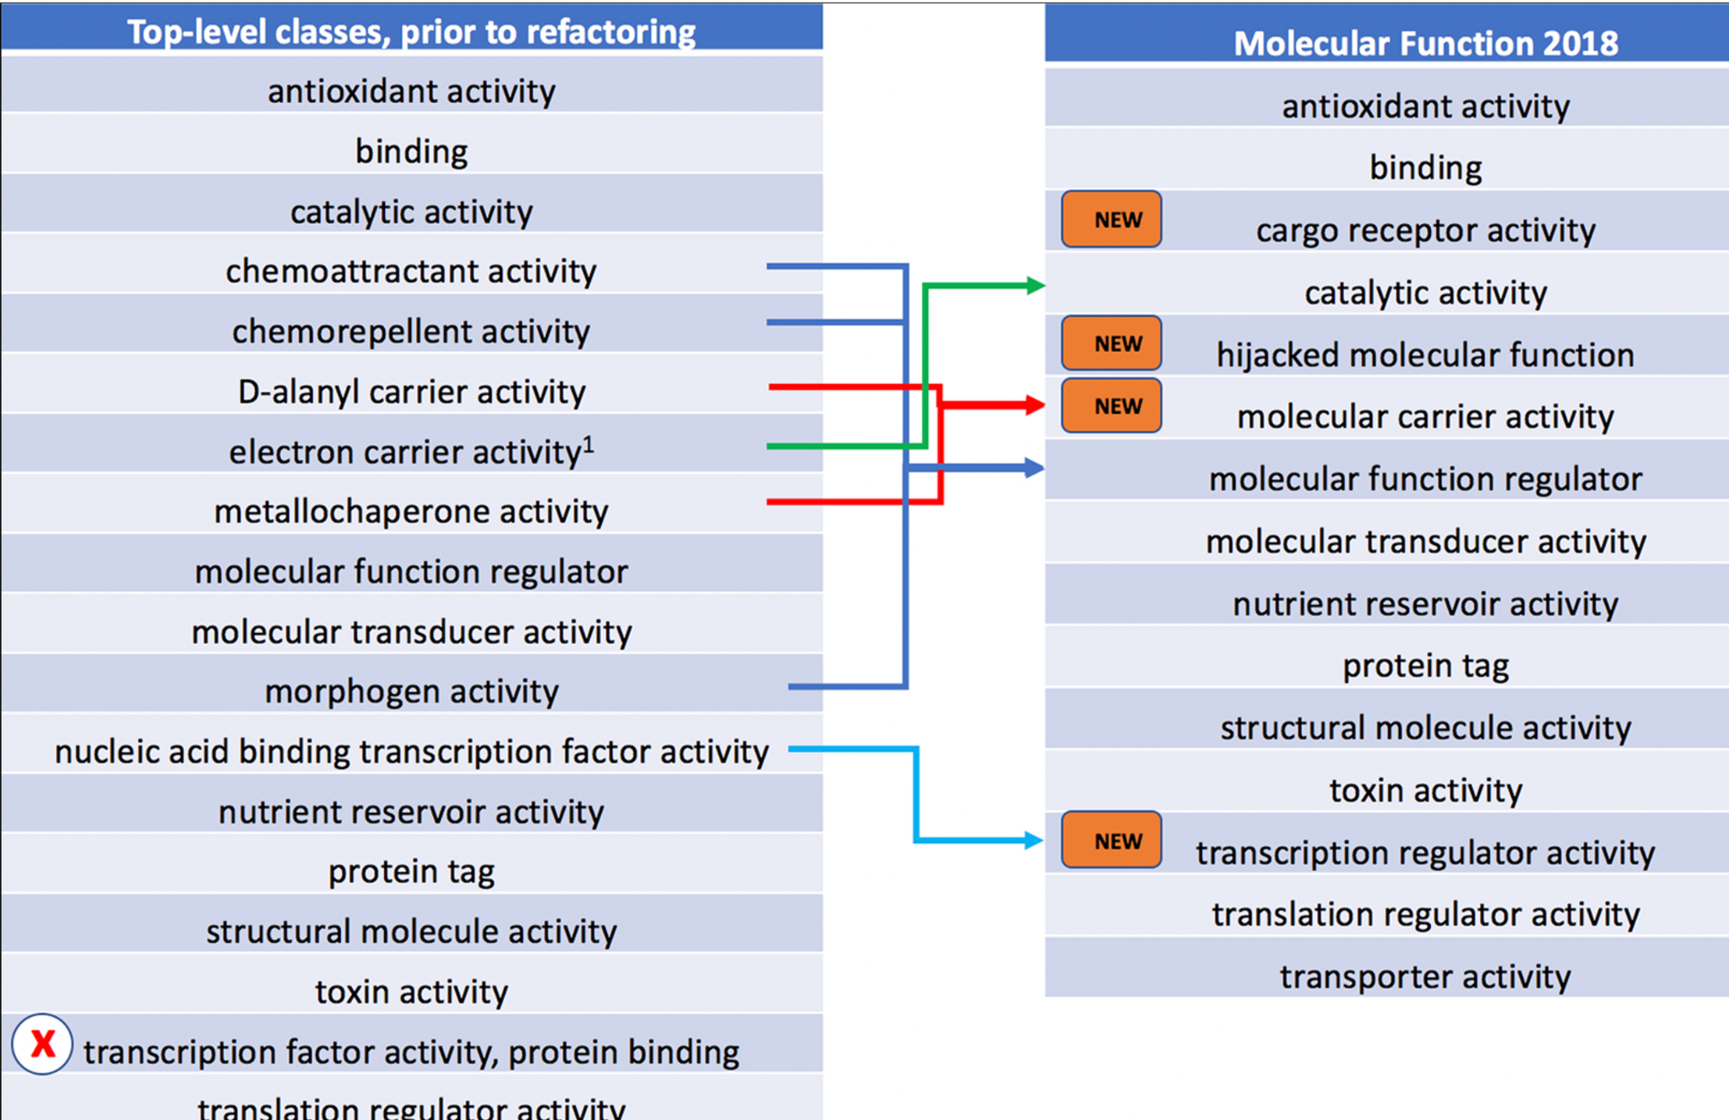
Limitations of our study
Test set was restricted to recently added terms to mature ontologies which may not be representative
Most ontology work is refactoring, not simply accumulating terms
Ontology Refactoring
Obsoletion and merging
GO consortium (2019), Nucleic Acids Research
geneontology.org/stats.html

Slide 45




DRAGON-AI part of Monarch suite of LLM tools
1
Interpret and summarize omics data and lists of entities
2
Derive structured knowledge from unstructured sources
SPIRES / OntoGPT
TALISMAN
Caufield et al (2024) Bioinformatics, btae104
Joachimiak et al (2023) arxiv, 2305.13338
Enhance GPT with trusted information from key knowledge providers
3
4
Find evidence for statements and hypotheses
Phenomics Assistant
CurateGPT
O’Neil et al (2023) biorxiv, 2024.01.31.578275
github.com/monarch-initiative/curate-gpt
5
6
Constructing Ontologies and KGs
Integrate different standards and vocabularies
DRAGON-AI
MapperGPT
Toro et al (2023) arxiv, 2312.10904
Matentzoglu et al (2023) arxiv, 2310.03666

Slide 46

Alliance of Genome Resources AI curation tools
Exploring models with large context windows for full papers
LLM-based virtual biocurator assistant to help curators extract complex information from papers
Automate article “triaging” using AI
Document classification using AI
Improving gene summaries using AI/LLM
Streamline AI/ML pipelines creation, evaluation, comparison and versioning through a centralized management framework
Publications
(PDF)
{
"reasoning": "The publication describes the L138F mutation in human Orai1, which can cause severe myopathy, and its corresponding mutation L210F in dOrai of Drosophila melanogaster. Molecular dynamics simulations were performed for the WT and the L210F mutant channels to understand how the L210F mutation activates the channel. This indicates that Drosophila is used as a model to study the activation mechanism of a mutation relevant to a human disease, which fits the criteria for Drosophila models of human disease as described in the prompt.",
"triage_result": true,
}
Disease Models
New Alleles
New Transgenes

Slide 47
Conclusions
High quality knowledge bases and ontologies can be used to improve accuracy of LLMs using Retrieval Augmented Generation (RAG)
  RAG works best with existing high quality curated knowledge
The combination has the potential to be useful assistants to ontology developers and knowledge base curators
  Results should be vetted by experts
  Care should be taken not to accumulate semantic debt
Integration into existing workflows and tools is essential
  Ontology Development Environments (e.g. Protege)

Slide 48
Acknowledgements
Sabrina Toro
Anna V Anagnostopoulos
Sue Bello
Kai Blumberg
Rhiannon Cameron
Leigh Carmody
Harry Caufield
Alexander D Diehl
Damion Dooley
William Duncan
Petra Fey
Pascale Gaudet
Nomi L Harris
Marcin Joachimiak
Leila Kiani
Tiago Lubiana
Monica C Munoz-Torres
Shawn O'Neil
David Osumi-Sutherland
Aleix Puig
Justin P Reese
Leonore Reiser
Sofia Robb
Troy Ruemping
James Seager
Eric Sid
Ray Stefancsik
Magalie Weber
Valerie Wood
Peter Robinson
Melissa A Haendel
NHGRI
HG010860 Phenomics First
HG012212 Gene Ontology
U24HG010859 Alliance
NIH OD
R24 OD011883 Monarch Initiative
NSF [OAC-2112606 ICICLE]
DOE [DE-AC0205CH11231]

