Slide 1
Module 2 - RDM strategy
MJ
Best practices from the ELIXIR portfolio of data management tools and services. A quick guide to adopting ELIXIR resources and optimising an ELIXIR Node's data management strategy
Facilitators: Mijke Jetten & Celia van Gelder
Finland, 27-28-29 June, 2023

Slide 2
Time schedule
MJ
Day 2 | Time (CEST/EEST) | Module 2: Best practices from the ELIXIR portfolio of data management tools and services. A quick guide to adopting ELIXIR resources and optimising an ELIXIR Node's data management strategy Contacts: Celia van Gelder & Mijke Jetten
June 28 | 9:00/10:00 | Welcome & introduction
June 28 | 9:30/10:30 | Data management: examples of ELIXIR tools and services from a Node strategy perspective - part 1
June 28 | 11:00/12:00 | Lunch
June 28 | 12:00/13:00 | Data management: examples of ELIXIR tools and services from a Node strategy perspective - part 2
June 28 | 13:00/14:00 | Funder requirements to FAIR data
June 28 | 14:00/15:00 | Break
June 28 | 14:30/15:30 | Data stewardship roles and competences
June 28 | 15:30/16:30 | Learn from & share with
June 28 | 16:00/17:00 | Finland: dinner & social event
Day 3 | Time (CEST/EEST) | Module 2: Best practices from the ELIXIR portfolio of data management tools and services. A quick guide to adopting ELIXIR resources and optimising an ELIXIR Node's data management strategy Contacts: Celia van Gelder & Mijke Jetten
June 29 | 9:00/10:00 | Maturity/services model, Node strategy and the ideal Node team
June 29 | 10:30/11:30 | Break
June 29 | 11:00/12:00 | Maturity/services model, Node strategy and the ideal Node team
June 29 | 12:00/13:00 | Finland: feedback lunch

Slide 3
Day 2/28 June
Module 2 - RDM strategy
MJ

Slide 4
Welcome & introduction
(9-9.30 CEST / 10-10.30 EEST)
MJ

Slide 5
Zoom housekeeping
MJ
We invite you to contribute actively, but to mute yourself if not speaking
Welcome to use the chat for further comments or discussions, however speaking up is preferred
Please use the “hand-raising function” to indicate you would like to contribute directly
Speak up if you feel unheard or unseen, and share suggestions to engage more from the F2F room
.
As a hybrid training with a big group is challenging, bare with us if we deviate from the time schedule

Slide 6
ELIXIR Code of Conduct principles
MJ
Notes:
The ELIXIR Code of Conduct has been created so all participants at ELIXIR events organised and /or funded by the ELIXIR Hub can interact with each other in a respectful and safe environment.
We value each other’s perspectives providing a safe environment for people to be themselves.
We adopt a zero-tolerance approach to harassment and discrimination in any form.
We will maintain high ethical standards across all ELIXIR events.
We will apply honesty and integrity in the dealing of any transgressions against the Code.
We are committed to making ELIXIR events collaborative, supportive and an enjoyable experience.
We will ensure that our environment allows everyone to feel respected and included.

Slide 7
ELITMa - ELIXIR training program in Management
CvG
History
  Building on survey Training Platform (link)
  ELITMa Curriculum designed in ELIXIR-CONVERGE WP6 and WP2 collaboration (link to Task 6.4 report)
  CONVERGE WP2 Uplift allowed to build the material and deliver pilot edition of two (tbc) Modules
Benefit for ELIXIR
  Node staff trained for more effective operations, including the ability to navigate ELIXIR complexities. Strengthening of ELIXIR people network.
Lead (Ana, PT)
  Committed Nodes: NL, NO, FI, UK, and Hub

Slide 8
CvG

Slide 9
Building your Node DM portfolio
CvG
Focus of the module: Node data management strategy
  We will define together what we precisely mean along the way
  Potentially: your Node’s strategy on data management services?
  Roles Data Managers & Node Coordinators
Thank you for the preparation work. We will jointly further populate your Node DM portfolio
  It is a working session and we want to define practical next steps for all involved
  Share with & learn from other Nodes
Please build your Node’s DM portfolio in the shared notes document, as they are for your use
  Formulate your own lessons learned
  Formulate your take home messages & next steps
It is the start of a journey, that will continue after today
  Get inspired by what your peers in other Nodes have written down

Slide 10
How we will work
MJ
You are the first cohort of the module in this form. Please share your experiences so that we can improve
We have a challenging mix of online and onsite participants, so bear with us; speak up if you don’t feel heard
Participants come from different backgrounds and have different levels of expertise
Focus is knowledge exchange, i.e., sharing and disseminating of knowledge and providing inputs to problem solving, so we are all key to the success of this workshop
We try to make the module as interactive as possible. We invite you to participate actively, and relate the information to your daily Node practice

Slide 11
Parking Lot
CvG
We have only 2 days to start reflecting and discussing
We will not have time to go into detail on all interesting topics
Let us collect together topics that we should not forget and/or that you miss in the current programme
We will try to come back to them as much as possible during the module and will also make sure that these topics are not forgotten going forward
Please add your topics in the Parking Lot section of the Shared Notes!

Slide 12
Introduction round
MJ
Visit the Shared notes document
Add your Node, name, role, F2F/online, email address
And a fun fact about yourself

Slide 13
ELIXIR Hub
FL
Supports executive management and administrative staff.
Develops and delivers ELIXIR scientific strategy and manages Commissioned Services by Nodes.
Coordinates services from ELIXIR Nodes.
Coordinates and supports ELIXIR governance bodies and technical committees.
Leads ELIXIR communications and external relations, including industry support.
Supports institutions within the Nodes.
Collaborates with national and European funders and policy-makers.
Fabio Liberante
Programme Manager
Data & Interoperability

Slide 14
ELIXIR Hub - Technical Team
FL
Peter Maccallum
Chief Technical Officer
Oversee operation/development of ELIXIR Services at European level
Interface between Nodes and International activities
Technical coordination of Nodes
Co-located with EMBL-EBI
Do not run ELIXIR Services directly
Fabio Liberante
Programme Manager
Data & Interoperability
Jonathan Tedds
Programme Manager
Compute & Tools
Katharina Heil
Programme Manager
Communities & Training
Manthos Pitoulias
Senior Science Officer
Tools & Training
David Lloyd
Technical Support Officer
Gavin Farrell
Technical Officer
Compute & Data
Clare Garrard
Science Officer
Communities & Interoperability

Slide 15
Platforms & Communities
FL

Slide 16
Data Platform Overview
FL
Mission
Leadership
01
Sustainably Funded
Core Data Resources
02
Coordinated Ecosystem of Node Data Resources
Ulrike Wittig
ELIXIR Germany
Platform Lead
Patrick Ruch
ELIXIR Switzerland
Platform Lead
Silvio Tosatto
ELIXIR Italy
Platform Lead
03
Support European Research Community
Fabio Liberante
ELIXIR Hub
Programme Manager
Gavin Farrell
ELIXIR Hub
Platform Officer
Notes:
Goal of the ELIXIR Data Platform is to drive the use, re-use and value of life science data. It aims to do this by providing users with robust, long-term sustainable data resources within a coordinated, scalable and connected data ecosystem.

Slide 17
Interoperability Platform Overview
FL
Mission
Leadership
01
Help people and machines to discover, access, integrate and analyse biological data
Susanna-Assunta Sansone
ELIXIR UK
Platform Lead
Chris Evelo
ELIXIR Netherlands
Platform Lead
Tony Burdett
EMBL-EBI
Platform Lead
02
Encourage adoption of standardised file formats, metadata, vocabularies and identifiers
Fabio Liberante
ELIXIR Hub
Programme Manager
Clare Garrard
ELIXIR Hub
Science Officer
Communities & Interoperability
Notes:
Goal of the ELIXIR Data Platform is to drive the use, re-use and value of life science data. It aims to do this by providing users with robust, long-term sustainable data resources within a coordinated, scalable and connected data ecosystem.

Slide 18
FL
National stakeholders
Services &
Resources
Nodes
RDM Community
Communities

Slide 19
ELIXIR Services - some definitions
FL
An ELIXIR Service is a set of technology, software, expertise and processes which together provide a defined capability to deliver data, analysis or a supporting function for ELIXIR’s objectives.
An ELIXIR Service can be one of the following service types:
ELIXIR Node Service - identified as part of an ELIXIR Node’s contribution to ELIXIR and is listed on a Node’s Service Delivery Plan.
ELIXIR Multi-Node Service - provided by two or more ELIXIR Nodes working together on one or more of the activities required to deliver the Service. The ELIXIR Hub does not count as a Node in this definition.
ELIXIR Commissioned Service - a type of contract - for Service Delivery or Development.
ELIXIR Infrastructure Service - ELIXIR Node or Multi-Node Service - identified as a critical dependency or core capability for ELIXIR such that its continued operation (or, where not possible, its replacement) is a strategic, funded, priority.

Slide 20
Multi-Node Services and Federation
FL
We are increasingly seeing ELIXIR Services delivered as Multi-Node Services, ranging from pairs of Nodes working together to fully federated Europe-wide networks
Some Benefits of being identified as a Multi-Node Service:
Public statement of multi-source support
Clarity on leadership & contributions to help funding decisions
Support for candidate Infrastructure Service status; Some costs (operations) eligible for Inf. Service funding
Some costs (development) eligible for Implementation Study funding
Status with National funders, attractive to EU funders
Some Responsibilities:
Good governance
A transparent process between partners
Quality
Oversight/interest by Technical Coordinators’ Group

Slide 21
Data management: examples of ELIXIR tools and services from a Node strategy perspective - Part 1
(9.30-11 CEST / 10.30-12 EEST)
MJ

Slide 22
Nodes’ good practices
MJ
Topic: Data management: examples of the implementation of ELIXIR tools and services from the perspective of a Node strategy - in two parts
Description: Examples from Nodes on the integration of core resources, deposition databases, recommended interoperability resources from/for their service delivery plans
Learning outcome: Reflect on the potential role of ELIXIR tools and services in the perspective of a Node's data management strategy, and how this strategy could be strengthened by good practices from other Nodes
Form: Pitches by speakers from various Nodes + discussion
Assignment: Add lessons learned to Node portfolio

Slide 23
Nodes’ good practices
MJ
Presentations [10 min]
  RDMkit:
    LU [Pinar Alper]
    NO [Korbinian Bösl]
  DSW:
    CZ [Anna Strachotova]
    NO [Korbinian Bösl]
  Federated EGA (CDR/EDD):
    FI [Riku Riski]
    NO [Korbinian Bösl]
Discussion
  What services are relevant to your Node?
  What/who do you need (from others) to implement it?
* CDR = ELIXIR Core Data Resource (CDR); EDD = ELIXIR Deposition Database

Slide 24
RDMkit, ELIXIR-LU, Pinar Alper

Slide 25
RDMkit as a Node Service at ELIXIR LU [LU, Pinar]
Why this service
  RDM has become prominent in our Node agenda
    Research Data Management and Stewardship
    FAIRification
  LU is represented in the FCB and RDMkit Editorial Boards
  LU has the FCB in its service portfolio.
  Luxembourg National Data Service has joined the Node.
    RDM Support at a national level
    Coordination of a national RDM Community

Slide 26
RDMkit as a Node Service at ELIXIR LU [LU, Pinar]
What are the challenges
  RDMkit is helpful as a consolidating overview for RDM and RDM resources. But,
    There are national guidelines and grey literature, which does not fit in RDMkit.
    We’re kickstarting a national RDM Community and need a place to capture the knowledge of this community.
Current RDMkit Node services focus on the central RDMkit (UK, BE)
Notes:
We want to deploy national RDM guidelines and link it to RDMkit as appropriate,

Slide 27
And RDMkit-based Node Service at ELIXIR LU [LU, Pinar]
What could work well with RDMkit
  RDMkit is not just a resource, it offers the means to spawn other resources:
    Site theme.
    Approach: open, documented,reusable processes.
    Content.
  RDMkit Alliance is in the works
    We know we will not be alone.

Slide 28
RDMkit as a Node Service at ELIXIR LU [LU, Pinar]
How will we implement it?
  Outline possible implementation options
  Estimate the implementation/maintenance cost for those options
  Perform a Decision Analysis and Resolution (DAR).
  If an RDMkit-based service is the chosen option, then apply our formal decision process.

Slide 29
End2End Support Service for controlled-access data sharing [LU, Pinar]
Background
  We provide a Data Hosting service for Translational Biomedicine projects that are nearing their end.
  We host data with the condition that it is shared.
  As part of hosting we facilitate controlled-access
  collect and publish ELSI Metadata,
  handle data access requests and coordinate the DAC review,
  provision the data for approved requests.
Why this service
  As the hosting service increased in popularity, the workload for controlled-access facilitation became rather significant,
  GDPR documentation requirements were pervasive,
  Data provision is transitioning from file download to cloud access.

Slide 30
End2End Support Service for controlled-access data sharing [LU, Pinar]
Access request handling, access management.

Slide 31
End2End Support Service for controlled-access data sharing [LU, Pinar]
How we implemented it
  We gradually increased automation in our process.
  Development spanned several years.
  All Node teams collaborated; ELSI, Data Stewardship, Tech/Infra.
  Data Protection By Design and By Default (DPbDD) was applied.
  Where possible:
    we re-used RDM tools from other Nodes (REMS)
    we adopted standards (OIDC)

Slide 32
End2End Support Service for controlled-access data sharing [LU, Pinar]
What worked well
  Focusing on the process and info models helped.
    First we optimised those, then we introduced automation.
  Our Node will join one or more data sharing federations.
    End2End was our prep work and we went live just in time.
  Our ELSI team is working on a DPbDD checklist for future assemblies/services.

Slide 33
End2End Support Service for controlled-access data sharing [LU, Pinar]
What were the challenges
  We underestimated the assembly development effort.
    Assembling tools takes time (connectors/parsers/mappers).
    Testing assemblies is non-trivial.

Slide 34
RDMkit, ELIXIR Norway - Korbinian Bösl

Slide 35
RDMkit at ELIXIR Norway, Korbinian Bösl & Nazeefa Fatima
Why this service:
RDM is central for us as a node
Need for >=1 place for RDM knowledge sharing
Synergistic effect with national project
Involved from the very beginning

Slide 36
2012
2017
2022
2026
ELIXIR3
ELIXIR4
RCN
BioMedData
Sustainability efforts
However: RDMkit is not (yet?) on our SDP (which is more shaped for non-core infrastructure)
NeIC
BY-COVID
EC (H2020, HE, DE)
CONVERGE
2012
2017
2022
2026

Slide 37
RDMkit at ELIXIR-Norway, Korbinian Bösl & Nazeefa Fatima
What works well
Good uptake from institutions and users
Recognition from funders
Usage of RDMkit in training
Reuse of theme

Slide 38
RDMkit at ELIXIR-Norway, Korbinian Bösl & Nazeefa Fatima
Challenges
Guiding users to our DS-Wizard instance
Multiple layers of information in RDMkit - overwhelming for passing by user
Cross linking with our additional RDM information resource (RDM lookup)
Convincing national RIs/community to contribute (often referring to their ESFRI instead)
Space to capture knowledge out of the RDMkit scope
Maintenance debts

Slide 39
NeLS tool assembly, Korbinian Bösl & Nazeefa Fatima
How we implemented it:
Historically evolved from our core storage infrastructure
Complementary functionality added through other tools over time
Based on national HPC/big data infrastructure

Slide 40
NeLS tool assembly, Korbinian Bösl & Nazeefa Fatima
What worked well
Covering classic sequencing/bioinformatic use cases
Focus on single processes
End-to-end PoC

Slide 41
NeLS tool assembly, Korbinian Bösl & Nazeefa Fatima
Challenges
Other use cases
Synergy with sensitive data tool assemblies
Long term effort
Automatisation of support processes
User experience
Many different technologies
Technical debts/History to carry
Projects w/o Data Stewards
Brokering

Slide 42
DSW, ELIXIR-CZ, Anna Strachotova

Slide 43
Data Stewardship Wizard https://ds-wizard.org/

Slide 44
Open science -> Open Science & Data management in CZ
Czech funding programmes start to require DMPs (usually based on Horizon EU)

Slide 45
Why DSW
Guidelines for open access to publications,
data and other research outputs
Data Management Plans: tools
The following resources support the generation of DMPs:
A template for the DMP can be found in the online H2020 guide for applicants, here.
The DMPONLINE tool, specifically supports the development of project data management plans: https://dmponline.dcc.ac.uk
ARGOS is an online tool to automate the creation, management, sharing and linking DMPs with the research artefacts to which they correspond. It is the joint effort of OpenAIRE and EUDAT CDI to deliver an open platform for Data Management Planning that addresses FAIR and Open best practices and assumes no barriers for its use and adoption (https://argos.openaire.eu).
The Data Stewardship Wizard is a joint ELIXIR CZ and ELIXIR NL tool, bringing a simple but powerful solution for researchers to help them understand what is needed for good, FAIR-oriented data stewardship, and build their own Data Management Plans (https://ds-wizard.org/).

Slide 46
Why DSW
Living DMPs as Inverative Questionnaires
Guidance and linded (ELIXIR) resources
Collaboration in Interactive Questionnaires (history, sharing project, comments)
Knowledge Models
Document Templates
Multiple Documents for Single Questionnaire

Slide 47
Why DSW
Living DMPs as Inverative Questionnaires
Guidance and linded (ELIXIR) resources
Collaboration in Interactive Questionnaires (history, sharing project, comments)
Knowledge Models
Document Templates
Multiple Documents for Single Questionnaire

Slide 48
Why DSW
Living DMPs as Inverative Questionnaires
Guidance and linded (ELIXIR) resources
Collaboration in Interactive Questionnaires (history, sharing project, comments)
Knowledge Models
Document Templates
Multiple Documents for Single Questionnaire

Slide 49
Why DSW
Living DMPs as Inverative Questionnaires
Guidance and linded (ELIXIR) resources
Collaboration in Interactive Questionnaires (history, sharing project, comments)
Knowledge Models
Document Templates
Multiple Documents for Single Questionnaire

Slide 50
Implementation of DSW - how to start
Several institutions (mainly universities) even beyond ELIXIR started or are starting to adopt DSW (with our support) for planning RDM…

Slide 51
Implementation of DSW - DSW Cloud for ELIXIR
PRO
CONS
minimization of claims on DSW users
DSW team operates the system -> installing and updating, hardware, storage, etc.
the institution uses DSW as a service and only takes care of configuring end-user settings
full dependence on the operators of the DSW Cloud for ELIXIR infrastructure
the end user cannot influence any maintenance windows, service outages, but neither can they prevent them transitions to new versions of software, etc.,
the user doesn't have control over the physical location of its data storage, backup, etc.
The ELIXIR operates a cloud infrastructure in which it is possible to host institutional DSW installations that are used by users as a service. The user has access on its own subdomain (e.g. https://vscht.ds-wizard.org/). Institutional instances in the ELIXIR infrastructure are available to ELIXIR members or projects with ELIXIR associates.
A special shared is available for end-researchers-individuals instance https://researchers.ds-wizard.org/ that individuals can directly use for preparation of their DMPs.

Slide 52
Implementation of DSW - Self-Managed
PRO
CONS
full control over installation, upgrade dates, configuration changes, etc.
freely available source codes allows multiple DSW instances ->easily run test or development
through its RESTful API can facilitate
integration with local systems
full responsibility for the complete management,
including security, backup, updating, etc.
actively monitor the development of DSW
Installation of the application on own hardware/infrastructure from downloaded source codes or Docker images. About the operation, backup, updates, settings, etc. of the entire instance of DSW then it must be taken care of by its user-operator.
https://discord.com/channels/693010138302513174/1102900416783597620

Slide 53
Challenges

Slide 54
Challenges
Several institutions (mainly universities) even beyond ELIXIR started or are starting to adopt DSW (with our support) for planning RDM…
Czech funding programmes also start to require DMPs (usually based on Horizon EU)
There is still relatively early phase of “proper” RDM in Czechia; however, National Repository Platform project is being prepared… and DSW with customized content is included!
National Data Steward community with more than 120 people

Slide 55
DSW, ELIXIR-NO, Korbinian Bösl

Slide 56
DMP Landscape analysis
Funder requirements (specific tool?)
Features
2019
Self-hosting vs SaaS?
KM from scratch or adapt life science KM
First workshops & Feedback
Dedicated Feature developments (financed by Centre for Digital Life Norway)
&
Exemplar DMPs from other RIs
Recommended tool by major funder
Integration with knowledge resource
Project for national pilot from major universities
2023

Slide 57
https://ds-wizard.org/comparison

Slide 58
The Data Stewardship Wizard is provided by:
https://ds-wizard.org
https://github.com/ds-wizard

Slide 59
Considerations

Slide 60
Recommendations
elixir-no.ds-wizard.org

Slide 61
Ambition
Compatible metadata export
Suggest Metadata
Templates & populate
Project information
Project information
Permissions
Storage request
Brokering orchestration

Slide 62
What works well
Using DSW in workshops, …
Convincing stakeholder about advantages of DSW
‘Smooth sailing’ in DSW Cloud (updates, …)
Linking ‘exemplar DMPs’ from our RDMlookup (=knowledge platform)

Slide 63
Challenges
Default KM can be overwhelming for 1st time users
Getting users to our instance (instead of generic DSW instance)
Difficulty for some stakeholders to understand tool (=DSW) vs. KM (e.g. LifeScience KM)
Text export from DSW w/o questionnaire - challenging for institutional support units
OpenID challenges with national edu ID service

Slide 64
fEGA, ELIXIR-FI, Riku Riski

Slide 65
Federated European Genome-phenome Archive (FEGA) Finland

Slide 66
Federated European Genome-phenome Archive (FEGA) Finland

Slide 67
Sensitive Data Services for Research

Slide 68
FEGA Finland

Slide 69
Summary
Why FEGA?
National customers/data
FHD community, centrepiece in IS 22-23
Co-lead the community, founding member
How we implemented it?
Reference, using global standards
Suite of audited sensitive data services
Growing a team systematically (e.g. PO, UX, tech support)
In collaboration with EGA & other nodes, Nordic development team
What works well
Cross-node collaboration
Scaling of existing components
Company policy SOPs/SLAs
Challenges
Contracts, contracts... (DPAs, CA slow)
Software dependencies / release management
Production stability

Slide 70
fEGA, ELIXIR-NO, Korbinian Bösl

Slide 72
Federated EGA makes EGA scalable and GDPR-compliant
Data
Metadata
Data
Data
Data
Data
Data

Slide 73
Timeline FEGA Norway (and GDI)
‘14
‘17
‘20
‘21
‘22
‘23
TSD/Tryggve
NO signing the CA
Tryggve2 LocalEGA SW development
Celebrations 5 nodes
Launch FEGA
Network
Operationalize FEGA Norway
FEGA Founding/Strategic Committee and
Operations Committee member
Heilsa Tryggvedottir
GDI
Slides: Kjell Petersen

Slide 74

FEGA Norway overview
Secure
Internet exposed
Proxy server
REST API
Auth. &
File ops
FEGA Norway
Project
Central EGA
and
LS login/
ELIXIR AAI
neicnordic/
sda-pipeline
Internet
Trusted
Slides: Kjell Petersen

Slide 76
What works well
Small team of generalists -> agile development
Using existing TRE legal and technical framework
Nordic collaboration and funding; synergy & exchange
Great recognition by national authorities

Slide 77
Challenges
Very long process
Vulnerable to staff turnover
Started work on legal framework late(r) than technical development
Legal status as consortium (!= single legal entity) complicates situation
Strong dependency on hosting TRE (vulnerable to changes and higher technical complexity)

Slide 78
Discussion
MJ
Based on the presentations (RDMkit, DSW, Federated EGA), plenary discussion:
  What services are relevant to your Node?
  What/who do you need (from others) to implement it?
Please build your Node’s DM portfolio in the shared notes document, as they are for your use
  Formulate your own lessons learned
  Formulate your take home messages & next steps

Slide 79
Lunch
(11-12 CEST / 12-13 EEST)

Slide 80
Data management: examples of ELIXIR tools and services from a Node strategy perspective - Part 2
(12-13 CEST / 13-14 EEST)
MJ

Slide 81
Nodes’ good practices
MJ
Presentations [10 min]
  MOLGENIS (RIR)
    NL [Joeri van der Velde]
  EDAM
    FR [Hervé Ménager], with help of NO [Korbinian Bösl]
  FAIRsharing (RIR)
    UK [Allyson Lister]
  FAIR Cookbook
    LU [Danielle] Welter, with help of CH [Vassilios Ioannidis]
Discussion
  What services are relevant to your Node?
  What/who do you need (from others) to implement it?
* RIR = ELIXIR Recommended Interoperability Resource

Slide 82
Molgenis, ELIXIR-NL, Joeri van der Velde

Slide 83
MOLGENIS [NL, Joeri van der Velde]
Run it yourself (Java + Postgres), it’s all yours, for free, forever
SaaS (we host it for you, €2500 per year or via a partnership)
Data management services available!
Web-based scientific data platform
Used for 15+ years
Currently 100+ servers
Free & open source (GNU LGPL 3.0)
NEW: ‘EMX2’
https://www.molgenis.org
https://github.com/molgenis

Slide 84
Many import/export APIs
MOLGENIS: research data platform
Simple upload formats
Add, explore, filter, publish
FAIR-out-of-the-box
100% flexible datamodel
it’s semantic

Slide 85
MOLGENIS: What works well?
Data management made easy and accessible
  Flexible data model, no mistakes are final
  Import/export using Excel/CSV/JSON if you want
Can be extended with rich user interfaces
New generation of MOLGENIS every ~5 years since 2002
  Keep the best bits, fresh start with latest tech
  Migrations are usually painless, import-export, done
Open source development
  The real value is not in the code, but in the people!
  We welcome contributions, extensions, feedback, etc.
Run MOLGENIS servers on separate virtual machines or k8s
  Allow customization and fine-tuning of each instance
  Zero chance of accidental cross-app data leaks
Blur the border between relational database and triple store
  Data can be represented differently, no problem
  A little semantics goes a long way - benefits everyone
EMX2
https://fairgenomes.org

Slide 86


















MOLGENIS: Communities & Best practice templates
Examples: cohort/biobank catalogue federations, patient registries, large genomics projects
Challenge: allow for heterogeneity in a complex data landscape while maintaining interoperability
Our solution: offer best-practice templates, but you can always extend or deviate when needed
DCAT
Only together we can define how to find, share and reuse *omics data in research and healthcare
Contact: k.j.van.der.velde@umcg.nl
Support: molgenis-support@umcg.nl

Slide 87
EDAM, ELIXIR-NO and ELIXIR-FR, Hervé Ménager

Slide 88
EDAM: a standard to improve findability of resources

Slide 89
What is EDAM
Topic
Paleogenomics
Electron cryotomography
Operation
Molecular docking
Image segmentation
Data
Sequence assembly
Gene ID
Format
FASTQ
SBML
Notes:
89

Slide 90
What is EDAM
Notes:
90

Slide 91
When and how can you use EDAM

Slide 92
When and how can you use EDAM

Slide 93
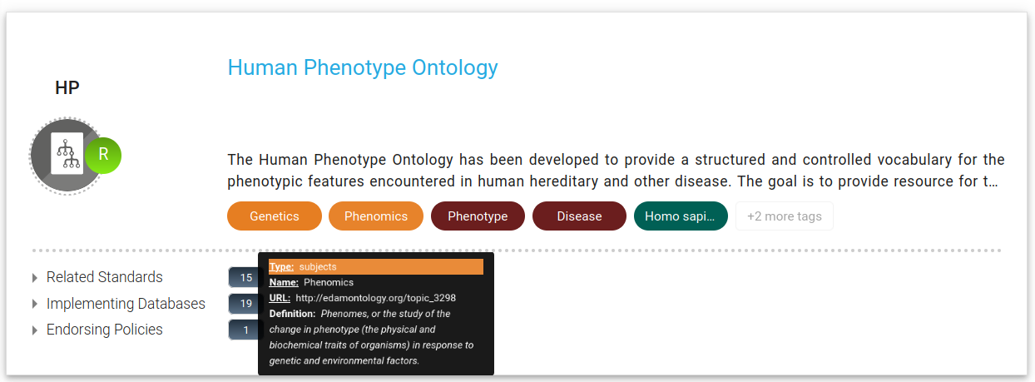
When and how can you use EDAM
https://fairsharing.org

Slide 94
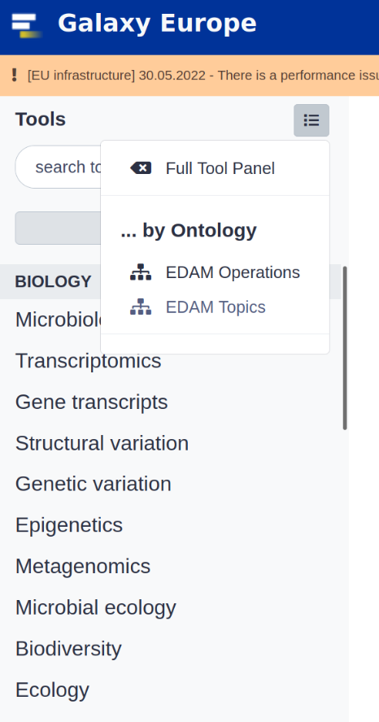
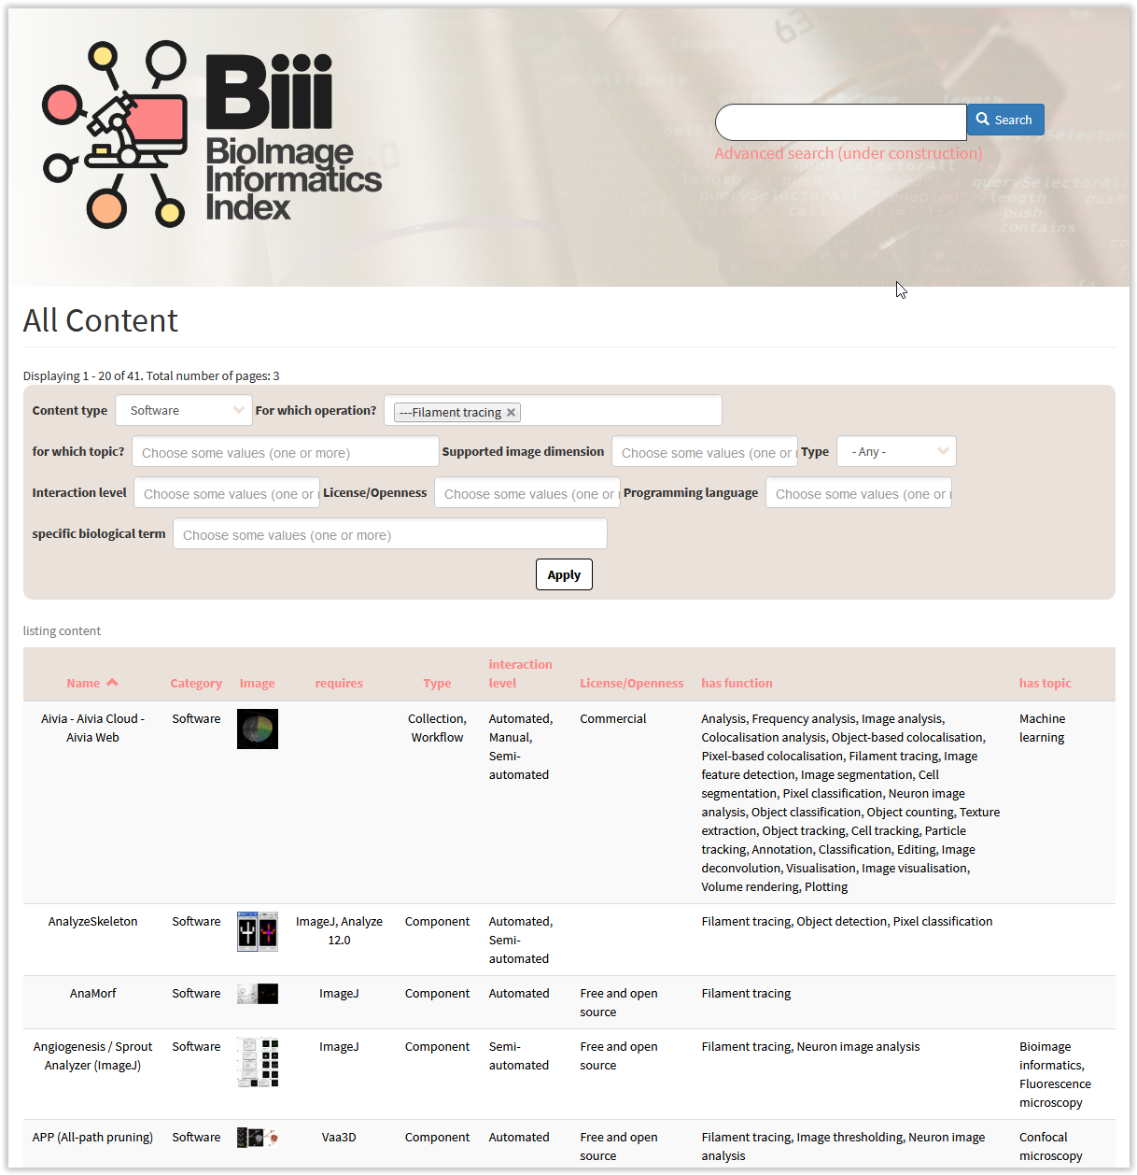
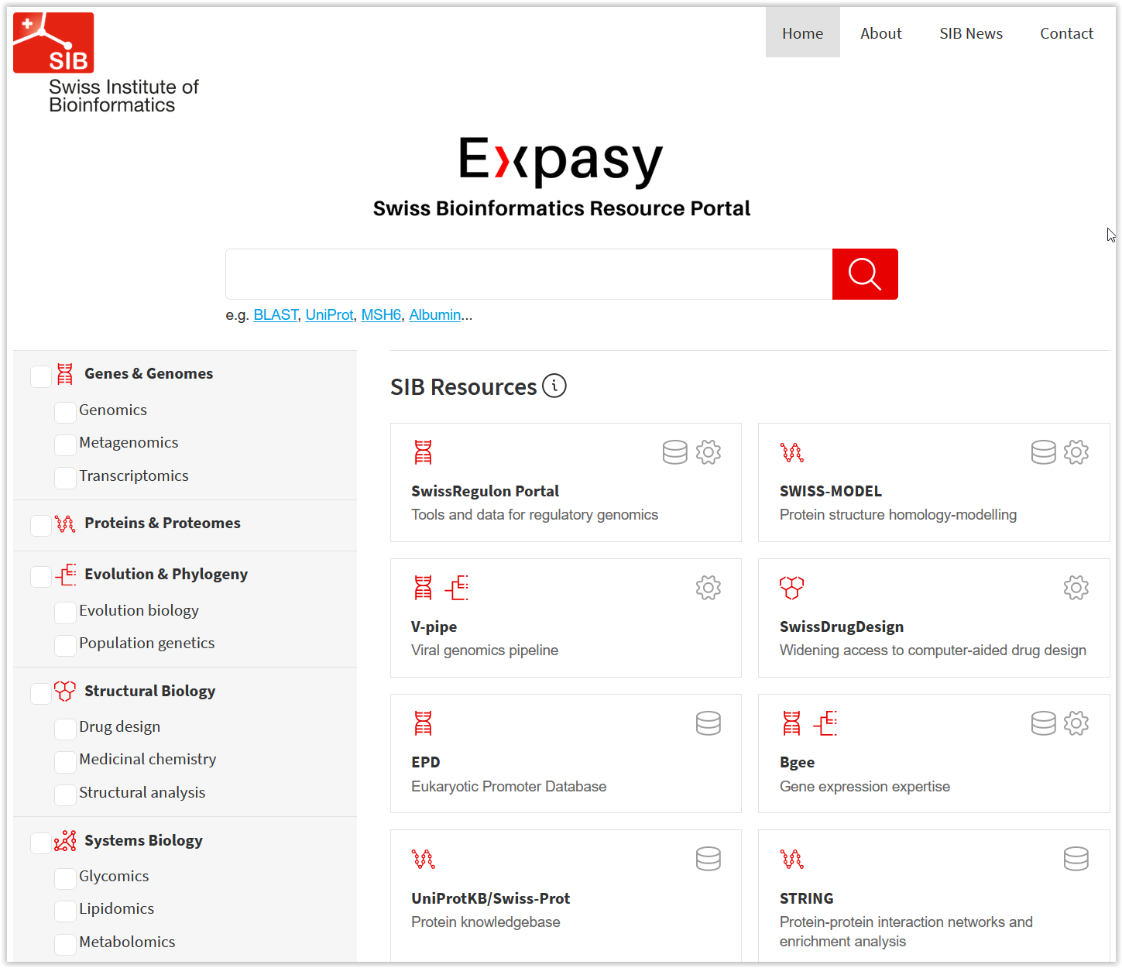
When and how can you use EDAM
https://expasy.org
https://usegalaxy.eu
https://biii.eu

Slide 95
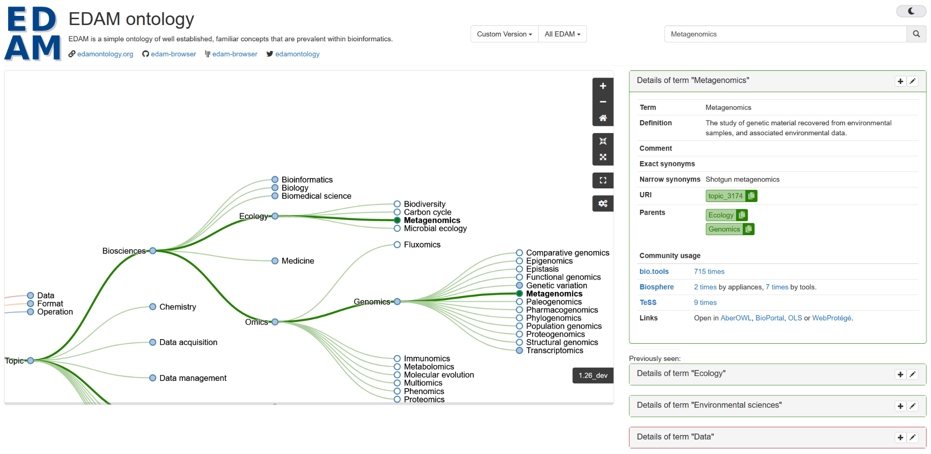
EDAM Browser: visualize the ontology
https://edamontology.github.io/edam-browser/

Slide 96
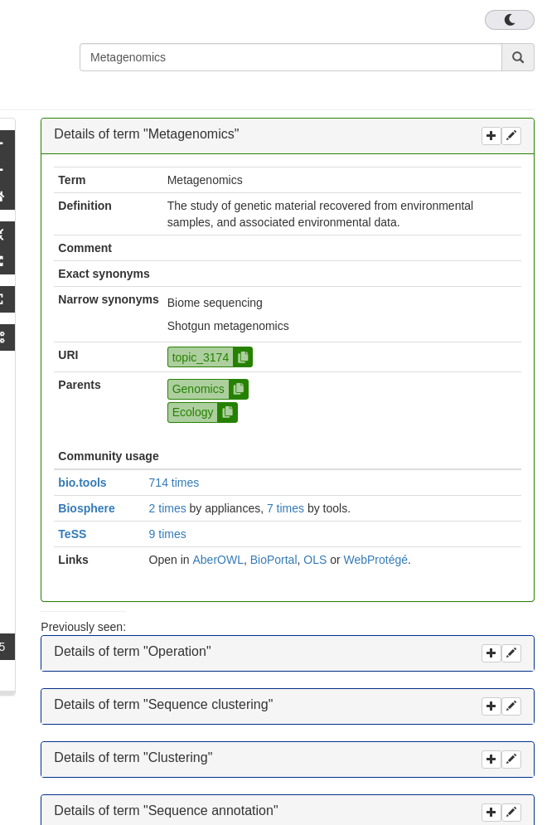
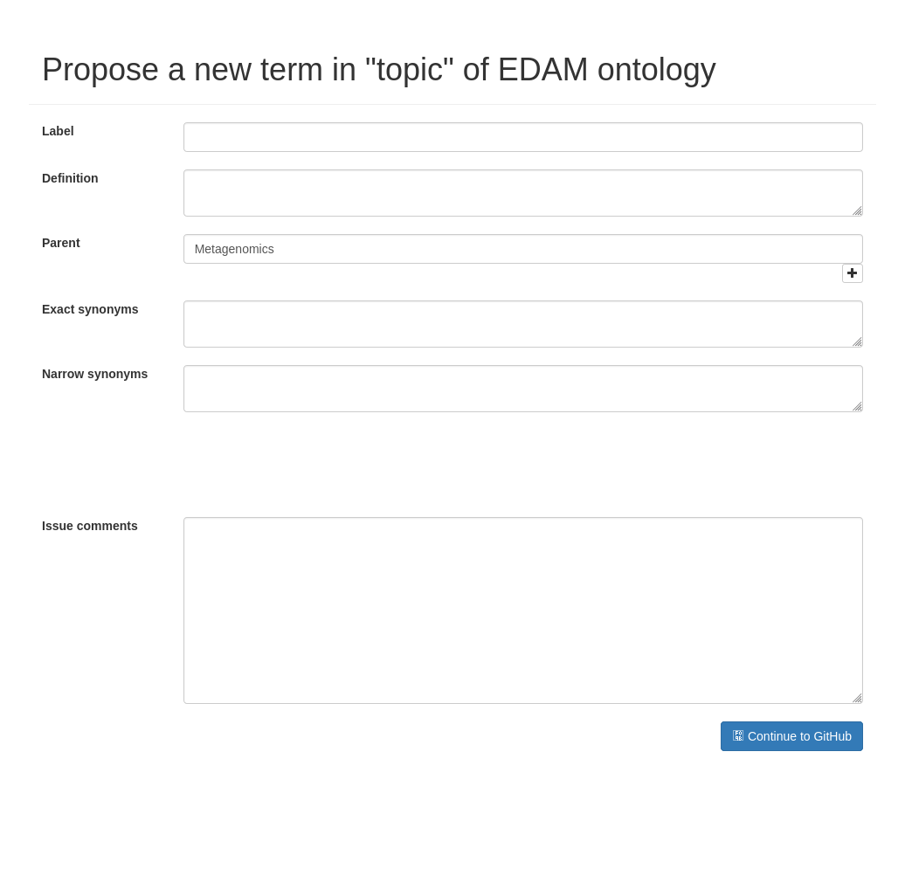
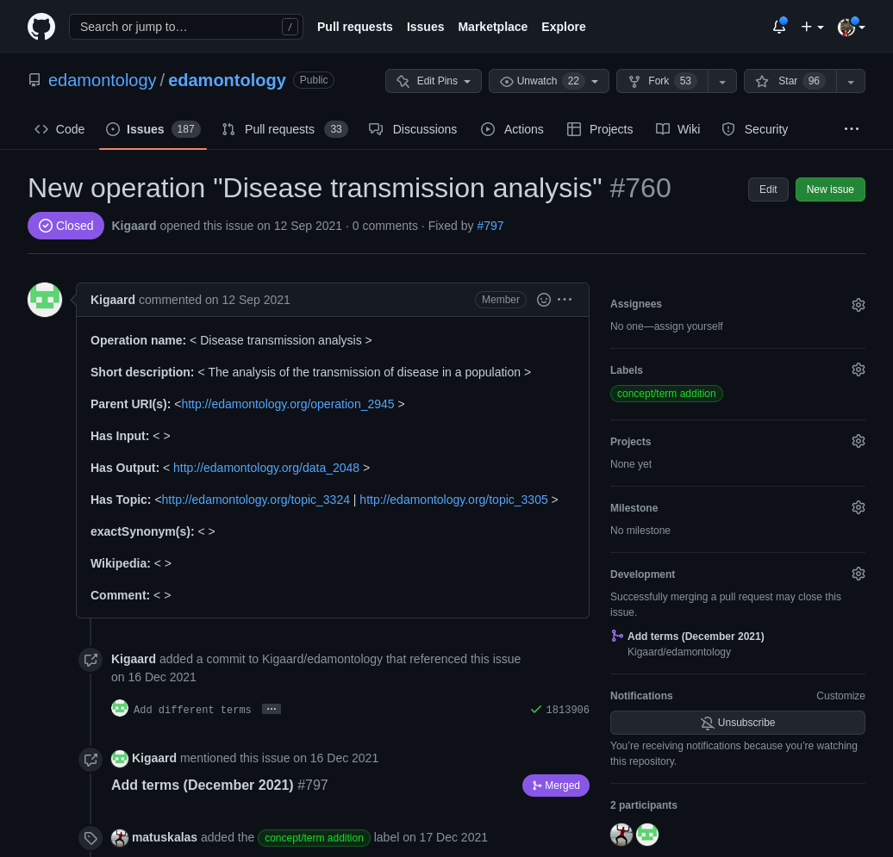
Contribute to EDAM!

Slide 97
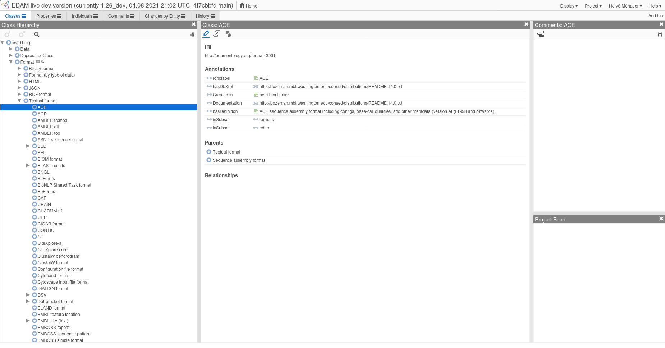
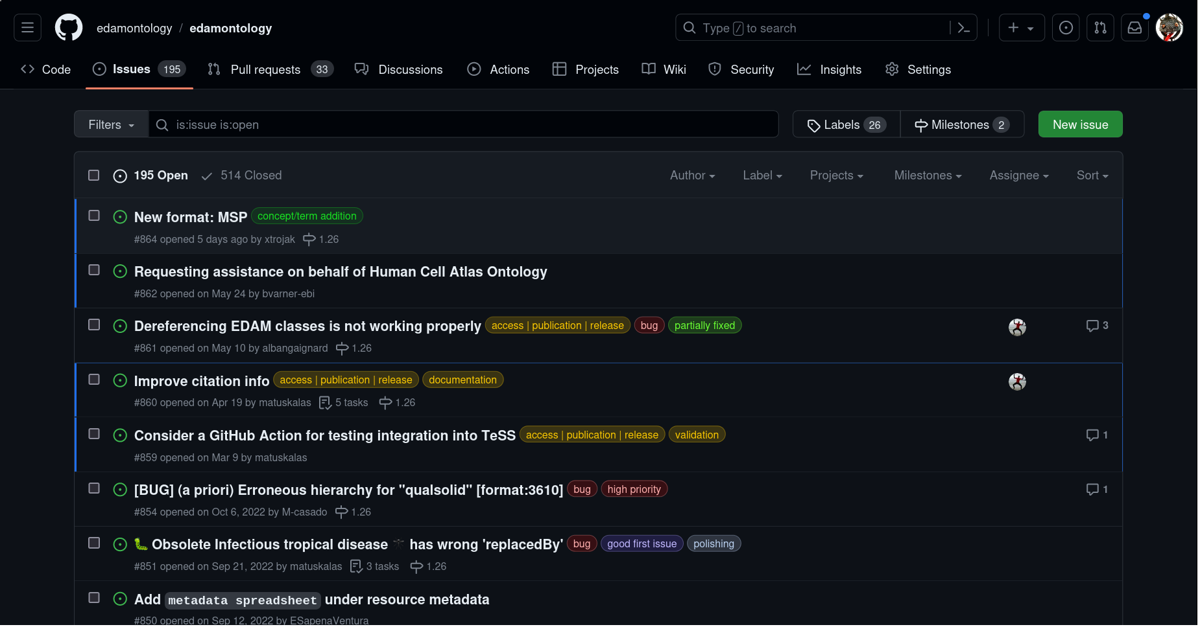
Contribute to EDAM!
Notes:
Or the possibility to directly submit new suggestions to GitHub, using a web form.

Slide 98
FAIRsharing, ELIXIR-UK, Allyson Lister

Slide 99








ELITMa - ELIXIR Training Program in Management (Module 1 & Module 2)
28 June 2023
Integrating FAIRsharing into ELIXIR Node strategies for data management
Allyson Lister, Content & Community Lead
with thanks to
Susanna-Assunta Sansone, PI
Allyson’s RDA/EOSC Future Domain Ambassadorship supported by
datareadiness.eng.ox.ac.uk
Supported by the Research Data Alliance through the RDA Open Calls as part of the EOSC Future project.
The project has received funding from the European Union’s Horizon 2020 research and innovation programme under grant agreement no 101017536.
contact@fairsharing.org
@fairsharing@fediscience.org
@FAIRsharing_org
Notes:
FAIRsharing is an informative and educational resource on interlinked standards, databases and policies, three key elements of the FAIR ecosystem. FAIRsharing is adopted by funders, publishers and communities across all research disciplines. It promotes the existence and value of these resources to aid data discovery, interoperability and sharing across all of our stakeholder groups. Enabling FAIR data is a key role within FAIRsharing, and we work with a variety of stakeholders (funders, researchers, research support such as librarians and data stewards, publishers, and resource developers) throughout the data management lifecycle to achieve this goal.
Here we will discuss how FAIRsharing can be searched and updated by our user community, and how the social sciences in particular can make the best use out of it as part of a broader data management infrastructure. We also will discuss the benefits of both in-house curation and community-driven curation provided by our stakeholder groups. Finally, we will show you how to take part and contribute to the development of the description of databases and standards within FAIRsharing through our Community Curation Programme (https://fairsharing.org/community_curation).

Slide 100
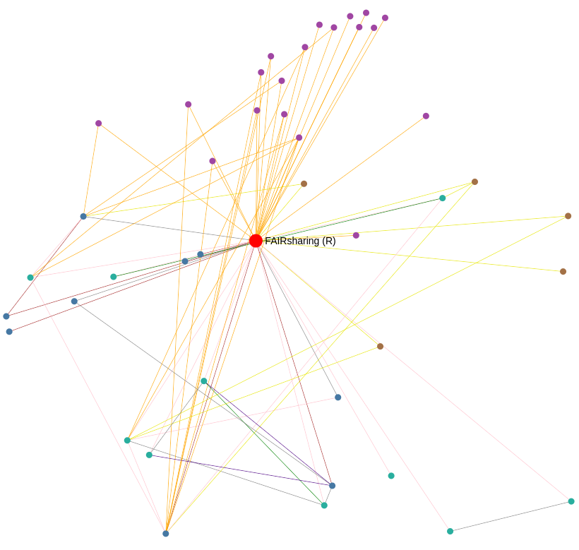


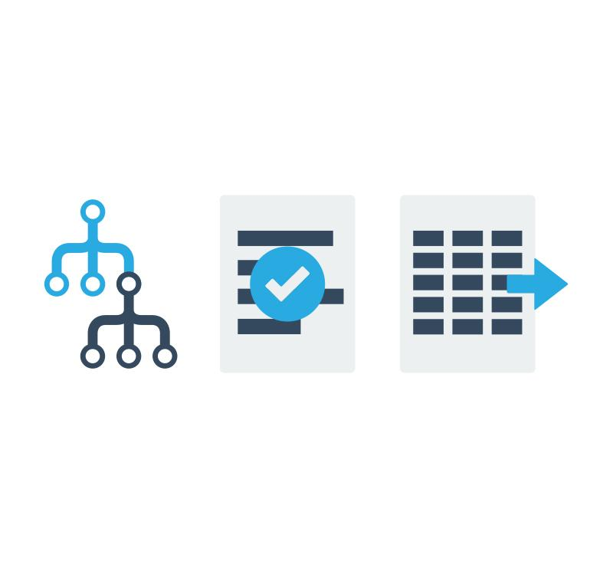


An informative and educational resource, and a service
POLICIES
by funders, journals
and other organizations
DATABASES
including repositories
and knowledgebases
COMMUNITY STANDARDS
Formats
Terminologies
Guidelines
Identifiers
FAIRsharing provides curated descriptions and relationship graphs of
standards, databases and policies

Slide 101
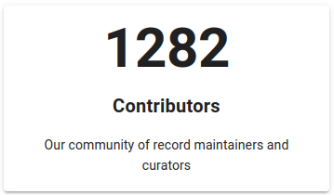
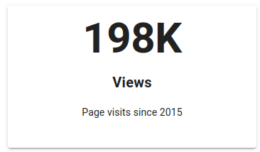
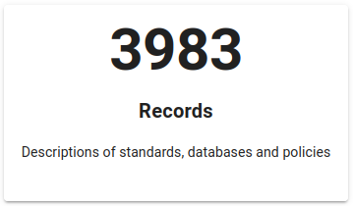
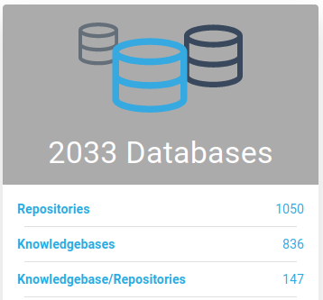
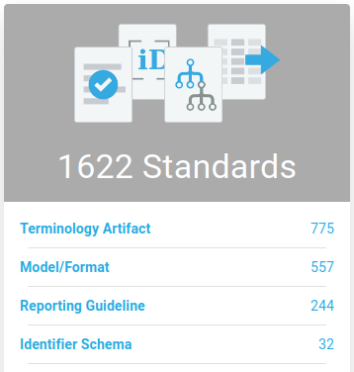
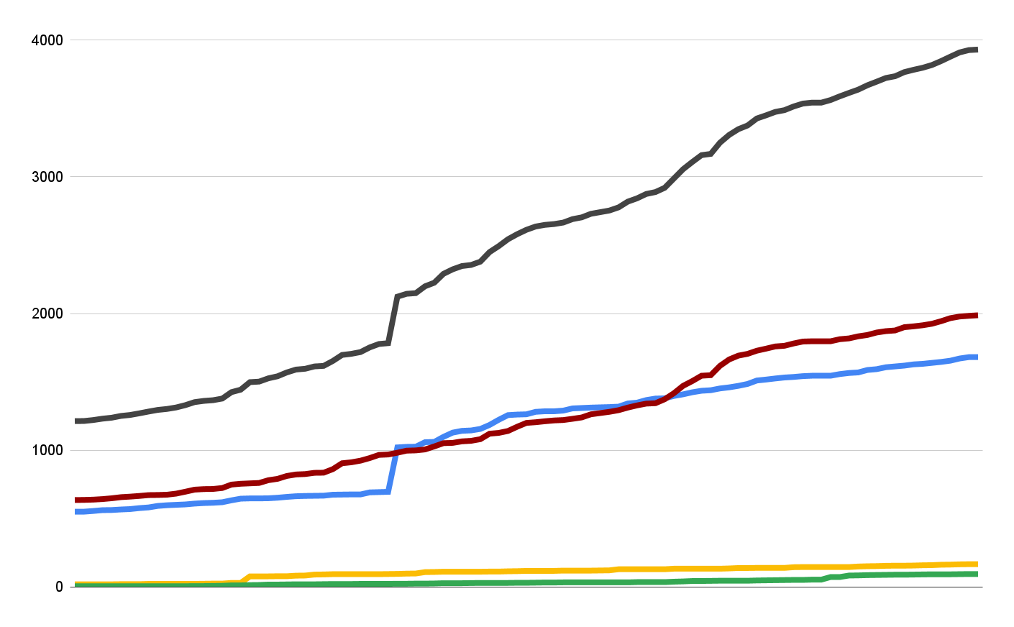
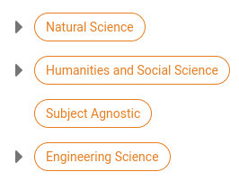

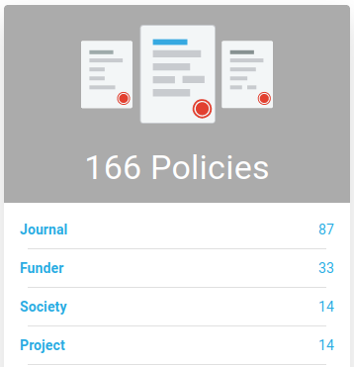
FAIRsharing in numbers: content, contributions, coverage
Types and subtypes
Growth since launch
Disciplines
all records
databases
standards
policies
2011-2015
2016
2017
2018
2019
2020
2021
2022
2023
collections
as of June 2023

Slide 102








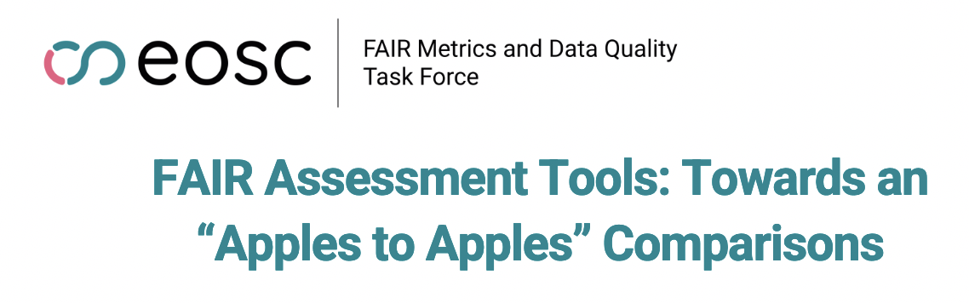
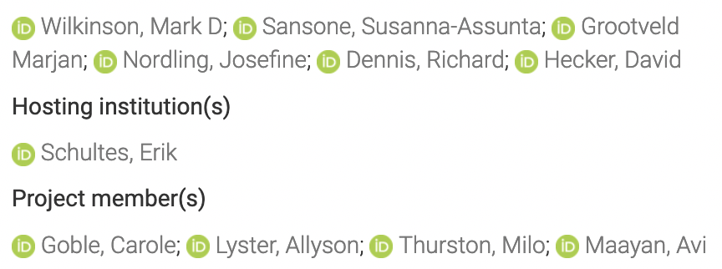


FAIRsharing connects your resource to dozens of services within ELIXIR and beyond
A growing number of tools and services access the FAIRsharing API, and use it for look-up, selection and content retrieval for standards and repositories in:
creation of data management plans
enrichment of guidance and training material
assessment of FAIRness
references
gets data from
new, in progress
doi.org/10.5281/zenodo.7463421

Slide 103
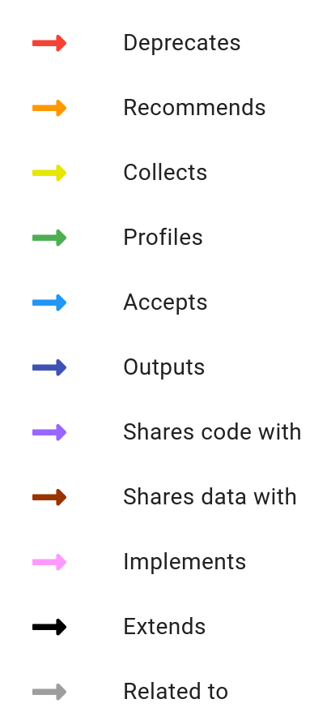





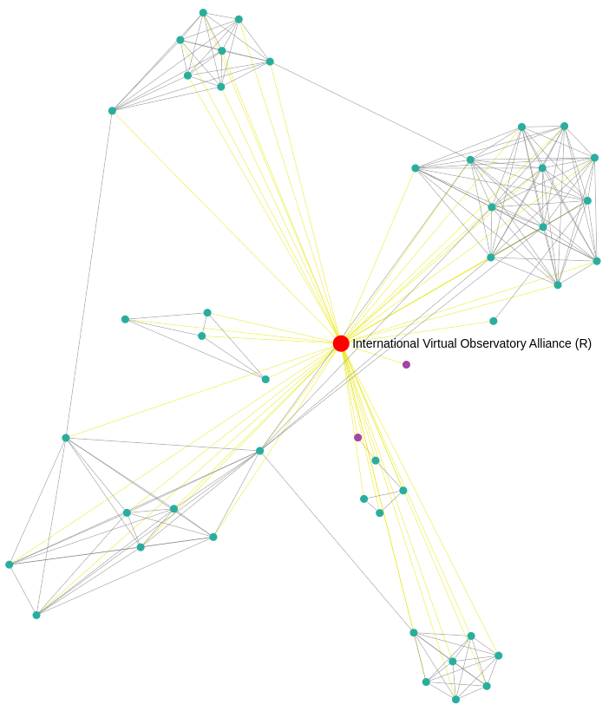
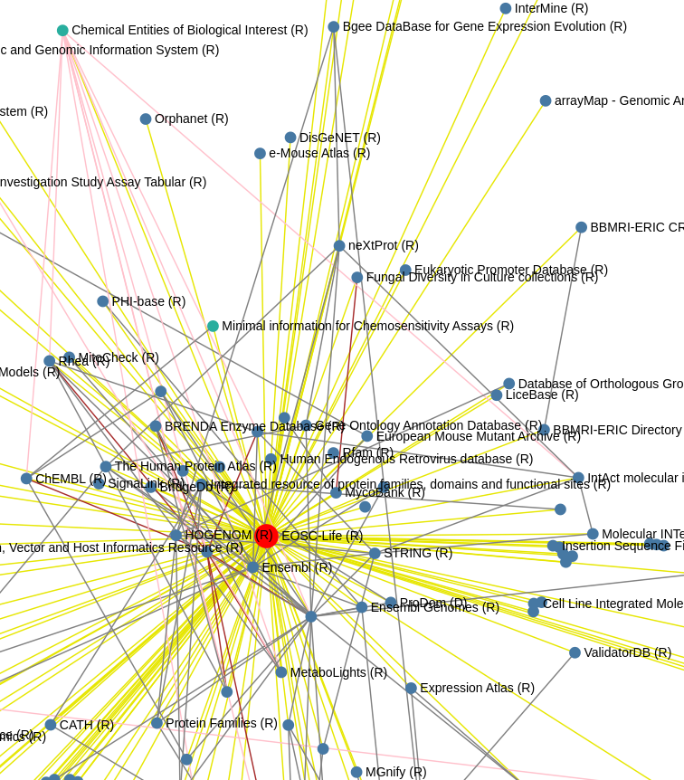
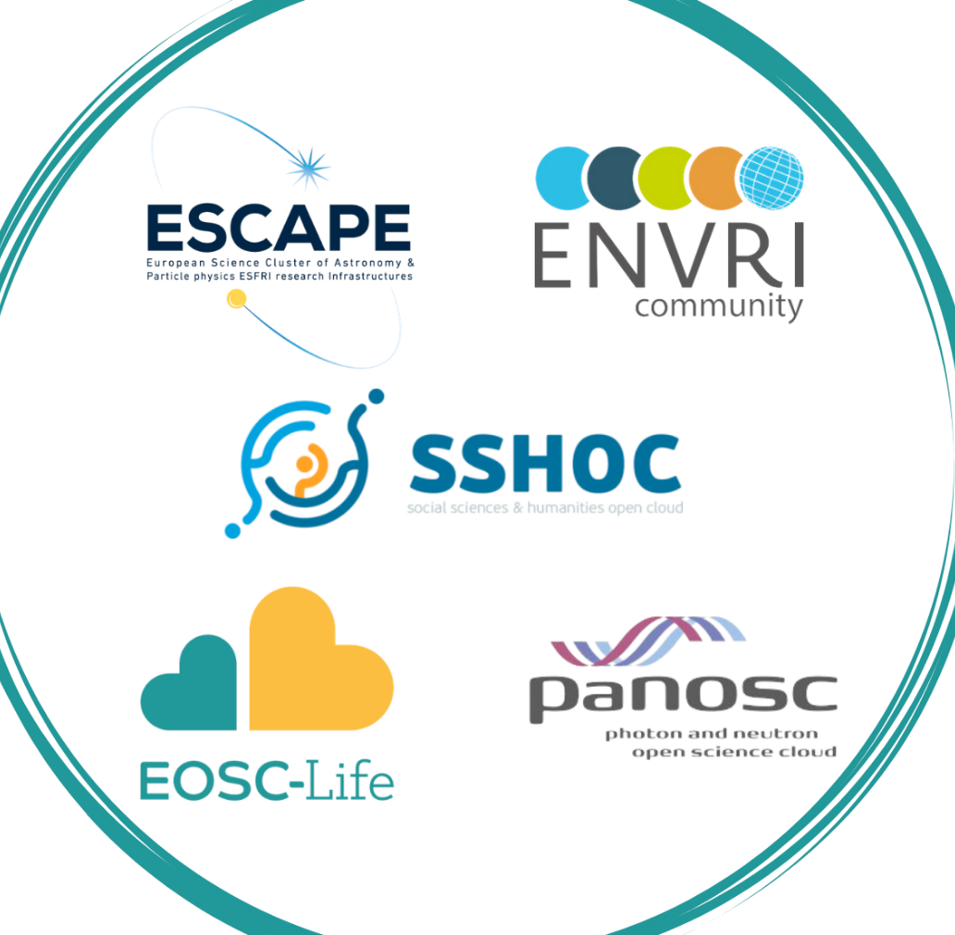
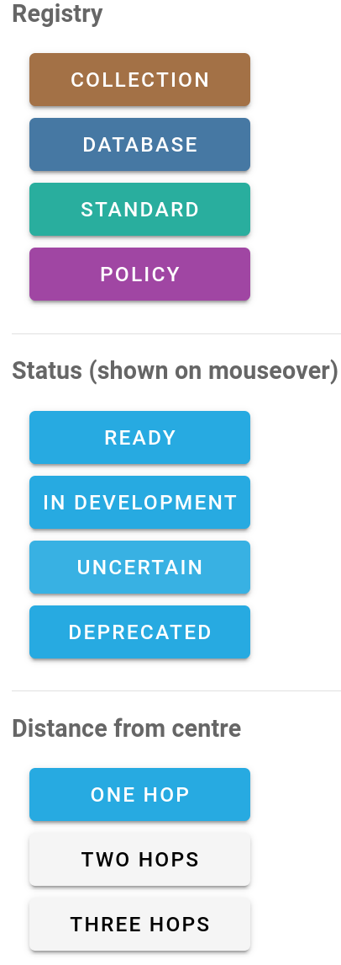
FAIRsharing makes your standard, database or policy discoverable to an entire ecosystem of resources
The standards, repositories and policies each EOSC Cluster uses or endorses
Collection URL: fairsharing.org/graph/3515;
each record has a DOI
Collection URL: fairsharing.org/graph/3513;
each record has a DOI

Slide 104
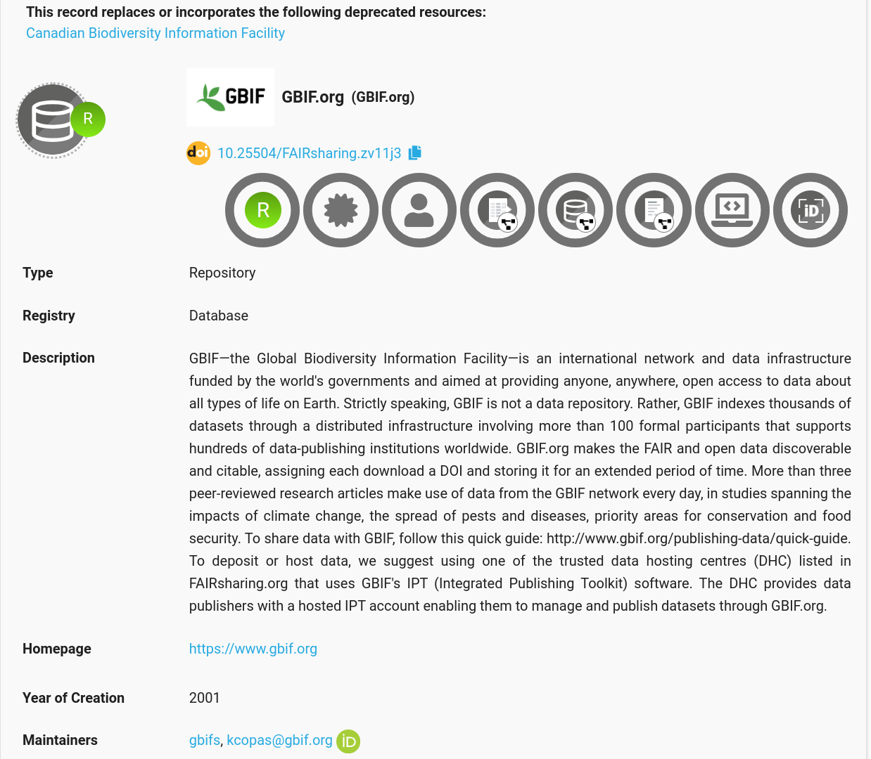
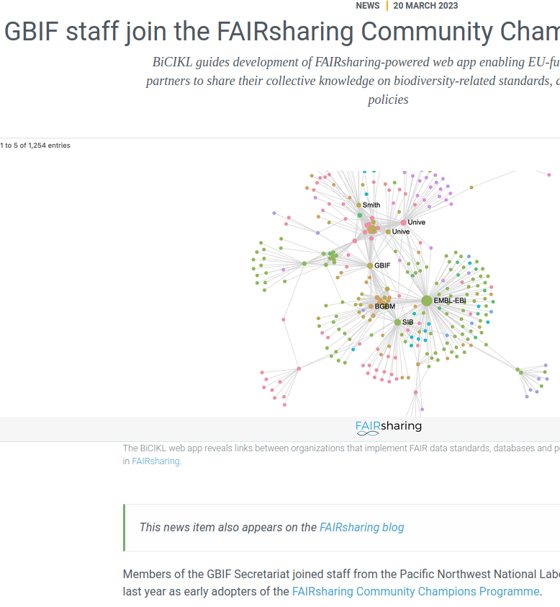
FAIRsharing benefits the databases, standards and policies registered within it
The registration of databases and/or standards
increases their discoverability, and
provides them (the maintainers of the records) with visibility and credit.
The more connected the resource, the greater its visibility
if a standard is implemented by a database, these two records will be interlinked
these links can be navigated, allowing new relationships to be explored and collaborations to be formed
https://doi.org/10.25504/FAIRsharing.zv11j3
https://www.gbif.org/news/6P2o4iu4iF3AXqQvUUszuZ/gbif-staff-join-the-fairsharing-community-champions-programme

Slide 105

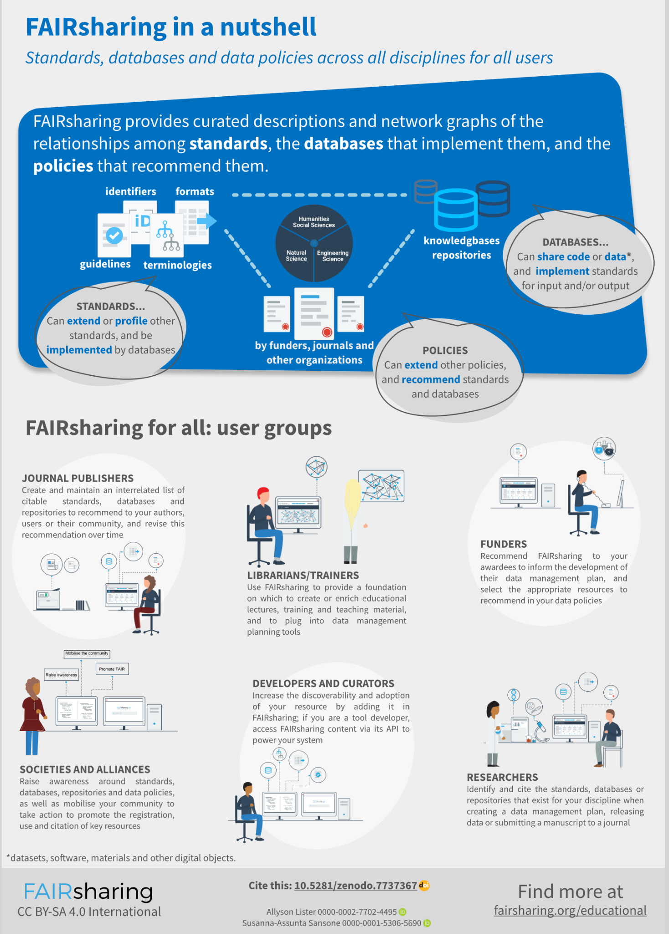
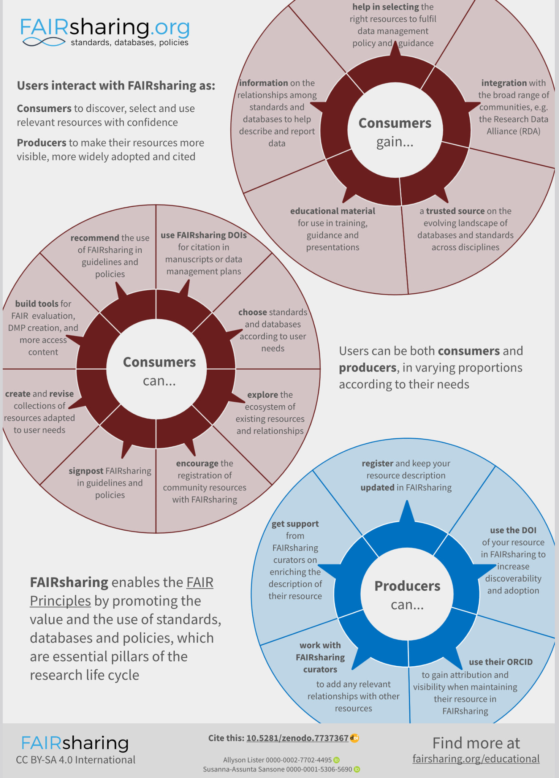
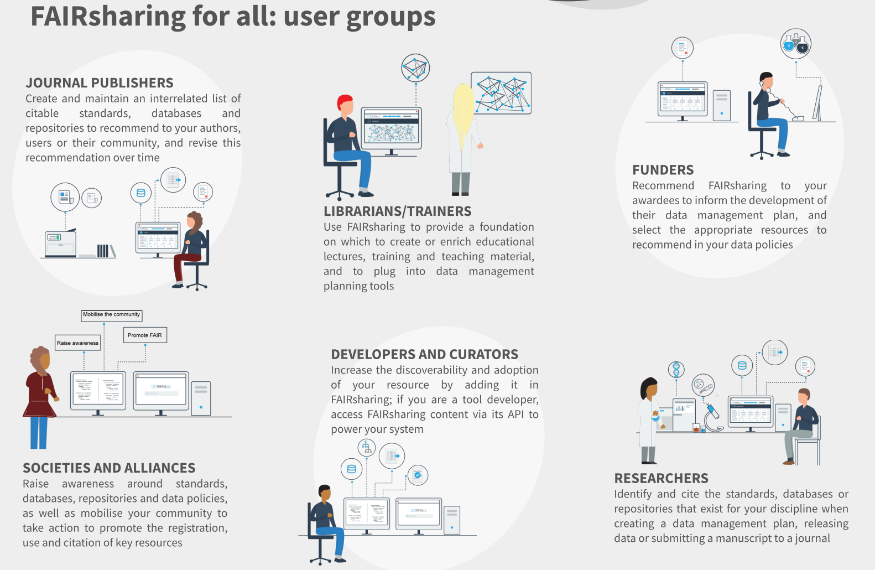
FAIRsharing for all
fairsharing.org/educational#nutshell
Notes:
Because we offer sooo much, we know we have to guide our users (consumers, producers, third-party tools) towards all we have to offer. Expand the wheels.

Slide 106
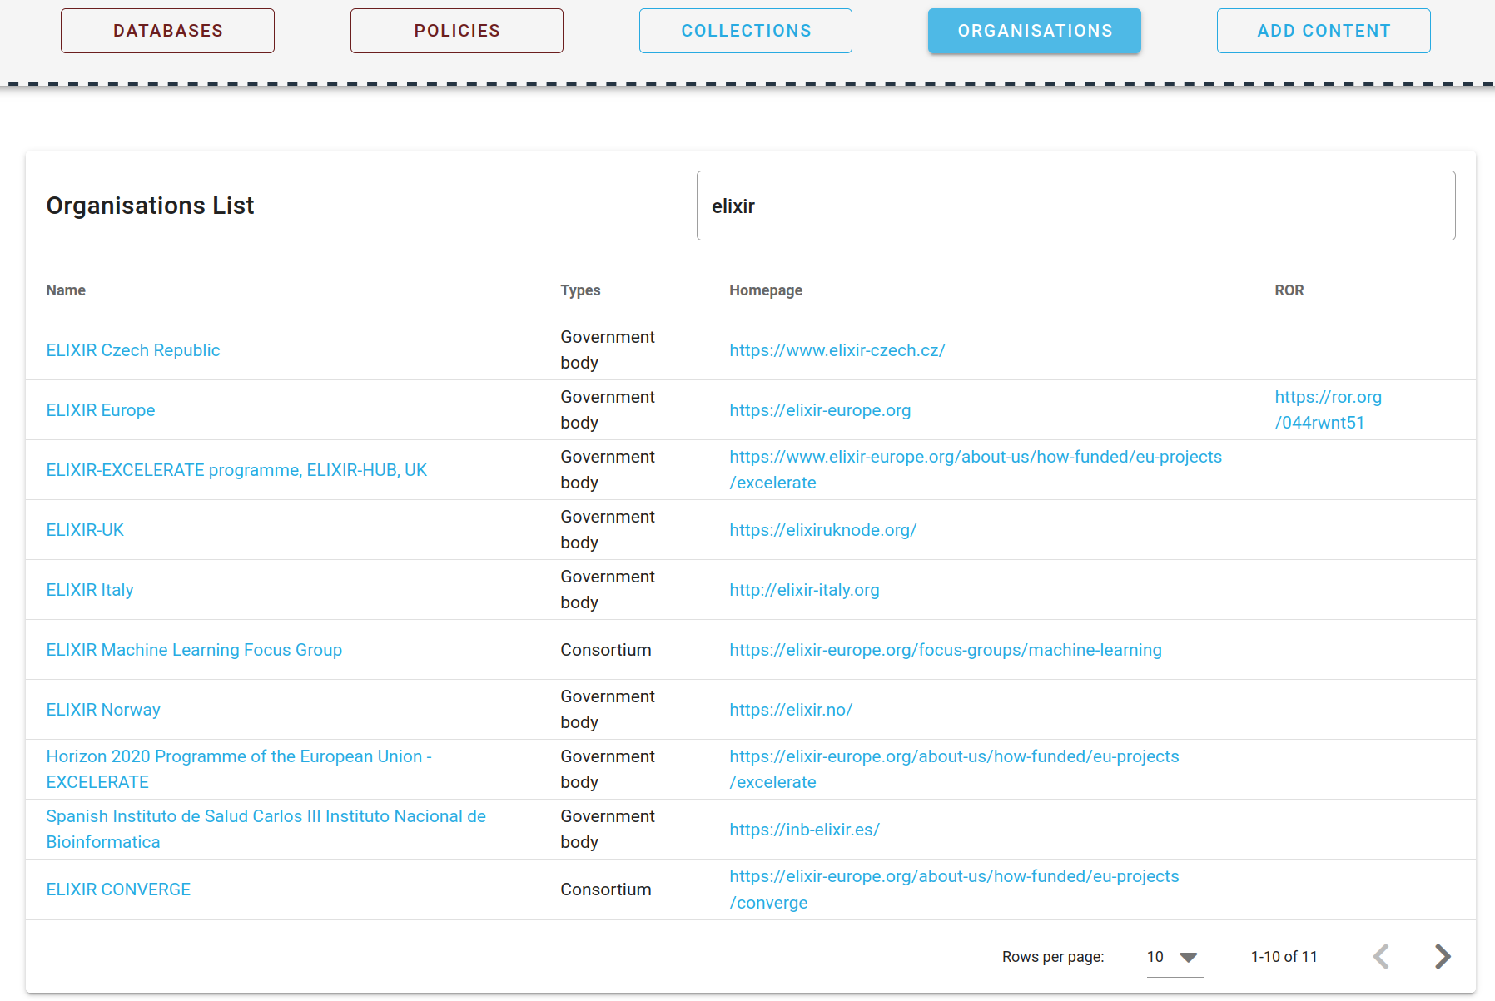
ELIXIR in FAIRsharing

Slide 107
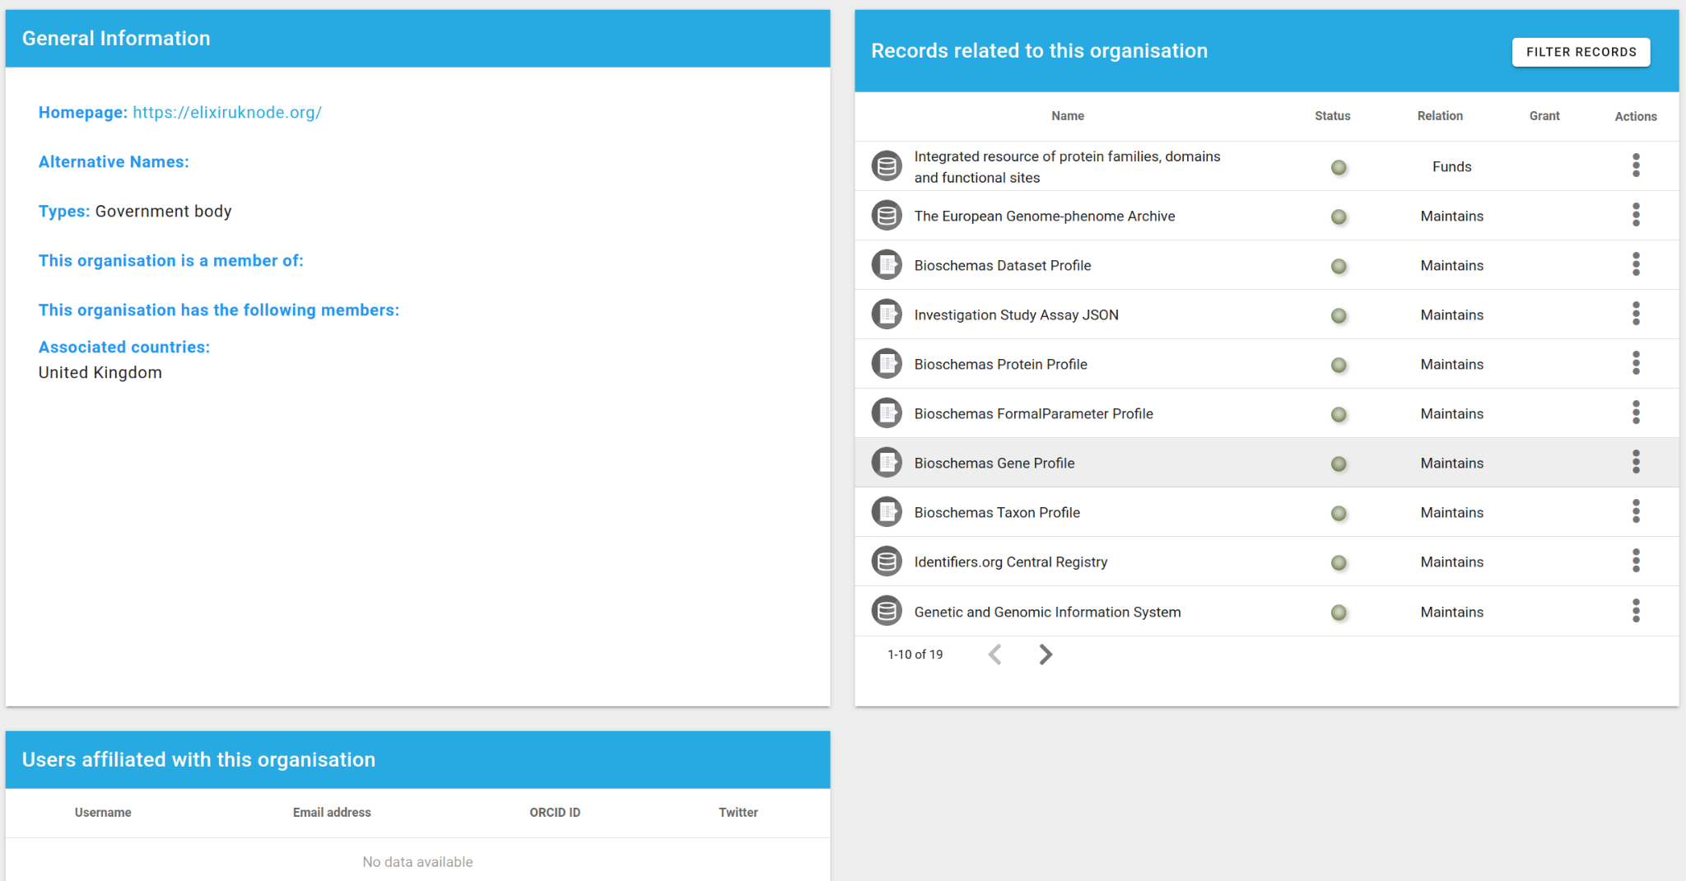
ELIXIR in FAIRsharing
https://fairsharing.org/organisations/843

Slide 108
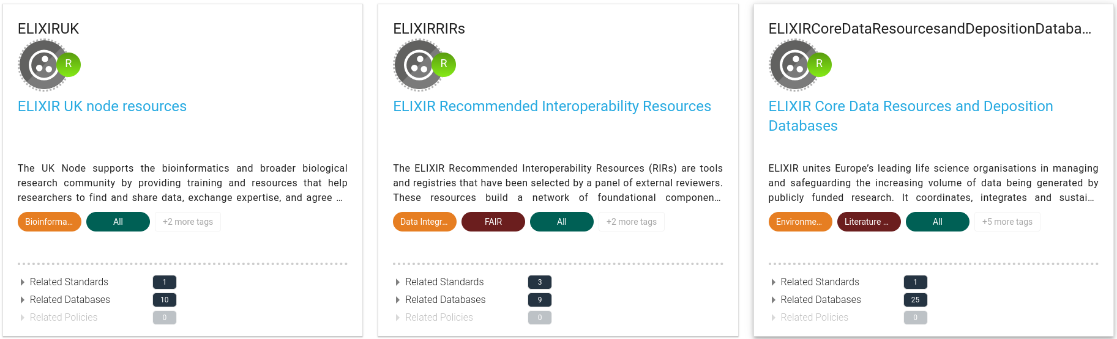
ELIXIR in FAIRsharing

Slide 109
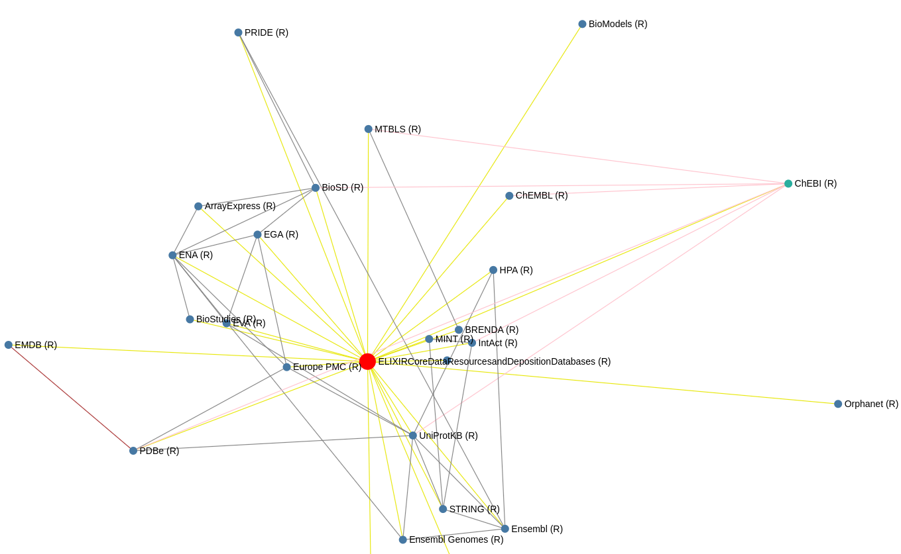
ELIXIR in FAIRsharing
ELIXIR CDRs: https://fairsharing.org/graph/3527

Slide 110
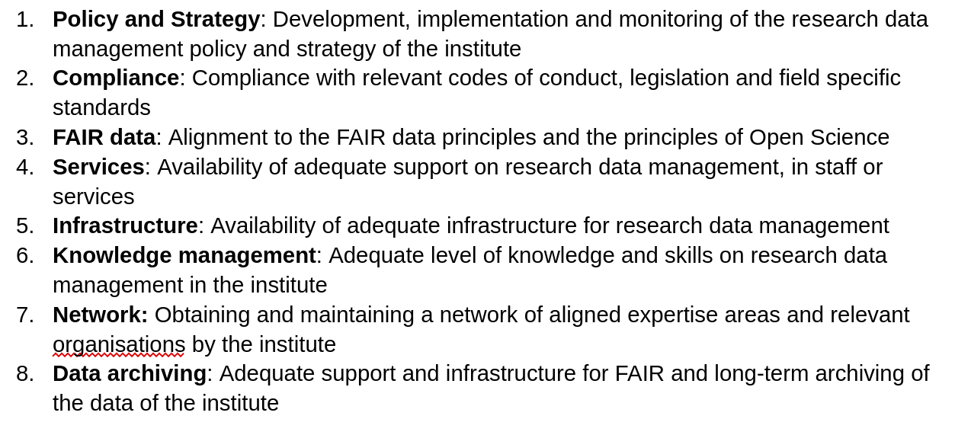
How can your Node integrate with FAIRsharing?

Slide 111
How can your Node integrate with FAIRsharing?
Nodes require…
helps you via…
Visibility for the resources they produce and endorse | Collections of Node resources to provide live representations of these resources
Visibility for the organisations responsible for them (incl the Nodes themselves) | Organisation-specific FAIRsharing pages that list all relationships e.g. all resources associated with your Node
Integration of Node resources with the ELIXIR ecosystem of tools | API access used by many tools including those for FAIR assessment and data management planning
Ways to discover resources of use to Node members | Search functionality to discover resources for collaboration and use
Policy and strategy (1); FAIR data (3)

Slide 112
How can your Node integrate with FAIRsharing?
Nodes require…
helps you via…
Visibility for the resources they produce and endorse | Collections of Node resources to provide live representations of these resources
Visibility for the organisations responsible for them (incl the Nodes themselves) | Organisation-specific FAIRsharing pages that list all relationships e.g. all resources associated with your Node
Integration of Node resources with the ELIXIR ecosystem of tools | API access used by many tools including those for FAIR assessment and data management planning
Ways to discover resources of use to Node members | Search functionality to discover resources for collaboration and use
Policy and strategy (1); FAIR data (3); Network (7)

Slide 113
How can your Node integrate with FAIRsharing?
Nodes require…
helps you via…
Visibility for the resources they produce and endorse | Collections of Node resources to provide live representations of these resources
Visibility for the organisations responsible for them (incl the Nodes themselves) | Organisation-specific FAIRsharing pages that list all relationships e.g. all resources associated with your Node
Integration of Node resources with the ELIXIR ecosystem of tools | API access used by many tools including those for FAIR assessment and data management planning
Ways to discover resources of use to Node members | Search functionality to discover resources for collaboration and use
Policy and strategy (1); FAIR data (3); Network (7)

Slide 114
How can your Node integrate with FAIRsharing?
Nodes require…
helps you via…
Visibility for the resources they produce and endorse | Collections of Node resources to provide live representations of these resources
Visibility for the organisations responsible for them (incl the Nodes themselves) | Organisation-specific FAIRsharing pages that list all relationships e.g. all resources associated with your Node
Integration of Node resources with the ELIXIR ecosystem of tools | API access used by many tools including those for FAIR assessment and data management planning
Ways to discover resources of use to Node members | Search functionality to discover resources for collaboration and use
Policy and strategy (1); FAIR data (3); Network (7); Compliance (2); Data archiving (8)

Slide 115
How can your Node integrate with FAIRsharing?
To enhance…
Nodes should integrate FAIRsharing by…
citability of Node resources | Using FAIRsharing record links in your guidance to members, providing stable PIDs for resources you want to recommend
discoverability of Node resources | Recommending that members register any newly-developed resources in FAIRsharing to improve their visibility to humans and machines
exploration of the existing ecosystem | Suggesting that members use FAIRsharing to discover standards and databases
Representation and visibility of your Node in FAIRsharing | Nominating Node representatives to join the FAIRsharing Community Champions program to aid delivery of all of these features
Policy and strategy (1); FAIR data (3)

Slide 116
How can your Node integrate with FAIRsharing?
To enhance…
Nodes should integrate FAIRsharing by…
citability of Node resources | Using FAIRsharing record links in your guidance to members, providing stable PIDs for resources you want to recommend
discoverability of Node resources | Recommending that members register any newly-developed resources in FAIRsharing to improve their visibility to humans and machines
exploration of the existing ecosystem | Suggesting that members use FAIRsharing to discover standards and databases
Representation and visibility of your Node in FAIRsharing | Nominating Node representatives to join the FAIRsharing Community Champions program to aid delivery of all of these features
Policy and strategy (1); FAIR data (3)

Slide 117
How can your Node integrate with FAIRsharing?
To enhance…
Nodes should integrate FAIRsharing by…
citability of Node resources | Using FAIRsharing record links in your guidance to members, providing stable PIDs for resources you want to recommend
discoverability of Node resources | Recommending that members register any newly-developed resources in FAIRsharing to improve their visibility to humans and machines
exploration of the existing ecosystem | Suggesting that members use FAIRsharing to discover standards and databases
Representation and visibility of your Node in FAIRsharing | Nominating Node representatives to join the FAIRsharing Community Champions program to aid delivery of all of these features
Policy and strategy (1); FAIR data (3)

Slide 118
How can your Node integrate with FAIRsharing?
To enhance…
Nodes should integrate FAIRsharing by…
citability of Node resources | Using FAIRsharing record links in your guidance to members, providing stable PIDs for resources you want to recommend
discoverability of Node resources | Recommending that members register any newly-developed resources in FAIRsharing to improve their visibility to humans and machines
exploration of the existing ecosystem | Suggesting that members use FAIRsharing to discover standards and databases
Representation and visibility of your Node in FAIRsharing | Nominating Node representatives to join the FAIRsharing Community Champions program to aid delivery of all of these features
Policy and strategy (1); FAIR data (3); Network (7)

Slide 119
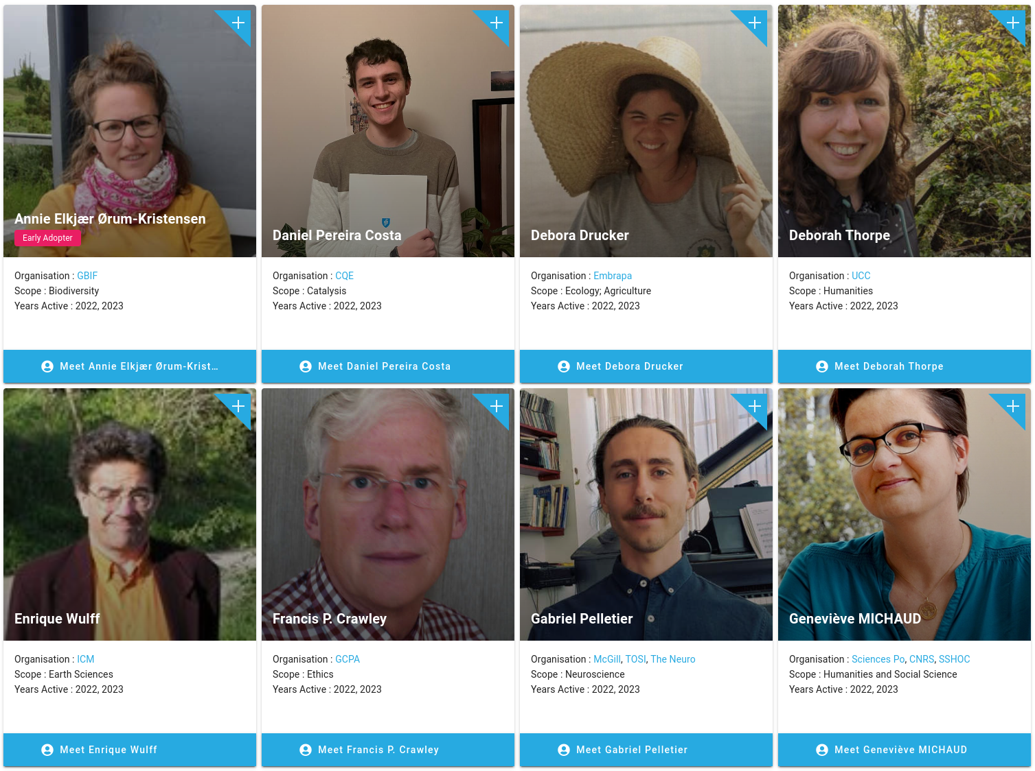
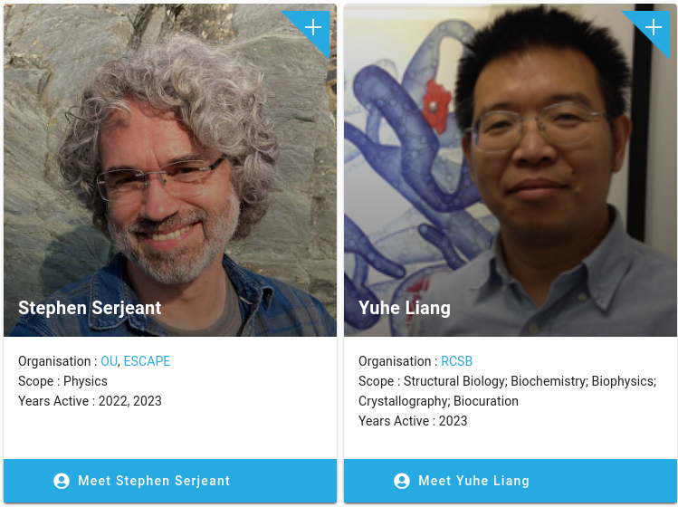
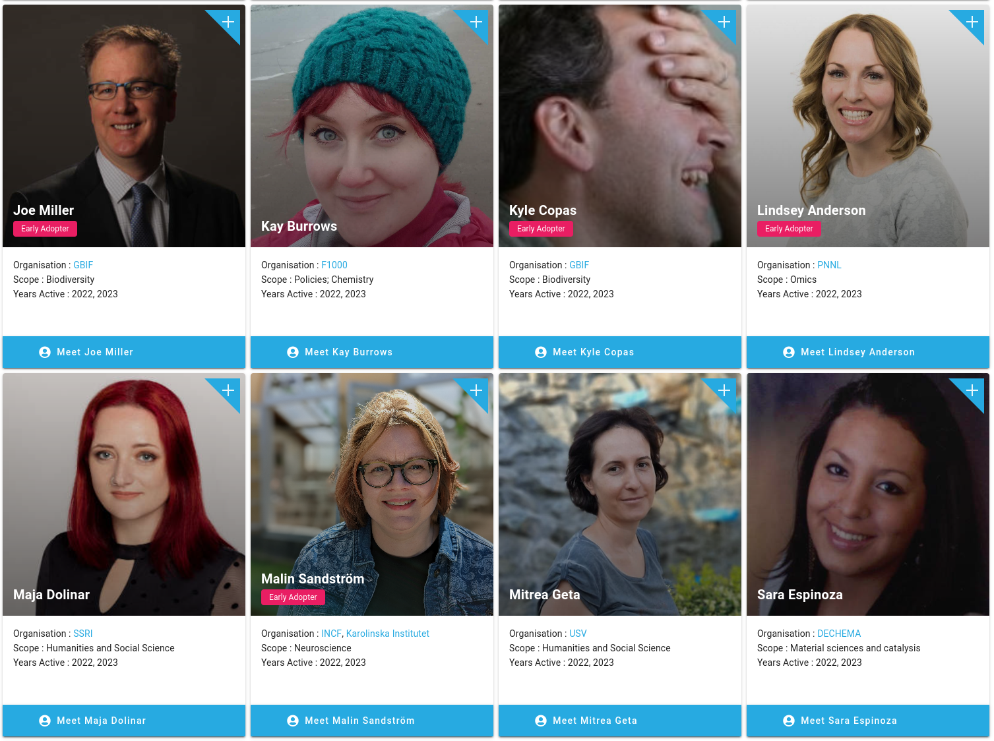

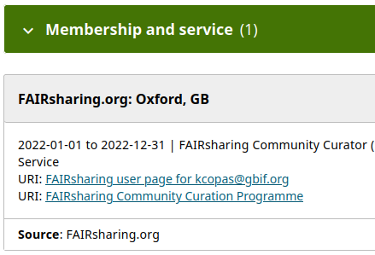
FAIRsharing Community Champion Programme
A thriving community of domain and discipline experts who:
1 . act as advocates to promote the value of standards, databases and policies for digital objects (incl. data, software).
2 . create educational material describing these resources helping researchers and other stakeholders to find, use and adopt them.
3 . enrich the content of FAIRsharing, adding and enhancing the description and discoverability of these resources.
This can be your node rep, JOIN US!
fairsharing.org/community_champions/our_champions

Slide 120

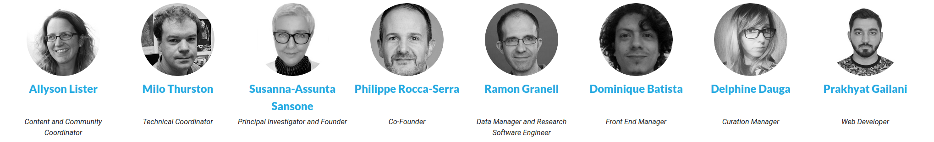
Thank you!
Stakeholder Advisors
Amye Kenall, Research Square
Adam Leary, Oxford University Press
Catriona MacCallum, Hindawi
Dagmar Meyer, ERC, Executive Agency
Dominic Fripp, JISC
Emma Ganley, Protocols.io
Geraldine Clement-Stoneham, MRC
Helena Cousijn, DataCite
Lauren Cadwallader, PLoS
Imma Subirats, FAO of the United Nations
Kiera McNiece, Cambridge University Press
Lauren Cadwallader, PLoS
Lorenzo Feri, Elsevier
Luiz Olavo Bonino, GO-FAIR
Mark Leggott, Digital Research Alliance of Canada
Marta Teperek, TUDelft
Michael Ball, Medical Research Council
Mike Huerta, NIH National Library of Medicine
Nick Everitt and Matthew Cannon, Taylor and Francis
Rebecca Grant, F1000
Sarah Callaghan, Strategy & Policy Unit, University of Oxford
Sarah Stewart, Bodleian Libraries, University of Oxford
Scott Edmunds, GigaScience, Oxford University Press
Simon Hodson, CODATA
Sowmya Swaminathan, Springer Nature
Theo Bloom, British Medical Journal
Thomas Lemberger, EMBO Press
Wei-Mun Chan, eLife
Executive Advisors
David Carr, Independent expert
Peter McQuilton, (FAIRsharing Founding Member), GSK
Robert Hanisch, NIST
Varsha Khodiyar, Independent Expert
RDA FAIRsharing WG Chairs
Graham Smith, Springer Nature
Holly Murray, Health Data Research UK
Peter McQuilton, GSK
Rebecca Grant, F1000
Simon Hodson, CODATA
Allyson Lister, University of Oxford
Susanna-Assunta Sansone, University of Oxford
Community Champions
fairsharing.org/community_champions/our_champions
www.rd-alliance.org/group/fairsharing-registry-connecting-data-policies-standards-databases.html
Operational Team
fairsharing.org/communities#governance

Slide 121
FAIR Cookbook, ELIXIR-LU, Danielle Welter

Slide 122

The FAIR Cookbook as a Node Service
Background
Developed by the FAIRplus project
Open, online resource of hands-on recipes for “FAIR doers” in the Life Sciences
Practical guidance on specific FAIR & RDM challenges
https://faircookbook.elixir-europe.org/

Slide 123
The FAIR Cookbook as a Node Service
Value of the FAIR Cookbook to ELIXIR nodes
Quality research data management practices & FAIR data are at the core of ELIXIR’s mission
ELIXIR nodes build up expertise in different areas of RDM and FAIR
The FAIR Cookbook is one way of sharing expertise with the wider community, both at node level and across ELIXIR

Slide 124
The FAIR Cookbook as a Node Service
Why we integrated the FAIR Cookbook into our Service Delivery Plan
Integration into Service Delivery Plan = sustainability!
  The Cookbook is deeply interconnected with other ELIXIR resources, such as the RDMkit
  ELIXIR is an active network of experts in a wide range of domains
  ELIXIR-LU & ELIXIR-CH represented on the Cookbook Editorial Board
Special case: no dedicated infrastructure or deployment requirement
  FAIR Cookbook runs on Github with open access tools and technologies, under the ELIXIR banner

Slide 125
The FAIR Cookbook as a Node Service
Integration into the Service Delivery Plan for ELIXIR-LU - practical steps
General ELIXIR-LU decision process - based on ELIXIR guidelines
  Review of Cookbook against inclusion criteria
    Including but not limited to quality of documentation, usability, licensing, scientific excellence, alignment with mission of ELIXIR/ELIXIR-LU
  Approval of inclusion proposal by ELIXIR-LU HoN
  Referral of inclusion proposal to ELIXIR

Slide 126
The FAIR Cookbook as a Node Service
Integration into the Service Delivery Plan for ELIXIR-CH - practical steps
Similar process to ELIXIR-LU, again based on ELIXIR guidelines
  Review of Cookbook against inclusion criteria such quality, purpose and sustainability of the resource
  Facilitated by precedent of similar assessment in other Nodes
  Inclusion proposal presented to ELIXIR-CH HoN for approval
  Referral of inclusion proposal to ELIXIR

Slide 127
Discussion
MJ
Based on the presentations (Molgenis, EDAM, FAIRsharing, FAIRcookbook), plenary discussion:
  What services are relevant to your Node?
  What/who do you need (from others) to implement it?
Please build your Node’s DM portfolio in the shared notes document, as they are for your use
  Formulate your own lessons learned
  Formulate your take home messages & next steps

Slide 128
Funder requirements for FAIR data
(13-14 CEST / 14-15 EEST)
MJ

Slide 129

Funder requirements for FAIR data
MJ
Topic: Funder requirements for FAIR data
Description: Examples of FAIR requirements by funders (ZonMw: Covid & Dementia data) to showcase what services are needed to help researchers meet those requirements
Learning outcome: Reflect on how funder requirements to FAIR data may affect the Nodes' DM strategy and identify potential implications
Form: Showcasing and discussion
Assignment: Add lessons learned to Node portfolio

Slide 130



Funder requirements for research data management and FAIR data:
From burden to benefit!
28-6-2023 Margreet Bloemers Elixir course
Alles over FAIR-datamanagement bij ZonMw
Toegangtotdata@zonmw.nl
Notes:
WHAT? WHY? HOW?
Topic: Funder requirements for FAIR data
Description: Examples of FAIR requirements by funders (ZonMw: Covid & Dementia data) to showcase what services are needed to help researchers meet those requirements
Learning outcome: Reflect on how funder requirements to FAIR data may affect the Nodes' DM strategy and identify potential implications
Form: Showcasing + questions
Assignment: Add lessons learned to Node portfolio

Slide 131
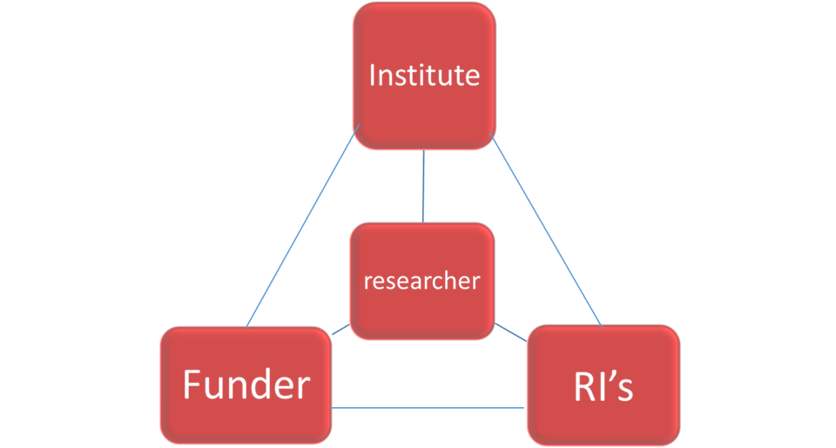
Learning outcomes RDM strategy
Elixir: How funder requirements may affect the Nodes' DM strategy
>> potential implications
ZonMw’s perspective (and of other funders):
Creating FAIR data is our mutual interest: value from research > reusable data
The funder is not a bureaucrat, but a collaborator!
Distinguish RDM - data FAIRification
From RDM requirements for single projects
towards organising research communities and domain specific FAIR implementations

Slide 132
Outline
About ZonMw and the role of a funding organisation in FAIR RDM
WHY does a funder bother about reusable data?
What & how? Collaboration!
RDM requirements in ZonMw’s grant procedures
Discussion about your experiences (perspective from an ELIXIR node)
Steps towards FAIR data – we started with COVID-19
Developing approaches and services for data FAIRification
Implementing data FAIRification in RDM requirements
The funder’s role is evolving ……
Discussion about your opportunities and collaborators

Slide 133
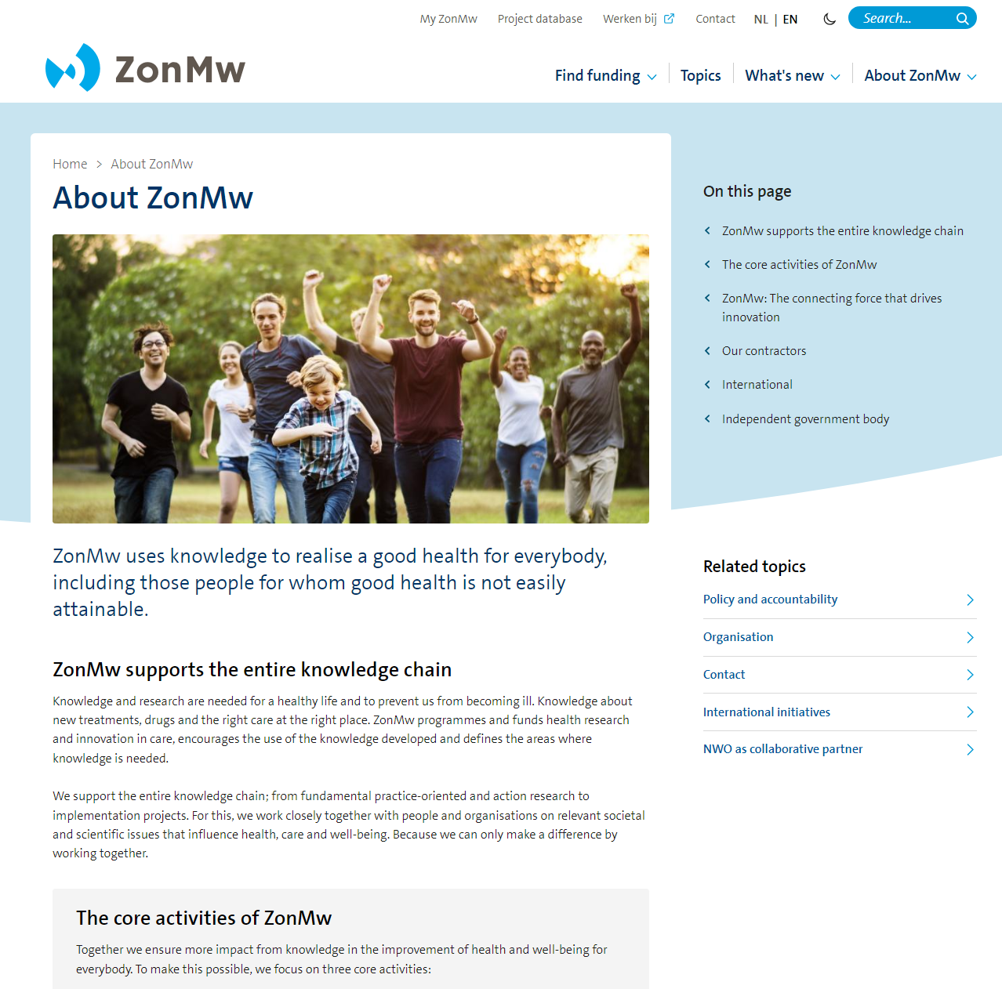
What is ZonMw?
Funding organisation for health research
  around 400 million a year
Signaling, research, implementation, impact
Collaborates (inter)nationally
Extra focus on Open Science
  Recognition & reward
  Education
  Citizen science
  Open Access and FAIR data
Notes:
Open Science: in het kort – gaat over samenwerking en transparantie in alle fasen van de wetenschap, en het zo vroeg mogelijk delen van data en andere onderzoeksobjecten (‘output’)
Recognition & reward: Voor impact/bereik van onderzoek (in plaats van impact factor journal)
Citizen science: voor iedereen toegankelijk – burgers doen onderzoek
FAIR data: data (en andere ‘output’) herbruikbaar maken, publiceren en delen
Onderzoek in de kenniscyclus
In de bovengenoemde gevallen gaat het steeds over onderzoek. In het begin van de kenniscyclus is dat wetenschappelijk onderzoek, zoals fundamenteel, translationeel, of effectiviteits- en doelmatigheidsonderzoek.
Verderop in de kenniscyclus betreft het onderzoek naar innovaties in de praktijk, bijvoorbeeld een nieuwe behandelmethode, beleidsmaatregel, of nieuw apparaat. Zulk praktijkgericht- of beleidsonderzoek is dan bijvoorbeeld de monitoring of evaluatie van effecten van innovaties in de praktijk, bijvoorbeeld in de zorg, of onder de bevolking.

Slide 134


Why does ZonMw require RDM & FAIR data?
> improve impact of research outputs and accelerate innovation!
Enable data reuse and data sharing:
  Less duplication: money, time, laboratory animals, subjects
  Enrich research (combining datasets)
  Pattern recognition in large datasets
  Accelarate knowledge and innovation for improving health
Enable verification of research results:
  Research integrity, responsible science
  Reproduction research
Ensure added value for the researcher!
  Improve efficiency; spend less time on ‘ordening data’
  Quality improvement
Data and other research outputs, e.g.:
Biological materials, recordings, images, etc.
Notes:
Allow other researchers to build upon existing data and knowledge (return on investment)
Why? FAIR data (and other open science practices) improve the impact of our projects
reusable data/resources > innovative research
accelerating knowledge development to solve health issues
Data management (strategy, plan) are essential!
In this presentation, I will show what is need for FAIR data > steps in FAIRification

Slide 135
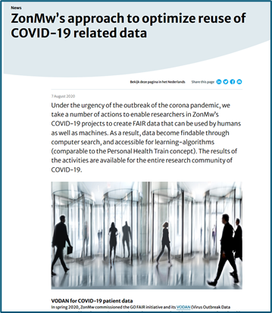
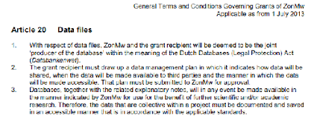
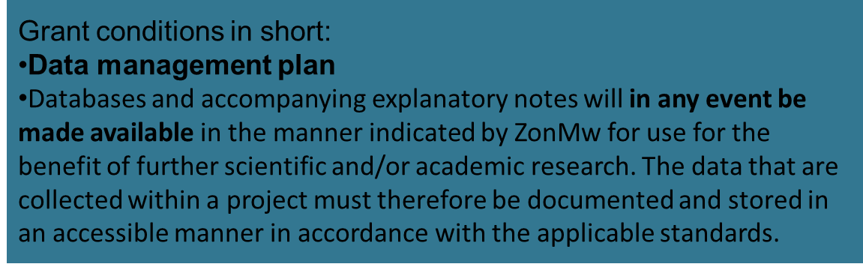
What is good datamanagement and FAIR data for ZonMw?
Good datastewardship is essential (has been mandatory since 2013)
FAIR data: Scientific input and output is available for re-use for humans and for computers
First FAIR implementations with COVID-studies (2020-2022),
Now spreading across other domains
Grant_Terms_and_Conditions_from_1st_July_2013.pdf (zonmw.nl)
Notes:
The grant recipient must draw up a data management plan in which it indicates how data will be shared, when data will be made available to third parties and the manner in which data will be made accessible. This plan must be submitted to ZonMw for approval.
Databases and accompanying explanatory notes will in any event be made available in the manner indicated by ZonMw for use for the benefit of further scientific and/or academic research. The data that are collected within a project must therefore be documented and stored in an accessible manner in accordance with the applicable standards.

Slide 136
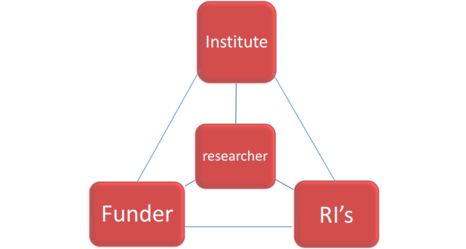
People and parties involved in RDM and data FAIRification
Research data
RI:
Health-RI, ELIXIR,
National & Domain specific infrastructure, services,
(COVID-19) Data Portal
Funder requires
‘regular’data management
Researcher generates data (& other assets)
Data steward supports, e.g. create M4M
Data FAIRification
Do researchers find local support?
Or services from RI’s?
Research institute facilitates: local infrastructure, services, HR-policy

Slide 137

Phase in the Research Data Life Cycle
Planning and executing RDM in your research project:
Funder requirements
Support & services & tools
Planning
Re-using
Collecting
Preserving
Processing and analysing
Publishing and sharing

Slide 138
Phase in the Research Data Life Cycle
Step 1- Planning RDM in application phase:
Check call for proposal.
Prepare for requirements in granted project.
Look for RDM services & tools*
Fill in the RDM-section in the grant application:
Reuse existing data
Explain the need to collect new data
Who is your datasteward
If possible: use standards of your research domain
Reserve sufficient budget
FAIR data requirements?*
Planning
Re-using
Collecting
Preserving
Processing and analysing
Publishing and sharing
Instructies FAIR-datamanagement subsidieaanvragers (zonmw.nl)

Slide 139
Phase in the Research Data Life Cycle
Step 2 – Planning RDM early in granted project:
Involve your datasteward (DS)
Select a DMP template**
Look for RDM services & tools
Write a DMP
Check quality with DS
Deliver DMP @ZonMw (check on completeness)
Prepare for ZonMw’s monitoring of key items ***
FAIR data activities?
Planning
Re-using
Collecting
Preserving
Processing and analysing
Voorbereiding van FAIR-datamanagement in onderzoeksprojecten | ZonMw
Publishing and sharing

Slide 140
Phase in the Research Data Life Cycle
Step 3 – Reporting on RDM output in monitoring phase
Involve your datasteward
Update your DMP
Deliver updated DMP @ZonMw
Report on ZonMw’s key items
Produce FAIR (meta)data?
Planning
Re-using
Collecting
Preserving
Processing and analysing
Instructies over rapportage over FAIR-datamanagement met kerngegevens | ZonMw
Publishing and sharing

Slide 141

How does ZonMw monitor the outcome of a researcher’s DM efforts?
Monitoring KEY ITEMS
  Persistent Identifier refering to the dataset
  Link to the repository or digital archive
  Search engine of repository/ online catalogue/ web portal
  Terms of Use of dataset
  Machine readable data format
  Standardized terminology for data
  Metadata scheme
How FAIR are the data?
>> key items give some indication of ‘FAIRness’
Findable
Accesible
Interoperable
Reusable
Notes:
Kerngegevens
https://www.zonmw.nl/fileadmin/zonmw/documenten/Toegang_tot_data/Key_items_overview_short_guidance_versie_1.0_text_file.pdf

Slide 142
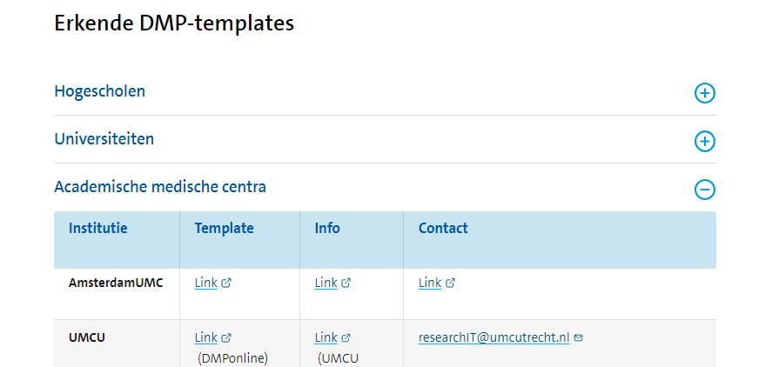


Select a DMP template
Options:
DMP template of your research institute,
provided it is acknowledged by ZonMw
(procedure, DS support, key items)
DMP template of ZonMw on DMPonline
DS-wizard

Slide 143

Discussion:
What kind of funder’s requirements do you know of? Or have you experienced?
‘Regular’ research data management? (we will later talk about FAIR data)
What services do you need?
Are they available for your RDM? What kind of opportunities or obstacles do you experience?
Please write in your portfolio your most important observations.
List the issues that you want to find out more about.
Notes:
Eindvraag
Who are your collaborators? What opportunities do you see for FAIRification within your node

Slide 144

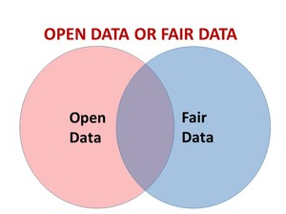
FAIR is not the same as Open.
“as open as possible, as closed as necessary¹”
¹Council of the European Union, 2016

Slide 145



FAIR principles are a guide towards reusable data
Technical infrastructure (generic operations)
Data/metadata (domain-specific content)
FAIR data: Background | ZonMw
Technical infrastructure (generic operations)
Data/metadata (domain-specific content)
FAIR data can be found, understood, and reused by humans and by machines (computers) (Fully-AI-Ready)
FAIRification is for 90% about metadata that tell us where to find, what they are about and how to use them
FAIRification is about community specific choices
Researchers are ‘domain experts’
A domain agrees about the terms (controlled vocabularies) to describe projects; about variables within datasets;
FAIR data experts (e.g. trained datastewards) build the metadata schemes (metadata-for-machines, M4M)
FAIR is not all or nothing
>> FAIRification is a process
>> Levels of FAIRness
Notes:
Looking at the table with the 15 FAIR guiding principles, the following aspects are notable:
Metadata: “ FAIR is 90% metadata”. This expert opinion points at the crucial role of metadata (i.e. the data about data, or other assets). Metadata after all, contain persistent identifiers, information on how data were generated, procedures to get access (or not), etc.
Machine actionable: the machine (or computer) can read, understand, and actually use the data, metadata, persistent identifiers, etc. The three-point FAIRification Framework involves the tools to accomplish this.
Generic vs. domain-specific: the FAIR principles guide to technical, generic operations (these are in principle the same for each research domain), and to domain-relevant aspects. Both are needed for FAIRification. For the domain-relevant aspects, a community (e.g. researchers in a specific research domain) agrees on certain standards, tools or infrastructures that are commonly used. Promoting the use of such community choices, improves the interoperability of data within that domain.
ZonMw promotes community choices: it stimulates grantees to choose, whenever this is possible, standards (etc) that are common within their research domain. By organising M4M-workshops for the COVID-19 research programme, ZonMw took the next step to develop machine readable metadata (M4M) schemes that include COVID-19 community choices

Slide 146



Steps in data FAIRification Hourglass model (GO FAIR)
3-Point FAIRification Framework 3-PFF
Researcher collects new data; RDM throughout data life cycle
Creation of (meta)data, and decisions on how to make them FAIR.
Typical resources for data FAIRification:
FIP – FAIR Implementation Profile
M4M – Metadata-for-Machines
FDP - FAIR data point
Controlled vocabularies
GUPRI’s (persistent identifiers)
FAIRification
Storage of machine-actionable (meta)data on the internet (FDP)
Data are FAIR! reusable for humans and machines (computer)
Find, access
and re-use
of (meta)data (engines/ indexing/
analytics).
FAIRification
FAIR Orchestration
Researcher finds existing data;
FAIR assessment > Data improvement
> Data re-use

Slide 147





Collaboration!
Researchers, Domain experts

Slide 148

COVID-19 related data initiatives - Portal

Slide 149





Workbench
Metadata schema > template > form to be “filled in”
The “questions”
Metadata Center
Controlled vocabularies
Drop-downs and autocomplete
The “answers”
NCBO BioPortal (bioontology.org)

Slide 150







COVID-19 Program aims to make data FAIR
https://www.gofairfoundation.org/m4m /
Dataset
Data goes to a data repository
Applies for funding
Awards funding
Publish article
Researcher
ZonMw
Research performed

Slide 151

FIP overview

Slide 152


Extending the approach for FAIRification to other domains
M4M:
Other funders plan to use M4M Project Admin
M4M:
Other research domains plan to develop specific M4M Project Content:
COVID, ID &AMR,
Pandemic Preparedness
Dementia
ME/CFS
Collaboration – workflow - services:
Other ‘FAIR supporting resosurces’:
Services & tools > catalogue @Health-RI
FIP
Controlled vocabularies
COVID-19 Data portal > health data portal

Slide 153
Discussion
1. Funders evolve from RDM requirements for single projects towards organising research communities, and domain specific FAIR implementations
  What examples do you know about?
  What is your opinion on this role?
  What do you expect from a funder?
2. Collaboration for FAIRification
  What opportunities for collaboration do you know? Are / Were they fruitful?
  Who are / were collaborating?
  What opportunities do you see for FAIRification within your Node
Reflect on how funder requirements to FAIR data may affect your Node DM strategy and identify potential implications
Reminder: Please build your Node’s DM portfolio in the shared notes document, as they are for your use
Formulate your own lessons learned
Formulate your take home messages & next steps

Slide 154
Extra slides:

Slide 155
Types of information – access – reuse
Type | Information | Access - Reuse
General | I (dr. Smith) do research with funding X: Do people with many UTI’s have a higher change of Alzheimers? | Everyone
Article | Written report (publication) on the research question. | Everyone if Open Access
Metadata | Information about the context of the sources, the project, information about the data, the conditions of how it was collected, and the conditions for (re)use. Name Age Tau (i) Fr UTI. (#/y) | Everyone (no sensitive information)
Data | J. de Boer 60 40 3 A. Vlecht 51 20 6 L. Smid 62 24 0 | Depending on conditions (access control)
Notes:
UTI Urinary tract infections and dementia | Alzheimer's Society (alzheimers.org.uk)

Slide 156
How do you set steps to FAIRify data?
Fully FAIR
(online: machine & human readable)
FAIR metadata
FAIR dataset
Project admin
FAIR variables
Project content
FAIR units
Dataset description
Data access
Examples:
Zonmw nr: 461000000
Onderwerp: Alzheimer
Methode: PET & CSF
Onderzoekers: Dr. Piet van UMC afd. VUmc
Beschikbaar: voor universiteits onderzoekers
Dataset:
  mensen van boven de 50, n = 40
  Aβ42 meting in CSF
  Distribution
Geslacht: man, vrouw of anders
Leeftijd: jaren
Aβ42: picogramen/milliliter
License

Slide 157
Break
(14-14.30 CEST / 15-15.30 EEST)

Slide 158
Data stewardship roles and competences
(14.30-15.30 CEST / 15.30-16.30 EEST)
CvG

Slide 159

Data stewardship roles and competences
CvG
Topic: Data stewardship roles and competences
Description: Brief overview of roles and competences and stock taking by the Nodes
Learning outcome: Reflect on the roles and the competences you have & need in your current Node team to implement the Node DM strategy
Form: Landscape overview and reflection from a Node perspective
Assignment: Add lessons learned to your Node portfolio

Slide 160




Data-related roles
CvG
OECD report Building digital workforce capacity and skills for data-intensive science (2020)
Table from our NPOS report (page 20-21)
Notes:
The Organisation for Economic Co-operation and Development (OECD) is an international organisation that works to build better policies for better lives.
Our goal is to shape policies that foster prosperity, equality, opportunity and well-being for all.

Slide 161



Data stewardship
CvG
Data Stewardship is the responsible planning and executing of all actions on digital data before, during and after a research project, with the aim of optimizing the usability, reusability and reproducibility of the resulting data​
​
Data stewardship and data management skills are essential in research​
https://doi.org/10.5281/zenodo.4769514 ​
https://doi.org/10.1038/d41586-020-00505-7 ​

Slide 162



DM Tasks identified by ELIXIR NC
CvG
Spreadsheet Tasks Node coordinators
This inventory by the NC contributed to the formulation of the ELITMa DM Module

Slide 163

The Node Triangle - Many tasks and responsibilities
CvG
Organise node meetings
Support HoN agenda
Source
Embedding the Coordinators’ Triangle (TeC-TrC-NC) in the operations of ELIXIR Nodes (AHM2021 Symposium)
Node Triangle Status & Challenges May 2021
Hiring
Node Oversight
Impact
Diversity
Human Resources
HoN agenda
Project Finance
Project Management
GDPR
Node Budgets
(Annual) Reporting
(HoN) Deadlines
News(letters)
Community organisation
Social media
National Priorities
Participate in communities/focus groups new to the node
PR materials
(National) Website
Project Acquisition
Node continuity
Service Delivery Plan
Hub Payments
Run Scientific Advisory C/B
Node Collaboration aggr.
Training Events
Technical reporting
Training Materials
Programme TC participation
Managing data/gdrive
Training Strategy
Technical strategy
Capacity Building
Technical infrastructure
TrCG participation
System management
TeCG participation
Spreadsheet Tasks Node coordinators

Slide 164



Data stewardship roles and competences - the landscape
CvG
ELIXIR/NPOS data stewardship competency framework
Data Steward Policy - institute and policy focused
Data Steward Research - project and research focused
Data Steward Infrastructure - data and e-infrastructure focussed
Responsibilities, Activities, KSAs (knowledge, skills & abilities),
Learning Objectives
https://competency.ebi.ac.uk/framework/datasteward/1.0
Professionalising data stewardship in the Netherlands. Competences, training and education. Dutch roadmap towards national implementation of FAIR data stewardship https://doi.org/10.5281/zenodo.4320504;

Slide 165
8 Competence Areas
https://competency.ebi.ac.uk/framework/datasteward/1.0 https://doi.org/10.5281/zenodo.3471707
CvG
Policy and Strategy:
Development, implementation and monitoring of the research data management policy and strategy of the institute
Compliance:
Compliance with relevant codes of conduct, legislation and field specific standards
FAIR data:
Alignment to the FAIR data principles and the principles of Open Science
Services:
Availability of adequate support on research data management, in staff or services
Infrastructure:
Availability of adequate infrastructure for research data management
Knowledge management:
Adequate level of knowledge and skills on research data management in the institute
Network:
Obtaining and maintaining a network of aligned expertise areas and relevant organisations by the institute
Data archiving:
Adequate support and infrastructure for FAIR and long-term archiving of the data of the institute
Your task for your Node Portfolio:
Analyse the competences of your current (and future) Node team,
based on the identified competence areas for data stewardship
(see Portfolio template)

Slide 166

Roles and competences - the landscape, cntd
CvG
Check out other competency profiles in the Competency hub for inspiration too! https://competency.ebi.ac.uk/

Slide 167


Roles and competences - the landscape, cntd
CvG
Netherlands eScience Center has released its role description and job profiles for Research Software Engineers (RSEs)!
Role description: 10.5281/zenodo.7994285
Job profiles: 10.5281/zenodo.7805869

Slide 168



EOSC Actors
CvG
Description of 10 roles within the EOSC ecosystem, one situational example for each role and a list of required skills
EOSC Working Group Report Digital skills ofr FAIR and open science https://op.europa.eu/en/publication-detail/-/publication/af7f7807-6ce1-11eb-aeb5-01aa75ed71a1/language-en/format-PDF/source-190694287%20%20.

Slide 169

The European Joint Programme on Rare Diseases (EJPRD) FAIRification steward
MJ
FAIRification steward: tasked to work with the other two parties to help manage FAIRification process of ERN registry towards a converged, EJPRD Virtual Platform (VP) compliant implementation of the ERN registries that the steward is assigned to
Registry software provider: tasked with implementing/configuring the software for the registry
ERN registry steward: tasked with one or more aspects of data or project management within the Registry project
EJPRD FAIRification website
ERN = European Reference Networks

Slide 170

Learning Paths for data steward (1)
MJ
BioHackathon 2022 project

Slide 171

Learning Paths for data steward (2)
MJ
BioHackathon 2022 project

Slide 172

Roles and competences - your reflections
CvG
Analyse the competences of your current (and future)
Node team, based on the identified competence areas
for data stewardship
  Fill the section in your Node Portfolio
Identify a challenge in/for your Node in relation to
roles and competences
  For plenary discussion and to take further tomorrow

Slide 173
Learn from & Share with
(15.30-16 CEST / 16.30-17 EEST)
MJ

Slide 174
Wrap up
3 minutes per Node, for example on:
  Identified challenge in/for your Node in relation to roles and competences
  Take-home messages for the day, eye openers, plans for the next steps for your Node DM strategy
  Parking Lot topics
Please help make notes

Slide 175

Tomorrow
Maturity/services model, Node strategy and the ideal Node team
With Ivan and Niclas
Presentation: current Node services maturity model
Template discussion: what should be in a model?
Node examples (vision, mission & Node team)
Breakout discussions: positioning your Node regarding selected topics from the model + ideal Node team
Discuss next steps for your Node’s strategy on data management services
Role of the newly established RDM Community and its network
Maturity model: a framework for measuring an organization's maturity
Measuring what? RDM services, activities, readiness, preparedness, awareness
Which organizations? Research institutions and national or Node level

Slide 176
Day 3/29 June
Module 2 - RDM strategy
Maturity/services model, Node strategy and the ideal Node team

Slide 177
Planning [updated version]
MJ
Maturity/services model, Node strategy and the ideal Node team
With Ivan and Niclas
Part 1: 9-10:30 CEST / 10-11:30 EEST
  Example ELIXIR-SE: what is a Node strategy for DM [10 min]
  Reflection: has anyone else done a similar exercise yet? [15 min]
  Node services maturity model [5 min]
  Template discussion: what should be in a model? [15 min]
  Breakout discussions: positioning your Node regarding selected topics from the model [40 min]
  Example ELIXIR-EE: ideal Node team to cater for a Node DM strategy [5 min]
Break: 10:30-11 CEST / 11:30-12 EEST
Part 2: 11-12 CEST / 12-13 EEST
  Discuss next steps for your Node’s strategy on data management services [20 min]
  Where does this effort sit? Role of the newly established RDM Community and its network [20 min]
  Where do the Parking Lot items sit? Any Other Business? [20 min]

Slide 178
Example ELIXIR-SE / what is a node strategy for DM
NJ
DM team of eight
  “Data manager” and seven Data Stewards
Not yet a full-fledged strategy
Vision & Mission statements as a starting point

Slide 179

ELIXIR-SE What’s our vision?
NJ
The desired future position
“Swedish Life Science researchers apply good Data Management practices so that the research outputs produced are available to the global research community, and to society at large, according to the principles of Open Science, Reproducible Research, and FAIR”
Notes:
Credit: This image was created by Scriberia for The Turing Way community and is used under a CC-BY licence.

Slide 180
What’s our mission?
NJ
The overall objectives
Support
Swedish Life Science researchers shall have access to Data Management support to be able to manage their research data according to international best practice
Training
Swedish Life Science researchers shall have access to training in efficient Data Management practices that can be applied in their daily work
Collaboration
Data Management practices, solutions and training for Swedish Life Science shall be established in collaboration with NBIS internally, and relevant national and international stakeholders

Slide 181
Support
NJ
The overall objective
The approaches
Swedish Life Science researchers shall have access to Data Management support to be able to manage their research data according to international best practice
Develop procedures for providing efficient Data Management support to research projects throughout the research data lifecycle
Provide data management planning knowledge and resources/tools for research projects
Provide support and resources/tools for data submission to recommended community deposition databases
Provide support and resources/tools to enable reproducible research

Slide 182
Training
NJ
The overall objective
The approaches
Swedish Life Science researchers shall have access to training in efficient Data Management practices that can be applied in their daily work
Provide Data Management training for researchers
Provide guidelines and documentation for Data Management best practises
Promote awareness of the importance of Open Science, Reproducible Research, and FAIR in the Swedish Life Science community
NBIS DM Team Training Strategy 2023 -- 2026

Slide 183

DM training strategy
NJ
Target audience
  Roles & Skill levels
Topics
Delivery formats
Roadmap 2023-26
Work Plan 2023

Slide 184
Collaboration
NJ
The overall objective
The approaches
Data Management practices, solutions and training for Swedish Life Science shall be established in collaboration with NBIS internally, and relevant national and international stakeholders
Collaborate with NBIS staff to develop Data Management aspects of support procedures and policies
Contribute to Data Management activities and capacity building within ELIXIR
Collaborate with SciLifeLab Data Centre to develop Data Management policies, procedures and solutions to support researchers
Interact with other national and international stakeholders to harmonise Data Management policies, procedures and solutions to support researchers

Slide 185
RDM Services strategy
NJ
Scope of your target audience? Who do we serve?
What is your mandate? Expectations from, and dependencies of, external funders/infrastructures/organizations?
What are the needs of your target audience?
What services do you want provide to fulfill those needs, given your staffing ? Which services to you want to prioritise? Are some needs solved by other infrastructures / organizations?
What’s your funding model(s)?
Roadmap for developing RDM services over time
RDM Services maturity model as a tool for strategy planning

Slide 186
Plenary reflection
MJ
Has anyone done a similar exercise for their Node?
Would you be able to do so for your Node based on the example of SE?
How to share our experiences, challenges, solutions when drafting a Node DM strategy?

Slide 187
Node services maturity model
IM
Maturity model: a framework for measuring an organization's maturity
Measuring what? RDM services, activities, readiness, preparedness, awareness
Which organizations? Research institutions and national or Node level
Strategy and sustainability | Data and metadata management
Legal | Support

Slide 188
Strategy and sustainability
Organisational DM strategy
cost recovery model
short-to-mid term funding
long-term sustainability
Data and metadata management
Data organisation
  standards, versioning, licensing
  file types, folder structure, naming conventions
Metadata standards (& harmonisation)
  identifiers, provenance, ontologies and CVs
  software tools (ELNs, LIMS, EDC systems…)
Data ingestion
Data storage
Data archiving
Reproducible data analysis
  Best practices, SOP, Policies
Data sharing
  machine actionability, publication
  brokering
DMP (support in developing) (example: DSW)
Risk assessment
Security breach / incident response plan
IM
Legal
Data protection
GDPR assessment
Data Protection Impact Analysis
Policies for data management
Policies for sensitive data infrastructure
Support
Training
Capacity building
Expert network
Communications
Onboarding and guides for DM personas
Guidelines for researchers (example: RDMkit)
DM support infrastructure

Slide 189
Template discussion
MJ
Are the proposed aspects relevant and useful?
If gaps, what should we further add?

Slide 190

Breakout discussions: Node positioning
MJ
Breakout session per 2 Nodes
Discuss the orange aspects from the model
Use the table in the Portfolio template to answer the following questions:
  How do you cater for the aspects of strategy and policies in your Node?
  On training, guidelines, metadata standards, data storage, data sharing and DMP:
    Are you offering services? Explain
    If not yet, do you plan to? Explain
    If out of scope, explain

Slide 191
Break
(10.30-11 CEST / 11.30-12 EEST)

Slide 192


Slide 193


Slide 194


Slide 196


Slide 197


Slide 198


Slide 199


Slide 200


Slide 201
Discussing next steps
MJ
What would you need to start/continue working with the model from your Node’s perspective to build your Node strategy for DM services?

Slide 202
RDM Community and wrap up
MJ
Where does this effort sit? Role of the newly established RDM Community and its network
Where do the Parking Lot items sit?
Any Other Business?

Slide 203




RDM Community: Co-leads
MJ
Munazah Andrabi
ELIXIR-UK
Flora D’Anna
ELIXIR-BE
Mijke Jetten
ELIXIR-NL
Niclas Jareborg
ELIXIR-SE

Slide 204


An ELIXIR RDM Community
MJ
Members identity
  Life science RDM professionals in ELIXIR and beyond.
  Inclusive to anyone that has a professional interest in RDM for the life sciences.
Scope of the Community
  The network of RDM professionals
    RDM knowledge exchange and capacity building
  Management of RDM knowledge
    Coordination of content management and editorial functions for
    “The RDM Knowledge Ecosystem” - RDMkit, FAIR Cookbook, DSW
  Management of RDM training resources and expertise
    The network of RDM Trainers, RDM learning paths and training resources
  External stakeholders
    Coordinate the interactions with external infrastructures, organizations and communities active in RDM

Slide 205
Out of scope for RDM Community
MJ
Technical service provisioning
  RDMkit
  Data Stewardship Wizard
  FAIR cookbook
RDM helpdesk support for researchers and consortia
  DMP writing / reviewing
  Data depositions support (consultations / hands-on)
Delivering training programmes
Curation of data deposited in data resources

Slide 206
MJ
National stakeholders
Services &
Resources
Nodes
RDM Community
Communities

Slide 207
Objectives of the RDM Community- Short term (~2 years) - I
MJ
Area | Objective
People network | Provide a forum that enables regular inter-personal knowledge exchange between life science RDM professionals.
 | Facilitate ELIXIR Node capacity building in deploying RDM services, e.g. by establishing a knowledge handbook for RDM service providers, and developing an RDM services maturity model for ELIXIR Nodes.
RDM knowledge | Coordinate and contribute to the RDM ecosystem content by collaborating with the editorial boards of RDMkit and FAIR Cookbook, to ensure that the content is continuously fit for purpose.
 | Collect requirements that would facilitate flow of FAIR data from researchers to repositories (such as the ELIXIR Deposition Databases) via RDM services, in order to improve the FAIRness of research data made available for life science and society at large.

Slide 208
Objectives of the RDM Community - Short term (~2 years) - II
MJ
Area | Objective
RDM training | Provide a forum that enables knowledge and teaching best practices exchanges among RDM trainers.
 | Ensure that RDM training materials are being developed and FAIRified, enabling reuse and adoption by the ELIXIR Nodes.
 | Develop RDM learning paths for researchers, data stewards, tool developers and trainers.
External stakeholders | Create and maintain an overview of external stakeholder engagements with RDM aspects across ELIXIR Platforms, Communities, Focus Groups and projects.

Slide 209
RDM Community: Next steps
MJ
Implementation study
  January 2024 – December 2025
  Draft project plan
    Organisational Framework
    Knowledge management and dissemination
    Capacity building
F2F meeting during the fall
Join the Community!
  #community_rdm slack channel
  rdm@elixir-europe.org mailing list (sign-up link)
  Web page to follow

Slide 210
RDM Community
MJ
Where does this DM strategy effort sit?
  Explicit part of the RDM Community short term goals and Implementation Study.
  People network: Facilitate ELIXIR Node capacity building in deploying RDM services, e.g. by establishing a knowledge handbook for RDM service providers, and developing an RDM services maturity model for ELIXIR Nodes.
  We will use input today as guidance for RDM Community to further develop the model aspects (template, descriptions etc.)
  Next steps: from January 2024 onwards formally via the RDM Community Implementation Study
  Don’t wait, as you are the RDM Community and it is already active: exchange with your peers (NC, DM) for your Node’s DM portfolio next steps
  Any need for reminders/follow-up activities, to coordinate your DM portfolio next steps?
Where do the Parking Lot items sit?
  Work that needs to be done anyway by your Nodes, so use the RDM Community to work together/prevent siloes
Any Other Business?

Slide 211

Topics missing
Are there important topics missing?
DM Community building (EE, UK, LU, CH, EE, CZ)
  Create engagement
  Share experiences
  Role of emerging RDM community (o.a. financial model, relation to Platforms)
Policies related to the data management strategies and best practices in different nodes (FI)
Formal education & to hear from other nodes if there is stories to share to establish formal programs on RDM (NO)
Monitoring routines for RDM (NO)
Best practice and emerging patterns in core tool deployments (LU)
DSW deployments and KM customisations in nodes (LU)
RDMkit instances, plans, if any, for further instances (LU)
Guidance documents for our application purposes (DE)
Show-and-tell sessions to exchange experiences (DE)
DMP and FAIRification as tightly bound issues (CZ)
Formal DS curriculum (ECTS awarded with a certificate or degree) (NO, CZ)
  Role and position Node data manager
  Training for Node data manager

Slide 212
Best practices
What are the current best practices in your Node on the topics above, to bring into the course to inspire others and share experiences?
Training & webinars around useful resources/knowledge dissemination via communities and ambassadors (UK, FI, BE, IT, NO, CH, EE, CZ)
  Self-study online course on RDM basics + National guidelines incl. declarations, policies and recommendations (FI)
  Fellowship (UK)
  Interactions with various stakeholders, incl. work regarding financial sustainability (NO)
  Taining course in collaboration with Portugal (CY)
Preparation to DMP via training (CH)
  National resources on RDMkit (CH, EE, CZ)
  DMPs (DE)
  DM at institutional level/as part of ELIXIR-CZ consortium (CZ)
  DS training (NL)
(Inter)national collaboration:
  We have a lot of national collaboration on RDM issues under national open science coordination (FI)
  We collaborate with the Flemish Research Data Network (BE)
  Currently Italy does not have a national program on data management although several local initiatives are building up (IT)
  Formal project with data producing RIs on RDM (NO)
  Currently, the national program on data management is being implemented (CY)
  DMPs training in national spring/summer schools + international bioinformatics conferences such as ECCB and GCB (DE)
  Training courses (ELIXIR-CZ consortium partners level so far) (CZ)
  Collaboration with funders (NL)
  Very well organisational structures (local and thematic DCCs; LCRDM; DSIG) (NL)
Tools:
  End2end solution for the stewardship of sensitive data (LU)
  DSW implementation (SE)
DM services strategy of the Node (SE)

Slide 213

Thanks a lot for your active participation & safe travels home

Slide 214
Showcase template
This is a template, make a copy and do not change the original. For questions contact Mijke
Pointers for your presentation (max 20 min + 10 min questions)
Idea: explain/present briefly to the group examples of FAIR requirements by ZonMw as funder (e.g., Covid & Dementia data) to showcase what services are needed to help researchers meet those requirements.
Context of the course, for ELIXIR Node Coordinators & Data Managers: “This module aims to guide Node Coordinators in strengthening data management in their Node. Its focus are best practices from the ELIXIR portfolio of data management tools and services. After this module, trainees should be able to navigate the ELIXIR data management portfolio and plan for consolidation of the relevant tools and services in their Nodes, aimed at strengthening data management life science research for and by the Nodes’ data stewards and researchers. The module aims to inspire Node Coordinators, providing them with new ideas to optimise (if applicable: create) their Nodes' DM strategy in the context of the ELIXIR Programme”
Goal: inspire Node representatives on rethinking their data management services from the perspective of a funder and the requirements they set to data/researchers/data stewards
Use visuals, e.g., a simple flowchart with decisions and checks
Questions to ask yourself
  How could this information help ELIXIR Node Coordinators and Data Managers setting up their services?
  What maturity level to expect from ELIXIR Nodes (some are - far - more mature (services, people, strategy) than other in data management services)
  How do you implement FAIR services in NL?
  What works well?
  What are the challenges?
  End with some takeaways for the discussion & assignment (they need to add their lessons learned to the portfolio during the course - see next slide)
Feel free to tweak the questions to your needs/story
Use as many slides as you like but keep to the indicated time

Slide 215
Pitch template
This is a template, make a copy and do not change the original. For questions contact Mijke
Service [Node/Presenter]
Pointers for your presentation (max 10 min)
Idea: explain/present briefly to the group the service and your experiences in getting this up and running in your Node
Goal: inspire other Node representatives on setting up a similar service as part of data management services in their (future) Service Delivery Plan
Use visuals, e.g., a simple flowchart with decisions and checks
Questions to ask yourself
  Why this service?
  How did you implement it?
  What works well?
  What are the challenges?
Feel free to tweak the questions to your needs/story
Use as many slides as you like but keep to the indicated time

