Slide 1


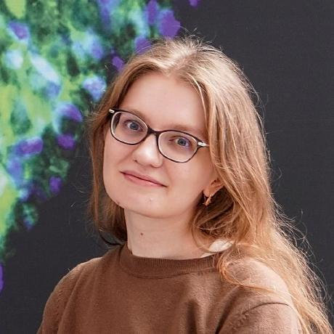






FLASH TALK on OPEN-SOURCE FLIM ANALYSIS SOFTWARE
GerBI FLIM Meeting München February 2024
napari-FLIM-phasor-plotter – a collaborative project
a plugin to generate interactive phasor plots from raw FLIM data
Marcelo Leomil Zoccoler
Postdoc in Bio-Image Analysis Development Group (Physics of Life, TU Dresden)
Cornelia Wetzker
Data steward (B CUBE/ CMCB, TU Dresden and NFDI4BIOIMAGE)
previously Light Microscopy Facility staff member (CMCB, TU Dresden)
© Magdalena Gonciarz
With materials from Marcelo Zoccoler
Svetlana Iarovenko
Student at CMCB TU Dresden, soon PhD student (IMP Vienna)
The content of these slides is shared under the terms of the Creative Commons Attribution License CC-BY 4.0 unless stated otherwise.
1

Slide 2
Scientists‘ needs and wishes for FLIM software
How can I chose a colorblind-friendly lookup table?
How can I access and export data at all steps of analysis?
How to apply downstream workflows?
Do I need licensed software to analyse FLIM data?
Are there open source software solutions?
Why is it so time-consuming?
GerBi FLIM workshop 2024 München – napari-flim-phasor-plugin Conni Wetzker
2

Slide 3


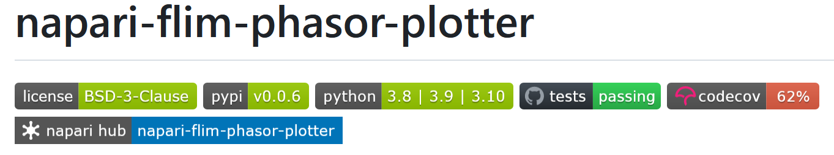
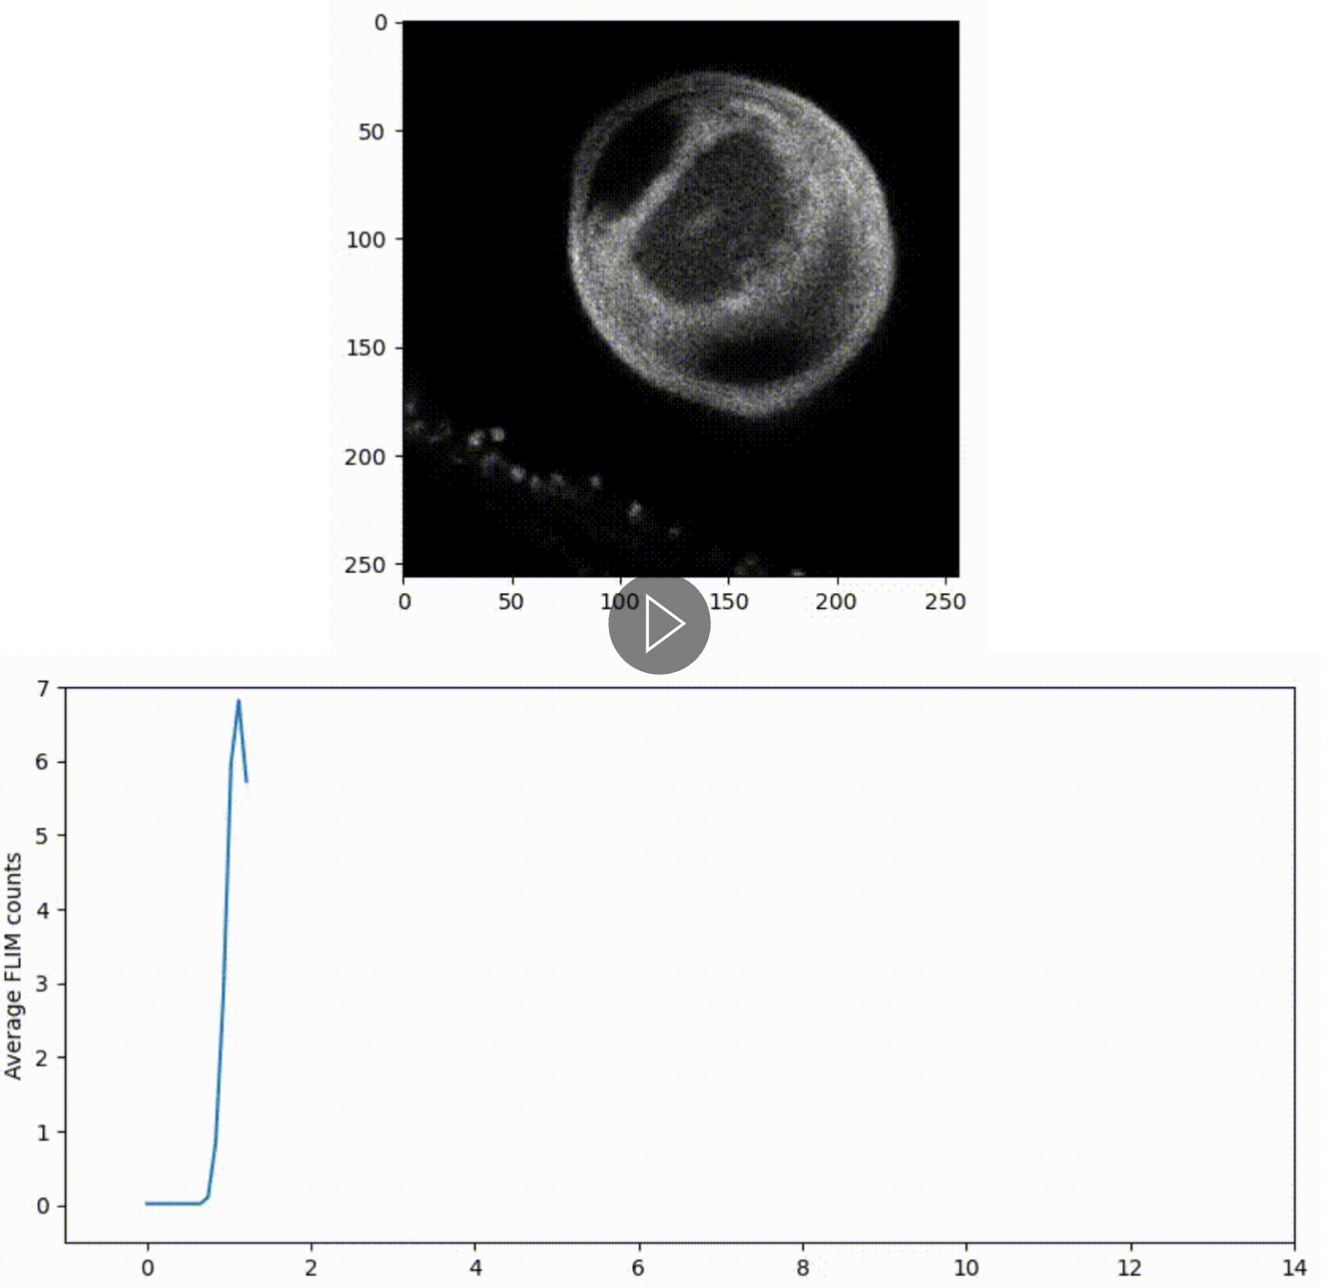

https://github.com/zoccoler/napari-flim-phasor-plotter
Napari-flim-phasor-plotter is a napari plugin to interactively load and show raw fluorescence lifetime imaging microscopy (FLIM) single images and series and generate phasor plots. These are Fourier transforms of the decay data being visualized using the napari-clusters-plotter plotter, adapted to suit the FLIM context. This allows qualitative and quantitative downstream analysis of FLIM images.
GerBi FLIM workshop 2024 München – napari-flim-phasor-plugin Conni Wetzker
Source: https://github.com/zoccoler/napari-flim-phasor-plotter
3

Slide 4
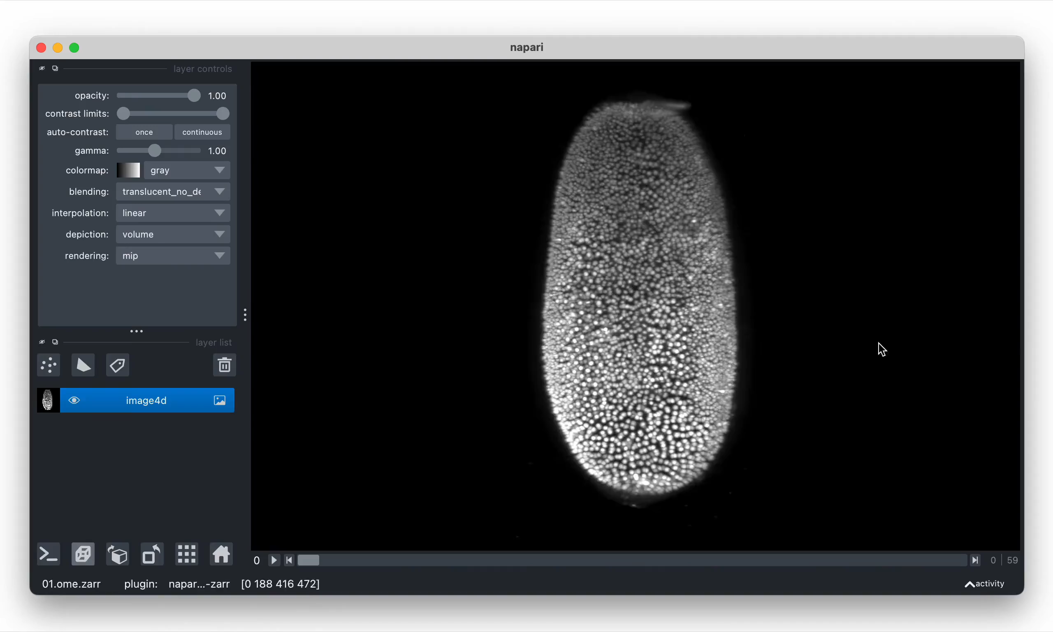
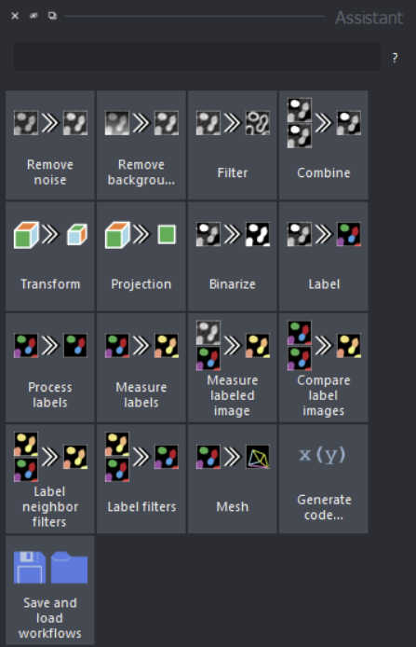

Napari: a fast, interactive viewer for multi-dimensional images in python
Napari assistant
Extendable by various plugins (widgets and user interfaces, readers and writers)
GerBi FLIM workshop 2024 München – napari-flim-phasor-plugin Conni Wetzker
4
Source: napari.org, https://www.napari-hub.org/plugins/napari-assistant, https://biapol.github.io/

Slide 5
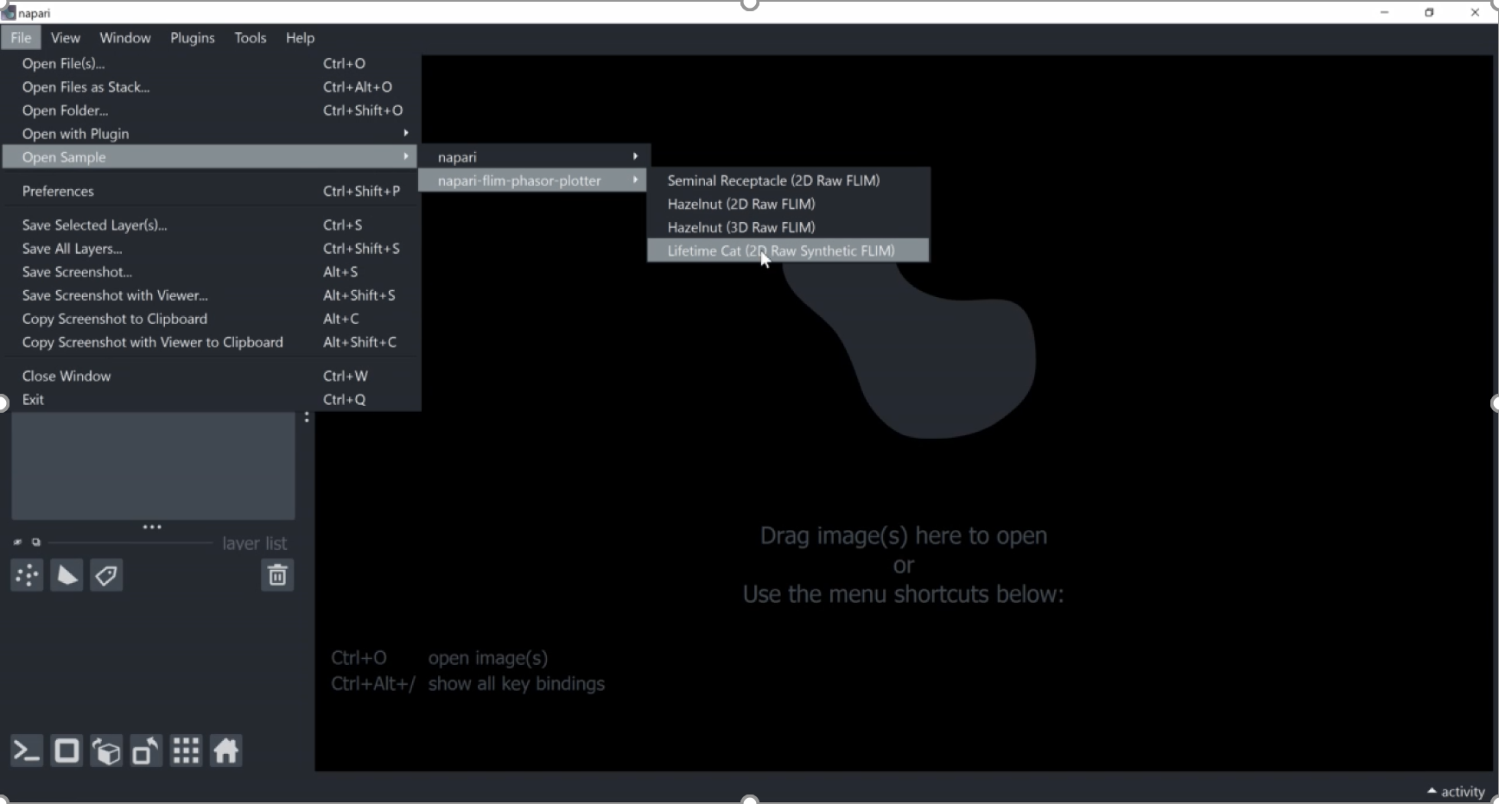
Usage of synthetic data – the lifetime cat example image
Svetlana Iarovenko
Open the sample dataset as part of the plugin
GerBi FLIM workshop 2024 München – napari-flim-phasor-plugin Conni Wetzker
5

Slide 6
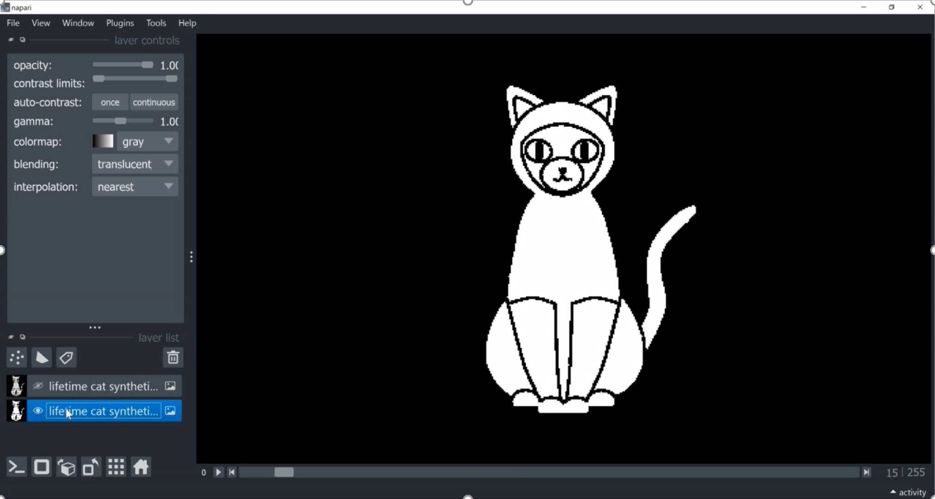
Usage of synthetic data – the lifetime cat example image
Svetlana Iarovenko
Select the image layer containing with lifetime information
GerBi FLIM workshop 2024 München – napari-flim-phasor-plugin Conni Wetzker
6

Slide 7
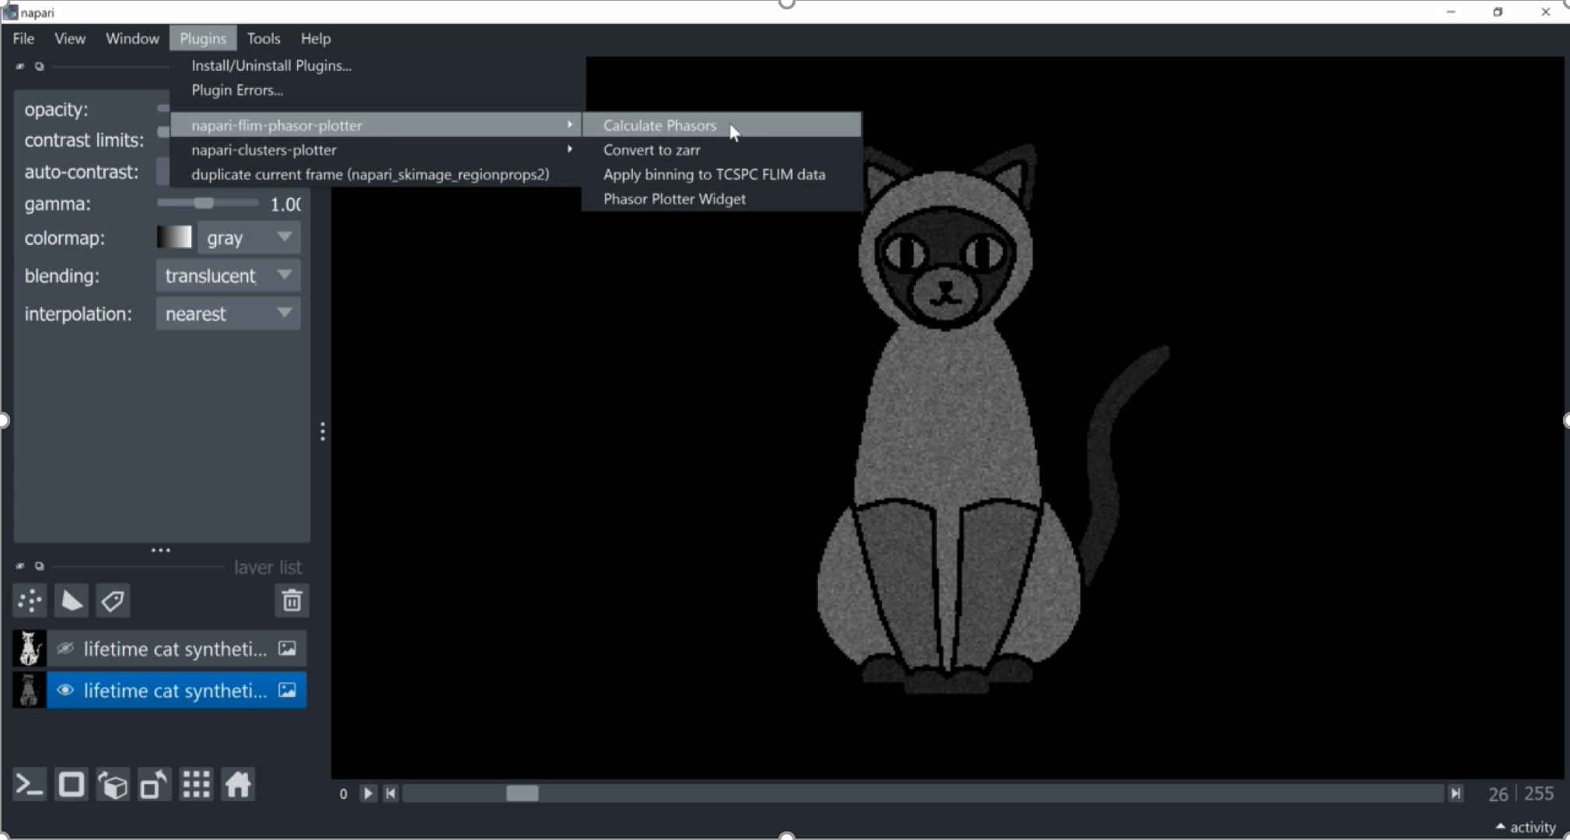
Usage of synthetic data – the lifetime cat example image
Select the calculation of the phasor plot in the plugin
Svetlana Iarovenko
GerBi FLIM workshop 2024 München – napari-flim-phasor-plugin Conni Wetzker
7

Slide 8
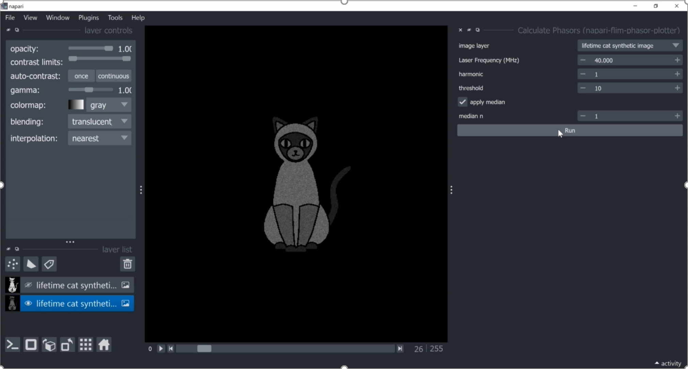
Usage of synthetic data – the lifetime cat example image
Svetlana Iarovenko
Define parameters for the calculation of the phasor
GerBi FLIM workshop 2024 München – napari-flim-phasor-plugin Conni Wetzker
8

Slide 9
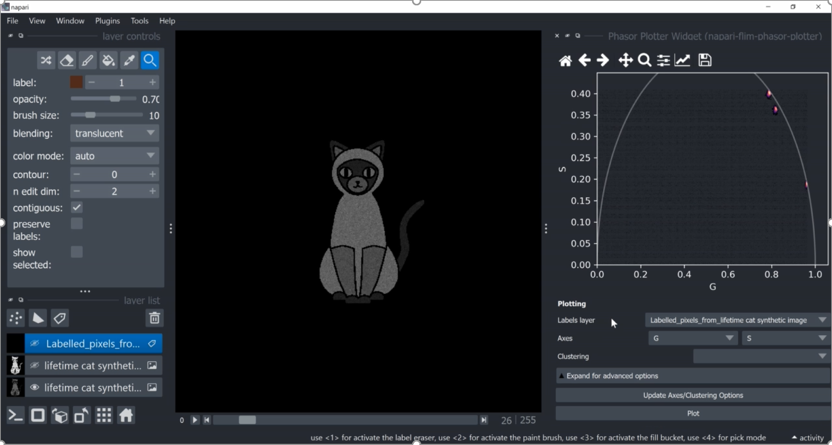
Usage of synthetic data – the lifetime cat example image
Svetlana Iarovenko
Adjust the visualization settings of the phasor
GerBi FLIM workshop 2024 München – napari-flim-phasor-plugin Conni Wetzker
9

Slide 10
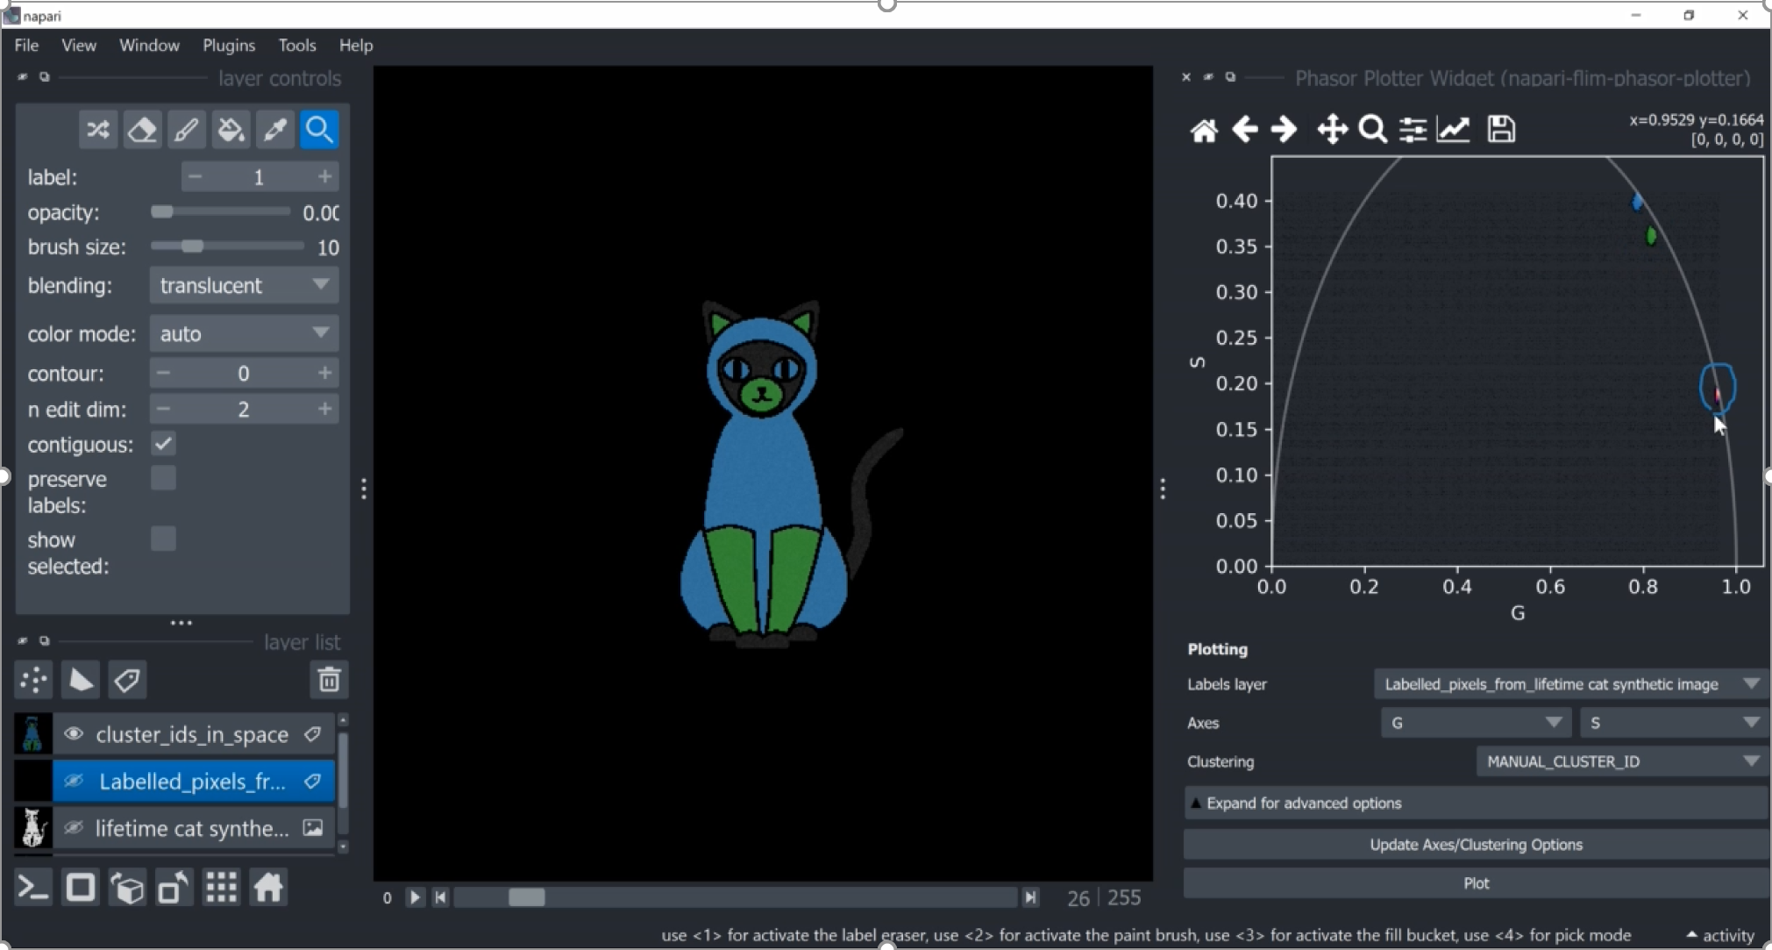
Usage of synthetic data – the lifetime cat example image
Svetlana Iarovenko
Select clusters, here manually by drawing ROIS in the phasor plot
GerBi FLIM workshop 2024 München – napari-flim-phasor-plugin Conni Wetzker
10

Slide 11
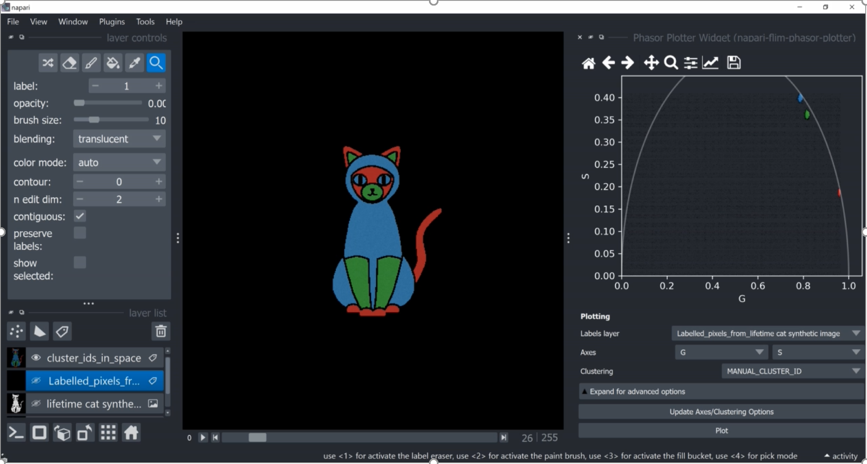
Usage of synthetic data – the lifetime cat example image
Svetlana Iarovenko
Pixels of selected phasor clusters are visualized in different colors in the image
GerBi FLIM workshop 2024 München – napari-flim-phasor-plugin Conni Wetzker
11

Slide 12
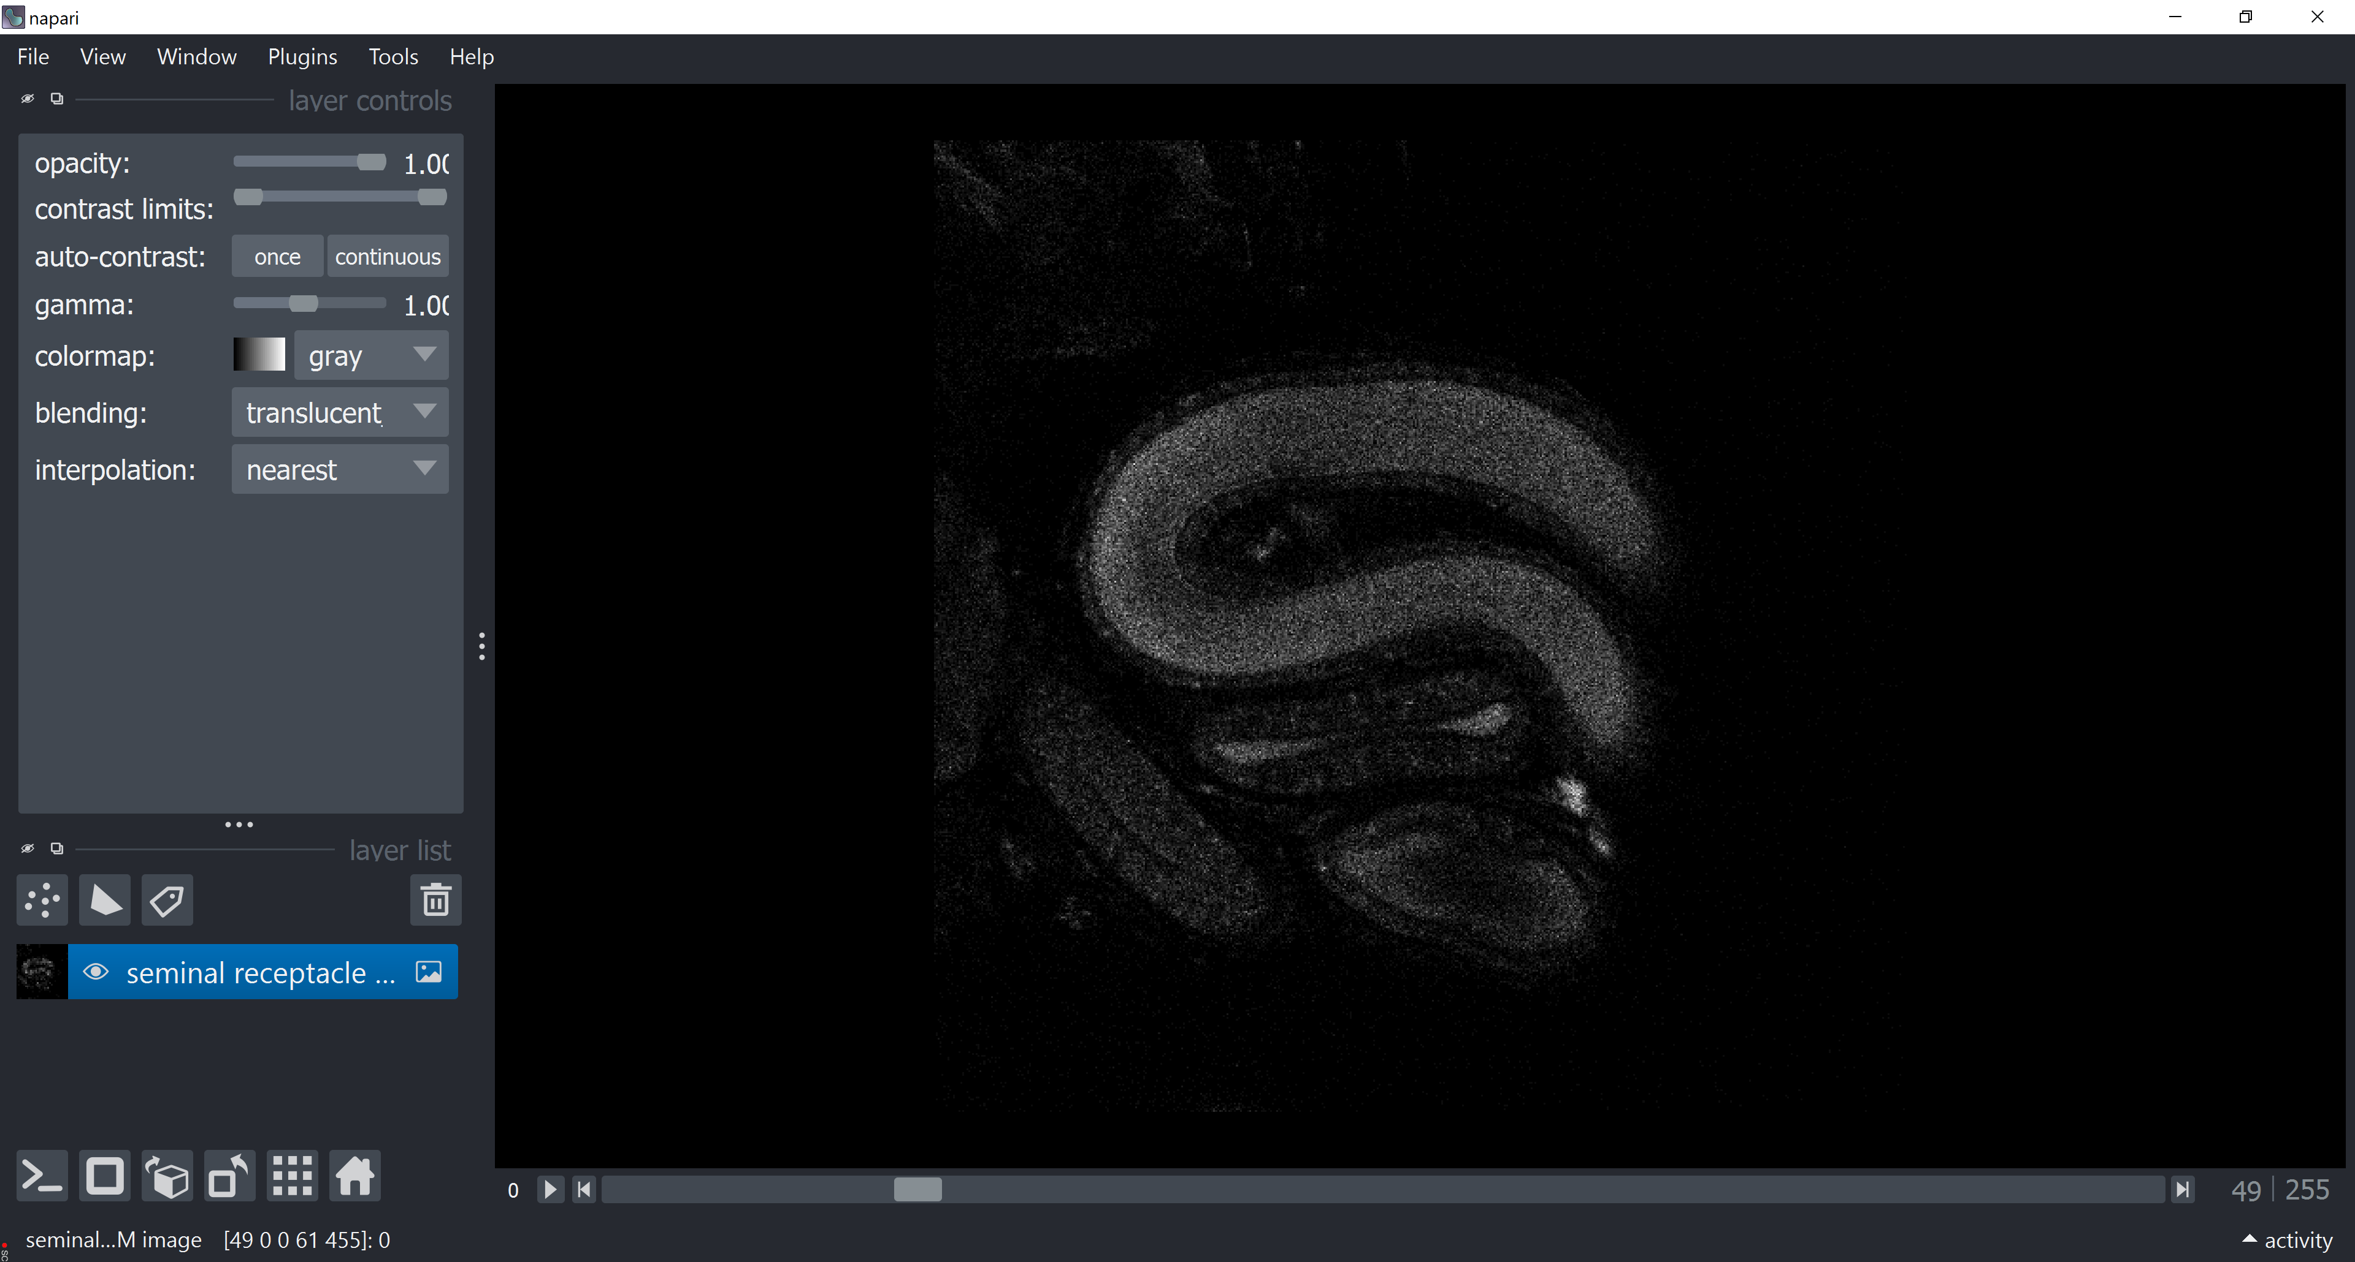
Integrating FLIM analysis into a bio-image analysis workflow
Metabolic FLIM of sperm in a female sperm-storage organ in Drosophila
Example workflow:
Open a raw FLIM image/ dataset
Open or drag&drop a raw FLIM image or series of images
GerBi FLIM workshop 2024 München – napari-flim-phasor-plugin Conni Wetzker
12

Slide 13
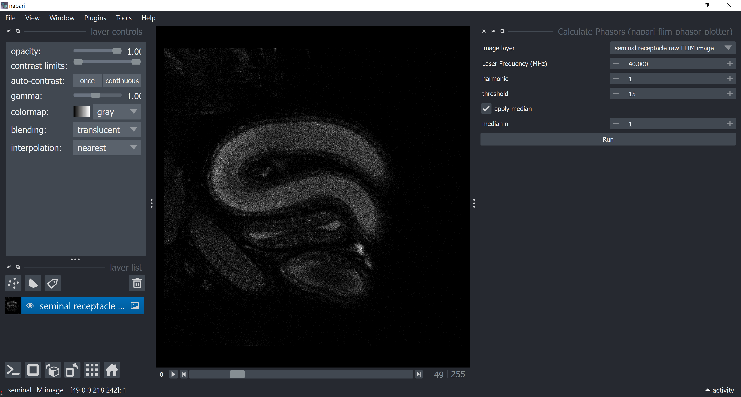
Integrating FLIM analysis into a bio-image analysis workflow
Metabolic FLIM of sperm in a female sperm-storage organ in Drosophila
Example workflow:
Open a raw FLIM image/ dataset
Generate a Phasor Plot
Define parameters such as a threshold and median to determine the g and s coordinates for the phasor plot by Fourier transformation
GerBi FLIM workshop 2024 München – napari-flim-phasor-plugin Conni Wetzker
13

Slide 14
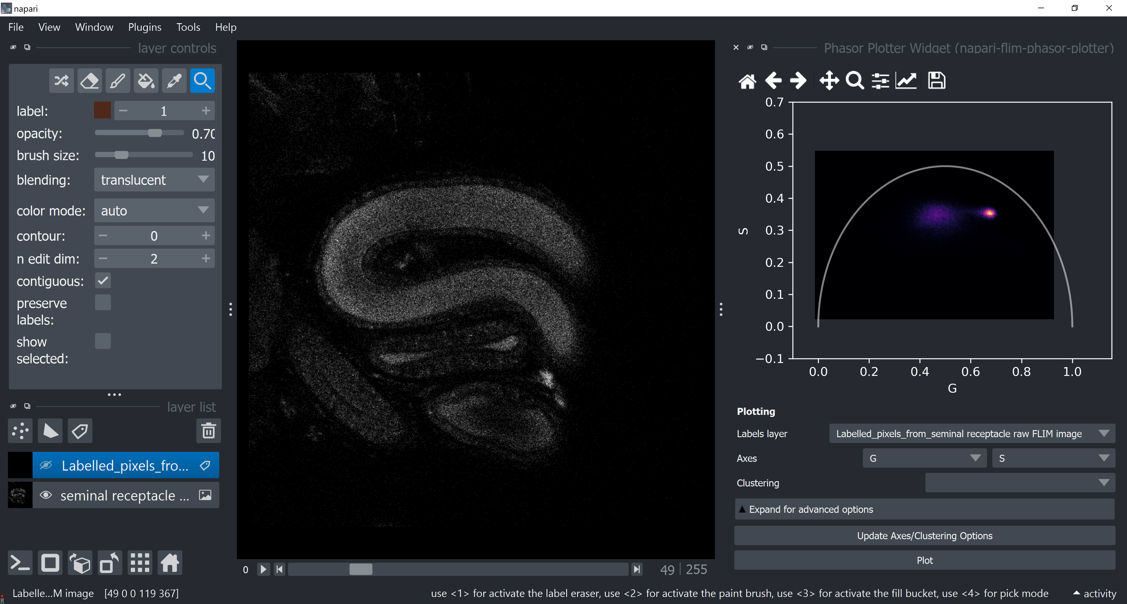
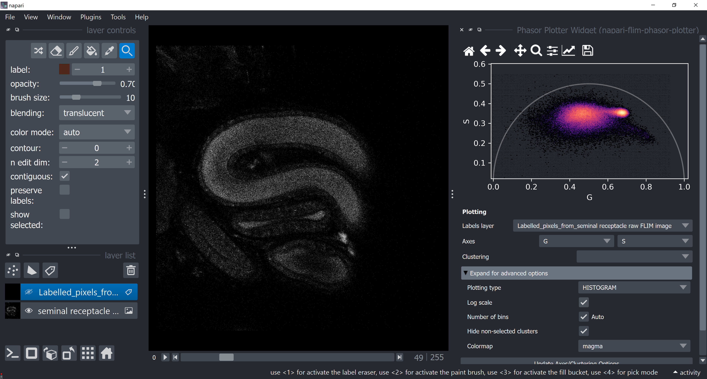
Integrating FLIM analysis into a bio-image analysis workflow
Metabolic FLIM of sperm in a female sperm-storage organ in Drosophila
Example workflow:
Open a raw FLIM image/ dataset
Generate a Phasor Plot
Change Phasor Plot display options
Adjust the settings for visualization
GerBi FLIM workshop 2024 München – napari-flim-phasor-plugin Conni Wetzker
14

Slide 15
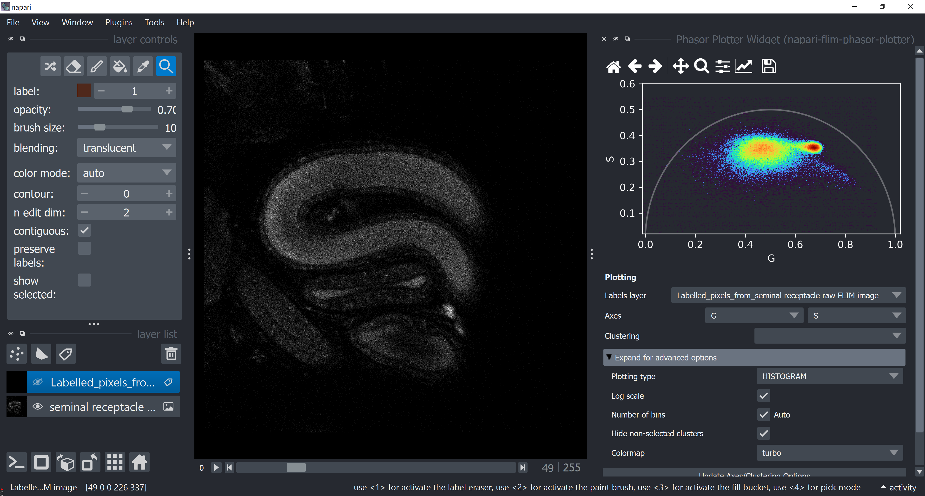
Integrating FLIM analysis into a bio-image analysis workflow
Metabolic FLIM of sperm in a female sperm-storage organ in Drosophila
Example workflow:
Open a raw FLIM image/ dataset
Generate a Phasor Plot
Change Phasor Plot display options
Change parameters of phasor plot visualization
GerBi FLIM workshop 2024 München – napari-flim-phasor-plugin Conni Wetzker
15

Slide 16
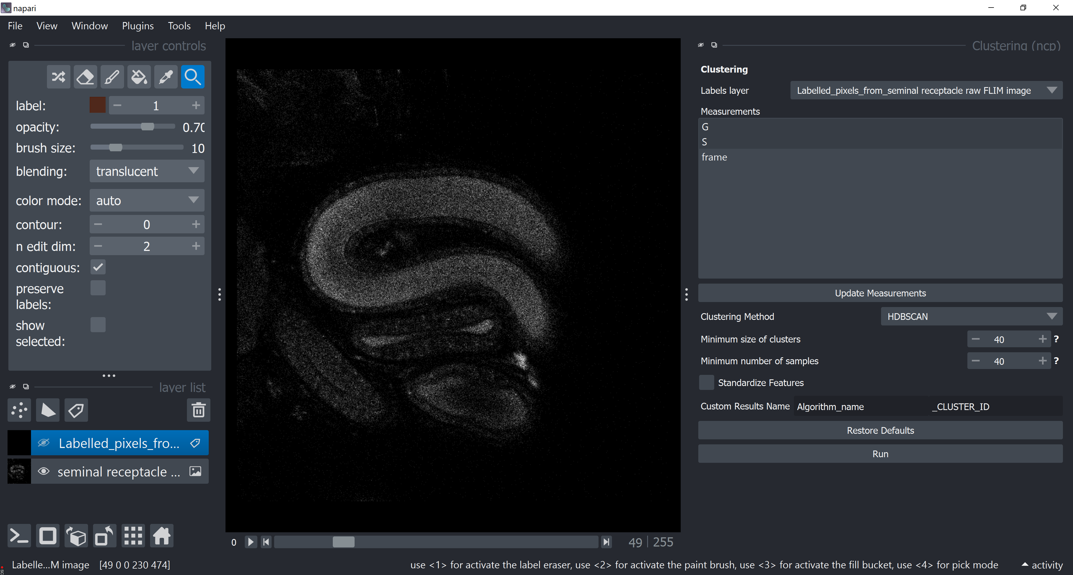
Integrating FLIM analysis into a bio-image analysis workflow
Metabolic FLIM of sperm in a female sperm-storage organ in Drosophila
Example workflow:
Open a raw FLIM image/ dataset
Generate a Phasor Plot
Change Phasor Plot display options
Select the parameters used for clustering
Select the clustering method
Identify and select reproducibly clusters in your dataset
GerBi FLIM workshop 2024 München – napari-flim-phasor-plugin Conni Wetzker
16

Slide 17
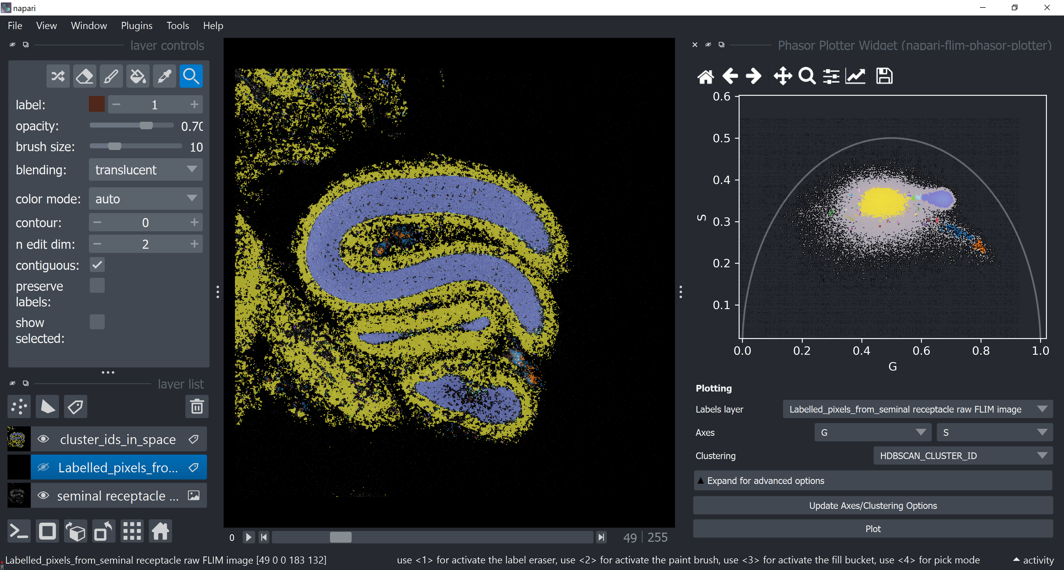
Integrating FLIM analysis into a bio-image analysis workflow
Metabolic FLIM of sperm in a female sperm-storage organ in Drosophila
Example workflow:
Open a raw FLIM image/ dataset
Identified clusters are visualized in the phasor plot and in the respective pixels of your image
Generate a Phasor Plot
Change Phasor Plot display options
Apply a clustering algorithm to the Phasor Plot (HDBSCAN) using the napari-clusters-plotter
GerBi FLIM workshop 2024 München – napari-flim-phasor-plugin Conni Wetzker
17

Slide 18
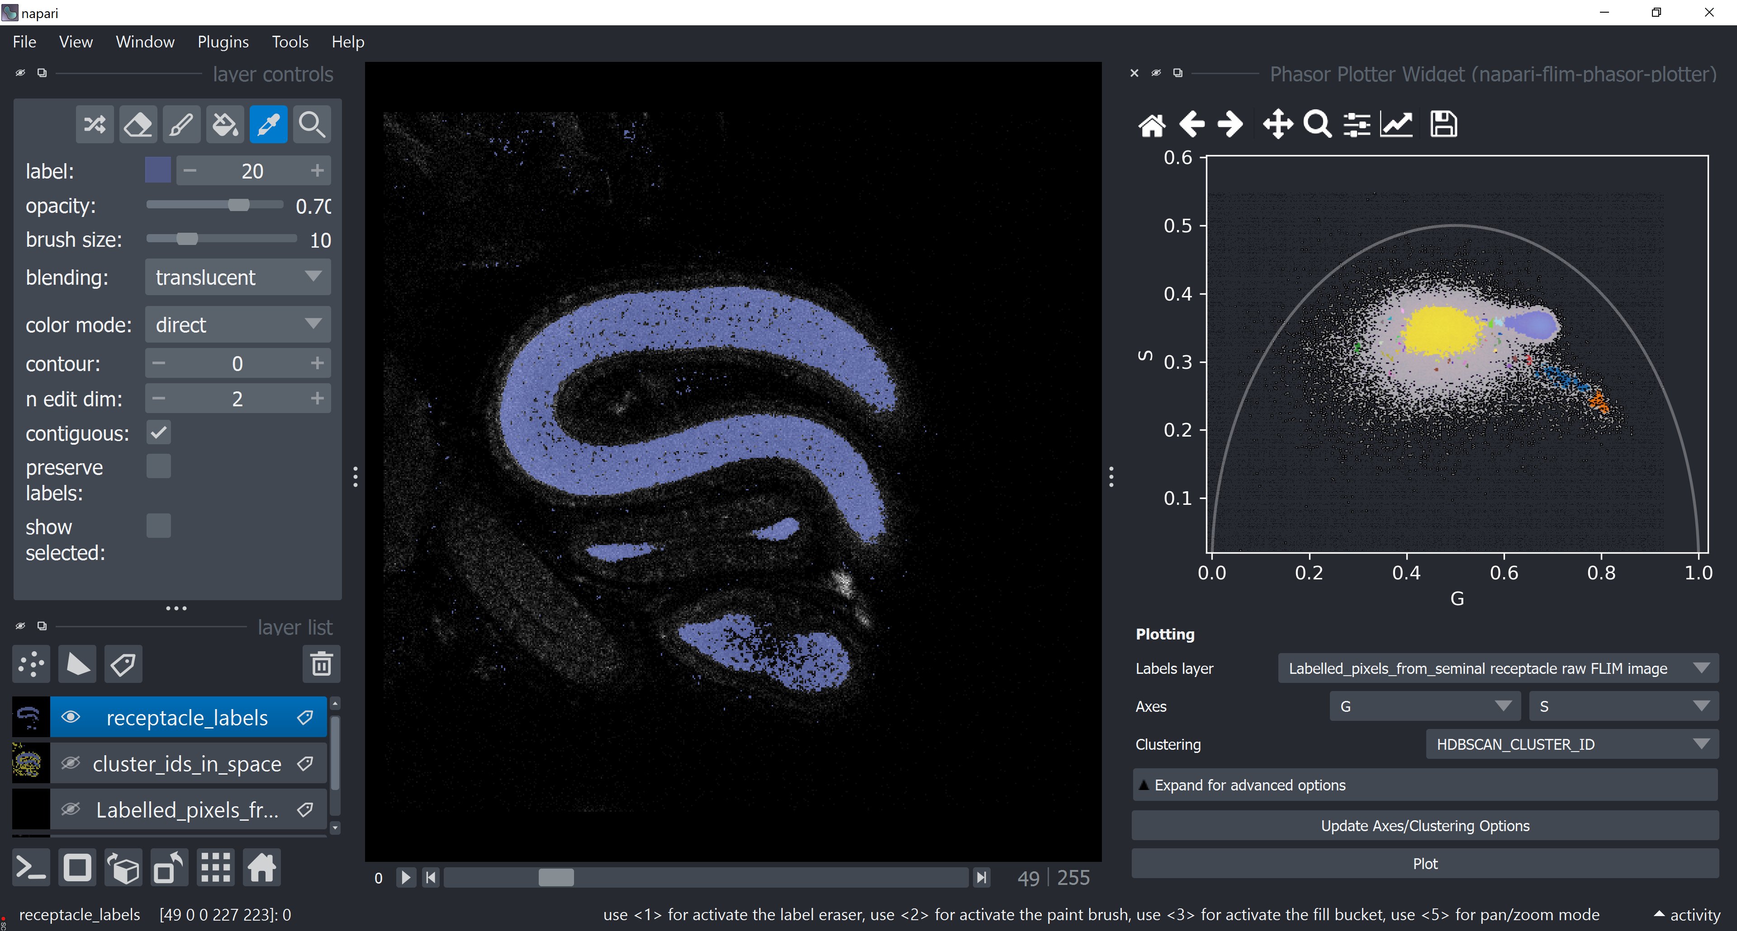
Integrating FLIM analysis into a bio-image analysis workflow
Metabolic FLIM of sperm in a female sperm-storage organ in Drosophila
Example workflow:
Open a raw FLIM image/ dataset
Chose a cluster of interest and further analyse the corresponding structures in your image
Generate a Phasor Plot
Change Phasor Plot display options
Apply a clustering algorithm to the Phasor Plot (HDBSCAN) using the napari-clusters-plotter
Extract cluster/class of interest
GerBi FLIM workshop 2024 München – napari-flim-phasor-plugin Conni Wetzker
18

Slide 19
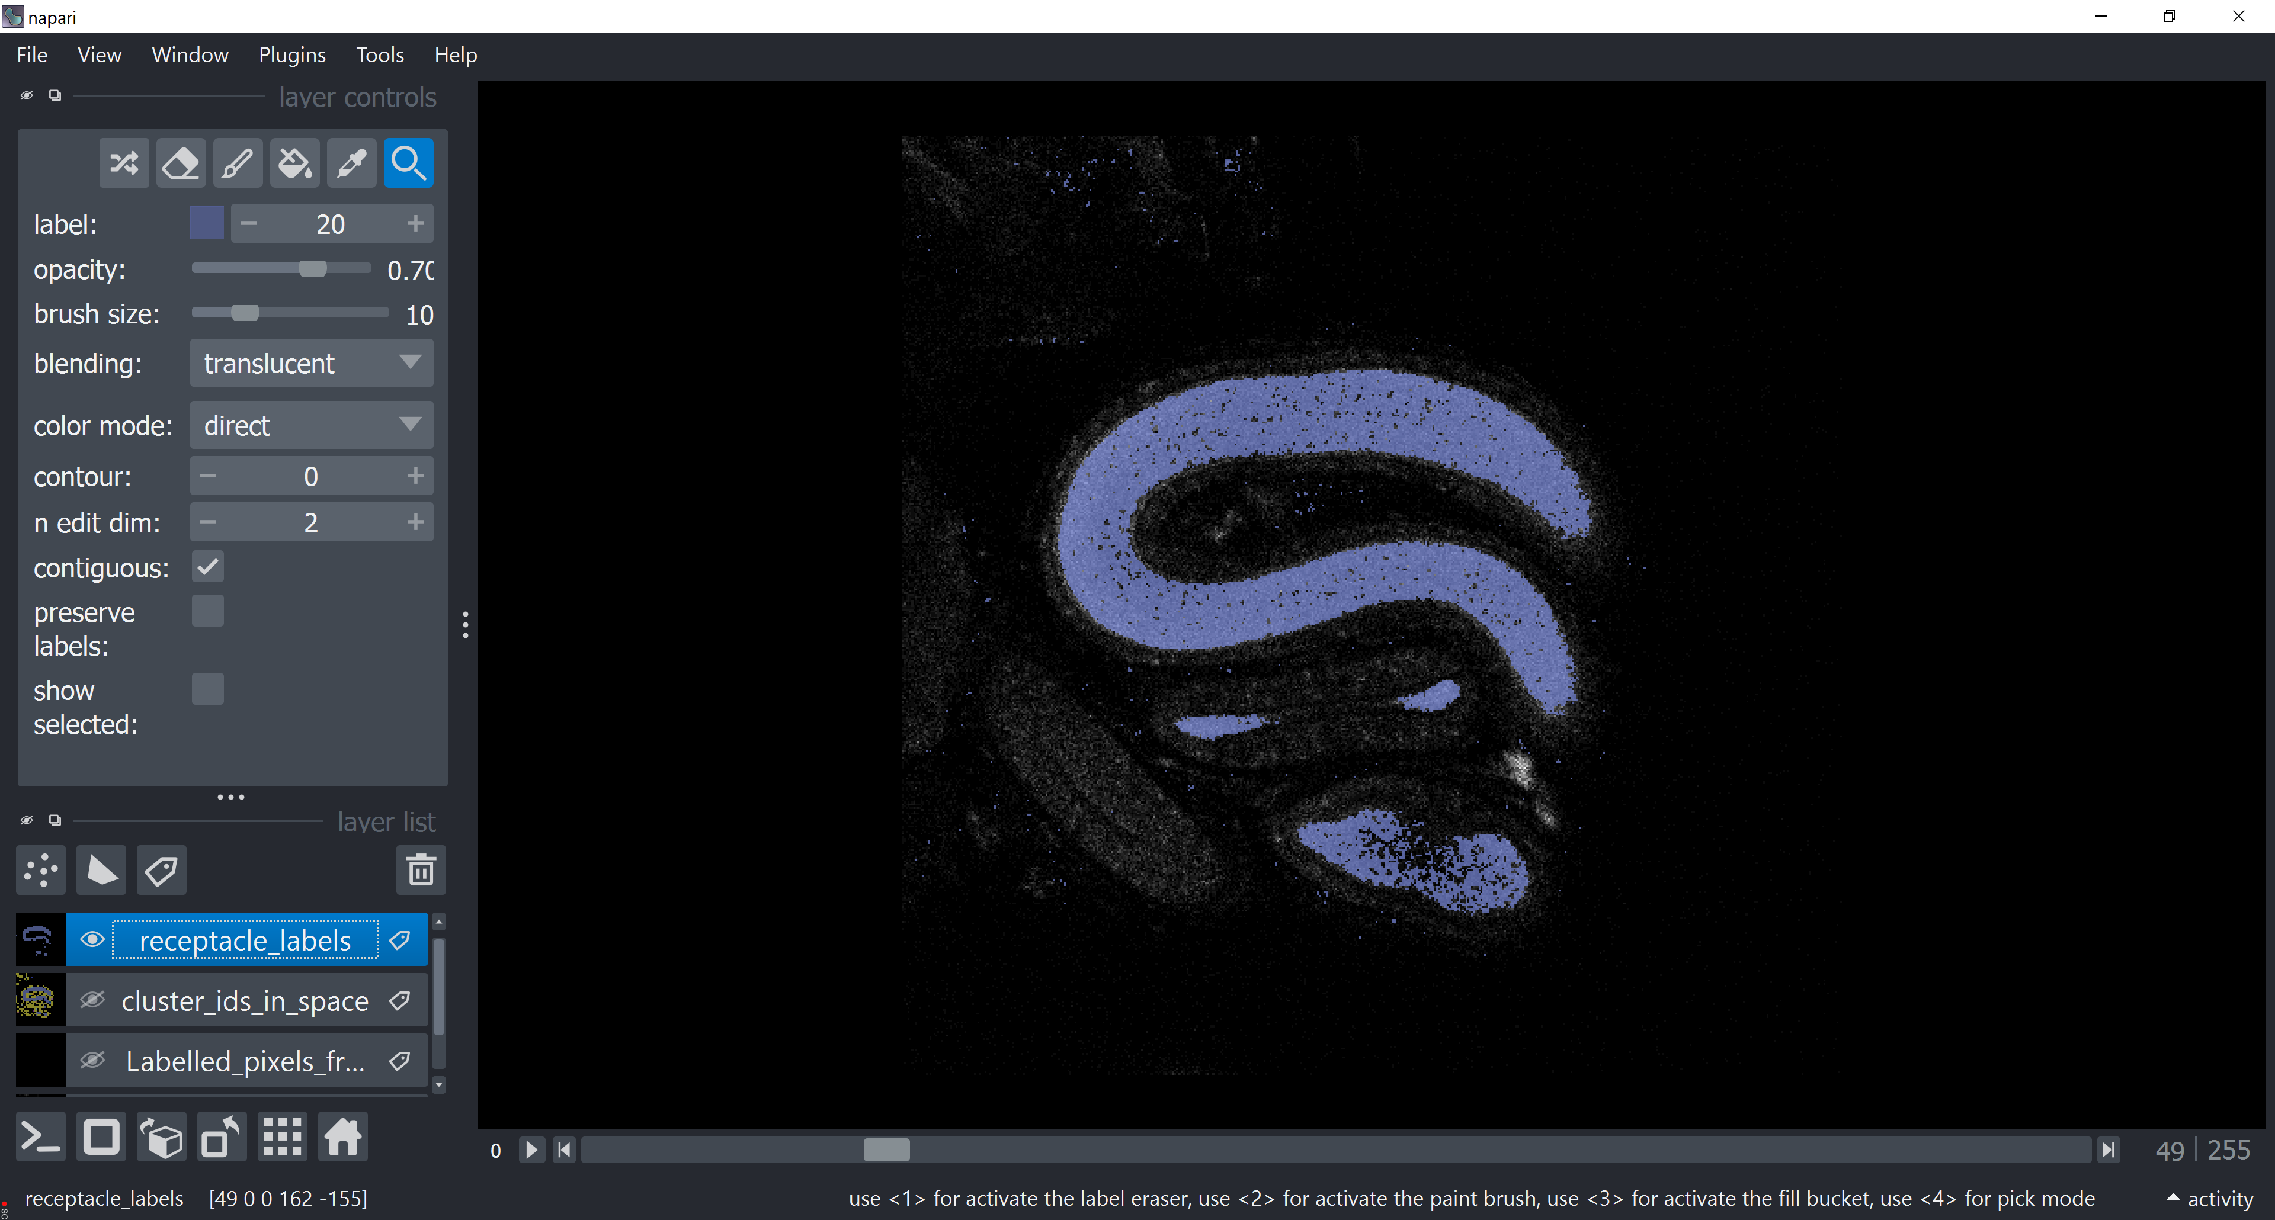
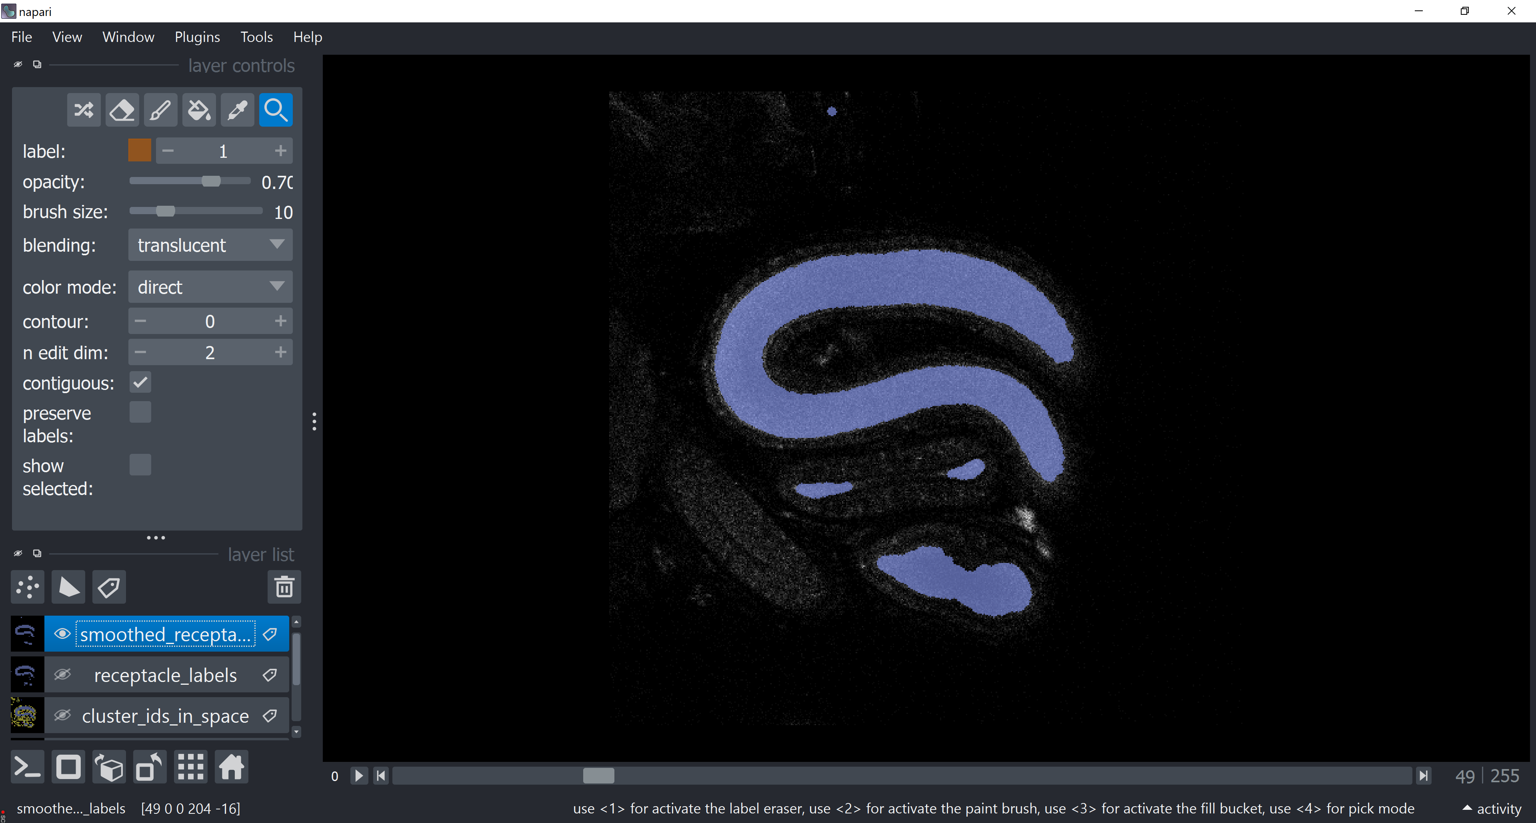
Integrating FLIM analysis into a bio-image analysis workflow
Metabolic FLIM of sperm in a female sperm-storage organ in Drosophila
Example workflow:
Open a raw FLIM image/ dataset
Post-process your labels image for further analysis
Generate a Phasor Plot
Change Phasor Plot display options
Apply a clustering algorithm to the Phasor Plot (HDBSCAN) using the napari-clusters-plotter
Extract cluster/class of interest
Post-processing: apply morphological operations
GerBi FLIM workshop 2024 München – napari-flim-phasor-plugin Conni Wetzker
19

Slide 20
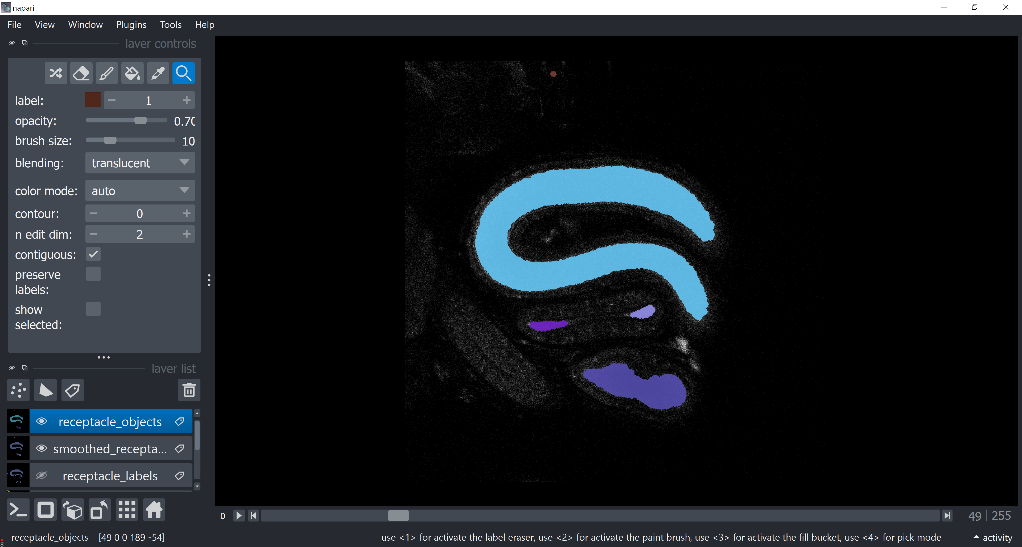
Integrating FLIM analysis into a bio-image analysis workflow
Metabolic FLIM of sperm in a female sperm-storage organ in Drosophila
Example workflow:
Open a raw FLIM image/ dataset
Identify objects of distinct lifetime properties in your image
Generate a Phasor Plot
Change Phasor Plot display options
Apply a clustering algorithm to the Phasor Plot (HDBSCAN) using the napari-clusters-plotter
Extract cluster/class of interest
Post-processing: apply morphological operations
Perform instance segmentation
GerBi FLIM workshop 2024 München – napari-flim-phasor-plugin Conni Wetzker
20

Slide 21
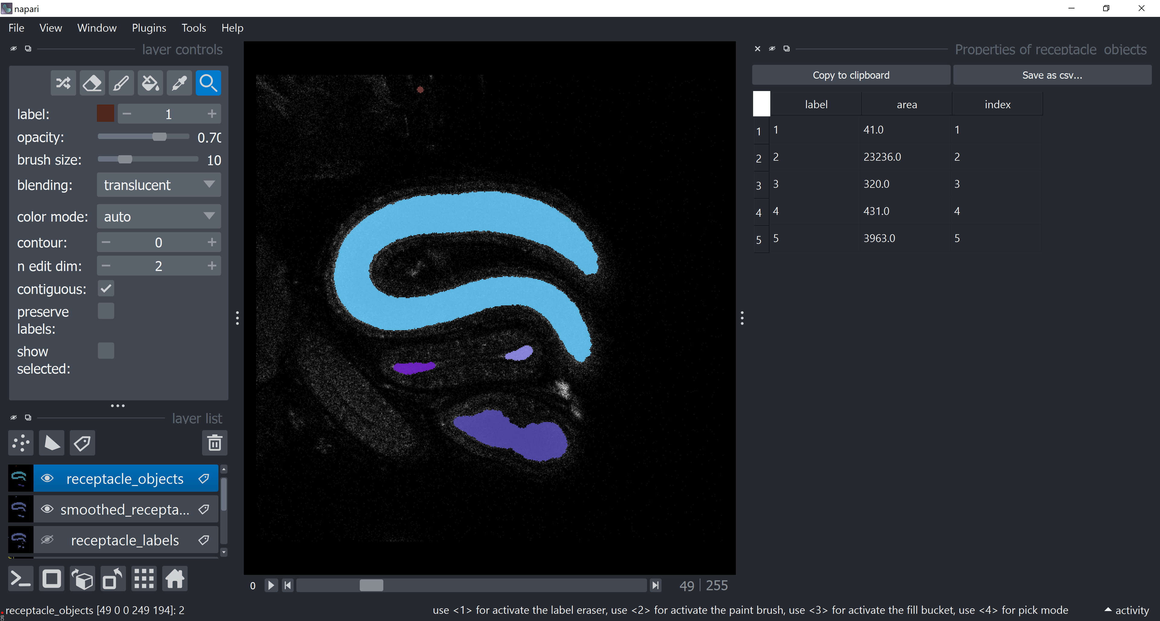
Integrating FLIM analysis into a bio-image analysis workflow
Metabolic FLIM of sperm in a female sperm-storage organ in Drosophila
Example workflow:
Open a raw FLIM image/ dataset
Generate a Phasor Plot
Change Phasor Plot display options
Apply a clustering algorithm to the Phasor Plot (HDBSCAN) using the napari-clusters-plotter
Extract features of your identified objects
Extract cluster/class of interest
Post-processing: apply morphological operations
Perform instance segmentation
Extract Features
GerBi FLIM workshop 2024 München – napari-flim-phasor-plugin Conni Wetzker
21

Slide 22
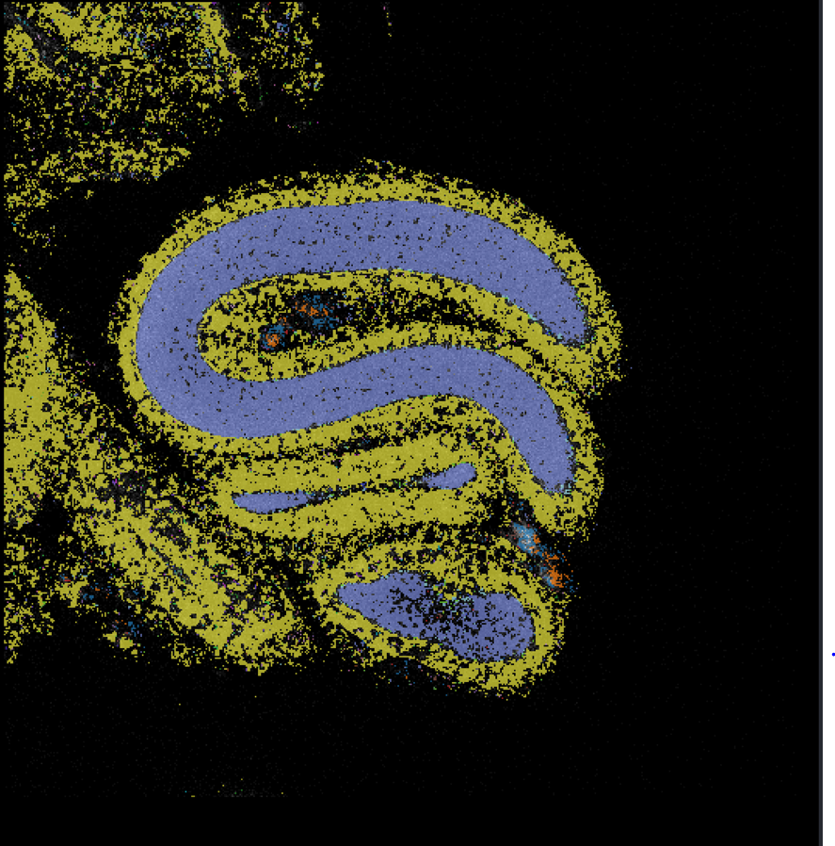
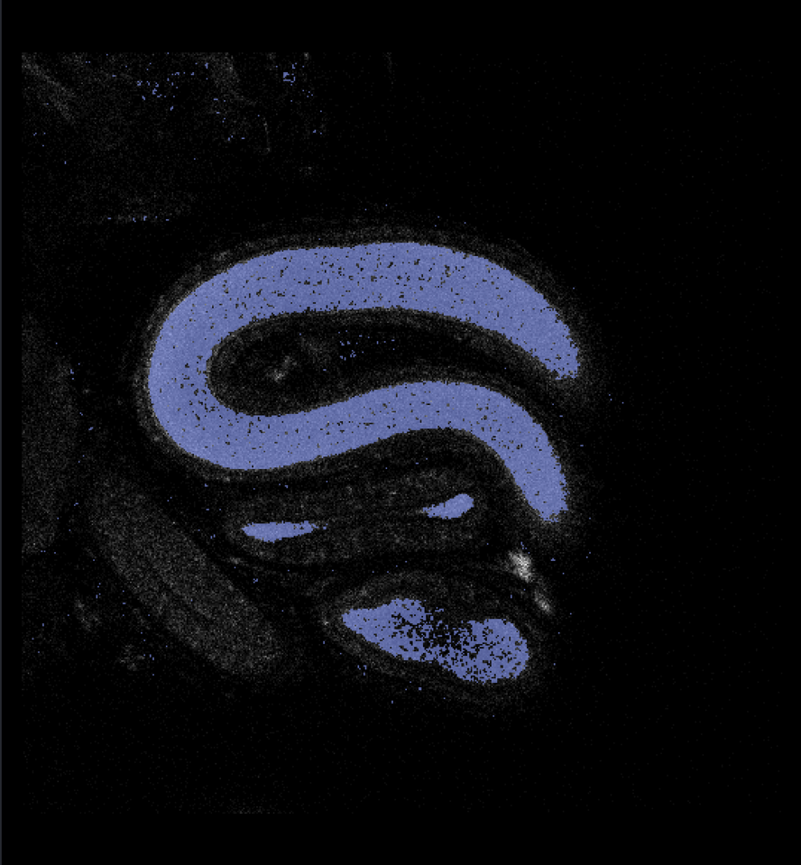
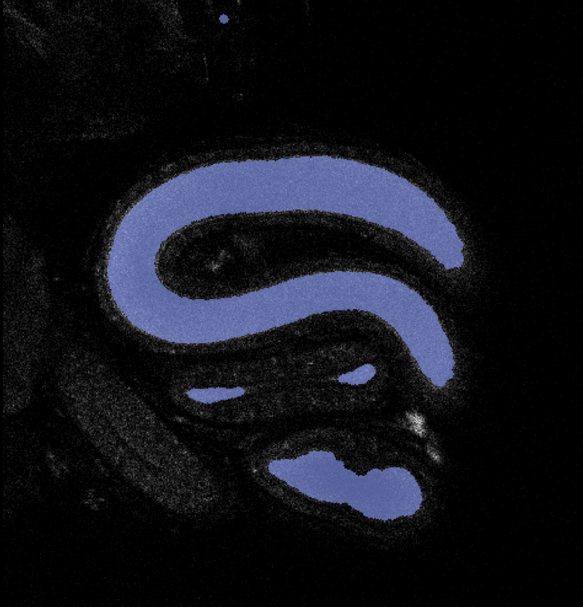
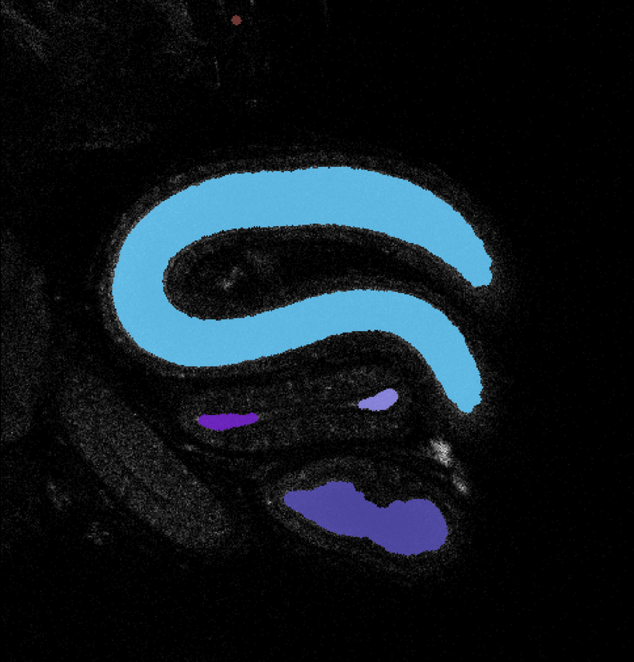
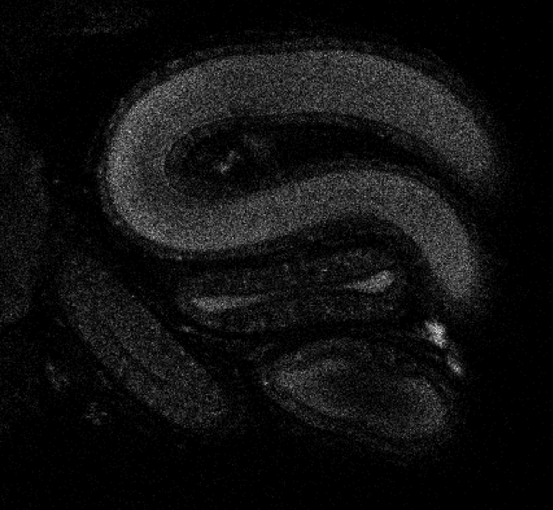
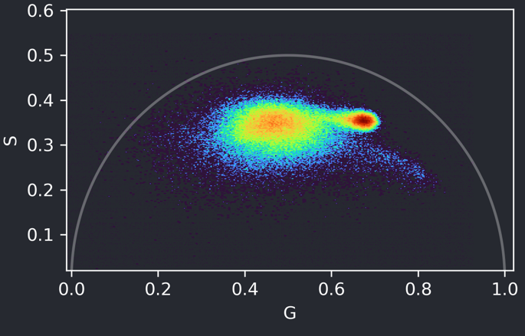
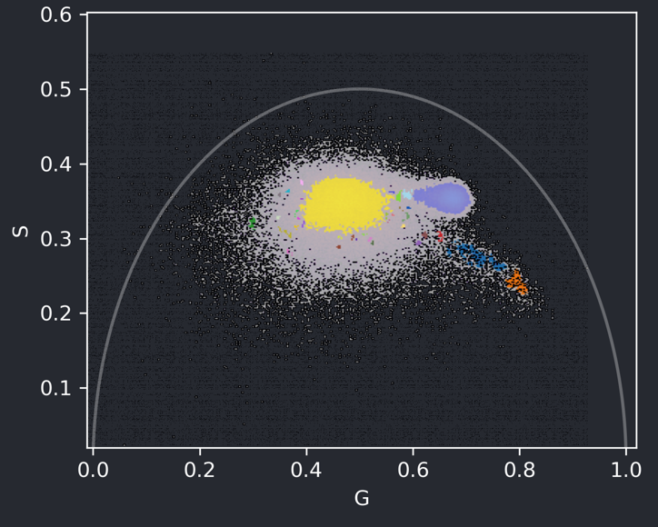
Integrating FLIM analysis into a bio-image analysis workflow
Instance segmentation & quantification
Raw data import & phasor analysis
Cluster analysis
Selection of individual cluster
Processing of selected cluster
label | area
1 | 41
2 | 23236
3 | 320
4 | 431
5 | 3963
GerBi FLIM workshop 2024 München – napari-flim-phasor-plugin Conni Wetzker
22

Slide 23
Input data
The plugin can import FLIM data of formats
  .sdt
  .ptu
  .tif
  .zarr
Of the data shapes:
  2D, 3D up to 3D multichannel timelapse FLIM data
Multidimensional .ptu data folders named _t001_z001 etc.
GerBi FLIM workshop 2024 München – napari-flim-phasor-plugin Conni Wetzker
23

Slide 24
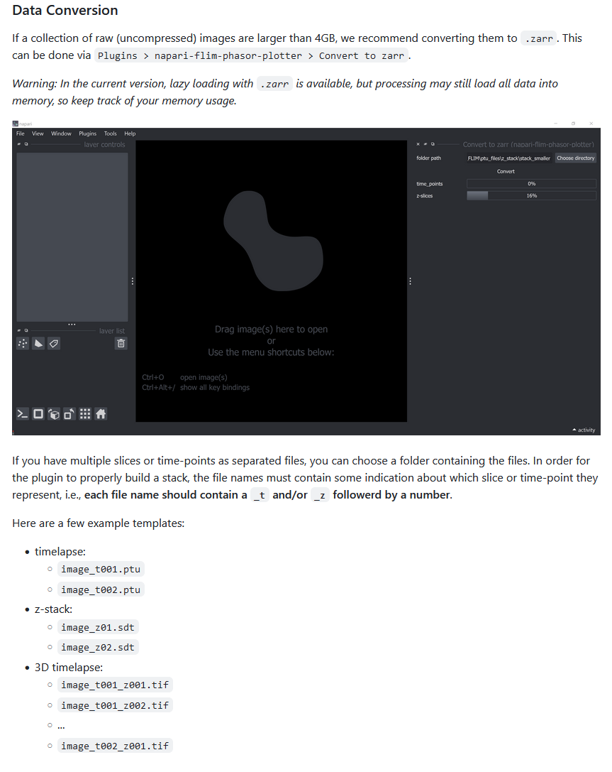
Data conversion to .zarr
The plugin can convert raw FLIM files of a folder to .zarr
GerBi FLIM workshop 2024 München – napari-flim-phasor-plugin Conni Wetzker
Source: https://github.com/zoccoler/napari-flim-phasor-plotter
24

Slide 25
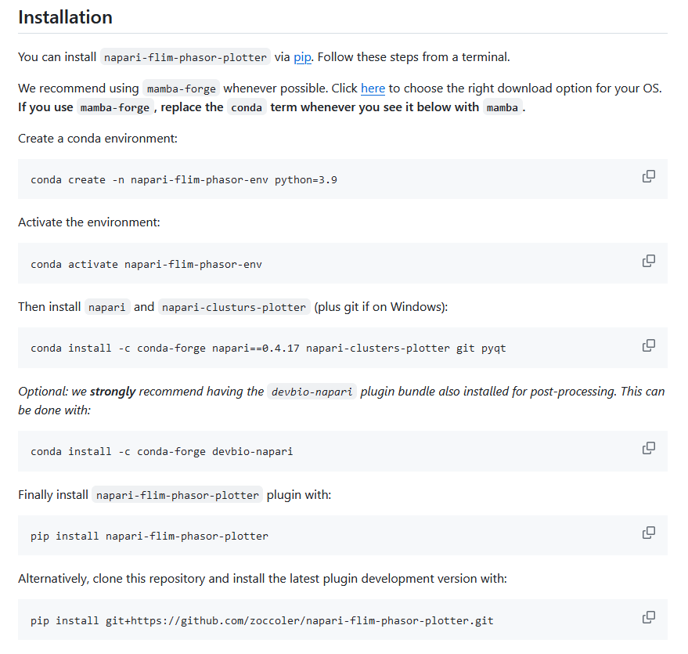
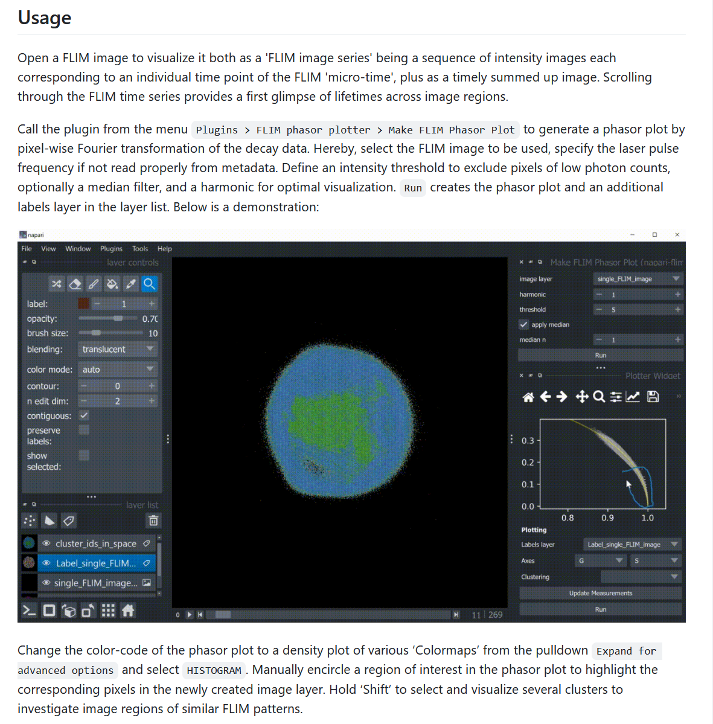
Napari-flim-phasor-plotter – code available on GitHub
Including documentation
In the next few days: install the development version (issue on sdt import)
GerBi FLIM workshop 2024 München – napari-flim-phasor-plugin Conni Wetzker
Source: https://github.com/zoccoler/napari-flim-phasor-plotter
25

Slide 26
Take-home message of napari-flim-phasor-plotter
It is a plugin for napari (a python-based image visualization tool that allows usage of many powerful image processing and analysis plugins)
open-source and allows contributions from community
Allows import of FLIM data of .sdt, . ptu, .tif and .zarr format and up to 5D FLIM data (xyzct)
Allows conversion of FLIM data to .zarr format
performs phasor analysis of FLIM raw data
Can implement cluster analysis of phasor plots using napari-clusters-plotter
Allows further downstream bio-image analysis of available napari plugins
Provides example datasets to test
Contributions warmly welcome!
GerBi FLIM workshop 2024 München – napari-flim-phasor-plugin Conni Wetzker
26

Slide 27
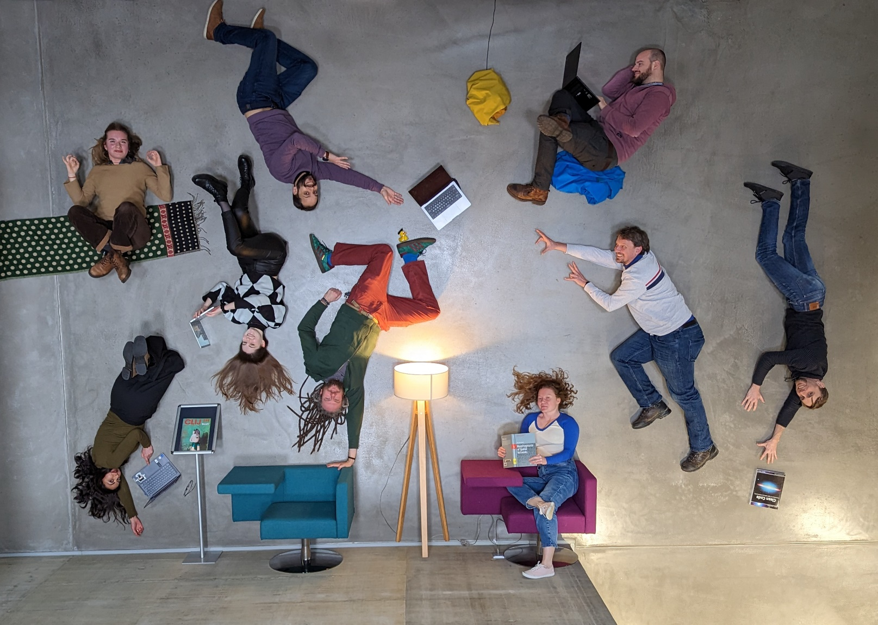




Thanks to
Marcelo Leomil Zoccoler
(maintainer of the napari-flim-phasor-plotter, Bio-Image Analysis Group, PoL TU Dresden)
Svetlana Iarovenko
(soon @ IMP Vienna)
Robert Haase
(ScaDS.AI Leipzig)
Bio-Image Analysis Group, PoL TU Dresden
© Magdalena Gonciarz
Test datasets:
.sdt format - https://zenodo.org/record/7542467 (https://doi.org/10.1038/s41598-019-56067-w)
.ptu format - https://zenodo.org/record/7656540 (DOI: 10.5281/zenodo.7656540)
Light Microscopy Facility, CMCB, TU Dresden
GerBi FLIM workshop 2024 München – napari-flim-phasor-plugin Conni Wetzker
Source: https://tu-dresden.de/cmcb/technologie-plattform/facilities/light-microscopy
27

