Slide 1


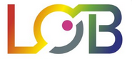



FLUTe – (F)luorescence (L)ifetime (U)ltima(T)e (E)xplorer
a Python GUI for interactive phasor analysis of FLIM data
Chiara Stringari
Laboratory For Optics and Biosciences (LOB)
Advanced Microscopies and Tissue Physiology
École Polytechnique, Institut Polytechnique de Paris,
(France)
February 27th 2024
GerBI FLIM Workshop 2024
26.-29. Feb. 2024

Slide 2
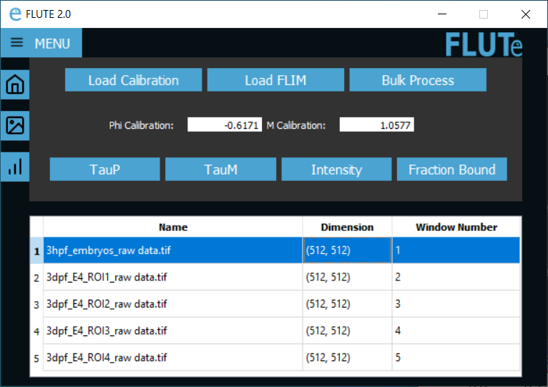
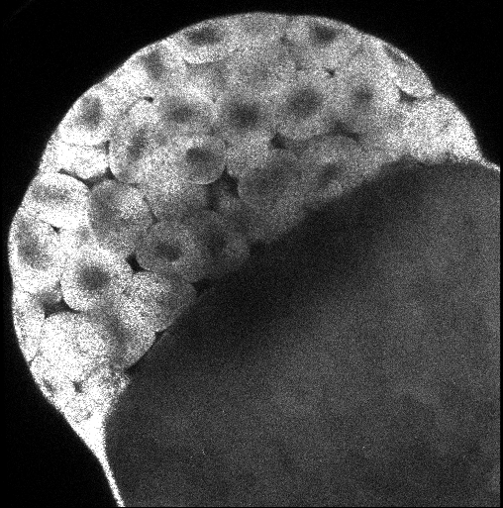

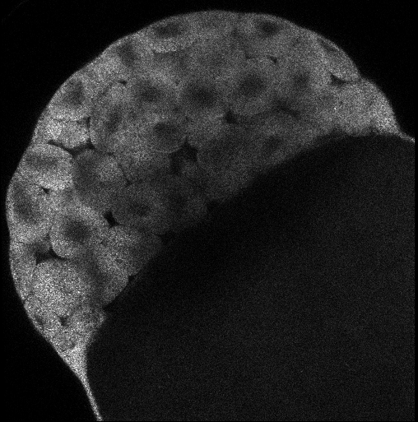
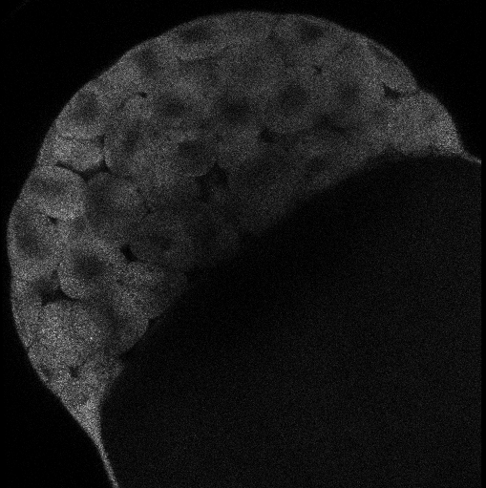
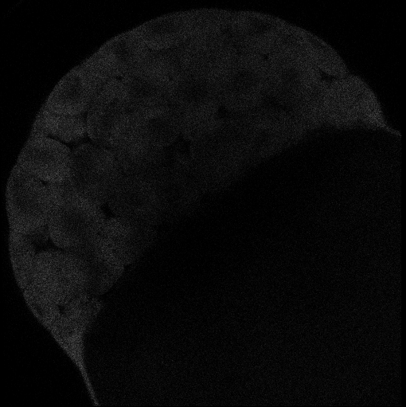
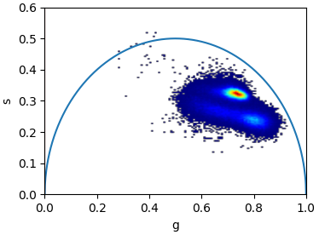
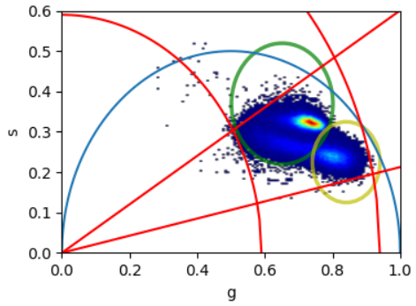
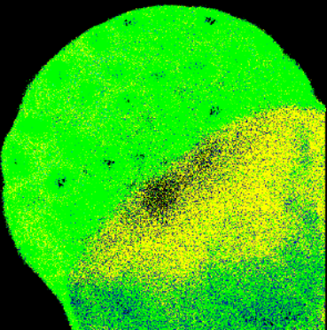
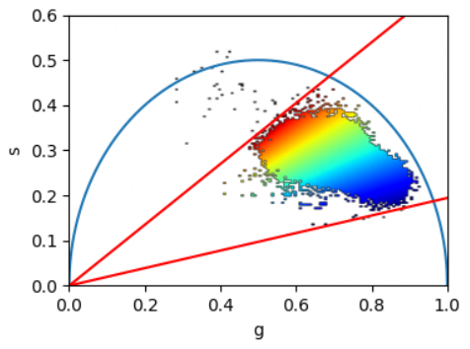
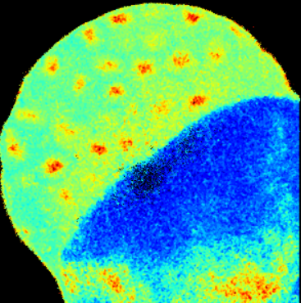

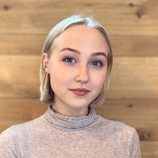

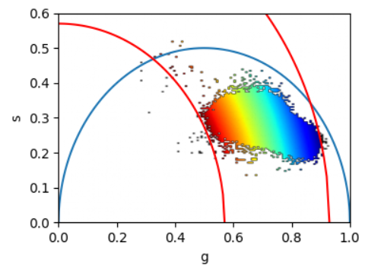
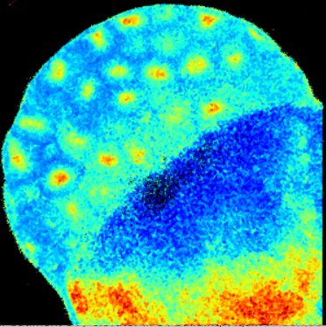
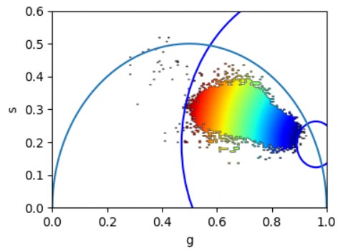
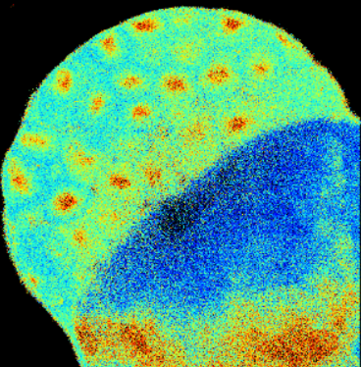
FLUTe – (F)luorescence (L)ifetime (U)ltima(T)e (E)xplorer
a Python GUI for interactive phasor analysis of FLIM data
Custom written free software
Open source code in Python
user-friendly GUI
large FLIM datasets
a
b
Open source code and Executable on GitHub
I
https://github.com/LaboratoryOpticsBiosciences/FLUTE
t
FLIM data in Zenodo repository
https://zenodo.org/records/8324901
c
Region Selection
d
Phase mapping
Lien
Ung
Bahar
Asadipour
Dale
Gottlieb
Polina
Kostina
e
Modulation mapping
f
Distance mapping
Gottlieb, D., Asadipour, B., Kostina, P., Ung, T., & Stringari, C. (2023). FLUTE: A Python GUI for interactive phasor analysis of FLIM data. Biological Imaging, 1-22. doi:10.1017/S2633903X23000211

Slide 3



Data format
FLUTE performs phasor analysis on FLIM data in the time domain,
  either acquired with a time-correlated single photon counting (TCSPC) electronic cards
  time-gating technique, provided that an entire period of the laser repetition is recorded and the lifetime decay it is not truncated
  FLIM data is read as a .tiff stack format
  where each image of the stack represents a temporal bin of the FLIM stack acquired in the time domain.
  FLIM data acquired with commercial cards that are not already in a .tiff format have to be first converted using either the associated commercial software or available open-source plugins (See Supplementary Information 11).
Conversion of Becker & Hickl (.sdt) files to .tiff files
.std files from Becker & Hickl can be exported into .tiff files using the opensource plugin Bio-Formats toolbox
Conversion of ISS (.fbd) files to .tiff files
.fbd files from ISS can be exported into .tiff files from The VistaVision software (See also VistaVision manual pages 28-29)
Conversion of Picoquant (.ptu) files to .tiff files
.ptu files from Picoquant can be exported into .tif files using first SymPhoTime64tware software to extract the binary .bin file and then files using the opensource plugin Bio-Formats toolbox to convert the .bin file in .tif
Alternatively .ptu files from Picoquant can be exported directly into .tiff files using the open source plugins PTU_Reader for Image J (https://github.com/UU-cellbiology/PTU_Reader. )
Conversion to .bin files
Then transformed to tif files with Bio-Formats toolbox
Gottlieb et al (2023). FLUTE: A Python GUI for interactive phasor analysis of FLIM data. Biological Imaging, 1-22.

Slide 4
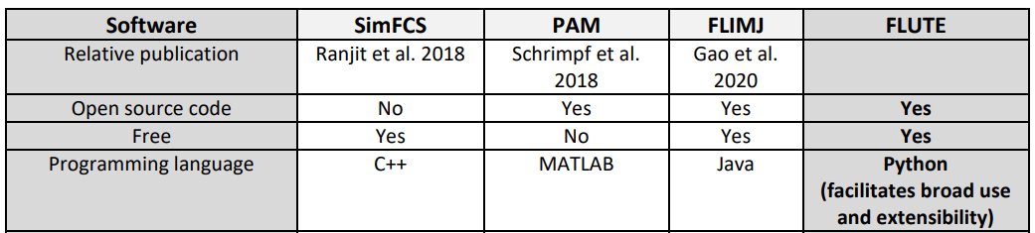
Free and open source software to perform phasor analysis of FLIM data
Reproducibility
Open access
Easy and quantitative analysis
Phyton
  Napari FLIM phasor plotter (C. Wetzker)
  Phasor Identifier: A Cloud-based Analysis of Phasor-FLIM Data on Python Notebooks (F. Cardarelli)

Slide 5
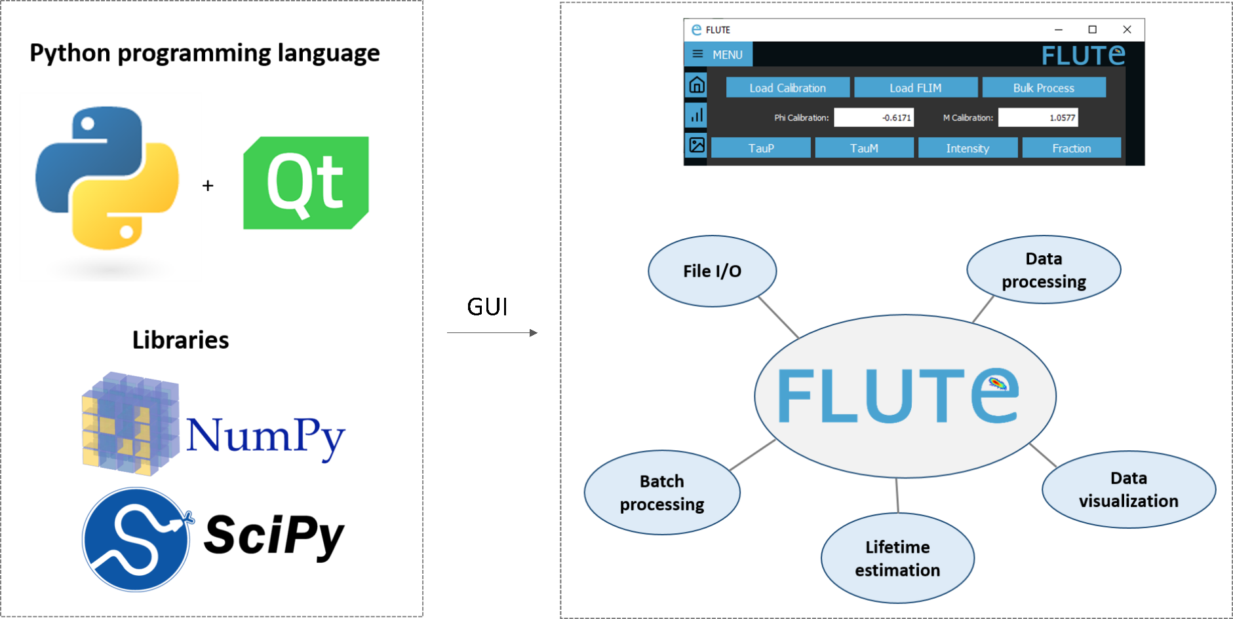
GUI Development and Implementation
Run ‘main.py’ in Pyhton after installing all the necessary packages (PyQt5, numpy, opencv-python, matplotlib, scikit-image). Works in OS: Windows, Linux and MacOS including M1 and M2 chips.
Use the GUI ‘FLUTE.exe’
Gottlieb et al (2023). FLUTE: A Python GUI for interactive phasor analysis of FLIM data. Biological Imaging, 1-22.

Slide 6
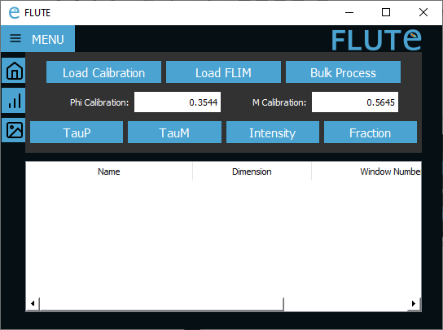
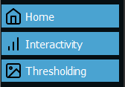
Menu button
Table
Gottlieb et al (2023). FLUTE: A Python GUI for interactive phasor analysis of FLIM data. Biological Imaging, 1-22.

Slide 7
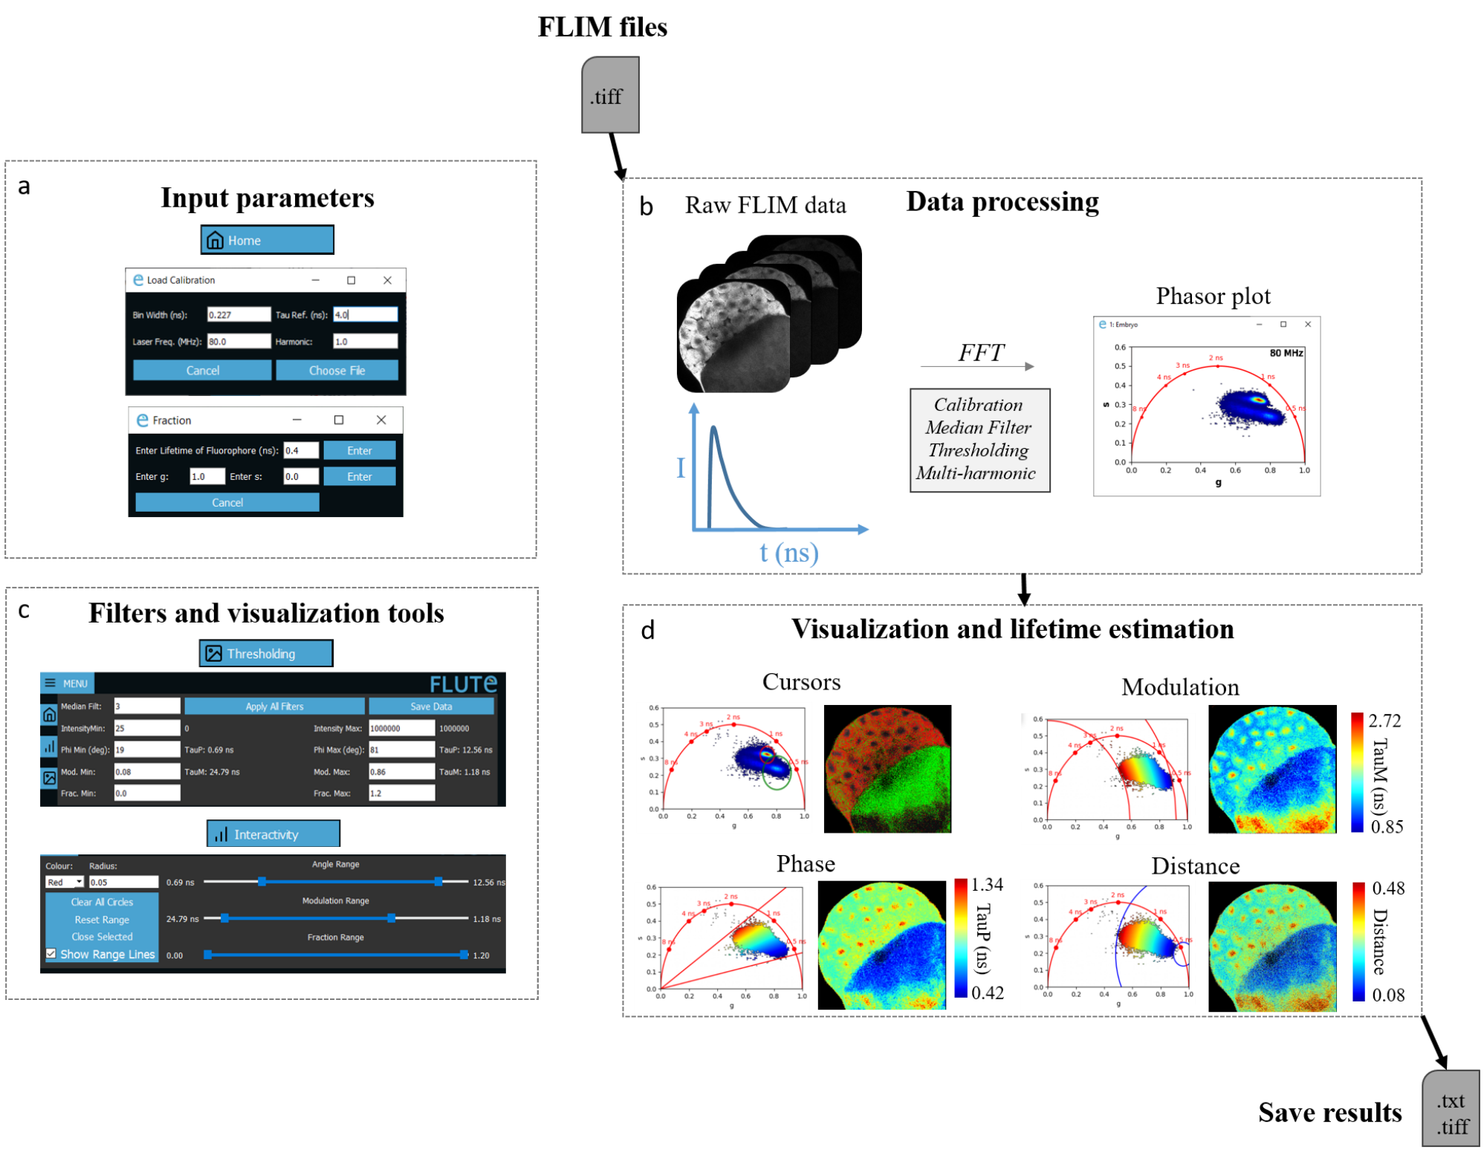
FLIM Data Processing
Data Processing
Gottlieb et al (2023). FLUTE: A Python GUI for interactive phasor analysis of FLIM data. Biological Imaging, 1-22.
Processing times with a MacBook Air (M1, 2020, 8 GB Memory) for a phasor transformation of FLIM stacks are: ~0.7 s for a 256 x 256 images, ~1.1 s for a 512x512 images and ~3 s for a 1024 x 1024 images with 56 time beans each

Slide 8
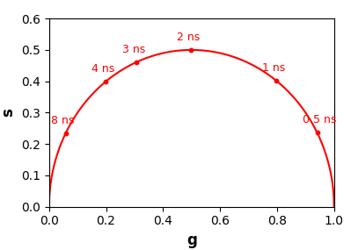
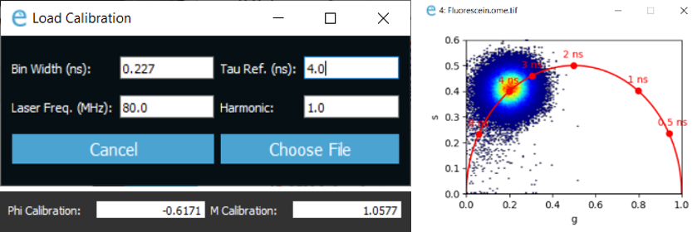


b. Calibration with reference lifetime
$$φ_{f}^{ }=φ_{i}^{ }+∆φ$$
$$m_{f}^{ }=m_{i}^{ }∗∆m_{ }^{ }$$
Δφ
m_{i}
φ_{f}
m_{f}
φ_{i}
Calibration with fluorophores with a known lifetime, e.g. Fluorescein (4 ns), Coumarin 6 (2.5 ns), Rodamine B (1.74 ns), or Rose Bengal (0.52 ns), or 0 ns lifetime of SHG signal from starch or KTP NPs
Gottlieb et al (2023). FLUTE: A Python GUI for interactive phasor analysis of FLIM data. Biological Imaging, 1-22.
Bin Width (ns): Duration of a single temporal bin of the time-domain FLIM acquisition
Laser Freq. (MHz): Laser repetition rate
Tau Ref. (ns): Known lifetime of the single-exponential reference sample
Harmonic: Integer multiple applied to calculate the Fourier transform

Slide 9
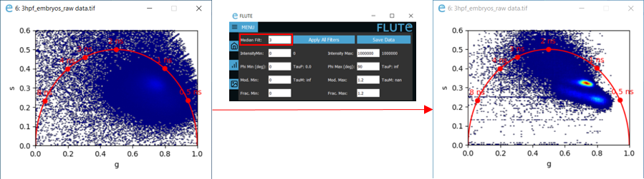
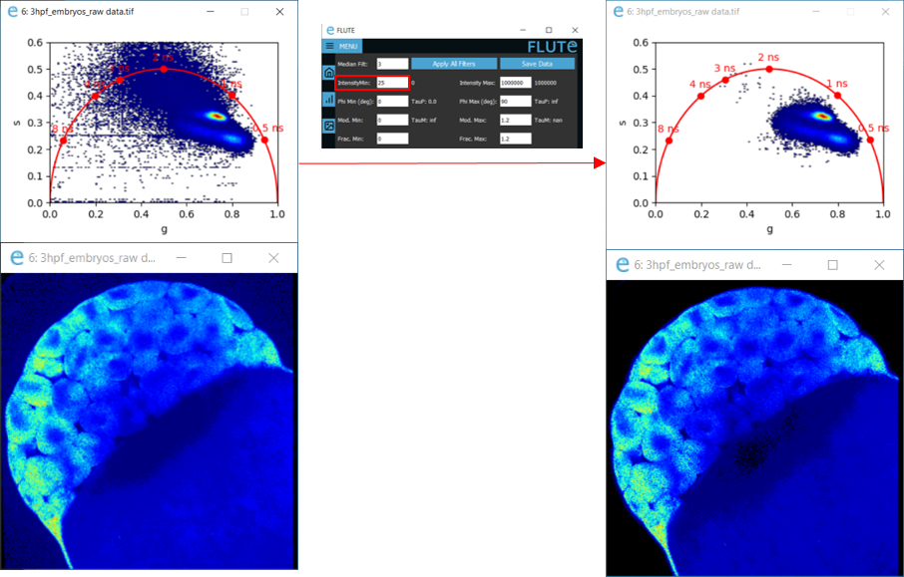
c. Median filter
A 3x3 convolutional median filter is applied n times to the phasor plot
d. Intensity threshold
Gottlieb et al (2023). FLUTE: A Python GUI for interactive phasor analysis of FLIM data. Biological Imaging, 1-22.
Changing the max and min of the intensity threshold

Slide 10
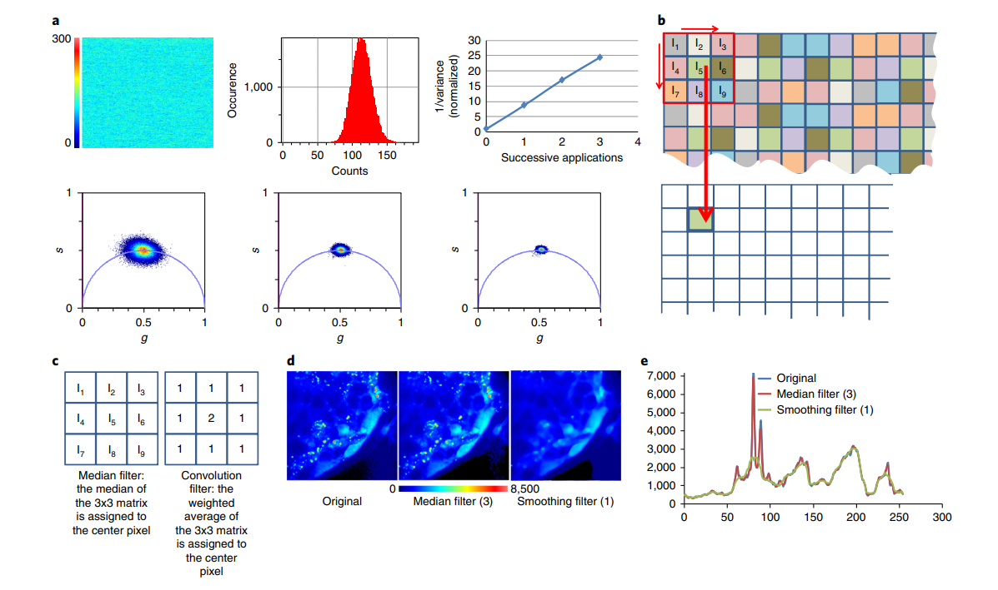
Median filter
Ranjit, S., et al., Fit-free analysis of fluorescence lifetime imaging data using the phasor approach. Nat Protoc, 2018.

Slide 11
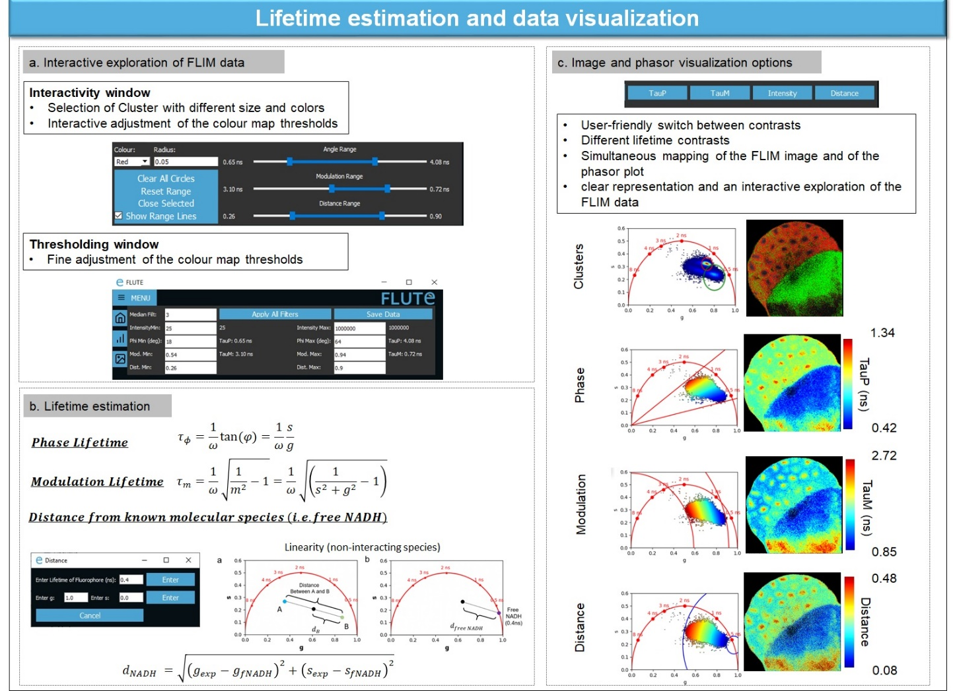
Gottlieb et al (2023). FLUTE: A Python GUI for interactive phasor analysis of FLIM data. Biological Imaging, 1-22.

Slide 12
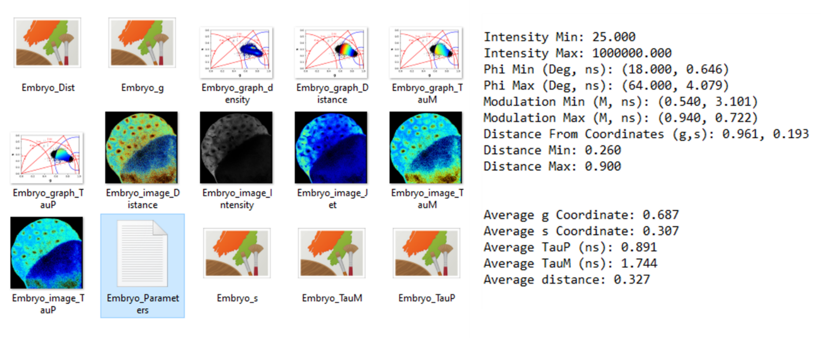
Exporting results and batch processing
Saving results.
Saved FLIM images and phasor plots (left) and applied filters (right) to create the mask and measurements of the average of g, s, TauPhase (TauP), TauModulation (TauM) and distance (right).
Batch processing on multiple FLIM images
Using the same parameters
Typical processing times for the full analysis of one image (that includes phasor transformation, applications of filters, saving results, images and measurements) with a MacBook Air (M1, 2020, 8 GB Memory) are:
~1.8 s for a 256 x 256 image
~2.5 s for a 512x512 image
~5.4 s for a 1024 x 1024 image
Gottlieb et al (2023). FLUTE: A Python GUI for interactive phasor analysis of FLIM data. Biological Imaging, 1-22.

Slide 13
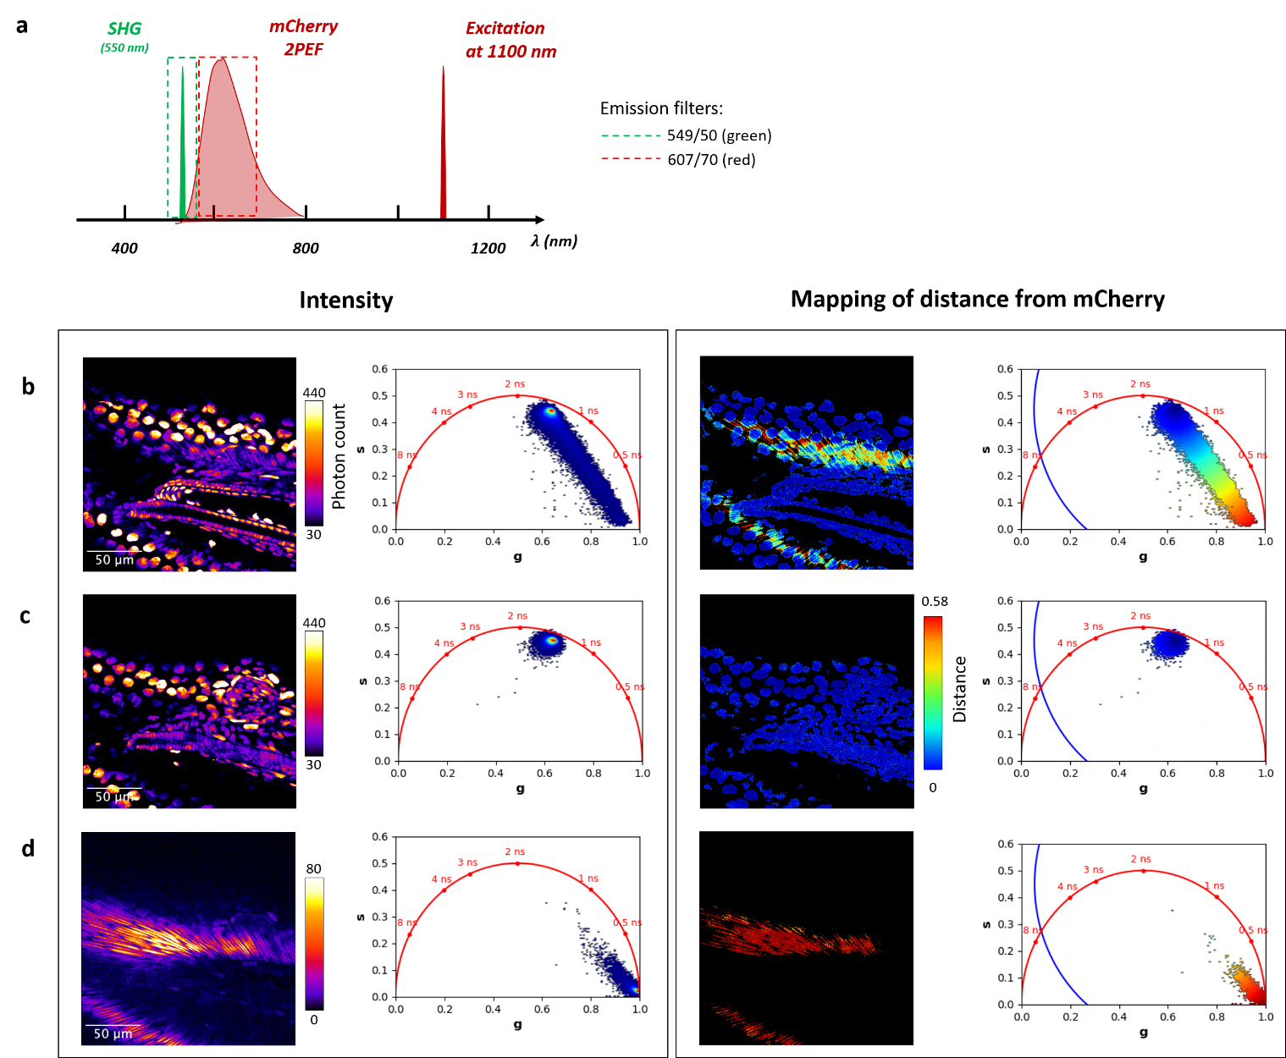
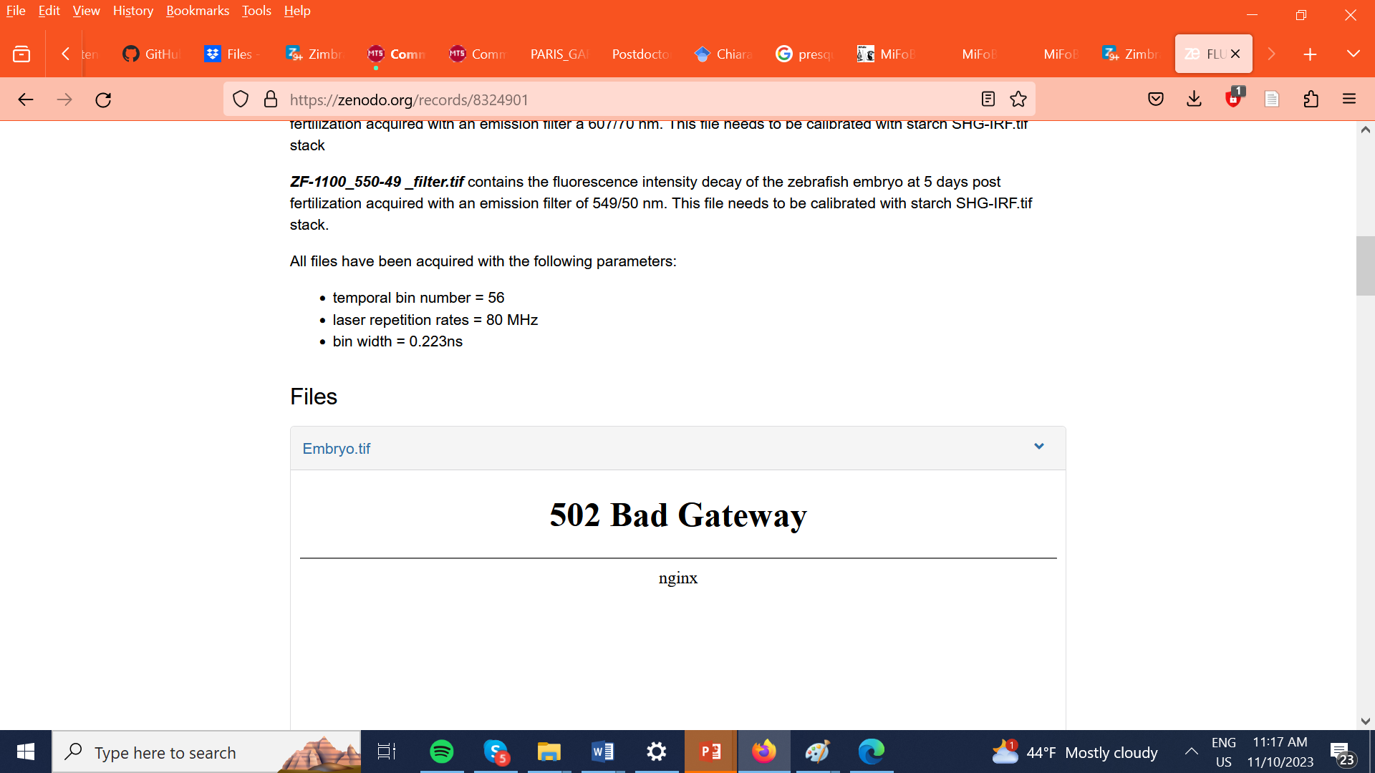
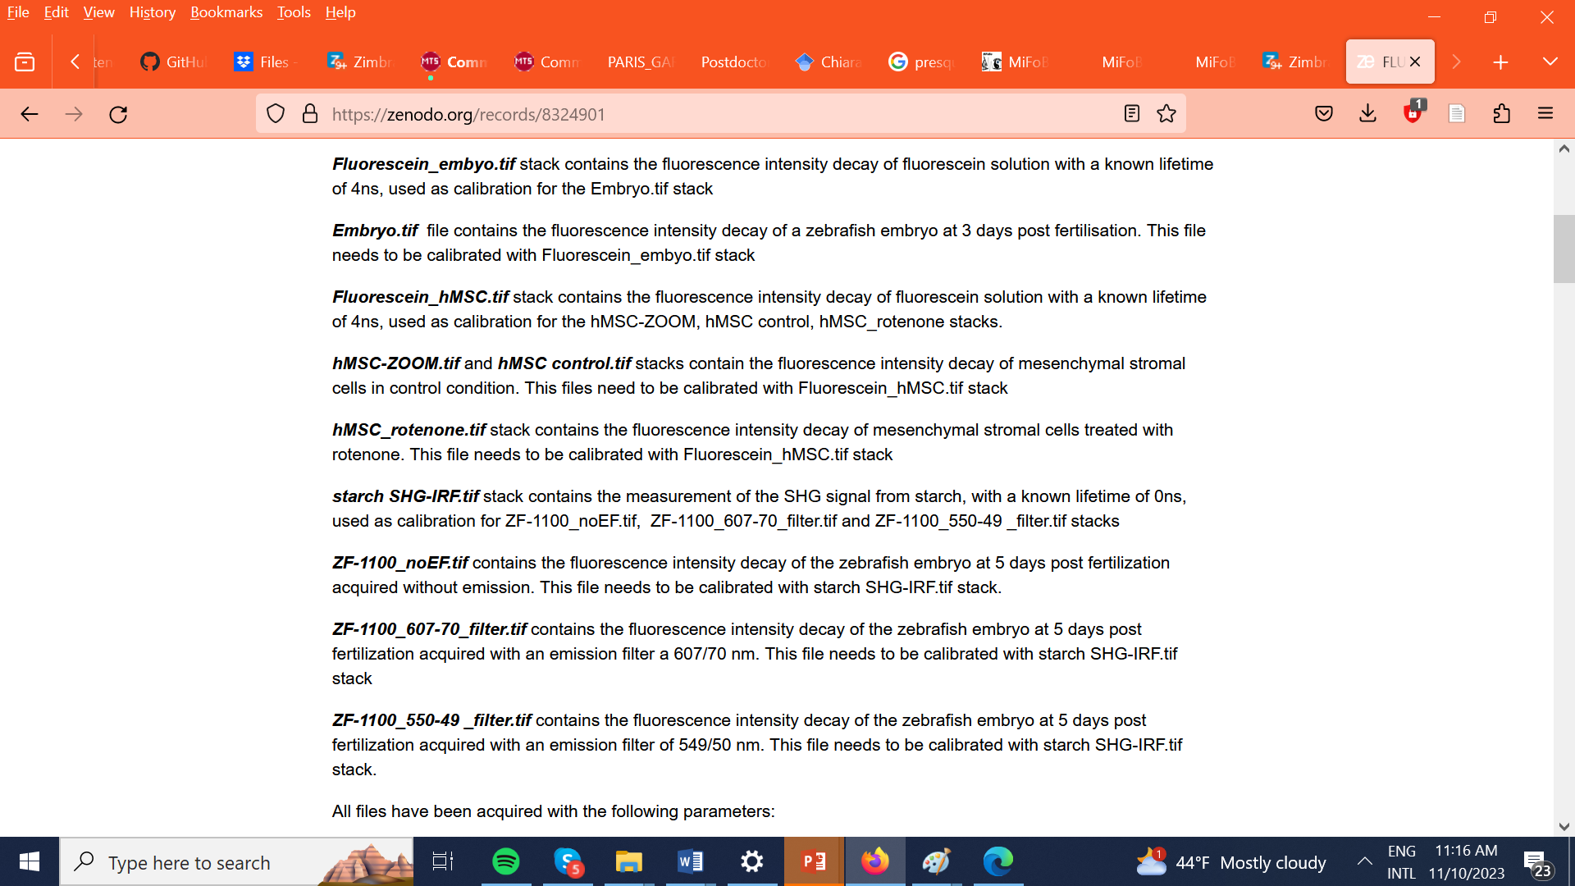
a. Mapping of distance from mCherry in a 5-day post-fertilization (dpf) zebrafish embryo tail (H2B-mCherry line) in vivo.
FLIM data in Zenodo repository
https://zenodo.org/records/8324901
Gottlieb et al (2023). FLUTE: A Python GUI for interactive phasor analysis of FLIM data. Biological Imaging, 1-22.

Slide 14
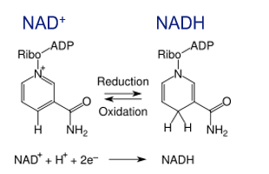
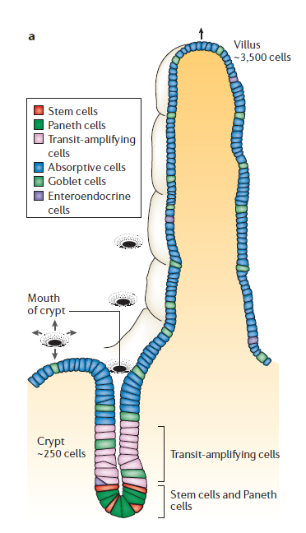
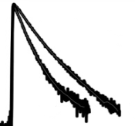
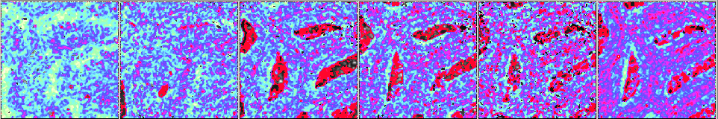
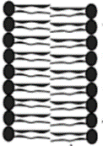
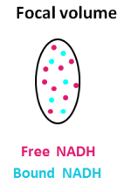


FLIM and intrinsic biomarker NADH for metabolic imaging
Nicotinamide adenine dinucleotide (NADH)
glucose
Metabolic gradient
Small Intestine
glucose
Bound
NADH
Differentiated cells
ATP
Glycolysis
NADH
NAD+
pyruvate
lactate
Oxidative
Phosphorylation
Acetyl CoA
Mitochondrion
Protein-bound
NADH
ATP
citrate
Fatty Acids
Lipids
Intensity
Lakowicz et al.. PNAS. 1992
Heikal at al. Biomark Med. 2010
Stringari et al. PNAS. 2011
Stringari et al. Sci Rep. 2012
TCA
Cycle
IV
NADH
FADH2
Macromolecular
biosynthesis
HO2
NAD+
II
Free
NADH
H+
O2
I
FAD
Free
NADH
Stem
Cells
H+
z
Stringari et al Sci Rep. 2017
Time( ns)
Resting cell
Proliferating cell
OxPhos ++
Long NADH Lifetime
Bound NADH
Glycolysis ++
Short NADH Lifetime
Free NADH
Stringari et al. Sci Rep. 2017
Ung et al et al. Sci Rep. 2021
Sánchez-Ramírez, et al. Journal of Cell Biology 2022
Paillon et al . Molecular Biology of the Cell 2024
Sánchez-Ramírez, et al. Mol Neurobiol. 2024
s
f1
f2
fB NADH$\text{∝} \frac{NAD+}{NADH}$
Stringari et al PNAS 2011
Stringari et al Sci Rep. 2012

Slide 15
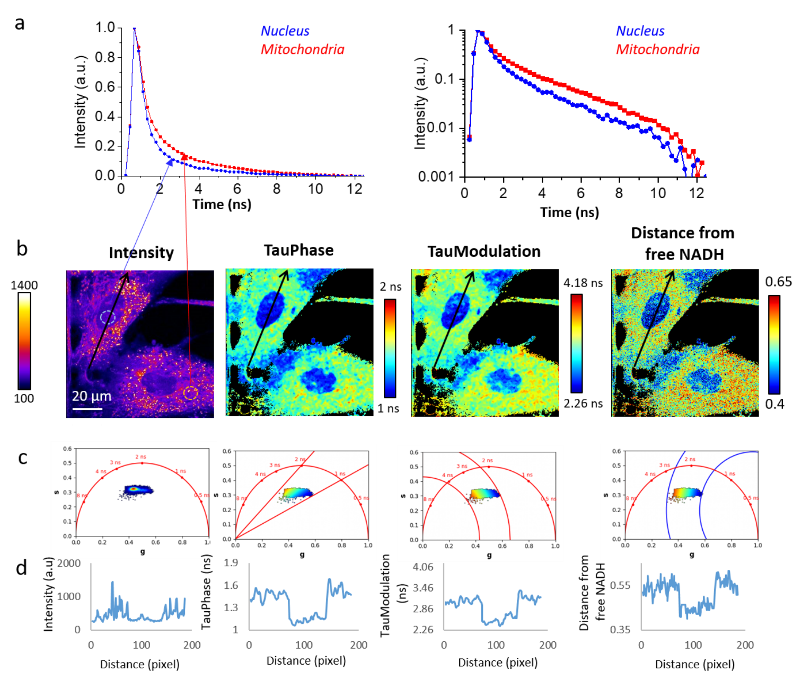
b. FLIM analysis of NADH reveals intracellular metabolic heterogeneity in mesenchymal stromal cells.
FLIM data in Zenodo repository
https://zenodo.org/records/8324901
Gottlieb et al (2023). FLUTE: A Python GUI for interactive phasor analysis of FLIM data. Biological Imaging, 1-22.

Slide 16
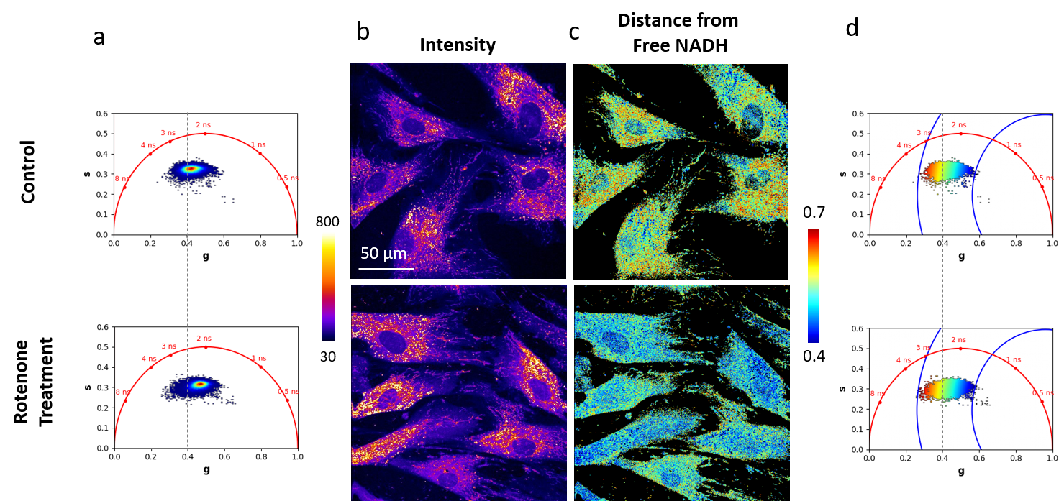
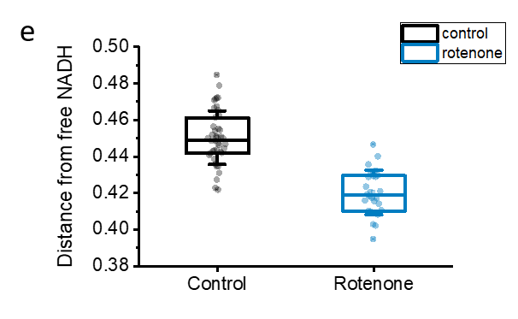
c. Shift in the distance from free NADH in live cells upon metabolic treatment.
glucose
glucose
ATP
Glycolysis
NADH
NAD+
pyruvate
lactate
Oxidative
Phosphorylation
Acetyl CoA
Mitochondrion
ATP
TCA
Cycle
citrate
Fatty Acids
Lipids
IV
NADH
Macromolecular
biosynthesis
HO2
FADH2
H+
NAD+
FAD
O2
I
II
H+
Rotenone
FLIM data in Zenodo repository
https://zenodo.org/records/8324901
Gottlieb et al (2023). FLUTE: A Python GUI for interactive phasor analysis of FLIM data. Biological Imaging, 1-22.

Slide 17
Future Developments
Direct import of the common FLIM file formats (.std, .fbd and .ptu) inside the Python code by using already available Python libraries and open-source codes
Intermediary file format which encompasses matrices for Intensity, g and s coordinates.
Increase FLUTE speed with parallel computing capabilities of Graphics processing units (GPUs) by using specialized Python libraries such as Numba and CuPy for real time phasor analysis and representation during experiments.
Adapt phasor analysis to typical time-gated sampling limitations by taking in account the effect of decay truncation and gate shape
Integrate a fully automated calculation and mapping of fraction of molecules (with 2 known moleculr species)
Advanced analysis tools such as, different filters, freehand cluster drawing, cluster analysis with Machine Learning, FRET trajectory estimation and calculation of absolute concentration of NADH.
Napari
Gottlieb et al (2023). FLUTE: A Python GUI for interactive phasor analysis of FLIM data. Biological Imaging, 1-22.

Slide 18
FLUTe – (F)luorescence (L)ifetime (U)ltima(T)e (E)xplorer
a Python GUI for interactive phasor analysis of FLIM data
Custom written free software
Open source code in Python
user-friendly GUI
large FLIM datasets
a
b
Open source code and Executable on GitHub
I
https://github.com/LaboratoryOpticsBiosciences/FLUTE
t
FLIM data in Zenodo repository
https://zenodo.org/records/8324901
c
Region Selection
d
Phase mapping
Lien
Ung
Bahar
Asadipour
Dale
Gottlieb
Polina
Kostina
e
Modulation mapping
f
Distance mapping
Gottlieb, D., Asadipour, B., Kostina, P., Ung, T., & Stringari, C. (2023). FLUTE: A Python GUI for interactive phasor analysis of FLIM data. Biological Imaging, 1-22. doi:10.1017/S2633903X23000211

Slide 19
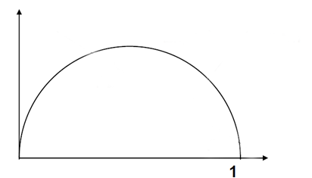
Multi harmonic phasor analysis
Multi-harmonics analysis
Multi-harmonics analysis separates different molecular components that have the same location in the phasor plot at one harmonic but arise from different lifetime distributions.
1st harmonic
2nd harmonic
ω = ω0
ω = 2 ω0
s
s
3 ns
3 ns
8 ns
0.3 ns
0.3 ns
0.1 ns
0.1 ns
8 ns
g
g
f = 80 MHz
Stringari et al. PNAS 2011

Slide 20
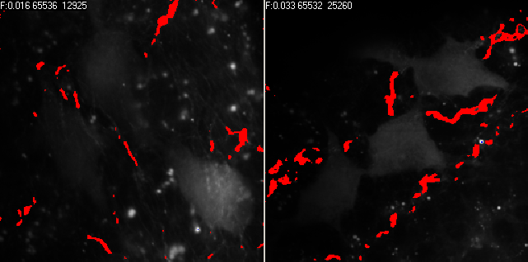
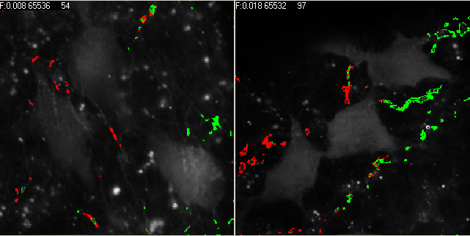
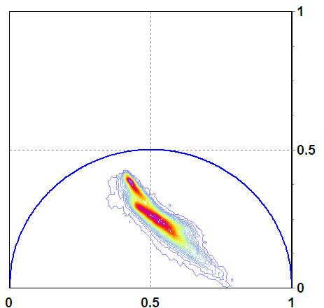
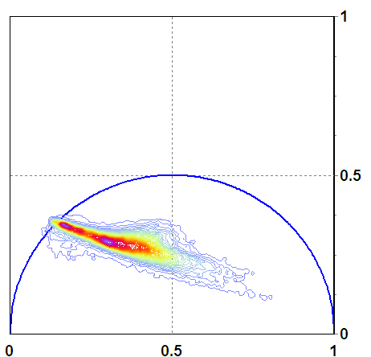
Multi harmonic analysis
1st harmonic FFT
2nd harmonic FFT
ω = ω0
ω = 2 ω0
Stringari et al. PNAS 2011

Slide 21
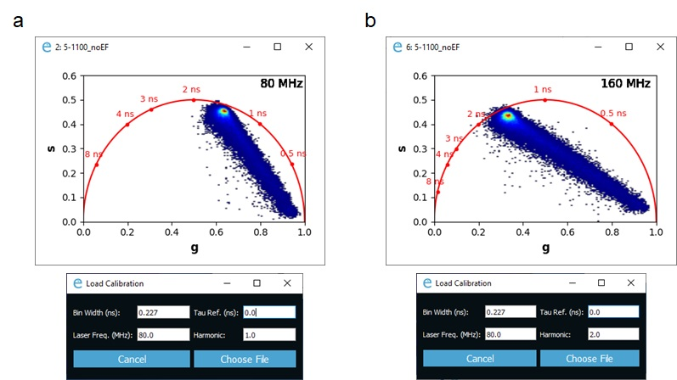
Multi harmonic phasor analysis with FLUTE
Figure S5: Calibration of FLIM image (ZF-1100_noEF.tiff) using the SHG at 0 ns lifetime (starch SHG-IRF.tiff) as a calibration. Phasor transformation and plot are calculated at the first (A) and second (B) harmonic of the laser repetition rate.
Gottlieb et al (2023). FLUTE: A Python GUI for interactive phasor analysis of FLIM data. Biological Imaging, 1-22.

Slide 22
FLIM data in Zenodo repository
https://zenodo.org/records/8324901
Gottlieb et al (2023). FLUTE: A Python GUI for interactive phasor analysis of FLIM data. Biological Imaging, 1-22.

