Slide 1
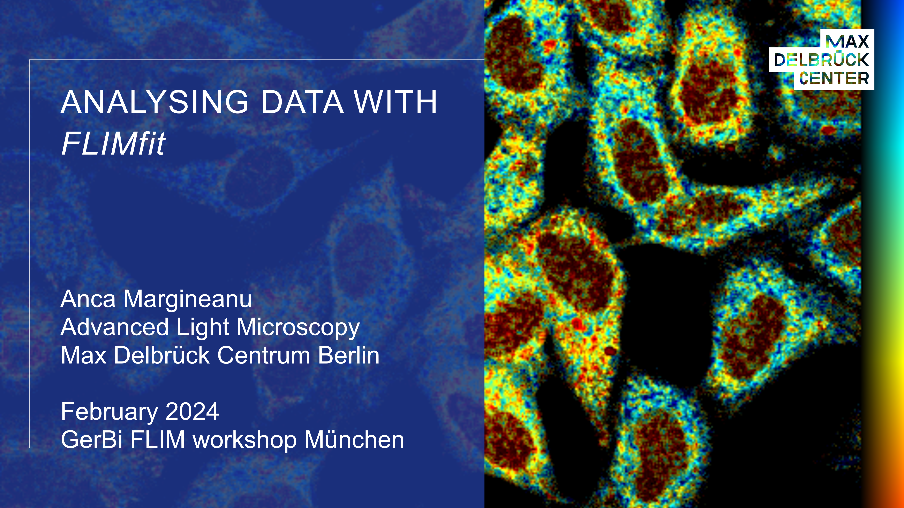

Slide 2
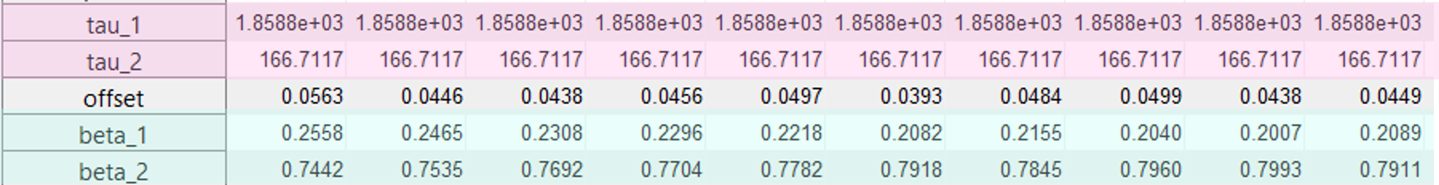
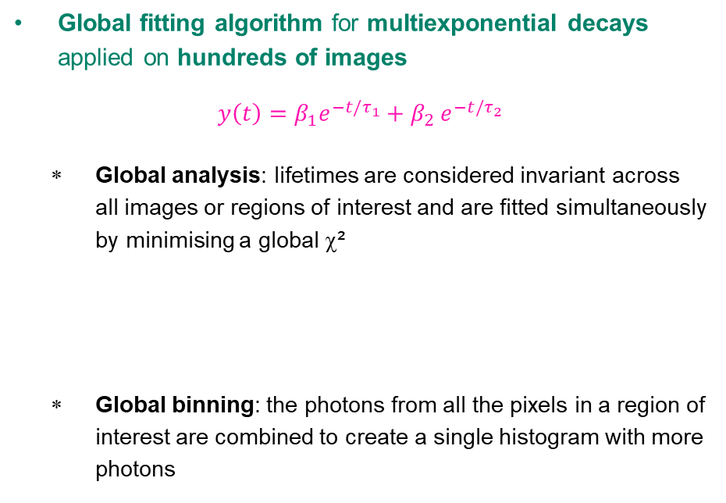
FLIMfit: FITTING ALGORITHMS
Global fitting algorithm for multiexponential decays applied on hundreds of images
$$y\left(t\right)=β_{1}e^{−t/τ_{1}}{+ β}_{2}e^{−t/τ_{2}}$$
    Global analysis: lifetimes are considered invariant across all images or regions of interest and are fitted simultaneously by minimising a global χ²
    Global binning: the photons from all the pixels in a region of interest are combined to create a single histogram with more photons
Publication: Warren et al. (2013), Rapid Global Fitting of Large Fluorescence Lifetime Imaging Microscopy Datasets, PLoS ONE 8(8): e70687. doi:10.1371/journal.pone.0070687
Website: https://flimfit.org/
Developed in Matlab, offered as a compiled GUI that runs independently (only the MCR necessary) to analyse time-domain FLIM data
Several versions are implemented in Omero

Slide 3
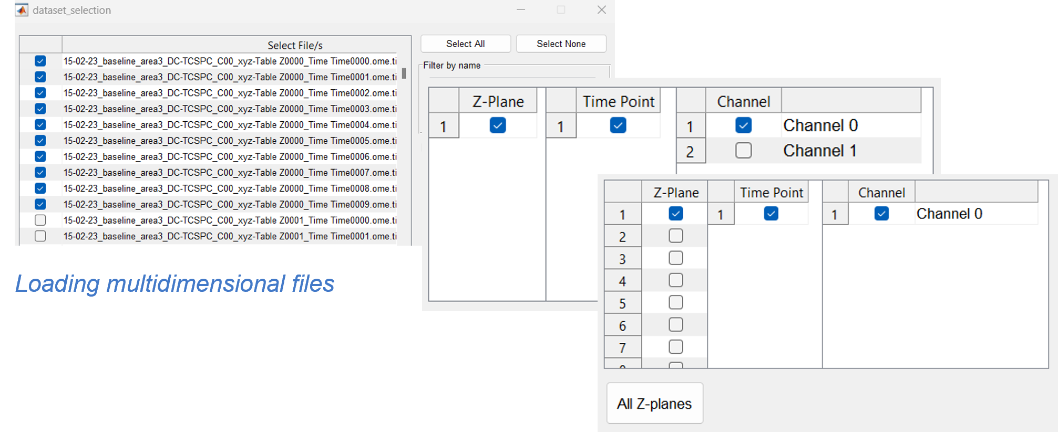
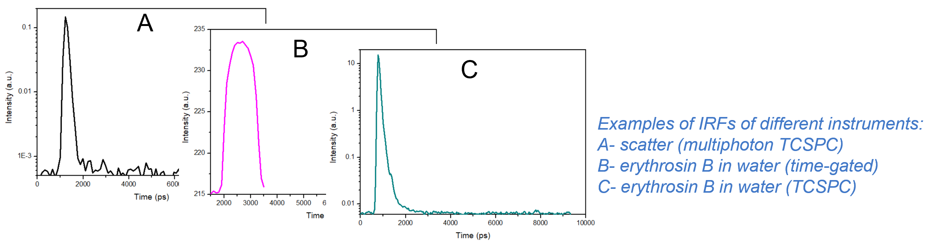
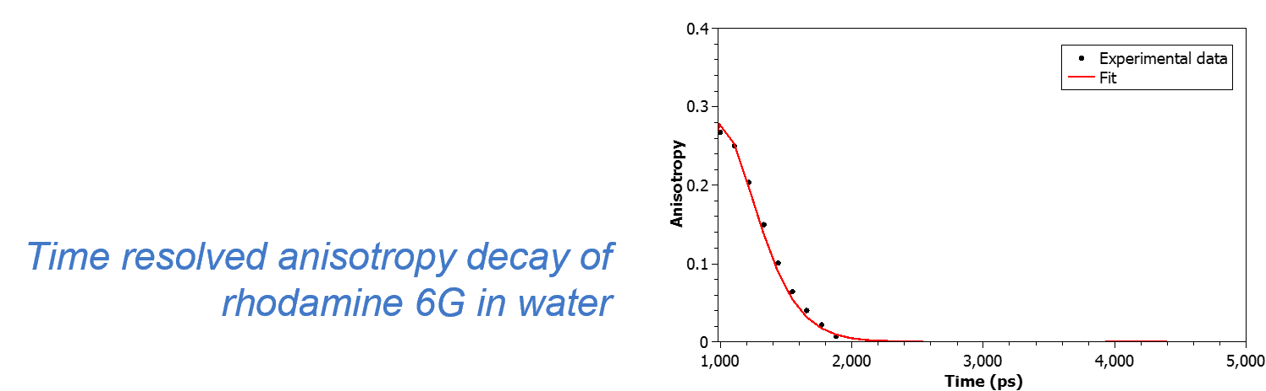
FLIMfit IMPLEMENTATIONS
Loading multidimensional file formats:
    B&H, Picoquant, ome-tiff LaVision Biotec, Leica .pt3, .tiff
    Single images
    Series of images: z stacks, time lapses, concentration
    Multiple channels (time-resolved anisotropy)
Instrument response function (IRF) (image/ascii):
    Fluorescent reference
    Scatter (multiphoton)
Background:
    Constant
    Time-varying
Scattered light
Pulse train correction (i.e. incomplete decays fitting)
FRET model for donors with complex fluorescence decay
Time-resolved anisotropy decays analysis

Slide 4
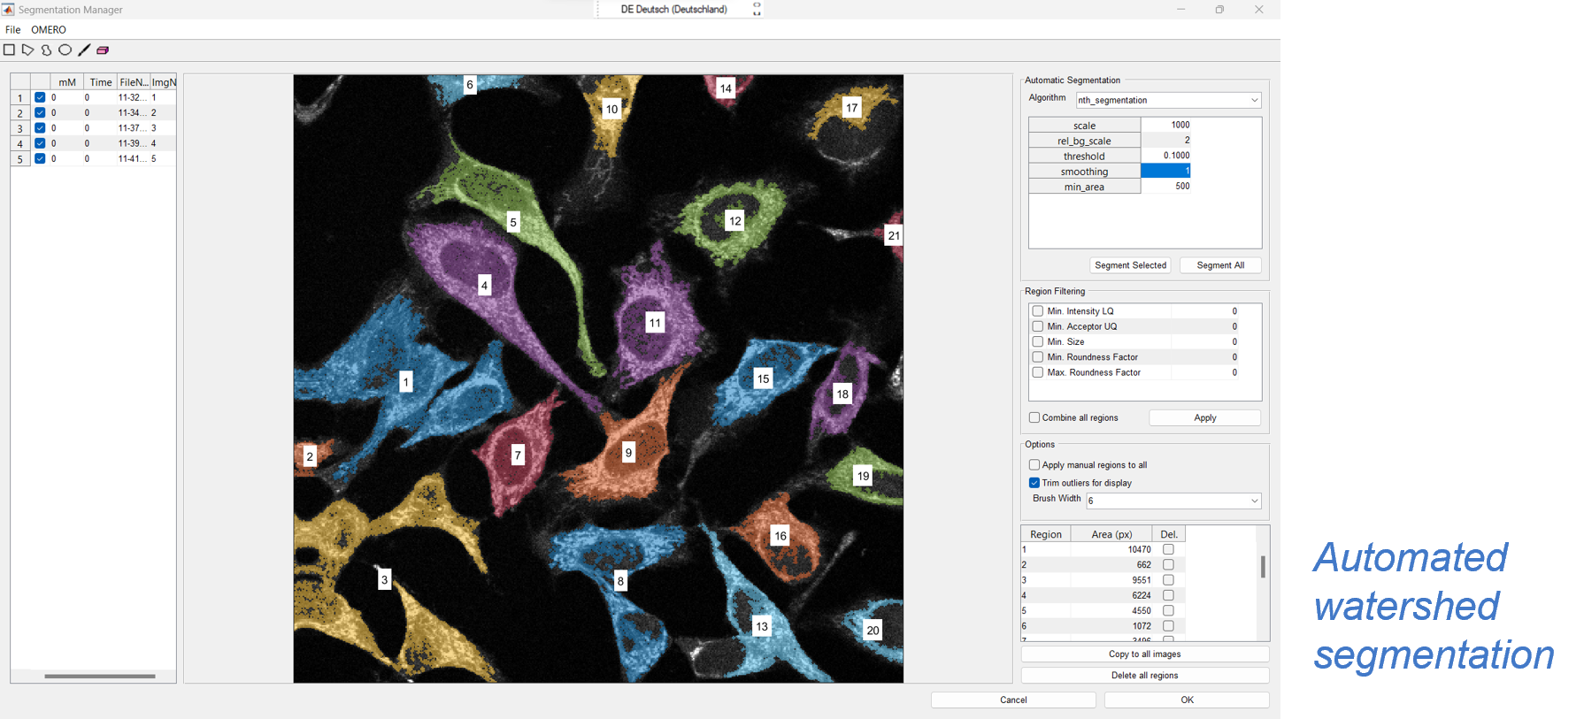
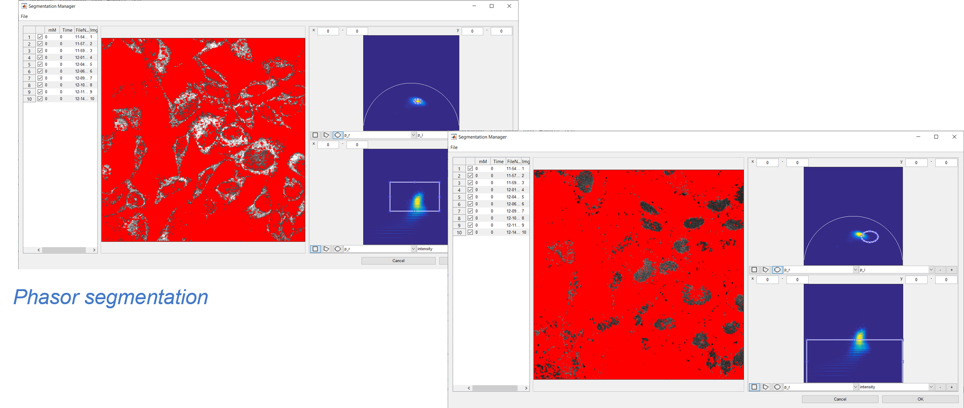
FLIMfit IMPLEMENTATIONS
Segmentation:
    Manual
    Automated: Watershed algorithm + options from Cell Profiler
    Acceptor images (for FRET experiments)
    Phasor segmentation (sine vs. cosine transforms of the decay, or intensity vs. sine/cosine transforms)
    Save and load multiple segmentation images using logical operators

Slide 5
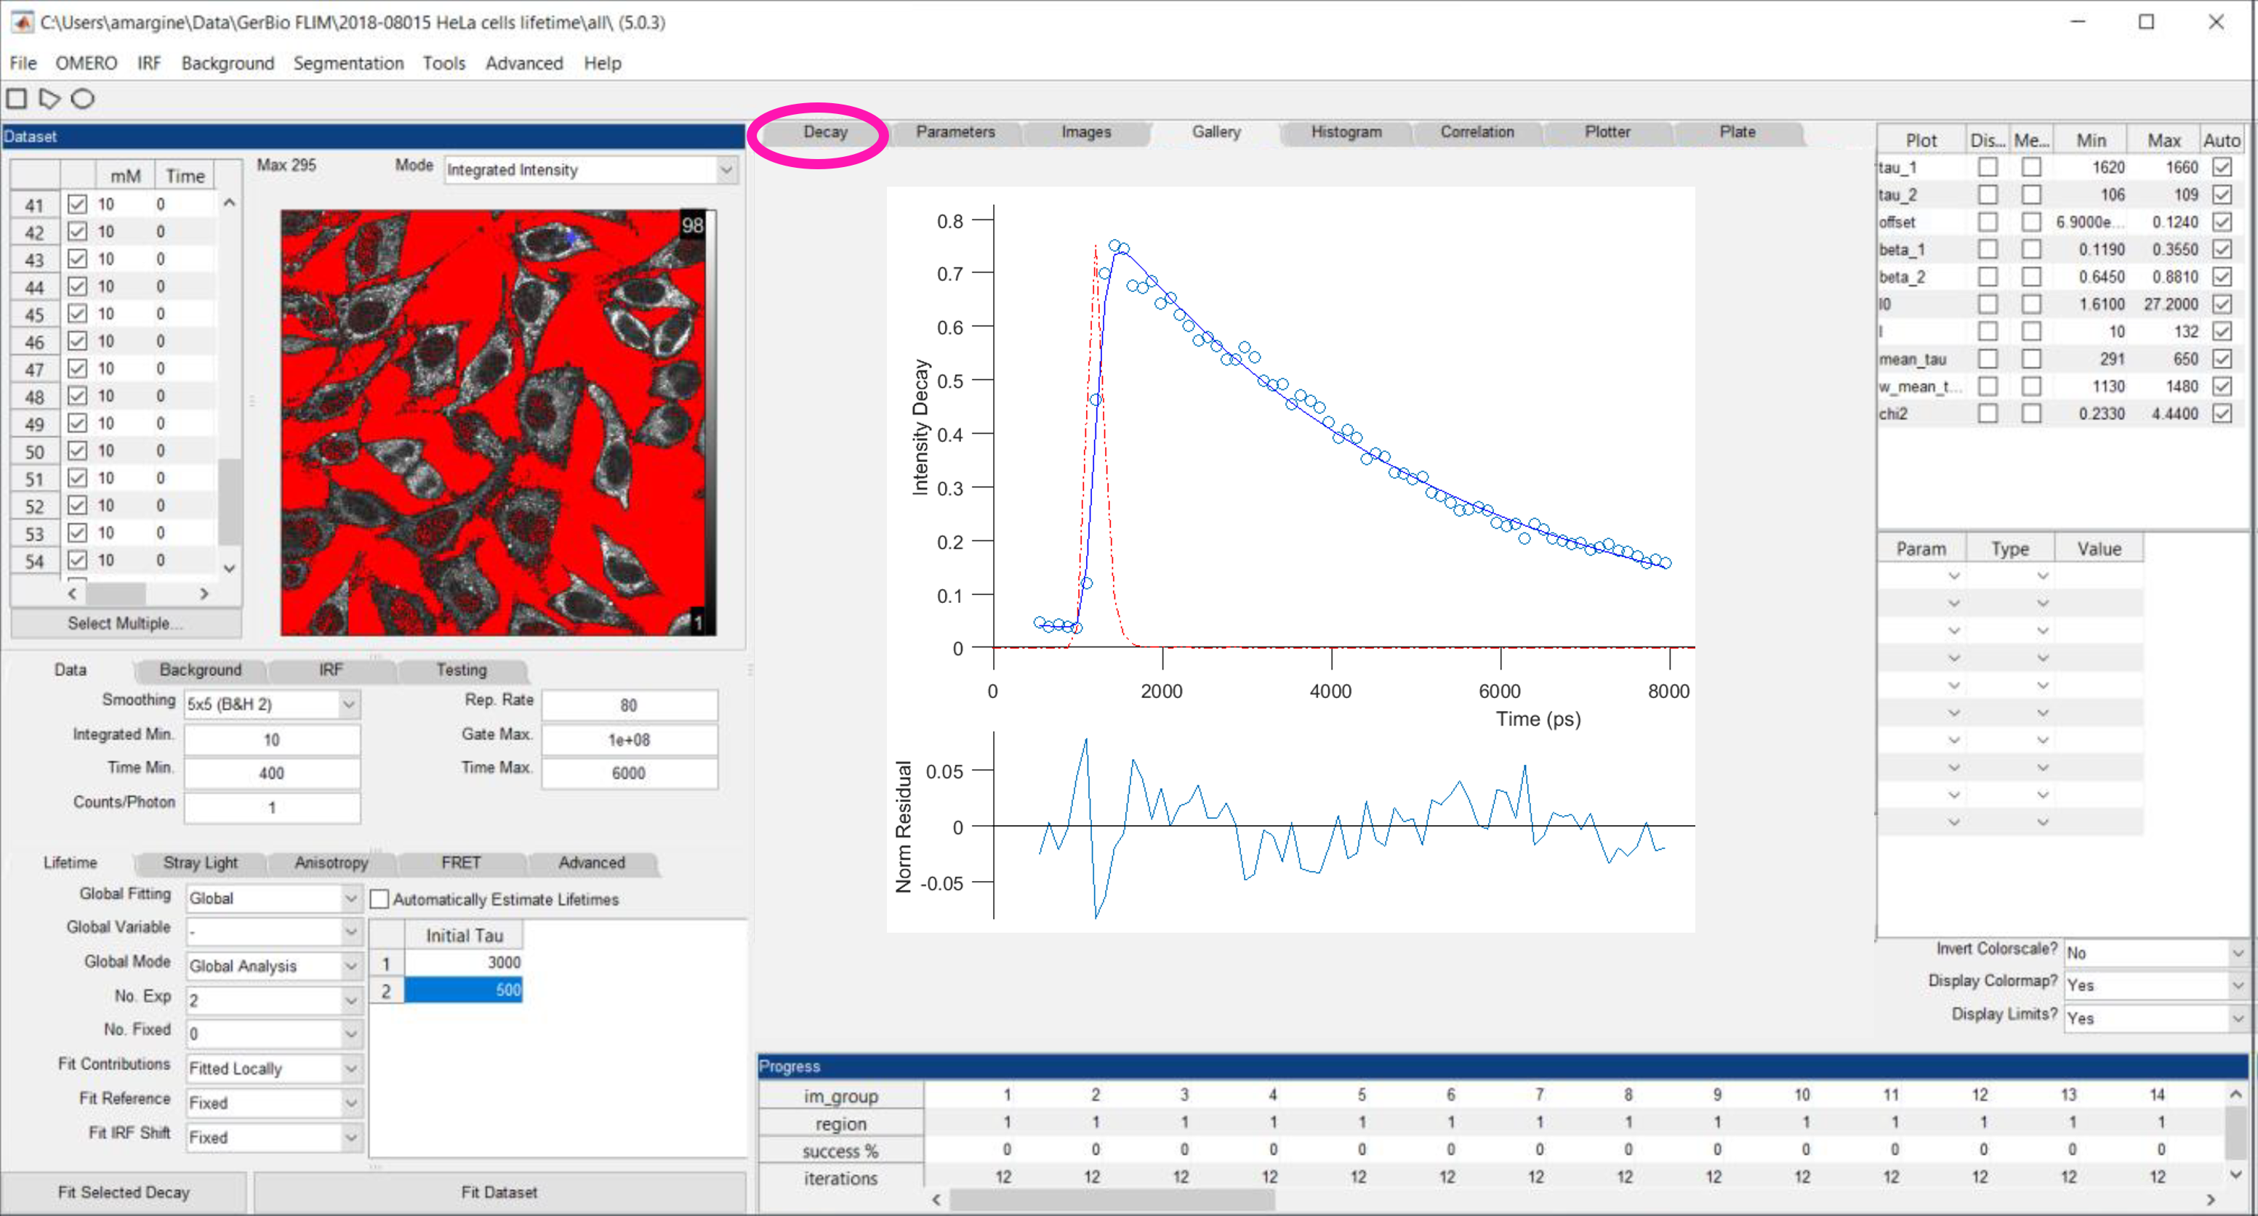
FLIMfit: DATA VISUALISATION
Time resolved fluorescence decay and fit

Slide 6
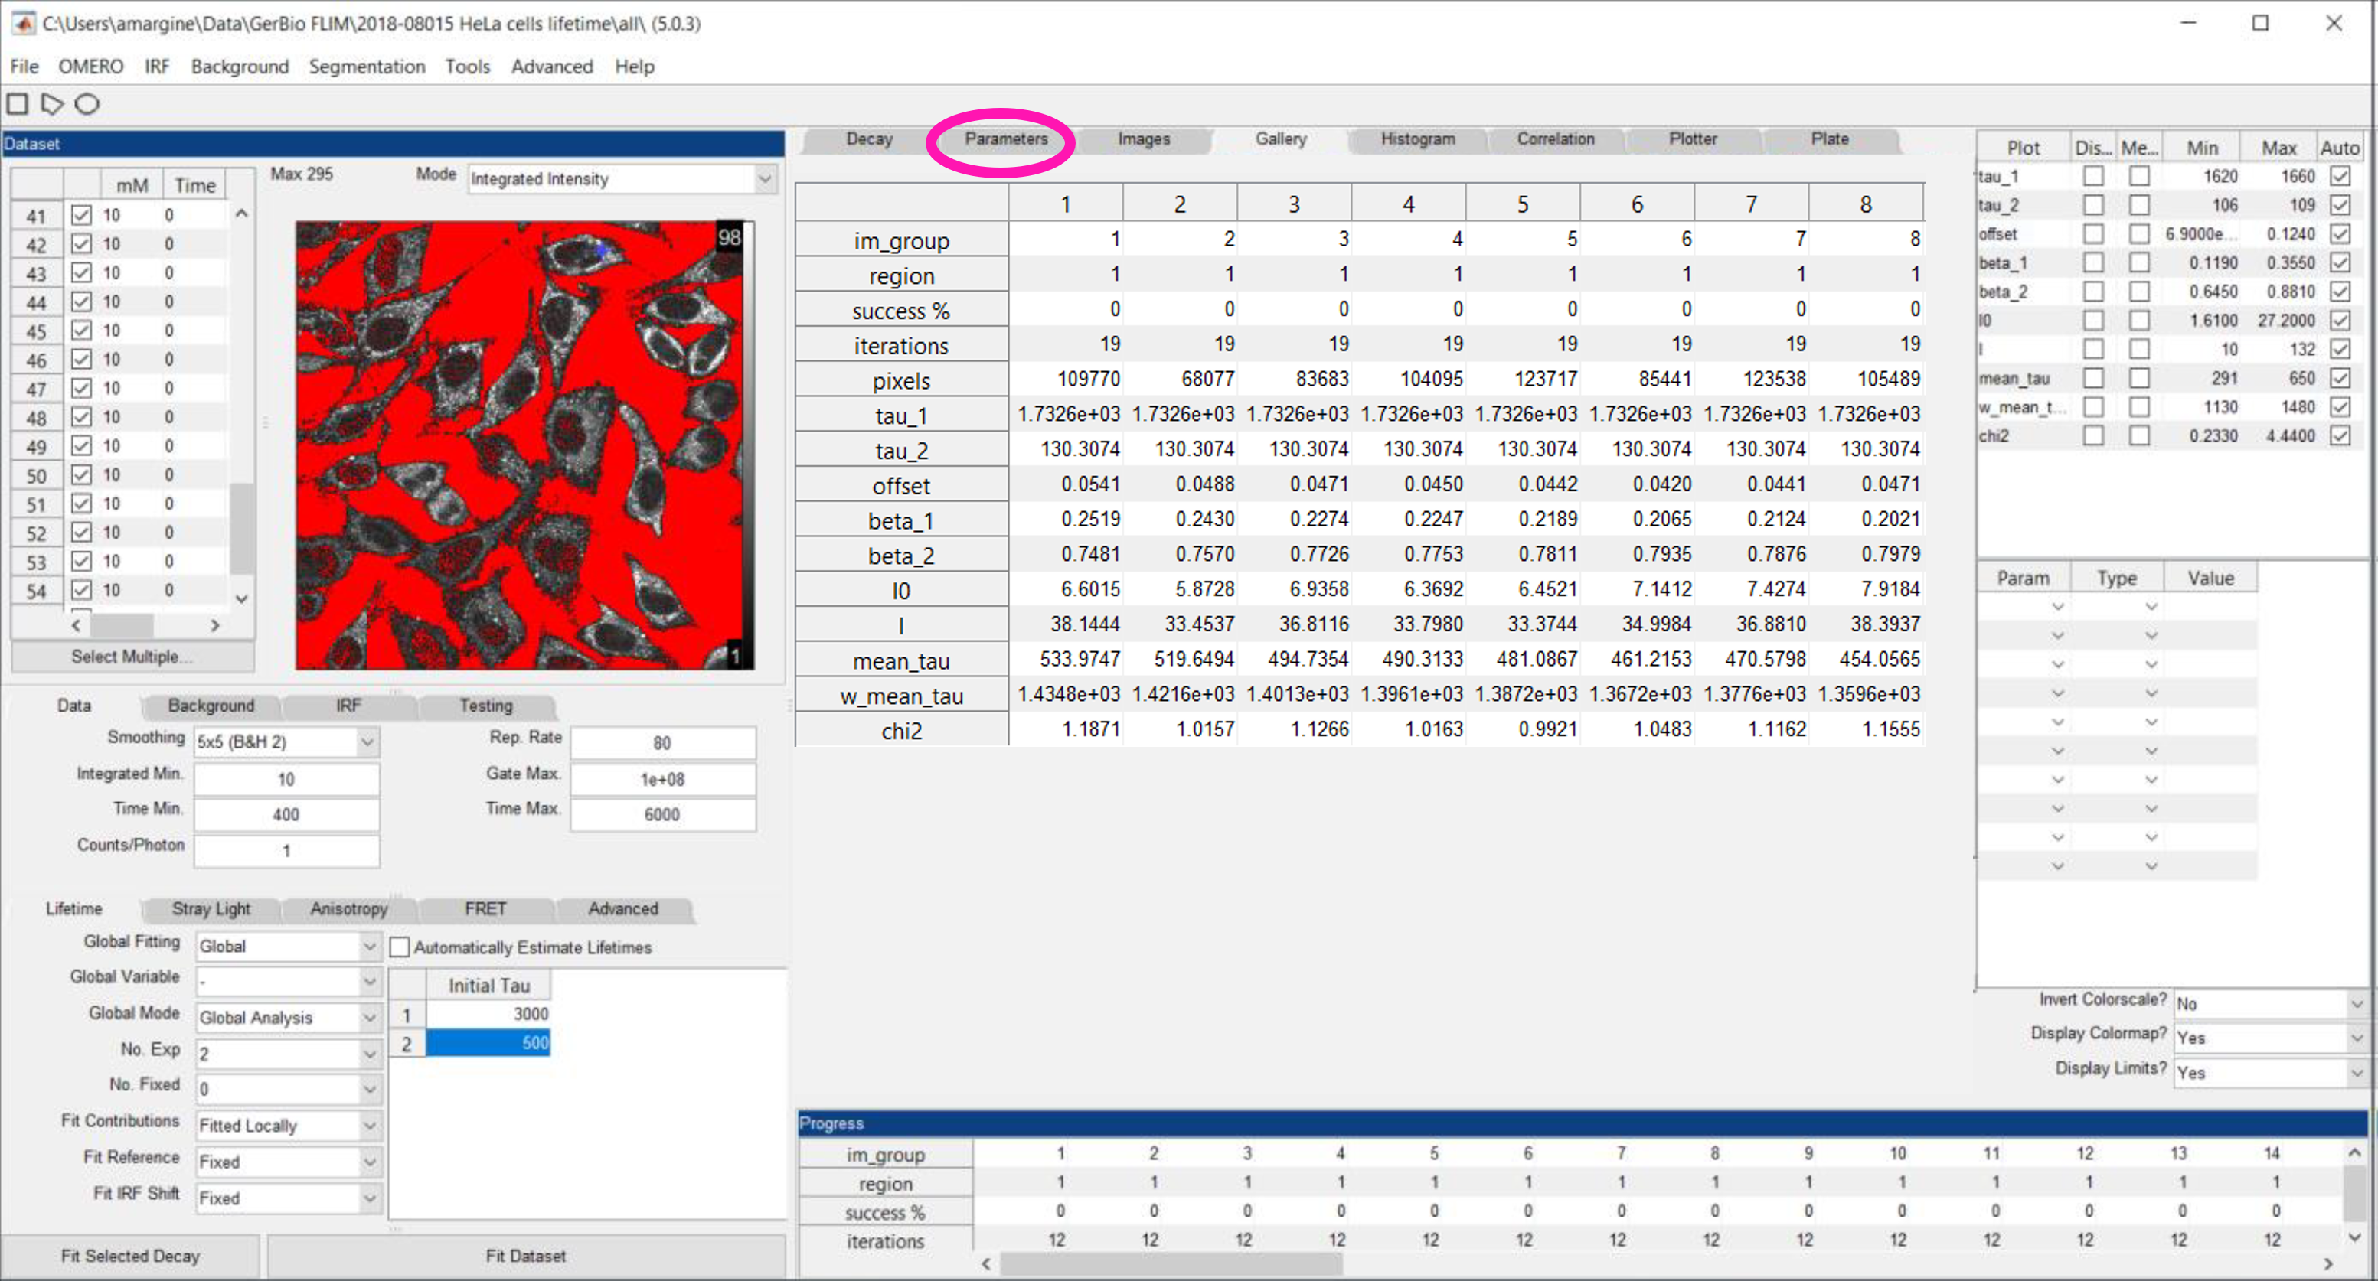
FLIMfit: DATA VISUALISATION
Tabel of fitted parameters (results)

Slide 7
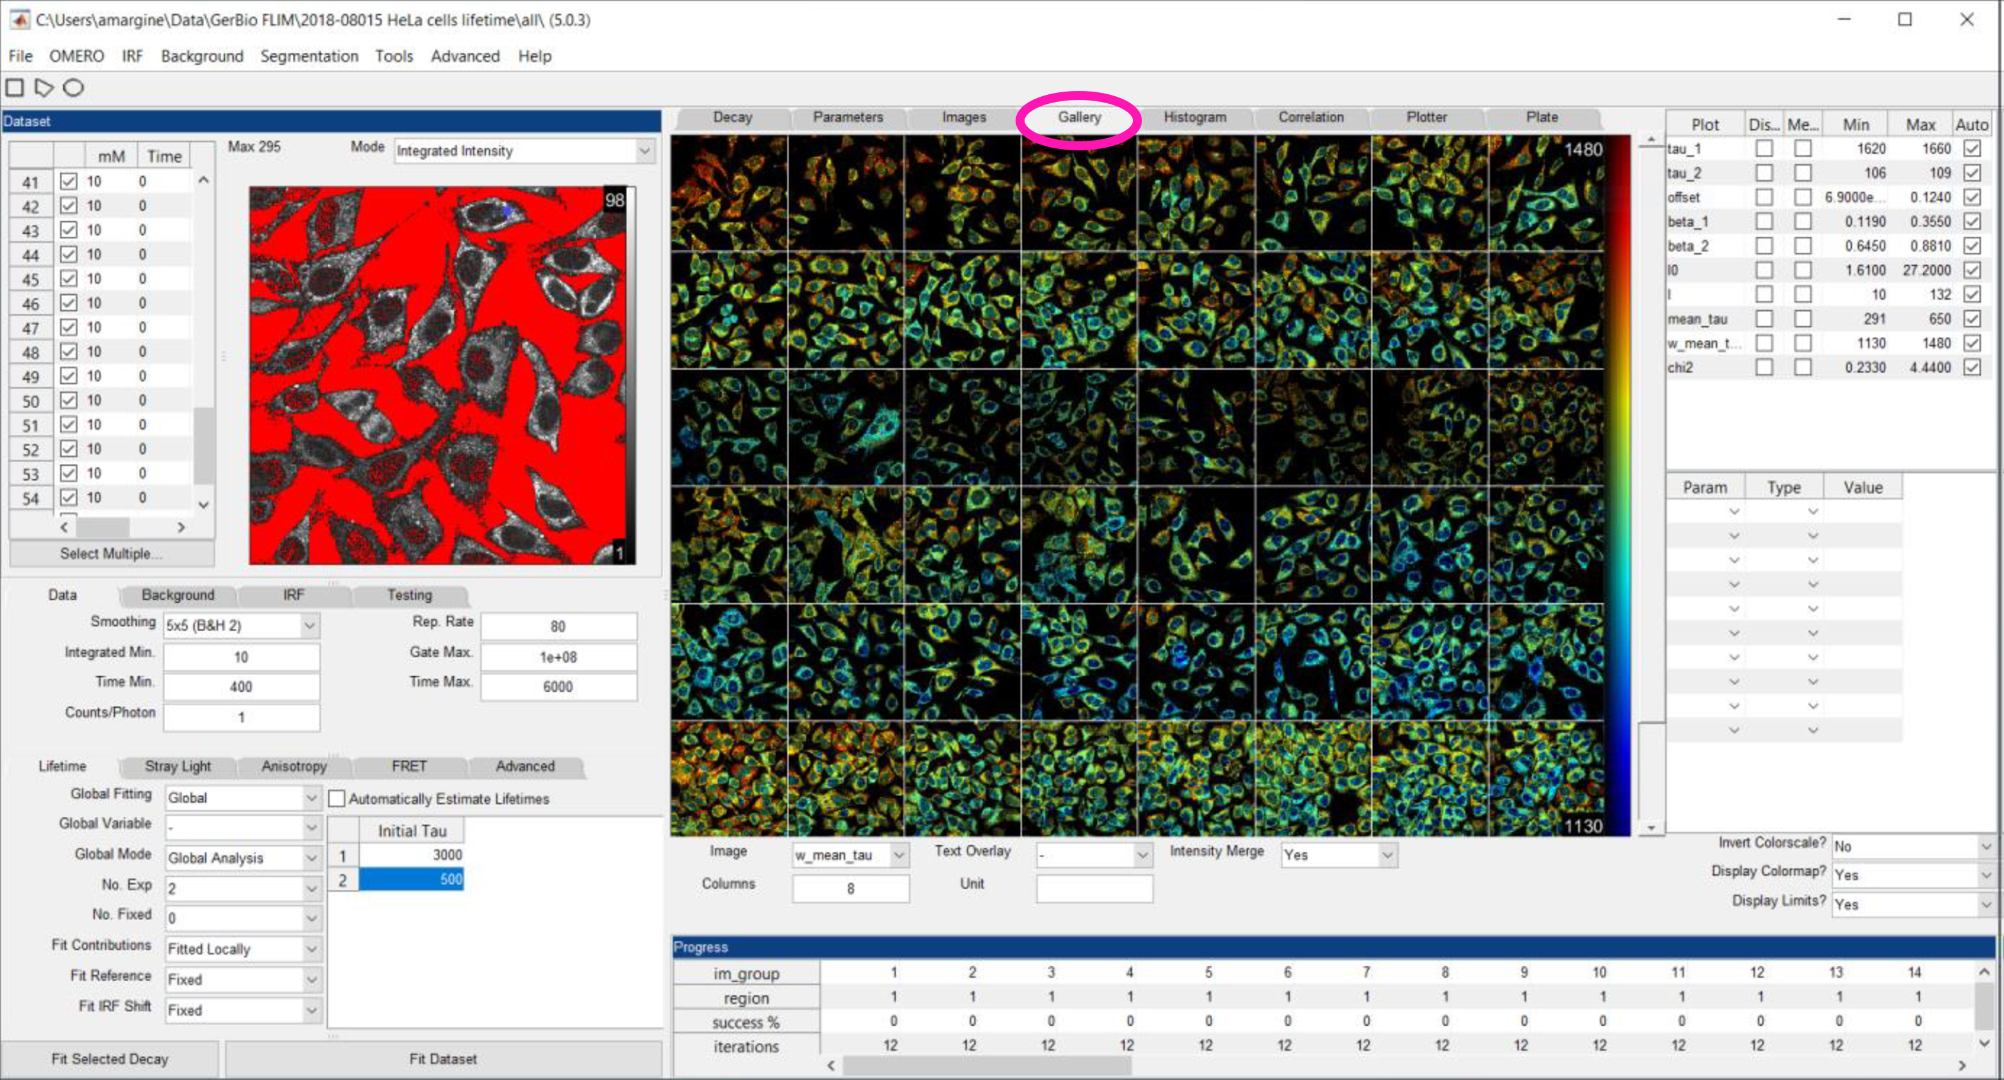
FLIMfit: DATA VISUALISATION
Image gallery of selected fitted parameters

Slide 8
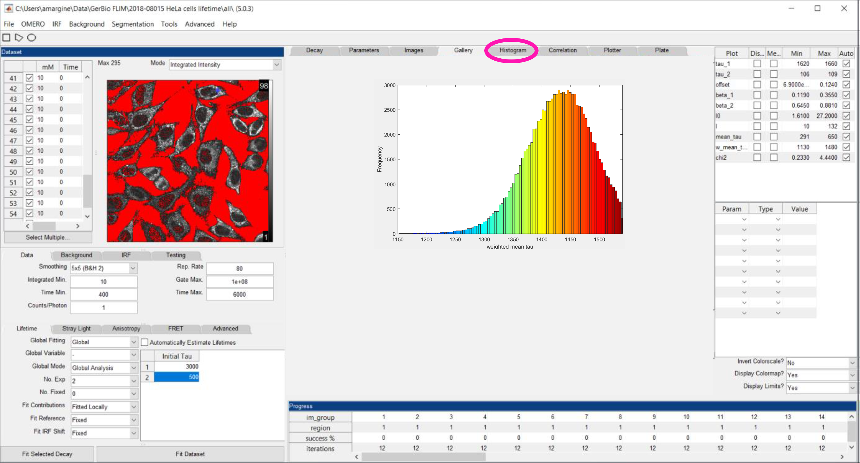
FLIMfit: DATA VISUALISATION
Histograms of selected fitted parameters

Slide 9
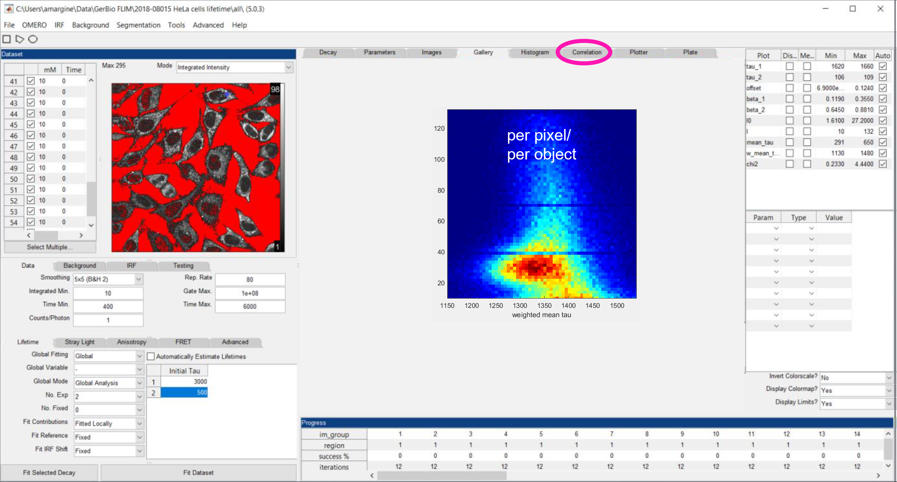
FLIMfit: DATA VISUALISATION
Correlation plots of selected fitted parameters

Slide 10
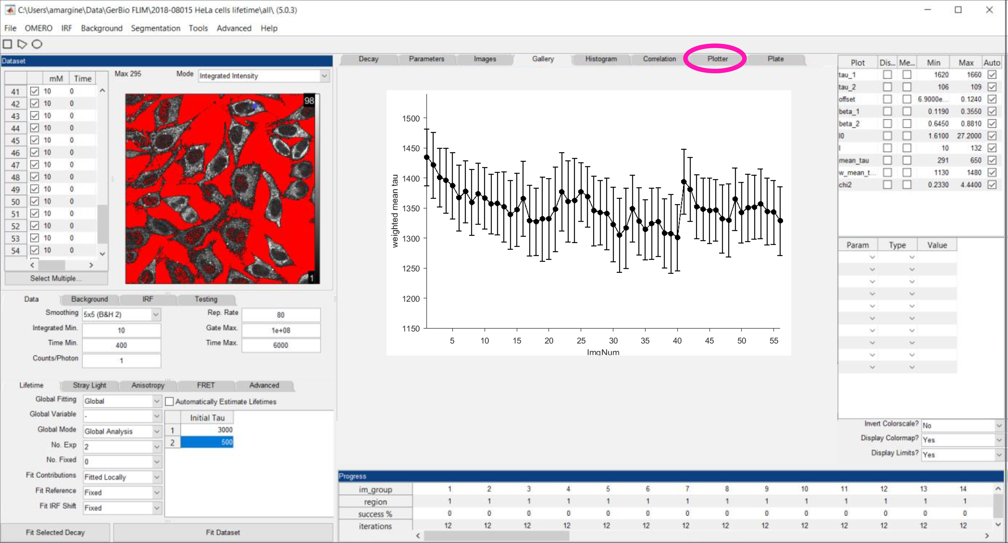
FLIMfit: DATA VISUALISATION
Plots of selected fitted parameters across all images

Slide 11
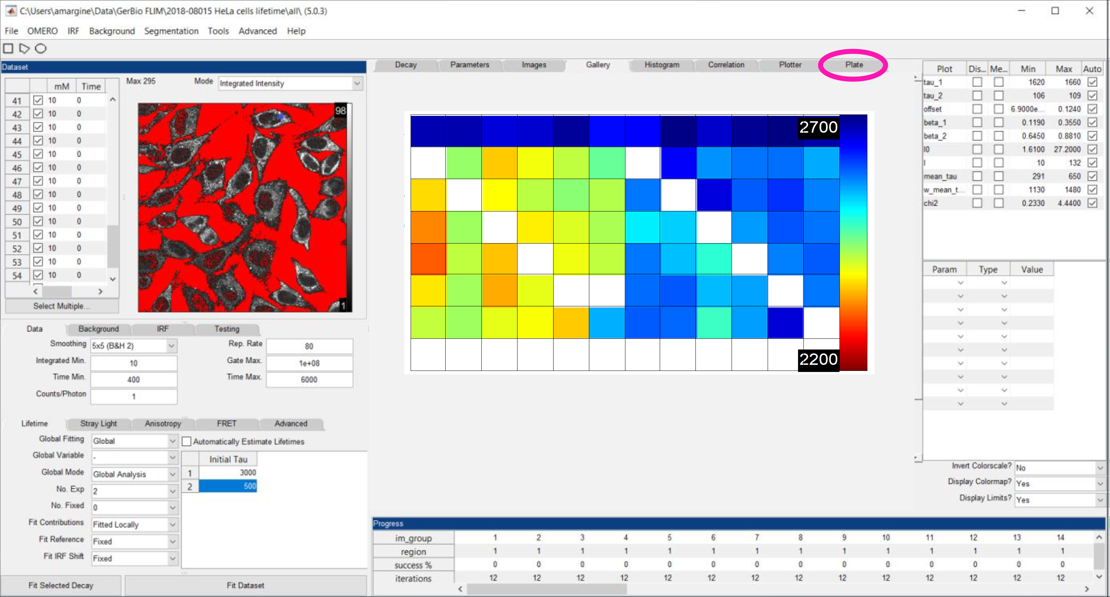
FLIMfit: DATA VISUALISATION
Average values of selected fitted parameters in a 96-well plate

Slide 12
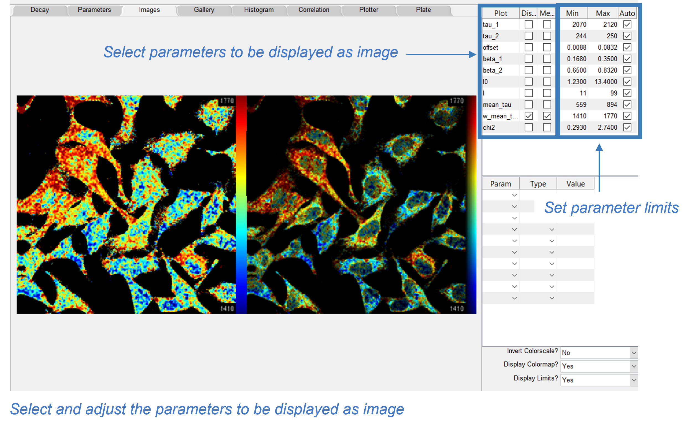
FLIMfit: EXPORTING RESULTS
Export images:
    FLIM values (.tif, raw 32-bit)
    FLIM (.tif, RGB)
    Intensity-weighted FLIM (.tif, RGB)
    Intensity (.tif, 16-bit)
Export results table (.csv)
Export histograms and plots (.csv)
Export to Power Point:
    Decay + IRF
    Galerie
    Histogram
    Correlation plots
    Plots

Slide 13
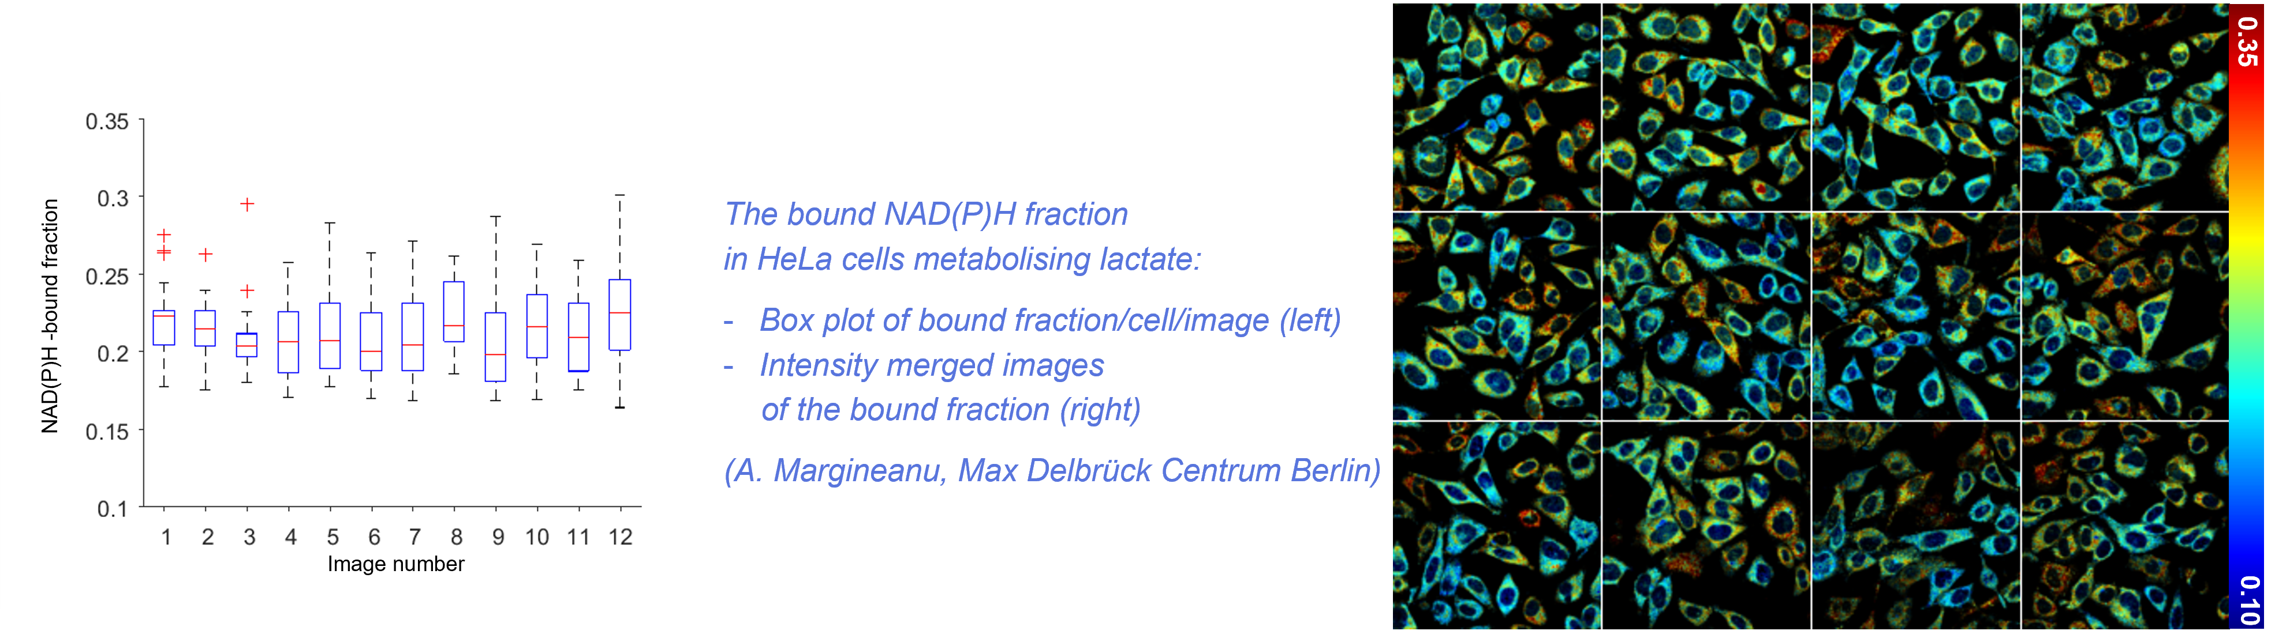
Biological Applications of flim global analysis
1. Estimate the free and bound NAD(P)H fractions in live cells
1. Global analysis with double exponential decay
Set the global analysis for all the images acquired in a given condition (i.e. tissue type, cell type, substrate, inhibitors concentrations etc.)
The short NAD(P)H lifetime corresponds to the free form
The long NAD(P)H lifetime corresponds lifetime to the bound form
Segment the images using the watershed segmentation available in FLIMfit to get statistics per cell
2. Display the results (e.g. images, statistical graphs)

Slide 14
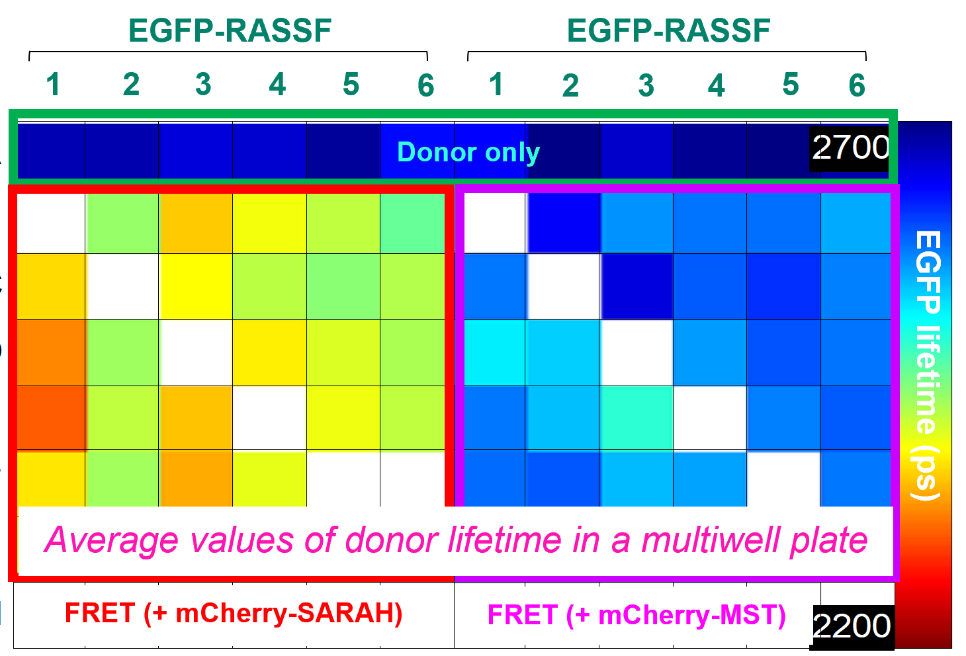
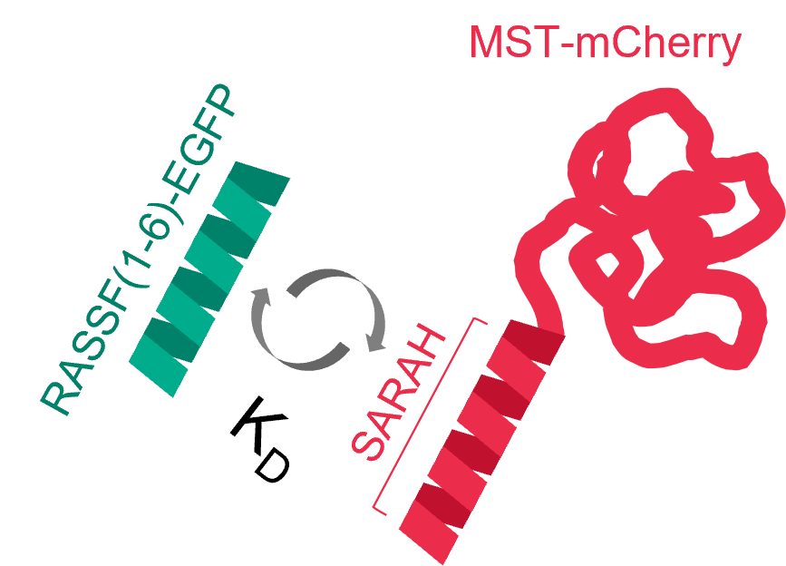
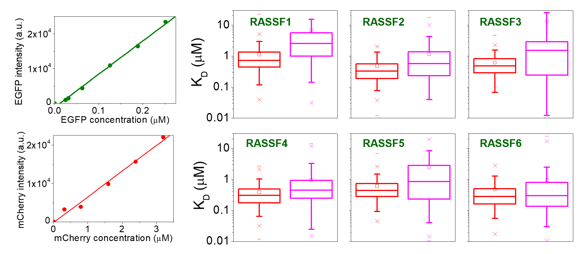


Biological Applications of flim global analysis
2. Estimate dissociation constants (K_{D}) using intermolecular FLIM-FRET
The biological interactions explored by FRET
Summary of the K_{D} calculations
Find the bound fraction β from the global double exponential fit of the FRET decays
$$I_{(t)}=I_{0}\left[(1−β)e^{−\frac{t}{τ_{D}}}+{βe}^{−\frac{t}{τ_{DA}}} \right]$$
Calibrate the EGFP and mCherry intensity vs. concentrations
Determine the dissociation constants K_{D}: $K_{D}=\frac{\left[D_{free}\right]\left[A_{free}\right]}{\left[DA\right]}$
Estimated values of the intracellular K_{D}
(statistics per cell):
- RASSF(1-6) with the SARAH domain (red box plots)
- RASSF(1-6) with the full length MST (magenta box plots)
Margineanu et al. (2016), Sci Rep. 6:28186, doi: 10.1038/srep28186

Slide 15
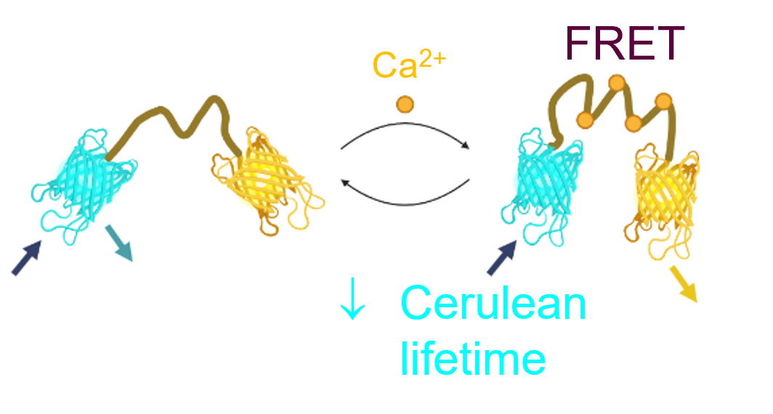
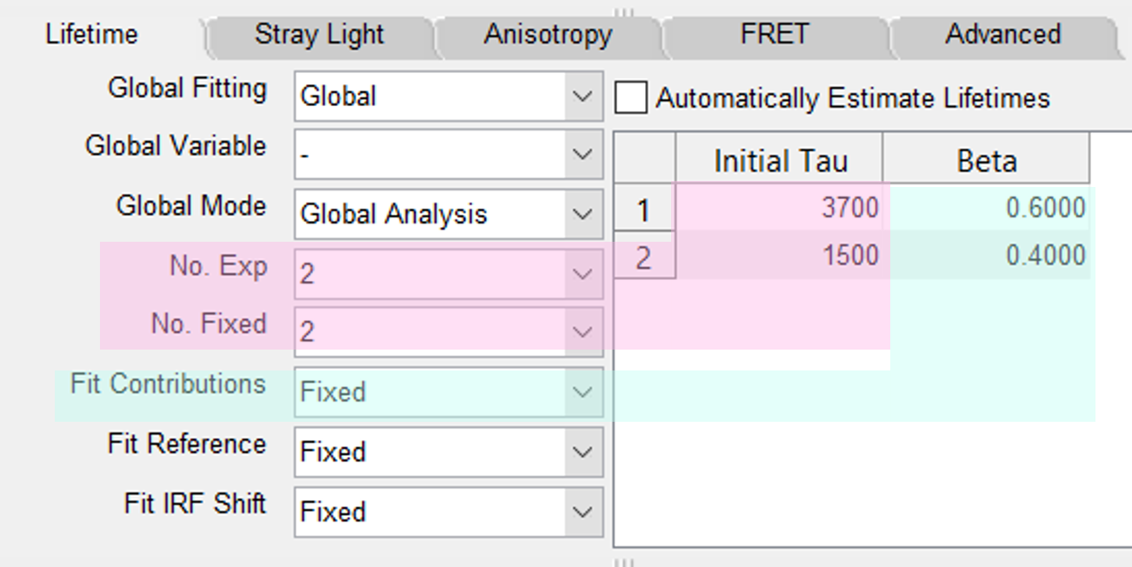
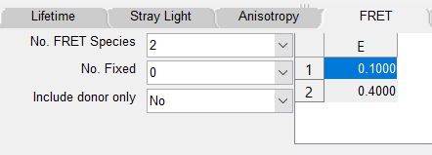
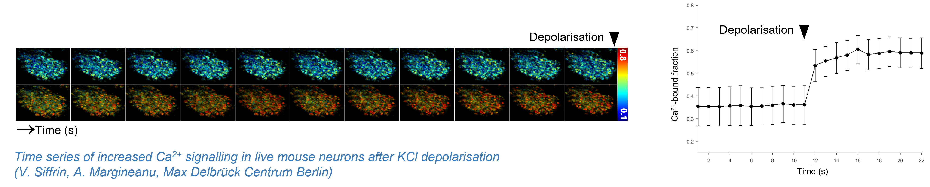
Biological Applications of flim global analysis
3. Estimate the free and bound fractions of a Ca²⁺ biosensor labeled with a multiexponential donor using the FRET model
CerTn-L15 Ca²⁺ biosensor
(Cerulean-Citrine)
1. Multiexponential donor (Cerulean)
Get the values of the lifetimes and contributions
of the donor not interacting with the acceptor and fix them
2. Set 2 FRET species with low (Ca²⁺- free)
and high (Ca²⁺-bound) FRET efficiencies
3. Display and plot the fraction of the component with high FRET efficiency (Ca²⁺-bound)

Slide 16
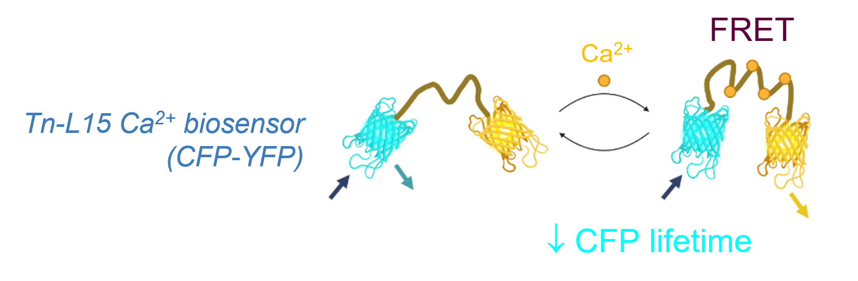
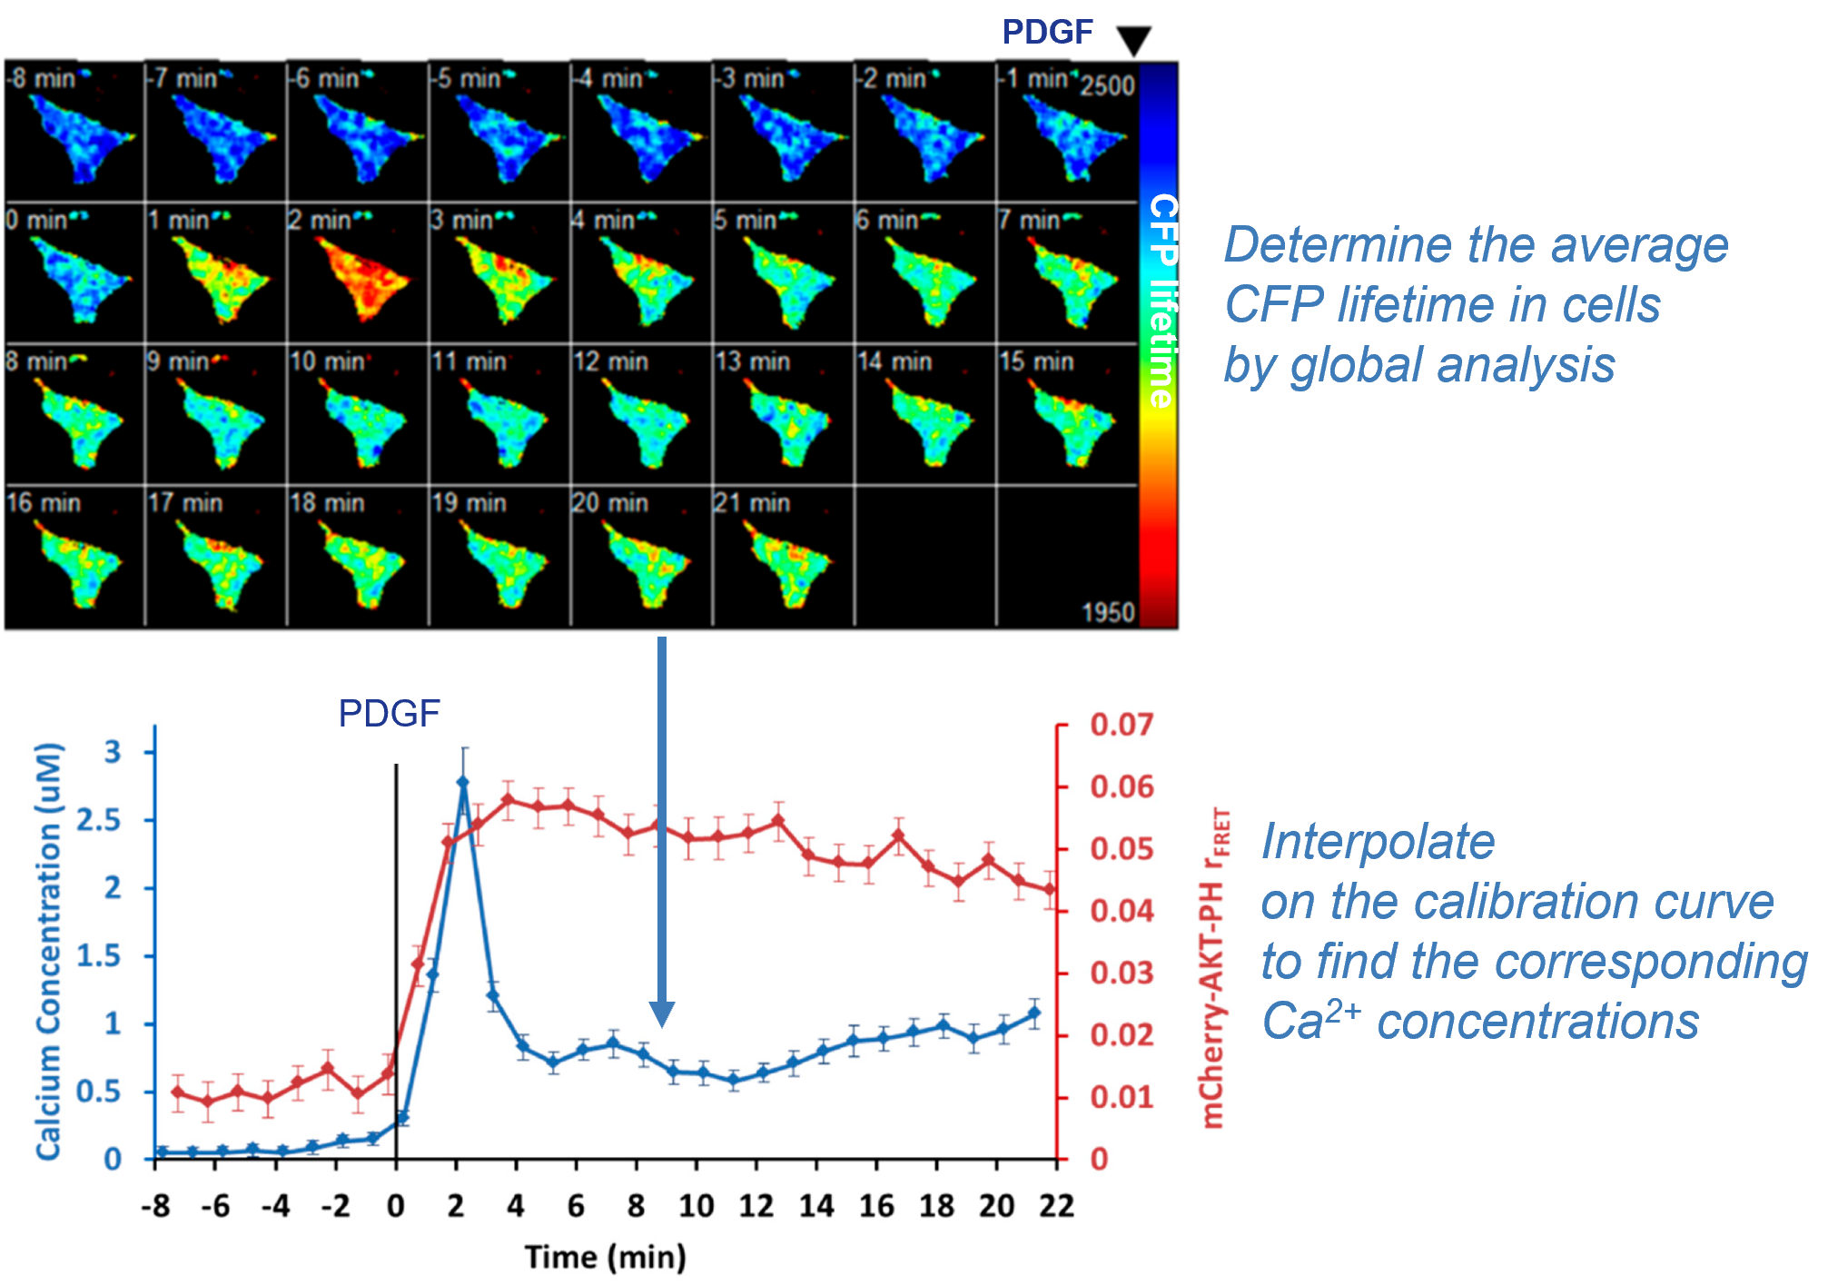
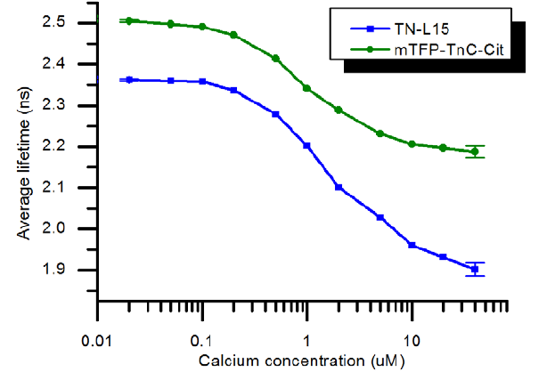
Biological Applications of flim global analysis
4. Estimate the intracellular Ca²⁺ concentration from the average lifetime of a FRET biosensor
1. Calibrate the average lifetime of a multiexponential donor
vs. Ca²⁺ concentration
2. Estimate the intracellular Ca²⁺ concentrations
Calibration curve
Laine et al. (2012), PLoS ONE 7(11): e49200. doi:10.1371/journal.pone.0049200
Warren et al. (2015), Int. J. Mol. Sci., 16: 14695

Slide 17



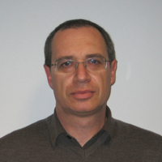

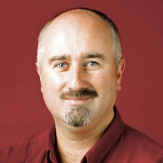
acknowledgments
The FLIMfit developers team
Dr. Sean Warren
Dr. Ian Munro
Dr. Yuriy Alexandrov
Please explicitly acknowledge “the FLIMfit software tool developed at Imperial College London”
Prof. Chris Dunsby
Prof. Paul French

