Slide 1



WS#6 Embrace the Open: Re-using and Creating OER
ENOEL Workshops
19 March 2024
1-2:30 PM CET
Zuzana Stožická, Slovak Centre of Scientific
and Technical Information
Bratislava, Slovakia

Slide 2




Introduction
Your Facilitator
Zuzana Stožická
Open Science Support, Citizen Science Ambassador
Slovak Centre of Scientific and Technical Information
(Bratislava, Slovakia)

Slide 3
Today we will talk about
What was covered in workshop #5
Diversity of OER formats
Benefits of re-using OER
Creating with Students Needs in Mind
Sharing Content in Reusable Manner
Selecting Appropriate License.
Workshop Program

Slide 4
Brief Recap Embrace the Open WS#5
Finding OER
We discovered what type of OER you can find online
We identified relevant repositories and resources
We looked at applying effective search strategies
We explored existing finding aids and search tools
We discussed where to go to get help from the community.
Recordings are available on @ENOELforOpen YouTube Channel.
Notes:
Credit:
European Network of Open Education Librarians. (2024, January 26). ENOEL WS#4 - Embrace the Open: OE Librarianship 101. Zenodo. https://doi.org/10.5281/zenodo.10573410. CC BY 4.0

Slide 5
In this workshop, you will
Identify OER for reuse according to the topic, the format, the license and the context you are working in
Select the OER that best fit your students' learning needs
Modify/adapt reused OER as allowed by their open license and acknowledge their authors properly
Increase the accessibility and reusability of the OER you are creating
Choose the right license for your OER according to the project requirements, your institutional policy, and the context.
Learning Objectives

Slide 6
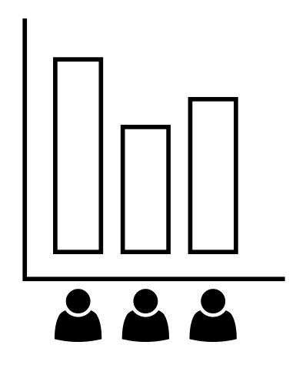

Who are you?
What is your favorite role in relation to OER?
https://answergarden.ch/4072424
Discoverer?
Creator?
Curator?
Adaptor?
User?
Notes:
Credits:
https://thenounproject.com/icon/poll-923772/, public domain

Slide 7
Who are you?
Typology of educators in relation to OER
(Admiraal 2022, dataset from Open University, UK)
ACTIONS:
Adapt / Reuse (less experienced educators)
Adapt / Comment (more experienced educators with lack of time)
Adapt / Create / Add (educators that add resources to the repository)
Adapt / Create / Publish / Add / Comment (experienced educators, interact with all phases of the reuse process)
Retain / Consume (low-level OER users).
Using, adapting and commenting on OER is a way to move the educator community forward and pass on experience.
Notes:
Credits:
Admiraal, W. (2022). A typology of educators using Open Educational Resources for teaching. International Journal on Studies in Education (IJonSE), 4(1), 1–23. [Online]. Available at: https://doi.org/10.46328/ijonse.60. (Accessed 17 March 2024)

Slide 8
Who are you?
A conscious OER user!
Importance of awareness
according to Schuwer and Baas (2023) many educators use open resources, but are not aware of it (“accessible = free“ assumption → may not distinguish between OER and other resources → possibility of unintentional copyright infringement)
My experience from Slovakia: faculties and NGOs often share their educational resources freely on internet to increase impact, but (unaware of Creative Commons licenses) with copyright or without any licensing information.
It is important not only to use, adapt and create OER, but also to talk about it – and teach best practices.
Notes:
Credits:
Schuwer, R., Baas, M. (2023). Reuse of OER, a Process Model Approach. In: Otto, D., Scharnberg, G., Kerres, M., Zawacki-Richter, O. (eds) Distributed Learning Ecosystems . Springer VS, Wiesbaden. [Online]. Available at: https://doi.org/10.1007/978-3-658-38703-7_7. (Accessed 17 March 2024)

Slide 9
Context and Diversity of OER
Open
Educational
Resources
Notes:
Credits:
UNESCO OER logo by Jonathasmello, https://en.m.wikipedia.org/wiki/File:Global_Open_Educational_Resources_%28OER%29_Logo_-_Black_and_White_variation.svg, Creative Commons Attribution 3.0 Unported, modified by Zuzana Stožická

Slide 10
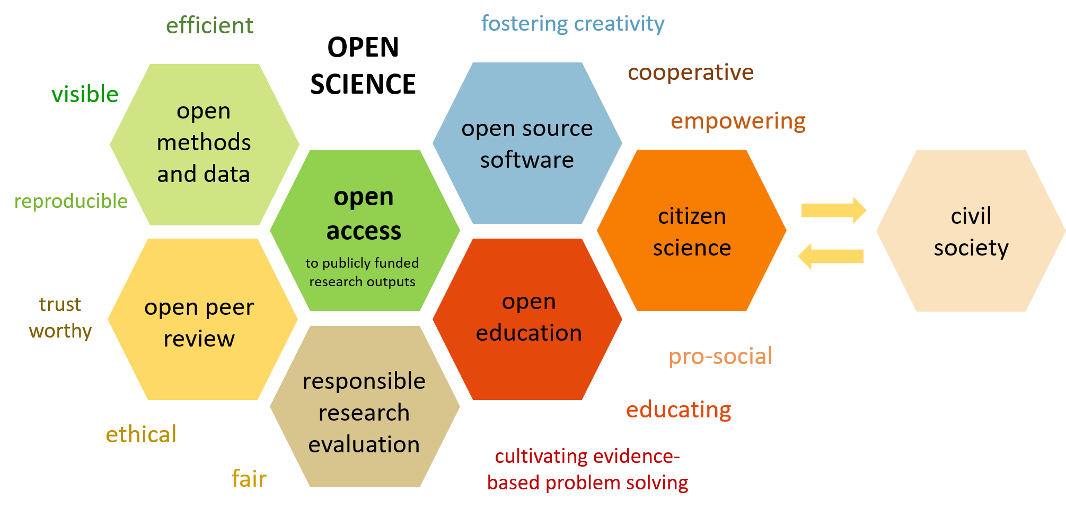
OER in context
Foster Open Science, adapted by Zuzana Stožická, CC BY.
Notes:
Foster Open Science (2018) What is Open Science? Introduction: Fig. 2, Open Science facets as a beehive. [Online]. Available at: https://www.fosteropenscience.eu/content/what-open-science-introduction (Accessed 17 March 2024). CC BY, adapted by Zuzana Stožická, 2024 (colors, development of the idea, connection to civil society), CC BY.

Slide 11
OER in context
Open Educational Resources
OER = overcoming barriers for education
access: free for reader/user
legal: public licenses
(clearly set permissions what can the user do with OER)
aimed for teaching/learning
various formats/media for various target groups and educational needs.
UNESCO definition (2012):
https://www.unesco.org/en/open-educational-resources
Notes:
Unesco (2021) Open educational resources. [Online]. Available at: https://www.unesco.org/en/open-educational-resources (Accessed 26 February 2024).

Slide 12

OER types and formats
lesson plans
infographics
instructions
images
worksheets
educational games
experiments
software
textbooks
podcasts
articles
maps
schemes
animations
courses
tests
modules
presentations
videos
methodologies...
Other sources of variability: languages, text complexity, use of terminology...
Notes:
Unesco logo for Open Educational resources by Jonathasmello (2012) Open educational resources. [Online]. Available at: https://en.m.wikipedia.org/wiki/File:Global_Open_Educational_Resources_Logo.svg (Accessed 26 February 2024), modified by Zuzana Stožická (types and formats of OER added), CC BY.

Slide 13
OER types and formats
The format of the OER may be influenced by:
age of the students (from children to retirees)
their knowledge background
perceptive abilities
learning objectives
subject/topic
timeframe for learning
number of students
technical limitations
expected learning circumstances
...
the copyright owner and provides permissions granting the
public the rights to access, re-use, re-purpose, adapt and redistribute
educational materials.”
… it is important to cooperate with representatives of target groups, and/or co-create.
Notes:
Unesco (2021) Open educational resources. [Online]. Available at: https://www.unesco.org/en/open-educational-resources (Accessed 26 February 2024).

Slide 14
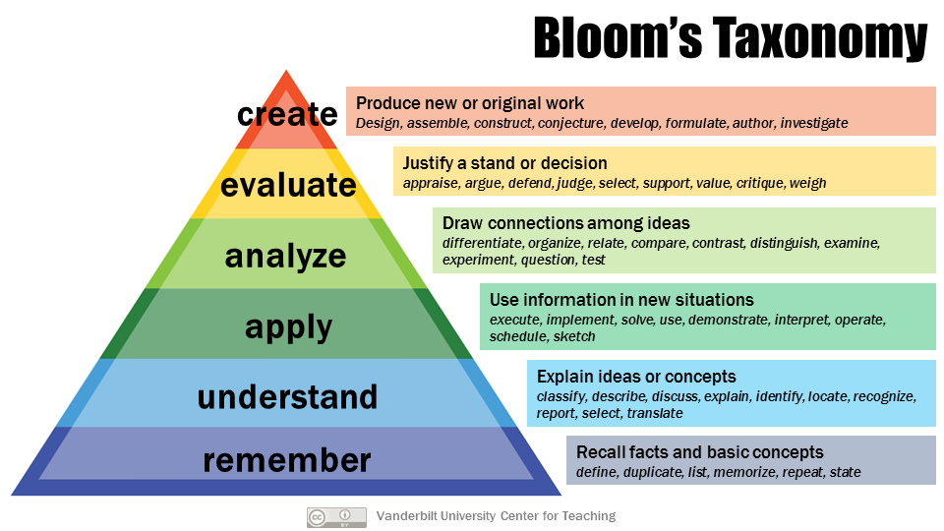
Bloom’s taxonomy of educational objectives
Framework for categorizing educational goals, which help us to choose the right OER – and accompanies us on our open educational journey.
Notes:
Armstrong, P. (2010). Bloom’s Taxonomy. Vanderbilt University Center for Teaching. Retrieved [18. 3. 2024] from https://cft.vanderbilt.edu/guides-sub-pages/blooms-taxonomy/ CC BY

Slide 15
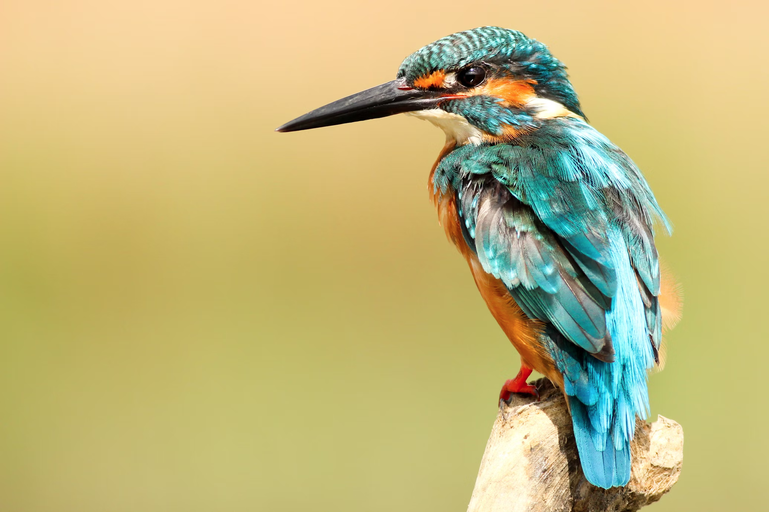
Example of Re-use
Image – one of the simplest (and most frequently used) OER units
Find it (WS#5, slide 22 - repositories)
Does it have open (re-use permissive) license?
Attribute it,
Use it in lesson, textbook or elsewhere.
the copyright owner and provides permissions granting the
public the rights to access, re-use, re-purpose, adapt and redistribute
educational materials.”
Photo: Kingfisher, by Boris Smokrovic, 2017, unsplash: https://unsplash.com/photos/blue-and-brown-bird-on-brown-tree-trunk-DPXytK8Z59Y, unsplash license.
T – title
A – author
S – source
L – license
CC search portal: https://search.creativecommons.org/
Unsplash: https://unsplash.com/
Notes:
https://unsplash.com/

Slide 16
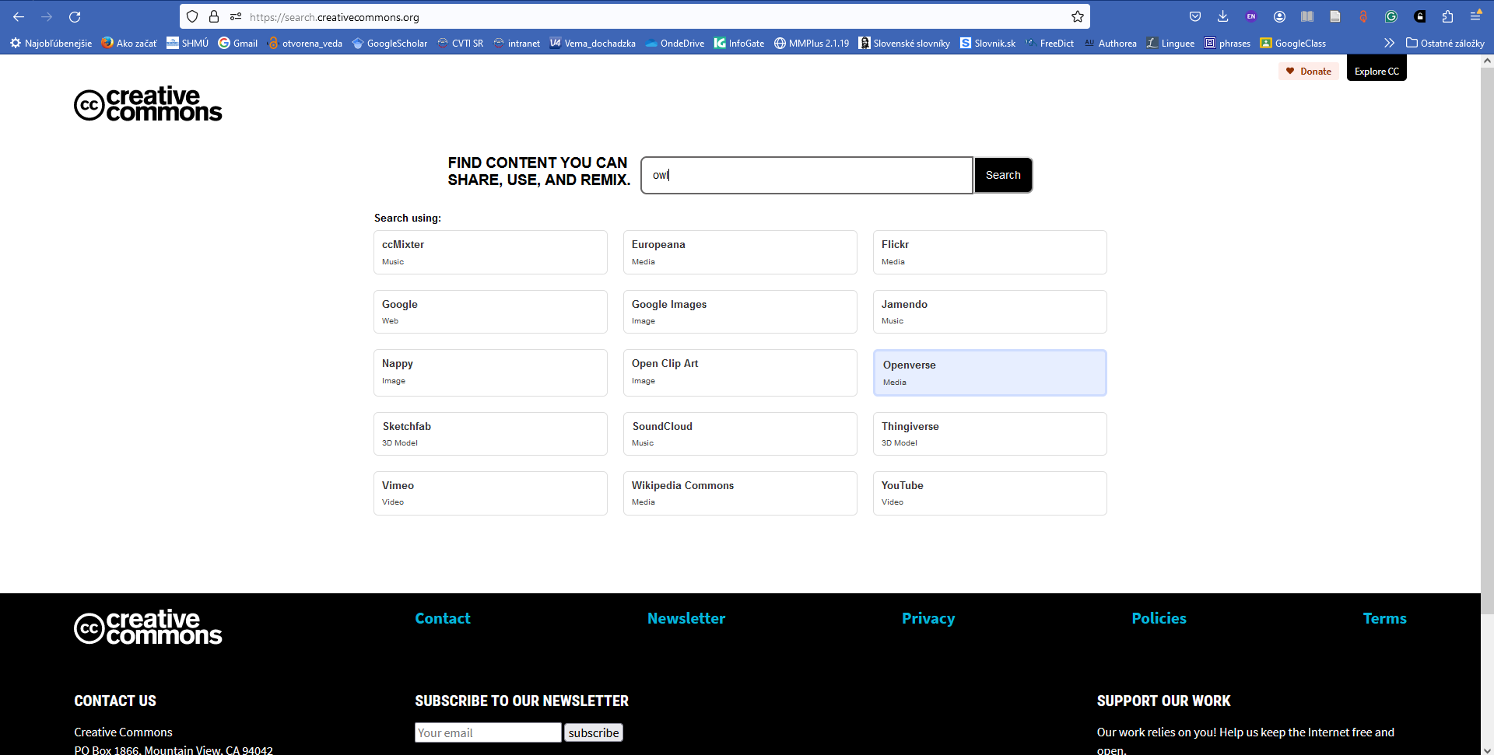
Example of search with CC search portal: https://search.creativecommons.org/

Slide 17
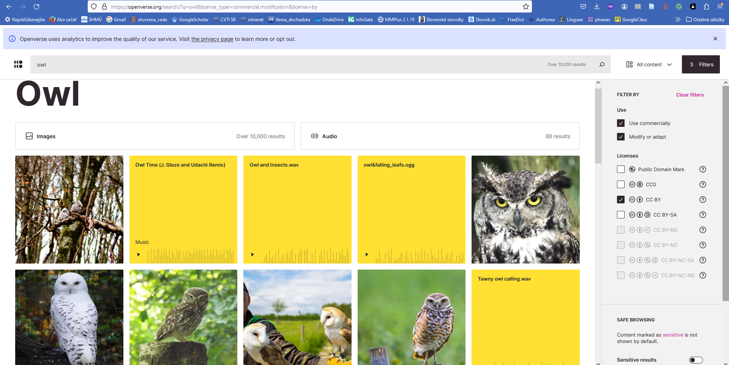
Example of search with CC search portal: https://search.creativecommons.org/

Slide 18
How to make OER meet students’ needs?
Ask:
What do we need?
Consider your aims as a teacher and student's needs.
Set your criteria (topic, form...)
Find OER fitting your criteria in open repositories
Evaluate and choose
Test with students, get feedback
Share openly (resources as well as experiences)
Is it good, but not exactly what you need?
Couldn't find any?
Need minor revisions?
Create your own OER
Adapt
Need to correct false assumptions?
Notes:
Inspired by Open Academy (2024): Adapting OER to meet learner needs (Fig. 1). [Online]. Available at: https://www.open.edu/openlearncreate/mod/oucontent/view.php?id=87869&printable=1 (Accessed 17 March 2024)

Slide 19
Activity
Search in your favorite repository
for OER to re-use/adapt:
OER Commons,
Merlot,
OASIS,
BC Campus Open Collection,
OERSI,
...
Choose one OER according to your priorities.
Determine which educational objectives you would like to achieve with this resource.
the copyright owner and provides permissions granting the
public the rights to access, re-use, re-purpose, adapt and redistribute
educational materials.”
Notes:
https://oercommons.org/
https://merlot.org/merlot/
https://www.oasis-open.org/oasis-open-repositories-overview-0/
https://solr.bccampus.ca/wp/
https://oersi.org/resources/
More open repositories mentioned in the presentation from workshop #5, “Finding OER” (slide 22): https://zenodo.org/records/10803062

Slide 20
How to choose?
Questions you have to ask:
Content: Does the OER cover what your students need to learn? Is the knowledge current, accurate, appropriate...?
Accessibility: Is it comprehensible? Can students understand this level of terminology? Is there any other factor that prevents students from accessing the content (e.g. technical)?
Use: Is the license open enough (to allow you what you want to do with the OER)?
Quality: Was it peer-reviewed?
Format: Does the material come in an accessible format (or proprietary software is needed to open it)?
...
the copyright owner and provides permissions granting the
public the rights to access, re-use, re-purpose, adapt and redistribute
educational materials.”
Other criteria: clear description, organization of content, modularity, trustworthy source, recommendations (rating, statistics, peer review...), easy to modify, interactivity...
The final arbiter is your personal assessment of suitability of the resource.
Rubric for Evaluating OER: https://docs.google.com/document/d/13evVG3cfSR_5kU47WLMh4OO88vcoG2qBHFy7WgpkZuE/edit#heading=h.gjdgxs
Notes:
UT Austin Instructor Learning Community (2021) Rubric for Evaluating OER. [Online]. Available at: https://docs.google.com/document/d/13evVG3cfSR_5kU47WLMh4OO88vcoG2qBHFy7WgpkZuE/edit#heading=h.gjdgxs (Accessed 17 March 2024).
Sample Rubric for Evaluating OER by the University of Texas at Austin is licensed under CC BY 4.0. It is an adaptation of DigiTex (SAMPLE) Checklist for Evaluating OER by DigiTex, which was adapted from Checklist for Evaluating Open Educational Resources (OER) by the Office of Instructional & Faculty Development at Austin Community College, licensed under CC BY 4.0.
Evaluating OER: list of tools https://guides.library.ucdavis.edu/open-educational-resources/evaluate

Slide 21
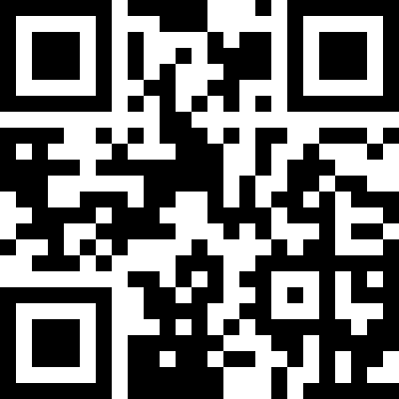
Which aspect of OER evaluation gives you the most trouble?
https://answergarden.ch/4078953
Assessing content? Licenses? Technical aspects?
Notes:
Credits:
https://thenounproject.com/icon/poll-923772/, public domain

Slide 22
Challenges and OER
Challenges of educators in relation to OER
(Admiraal 2022, dataset from Open University, UK):
Suitability of resources (58 %)
Quality of resources (56 %)
Time to search (48 %)
Up-to-date resources (39 %)
Relevance of resources (37 %)
Time to experiment (33 %)
Notes:
Credits:
Admiraal, W. (2022). A typology of educators using Open Educational Resources for teaching. International Journal on Studies in Education (IJonSE), 4(1), 1–23. https://doi.org/10.46328/ijonse.60.

Slide 23
Benefits of re-using / adapting OER
Professional development
Learn new topics
Prepare teaching
Open
Broaden resources
Educational
Broaden methods
Engage students
Resources
New ideas
Stay up-to-date

Slide 24
Benefits of re-using and adapting OER
Why do educators re-use/adapt OER?
efficiency: OER save energy and time of authors (which can be devoted to the practical work with students), OER accessible immediately
increase equity: students can access materials regardless their social status or disability
engagement: innovative material and open pedagogy motivates students to take active part in the process of learning and creating OER
development: possibility to improve, increase relevance
flexibility: possibility to update quickly, to various groups of students (special educational needs)
cooperation: possibility to contact authors (give credit, notify how their resource is used, offer experience with your modified version of their source, or improve it together)
display benefits of open science and open education.

Slide 25
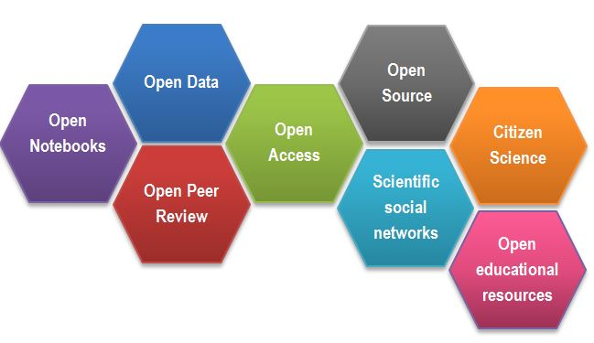
Example of adapting OER
Image – one of the simplest (and most frequently used) OER units
Find it
Does it have re-use/revise permissive license? (not CC BY-ND – Creative Commons attribution no-derivative license does not allow any changes)
Make changes (update, translation, correction, addition, refinement or simplification for different target group, development of the idea...)
Attribute it,
Integrate it into your teaching and use it.
Foster Open Science (2018) What is Open Science? Introduction: Fig. 2, Open Science facets as a beehive. [Online]. Available at: https://www.fosteropenscience.eu/content/what-open-science-introduction (Accessed 17 March 2024). CC BY, adapted by Zuzana Stožická, 2024 (colors, development of the idea, connection to civil society), CC BY.

Slide 26
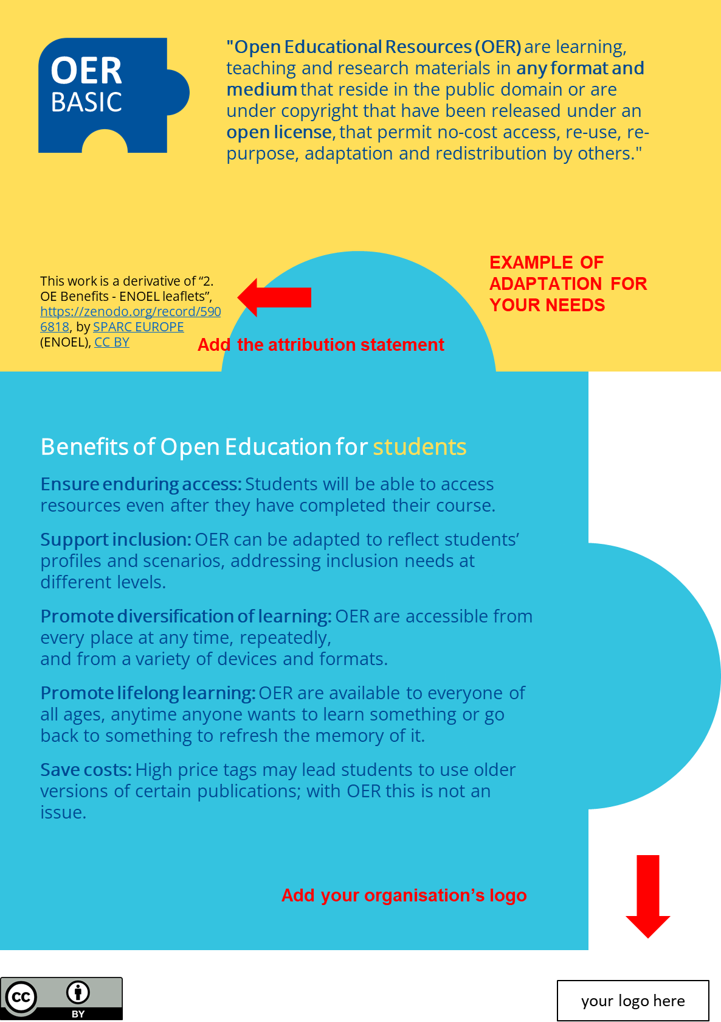
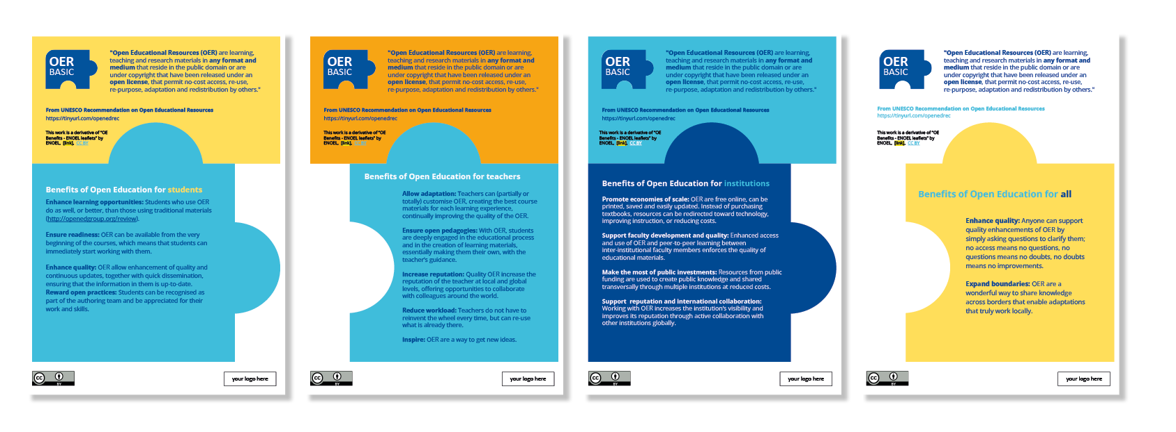
Example of adapting OER
ENOEL Toolkit
Set of tools (presentation slides, leaflets, twitter cards) aiming to help raise awareness of the importance of Open Education. It points out benefits for students, teachers, institutions, and society.
OER ready to be re-used and adapted (CC BY license, accessible format, instructions for attribution).
European Network of Open Education Librarians. (2022). An ENOEL Toolkit: Open Education Benefits. Version 3. Zenodo. 10.5281/zenodo.5568482
Notes:
European Network of Open Education Librarians. (2022). An ENOEL Toolkit: Open Education Benefits. Version 3. Zenodo. 10.5281/zenodo.5568482

Slide 27
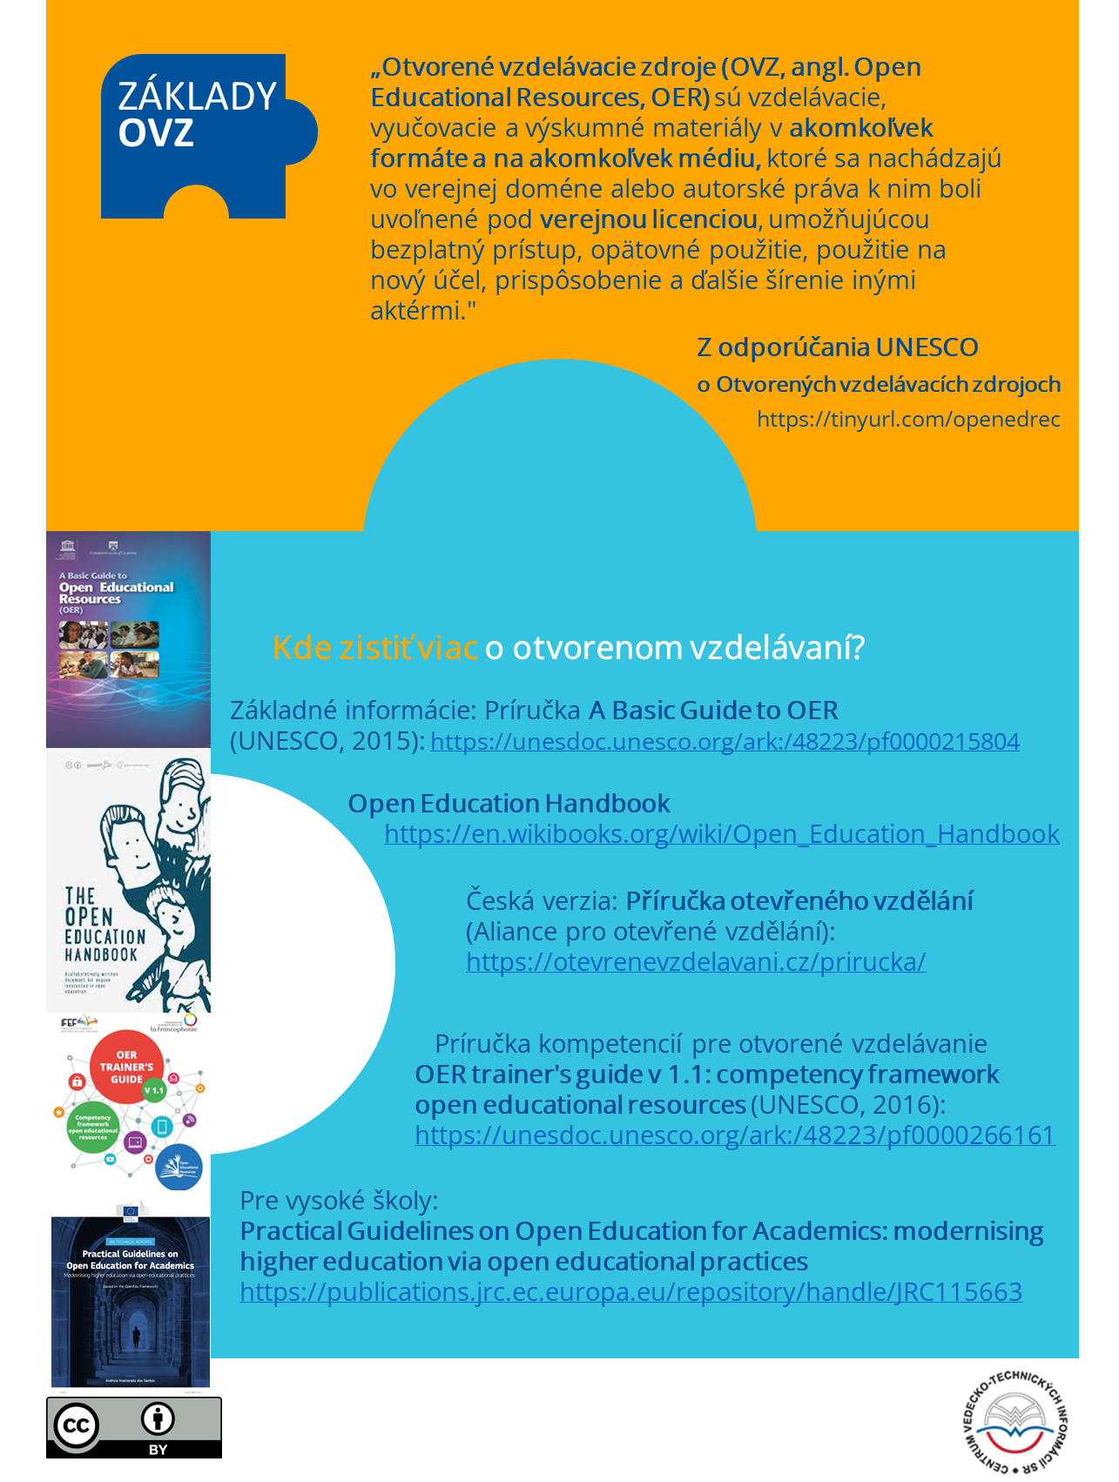
Example of adapting OER
ENOEL Toolkit
In Slovak leaflet version, we added examples of repositories (Where to find OER) in the part for students and examples of textbooks and guides on open education in the part for teachers (Do you want to know more about open education?).
European Network of Open Education Librarians. (2022). An ENOEL Toolkit: Open Education Benefits. Version 3. Zenodo. 10.5281/zenodo.5568482

Slide 28
Modifying more complex OER
5R: Retain, Reuse, Revise, Remix, Redistribute.
How to modify more complex OER (e.g. textbook)
OER = overcoming barriers for education:
find it
check the license (ND = non-derivative forbids adaptation) and if there is third-party content (e.g. illustrations used with permission)
plan your work: how do you want to modify the OER? (content and technical point of view, cooperation - agree on objectives, responsibilities and conditions, including legal and financial)
format: open
maintain clarity
respect for the original authors, notify them (courtesy, not mandatory), cite sources, describe modifications done by you
accessibility and openness in mind
Local relevance in mind
Put an open license to your work.
Notes:
Cullier et al. (2016) Modifying an Open Textbook: What You Need to Know. [Online]. Available at: https://pressbooks.pub/oenmodify/ (Accessed 18 March 2024).

Slide 29

5Rs
How to put a CC license on your OER
BY = attribution (recommended)
NC = non-commercial
ND = no derivatives (against revise/remix)
SA = share alike
Three layers of the license: the lawyer-readable legal code, the human-readable deed, and the machine-readable code (for search engines).
Consider that in the future you will be able to loosen the license of your work, but not “tighten it back“.
CC BY 4.0 (http://creativecommons.org/licenses/by/4.0)
Notes:
CC license chooser: https://chooser-beta.creativecommons.org/
CC badges and logos for download in svg/eps/png format: https://creativecommons.org/mission/downloads/

Slide 30
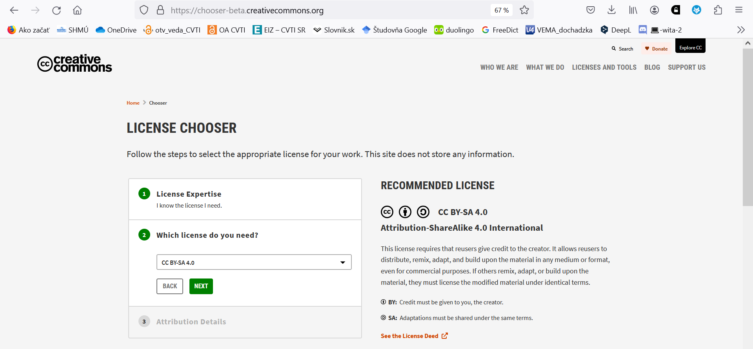
Tool: Creative Commons License chooser

Slide 31
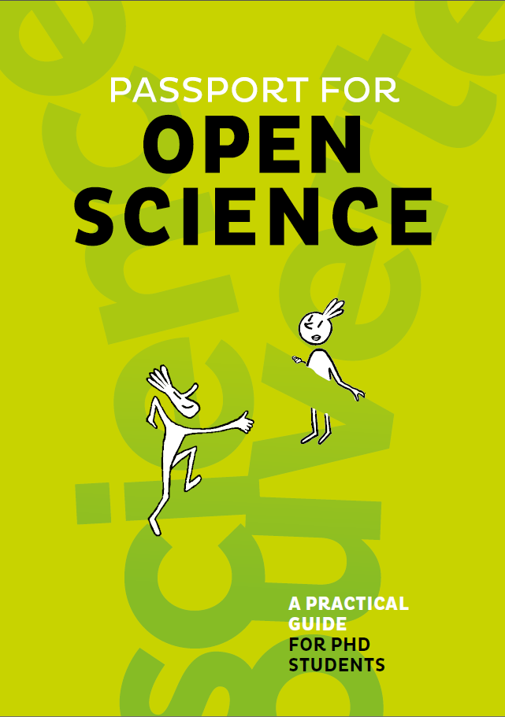

Translating OER
In countries with less developed culture of open science the most frequent way to adapt OER is translation.
Quick way to transfer knowledge to our academic community – with a trust-increasing bonus – origin from prestigious western institutions.
CC BY-SA
Ouvrir la science – OER on various aspects of open science in French and English: https://www.ouvrirlascience.fr/home/
Notes:
Barthonnat et al. (2020) Passport for Open Science. [Online]. Available at: https://www.ouvrirlascience.fr/passport-for-open-science-a-practical-guide-for-phd-students/ (Accessed 18 March 2024). CC BY

Slide 32
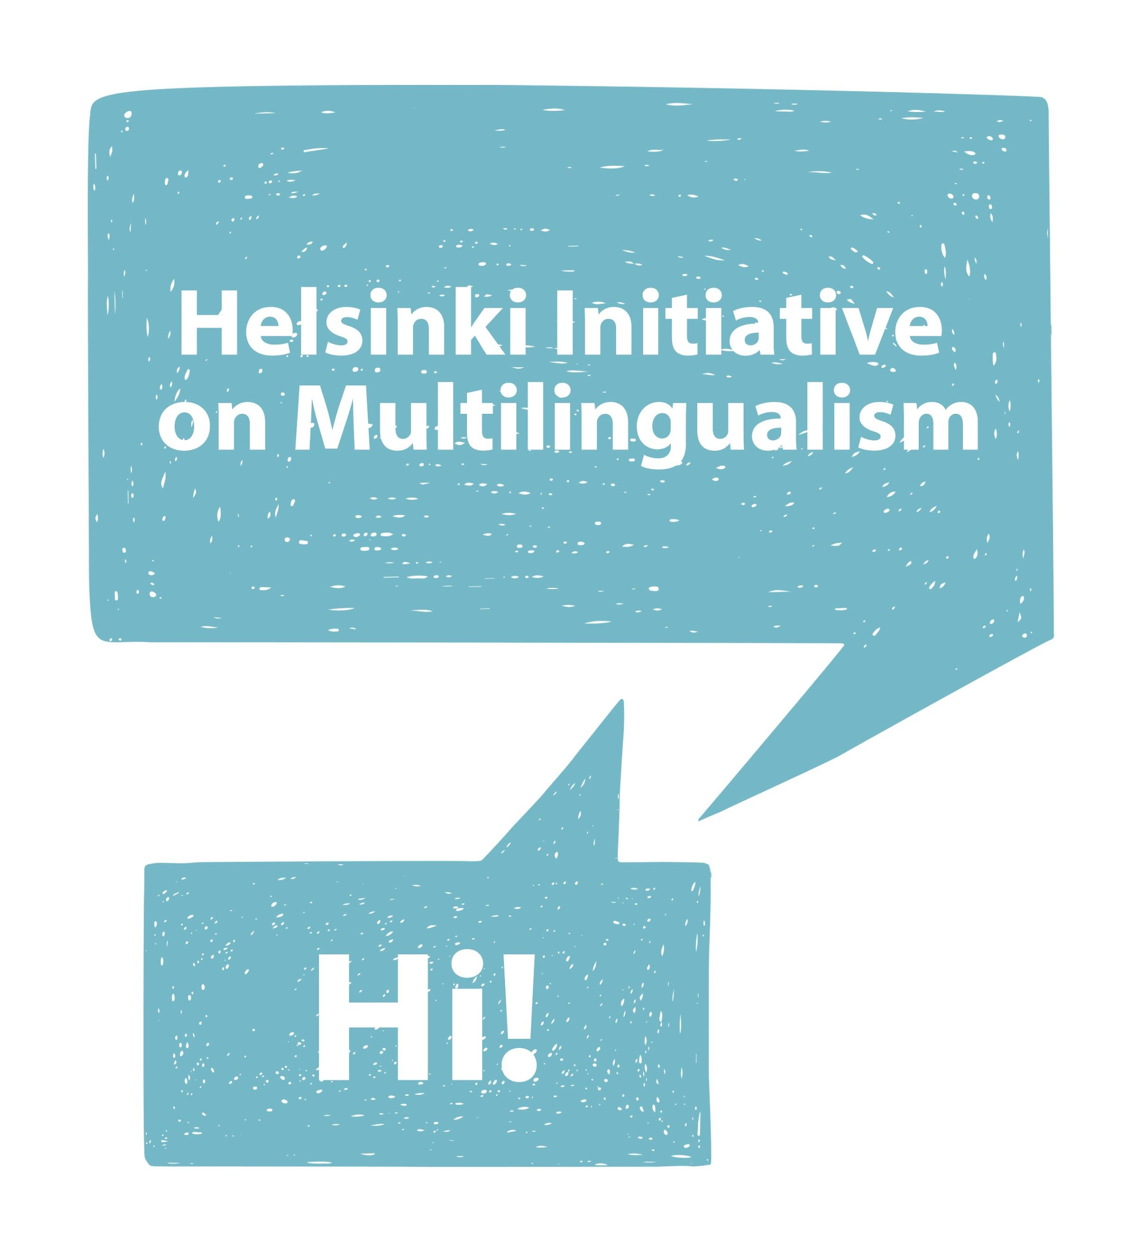
Translating OER
Why multilingualism
New topics (in any field of science) and educational materials need to be translated to national languages:
to support learning efficiency (new ideas are easier to grasp in mother tongue),
to ensure societal impact (we need to discuss science with public – various stakeholders in media, schools, health care...),
to maintain terminology and national infrastructures for publishing of locally relevant research.
Helsinki initiative on multilingualism (2019)
Notes:
https://www.helsinki-initiative.org/en/media/multilingualism-key-challenge-open-science-and-research-assessment

Slide 33
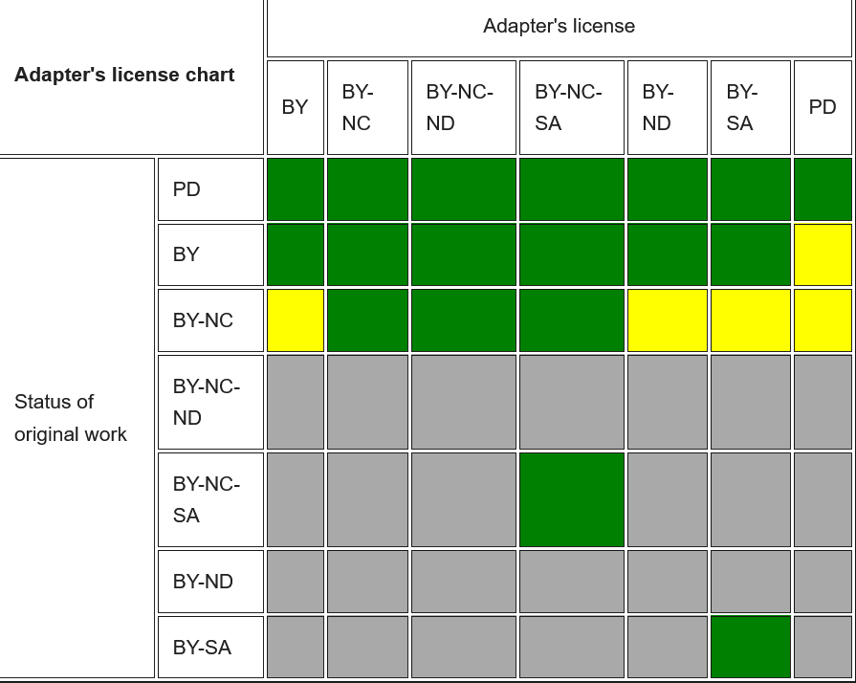
5Rs
Adaptor license chart
5R: Retain, Reuse, Revise, Remix, Redistribute,
If you want to publish adopted work under different license, be careful. You can't open content that the original authors have chosen to share under a more restrictive license.
Green: OK,
Yellow: technically possible, but not recommended,
Grey: not OK.
Wiki Creative Commons
Notes:
https://wiki.creativecommons.org/index.php/Frequently_Asked_Questions#Can_I_combine_material_under_different_Creative_Commons_licenses_in_my_work.3F

Slide 34
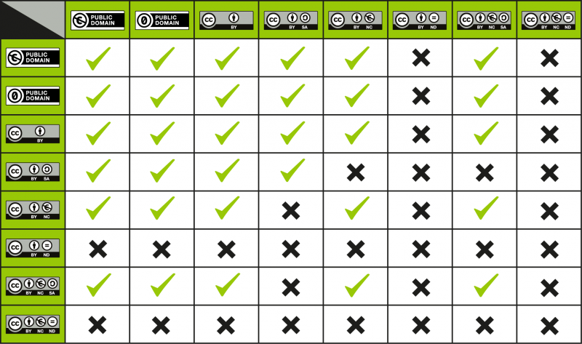
5Rs
What if I want to combine materials with different licenses?
5R: Retain, Reuse, Revise, Remix, Redistribute.
Combining material under different licenses is possible, with a certain amount of caution
Pay attention to licenses
Wiki Creative Commons
Notes:
https://wiki.creativecommons.org/wiki/Wiki/cc_license_compatibility

Slide 35
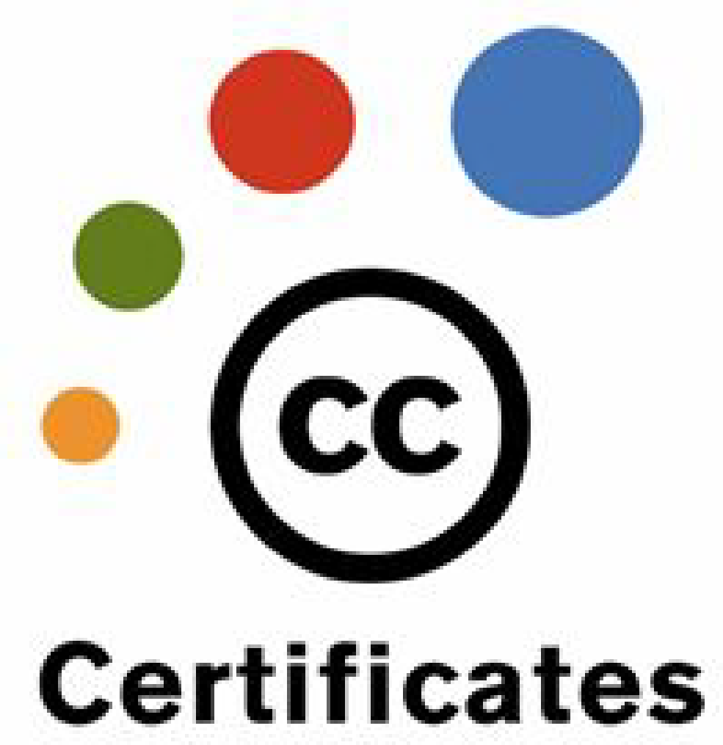
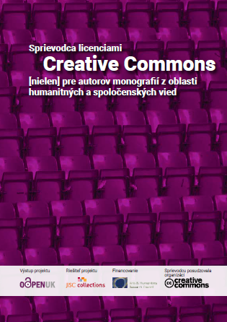
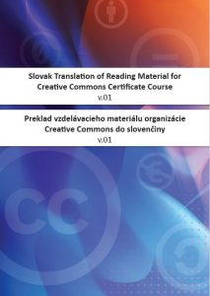
5Rs
Do you want to know more about CC licenses?
Certified open course on Creative Commons licensing: https://certificates.creativecommons.org/
Notes:
Certified open course on Creative Commons licensing: https://certificates.creativecommons.org/
Slovak translation to of Creative Commons course material (https://zenodo.org/records/8344376)
Collins et al. (2013): Guide to Creative Commons for Humanities and Social Science Monograph Authors: https://openaccess.city.ac.uk/id/eprint/11863/, Slovak translation: Sprievodca licenciami Creative Commons nielen pre autorov monografií z oblasti humanitných a spoločenských vied (https://zenodo.org/records/4955611)

Slide 36
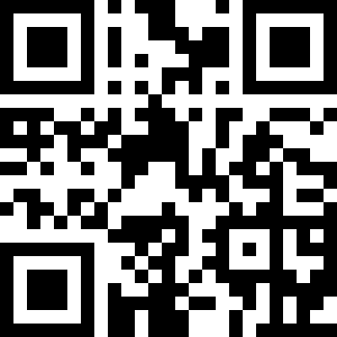
Your experience with adapting OER
If you already adapted OER, in which way did you adapt?
https://answergarden.ch/4079794
What changes did you make – or what changes do you want to make in your selected OER?
Notes:
Credits:
https://thenounproject.com/icon/poll-923772/, public domain

Slide 37
Can't find the resource you need?
Create it!
Creating your own OER
Knowledge gap
Educational goal
Institutional policies and project requirements
Form (technical and personal requirements)
Structure
Content
License (permissive for re-use)
Cooperation (collaborative software as Authorea, Overleaf...)
More freedom – and also more decisions, responsibility and cost – than in adapted OER.
OER policy development tool: https://policy.lumenlearning.com/
Notes:
OER policy development tool: https://policy.lumenlearning.com/

Slide 38
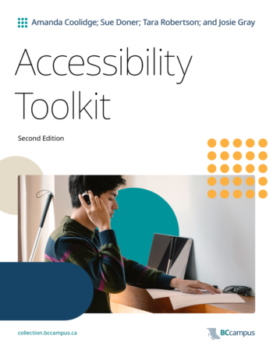
Create with accessibility in mind
Accessibility for equal opportunities
Digital accessibility (offering alternatives to those who can not use particular sense or OER form – e.g. podcasts with available text transcription, or images with alternative text).
POUR principles based on Web Content Accessibility Guidelines
Perceivable: by more than one sense,
Operable: usable by different devices and software,
Understandable: easy to read, clear explanations, consistent rules through the text predictable form and functionality,
Robust: content should work with all browsers and assisting technologies.
More information e.g.: https://www.oer.iastate.edu/accessibility-oer,
Toolkit (Accessibility): https://opentextbc.ca/accessibilitytoolkit/
Notes:
More information e.g.: Iowa state university https://www.oer.iastate.edu/accessibility-oer
Toolkit (Accessibility): BC Campus https://opentextbc.ca/accessibilitytoolkit/

Slide 39
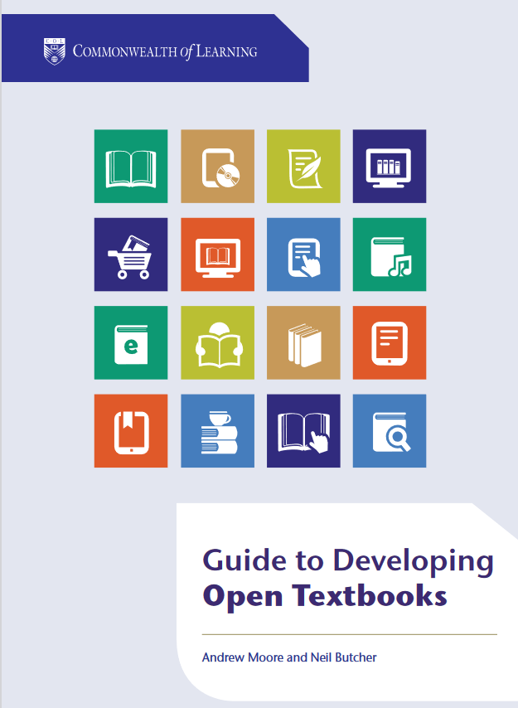
5Rs
How to develop open textbooks
Guide to developing open textbooks (Andrew Moore, Neil Butcher, 2016) http://oasis.col.org/handle/11599/2390
How to develop open textbook (using platforms Gooru, OER Commons, Pressbook), remix OER, set up a platform or OER repository.
Interesting points to challenges, as:
Tackling protective mindset
Incentivizing innovation
Notes:
Moore and Butcher (2016): Guide on developing open textbokoks. [Online]. Available at: https://oasis.col.org/items/2d02641d-b30d-409e-a7df-28a787bf1309 (Accessed 19 March 2024). CC BY-SA

Slide 40
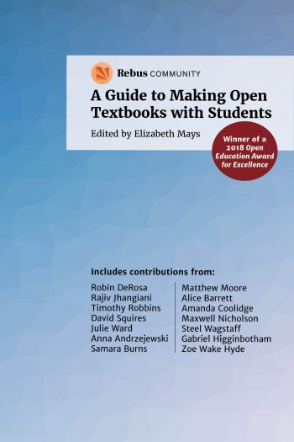
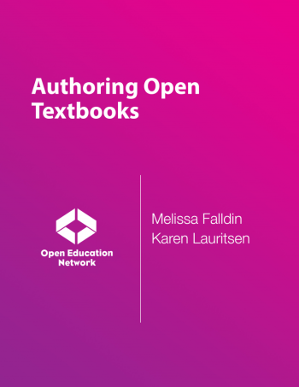
How to develop open textbooks
Creating and co-creating OER
Rebus Community, ed. E. Mays (2017): A Guide to Making Open Textbooks with Students:
https://press.rebus.community/makingopentextbookswithstudents/,
Open pedagogy is more than OER – it is a way to engage students as active learners and co-creators of educative process.
  Falldin and Lauristen (2017): Authoring Open Textbooks: https://press.rebus.community/authoropen/
Notes:
Credits:
Rebus Community, ed. E. Mays (2017) A Guide to Making Open Textbooks with Students. [Online]. Available at: https://press.rebus.community/makingopentextbookswithstudents/, (Accessed 18 March 2024).
Falldin and Lauristen (2017): Authoring Open Textbooks. [Online]. Available at: https://press.rebus.community/authoropen/, (Accessed 18 March 2024).

Slide 41
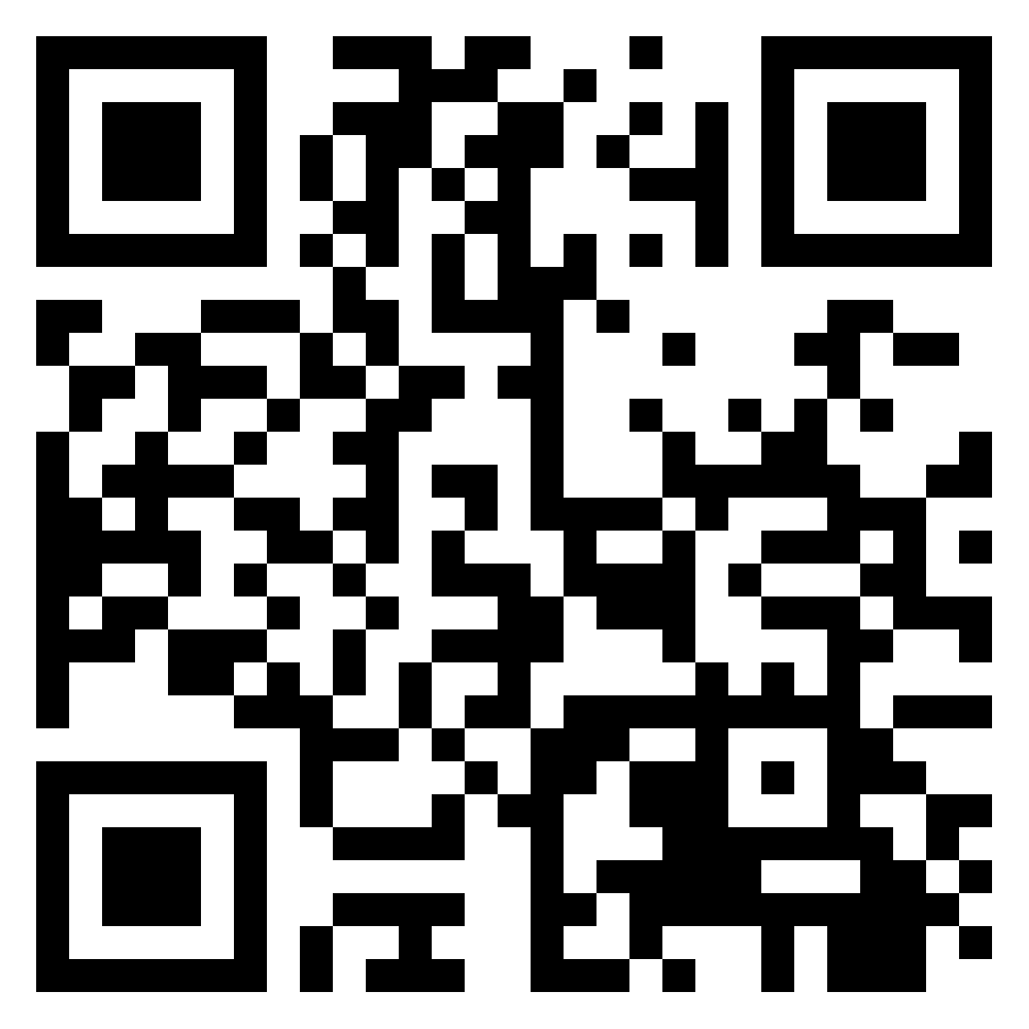
Activity and discussion
What is the best / most useful OER you adapted or created?
Do you have plans or knowledge gaps you want to fill with new OER?
  Padlet:
  https://padlet.com/zuzanastozicka/best-oer-adapted-created-by-you-8hw3992f9c7tkqsa

Slide 42
Summary
What did we discuss today?
How to identify OER for reuse according to various characteristics;
How to select the OER that best suits our students' learning needs;
How to modify/adapt reused OER as allowed by their open license and acknowledge their authors properly;
How to increase the accessibility and reusability of the OER we work on;
How to choose the right license for our OER according to the project requirements, our institutional policy, and the context.

Slide 43
Final message
By re-using, revising, adapting and creating OER you benefit
students (wide spectrum of resources, lower costs, higher success rate, possibility to engage),
other educators (they can save time and effort re-using your resources, and also learn from the best),
your institution (showcase quality and culture of sharing),
yourself (impact, feedback, cooperation, legacy – and last but not least – more motivated and active students),
... and the wider public (including unexpected recipients).
Create with re-use and accessibility in mind, approach for the best, although it is not always possible to fulfill all conditions.

Slide 44
Thank you for joining!
ENOEL Workshops
oer@sparceurope.org
www.sparceurope.org
@SPARC_EU

Slide 45
Let’s continue the conversation!
Curious to learn more?
Embrace the Open: Sharing OER
          15th April 1-2:30 pm CEST
Embrace the Open: OER as Open Education Pedagogy
6th May 1-2:30 pm CEST
Do you want to be updated on upcoming events?
Send us an email: oer@sparceurope.org.
Slide deck and work plan for each workshop are available in the SPARC Europe Collection on Zenodo.
The recordings are collected in the Embrace the Open playlist on @ENOELforOpen YouTube Channel.
Notes:
SPARC Europe Collection on Zenodo https://zenodo.org/communities/sparceurope/records?q=&l=list&p=1&s=10&sort=newest
Embrace the Open playlist https://www.youtube.com/playlist?list=PLbvdC-WdvjAjR0aYZYQ4an1x4L3dU0gjv
@ENOELforOpen YouTube Channel https://www.youtube.com/channel/UC5Wtl726waSHbBgCbaHNWrQ

Slide 46
Image credits
Slide 2: https://oeweek.oeglobal.org/guide/2024-visuals/, CC Attribution 4.0 International License.
Slide 6, 21, 36: https://thenounproject.com/icon/poll-923772/, public domain.
Slides 9, 12, 23: https://en.m.wikipedia.org/wiki/File:Global_Open_Educational_Resources_%28OER%29_Logo_-_Black_and_White_variation.svg CC BY 3.0, OER logo by Jonathsmello.
Slide 10: https://www.fosteropenscience.eu/content/what-open-science-introduction , CC BY, Foster Open Science.
Slide 14: https://cft.vanderbilt.edu/guides-sub-pages/blooms-taxonomy, CC BY.
Slide 15: https://unsplash.com/photos/blue-and-brown-bird-on-brown-tree-trunk-DPXytK8Z59Y, unsplash license.
Slide 26, 27: https://doi.org/10.5281/zenodo.7248918, CC BY 4.0.

Slide 47
Image credits
Slides 29, 34: https://creativecommons.org/mission/downloads/, CC BY 4.0 International License.
Slide 35: https://certificates.creativecommons.org/, CC BY 4.0 International License.
Slide 38: https://opentextbc.ca/accessibilitytoolkit/, CC BY 4.0.
Slide 39: https://oasis.col.org/items/2d02641d-b30d-409e-a7df-28a787bf1309, CC BY SA.
Slide 40: https://press.rebus.community/makingopentextbookswithstudents/, CC BY. https://press.rebus.community/authoropen/, CC BY.

Slide 48
References
Foster Open Science (2018) What is Open Science? [Online]. Available at: https://www.fosteropenscience.eu/content/what-open-science-introduction (Accessed 17 March 2024).
Armstrong, P. (2010). Bloom’s Taxonomy. Vanderbilt University Center for Teaching. [Online] Available at: https://cft.vanderbilt.edu/guides-sub-pages/blooms-taxonomy (Accessed 18 March 2024)
Open Academy (2024): Adapting OER to meet learner needs. [Online]. Available at: https://www.open.edu/openlearncreate/mod/oucontent/view.php?id=87869&printable=1 (Accessed 17 March 2024)
UT Austin Instructor Learning Community (2021) Rubric for Evaluating OER. [Online]. Available at: https://docs.google.com/document/d/13evVG3cfSR_5kU47WLMh4OO88vcoG2qBHFy7WgpkZuE/edit#heading=h.gjdgxs (Accessed 17 March 2024).
European Network of Open Education Librarians. (2022). An ENOEL Toolkit: Open Education Benefits. Version 3. [Online]. Available at: Zenodo. https://doi.org/10.5281/zenodo.7248918 (Accessed 19 March 2024)
Barthonnat et al. (2020) Passport for Open Science. [Online]. Available at: https://www.ouvrirlascience.fr/passport-for-open-science-a-practical-guide-for-phd-students/ (Accessed 18 March 2024).

Slide 49
References
Creative Commons. (2024). Creative Commons Search tool. https://search.creativecommons.org/
Helsinki Initiative on Multilingualism in Scholarly Communication (2019). Helsinki: Federation of Finnish Learned Societies, Committee for Public Information, Finnish Association for Scholarly Publishing, Universities Norway & European Network for Research Evaluation in the Social Sciences and the Humanities. https://doi.org/10.6084/m9.figshare.7887059.
Certified open course on Creative Commons licensing: https://certificates.creativecommons.org/
CVTI SR (2023): Slovak translation to of Creative Commons course material (https://zenodo.org/records/8344376)
Collins et al. (2013): Guide to Creative Commons for Humanities and Social Science Monograph Authors: https://openaccess.city.ac.uk/id/eprint/11863/, Slovak translation: Sprievodca licenciami Creative Commons nielen pre autorov monografií z oblasti humanitných a spoločenských vied (https://zenodo.org/records/4955611)
Moore and Butcher (2016): Guide on developing open textbokoks. [Online]. Available at: https://oasis.col.org/items/2d02641d-b30d-409e-a7df-28a787bf1309 (Accessed 19 March 2024).
Rebus Community, ed. E. Mays (2017) A Guide to Making Open Textbooks with Students. [Online]. Available at: https://press.rebus.community/makingopentextbookswithstudents/ (Accessed 18 March 2024)

Slide 50
References
Falldin and Lauristen (2017): Authoring Open Textbooks. [Online]. Available at: https://press.rebus.community/authoropen/ (Accessed 18 March 2024)

