Slide 1




NATIONAL RESEARCH DATA MANAGEMENT INFRASTRUCTURE FOR MICROSCOPY AND BIOIMAGE ANALYSIS
GLOBAL BIOIMAGE ANALYSTS SOCIETY
CENTER FOR SCALABLE DATA ANALYTICS AND
ARTIFICIAL INTELLIGENCE
Cultivating
Open Training
Robert Haase
https://doi.org/10.5281/zenodo.10816895
These slides can be reused under the terms of the CC-BY 4.0 license unless mentioned otherwise.

Slide 2
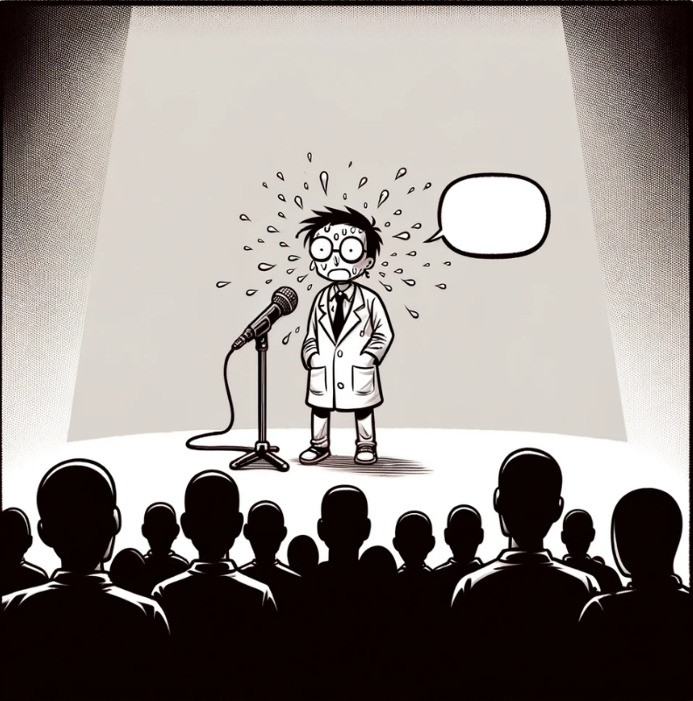
Closed science
Why are some science-related
materials/data/code not shared?
Risk of being scooped
Fear of blaming oneself (imposter syndrome)
Lack of awareness (who is allowed to publish my work?)
Assumption: it’s not worth the effort.

Slide 3
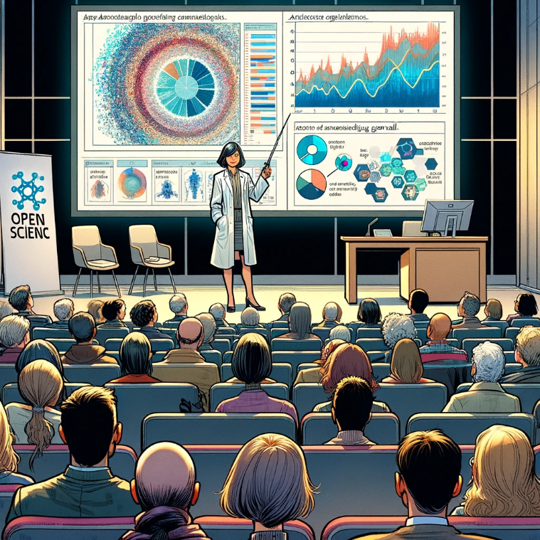
Open Science
Open Training
Research related
(hot topics)
Often tailored towards general audience
(science communication)
Earliest at the time a manuscript is published
(e.g. as preprint)
Routine tasks
(colder topics)
Transfer of
domain-specific
knowledge

Slide 4
Am I allowed to publish my stuff?
Define responsibilities and procedures early!
Open Science
Experiment design
Imaging / data acquisiton
Data Analysis
Paper writing
Open Training
Training design
Attendee + trainer acquisition
Training material preparation
Conduct workshop
“Data / materials we produce will be published under CC-BY 4.0”
Only if procedures are defined early, everyone can follow them.
Licenses are important when assembling materials (-> Copyright)
Meta-data might have higher quality if the person responsible for publishing the data is aware of their duties.
Are we going to publish data / materials / code?
What license can we use?
“Robert will do this by end of 2025!”
Deciding by the end of the project is too late!
DMP

Slide 5
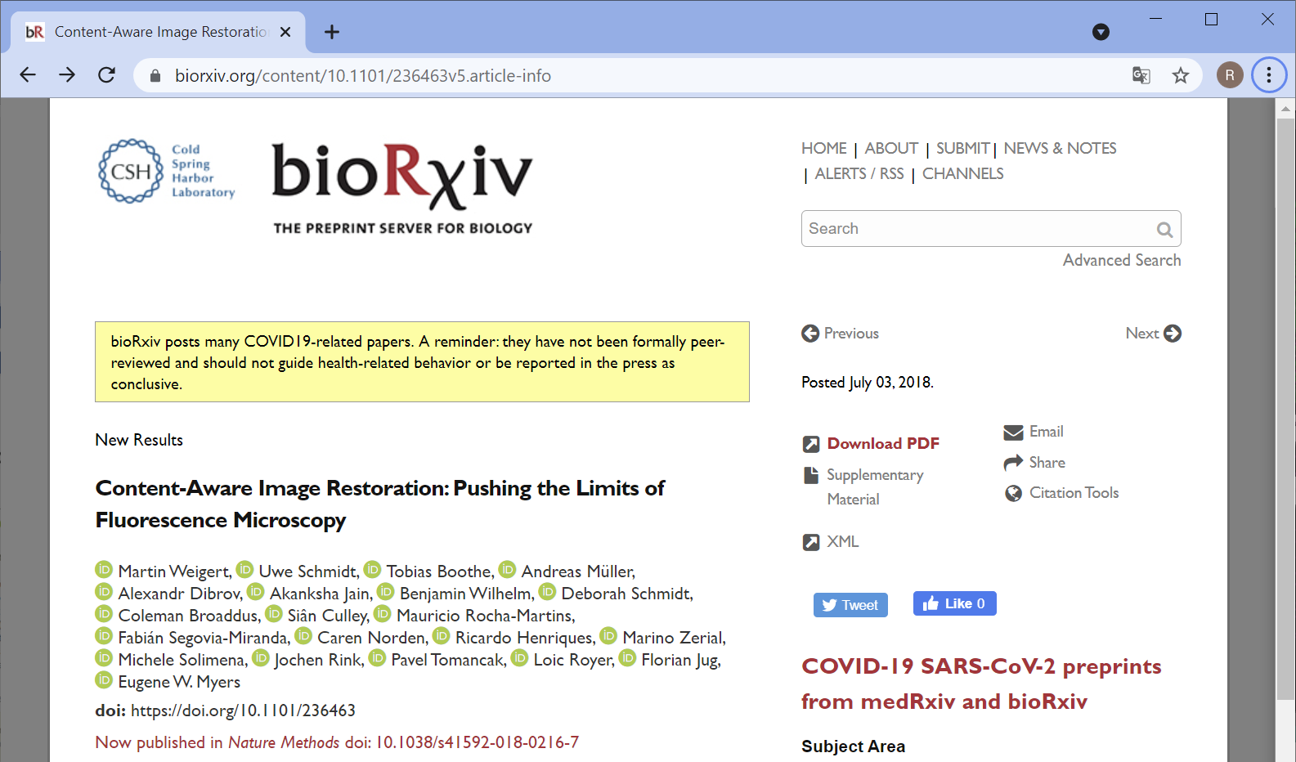
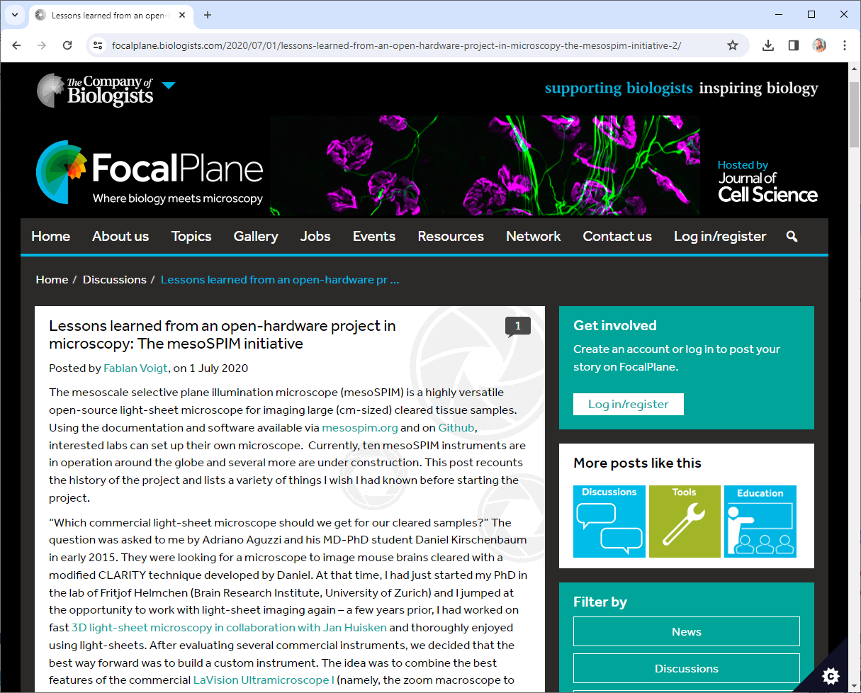
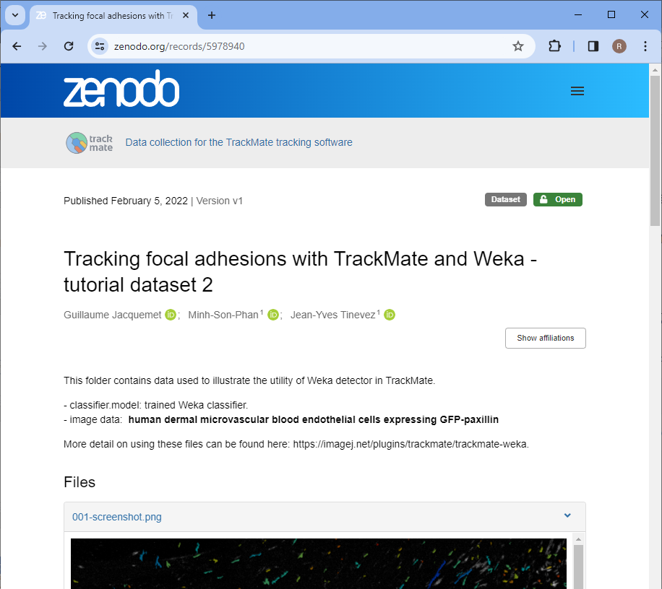
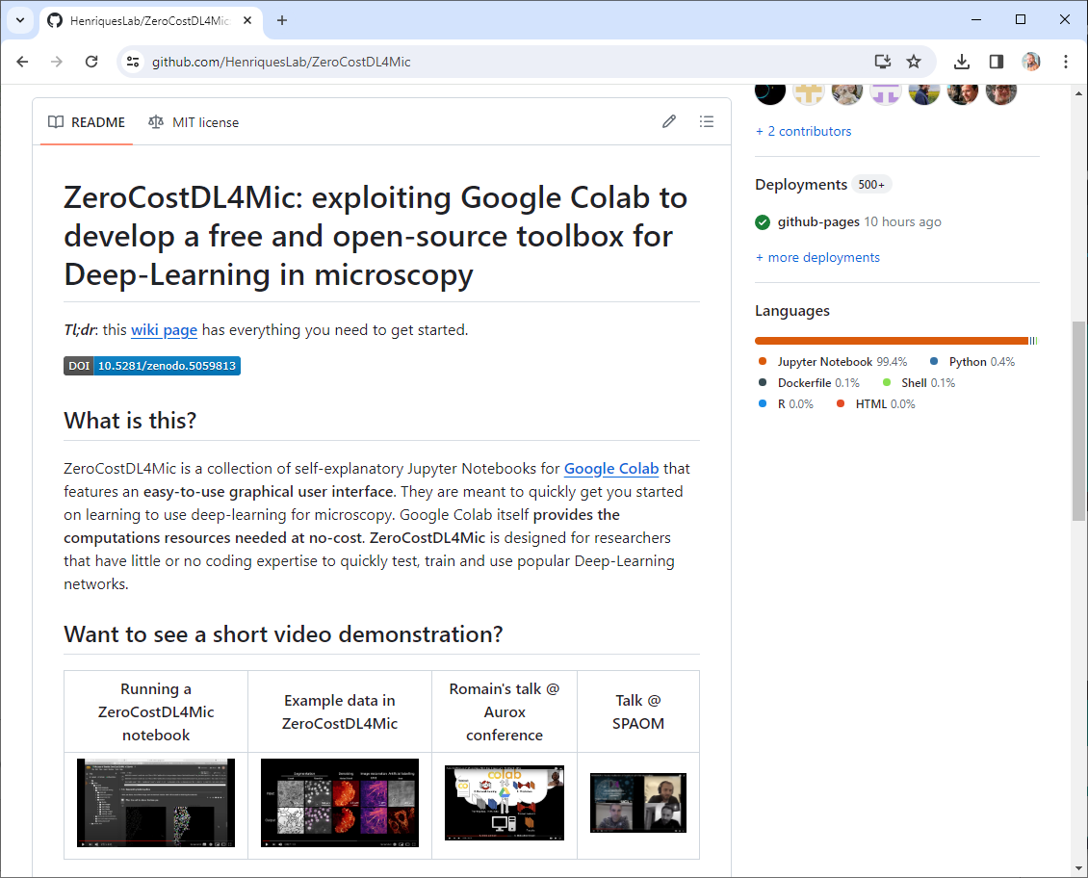
Where to share?
Open science related content
  bioRxiv (manuscripts, no reviews)
  Figshare
  F1000
  Bioimage Archive (data)
  Github (code)
  Zenodo
  Focalplane
  Institutional servers
  (if there is no alternative)
https://www.biorxiv.org/content/10.1101/236463v5.article-info https://github.com/HenriquesLab/ZeroCostDL4Mic https://focalplane.biologists.com/2020/07/01/lessons-learned-from-an-open-hardware-project-in-microscopy-the-mesospim-initiative-2/
https://zenodo.org/records/5978940

Slide 6
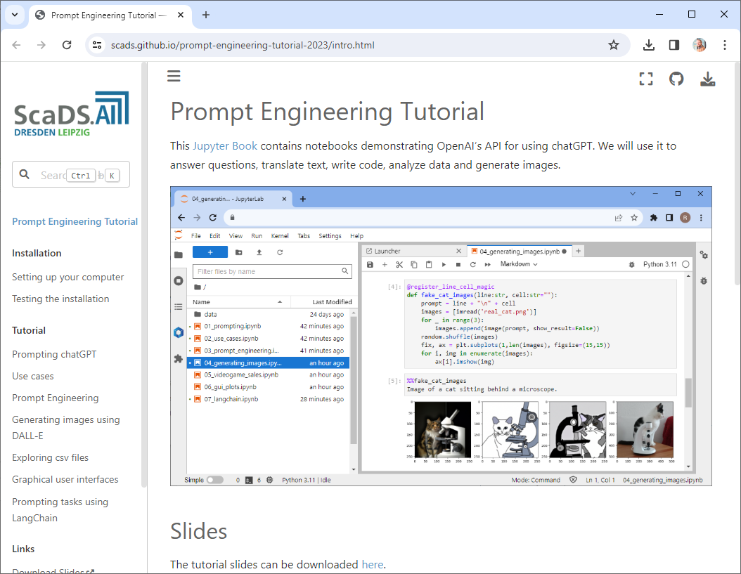
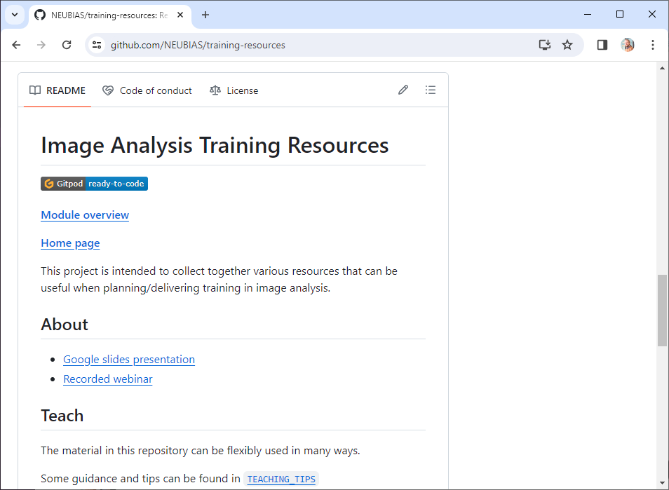
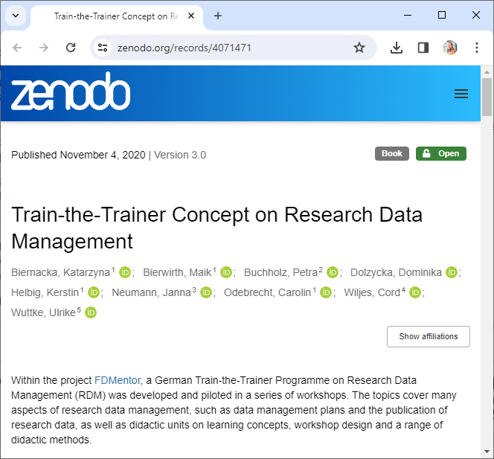
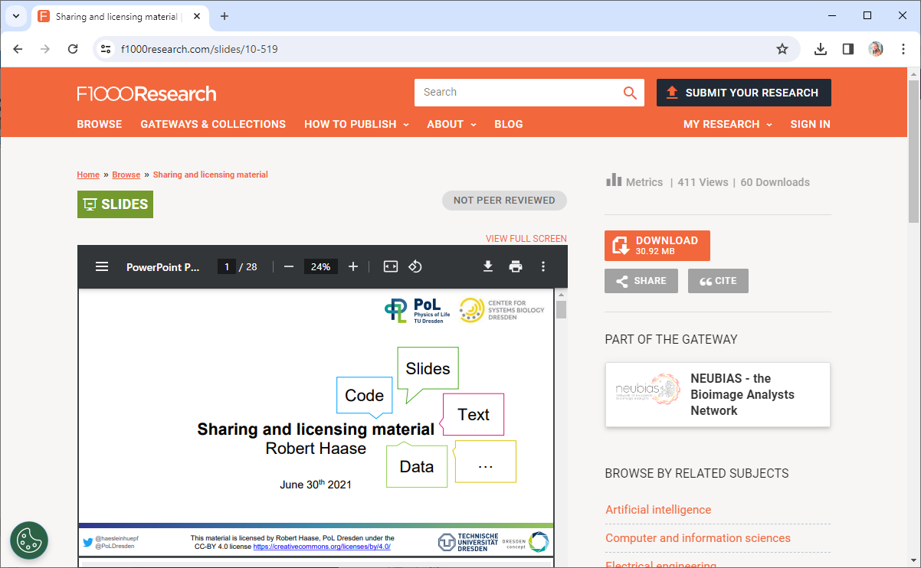
Where to share?
Github pages 🤯
Open training related content
  bioRxiv (manuscripts, no reviews)
  Figshare
  F1000
  Bioimage Archive (data)
  Github (code)
  Zenodo
  Focalplane
  Institutional servers
  (if there is no alternative)
https://f1000research.com/slides/10-519
https://scads.github.io/prompt-engineering-tutorial-2023/intro.html https://zenodo.org/records/4071471
https://github.com/NEUBIAS/training-resources

Slide 7
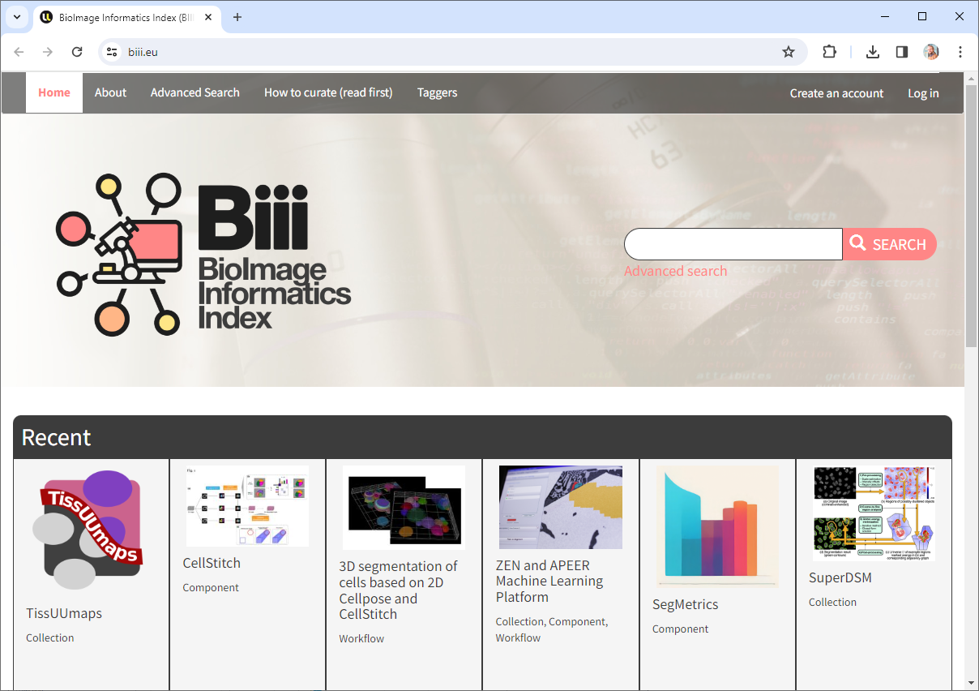
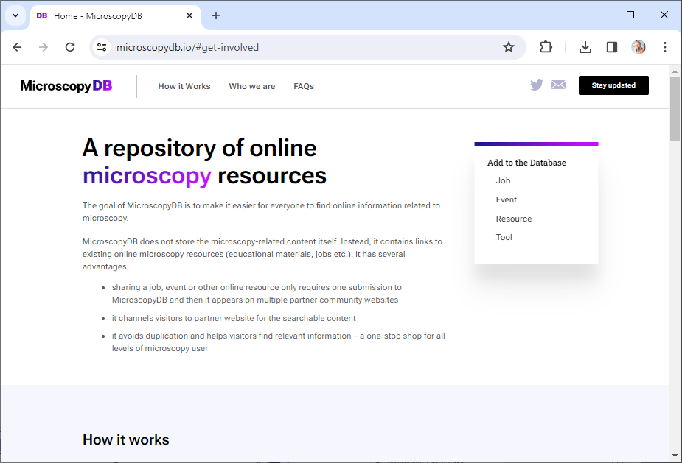
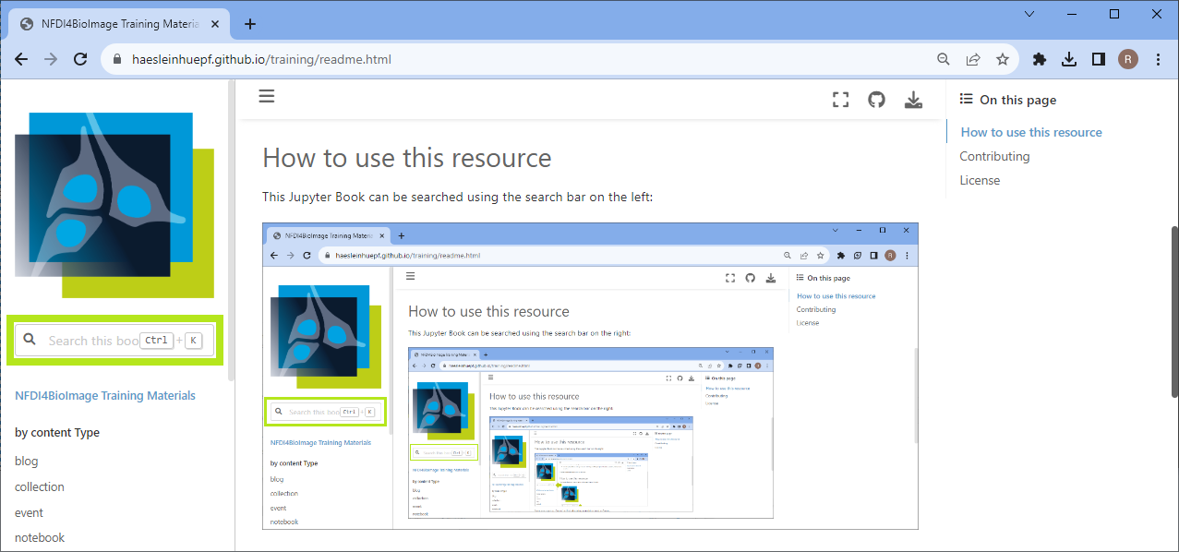
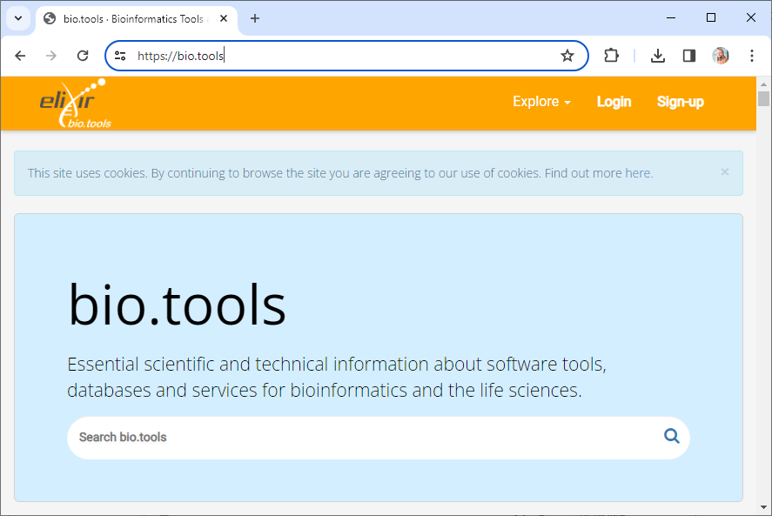
Indexing
Make sure your materials are listed in public search indices
Do not trust google to make your stuff findable
https://biii.eu/ https://bio.tools/
https://microscopydb.io/#get-involved https://nfdi4bioimage.github.io/training

Slide 8


Licensing: Permissive versus restrictive
Restrictive
  You can reuse our stuff, but only if you …
    License your work with the same license we do
    Make your stuff openly available
    Make no money with derivatives of our work
  Examples: GPL, CC-BY-SA, CC-BY-NC, CC-BY-ND
Permissive licensing:
  Do whatever you like with our stuff,
  just make sure to mention / cite us …
  Examples: BSD, MIT, Apache, CC-BY
I conclude,
these are less open in a sense

Slide 9
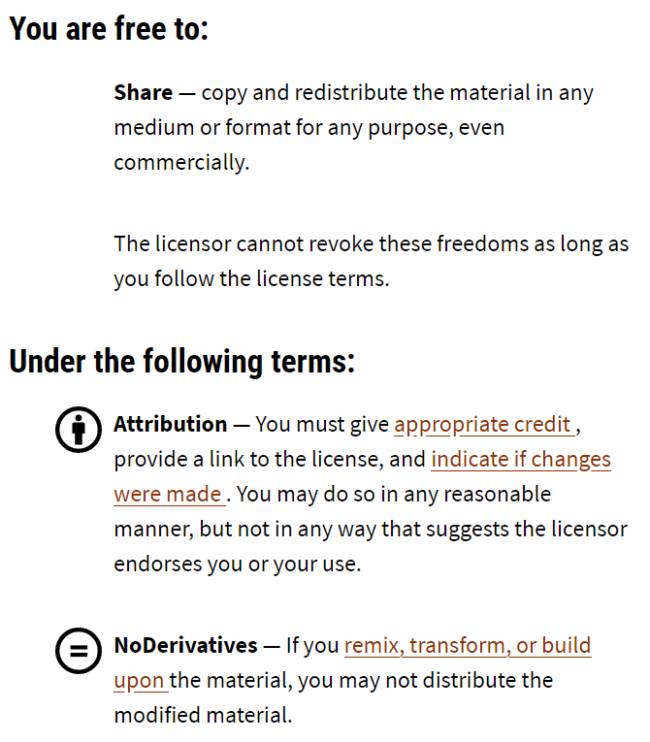

Licensing: Permissive versus restrictive
Who knows what the ND stands for?
“permissive”
“restrictive”
https://creativecommons.org/licenses/by-nd/4.0/deed.en

Slide 10
Licensing: Permissive versus restrictive
I hope nobody feels hurt
by the following slides.
I just would like to make a point.

Slide 11
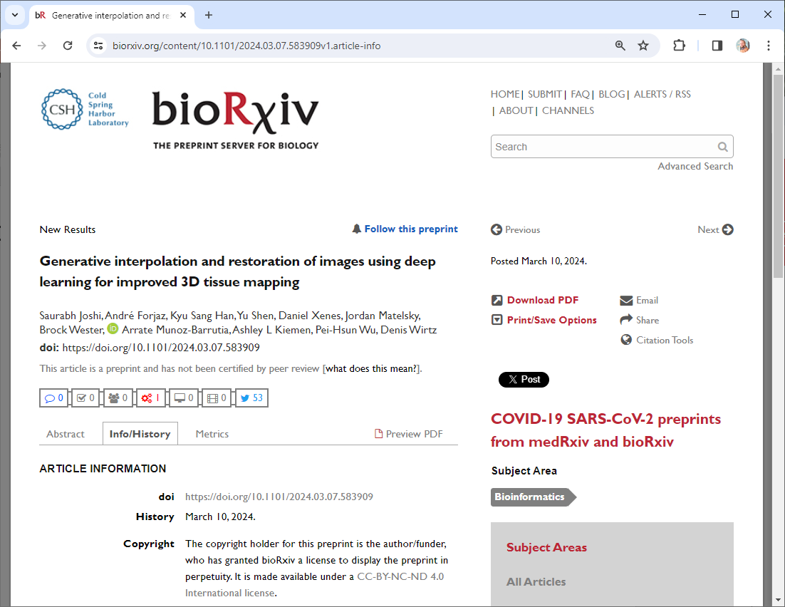
Licensing: Permissive versus restrictive
Example
I would love to show you a Figure from this paper!
But I’m not allowed!
https://www.biorxiv.org/content/10.1101/2024.03.07.583909v1

Slide 12
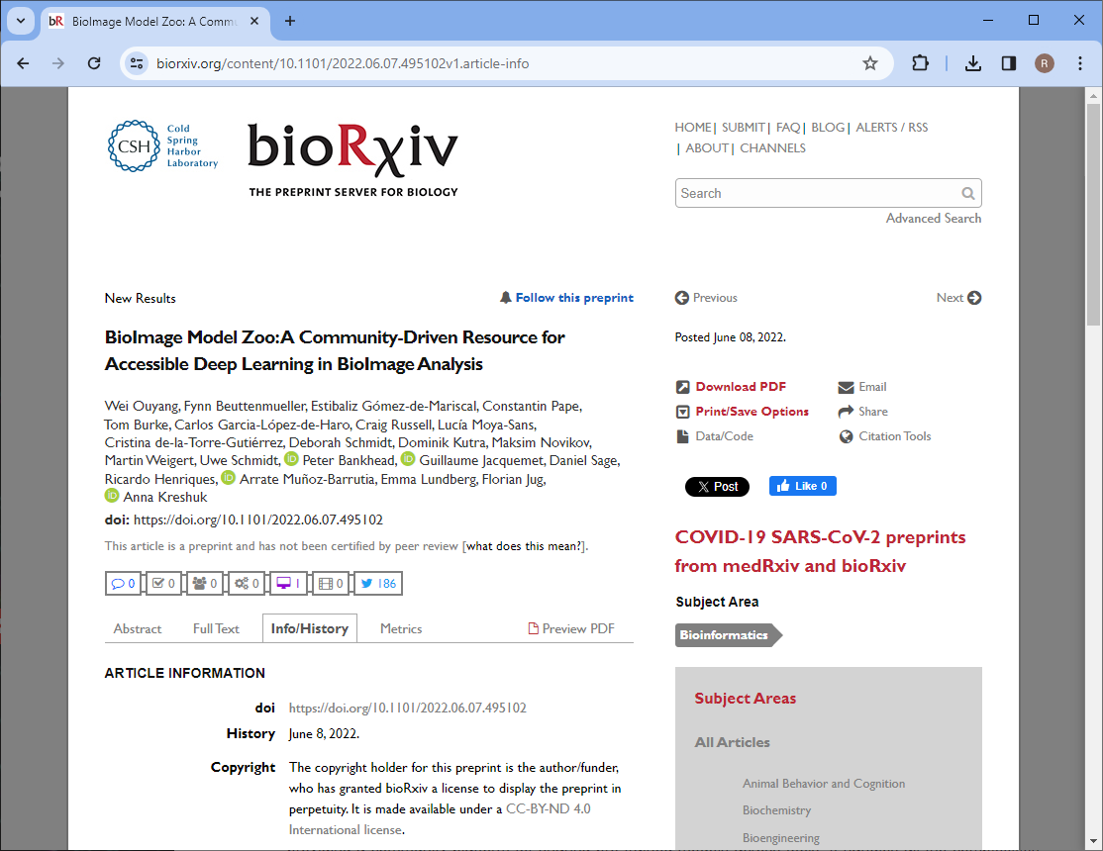
Licensing: Permissive versus restrictive
Example
I would love to show you a Figure from this paper!
But I’m not allowed!
https://www.biorxiv.org/content/10.1101/2022.06.07.495102v1.article-info

Slide 13
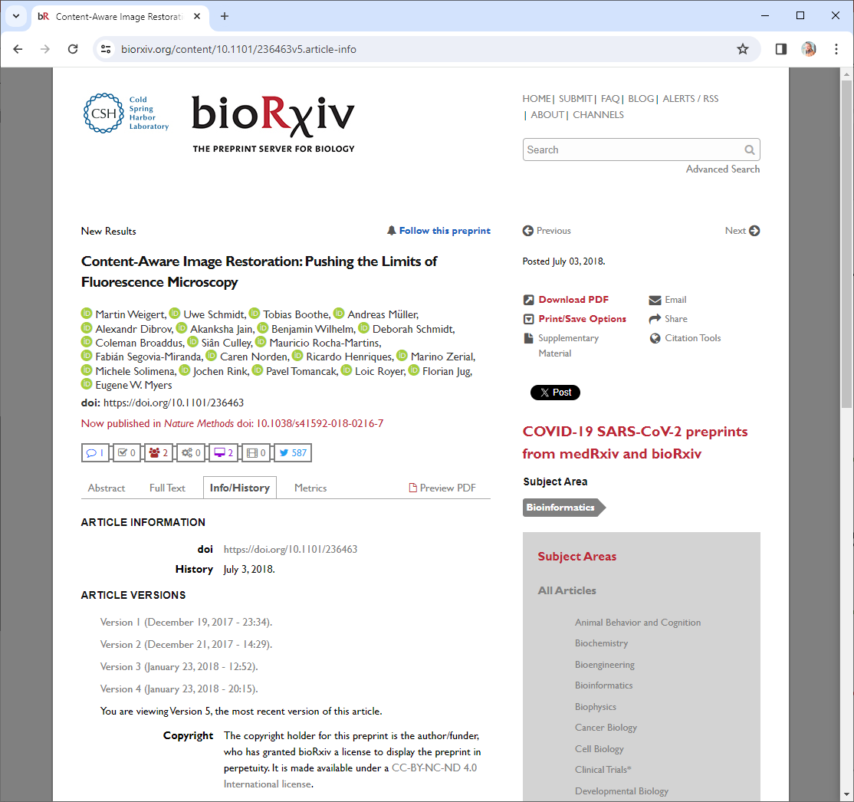
Licensing: Permissive versus restrictive
Example
I would love to show you a Figure from this paper!
But I’m not allowed!
https://www.biorxiv.org/content/10.1101/236463v5.article-info

Slide 14
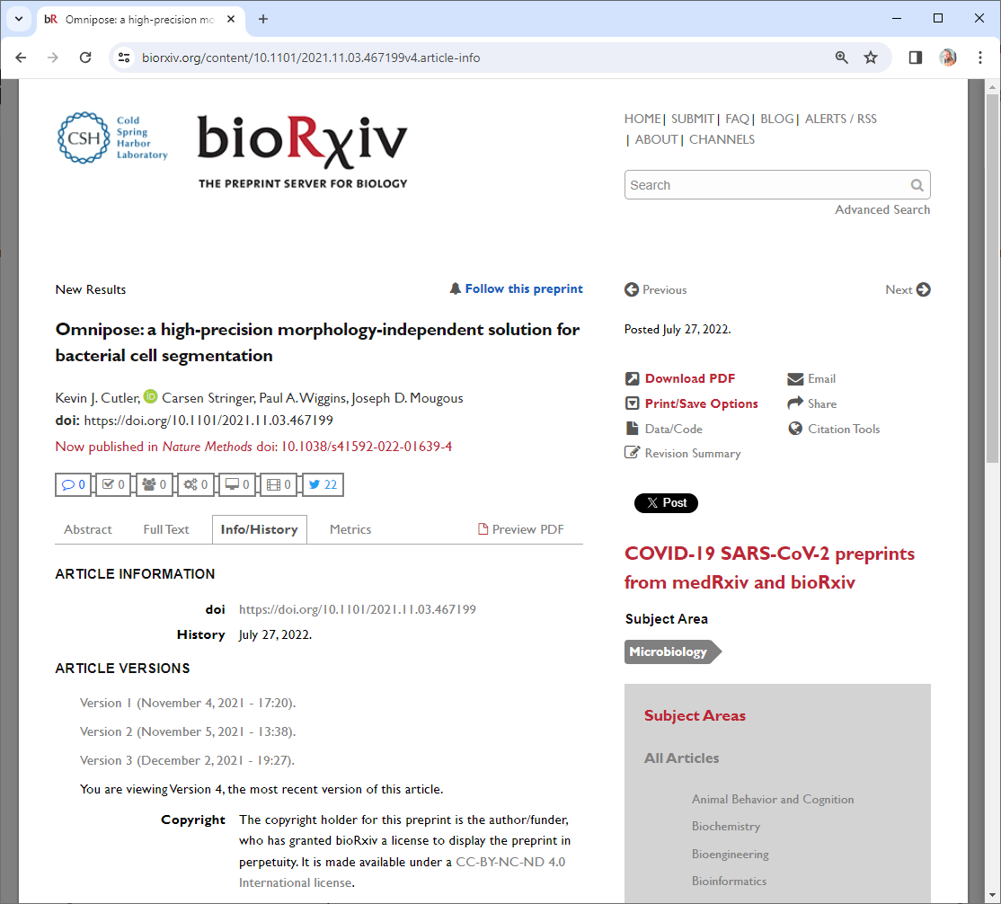
Licensing: Permissive versus restrictive
Example
I would love to show you a Figure from this paper!
But I’m not allowed!
https://www.biorxiv.org/content/10.1101/2021.11.03.467199v4.article-info

Slide 15
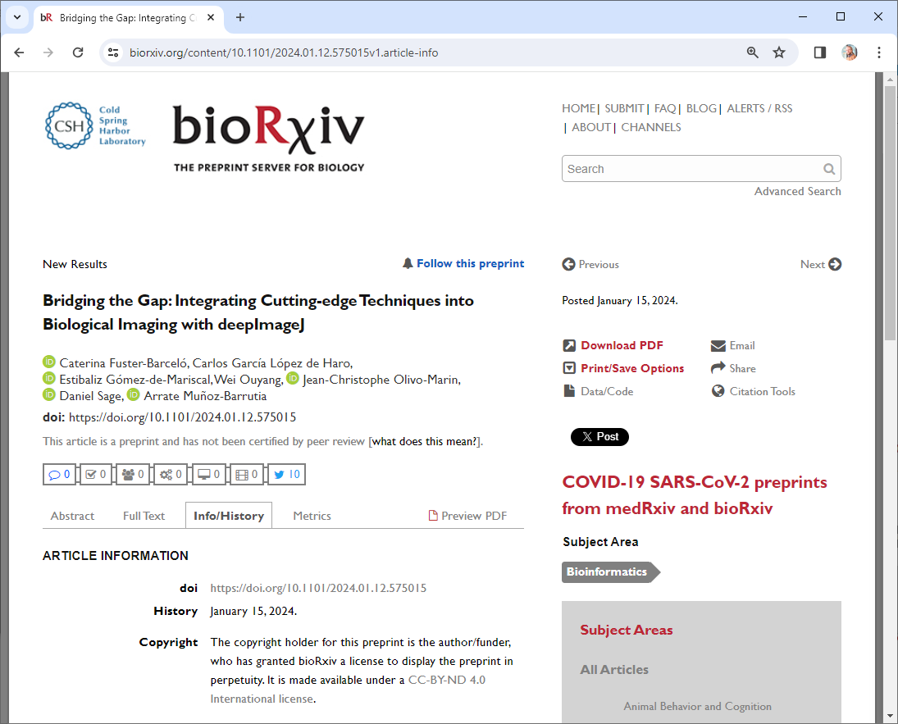
Licensing: Permissive versus restrictive
Example
I would love to show you a Figure from this paper!
But I’m not allowed!
https://www.biorxiv.org/content/10.1101/2024.01.12.575015v1.article-info

Slide 16
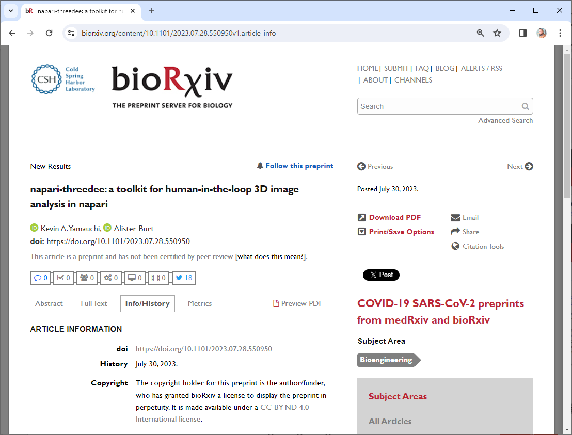
Licensing: Permissive versus restrictive
Example
I would love to show you a Figure from this paper!
But I’m not allowed!
https://www.biorxiv.org/content/10.1101/2023.07.28.550950v1.article-info

Slide 17
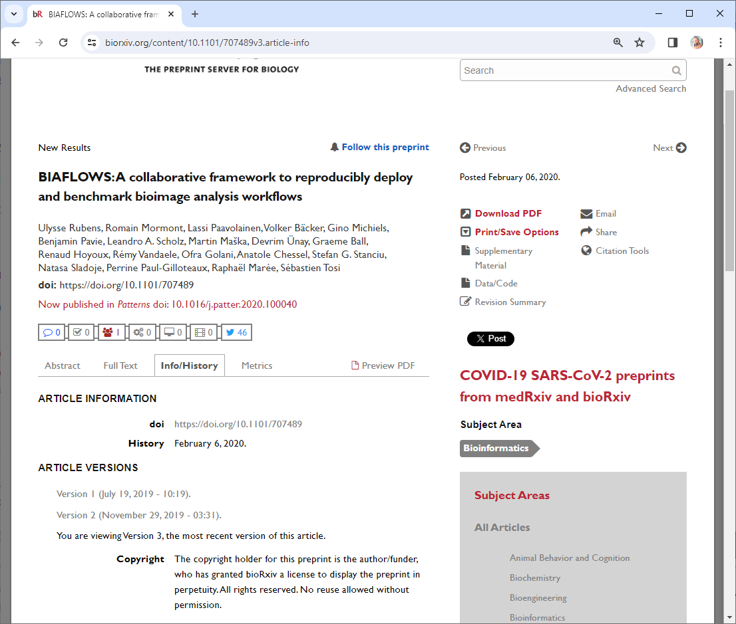
Licensing: Permissive versus restrictive
Example
I would love to show you a Figure from this paper!
But I’m not allowed!
https://www.biorxiv.org/content/10.1101/707489v3.article-info

Slide 18
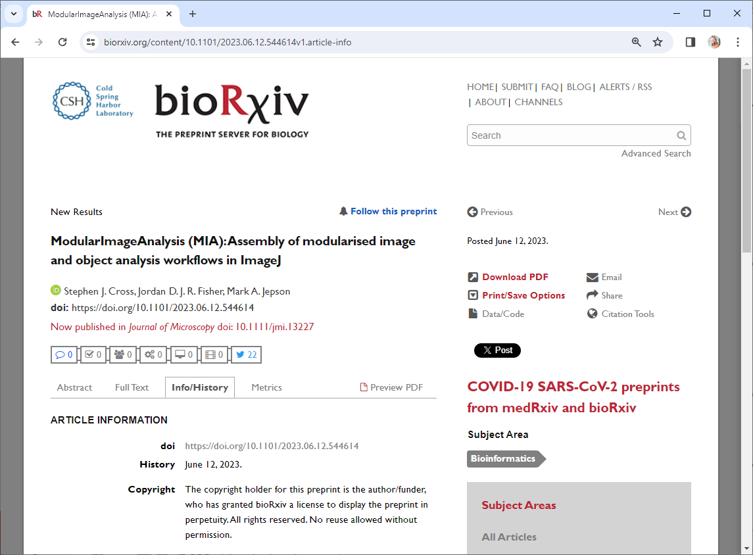
Licensing: Permissive versus restrictive
Example
I would love to show you a Figure from this paper!
But I’m not allowed!
https://www.biorxiv.org/content/10.1101/2023.06.12.544614v1.article-info

Slide 19
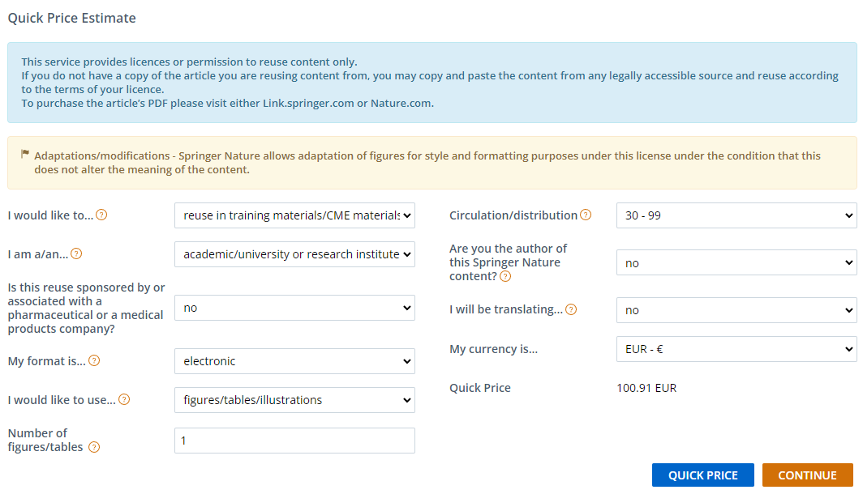
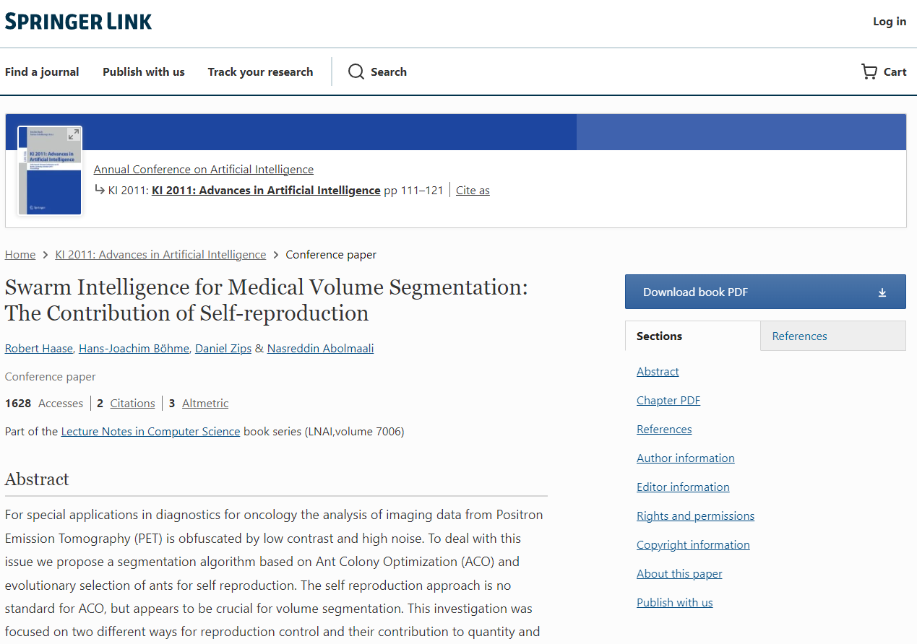
Licensing: Permissive versus restrictive
Example
The issue is not so much paying 100 Eur, but the related administrative effort.
https://link.springer.com/chapter/10.1007/978-3-642-24455-1_10

Slide 20
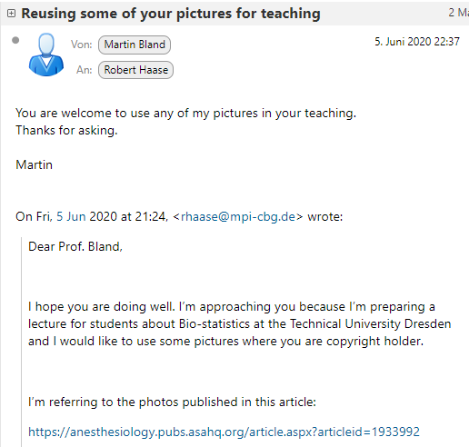
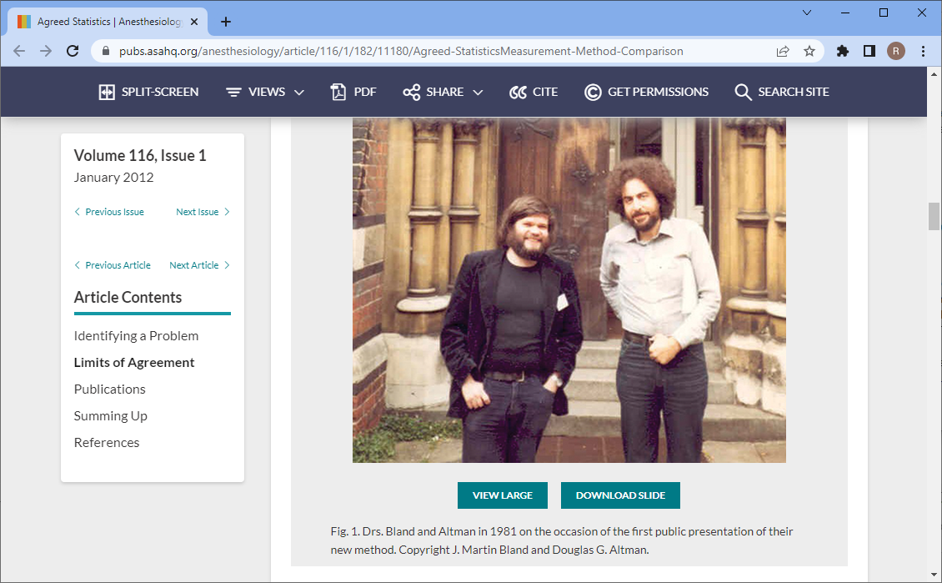
Licensing: Permissive versus restrictive
Example
Source:
https://anesthesiology.pubs.asahq.org/article.aspx?articleid=1933992

Slide 21
Licensing: Permissive versus restrictive
Restrictive licensing is
a community-wide issue.
I presume due to lack of awareness & training
Train the trainers!

Slide 22
Licensing: Permissive versus restrictive
Download and share for free
Reuse parts, e.g. Figures
Reuse parts, e.g. in paid training
CC-BY
CC-BY-SA
Only under CC-BY-SA
Only under CC-BY-SA
Only under CC-BY-SA
CC-BY-NC
(if free of charge)
Bad for the progress of science
CC-BY-ND
In particular in the context of training
CC-BY-NC-ND

Slide 23
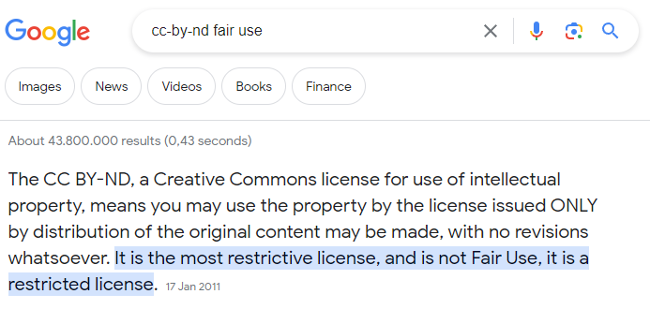
Licensing: Permissive versus restrictive

Slide 24
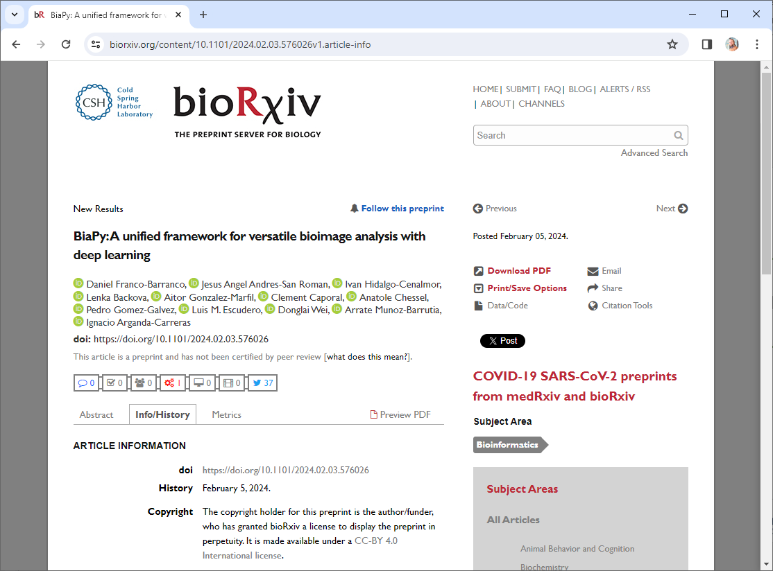
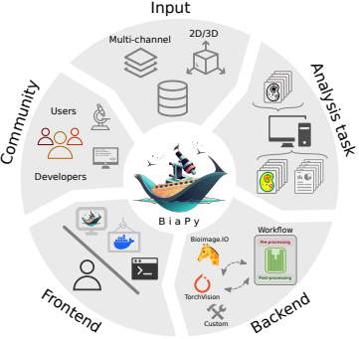
Licensing: Permissive versus restrictive
Look at this great figure! It’s cropped from / licensed CC-BY 4.0 by D. Franco-Barranco et al.
Example
https://www.biorxiv.org/content/10.1101/2024.02.03.576026v1.article-info

Slide 25
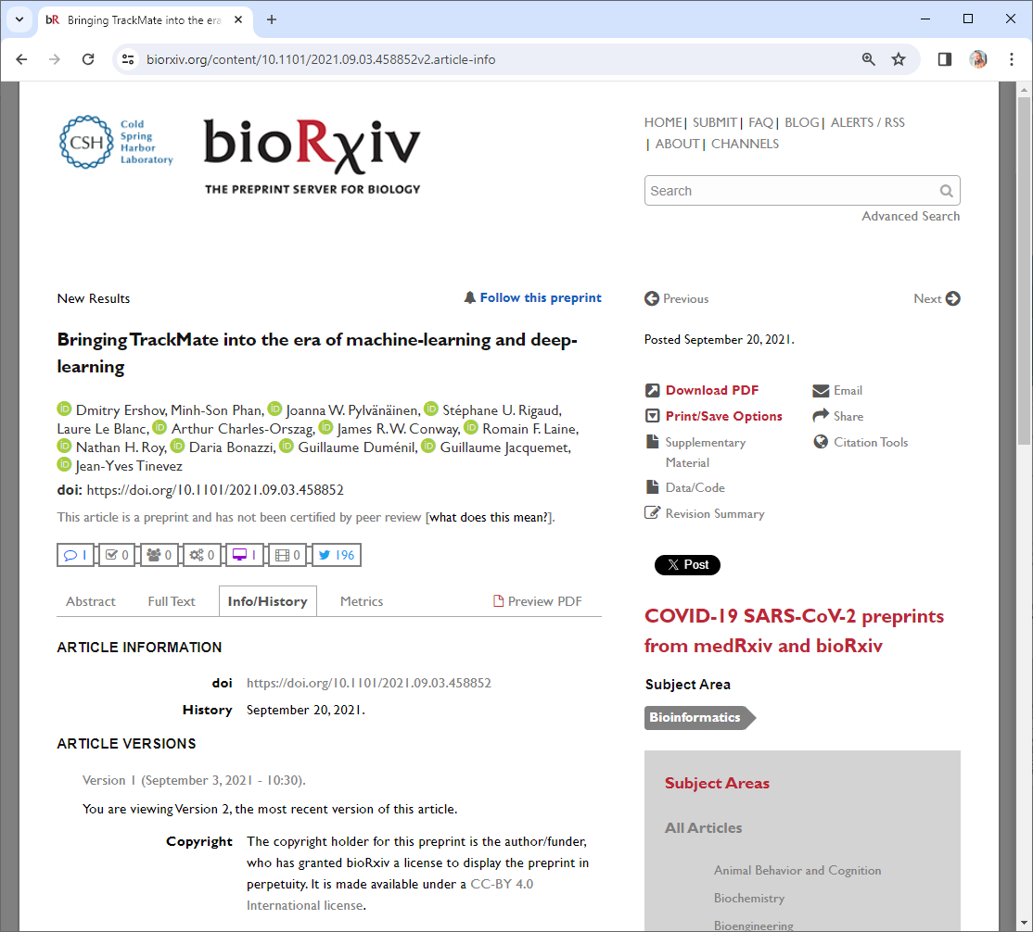
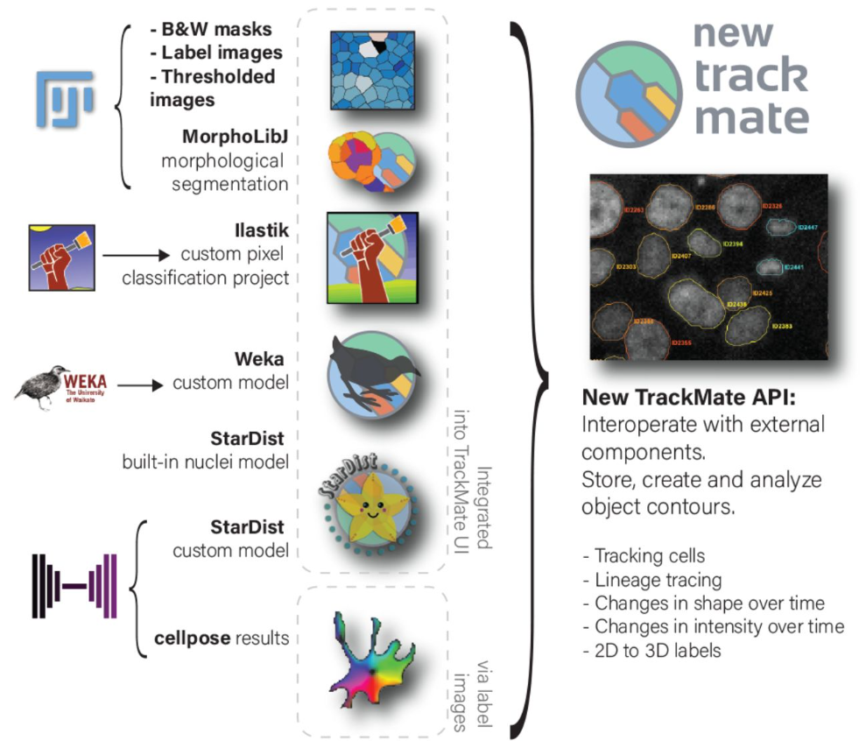
Licensing: Permissive versus restrictive
Look at this great figure! It’s take from / licensed CC-BY 4.0 by D. Ershov et al.
Example
https://www.biorxiv.org/content/10.1101/2021.09.03.458852v2.full

Slide 26
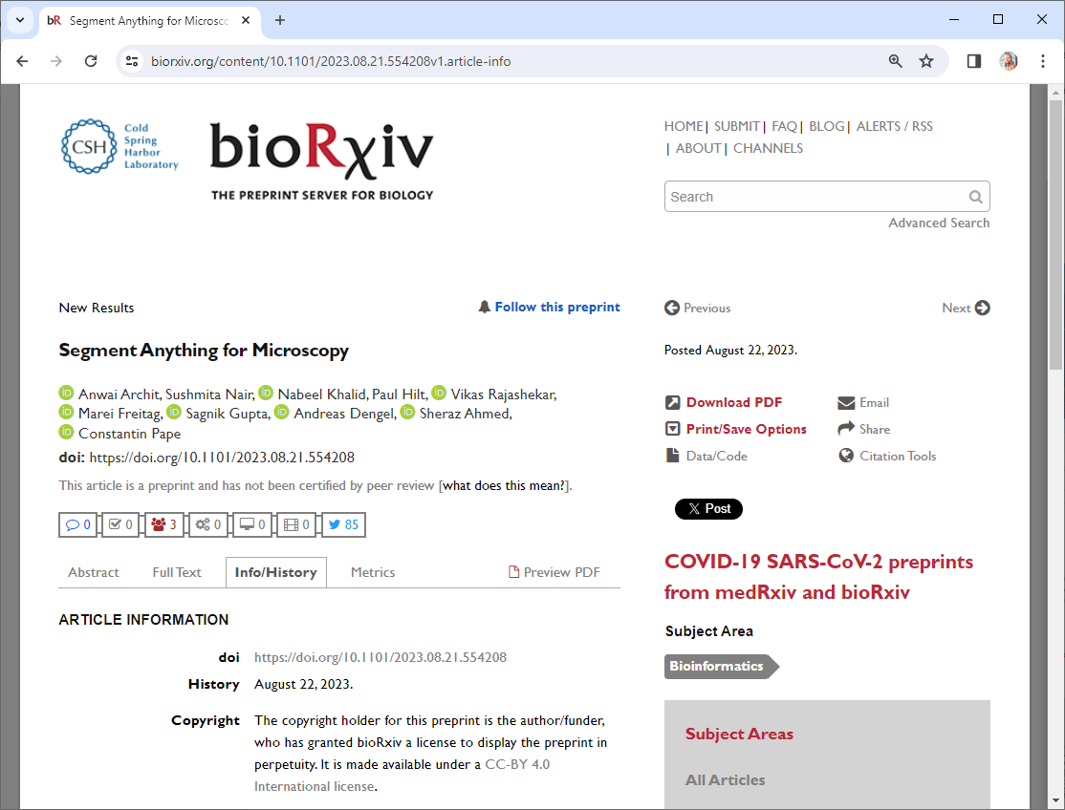
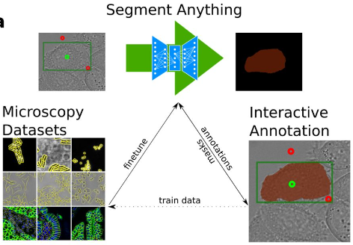
Licensing: Permissive versus restrictive
Look at this great figure! It’s cropped from / licensed CC-BY 4.0 by A. Archit et al.
Example
https://www.biorxiv.org/content/10.1101/2023.08.21.554208v1.article-info

Slide 27
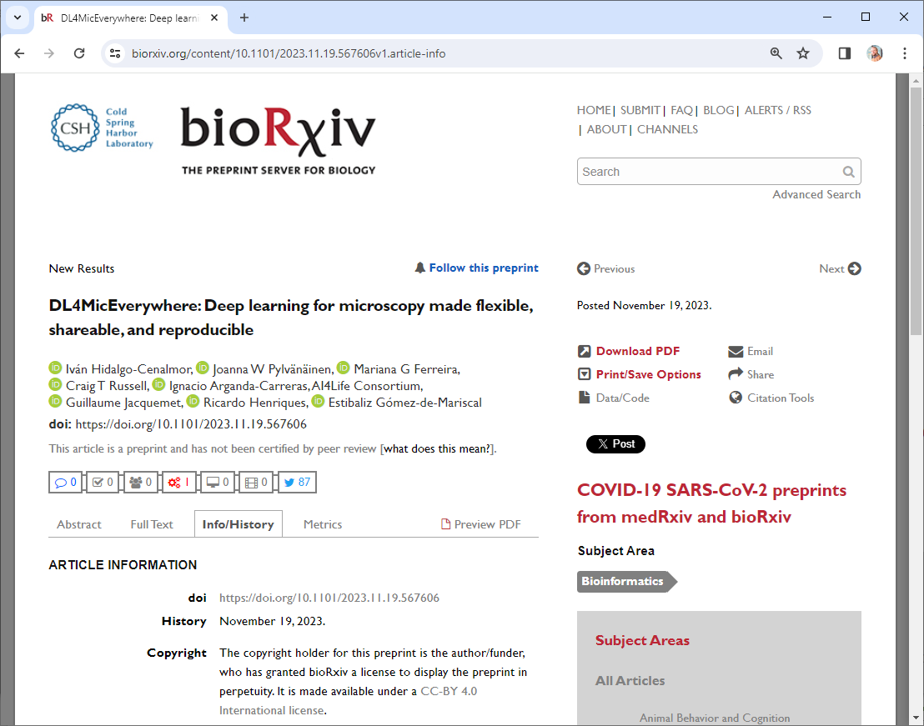
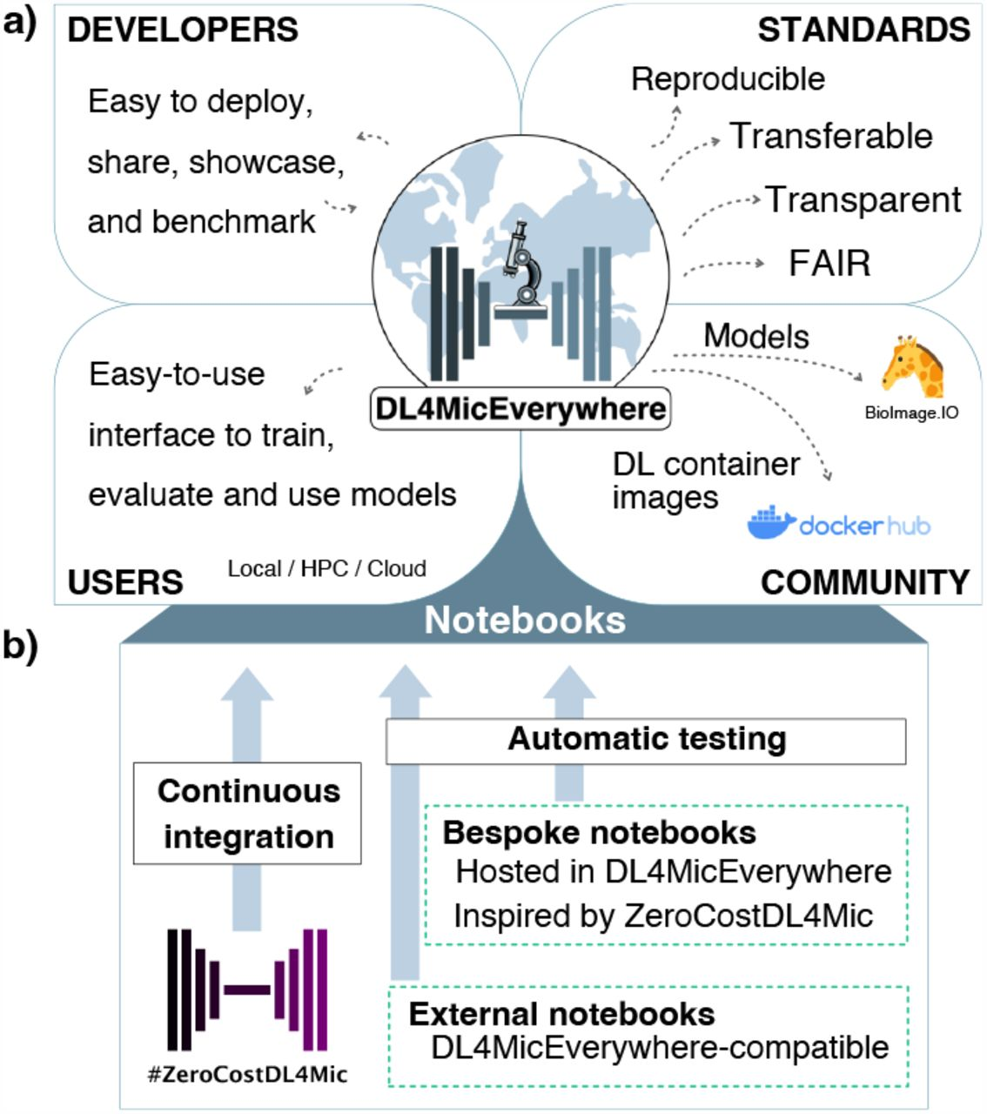
Licensing: Permissive versus restrictive
Look at this great figure! It’s cropped from licensed CC-BY 4.0 by I. Hidalgo-Cenalmor et al.
Example
https://www.biorxiv.org/content/10.1101/2021.09.03.458852v2.full

Slide 28
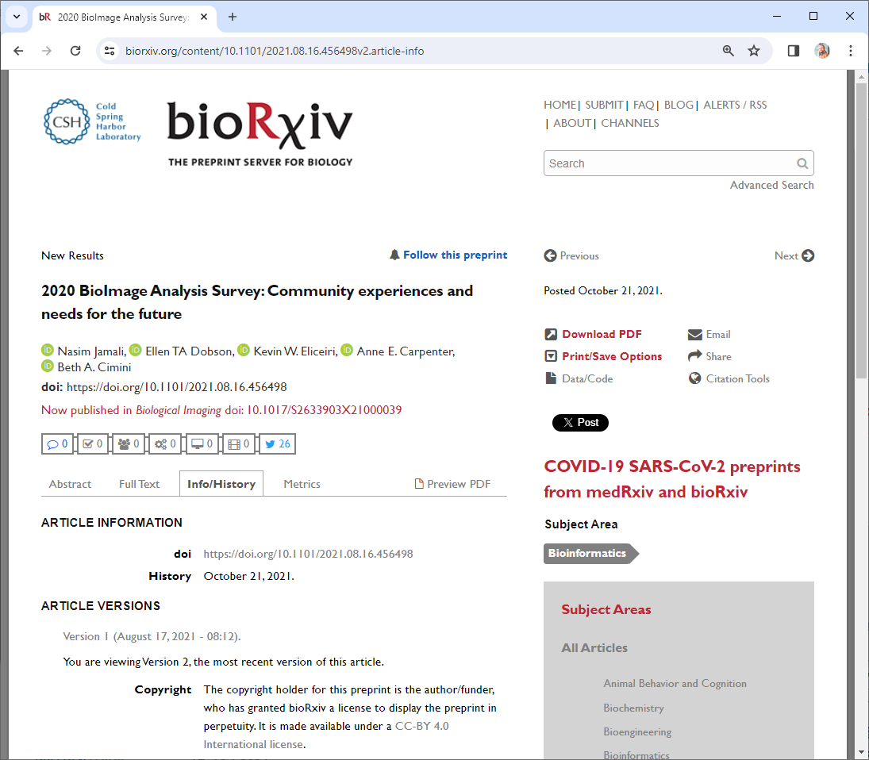
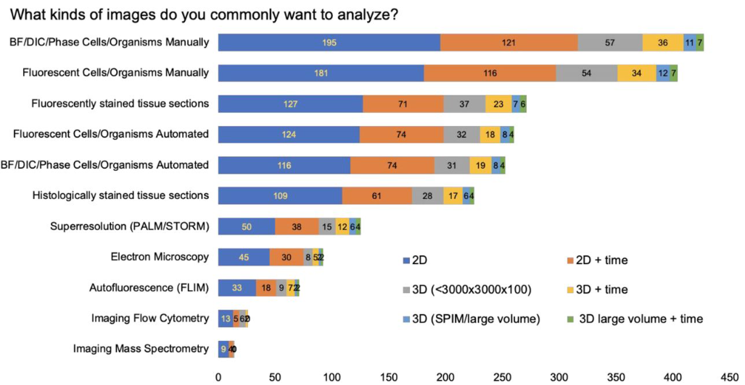
Licensing: Permissive versus restrictive
Look at this great figure! It’s cropped from / licensed CC-BY 4.0 by N. Jamali et al.
Example
https://www.biorxiv.org/content/10.1101/2021.09.03.458852v2.full

Slide 29
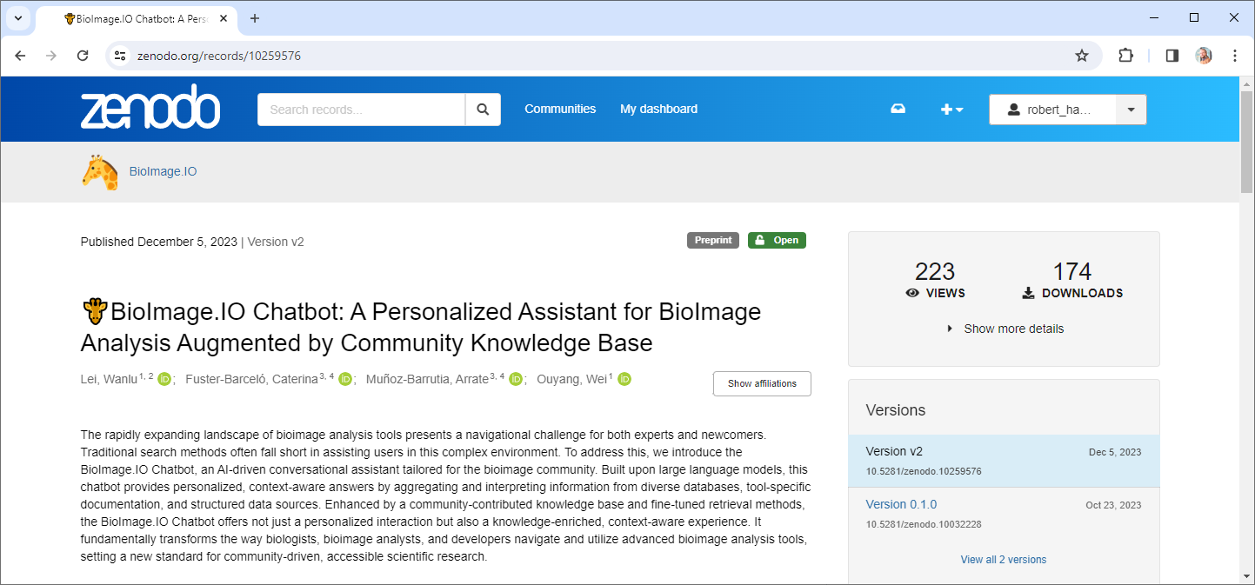
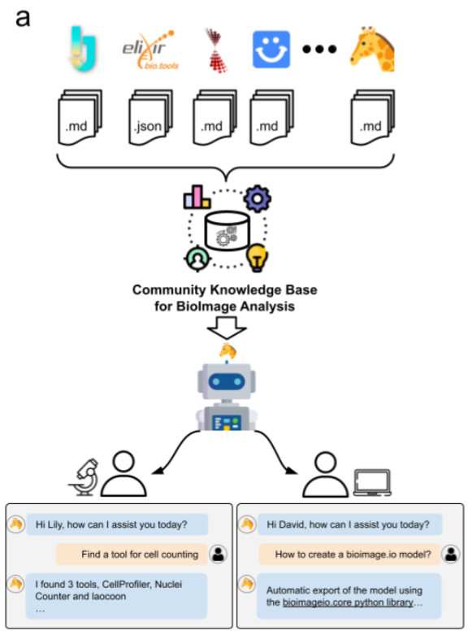
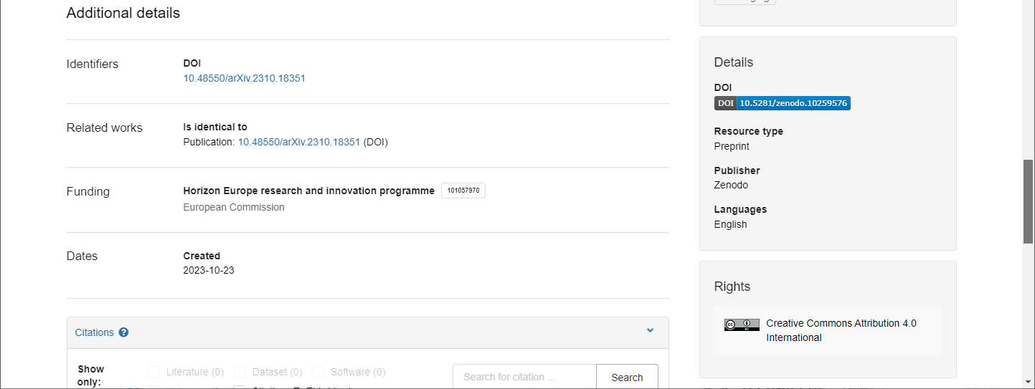
Licensing: Permissive versus restrictive
Look at this great figure! It’s cropped from / licensed CC-BY 4.0 by W. Lei et al.
https://zenodo.org/records/10259576

Slide 30
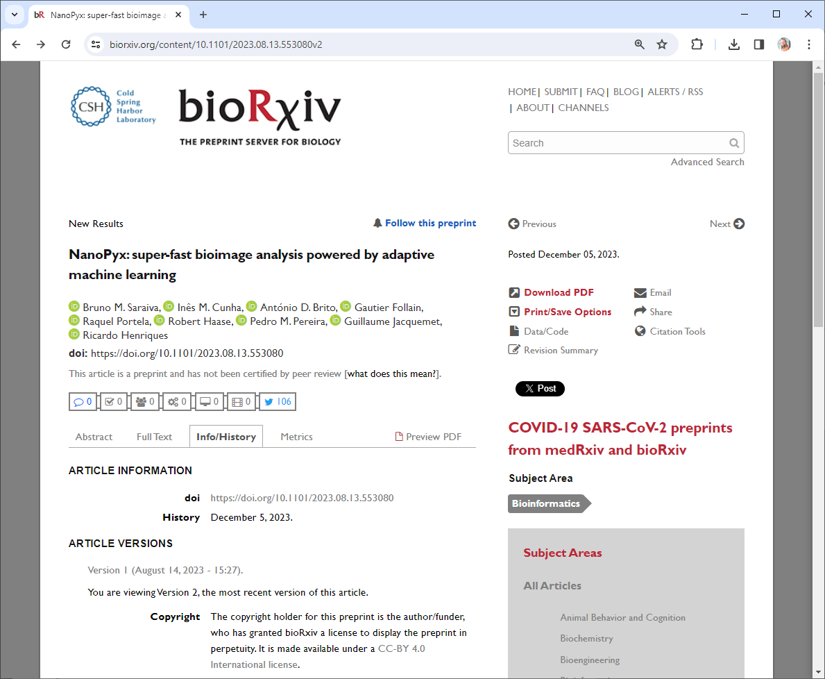
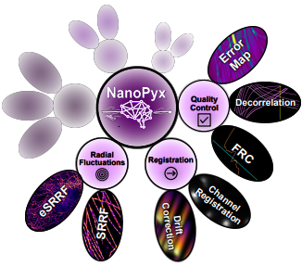
Licensing: Permissive versus restrictive
Look at this great figure! It’s taken from / licensed CC-BY 4.0 by B.M. Saraiva et al.
Example
https://www.biorxiv.org/content/10.1101/2023.08.13.553080v2

Slide 31
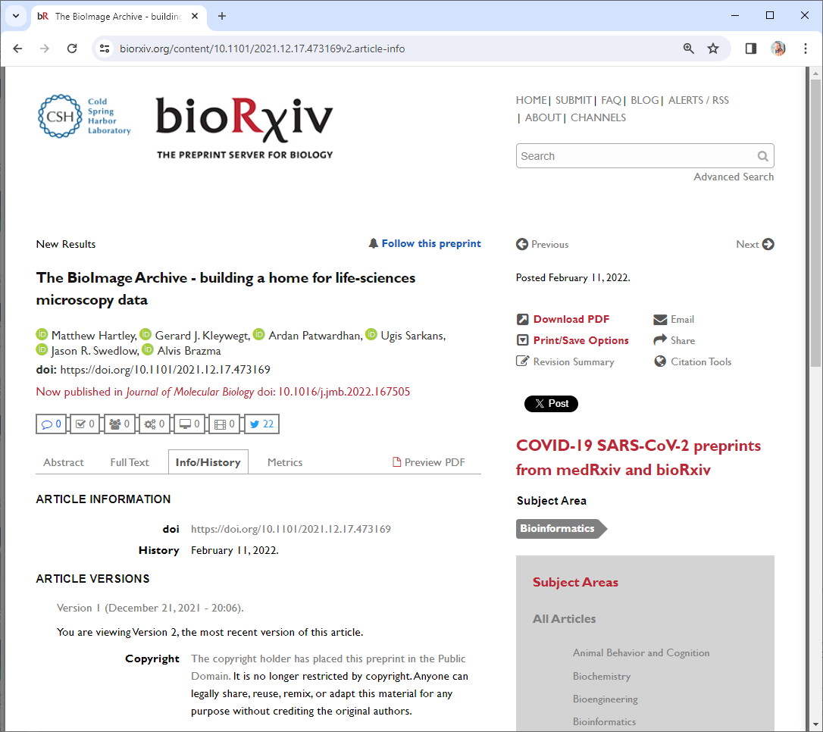
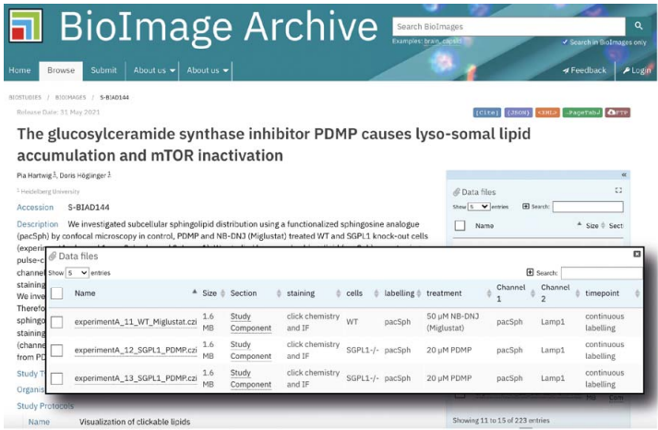
Licensing: Permissive versus restrictive
Look at this great figure! It’s taken from M. Hartley et al.
Example
https://www.biorxiv.org/content/10.1101/2021.12.17.473169v2.article-info

Slide 32
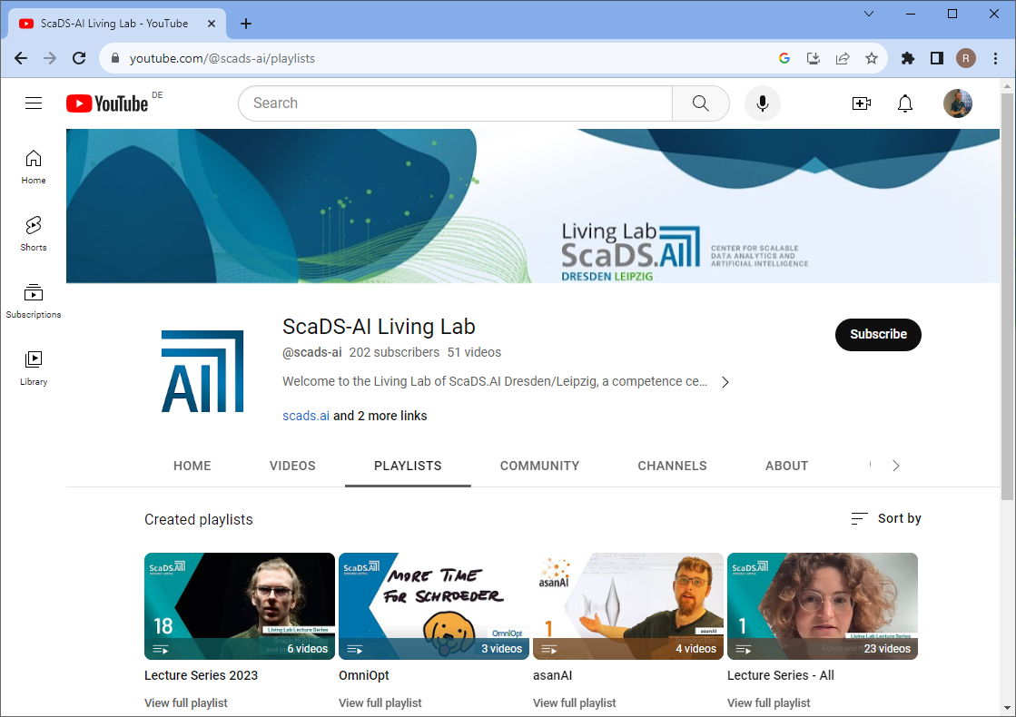
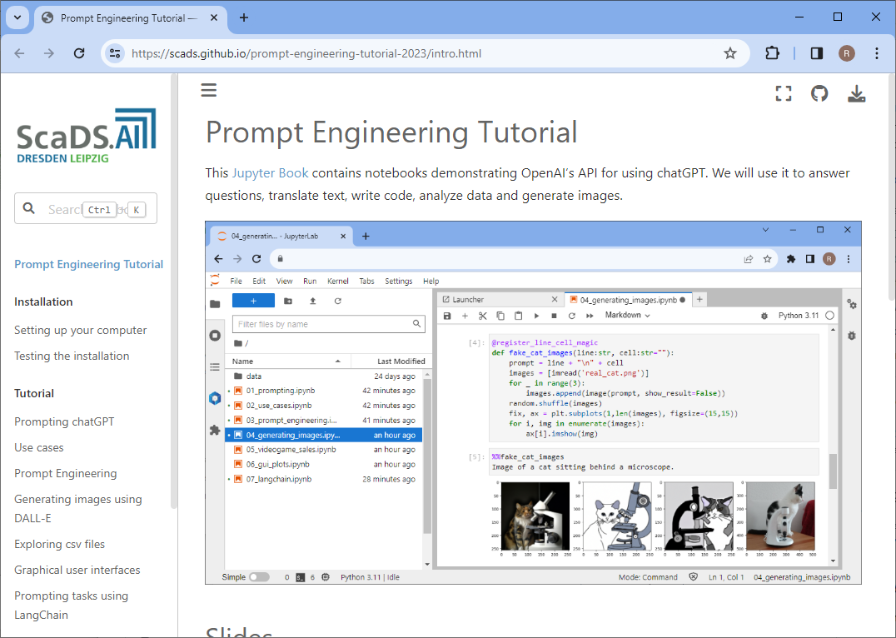
Incentives: Visibility
YouTube, Github,…
Findable
Accessible
Interoperable
Reusable
Open & FAIR Training
is a PR instrument
… leading to
more course attendees
new collaborations
https://www.youtube.com/@scads-ai
https://scads.github.io/prompt-engineering-tutorial-2023/intro.html

Slide 33
Incentives: Findability
Your future-self will thank you, because they will find your work
You remember that talk you gave in 2021?
Where are the slides?
Online,
open access!
https://f1000research.com/slides/10-519

Slide 34
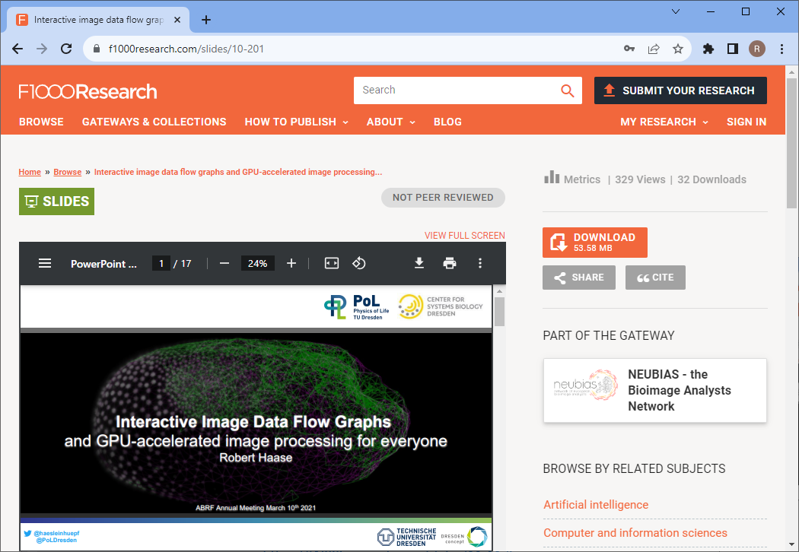
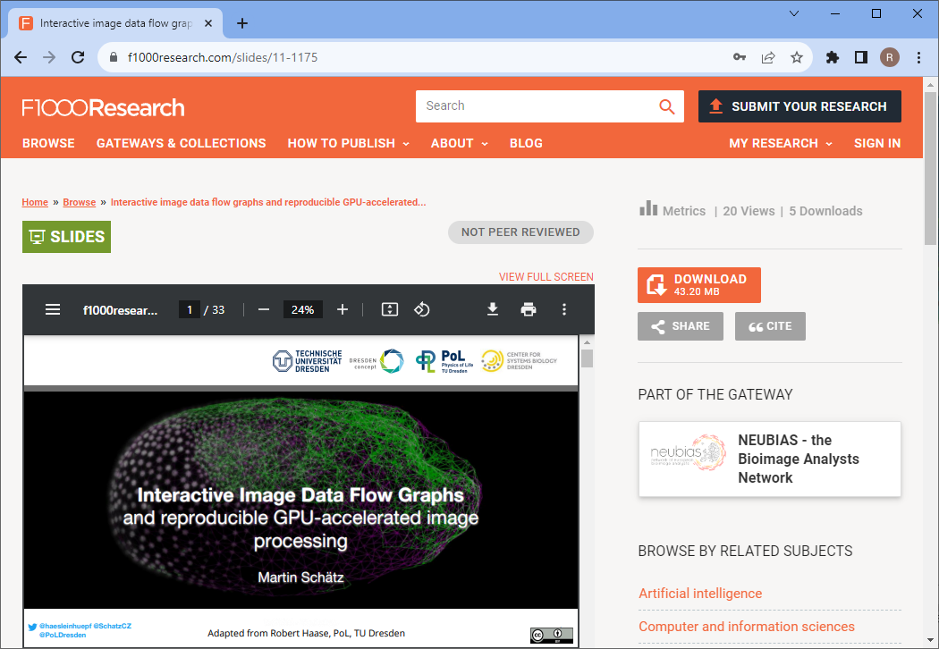
Incentives: Reusability
Open Access -> Others teach how to use your tools & methods
https://f1000research.com/slides/10-201
https://f1000research.com/slides/11-1175

Slide 35
Please use
CC-BY
as license for your materials to make them reusable.
https://creativecommons.org/licenses/by/4.0/

Slide 36
Summary
If you want to make your stuff reusable:
  Use permissive licenses
  Share it on community-wide platforms (not institutional servers)
  Register them in search-indices
Read more:
  Sharing on Zenodo
  https://focalplane.biologists.com/2023/02/15/sharing-research-data-with-zenodo/
  Sharing on Figshare
  https://focalplane.biologists.com/2023/07/26/sharing-your-poster-on-figshare/
  Collaborative work on github
  https://focalplane.biologists.com/2021/09/04/collaborative-bio-image-analysis-script-editing-with-git/
  Licensing
  https://focalplane.biologists.com/2023/05/06/if-you-license-it-itll-be-harder-to-steal-it-why-we-should-license-our-work/
https://doi.org/10.5281/zenodo.10816895

Slide 37


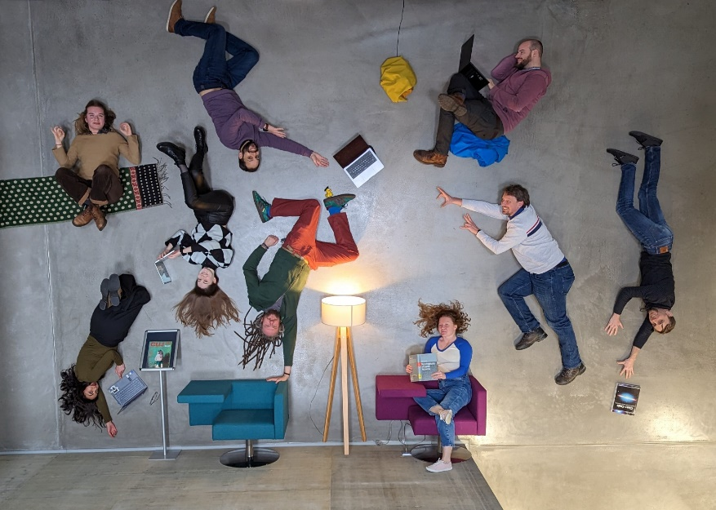








Acknowledgements
Communities & platforms
BiAPoL team
Marcelo Zoccoler
Johannes Soltwedel
Maleeha Hassan
Stefan Hahmann
Former lab members:
Ryan George Savill
Laura Zigutyte
Mara Lampert
Allyson Ryan
Conni Wetzker
Somashekhar Kulkarni
Till Korten
Funding
Some Figures were generated using

