Slide 1


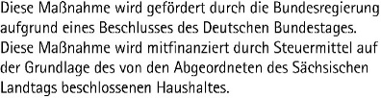
CENTER FOR SCALABLE DATA ANALYTICS AND
ARTIFICIAL INTELLIGENCE
Bio-image Analysis with the Help of Large Language Models
Robert Haase
Funded by
These slides can be reused under the terms of the CC-BY 4.0 license unless mentioned otherwise.
https://doi.org/10.5281/zenodo.10811747

Slide 2
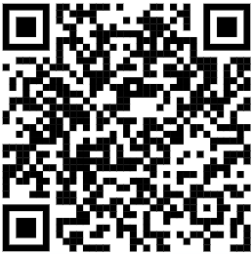
Quick survey
Question | Number of raised hands
Who has tried ChatGPT, Dall-E or other large language model based tools before? | 25
Who is using them on a daily basis? | 10
Who knows how they work under the hood (roughly)? | 5
https://doi.org/10.5281/zenodo.10811747
https://zenodo.org/records/10811747

Slide 3
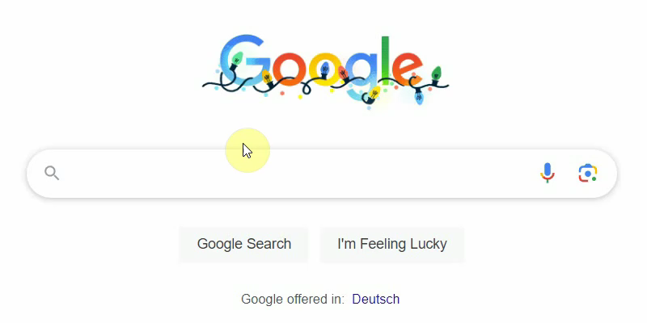
Artificial intelligence in daily programmer’s life
How it started

Slide 4
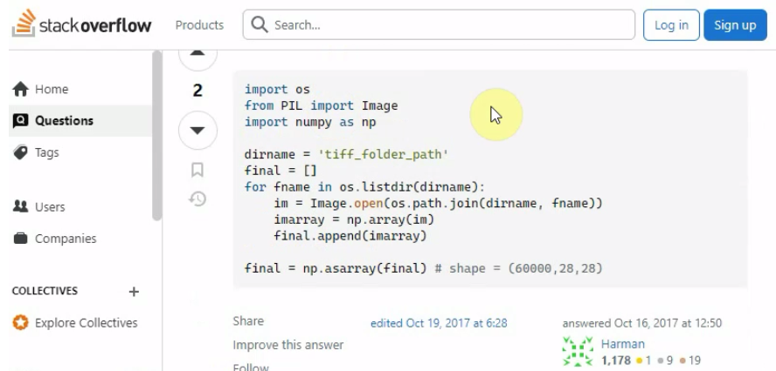
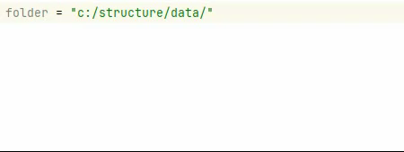
Artificial intelligence in daily programmer’s life
How it started
How it’s going
(GitHub copilot)

Slide 5
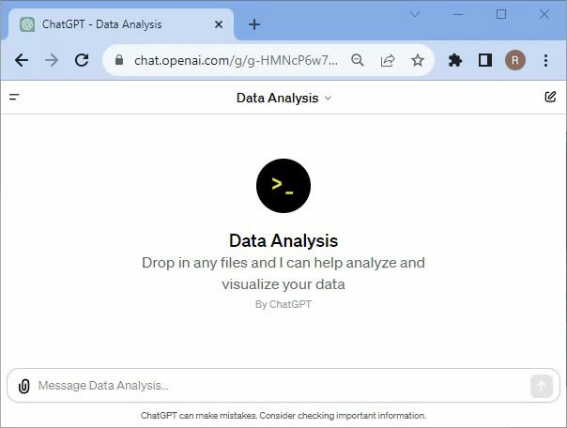
Prompting to analyze data
… using ChatGPT’s Data Analysis
access data via prompts
super easy to use
requires uploading our data
is a bit untransparent
Data source: videogame sales dataset by Gregory Smith, licensed CC-BY 4.0

Slide 6

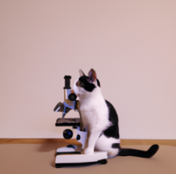
Short detour: Generative Artificial Intelligence
Definition: “Generative artificial intelligence […] is a type of artificial intelligence (AI) system capable of generating text, images, or other media in response to prompts.”¹
Commonly based on Neural Networks
Bridges fields:
  Natural Language Processing (NLP)
  Computer Vision (CV)
Use-cases
  Translating text
  Writing emails, text, grant proposals
  Summarizing articles
  Writing code
  General question answering
  Image generation
A picture of a cat and a microscope
¹ source: https://en.wikipedia.org/wiki/Generative_artificial_intelligence

Slide 7
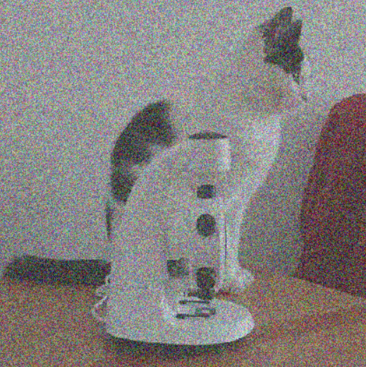
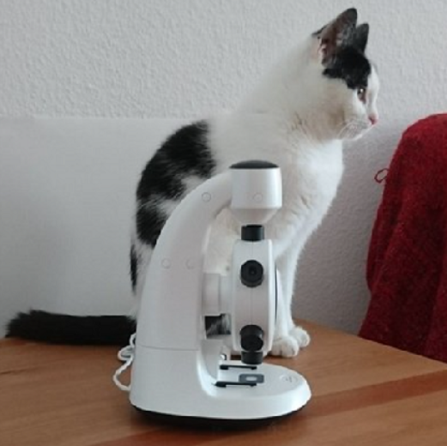
How does it work?
Combination of neural networks + other elements + various [multi-modal] data sources
Examples: GPT / DALL-E,
Stable Diffusion
Use-case:
  Generate image from
  noise + text
The cat’s fur is black and white.
Input
Output

Slide 8
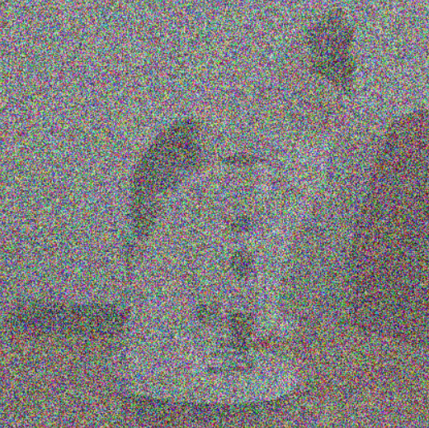
How does it work?
Combination of neural networks + other elements + various [multi-modal] data sources
Examples: GPT / DALL-E,
Stable Diffusion
Use-case:
  Generate image from
  noise + text
The cat’s fur is black and white.
Input
Output

Slide 9
How does it work?
Combination of neural networks + other elements + various [multi-modal] data sources
Examples: GPT / DALL-E,
Stable Diffusion
Use-case:
  Generate image from
  noise + text
The cat’s fur is black and white.
Input
Output

Slide 10
How does it work?
Combination of neural networks + other elements + various [multi-modal] data sources
Examples: GPT / DALL-E,
Stable Diffusion
Use-case:
  Generate image from
  noise + text
The cat’s fur is black and white.
Input
Output

Slide 11
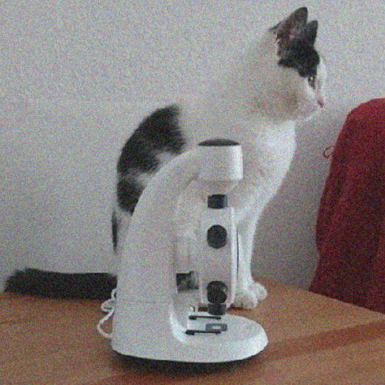
How does it work?
Combination of neural networks + other elements + various [multi-modal] data sources
Examples: GPT / DALL-E,
Stable Diffusion
Use-case:
  Generate image from
  noise + text
The cat’s fur is black and white.
Self-attention
Word Embedding
1
“microscope”
0
1
4
3
2
1
Input
Output
The
cat’s
is
fur
black
and
white.
“cat”
“black”
“white”
“fur”
0
0
1

Slide 12
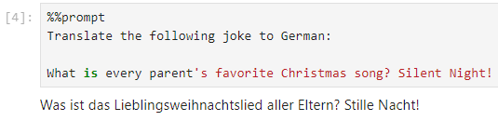
What are large language models good in?
Translation tasks
https://scads.github.io/prompt-engineering-tutorial-2023/01_prompts/02_use_cases.html

Slide 13
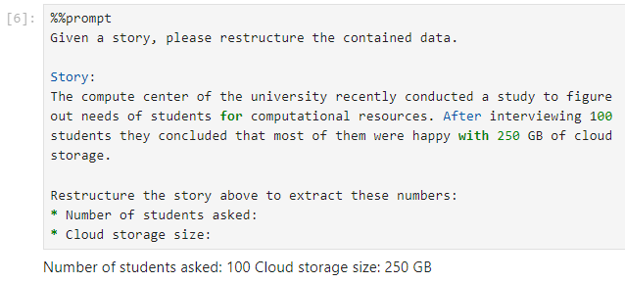
What are large language models good in?
Restructuring data
https://scads.github.io/prompt-engineering-tutorial-2023/01_prompts/02_use_cases.html

Slide 14
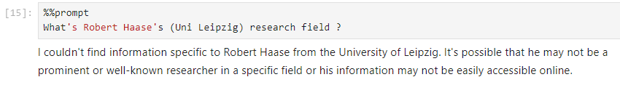

What are large language models not so good in?
Querying knowledge
(e.g. for recent information)
https://scads.github.io/prompt-engineering-tutorial-2023/01_prompts/02_use_cases.html

Slide 15

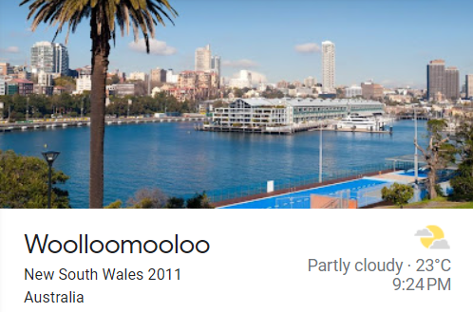
What are large language models not so good in?
Math (e.g. counting)
https://scads.github.io/prompt-engineering-tutorial-2023/01_prompts/02_use_cases.html

Slide 16
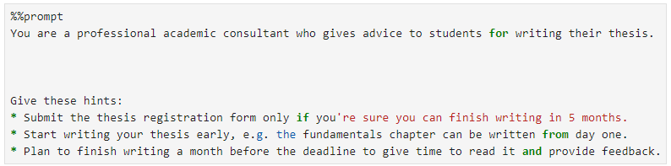
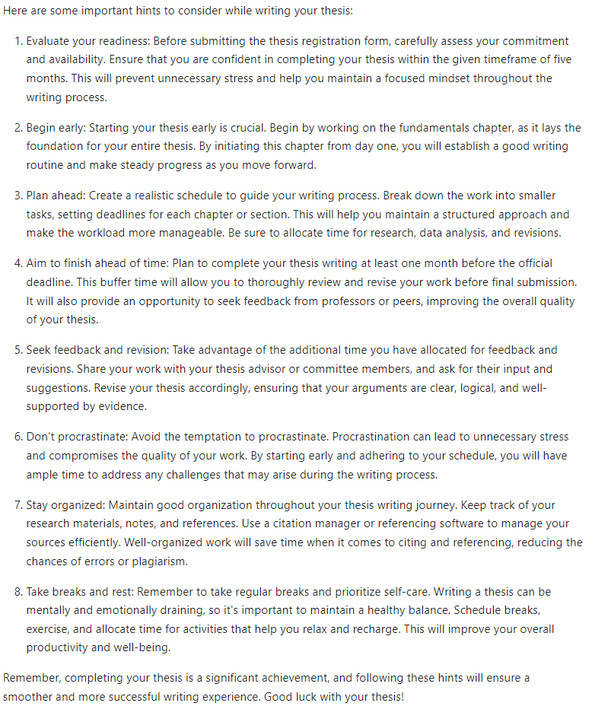
Prompt Engineering
Set context / assign role
Define output style
Give hints / conditions
List tasks
Provide data
https://scads.github.io/prompt-engineering-tutorial-2023/01_prompts/03_prompt_engineering.html

Slide 17
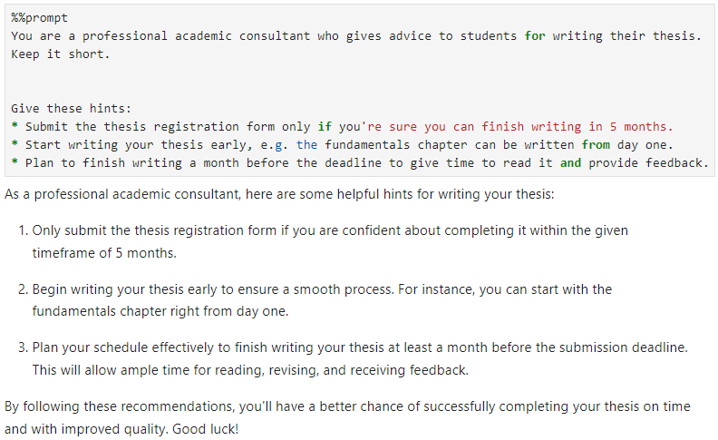
Prompt Engineering
Set context / assign role
Define output style
Give hints / conditions
List tasks
Provide data
https://scads.github.io/prompt-engineering-tutorial-2023/01_prompts/03_prompt_engineering.html

Slide 18
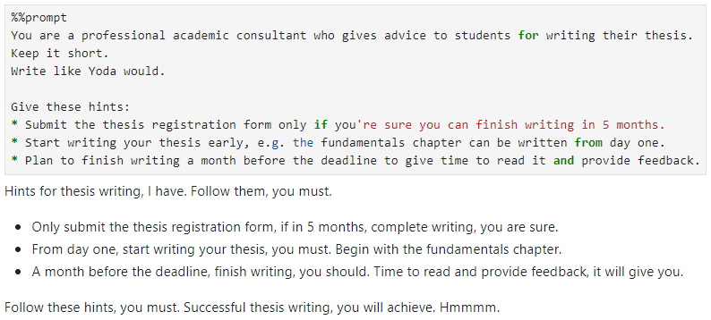
Prompt Engineering
Set context / assign role
Define output style
Give hints / conditions
List tasks
Provide data
https://scads.github.io/prompt-engineering-tutorial-2023/01_prompts/03_prompt_engineering.html

Slide 19
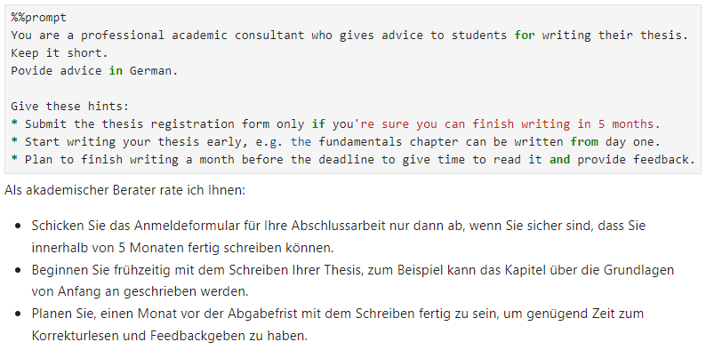
Prompt Engineering
Set context / assign role
Define output style
Give hints / conditions
List tasks
Provide data
https://scads.github.io/prompt-engineering-tutorial-2023/01_prompts/03_prompt_engineering.html

Slide 20
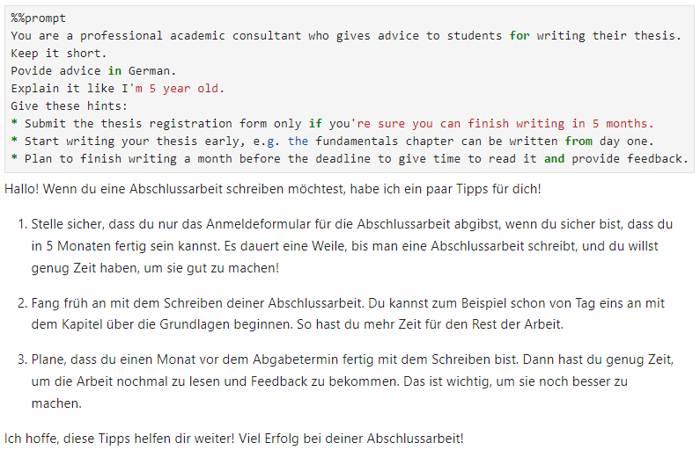
Prompt Engineering
Set context / assign role
Define output style
Give hints / conditions
List tasks
Provide data
https://scads.github.io/prompt-engineering-tutorial-2023/01_prompts/03_prompt_engineering.html

Slide 21
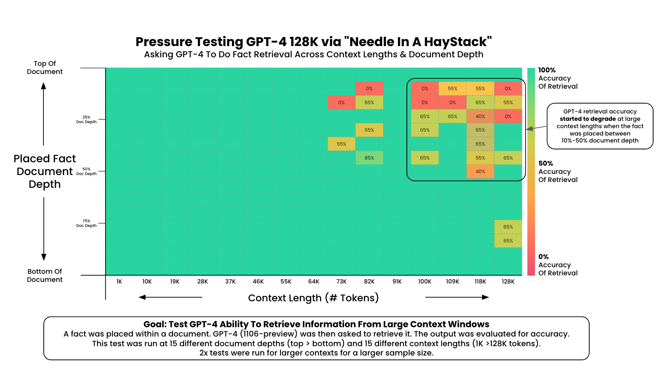
Context length
Visualization by Greg Kamradt, Licensed MIT (modified), Source: https://github.com/gkamradt/LLMTest_NeedleInAHaystack

Slide 22
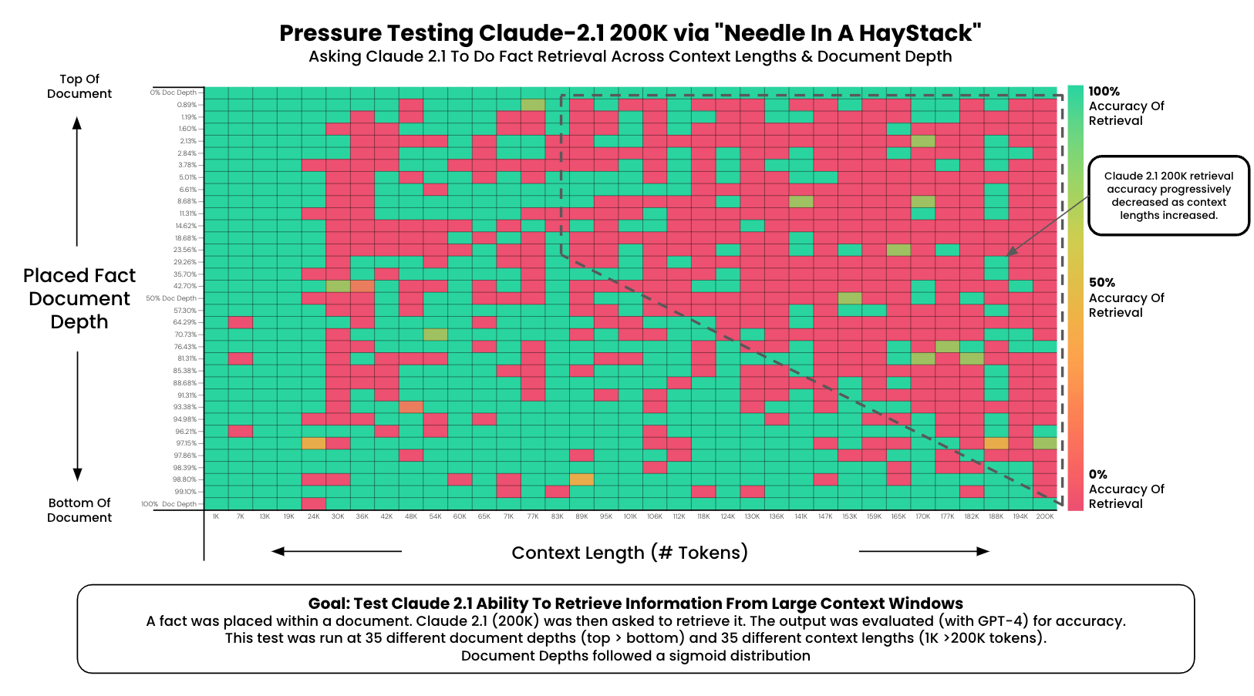
Context length
Visualization by Greg Kamradt, Licensed MIT (modified), Source: https://github.com/gkamradt/LLMTest_NeedleInAHaystack

Slide 23
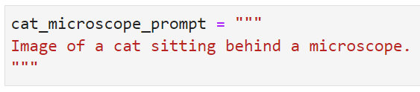
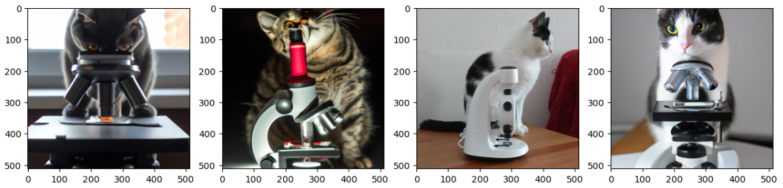
Prompt engineering
Prompts can also be used to generate images, e.g. with DALL-E.
One can generate quite realistic images given a detailed prompt.
One cat
is real.
https://haesleinhuepf.github.io/BioImageAnalysisNotebooks/07_prompt_engineering/02_generating_images.html

Slide 24
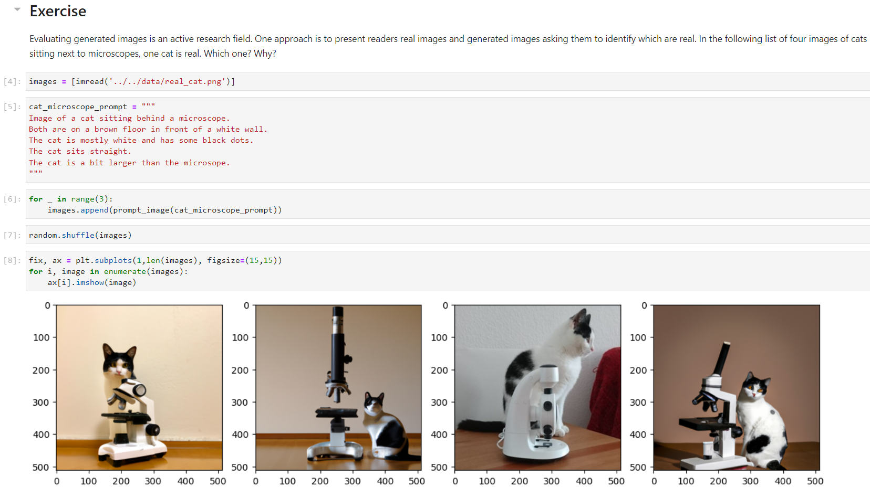
Prompt engineering
Prompts can also be used to generate images, e.g. with DALL-E.
One can generate quite realistic images given a detailed prompt.
One cat
is real.
https://haesleinhuepf.github.io/BioImageAnalysisNotebooks/07_prompt_engineering/02_generating_images.html

Slide 25
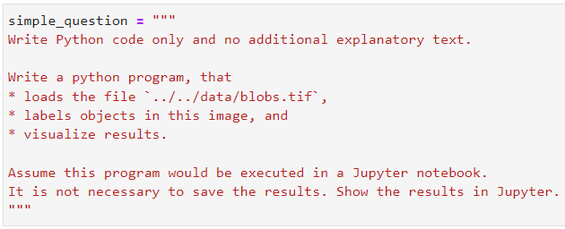
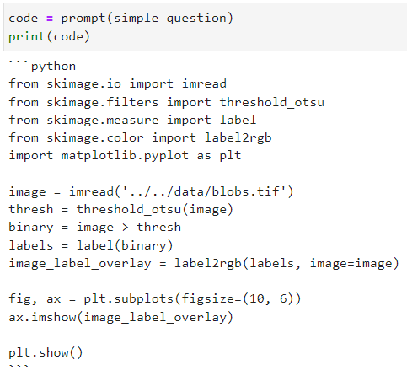
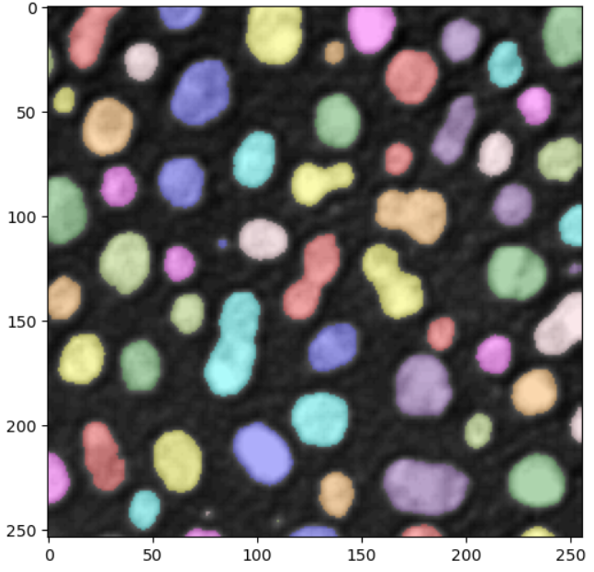
Prompt engineering
chatGPT can solve simple image analysis tasks
Prompt
Response
Result
https://haesleinhuepf.github.io/BioImageAnalysisNotebooks/07_prompt_engineering/04_generating_code_for_processing_images.html

Slide 26
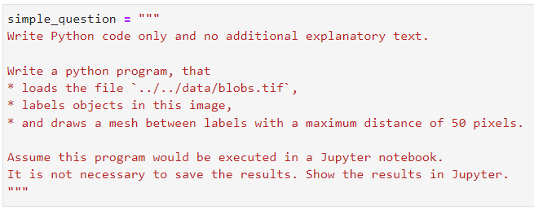
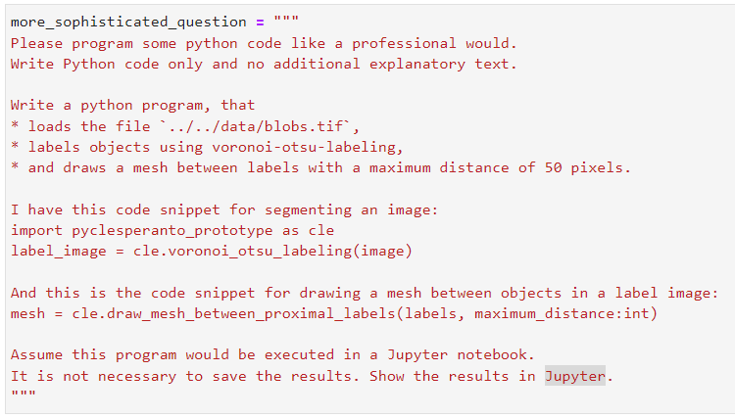
Prompt engineering
With more advanced tasks, it requires hints
ChatGPT does not know how to do this and hallucinates code that does not work
https://haesleinhuepf.github.io/BioImageAnalysisNotebooks/07_prompt_engineering/05_generating_advanced_image_processing_code.html

Slide 27

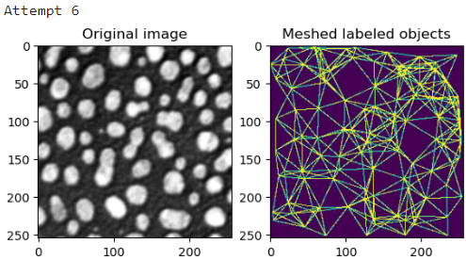
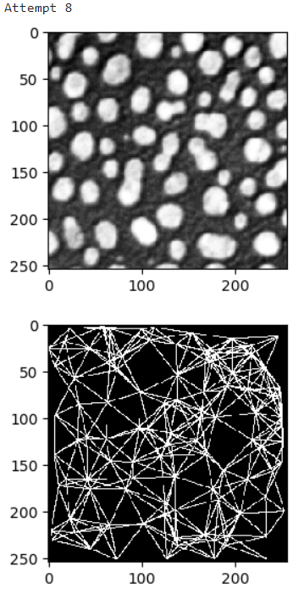
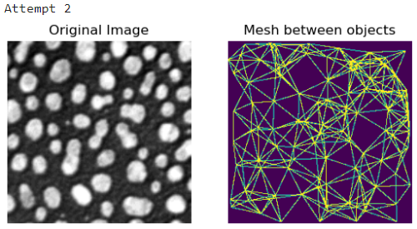
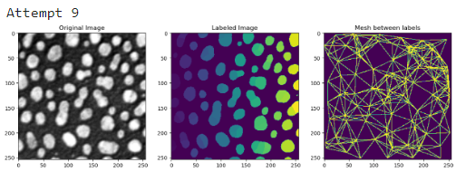
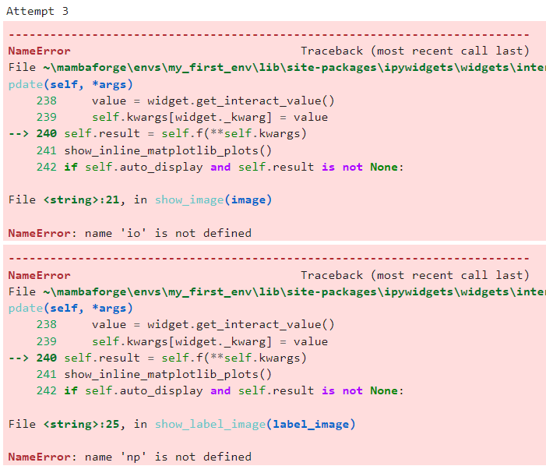
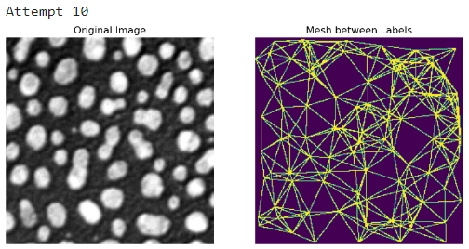
Prompt engineering
With more advanced tasks, it requires hints
The more sophisticated prompt had errors in 4 out of 10 runs.
The more sophisticated prompt produced useful results in 5 out of 10 runs.
https://haesleinhuepf.github.io/BioImageAnalysisNotebooks/07_prompt_engineering/05_generating_advanced_image_processing_code.html

Slide 28
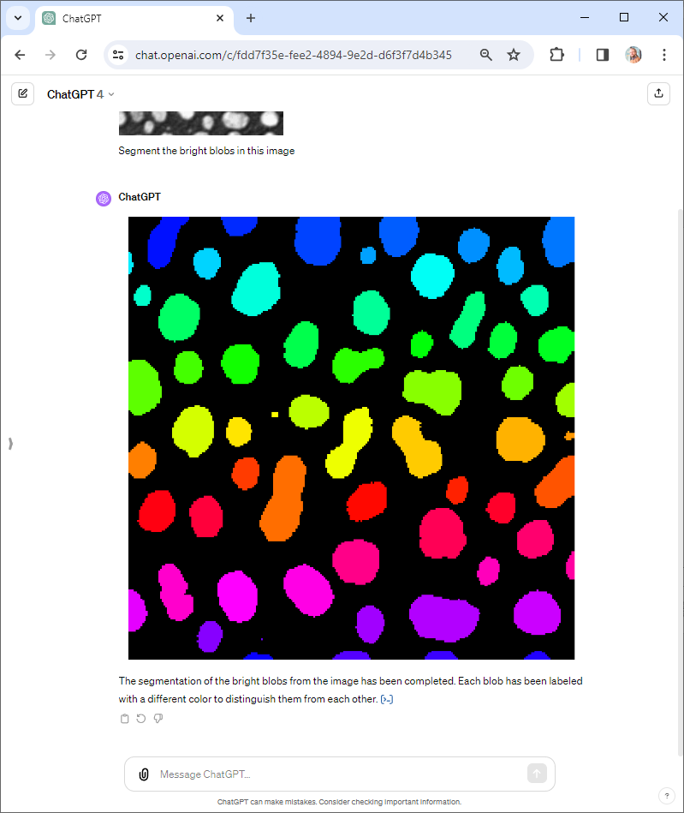
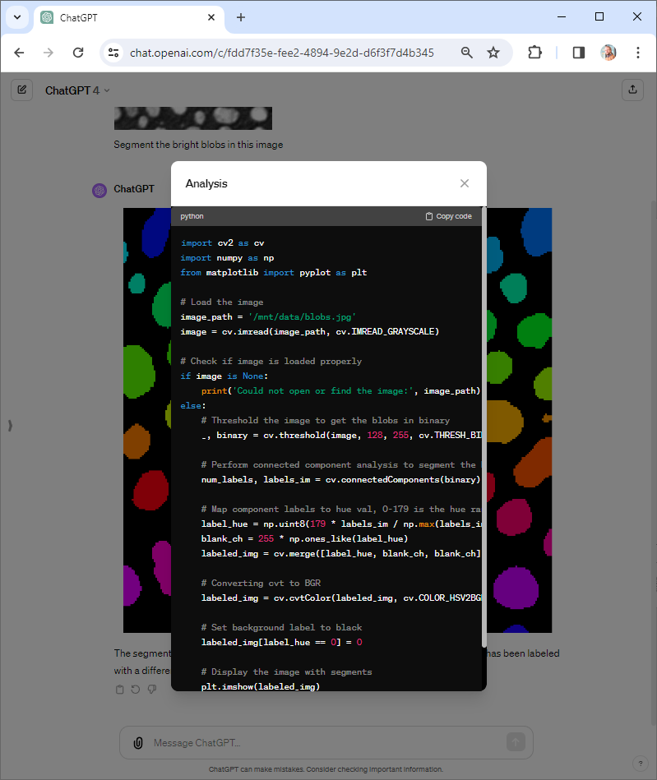
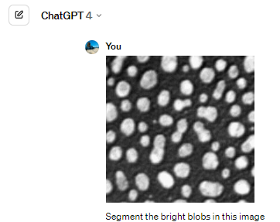
ChatGPT for analyzing scientific image data
ChatGPT can perform [yet simple] analysis tasks,
and tell you what it did.
https://chat.openai.com/g/g-HMNcP6w7d-data-analyst

Slide 29
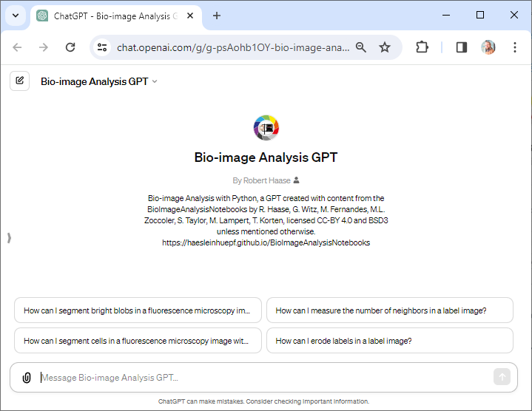
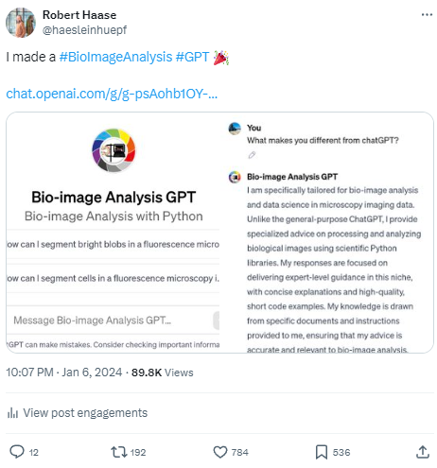
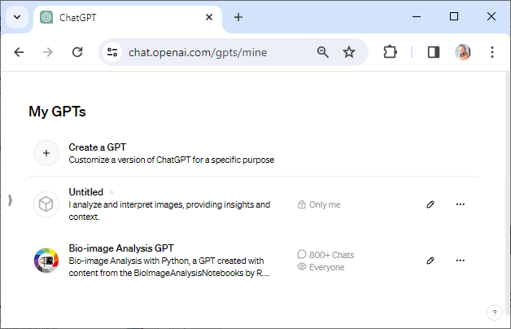
How about a Bio-image Analysis GPT
OpenAI allows customization of ChatGPT
https://chat.openai.com/g/g-psAohb1OY- bio-image-analysis-gpt
https://twitter.com/haesleinhuepf/status/1743741036701077849

Slide 30
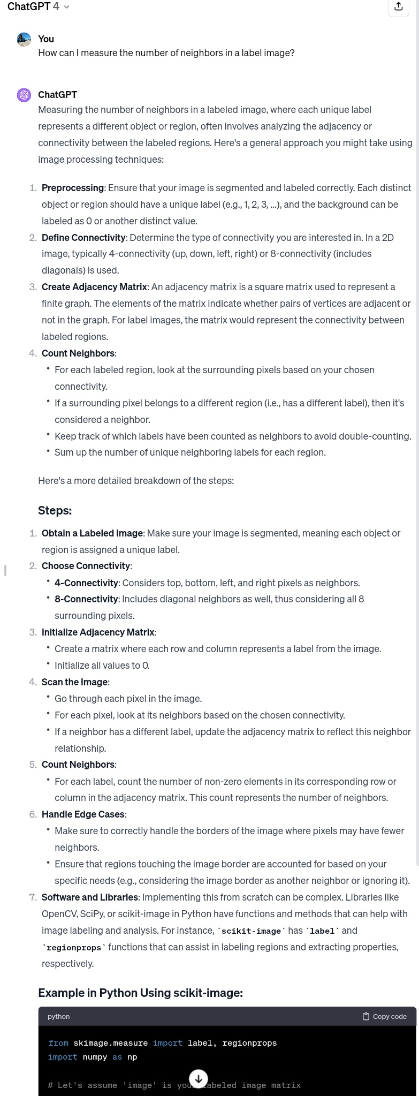
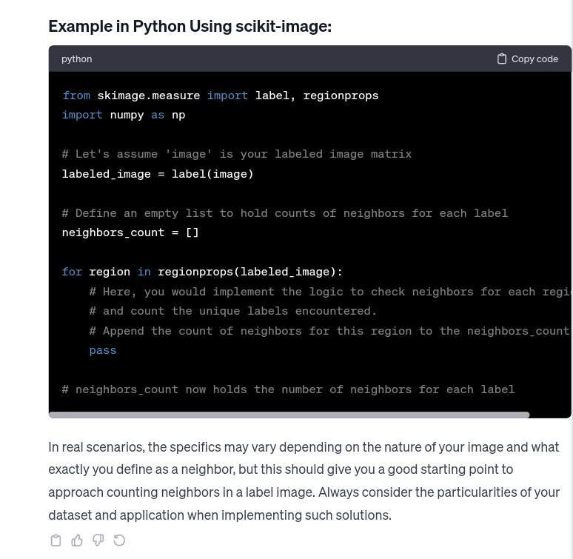
ChatGPT for analyzing scientific image data
ChatGPT in comparison with the Bio-image Analysis GPT
https://chat.openai.com/g/g-psAohb1OY- bio-image-analysis-gpt

Slide 31
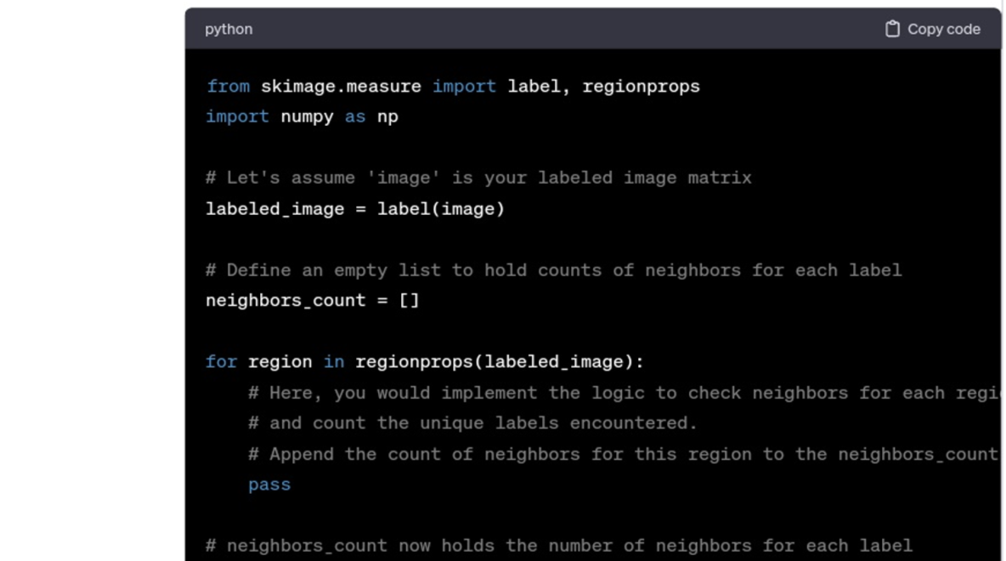
ChatGPT for analyzing scientific image data
ChatGPT in comparison with the Bio-image Analysis GPT
Limited Bio-image Analysis domain-specific knowledge
https://chat.openai.com/g/g-psAohb1OY- bio-image-analysis-gpt

Slide 32
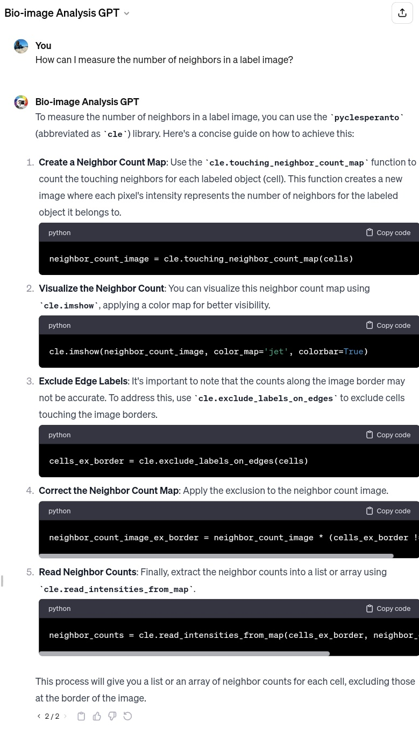
ChatGPT for analyzing scientific image data
ChatGPT in comparison with the Bio-image Analysis GPT
Containing some Bio-image Analysis knowledge
More concise responses
https://chat.openai.com/g/g-psAohb1OY- bio-image-analysis-gpt

Slide 33
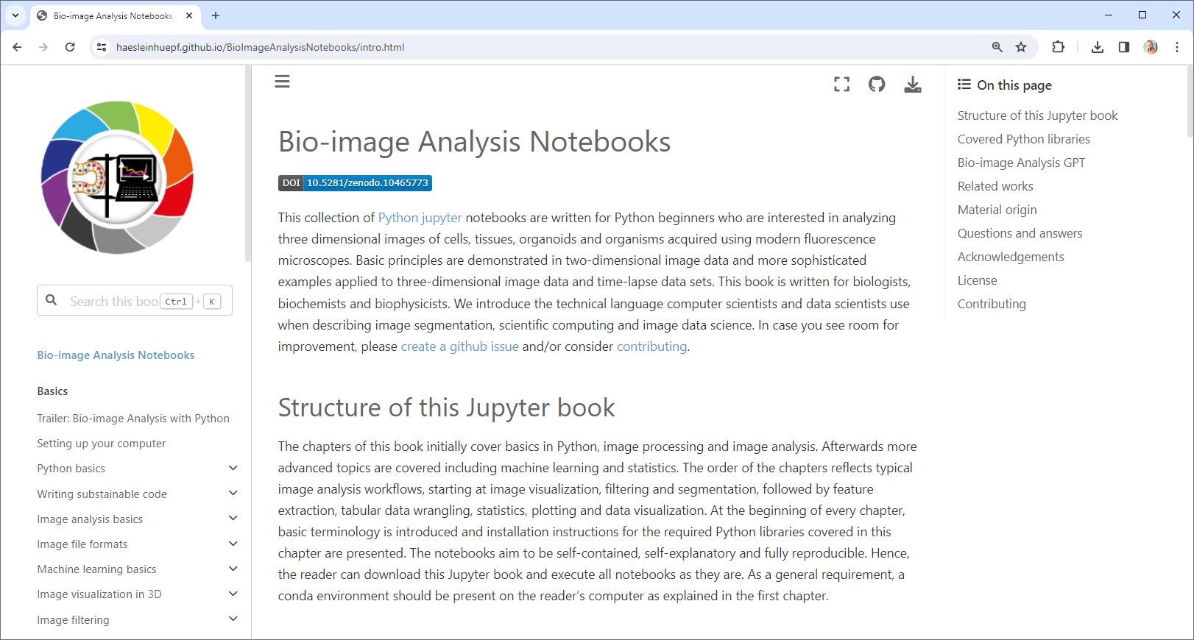
ChatGPT for analyzing scientific image data
Bio-image Analysis GPT is extensible, it’s knowledge base is made from:
Just submit a pull-request to the Bio-image Analysis Notebooks
https://haesleinhuepf.github.io/BioImageAnalysisNotebooks https://chat.openai.com/g/g-psAohb1OY-bio-image-analysis-gpt

Slide 34
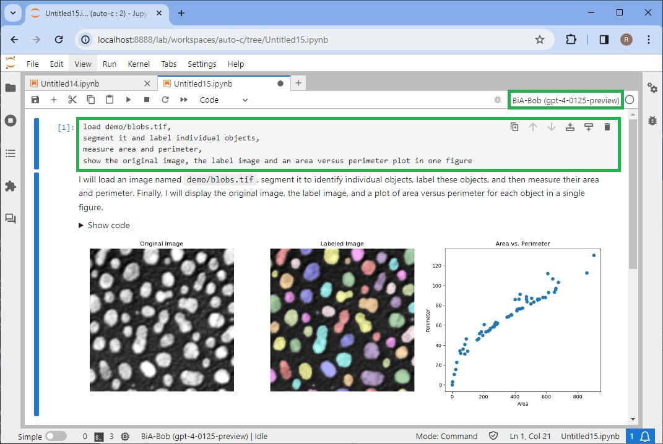
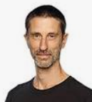
How about doing this locally? BiA-Bob
Open-source alternative to OpenAI’s Data Analyst
No need to upload your [image] data
Extensible through plugins
With Christian Tischer (EMBL Heidelberg)
@tischitischer
https://github.com/haesleinhuepf/bia-bob

Slide 35

How about doing this locally? BiA-Bob
Open-source alternative to OpenAI’s Data Analyst
No need to upload your [image] data
Extensible through plugins
With Christian Tischer (EMBL Heidelberg)
@tischitischer
https://github.com/haesleinhuepf/bia-bob

Slide 36

Analyzing images using LLMs / BiA-Bob
Use the %bob … syntax to ask for small things.
With Christian Tischer (EMBL Heidelberg)
@tischitischer
https://github.com/haesleinhuepf/bia-bob/blob/main/demo/basic_demo.ipynb

Slide 37



Analyzing images using LLMs / BiA-Bob
Use the %%bob … syntax to ask for complex analysis tasks.
With Christian Tischer (EMBL Heidelberg)
@tischitischer
https://github.com/haesleinhuepf/bia-bob/blob/main/demo/basic_demo.ipynb

Slide 38


BiA-Bob: Available language models / backends
ChatGPT by OpenAI
Gemini by Google
Interesting variable names
https://github.com/haesleinhuepf/bia-bob/blob/main/demo/gemini.ipynb

Slide 39


BiA-Bob: Available language models / backends
Runs on your local computer (offline)
Mistral through Blablador
CodeLLama via ollama
Free online service for German academics, offered by HelmholtzAI
Many OpenSource models seem less capable than the commercial models, when it comes to complex code
https://login.helmholtz.de/oauth2-as/oauth2-authz-web-entry
https://ollama.com
https://github.com/haesleinhuepf/bia-bob/blob/main/demo/custom_endpoints.ipynb

Slide 40


BiA-Bob: Vision models
Image-input, for interpreting natural images
ChatGPT by OpenAI
https://github.com/haesleinhuepf/bia-bob/blob/main/demo/vision.ipynb

Slide 41

BiA-Bob: Vision models 🤓
Image-input, for interpreting natural images
  Gemini by Google
https://github.com/haesleinhuepf/bia-bob/blob/main/demo/vision.ipynb

Slide 42



BiA-Bob: Vision models 🤓
Image-input, for interpreting natural images
Llava via ollama
Work in progress, join efforts if you’re interested!
https://github.com/haesleinhuepf/bia-bob/pull/115
https://llava-vl.github.io/

Slide 43


BiA-Bob: Vision models 🤓
Image-input, to guide analysis / code generation
ChatGPT by OpenAI
https://github.com/haesleinhuepf/bia-bob/blob/main/demo/vision-microscopy.ipynb

Slide 44



Function Calling using LangChain
LangChain is used to combine tools.
It uses chatGPT under the hood.
https://github.com/langchain-ai/langchain
https://scads.github.io/prompt-engineering-tutorial-2023/01_prompts/07_langchain.html

Slide 45




Function Calling using LangChain
After combining tools, large langue model and memory in an agent, you can interact with it.
https://github.com/langchain-ai/langchain
https://scads.github.io/prompt-engineering-tutorial-2023/01_prompts/07_langchain.html

Slide 46

Voice Assistance
Combining voice recognition with large language models
https://github.com/haesleinhuepf/blablado
https://github.com/haesleinhuepf/blablado/blob/main/demo/microscope_stage_demo.ipynb

Slide 47


napari-chatGPT
Napari-chatGPT can automate programming plugins / “widgets”.
Source: https://github.com/royerlab/napari-chatgpt (BSD3 license)
https://twitter.com/loicaroyer/status/1653600252807757824

Slide 48


ChatGPT @Fiji’s Script-Editor
ChatGPT’s knowledge about ImageJ and Macro is limited
… will also come at some point
https://github.com/scijava/script-editor/pull/67

Slide 49




What else can [multi-modal] LLMs do?
Potentially useful to make algorithms more robust
Generate images, e.g. for augmenting data
Image Variation
https://haesleinhuepf.github.io/BioImageAnalysisNotebooks/07_prompt_engineering/60_image_variations_huggingface.html

Slide 50

New technologies bring new risks…
If you can generate images,
you can also generate parts of images….
Interesting challenges for our community ahead
https://github.com/haesleinhuepf/darth-d/blob/main/demo/demo_replacing.ipynb

Slide 51






Generative Artificial Intelligence
Challenges
  Data safety / security / integrity
  Computational cost of training of neural networks
        CO2-footprint/climate change
        Accessibility
  Bias: “a nice photo of a human”
  Hallucinations
  False information / fake news
  Glitch tokens
  Debugging is hard
May 2023
March 2024
Sources: https://replicate.com/stability-ai/stable-diffusion https://chat.openai.com/

Slide 52





Further reading / watching
https://www.youtube.com/watch?v=JMo6Sn-L_j4
https://www.youtube.com/c/digitalsreeni

Slide 53
CENTER FOR SCALABLE DATA ANALYTICS AND
ARTIFICIAL INTELLIGENCE
Exercises
Robert Haase
Funded by
These slides can be reused under the terms of the CC-BY 4.0 license unless mentioned otherwise.

Slide 54



Optional exercise: Install mambaforge
Detailed instructions:
https://biapol.github.io/blog/mara_lampert/getting_started_with_mambaforge_and_python/readme.html
Blog post by Mara Lampert licensed CC-BY 4.0

Slide 55

Optional exercise: Installation
Install a collection of Python packages in a new conda-environment like this:
mamba create --name prompt-env python=3.9 jupyterlab openai scikit-image pandas matplotlib -c conda-forge
Then activate the environment and start JupyterLab
mamba activate prompt-env
jupyter lab
https://scads.github.io/prompt-engineering-tutorial-2023/00_preparation/readme.html

Slide 56



Get an OpenAI API key
Yes, this costs money.
https://openai.com/blog/openai-api

Slide 57



Optional: Store the API key in your environment
Add the OPEN AI API Key to your environment variables
4
2
3
1

Slide 58


Exercise: Text generation
Reproduce the prompts stored in the Jupyter Notebooks

Slide 59


Exercise: Generating images
Use DALL-E’s API to generate an image of students in the living lab
To make it look realistic, you may have to describe the scene in very detail.
https://scads.github.io/prompt-engineering-tutorial-2023/01_prompts/04_generating_images.html

Slide 60


Exercise: Generating code
Ask ChatGPT to generate code to determine the most sold computer game in a CSV file.
https://scads.github.io/prompt-engineering-tutorial-2023/01_prompts/05_videogame_sales.html

Slide 61

Exercises: Executing code using LangChain
Figure out when code is actually executed.
https://scads.github.io/prompt-engineering-tutorial-2023/01_prompts/07_langchain.html

Slide 62









Acknowledgements
Communities & platforms
BiAPoL team
Marcelo Zoccoler
Johannes Soltwedel
Maleeha Hassan
Stefan Hahmann
Somashekhar Kulkarni
Former lab members:
Ryan George Savill
Laura Zigutyte
Mara Lampert
Allyson Ryan
Conni Wetzker
Till Korten
Funding
https://scads.ai
http://haesleinhuepf.github.io

