Slide 1






CoARA
National Chapters Exchange Forum
Porto, February 22-23
National Chapters
Exchange Forum
22-23 February 2024
Porto, Portugal - Alfândega Congress Centre

Slide 2
National Chapter
HUNgary
22-23 February 2024
Alfândega Congress Centre Porto, Portugal
Krisztina SZEPESVÁRI – Andrea BALLA – Miklós GYÖRFFI

Slide 3
Local context and motivation for setting up the CoARA Hungarian National Chapter
Established on 8 November 2023 with 7 members
Main reasons to join:
  sharing the workload of the participation in CoARA WGs – sharing information,
  identify the matching points of interests in research assessment among the Hungarian organisations – best practices and mutual learning,
  recognize and acknowledge the Hungarian specificities, and
  development and representation of a national standpoint.
Notes:
The most important added value is the opportunity to optimise the capacities of the Hungarian CoARA members participating in CoARA Working Groups.
The Hungarian National Chapter would provide a platform for sharing knowledge, experience, and good practices of the implementation of CoARA commitments.
The Hungarian National Chapter would facilitate the identification of national specificities and characteristics of the implementation process.
It would also contribute to elaborate national points of view to be advocated and represented by members of the National Chapter in different working groups.

Slide 4
Local context and motivation for setting up the CoARA Hungarian National Chapter
Objectives of the Hungarian National Chapter
establishment of the state of the art of research assessment,
compliance with CoARA commitments,
assessment of needs and obstacles of the institutional implementation,
identify external factors with influence on the change process,
development of a database of tools, mechanisms,
update of the existing national bibliometric database,
share of good practices,
yearly evaluation of new practices, collection of feedback from stakeholders and comparison to international best practices,
optimize resources.
Notes:
The mission of the Hungarian National Chapter is to harmonise and align the development and update of assessment systems of the participant Hungarian entities on national level along the CoARA commitments in order to create a framework for the interoperability of assessment.
Targeted objectives are:
initiate a discussion and exchange forum for establishment of the state of the art of research assessment in the participating institutions,
evaluation to what extent these are compliant or not with CoARA commitments,
assess the possible and feasible changes, as well as the hurdles and bottlenecks in their institutional implementation,
identify external factors with influence on the change process,
development of a database of tools, and evaluation mechanisms aimed primarily to fill in institutional gaps, update of the existing national bibliometric database of research assessment data,
share of good practices,
evaluation of the new practices from year to year; start building a database of the feedback from all stakeholders and compare to international best practices,
optimize resources.

Slide 5
Special characteristics of the
CoARA Hungarian National Chapter
All the current Hungarian CoARA members - direct and active involvement in the National Chapter meetings
  Hungarian Research Network
  Hungarian Universities – Budapest University of Technology and Economics, Eötvös Loránd University, Corvinus University of Budapest, University of Debrecen, Jewish Theological Seminary – University of Jewish Studies, Andrássy University Budapest
      + Library and Information Centers: HAS and University of Debrecen
  Hungarian Rectors' Conference
  Hungarian Accreditation Committee
  Hungarian Academy of Sciences
Notes:
HUN-REN comprises 11 research centres, 7 research institutes and 116 additional supported research groups operating at universities and other public institutions, conducting research in the most varied disciplines of mathematics and natural sciences, life sciences, social sciences and the humanities.
HUN-REN builds on the rich legacy of the collective wealth of knowledge accumulated in the research network over more than a century.
Hungarian Universities: most popular and renowend, prestigeous institutions from the country
Hungarian Rectors' Conference: representing the whole higher education institution, a body comprising the heads of higher education institutions.
Hungarian Accreditation Committee: a national-level, independent body of experts tasked with the external evaluation of the quality of educational and related research activities and the internal quality assurance (QA) systems of higher education institutions in Hungary.
Hungarian Acacemy of Sciences: the oldest science-funding organization in the country, based on a nearly 200-year-long experience, acts as prominent member of the Hungarian scientific ecosystem. As a significant science-funding organization in Hungary the MTA advocates scientific views and is a major representative of the interests of the research community in Hungary.

Slide 6
Special characteristics of the
CoARA Hungarian National Chapter
brings together the representatives of the main science policy stakeholders, that support researchers in both institutional and academic career paths,
provides a platform to listen the special needs of the members regarding the implementation of CoARA principles and initiates dialogue and collaboration between stakeholders, to share knowledge, experiences and learn from each other,
facilitates the identification of national specificities/context and characteristics of the implementation process,
as a forum is able to provide feedback on its suggestions to the science community and scientific ecosystem,
helps to elaborate national contribution to be conveyed by members of the National Chapter in different CoARA working groups.
Notes:
It is a need to establish a framework that supports researchers in both institutional and academic career paths, ideally with minimal discrepancy between the two. The working group includes national stakeholders who are capable of identifing such a framework, provided they are open to the needs of the participants and can effectively communicate their findings to them.
Member institutions have a diverse and multidisciplinary research community dealing with the reform of research and researcher assessment, carieer stages and paths, evaluating institutions…. The members have the opportunity to represent and promote the needs of its researchers in the reform of research assessment. It's crucial to take into account the advancements in new technologies during this process, as they can significantly impact the evaluation of research outcomes and the measurement of scientific performance.
During the establishment of a national-level research assessment reform, the NCh initiates dialogue and collaboration with relevant stakeholders. This enables them to effectively advocate for the interests and needs of their own research community. Additionally, it's important for the new system to be flexible and adaptable to the changing scientific environment and technological developments. Thus good practices and suggestions are wellcomed. This way other members or organisations from outside CoARA could avoid beginner’s mistakes, and set their goals according to lessons learned.
Hungarian NCh working group meetings (in person and remote) to discuss joint proposals and develop a common action plan on national level.
Invitation of other members (non CoARA members) of the Hungarian scientific ecosystem is a practice.
Any implemented CoARA assessment methodology will have an impact also on non-CoARA institutions as evaluation of research performance is based partly on national services (MTMT - the national CRIS system), and heavily influenced by national organisations (MAB, ODT) and govenment offices (NKFIH), the need of national coordination of Hungarian CoARA members is a necessity.

Slide 7
Challenges and opportunities that could be shared across National Chapters
Challenges:
What might be the added value of a National Chapter?
How to integrate a National Chapter in the overall activity of CoARA?
How to make benefit of other supporting developments?
What is the role of communication?
Diversity of actors?
harmonizing the fragmented ecosystem
bridging the perspectives of various stakeholders
Notes:
Challenges:
Harmonizing the fragmented ecosystem.
Bridging the perspectives of various stakeholders.
Opportunities:
Understanding the different point of views
Observing current activities from various perspectives at different stakeholder levels
Harmonizing the fragmented ecosystem.

Slide 8
Challenges and opportunities that could be shared across National Chapters – HU: how to proceed?
Regular meetings
Dissemination of information on running CoARA
Share experience of CoARA WGs with HU participation
Discuss genuine action areas
Identify possible resources

Slide 9
Challenges and opportunities that could be shared across National Chapters – What they should not treat ? HU in existing WGs
Towards Open Infrastructures for Responsible Research Assessment
Multilingualism and language biases in research assessment
Experiments in Assessment – Idea generation, co-creation, and piloting
Reforming Academic Career Assessment
Responsible metrics and indicators
Improving practices in the assessment of research proposals
Supporting the alignment of research assessment systems with CoARA in biomedical disciplines through administrative reforms and governance
Towards Transformations: Transdisciplinarity, Applied/Practice-Based Research, and Impacts
Recognizing and Rewarding Peer Review
Early-and-mid-Career Researchers (EMCRs) – Assessment and research culture
Notes:
Remélhetőleg hamarosan felveszik az MTA KIK-et a „Responsible metrics and indicators” munkacsoportba, a CoARA visszajelzését várjuk.
Az FKA tagok révén (indirekt módon) benne vagyunk az „Early-and-mid-Career Researchers (EMCRs) – Assessment and research culture” mcs-ban is.

Slide 10
Challenges and opportunities that could be shared across National Chapters – HU: which commitments to tackle first?
1. Recognize the diversity of contributions to, and careers in, research in accordance with the needs and nature of the research
2. Base research assessment primarily on qualitative evaluation for which peer review is central, supported by responsible use of quantitative indicators
3. Abandon inappropriate uses in research assessment of journal- and publication-based metrics, in particular inappropriate uses of Journal Impact Factor (JIF) and h-index
4. Avoid the use of rankings of research organizations in research assessment
5. Commit resources to reforming research assessment as is needed to achieve the organizational changes committed to
6. Review and develop research assessment criteria, tools and processes
7. Raise awareness of research assessment reform and provide transparent communication, guidance, and training on assessment criteria and processes as well as their use
8. Exchange practices and experiences to enable mutual learning within and beyond the Coalition
9. Communicate progress made on adherence to the Principles and implementation of the Commitments
10. Evaluate practices, criteria and tools based on solid evidence and the state-of-the-art in research on research, and make data openly available for evidence gathering and research

Slide 11
Challenges and opportunities that could be shared across National Chapters – HU: how to proceed?
E.g. consider the diversity of research outputs – source: CoARA principles
E.g. consider evaluation procedures and resources (agreement toolbox)
  scientific publications
  (conferences)
  data
  software
  models
  methods
  theories
  algorithms
  Protocols
  workflows
  exhibitions
  strategies
  policy contributions
  patents
  standards
  etc.,
Peer review – the WG currently deals only with proposal/application and publication peer review - to be extended to conference peer review ?
Data repositories – how these could be used to support assessment ?
Notes:
Part of action plan (HU): In the training of researchers different publication practices and publishing customs should be explained, and the practice of publishing in journals with questionable publication practices should be clearly condemned.
Recommendations aimed at curbing the predator phenomenon. There are basically three equally important ways to tackle this phenomenon:
- monitoring, controlling and sanctioning;
- reviewing and refining our scientometric measurements;
- eliminating the systemic causes.

Slide 12
Challenges and opportunities that could be shared across National Chapters
Opportunities:
Existing communication channels – e.g. institutional websites, journal Magyar Tudomány (Hungarian Science)
Dissemination of international results/trends at national scale
International fora (World Science Forum, European Science Open Forum, etc.)
Possibly other national and regional fora (e.g. regional exchange scheme on assessment, Hungarian Science Festival)
Diversity of actors
understanding the different points of view
observing current activities from various perspectives at different stakeholder levels
harmonizing the fragmented ecosystem
Notes:
Existing communication channels – e.g. journal Magyar Tudomány (Hungarian Science), + javaslat kiegészítésre: institutional websites and conferences on science policy, Hungarian Science Festival

Slide 13
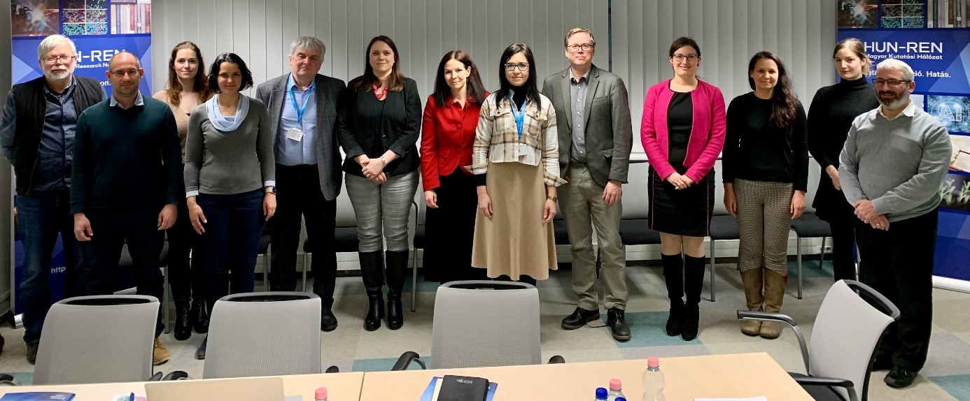
On behalf of the CoARA Hungarian National chapter
Thank you for your attention
szepesvári.krisztina@hun-ren.hu – balla.andrea@titkarsag.mta.hu – gyorffi.miklos@hun-ren.hu

