Slide 1






CoARA
National Chapters Exchange Forum
Porto, February 22-23
National Chapters
Exchange Forum
22-23 February 2024
Porto, Portugal - Alfândega Congress Centre

Slide 2
National Chapter
FRANCE
22-23 February 2024
Alfândega Congress Centre Porto, Portugal
Fabien BORGET

Slide 3








Local context and motivation for setting up the CoARA National Chapter
Franch Assessment
  HCERES
  Universities (hiring, promotions, projects …)
  RPOs
  National by CNU (National Council of Universities) : half of the individual promotions
  Projects
Over a hundred ways of performing assessment
Coordination on its way

Slide 4
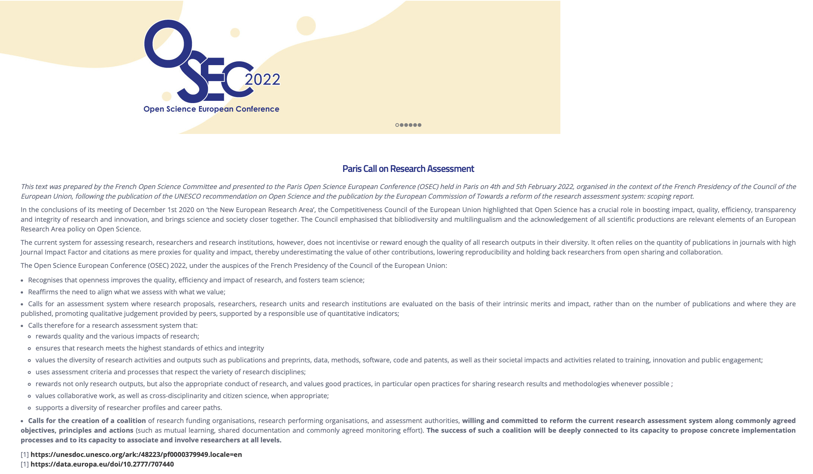
History of the french chapter
DORA Working group –
Open Science French commitee
Why:
  2021 creation of a specific WG for OSEC during the French presidency of the EU
  Discussion between different actors
  Political group
Who: institutions who signed DORA or will do
  Universities
  RPOs
  Funding Agencies
  Evaluation agencies
How:
  Discussion and presentation of each usage
  Specialists interventions.
Delivrables
Paris Call text : OSEC2022
Needs to become operational
Evolution into the new framework of CoARA
Two DORA WG members were in the Core group to design CoARA texts : Sylvie Rousset (in CoARA board) and Bernard Larrouturou.

Slide 5
CoARA French Chapter creation
Base: DORA WG
Socle: nationwide multi-organisations
Ministry as facilitator
  Letters to the signatories governance to propose member for the chapter
Since CoARA creation, we extended the members of the DORA WG, accepting any signatories who made the request
Larger scope of the French chapter than the DORA WG
  More participants (53 signatories)
  Operational: CoARA WG are in progress

Slide 6
CoARA in France – 53 signatories
French member in CoARA board:
Sylvie Rousset, DDOR, CNRS
French signatories February 22nd 2024
33 universities
7 RPOs (CNRS, INSERM, INRAE, IFREMER, INRIA, CIRAD, IRD)
National Chapter :
In forthcoming weeks:
Operational: exchanges of good practices, web site
Since October 2023
Coordination of CoARA-EU WG participation
13 agencies, Schools and associations (including France Université, UDICE, Science Po …)
Dialogue avec CoARA-EU and other NC
36 organisations represented
22 universités, 8 RPOs, 5 agencies, ministry as facilitator
Some participants are not signatories

Slide 7
Special characteristics of the National Chapter
The aim of the French chapter is to create a place for exchange on the initiatives and good practices promoting CoARA commitments in universities, research performing organizations, funding agencies, assessment authorities…
Focuses for the French chapter
Discuss on the best practices
Report and share information on ongoing work in French organization and within CoARA, especially within the CoARA WG, coordinating the French participation in these CoARA WG
Coordinate an inventory of evaluation uses in the different organizations
Promote the action plan proposed by CoARA
Create synergy between people in charge of research assessment and research assessment coordination to avoid isolation in their functions.
Promote the signature of CoARA agreement

Slide 8
Challenges and opportunities that could be shared across National Chapters
Concretely
Place to discuss and diffuse the results of CoARA
  Web site for diffusion in coordination with CoARA secreatriat ESF
  Diffusion of the CoARA documents
  Translation of CoARA documents
  Results of the French Chapter discussion
Place to coordinate and exchange on the CoARA WG contents
  Having French members in each CoARA WG
  Could propose some mirror WG at national level
  Could have specific discussion for national implementation
  Thinking shared guidelines based on CoARA commitments

Slide 9
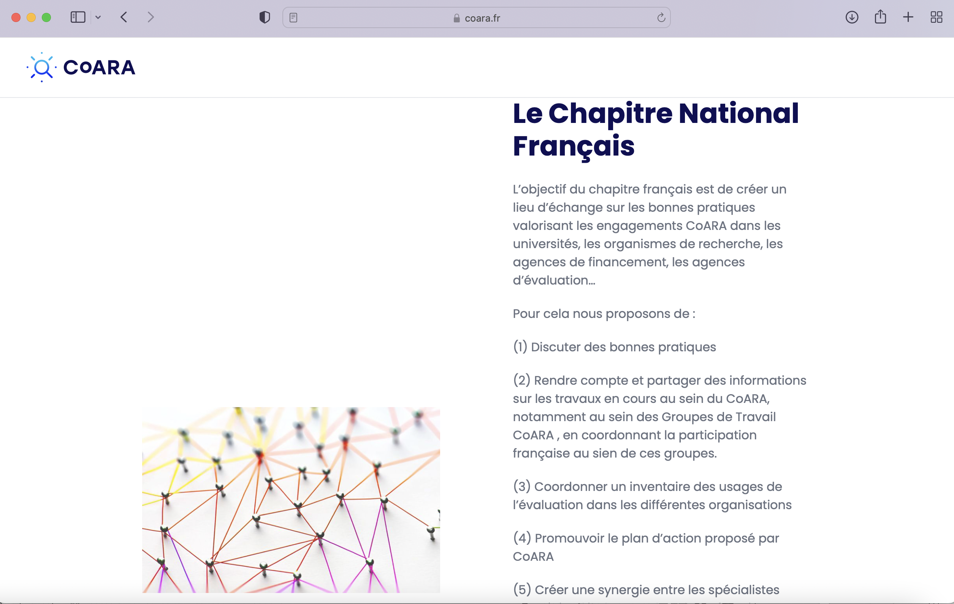
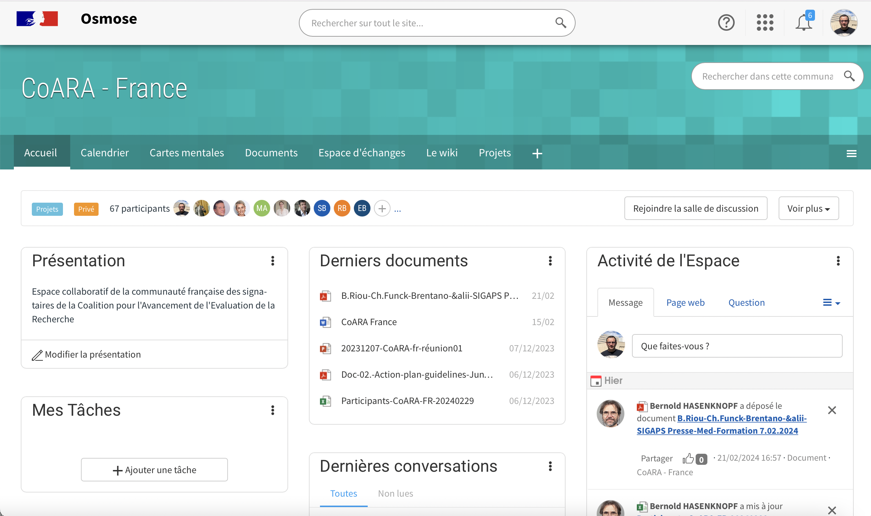
Tools
Periodic meetings in visio, first in dec 2023
In person meeting, 29th of February
We would like to organize in person meeting once a year

Slide 10
Points of attention
Identify roadblocks in the process and find solutions to surpass them
CoARA commitments: Integrity and data sharing -> Research on Research have to be taken into account
Assessment is at the heart of extremely complex system
Keeping a bottom-up process
Taking care of national laws: use a comparative law methodology, coordination with CoARA WG
Reviewer fatigue: taking care of the growing numbers of evaluations, time consuming and evaluation rhythm
Include CoARA commitments in HRS4R policy ?

Slide 11


Thank you for your attention
Staying available for any question
Fabien.Borget@univ-amu.fr
Marion.Cipriano@inserm.fr

