Slide 1



What does mathematics have to do with arts education?
An exploration of socio-economic conditions and needs for STEAM education
Elisabeth Unterfrauner and Claudia Magdalena
Centre for Social Innovation, Vienna

Slide 2
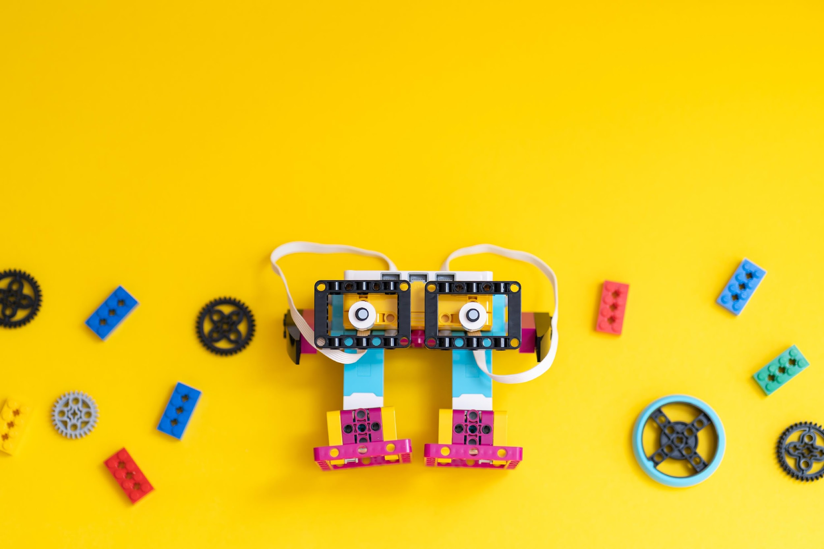
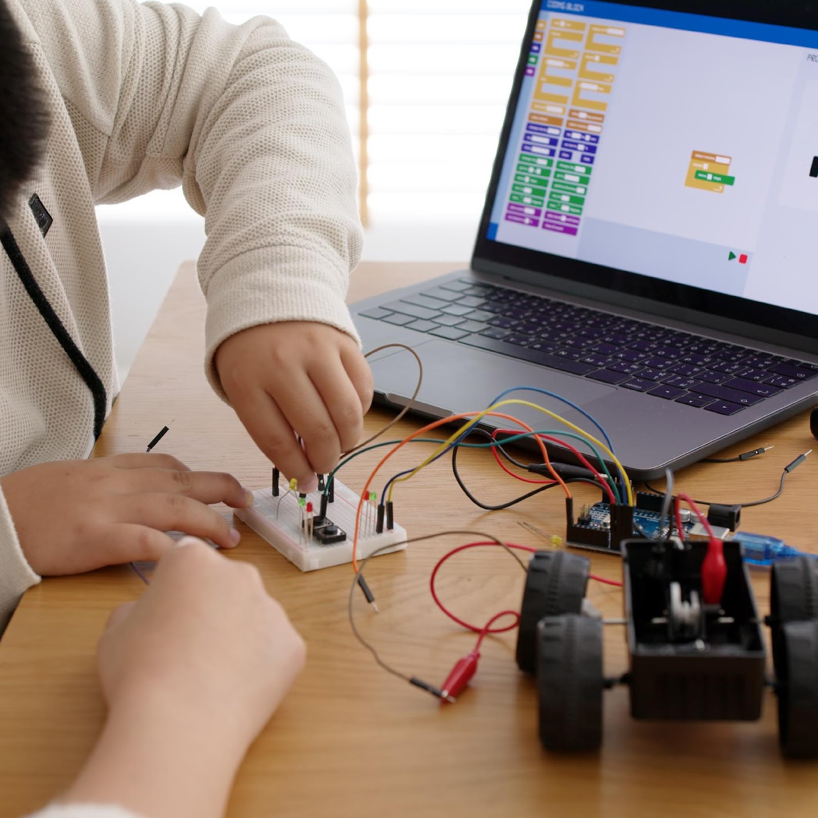
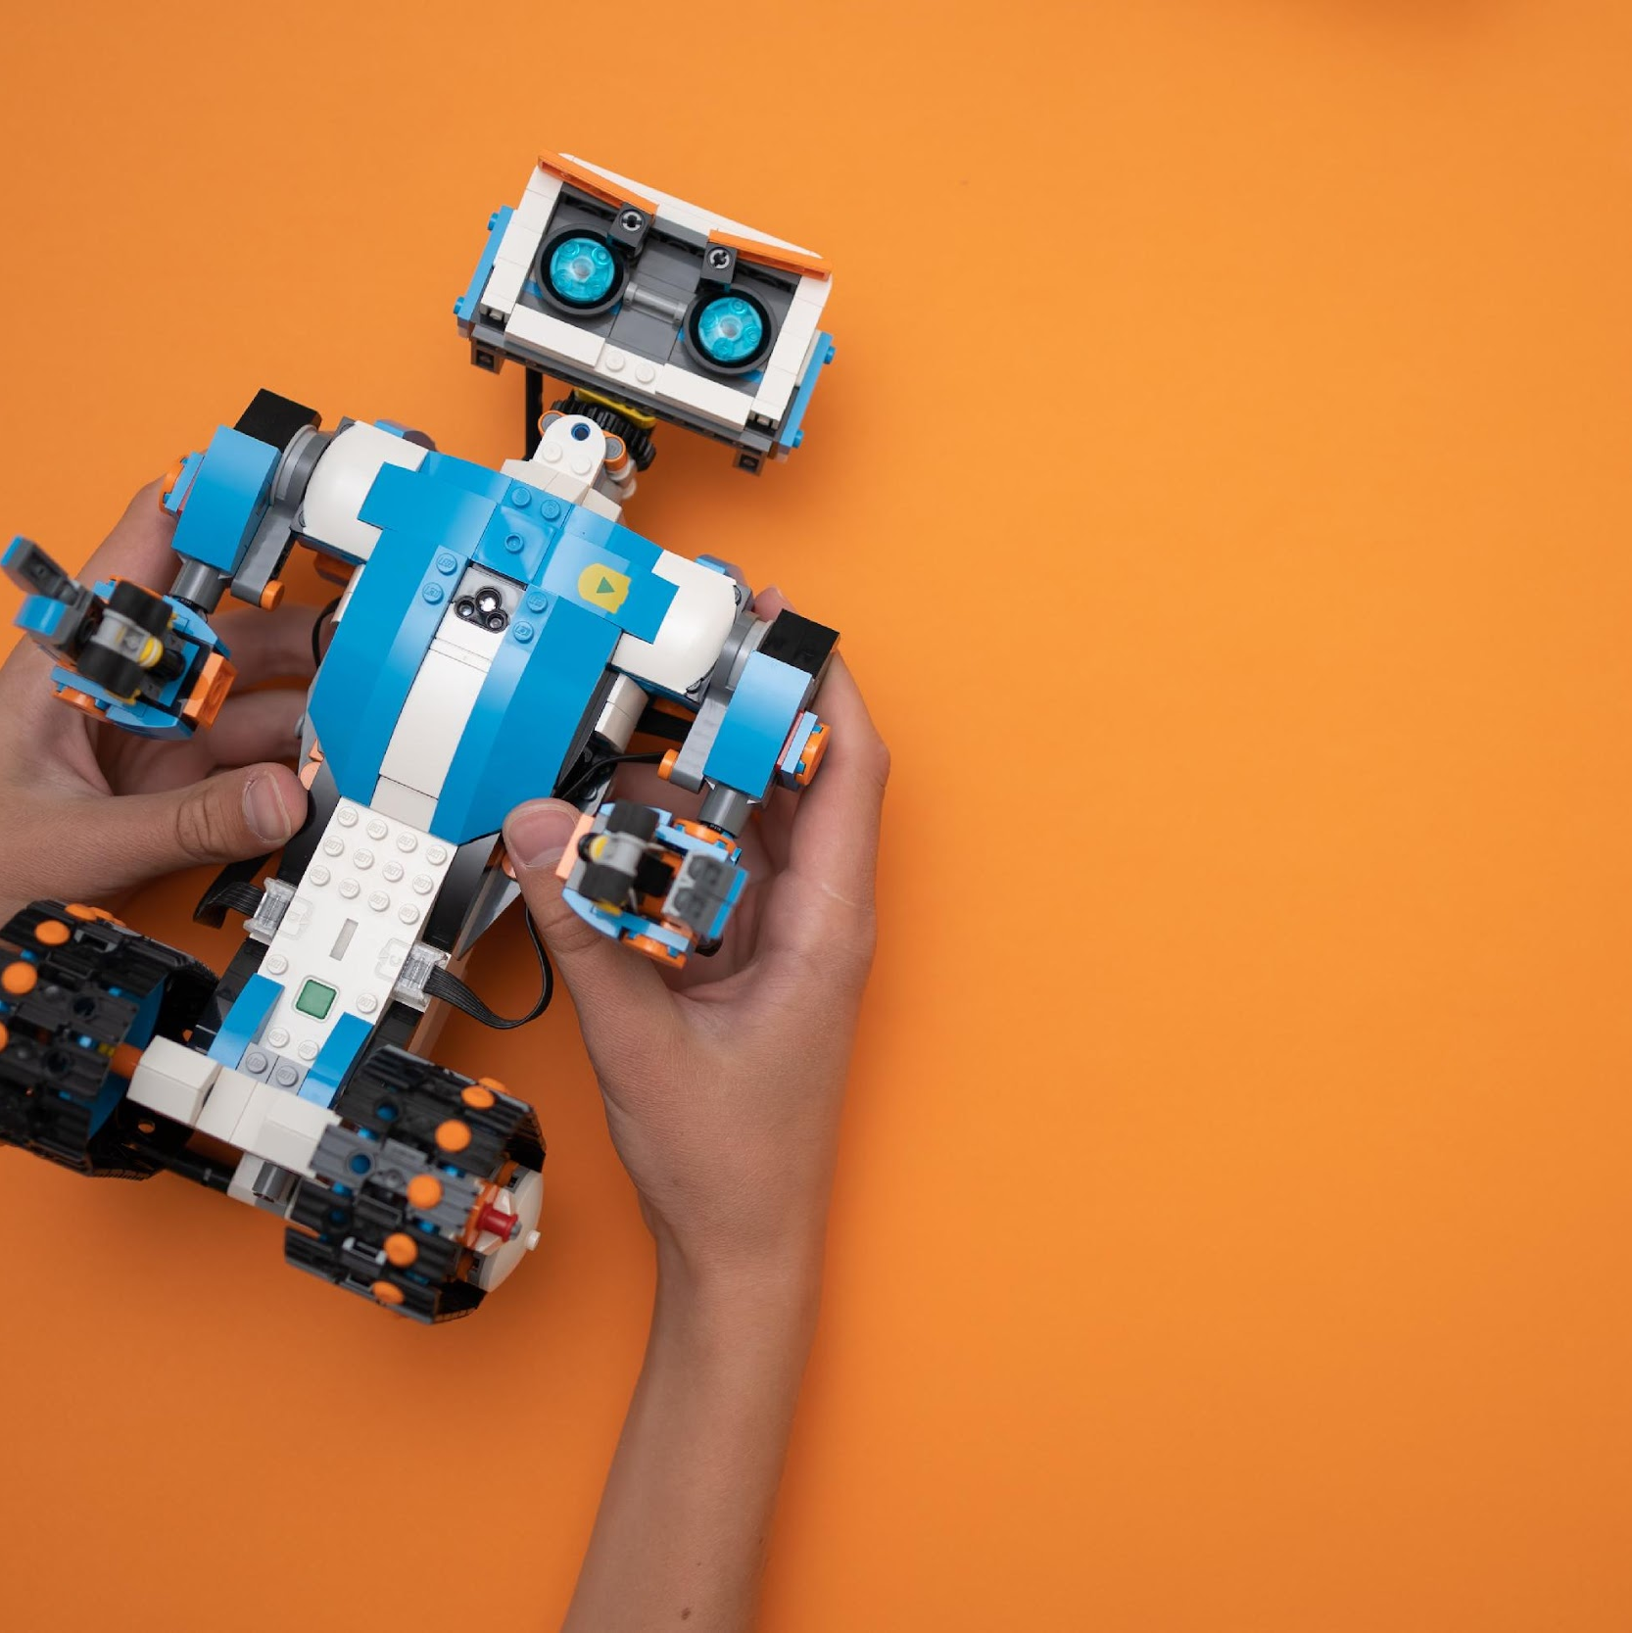
Road-STEAMer project
Developing a STEAM Roadmap for Science Education in Horizon Europe
September 2022 – August 2025
Coordinated by The Lisbon Council, 12 partners (EA, Ecsite, Traces, Uni Malta, Panteion University, Uni Exeter, Politecnico di Milano, ScienceView, Engineering, ESHA)
Objectives:
Co-creating a STEAM roadmap
Bridging open science with open school

Slide 3
What is STEAM?
STEM education is a teaching practice challenging the view that science, technology, engineering and mathematics are detached disciplines that require unique and context-sensitive methodologies and content.
Holistically
Incorporate Arts
More attractive and impactful
Problem-solving and inquiry-based learning
Notes:
Instead, it asserts that they need to be treated holistically, as a unique field of both research and application in the classroom. STEM’s latest version attempts to incorporate the arts (STEAM), with an aim to transform its teaching to a more attractive and impactful exercise. Modern STEAM approaches also integrate problem-solving and inquiry-based learning, developing both hard and soft capabilities, as properly developed in the framework of 21st Century skills.

Slide 4
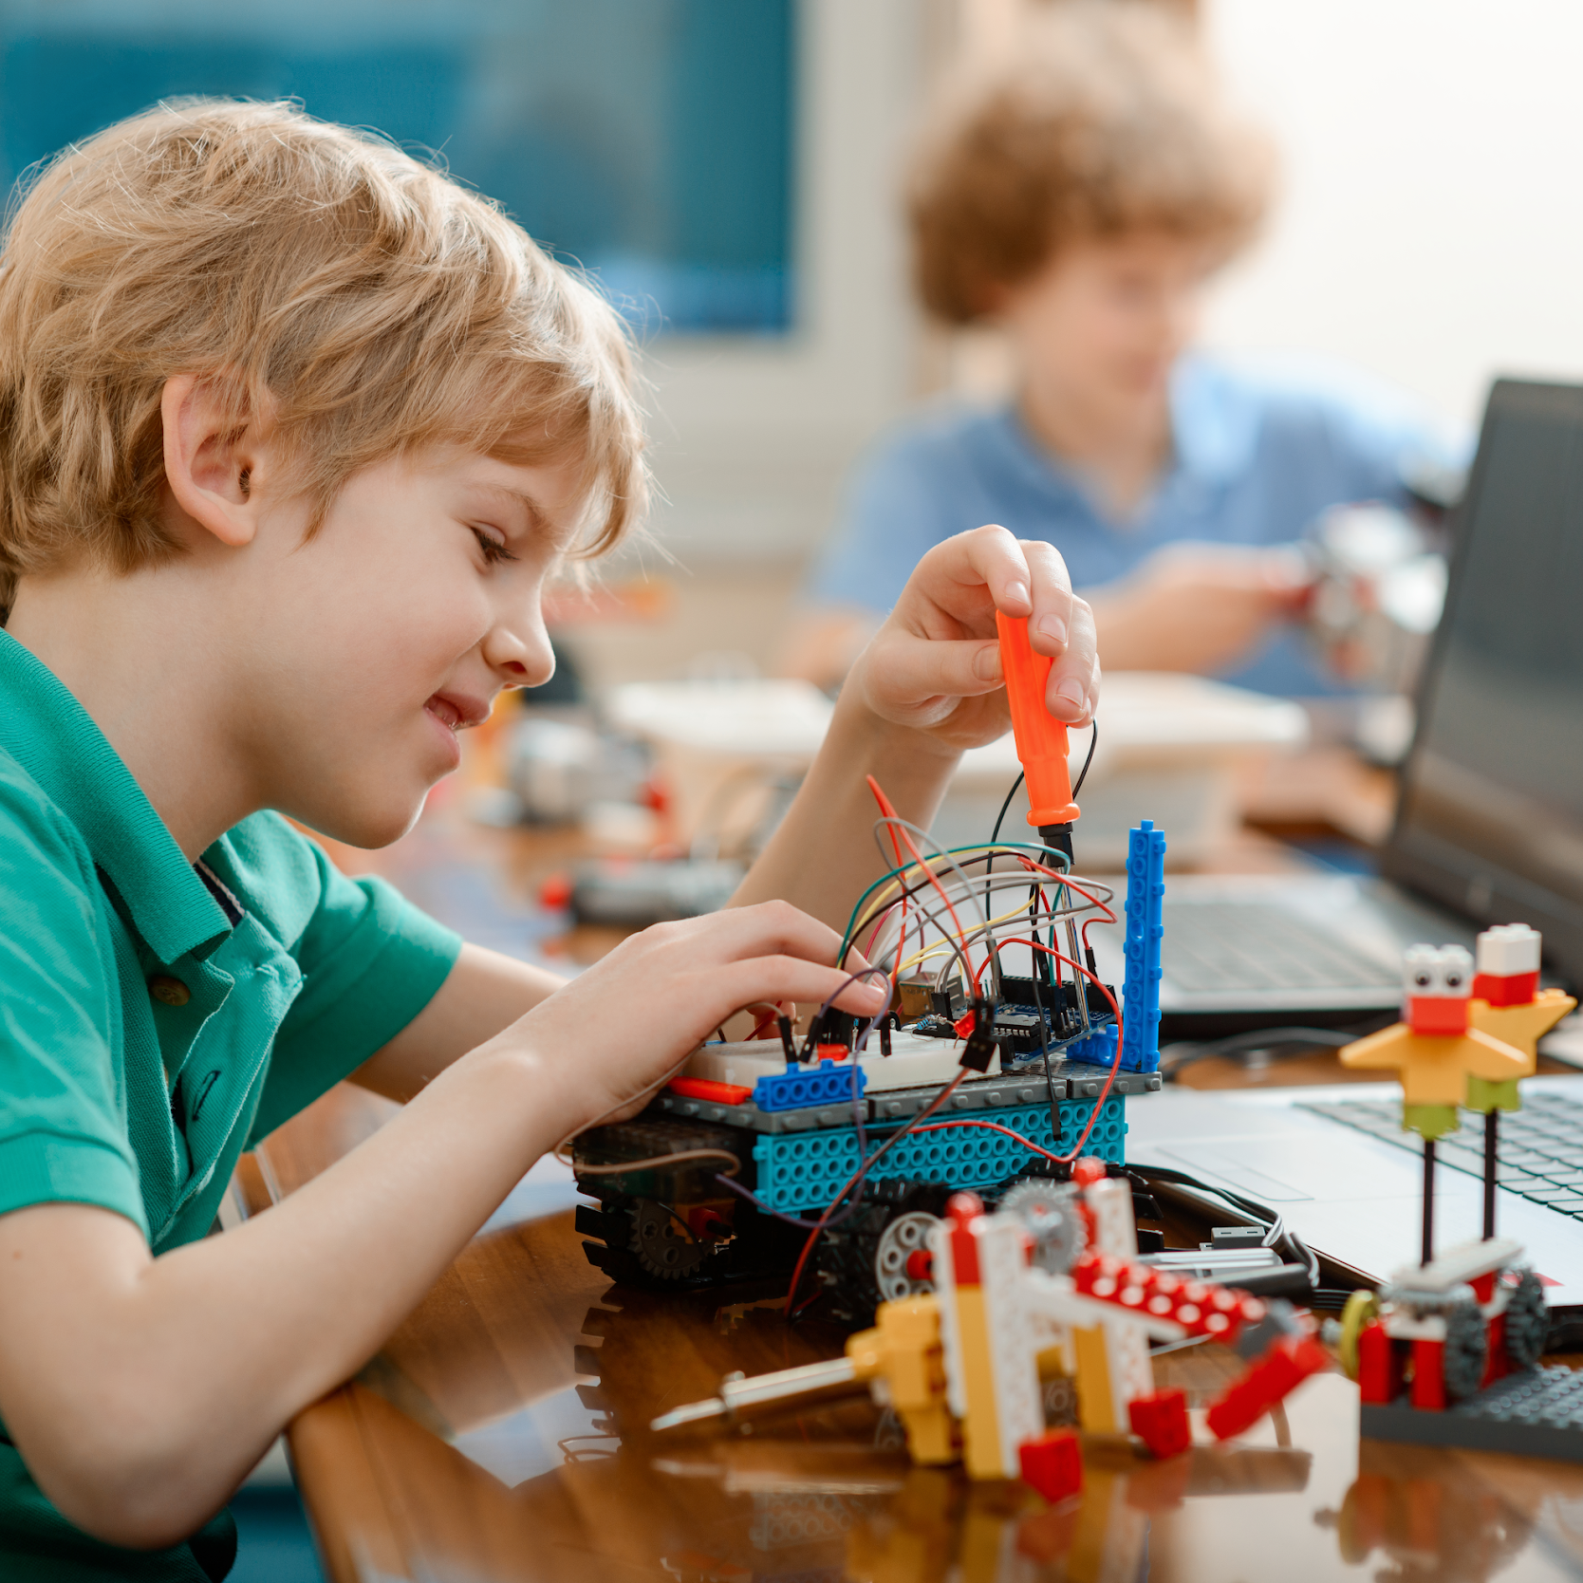
Analysis of socio-economic context and needs
Desktop Research
Literature analysis, secondary data analysis
Co-creation workshop with stakeholders and consortium members

Slide 5
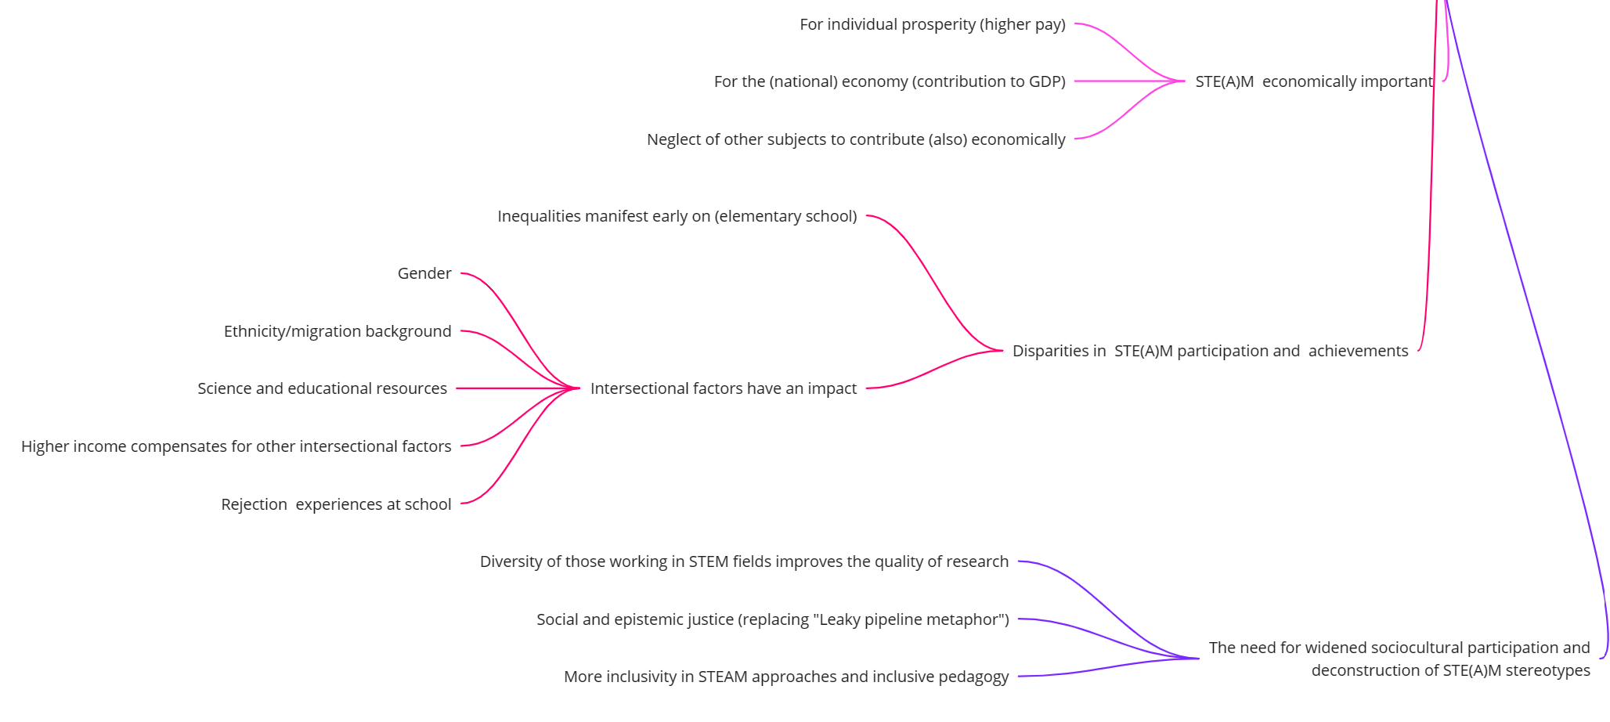

Slide 6
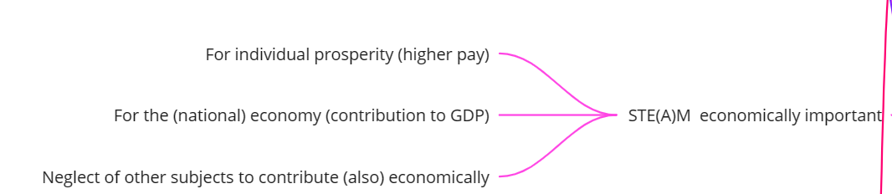
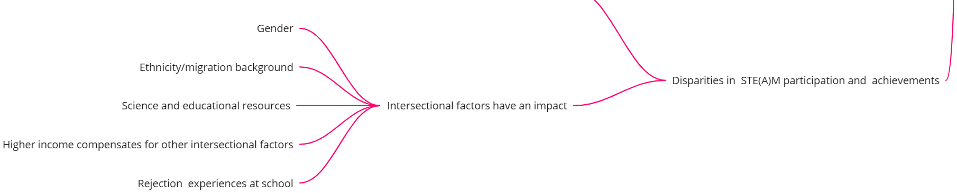
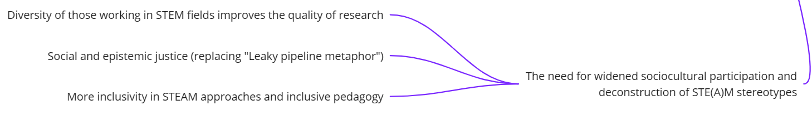

Slide 7
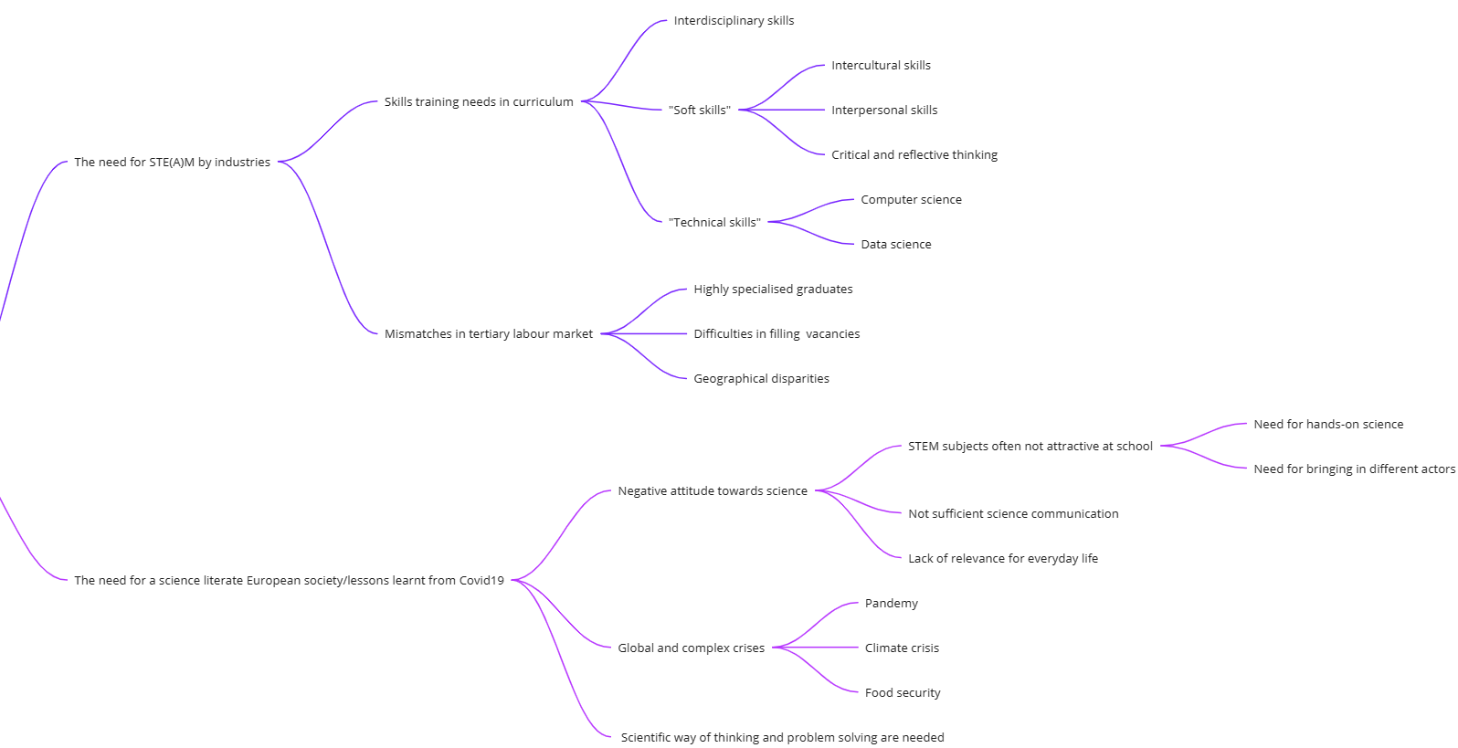

Slide 8
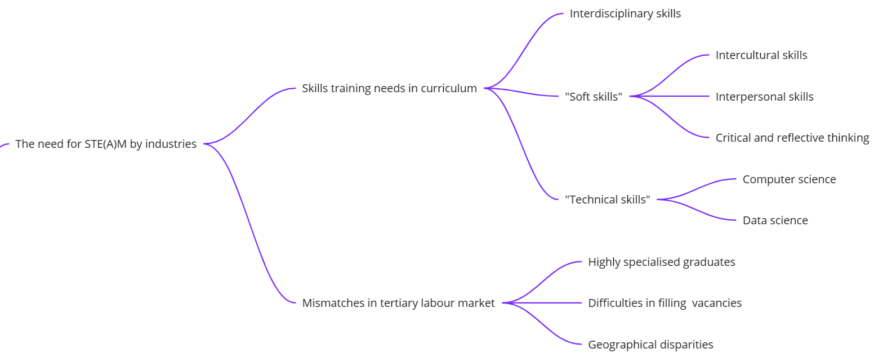
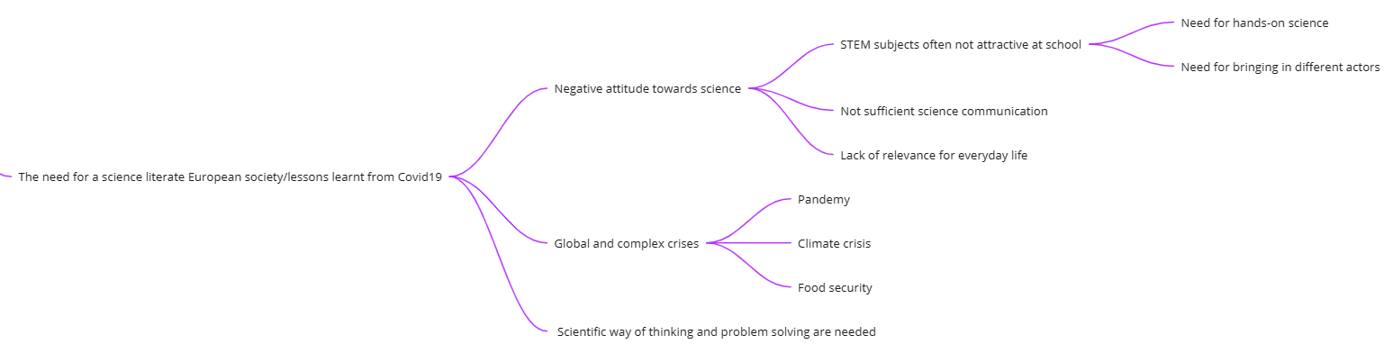

Slide 9
Recommendations I – more scientists
Recommendations
-More research on STEAM education effectiveness (Arts in addition and/or integrated with STEM); -Make science learning inclusive and appealing: teachers have STEAM easy-to-use material; -Communicate to schools and teachers the values of the STEAM approach; -Expose students to science careers from the early years; -Expose students to science role models from primary years; -Value STEAM approach: supporting young people to bring these subjects together, a holistic and subject integrative view is necessary.

Slide 10
Recommendations II- Alignment of industry and societal needs with education
Recommendations
-Open schools (and other real world approaches); -Data on industries and organisations’ needs are used to support education policies; -Project-based collaborative learning to develop soft skills and inclusivity; -Multidisciplinary and interdisciplinary projects; -Support entrepreneurship and self-employment

Slide 11
Recommendations III - More diversity (gender, ethnic, socio-economic, etc.)
Recommendations
-Policy to affect structural changes (inclusion, access, diversity); -Replace the leaky pipeline metaphor with epistemic justice; -Role models to redefine identities and change culture; -Include families to change science stereotypes; -STEAM focused career training; -More research on moderating factors and career paths to optimise policies (e.g. family’s attitude, education and career choices, engagement, parents' STEM experience); -Analyse the impact of national differences in school systems.

Slide 12
Recommendations IV - Increase science literacy for all
Recommendations
-Better connection between the needs of the labour market and lifelong learning; -Provide sufficient professional development and training of educational professionals; -Focus on societal challenges and real problems to promote interest in science; -Integrate the need for scientific thinking also in non-scientific/arts topics; -Acknowledge the imbalance of financial support for ‘Arts’ and how these issues could be (re-addressed in STEAM); -Promote positive attitudes towards STEAM.

Slide 13

Stay in touch
Elisabeth Unterfrauner
Centre for Social Innovation, Vienna
unterfrauner@zsi.at
Contribute to our
Community of practice platform!
www.road-steamer.eu

