Slide 1


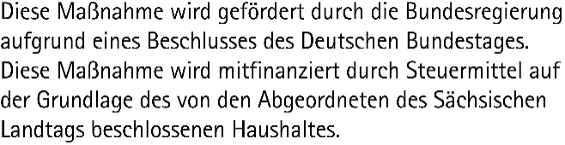
CENTER FOR SCALABLE DATA ANALYTICS AND
ARTIFICIAL INTELLIGENCE
Cultivating Open Training
Robert Haase
These slides can be reused under the terms of the CC-BY 4.0 license unless mentioned otherwise.

Slide 2


Career update: Cultivating Open Training
Since 2023: PI of the “Global BioImage Analysts' Society (GloBIAS)”, formerly known as the Society for
Knowledge Exchange in BioImage Analysis
Since 2023: Task area lead “Training and community integration” of the German National Research Data Management Infrastructure for BioImaging NFDI4BioImage
Since 2024: Lecturer and training coordinator at the Center for Scalable Data Analytics and Artificial Intelligence (ScaDS.AI / Leipzig University)

Slide 3
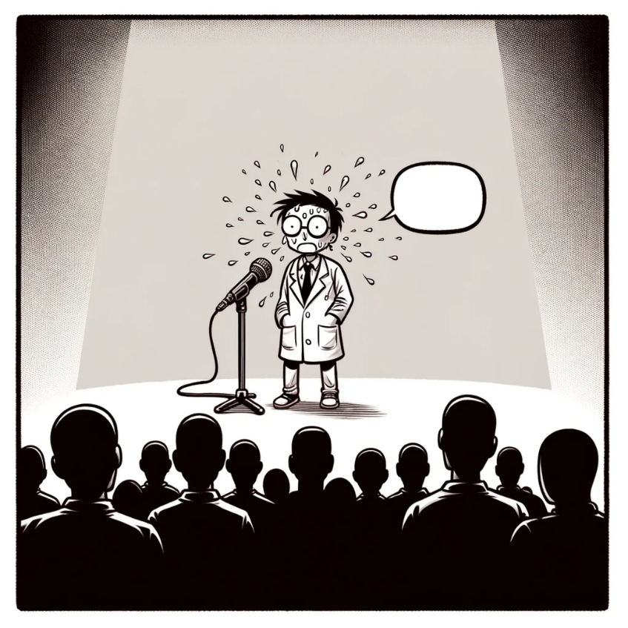
Closed science
Why are some science-related
materials/data/code not shared?
Reasons
  Risk of being scooped
  Fear of blaming oneself
  (imposter syndrome)
  Lack of awareness
  (who is allowed to
  publish my work?)

Slide 4
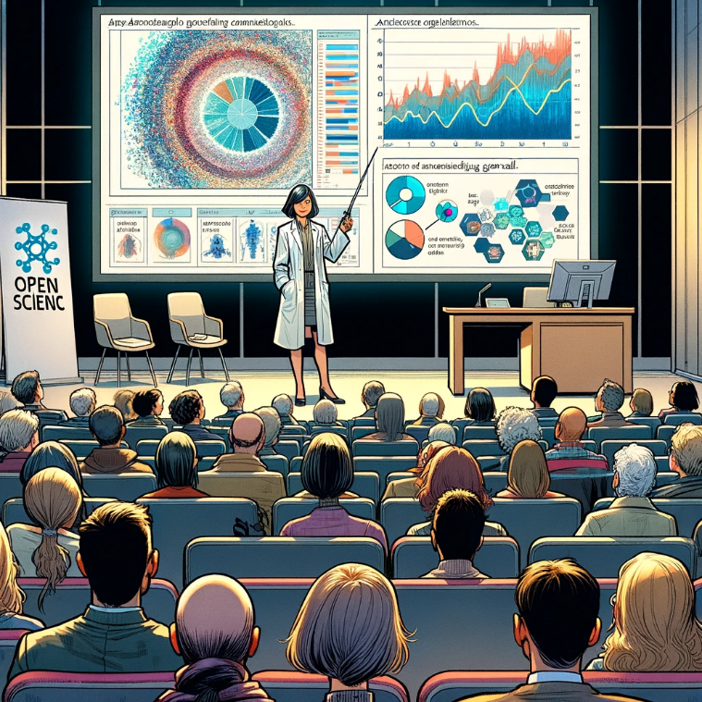
Open Science
Open Training
Research related
(hot topics)
Often tailored towards general audience
(science communication)
Earliest at the time a manuscript is published
(e.g. as preprint)
Routine tasks
(colder topics)
Transfer of
domain-specific
knowledge

Slide 5
Openness of software / projects
Closed source
Open source
Benevolent
dictatorship
Community driven
Openly extensible
8
x=1/y
z=y+1
x=1/y
x=1/y
z=y+1
x=1/y
z=y+1
z=y+1
Open to collaborations
“Black box”
Compiled code (e.g. C/C++)
Good for protecting intellectual properties ($$$)
Code available to read
Not necessarily executable code
No maintenance / support efforts
Open to contributions
Single maintainer, often overwhelmed
Efficient decision making
Bus factor ≈1
Open to contributions
Partially democratic
Board of maintainers (core developers)
Long-winded decision making
Openly extensible; without maintainers involved
Partially community driven
Hardware device drivers
Custom image analysis scripts
TrackMate, SNT, MorpholibJ, CLIJ
scikit-image, scipy, OpenCL
ImageJ, Python, numpy
Read more: https://coiled.io/blog/stages-of-openness/

Slide 6
Openness of training
Closed training
Open access materials
Benevolent
dictatorship
Community driven
Openly extensible
8
x=1/y
z=y+1
x=1/y
x=1/y
z=y+1
x=1/y
z=y+1
z=y+1
[Online] training for $$$
Slides available, e.g. as PDF
Not necessarily reusable materials
Often incomplete materials
?
Open to contributions
Partially democratic
Board of maintainers (core developers)
Long-winded decision making
?
Coursera
Institutional training, Youtube lectures
Bioimage Analysis Notebooks, BiAPoL Trainings
The Carpentries, NEUBIAS Training
Wikipedia
Read more: https://coiled.io/blog/stages-of-openness/

Slide 7
Am I allowed to publish my stuff?
… it depends… on who is responsible
Do the work!
The work / product
World
Copyright holder
E.g. employer
of the author
Author
Creator of the work
Publisher
The person who made
the work available
Licensee
The person who uses / reuses the material

Slide 8
Am I allowed to publish my stuff?
… it depends… on what materials served as basis
Sharing privately
?
Document with unclear copyright
Publish
Author of related material
Licensee / author of derived material

Slide 9
Am I allowed to publish my stuff?
Define responsibilities and procedures early!
Open Science
Experiment design
Imaging / data acquisiton
Data Analysis
Paper writing
Open Training
Training design
Attendee + trainer acquisition
Training material preparation
Conduct workshop
“Data / materials we produce will be published under CC-BY 4.0”
Only if procedures are defined early, everyone can follow them.
Licenses are important when assembling materials (-> Copyright)
Meta-data might have higher quality if the person responsible for publishing the data is aware of their duties.
Are we going to publish data / materials / code?
What license can we use?
“Robert will do this by September!”
Deciding by the end of the project is too late!
DMP

Slide 10
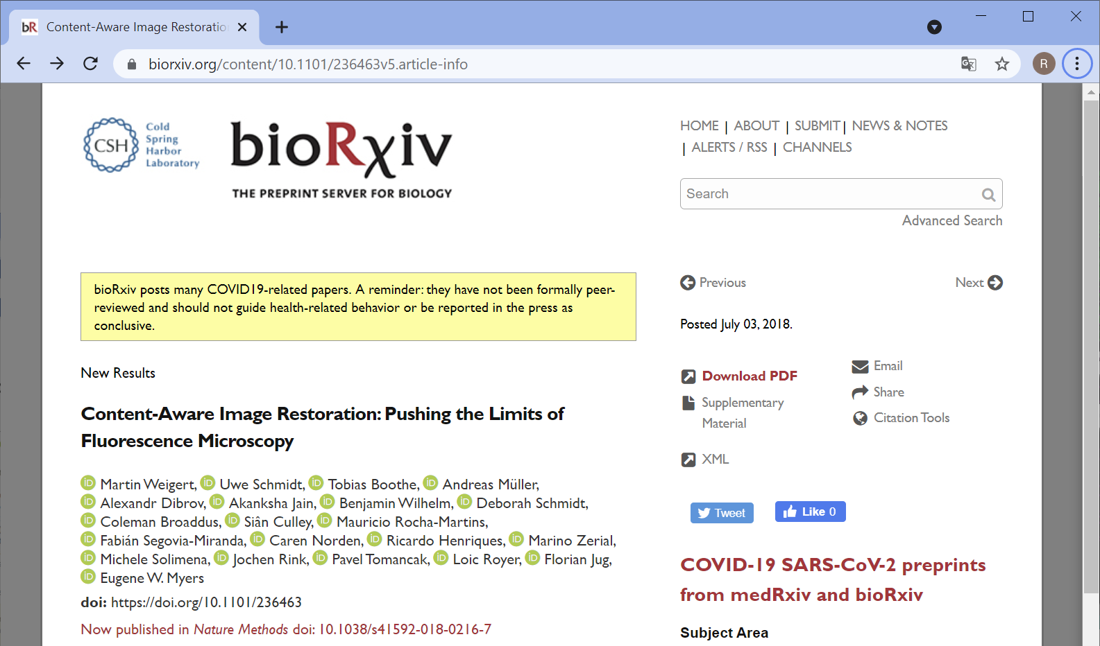
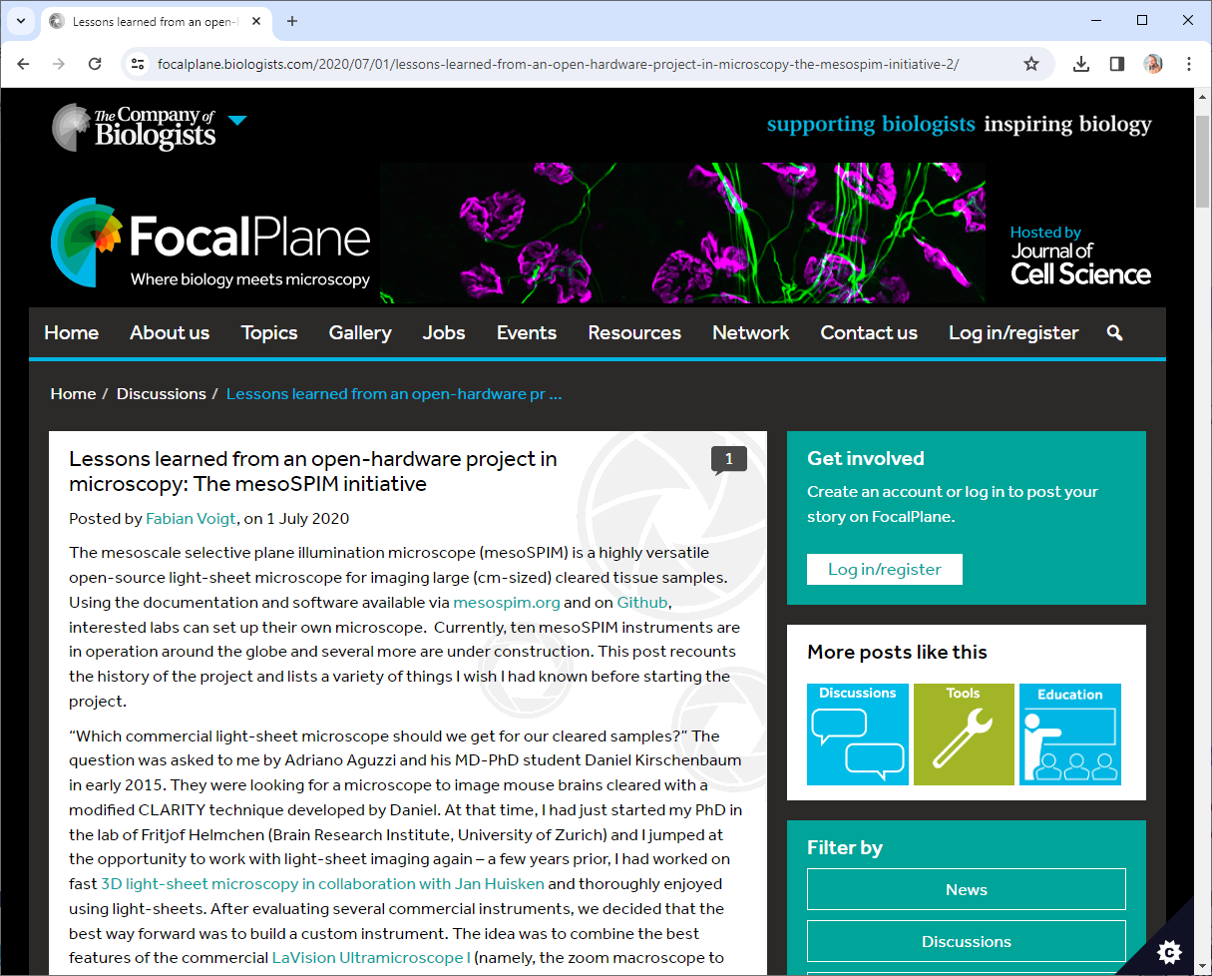
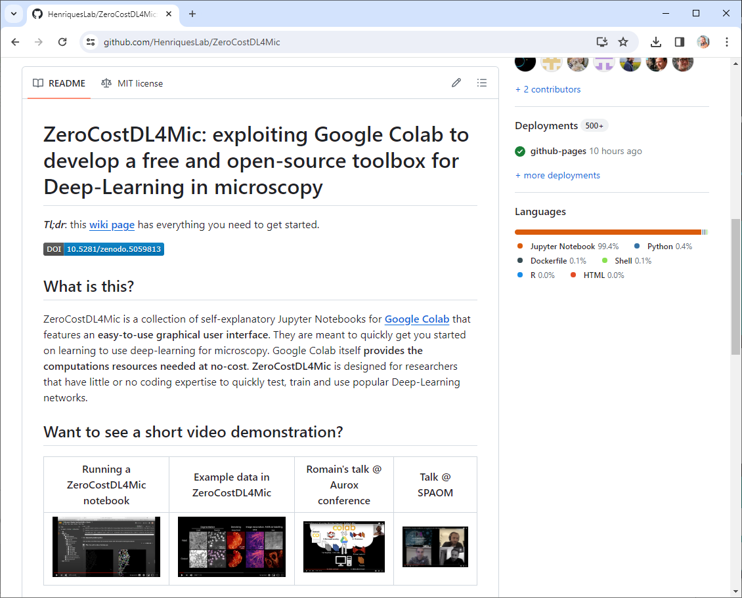
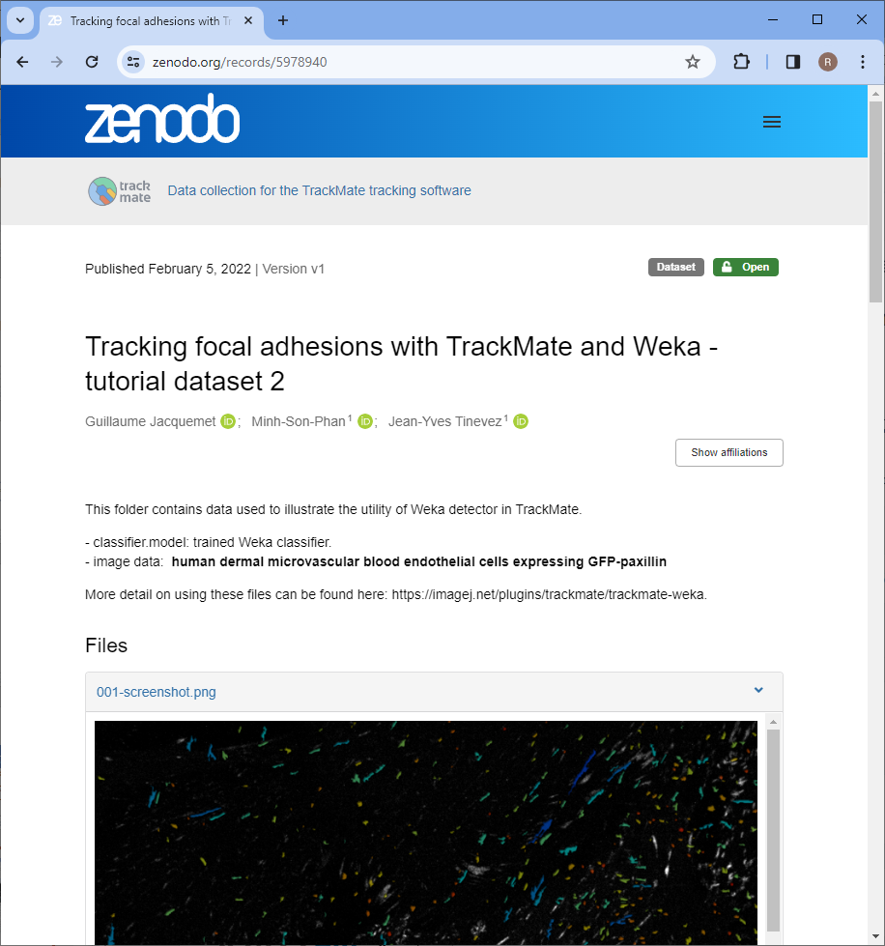
Where to share?
Open science related content
  bioRxiv (manuscripts, no reviews)
  Figshare
  F1000
  Bioimage Archive (data)
  Github (code)
  Zenodo
  Focalplane
  Institutional servers
  (if there is no alternative)
https://www.biorxiv.org/content/10.1101/236463v5.article-info https://github.com/HenriquesLab/ZeroCostDL4Mic https://focalplane.biologists.com/2020/07/01/lessons-learned-from-an-open-hardware-project-in-microscopy-the-mesospim-initiative-2/
https://zenodo.org/records/5978940

Slide 11
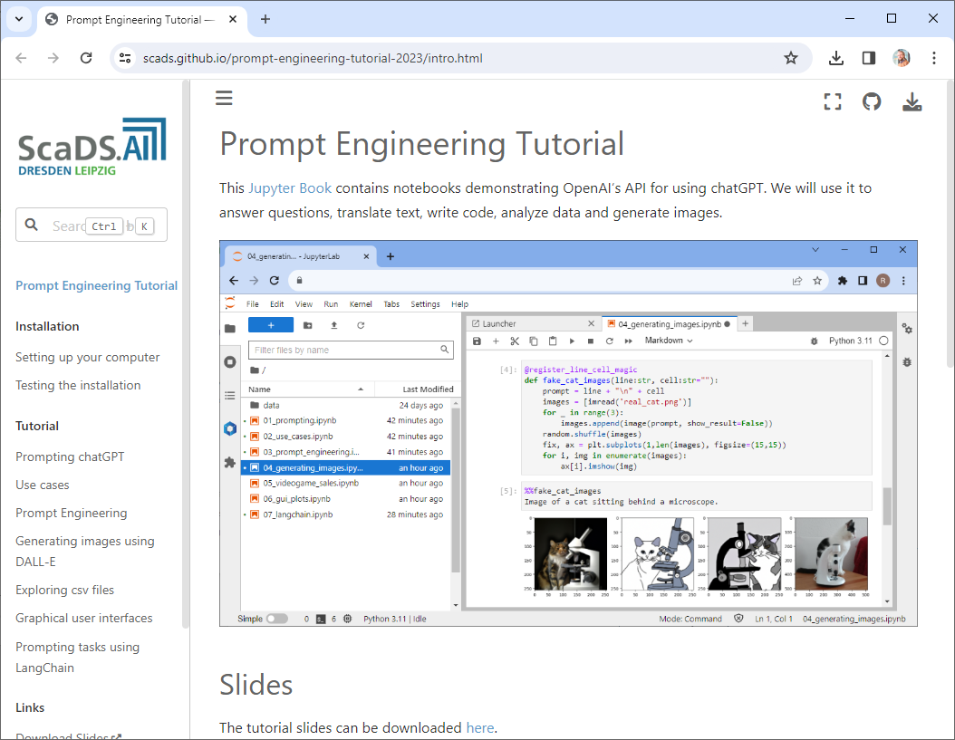
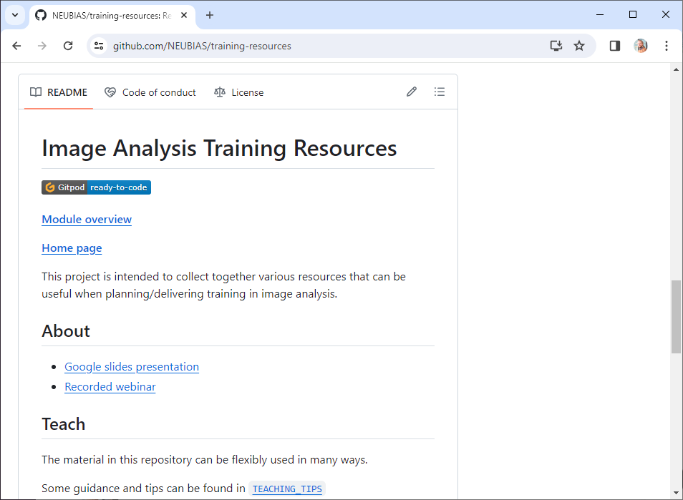
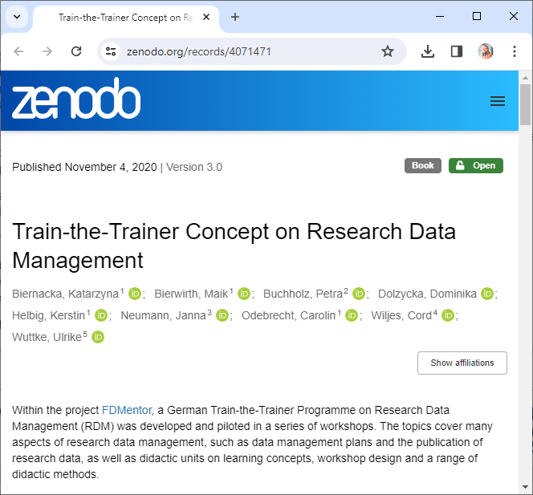
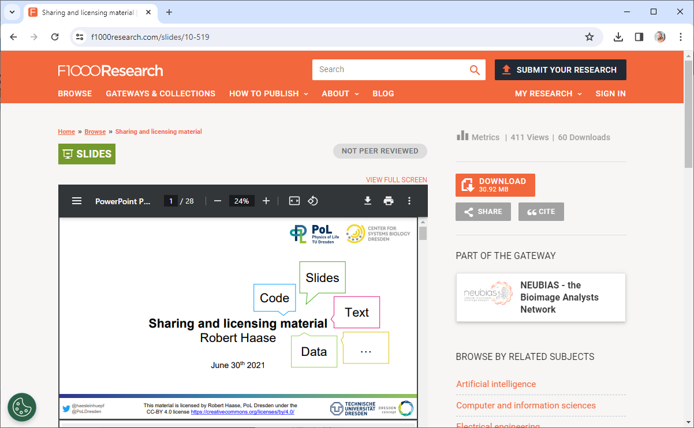
Where to share?
Github pages 🤯
Open training related content
  bioRxiv (manuscripts, no reviews)
  Figshare
  F1000
  Bioimage Archive (data)
  Github (code)
  Zenodo
  Focalplane
  Institutional servers
  (if there is no alternative)
https://f1000research.com/slides/10-519
https://scads.github.io/prompt-engineering-tutorial-2023/intro.html https://zenodo.org/records/4071471
https://github.com/NEUBIAS/training-resources

Slide 12


Licensing: Permissive versus restrictive
Restrictive
  You can reuse our stuff, but only if you …
    License your work with the same license we do
    Make your stuff openly available
    Make no money with derivatives of our work
  Examples: GPL, CC-BY-SA, CC-BY-NC, CC-BY-ND
Permissive licensing:
  Do whatever you like with our stuff,
  just make sure to mention / cite us …
  Examples: BSD, MIT, Apache, CC-BY
I conclude,
these are less open in a sense

Slide 13
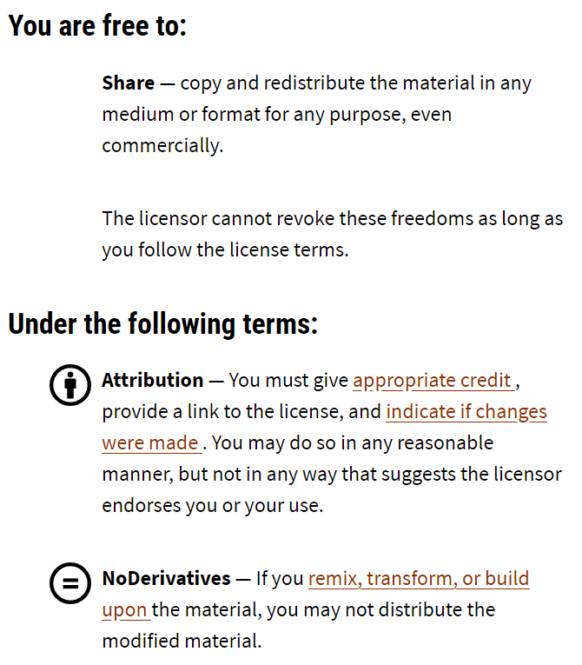

Licensing: Permissive versus restrictive
Who knows what the ND stands for?
“permissive”
“restrictive”
https://creativecommons.org/licenses/by-nd/4.0/deed.en

Slide 14
Licensing: Permissive versus restrictive
I hope nobody feels hurt
by the following slides.
I just would like to make a point.

Slide 15
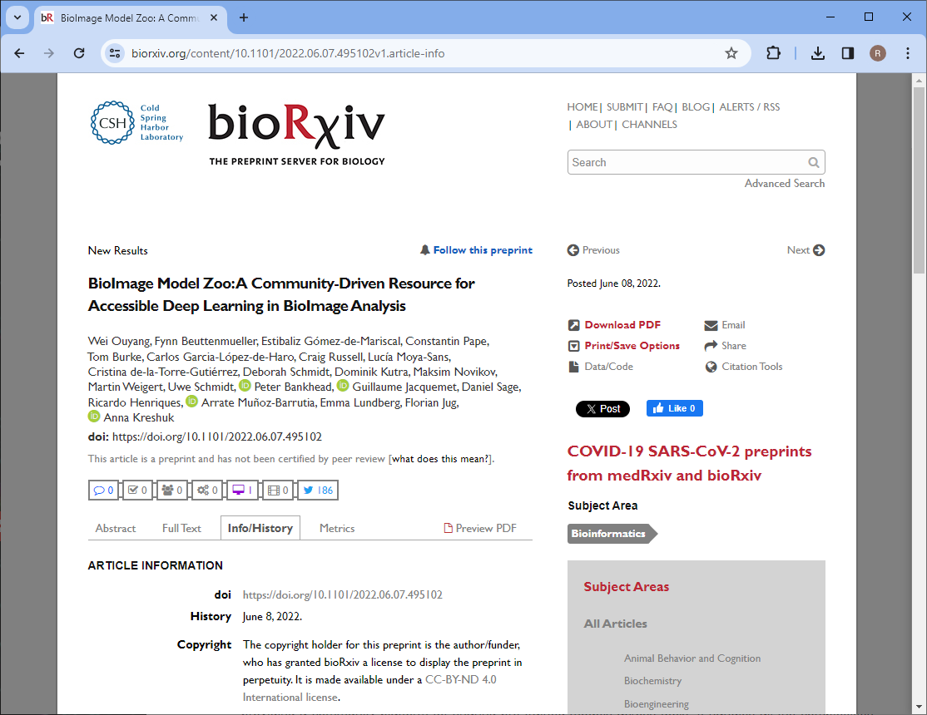
Licensing: Permissive versus restrictive
Example
I would love to show you a Figure from this paper!
But I’m not allowed!
https://www.biorxiv.org/content/10.1101/2022.06.07.495102v1.article-info

Slide 16
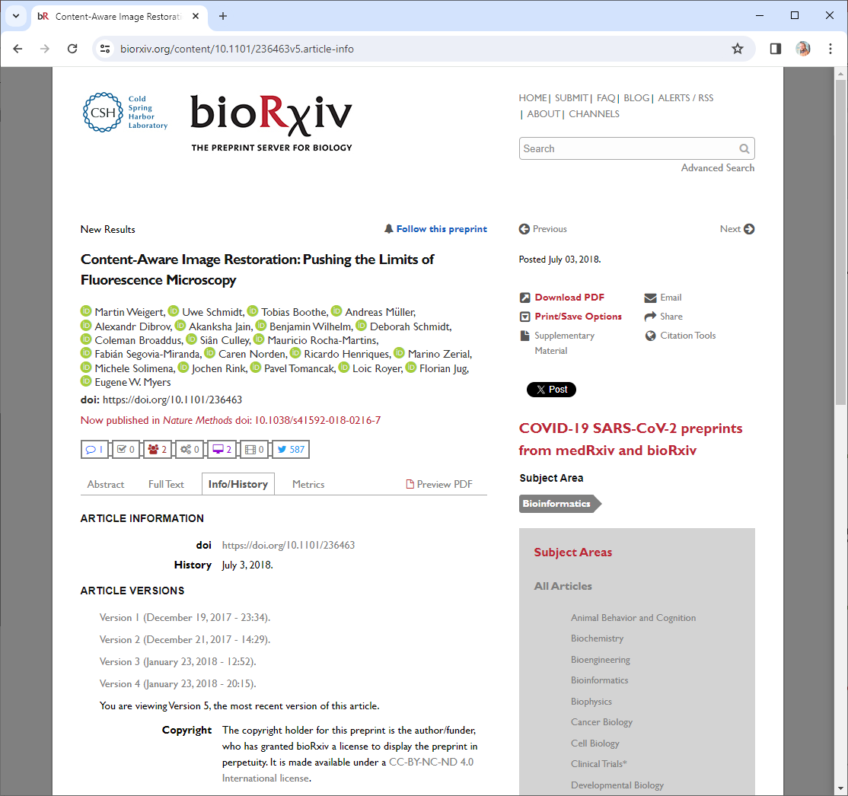
Licensing: Permissive versus restrictive
Example
I would love to show you a Figure from this paper!
But I’m not allowed!
https://www.biorxiv.org/content/10.1101/236463v5.article-info

Slide 17
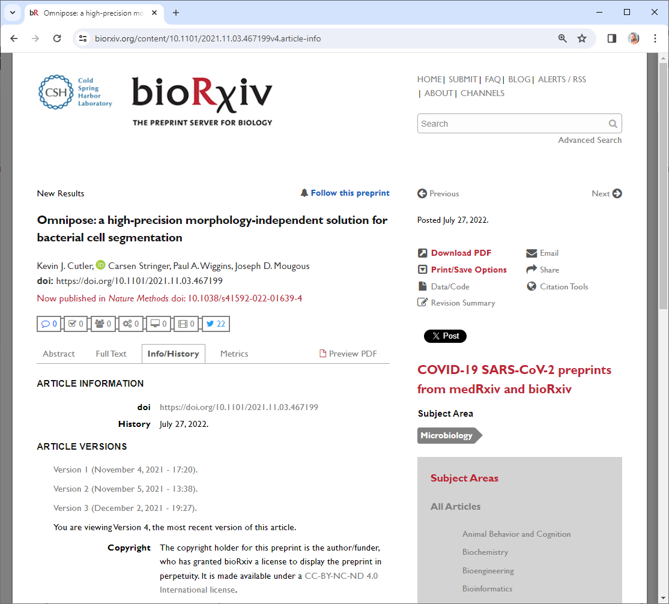
Licensing: Permissive versus restrictive
Example
I would love to show you a Figure from this paper!
But I’m not allowed!
https://www.biorxiv.org/content/10.1101/2021.11.03.467199v4.article-info

Slide 18
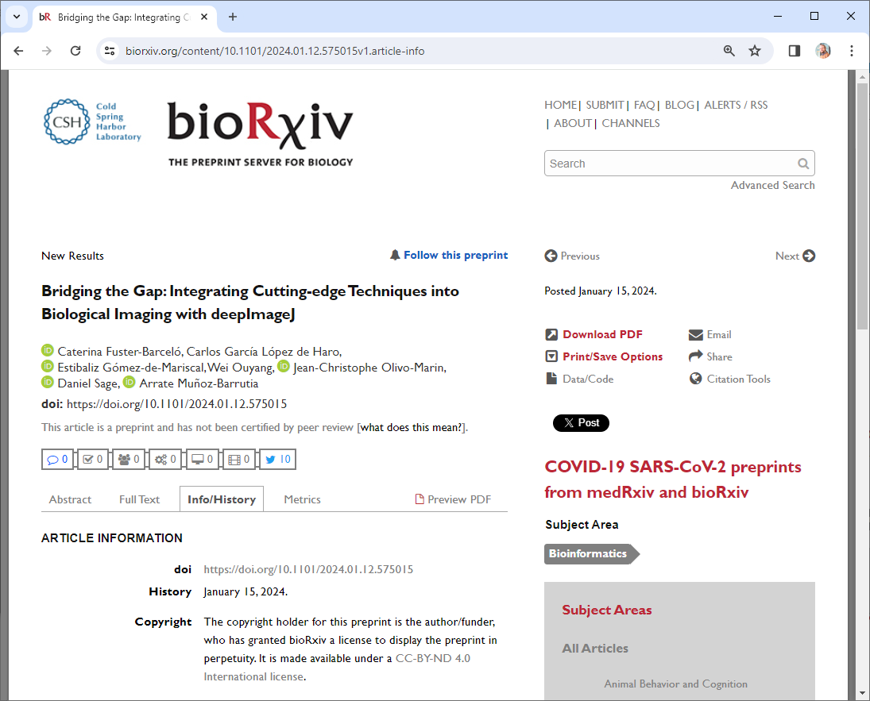
Licensing: Permissive versus restrictive
Example
I would love to show you a Figure from this paper!
But I’m not allowed!
https://www.biorxiv.org/content/10.1101/2024.01.12.575015v1.article-info

Slide 19
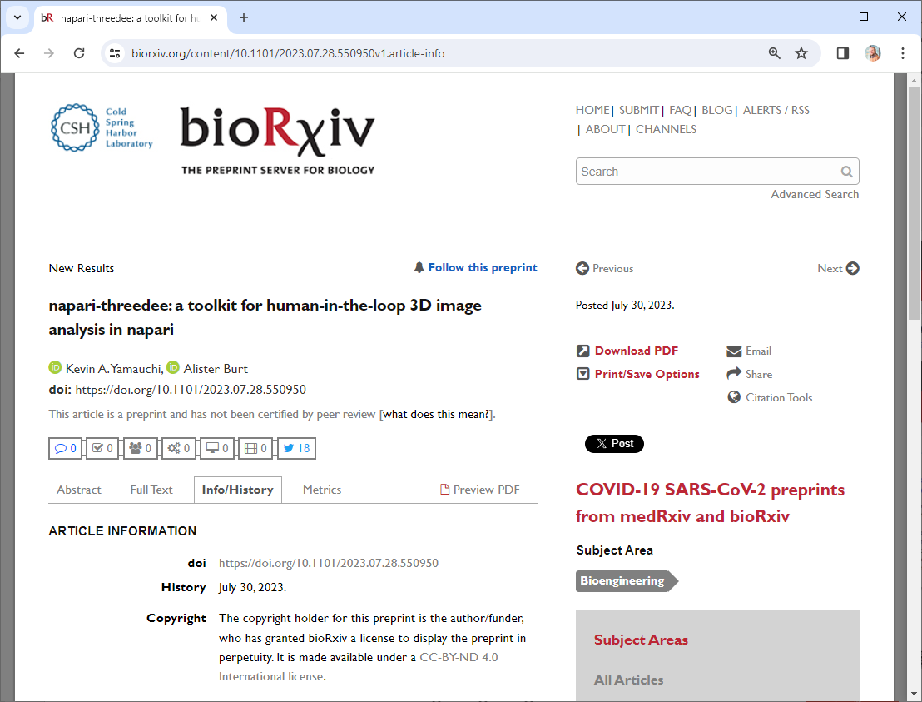
Licensing: Permissive versus restrictive
Example
I would love to show you a Figure from this paper!
But I’m not allowed!
https://www.biorxiv.org/content/10.1101/2023.07.28.550950v1.article-info

Slide 20
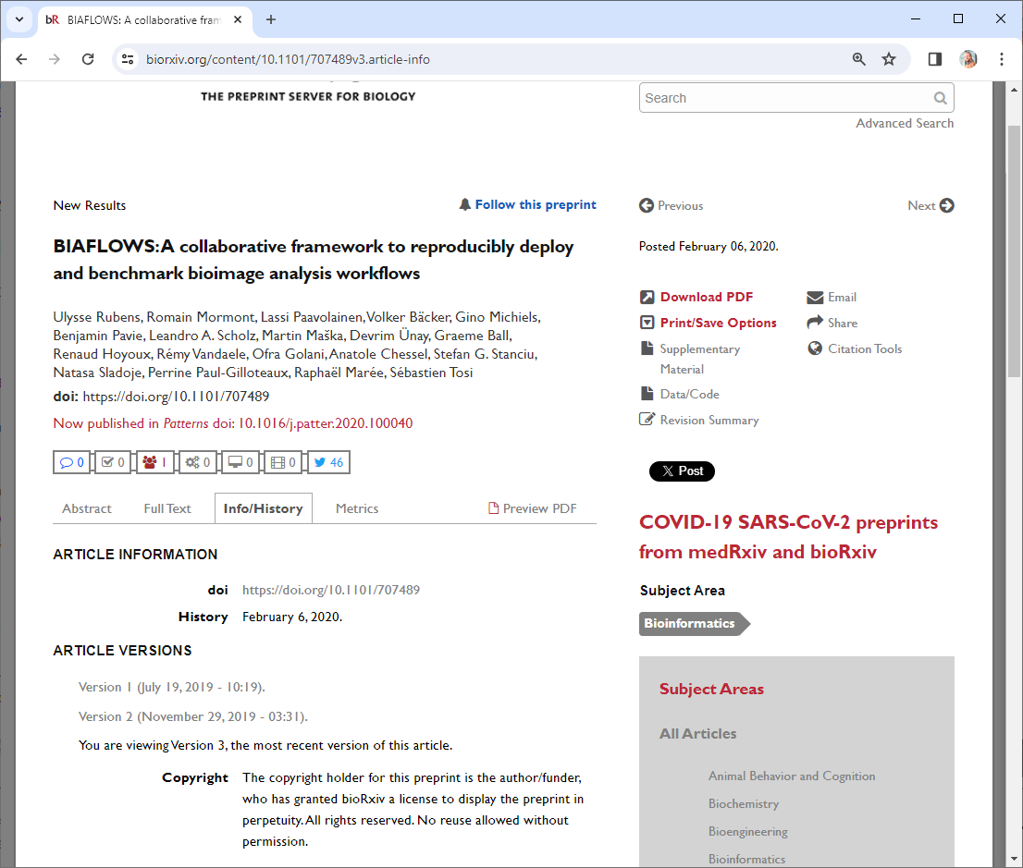
Licensing: Permissive versus restrictive
Example
I would love to show you a Figure from this paper!
But I’m not allowed!
https://www.biorxiv.org/content/10.1101/707489v3.article-info

Slide 21
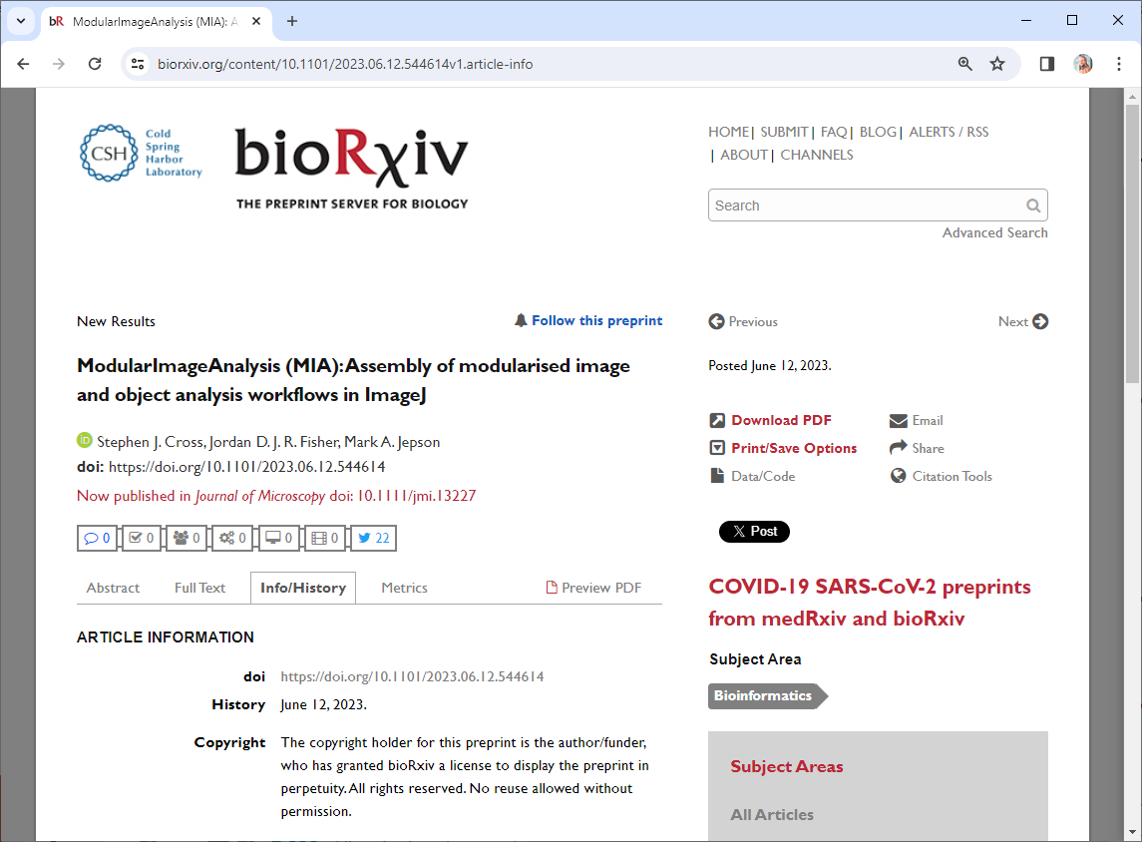
Licensing: Permissive versus restrictive
Example
I would love to show you a Figure from this paper!
But I’m not allowed!
https://www.biorxiv.org/content/10.1101/2023.06.12.544614v1.article-info

Slide 22
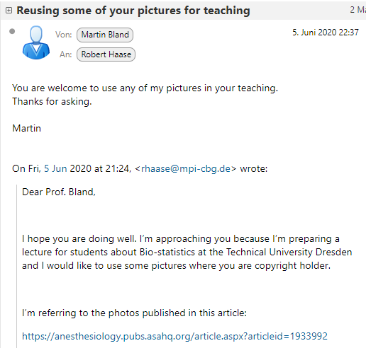
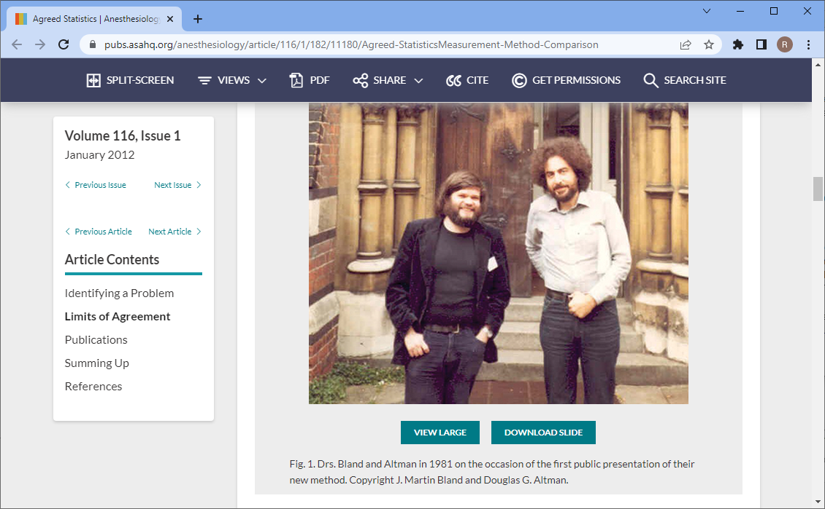
Licensing: Permissive versus restrictive
Example
Source:
https://anesthesiology.pubs.asahq.org/article.aspx?articleid=1933992

Slide 23
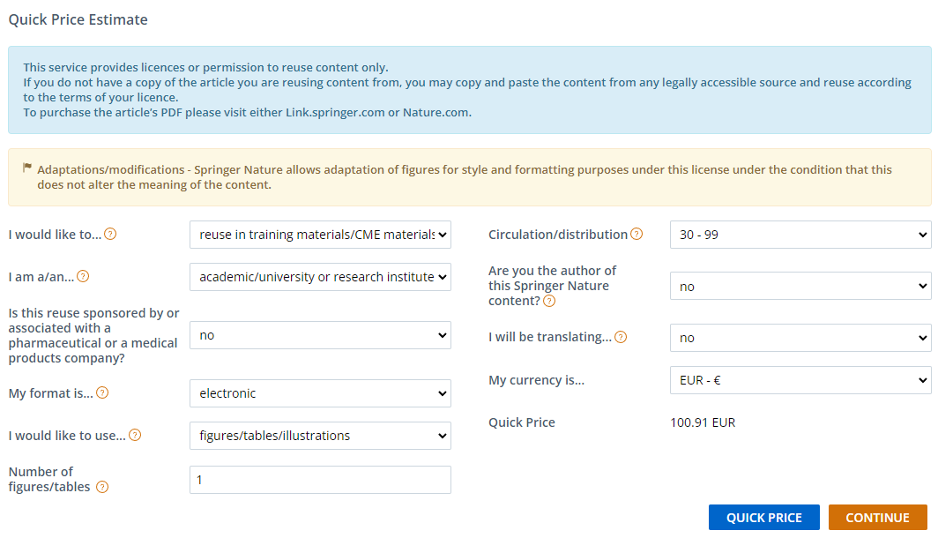
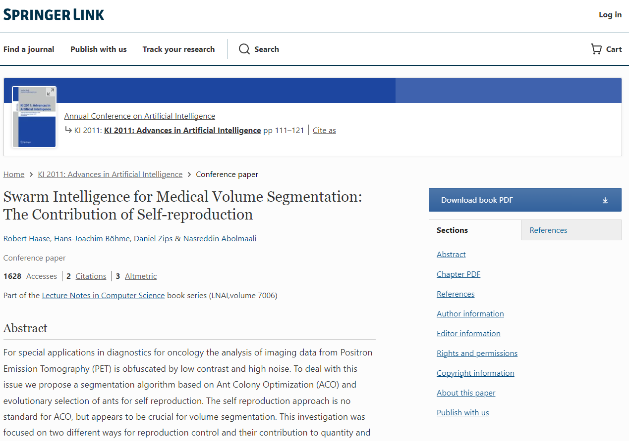
Licensing: Permissive versus restrictive
Example
The issue is not so much paying 100 Eur, but the related administrative effort.
https://link.springer.com/chapter/10.1007/978-3-642-24455-1_10

Slide 24
Licensing: Permissive versus restrictive
Restrictive licensing is
a community-wide issue.
I presume due to lack of awareness & training
Train the trainers!

Slide 25
Licensing: Permissive versus restrictive
Download and share for free
Reuse parts, e.g. Figures
Reuse parts, e.g. in paid training
CC-BY
CC-BY-SA
Only under CC-BY-SA
Only under CC-BY-SA
Only under CC-BY-SA
CC-BY-NC
(if free of charge)
Bad for the progress of science
CC-BY-ND
In particular in the context of training
CC-BY-NC-ND

Slide 26
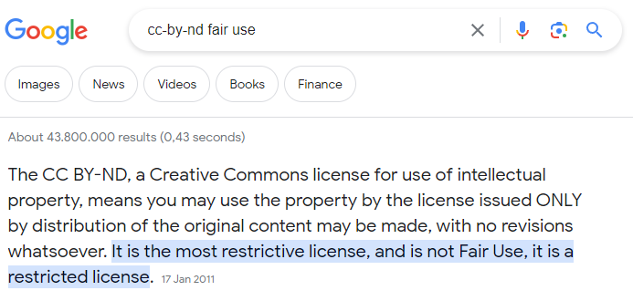
Licensing: Permissive versus restrictive

Slide 27
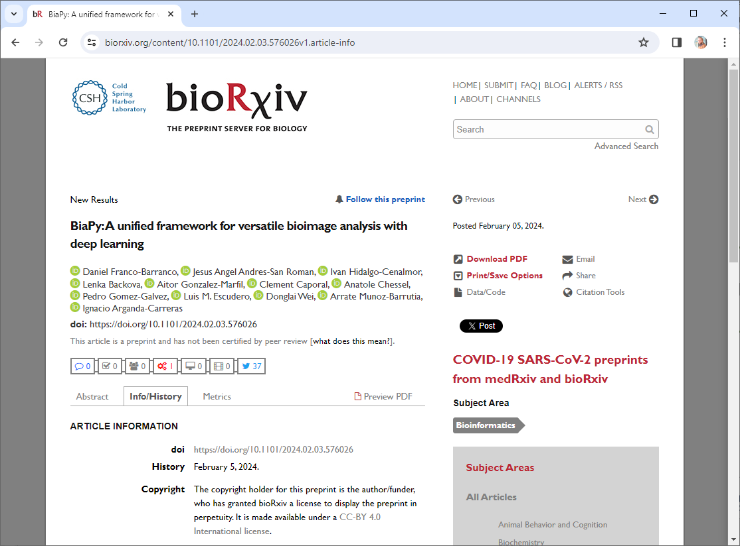
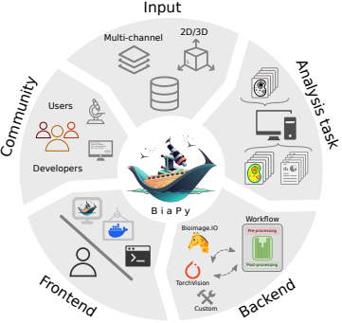
Licensing: Permissive versus restrictive
Look at this great figure! It’s cropped from / licensed CC-BY 4.0 by D. Franco-Barranco et al.
Example
https://www.biorxiv.org/content/10.1101/2024.02.03.576026v1.article-info

Slide 28
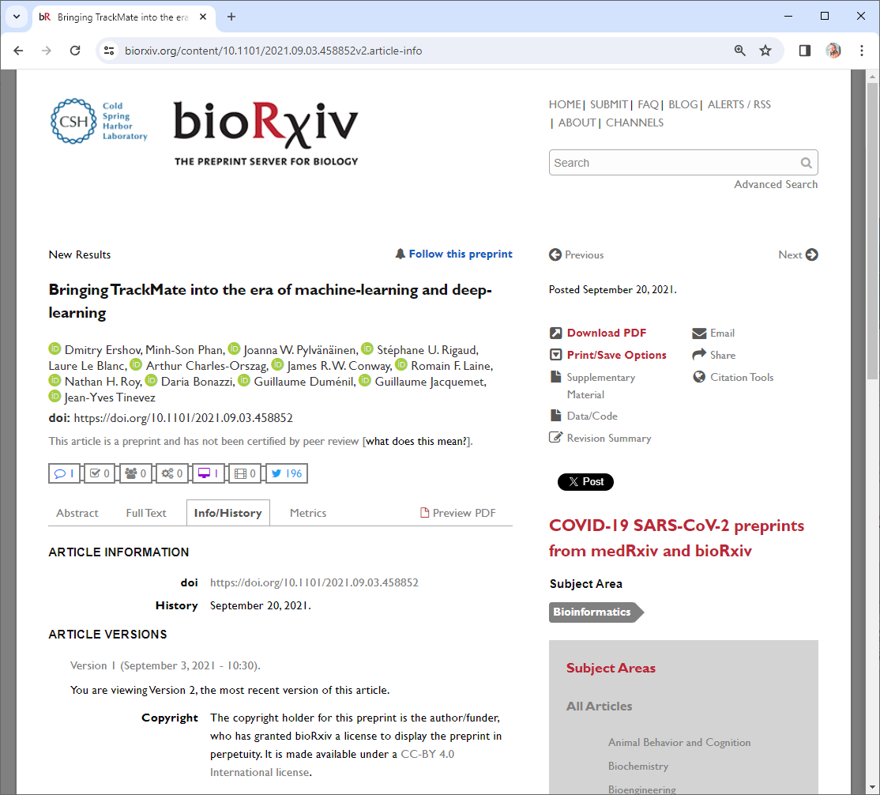
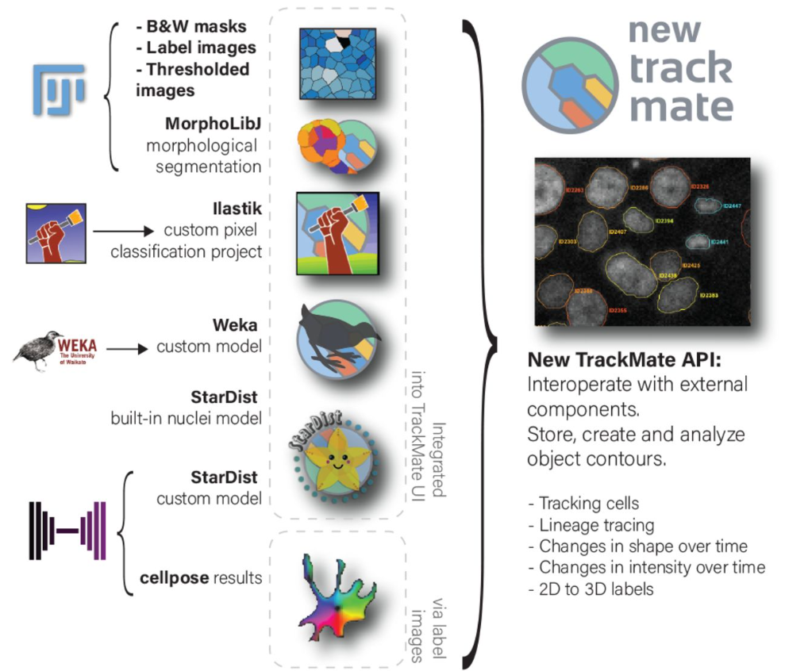
Licensing: Permissive versus restrictive
Look at this great figure! It’s take from / licensed CC-BY 4.0 by D. Ershov et al.
Example
https://www.biorxiv.org/content/10.1101/2021.09.03.458852v2.full

Slide 29
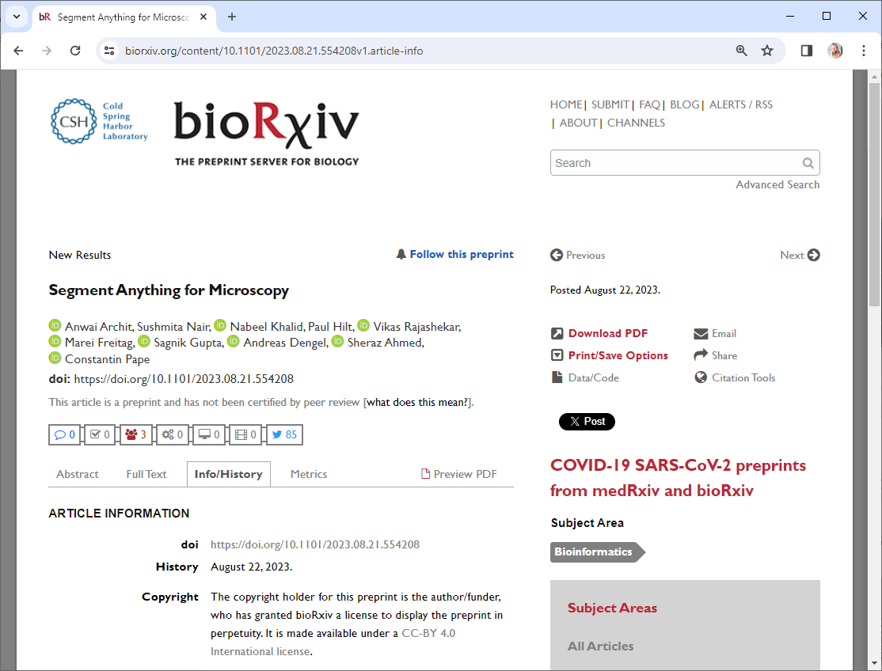
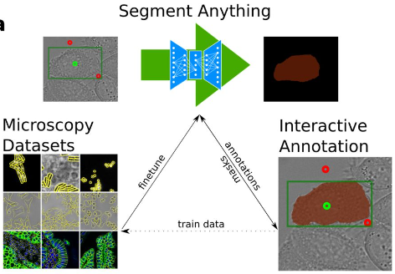
Licensing: Permissive versus restrictive
Look at this great figure! It’s cropped from / licensed CC-BY 4.0 by A. Archit et al.
Example
https://www.biorxiv.org/content/10.1101/2023.08.21.554208v1.article-info

Slide 30
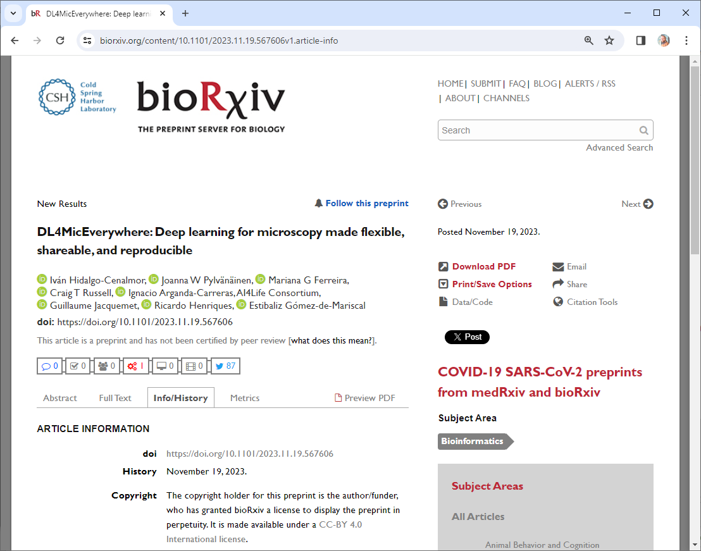
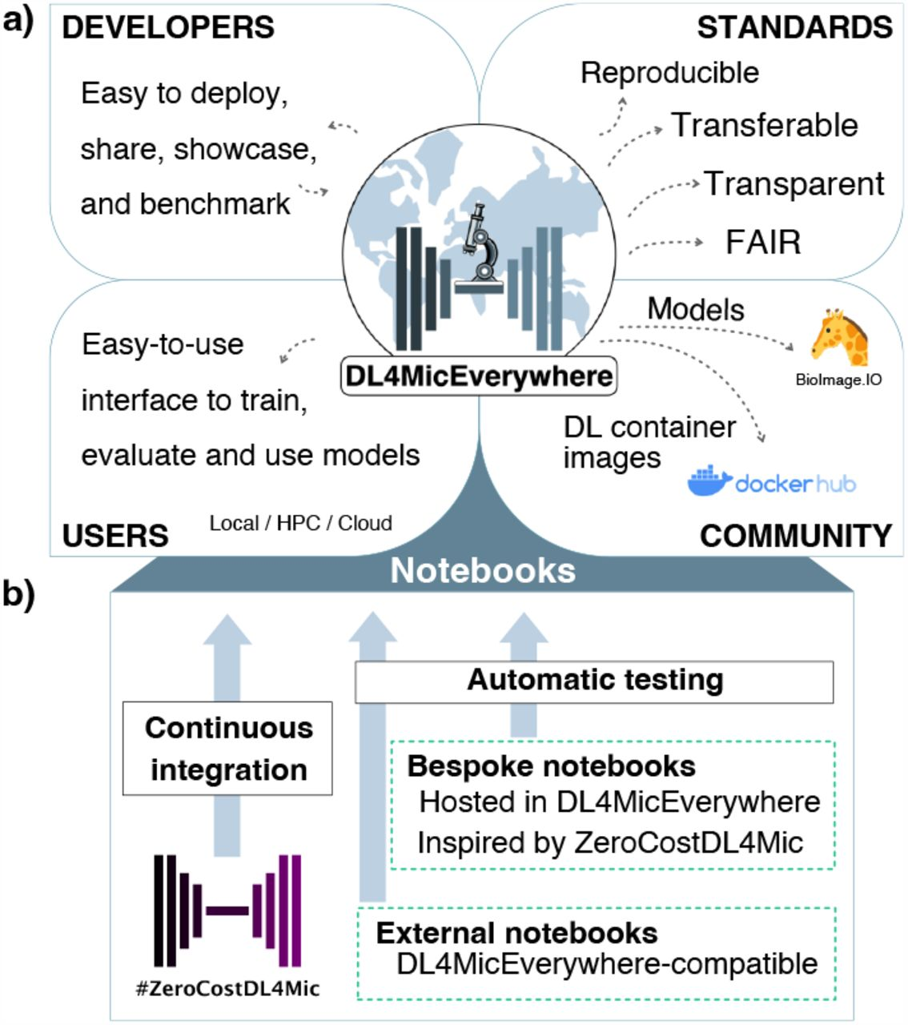
Licensing: Permissive versus restrictive
Look at this great figure! It’s cropped from licensed CC-BY 4.0 by I. Hidalgo-Cenalmor et al.
Example
https://www.biorxiv.org/content/10.1101/2021.09.03.458852v2.full

Slide 31
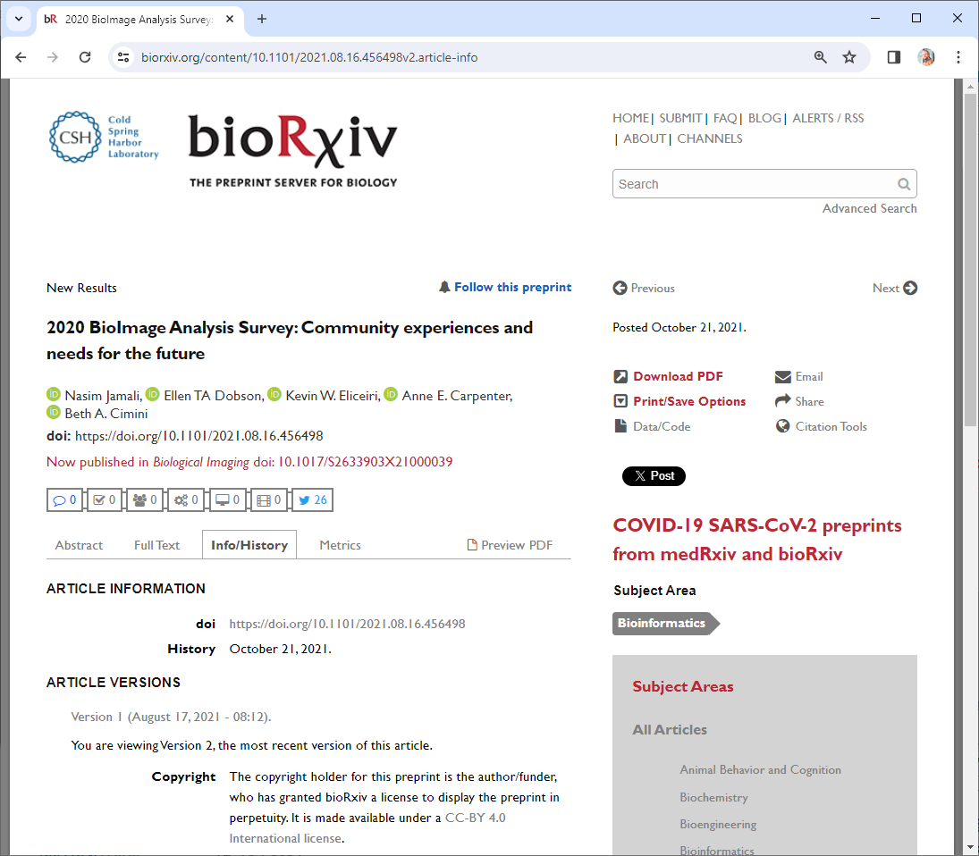
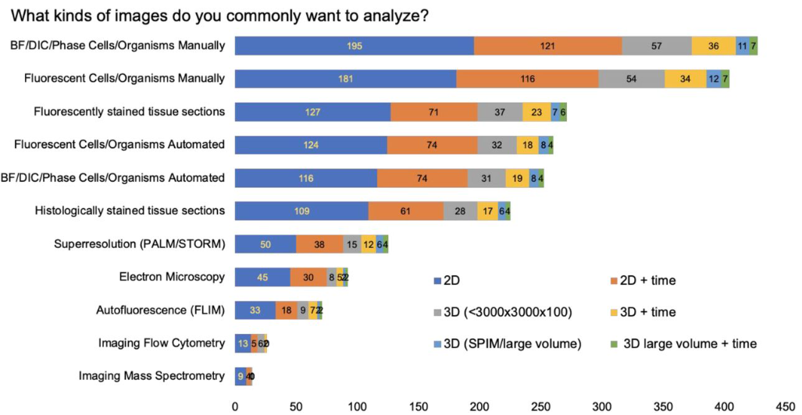
Licensing: Permissive versus restrictive
Look at this great figure! It’s cropped from / licensed CC-BY 4.0 by N. Jamali et al.
Example
https://www.biorxiv.org/content/10.1101/2021.09.03.458852v2.full

Slide 32
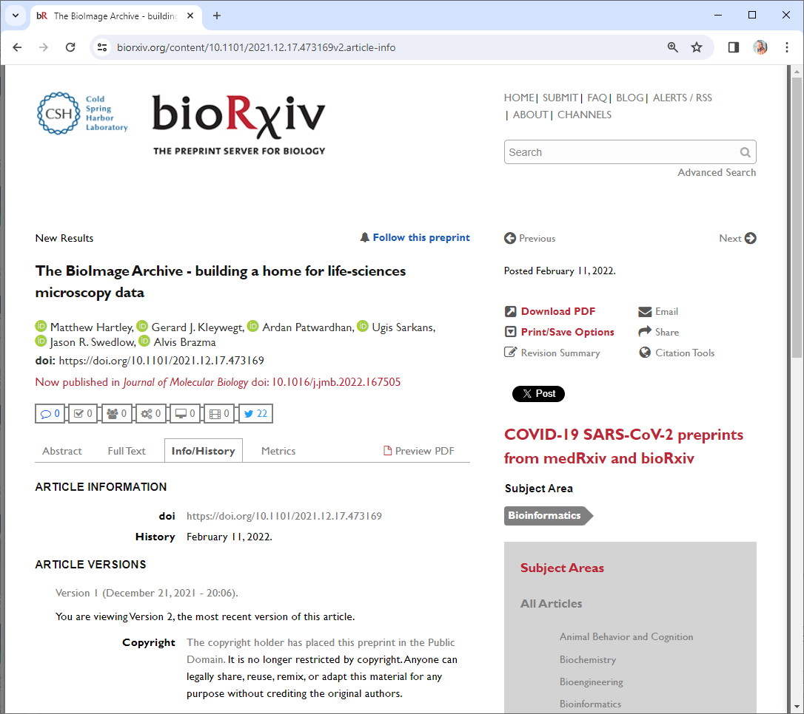
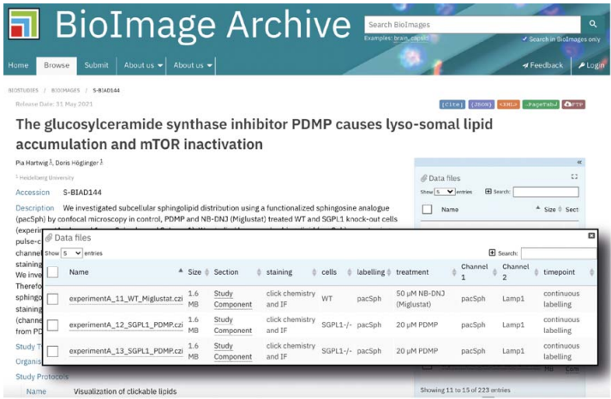
Licensing: Permissive versus restrictive
Look at this great figure! It’s taken from M. Hartley et al.
Example
https://www.biorxiv.org/content/10.1101/2021.12.17.473169v2.article-info

Slide 33

Incentives
The system is changing currently towards more openness (thankfully)
Open Science
Open Training
Career goal:
Research PI / Professor
Lecturer*
Academic staff scientist
Also this seems to be changing thanks too new business models…
In industry, secrecy plays a key role because of $$
Industry engineer
* Note: this may differ depending on the country. In the US, lecturer is a career path, in Germany not really.

Slide 34
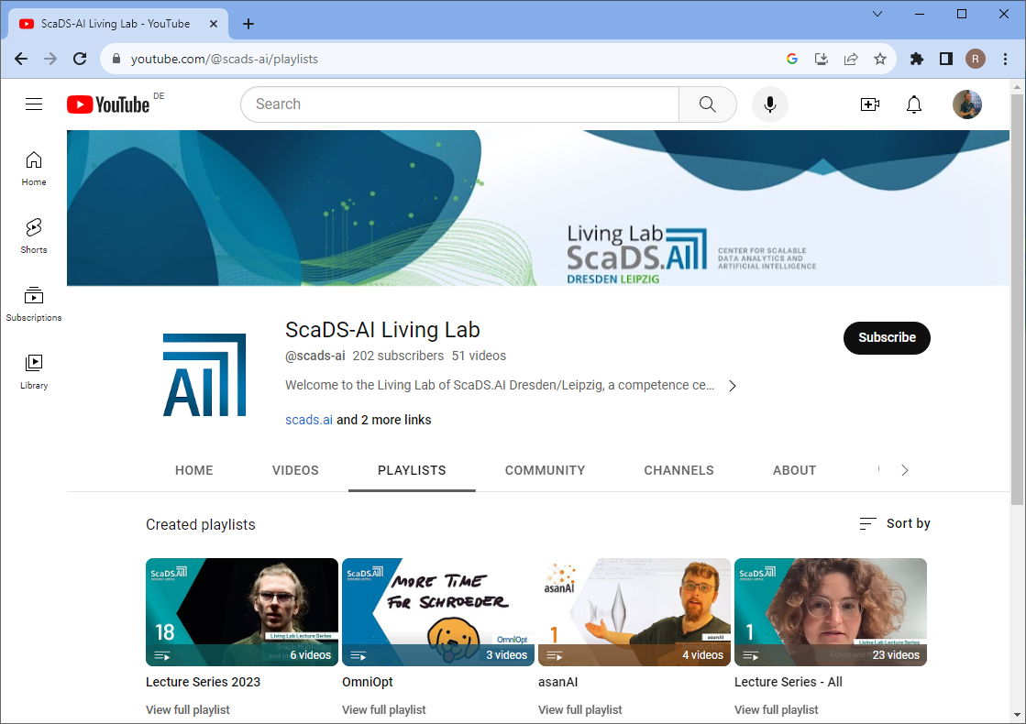
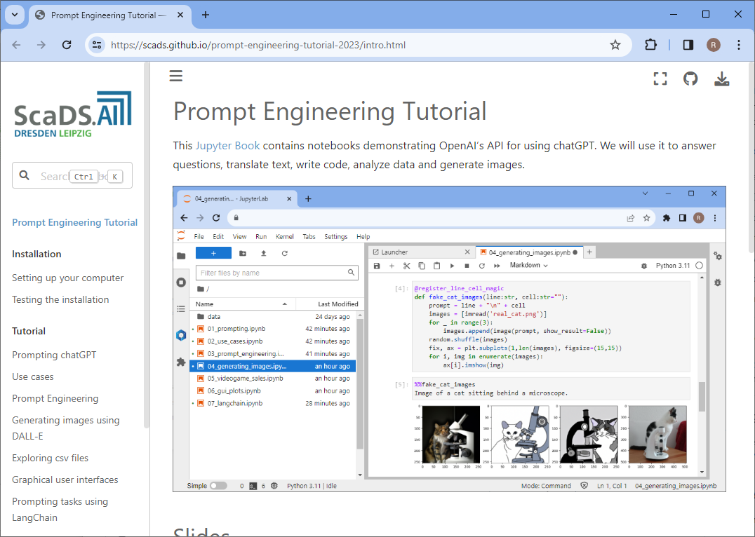
Incentives: Visibility
YouTube, Github,…
Findable
Accessible
Interoperable
Reusable
Open & FAIR Training
is a PR instrument
… leading to
more course attendees
new collaborations
https://www.youtube.com/@scads-ai
https://scads.github.io/prompt-engineering-tutorial-2023/intro.html

Slide 35
Incentives: Findability
Your future-self will thank you, because they will find your work
You remember that talk you gave in 2021?
Where are the slides?
Online,
open access!
https://f1000research.com/slides/10-519

Slide 36
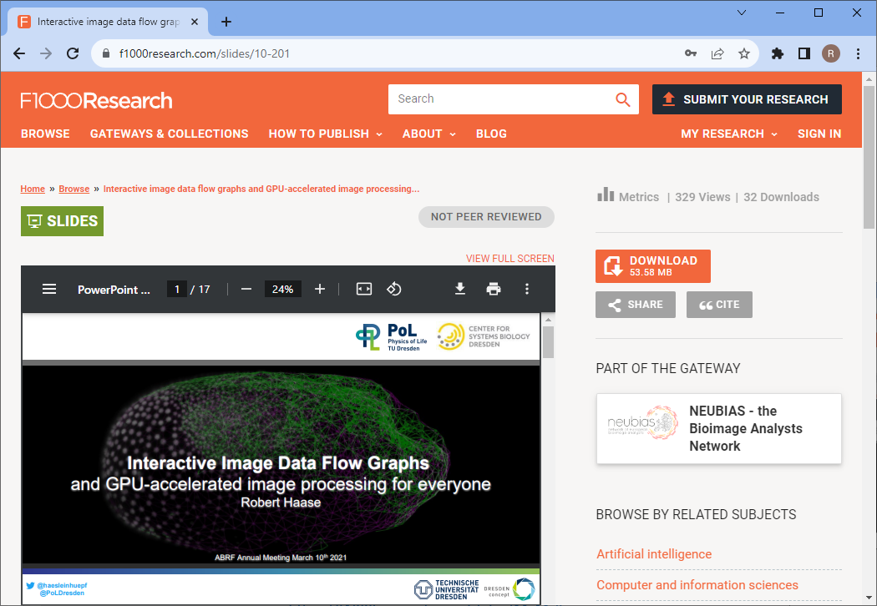
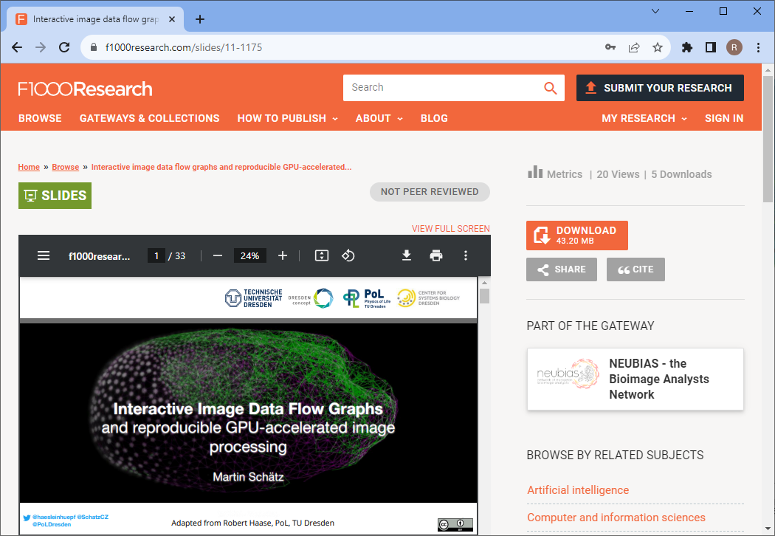
Incentives: Reusability
Open Access -> Others teach how to use your tools & methods
https://f1000research.com/slides/10-201
https://f1000research.com/slides/11-1175

Slide 37
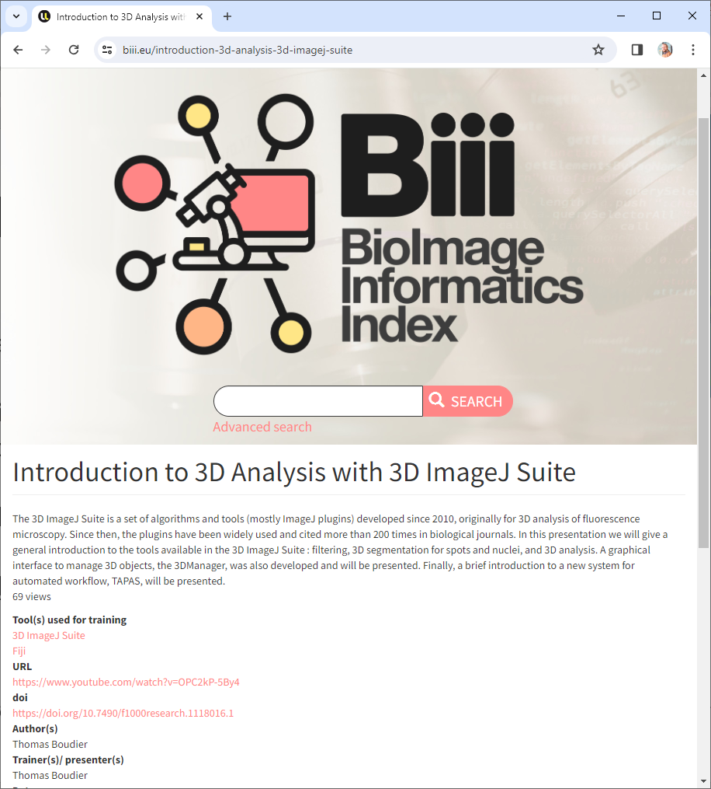
The FAIR-principles
Findable
F1. (Meta)data are assigned a globally unique and persistent identifier
F2. Data are described with rich metadata (defined by R1 below)
F3. Metadata clearly and explicitly include the identifier of the data they describe
F4. (Meta)data are registered or indexed in a searchable resource
Hint: Do not invent a new search-engines for this ;-)
https://www.go-fair.org/fair-principles/
https://biii.eu/introduction-3d-analysis-3d-imagej-suite

Slide 38
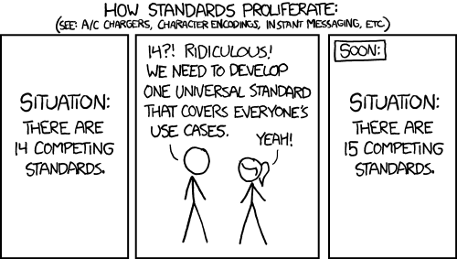
The FAIR-principles
Accessible
A1. (Meta)data are retrievable by their identifier using a standardised communications protocol
  A1.1 The protocol is open, free, and universally implementable
  A1.2 The protocol allows for an authentication and authorisation procedure, where necessary
A2. Metadata are accessible, even when the data are no longer available
https://www.go-fair.org/fair-principles/
Comic taken from https://xkcd.com/927/ licensed under a Creative Commons Attribution-NonCommercial 2.5 License.

Slide 39
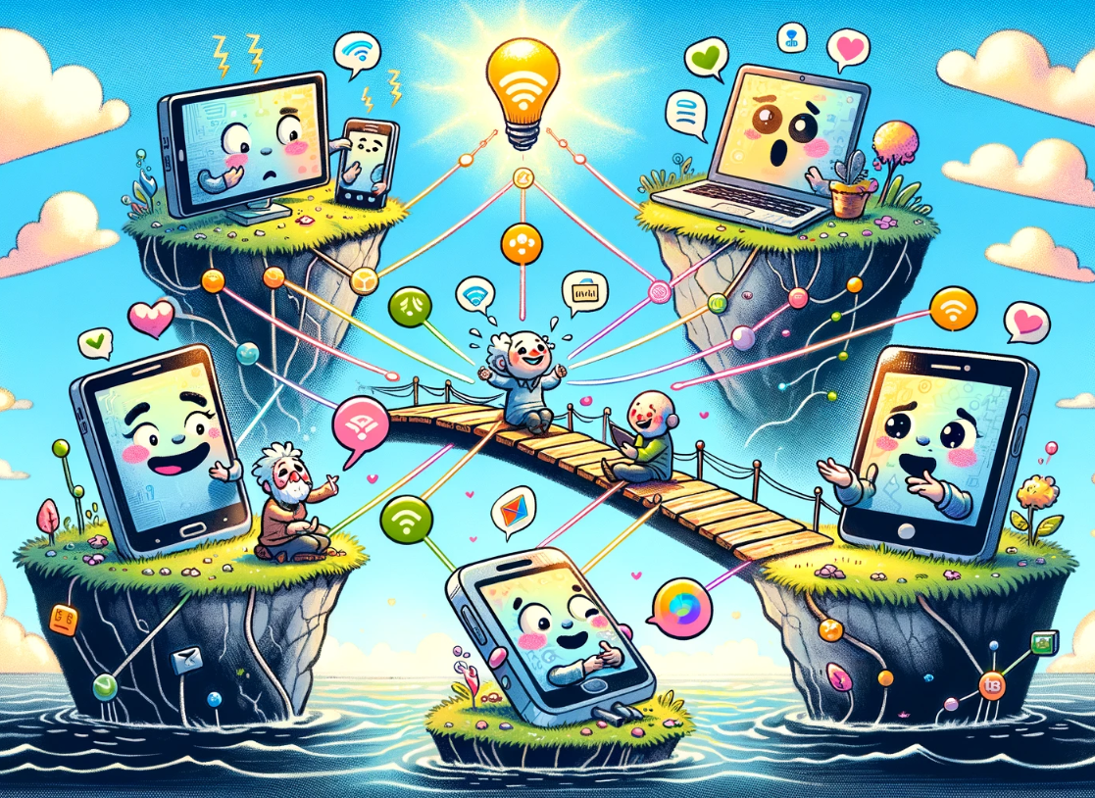
The FAIR-principles
Interoperable
I1. (Meta)data use a formal, accessible, shared, and broadly applicable language for knowledge representation.
I2. (Meta)data use vocabularies that follow FAIR principles
I3. (Meta)data include qualified references to other (meta)data
https://www.go-fair.org/fair-principles

Slide 40


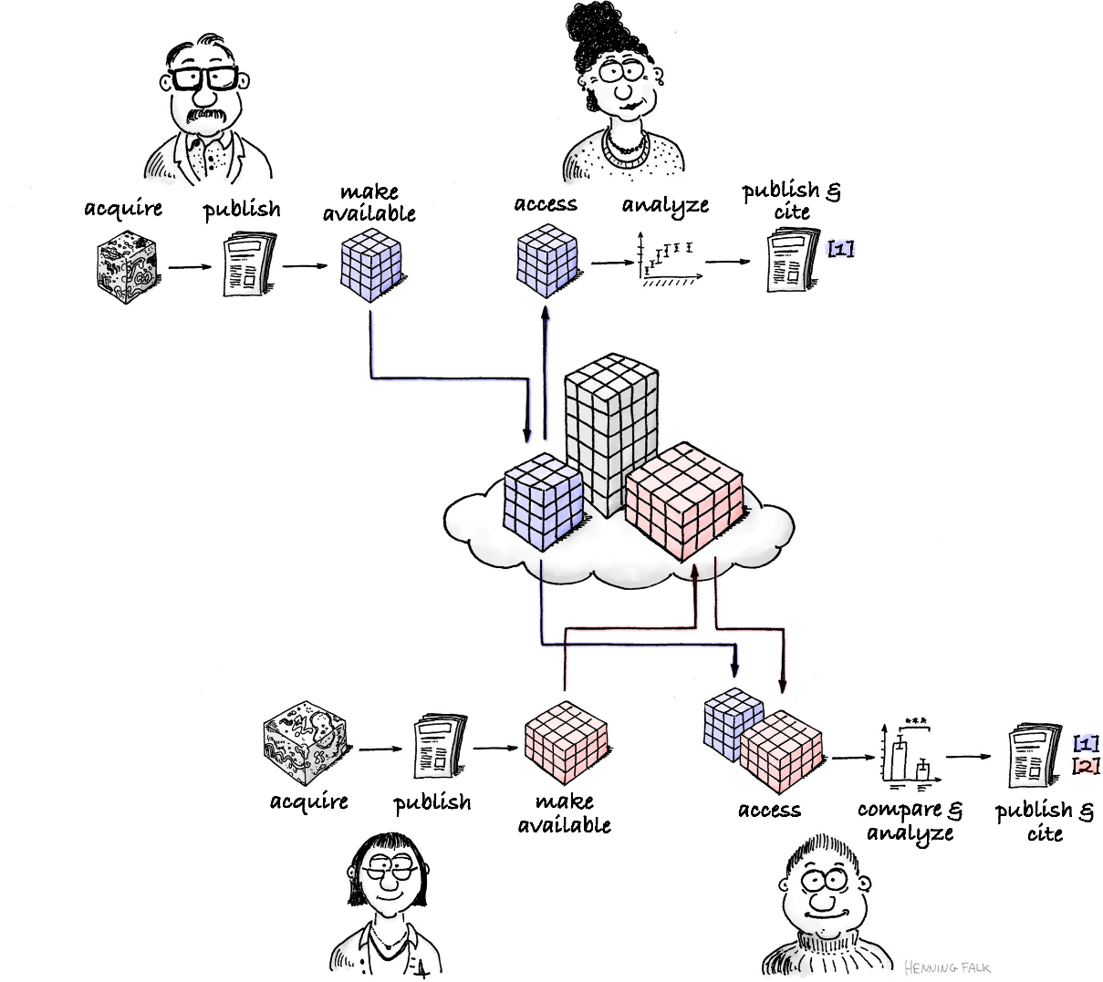
The FAIR-principles
Reusable
R1. (Meta)data are richly described with a plurality of accurate and relevant attributes
R1.1. (Meta)data are released with a clear and accessible data usage license
R1.2. (Meta)data are associated with detailed provenance
R1.3. (Meta)data meet domain-relevant community standards
https://www.go-fair.org/fair-principles/
Drawing made by Henning Falk, ©2022 NumFOCUS, reused under a CC BY 4.0 license

Slide 41
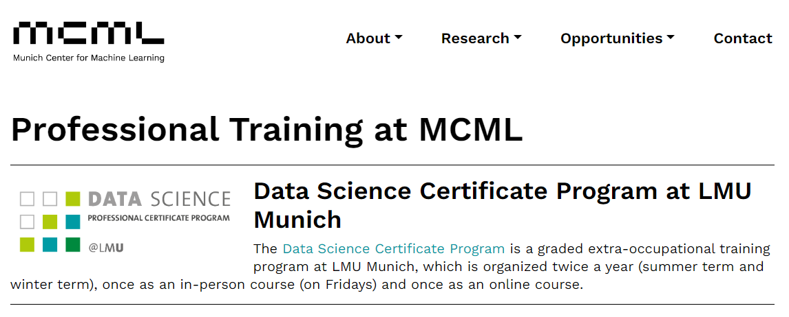
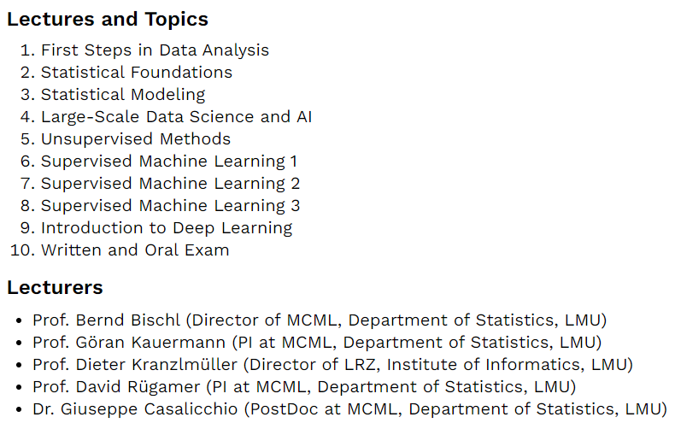

Incentives
You can actually make money
with training…
https://mcml.ai/opportunities/training/
http://www.datascience-certificate.de/

Slide 42
Please use
CC-BY
as license for your materials to make them reusable.
https://creativecommons.org/licenses/by/4.0/

Slide 43

Summary
If you want to make your stuff reusable:
  Use permissive licenses
  Share it on community-wide platforms (not institutional servers)
  Register them in search-indices
Read more:
  Sharing on Zenodo
  https://focalplane.biologists.com/2023/02/15/sharing-research-data-with-zenodo/
  Sharing on Figshare
  https://focalplane.biologists.com/2023/07/26/sharing-your-poster-on-figshare/
  Collaborative work on github
  https://focalplane.biologists.com/2021/09/04/collaborative-bio-image-analysis-script-editing-with-git/
  Licensing
  https://focalplane.biologists.com/2023/05/06/if-you-license-it-itll-be-harder-to-steal-it-why-we-should-license-our-work/
https://doi.org/10.5281/zenodo.10654775

Slide 44

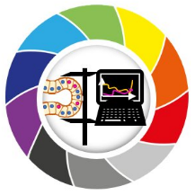
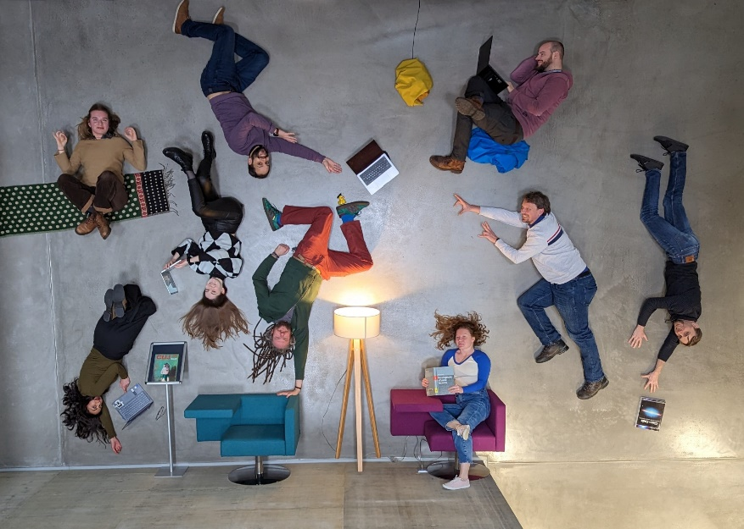







Acknowledgements
Communities & platforms
BiAPoL team
Marcelo Zoccoler
Johannes Soltwedel
Maleeha Hassan
Till Korten
Stefan Hahmann
Somashekhar Kulkarni
Former lab members:
Ryan George Savill
Laura Zigutyte
Mara Lampert
Allyson Ryan
Conni Wetzker
Funding
Some Figures were generated using

