Slide 1
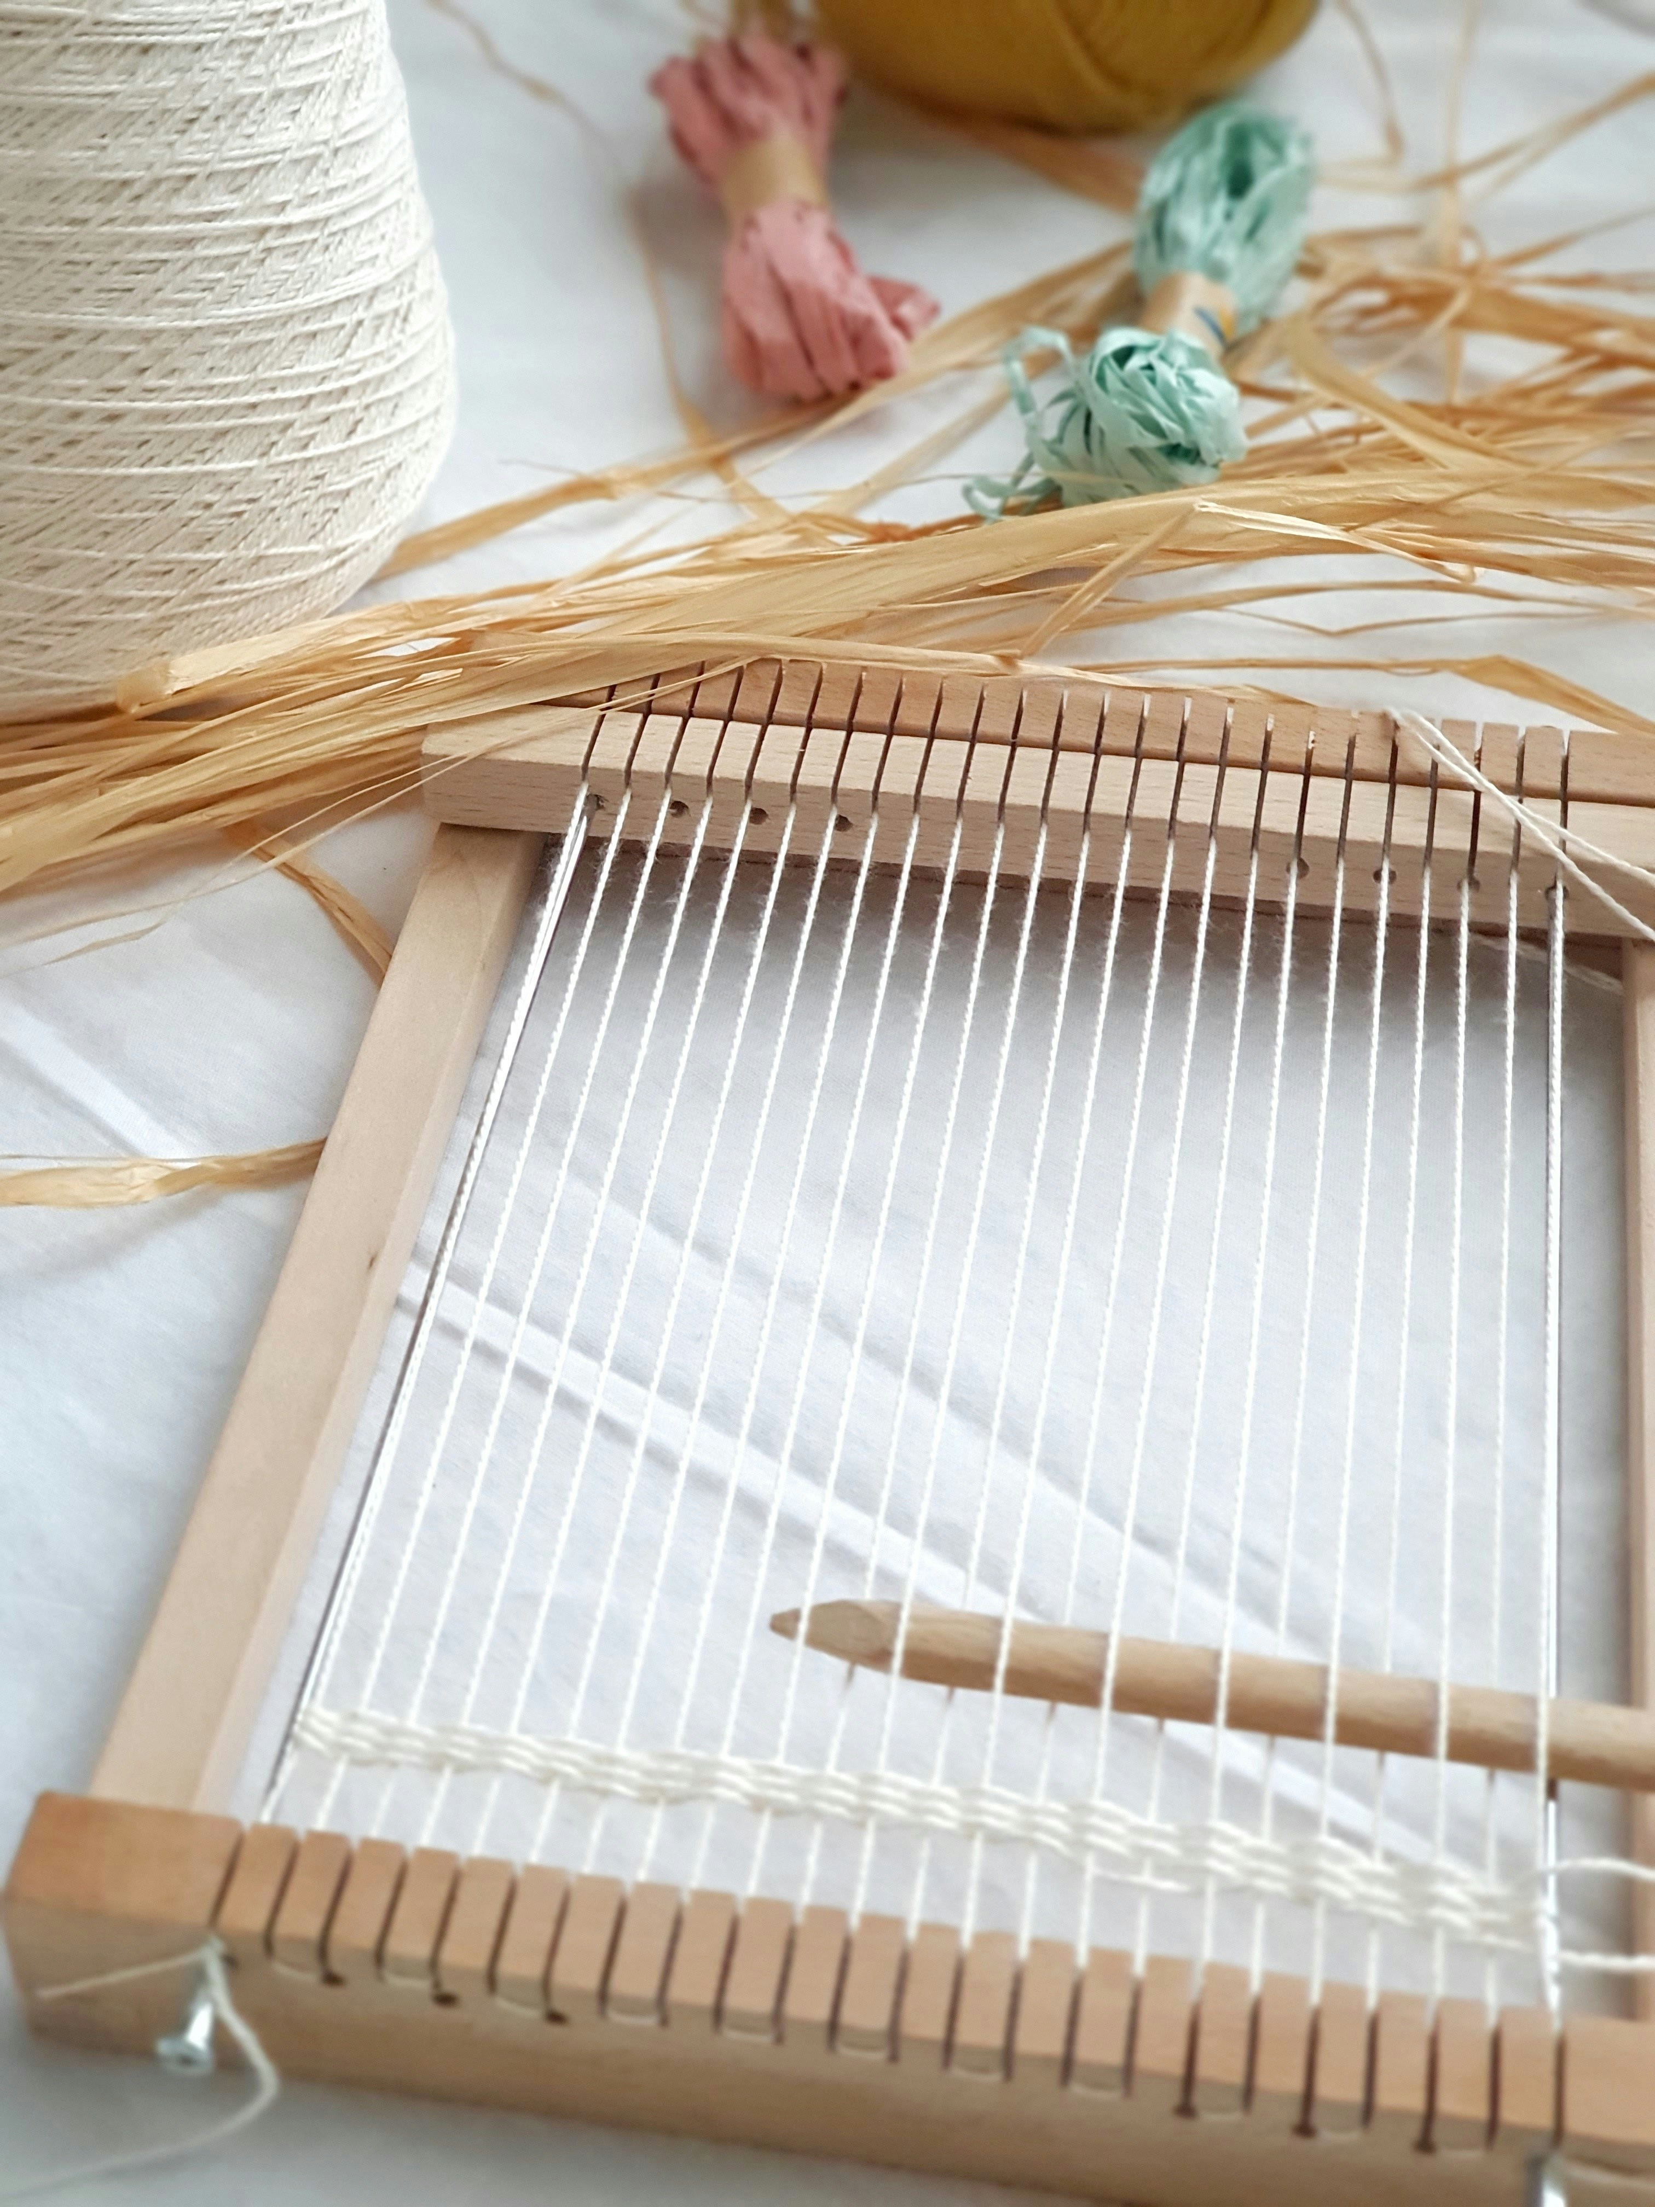
Weaving the future: making machine learning work for GLAMs
Dr Mia Ridge
Digital Curator, British Library
@mia@hcommons.social
@BL_DigiSchol@techhub.social
Photo Ivana Matijevac https://unsplash.com/photos/white-and-brown-wooden-sticks-on-white-paper-5Y-paMhTVRQ
Notes:
The Machines looking back at us
We’ve heard how artists and creators are making sense of, and testing the edges of artificial intelligence. In this session, we look at how different institutions are using the same technologies to augment access to the archives and activities. We will hear how experimentation with emerging technologies requires the ability to collaborate and be confident in the uncertainties that the experimentation brings. How do machines see and hear archival collections? What new possibilities emerge from the archive as a result?
Speakers: Dr Mia Ridge (British Library), Dr Keir Winesmith (NFSA), Simon Loffler (via Zoom) (ACMI), moderated by Jeff Williams (ACMI)

Slide 2
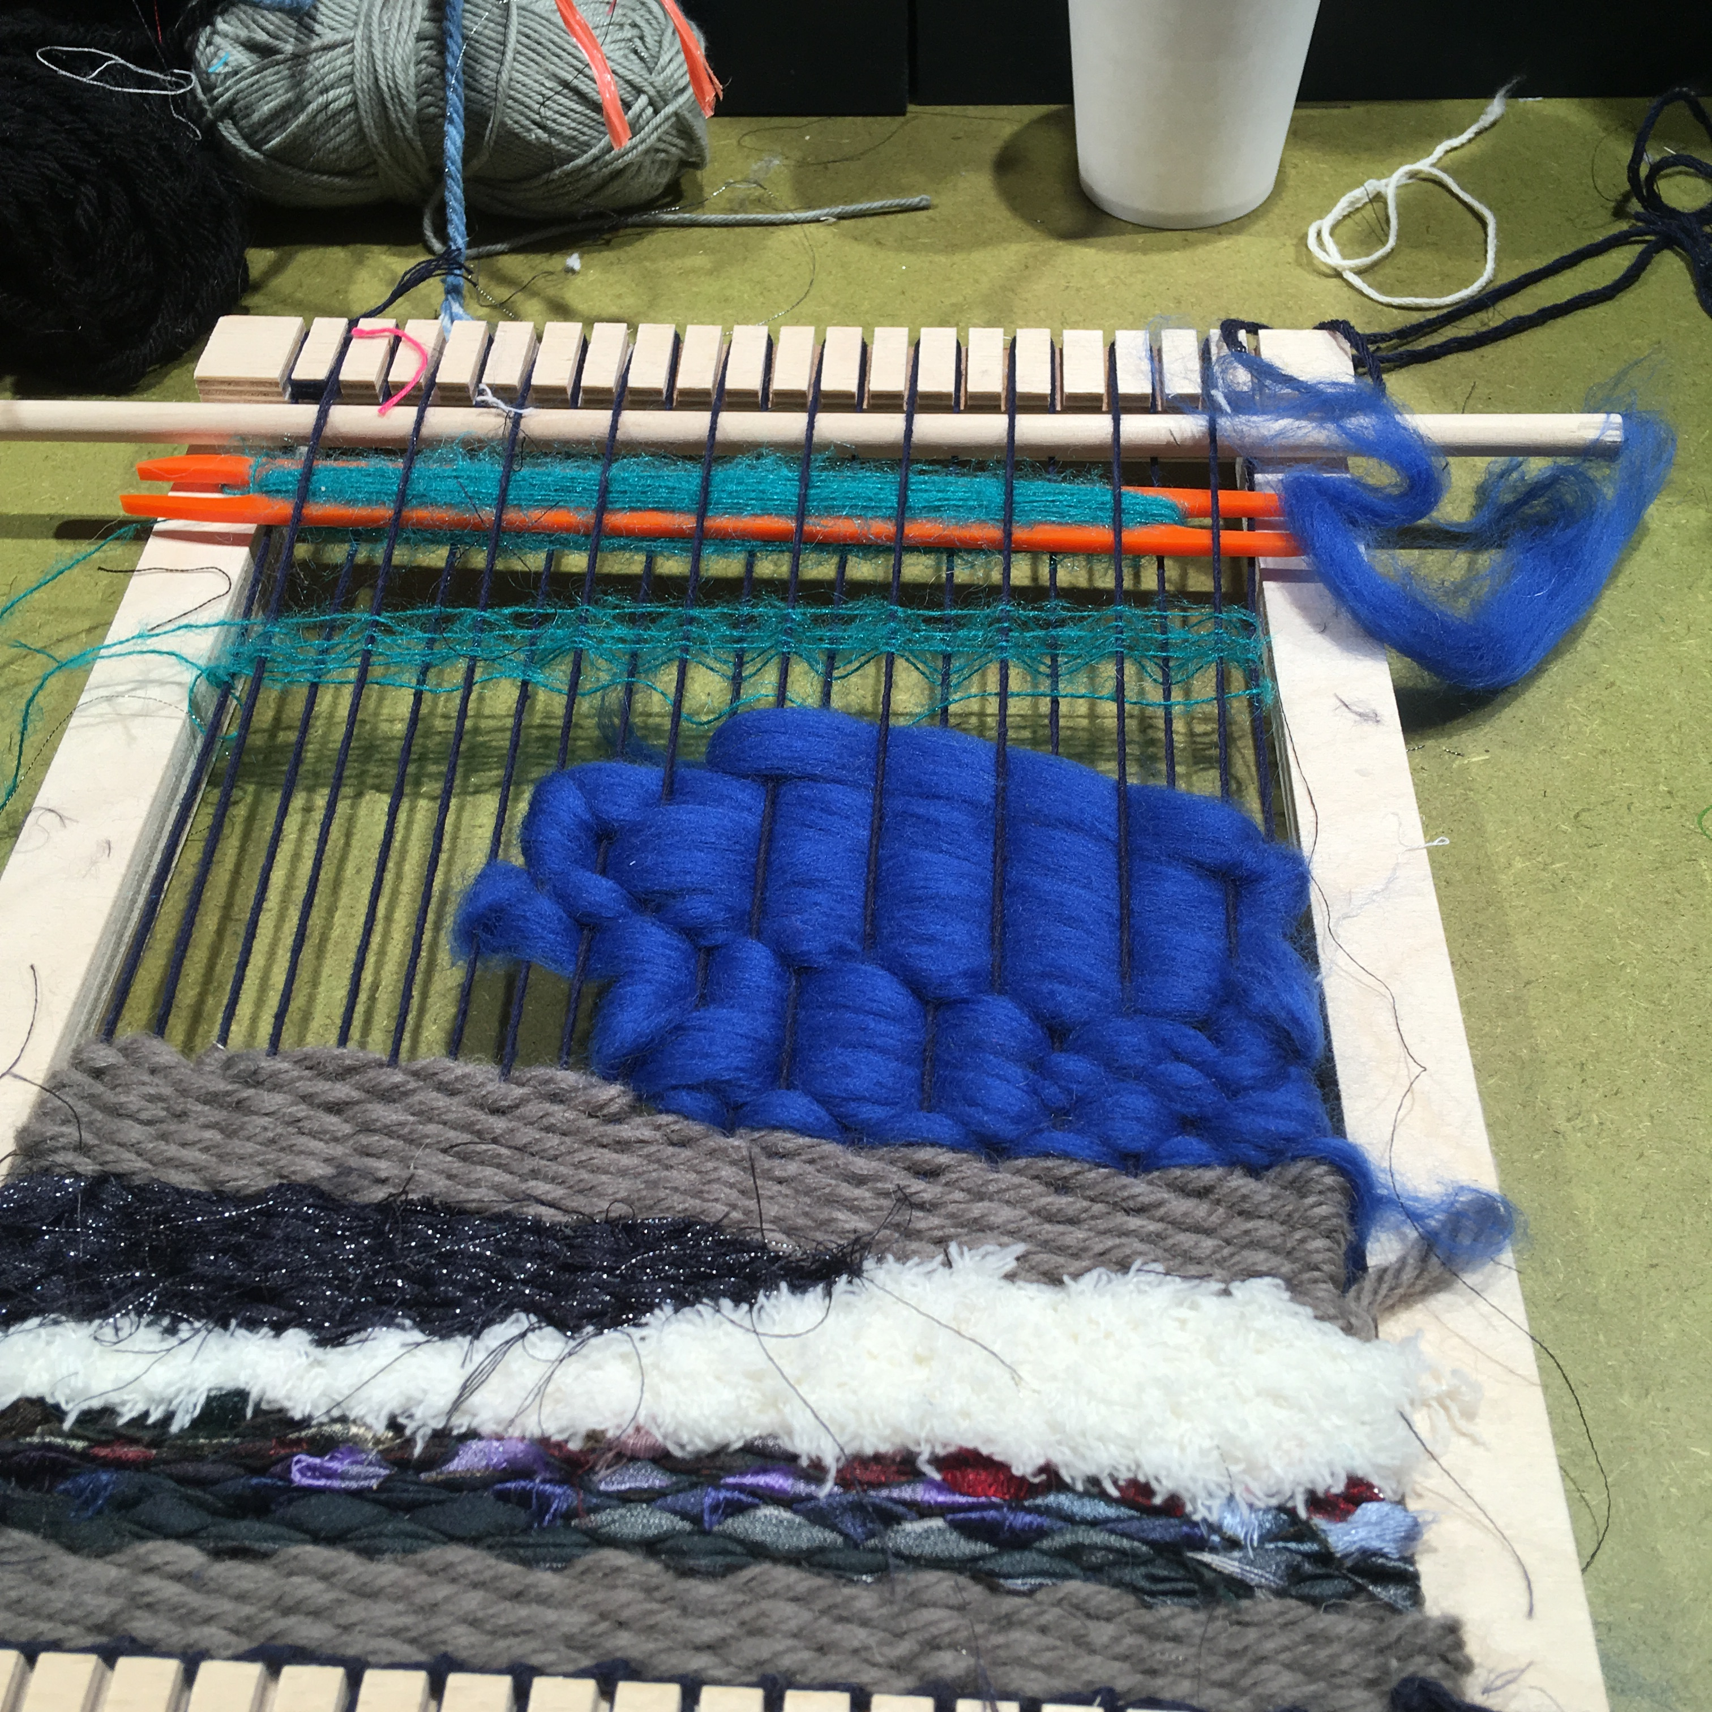
'AI' can help enrich and analyse collections data, but it needs supervision.
Every GLAM is different. The art is in weaving 'AI' into your collections and engagement strategies
Notes:
My argument / challenge to you today… GLAMs should use AI to enrich collections *and* enrich online volunteering and staff work

Slide 3

'AI' is marketing-speak for 'machine learning'
ML is statistical models of words, images, audio that can be used to predict classifications or generate new images, text, audio
Built from the best and the worst of online content
Fancy predictive text - doesn't 'know' anything about the world
Image: craiyon.ai 'rare books and special collections'
Notes:
What is AI?
My argument today… My challenge to you: GLAMs should use AI to enrich collections *and* enrich online volunteering

Slide 4
But it's kinda worth the hype

Slide 5

AI methods for research with collections
Analysing text with Natural Language Processing (NLP), Large Language Models (LLM):
Algorithms to 'link' individuals across census years
Linguistic research to find machines assigned human-like agency; semantic shifts as words change over time
Contextualising data (newspapers) with historical paradata (Mitchells press directories)
Machine learning for 'fuzzy' search with bad OCR
'Reading' maps with computer vision models – finding patterns at scale
https://livingwithmachines.ac.uk/achievements
Notes:
Some positive examples 5.5 year project, collaboration with BL and Turing; work of many in the team and supporting organisations

Slide 6
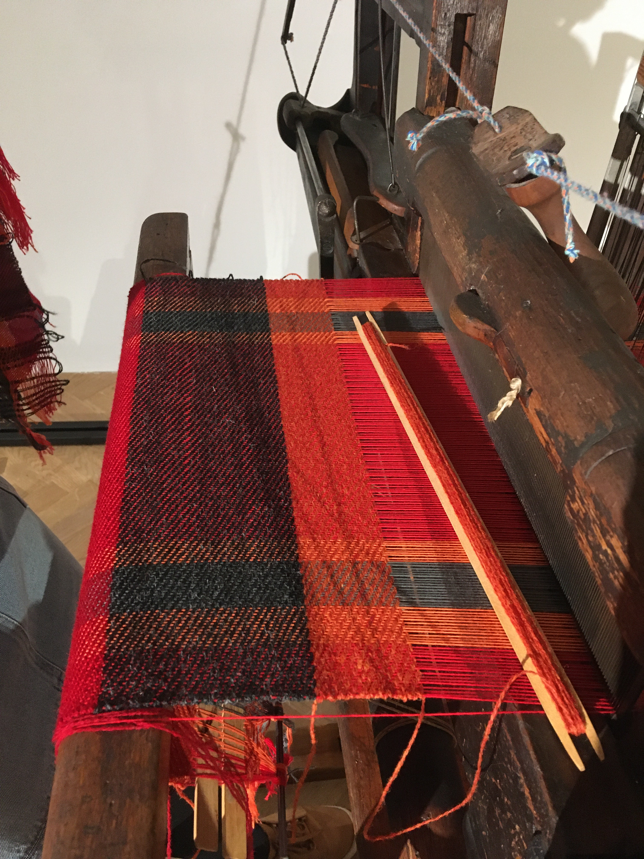
AI tools can enrich GLAM records
Transcribe text from images and audio
Recognise layouts - understand page structure, relating images and texts
Translate text and speech into text or audio
Detect objects in images; writing keywords, labels, descriptions
Detect and link entities - people, places, dates, concepts
Cluster similar images, texts / improve search by expanding input keywords, images
Notes:
'new human and machine-generated metadata, transcriptions, subtitles, and other types of enrichments' … Enrichments are data about a cultural heritage object (i.e. metadata) or of the object itself (i.e. its content) that augment or rectify the authoritative data made available by cultural heritage institutions.
https://pro.europeana.eu/post/we-re-listening-share-your-thoughts-about-improving-cultural-heritage-data

Slide 7
But it's a long way from 'ready to wear'

Slide 8
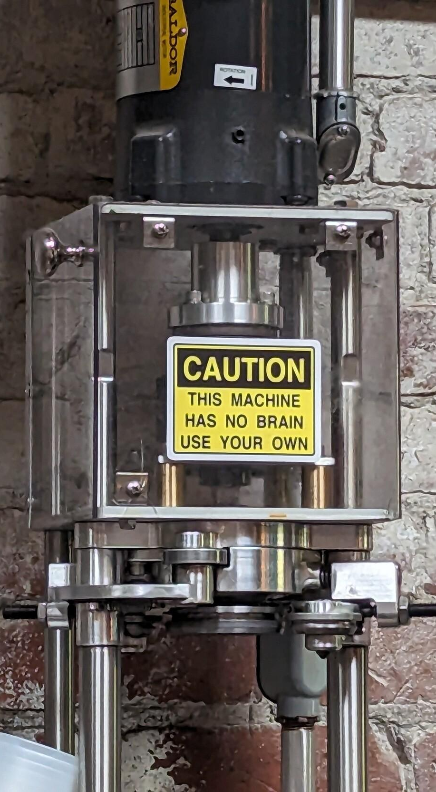

What is AI not?
It's not intelligent.
It's not conscious.
It's not a 'magic wand' that will solve all your problems.
It won't cope with your messy data.
It may not be the right solution for the problems you're trying to solve. (But it might get you funding)
Image https://fediscience.org/@dustinstoltz/111211420966814062 taken at Evil Genius brewery, PA
Notes:
Image https://fediscience.org/@dustinstoltz/111211420966814062, taken at the Evil Genius brewery, Philadelphia

Slide 9
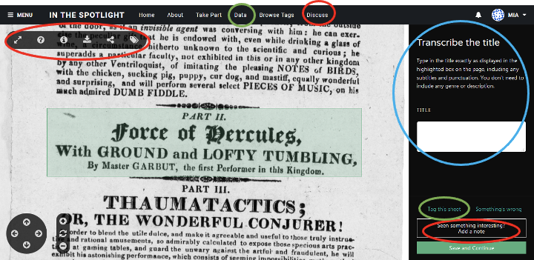
Crowdsourcing as a framework for public engagement that enriches collections records
Notes:
Building on previous work I've presented on before…

Slide 10
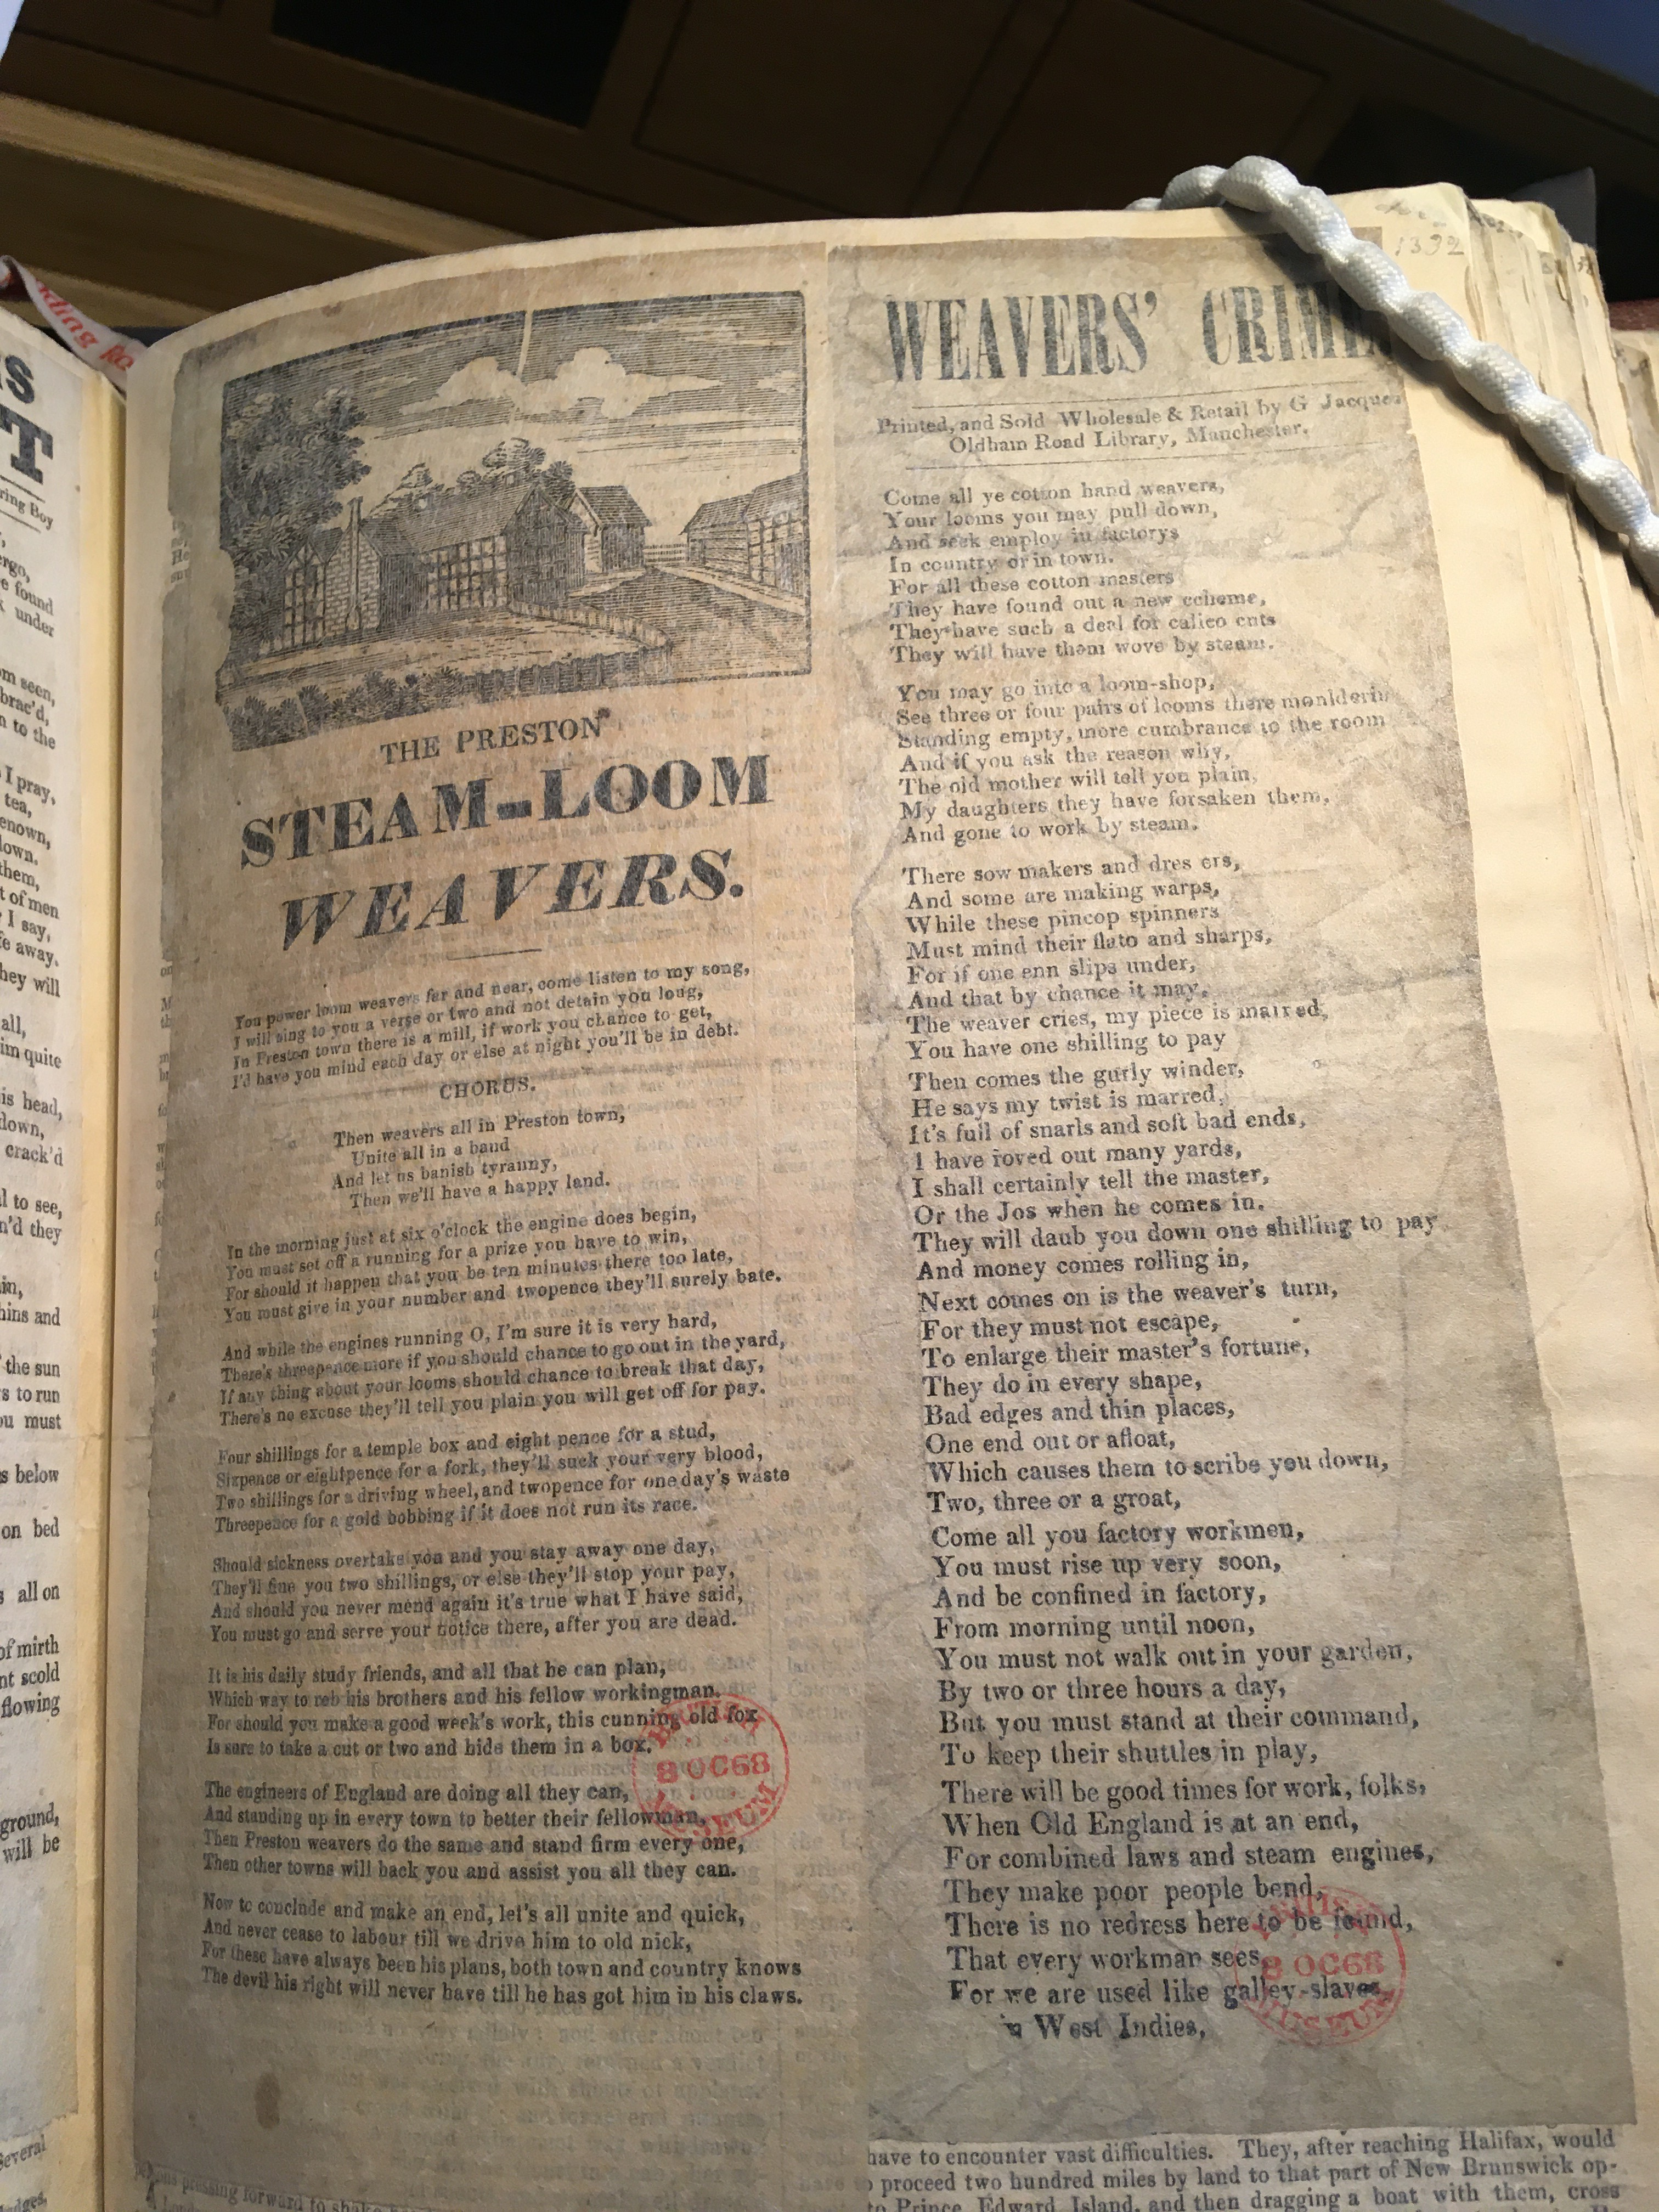
What does AI mean for crowdsourcing as a framework for productivity and public engagement?
Online volunteers find pleasure, learning and community in crowdsourcing tasks like:
Transcribing handwritten text
Tagging or classifying pictures
Puzzle-like tasks are a low-pressure first interaction with collections
Enjoyable tasks provide opportunities for learning, curiosity, developing skills and knowledge – they support volunteers trying more complex tasks
Notes:
crowdsourcing gave the public a reason to spend time with collections; it also let them start with relatively simple tasks and build skills and familiarity with collections, leading to curiosity and delight…
Not such a simple question – it's about finding work that is both needed and interesting
Image is a protest song from the late 18th or early 19th century

Slide 11
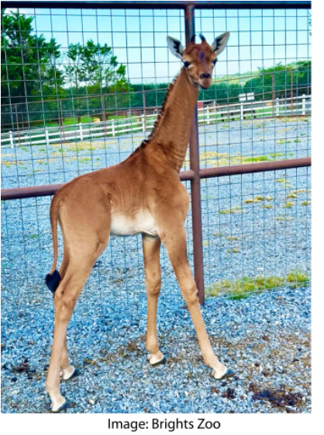
AI isn't great at 'rare' or 'special'
'AI tends to sand away the unusual. It's trained to answer with the most likely answer to your question, which is not necessarily the most correct answer.' (or the most interesting one)
    Janelle Shane, https://www.aiweirdness.com/ai-vs-a-giraffe-with-no-spots/
Notes:
So there's still a role for people…

Slide 12

Do your systems support enriched data?
Crowdsourcing volunteers and/or machine learning can enrich collections data - but can you import new or updated records into your catalogue?
Can you display the provenance and error rate for data?
    Can you build search and discovery interfaces with enriched data?
    Tried ingesting? Please share your experience! https://forms.gle/JgArpbL6VNM6W3Vk9
Notes:
No image credit, reverse search didn't work, but it suggests two forces meeting, one more diverse than the other

Slide 13
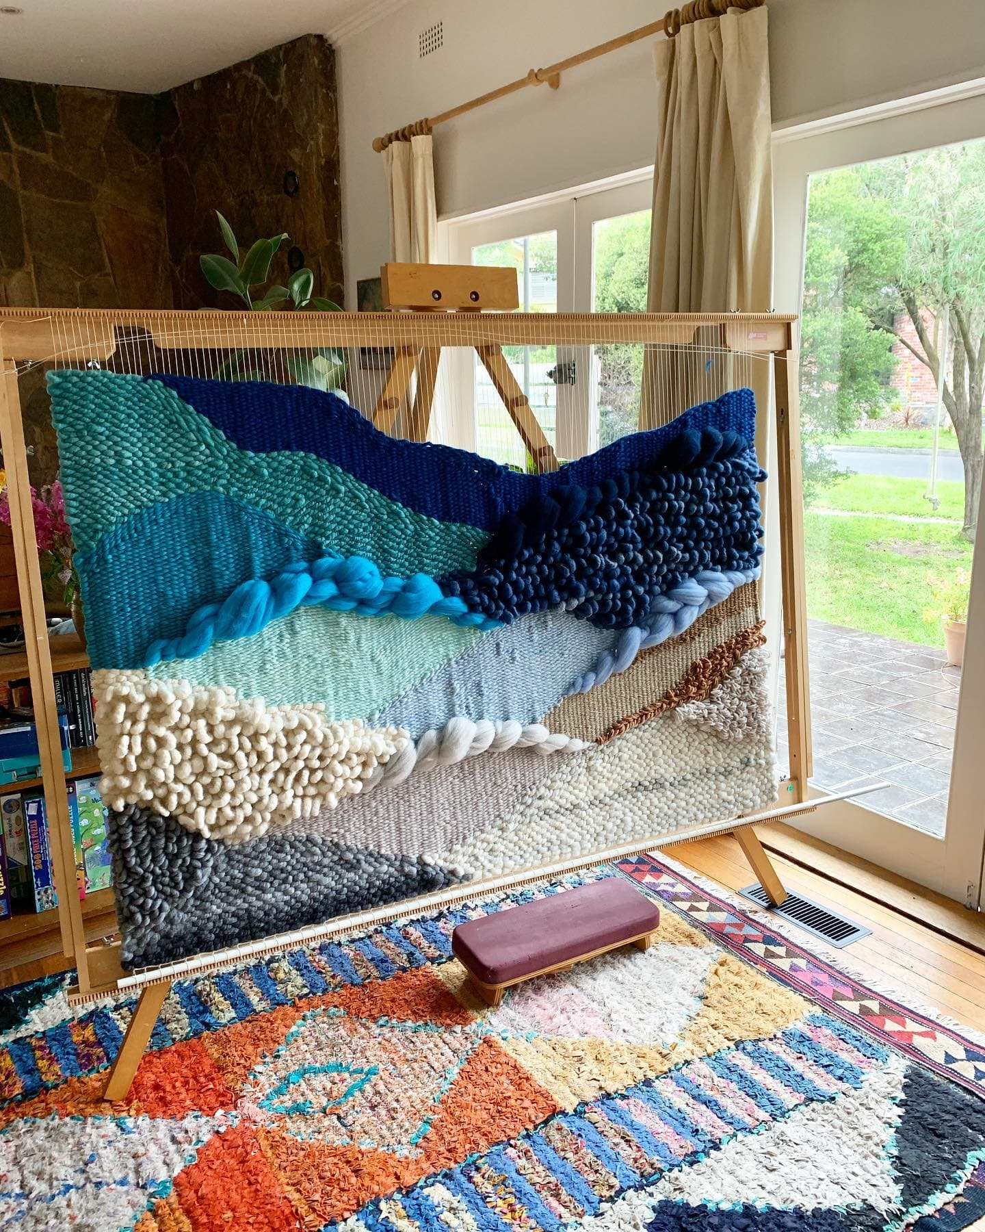
Weaving AI into your existing strategies
'imaginative abstract landscape' by Maryanne Moodie maryannemoodie.com
Notes:
My challenge to you: GLAMs should use AI to enrich collections *and* enrich online volunteering

Slide 14
Use AI to support staff and volunteers
Machine learning can help create better volunteer and staff experiences
'Automate the boring stuff' - redesign workflows for the benefit of humans
  Involve staff (and volunteers) in these decisions
Support volunteer learning - interactive feedback, tutorials
Where is imperfect AI or volunteer data better than no data?
It's easier to review than create – but beware the 'paradox of automation' and ensure that consequential decisions aren't waved through
Notes:
crowdsourcing gave the public a reason to spend time with collections; it also let them start with relatively simple tasks and build skills and familiarity with collections, leading to curiosity and delight…
Not such a simple question – it's about finding work that is both needed and interesting
Image is a protest song from the late 18th or early 19th century

Slide 15
Thanks for listening!
Find out more: digitalresearch@bl.uk
@mia@hcommons.social
@BL_DigiSchol@techhub.social

