Slide 1
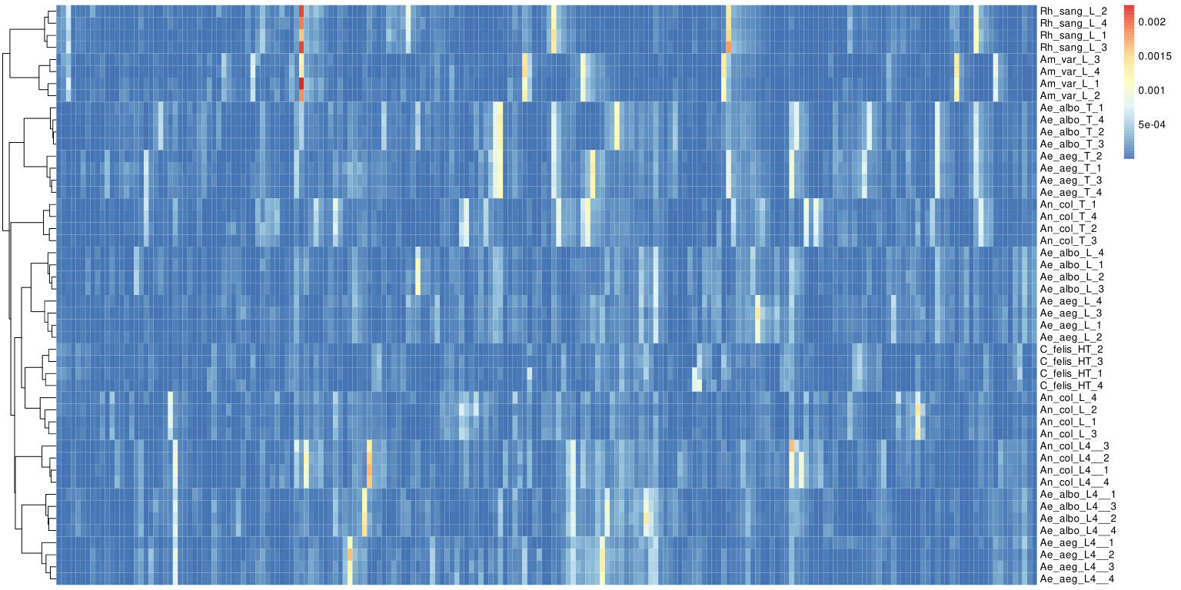
Rh. sanguineus
Legs
Am. variegatum
Ae. albopictus
Ae. aegypti
Thoraxes
An. coluzzii
Ae. albopictus
Ae. aegypti
Legs
Ct. felis
An. coluzzii
An. coluzzii
Ae. albopictus
Larvaes
Ae. aegypti
Peak list (n=202)
Supplementary Figure S8: Hierarchical clustering of the averaged spectra from dataset N°1. The body part, species and sample names are indicated. Each line of the heatmap corresponds to sample protein profile of selected peaks. The colunms correspond to intensity of a peak among the dataset. Ae. aegypti; Am. amblyomma; An. anopheles; Ct. ctenocephalides; Rh. rhipicephalus.

Slide 2
