Slide 1
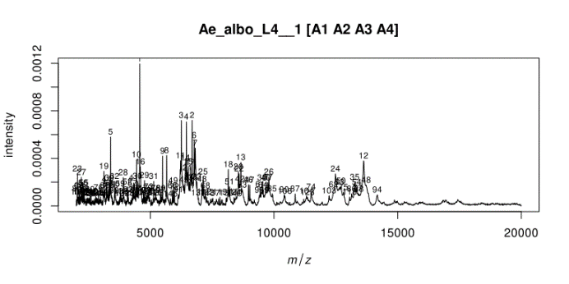
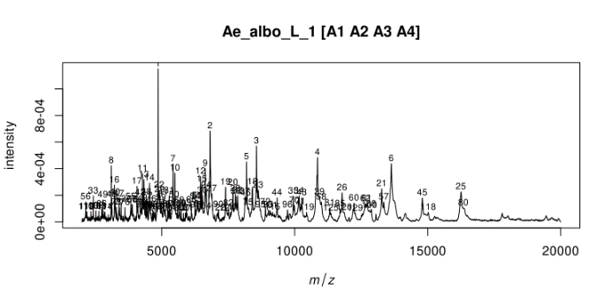
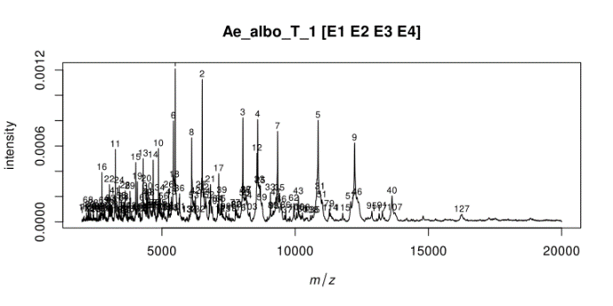
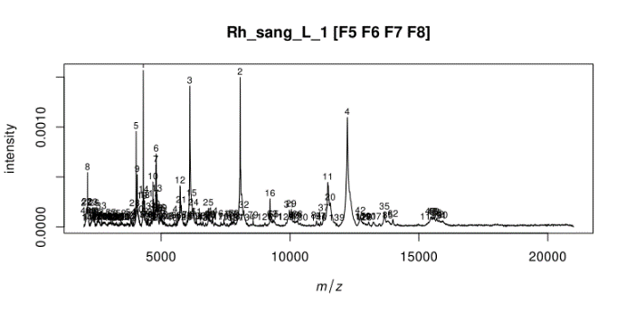
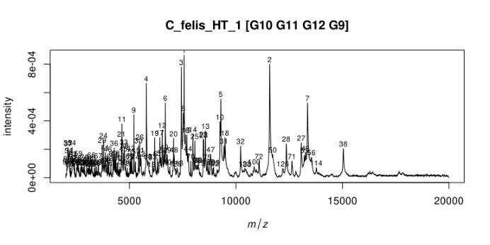
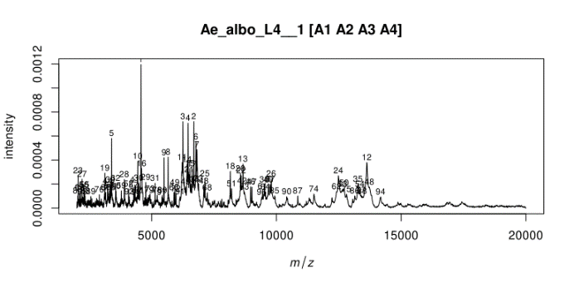
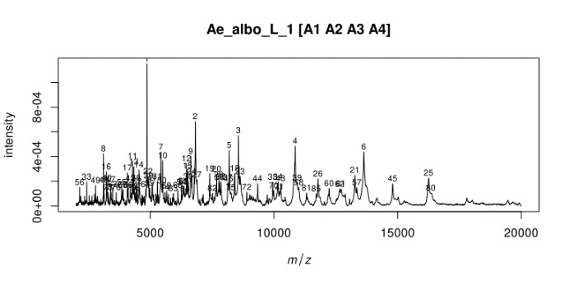
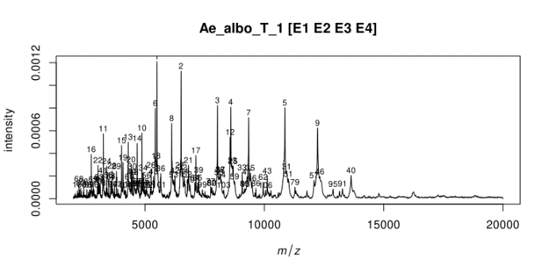

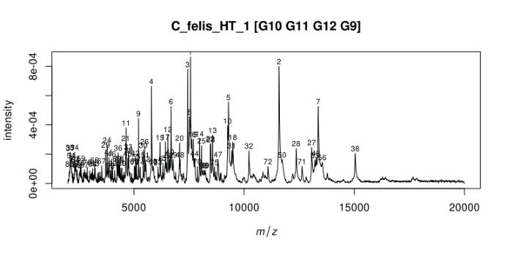
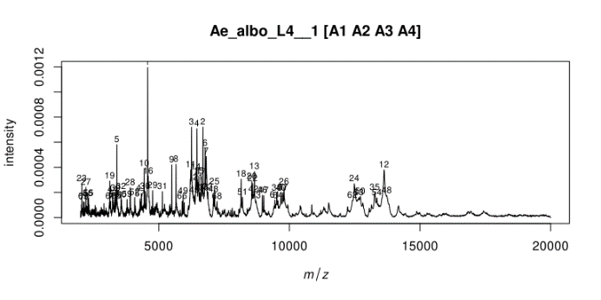
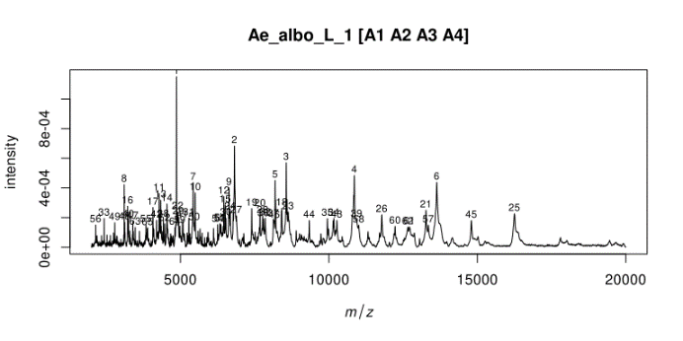
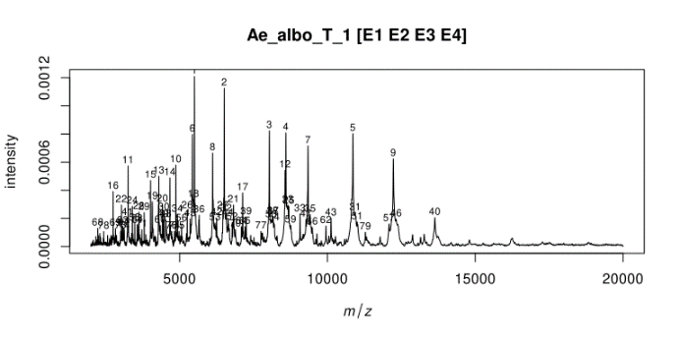
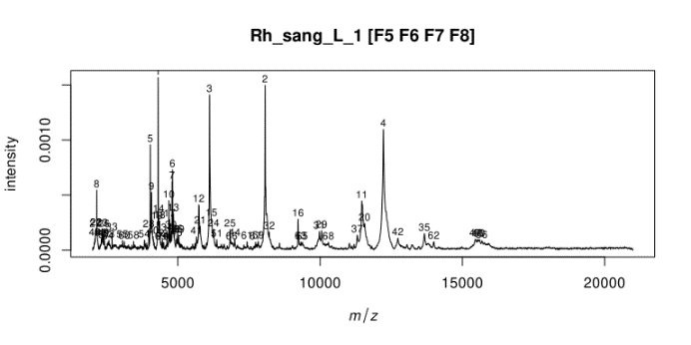
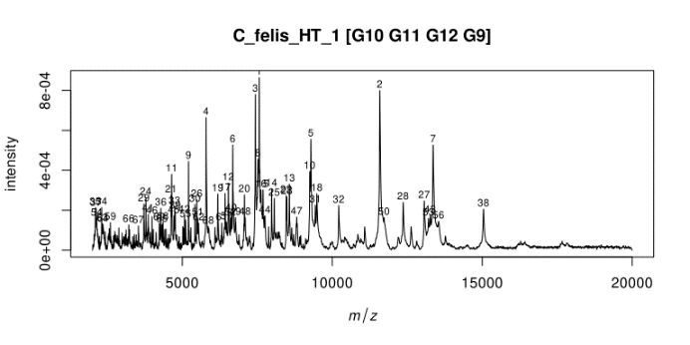
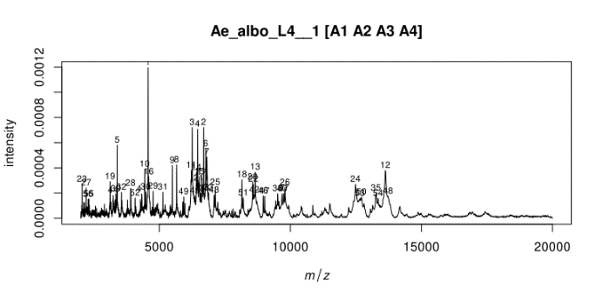
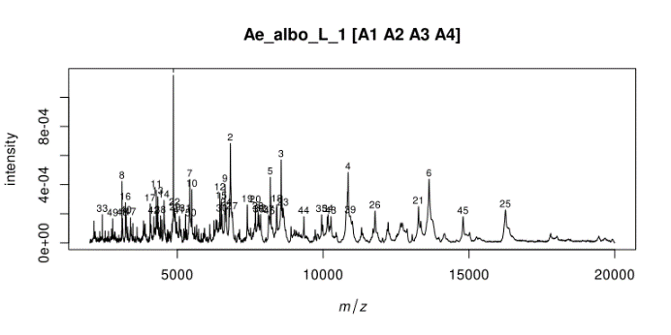
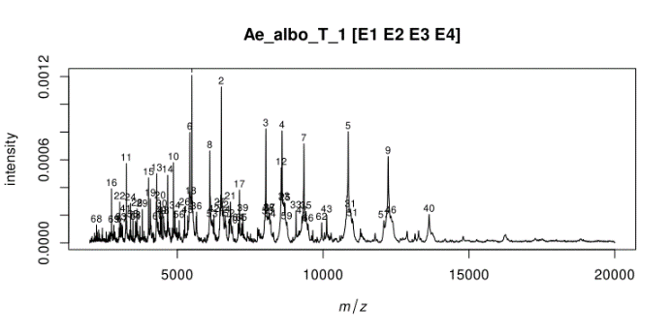
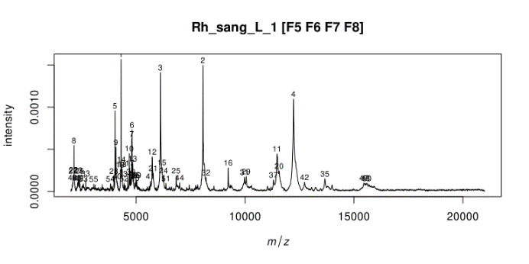

A
B
C
D
E
SNR values
n=145
n=129
n=141
n=137
n=131
2
n=97
n=85
n=106
n=91
n=93
3
n=71
n=65
n=79
n=63
n=68
4
n=56
n=50
n=70
n=52
n=55
5
Supplementary Figure S7: Peak detection according to SNR values per arthropod family and per body part. The list of peak detected on spectra from larvae (#Ae_albo_L4_1) (A), legs (#Ae_albo_L_1) (B) and thoraxes (#Ae_albo_T_1) (C) of Ae. albopictus, from legs of Rh. sanguineus (#Rh_sang_L_1) (D) and from cephalothorax of Ct. felis (#C_felis_HT_1) (E) are indicated by numbers. In the right corner of each panel is indicated the number of peak detected according to SNR value. Region with peak detection corresponding to background are indicated by red lines for SNR equal to 2. Region with real peaks lost after increase of SNR values at 3 are indicated by green lines. SNR, signal-to-noise ratio.

