Slide 1
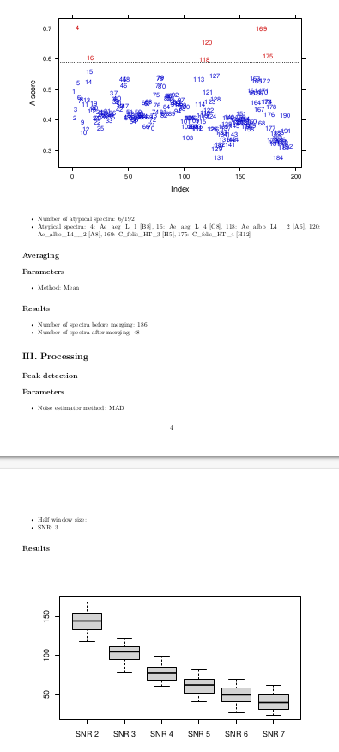
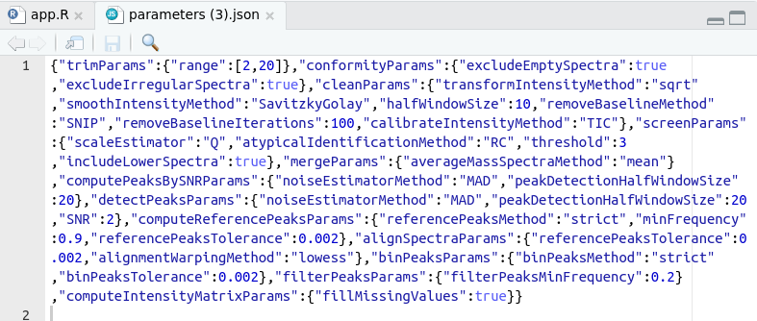
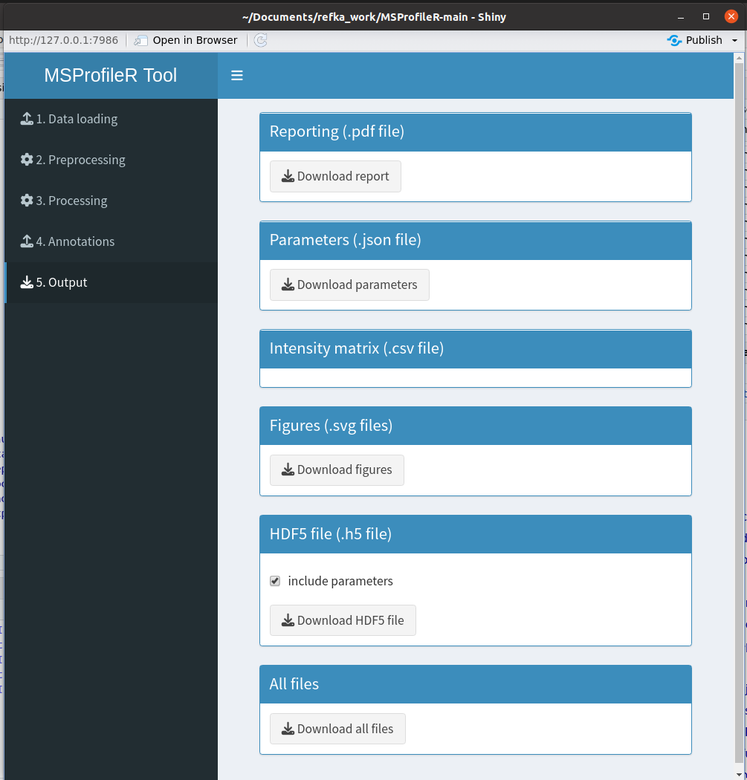
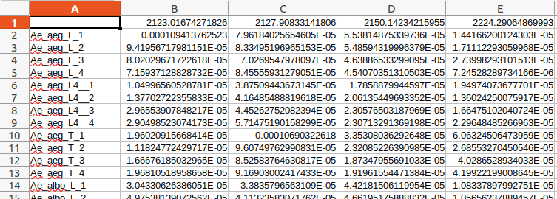
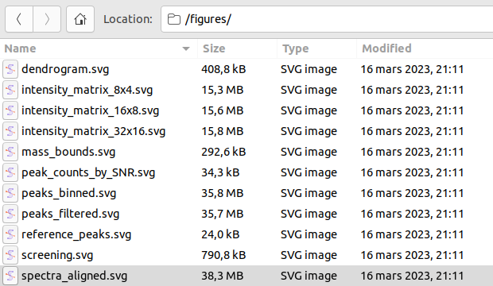
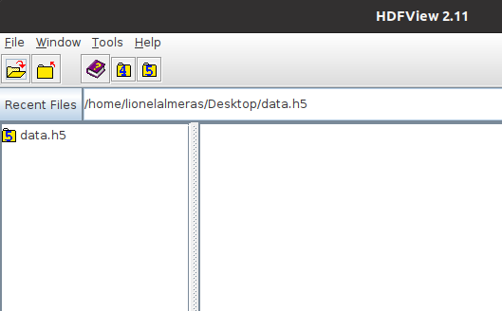
(a)
(b)
(c)
B
(d)
C
A
D
E
(e)
F
G
(f)
Supplementary Figure S5: User interface of the "Output" (A) tab. This window was divided into six panels, the reporting (B), the parameters (C), the intensity matrix (D), the figures (E), the HDF5 file (F) and the all files module which englobe all previous modules (G). The result of each module is downloadable using download button. Print screens of the files generated by the reporting (b), the parameters (c), the intensity matrix (d), the figures (e), the HDF5 file (f) are presented.

