Slide 1
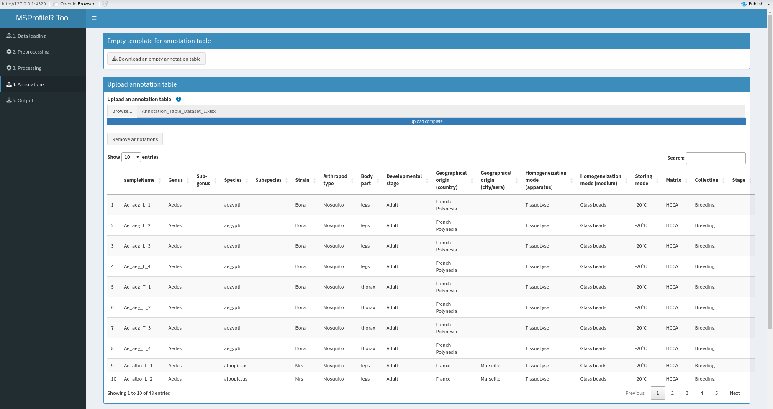
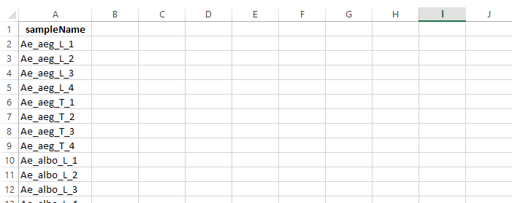
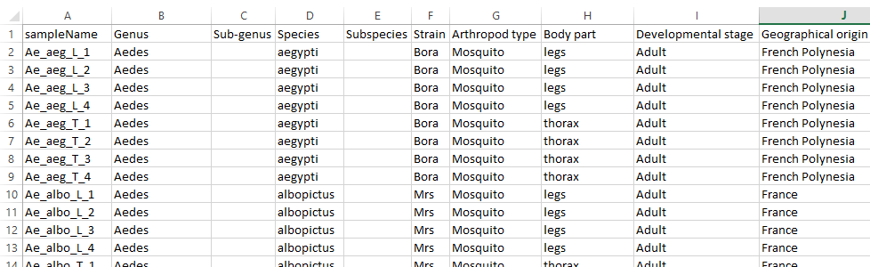
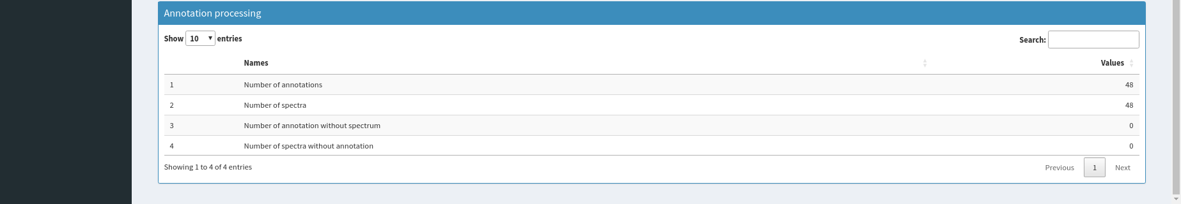
(a)
B
(b)
A
C
(c)
D
Supplementary Figure S4: User interface of the "Annotation" (A) tab. The window of the User interface (a) was divided into three panels, the Empty template for annotation table (B), the Upload annotation table (C), and the Annotation processing (D) checking the correspondence between averaged spectra and metadata included in the annotated table. An exemple of an Empty annotation table template (.xlsx format) containing uniquely sample name list of the dataset is presented (b), as well as the same table filled by the user which could be then upload (c).

