Slide 1
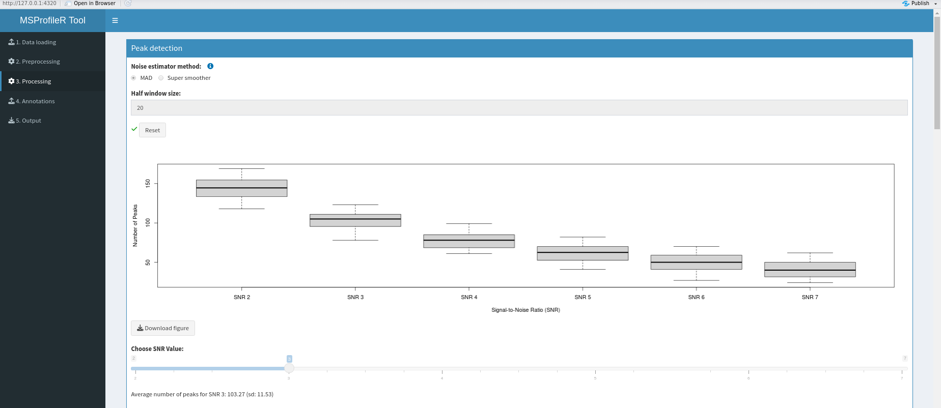
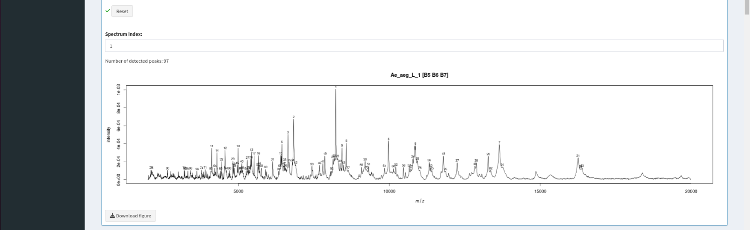
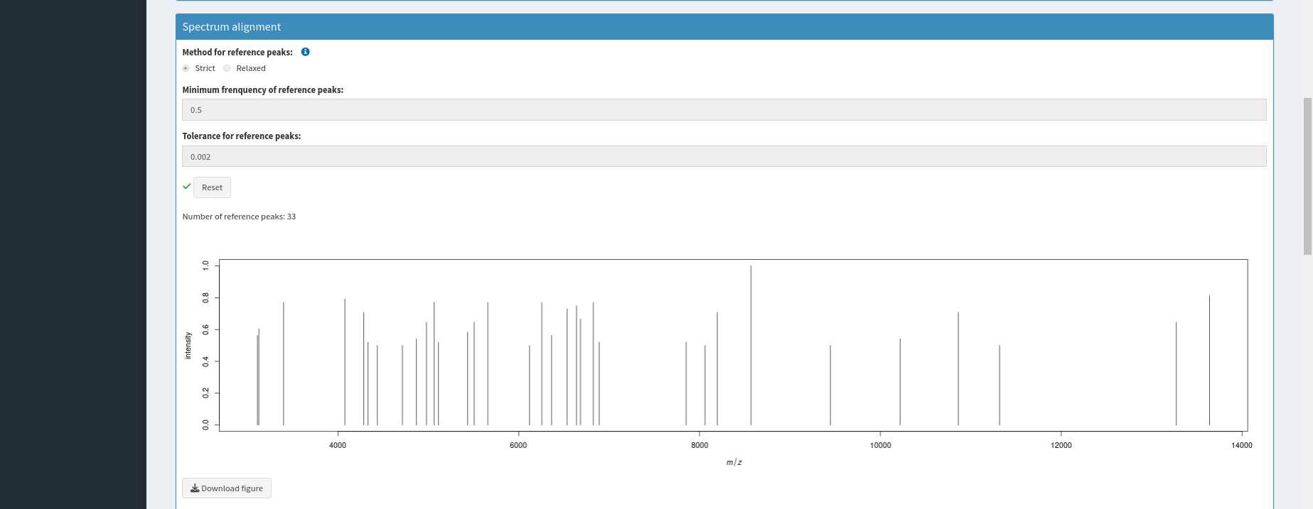
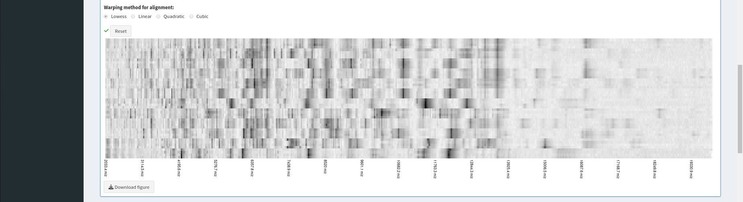
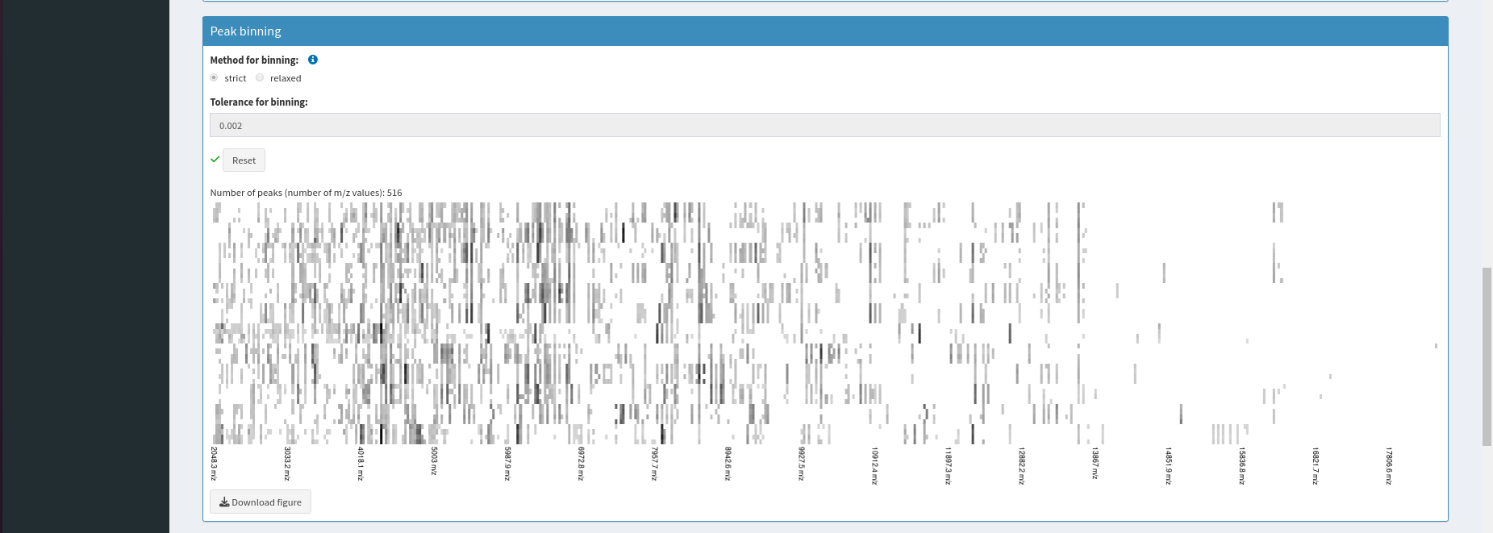
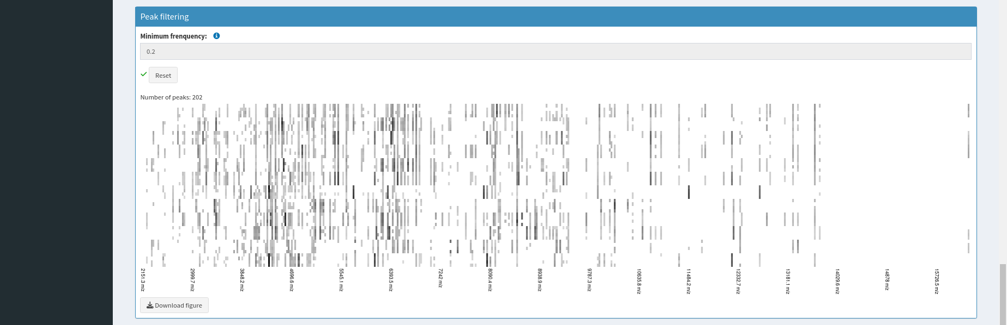
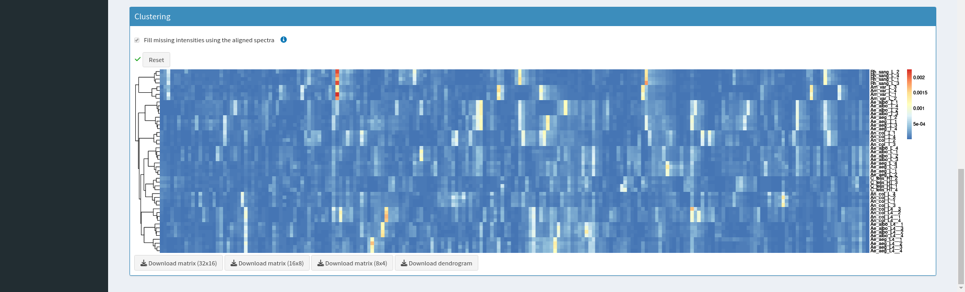
A
B
C
D
E
F
Supplementary Figure S3: User interface of the "Processing" (A) tab. This window was divided into five panels, the peak detection (B), the spectra alignment (C), the peak binning (D), the peak filtering (E) and the clustering (F). Each plot is downloadable using download buttom. Spectra from dataset N°1 were used.

