Slide 1
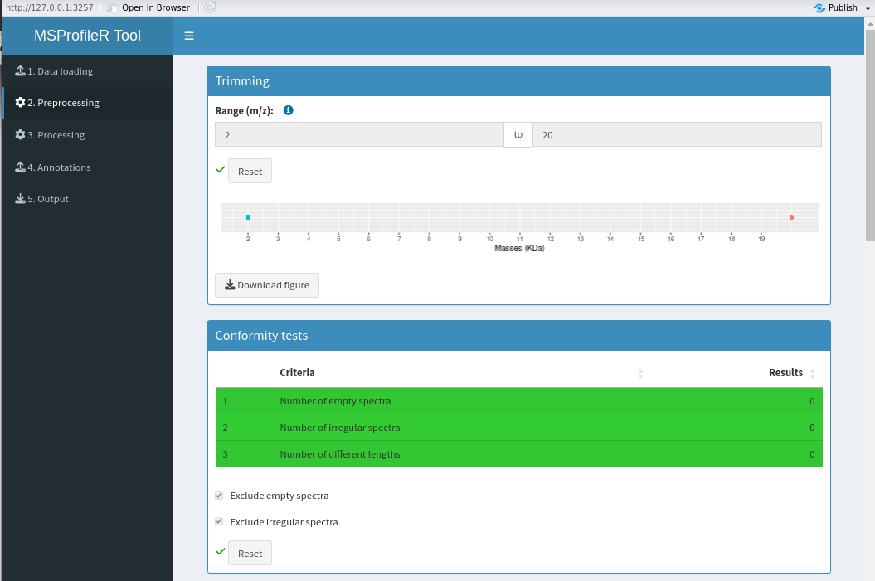
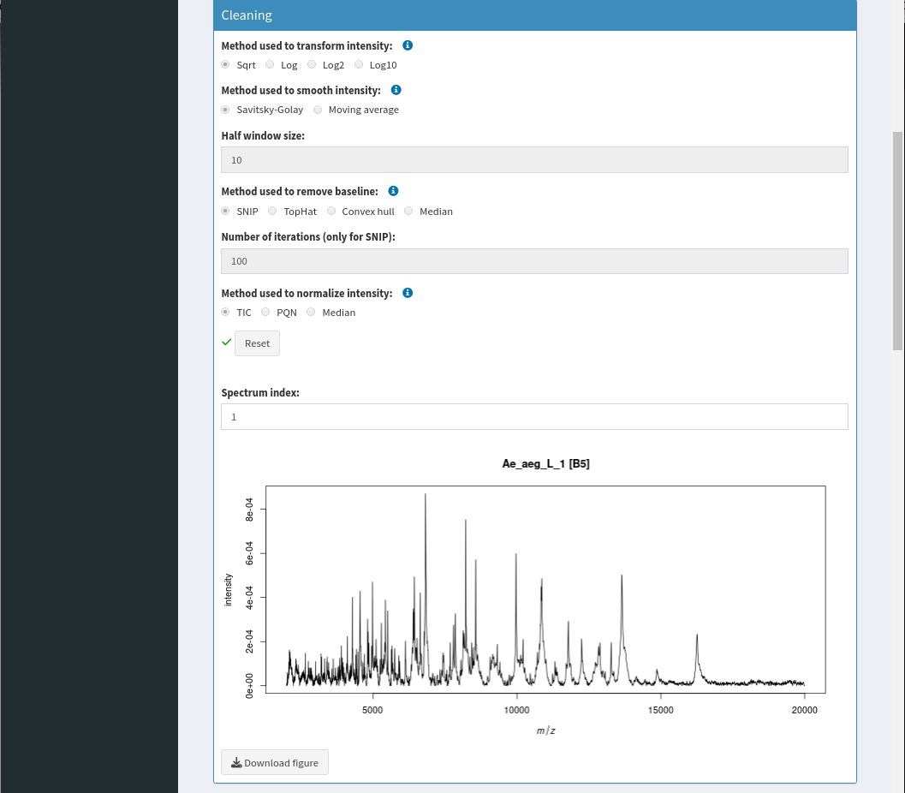
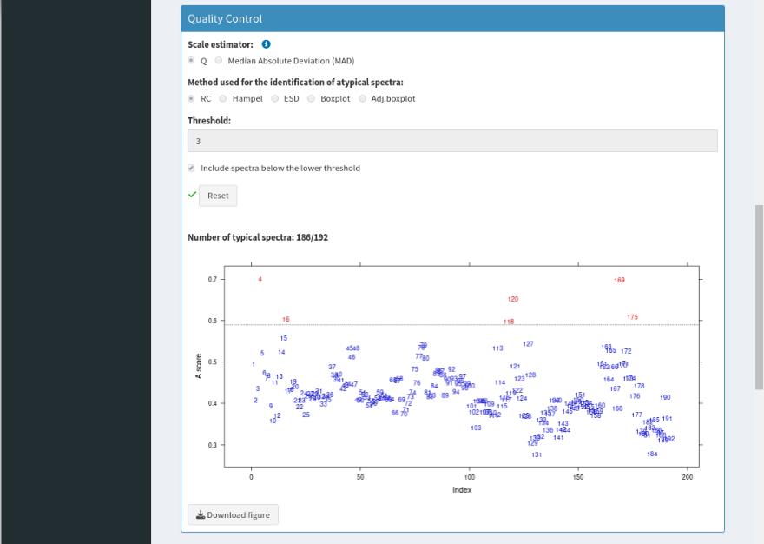
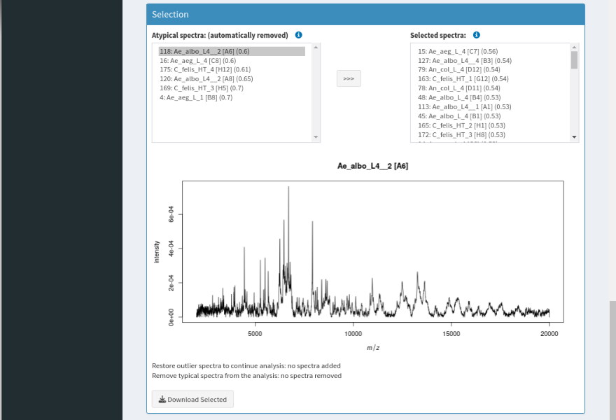
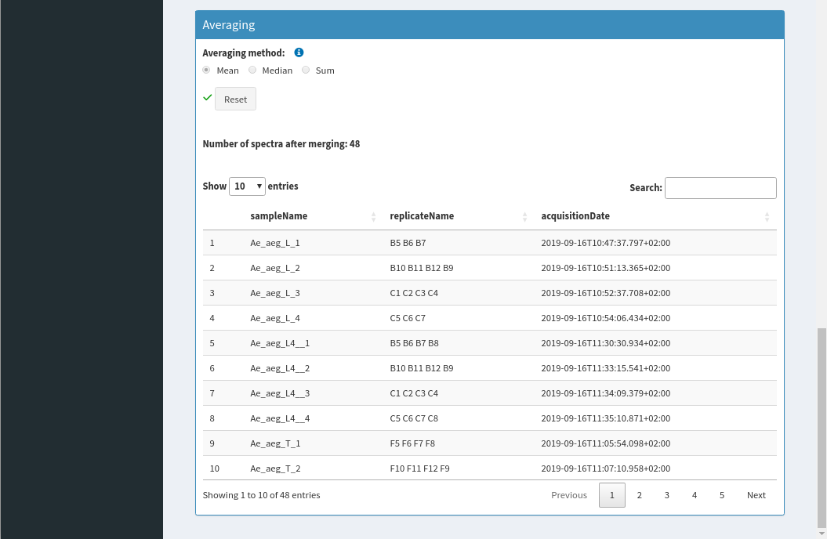
A
B
C
D
E
F
G
Supplementary Figure S2: User interface of the "Preprocessing" (A) tab. This window was divided into six panels, the trimming (B), the conformity tests (C), the cleaning (D), the quality control (E), the selection (F) and averaging (G). Each plot is downloadable using download buttom. Spectra from dataset N°1 were used.

