Slide 1
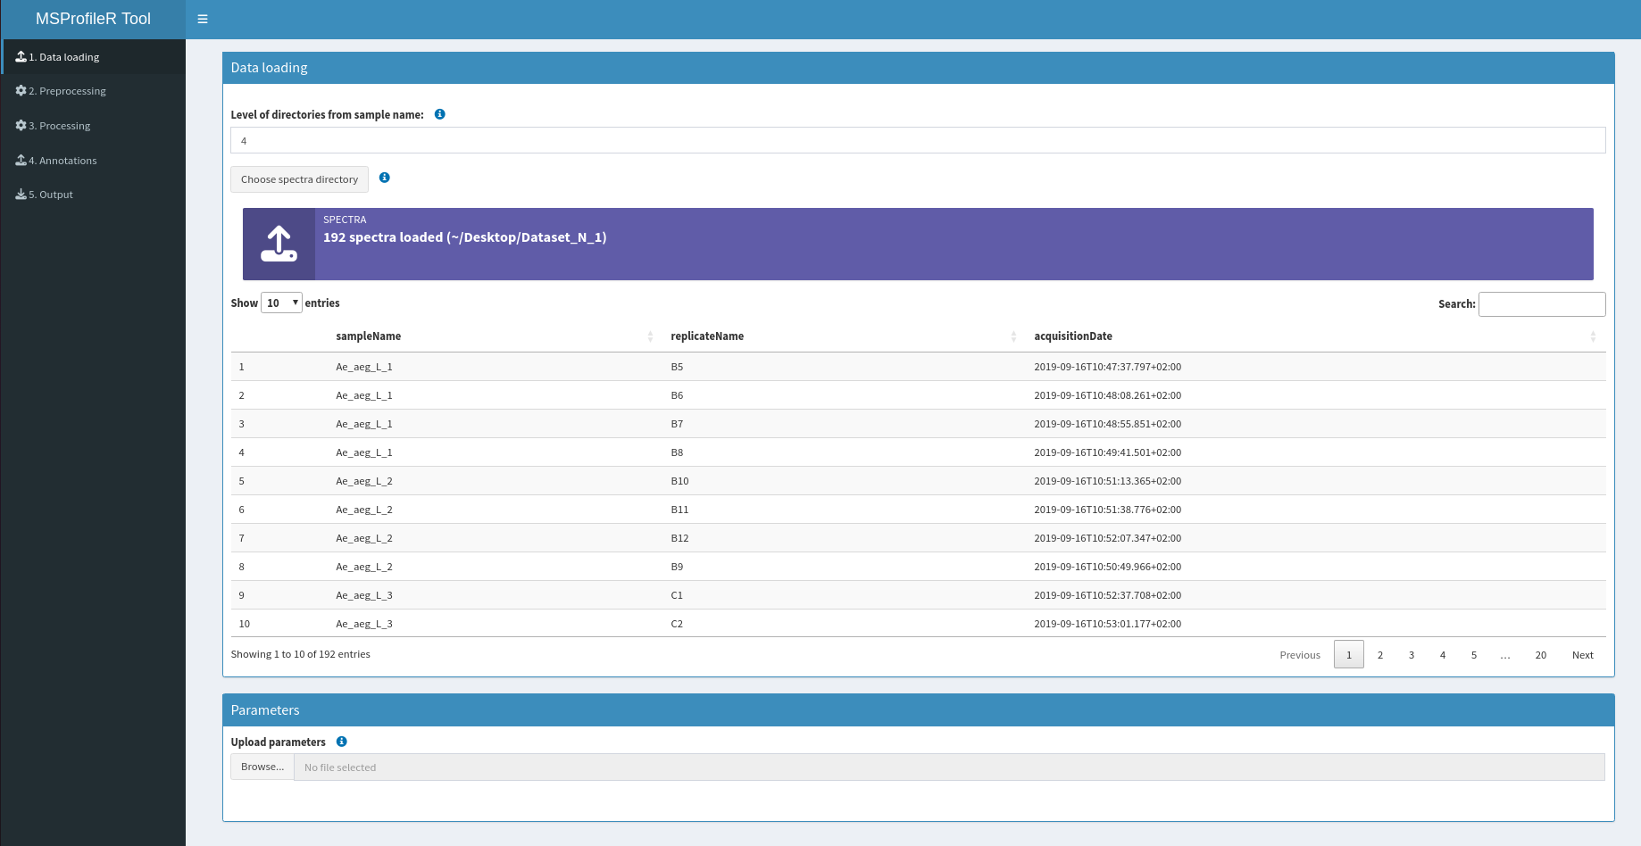
A
B
C
Supplementary Figure S1: User interface of the "Data loading" (A) tab. This window was divided into two panels, the data loading (B) including the determination of the level of the spectra path from the directories generated by MALDI-TOF MS and the spectra selection, and the parameter panel (C) allowing to upload and to set the same parameters used in a precedent analysis. Spectra from dataset N°1 were used.

