Slide 1
Sustainable Research Software
Shoaib Sufi, Community Lead SSI, Software in Polar Research Workshop 7th Feb 2024

Slide 2
Slides licensed under CC BY 4.0 - https://creativecommons.org/licenses/by/4.0/
You are free to reuse any uncredited slides, crediting
Sufi, Shoaib (2024).
Sustainable Research Software
10.5281/zenodo.10610747
(for slides which are credited please check)

Slide 3
What is Research Software?

Slide 4

Inclusive definition
All code and software artifacts that are used, produced, or might be related to the research process in one or more stages of the research lifecycle and regardless of the layer of the software stack.
Software that was not necessarily developed with the intention of being part of research, for example, a library for interfacing with a sensor, or software that ceased to be exclusive to the research domain, for example, certain programming languages developed in research projects, e.g., Python, Scala, R.
Exclusive definition
Well identified software that is part of the research discovery process, which might require specialized domain knowledge and is by itself a contribution to science and research.
Software that was developed with the intention of being part of research.
Defining Research Software: a controversial discussion, Gruenpeter et al, 2021, https://zenodo.org/record/5504016
What is Research Software?

Slide 5
What is Sustainable Research Software?

Slide 6














Sustainable research software
Making research software sustained in the long term
                Funding
                People - Recognition & Reward (e.g., career paths)
                Citation
                Training
                Reproducibility / Open Research
                Many organisations now have a focus on this area and are working together to improve the understanding and funding of research software
Software as a first class research object

Slide 7
Key advocacy

Slide 8
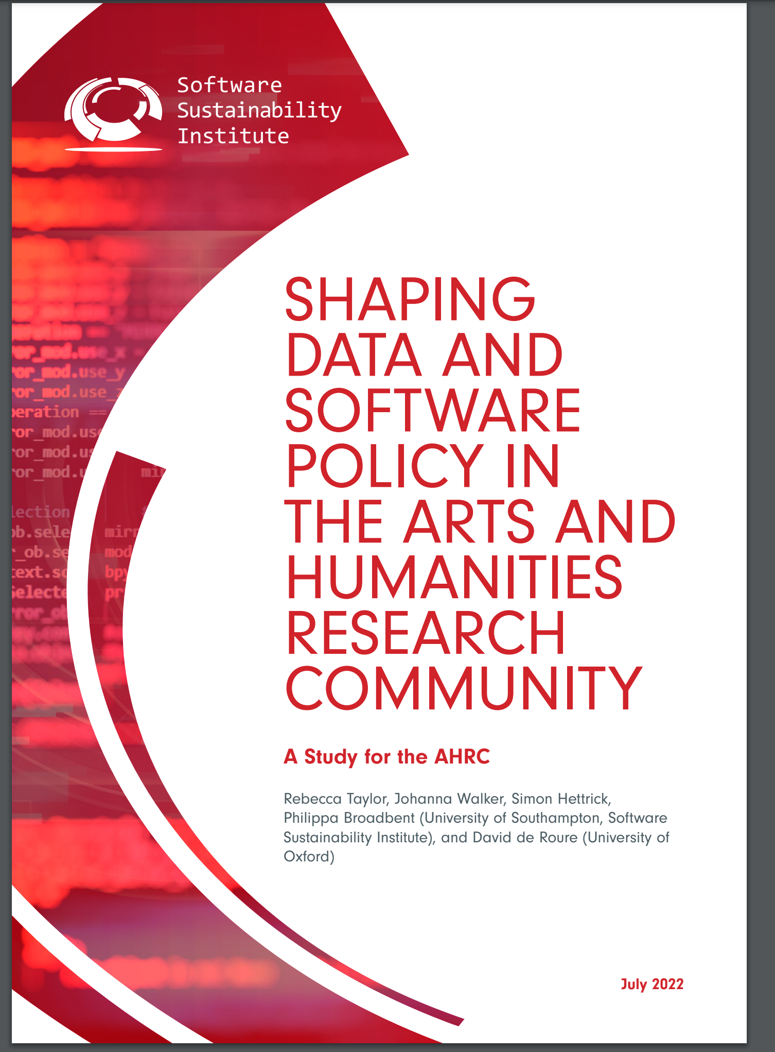

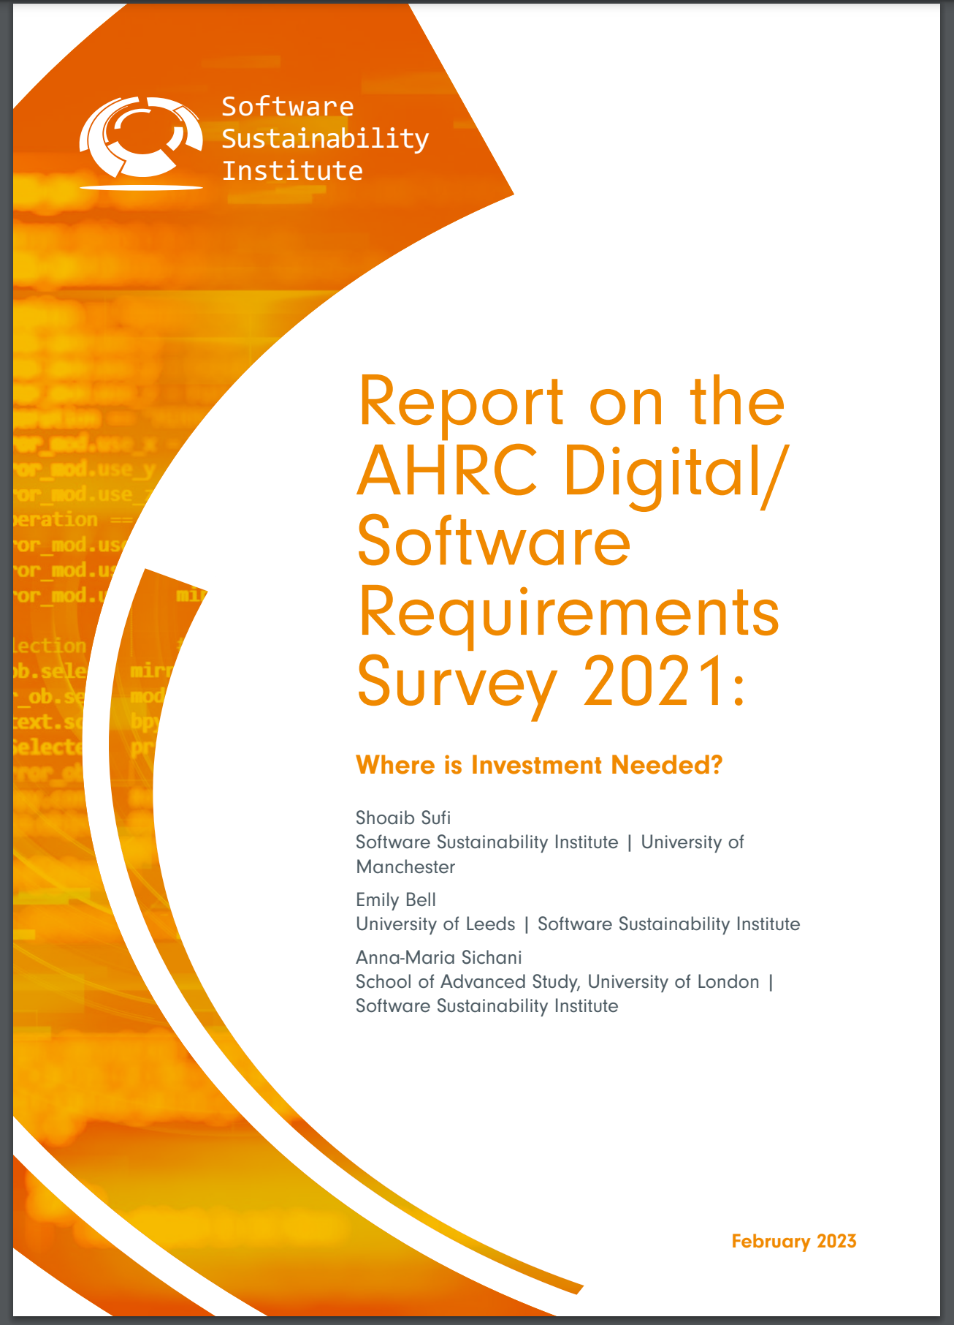


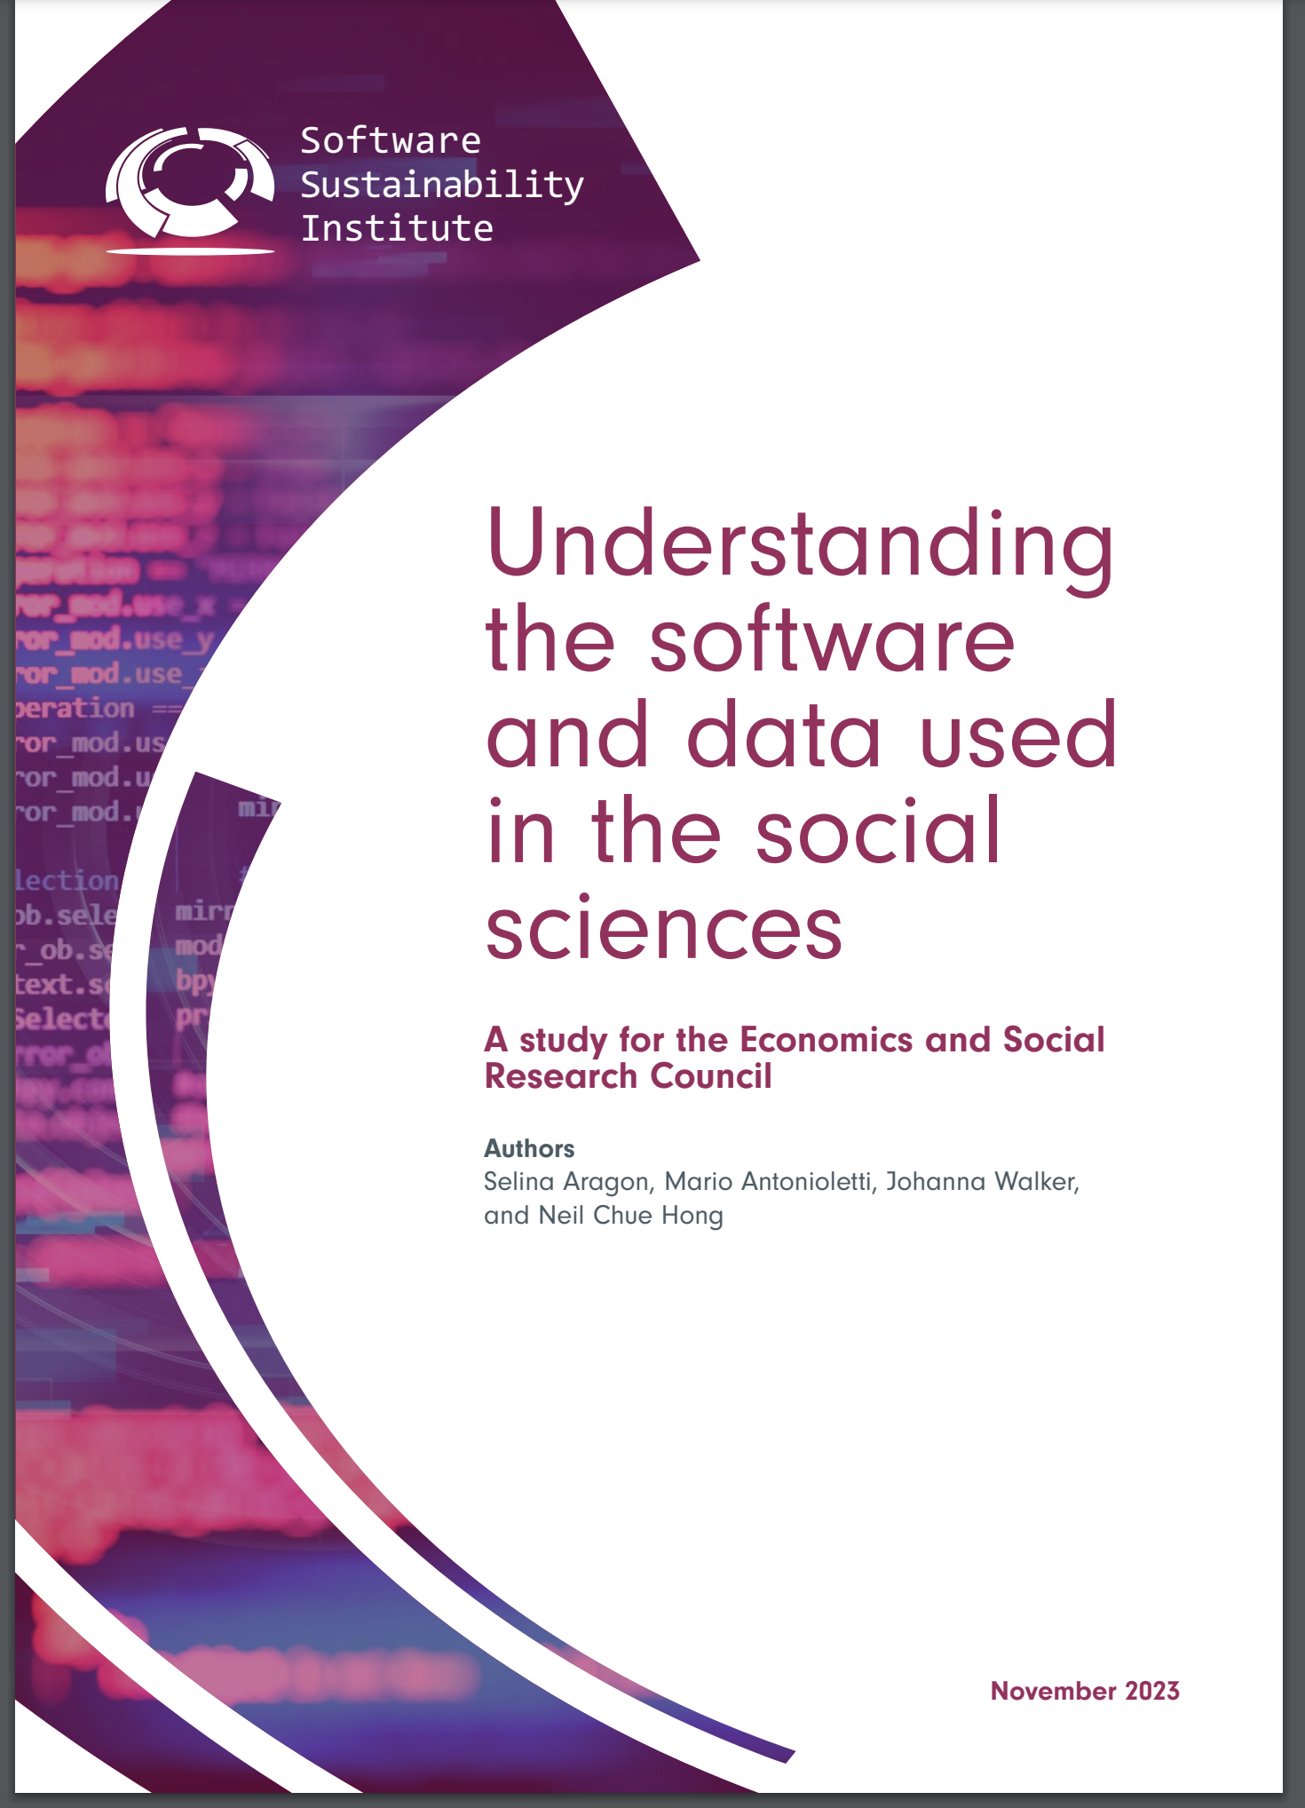

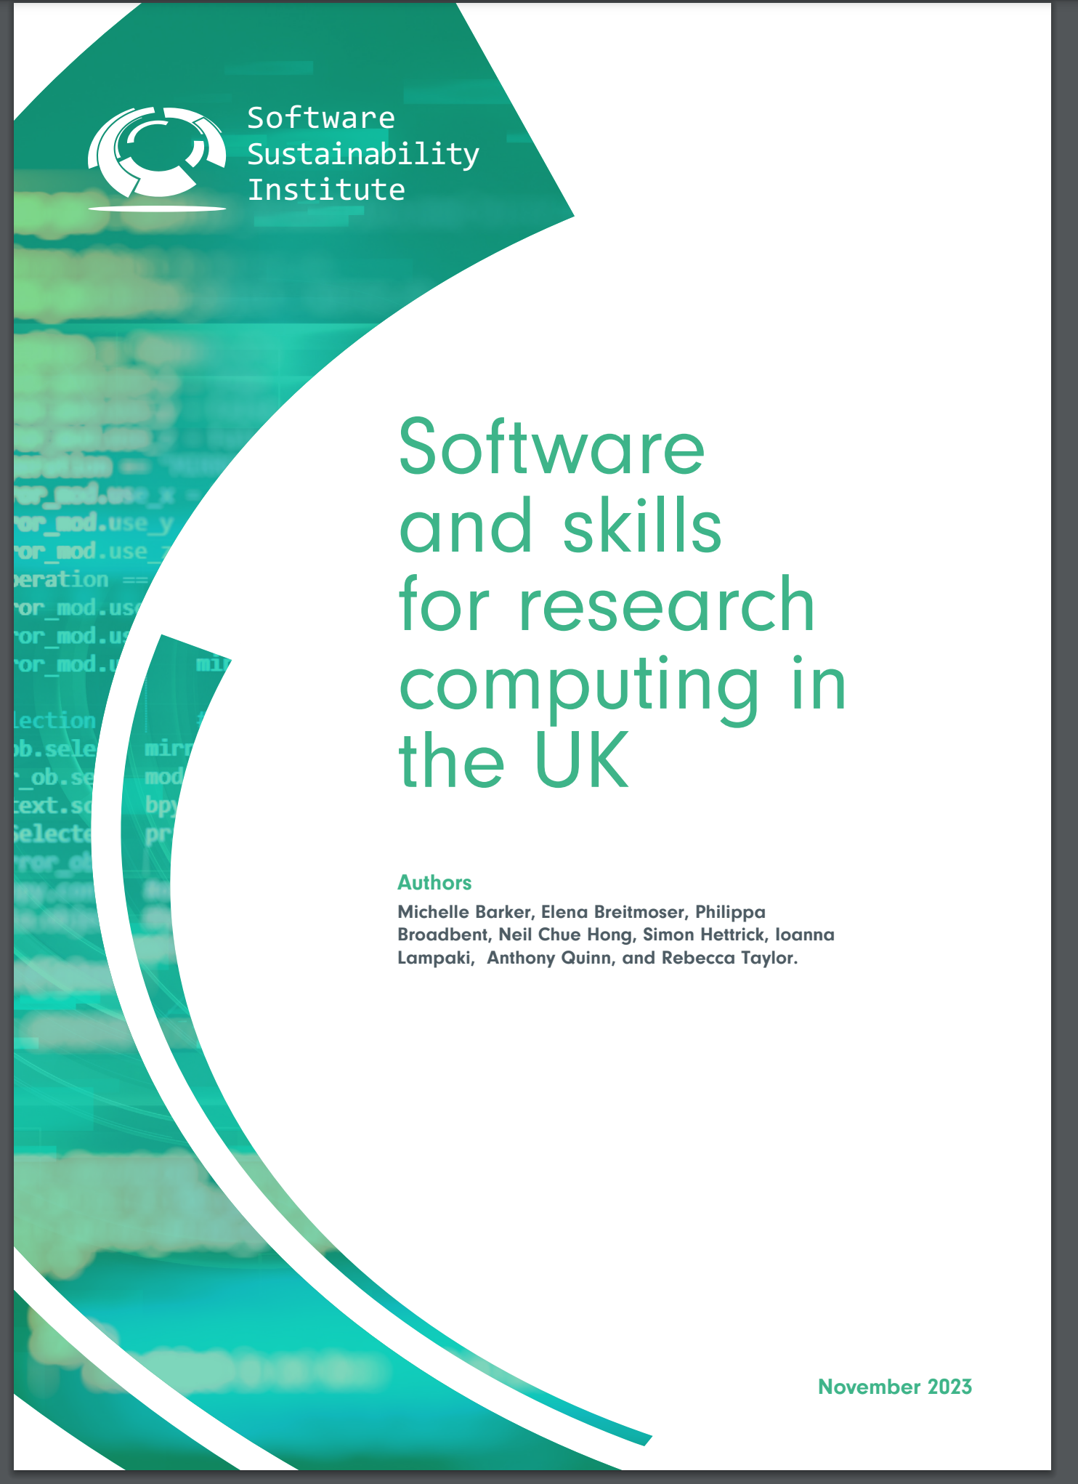








Advocacy
International
www.unesco.org/en/open-science/about?hub=686
National
(2022)
“Recommendation:
Invest in training, education, digital literacy and capacity-building to support open science” (2021)
“It's impossible to conduct research without software, say 7 out of 10 UK researchers” (2014)
“In addition, the re-use of data is increasingly and critically dependent on the availability of related metadata, as well as bespoke algorithms, workflows, models, and software (including code), which are essential for their interpretation.” (2021)
(2023)
S.J. Hettrick et al, UK Research Software Survey 2014
zenodo.org/records/1183562
(2023)
Digital skill development
Recognition & Reward
(2023)
legalinstruments.oecd.org/en/instruments/OECD-LEGAL-0347
https://www.software.ac.uk/our-outputs/reports
Notes:
Lot’s learn on the job, not so many on courses and some did not have the time – and there was a need for recognition and reward for developing software

Slide 9
Organisational Policies

Slide 10
Organisational Policies
This is BAS – could be other R&D led organisations
Mission – BAS is a research driven organisation recognised for:
Operational professionalism and innovation in everything we do
Developing our staff to reach their full potential
Terms of Reference
Foster and develop a skilled and adaptable workforce that can meet future challenges
Ensure that BAS communicates its work and engages with the wider scientific community, decision maker and general public
Strategy –
The provision and management of large-scale polar infrastructure assets, services and facilities in the most cost-effective and efficient way possible.
Science Strategy Exec Group –
foster a vibrant and fertile intellectual environment within BAS, in which all scientists are challenged to develop bold and exciting scientific ideas, and to develop their personal and professional skills;
Developing Staff Skills

Slide 11
Developing Computational Skills

Slide 12
Confidence in your coding
“My code is not as good as a proper software engineer”
“imposter syndrome”
“learnt on the job”
How do you gain confidence – or even know where you are at?
What about coding skills related to better group working?

Slide 13






Research Community Coding initiatives
coderefinery.org
carpentries.org
ourcodingclub.github.io

Slide 14
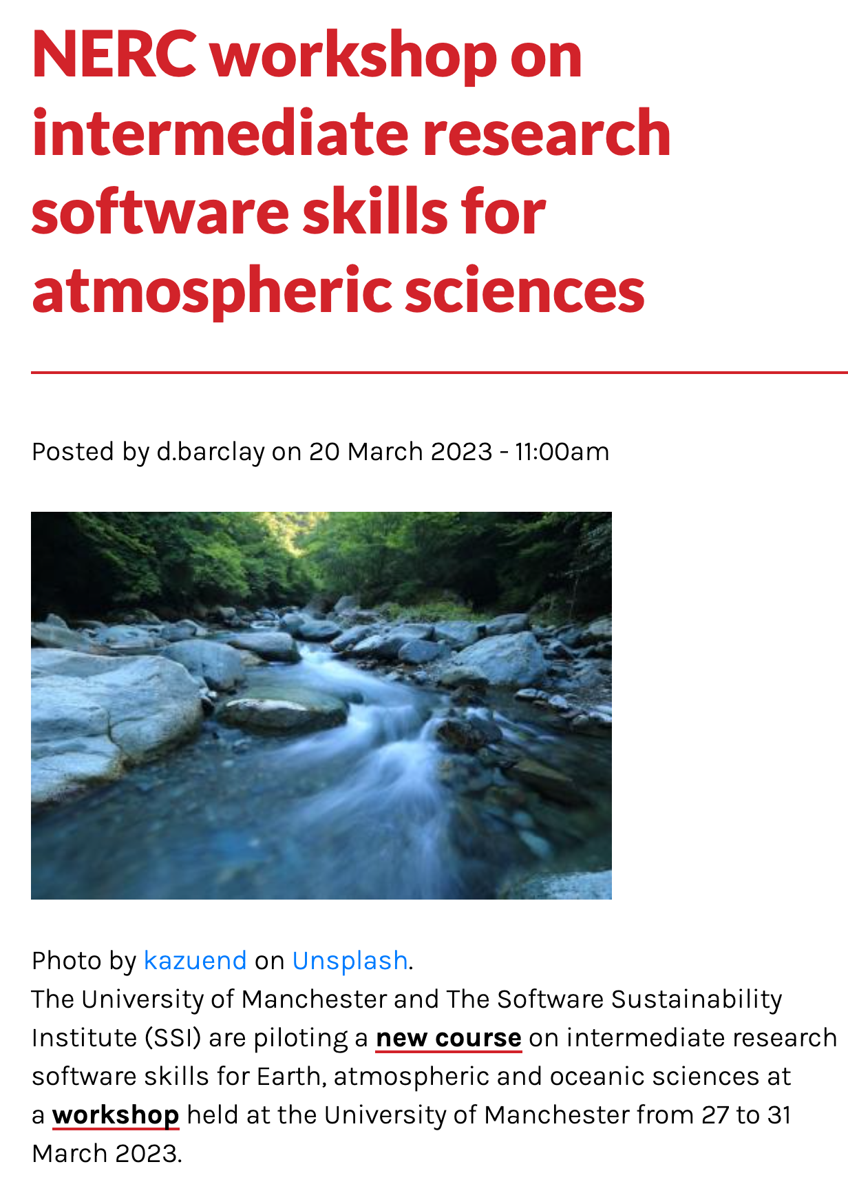

Software Carpentry
Develop Skills
  Introductory – core lessons
    software-carpentry.org/lessons/
  Intermediate
    https://carpentries-incubator.github.io/python-intermediate-development/
Package and deliver skills
  Lesson development
    https://carpentries.github.io/lesson-development-training/
  Instructor training
    https://carpentries.github.io/instructor-training/
Infrastructure
  https://carpentries-incubator.org/
Integrated development environments
Verifying software correctness
Software design paradigms and architecture
Code review to improve software quality
Best practices in documenting, licensing, tracking issues, maintaining, releasing and supporting software
60 applicants 30 places!
A lesson as a unit of sharing
carpentries-incubator.github.io/python-intermediate-development-earth-sciences/00-setting-the-scene/index.html
Notes:
Material is freely licensed

Slide 15
Beyond learning
Exec Committee
Instructor trainer
Curriculum developer
Organiser
Instructor
Commitment
Helper
carpentries.org
Attendee
Complexity

Slide 16

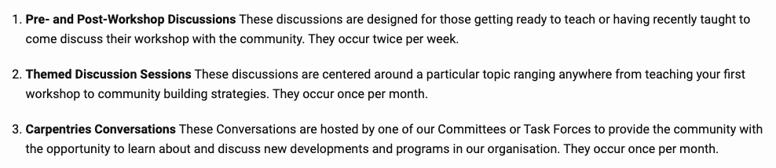


Teaching Community
carpentries.org/community_discussions
Join The Carpentries on Slack.
4400+ users are registered so far.
swc-slack-invite.herokuapp.com

Slide 17
Open Research & FAIR

Slide 18
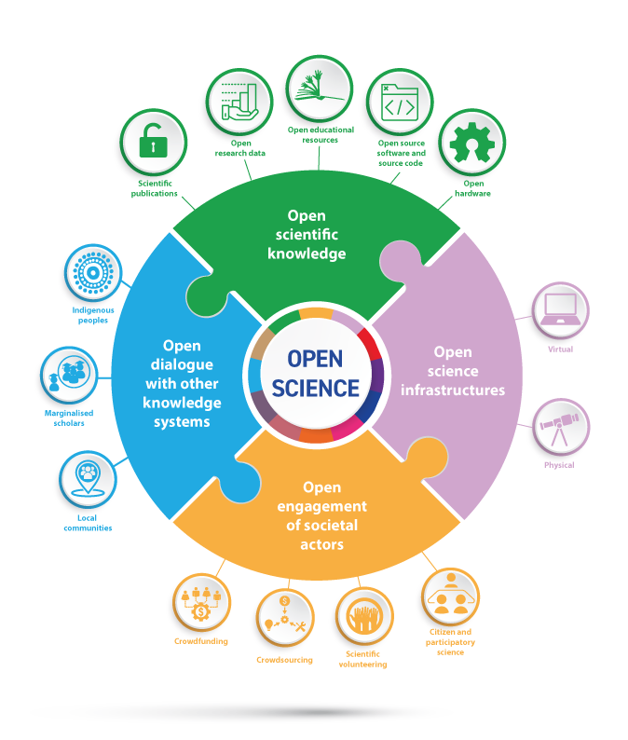
Open Science/Research
Open Scientific Knowledge:
    Open source software and source code
    Open research data
UNESCO Pillars of Open Science (2021)
By UNESCO.org - Understanding open science (p:6) followingUNESCO Recommendation on Open Science.Documents available in:Understanding open science : English, Français,UNESCO Recommendation on Open Science: English, Français, Español, Português, العربية, 汉语, Русский язык, монгол хэл ., CC BY-SA 4.0, https://commons.wikimedia.org/w/index.php?curid=130456946
Transparency | Openness | Verification | Reproducibility => Research Integrity

Slide 19
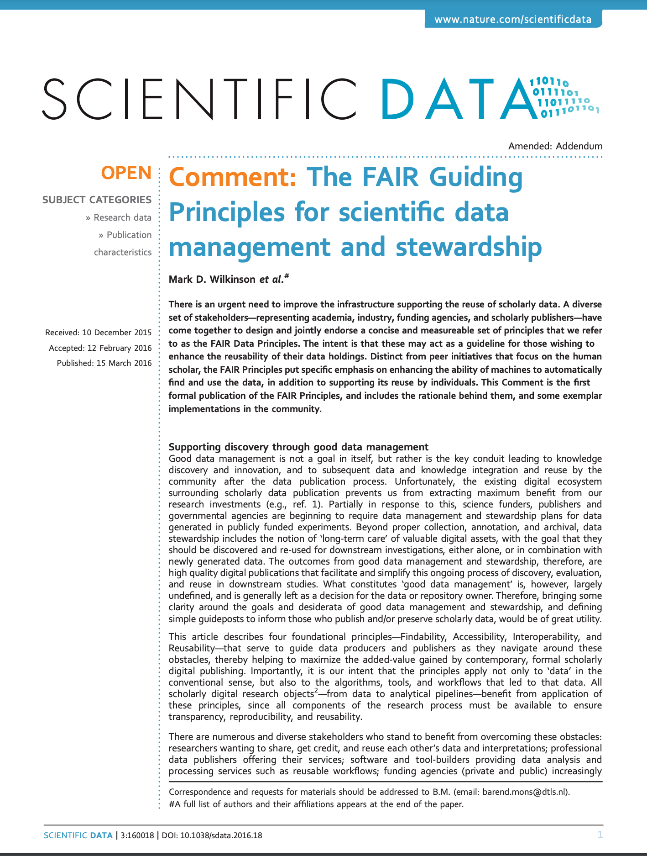
FAIR Data
Findable
  Unique id, metadata, Indexed
Accessible
  Note this is not the same as Free (where FAIR differs from Open)
  Open protocols, accessible metadata
Interoperable
  Metadata – language, vocabularies, references
Reusable
  Description, license, provenance, domain standards

Slide 20
FAIR Principles for Research Software
F: Software, and its associated metadata, is easy for both humans and machines to find
F1. Software is assigned a globally unique and persistent identifier.
F1.1. Components of the software representing levels of granularity are assigned distinct identifiers.
F1.2. Different versions of the software are assigned distinct identifiers.
F2. Software is described with rich metadata.
F3. Metadata clearly and explicitly include the identifier of the software they describe.
F4. Metadata are FAIR, searchable and indexable.
A: Software, and its metadata, is retrievable via standardized protocols.
A1. Software is retrievable by its identifier using a standardized communications protocol.
A1.1. The protocol is open, free, and universally implementable.
A1.2. The protocol allows for an authentication and authorization procedure, where necessary.
A2. Metadata are accessible, even when the software is no longer available.
I: Software interoperates with other software by exchanging data and/or metadata, and/or through interaction via application programming interfaces (APIs), described through standards.
I1. Software reads, writes and exchanges data in a way that meets domain-relevant community standards.
I2. Software includes qualified references to other objects
R: Software is both usable (can be executed) and reusable (can be understood, modified, built upon, or incorporated into other software).
R1. Software is described with a plurality of accurate and relevant attributes.
R1.1. Software is given a clear and accessible license.
R1.2. Software is associated with detailed provenance.
R2. Software includes qualified references to other software.
R3. Software meets domain-relevant community standards.
Chue Hong, N. P., et al. (2022). FAIR Principles for Research Software version 1.0. (FAIR4RS Principles v1.0). Research Data Alliance. DOI: https://doi.org/10.15497/RDA00068
Slide courtesy of - Chue Hong, Neil (2023). - Introduction to research software policies - https://doi.org/10.6084/m9.figshare. 24233617

Slide 21
Software Quality

Slide 22


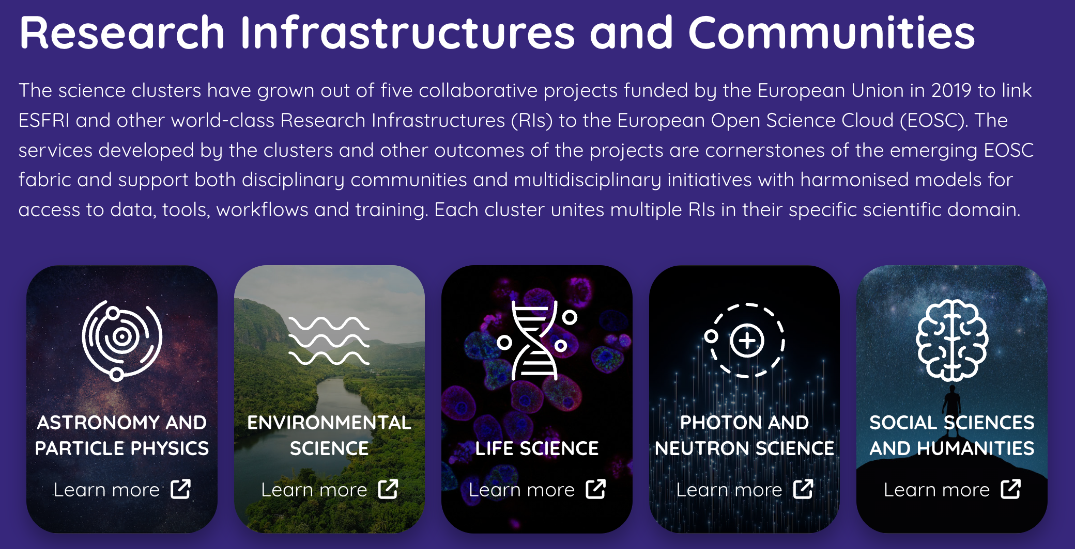


EVERSE
… starts March 2024 (Horizon Europe project – 18 partners, 3 years, €6.8M)
Research Software Quality
  RSQKit (built on the idea of RDMKit – https://rdmkit.elixir-europe.org/)
    Research Software Quality practices
    Relevant to the European Open Science Cloud (EOSC) Science clusters
A research infrastructure (RI) is an organization that enables the research community to use specific facilities, resources and services in order to accelerate scientific achievements and promote sustainable research
26 Earth Systems RI’s
envri.eu
envri-hub.envri.eu

Slide 23
Research Software Engineering

Slide 24
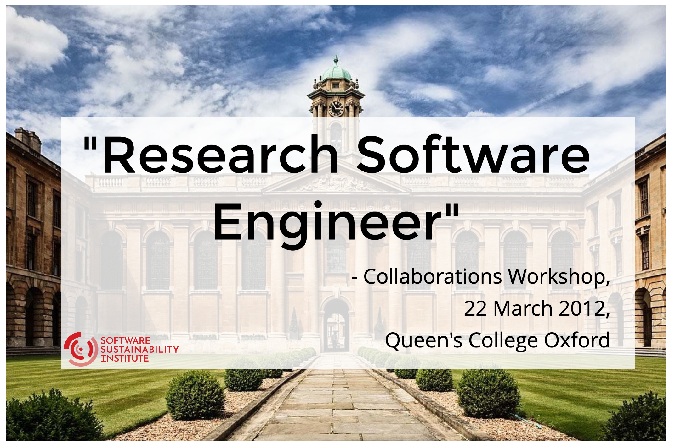
Image courtesy of – Hettrick, Simon (2023). - Research software, research culture and RSEs - https://slides.com/simonhettrick/research-software-research-culture-and-rses-2023

Slide 25
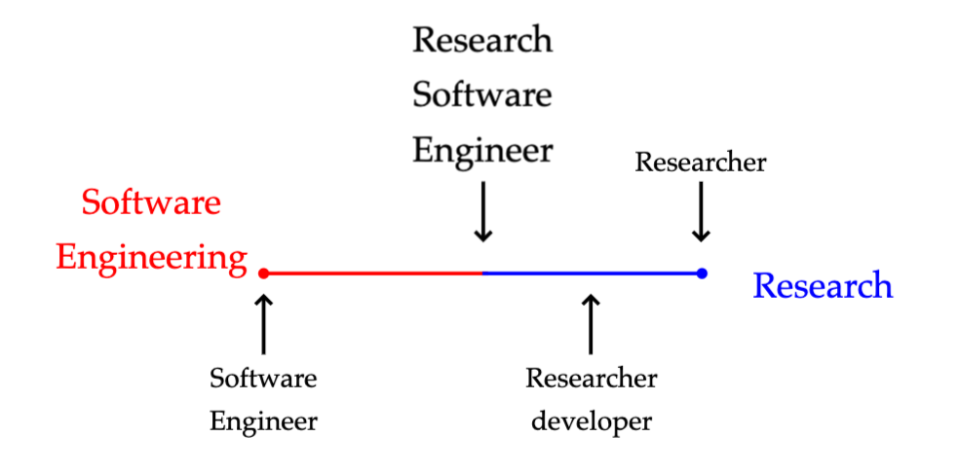
Application
Development
Arts &
Humanities
Modelling &
Simulation
Embedded
Social
Sciences
Data
Science
Inter-disciplinary
Life
sciences
Porting &
Optimisation
Central
Team
DevOps /
ResOps
Mathematical &
Physical Sciences
Slide courtesy of - Chue Hong, Neil (2023). Research software engineering – from “what” and “where” to “why” and “how” - https://doi.org/10.6084/m9.figshare.24319828
Notes:
With apologies to my colleague Simon Hettrick, whose slide I’ve stolen, the problem is that we often try and fit RSEs into neat categories.
But what makes RSEs great is that they don’t fit in boxes!

Slide 26
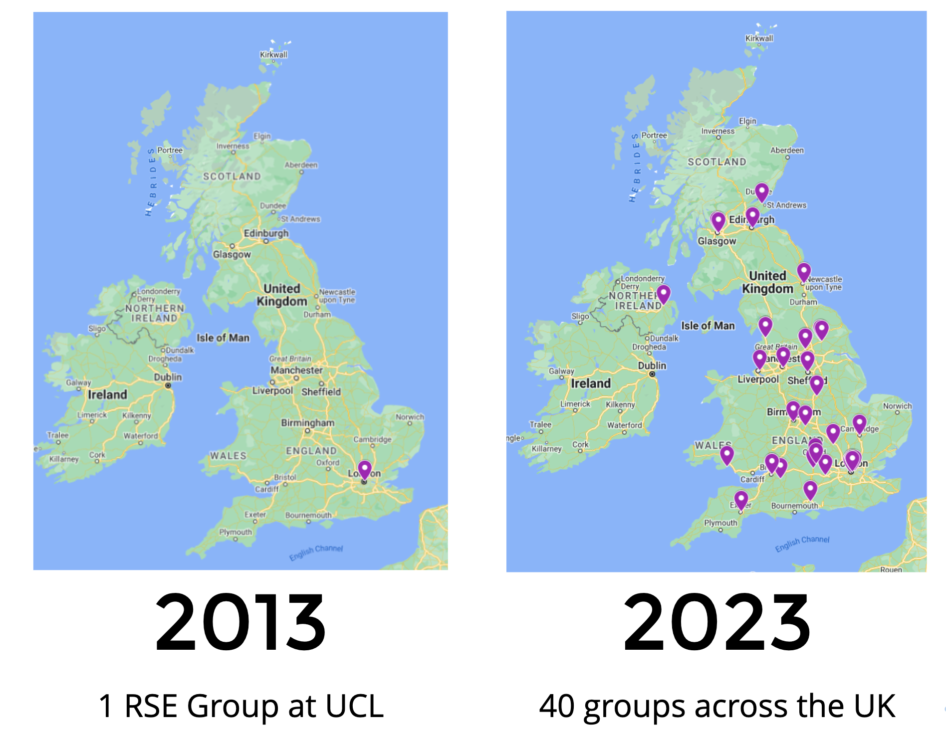
The Growth in Institutional
Research Software Engineering Groups
Image courtesy of – Hettrick, Simon (2023). - Research software, research culture and RSEs - https://slides.com/simonhettrick/research-software-research-culture-and-rses-2023

Slide 27


RSE Resources
Maturing
rsetoolkit.github.io/roles/new-rse
RSE Careers
https://www.esciencecenter.nl/news/the-netherlands-escience-center-releases-job-profile-and-role-description-for-research-software-engineers/
Definition of RSE - https://zenodo.org/records/7994286
5 Level’s of role description 1-3 RSE and 4&5 SRSE - https://zenodo.org/records/7805870
Similar work done at UCL and Manchester

Slide 28

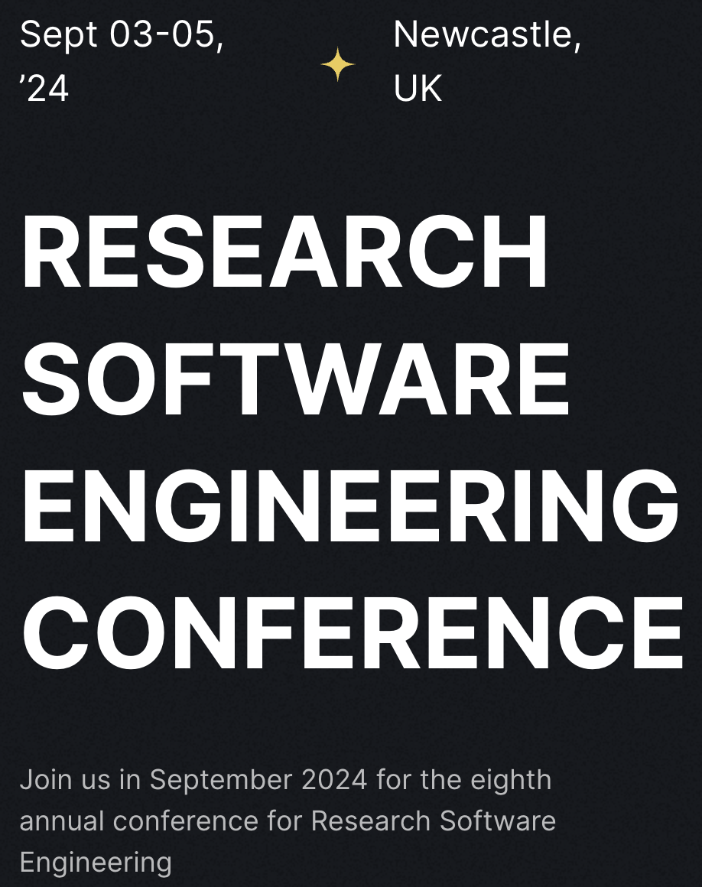
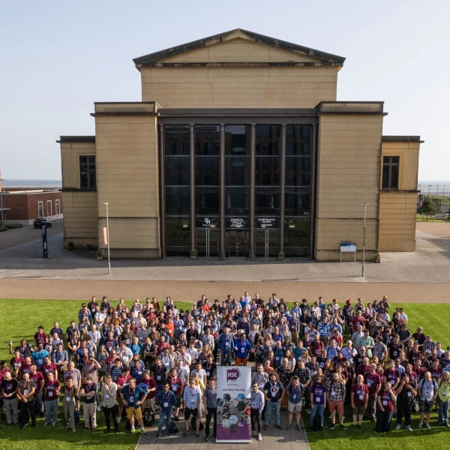
RSECon24
rsecon24.society-rse.org
300-400 people
Learn about the latest tools and techniques.
Forge valuable connections with fellow RSEs.
Showcase your work and get feedback from experts.
RSECon23

Slide 29
SSI Fellows

Slide 30
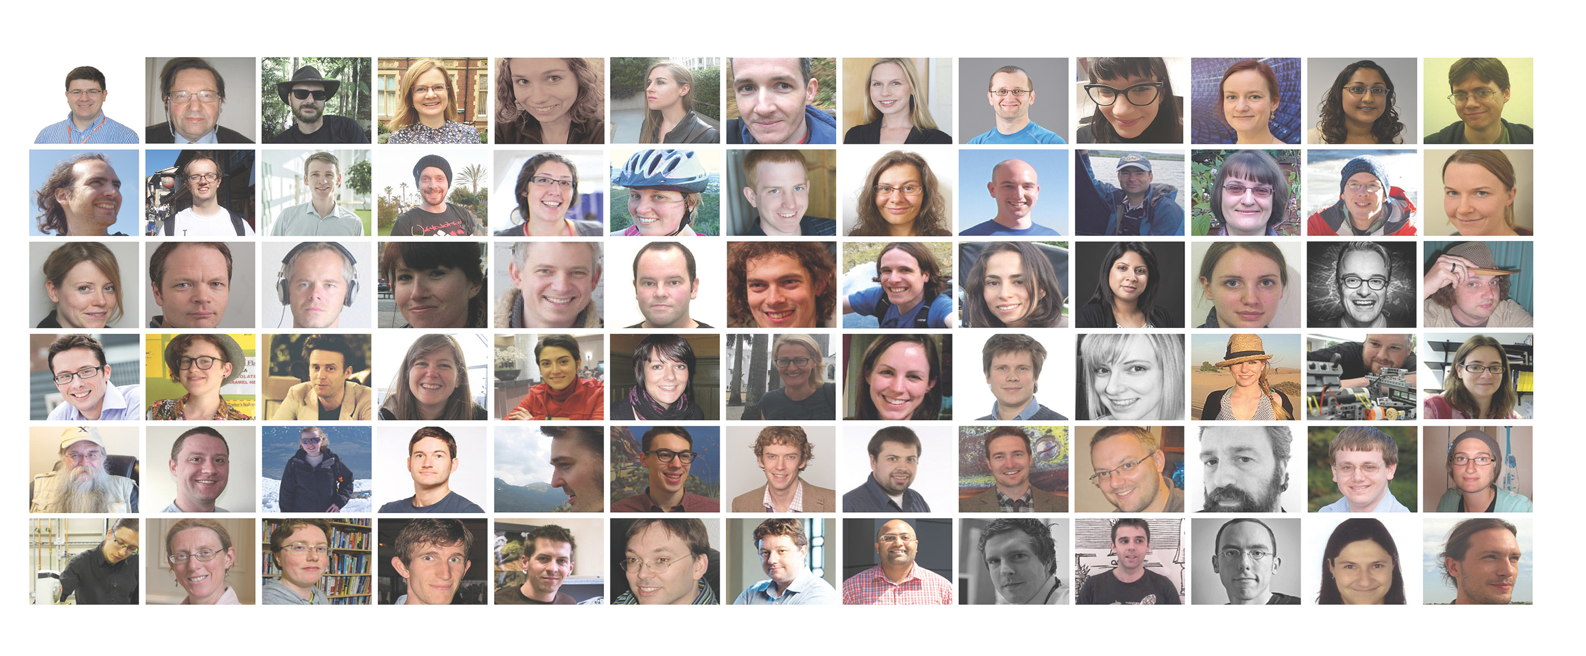
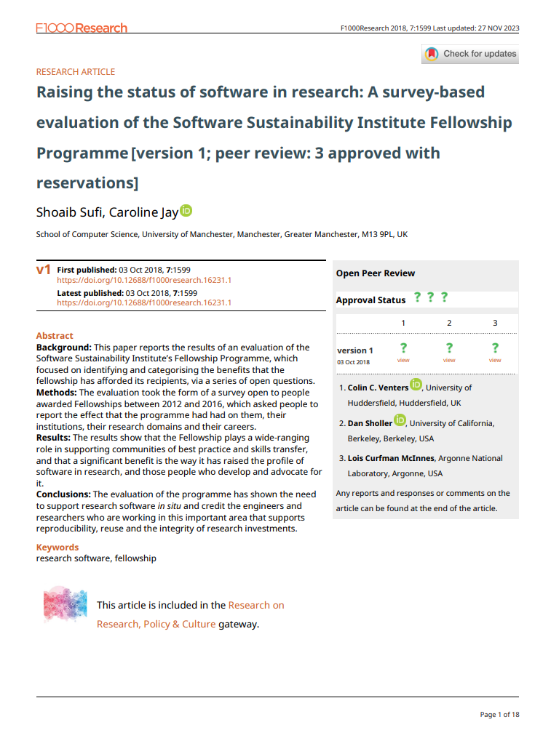
SSI Fellows
Running cohorts since 2012
Now have 210+ Fellows
We give them £3K funding
  They have a plan for software in research in their area
  Different Career stages & domains
  We give them networking & collaboration opportunities
  90% said it made a difference to them & their domains
  70% said it improved their careers

Slide 31




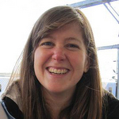
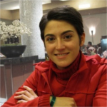

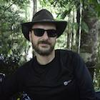

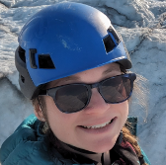
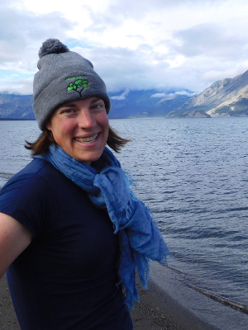
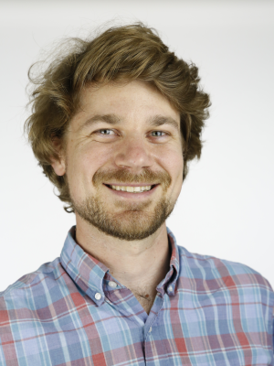


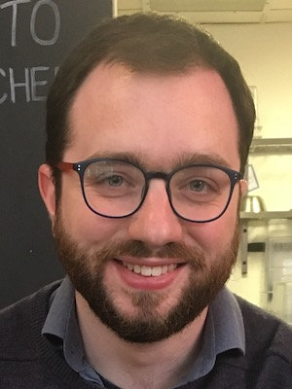
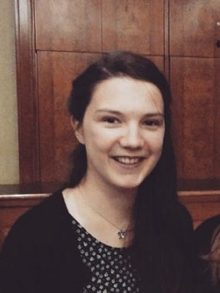
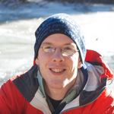
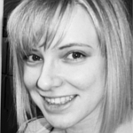
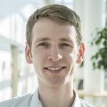
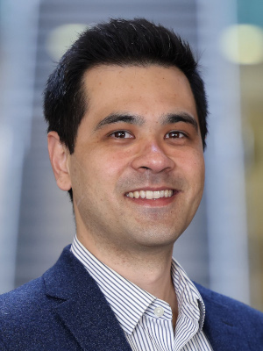
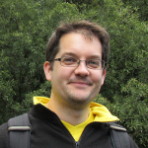

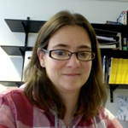
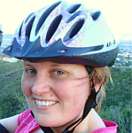

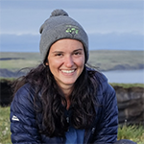
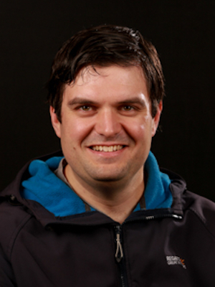

Earth Systems SSI Fellows
Kathryn Rose
Glaciology, Glacial Geomorphology
Kayla Lacovino
Volcanology
John Hill
Environmental Modelling
Sammie Buzzard
Glaciology
Isla Myers-Smith
Ecology
Philipp Boersch-Supan
Ecology
Allen Pope
Glaciology
Leanne May Wake
Sea-Level change
Craig MacLachlan
Climate Science
Stuart Geoscience
Grieve
Jessica Ward
Ecology
Leonardo Uieda
Geophysics
Melody Sandells
Snow and soil moisture
Bethan Davies
Glacial Geology
Thomas Etherington
Ecology
Gergana Daskalova
Ecology
Colin Sauze
RSE - Oceanography
Picture by Elena Mozhvilo on Unsplash covered by the unsplash license

Slide 32
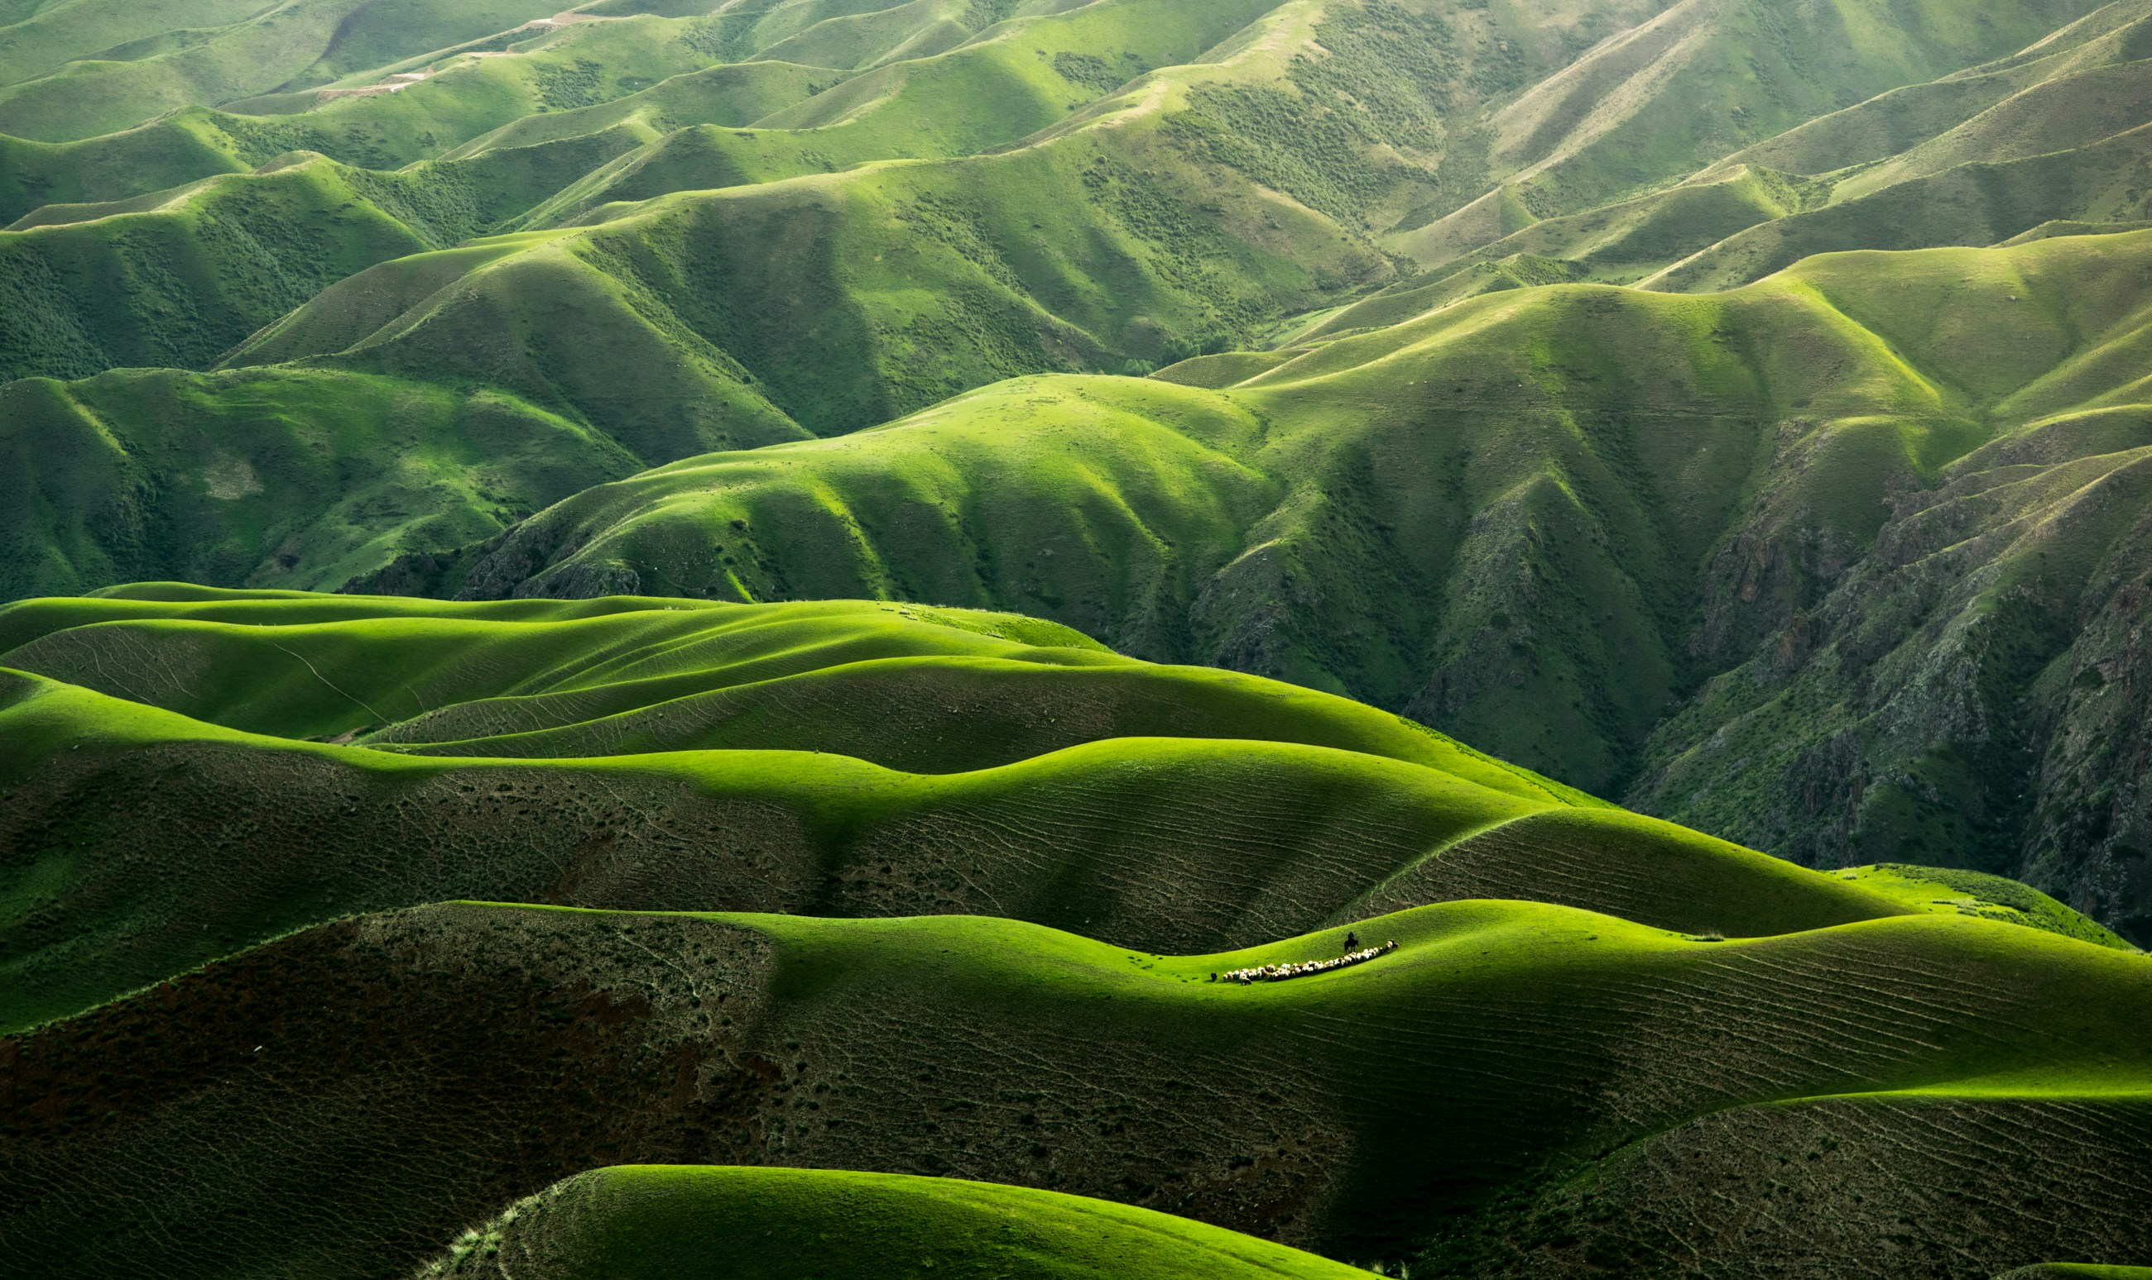
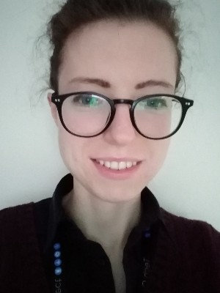

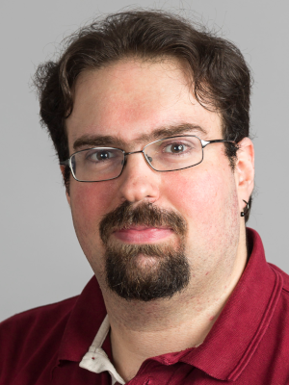
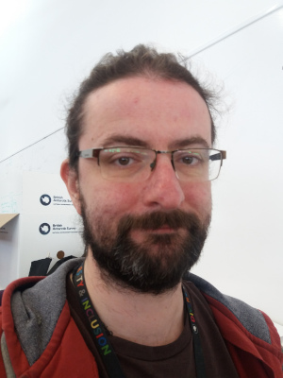
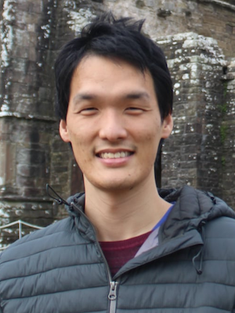

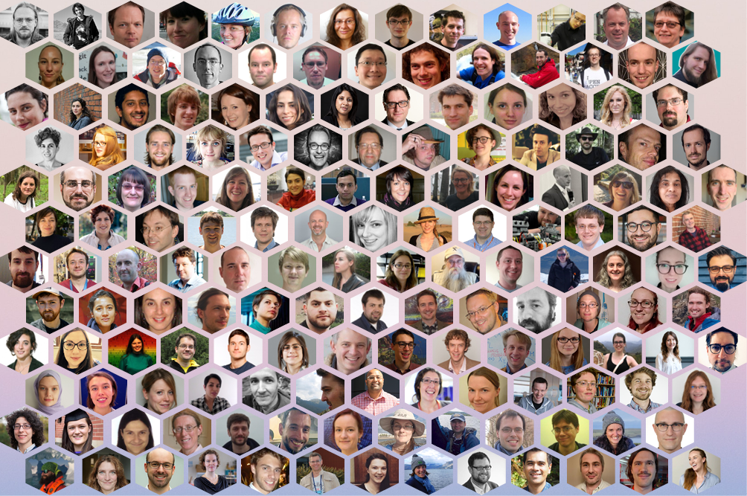
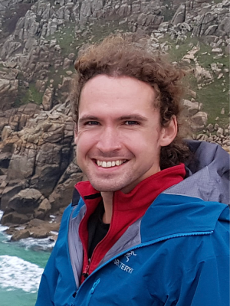
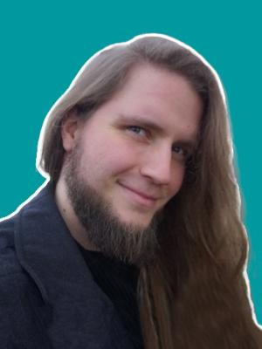
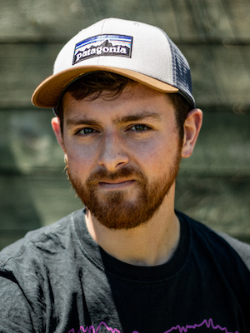
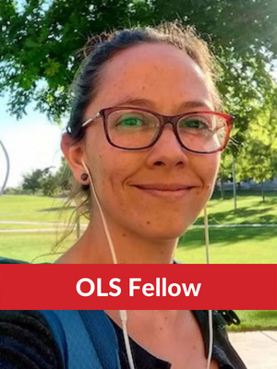
Earth Systems SSI Fellows 2
www.software.ac.uk/fellows
Profile
Social links
Mentions on the SSI website
Sadie Bartholomew
Atmospheric Science
Luke Abraham
Climate modelling
James Byrne
RSE Lead –
Polar Research
Michael Tso
Environmental
data science
Sam Harrison
Geospatial Modelling
Jesper Dramsch
ML –
Weather Models
David Wilby
RSE –
Polar Research
Andrea Sánchez Tapia
Ecology
Applications for Fellows 2025 planned to open in August/Sept 2024
Photo by Qingbao Meng on Unsplash

Slide 33
Sustainable practices

Slide 34
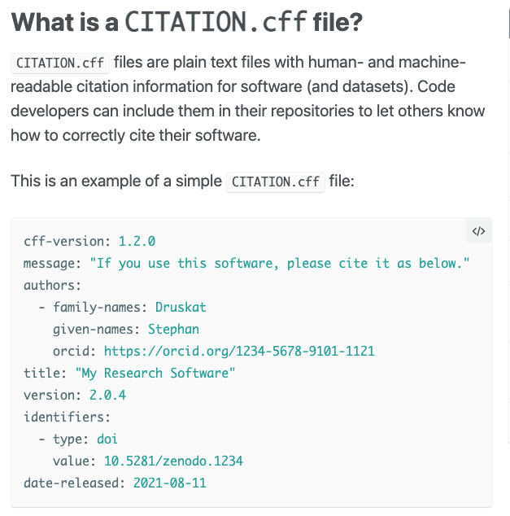



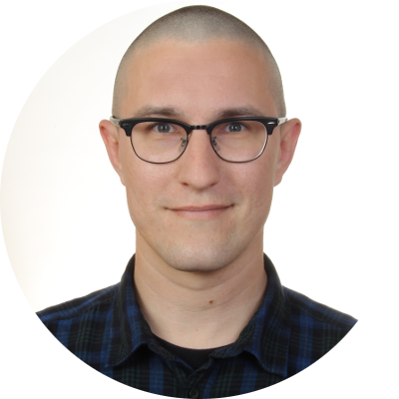

Citing Software
Citation File Format (CFF)
A standard for being able to cite software
A file which goes alongside a ReadMe, License, Contributing, Code of Conduct file
citation-file-format.github.io

Slide 35
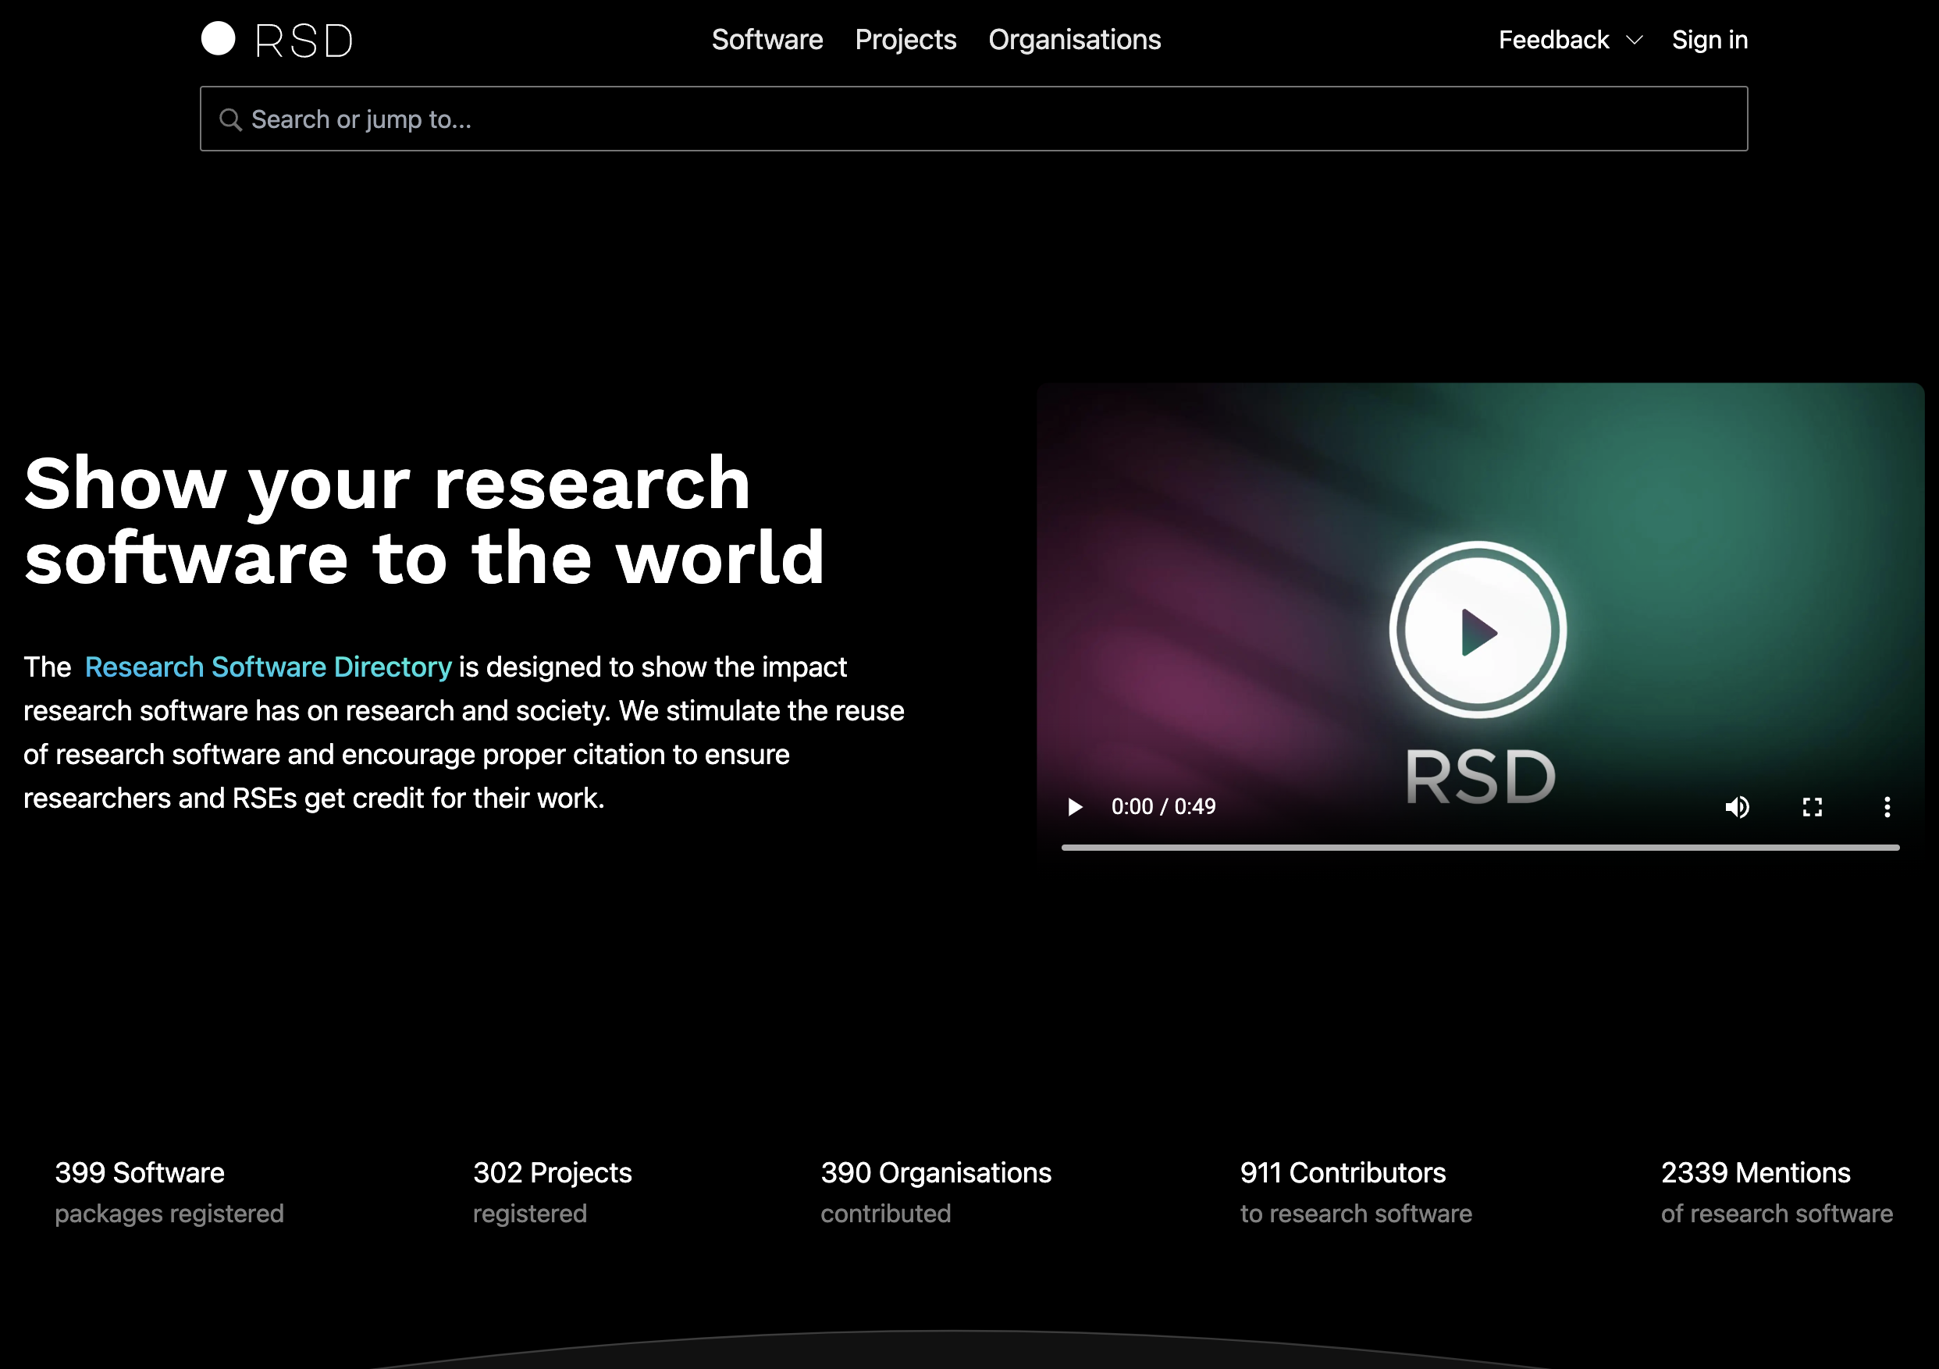



Software Directories
Making Software
Findable
Visible
Related projects & organisations
Mentions
Open Source
  github.com/research-software-directory
e.g.
research.software

Slide 36


Software Papers
Write a paper about the software and then cite that
E.g. JoSS
  Developer friendly
  Open access
  No APC
  Authors retain copyright
joss.theoj.org
Why
Citations as academic career currency
How
Simple submission workflow

Slide 37




Other practices
Special Interest Groups
Training oriented search portal
Metadata for Reproducibility
Making Workflows visible
UK Health Security Agency
Software Community of Practice
Networking across the organisation
Share tools, practices, projects
Discovery & reuse of computational workflows
Aiding accessibility & interoperability
Originally for Life Science but Open
Courses
Events
Learning pathways
Etc
Life Science focused, Open Source
Others have their own version
www.researchobject.org/ro-crate/
Packaging research data with their metadata
From those working with a folder of data to data-intensive computational environments
Uses schema.org annotations in JSON-LD
workflowhub.eu
tess.elixir-europe.org
bit.ly/UKHSA-SCoP-2024
Not exhaustive – other work such as Turing Way, HiddenREF, Organisational Software & Open Research Policies, AEC, CODECHECK, ReproHacks, EDIA & the Research Software Community, Green Computing & RS …

Slide 38
Collaborations Workshop 2024 (CW24)

Slide 39



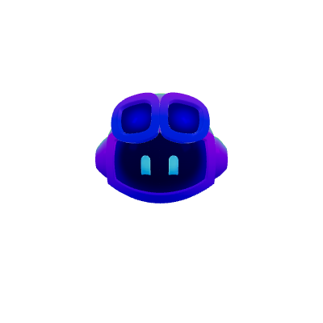
CW24
Collaborate | Network | Learn | Have fun!
Themes
  Environmental Sustainability
  AI/ML tools for science
  Citizen science
CW24 brings together:
  Researchers
  Developers
  Innovators
  Managers
  Funders
  Publishers
  Policy makers
  Educators
  & more
www.software.ac.uk/cw24
Interactive
  Discussions & speed blogging
  Collaborative ideas sessions
  Hack day with prizes
First Keynote confirmed
Arfon Smith
Product Lead GitHub Copilot
GitHub Octocat and CoPilot included here under fair use - https://octodex.github.com/faq/

Slide 40
In conclusion

Slide 41
Take Homes
Software in research is becoming more visible
  As are the people doing this
UKRI and other funders are taking note and are keen to understand
Software Citation now has more standards
Software directories are out in the wild as is their software
Many Earth systems researchers/RSE’s are engaged and are connecting to a wider selection of researchers interested in software
There are software related careers in research
You might really enjoy CW24!
There are community generated mechanisms for improving digital skills
There is a big push in the Open and FAIR space around data and software esp. for European funding.

Slide 42
Any Questions?
?

