Slide 1


Ocean-Cryosphere Exchange in Antarctica: Impacts on Climate and the Earth System
Impacts of ocean-ice interactions on climate
Speakers:
Dr Ruth Mottram, Senior Scientist, Danish Meteorological Institute
Dr Andrew Meijers, Polar Oceans Science Leader, British Antarctic Survey
Event: The Changing Poles: how Antarctic and Arctic science helps inform and prepare the EU for changes in sea level rise and global climate
Date: 24/1/2024
OCEAN:ICE is co-funded by the European Union, Horizon Europe Funding Programme for research and innovation under grant agreement Nr. 101060452 and by UK Research and Innovation

Slide 2
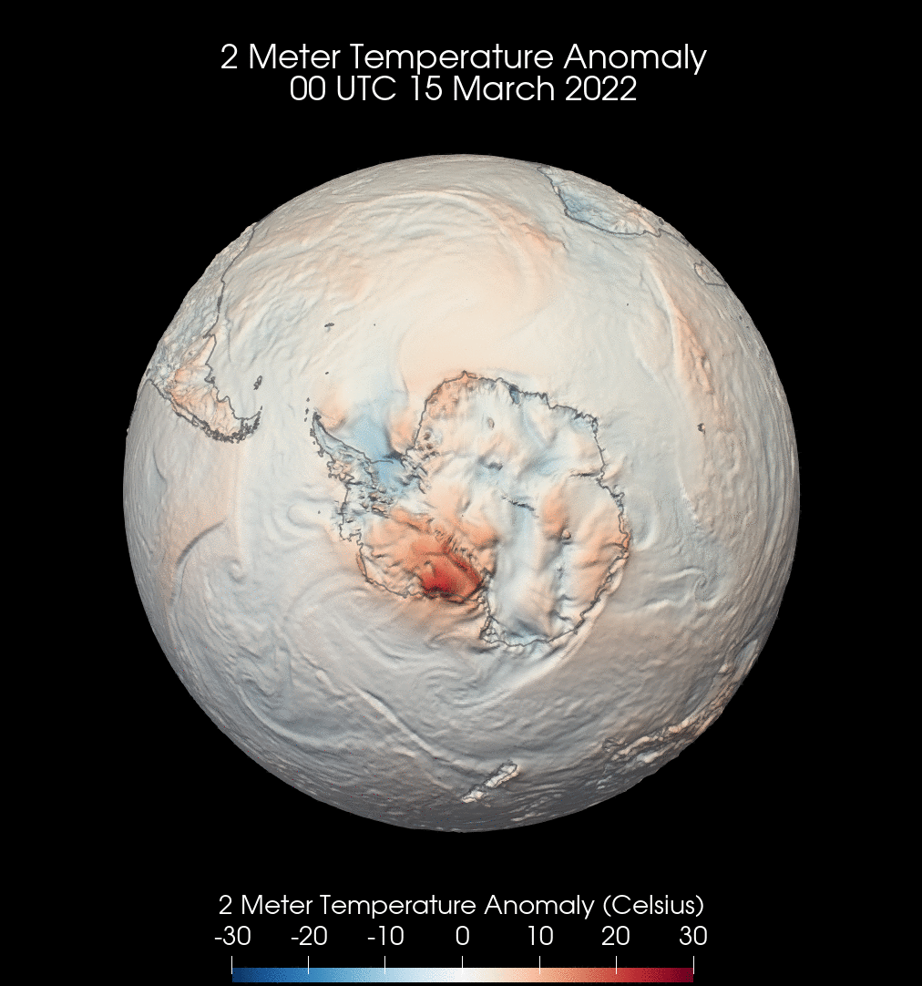
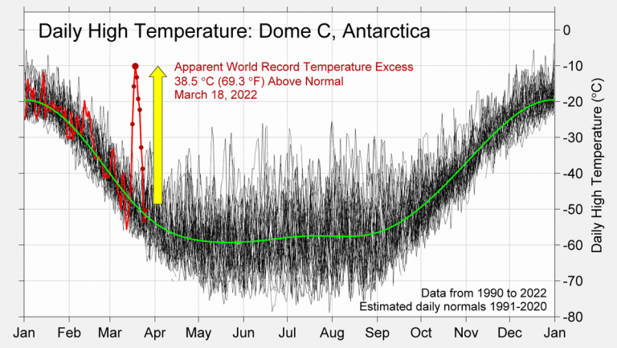
Climate Extremes in Antarctica
Data visualisation: DR Robert Rohde, Berkely Earth
Temperatures at the French-Italian Concordia station were 38.5°C above normal in March 2022 – a new world record.
Data visualisation: Prof Mathew Barlow, ERA5 via Copernicus climate change service
Climate model simulation with data assimilation

Slide 3
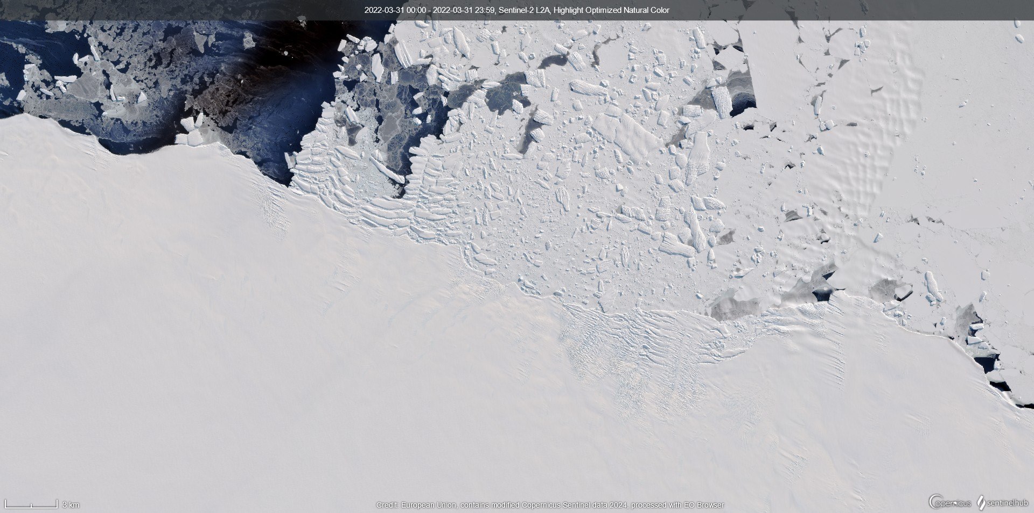
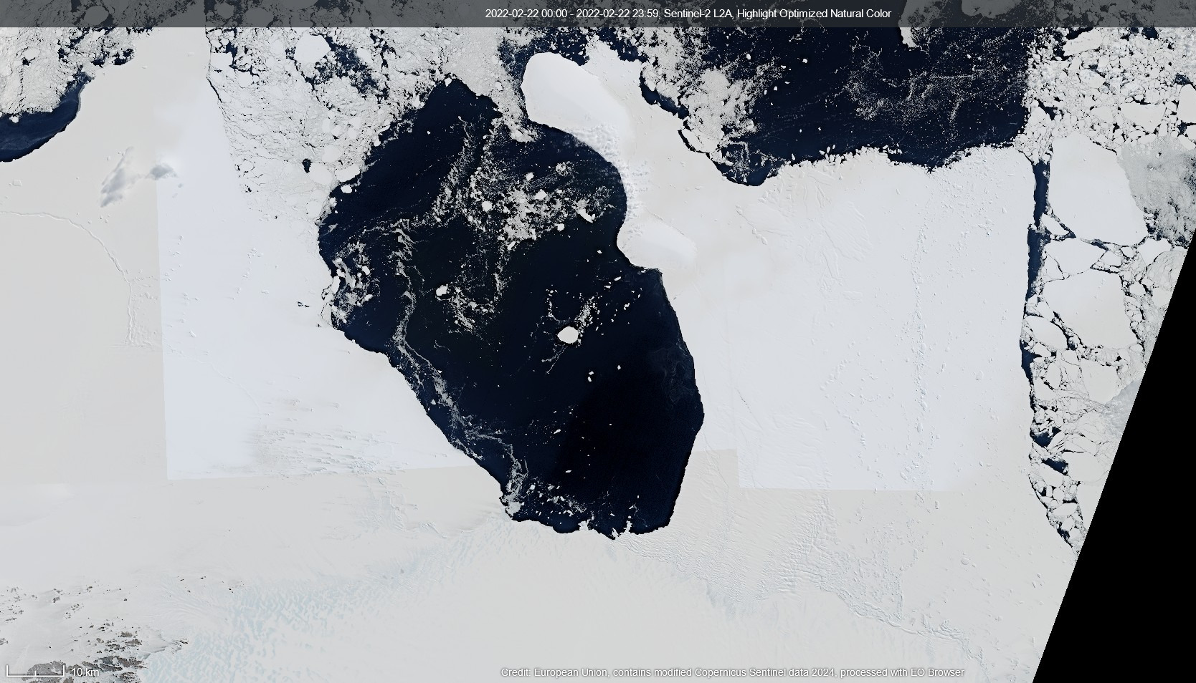
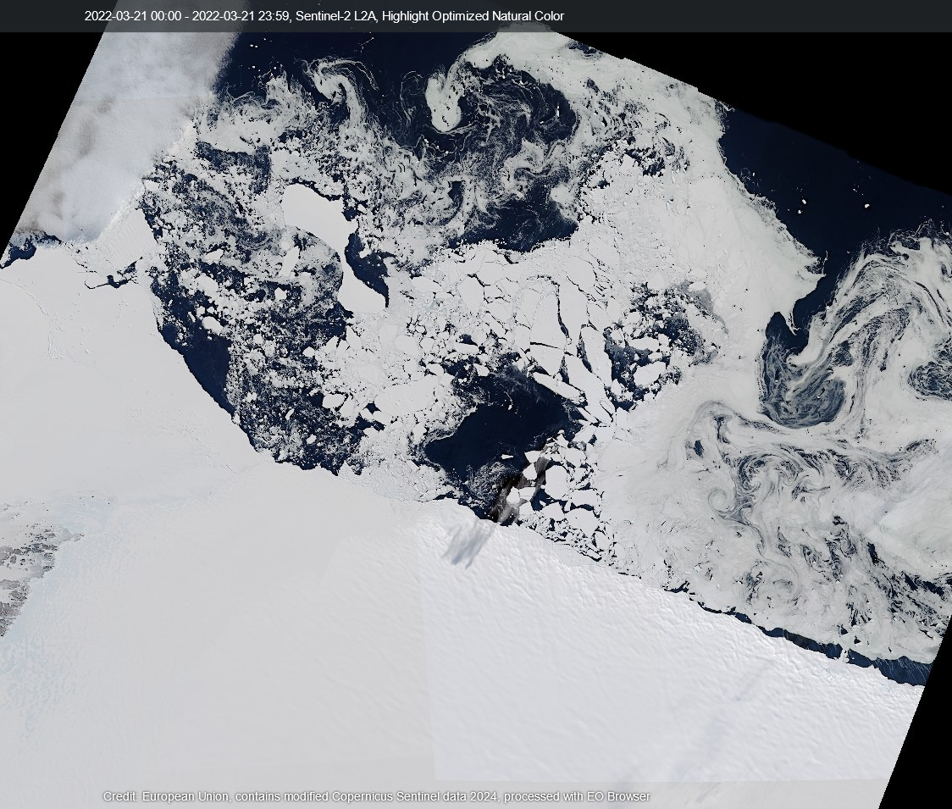
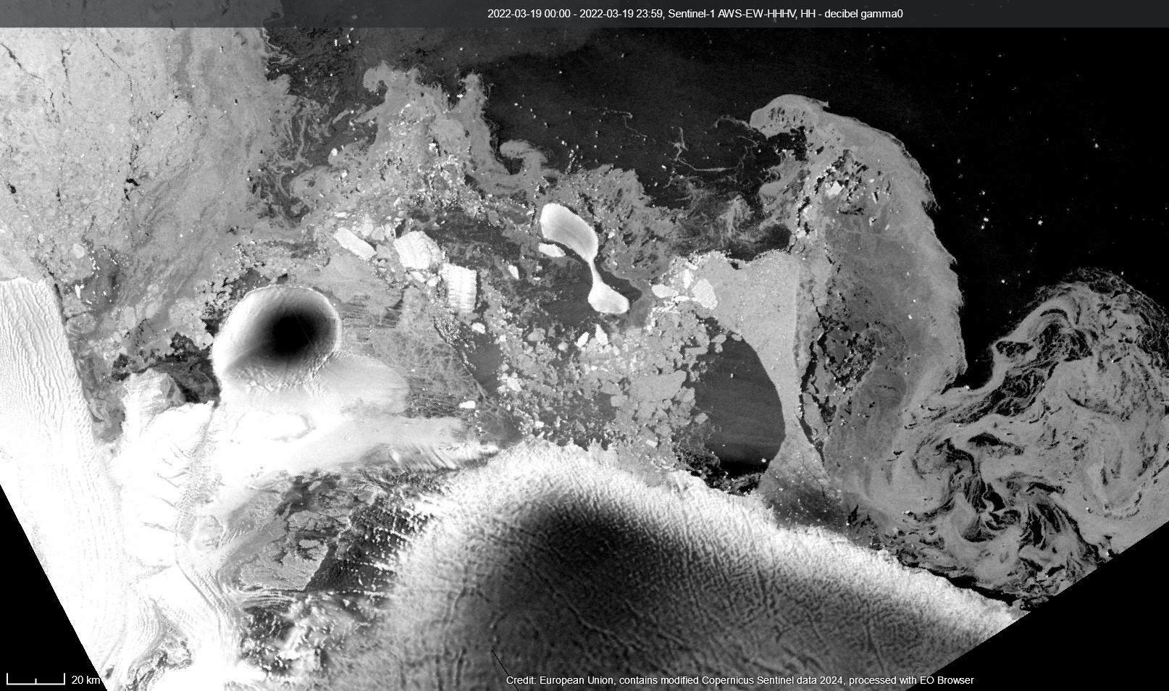
Death of an ice shelf

Slide 4
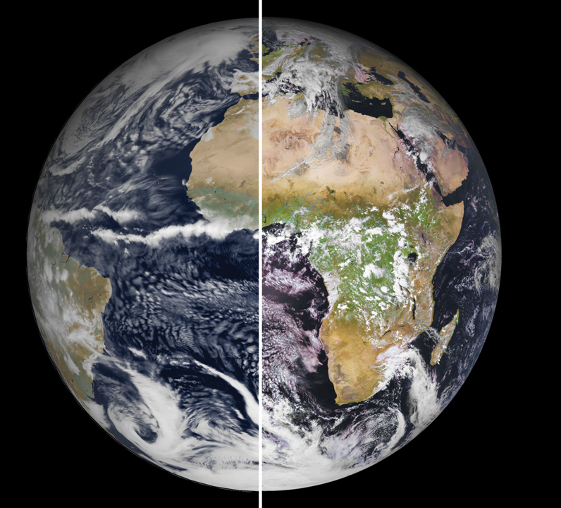
Climate projections and downstream effects
Climate extremes can lead to rapid and irreversible changes in the Polar environment
In order to understand and predict these we need:
  Models
  Satellite data
  In-situ observations
1-kilometre resolution, European climate model (left) is nearly indistinguishable from reality (right).(LEFT TO RIGHT) ECMWF; © EUMETSAT

Slide 5
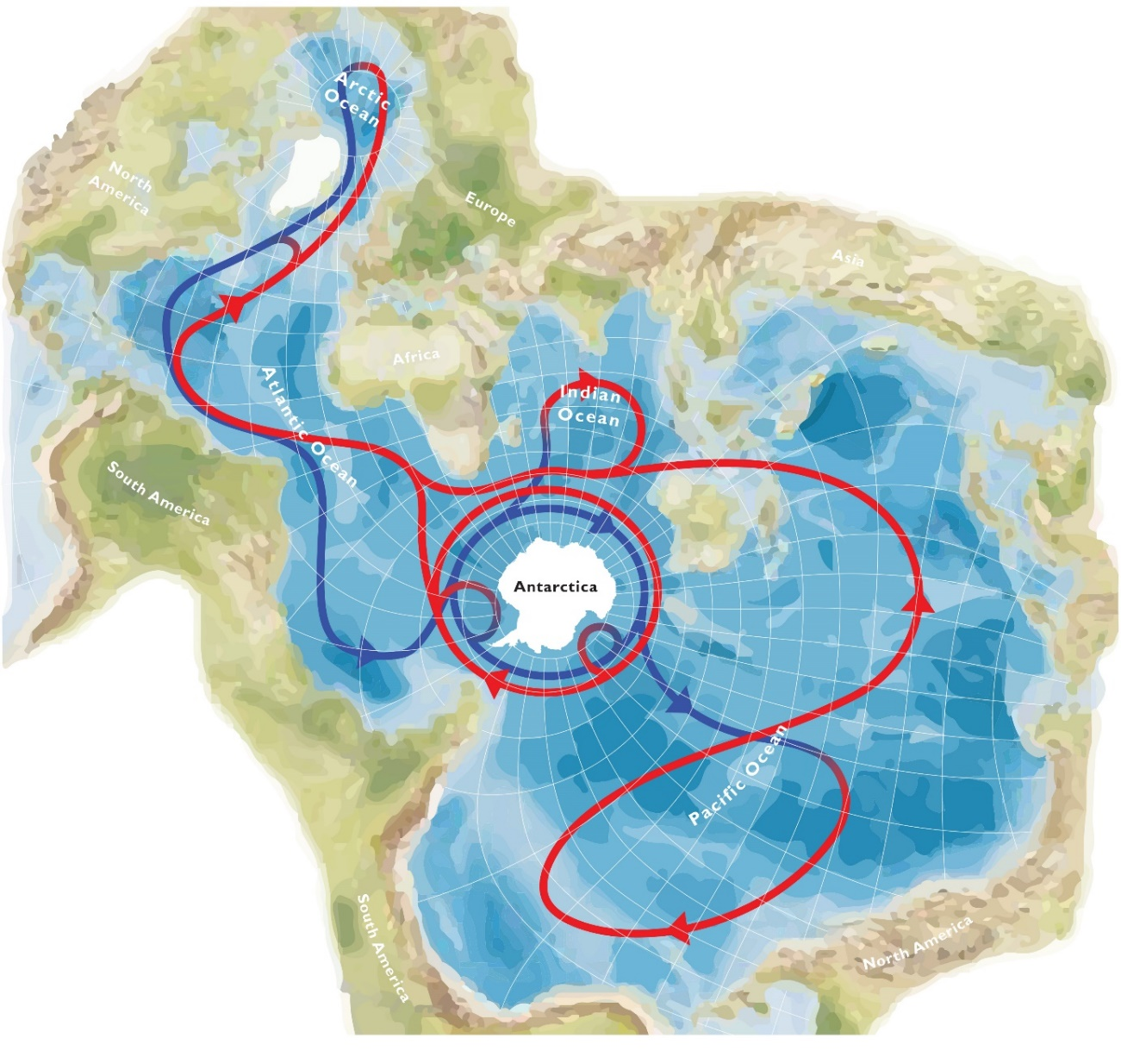

The continent at the centre of the world

Slide 6
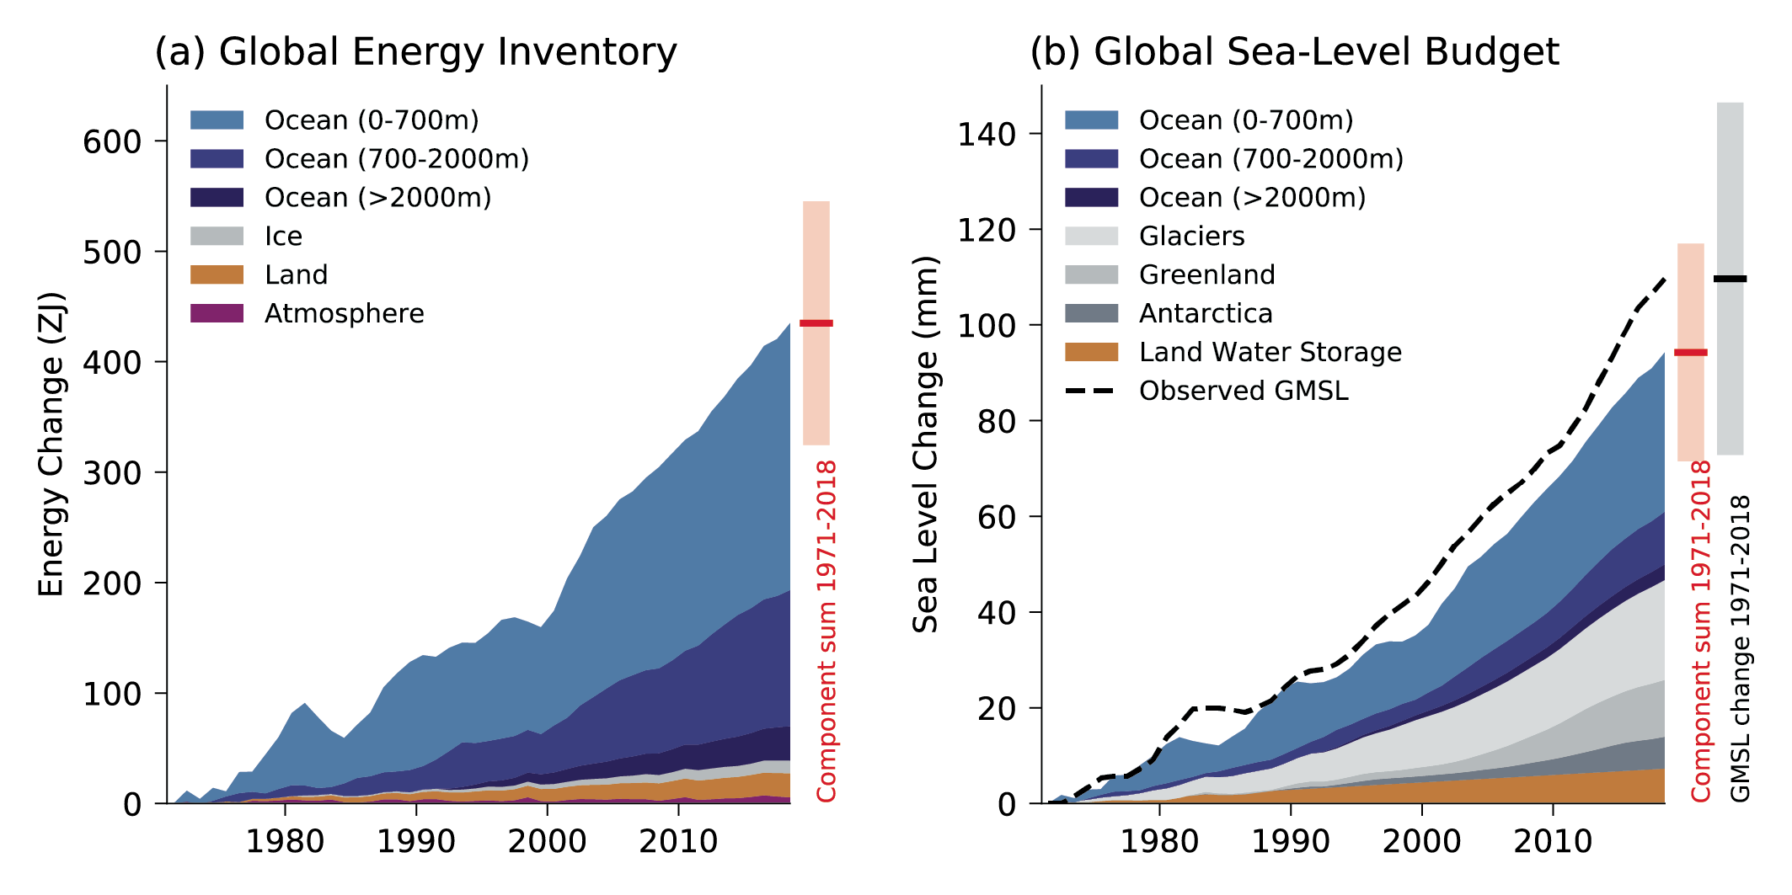
Global warming is ocean warming
IPCC AR6 (2021)
>90% of all human generated heat goes into the ocean (blue)
Notes:
Emphasise: Science isn’t restricted to these WPs and most tools (eg models, obs, climate models and metrics) are cross cutting. Also note that no center is restricted to a single WP.

Slide 7
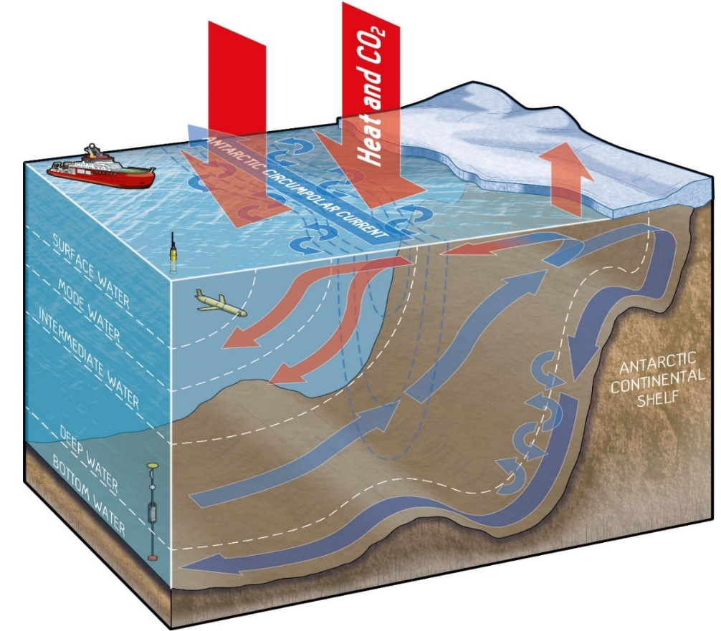
Global warming is ocean warming – mostly via the Southern Ocean
75% global ocean heat uptake
40% global ocean CO2 uptake
Climate service value ~ 80 billion €/y
Based on carbon price 80€/tCO2 (N.Gruber)
Notes:
Emphasise: Science isn’t restricted to these WPs and most tools (eg models, obs, climate models and metrics) are cross cutting. Also note that no center is restricted to a single WP.

Slide 8
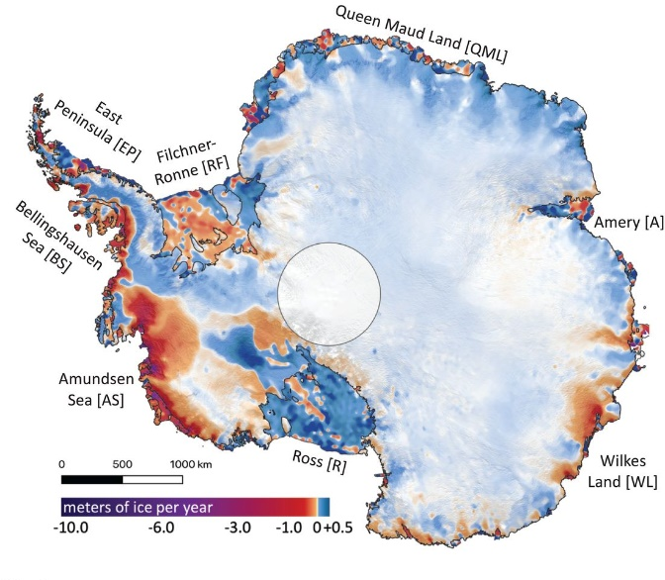
The Antarctic Ice Sheet is melting
– largely due to extra ocean heat delivery
IceSat(-2) Ice loss (2003-19)
Smith et al., 2020
Notes:
Emphasise: Science isn’t restricted to these WPs and most tools (eg models, obs, climate models and metrics) are cross cutting. Also note that no center is restricted to a single WP.

Slide 9
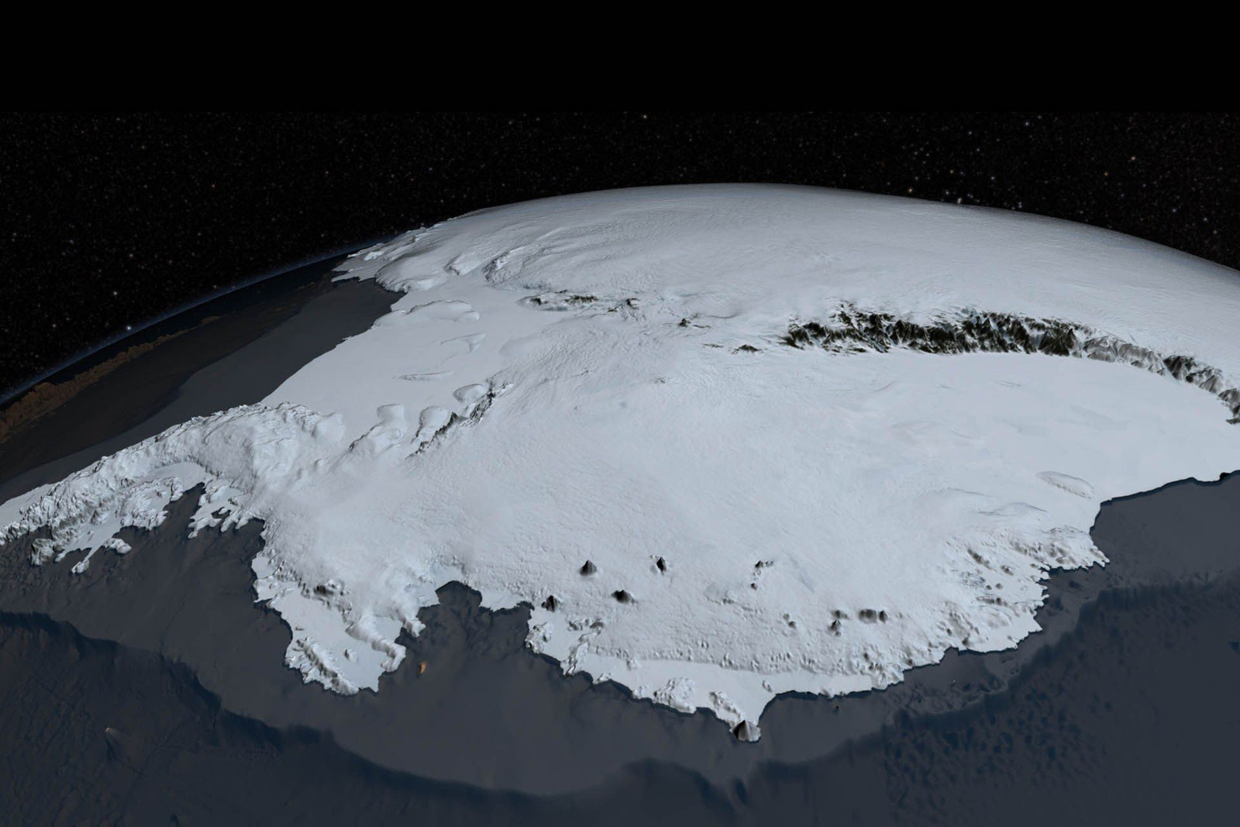
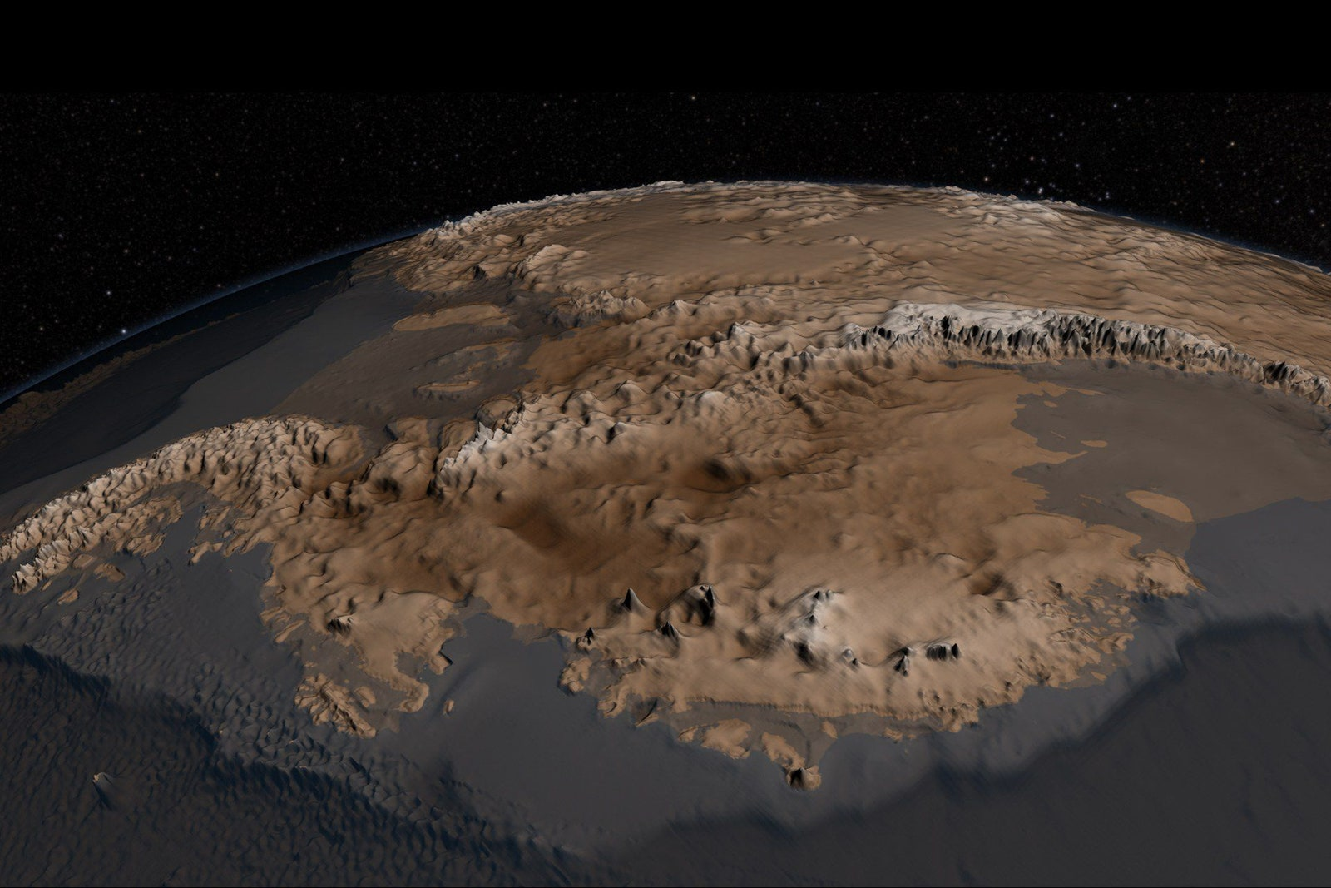
The Antarctic Ice Sheet is melting – largely due to extra ocean heat delivery
Bedmap2, Fretwell et al., (2013)
Notes:
Emphasise: Science isn’t restricted to these WPs and most tools (eg models, obs, climate models and metrics) are cross cutting. Also note that no center is restricted to a single WP.

Slide 10
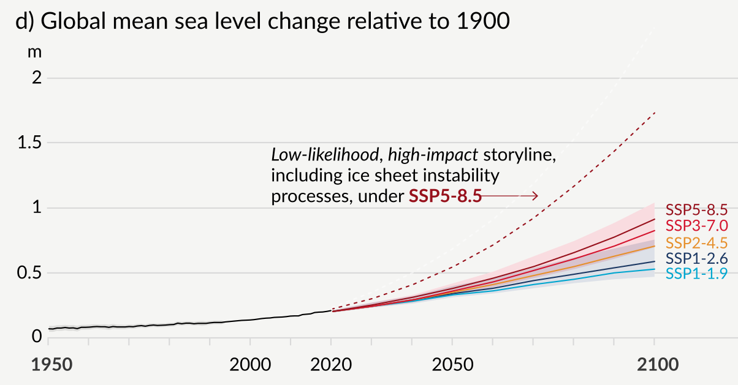
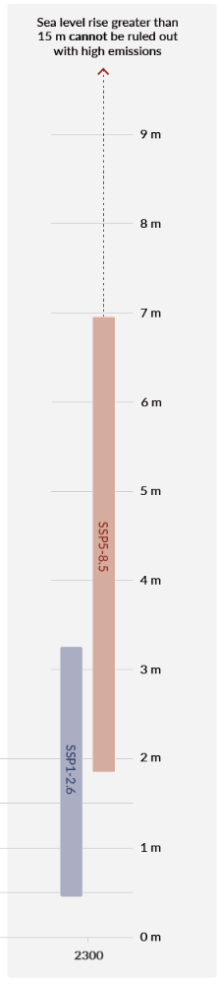
IPCC AR6 (2021), Summary for policy makers high impact storyline from an expert survey and structured expert judgement (i.e. not modelled)
9m
8m
7m
6m
5m
4m
3m
2m
1m
0m
2000
2100
2200
2300
Year
Future ice sheet mass loss is one of the greatest climate uncertainties

Slide 11
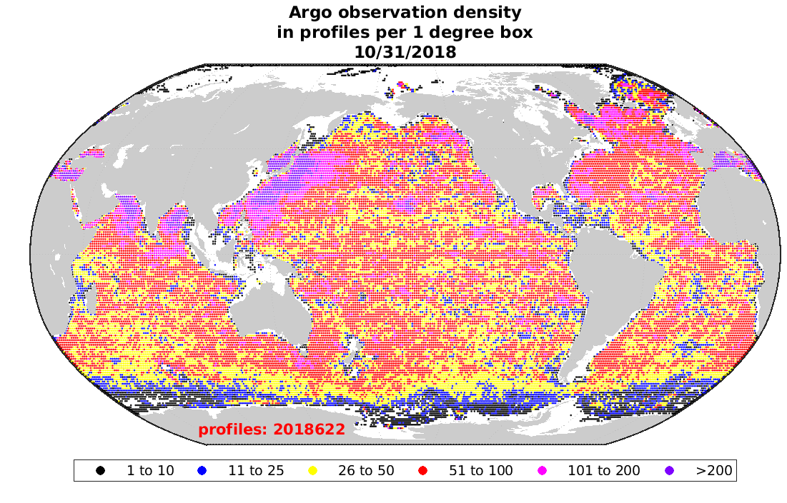
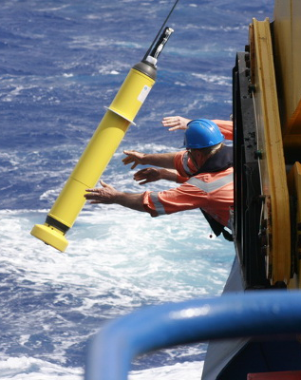
Yet the Southern Ocean and Antarctic is (still) a huge hole in our observing network
From Josey et al., 2023
Observations of top 2km of ocean by Argo floats since 2004 (>2 million)
Notes:
Emphasise: Science isn’t restricted to these WPs and most tools (eg models, obs, climate models and metrics) are cross cutting. Also note that no center is restricted to a single WP.

Slide 12
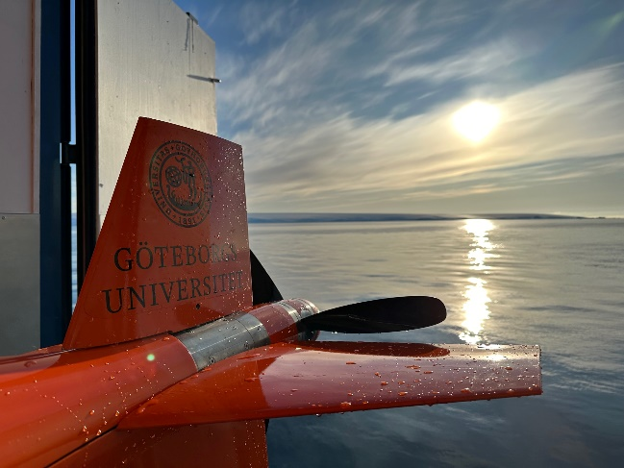
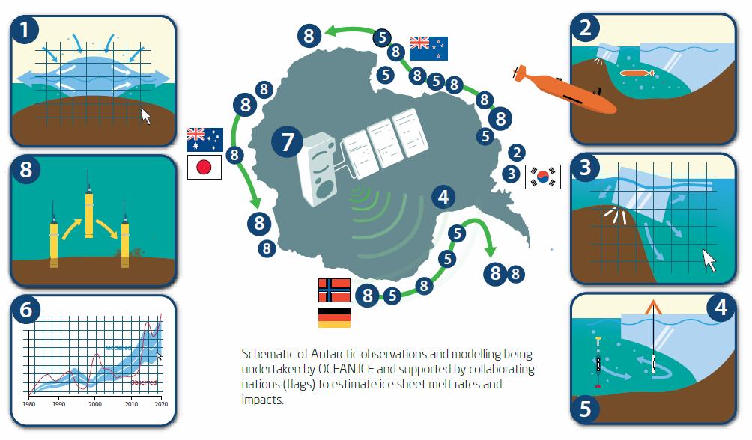
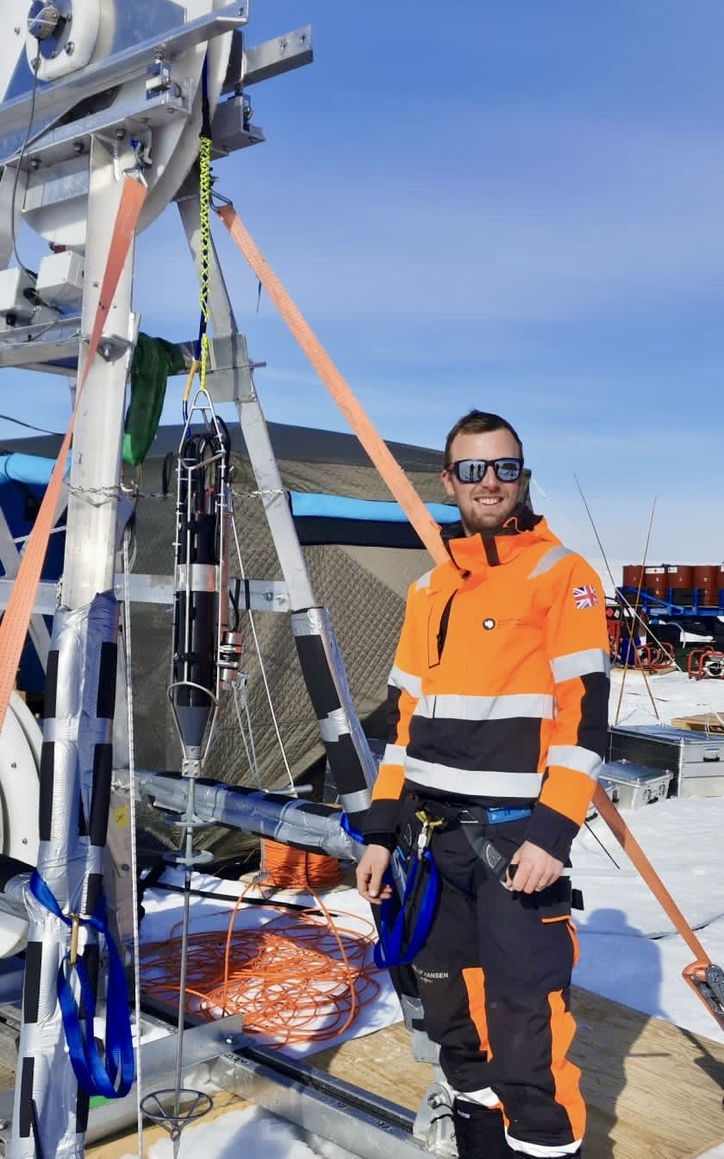


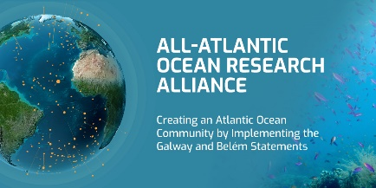


Antarctic research elements

Slide 13
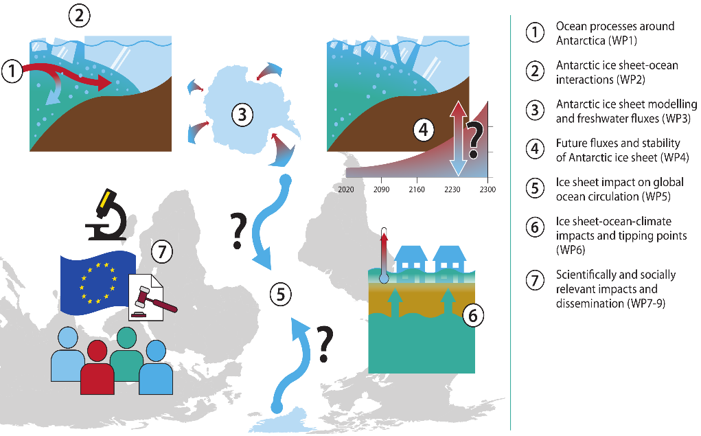
Impact of Antarctic and Southern Ocean processes and feedbacks on planet Earth

Slide 14
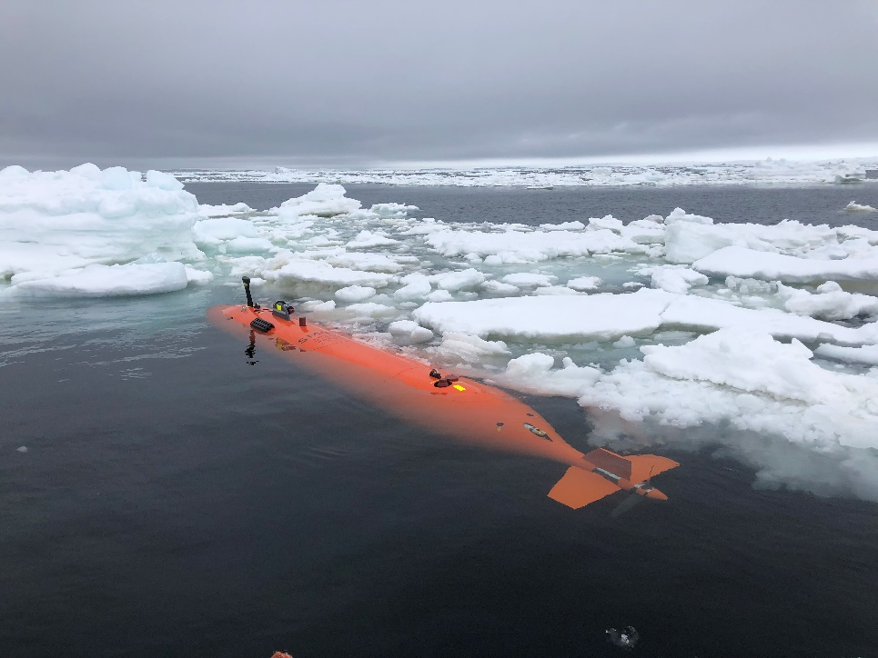
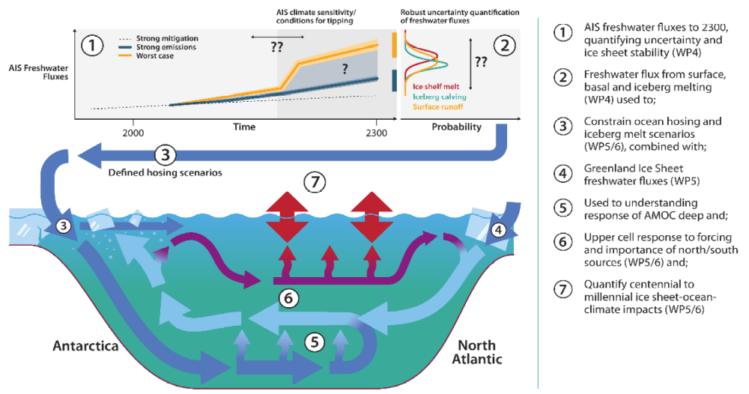
Impact of Antarctic and Southern Ocean processes and feedbacks on planet Earth
New projections of sea level rise
New assessments polar tipping point risk
New observations under different types of ice shelves
Improvements to regional and global climate models
First projections of global climate indicators with active ice sheets
Data interoperability
Direct collaboration with regional modellers and policy makers for long term planning

Slide 15
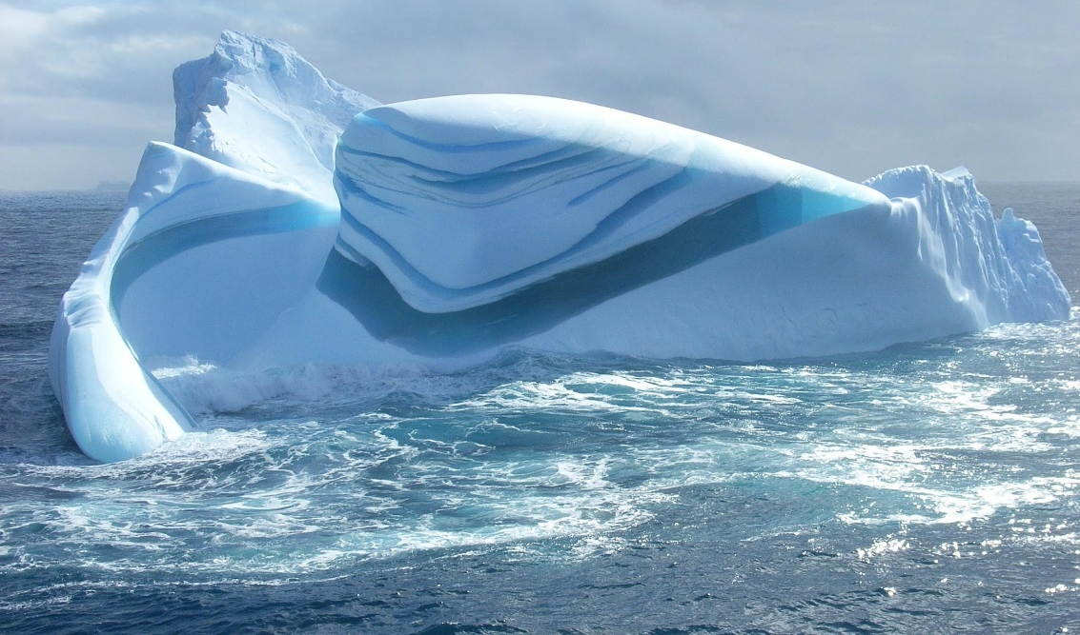
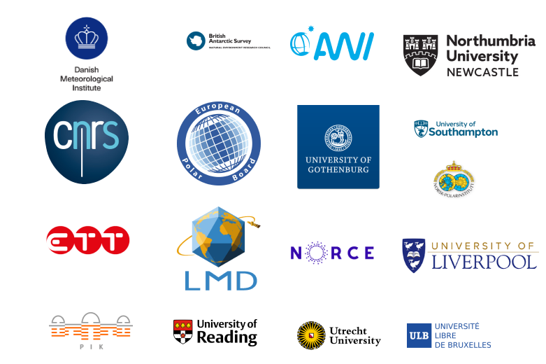
Takeaways
The Southern Ocean, Antarctic and their interaction are disproportionally important for future climate and sea level rise.
Both are critically under-observed and lack structured observing systems.
Need for observations and model improvements to:
  Reduce uncertainty in future global climate projections and impacts
  Deliver results to climate assessments and society

Slide 16






oceanice.eu@gmail.com
www.oceanice.eu
@OCEANICE_EU
https://fediscience.org/@OceanIceEU
https://www.linkedin.com/company/euoceanice/
https://www.facebook.com/OCEANICEEU/
OCEAN:ICE is co-funded by the European Union, Horizon Europe Funding Programme for research and innovation under grant agreement Nr. 101060452 and by UK Research and Innovation

