Slide 1
Welcome! :-)
Please turn off your microphones and cameras.
We will start shortly.
Session will be recorded.

Slide 2
Introduction to
Open Science and Research Integrity
Milan Janíček (CU)
Léa Gonnet (SU)

Slide 3
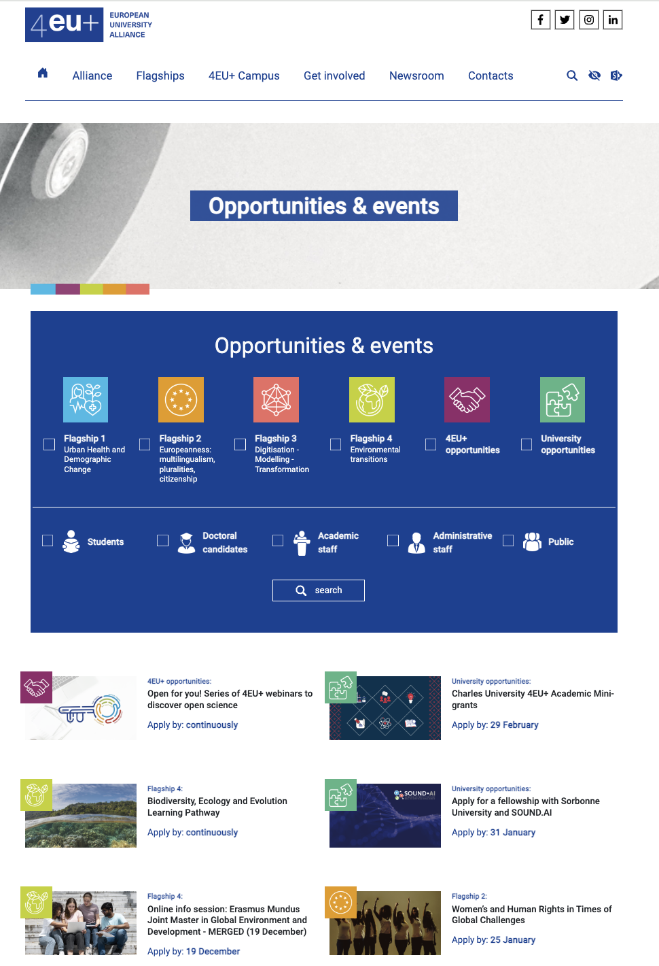
4EU+ Alliance
4EU+ is a transnational strategic university association.
Vision: to create one comprehensive research-intensive European University through a new quality of cooperation in
  teaching
  education
  research
  administration
For more: https://4euplus.eu/

Slide 4

Open for you!
3rd series about Open Science – (01-07/2024)
11 webinars:
  responsible publishing
  research data management
  advanced Open Science practices
  citizen science
  science evaluation
Introduction of topics & interviews with experts
Current series: https://4euplus.eu/4EU-768.html, materials from previous series here
Do you see in this presentation? → There will be specialized webinar about this topic!

Slide 5

Question for you:
Which word comes into your mind in relation to open science?
Please answer on

Slide 6
Open Science
Open Science is the practice of science in such a way that others can collaborate and contribute, where research data, lab notes and other research processes are freely available, under terms that enable reuse, redistribution and reproduction of the research and its underlying data and methods.
project FOSTER definition

Slide 7
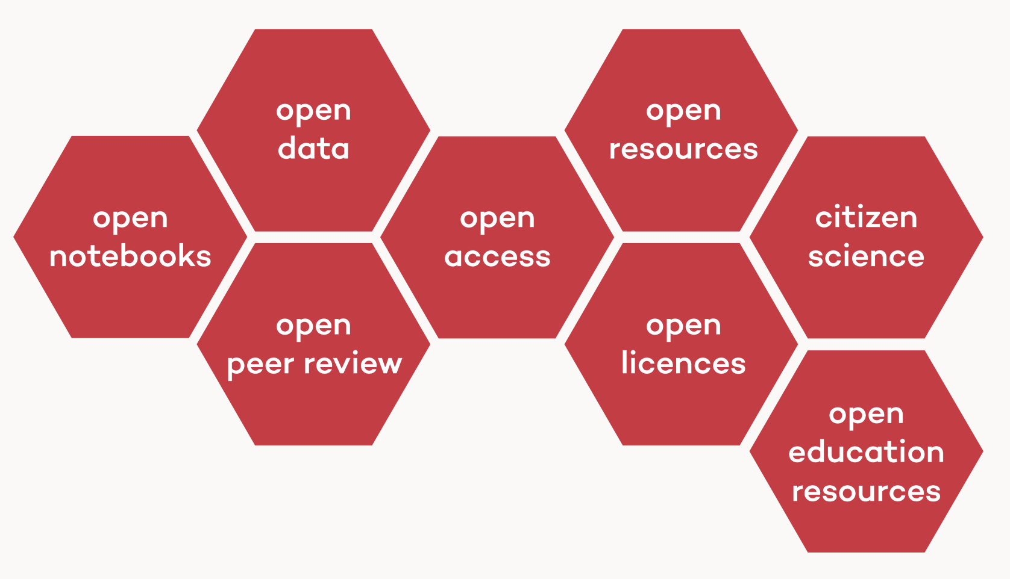
Open Science
Goals:
  transparency (openness)
  reliability / reproducibility
  reusability
  societal impact (trustworthiness, communication)
    including Citizen Science
  and effective use of public money...

Slide 8
Open Access (OA)
Is a publication model that seeks to achieve immediate, free, permanent and independent online access to the results of publicly funded science and research.
Is reacting to problems with scientific publishing

Slide 9



Subscription model vs OA model
research
€
€

Slide 10
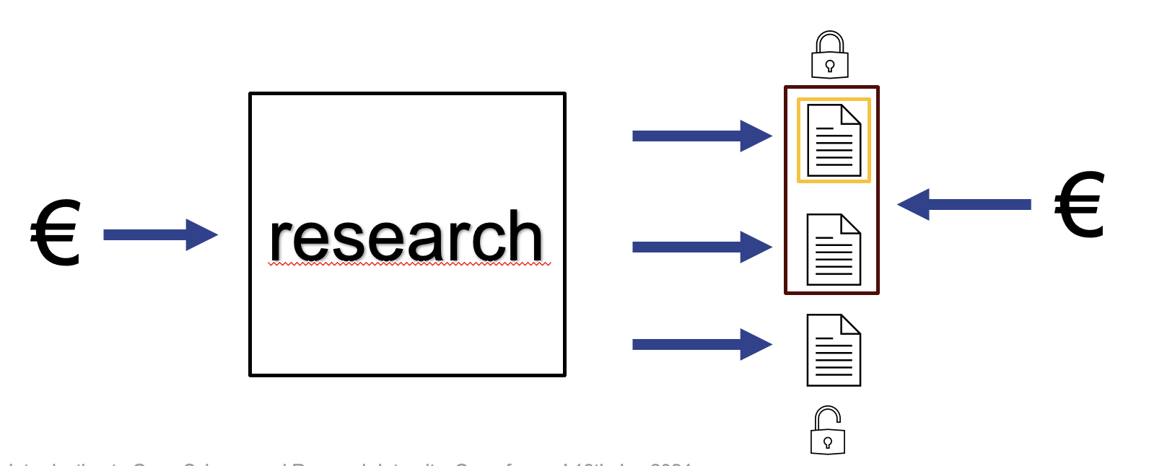
Academic publishing
Researchers (for free)
  write papers
  review papers
Publisher
  provides infrastructure
  reviewing, editing, publishing, distribution..
  costs but also chance for profit
Someone has to pay for researcher’s work and subscriptions...

Slide 11
Academic publishing
Open Access eliminates subscriptions → better access, larger impact
Someone has to pay for publisher’s work...
  APC (article processing charges) for publishing each article? Some other way?

Slide 12



Open Access ways
Green – authors retain rights to their articles, publish them also in a repository
Gold – authors pay APC, article is published as OA by publisher
Diamond – journals are financed from different sources; publish OA and do not need APCs

Slide 13
Side note
(Some) publishers are trying to make money in both systems
  Prestigious subscription journal? Increase subscription fees!
  Gold Open Access journal? Increase number of published articles and get more from APCs!
Dependency on for-profit companies as part of research workflow is risky (especially in cases of possible vendor lock-in)

Slide 14
Open Science is much more than Open Access
Science is not article shaped, paper should not be limit
New technologies → new technologies in research
Data, software, algorithms, workflows, protocols, models...
... can be shared and/or published

Slide 15



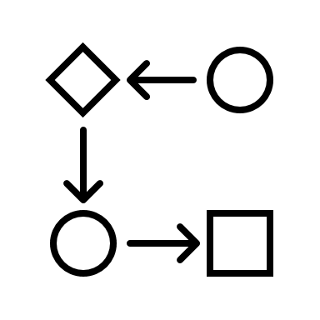

Science is not article shaped
€
DOC

Slide 16
Research Data
Research data can be characterised as any information that has been collected, observed, generated, or created to validate or reproduce your research findings.
Spreadsheets, documents
Audio and video recordings
Images, photographs
Questionnaires, test responses, interview transcripts
Laboratory notebooks, field notebooks, diaries
Samples, specimens, artefacts
reproduce/check
reuse

Slide 17
”Open Data”? Not always.
According to the rule:
  ”as open as possible, as closed as necessary”.
Not everything can/should be shared
  personal data
  intellectual property
  ...
Idealistic viewpoint: sharing as much as possible as soon as possible
  example: COVID pandemics (faster progress but could be misunderstood)

Slide 18
How to share?
Imagine just putting files from your computer on the web...
There have to be some rules HOW & WHERE share the data
FAIR Data Principles
Data repositories

Slide 19
FAIR – Findable, Accessible, Interoperable, Reusable
You (or anyone) should be able to
  find the data
  access or know how to access the data
  combine data with their own data & services and understand them (using documentation)
  reuse data confidently and in accordance with specified reuse rules
FAIR - 15 principles

Slide 20
Research data management
Do you want to create FAIR data? → Work with them accordingly during the research process!
There are many aspects of research data management
  what kind of data, where, who, when, for how much, for how long, share with whom...
→ Create a structured document?
➔ Data Managment Plan (DMP)

Slide 21
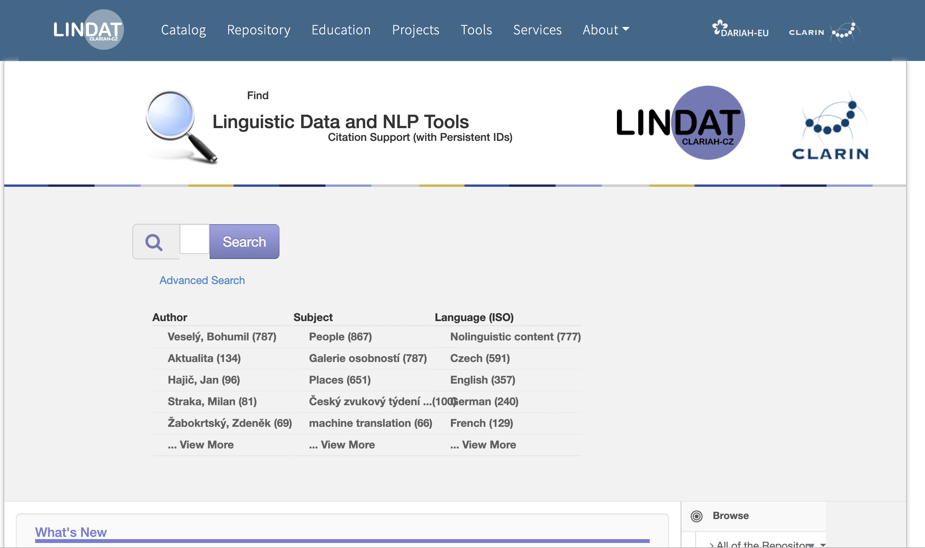
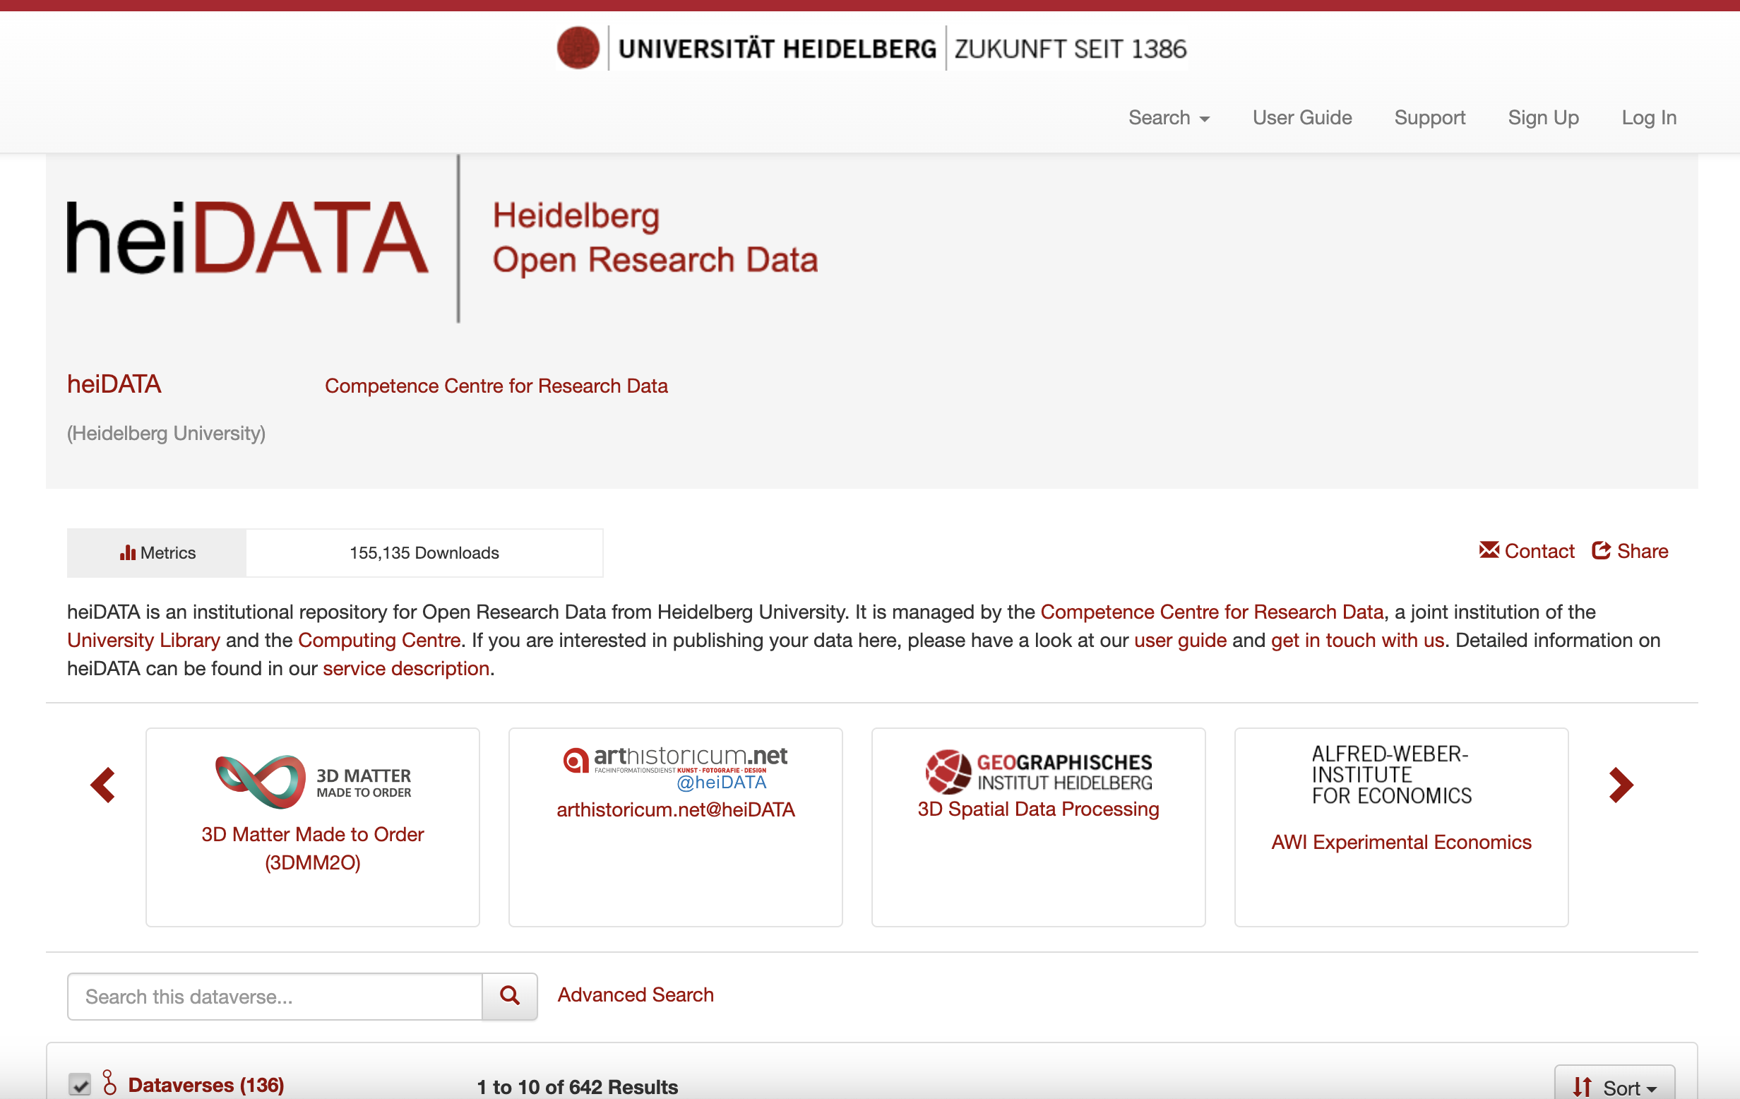
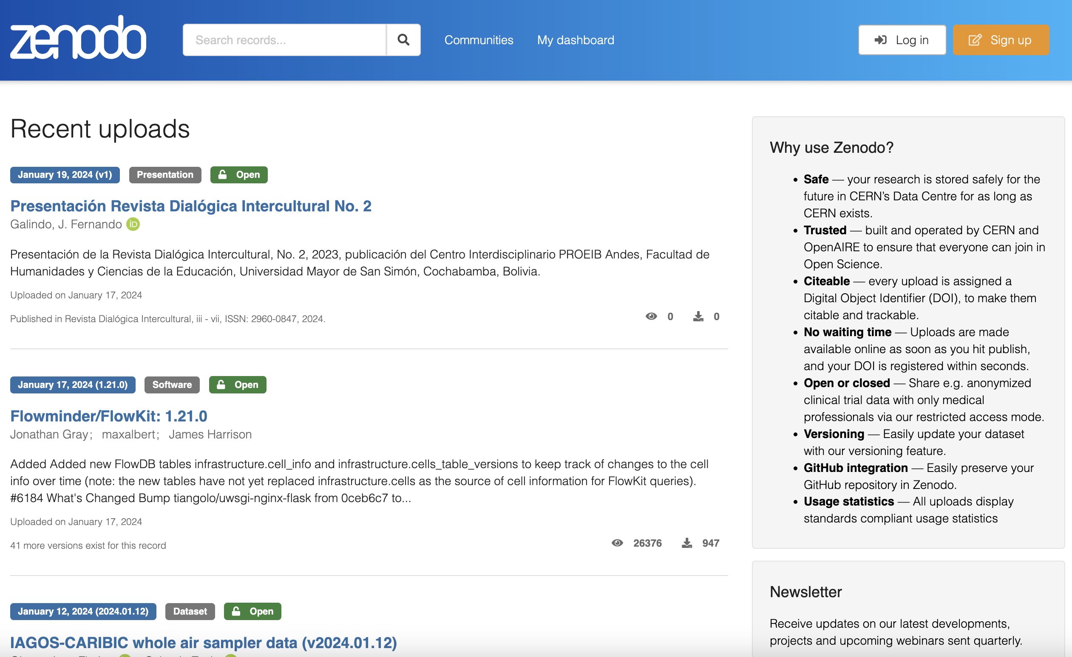
Have you got your data ready? Publish them in a repository!
Choose proper repository:
1) domain specific
2) institutional
3) generic/catch-all

Slide 22
Side note
Some FAIR principles are fulfilled by repositories, others depend on the way you handle your data during research!

Slide 23
Other Open Science practices
Sharing of other research outputs
  software & scripts
  lab notebooks
  protocols
  ...
Publishing earlier versions of manuscripts (pre-prints), taking part in open peer review
Preregistration of research

Slide 24
Rewards?
This means more work... Will it be rewarded?
OS tries to address this – it is looking for different approach to research evaluation.
  not depending on impact factor and similar indicators
  considering different research outputs
  eliminating negative incentives of “publish or perish”
Paris Call on Research Assessment (OSES 2022)
CoARA Initiative (Coalition for Advancing Research Assessment)

Slide 25
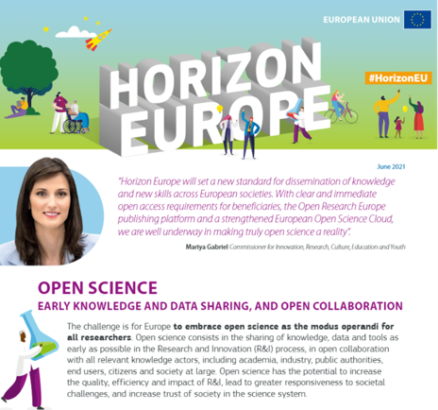
Open Science practices as project requirements
Open Science is already part of project requirements (Horizon Europe)
  Open Access
  FAIR Data
  Data Management Plan
  Open Science practices as integral part of research process

Slide 26

Research Integrity
Important document: The European Code of Conduct for Research Integrity
Describes appropriate conduct of research
Guiding principles of Research Integrity
  reliability
  honesty
  respect
  accountability

Slide 27
Question for you:
Which word comes into your mind in relation to research integrity?
Please answer on

Slide 28
Good Research Practices
Research Environment
Training, Supervision, and Mentoring
Research Procedures
Safeguards
Data Practices and Management
Collaborative Working
Publication, Dissemination, and Authorship
Reviewing and Assessment
some parts of are very close to, or exactly same as Open Science requirements
some are closely related

Slide 29
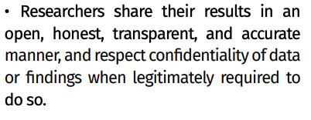
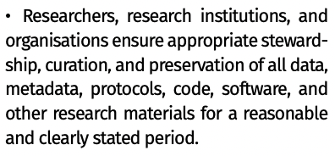
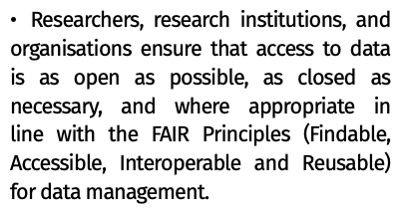
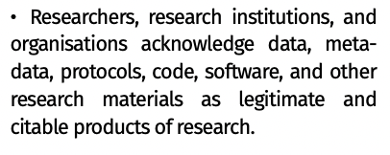
Good Research Practices & OS
transparency
data management
outputs
FAIR Data

Slide 30
Research Misconduct
in proposing research
in performing research
in reviewing research
in reporting research results
Fabrication
Falsification
Plagiarism

Slide 31

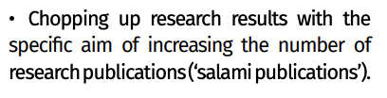
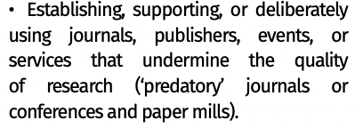




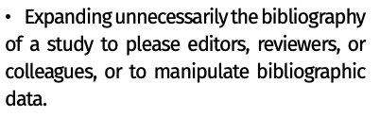


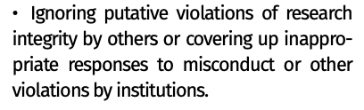


Research Misconduct – some examples

Slide 32
Question for you:
Are you familiar with any of situations mentioned on previous slide?
Please answer on
Don´t worry, answers anonymous and won´t be processed further in any way.

Slide 33
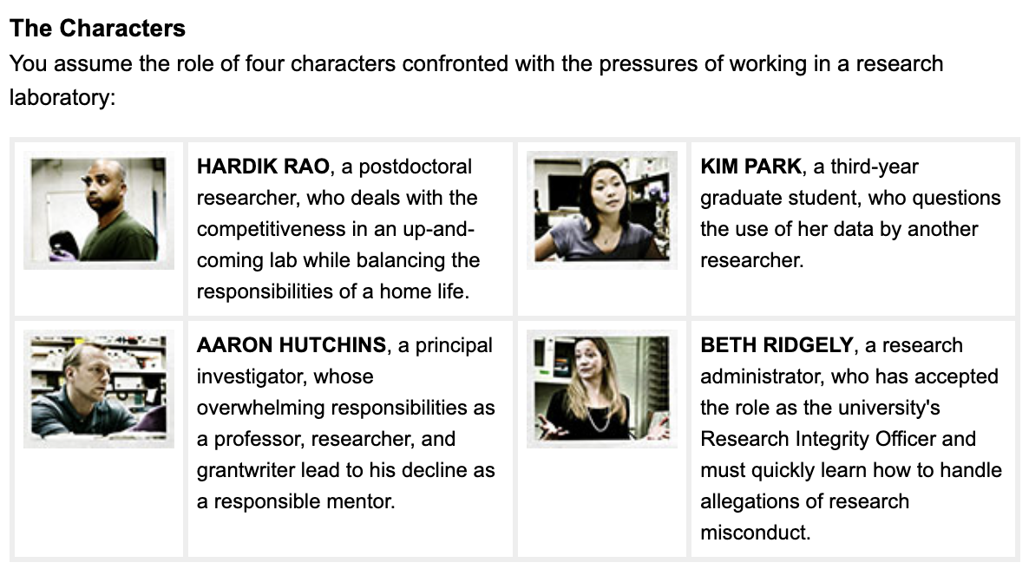
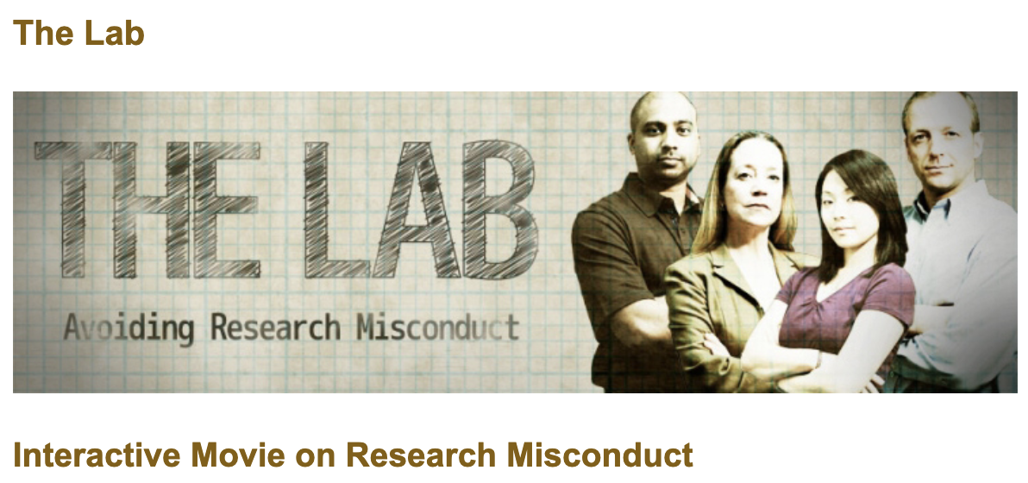
How to prevent violations?
Prevention of misconduct and proper training are very important.
example: Tha LAB by ORI
https://ori.hhs.gov/the-lab

Slide 34
How to handle violations?
There should be process in place to allow to handle violations in fair, consistent, transparent way.
These processes differ between institutions (and nations).
  specific persons, commisions, rules, codes of ethics, codes of conduct
France: Office français de l’intégrité scientifique [French Office for Research Integrity] – director Stéphanie Ruphy

Slide 35
Interview with ...
Stéphanie Ruphy
Office français de l’intégrité scientifique

Slide 36
Open for you!
NEXT:
Preprint and Open Peer Review
  15 February 2024, 4 pm
  Open access began with preprints in the 1990s. Today, preprints remain a popular means of disseminating scientific results in certain disciplines. It also makes it possible to experiment with new ways of carrying out peer review and to build new publication models. The presentation will be followed by an interview with Daniela Saderi, neuroscientist, co-founder and director at PREreview.
"I'm signing a publishing agreement": intellectual property and publication (in open access) – March 2024
Publishing in Diamond Open Access – April 2024
Predatory publishers and identity fraud – how to identify dubious providers – 17 April 2024

Slide 37
Thank you!
Milan Janíček (CU)
Léa Gonnet (SU)

