Slide 1
Societal Relevant impact
CC-BY: Maurice Vanderfeesten (orcid.org/0000-0001-6397-4759) & René Otten, Societal Relevant Impact, Societal Impact and Relevance of Research workshop, AurorA conference, Norwich, 2017-11-09, doi:10.5281/zenodo.1041406

Slide 2
Agenda
  Intro: Aurora Mission
    Societal Relevance = relevant topics for society: SDG’s and SC’s
  Research Excellence (morning session ARBI 1)
    Bibliometric: Institutional production profiles on Societal relevant themes
    Bibliometric: Institutional excellence profiles (Top 1%) on Societal relevant themes
    Suggestions for bibliometric collaboration:
      Who want to join for a first collaborative bibliometric analysis for institutional profiles on societal relevant themes (phase1: production and excellence only, o SDG’s & SC)
      Consensus on keywords for search queries on societal relevant topics
      Present results in next AurorA meetup.
  Societal Impact (noon session ARBI 2)
    Societal relevant themes
    Open Science for an Open Society (ARBI 3)
    Alternative metrics: known & unknown influence on policy on national and international level
    Show case catalogue: ACASI > Gross Academic Value (BAW) and PURE

Slide 3
Aurora Mission
“United by our commitment to build a different kind of inclusive university community …
AurorA institutions are committed to working together to find solutions to
globally relevant problems”

Slide 4
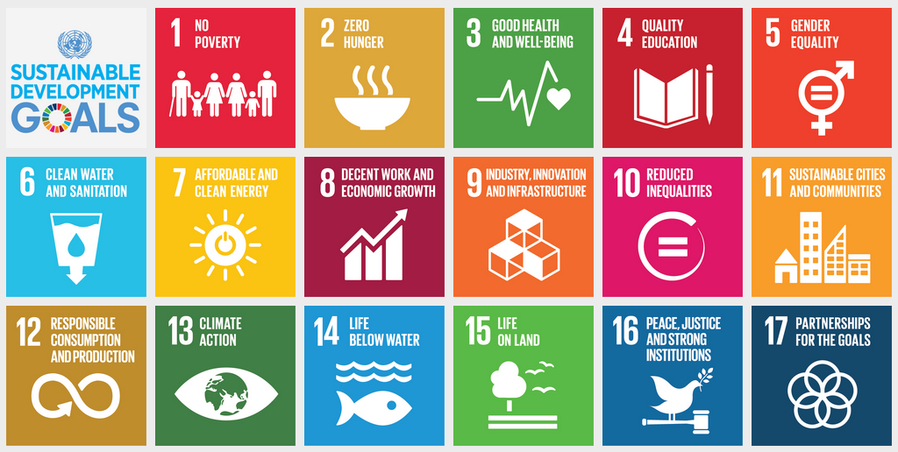
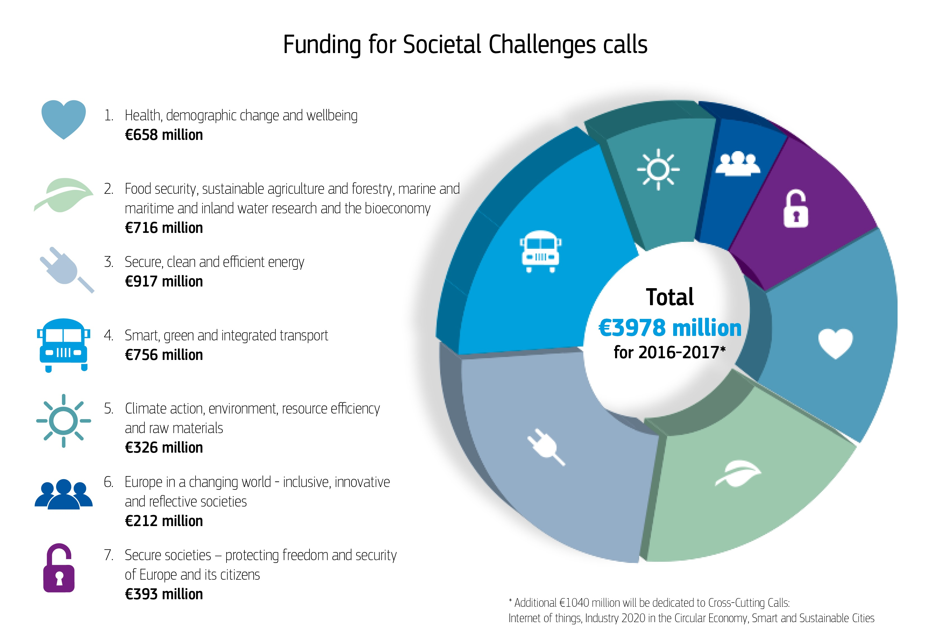

globally relevant problems (GRP’s)
Societal
Challenges

Slide 5
Why are these GRP’s important?
Policy
€
$
€
€
$
$
Research influences shaping policy uptake
Policy influences
shaping research focus
Societal
Challenges
Research
Notes:
1. Societal relevant topics bring money for research. This money shapes the focus on which topics research time is spent.
2. Fact based policy making. Policy makers want to base their policy on societal demand and scientific facts.

Slide 6


Why are these GRP’s important?
Policy
Research Quality
Research production
Research influences shaping policy uptake
Policy influences
shaping research focus
Societal
Challenges
Research excellence
Research
Notes:
Where money is shaping research, this in influences the publications output on these topics.
And within these topics, you want to know what institution performs excellent research.
This can be used to get noticed by funders on specific topics.

Slide 7


Why are these GRP’s important?
Policy
Societal Impact
Societal use
Research influences shaping policy uptake
Policy influences
shaping research focus
Societal
Challenges
Societal availablility (Open Access)
Research
Notes:
And on the other hand research can have an impact on society, where the output is made open available, for others to benefit the reaps of science.

Slide 8
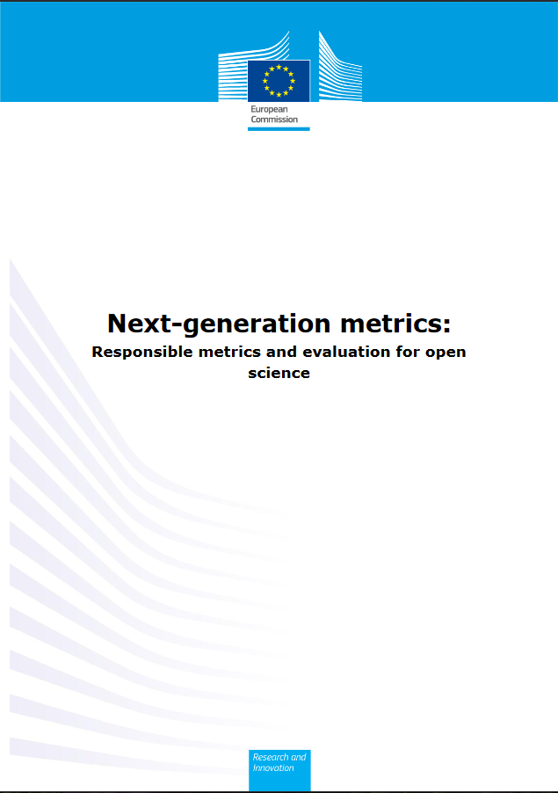
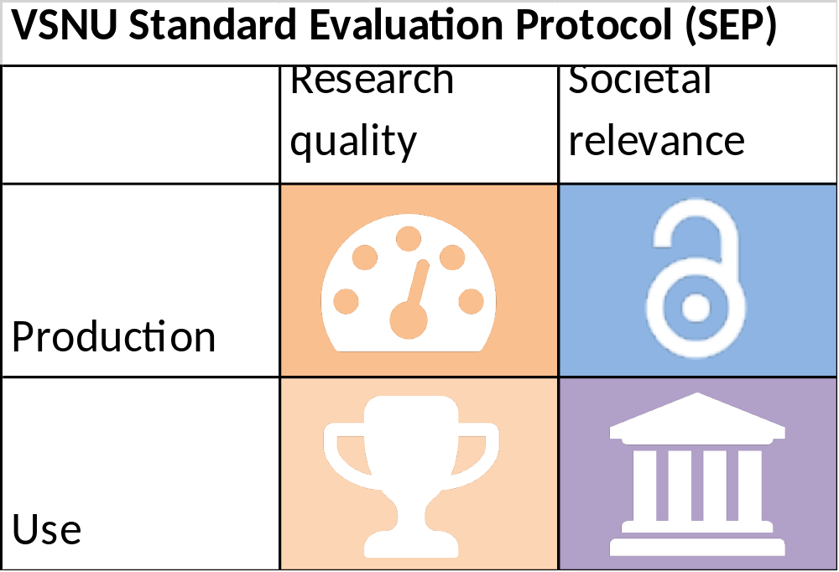
Next-gen Metrics? | Responsibly using Existing frameworks
June 2017
2015-2021
http://ec.europa.eu/research/openscience/pdf/report.pdf
http://www.vsnu.nl/sep
Notes:
An expert group on alternative metrics for open sciences have written a report to advise the European commission on what metrics and frameworks to use for evaluating research in its full context, where these is given more attention to societal relevance of research.
Research quality and Societal relevance are both topics in the Dutch Standard evaluation protocol. Where the production of output and use of the output is measured.

Slide 9

Impact of our research on societal relevant themes

Slide 10


Visual example of Impact-strength of research on societal relevant themes
Rebecka H. Jorquera, & Anna Nordén. (2017). Oceans Solutions Report (No. 2017:1) (p. 64). Sustainable Development Solutions Network Northern Europe, SDSN NE. Retrieved from https://www.unsdsn-ne.org/wp-content/uploads/2017/05/Oceans-Solutions-Report_Pages_Web.pdf

Slide 11
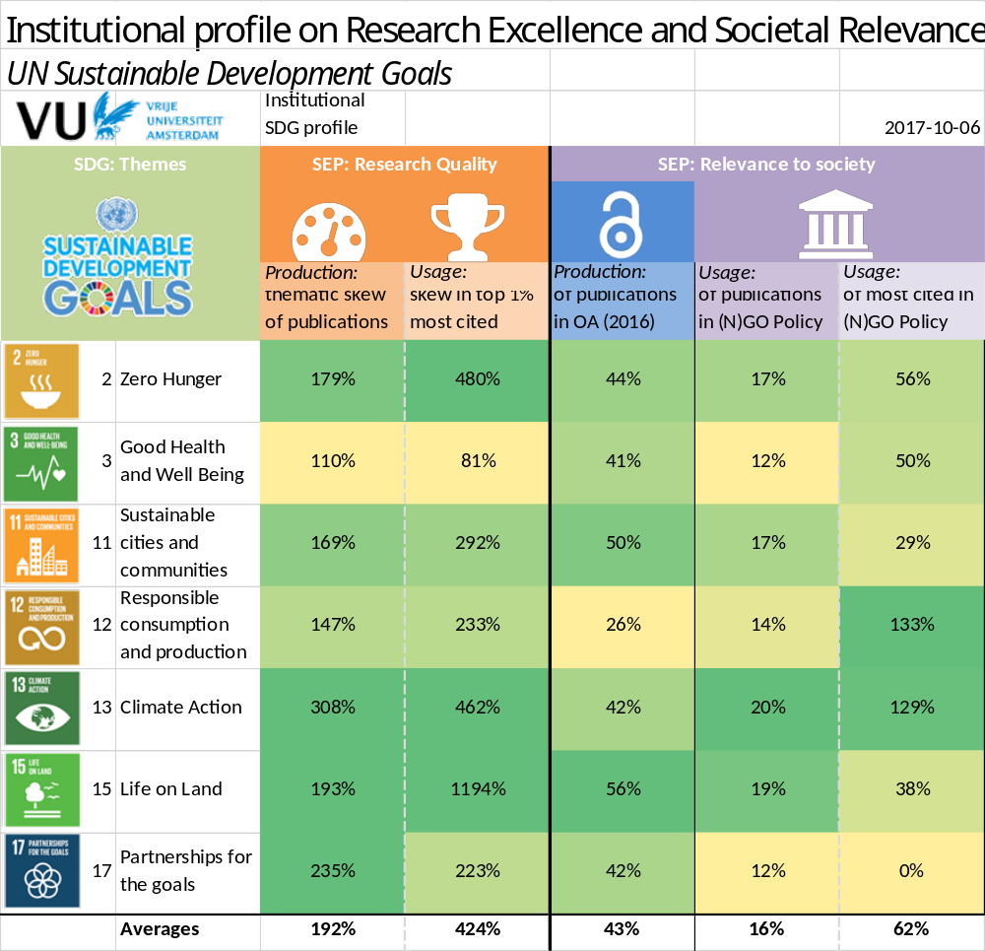
Example: Institutional profile of the VU on 7 SDG’s; Research Quality
Notes:
For example: the VU produces 3 times more climate papers than the production on average ot he VU on all topics, and it contains 4.6 times more publication in the top 1% of most cited papers.

Slide 12
Example: Institutional profile of the VU on 7 SDG’s; Societal Impact (more in ARBI 2)
Notes:
On average 42% of the paper on SDG-13 (in 2016) are open accessible for all citizens and are not just available to the research community.
20% on the 2.006 papers are mentioned in policit documents, and 129% of the top 1%.

Slide 13
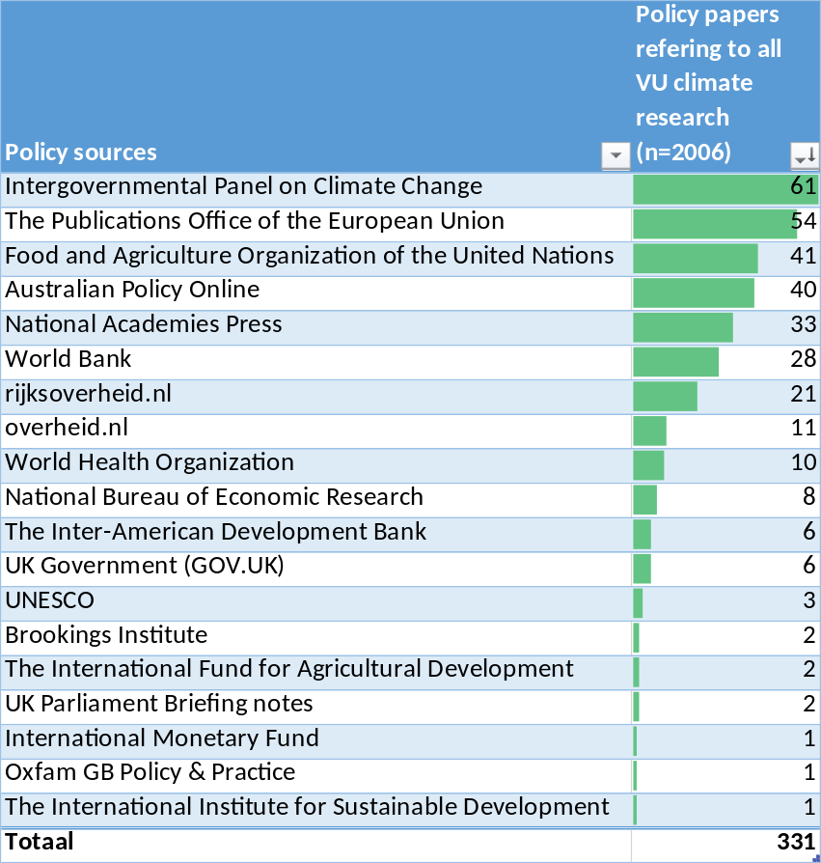
Example: Institutional profile of the VU on 7 SDG’s;
Policy impact of SDG13 (more in ARBI 2)
Notes:
Here we can see that climate papers are mostly used in policy at the IPCC.

Slide 14
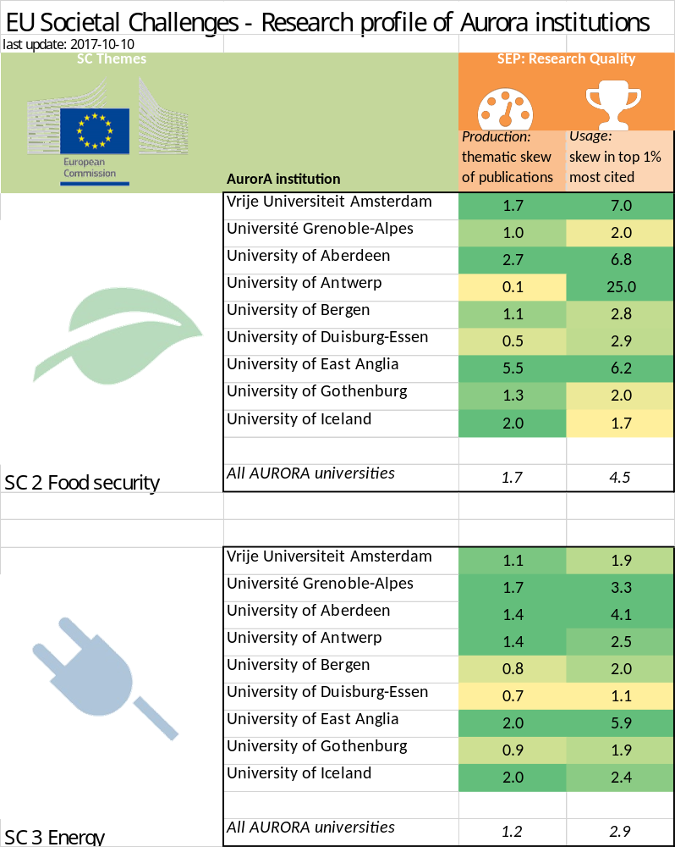

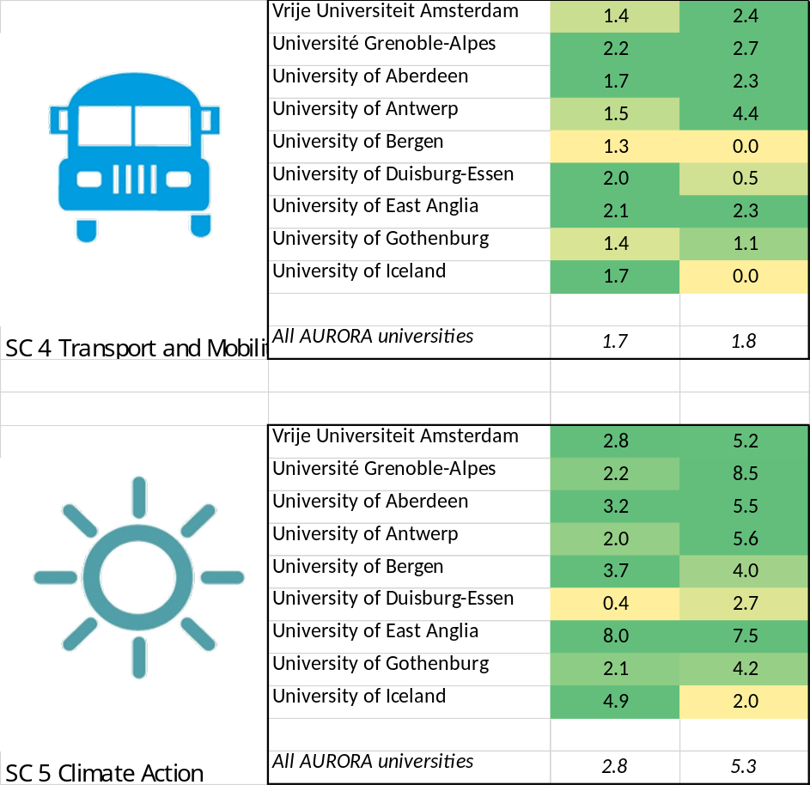
Example: Institutional profiles of the Aurora institutions on 4 SC’s;
Notes:
The tables illustrates that the Aurora network as a whole produces more publications on these themes than the world wide average. For example: on the theme Climate action the partners in the Aurora network produce 2.8 times more publications when compared to the overall production worldwide. The table also shows that there are 5.3 times more publications of the partners in the Aurora network in the top 1% of the most cited papers on climate action. Within the Aurora network there is also more collaboration between partners on different topics.

Slide 15
End of introduction

Slide 16


#HOWTO | How did we make this work?
Now comes the monkey out of the sleeve
… literal translation of a Dutch proverb

Slide 17
#HowTO | Measuring Research Quality – for Societal Relevant Topics
Policy
Research Quality
  Research Quality (morning session ARBI 1)
    Bibliometric: Institutional production profiles on Societal relevant themes
    Bibliometric: Institutional excellence profiles (Top 1%) on Societal relevant themes
    Suggestions for bibliometric collaboration:
      Who want to join for a first collaborative bibliometric analysis for institutional profiles on societal relevant themes (phase1: production and excellence only, o SDG’s & SC)
      Consensus on keywords for search queries on societal relevant topics
      Present results in next AurorA meetup.
Research production
Societal
Challenges
Research excellence
Research
Notes:
Where money is shaping research, this in influences the publications output on these topics.
And within these topics, you want to know what institution performs excellent research.
This can be used to get noticed by funders on specific topics.

Slide 18
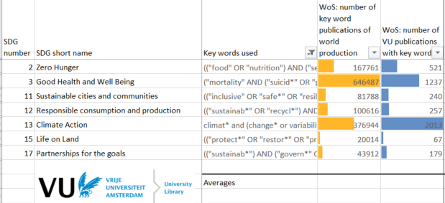
Selection of keywords per topic | clustering and segmentation
Research papers
worldwide
SDG 2 papers on food security
SDG 13 papers on climate action

Slide 19
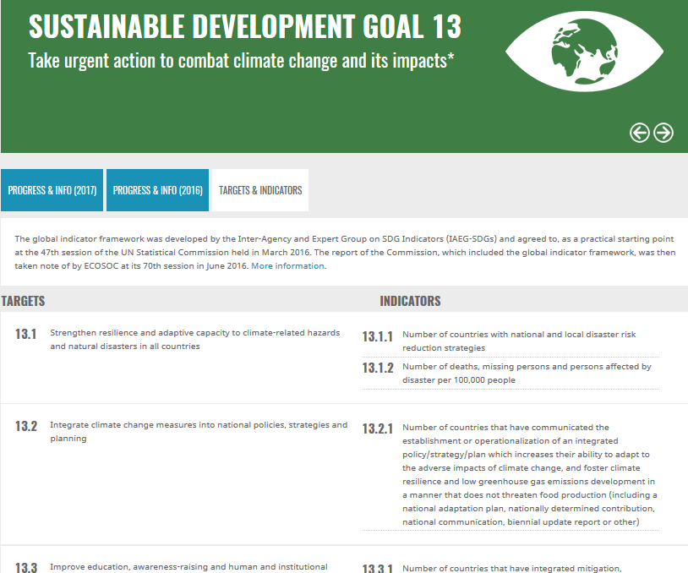
Current issues with selecting keywords
| Sensitivity vs specificity | Recall vs Precision | Authority |
“Climate Change”
vs.
“climat* and (change* or variabilit* or anthropogenic* or model* or strategy* or policy* or regime* or scenario* or carbon* or ”integrated assessment” or environment* or reforestati* or deforestati* or desertificati* or ”greenhouse gas”* or GHG or ecolog* or environment* or biodiversity or ”global change” or ”water stress”) or climate-driven or ”global warming” or "sea level*" and (change* or rising)”
Besselaar, P. A. A. van den, & Sandstrom, U. (2013). The effects of funding modes on the quality of knowledge production.
Retrieved from https://research.vu.nl/en/publications/the-effects-of-funding-modes-on-the-quality-of-knowledge-producti

Slide 20
phase 1: Production & Excellence profiles
VU SDG climate
Thematic skew of amount of papers in SDG topic x
Research production
% of papers
compared to world
=
VU average
(factor VU SDG production, compared to VU total production)
Amount of citations
(
)
VU SDG climate (0.7%)
(percentage VU SDG production of SDG production worldwide on topic x)
(percentage VU total production of worldwide total production)
VU SDG papers published on topic x,
SDG papers published worldwide on topic x
VU total papers published
total papers published worldwide
=
=
(
)
VU average (0.17%)

Slide 21
phase 1: Production & Excellence profiles
Research excellence
Actual distribution of
VU SDG climate
Top 1%
Normal distribution of
VU SDG climate
% of papers
compared to world
VU average
4.6 times more in top 1%
Amount of citations

Slide 22
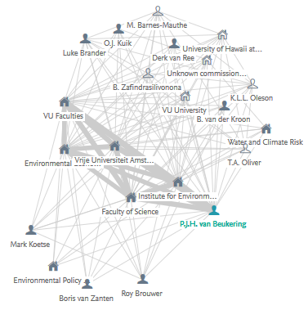
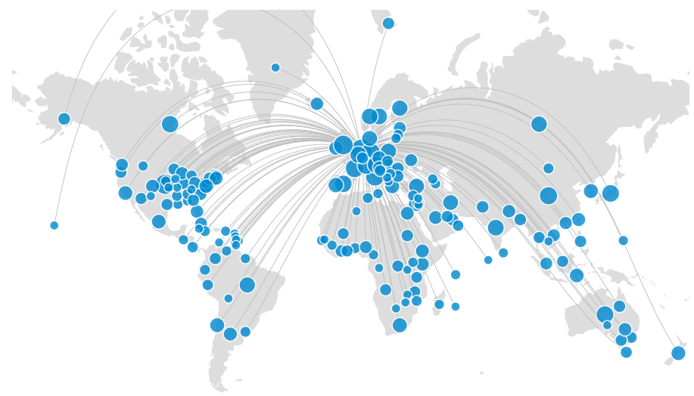
Phase 2: future analyses | aurorA collaboration on SDG’s and SC’s
VU Africa Projects
Network Analysis,
current and potential collaboration
On SDG’s and SC’s
Between and within Aurora universities.
Identify important projects
On SDG’s and SC’s
Between and within Aurora universities.

Slide 23
Suggestions for bibliometric collaboration in AURORA
Who wants to join for a first collaborative bibliometric analysis for institutional profiles on societal relevant themes?
Develop consensus on keywords for search queries on 24 societal relevant topics (17 SDG’s & 7 SC’s)
Work on institutional profiles (production and excellence) of these societal relevant topics
Present results in next AurorA SIRR meetup.
Notes:
Why? Set an European standard.
By products:

Slide 24
End of explanation 1

Slide 25
#HowTO | Measuring Societal impact – for Societal Relevant Topics
Policy
Societal Impact
  Societal Impact (noon session ARBI 2)
    Societal relevant themes
    Open Science for an Open Society (ARBI 3)
    Alternative metrics: known & unknown influence on policy on national and international level
    Show case catalogue: ACASI > Gross Academic Value (BAW) and PURE
Societal use
Societal
Challenges
Societal availablility (Open Access)
Research

Slide 26

Why open ? | Open Science for an Open Society
“Everyone has the right (…)
to share in scientific advancement and its benefits.”
(Article 27, Universal Declaration of Human Rights)

Slide 27

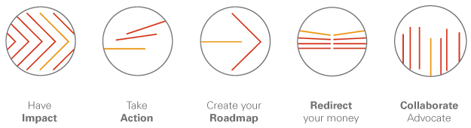

Open Science: Open access to publications (discussed in session ARBI 3 – skip in 2)
  Initiatives
  Tools:
  Issues in Benchmarking Open Access Publications
    Defining Open Access
    Only scientific papers? Or also Popular articles?
    Peer reviewed articles only?
    Only account for papers in an Open Access journal? (Gold)
    Also count the papers in a repository? (Green) Your local repository, or appearance elsewhere?
    What about articles made open, in traditionally closed journals? (Hybrid)
Notes:
On average 43% of the papers (in 2016) in Sustainability goals are open accessible for all citizens and are not just available to the research community.
Join open access initiatives to share information about open access.
Tools used for benchmarking
Issues in benchmarking; just to name few, but this is discussed in detail in the other session.

Slide 28
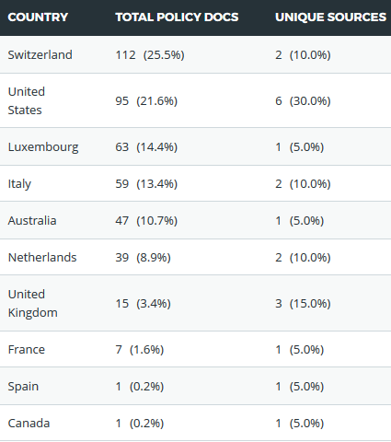
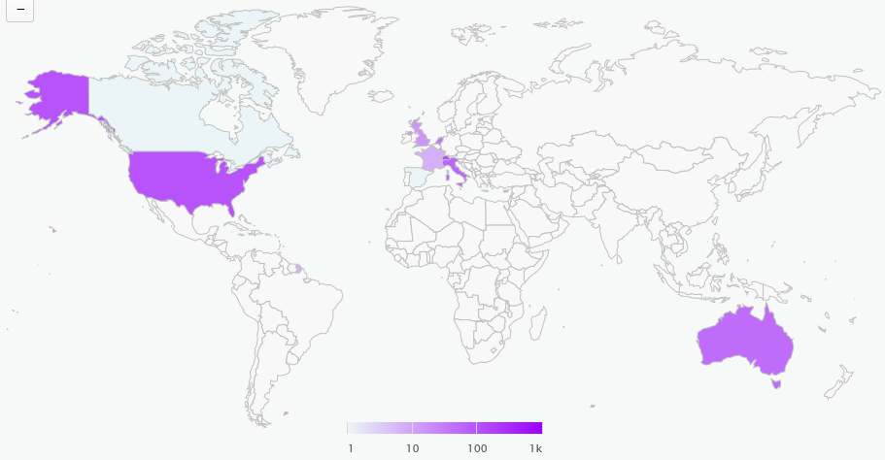
Know and unknown influence on national and international policy
unknown policy influence
Known policy influence
Notes:
Research reached into policy. We see what SDG papers are referred to in policy documents.
When we zoom into Climate change papers. We know we have collaborated actively on incluencing Dutch policy with our research. What we didn’t know, was that we as a by product influenced other international policy. Our span on influence just got much bigger.
Researchers often know what policy papers they have worked on due to active collaboration. But there is a big part they are not aware of what their research influenced policy indirectly.

Slide 29
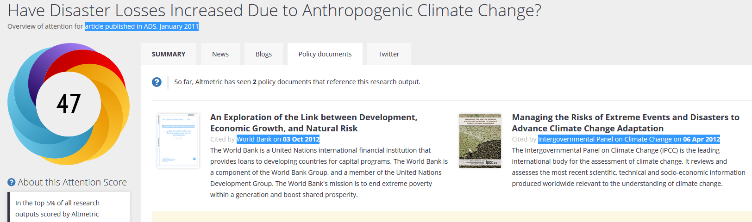
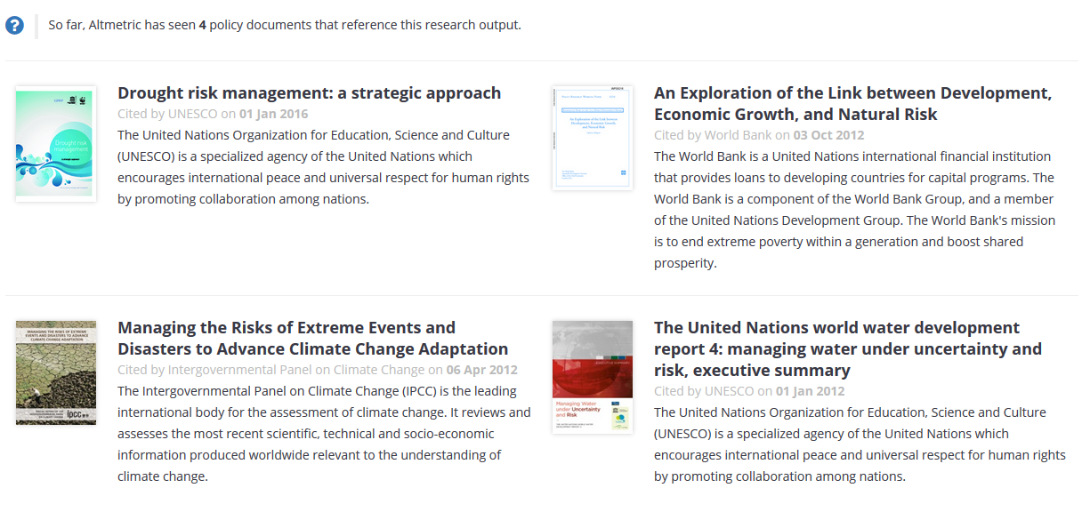
Example of evidence on policy influence of a VU climate change paper on policy
https://research.vu.nl/en/publications/have-disaster-losses-increased-due-to-anthropogenic-climate-chang

Slide 30
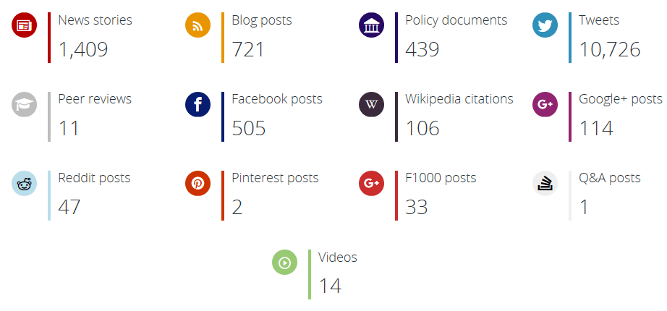
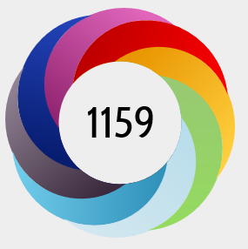
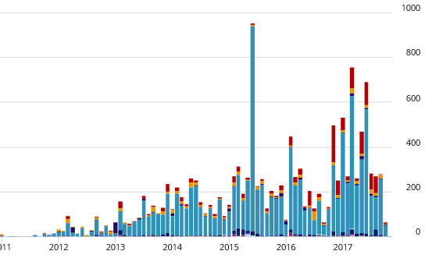
Societal Attention on research Papers: VU research papers on climate change
400+ Policy papers
long term
Lasting effect on society
1400+ News items
short term
10.000+ mentions in
Social media discussions
fast
slow
Speed of information
https://www.altmetric.com/explorer/report/fcca2502-18d6-40da-8807-cb2a1db62f94

Slide 31

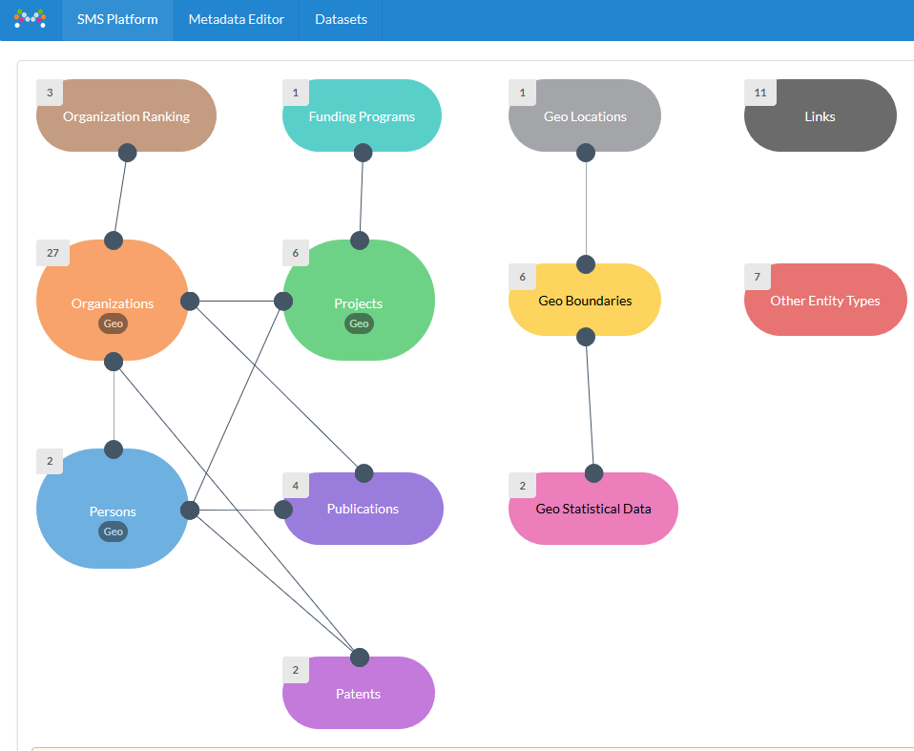

Societal impact of Research elements as Linked data
https://risis.eu/

Slide 32
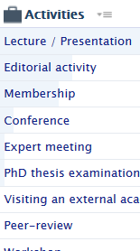
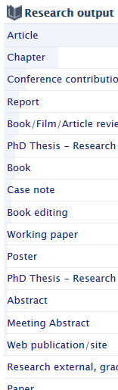
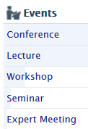






Gross Academic Value at VU | USING PURE in Making Academic Value Visible
Simplified example of GAV template; under discussion by VU researchers and HRM
ACASI
AurorA Catalogue of Societal Impact
Level: Institute|Faculty|Department|Individual
Contribute to a better world
Shaping academic character
Embracing diversity
Immersing in society
Narrative: Motivation | Past | Future
Based on evidence:
Activities
Output
Impact
Pursuit of knowledge
Transfer of knowledge
Policy docs
Address complex (societal) problems
Enhance societal understanding of complex problems
Communal service in academia
https://youtu.be/AksSQE9rfE4

Slide 33
Aurora catalogue of Societal impact – show cases on societal relevant themes
ACASI
Differentiate showcases on each SDG or SC?

Slide 34
Questions for Societal impact collaboration in AURORA
Is the Gross Academic Value template a useful framework to use in the aurora catalogue of societal impact (ACASI)?
Is it an idea to differentiate the show cases on the SDG and SC topics?
Aurora institutions who use a RIS (eg. PURE), is it an idea to share the other elements (projects, activities, awards, etc.) that relate to a SDG/SC?
Present results in next AurorA SIRR meetup?
Notes:
Why? Set an European standard.
By products:

Slide 35
End of explanation 2

