Slide 1


Envisioning the Future of DDI in the Metadata Landscape
Hilde Orten, Chair, DDI Scientific Board
Jared Lyle, Executive Director, DDI Alliance
Jon Johnson, Chair, DDI Executive Board
European DDI User Conference
28 November 2023
License: Creative Commons Attribution 4.0 International (CC BY 4.0)
Notes:
https://events.geant.org/event/1457/contributions/1610/
Nov 28, 2023, 4:20 PM
1h 10m
Hotel Slon (Slovenska cesta 34 1000 Ljubljana Slovenia)
Complete Session User Needs, Efficient Infrastructures and Improved Quality DDI Alliance Plenary
Speakers
Hilde Orten (Sikt - Norwegian Agency for Shared Services in Education and Research)
Jared Lyle (ICPSR, University of Michigan)
Jon Johnson (CLOSER, UCL)
Description
Join the chairs of the DDI Executive Board and the DDI Scientific Board, as well as the DDI Executive Director, to discuss Alliance priorities and plans, especially with an eye toward user and member needs. Engage in thoughtful conversations and Q&A, especially as we envision DDI's strategic role in the exciting future of metadata.

Slide 2
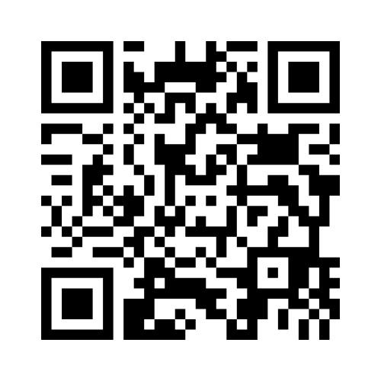

Feedback!

Slide 3

DDI is being used in over 80 countries around the world!
Notes:
We want to start with organizational context about DDI
DDI = Data Documentation Initiative
A free and open international metadata standard
Used primarily in the social and behavioural sciences, economics, health
An open standard designed for data sharing and reuse
A structure for describing data and its related information
Describes data from surveys and other observation-based data collection methods
Currently moving towards covering new data types and data from new domains.
Source: Beuster, Benjamin, & Fry, Jane. (2020, November). What can DDI do for you? An introduction to the DDI. Presented at the 12th Annual European DDI User Conference (EDDI20), Zenodo. http://doi.org/10.5281/zenodo.4298302

Slide 4
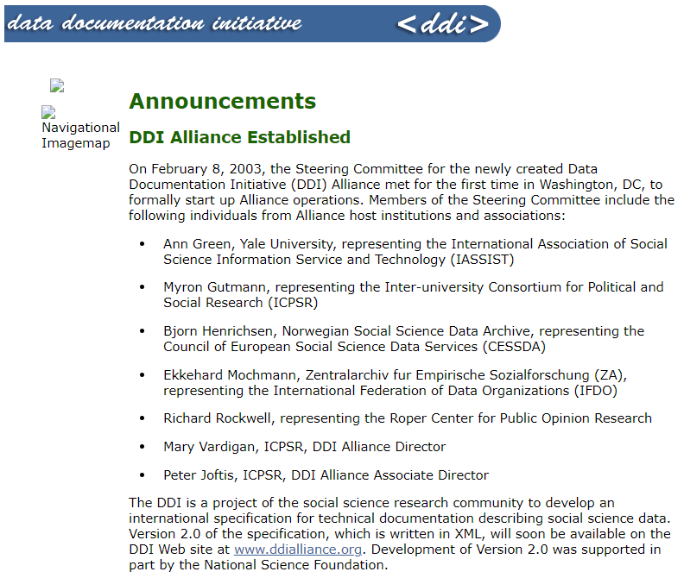
http://web.archive.org/web/20030620084125/http://www.icpsr.umich.edu/DDI/announce.html#alliance
Notes:
They needed a way to support the continued development of the DDI specification. A self-sustaining membership Alliance was organized, which provided funding and an organizational structure to support the products and activities.
“It was becoming clear that generating external funding to support continued development of the DDI specification would be challenging so another approach was considered: becoming a self-sustaining membership Alliance, modeled along the lines of the successful World Wide Web Consortium.
“In June 2002, the DDI Committee met in Storrs, CT, in conjunction with the IASSIST meeting. The main focus of this meeting was a draft charter, written by Richard Rockwell, to create a DDI Alliance – a new membership structure and funding base that would provide support so that the initiative could continue. The charter document provided for an Expert Committee with representation from the DDI Alliance membership, with each member of the Committee having a vote and thus a say in the future of the DDI. A Steering Committee to provide oversight was also established via the charter.
“The final meeting of the original DDI Committee was held in February 2003, in Washington, where the group approved numerous changes to the DTD leading to the publication of DDI 2.0 (see above). An Open Meeting of the DDI Alliance was held in conjunction with IASSIST in Ottawa in May 2003. Meeting participants discussed the new Alliance structure and elements of a Strategic Plan for the next three years of the Alliance.”
Source: Vardigan, M. (2014). The DDI Matures: 1997 to the Present. IASSIST Quarterly, 37(1-4), 45. https://doi.org/10.29173/iq501

Slide 5
DDI Alliance
Self-sustaining member organization (created in 2003)
Members have a voice in DDI development
Organizational structure
  Executive Board - The policymaking and oversight body of the Alliance.
  Scientific Board - Facilitates the scientific and technical work activities.
  Technical Committee - Maintains and updates the various DDI products, in collaboration with the different working groups of the DDI Alliance.
  Working Groups - Convened to work on different activities and topics within the work areas of the DDI Alliance.
Source: Beuster, Benjamin, & Fry, Jane. (2020, November). What can DDI do for you? An introduction to the DDI. Presented at the 12th Annual European DDI User Conference (EDDI20), Zenodo. http://doi.org/10.5281/zenodo.4298302

Slide 6
Funding Support (FY23)
Scientific Board -- In-Person Meeting
DDI Technical Committee -- In-Person Meeting, Administrative Data Workshop in collaboration with CLOSER, Infrastructure support
DDI Training Working Group -- Workshops and Webinars
DDI-CDI Working Group -- In-Person Meeting, Syntax Representations/Support for User Software Tools
Dagstuhl Organizers Group
“DDI-CDI: Realising interoperable data services in the metadata ecosystem” Dagstuhl workshop
"Defining a core metadata framework for cross-domain data sharing and reuse" Dagstuhl workshop
DDI Developers Working Group -- Hackathon
DDI website migration

Slide 7
Join Us!
Funding support for DDI products, services, and activities.
Vote on Alliance products, including additions and modifications to specifications.
Be elected to Alliance leadership, including the Executive Board and the Scientific Board.
Have a seat at annual meetings, including the Annual Meeting of Members and the Annual Meeting of the Scientific Community.
Participate on working groups, which develop DDI products and advise DDI leadership.
Notes:
If you are planning on implementing DDI in your institution, you should look into the DDI Alliance. Being part if it means being able to give input when they are discussing changes, edits, new formatting, …

Slide 8
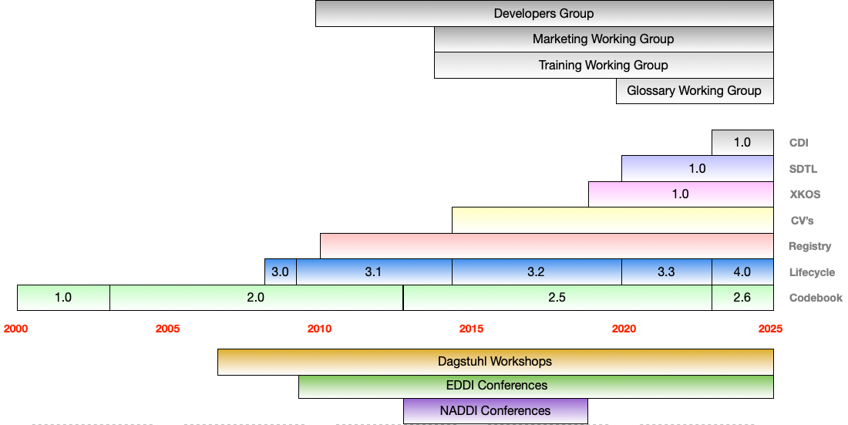
It’s been a busy 20+ years

Slide 9
Question:
What are some of the things that you were really pleased or excited about with DDI in 2023?

Slide 10
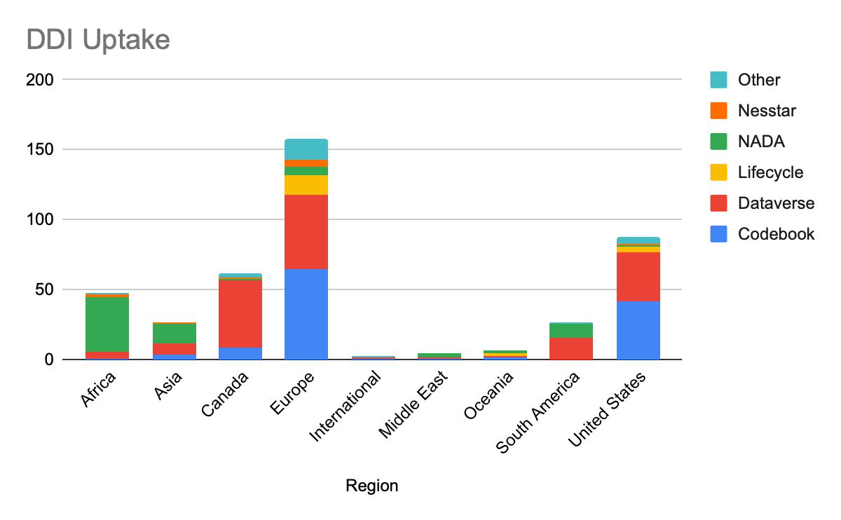
How is DDI being used?
DDI-Codebook is the major use case for most data sharing
Not only Europe, USA and Canada!
Half of the repositories in re3data support DDI

Slide 11
Challenges
Adoption of DDI standards by existing or emerging infrastructures,
More diverse user base as DDI spreads outside of our traditional ‘stronghold’ of social science Archives and NSO’s.
Interoperability of these with each other and wider infrastructures e.g. EOSC and non-traditional data
Secular trend towards Trusted Research Environments and ‘metadata privacy issues’

Slide 12
Question:
What challenges are you or your organization currently facing that you need DDI products and/or services to solve?

Slide 13
Opportunities
Funder adoption of FAIR and statements of need for metadata and recommendation for specific standards
Mature standards with established user bases that solve real problems of data transparency
Emergence of metadata only platforms, CESSDA, EOSC
Developing further the DDI Community

Slide 14

DDI in the standards landscape
Catalogs
Findability
Interoperability
Structural standards
Reusability
Vocabularies
Findability

Slide 15
Our committees and working groups
TC
Technical Committee
CDI
DDI-Cross Domain Integration Working Group
SDTL
The Structured Language Transformation Working Group
XKOS
The Extended Knowledge Organization System Working Group
Developers
The Developers Working Group

Slide 16
Our working groups
CV
Training
Controlled Vocabularies Working Group
Training Working Group
Glossary
Glossary Working Group
RDF Equivalence
Marketing
RDF Equivalence Working Group
Marketing Working Group.
Under the EB.
Reestablishment ongoing
Paradata
Paradata Working Group

Slide 17
Outlook
DDI - from a single product to a suite of products
Look ahead and address emerging needs
  New technologies, cross-domain research, modularity, interoperability between DDI products as well as with DDI products and other standards
Maintenance and refinement of existing products
Collaboration with other standards bodies and organisations
  W3C, UNECE, ISO, CODATA
Training, outreach and engagement

Slide 18
Question:
What are important focus points for the scientific and technical work of the DDI Alliance in the next two years?

Slide 19
Question:
What DDI training opportunities would you like to see in the next year?

Slide 20
Thank you!
Please visit https://ddialliance.org/ or contact secretariat@ddialliance.org to:
Join a working group
Subscribe to DDI mailing lists
Become a DDI Alliance member

