Slide 1
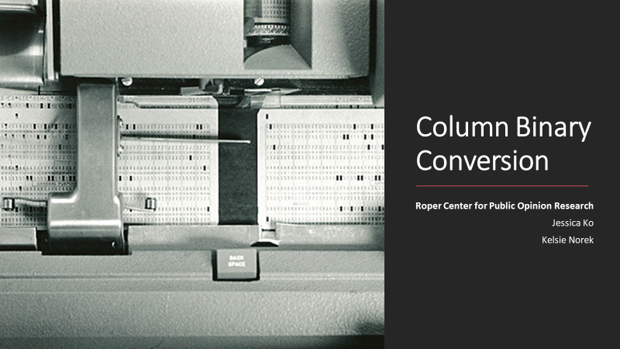
DCN Webinar
Thursday, December 14, 2023

Slide 2
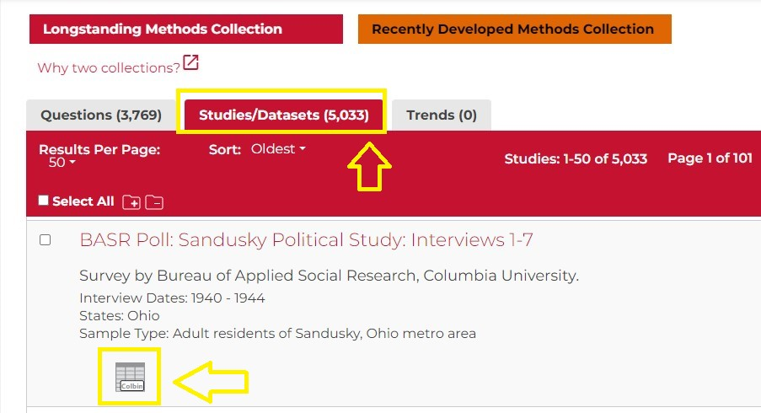
iPoll Search Results

Slide 3
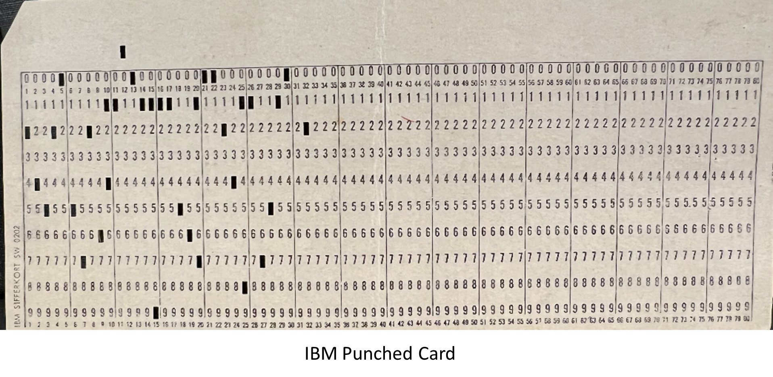

Slide 4
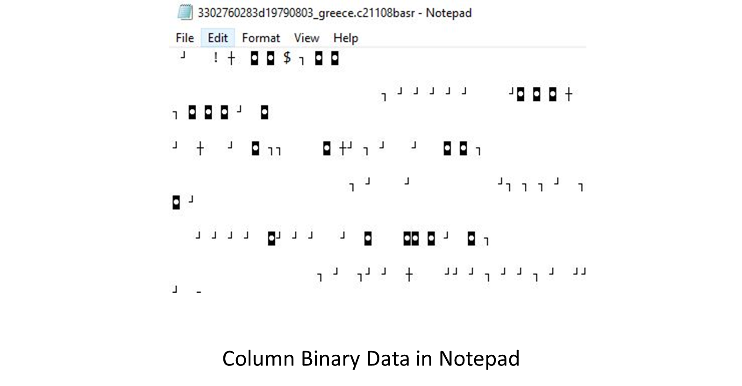

Slide 5
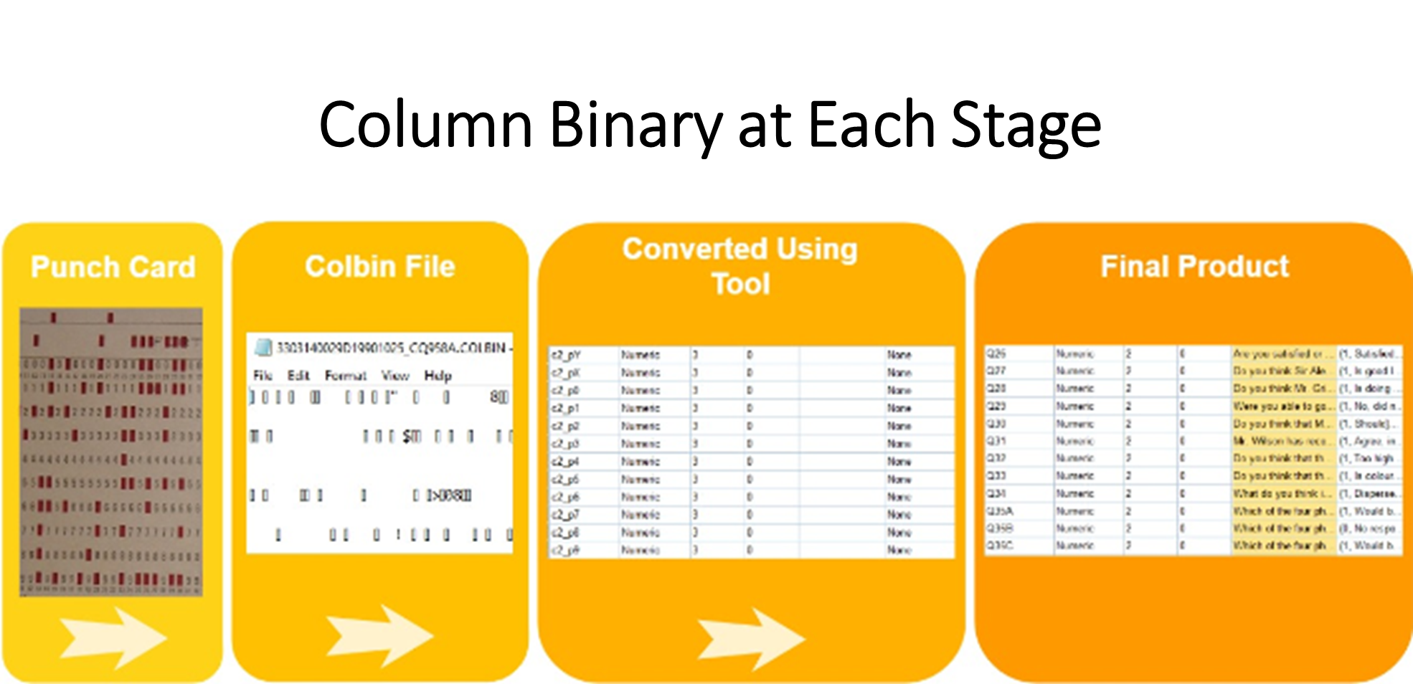
SAS
SAS

Slide 6
Column Binary Conversion: CURATE Steps
Check: Verify file type
Understand: Review raw data and check against codebook
Request: Identify potential sources of missing information
Augment: Recode, label, and clean raw data
Transform: Save converted data in multiple formats
Evaluate: Evaluate data for FAIRness
  Findability
  Accessibility
  Interoperability
  Reusability

Slide 7
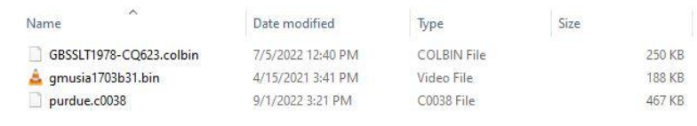
Column Binary Conversion: CURATE Steps
Check: Verify file type

Slide 8
Column Binary Conversion: CURATE Steps
Check: Verify file type
Understand: Review raw data and check against codebook
Request: Identify potential sources of missing information
Augment: Recode, label, and clean raw data
Transform: Save converted data in multiple formats
Evaluate: Evaluate data for FAIRness
  Findability
  Accessibility
  Interoperability
  Reusability

Slide 9
Contributions and Future Directions
Format description
Key considerations
Step-by-step guide to conversion process
Recommendations for metadata and curation documentation
Future primers: Focus on conversion using specific software (e.g., R)

Slide 10
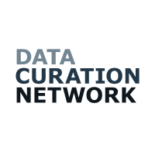

Thank you for your time!
Contact: Jessica Ko (jessica.ko@cornell.edu); Kelsie Norek (kn397@cornell.edu)
Additional information:
Primer available at: https://github.com/DataCurationNetwork/data-primers/blob/master/Column%20Binary%20Data%20Curation%20Primer/column-binary-data-curation-primer.md
Affiliate Contributors (peer reviewers): Marley Kalt, Jane Fry
DCN Mentors: Wendy Kozlowski – Cornell University, Neggin Keshavarzian – Princeton University
Special thanks to Mikala Narlock for making it all possible

