Slide 1

UK TRE Community meeting
5th December 2023

Slide 2
Agenda
13:30 - 13:45 - Welcome and introduction
13:45 - 14:30 - ‘Keynote’ - UK TRE Community update
14:30 - 14:45 - Community updates
14:45 - 14:55 - Break
15:00 - 15:45 - Breakout session 1
15:45 - 15:55 - Break
16:00 - 16:45 - Breakout session 2
16:45 - 17:00 - Wrap up
5th December 2023
UK TRE Community meeting

Slide 3
Agenda
13:30 - 13:45 - Welcome and introduction
13:45 - 14:30 - ‘Keynote’ - UK TRE Community update
14:30 - 14:45 - Community updates
14:45 - 14:55 - Break
15:00 - 15:45 - Breakout session 1
15:45 - 15:55 - Break
16:00 - 16:45 - Breakout session 2
16:45 - 17:00 - Wrap up
5th December 2023
UK TRE Community meeting

Slide 4
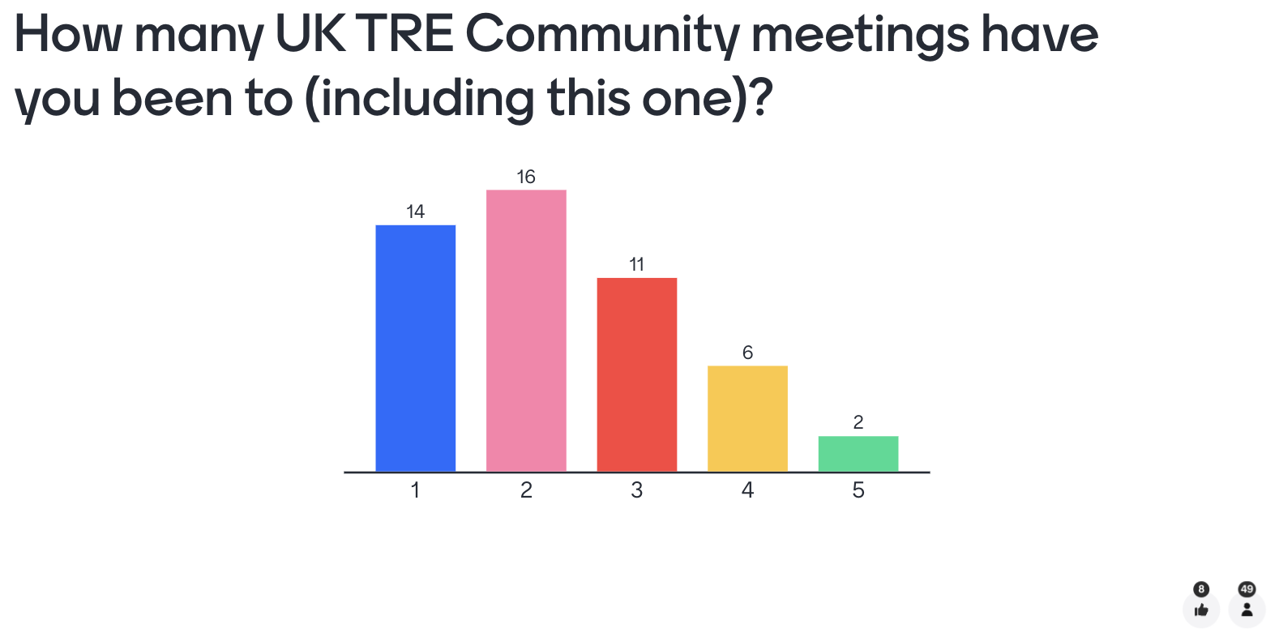
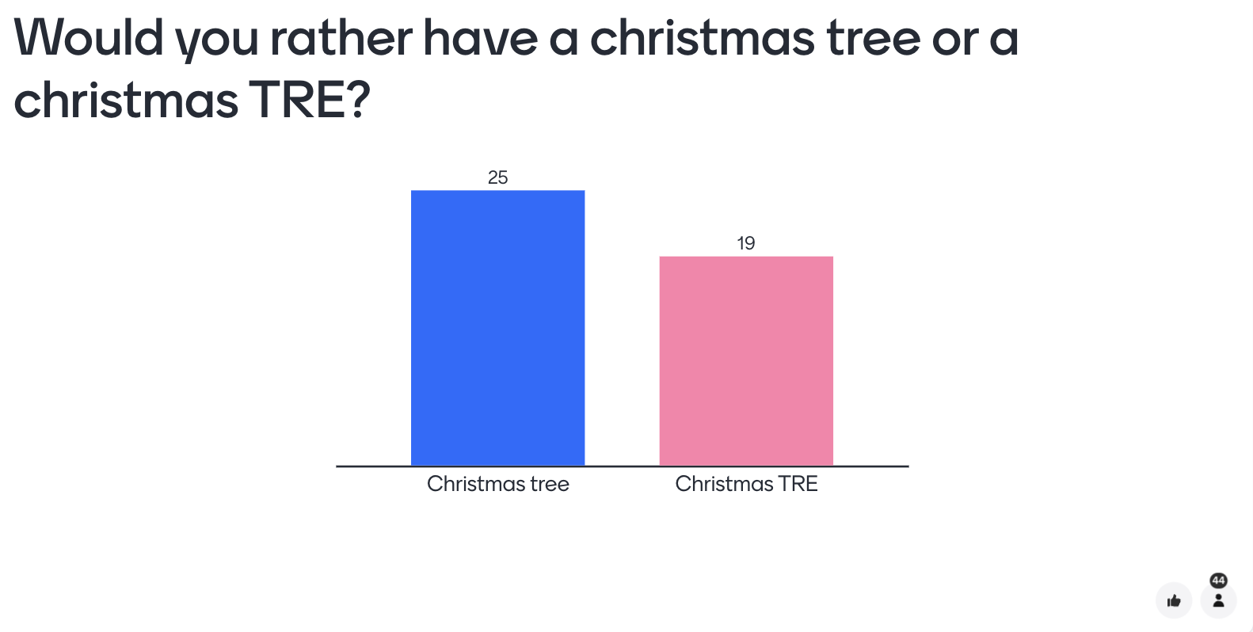
Some quick questions…
5th December 2023
UK TRE Community meeting

Slide 5
Housekeeping
HackMD: https://hackmd.io/lM_bv4q9QhOswMHvyD7NLg
Agenda: https://www.uktre.org/en/latest/events/wg_workshops/2023-12-05-december-meeting/index.html
Co-chairs are here to help!
  Hari, David, Simon, Madalyn, Lucy, Balint
Questions can go in chat (or raise your virtual hand)
Recording - keynote and community updates, breakout rooms we are relying on notes!
5th December 2023
UK TRE Community meeting

Slide 6
Agenda
13:30 - 13:45 - Welcome and introduction
13:45 - 14:30 - ‘Keynote’ - UK TRE Community update
14:30 - 14:45 - Community updates
14:45 - 14:55 - Break
15:00 - 15:45 - Breakout session 1
15:45 - 15:55 - Break
16:00 - 16:45 - Breakout session 2
16:45 - 17:00 - Wrap up
5th December 2023
UK TRE Community meeting

Slide 7
5th December 2023
UK TRE Community meeting
Notes:
Today’s presentation is about the latest updates from the UK TRE Community - we’ve recently gone through a number of changes, and momentum is really building!

Slide 8
Why?
5th December 2023
UK TRE Community meeting
Notes:
We’ll cover:
Why - Why does the community exist, and what is it trying to achieve? This can be considered the community ‘vision’

Slide 9
How?
Why?
5th December 2023
UK TRE Community meeting
Notes:
How - How is the community set up to achieve this vision? This can be considered the community ‘mission

Slide 10
What?
How?
Why?
5th December 2023
UK TRE Community meeting
Notes:
What - What is the community doing right now and for the next few months in line with this mission?

Slide 11
What?
How?
Who?
Why?
5th December 2023
UK TRE Community meeting
Notes:
There is also the question of who and where, but those questions are simply answered:
Who = Anyone who wants to be involved, is on the mailing list or who joins these meetings

Slide 12
What?
How?
Who?
Where?
Why?
5th December 2023
UK TRE Community meeting
Notes:
Where = Our communication channels, website, repos and these quarterly meetings. More info can be found on https://www.uktre.org/en/latest/

Slide 13
What?
How?
Why?
5th December 2023
UK TRE Community meeting

Slide 14
Why?
5th December 2023
UK TRE Community meeting
Notes:
To answer the question of why, we can take a lesson from the world of philosophy

Slide 15
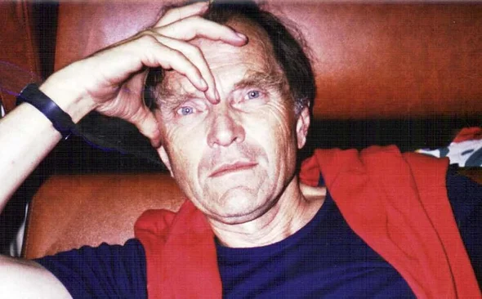
Why?
5th December 2023
UK TRE Community meeting
Notes:
This is Paul Feyerabend, a 20th century German philosopher who promoted a version of ‘epistemological anarchism’

Slide 16

Why?
5th December 2023
UK TRE Community meeting
Notes:
One of his most famous works is the book ‘Against Method’, which is, amongst other things, a critique of rationality and the scientific method.
Whilst there are many great ideas in this book, to elucidate the focus of the UK TRE community we will centre on one particular concept

Slide 17
Why?
Knowledge
5th December 2023
UK TRE Community meeting
Notes:
Feyerabend introduces the question of how new discoveries, methods, concepts and ideas eventually become new ‘knowledge’.
In this very basic visualisation, you can consider the dotted line to represent the surface of all current knowledge, i.e., what we currently know. This can equally apply to all knowledge humanity has, or particular domains
There is no particular measurement on the X or Y axis above

Slide 18
Why?
Knowledge
5th December 2023
UK TRE Community meeting
Notes:
Feyerabend is interested in understanding how we can consider knowledge to have ‘grown’

Slide 19
Why?
Knowledge
5th December 2023
UK TRE Community meeting
Notes:
He argues that knowledge doesn’t simply ‘improve’, but there is a more nuanced way that knowledge develops

Slide 20
Why?
Knowledge
5th December 2023
UK TRE Community meeting
Notes:
Let’s start back at the beginning, where knowledge is currently at
Feyerabend’s argument proceeds thus (in the next slides)

Slide 21
Why?
Knowledge
5th December 2023
UK TRE Community meeting
Notes:
The journey to new knowledge begins when someone comes up with a new concept, theory or method that is in some way different, in contradiction or in tension with the pre-existing accepted body of knowledge
By itself, this is just a new, radical, unaccepted concept

Slide 22
Why?
Knowledge
5th December 2023
UK TRE Community meeting
Notes:
Eventually a new concept will emerge in a similar way (in contradiction to the pre-existing body of knowledge)
Again, by itself it is just a new, contradictory, radical concept

Slide 23
Why?
Knowledge
5th December 2023
UK TRE Community meeting
Notes:
However, interesting things start to happen when we realise that the new concepts actually complement each other

Slide 24
Why?
Knowledge
5th December 2023
UK TRE Community meeting
Notes:
Eventually more and more new concepts, all somehow incompatible with the pre-existing level of knowledge, emerge

Slide 25
Why?
Knowledge
5th December 2023
UK TRE Community meeting
Notes:
And as they complement the other new theories, stronger ties are made

Slide 26
Why?
Knowledge
5th December 2023
UK TRE Community meeting

Slide 27
Why?
Knowledge
5th December 2023
UK TRE Community meeting

Slide 28
Why?
Knowledge
5th December 2023
UK TRE Community meeting

Slide 29
Why?
Knowledge
5th December 2023
UK TRE Community meeting
Notes:
This continues until there are many new concepts, all connected that in some way sit ‘beyond’ our current accepted knowledge

Slide 30
Why?
Knowledge
5th December 2023
UK TRE Community meeting
Notes:
This new ‘level’ can be considered a new knowledge level that supersedes what we had before

Slide 31
Why?
Knowledge
5th December 2023
UK TRE Community meeting
Notes:
And in this way new knowledge is adopted

Slide 32
Why?
UK TRE progress
5th December 2023
UK TRE Community meeting
Notes:
We can use this theory of knowledge development for the UK TRE Community
Consider this current level to now not be knowledge, but UK TRE progress in the UK
How can we move it forwards?

Slide 33
Why?
NHS SDEs
UK TRE progress
5th December 2023
UK TRE Community meeting
Notes:
We may have new developments, that in some way go further than where we were before
These could be the development of new TREs, for instance the NHS SDEs

Slide 34
Why?
DEA accreditation
NHS SDEs
UK TRE progress
5th December 2023
UK TRE Community meeting
Notes:
It could be the development of new standards/accreditations

Slide 35
Why?
Goldacre review
DEA accreditation
NHS SDEs
UK TRE progress
5th December 2023
UK TRE Community meeting
Notes:
It could be reports and recommendations for future work

Slide 36
Why?
Goldacre review
DEA accreditation
DARE federated architecture
NHS SDEs
UK TRE progress
5th December 2023
UK TRE Community meeting
Notes:
Or frameworks and architectures that others can adopt

Slide 37
Why?
Goldacre review
TRE-FX
PEDRI
DEA accreditation
DSPT
SDAP
ISO27001
SATRE
SAIL
TELEPORT
DARE federated architecture
TREEHOOSE
Turing Data Safe Haven
SARA
RDA
NHS SDEs
openSAFELY
UK TRE progress
5th December 2023
UK TRE Community meeting
Notes:
At the moment, there are so many new and latest developments in the UK TRE space
However, like new concepts, if they stand alone, all they are are individual ideas or developments, that don’t represent wider progress

Slide 38
Why?
Goldacre review
TRE-FX
PEDRI
DEA accreditation
DSPT
SDAP
ISO27001
SATRE
SAIL
TELEPORT
DARE federated architecture
TREEHOOSE
Azure TRE
Turing Data Safe Haven
SARA
RDA
NHS SDEs
openSAFELY
UK TRE progress
5th December 2023
UK TRE Community meeting
Notes:
If, however, we manage to connect all these new developments effectively, we start to see a wider shift in UK TRE progress

Slide 39
Why?
Goldacre review
TRE-FX
PEDRI
DEA accreditation
DSPT
SDAP
ISO27001
SATRE
SAIL
TELEPORT
DARE federated architecture
TREEHOOSE
Azure TRE
Turing Data Safe Haven
SARA
RDA
NHS SDEs
openSAFELY
UK TRE progress
5th December 2023
UK TRE Community meeting

Slide 40
Why?
UK TRE progress
5th December 2023
UK TRE Community meeting
Notes:
And in this way we can say we have moved forwards

Slide 41

Why?
UK TRE progress
5th December 2023
UK TRE Community meeting

Slide 42
Why?
Goldacre review
TRE-FX
PEDRI
DEA accreditation
DSPT
SDAP
ISO27001
SATRE
SAIL
TELEPORT
DARE federated architecture
TREEHOOSE
Azure TRE
Turing Data Safe Haven
SARA
RDA
NHS SDEs
openSAFELY
UK TRE progress
5th December 2023
UK TRE Community meeting
Notes:
Using this analogy, we can see where the UK TRE Community plays a role

Slide 43
Why?
Key:
UK TRE community
Goldacre review
TRE-FX
PEDRI
DEA accreditation
DSPT
SDAP
ISO27001
SATRE
SAIL
TELEPORT
DARE federated architecture
TREEHOOSE
Azure TRE
Turing Data Safe Haven
SARA
RDA
NHS SDEs
openSAFELY
UK TRE progress
5th December 2023
UK TRE Community meeting
Notes:
We see the UK TRE Community existing to be the connecting force, i.e. the blue lines, between all this work
Doing so effectively means we can see where there are connections, where there are differences, and where consensus for moving forward together can be achieved

Slide 44
The UK TRE community
Vision
5th December 2023
UK TRE Community meeting
Notes:
Based on this, we want to introduce a first version of a vision and mission for the community

Slide 45
The UK TRE community
To have a four nations, coordinated, collaborative approach to research infrastructure for working with sensitive data
Vision
5th December 2023
UK TRE Community meeting

Slide 46
The UK TRE community
To have a four nations, coordinated, collaborative approach to research infrastructure for working with sensitive data
Vision
Mission
5th December 2023
UK TRE Community meeting

Slide 47
The UK TRE community
To have a four nations, coordinated, collaborative approach to research infrastructure for working with sensitive data
Vision
To provide the space to signpost, share knowledge and facilitate conversations across the UK TRE landscape
Mission
5th December 2023
UK TRE Community meeting

Slide 48
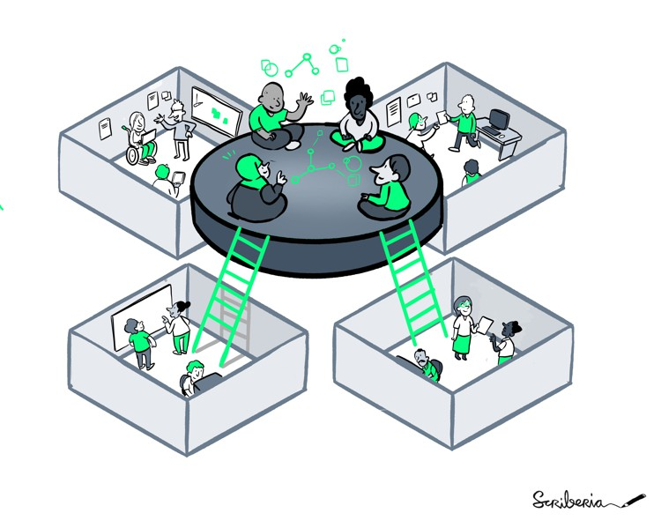
The UK TRE community
Foster collaboration
Vision
Knowledge exchange
To have a four nations, coordinated, collaborative approach to research infrastructure for working with sensitive data
Avoid duplication
Mission
To provide the space to signpost, share knowledge and facilitate conversations across the UK TRE landscape
Move towards standardisation
Share best practice
5th December 2023
UK TRE Community meeting
Notes:
This is similar to conversations we had in September about what we see as the function for the UK TRE Community

Slide 49
The UK TRE community
Foster collaboration
Vision
Knowledge exchange
To have a four nations, coordinated, collaborative approach to research infrastructure for working with sensitive data
Driven by community needs!
Avoid duplication
Mission
To provide the space to signpost, share knowledge and facilitate conversations across the UK TRE landscape
Move towards standardisation
Share best practice
5th December 2023
UK TRE Community meeting
Notes:
The key here is our perceived role as facilitators, rather than drivers - a lot of great work is already happening and we want to make sure it is joined up effectively. We have no set agenda ourselves apart from doing this, and being driven by what the community needs

Slide 50

UK TRE Community: A history
4th September 2023
UK TRE Community meeting
Notes:
A brief bit of history about the UK TRE Community
We started in September 2022 with a meeting of approx. 30 people at a satellite event to the RSE Conference in Newcastle

Slide 51
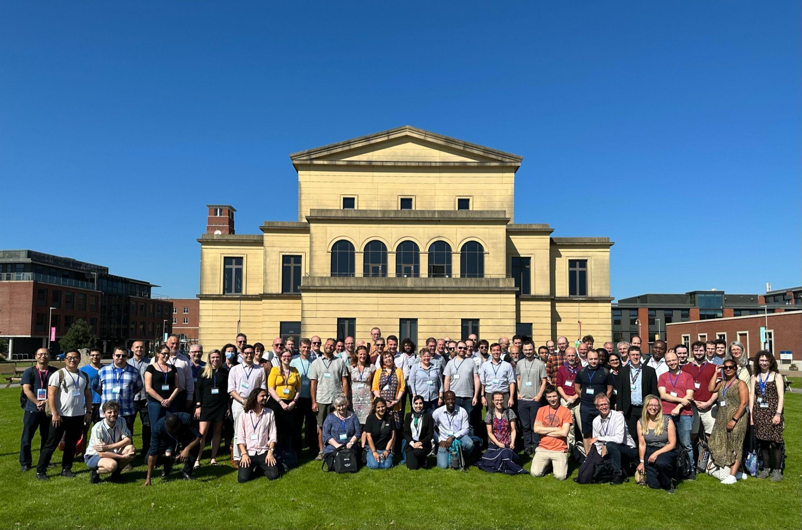
UK TRE Community: A history
4th September 2023
UK TRE Community meeting
Notes:
We have grown over the last year, through our working groups and quarterly meetings, and in September 2023 had the biggest meetup of people working in, or interested in, the UK TRE space to day, with over 150 people attending (100 in person in Swansea - photo above - and over 50 online)

Slide 52
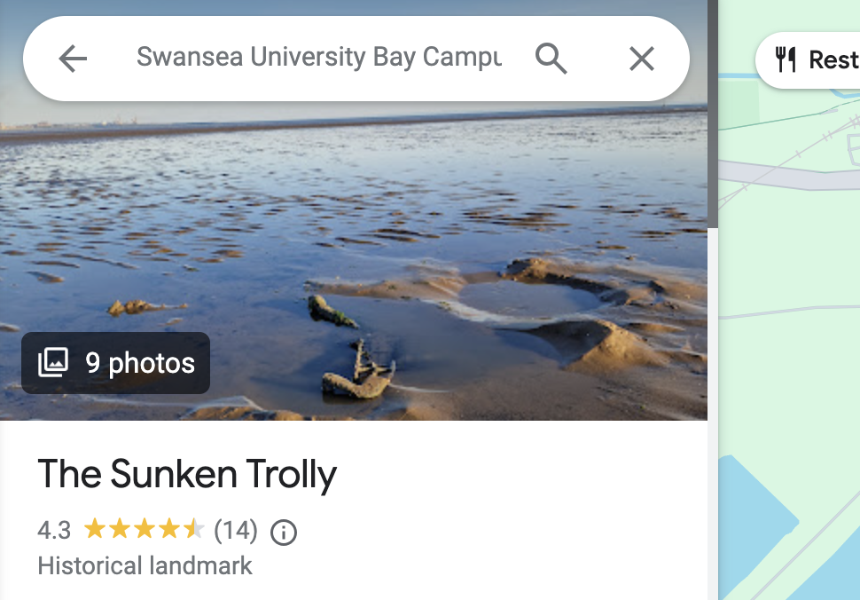
UK TRE Community: A history
4th September 2023
UK TRE Community meeting
Notes:
We also made a few expeditions out to ‘The Sunken Trolly’, thank you those who joined!

Slide 53
What are we doing now?
5th December 2023
UK TRE Community meeting

Slide 54
What are we doing now?
March 2024
5th December 2023
UK TRE Community meeting

Slide 55
What are we doing now?
Current delivery
Future plans
March 2024
5th December 2023
UK TRE Community meeting
Notes:
In terms of thinking about the timelines for the community, we are thinking in terms of a key split in March 2024 - before then is our current focus, and after then is our future plans

Slide 56
What are we doing now?
Current delivery
March 2024
5th December 2023
UK TRE Community meeting
Notes:
The rest of this talk is focused on our current delivery

Slide 57
DARE Community Funding
5th December 2023
UK TRE Community meeting
Notes:
March 2023 represents a key checkpoint as we have received DARE community funding that ends in March 2023

Slide 58

DARE Community Funding
5th December 2023
UK TRE Community meeting
Notes:
We are an officially recognised DARE UK Community Interest Group, and received £40,000 funding to take the community to the next level!

Slide 59
DARE Community Funding
Arielle Bennett
Balint Stewart
Chris Cole
Fatemeh Torabi
James Robinson
Katherine O’Sullivan
Lucy Cheesman
Madalyn Hardaker
Simon Li
Stuart Wheater
Will Crocombe
…and more!
Thank you to all these awesome people!
5th December 2023
UK TRE Community meeting
Notes:
Thank you to everyone who helped with the funding proposal!

Slide 60
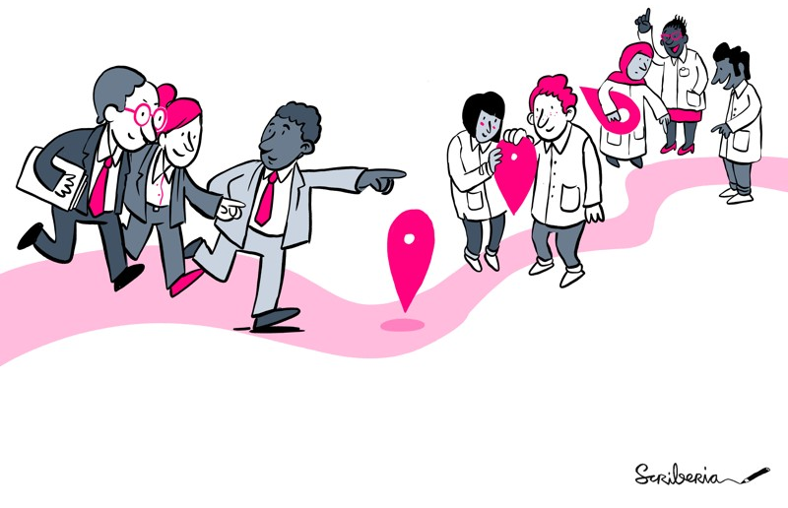
DARE Community Funding
5th December 2023
UK TRE Community meeting

Slide 61
DARE Community Funding
Strengthening the Community
5th December 2023
UK TRE Community meeting

Slide 62
DARE Community Funding
Strengthening the Community
Enhancing outreach and engagement
5th December 2023
UK TRE Community meeting

Slide 63
DARE Community Funding
Strengthening the Community
Enhancing outreach and engagement
Developing a resource hub
5th December 2023
UK TRE Community meeting
Notes:
The funding proposal focused on three main aspects, which make up our focus until March 2023
Strengthening the community
Enhancing outreach and engagement
Developing a resource hub

Slide 64
Strengthening the community
5th December 2023
UK TRE Community meeting

Slide 65
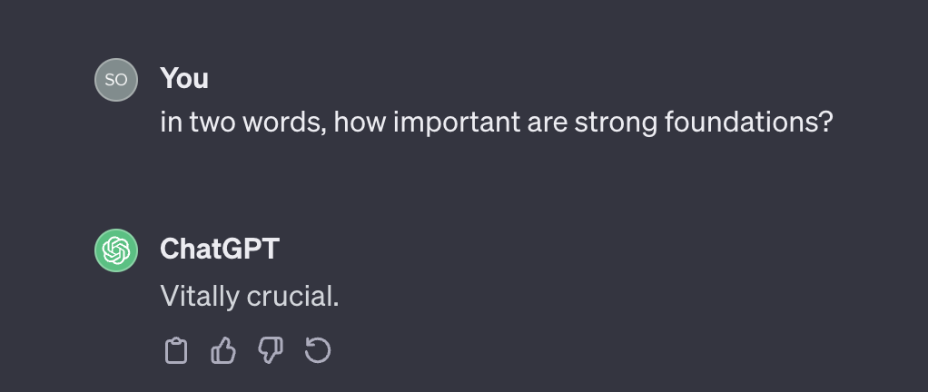
Strengthening the community
5th December 2023
UK TRE Community meeting
Notes:
As ChatGPT confirms, strong foundations are ‘vitally crucial’

Slide 66
Strengthening the community
Governance
5th December 2023
UK TRE Community meeting

Slide 67
Strengthening the community
Roles and responsibilities
Governance
5th December 2023
UK TRE Community meeting

Slide 68
Strengthening the community
Roles and responsibilities
Governance
Membership
5th December 2023
UK TRE Community meeting

Slide 69
Strengthening the community
Roles and responsibilities
Governance
Membership
Governing document
5th December 2023
UK TRE Community meeting
Notes:
We are focusing on setting up the community robustly, through the creation of formal governance methods and processes, including
Roles and responsibilities: Clearly defined roles within the community
Membership: A clear way to become an official member of the community
Governing doc: Reviewing the Newcastle Commitment to ensure it remains up to date and relevant for the community

Slide 70
Strengthening the community
Ways of working
https://github.com/orgs/uk-tre/projects/1
5th December 2023
UK TRE Community meeting
Notes:
We are also setting up a clear way of working, primarily through a Kanban board on GitHub
We will also create guidance docs for how to use this!

Slide 71
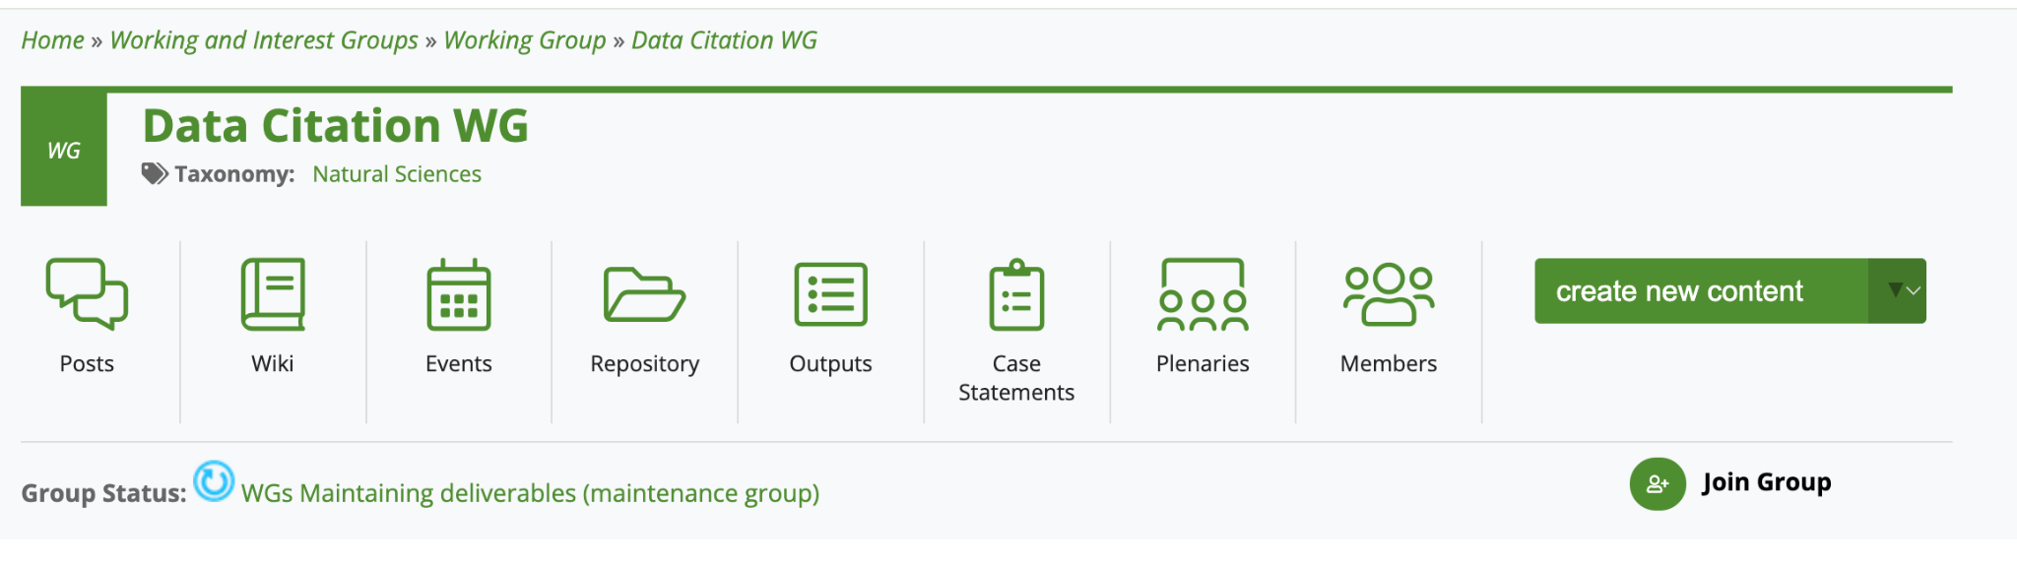
Strengthening the community
Working groups
5th December 2023
UK TRE Community meeting
Notes:
We are also introducing the idea of working groups to take forward specific work packages for the community, modelled heavily of the concept of working groups already in place with the Research Data Alliance

Slide 72
Strengthening the community
Community-based efforts and collaborations in public involvement and engagement
Future governance of the SATRE Specification
TRE sustainability
& operations
Working groups
Safety and security of Python and R package import into TREs
Cloud vs on-prem TREs: costs, constraints, pros & cons
5th December 2023
UK TRE Community meeting
Notes:
We already have a number of suggested working groups for the community, which we’ll work to set up and support through the next few months

Slide 73
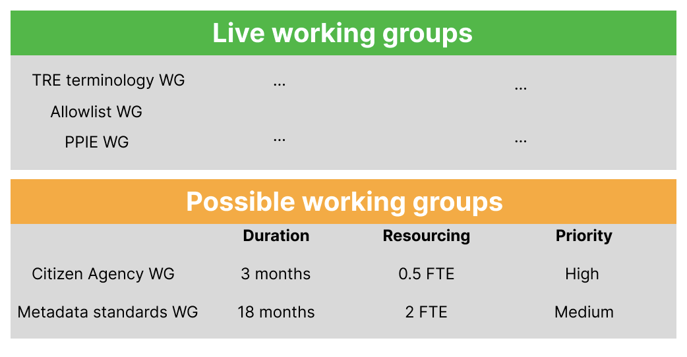
Strengthening the community
Roadmap
5th December 2023
UK TRE Community meeting
Notes:
We also want to create a community roadmap, that lays out:
Live working groups: What work is already happening in the community
Possible working groups: Ideas for working groups that can be picked up by members of the community
These will NOT be exclusive, i.e. to be in the community you won’t have to pick one of these up
They will be more intended for ideas of what the community feels it would be important to work on at some point

Slide 74
Enhancing outreach and engagement
5th December 2023
UK TRE Community meeting

Slide 75
Enhancing outreach and engagement
Landscape review
5th December 2023
UK TRE Community meeting

Slide 76
Enhancing outreach and engagement
Landscape review
Goldacre review
TRE-FX
PEDRI
DEA accreditation
DSPT
SDAP
ISO27001
SATRE
SAIL
TELEPORT
DARE federated architecture
TREEHOOSE
Azure TRE
Turing Data Safe Haven
SARA
RDA
NHS SDEs
openSAFELY
UK TRE progress
5th December 2023
UK TRE Community meeting

Slide 77
Enhancing outreach and engagement
Landscape review
Make this make sense
Goldacre review
TRE-FX
PEDRI
DEA accreditation
DSPT
SDAP
ISO27001
SATRE
SAIL
TELEPORT
DARE federated architecture
TREEHOOSE
Azure TRE
Turing Data Safe Haven
SARA
RDA
NHS SDEs
openSAFELY
UK TRE progress
5th December 2023
UK TRE Community meeting
Notes:
We want to pull together work already done across the community (e.g. DARE, SAIL) to get a realistic picture of what work is currently going on in the community, and how it all links together, to provide an up to date and comprehensive UK TRE landscape

Slide 78
Enhancing outreach and engagement
Communication and collaboration spaces
5th December 2023
UK TRE Community meeting

Slide 79

Enhancing outreach and engagement
Communication and collaboration spaces
Announcements/asks
5th December 2023
UK TRE Community meeting

Slide 80

Enhancing outreach and engagement
Communication and collaboration spaces
Announcements/asks
Discussions/working groups
5th December 2023
UK TRE Community meeting

Slide 81
Enhancing outreach and engagement
Communication and collaboration spaces
Quarterly meetings - couldn’t think of a graphic
Announcements/asks
Discussions/working groups
Collaboration spaces
5th December 2023
UK TRE Community meeting
Notes:
We have a number of spaces, including:
Jisc mailing list - mainly intended for announcements and asks - which is our baseline level of engagement
Slack workspace - for working groups and more in depth conversations. We understand that not everyone has access to Slack, so will also be circulating announcements/key updates via the mailing list
Quarterly meetings - like this one! We are also open to having more synchronous sessions, e.g. town halls or coworking, if that would be helpful - let us know!

Slide 82
Developing a resource hub
5th December 2023
UK TRE Community meeting

Slide 83
Developing a resource hub
Content generation
5th December 2023
UK TRE Community meeting
Notes:
We finally want to develop a rich resource hub for reusing and sharing key tools, code, methods and frameworks across the community
By doing so we hope to see more alignment across the TRE community, where possible, on how we provision this infrastructure, and where differences exist and need to kept separate

Slide 84
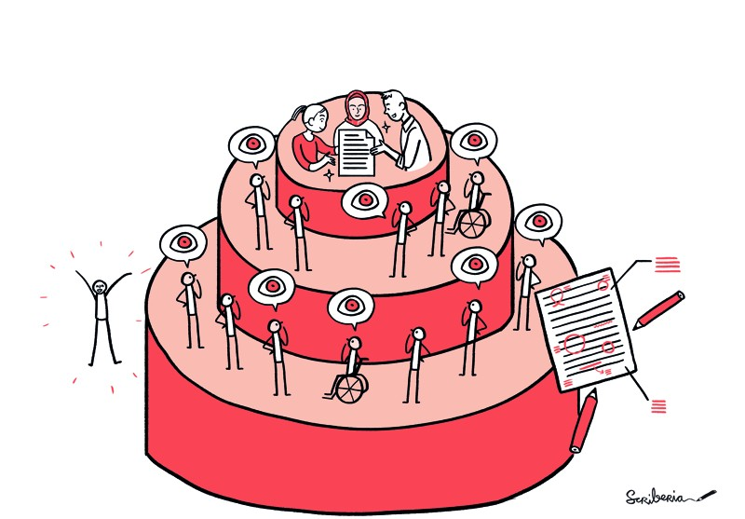
Developing a resource hub
Contribution pathways
Technical and non-technical
Generation and review
Maintenance and support
Roles and positions
5th December 2023
UK TRE Community meeting
Notes:
This resource hub will also contain contribution pathways for the whole community, including:
Technical (e.g. GitHub contributions) and non-technical (e.g. forms and discussions)
Generation (creating and sharing new content) and review (feeding back on provided content)
Maintenance and support (keeping everything up to date)
Roles and positions (different responsibilities to match members’ ability to get involved

Slide 85
Developing a resource hub
Website
5th December 2023
UK TRE Community meeting

Slide 86

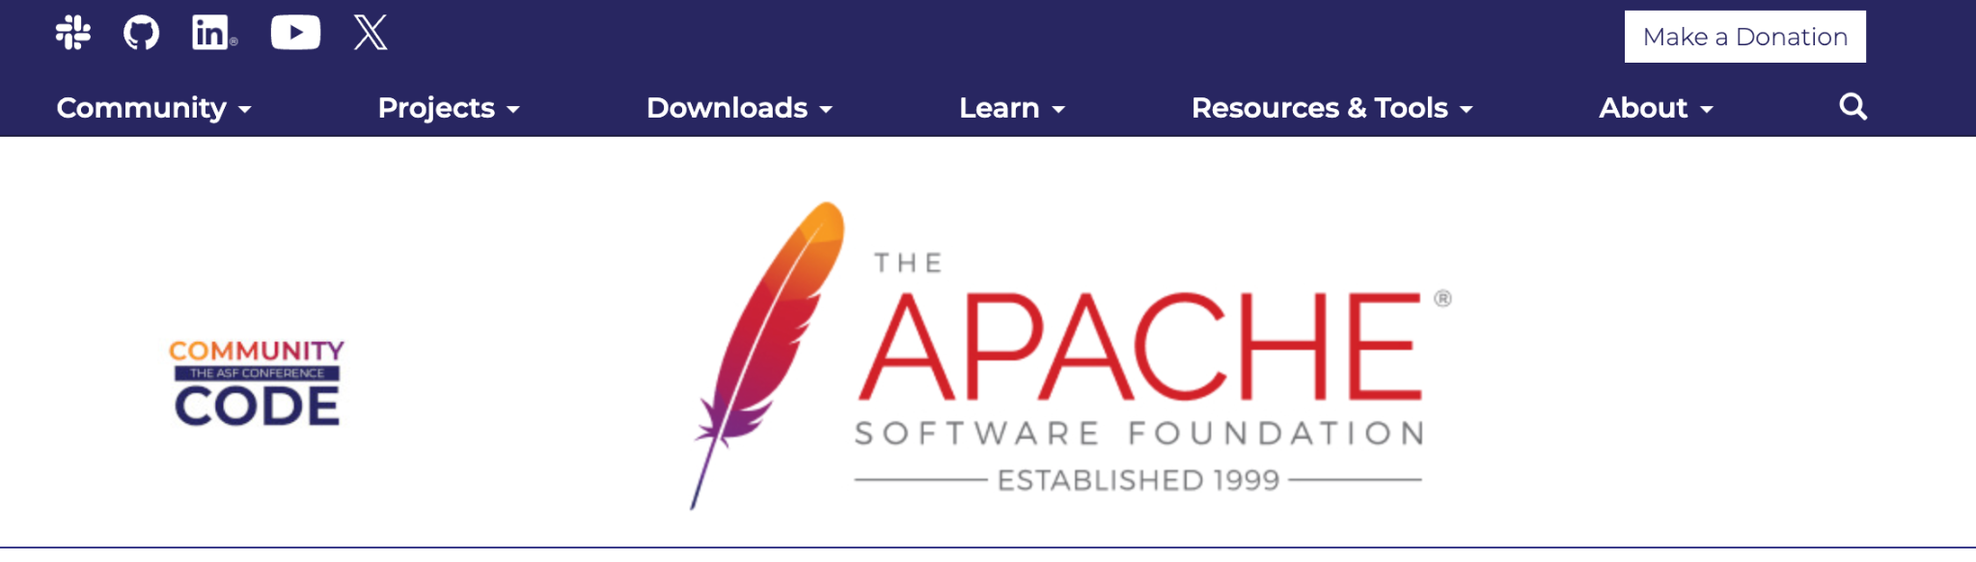
Developing a resource hub
Website
5th December 2023
UK TRE Community meeting
Notes:
Finally, we want the central place for the resource hub to be an easy to navigate website, similar to that of the Software Sustainability Institute, or Apache Foundation

Slide 87
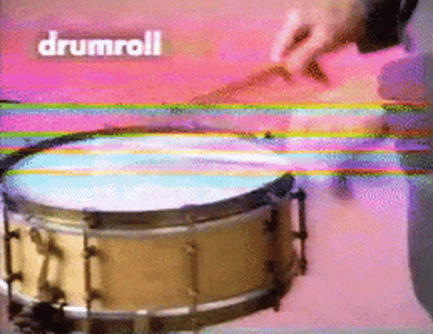
Developing a resource hub
5th December 2023
UK TRE Community meeting

Slide 88
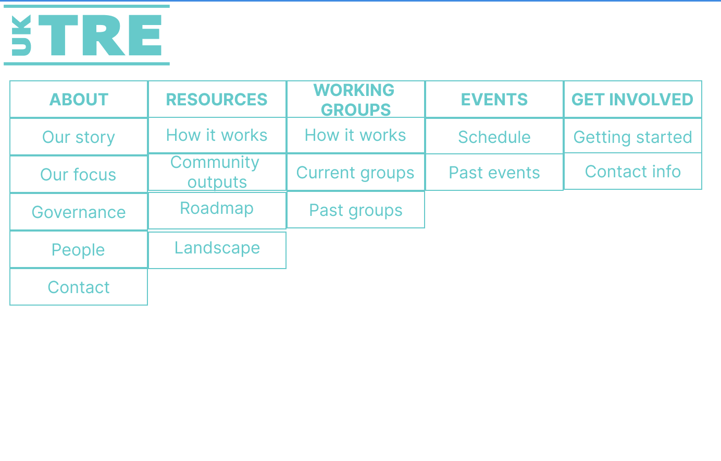
Developing a resource hub
5th December 2023
UK TRE Community meeting
Notes:
We have a draft skeleton of what it would contain:
About
Resources
Working Groups
Events
Get involved

Slide 89
What are we doing now?
Future plans
March 2024
An open question…
5th December 2023
UK TRE Community meeting
Notes:
In terms of the future, this is an open question
So please get involved and help shape where we go in the future!

Slide 90
How does today fit in?
5th December 2023
UK TRE Community meeting

Slide 91
How does today fit in?
Local vs cloud hosting
PPIE
Package allow lists
C4 data architecture
TRE
Federation
Manual output checking
EAOCAMRA
CoI
SATRE
Researcher
passports
NHS SDE network
Metadata standards
Multi-TRE analysis
5th December 2023
UK TRE Community meeting
Notes:
Going back to the Feyerabend analogy, today we have 12 topics that can be considered part of this latest developments in the UK TRE space

Slide 92
How does today fit in?
Local vs cloud hosting
PPIE
Package allow lists
C4 data architecture
TRE
Federation
Manual output checking
EAOCAMRA
CoI
SATRE
Researcher
passports
NHS SDE network
Metadata standards
Multi-TRE analysis
5th December 2023
UK TRE Community meeting
Notes:
Today is about seeing how and where we can help connect this work, share latest knowledge and updates, and identify opportunities for collaboration

Slide 93
What now?
Breakout rooms diving deeper into our approach
Vision/mission feedback
What should we prioritise to finish by the end of March?
Deliverables feedback
What should we be aiming for post-March?
5th December 2023
UK TRE Community meeting
Notes:
We will also have a breakout room to dive deeper into this presentation, including feedback on the above topics

Slide 94
Acknowledgements
The Turing Way Community. Illustrations in this deck are created by Scriberia with The Turing Way community, used under a CC-BY 4.0 licence. DOI: 10.5281/zenodo.3332807
The Community Management Working group
DARE UK
All our 239 members!
5th December 2023
UK TRE Community meeting

Slide 95
Agenda
13:30 - 13:45 - Welcome and introduction
13:45 - 14:30 - ‘Keynote’ - UK TRE Community update
14:30 - 14:45 - Community updates
14:45 - 14:55 - Break
15:00 - 15:45 - Breakout session 1
15:45 - 15:55 - Break
16:00 - 16:45 - Breakout session 2
16:45 - 17:00 - Wrap up
5th December 2023
UK TRE Community meeting

Slide 96
Community updates
SDEs, TREs etc - terminology and definitions working group introduction
  Pete Barnsley & Madalyn Hardaker
The citizen and their increased / retained agency working group introduction
  Pete Barnsley
An architecture for extending the domain of control - custody of data working group introduction
  Pete Barnsley
5th December 2023
UK TRE Community meeting

Slide 97
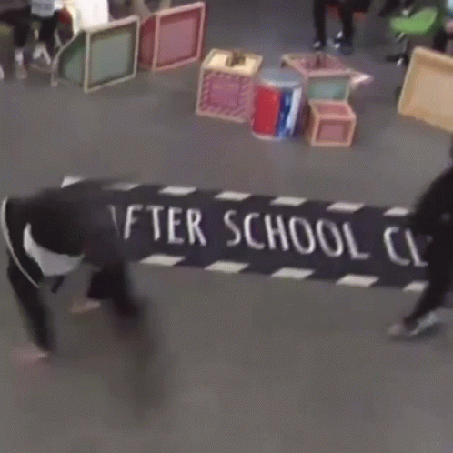
Break time
5th December 2023
UK TRE Community meeting

Slide 98
Agenda
13:30 - 13:45 - Welcome and introduction
13:45 - 14:30 - ‘Keynote’ - UK TRE Community update
14:30 - 14:45 - Community updates
14:45 - 14:55 - Break
15:00 - 15:45 - Breakout session 1
15:45 - 15:55 - Break
16:00 - 16:45 - Breakout session 2
16:45 - 17:00 - Wrap up
5th December 2023
UK TRE Community meeting

Slide 99
Breakout session 1
Room 1: Researcher Passports
Room 2: Evaluation of Automated Output Checking and AI Model Risk Assessment Community of Interest
Room 3: Data architecture of a TRE with C4 modelling language
Room 4: Hosting TRE/SDEs locally vs cloud
Room 5: TRE Federation: appetite for a standards working group(s)?
Room 6: Community-based efforts and collaborations in public involvement and engagement
Room 7: Community management feedback
Room 8: General discussion
Room 9: General discussion
5th December 2023
UK TRE Community meeting

Slide 100

Break time
5th December 2023
UK TRE Community meeting

Slide 101
Agenda
13:30 - 13:45 - Welcome and introduction
13:45 - 14:30 - ‘Keynote’ - UK TRE Community update
14:30 - 14:45 - Community updates
14:45 - 14:55 - Break
15:00 - 15:45 - Breakout session 1
15:45 - 15:55 - Break
16:00 - 16:45 - Breakout session 2
16:45 - 17:00 - Wrap up
5th December 2023
UK TRE Community meeting

Slide 102
Breakout session 2
Room 1: Package allow lists
Room 2: Streamlining manual output checking
Room 3: SATRE next steps
Room 4: NHS England’s SDE Network
Room 5: The role of standards for provenance and metadata in federated TRE architectures
Room 6: Multi-TRE analysis : can a common governance model breaks data silos?
Room 7: Community management feedback
Room 8: General discussion
Room 9: General discussion
5th December 2023
UK TRE Community meeting

Slide 103
Agenda
13:30 - 13:45 - Welcome and introduction
13:45 - 14:30 - ‘Keynote’ - UK TRE Community update
14:30 - 14:45 - Community updates
14:45 - 14:55 - Break
15:00 - 15:45 - Breakout session 1
15:45 - 15:55 - Break
16:00 - 16:45 - Breakout session 2
16:45 - 17:00 - Wrap up
5th December 2023
UK TRE Community meeting

Slide 104
Wrap up
5th December 2023
UK TRE Community meeting

Slide 105
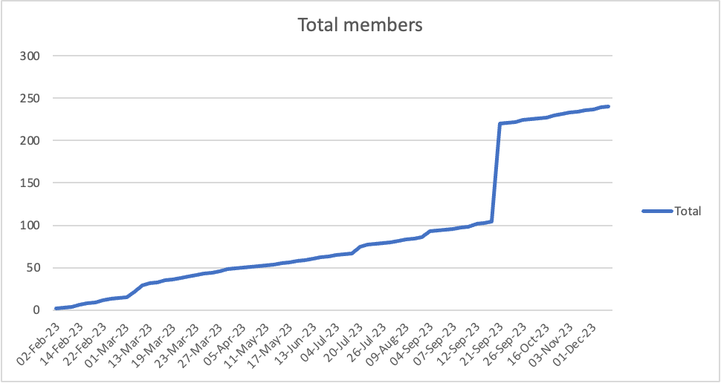
Wrap up
5th December 2023
UK TRE Community meeting

Slide 106
Why?
Key:
UK TRE community
Goldacre review
TRE-FX
PEDRI
DEA accreditation
DSPT
SDAP
ISO27001
SATRE
SAIL
TELEPORT
DARE federated architecture
TREEHOOSE
Azure TRE
Turing Data Safe Haven
SARA
RDA
NHS SDEs
openSAFELY
UK TRE progress
5th December 2023
UK TRE Community meeting

