Slide 1
Inclusive Open Access in Academia: Coming Together against Exclusive
Publishing
Sarah.Nouwen@eui.eu

Slide 2

Come Together! Enabling Collaboration and Inclusivity in Research Libraries

Slide 3
Come Together! Enabling Collaboration and Inclusivity in Research Libraries

Slide 4

Area for collaboration:
Open Access

Slide 5
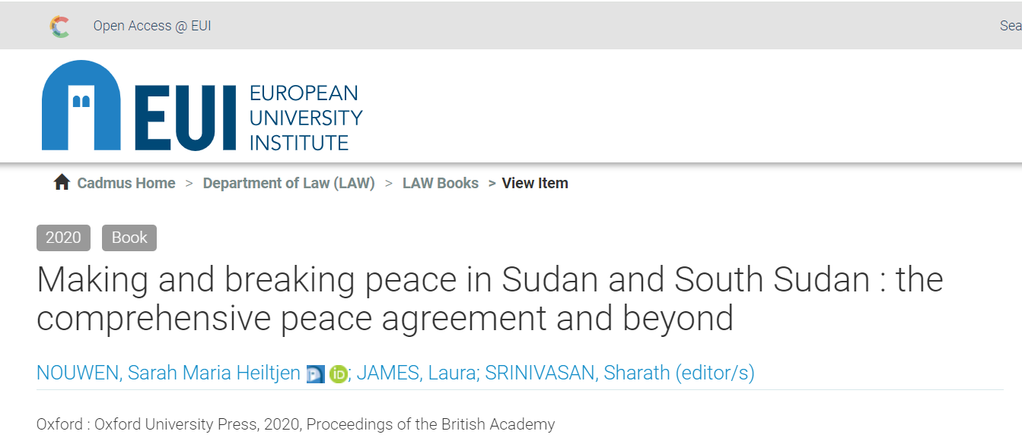
Coming together around Open Access: verbal consensus only?
Cf:

Slide 6
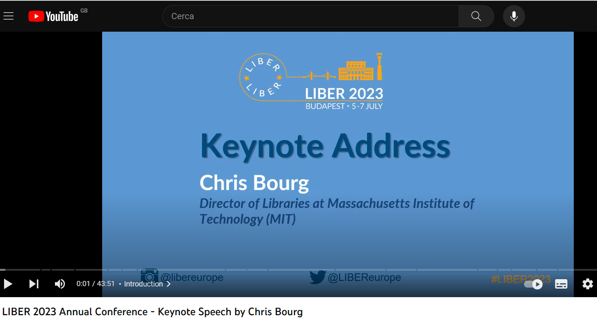
Coming together around Open Access: a need for collaboration and inclusivity
“libraries took on all the burden of scholarly communication without requiring faculty to change their practices”
“… and by signing the big read and publish agreements we are relieving the faculty from responsibility for changing their behaviour, in a system that they created.”
Faculty as a “barrier”

Slide 7

Today
What do we talk about when we talk about Open Access?
Some of the doubts
Moving forward: points for discussion and collaboration

Slide 8
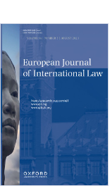



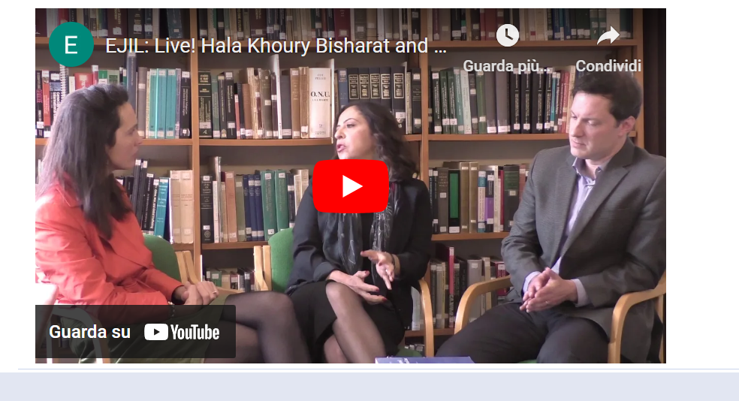
My perspective

Slide 9

What do we talk about when we talk about Open Access?
GREEN
GOLD
DIAMOND / PLATINUM
Pro Open Access but against “The Real Open Access”?

Slide 10
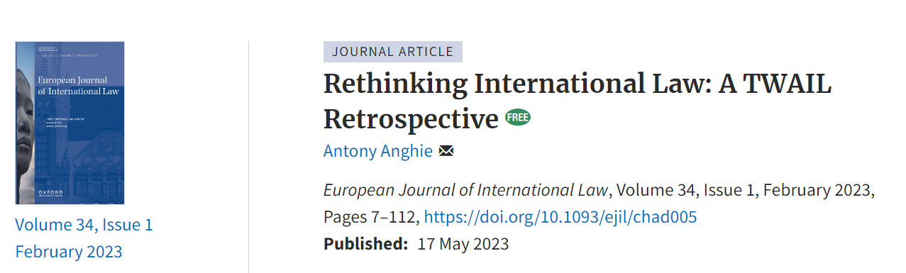
What do we talk about when we talk about Open Access?
2) Is Free Access never enough/sometimes better?

Slide 11

Open Access: Aim versus Modality?
Key role of librarians:
Conveying the message of what Open Access is.
Negotiating with publishers: drawing up a framework of principles?

Slide 12

Some of the doubts
Does the currently dominant model promote equity and inclusion?
Equity
Inclusion
  Who gets published?
Open Access for all Readers = Access Closed for Some Authors?
Increase in Access to Knowledge Consumption = Decrease in Access to Knowledge Production?
Need for adjustments => librarians can make a difference

Slide 13
Some of the doubts
Does the currently dominant model promote equity and inclusion?
Equity
Inclusion
  Who gets published?
  What gets published?
  Need for the recognition of diversity in scholarly “outputs” => librarians can make a difference.

Slide 14

Some of the doubts
2) Is this shift sustainable?
What is libraries’ post-transformation vision? Who will keep paying for the production costs?
Need for transparency in what libraries are paying for and willing to pay for.
Direction of travel: flip from hybrid to full?
Publish more more more? Quantity versus quality? (Role of libraries)
Change in direction of travel? Green + modest subscription?
Hybrid journals not so bad after all?
Is Diamond OA the panacea?
Or: fund online diamond open access platforms of journals rather than APCs?

Slide 15
Points for discussion and collaboration
Develop a framework of principles that contracts need to be consistent with:
  equity (not huge profits);
  inclusiveness (fee-waivers for all those who otherwise cannot afford to publish, across all journals);
  sustainability (also mechanisms against freeriding).
Recognise disciplinary diversity in terms of what is required to make scholarship “open”:
  Free access or open access;
  Scholarly “outputs”
  Sustainability in journals
Hybrid journals may not be just double dipping and worth protecting until full waiver schemes in place.
Don’t push for more more more publications by journals: that is not the added value of journals.
Consider moving to a system where libraries and research councils fund collective “diamond” non-for-profit (but yes-for-expansive-scholarly-services) platforms of journals.

Slide 16
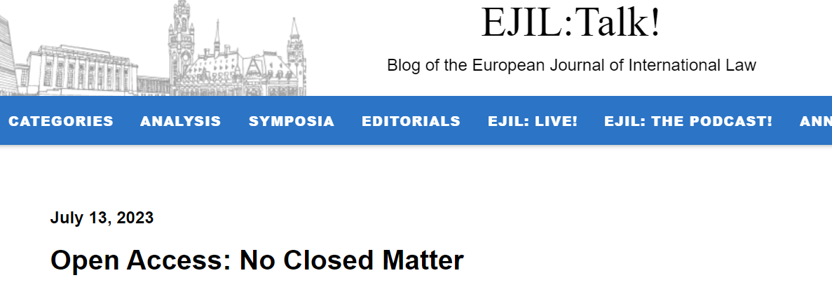
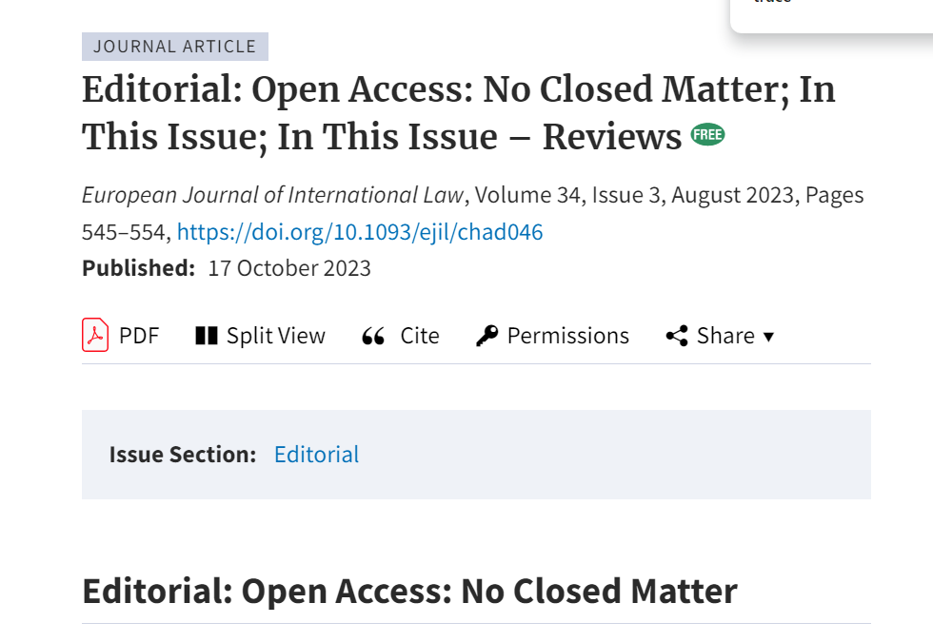
Conclusion: Open Access, No Closed Matter

