Slide 1
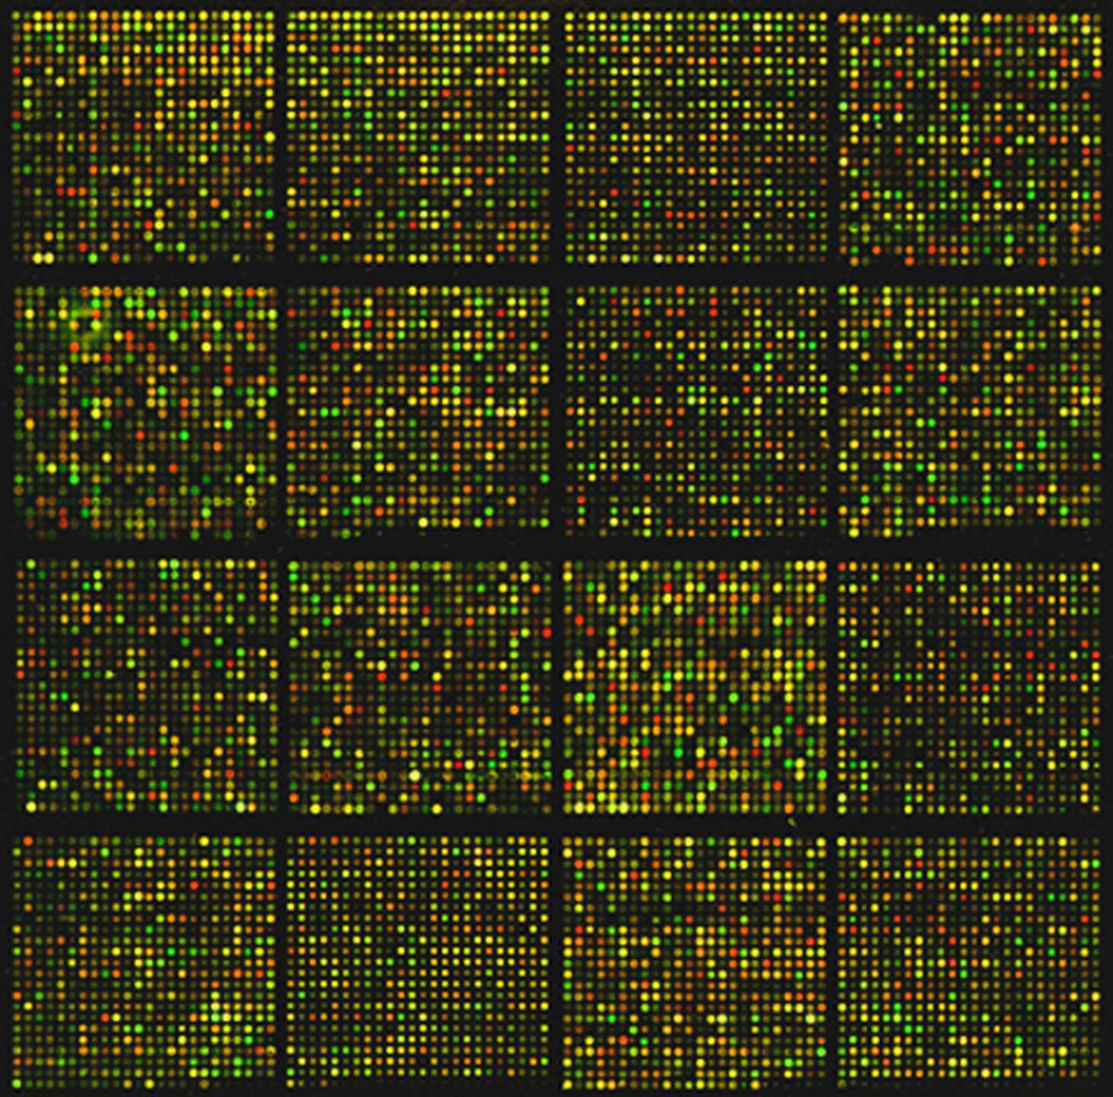

ZOO560
Part III
Polymorphism
Photo by National Cancer Institute on Unsplash
1

Slide 2
DNA polymorphisms
  Polymorphisms may be:
  1. Silent: present in the coding region but does not alter the AA sequence.
  2. Noncoding: affects nucleotides in noncoding regions.

Slide 3
Alcohol metabolism
  The primary enzymes involved in alcohol metabolism are:
  alcohol dehydrogenase (ADH)
  aldehyde dehydrogenase (ALDH).
  Both enzymes occur in several forms that are encoded by different genes; moreover, there are variants (i.e., alleles) with different characteristics and which have different ethnic distributions.
  Which ADH or ALDH alleles a person carries influence his or her level of alcohol consumption and risk of alcoholism.

Slide 4
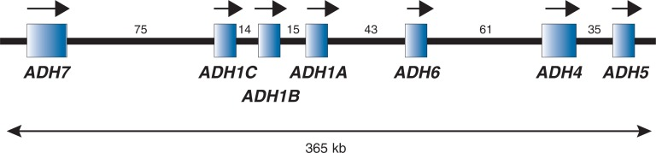
In humans
Seven different genes of adh:
ADH1A, ADH1B, ADH1C, ADH4, ADH5, ADH6, and ADH7, all are aligned along a small region of chromosome 4 (4q)
https://www.ncbi.nlm.nih.gov/pmc/articles/PMC3860432/

Slide 5
The effects of ingested ethanol on different organs depend on:
  the ethanol concentration achieved
  the duration of exposure.
  Both 1 & 2 are affected by the absorption of ethanol into the blood stream and tissues as well as by ethanol metabolism.
  The main site of ethanol metabolism is the liver.
  Some metabolism also occurs in other tissues and can cause local damage there.

Slide 6
The main pathway of ethanol metabolism
Involves:
  Oxidation of EtOH to acetaldehyde, mediated (i.e., catalyzed) by the enzymes alcohol dehydrogenases (ADHs) (reversible reaction).
  In a second reaction catalyzed by aldehyde dehydrogenase (ALDH) enzymes, acetaldehyde is oxidized to acetate.
  Other enzymes, such as cytochrome P450 (e.g., CYP2E1), metabolize a small fraction of the ingested ethanol.

Slide 7
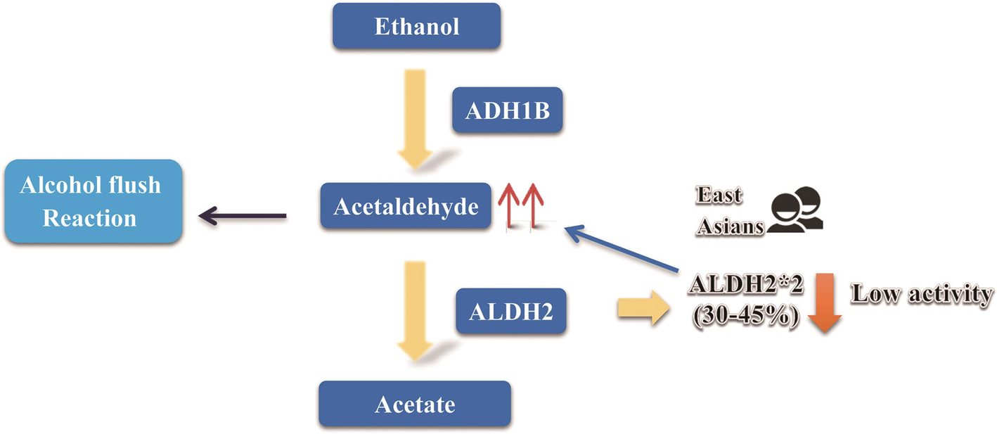
  Increased amounts of acetaldehyde are associated with adverse reactions to alcohol such as flushing, nausea and headaches.
  These adverse reactions lead to limited alcohol consumption and subsequently protection against alcoholism.

Slide 8
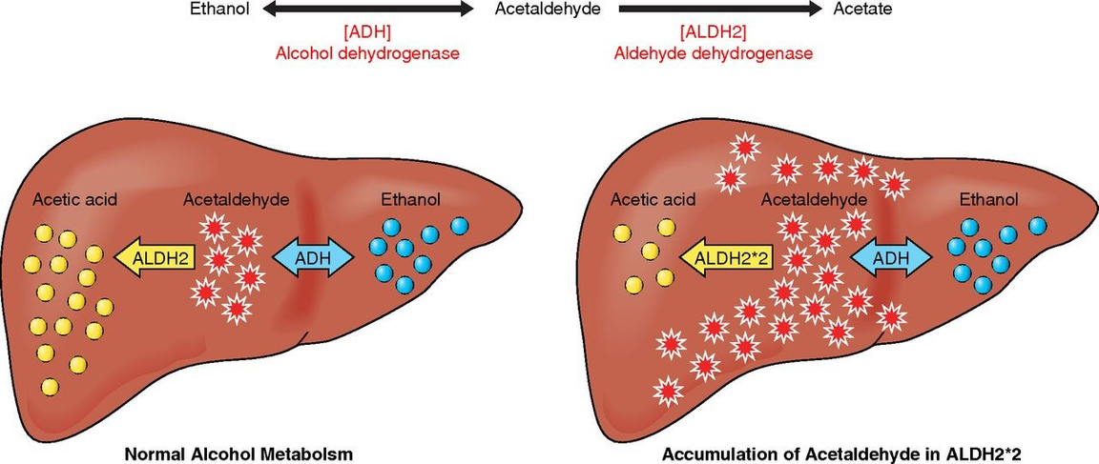
  EtOH metabolism occurs mainly in the liver.
  In normal ALDH2 individuals, acetaldehyde is quickly oxidized to nontoxic acetate.
  In ALDH2 enzyme-deficient (ALDH2*2) individuals, a significant amount of acetaldehyde is rapidly accumulated causing adverse reactions.
  Acetaldehyde is very diffusible and crosses biological membranes. It can be circulated in the blood and metabolized in all tissues.

Slide 9
Allele | Ethnic group | Presence | Protection against alcoholism
ADH1B*2 | European or African | not very common | yes
 | Jewish | moderate frequencies | yes
 | East Asians | common | yes
2. ADH1B*3 | Exclusively in Blacks | common | yes
 | Southwest California Indians | common | yes
  ADH1C*2 allele is associated with a slightly reduced oxidizing capacity
  ADH1B*2 and ADH1B*3 alleles are associated with a substantially higher oxidative capacity (i.e., more rapid ethanol oxidation to acetaldehyde) leading to protection against alcoholism.

Slide 10
Black adolescents and young adults are more likely to abstain from alcohol use than other racial groups and, when drinking, are less likely to drink heavily and get drunk than their White and Hispanic peers

Slide 11
Overall:
  The protective effect of ADH1B*2 appears to be weaker in Europeans and Africans than in Asian populations.
  The ADH1B*3 allele is associated with protection against fetal alcohol syndrome (a congenital syndrome associated with excessive consumption of alcohol by the mother during pregnancy, and characterized by restriction of mental development and of physical growth, particularly of the skull and face).

Slide 12
Two main ALDH enzymes metabolize the acetaldehyde produced during ethanol oxidation
  ALDH1: is found in the cytosol and is encoded by the ALDH1A1 gene. About 52 kb on chromosome 9.
  ALDH2: is found in the mitochondria and is encoded by the ALDH2 gene. 43 kb on chromosome 12.
  Both genes have a similar structure with 13 exons.
  The proteins they encode are 70% identical in sequence and very similar in structure

Slide 13
ALDH2 is highly conserved from bacteria all the way up to humans

Slide 14
In Drosophila melanogaster
The primary ethanol-metabolizing pathway in flies involves the enzymes:
  alcohol dehydrogenase (ADH)
  acetaldehyde dehydrogenase (ALDH)
Their role in adaptation to ethanol-rich environments has been studied extensively.

Slide 15
Drosophila melanogaster ADH
Segregation of an amino acid replacement polymorphism at nucleotide 1490, which generates a difference in electrophoretic mobility.

Slide 16
Alcohol dehydrogenase (Adh)
    High concentration of alcohol causes cell death
    Fruit flies tested by feeding them food with alcohol
    Most flies find alcohol poisonous, but there are some (about 10% occurring naturally) who have a gene that can reduce to a less toxic form
    Conducted experiment for 57 generations
    Compared results

Slide 17
It is an e.g. of extensive silent polymorphism
  In Drosophila sp.: Allozyme polymorphism= Adh-S and Adh-F
  Adh-S: slow electrophoretic mobility, has got AAG coding AA # 193 (lysine), synthesised in lower amounts & has lower enzymatic activity
  Adh-F: fast electrophoretic mobility, got ACG coding AA # 193 (threonine), synthesised in greater amounts & has greater enzymatic activity

Slide 18
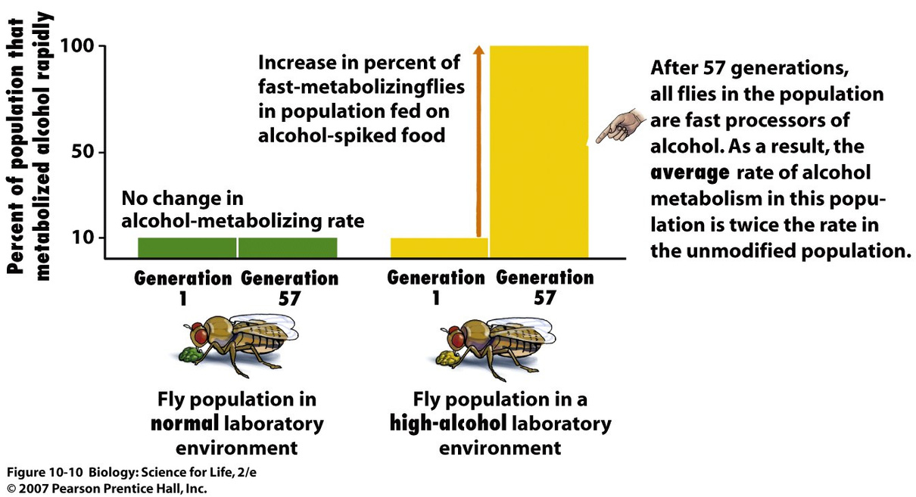

Slide 19
What happened was
  Experimental population showed consistent long-term increase in frequency of ADH-F
  Flies with adhF allele have higher fitness when ethanol is present.
  ADH-F enzyme breaks down ethanol twice as fast as ADH-S enzyme.

Slide 20
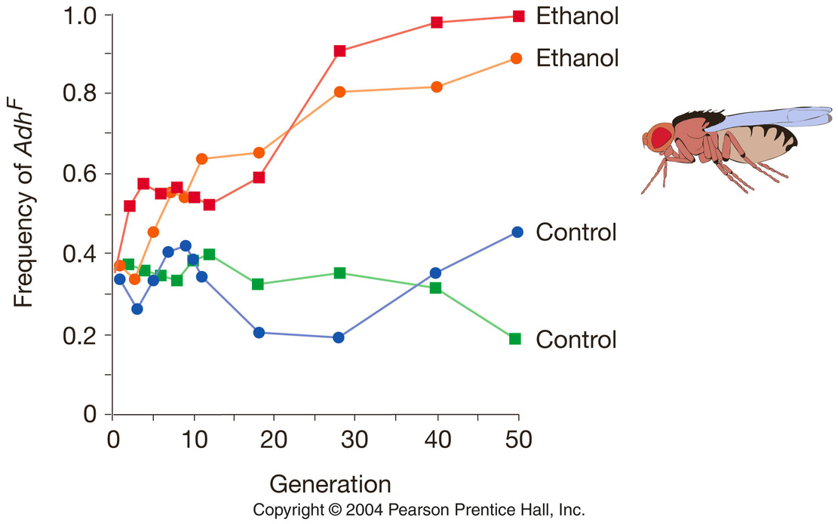
Fig 5.13
Notes:
Mohammad A. Siddiq, David W. Loehlin, Kristi L. Montooth, Joseph W. Thornton. Experimental test and refutation of a classic case of molecular adaptation in Drosophila melanogaster. Nature Ecology & Evolution, 2017; 1: 0025 DOI: 10.1038/s41559-016-0025
7

Slide 21
Types of DNA polymorphisms
  Single nucleotide polymorphisms
  Insertion/deletion polymorphisms
  Polymorphic repetitive sequences
  Structural and copy number variations

Slide 22
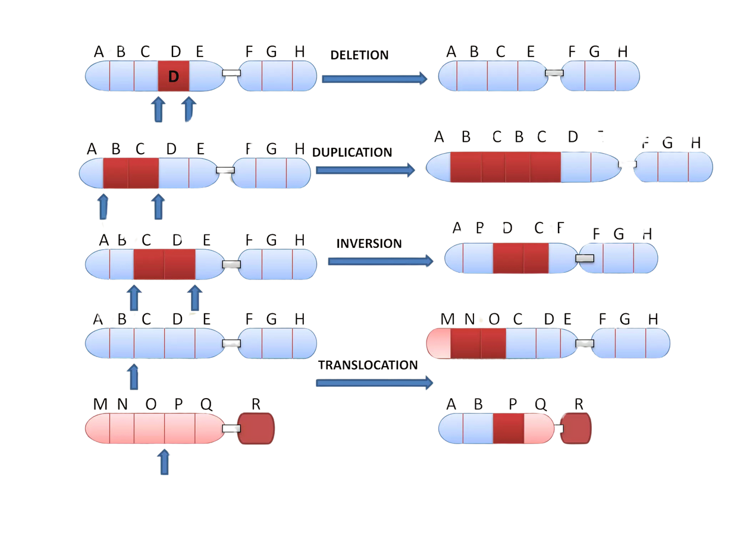
Structural variations

Slide 23
Prakash et al. (1969) introduced the term ‘‘allozymes’’ to describe the different allelic forms of an enzyme.

Slide 24
Allozymes & polymorphism
Protein electrophoresis is a convenient method for detecting polymorphisms
BUT
it is difficult to extrapolate from electrophoretic surveys of enzymes to the entire genome because the enzymes may not be representative.
Why?

Slide 25
Allozymes polymorphism use: disadvantages
(1) it requires use of a large amount of protein;
(2) it is time consuming, laborious, expensive and technically demanding
(3) has relatively poor discrimination power since it only detects changes in AAs, yet changes in AA composition that do not affect the electrophoretic mobility will remain unobserved.
(4) bands with equal electrophoretic mobility may not be homologous.

Slide 26
Quantitation of DNA polymorphism
  Nucleotide polymorphism (θ): the proportion of nucleotide sites that are expected to be polymorphic in any suitable sample.
  Nucleotide diversity (π):is the average proportion of nucleotide differences between all possible pairs of sequences in the sample

Slide 27
Genetic polymorphism, whether studied through allozymes or nucleotide sequences, provides a set of markers for the study of organisms in their natural habitats.

Slide 28
Uses of polymorphism detection
  To investigate the genetic relationships among an organism subpopulations,
  As diseases markers and in early diagnosis,
  Mating systems of organisms investigations (e.g. inbreeding, selfing, outbreeding)
  Crime investigations (e.g. CODIS system)
  To infer evolutionary histories,

Slide 29
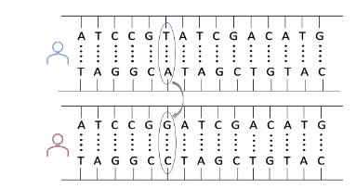
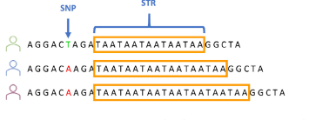
Human forensic ID testing
SNPs transversion
SNPs VS. tandem repeats

Slide 30
Overview of analytical approach and the identified fingermark proteome

Slide 31
APPLICATIONS
in Forensic Investigation:
1. Tissue identification: to determine the origin of a biological sample (e.g. blood, semen, saliva, or urine).
2. Cause of death: to detect the presence of specific toxins or other substances in the body, which can help determine the cause of death.
3. Identification of suspects: e.g. DNA analysis, proteomics, and immunoassays to identify suspects.
4. Matching crime scene samples: to provide evidence in court.

Slide 32
5. Post-mortem interval: changes in protein degradation patterns + pharmacogenetic SNPs: used to estimate the post-mortem
interval of a deceased individual.
6. Sexual assault investigations: Proteins found in
semen, such as semenogelin and prostate-specific
antigen.
7. Species identification: animal species ID, useful in cases involving wildlife crimes or poaching.
8. Biometric identification: Phenotype-informative SNPs: e.g. in the analysis of fingerprints, hair, or skin.
9. Novel forensic applications: Ancestry-informative SNPs: e.g. the analysis of ancient DNA and proteins in archaeological samples, or the analysis of microorganisms in forensic investigations.
(Verma and Mukherjee; 2023)

