Slide 1

EBAME 8 – Metagenomics in the context of long reads
Rob.james@quadram.ac.uk
Robert.James@Earlham.ac.uk

Slide 2
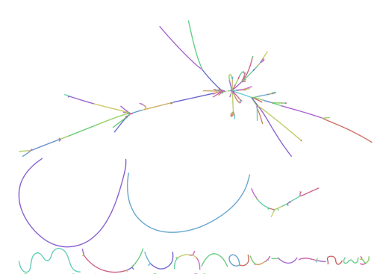
Overview
Shotgun metagenomic sequencing in the lab
Introduction to long read metagenomic sequencing
  What is “Long read” metagenomics
  ”Long-read” and “short-read” sequencing
Sequencing platforms overview
  Sanger, Illumina, Pacific Bioscience, Nanopore
Technical aspects of shotgun metagenomics.
  Sample Collection and Storage
  DNA Extractions
  Library preparations

Slide 3
”Shotgun” Metagenomics
Metagenomics: The study of multiple genes in multiple contexts.
Isolate and purify the total DNA from all microbes in a complex living communities / samples.
Fragment / Linearize DNA
Prepare DNA for sequencing
Sequence fragments of DNA in a sample all together
Analyze sequence data appropriately – Sample comparison
  Alignment, Taxonomic marker genes, Relative abundance estimates,
  (Co) Assembly + MAG coverage

Slide 4

”Shotgun” Metagenomic Assembly
A complex jigsaw puzzle

Slide 5
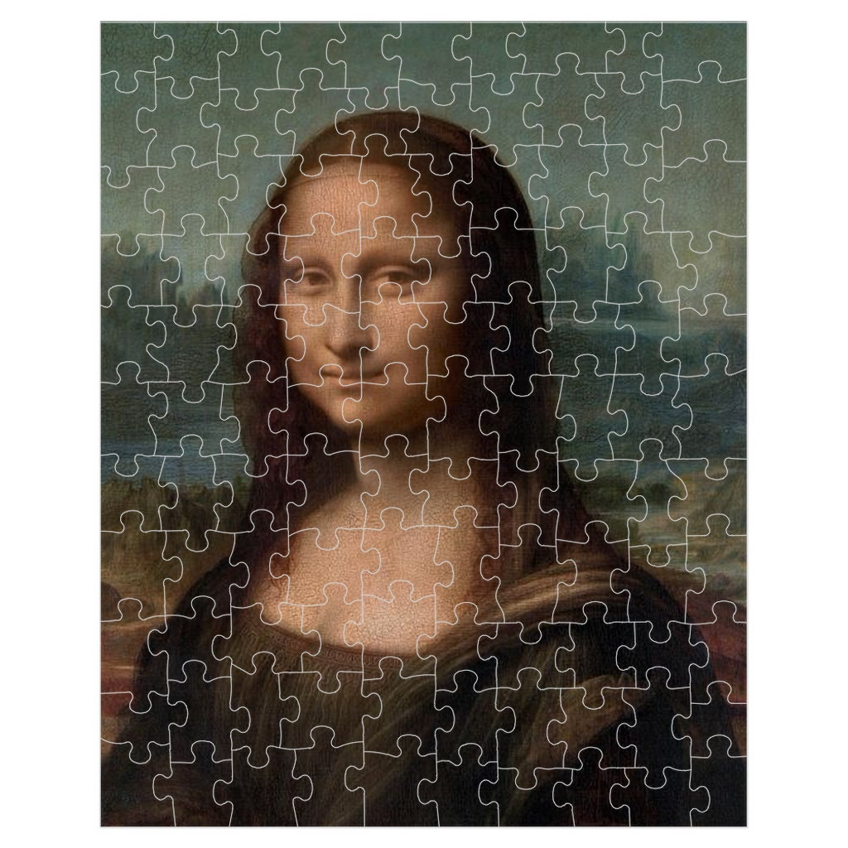
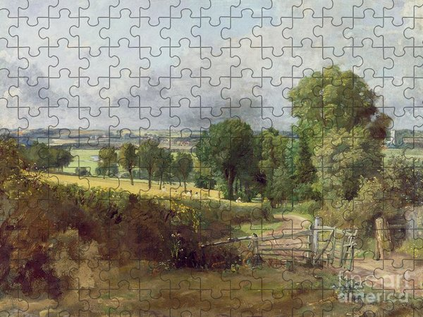





Slide 7


Slide 8

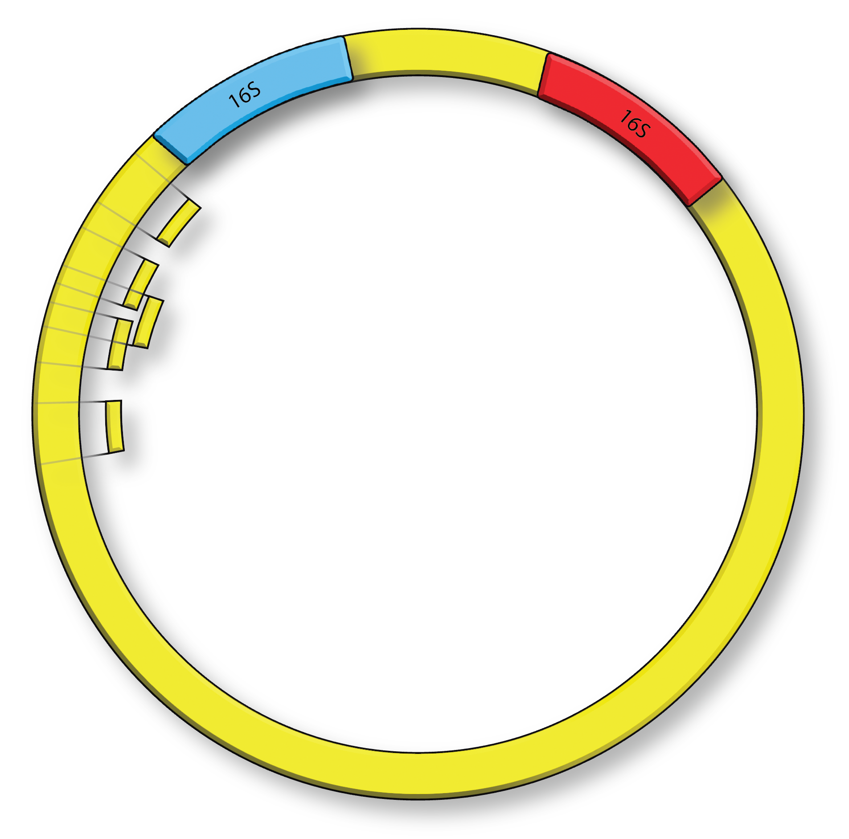
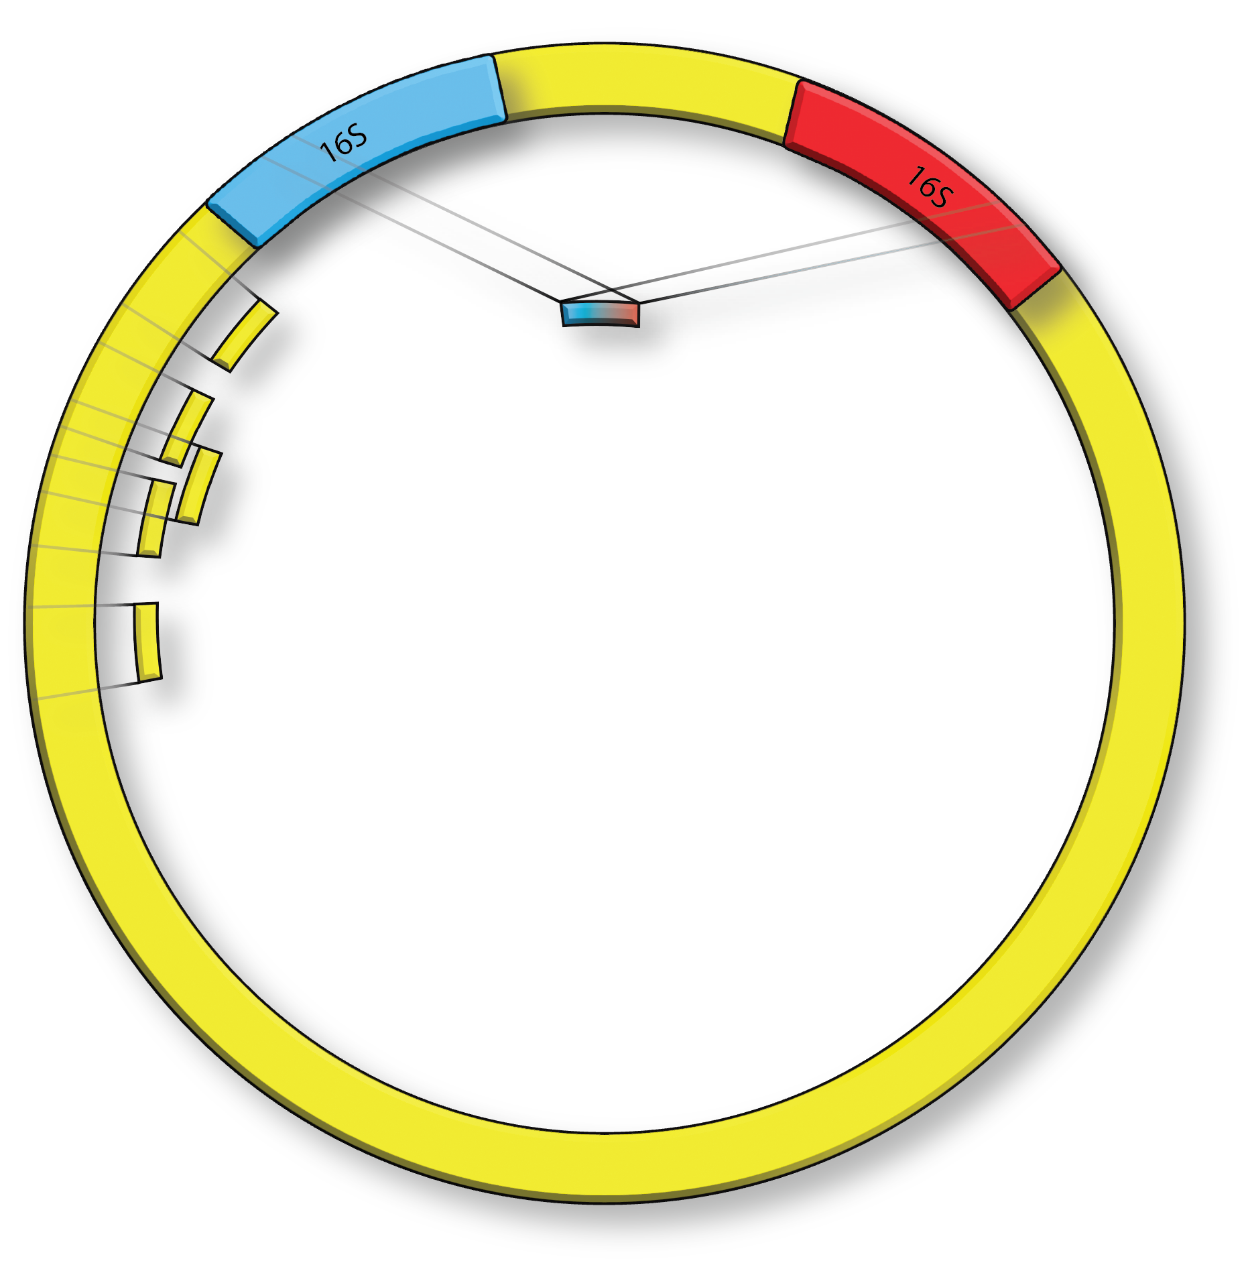
Longer overlaps = More contiguous assemblies
Reduced secondary alignments in repeat regions
e.g. multiple copy 16s, telomeres etc.

Slide 9
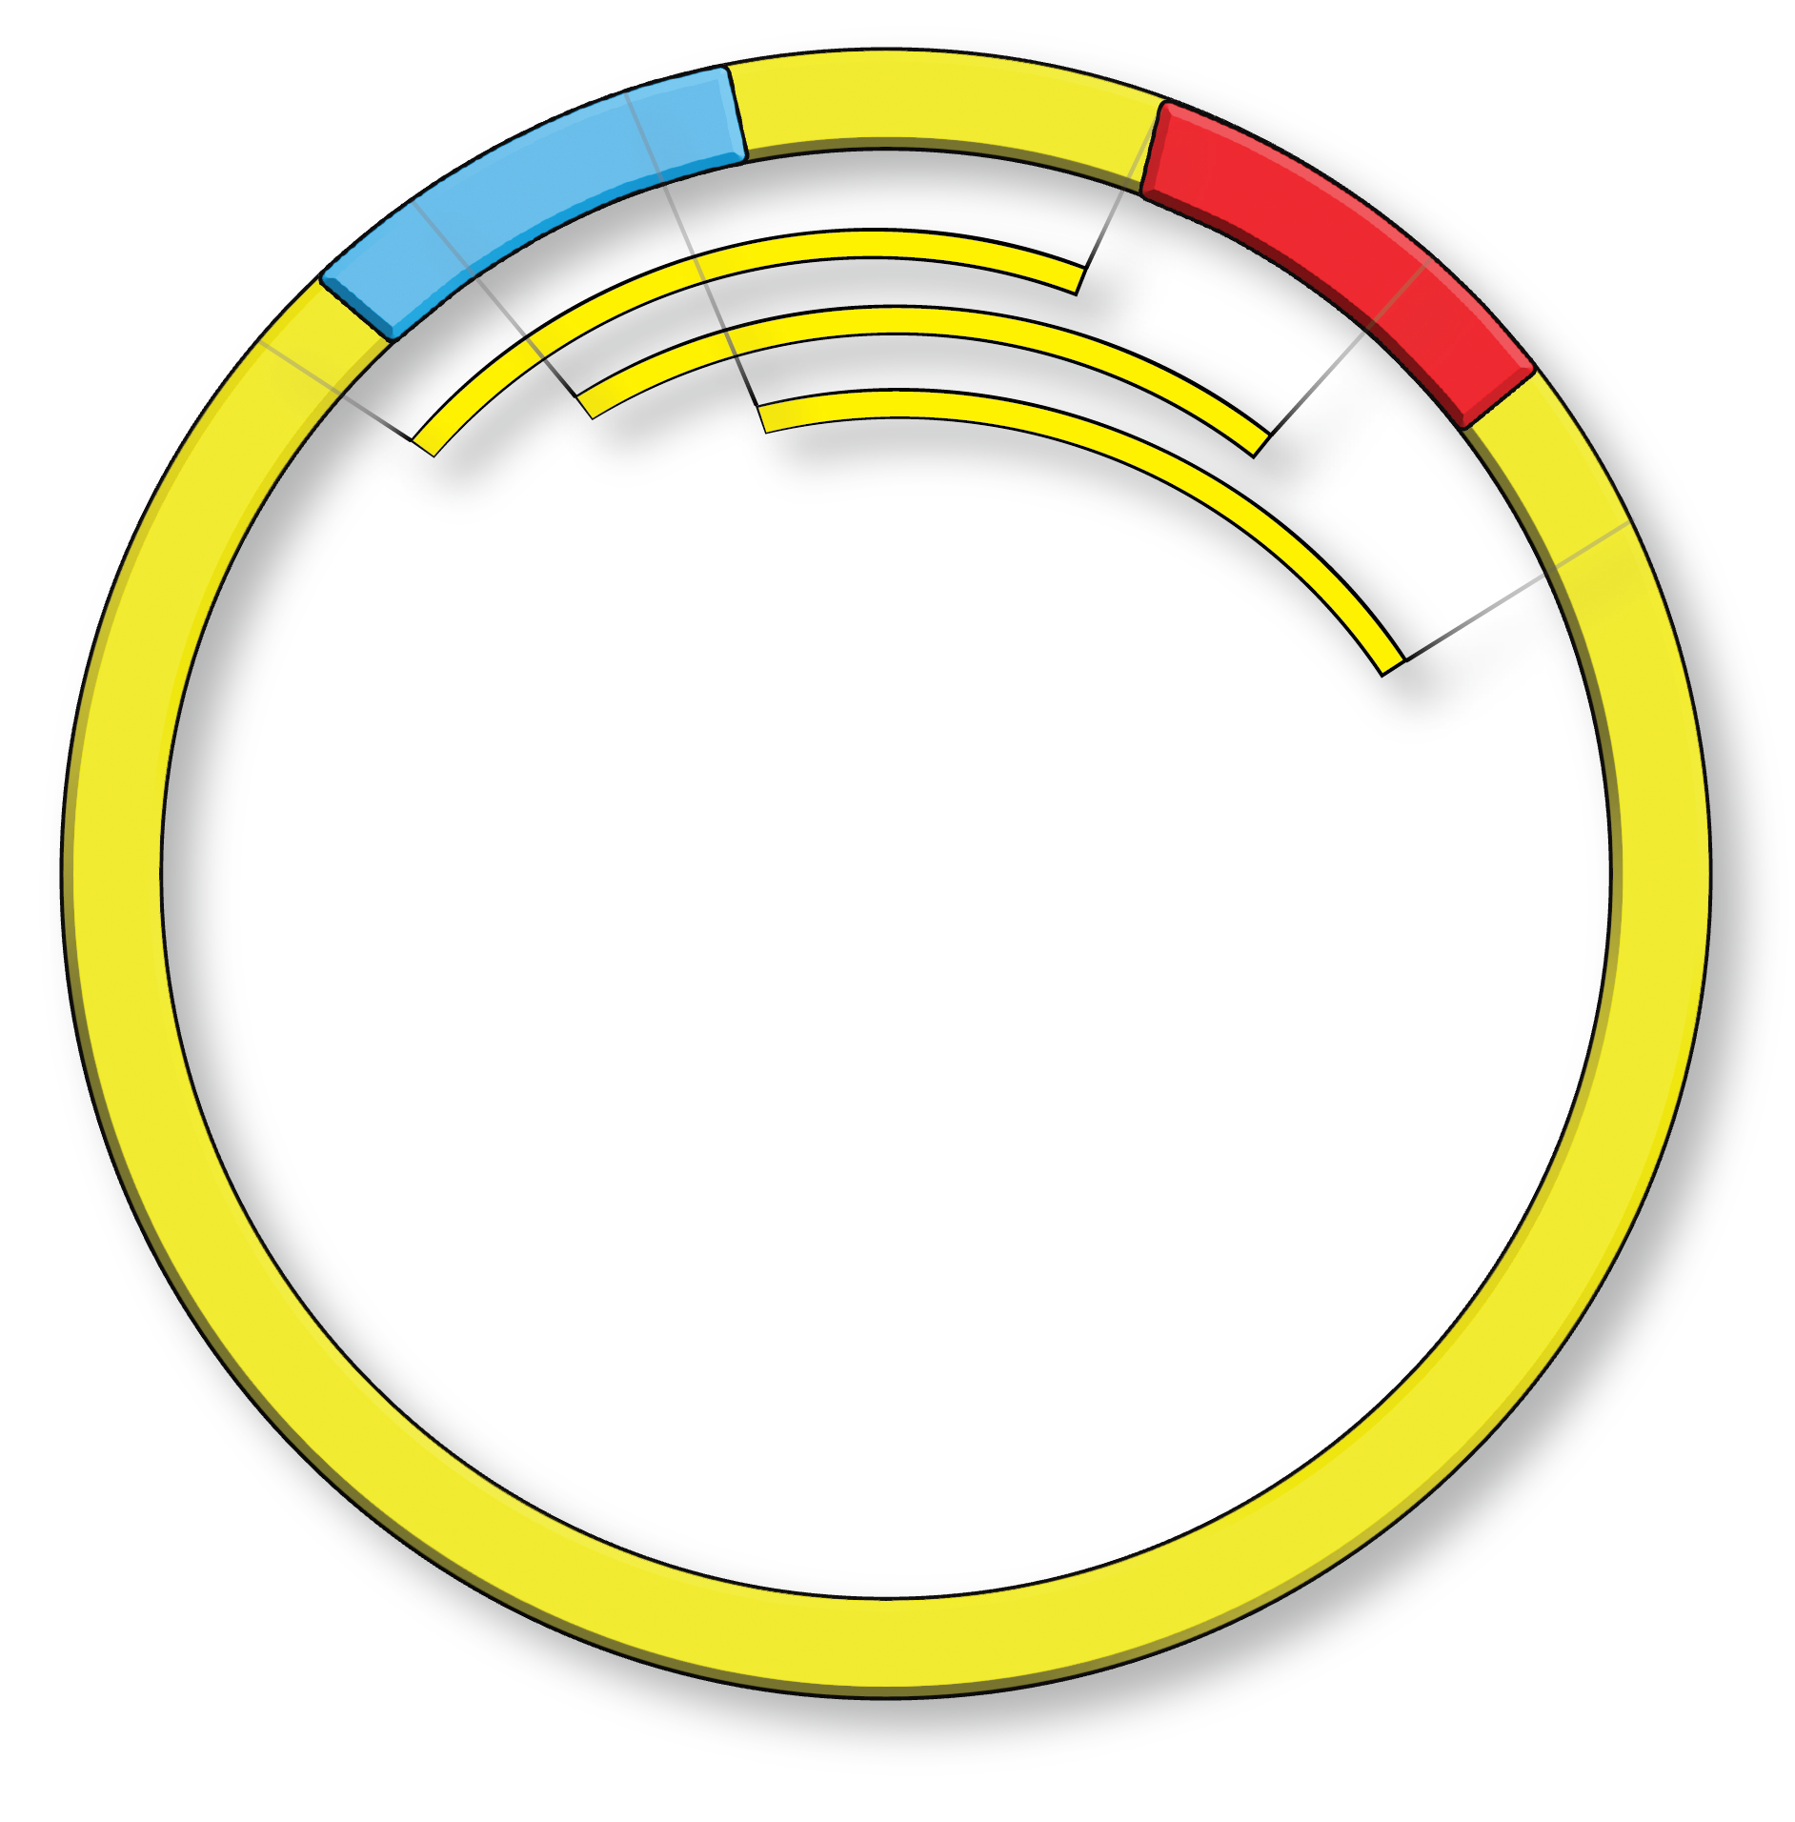
Longer overlaps = More contiguous assemblies
Reduced secondary alignments in repeat regions
e.g. multiple copy 16s, telomeres etc.

Slide 10
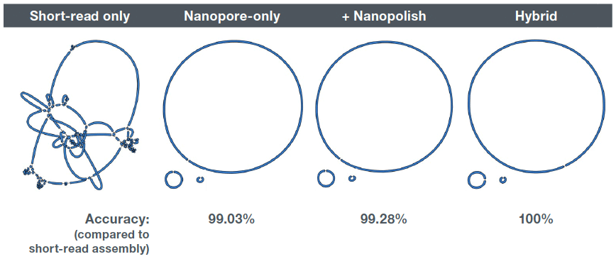
Long-reads with an isolate
Figure: A hybrid analysis strategy using the Unicycler assembly tool to combine data derived from short‑read sequencing technology with long read data (28x depth) of the K. pneumoniae isolate INF177.
Ryan Wick, University of Melbourne, Australia.

Slide 11
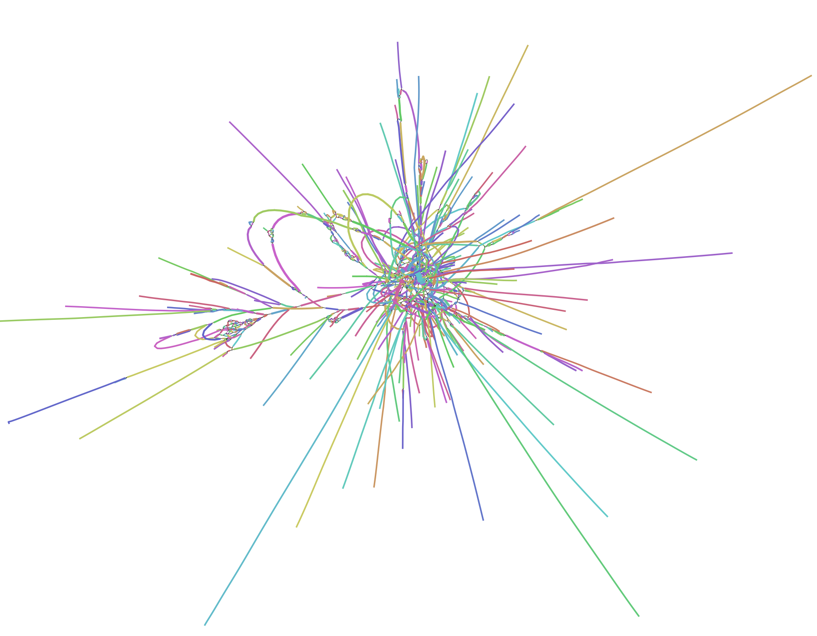
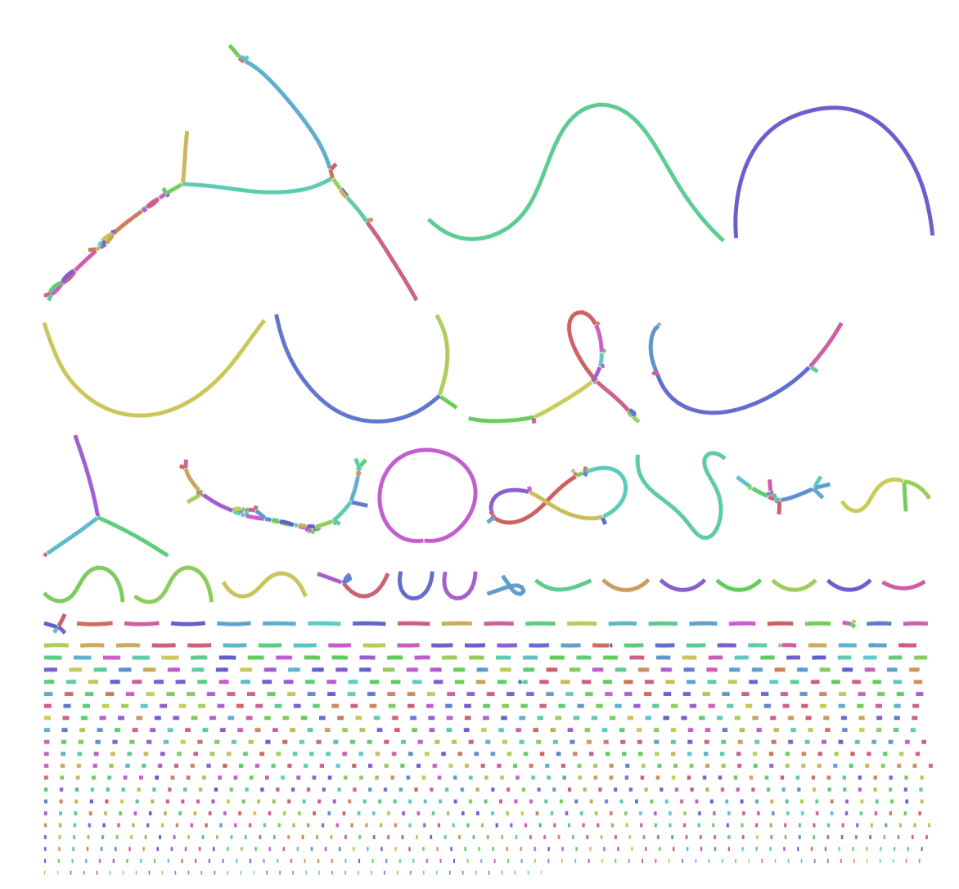
Metagenomic Long-reads
Anerobic digester Assemblies

Slide 12
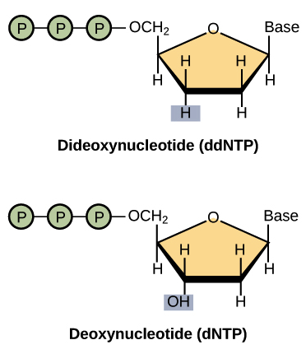
Sanger Sequencing
DNA strands are amplified in parallel using a
polymerase
Random incorporation of labeled nucleotides that
Initiate chain termination during polymerization
hydrolysis.
Each ddNTP labeled with a different fluorophore
A T C G
Didioxy chain termination

Slide 13
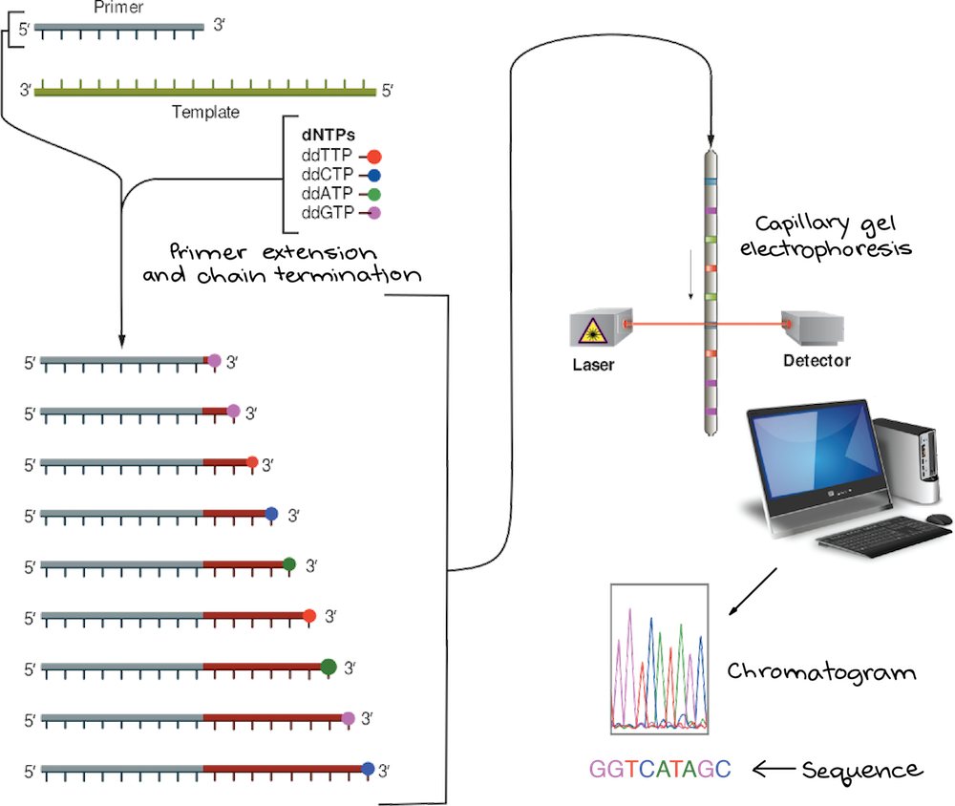
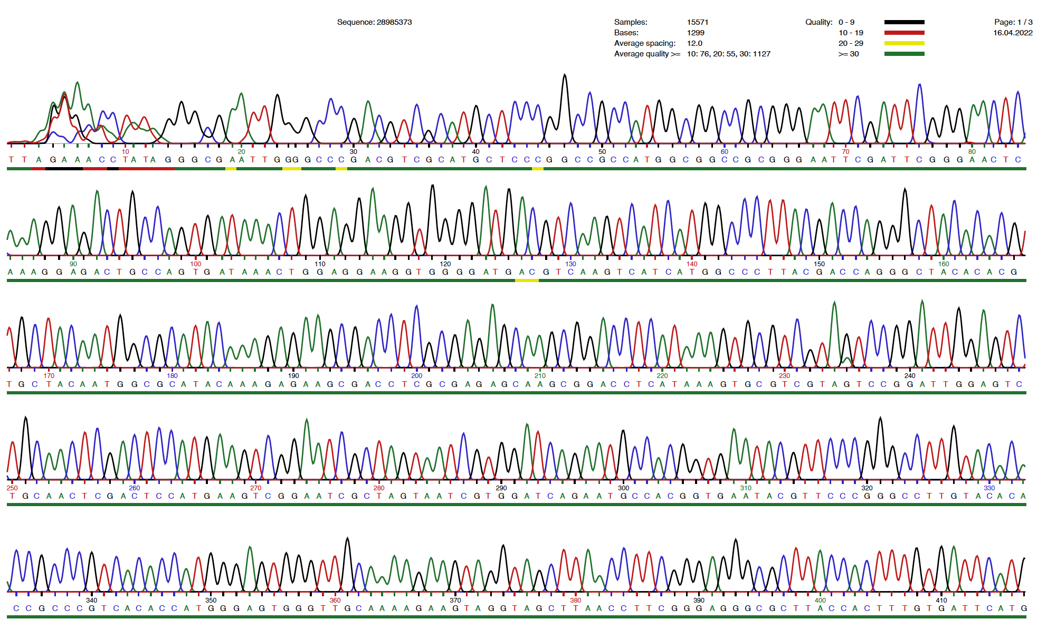

Slide 14
Workflow
Sanger sequencing review
Not for shotgun metagenomics
Old technology
800-1000 bp range
Single Isolate 16S amplicons – purity
Amplicons and vector inserts
Amplify 16S from isolate of interest
Clean up PCR product.
Dilute PCR fragment to:
150-300 bp: 1 ng/µl
300-1000 bp: 5 ng/µl
1000-3000 bp: 10 ng/µl
Add 5 ul to microtube
Add 5 ul F primer @ 5 uM (FC)
Add prepaid barcode
Send to Eurofins / GATC
Data returned in 24 – 48 h.

Slide 15
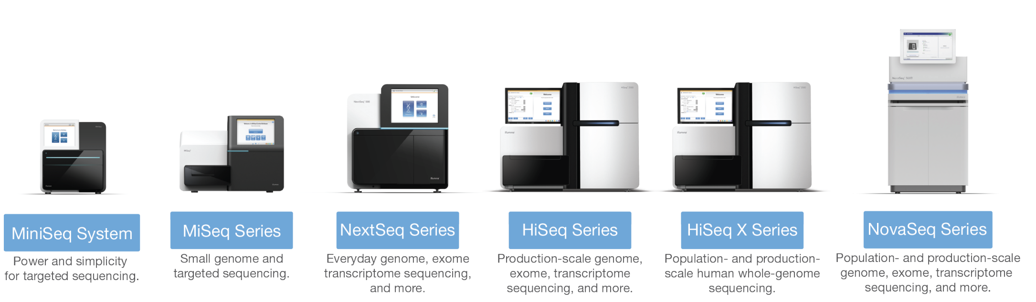
Illumina Sequencing
150 bp PE, 75bp PE, 300 bp PE, RNAseq

Slide 16
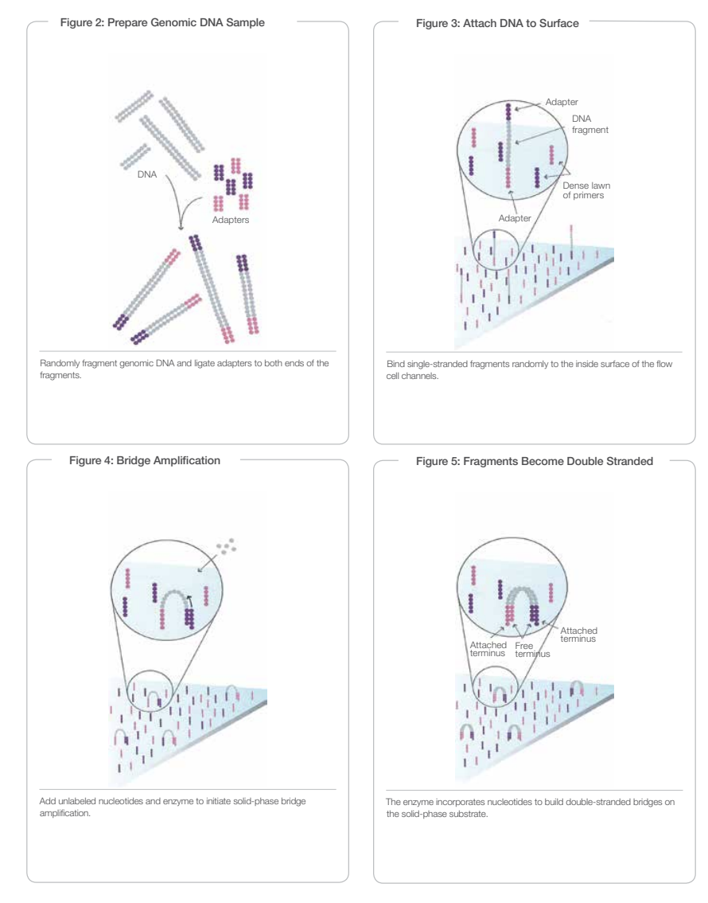
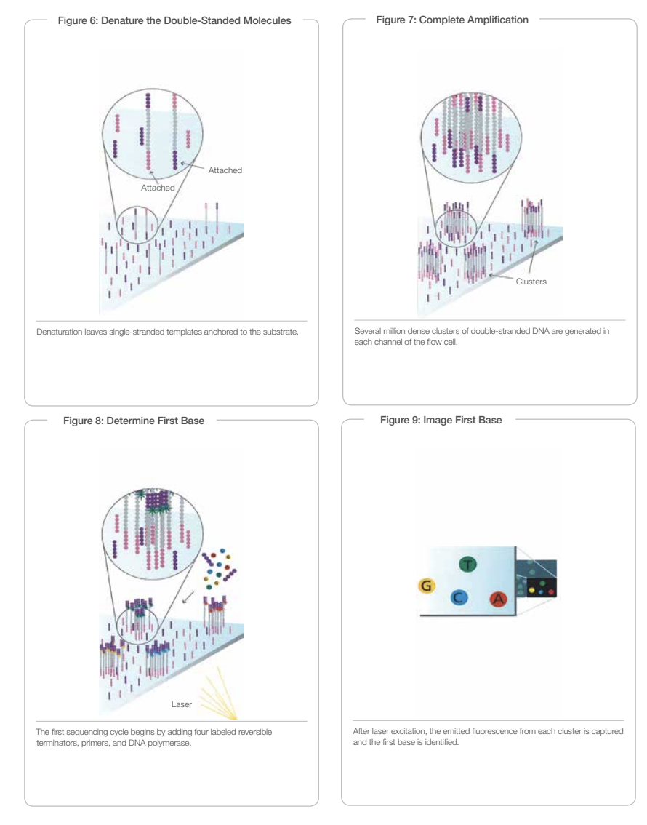

Slide 17
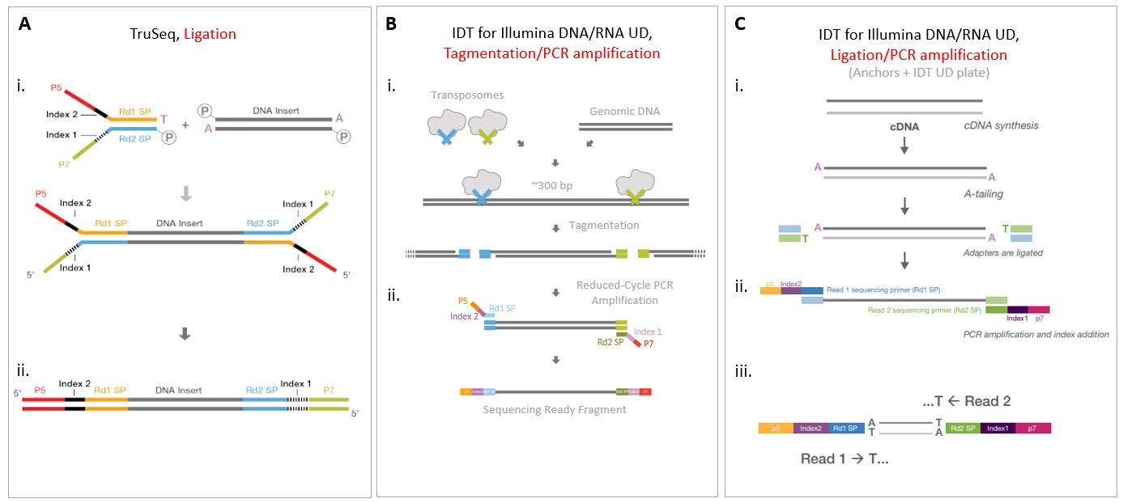

Slide 18
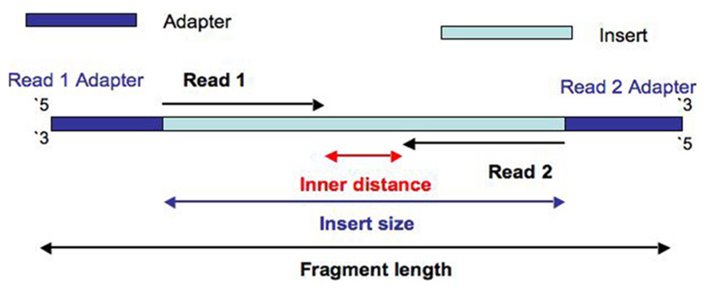
Illumina paired end read structure

Slide 19
Illumina Sequencing Review
Advantages
Highest accuracy 99.9
High Throughput
Lower cost per sample
Standardized developed technology
Lower DNA input requirements
Lower quality DNA requirements (HMW)
Commercial sequencing standardization

Slide 20
Illumina Sequencing Review
Advantages
Highest accuracy 99.9 %
High Throughput
Lower cost per sample
Standardized developed technology
Lower DNA input requirements
Lower quality DNA requirements (HMW)
Commercial sequencing standardization
Disadvantages
Very short reads
Sequencing by synthesis loss of info
Library prep bias – PCR / Chimeric reads
PCR often required
Commercial sequencing standardization

Slide 21
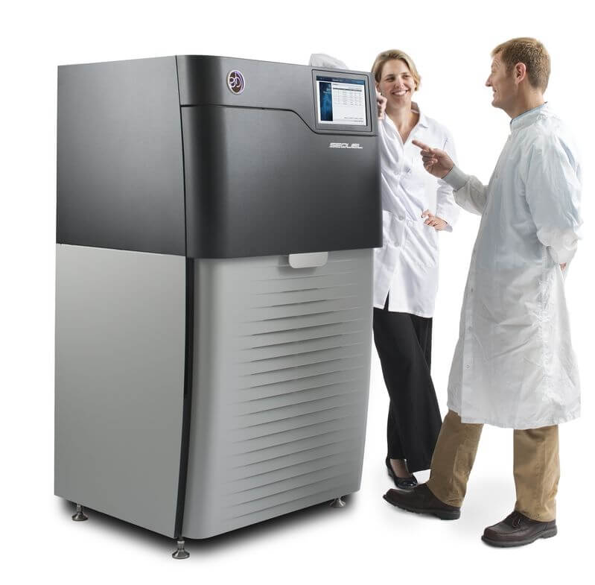
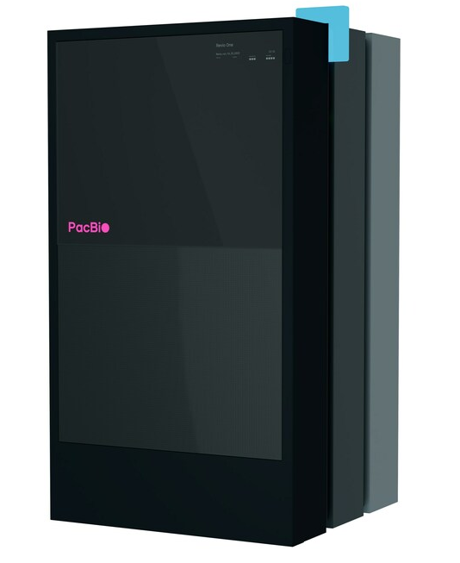
Pacific Bioscience HiFi CCS sequencing
High accuracy long-read sequencing
Sequel II
Revio

Slide 22
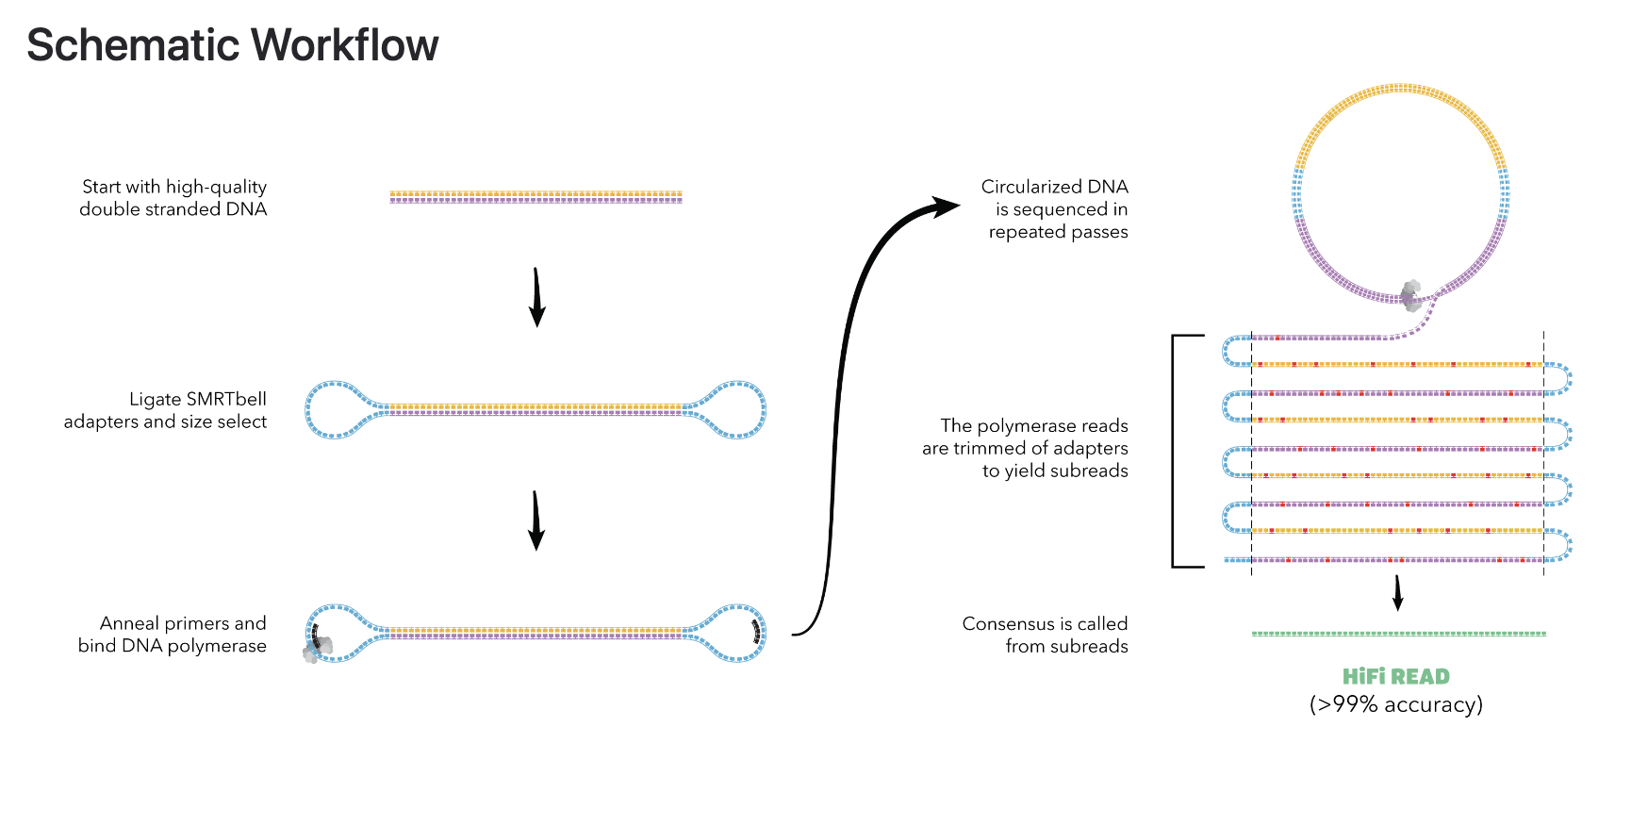
Pacific Bioscience CCS long read sequencing

Slide 23
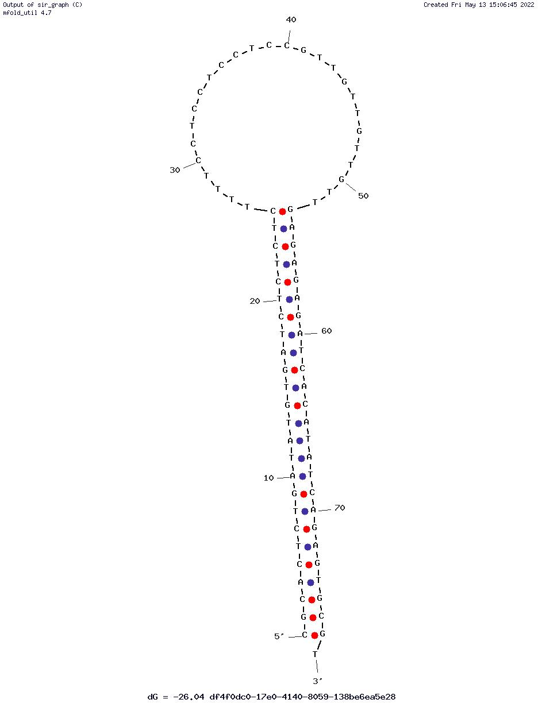
Pacific Bioscience CCS long read sequencing

Slide 24
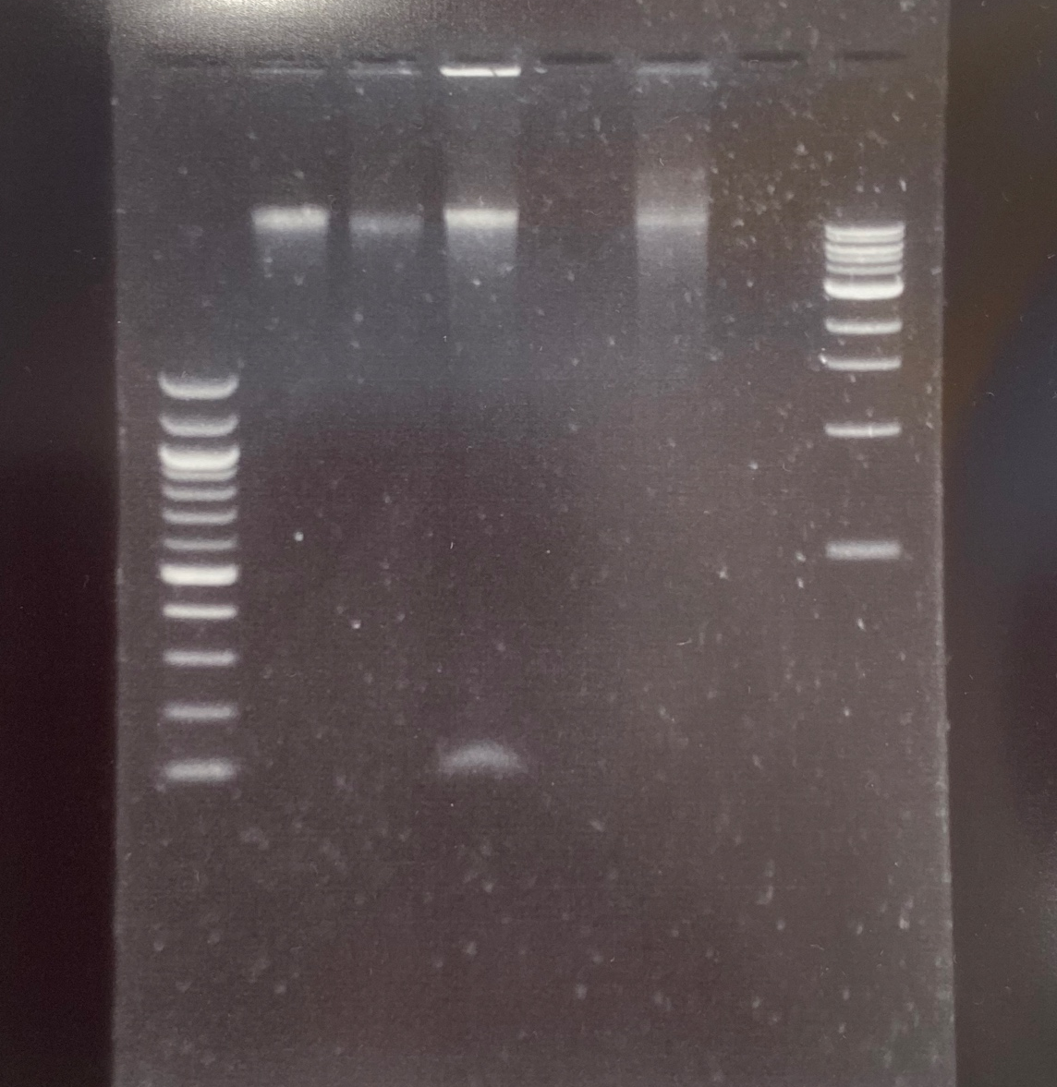
PacBio Exonuclease cleanup: The scary part of PacBio library preparations
Lane 1 NEB 100 bp ladder
Lane 2: Input DNA
Lane 3: Endprep (pre ligation)
Lane 4: Post ligation of adapters
Lane 5: Nuclease treatment of pre ligation
Lane 6: Nuclease treatment of post ligation
Lane 7: PB elution buffer
Lane 8: NEB 1kb ladder

Slide 25
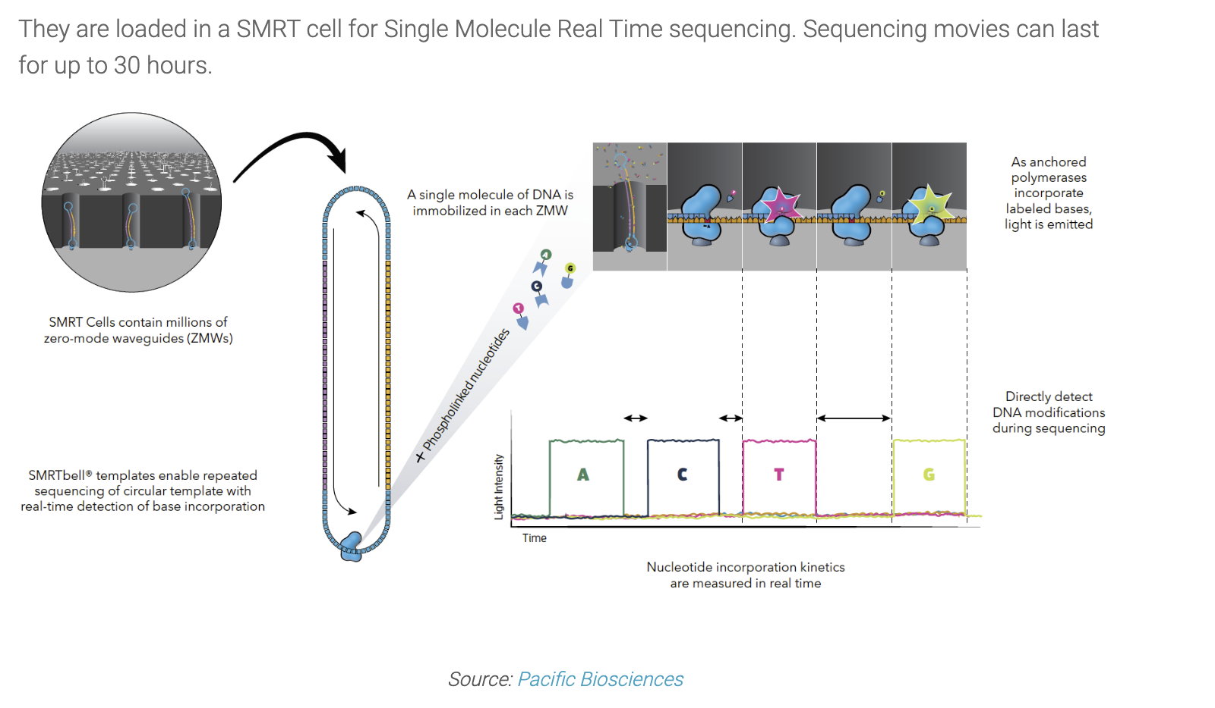

Slide 26
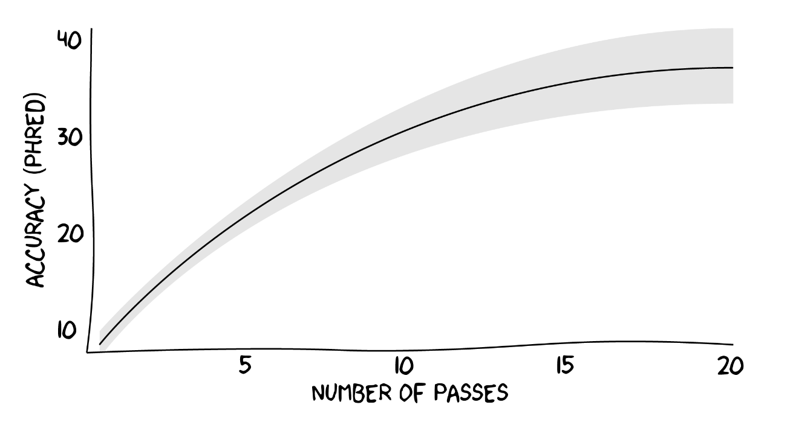
Number of passes vs Q score PacBio CCS reads
10 passes = ~ q 30
10 kb smartbell
100 kb raw read

Slide 27
PacBio Sequencing Review
Advantages
High accuracy ~99%
Longer reads = more contiguous assemblies
25 kb tissue, 6-10 kb metagenomic
5mC metalation calling epigenetics
Up to 500 GB / flowcell (Raw – pre CCS)
Sequel IIe lower throughput
Revio – Higher throughput than Sequel IIe

Slide 28
PacBio Sequencing Review
Advantages
High accuracy propertied 99%
Longer reads
25 kb tissue, 6-10 kb metagenomic
5mC metalation calling epigenetics
Up to 500 GB / flowcell (Raw – pre CCS)
Sequel IIe lower throughput
Revio – Higher throughput than Sequel IIe
Disadvantages
Sample preparation challenging
Sensitive to short fragments
Revio very sensitive to short fragments
Sample dependent methods
Large DNA input requirements ~15-20ug
HMW DNA required
Very tight sheer pattern
Very “hungry” library preparation
Aimed at centralized service providers

Slide 29
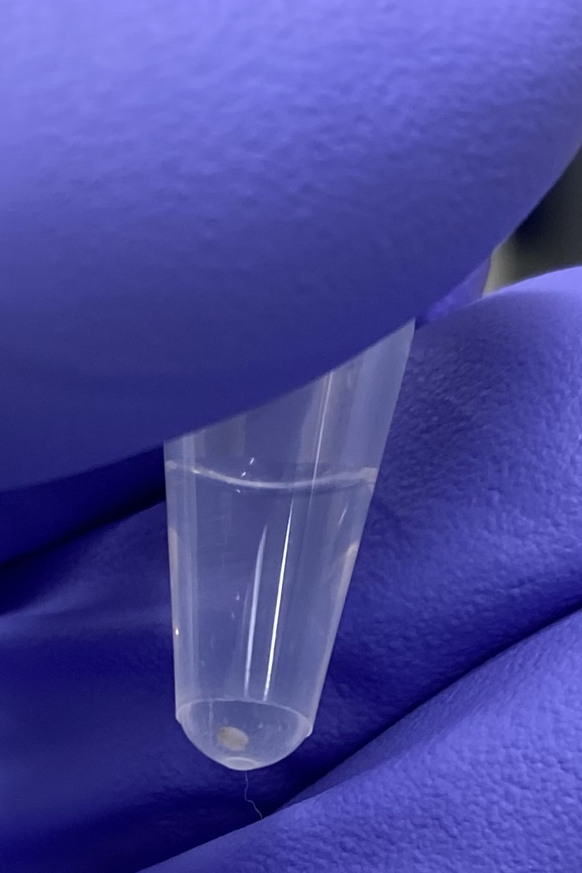
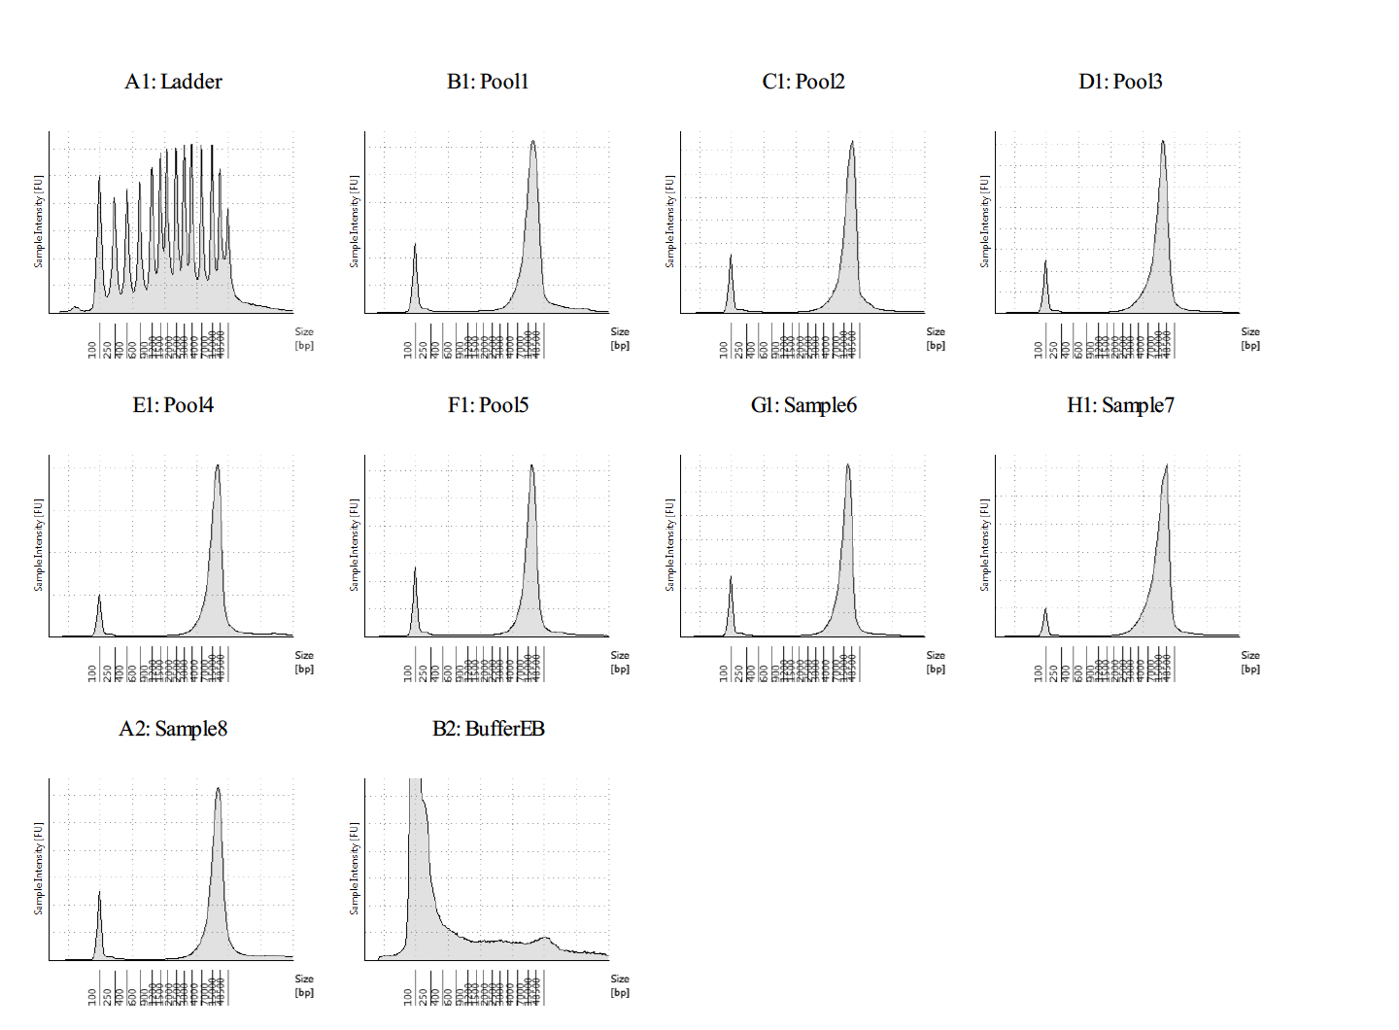
PacBio pooled libraries sizes from faeces
Short read depletion Circulomics SRX kit
>7kb kb DNA pellet
from faecal sample
input

Slide 30
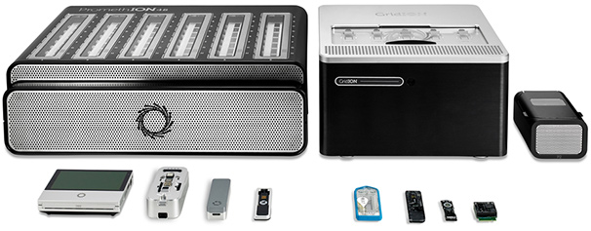
Nanopore long-read sequencing

Slide 31
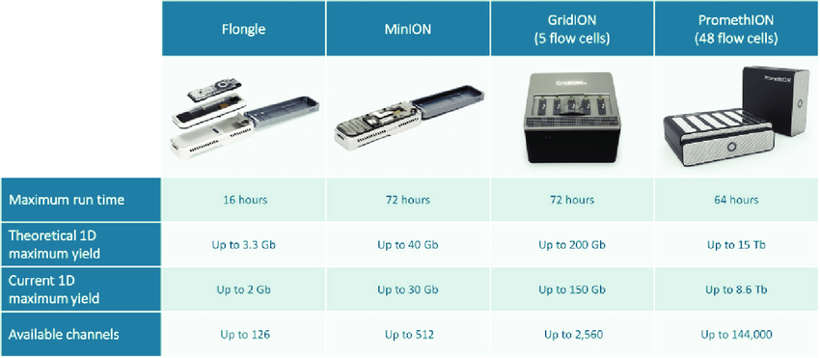
Nanopore long-read sequencing

Slide 32
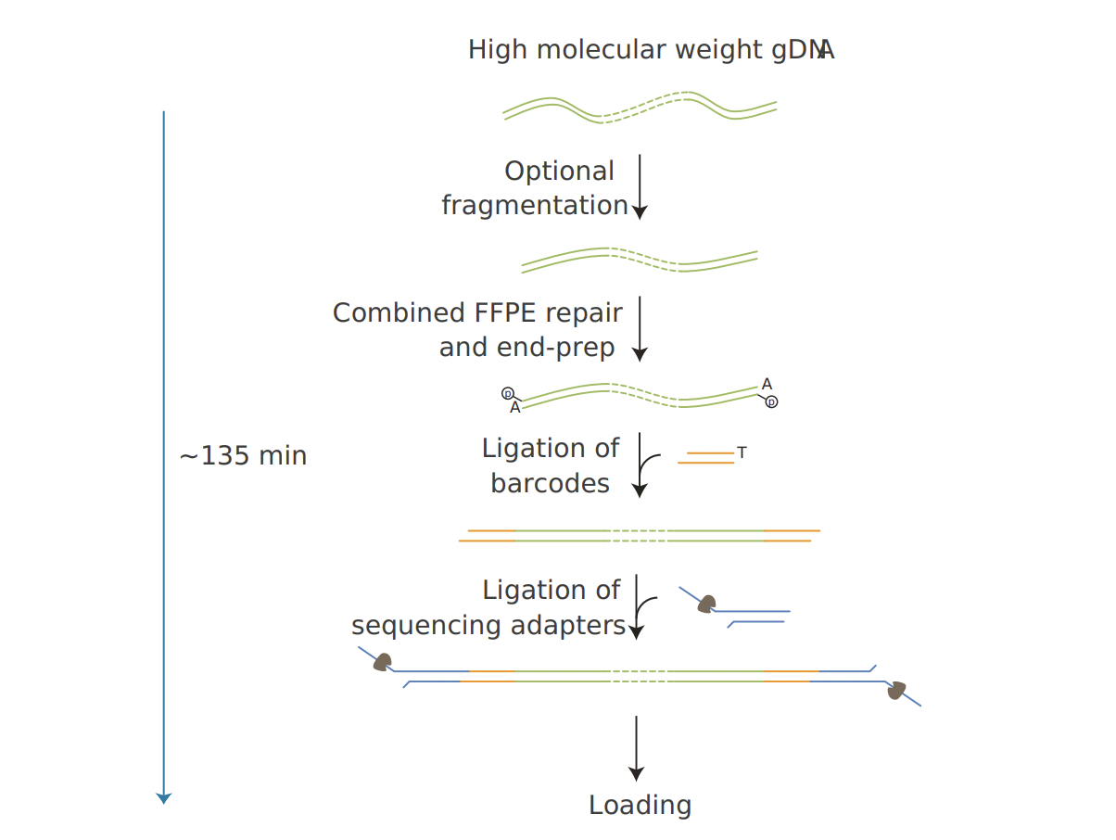
Ligation of sequencing adapters using T4 ligase.
Requires Solid Phase Reversable Immobilization (SPRI) beads for clean up.
To fragment or not to fragment?
Ligation Sequencing Kit

Slide 33
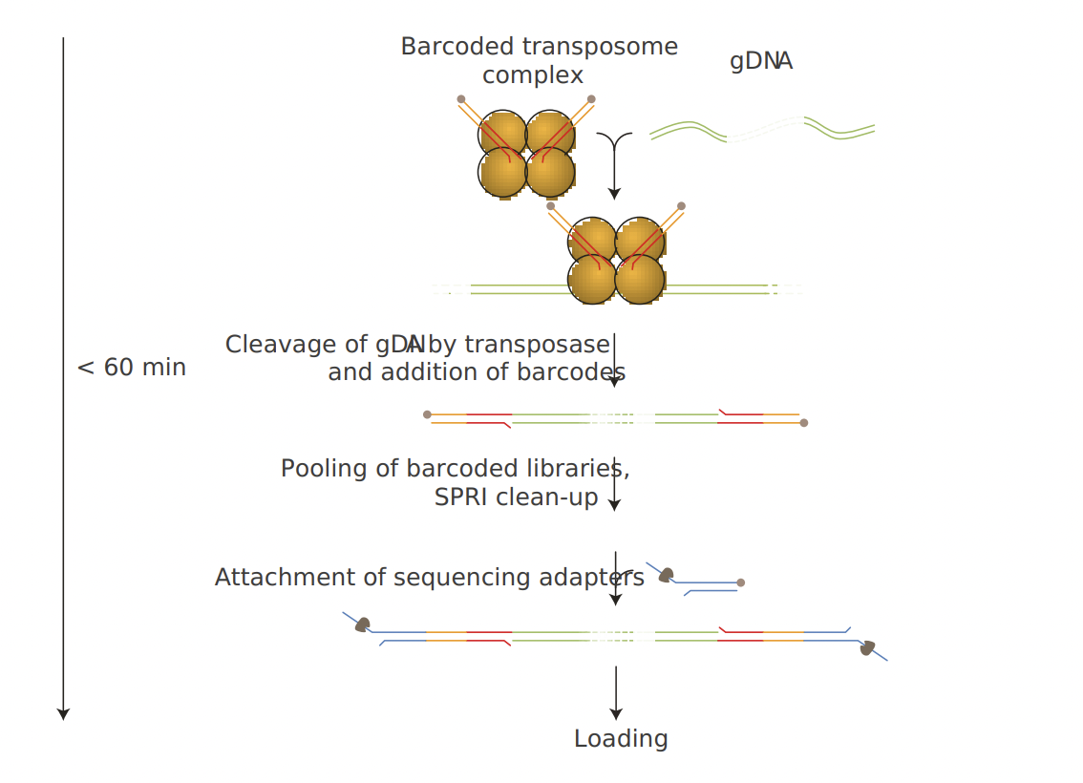
Rapid attachment chemistry with random cleavage
Optimized user-based protocols for transposase vs read length (mb reads)
Lower throughput compared with ligation sequencing

Slide 34
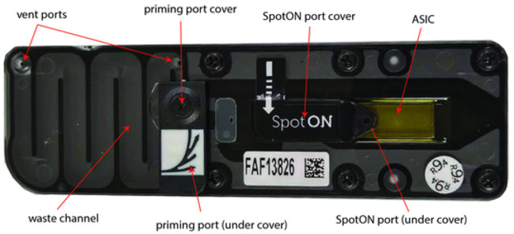

Slide 35
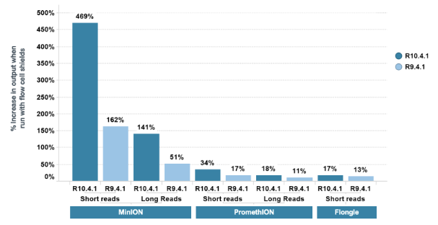
Effect of Light on flow cell output:
“Increase” in throughput using light shields.

Slide 36


Slide 37
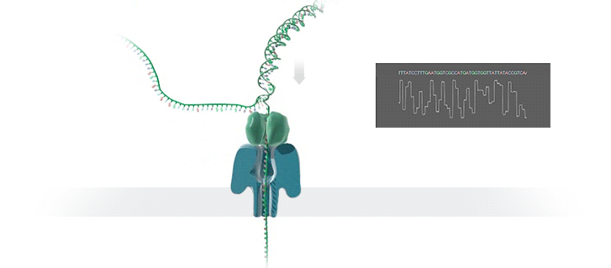

Slide 38
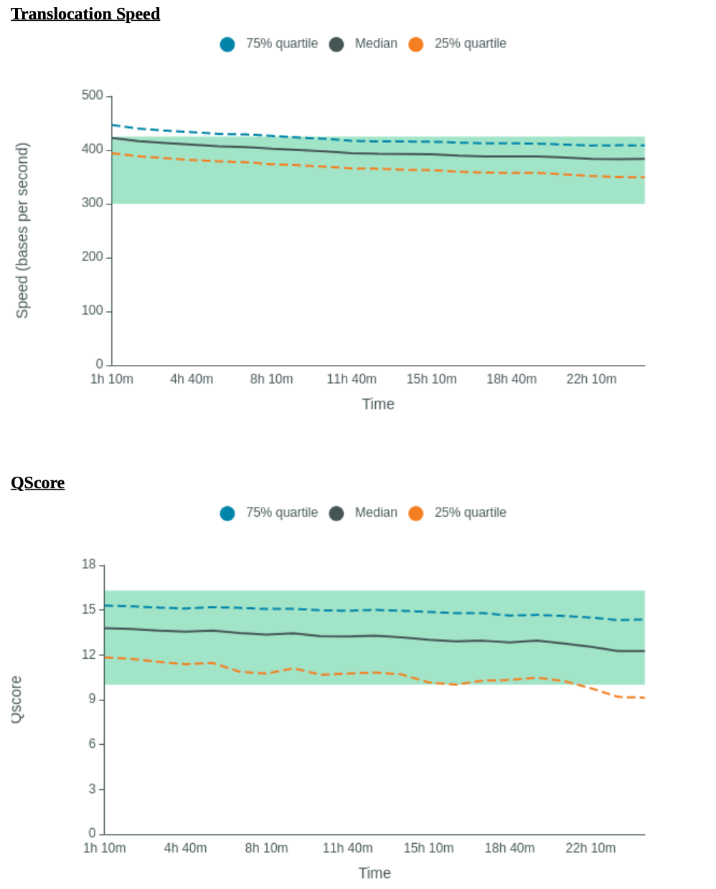
DNA translocation through pore via motor protein
Motor protein powered via ATP
Disruption of signal as DNA passes through pore
Pore and kit development increase in accuracy
Kit LSK114 motor and R10.4.1 flow cells
Duplux flow cells + Stereo Basecalling
Up to 150 GB per flow cell (48 flow cells)

Slide 39
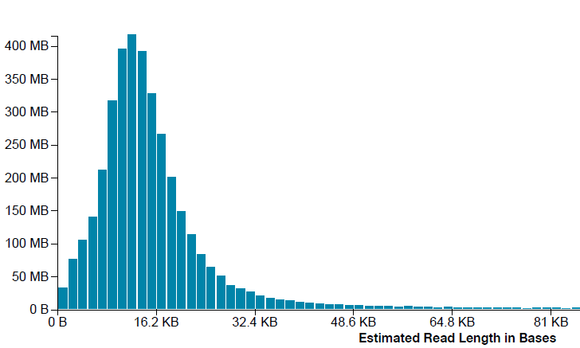
Nanopore read length distribution

Slide 40
.Fast5
Raw fast5 files containing signal data
.Fastq
Basecall via RNN to fastq files
Align
De novo
Alignment or de-novo assembly
Consensus
Polished consensus
Reduction of sequencing errors via polishing

Slide 41
.Fast5
Raw fast5 files containing signal data
.Fastq
Basecall via RNN to fastq files
De novo
De-Novo assembly
Consensus
Reduction of sequencing errors
via polishing = Consensus sequence
Polished consensus

Slide 42
Nanopore Sequencing Review
Advantages
Long reads = greater contiguity of assemblies
Genetic context of genes of interest
Native DNA sequencing Not sequencing by synthesis
5mC metalation calling epigenetics
Less sensitive to shorter fragments
No PCR step ligation of adapters
Low cost
Portable
Decentralized sequencing
Potential for duplex reads now available- Stereo Basecalling with ‘Dorado’

Slide 43
Nanopore Sequencing Review
Advantages
Long reads = greater contiguity of assemblies
Genetic context of genes of interest
Native DNA sequencing
5mC 3mC metalation calling epigenetics
Less sensitive to shorter fragments
Multiple platforms
No PCR step ligation of adapters
Low(er) cost / sample
Portable
Decentralized sequencing
Potential for duplex reads now available
Disadvantages
Lower mode accuracy
Sample dependent methods
Fast development
Large DNA input requirements 1ug
HMW DNA beneficial
“Hungry” library preparation

Slide 44
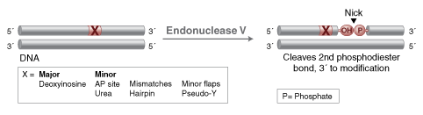
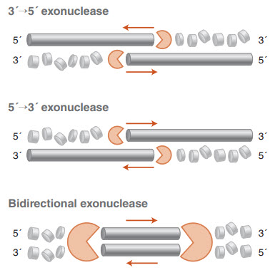
Sample collection and storage
Best Practice
No one size fits all
Sample type dependent
Down stream application dependent
Aim: to reduce DNA degradation and
preserve community composition
  Nuclease activity
  UV degradation
  Oxidative DNA damage
  Freeze thaw cycle damage
  Inhibit further growth
  A snapshot in time

Slide 45
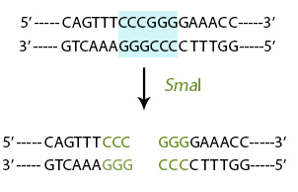
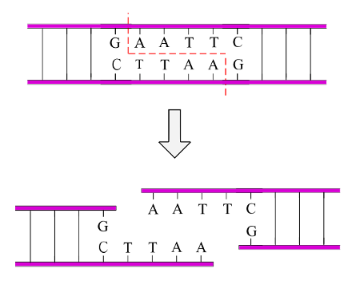
DNA Damage
Nicks:
Single strand break
Cuts:
Double strand break blunt end
Shear:
Double strand break
Often mechanical

Slide 46
Pacific Bioscience CCS long read sequencing
Both PacBio and nanopore sensitive to single strand nicks and double strand breaks.

Slide 47
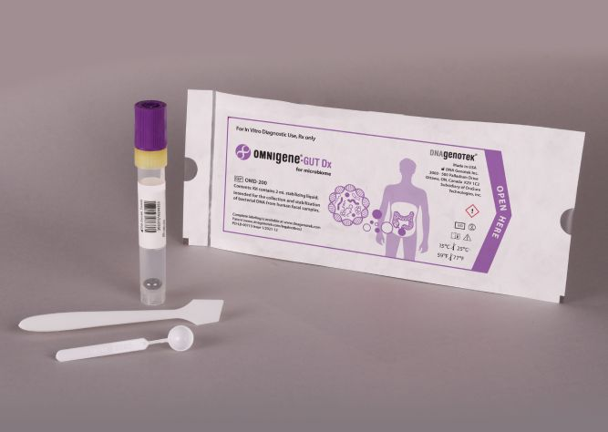
Sample collection and storage
Low temperatures reduce nuclease activity
Store samples at -20 to – 80 C if processing at
a later date.
Store at 4 C if processing samples directly.
Use a cryoprotectant
  PBS + Glycerol –maintains viability
  Omnigene gut – can inhibit some downstream
  applications (SDS in buffer)
  STAR buffer – inhibits cell growth
  Zymo DNA / RNA shield – fixes cells
  Limit freeze thaw cycles
  Keep good sample records and labeling
    Database / Access

Slide 48
Many methods available
MP Bio FastPrep DNA extraction for soil and faeces
Sample collection
Sample storage
Sample preparation
Cell lysis
Protein precipitation
DNA binding / salt precipitation
PCR inhibitor removal / wash Chemical carry over
DNA elution into buffer for downstream analysis

Slide 49
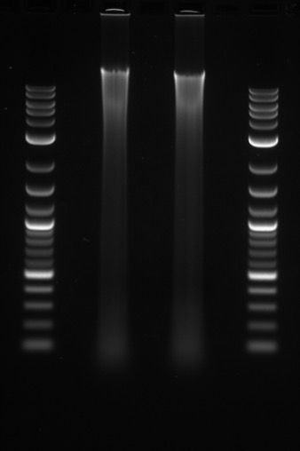
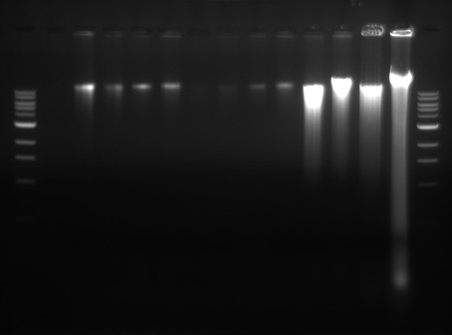
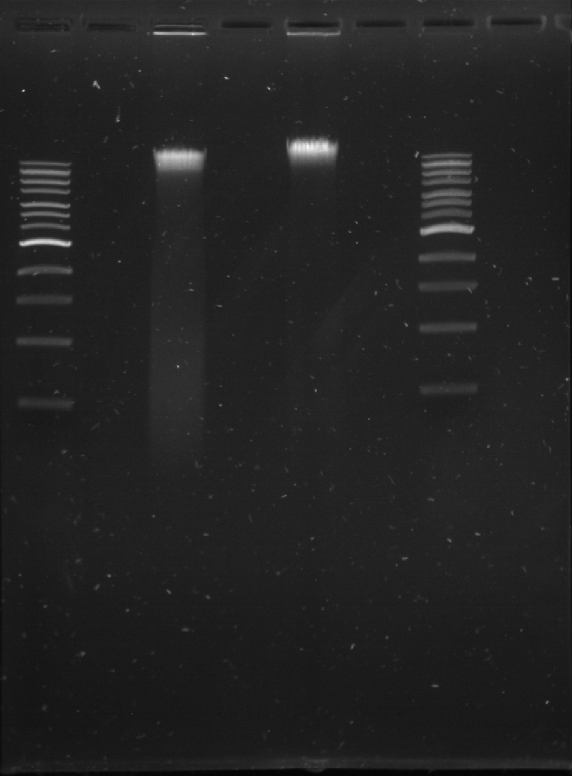
DNA extraction examples
Ph:Ch:IAA extraction
of human faeces
Qiagen total microbiome
Kit from human faeces
Genomic tip extraction

Slide 50
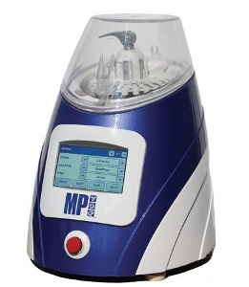
DNA extraction and Library preparation
Mechanical shearing good for hard to lyse bacteria
Leads to DNA sheering and shorter DNA fragments
Good community representation
Ideal for short read illumine sequencing
Less applicable to Nanopore long read sequencing
Detrimental to PacBio HiFi sequencing

Slide 51
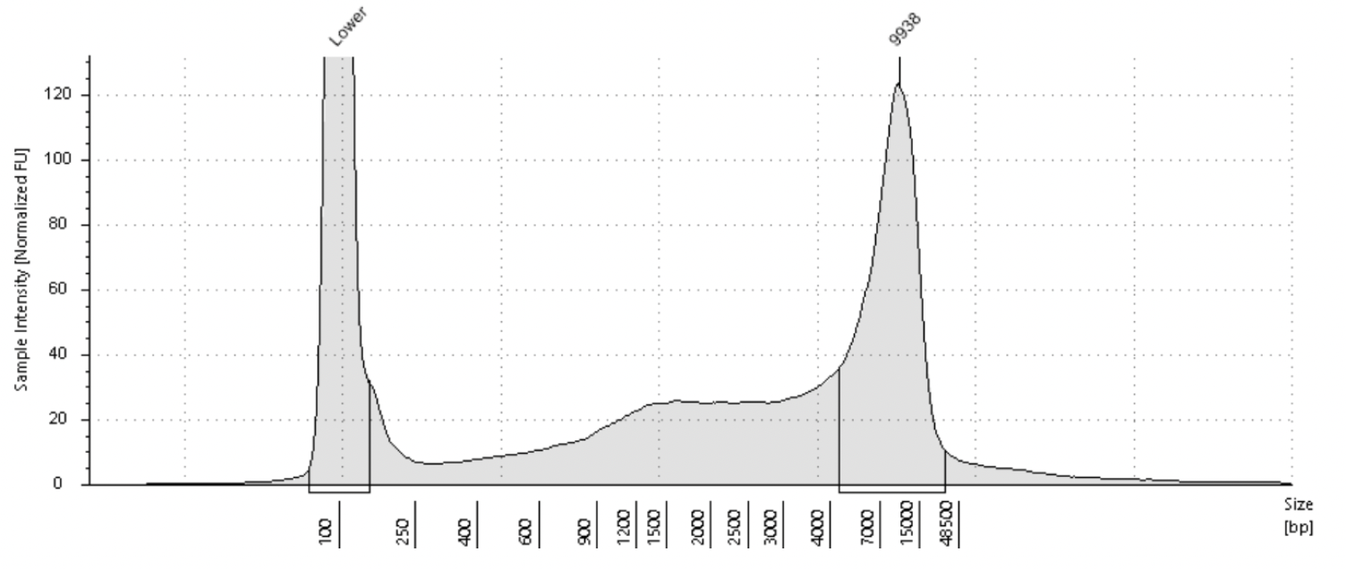
DNA size distribution following mechanical lysis

Slide 52
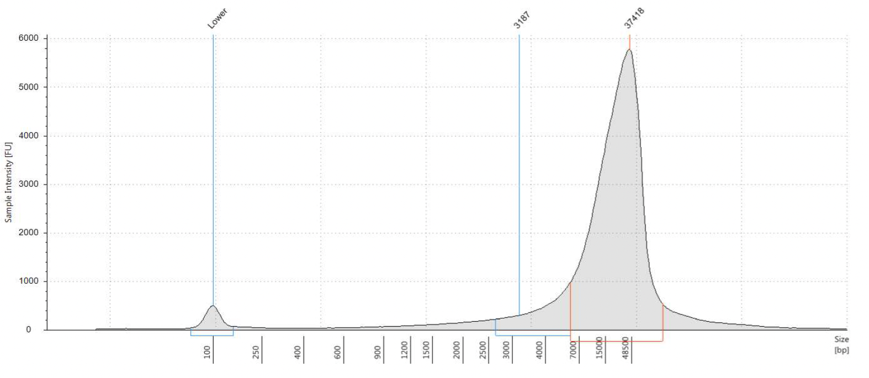
DNA size distribution following enzymatic and mechanical lysis and short read depletion

Slide 53
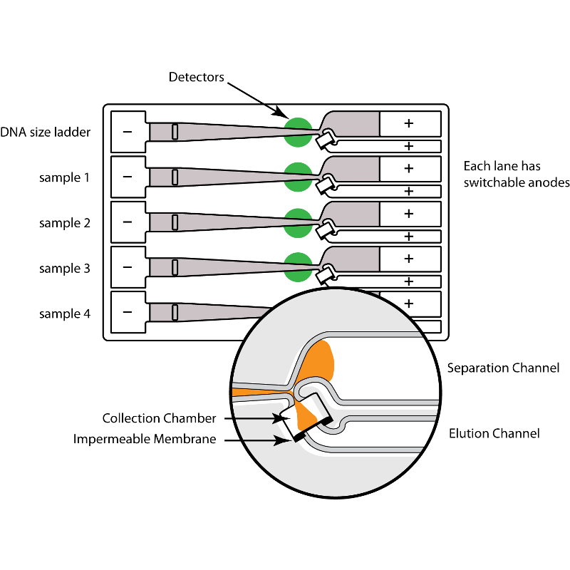
Library preparation for long read sequencing
DNA size selection via Circulomics kit / Blue pippin / Sage Elf
Uses a preliminary preparation and repair step to remove nicks from template DNA
FFPE Nick translation
Prepares ends for ligation of sequencing adapters (5’ phosphorylation 3’ dA tail)

Slide 54
Library preparation for long read sequencing
Key points for Library preparation and sequencing
Store samples appropriately to reduce degradation and community bias
Use appropriate extraction method for sequencing platform
Use recommended repair and library preparation protocols (kit dependent)
Use correct molarity for cluster generation / flow cell loading (Very important).
QC samples before loading is often (but not always) recommended.

Slide 55
PacBio info: https://ccs.how/faq/
Nanopore Info: https://nanoporetech.com/community
Illumina Info: https://emea.illumina.com/
Molecular biology info: https://uk.neb.com/
Protocols (user made): https://www.protocols.io/
Resources

