Slide 1
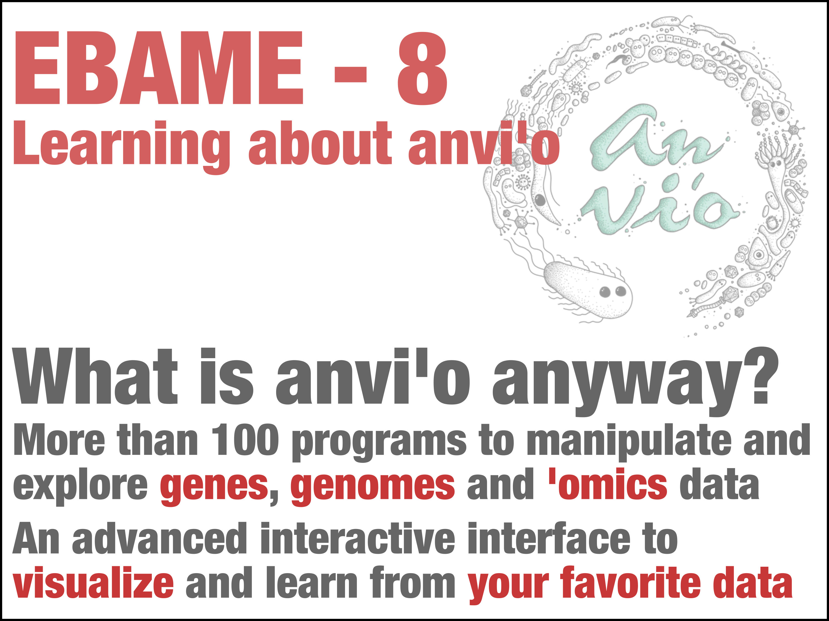

Slide 2
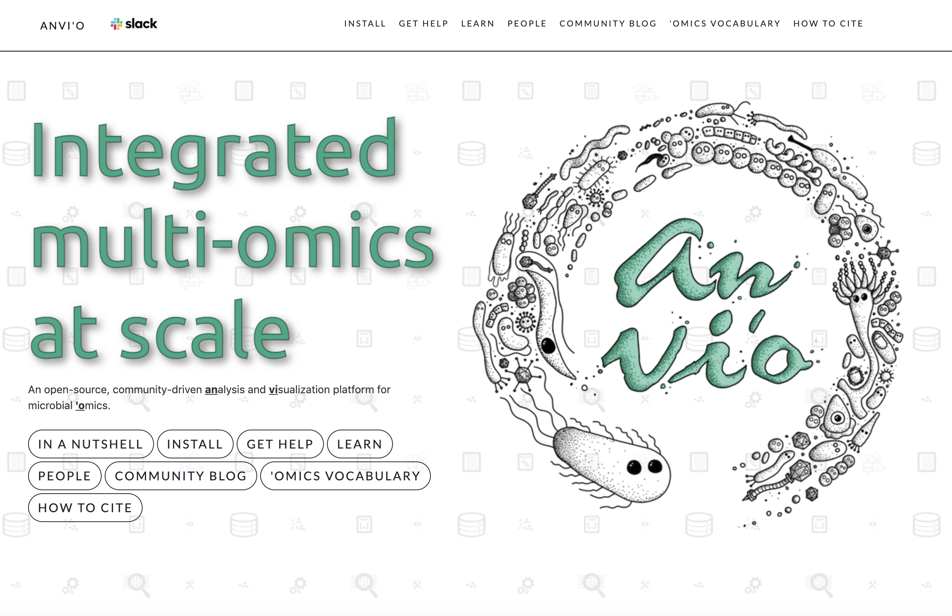


Slide 3



















Anvi’o is an open-source, community-driven software platform for integrated ‘omics
A. Murat Eren
Notes:
it has,

Slide 4
Genome-resolved
metagenomics
Population
genetics
Comparative
genomics
Phylogenomics
Eren et al., PeerJ 2015
Eren et al., Nature Microbiology 2021

Slide 5
Notes:
Here is a quick summary of some of the most common ‘omics data types.
Omics: Analysis of large amounts of data representing an entire set of some kind.

Slide 11
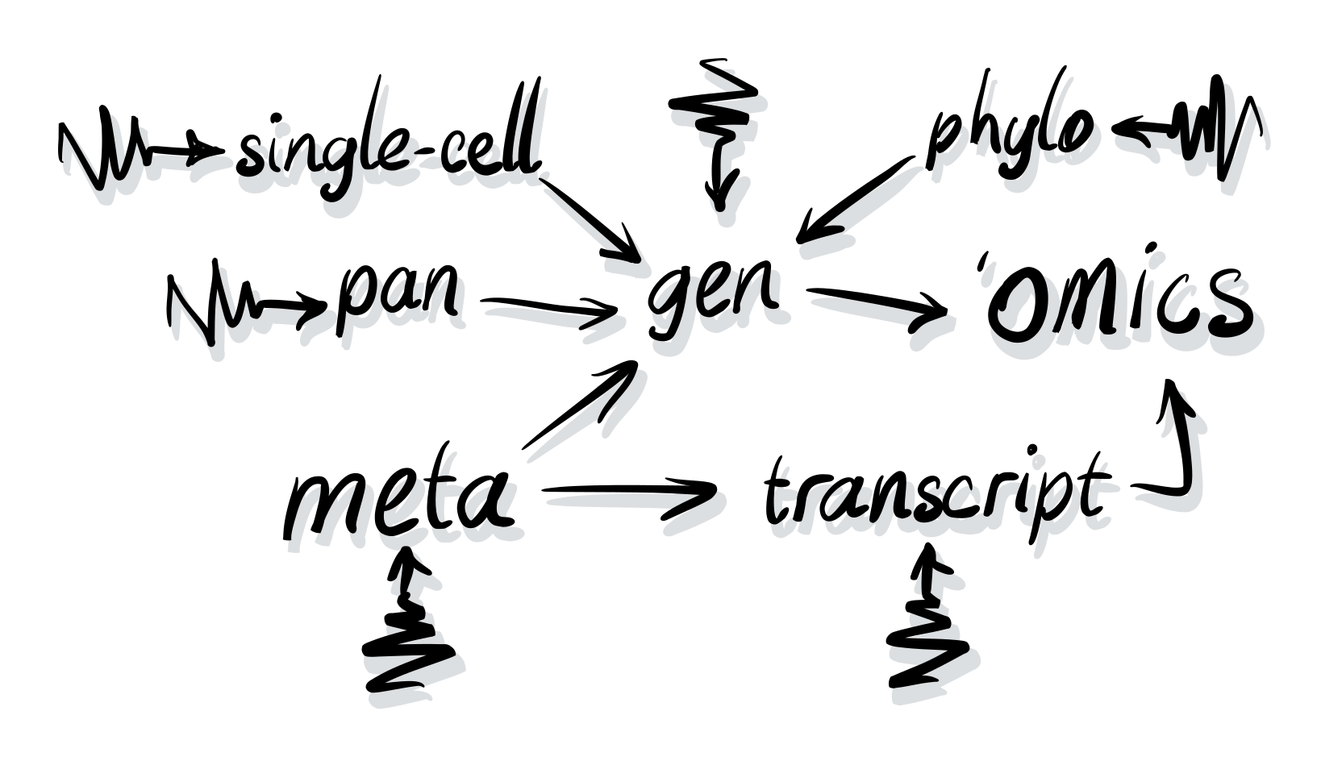


Slide 13
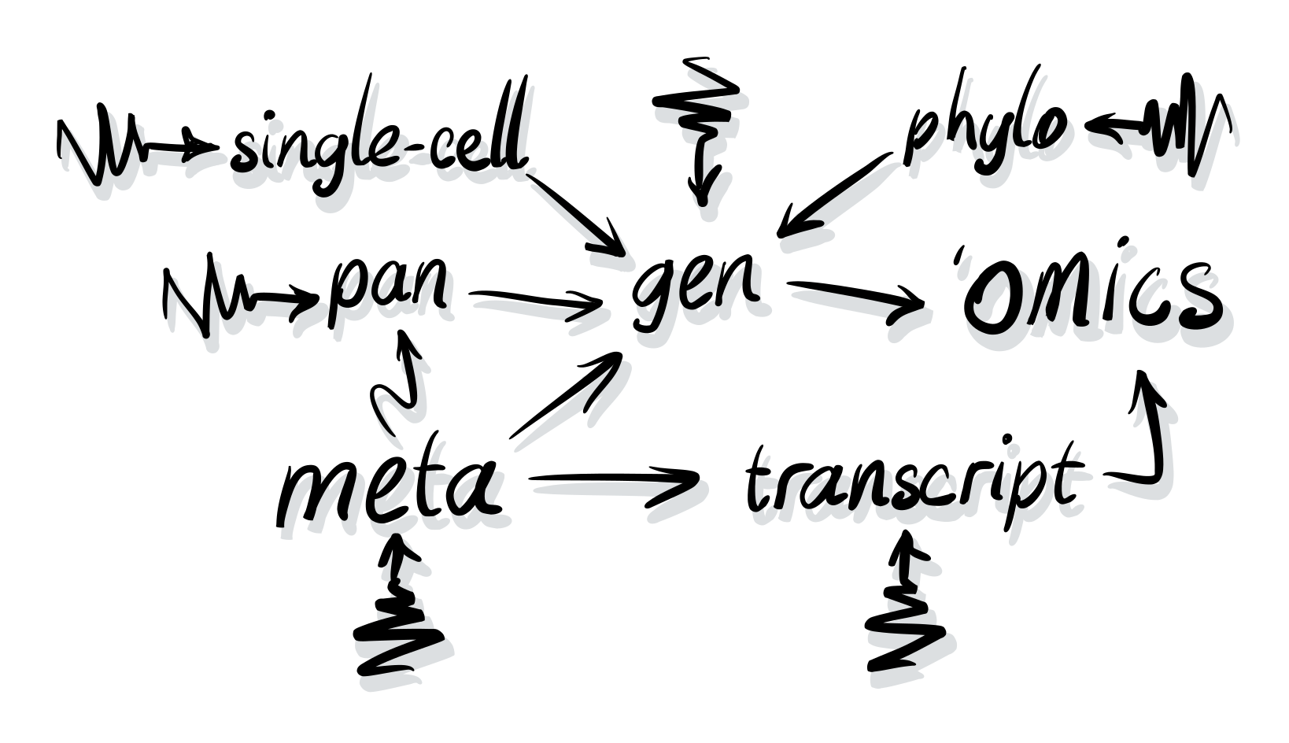
Notes:
During the next few weeks we will discuss some these approaches in greater detail.

Slide 15
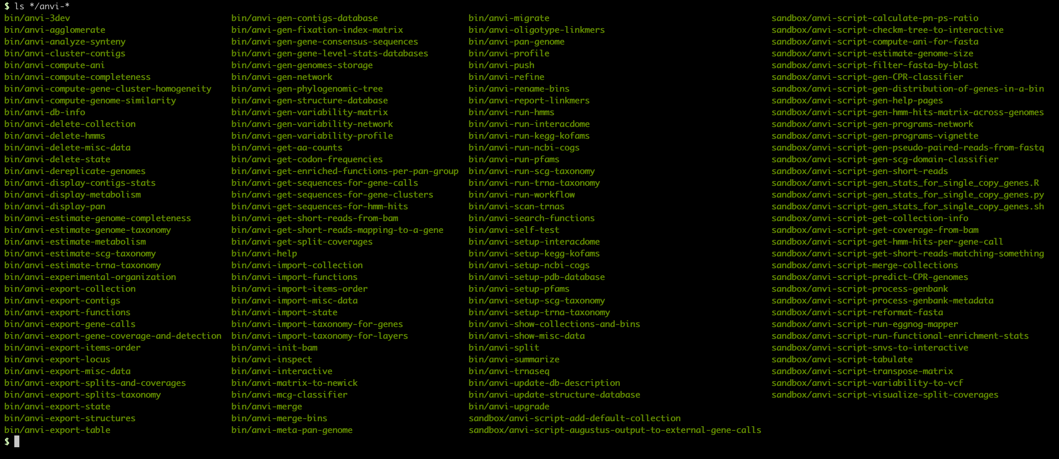
A LEGO-like architectural design
Notes:
Anvi’o represents a departure from the current software development practices and stands on a unique architecture that empowers its users with tremendous amount of flexibility.
For instance, anvi’o comes with a large number of small programs, each of which performs simple tasks rather than trying to accomplish entire workflows. In this sense anvi'o is a lot like LEGO: people who know their questions can piece together different components of anvi’o to implement unique workflows to address unique needs.
Different programs interface with each other through anvi'o artifacts that are generated, modified, queried, split, and merged by individual anvi'o programs.

Slide 18
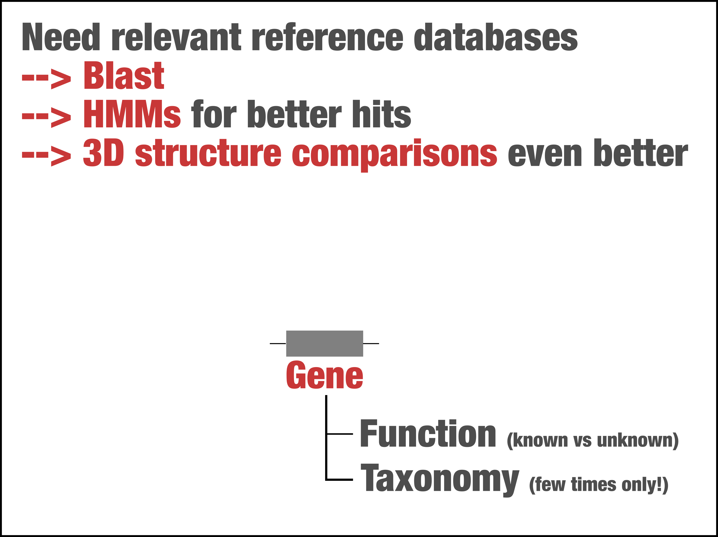

Slide 19
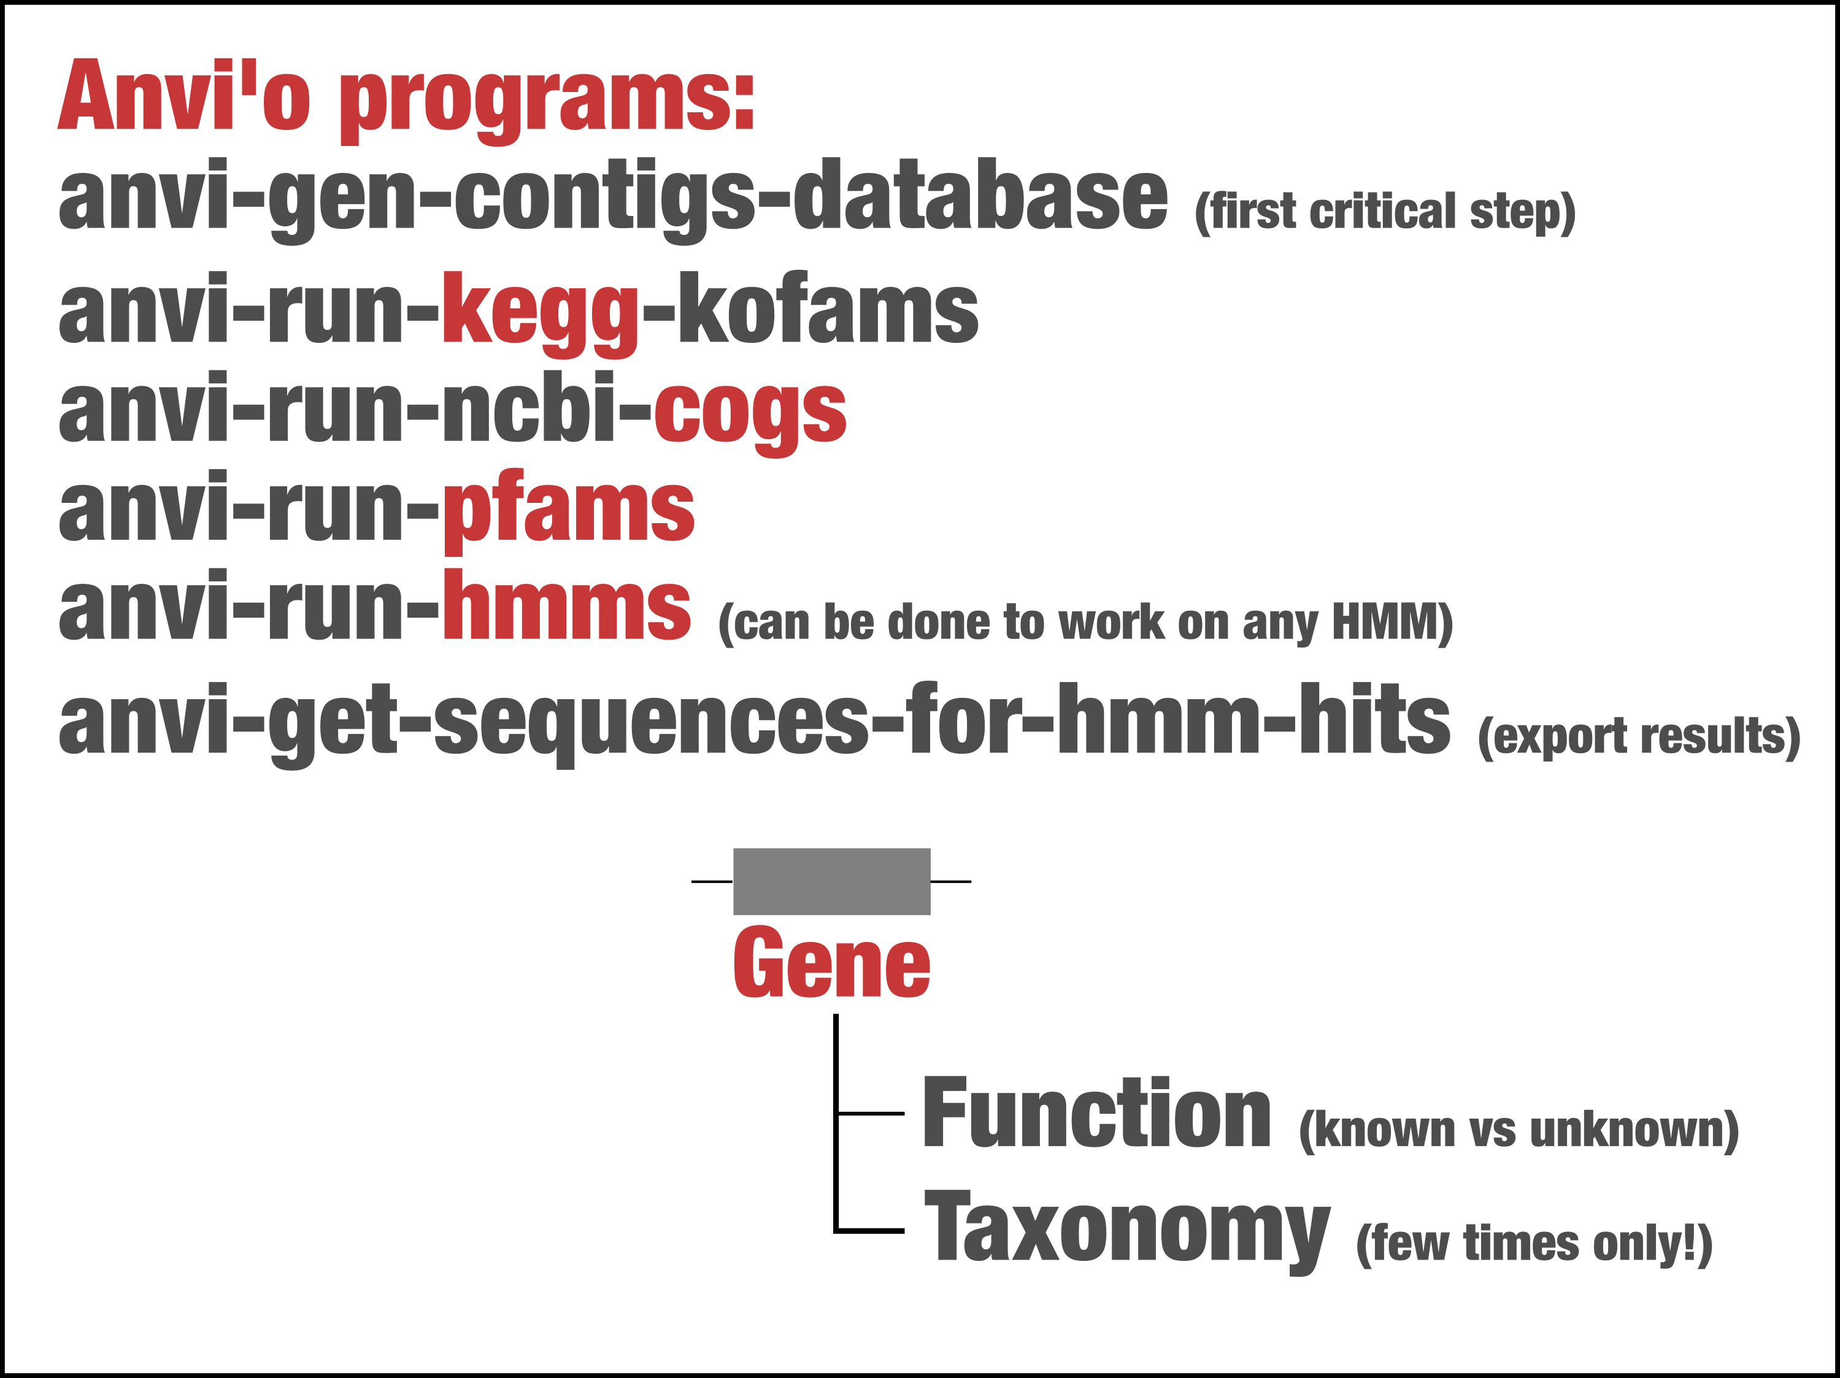

Slide 20
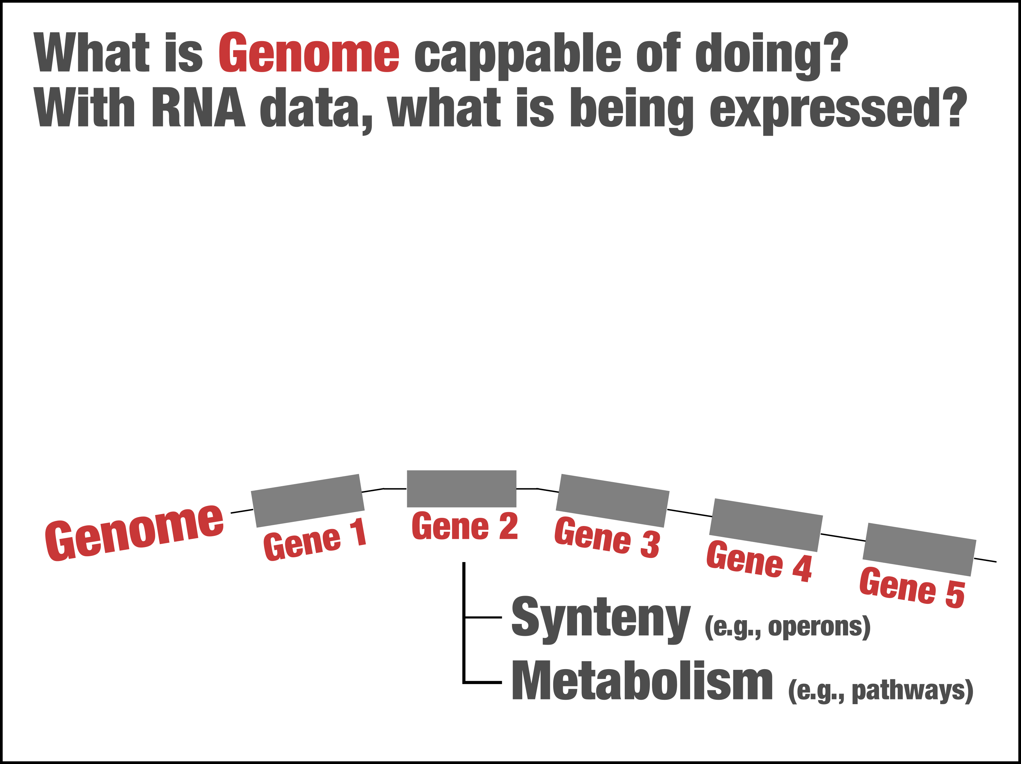

Slide 21
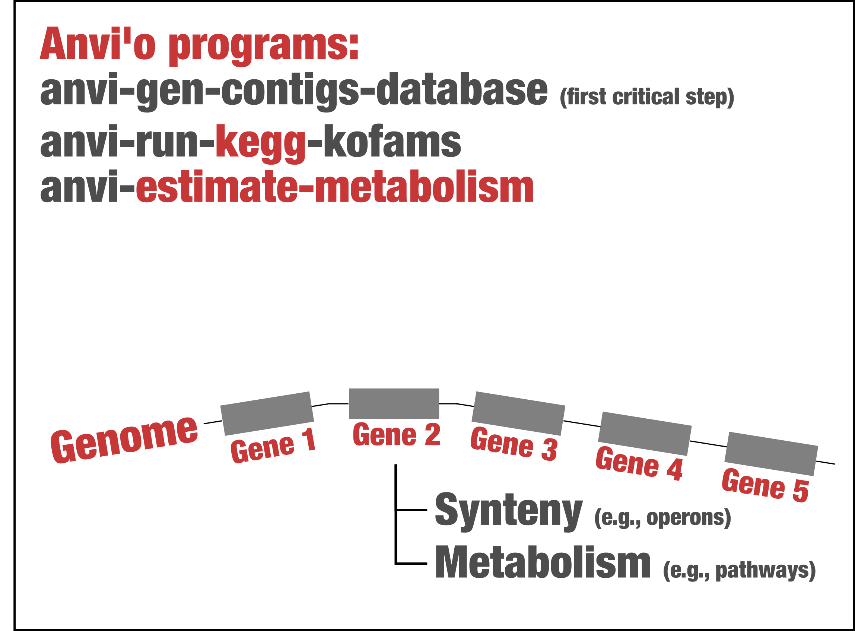

Slide 22
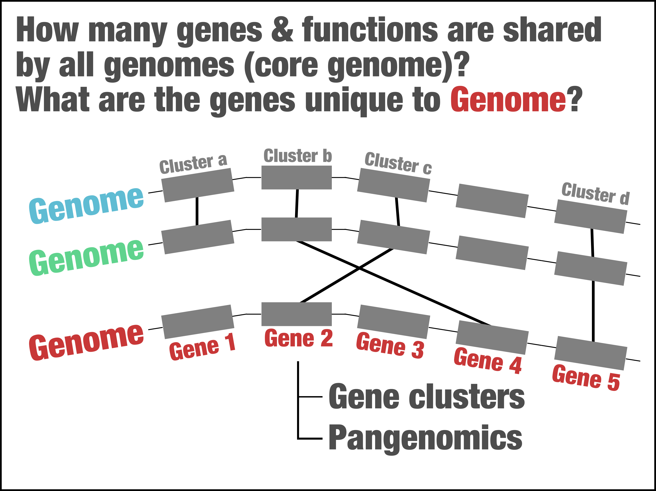

Slide 23
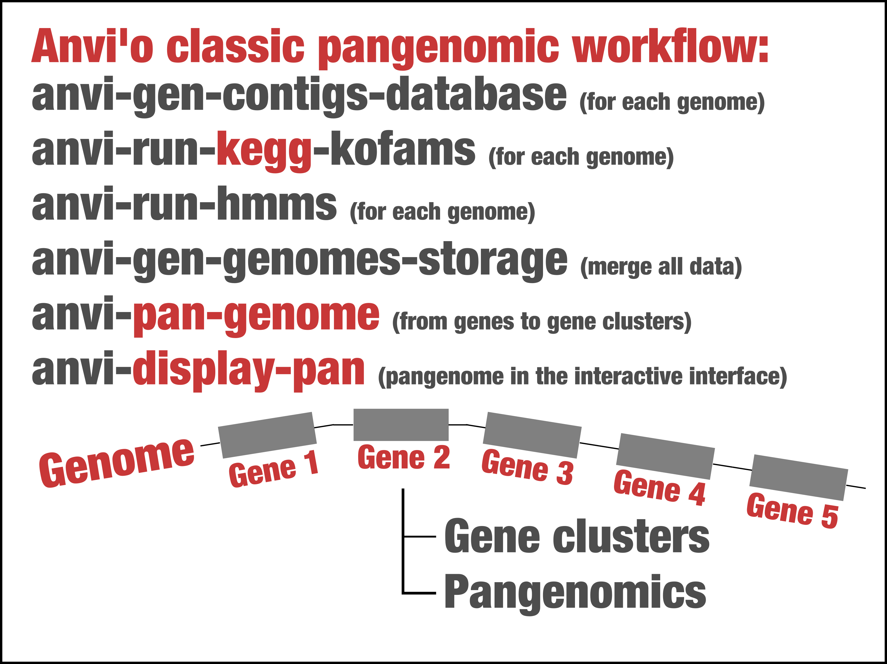

Slide 24
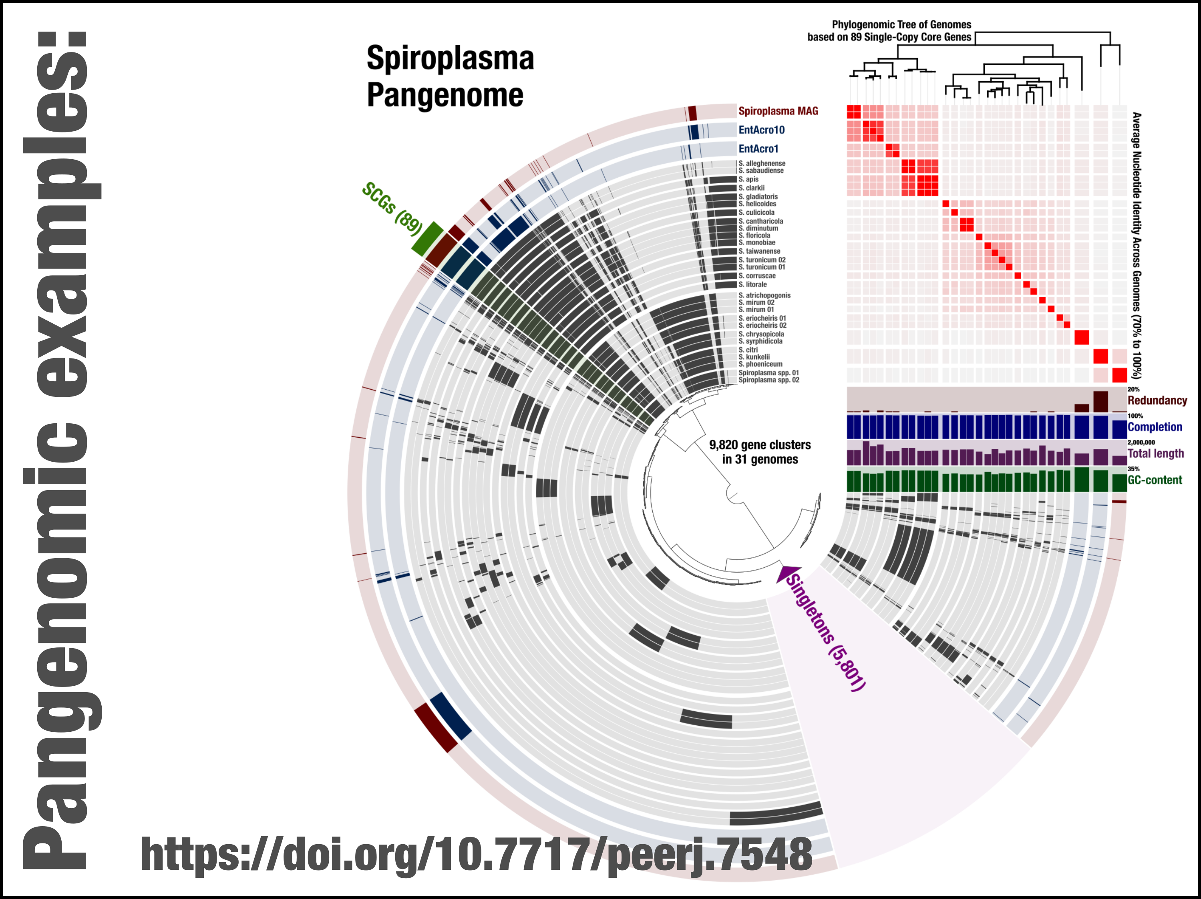

Slide 25
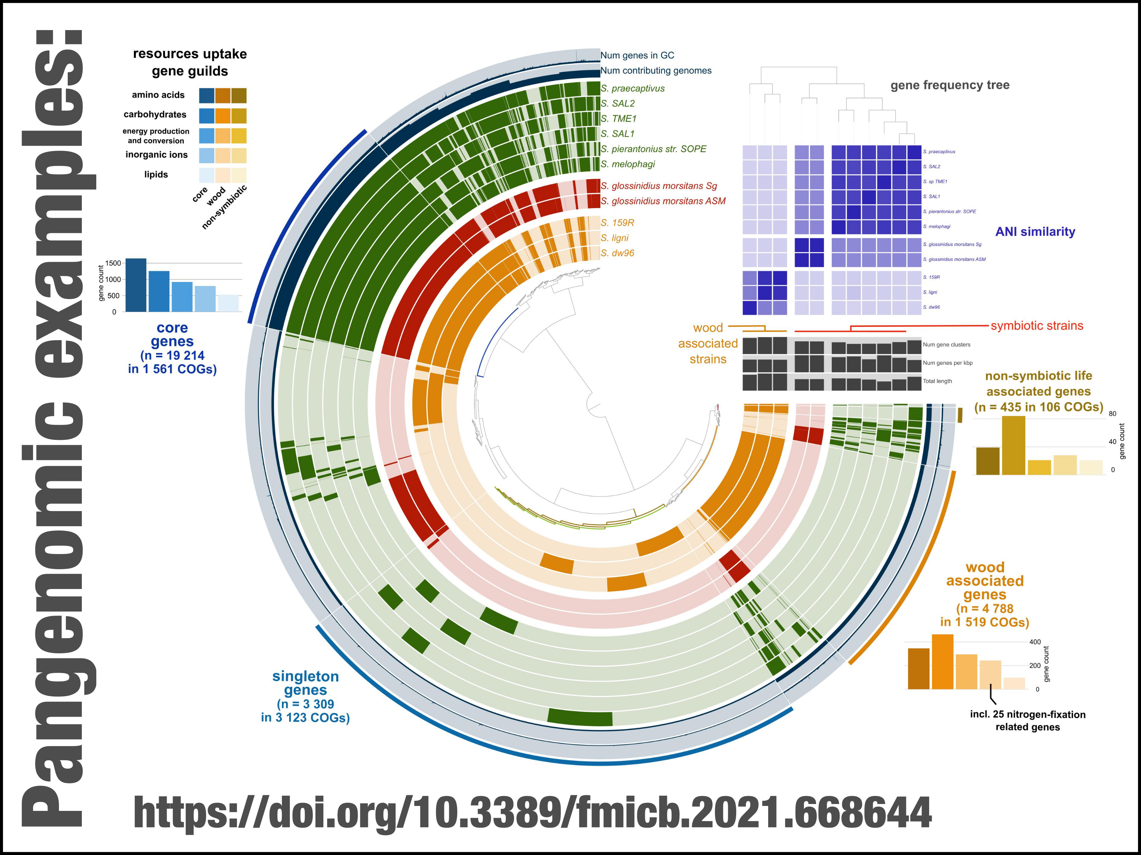

Slide 26
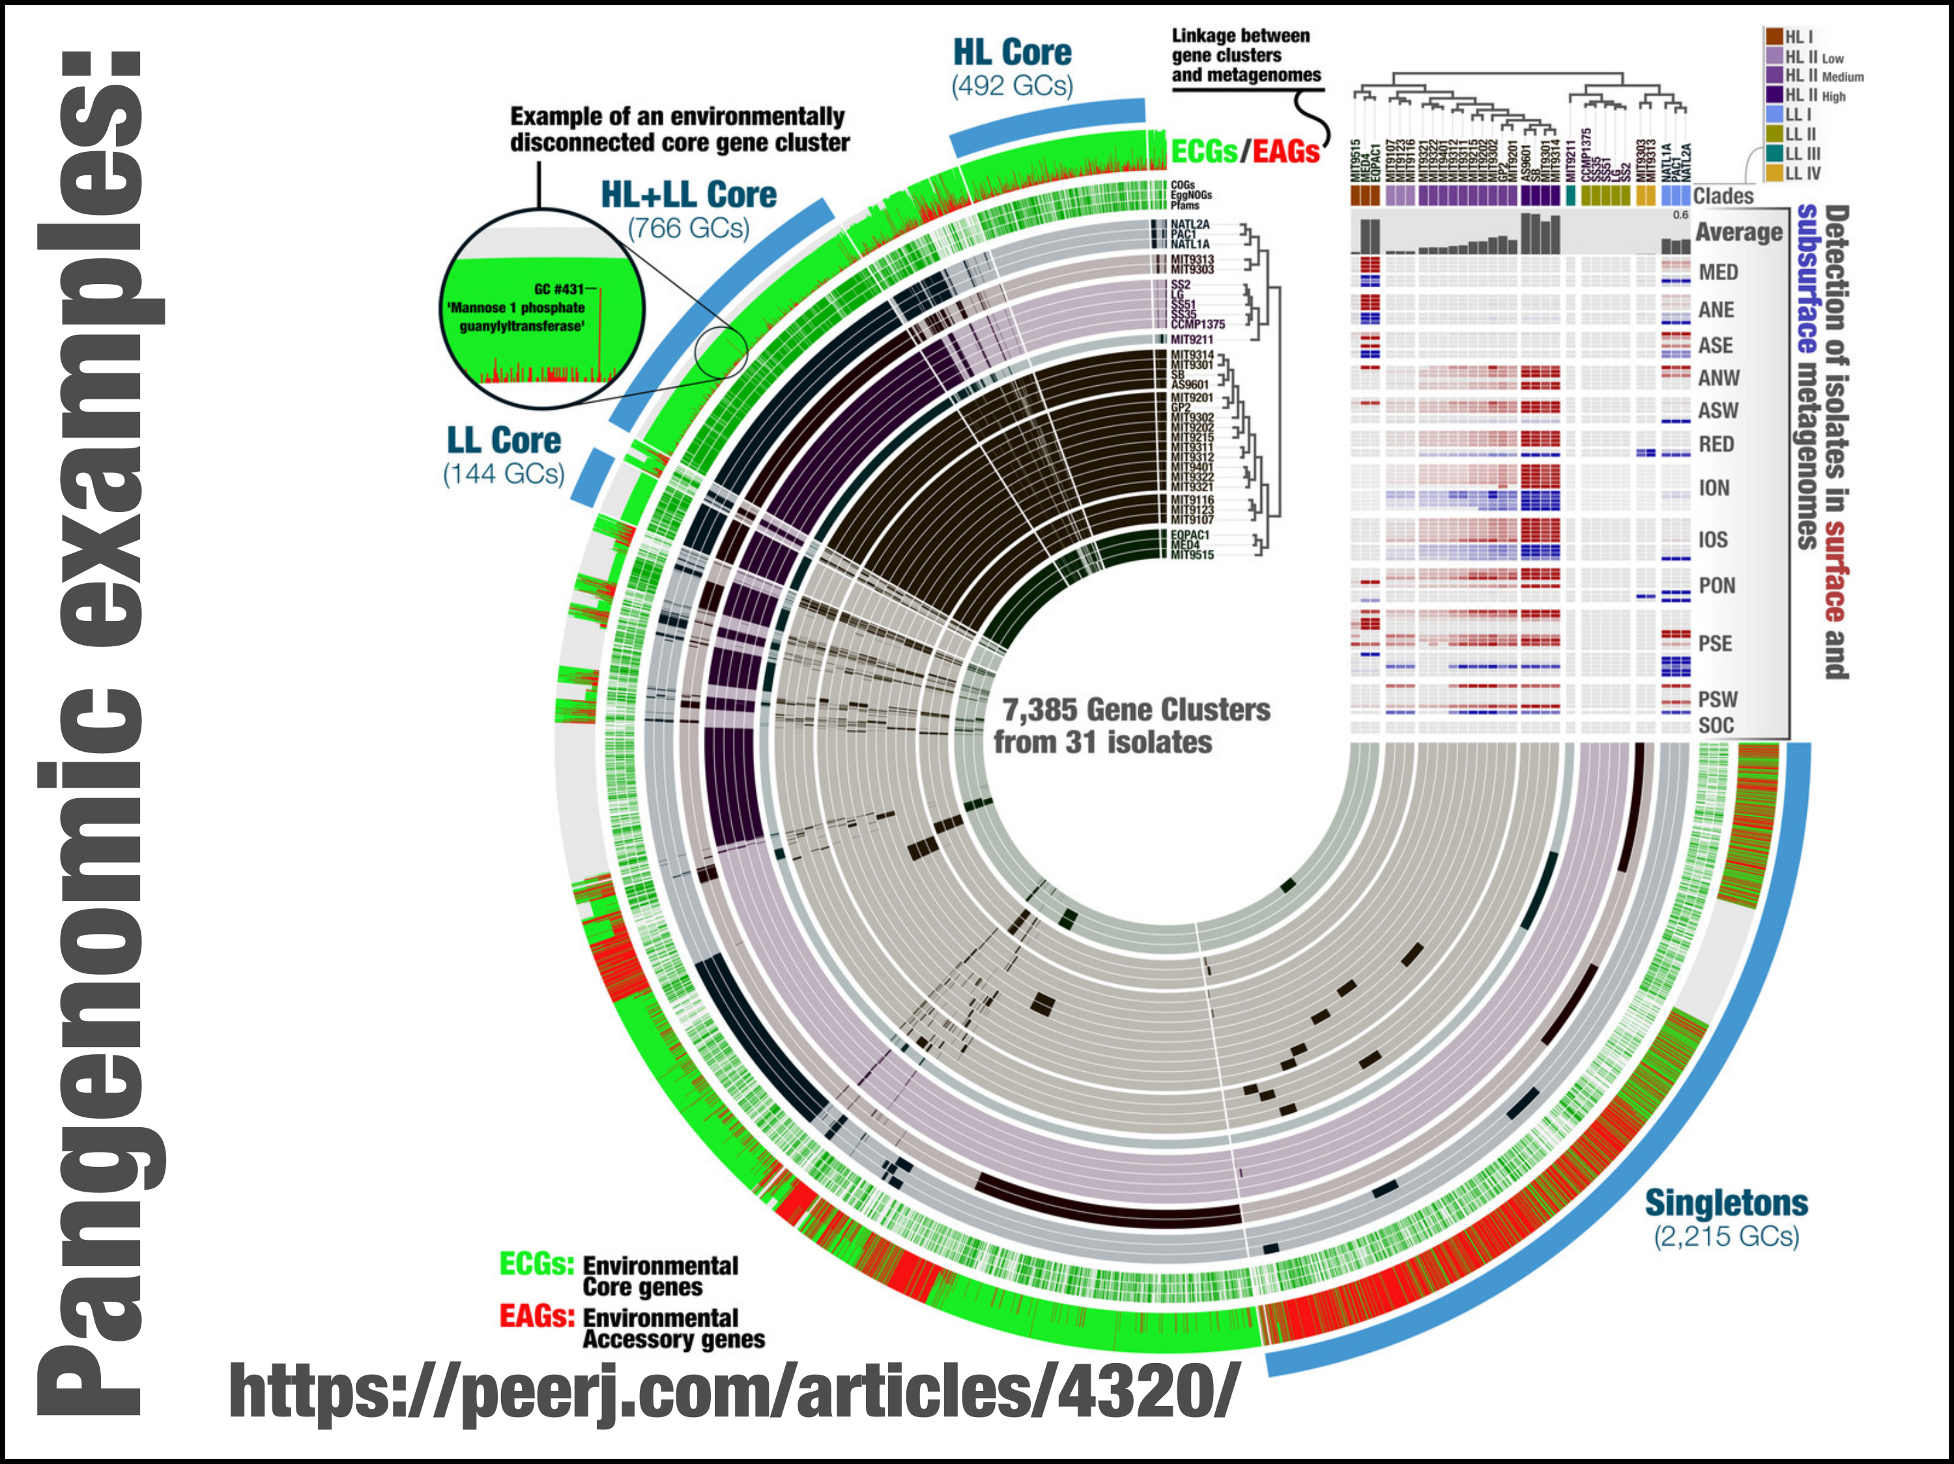

Slide 27
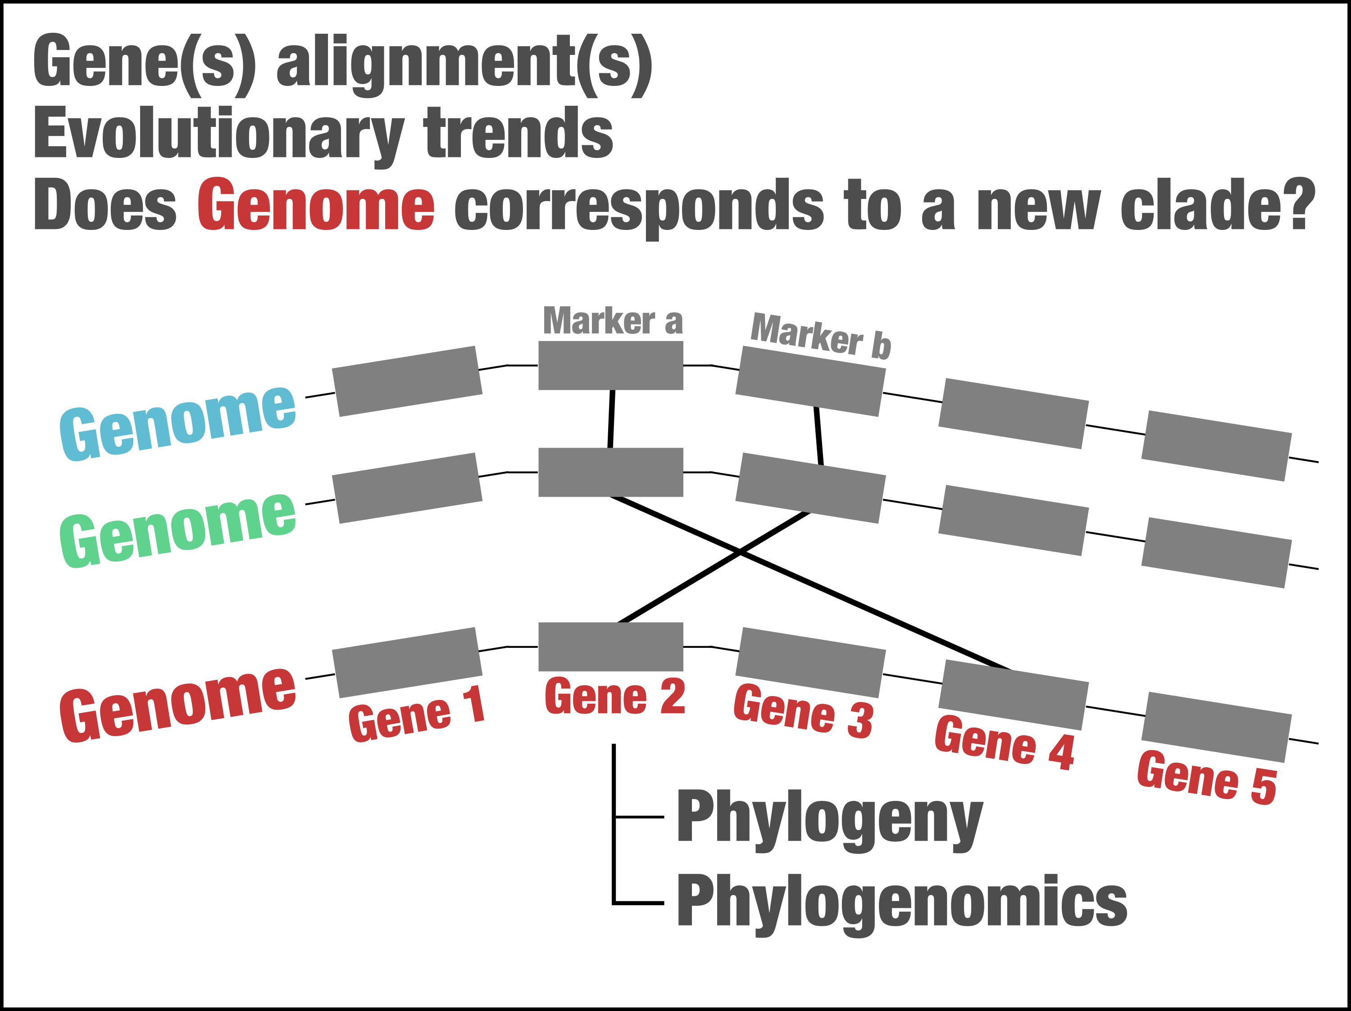

Slide 28
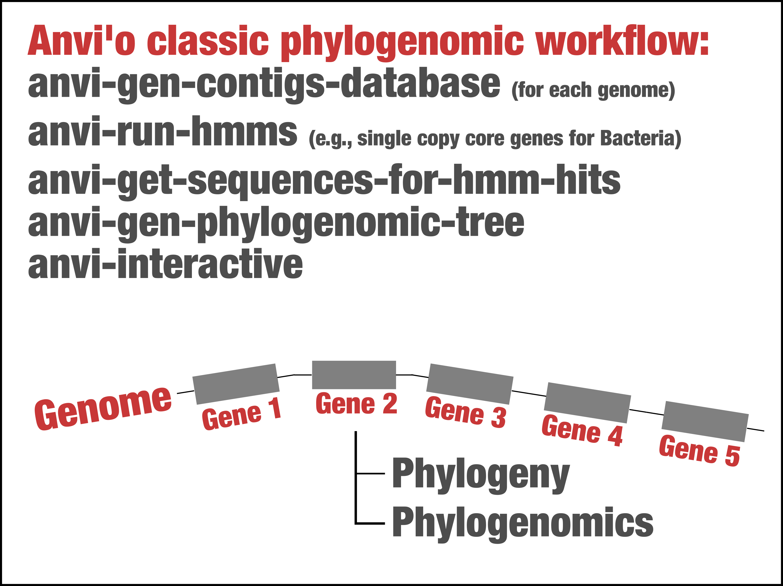

Slide 29
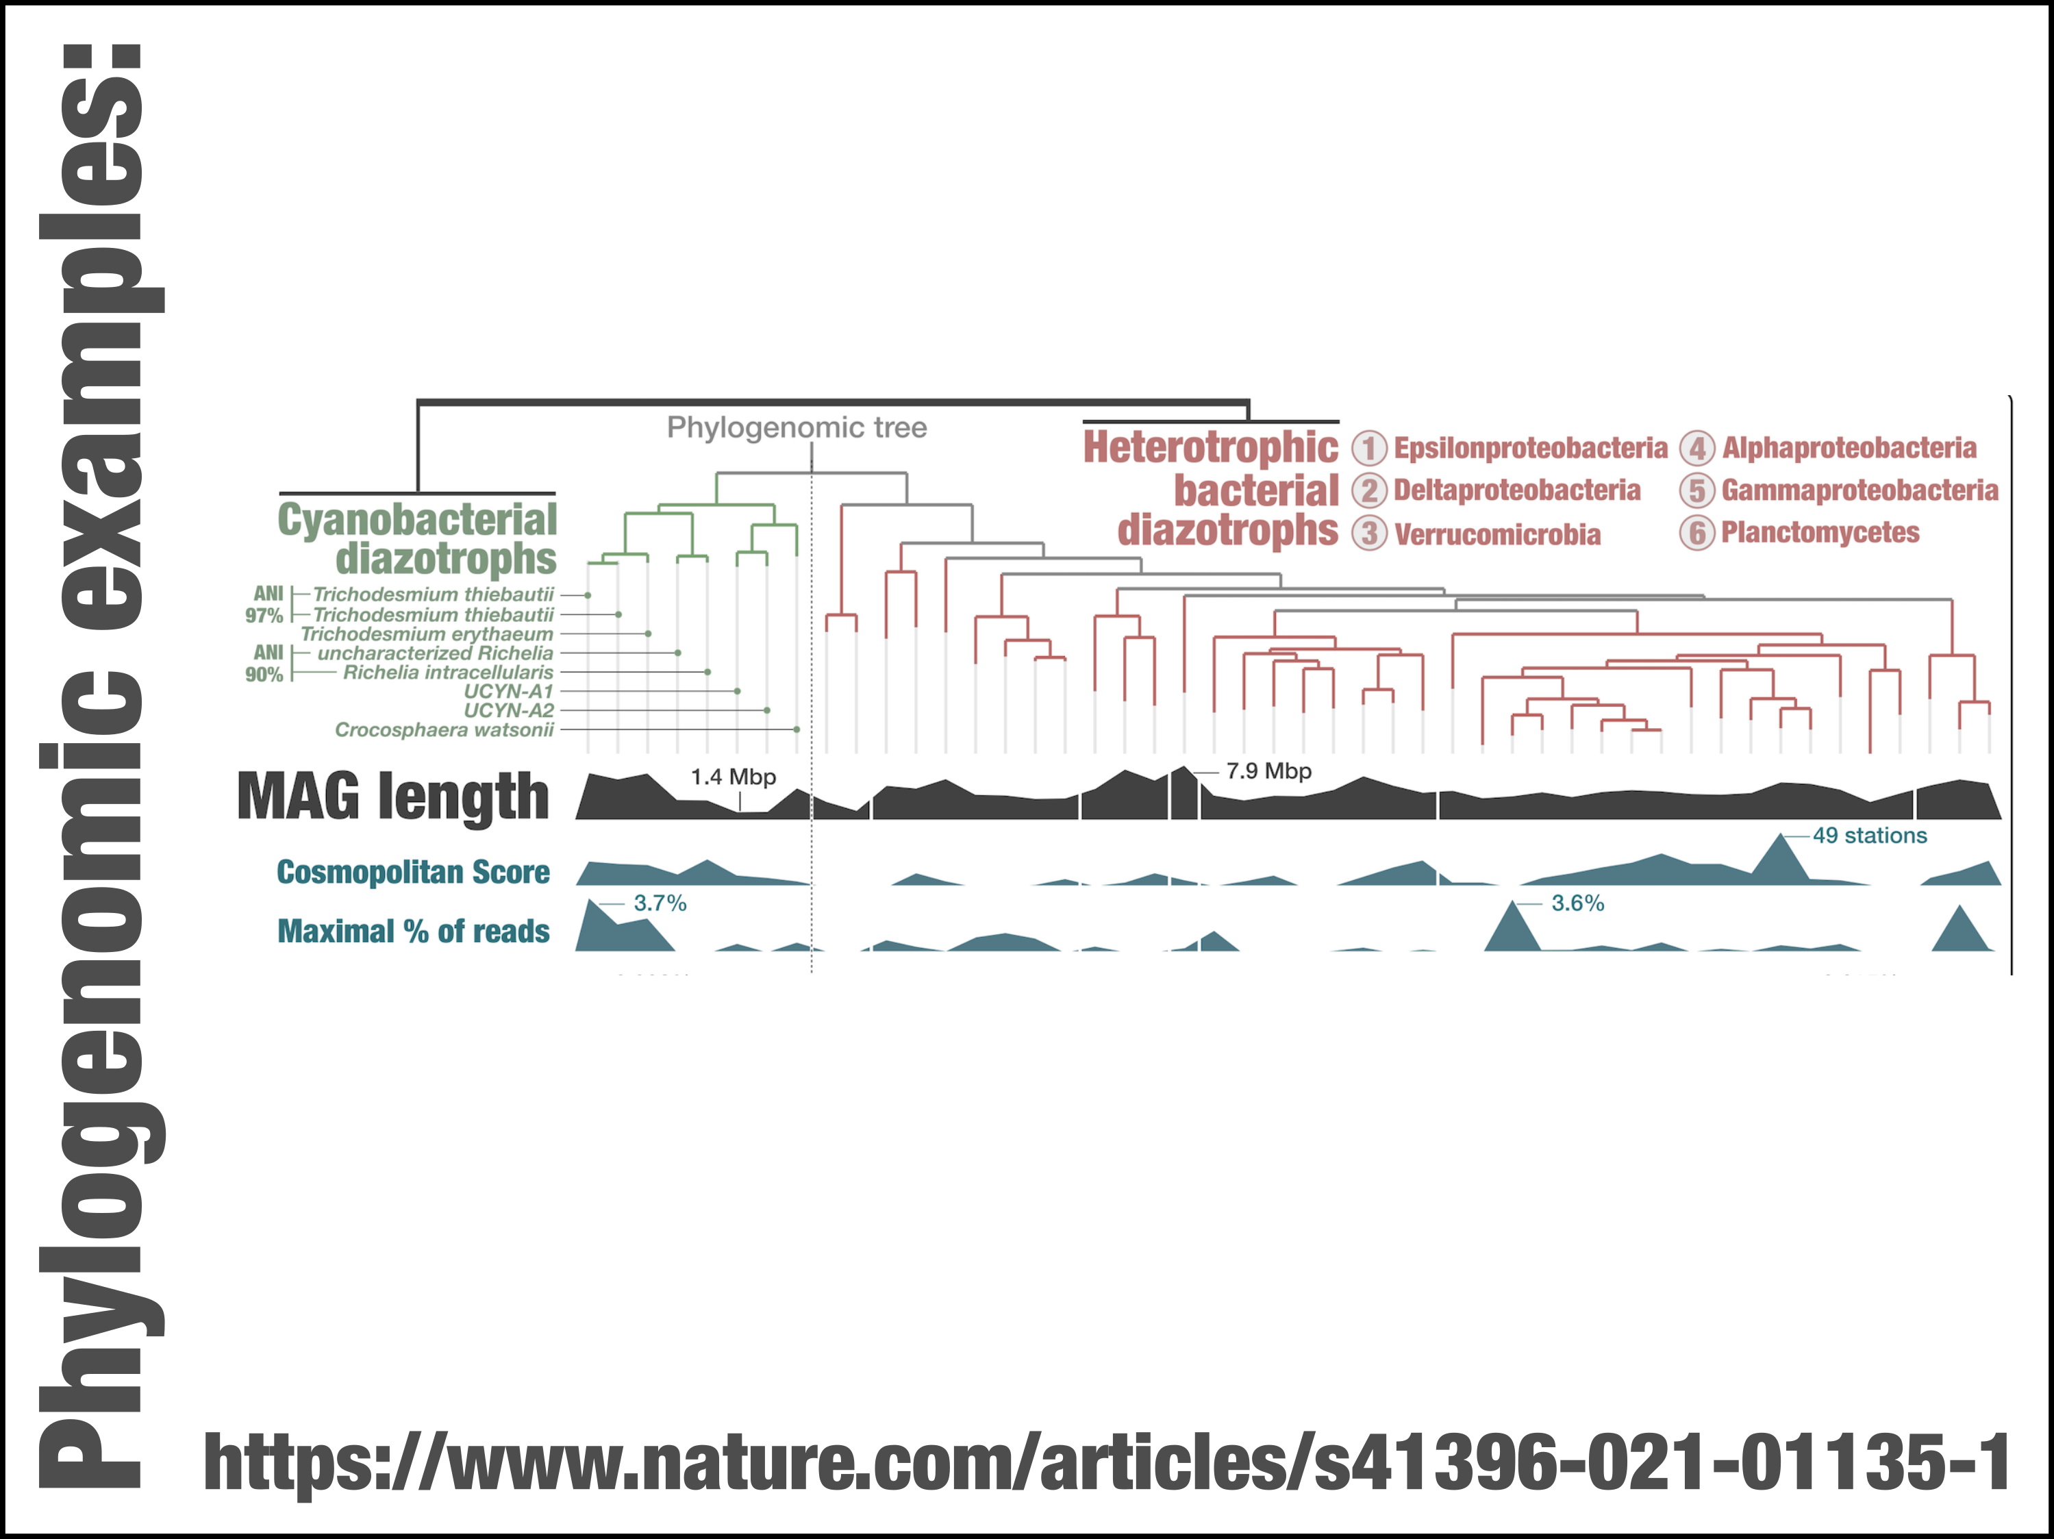

Slide 30
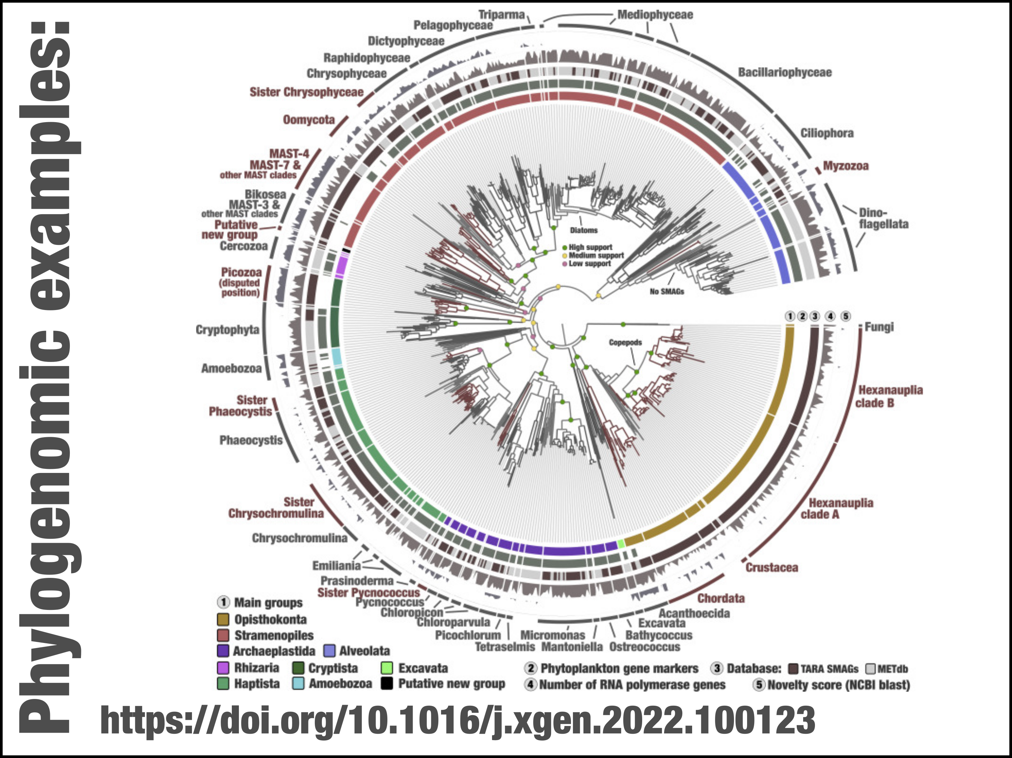

Slide 31
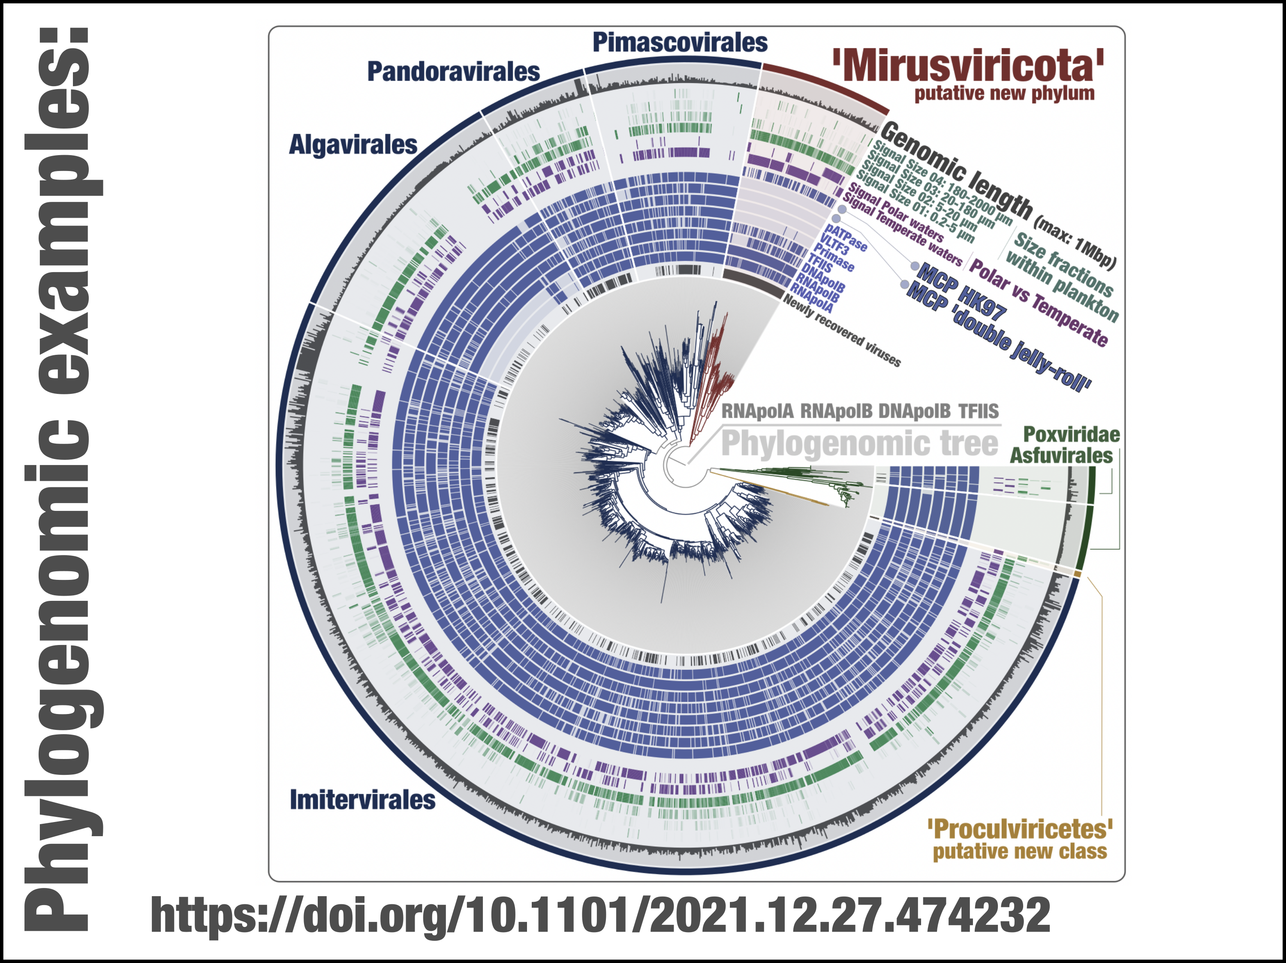

Slide 32
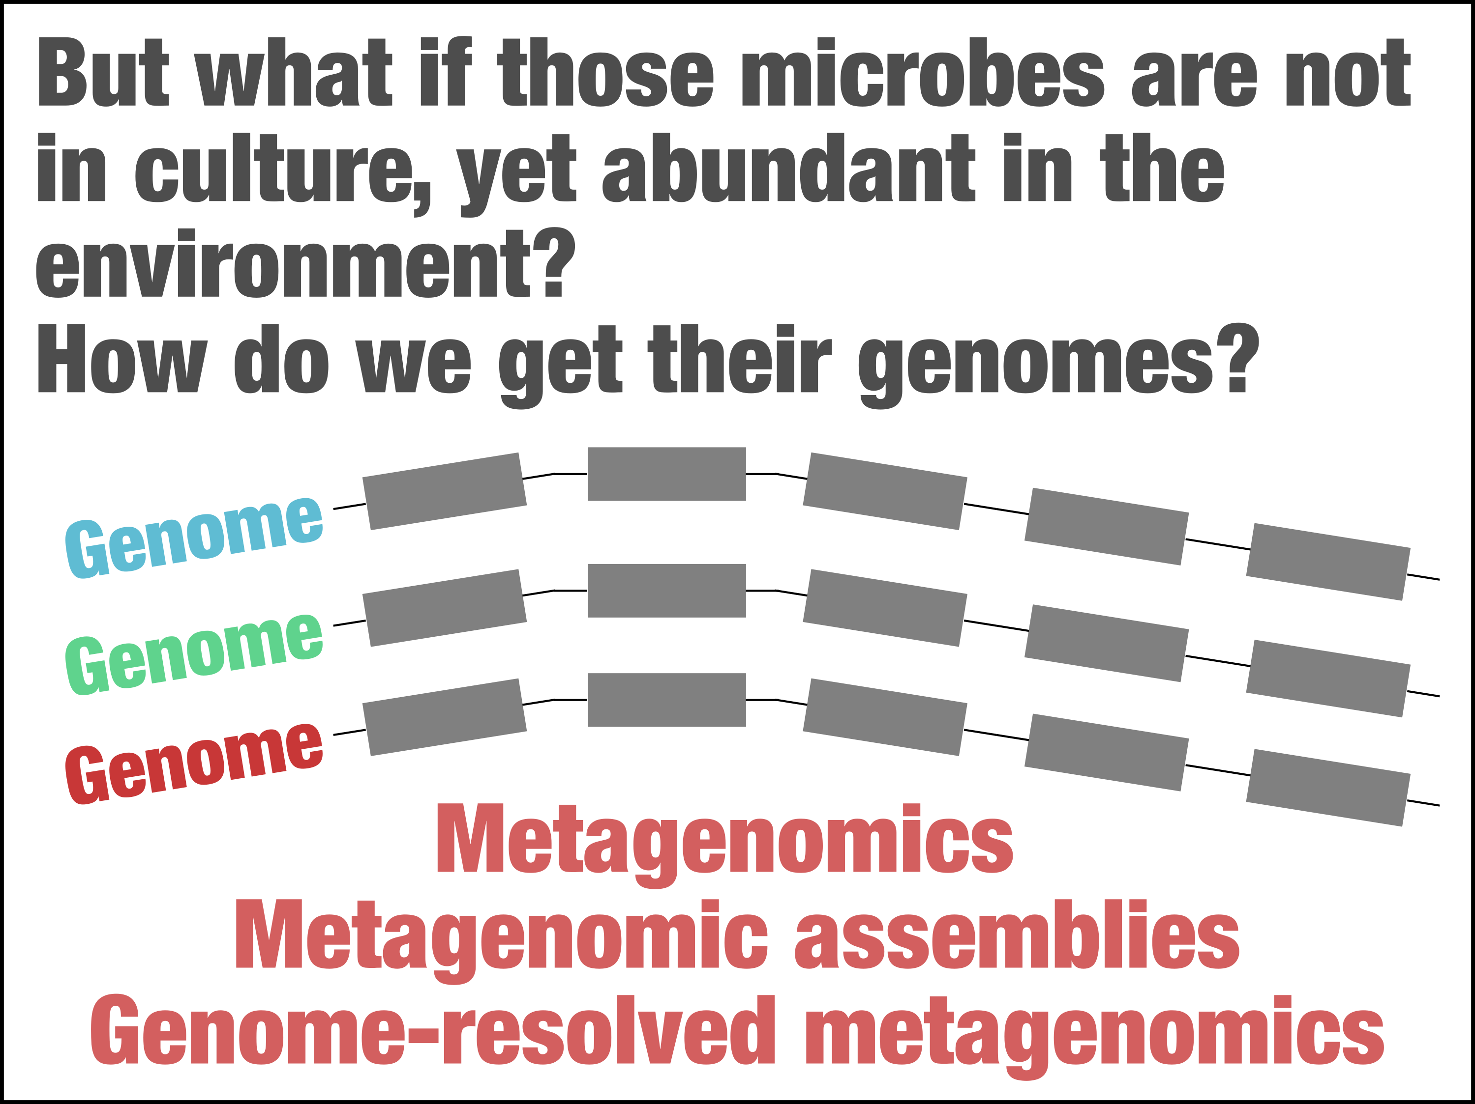

Slide 33
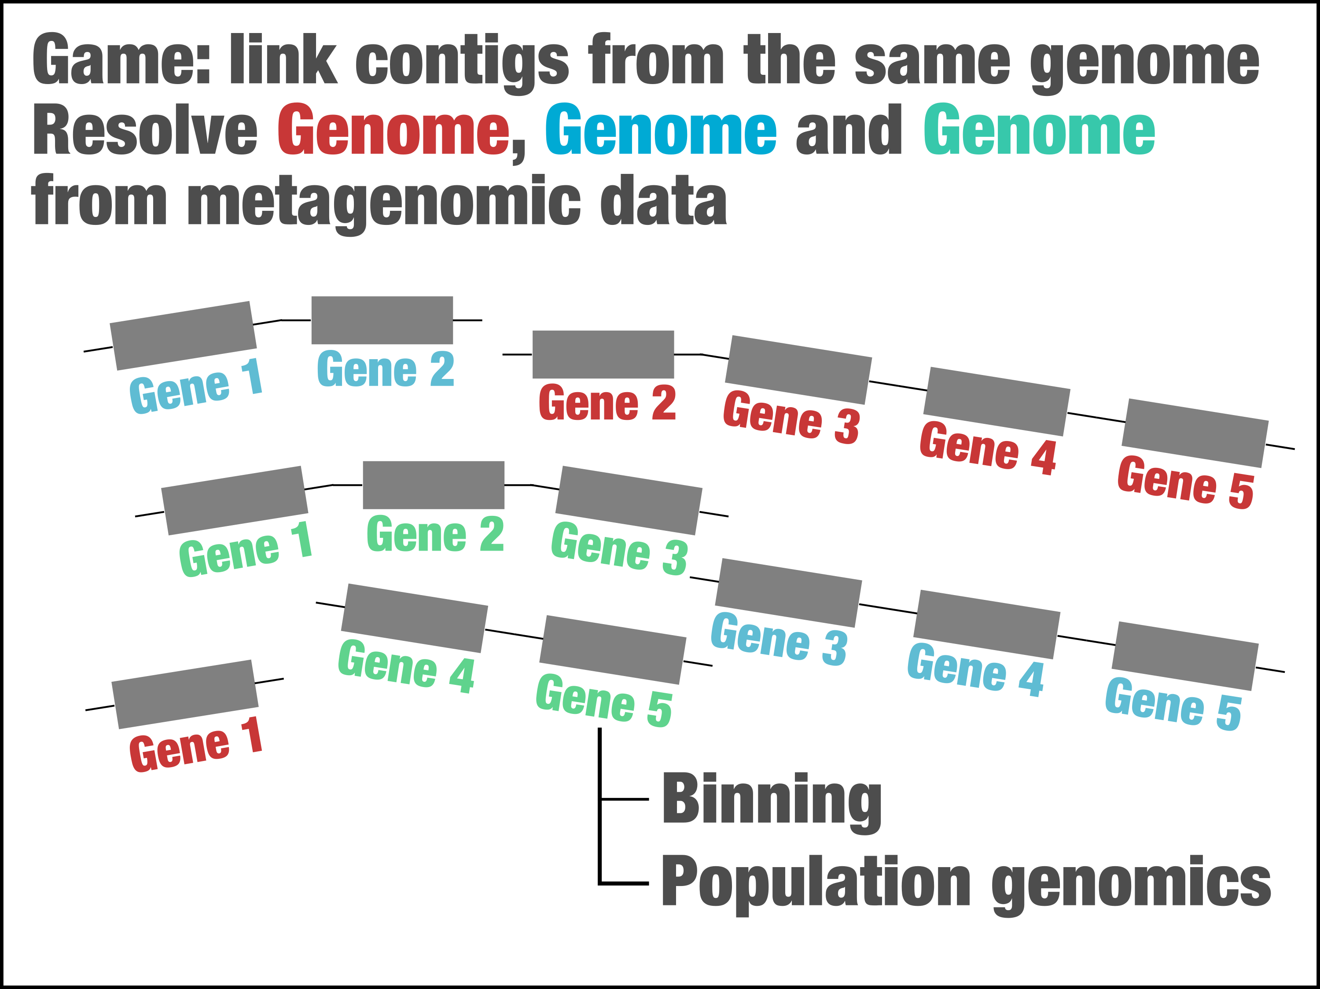

Slide 34
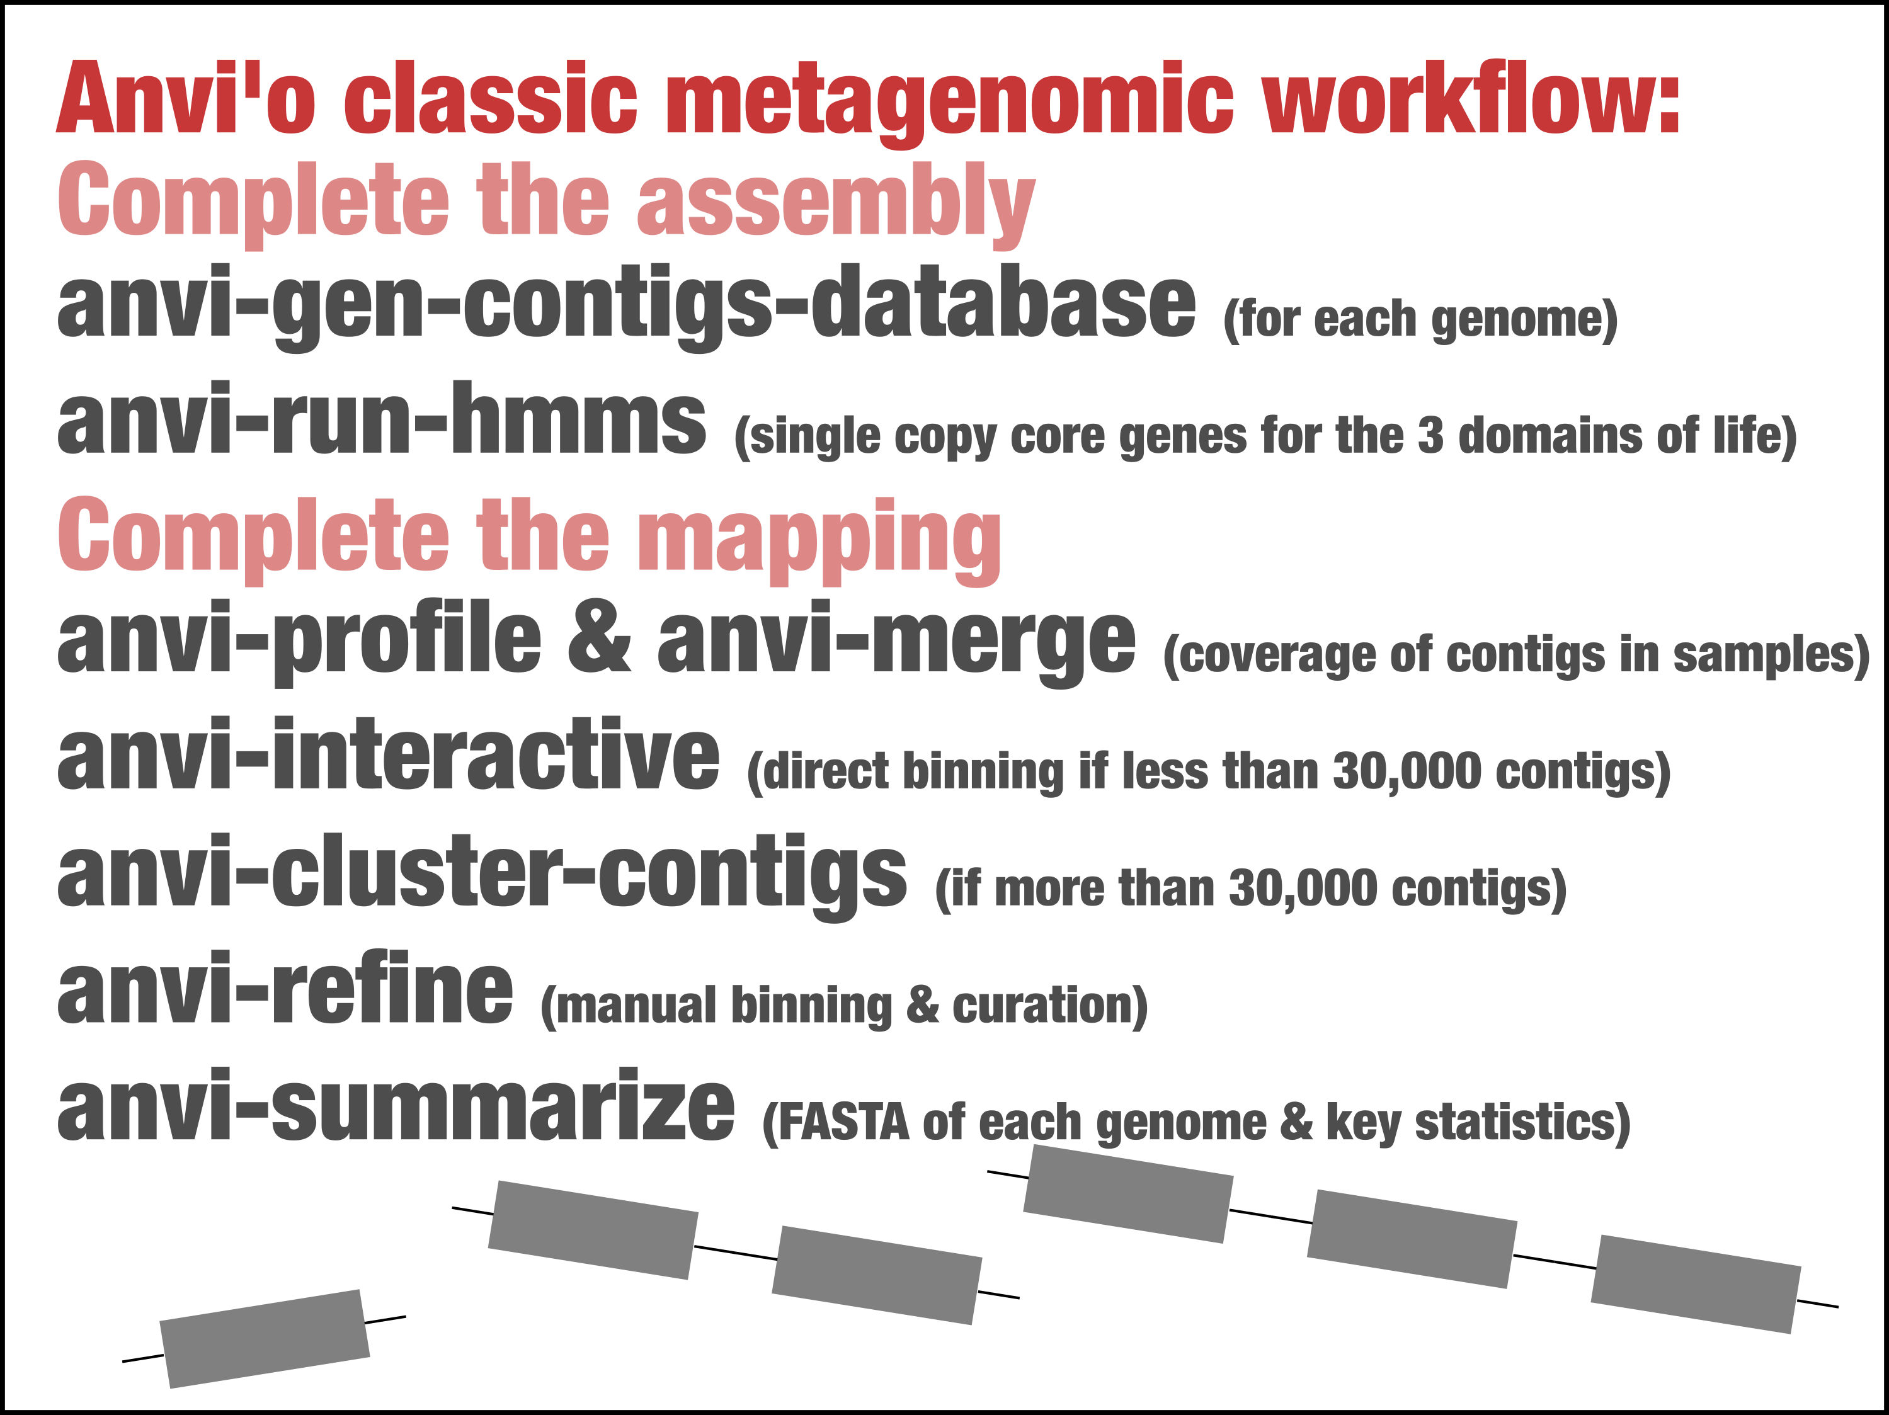

Slide 35
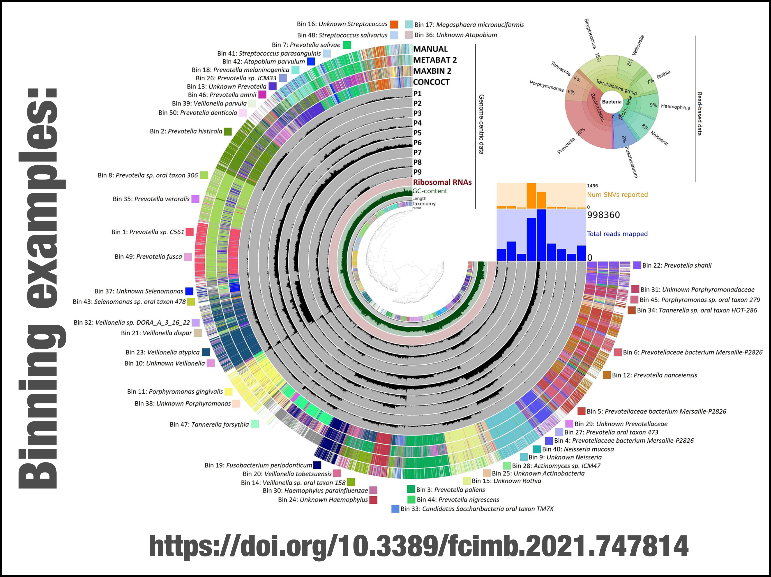

Slide 36
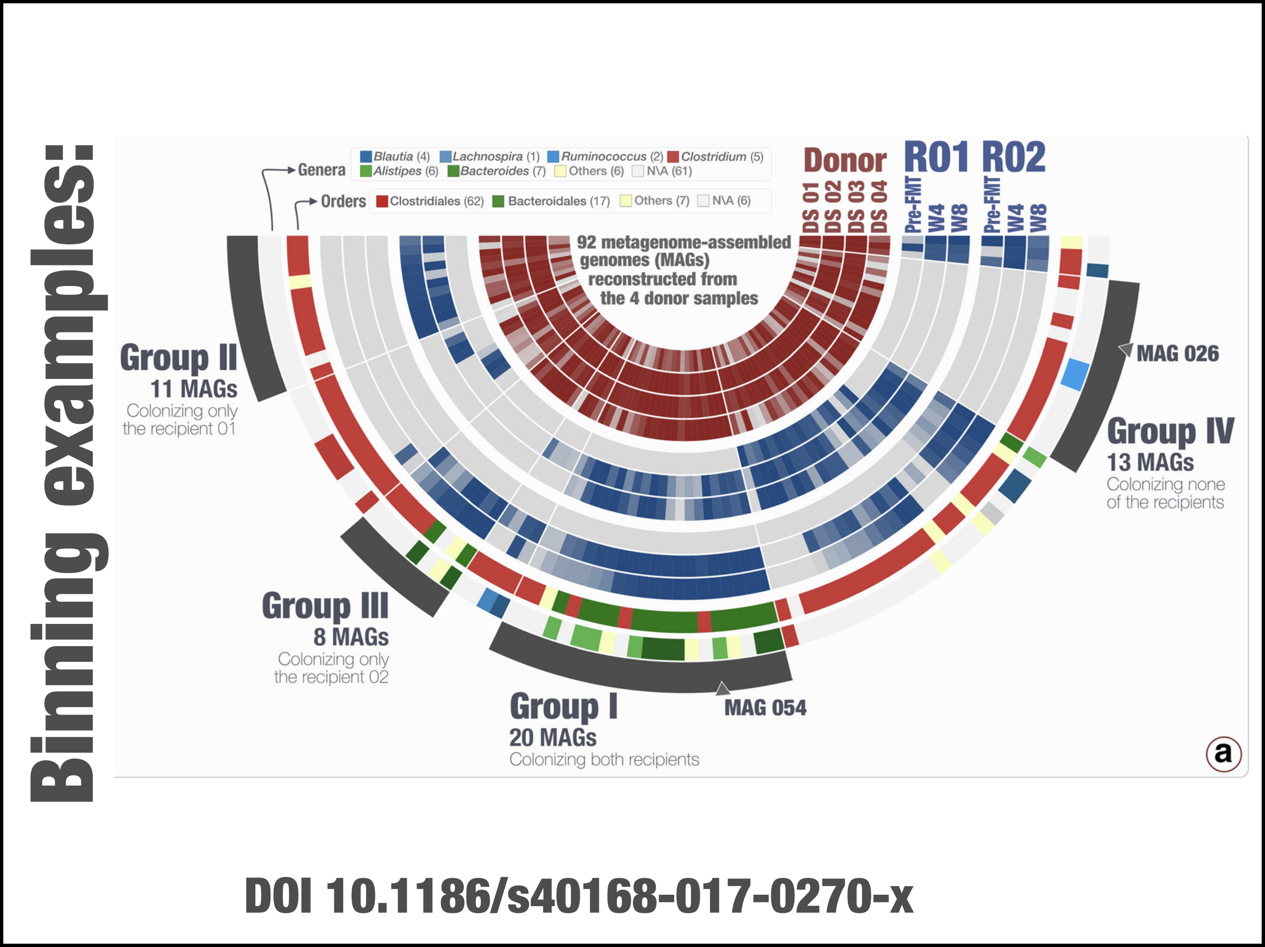

Slide 37
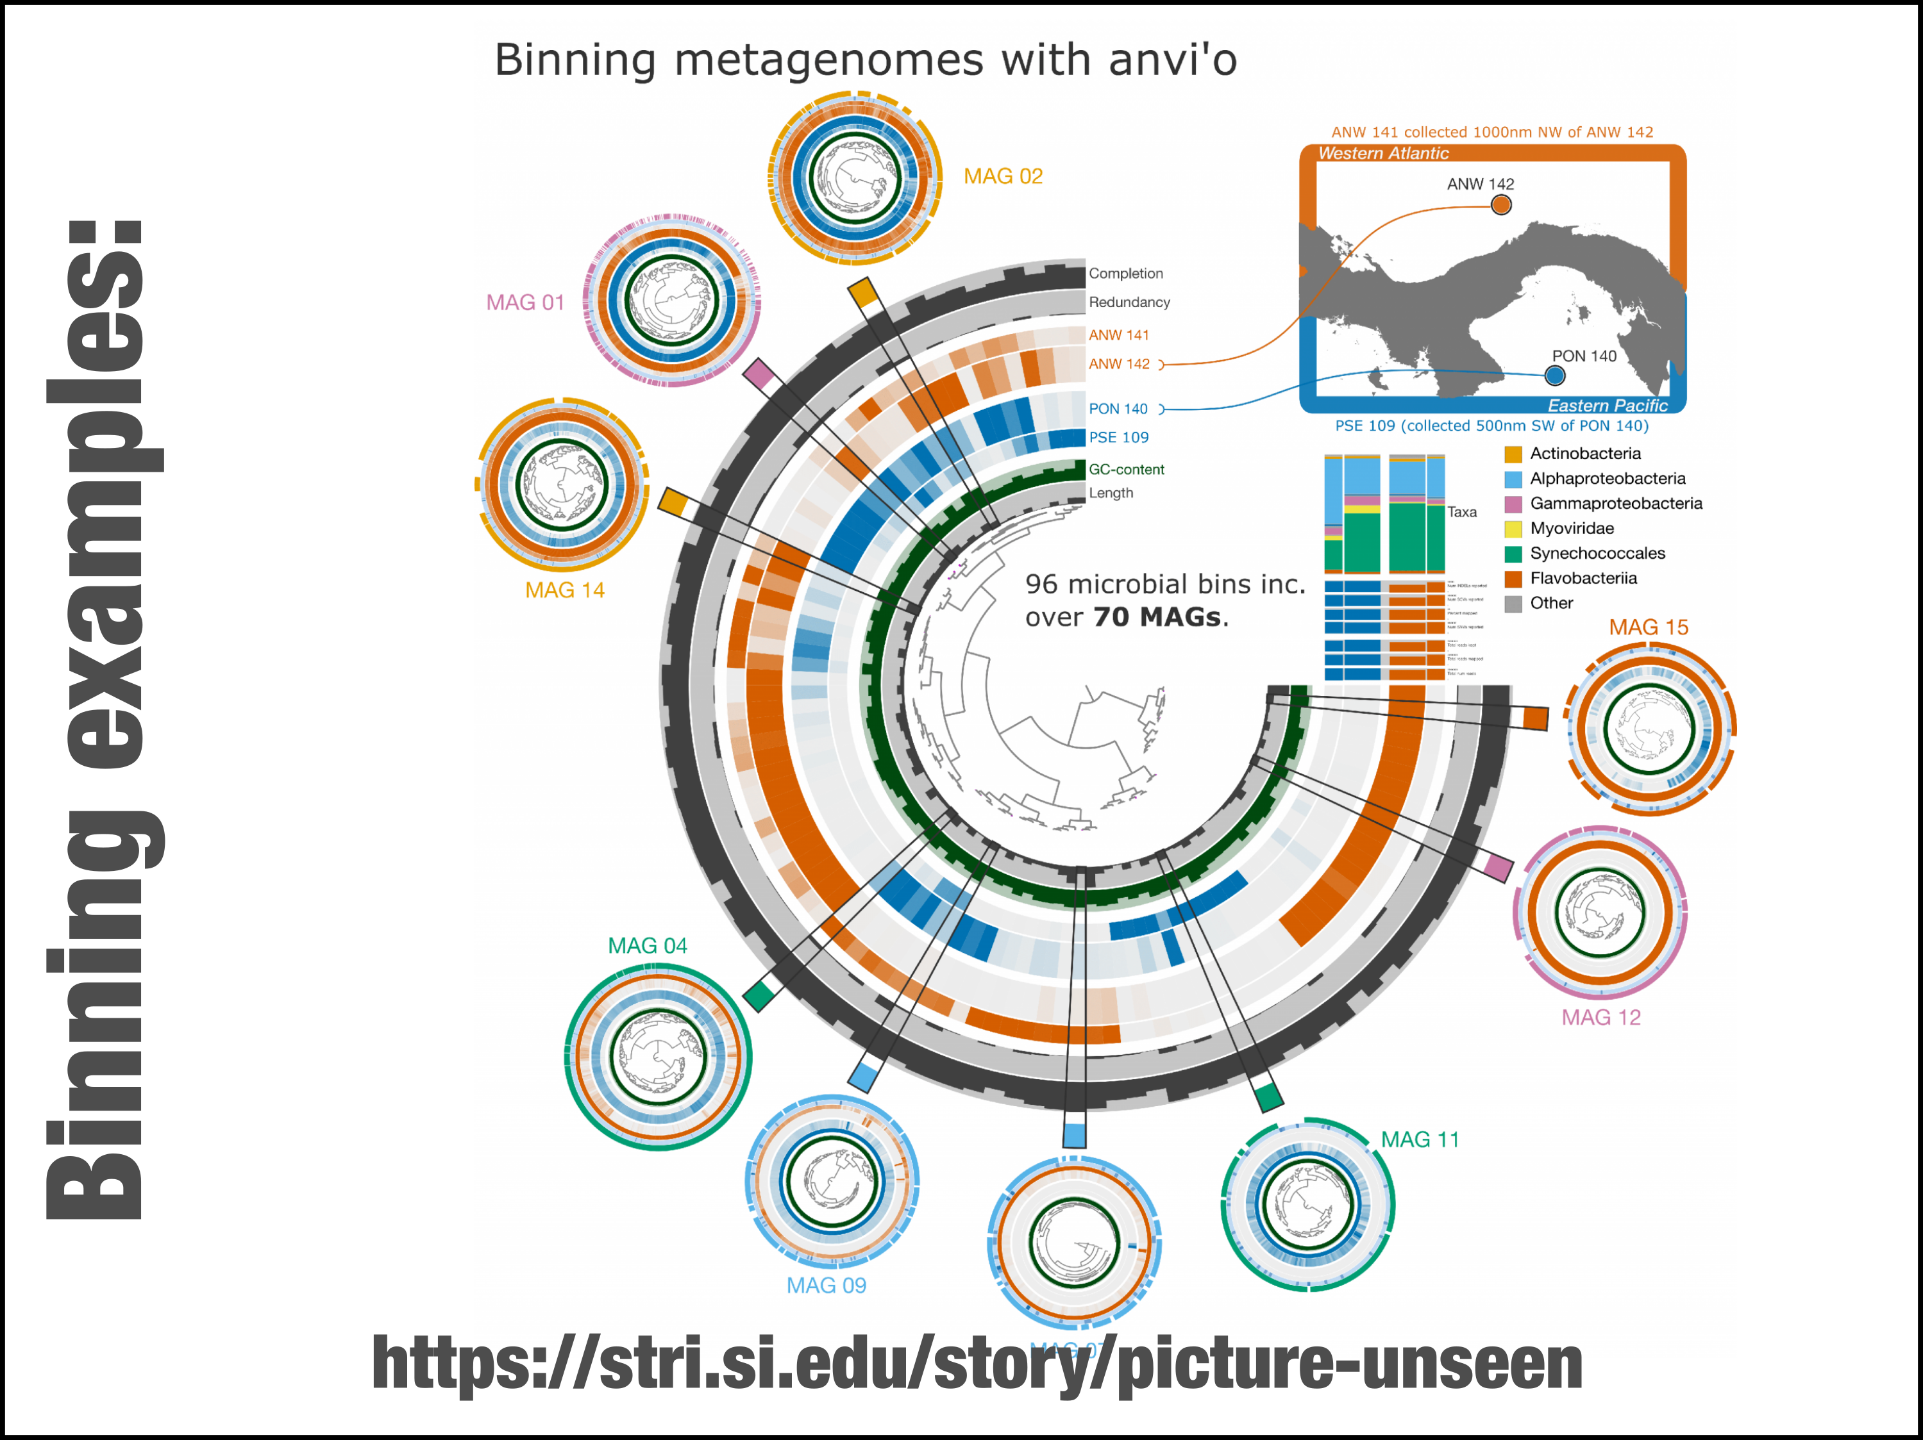

Slide 38
