Slide 1

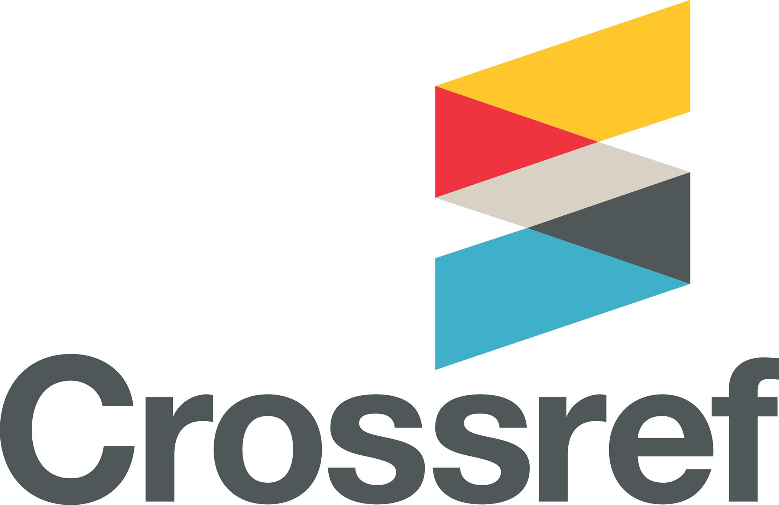
The Research Nexus
A rich and reusable open network of relationships of the scholarly record
Forum for Open Research in MENA 2023
October 25, 2023

Slide 2
Crossref in brief
>18,000 organisational members from ~150 countries
34% are university/faculty or other research institutions
148 million open metadata records with a DOI
1.1 billion DOI resolutions every month
1000 systems reusing metadata through search/API
Technical solution but also a community convener
POSI-compliant nonprofit open infrastructure
46 staff across 7 time zones and 9 countries
Notes:
To start - A quick overview of who and what Crossref is and does. Crossref was founded in 2000 by a few scientific societies and publishers, mostly in the US and Western Europe, seeking an efficient way to link references in journal articles. Bilateral agreements. Solution was using DOIs.
23 years later, Today membership now comprises just 35% publishers, with the largest group (40%) self-identifying as research institutions and universities a lot only have w/1 or 2 publications. The other 25% is made up of a combo of funders (who started joining to record grants, use of facilities and other support) alongside hundreds of museums, repositories, government organisations, conference providers, standards bodies, individual scholars, and news outlets. For this reason we have moved away from the word publishers, to focus on member, as many of our members do not self-associate as publishers as publishing is not their primary function.
we are a POSI - -compliant membership organization - Principles of Open Scholarly Infrastructure (community governance, transparent operations, open codes, org resilience). Membership org open to orgs that produce research outputs. Currently over 18k from 150 countri
We are small! 46 staff across 7 time zones, and 9 countries.
We facilitate an average of 1.1 billion DOI resolutions (clicks of a DOI link) every month. And our APIs see over 1 billion queries of our metadata every month.
We also work with third party service providers and metadata users who do not contribute to our metadata store, but make use of it via our API and search interfaces for a variety of different purposes. All of our metadata is openly available.
Our members have Reg over 148m registered records across all content types. All of these items contain a range of metadata which varies based on the content type. However, regardless of the type of content, the richer and more comprehensive the metadata is, the more value there is for our members and the community. And this metadata forms the basis for what I what we call the Research Nexus. (more detail next slide)

Slide 3
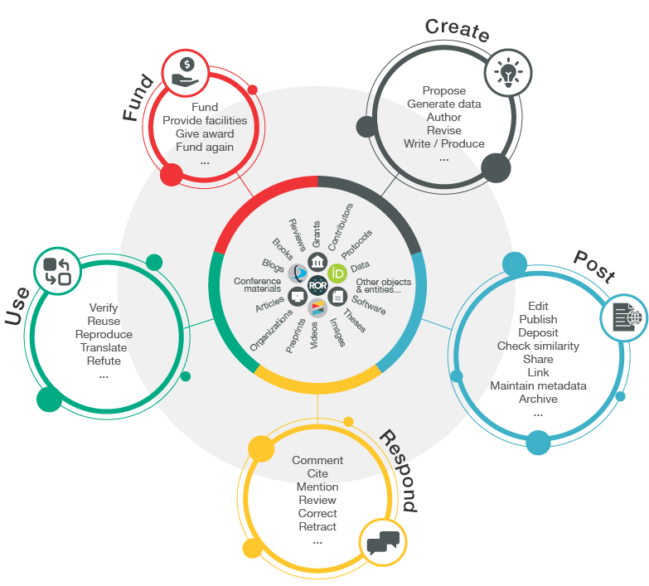
WHAT WE’RE AIMING FOR
Bringing together the disparate pieces of the scholarly record
Better view of relationships (beyond PIDs)
Exposing internal stuff publicly
Enabling multi-party assertions
Evidence. Provenance. Persistence.
60% of this is possible, the rest is aspirational
Notes:
A rich and reusable open network of relationships connecting research organizations, people, things, and actions; a scholarly record that the global community can build on forever, for the benefit of society.
The importance of relationships:
A big part of the research nexus is establishing connections between and among different research objects which establishes provenance over time. Adding relationships to your metadata records can convey much richer and more nuanced connections beyond traditional references.
These relationships may consist of versions, corrections, translations, data, formats, supplements, and components. There are no extra fees for including relationships in your metadata.
Currently, relationships can only be established by direct deposit of XML. Read our relationships metadata best practice page and our relationships markup guide.
Why the Research Nexus?
Students: Students across all subject areas identified a connection between teaching and research, helping students to better envisage themselves as researchers.
Institutions: Practical structural separation between teaching and research is apparent across a number of higher education institutions
Open Access: Open access improves the educational environment engage in problem solving, and take action to improve the environment.
Data Citation: Data citations can be included in data deposits in relationship metadata, usually using the ‘Research Nexus’

Slide 4
What is nexus in research?
This relationship is termed here a 'nexus' – an extensive, visible, and institutionally supported series of productive, interlocking and often bidirectional connections between teaching and research in higher education, within and across all subjects.
The British Academy , Research Nexus, 2022 https://www.thebritishacademy.ac.uk/publications/teaching-research-nexus/
Notes:
The community needs open scholarly infrastructure that can adapt to the changes in scholarly research and communications, and we’ve been changing and adapting already by building on the concept of the scholarly record with our vision:
We envision a rich and reusable open network of relationships connecting research organizations, people, things, and actions; a scholarly record that the global community can build on forever, for the benefit of society.

Slide 5
What is metadata?
“Metadata is communication.
It describes and identifies an item, it defines relationships, it sets parameters for the range of actions something can engage in.
As the things we read, write, create, use, move around, and engage with become more digital, metadata becomes more important, because without metadata, all that movement, interaction, and discovery, could not happen.”
Juliane Schneider, Metadata 20/20 blog, 2017 https://metadata2020.org/blog/2017-09-14-metadata-and-communication

Slide 6
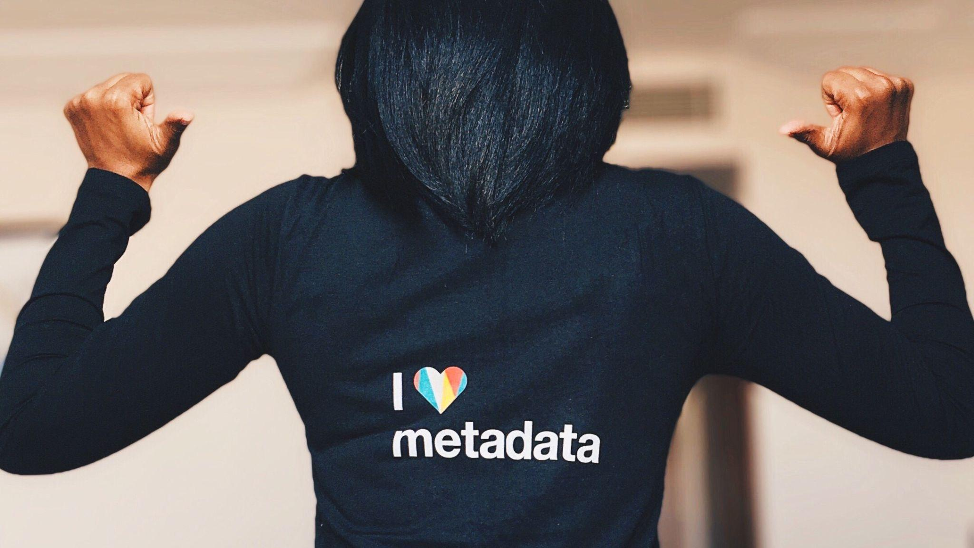

Slide 7
Why metadata?
Research integrity
Reproducibility
Metadata as signals of trustworthiness including provenance information
Metadata as relationships between literature, data, software, protocols and more
Assessment
Discoverability
Metadata can be used to analyze the outcomes of research and demonstrate compliance
More metadata means more systems have more pathways to find your work
Notes:
Metadata and relationships between research objects and entities can support the whole scholarly research ecosystem in many ways, including:
Research Integrity: helping to provide signals about the trustworthiness of the work including provenance information such as who funded it (when and for how much), which organizations and people contributed what, whether something was updated or corrected, and whether it was checked for originality. All of these signals can be expressed through Crossref metadata.
Reproducibility: helping others to reproduce outcomes by adding relationships between literature, data, software, protocols and methods, and more. All of these relationships can be asserted through members’ ongoing stewardship of their Crossref metadata records.
Reporting and Assessment: helping organizations such as universities, funders, governments, to track and demonstrate the outcomes of investment; provide benchmarking information; show compliance with funder mandates; and decide what other research to fund. This kind of information can be included in Crossref metadata.
Discoverability: helping people and systems identify work through multiple angles. Registering content with Crossref makes it possible for work to be found and used. Thousands of systems use Crossref metadata, therefore the richer the records are, the more visibility there is likely to be of your work. Including metadata like abstracts and references are very simple ways to increase the visibility of your records.

Slide 8
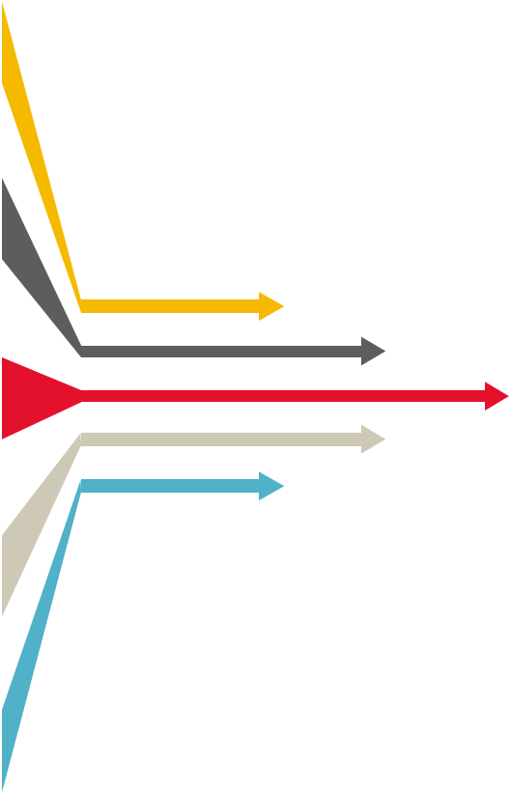
What kind of <metadata>?
Basic: titles; dates; author names; abstracts; DOI; location URL
Full-text URLs: e.g. for text-mining and Similarity Check
Crossmark: updates, retractions, corrections
Relationships: versions; translations; data; references; citation
Provenance: publisher/funder/steward information
Subject-specific: e.g. clinical trial info
Funding information: Funder Registry ID; award numbers/Grant DOIs
Contributor & Affiliations: ORCID iDs and ROR IDs preferred
Notes:
In regards to record types that can be registered with Crossref, we are working to make our input schema more flexible so that almost any type of object can be registered and distributed openly through Crossref. At the moment, members tend to register the following:
Books, Chapters, and Reference Works: includes book title and/or chapter-level records. Books can be registered as a monograph, series, or set.
Conference Proceedings: information about a single conference and records for each conference paper/proceeding.
Datasets: includes database records or collections.
Dissertations: includes single dissertations and theses, but not collections.
Grants: includes both direct funding and other types of support such as the use of equipment and facilities.
Journals and Articles: at the journal title and article level, and includes supplemental materials as components.
Peer reviews: any number of reviews, reports, or comments attached to any other work that has been registered with Crossref.
Pending Publications: a temporary placeholder record with minimal metadata, often used for embargoed work where a DOI needs to be shared before the full content is made available online.
Preprints and Posted content: includes preprints, eprints, working papers, reports, and other types of content that has been posted but not formally published.
Reports and Working Papers: this includes content that is published and likely has an ISSN.
Standards: includes publications from standards organizations.
You can also establish relationships between different research objects (such as preprints, translations, and datasets) in your metadata.

Slide 9

The PLACE
Publisher Learning and Community Exchange
https://theplace.discourse.group/
Notes:
The Publishers Learning And Community Exchange (PLACE) at theplace.discourse.group is a new online public forum created for organisations interested in adopting best practices in scholarly publishing. New scholarly publishers can access information from multiple agencies in one place, ask questions of the experts and join conversations with each other.
Link https://theplace.discourse.group/

Slide 10
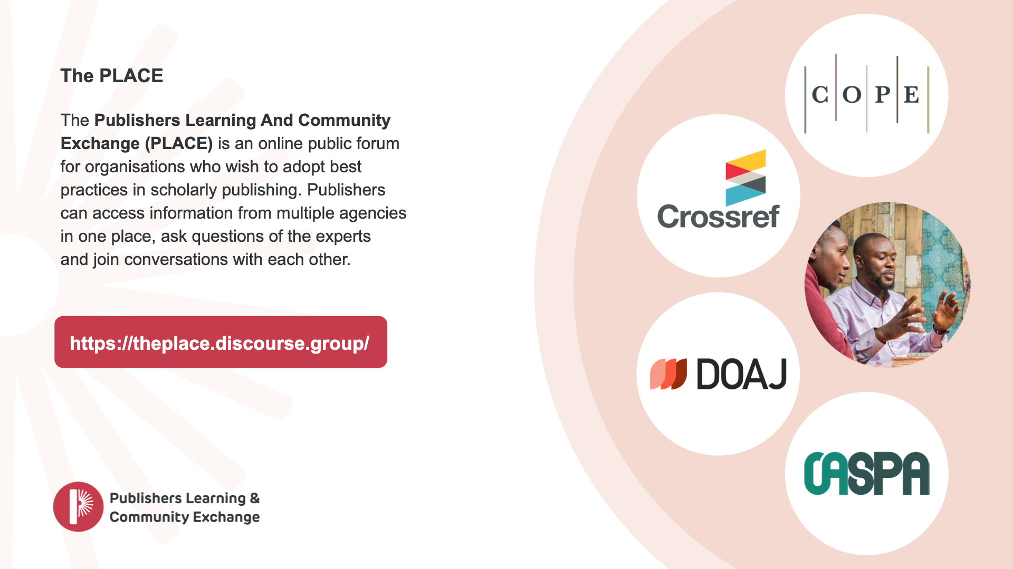

Slide 11
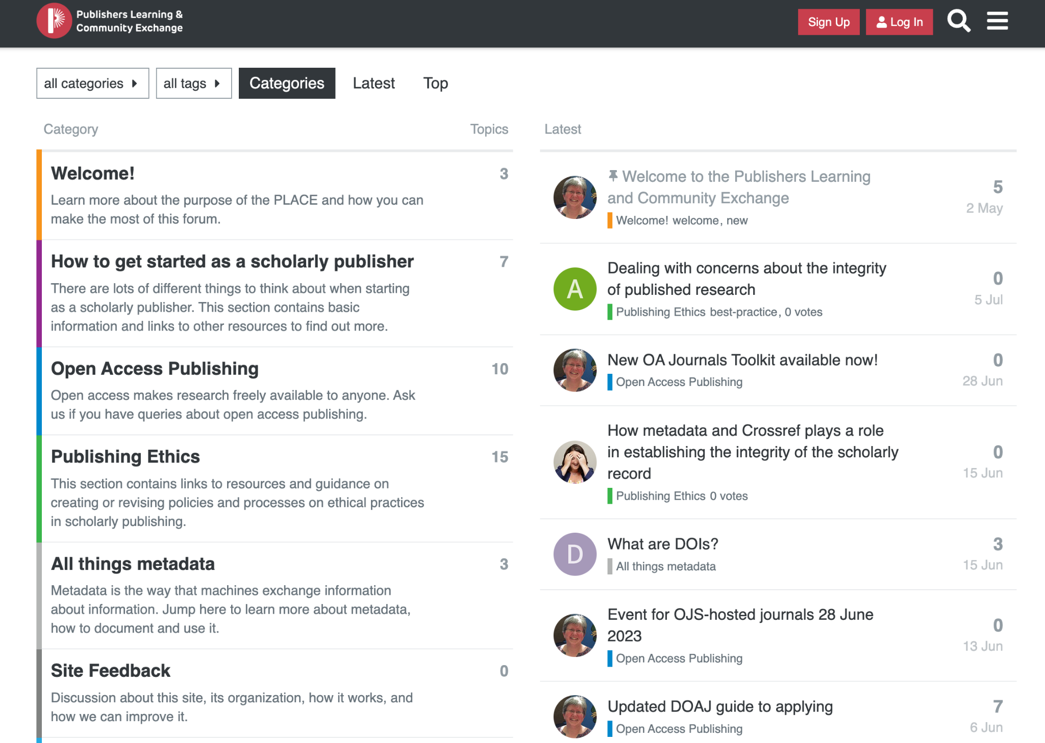
Notes:
The PLACE is an information service ase up as a forum to encourage encourage open exchange with publishers who aspire to do things right. After you join, you can browse through the topics of interest, ask questions in response to posts already existing on this forum, and by starting new topics within any of the forum categories (you will need to register as a user to do that).

Slide 12
The Place
Online forum for the scholarly community where you can…
Find trusted and accurate information
Find solutions to problems
Gain a better understanding of publishing processes and standards
Share experiences and best practice

Slide 13

…And ask your own questions

Slide 14
THANK YOU
community.crossref.org
Assist. Prof. Dr. Salwan Abdulateef
Crossref Ambassador
University of Anbar - Iraq
ag.salwan.mahmood@uoanbar.edu.iq
+9647807824433
—
Johanssen Obanda
Crossref
jobanda@crossref.org

