Slide 1
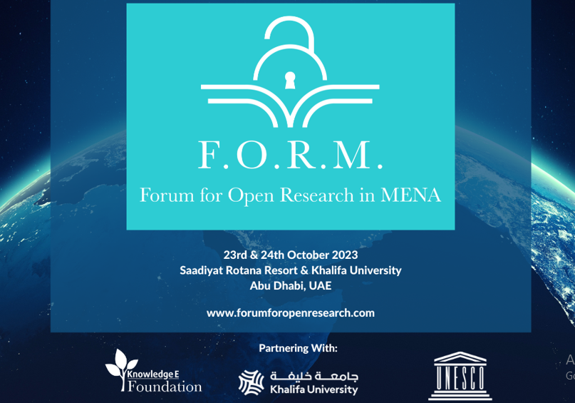

Slide 2

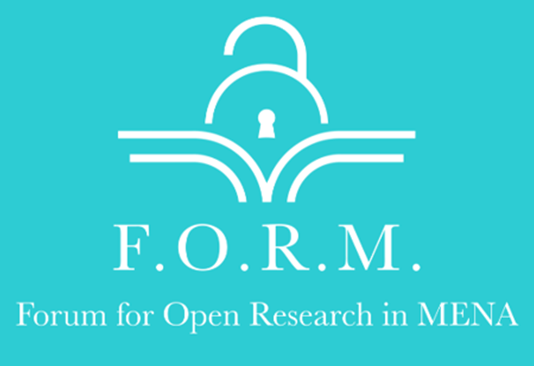
Sosil Somokian (M.A. in Education and SLP)
Forum for Open Research in MENA
23-24 October 2023
Education for sustainable development (ESD) in the Arab World: Strategies for Collaboration and Knowledge Sharing
Academic Manager of IEP at BHCK
Senior Lecturer at Kuwait Diplomatic Institute (KDI)
s.somokian@bhck.edu.kw
sosil2@yahoo.com

Slide 3
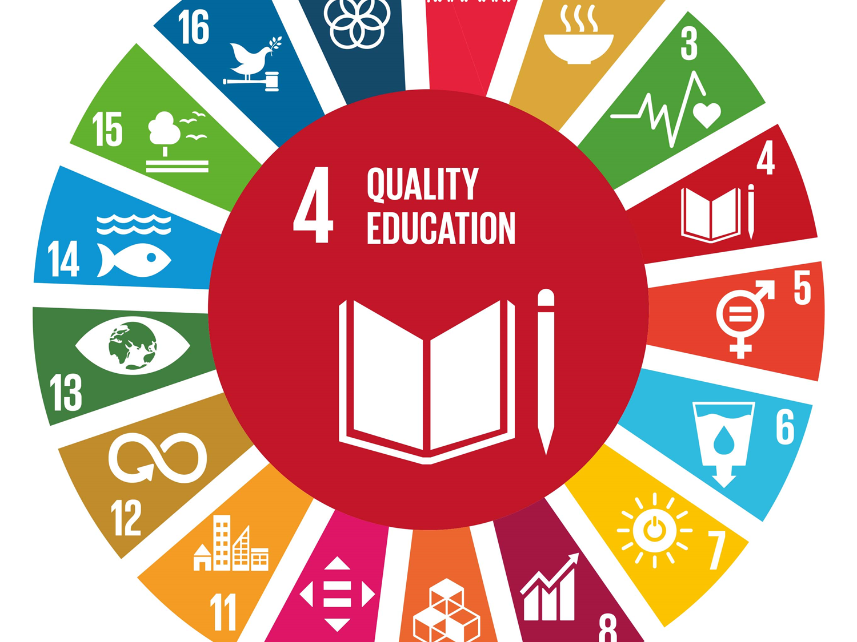
A crucial role was assigned to Higher education in achieving UN’s sustainability goals

Slide 4
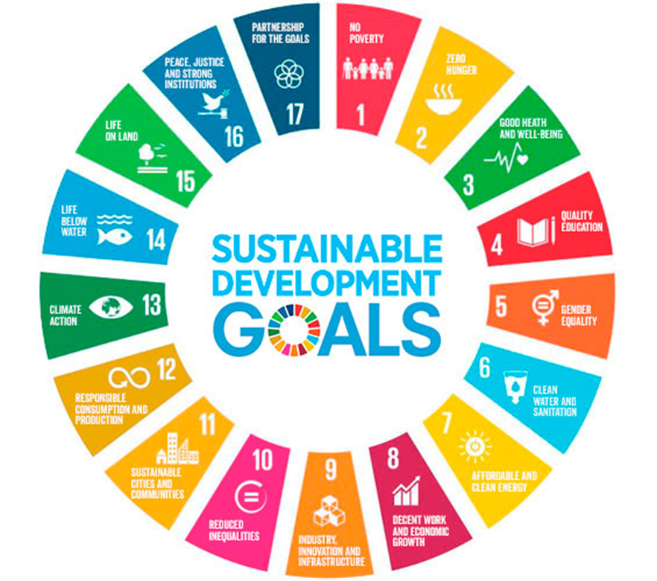
HEI’s role in achieving SDG’s
HEIs are expected to play a key role in achieving the SDGs of 2030 by
1. Raising awareness about sustainability
2. Advocating for environmental issues in their communities,
3. Preparing workforce - the change agents who will build the sustainable economies of tomorrow.

Slide 5

(UNESCO, 2017)
University students should have the information, critical literacy, social connections, appreciation for diversity, moral responsibility, and civic engagement necessary to address today's pressing issues.

Slide 6

UNESCO indicated that (H)ESD should place greater emphasis on learning rather than on teaching. From this perspective, student-centered approaches like Project-based learning (PBL) and Problem-based learning (PrBL) can be effective tools for achieving sustainable development goals in higher education (Lozano et al., 2017), as they encourage active engagement and real-world problem-solving.

Slide 7
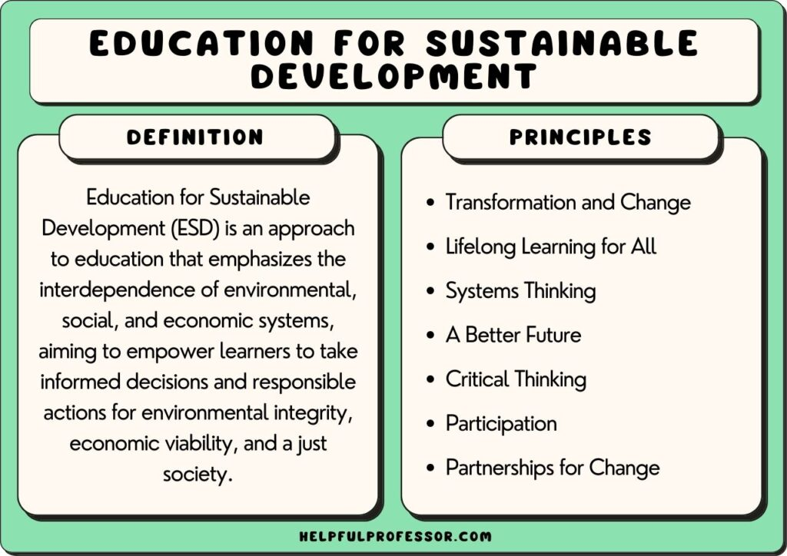

Slide 8
This presentation will try to answer the following questions
Where do HEI’s stand now?
Why? What are the challenges?
What can HEI’s do for to provide ESD and build capacities?
How can HEI’s collaborate among themselves?
How can HEI’s collaborate with local communities?
How can HEI’s work with local businesses to achieve SDG’s?

Slide 9
GCC - Literature Review (1)
Challenges and Barriers at Student and Program level
Limited awareness and concern for sustainability issues are evident among students in the GCC region.
Lack of interest and willingness to participate in sustainability initiatives is observed among students.
The integration of sustainability concepts into curricula and studio courses, especially in architecture programs, needs improvement.
Discontinuity between theory-based and practical courses hinders the incorporation of sustainability as a central factor in education.

Slide 10
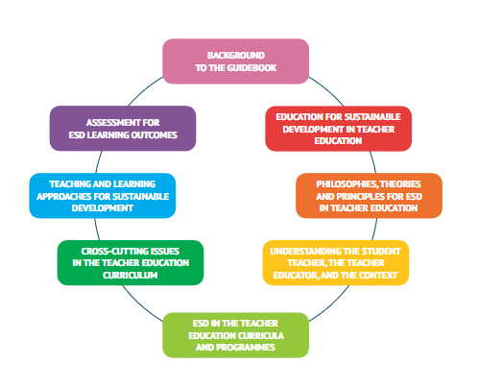
TRANSFORMATION
& CHANGE is needed

Slide 11
GCC - Literature Review (2)
Challenges at the Institutional level
Research indicates that embedding SDGs in university curricula can produce results if an interdisciplinary approach is adopted and student-centered teaching-learning methods are implemented
Universities in the Arab world are facing considerable challenges in delivering education for sustainable development (ESD). As they often lack the infrastructure to deliver interdisciplinary programs and the agility to move from traditional to student-centered problem-oriented learning methods.

Slide 12




Mastery level knowhow in taking interdisciplinary approach to curriculum development in ESP
Pedagogical agility in delivery of interdisciplinary curricula is essential

Slide 13
GCC Literature Review (3)
Recommendations:
Higher education institutions in the GCC region should adopt a holistic approach to (ESD) and embed the Sustainable Development Goals (SDGs) into their courses.
PBL can be a valuable method for delivering sustainability education and developing the needed competencies
Efforts should focus on increasing knowledge and awareness of sustainability issues in all areas of the curriculum, and promoting student participation in sustainable practices.
Universities should collaborate with stakeholders, devise policies, and implement sustainability measures to achieve SD on campus and in the wider community.

Slide 14
GCC Literature Review (4)
A capacity-building and knowledge-sharing model through academic centers
Educators receive training on data management, data sharing, and open-access publishing
Educators successfully collaborate with international organizations and HEIs for expertise and resources.
Institutional repositories and data-sharing platforms are created to help educators, researchers, institutions, policymakers and funding agencies collaborate in reinforcing a culture of open science, open-access publishing, and knowledge sharing
Learning communities are formed, they organize workshops and conferences to share best practices.

Slide 15
Areas of collaboration among HEI’s towards ESD
Integration of Sustainability Courses into their curricula. Courses that cover topics such as environmental conservation, renewable energy, sustainable business practices, and social responsibility.
Establishing Research Centers and Institutes dedicated to sustainability and environmental studies. These centers conduct research on regional sustainability challenges and solutions.
Sustainable Campus Operations: Sharing knowhow about implementing sustainable practices on campus, such as energy-efficient buildings, waste reduction, and water conservation. Some institutions have also adopted green building standards (QU).

Slide 16
HEI’s can share information knowhow among themselves regarding
Community Engagement: how they engage with their local communities to address sustainability challenges and develop solutions together. This can include sharing information abut outreach programs, workshops they offer, and partnerships they have with local organizations.
Student-Led Initiatives: how they encourage student-led sustainability initiatives, including clubs, events, and projects focused on environmental conservation and social responsibility.
Faculty Development: Faculty development programs and workshops they offer to equip educators with the knowledge and tools needed to integrate sustainability into their teaching.
Collaboration with Industry: How they collaborate with industry partners to offer internships, research opportunities, and practical experience related to sustainability and green technologies.
Sustainability Reporting: Some institutions publish annual sustainability reports to track and communicate their progress in achieving sustainability goals. They can share those reports.

Slide 17
HEI’s in communities: HEI’s can serve as change agents in their communities through
Promotion of Sustainable Transportation: Encouraging sustainable transportation options for students and faculty, such as cycling, carpooling, and public transportation.
Renewable Energy Initiatives: Investing in renewable energy sources like solar panels to reduce the carbon footprint of campus operations.
Environmental Awareness Campaigns: Organizing awareness campaigns and events on topics such as climate change, biodiversity conservation, and waste reduction.
Collaborative Research Projects: Partnering with government agencies and industry stakeholders to conduct research projects related to sustainability and environmental protection.
International Partnerships: Collaborating with international universities and organizations to share best practices and promote global sustainability initiatives.

Slide 18



Concern
Defining the problem
Understanding the problem
Knowledge and skills
Analyzing Causes
Critical thinking and problem-solving skills
Taking Action
Initiatives
Citizenry
Raising awareness using Social media and campaigns

Slide 19
HEI’s and local businesses collaborating for SD
Incorporating Sustainable Practices in Business Programs: Integrating sustainability principles into business and management programs, emphasizing corporate social responsibility and sustainable business practices.
Sustainability Awards and Competitions: Hosting or participating in sustainability-focused competitions and awards to recognize and incentivize innovative ideas and projects.
Green Certification: Pursuing green certifications for campus facilities, such as LEED (Leadership in Energy and Environmental Design) certification for buildings.

Slide 20
Support for Sustainable Startups: Providing support and resources for student and alumni entrepreneurs working on sustainable startup ventures.
Sustainable Agriculture and Food Initiatives: Initiatives related to sustainable agriculture, including organic farming practices and sourcing locally-produced, sustainable food for campus dining.
Environmental Studies Programs: Offering specialized environmental studies programs or degrees to train future leaders in sustainability and conservation.
Cultural Heritage Preservation: Emphasizing the importance of preserving cultural and historical heritage as a part of sustainability efforts.

Slide 21
Strategies for collaboration and knowledge sharing within each UNI
Establishing Interdisciplinary Centers: Creating dedicated centers or departments focused on ESD that encourage collaboration among different faculties, departments, and disciplines within each university.
Mentorship Programs: Establish mentorship programs where experienced faculty members can guide and support ESD initiatives at other departments within the same university

Slide 22
These are some strategies through which universities can foster meaningful collaboration and knowledge sharing in the field of Education for Sustainable Development, contributing to a more sustainable and responsible future.
Collaboration among themselves and collaboration with their communities.

Slide 23
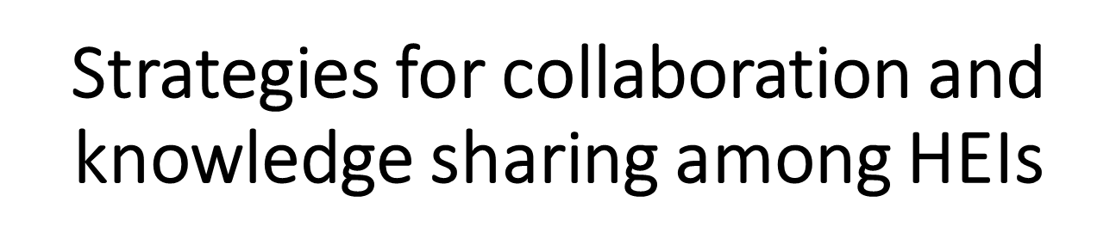
Joint Curriculum Development: Collaboratively design ESD curricula that can be shared among universities, ensuring consistency in content and learning outcomes.
Regular Workshops and Conferences: Organize and participate in workshops, conferences, and seminars focused on ESD to exchange knowledge with colleagues
Faculty Exchange Programs: Facilitate faculty exchange programs to encourage educators to share their expertise, teaching methods, and research findings related to ESD with other universities.

Slide 24
Strategies for collaboration and knowledge sharing among Universities and societies
Online Platforms: Developing online platforms or repositories where universities can share ESD-related course materials, research publications, and best practices. Open-access resources can be particularly beneficial.
Student Exchange Programs: Develop student exchange programs that allow students to experience ESD initiatives and approaches at different universities, fostering a global perspective.
Community Engagement: Encourage universities to collaborate with local communities on ESD initiatives. This can create opportunities for experiential learning and knowledge sharing.

Slide 25
Strategies for collaboration and knowledge sharing in Research
Joint Research Projects: Collaborating on research projects that address specific ESD challenges. Funding agencies often support such collaborations, making it easier for universities to work together.
Research Collaborations with External Stakeholders: Partner with government agencies, non-profit organizations, and industry stakeholders on ESD research projects. These collaborations can offer diverse perspectives and resources.
Shared Data and Databases: Develop shared databases or repositories for ESD-related data and research findings, making it easier for researchers to access and utilize this information. Promote the creation and sharing of ESD-related OER to make educational materials more accessible to a wider audience.

Slide 26
Forming national and regional networks of HEIs dedicated to ESD for:
Policy Advocacy and Influence: to advocate for policy changes that support ESD initiatives at the institutional, regional, or national levels.
Lifelong Learning and Alumni Engagement: to engage alumni in ongoing education and outreach efforts related to ESD, creating a network of support and knowledge sharing within each society and among GCC.
Monitoring and Evaluation: to monitor and evaluate the impact of collaborative ESD initiatives, ensuring continuous improvement and accountability.
International Partnerships: to seek international partnerships and collaborations with universities in different countries to bring diverse perspectives and experiences into ESD programs and continue to grow

Slide 27
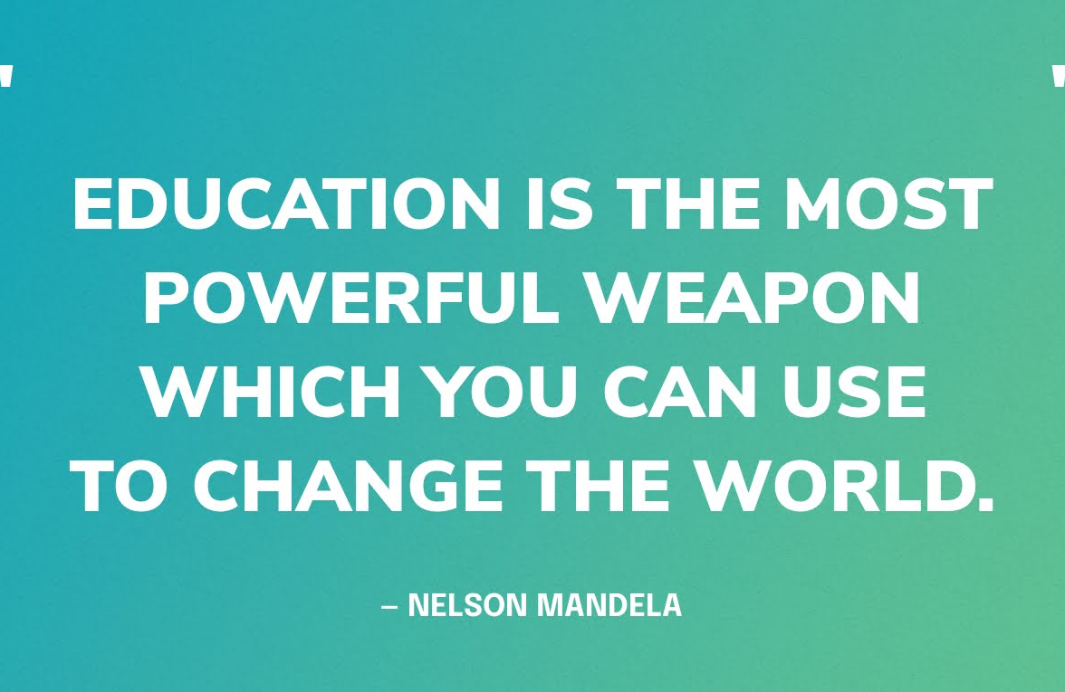
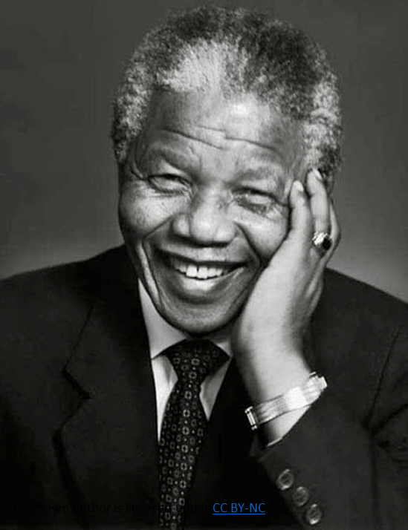
Given the paramount challenges collaboration and working together is the only way out.

Slide 28
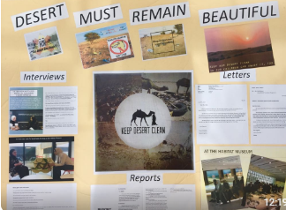

Slide 29
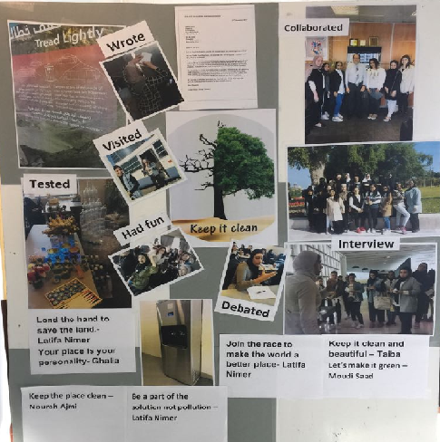

Slide 30
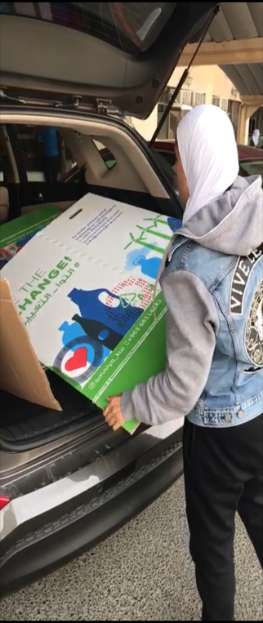
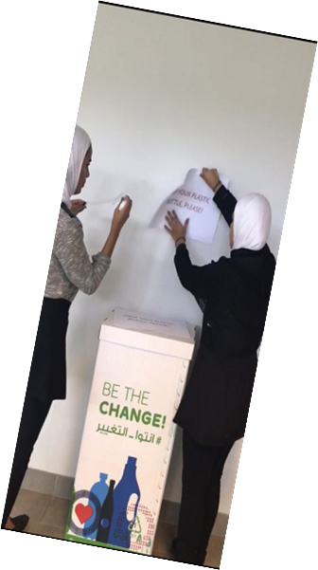
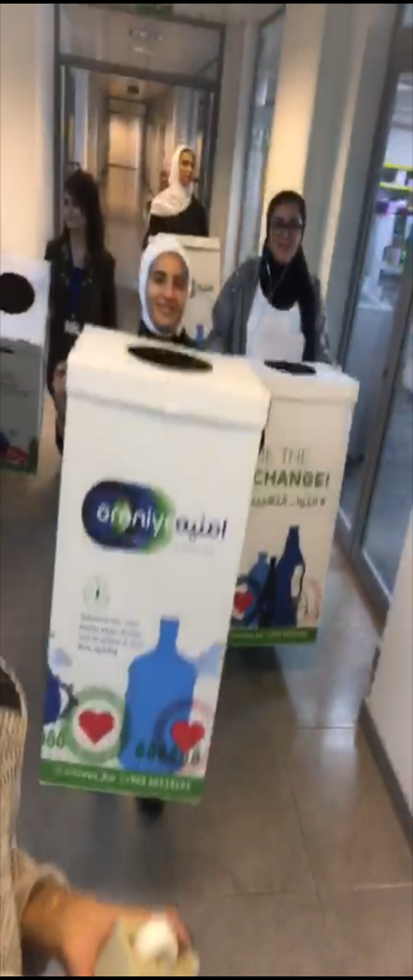
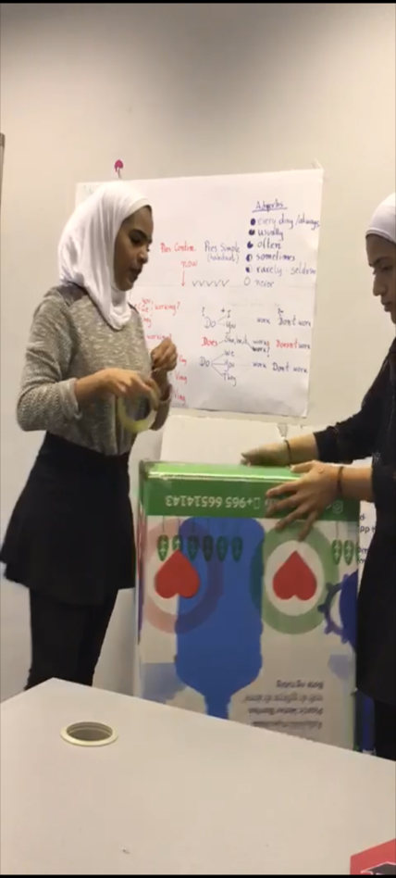
Solutions: Collecting water bottles at BHCK
(Recycling -OMNIA)

Slide 31
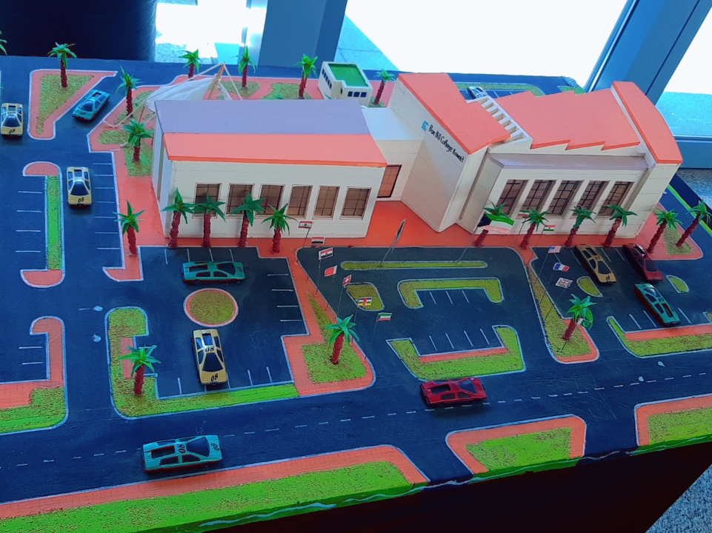
Green campus

Slide 32
References
Abubakar, Ismaila Rimi, Yusuf A. Aina, and Habib M. Alshuwaikhat. (2020), "Sustainable Development at Saudi Arabian Universities: An Overview of Institutional Frameworks" Sustainability 12, no. 19: 8008. https://doi.org/10.3390/su12198008
Al-Balushi, S. M., & Al-Aamri, S. S. (2014). The effect of environmental science projects on students’ environmental knowledge and science attitudes. International Research in Geographical & Environmental Education, 23, 213–227.
Almazroui, K. M. (2022, October 22). Project-Based Learning for 21st-Century Skills: An Overview and Case Study of Moral Education in the UAE. The Social Studies, 114(3), 125–136. https://doi.org/10.1080/00377996.2022.2134281
Bell, S. (2010). Project-based learning for the 21st century: Skills for the future. The Clearing House: A Journal of Educational Strategies, Issues and Ideas, 83, 39–43.

Slide 33
Brundiers, K., Barth, M., Cebrián, G., Cohen, M., Diaz, L., Doucette-Remington, S., Dripps, W., Habron, G., Harré, N., Jarchow, M., Losch, K., Michel, J., Mochizuki, Y., Rieckmann, M., Parnell, R., Walker, P., & Zint, M. (2020, July 28). Key competencies in sustainability in higher education—toward an agreed-upon reference framework. Sustainability Science, 16(1), 13–29.
C. Scarff Seatter, K. Ceulemans (2017) Teaching Sustainability in Higher Education, CJHE / RCES Volume 47, No. 2, 2017
Cotton, D., & Winter, J. (2010). It’s not just bits of paper and light bulbs. A review of sustainability pedagogies and their potential for use in higher education. In P. Jones, D. Selby, & S. Sterling (Eds.), Sustainability Education: Perspectives and Practice Across Higher Education (pp. 39–54). New York, NY: Earthscan
Dewey, J., & Small, A. W. (1897). Learning: Sustaining the doing, supporting the learning. Educational Psychologist, 26(3/4), 369-398. My pedagogic creed (No. 25). New York: EL Kellogg & Company.
Hertog, S., & Luciani, G. Energy and sustainability policies in the GCC (2009), “The Kuwait Programme on Development, Governance and Globalisation in the Gulf States; London School of Economics. https://dro.dur.ac.uk/7178

Slide 34
Huijser, Henk and Wali, Fatima. 2012. "A PBL approach to teaching Bahraini perspectives at Bahrain Polytechnic." 3rd International PBL Symposium 2012: PBL and the Problematization of Teaching and Learning. Singapore 07 - 09 Mar 2012 Singapore.
Krajcik, Joseph & Blumenfeld, Phyllis & Marx, Ronald & Soloway, Elliot. (2000). Instructional, Curricular, and Technological Supports for Inquiry in Science Classrooms.
Lozano, R., & Barreiro-Gen, M. (Eds.). (2021). Developing Sustainability Competences Through Pedagogical Approaches. Strategies for Sustainability. https://doi.org/10.1007/978-3-030-64965-4
Lozano, R., Ceulemans, K., & Scarff Seatter, C. (2015). Teaching organizational change management for sustainability: Designing and delivering a course at the University of Leeds to better prepare future sustainability change agents. Journal of Cleaner Production, 106, 205–215.

Slide 35
Meerkerk, E.M. van, Neele, A. & Korven, I. van (2021). Inclusion, Life and Innovation. The Relative Uses of Arts Education in Relation to the Sustainable Development Goals. In E. Wagner,
C. Svendler Nielsen, L. Veloso, A. Suominen & N. Pachova (Eds.), Arts, Sustainability and Education (Yearbook of the European Network of Observatories in the Field of Arts and Cultural Education (ENO), 2) (pp. 239-262).
Mohammed, N. (2017). Project-based learning in higher education in the UAE: a case study of Arab students in Emirati Studies. Learning and Teaching in Higher Education: Gulf Perspectives, 14(2). http://doi.org/10.18538/lthe.v14.n2.29
Radwan, A.F. and Khalil, E.M.A.S. (2021), "Knowledge, attitude and practice toward sustainability among university students in UAE", International Journal of Sustainability in Higher Education, Vol. 22 No. 5, pp. 964-981. https://doi.org/10.1108/IJSHE-06-2020-0229
Rieckmann, Marco. (2011). Future-oriented higher education: Which key competencies should be fostered through university teaching and learning?. Futures. 44. 127-135. 10.1016/j.futures.2011.09.005.https://doi.org/10.1007/s11625-020-00838-2
Savin-Baden, M. (2014). Using problem-based learning: New constellations for the 21st century. Journal on Excellence in College Teaching, 25(3&4), 197–219.

Slide 36
Tejedor, G., Segalàs, J., & Rosas-Casals, M. (2018). Transdisciplinarity in higher education for sustainability: How discourses are approached in engineering education. Journal of Cleaner Production, 175, 29-37. https://doi.org/10.1016/j.jclepro.2017.11.085
Tilbury, Daniella. (2011). Tilbury, D. (2011) 'Are We Learning to Change? Mapping global progress in education for sustainable development in the lead-up to Rio+20' Global Environmental Research 14(2) 101-107 ISSN 1343 8808. Global Environmental Research
Wiek, A., Withycombe, L., & Redman, C. L. (2011, May 19). Key competencies in sustainability: a reference framework for academic program development. Sustainability Science, 6(2), 203–218. https://doi.org/10.1007/s11625-011-0132-6
Sustainable Development Goals | United Nations Development Programme. (n.d.). UNDP. https://www.undp.org/sustainable-development-goals
The UN Sustainable Development Cooperation Framework | UNSSC | United Nations System Staff College. (2023, December 31). The UN Sustainable Development Cooperation Framework | UNSSC | United Nations System Staff College.
https://unfccc.int/sites/default/files/english_paris_agreement.pdf
UNESCO 2017, programme and meeting document
https://unesdoc.unesco.org/ark:/48223/pf0000261971
2020 Year in Review: Executive Director Catherine O’Riordan – 2020 Annual Report of the Ecological Society of America. (n.d.). 2020 Year in Review: Executive Director Catherine O’Riordan – 2020 Annual Report of the Ecological Society of America.
https://www.esa.org/2020/our-people/2020-year-in-review-executive-director-catherine-oriordan/
Knowledge, attitude, and practice toward sustainability among university students in UAE | Emerald Insight. (2021, June 18). Knowledge, Attitude and Practice Toward Sustainability Among University Students in UAE | Emerald Insight. https://www.emerald.com/insight/content/doi/10.1108/IJSHE-06-2020-0229/full/html
United Nations. Transforming Our World: The 2030 Agenda for Sustainable Development; United Nations: Paris, France, 2015; Available online: https://sustainabledevelopment.un.org/post2015/transformingourworld/ publication

