Slide 1

Improving Open Access Workflows in Scholarly Communication with the Advent of Artificial Intelligence
Kamel Belhamel
Directory of Open Access Journals
Notes:
Entered text
Open access workflows in scholarly communications refer to the processes and practices involved in publishing research outputs, such as articles, papers, and data, in an open access manner.
Before the advent of AI technology, these open access workflows mainly relied on traditional methods, resulting in the time-consuming and labor-intensive. Actually, they continue to evolve with emerging technologies, collaborative platforms, and changing publishing models.
This proposal aims to describe how AI can play a significant role in improving open access workflow in scholarly communication in several ways by automating many processes, such as article submission, peer-review, and publication, which can improve efficiency and help reduce the turnaround time for publishing the research by reducing the time taken to compile, edit, proofread, review, and publish the research content. AI can be used to analyze large volumes of open access content to identify patterns, trends, and insights, which can help researchers make new discoveries and advance knowledge. Some examples of existing AI-powered platforms and tools that are being used in open access workflows in scholarly communications will be described.
It's important to note that while AI can significantly enhance open access workflows, it should be used in conjunction with human expertise and oversight to ensure the integrity and ethical considerations of scholarly communications.
Entered text
1. Manuscript Preparation: Researchers write their manuscripts following the guidelines of their chosen open access journals or platforms. They ensure that their work meets the standards of quality and integrity.
2. Selection of Open Access Journals or Platforms: Authors choose reputable open access journals or platforms to submit their manuscripts. They consider factors like the journal's scope, reputation, impact factor, and publishing policies.
3. Submission and Peer Review: Authors submit their manuscripts to the chosen open access journal or platform. The journal's editorial team performs initial checks and assigns peer reviewers to evaluate the work's quality, methodology, and significance. Peer review ensures the integrity and validity of the research.
4. Publication: Upon successful peer review, the open access journal publishes the accepted manuscript. Depending on the publishing model, the article may be immediately available online or go through additional production processes like copyediting and formatting before publication.
5. Licensing and Copyright: Authors often choose a Creative Commons (CC) license to grant users the right to access, use, and distribute their work with proper at tribution. Different CC licenses offer varying permissions and restrictions.
6. Article Processing Charges (APCs): Some open access journals require authors to pay Article Processing Charges to cover the costs of peer review, editing, and publication. APCs can vary depending on the journal's reputation, scope, and services provided.
7. Post-publication Promotion: After publication, authors and researchers promote their open access articles through various channels, including social media, academic networks, conferences, and institutional repositories. This helps increase visibility and citations for their work.
Entered text
1. Automated Peer Review: AI-powered systems can assist with the peer review process by analyzing manuscripts, checking for plagiarism, evaluating research integrity, and providing feedback on the quality and relevance of the work. This can help streamline the review process, reduce the burden on human reviewers, and expedite the publication timeline.
2. Content Curation and Recommendation: AI algorithms can analyze vast amounts of research articles, metadata, and user preferences to provide personalized recommendations to researchers, helping them discover relevant open access content. This can facilitate access to diverse and valuable research outputs and promote interdisciplinary collaboration.
3. Text Mining and Data Extraction: AI techniques, such as natural language processing (NLP), can automate the extraction of information from research articles, enabling efficient data mining and analysis. Researchers can use AI tools to identify trends, extract key findings, and aggregate knowledge from large volumes of open access content.
4. Language Translation and Accessibility: AI-powered translation tools can overcome language barriers and facilitate the translation of research articles into different languages. This can enhance the accessibility of open access content to a global audience, enabling broader dissemination and understanding of research findings.
5. Metadata Enhancement: AI algorithms can analyze and enrich metadata associated with open access publications, improving searchability and discoverability. By automatically extracting key metadata elements from articles, such as author names, affiliations, keywords, and citations, AI can enhance the accuracy and completeness of metadata records.
6. Preprint Screening and Fact-Checking: AI can assist in screening preprints for potential ethical concerns, errors, or misleading information. AI-based fact-checking tools can analyze the content and cross-reference it with existing knowledge to identify inaccuracies or inconsistencies, helping ensure the reliability of open access research.
7. Recommendation for Open Access Journals: AI can analyze a researcher's manuscript and suggest suitable open access journals or platforms for submission based on factors such as topic relevance, publication history, citation patterns, and journal impact factors. This can save researchers time and help them find the best-fit open access outlets for their work.

Slide 2

Introduction
Key Components of Scholarly Communication
key components of open access workflows
Developments in artificial intelligence (AI)
AI-powered tools available used for (OA) workflows
UNESCO’s First Global Guidance on GenAI
AI and its own set of challenges and opportunities
Credit: Steve Johnson on Unsplash

Slide 3

What is scholarly communication?
In 2003, ACRL (Association of College and Research Libraries) defined scholarly communication as "the system through which research and other scholarly writings are created, evaluated for quality, disseminated to the scholarly community, and preserved for future use.
Traditionally scholarly communication has occurred in the formal literature - in journal articles, conference proceedings, book chapters and books.

Slide 4
Key Components of Scholarly Communication
Research, Data Collection & Analysis
Scholarly communication includes the research outputs of all academic disciplines:
Publications, inventions, software, masterclass workshops, lecture-recitals, gallery showings, performances and other public displays, multidimensional objects, multimedia, and many more products of academic inquiry besides.
Discovery & Dissemination
Authoring
Publication
Peer review
(Diagram Source -- ACRL, 2010 via Creative Commons Attribution-NonCommercial-ShareAlike 4.0 International License.)

Slide 5
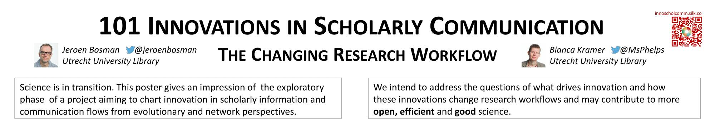
In 2015 & 2016 : Jeroen Bosman & Bianca Kramer ran a survey about the changing landscape of scholarly communication
They were interested in the way information is created, shared and processed in Academia
Innovative tools & sites were cited in Scholarly Communication

Slide 6
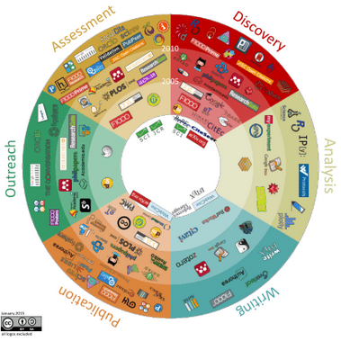
6 workflow phases in Scholarly Communication
Jeroen Bosman & Bianca Kramer, Innovations in Scholarly Communication | Changing Research Workflows (wordpress.com)

Slide 7
Scholarly communication in transition mode

Slide 8


Scholarly communications cover a wide spectrum of activity, broadly in two areas:
1
Publishing and disseminating the results of research.
2
Providing access to the published material.

Slide 9
Publishing environment is changing in many ways

Slide 10
The publishing environment is changing
New concepts and models are replacing the traditional forms of doing research and publishing.
Debates about peer review, access to information, and metrics for measuring academic impact are creating a very dynamic and competitive environment.
The traditional peer-reviewed journal article is still the most important form of scientific communication

Slide 11
The key components of open access workflows
Open access (OA) workflows are designed to facilitate the publication and dissemination of research articles, data, and other scholarly materials to a wider audience, without any financial, legal, or technical barriers.
OA workflows include…

Slide 12
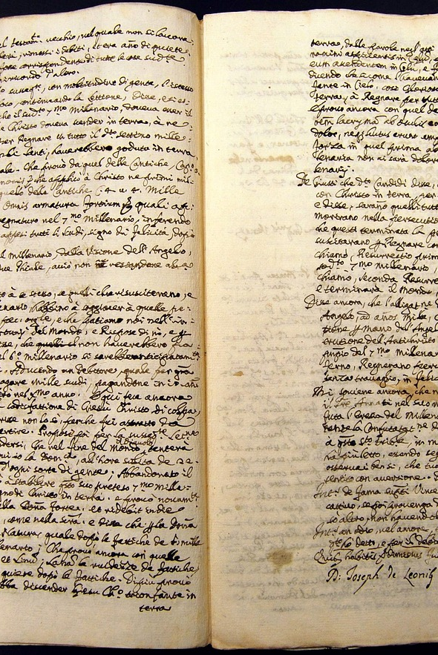

Manuscript preparation
01
Researchers ensure that their work meets the standards of quality and integrity.
02
Researchers write their manuscripts following the guidelines of their chosen open access journals or platforms. This may involve formatting and structuring the content, including citations, references, and other metadata

Slide 13
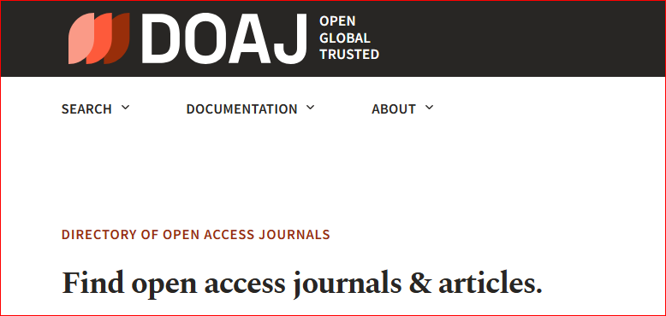

Selection of Open Access Journals or Platforms
01
Authors consider factors like the journal's scope, reputation, impact factor, and publishing policies.
02
Authors choose reputable open access journals or platforms to submit their manuscripts.
https://doaj.org

Slide 14

Submission and Peer Review
01
Authors submit their manuscripts to the chosen open access journal or platform.
02
The journal's editorial team performs initial checks and assigns peer reviewers to evaluate the work's quality, methodology, and significance.
Peer review ensures the integrity and validity of the research.

Slide 15


Publication
01
Depending on the publishing model, the article may be immediately available online or go through additional production processes like copyediting and formatting before publication.
Immediate
Free
Research articles
Open Access
Re-use rights
02
Upon successful peer review, the open access journal publishes the accepted manuscript.
Online
Availability

Slide 16

Licensing and Copyright
01
Different CC licenses offer varying permissions and restrictions.
02
Authors often choose a Creative Commons (CC) license to grant users the right to access, use, and distribute their work with proper attribution.
Credit: Markus Winkler on Unsplash

Slide 17
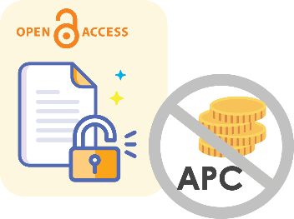
Article Processing Charges (APCs)
01
APCs can vary depending on the journal's reputation, scope, and services provided.
02
Some open access journals require authors to pay Article Processing Charges to cover the costs of peer review, editing, and publication.

Slide 18

Post-publication Promotion
After publication, authors and researchers promote their open access articles through various channels, including social media, academic networks, conferences, and institutional repositories.
This helps increase visibility and citations for their work.

Slide 19
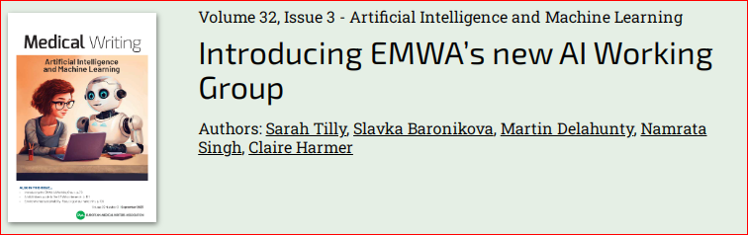
Rapid developments in artificial intelligence (AI)
AI (Artificial Intelligence) has become a hot topic. This has changed the way organizations work, and many companies are now adopting a 'ChatGPT' policy, as workers increasingly rely on it for computing, drafting emails and asking work-related questions.
In just 11 months since the launch of OpenAI ChatGPT 3.5, there has been an explosion in both interest and concerns in the use of AI tools in scientific writing.

Slide 20

Machine learning (ML) and artificial intelligence (AI) can be used to automate various aspects of open access (OA) workflows

Slide 21
Automated Peer Review
Provide feedback on quality and relevance
AI-powered systems can analyze manuscripts
Check for plagiarism and evaluate research integrity
Streamline the review process and reduce burden on human reviewers
Expedite the publication timeline

Slide 22
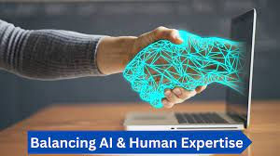
Integrating AI with Human Expertise
Ensuring integrity and ethical considerations
The importance of human oversight in scholarly communications
Image Credit: Ravi Vaithialingam

Slide 23
Text Mining and Data Extraction
AI techniques automate information extraction from research articles
Identify trends and extract key findings
Enable efficient data mining and analysis
Aggregate knowledge from large volumes of open access content

Slide 24
Language Translation and Accessibility
Enhance accessibility of open access content to a global audience
AI-powered translation tools overcome language barriers
Enable broader dissemination and understanding of research findings
Facilitate translation of research articles into different languages

Slide 25
Metadata Enhancement
Automatically extract key metadata elements from articles
AI algorithms analyze and enrich metadata of open access publications
Improve searchability and discoverability
Enhance accuracy and completeness of metadata records

Slide 26

Preprint Screening and Fact-Checking
AI assists in screening preprints for ethical concerns and errors
Factchecking tools cross-reference content with existing knowledge
Identify inaccuracies or inconsistencies
Ensure reliability of open access research
Image credit: Jeff Grabmeie, Ohio State News

Slide 27
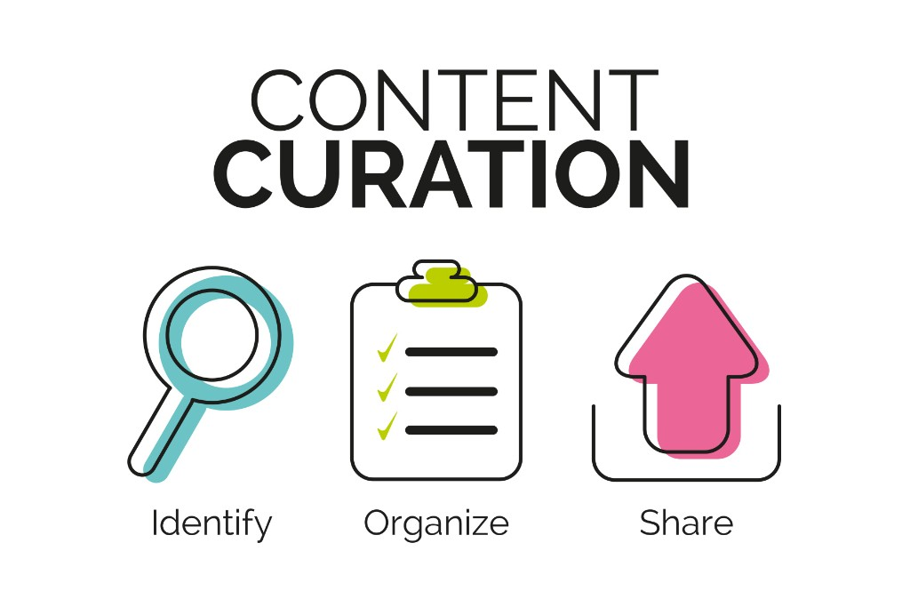
Content Curation and Recommendation
AI algorithms analyze research articles, metadata, and user preferences
Provide personalized recommendations to researchers
Facilitate access to diverse and valuable research outputs
Promote interdisciplinary collaboration

Slide 28
Recommendation for Open Access Journals
AI analyzes researcher's manuscript
Consider factors like topic relevance, publication history, and impact factors
Suggest suitable open access journals or platforms for submission
Save researchers time and find best-fit outlets for their work

Slide 29

Benefits of AI in Open Access Workflows
Automation of article submission, peer review, and publication
Improved efficiency and reduced turnaround time
Analyzing open access content to identify patterns and trends
Advancing knowledge through new discoveries

Slide 30
There are several AI-powered tools available that can help automate various aspects of (OA) workflows, including :
Article classification
License detection
APC detection
Institutional repository deposit
Funder policy compliance
Article-level metrics
Automated email filtering
Rights management

Slide 31



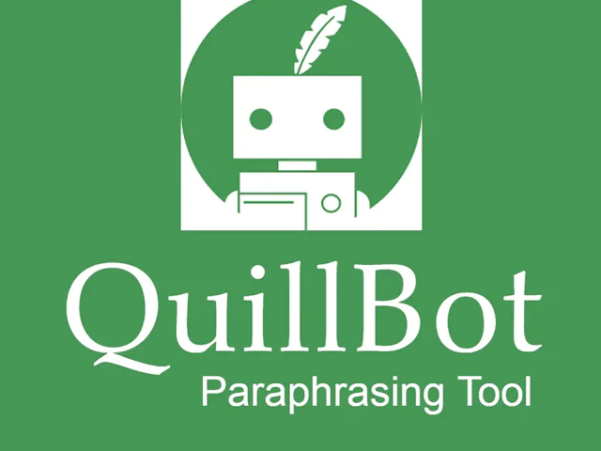


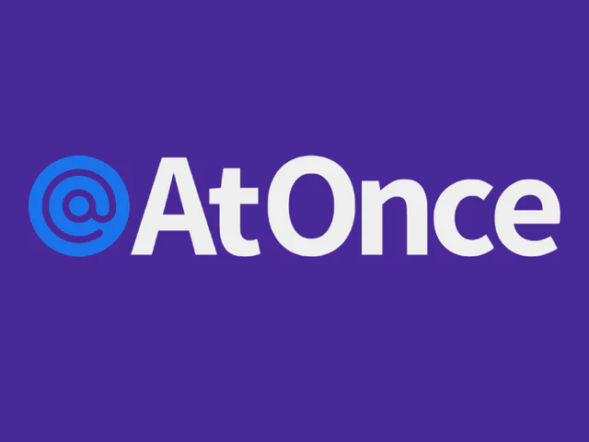

Some AI Tools for Text Generation and Content Creation

Slide 32
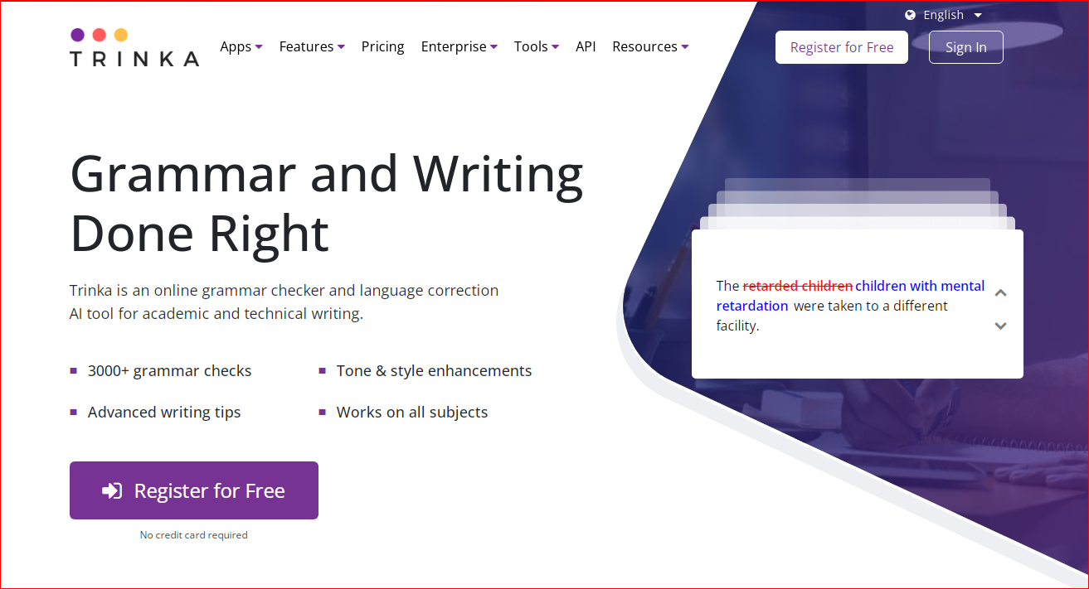
Trinka can help authors improve the writing quality of their manuscripts

Slide 33
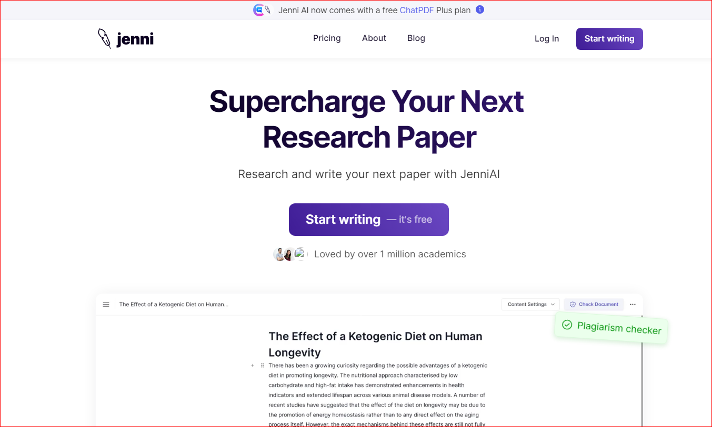
Jenni is an AI-powered academic writing assistant

Slide 34
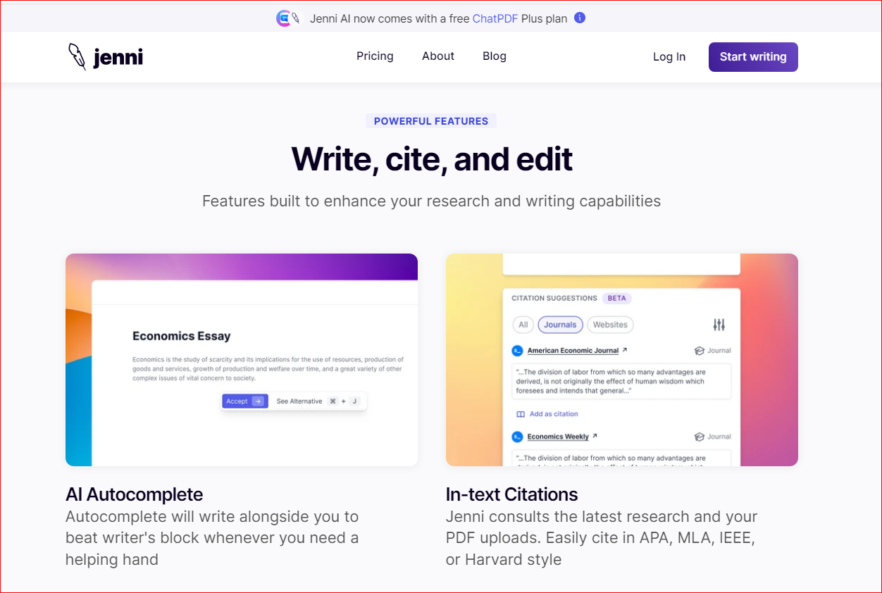

Slide 35
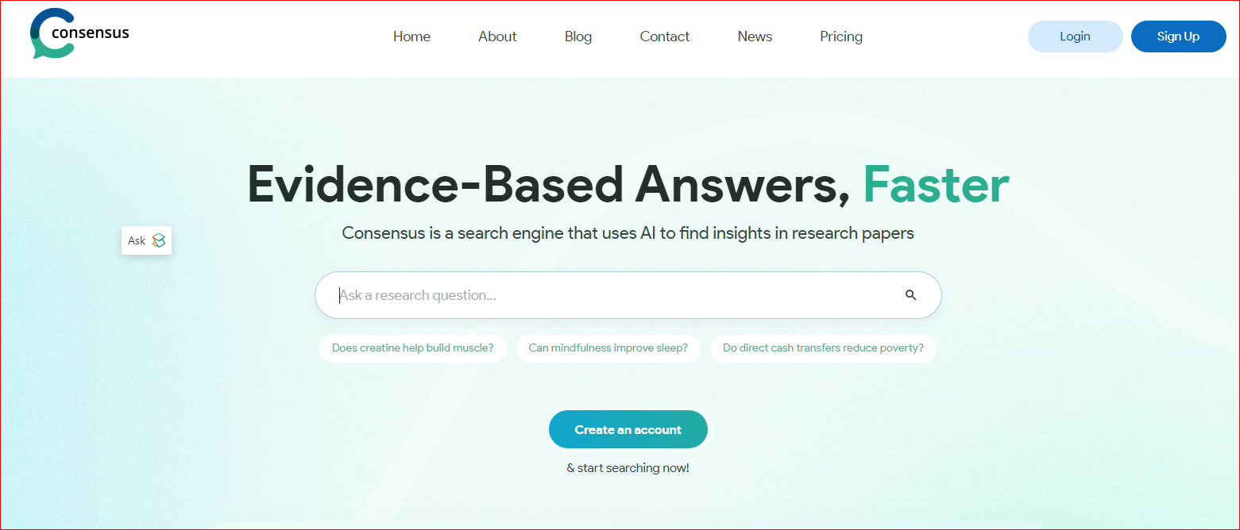
Consensus app can help to find relevant papers in minutes.

Slide 36
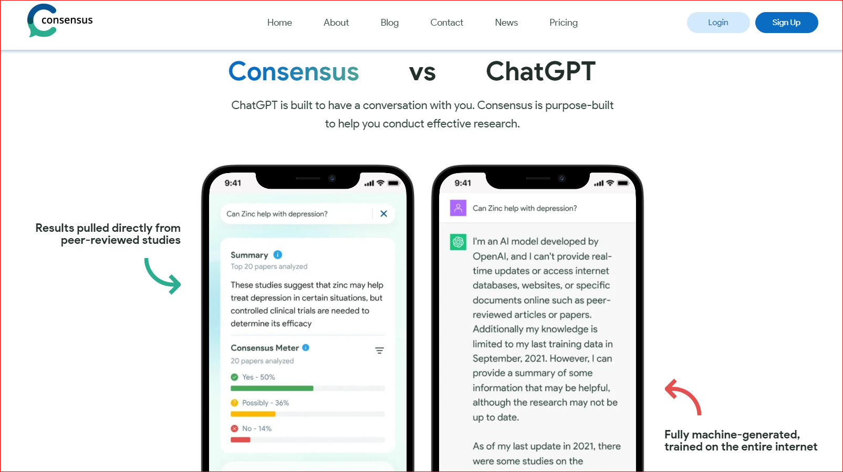

Slide 37
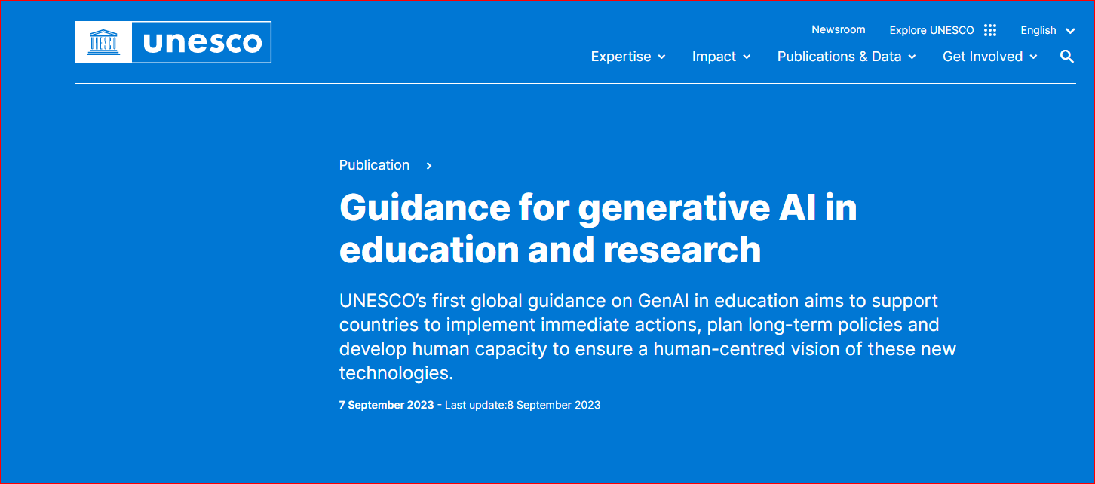
UNESCO’s First Global Guidance on GenAI

Slide 38
UNESCO’s First Global Guidance on GenAI
Towards a human-centered approach to the use of generative AI
Publicly available generative AI (GenAI) tools are rapidly emerging, and the release of iterative versions is outpacing the adaptation of national regulatory frameworks. The absence of national regulations on GenAI in most countries leaves the data privacy of users unprotected and educational institutions largely unprepared to validate the tools.

Slide 39
UNESCO’s First Global Guidance on GenAI
Towards a human-centered approach to the use of generative AI
The Guidance
looks into what GenAI is and how it works, presenting the diverse technologies and models available
identifIes a range of controversial ethical and policy issues around both AI in general, and GenAI specifically
discusses the steps and key elements to be examined when seeking to regulate GenAI based on a human-centred approach – one that ensures
ethical, safe, equitable and meaningful use
proposes measures that can be taken to develop coherent, comprehensive policy frameworks to regulate the use of GenAI in education and research
looks into the possibilities for creatively using GenAI in curriculum design, teaching, learning and research activities
explores long-term implications of GenAI for education and research

Slide 40
AI revolution presents its own set of challenges and opportunities

Slide 41
AI poses certain risks in terms of ethical and socioeconomic consequences. It is important to carefully consider the ethical implications, intellectual property, copyright, licensing, privacy concerns, and potential impact on the workforce as AI continues to advance.
AI tools are often trained on personal and copyrighted data scraped from the internet, leading to privacy and intellectual property fears. They can also be used to generate harmful misinformation and disinformation. With generative AI, it is even possible to manipulate images and create fake profiles.
AI often involves collecting and processing large amounts of data, there is the risk that this data will be accessed by the wrong people or organizations.
More tasks become automated, especially in such industries as marketing and health care.
We get to make choices about how we want to use AI help to make work more productive, interesting, and meaningful.

Slide 42
Thank you for your attention
Kamel Belhamel
kamel@doaj.org

