Slide 1
From a museum of things …
… to a narrative about people

Slide 2




“Maybe this is the end of the classic 19th century museum and the beginning of something else”
(Benedicte Savoy)
Conservative memory organization “Museum”
Challenges
Emotional suggestions
…
Persons not objects
Conclusions

Slide 3
Conservative memory organization “Museum”
Memory organization “Museum”: past & present
Wikidata: Potential for cultural heritage
Salvation paradigm, collecting hype and overload
Overload: Green Museum?

Slide 4
Conservative memory organization “Museum”
Past
Present
18th century
  Collecting in the era of European expansion
19th century
  Humanist scholars → Passion for collecting
Around 1900
  “Collecting hype”
Museum websites
  presented like exhibitions
Objects online
  like printed catalogs
  limited interconnections (concepts, authority records, etc.)
  hardly any inter-collection references
“Old-fashioned concept of experts”
(Mohr, Niemann, Knapp, 2019)
  only limited “open content”
Digital transformation
→ low level

Slide 5

Wikidata: Potential for cultural heritage
Linked Open Data (LOD)?
  ↔ “Lack of museum nodes”
Wikidata
  Item, statement, property, and relationship
  ↳ Highly flexible information system
  ↳ Linking distributed data sources
  ↳ Cross-comparisons can be made
  ↳ Open knowledge platform for the creation and distribution of LOD

Slide 6
Salvation paradigm, collecting hype, and overload
Salvation paradigm and the idea of preservation
  “The last moment has come, the twelfth hour has arrived! Documents of immeasurable, irreplaceable value for human history are perishing. Save! save! before it is too late.”
  (“Memorial speech for Adolf Bastian”, Karl von den Steinen, 1905)
  Collecting as a bourgeois mass phenomenon
  Material objects as the exclusive source
    “Imperialist nostalgia”
    “Crisis of the European modernity”
    Demonstration of national superiority in the great national museums

Slide 7
An overload for the museum
Smithsonian Institution 2013 (Congress Hearing)
  Insufficient inventory controls and inadequate preservation practices
  Incomplete and inaccurate inventory records
Prussian Cultural Heritage Foundation 2020 (Academic Council)
  Lack of staff capacity for
    Preservation of collections
    Collection documentation
  Insufficient:
    Information technology
    Digital transformation
British Museum 2023 (ARTnews, NYT, The Art Newspaper)
  Important questions about security, record keeping, and funding priorities
  Dysfunctional institutional culture

Slide 8
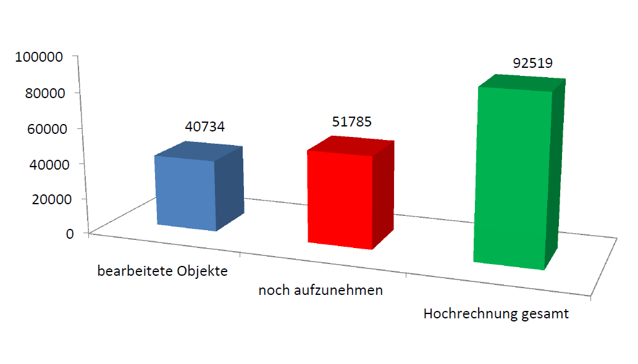
Objects in the museum documentation system (Museum of Islamic Art, Berlin, 2018)
Extrapolation total
Yet to be recorded
Objects recorded

Slide 9
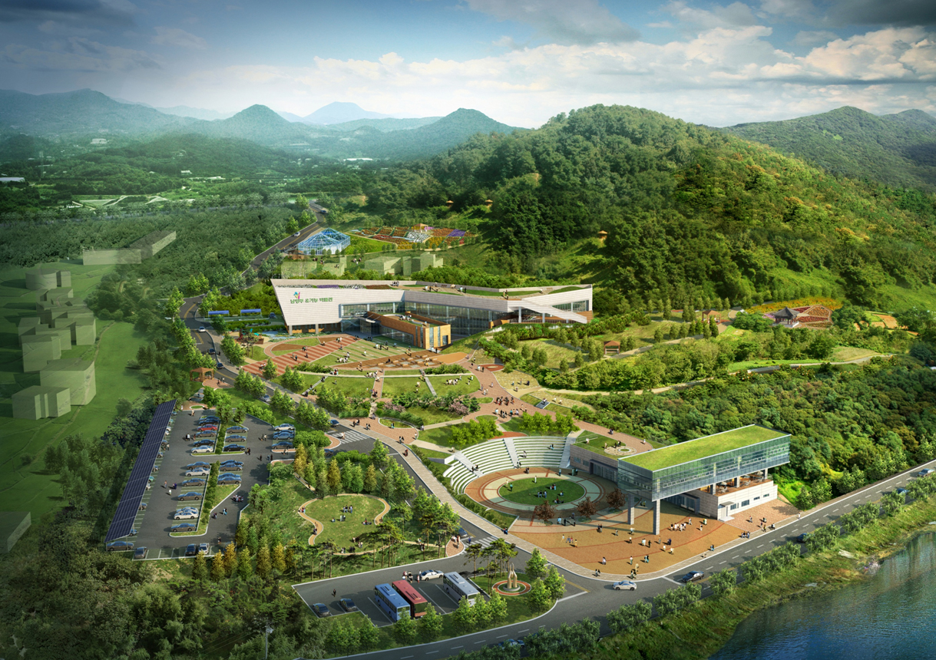
Overload: Green Museum?
Collection size → Ecological footprint
  Buildings
  Heating, ventilation, and air conditioning
  Conservation
“Who knows whether there will be a society that can or wants to visit our museums in a hundred years’ time?”
(Stefan Simon)

Slide 10
Challenges
Re-auratization or contextualization?
Provenance, decolonization and restitution

Slide 11
From object space to information space
Information
(Museum documentation)
Collect
Conserve
Research
Exhibit
Interpret
Objects

Slide 12

Contextualization requires information system “Museum”
Linked Open Data
Data standardization
Authority
control
CIDOC CRM
Extrinsic data
Intrinsic data
Objects

Slide 13
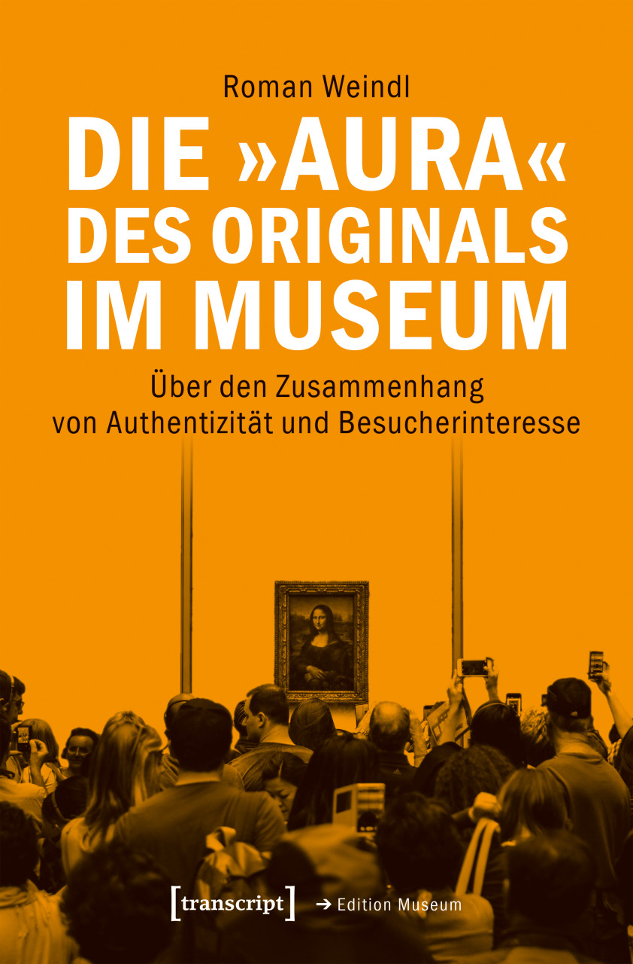
“Aura of the original”?
Criticism
  “concept of the Bildungsbürgertum” (German educated bourgeoisie)
  “faked aura”
  “re-auratization”
  something staged as intended by the museum
Instead of “Aura” → more contextualization
  with support using the tools and methods of digital transformation
  replacing information that was inevitably lost when the objects were removed from their original context
The “Aura”
of the original
in the museum
About the connection between authenticity and visitor interest

Slide 14
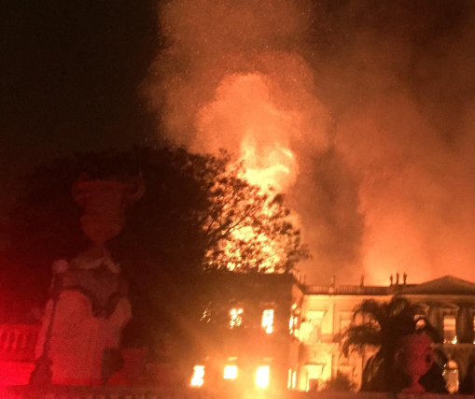
Information space and digital twin
Information space
  Comprehensive
  Standardized
  Complex structured
Saving the future of museums
  Changes to the objects
  Destruction
Object
Physical
Representations (image, video, audio, ...)
Data
intrinsic
extrinsic
Information (digital twin)
Intangible value
Collectively available
Collaborative use
Museo Nacional
Río de Janeiro
2.9.2018

Slide 15
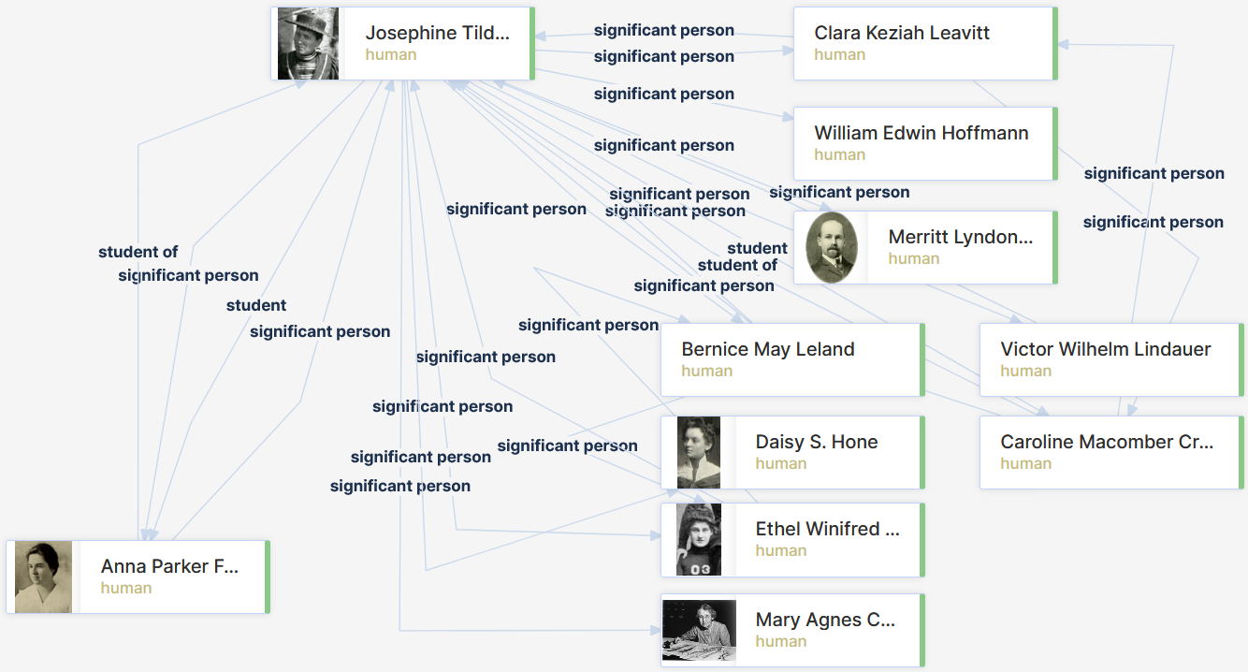
Provenance, decolonization and restitution
Source situation in the museum
  “Not-knowing in the collection documentation”
“Individuals”
  Identification and historical context
  Anonymous collectors
  Incomplete provenance information
  Different roles:
    Researcher
    Dealer
    “Ethnologist”
    Trickster ...
↔ Persons in Wikidata (science)
  “The Disambiguation of People Names in Biological Collections”

Slide 16
Persons not objects
Demasking the museum by registering its shamans (“somebody who knows”)
People as actors and network nodes
People and intangible cultural heritage: narrative tradition
Kiʻi Kihawahine
Aleppo-Room

Slide 17
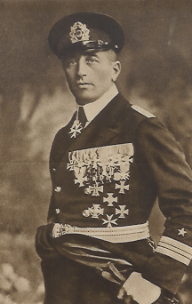
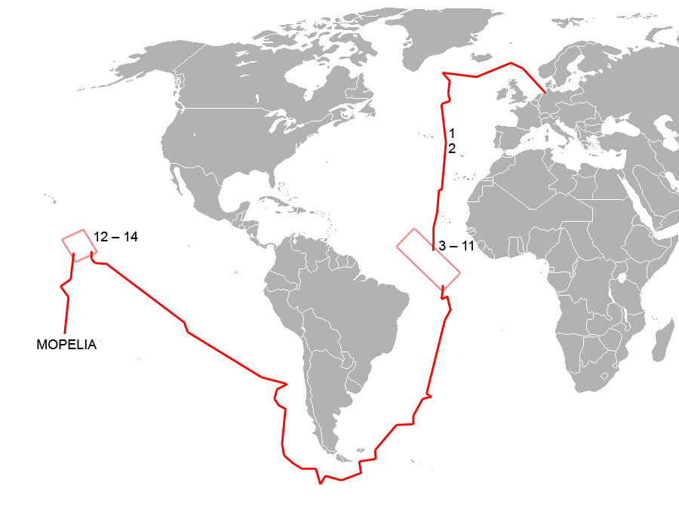
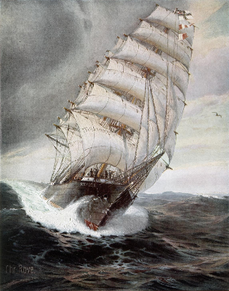
People instead of objects:
Felix Graf von Luckner (Q215804)
SMS „Seeadler“

Slide 18
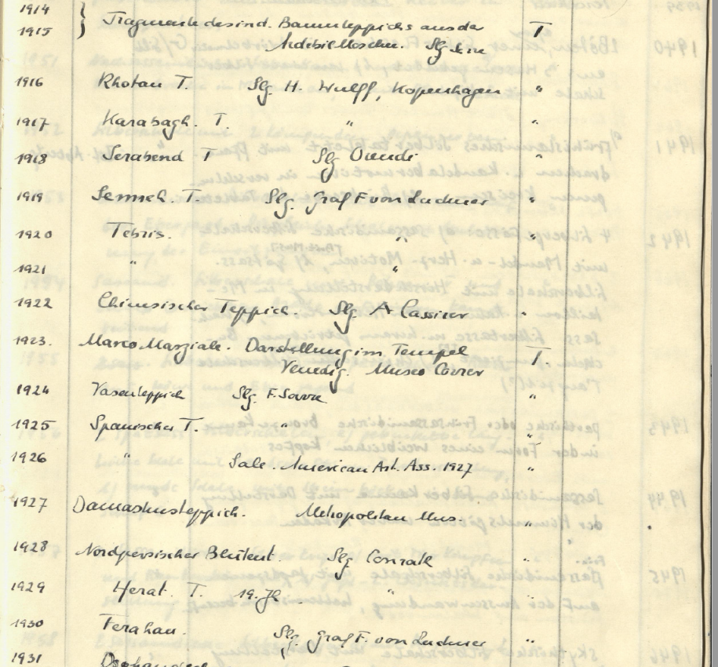
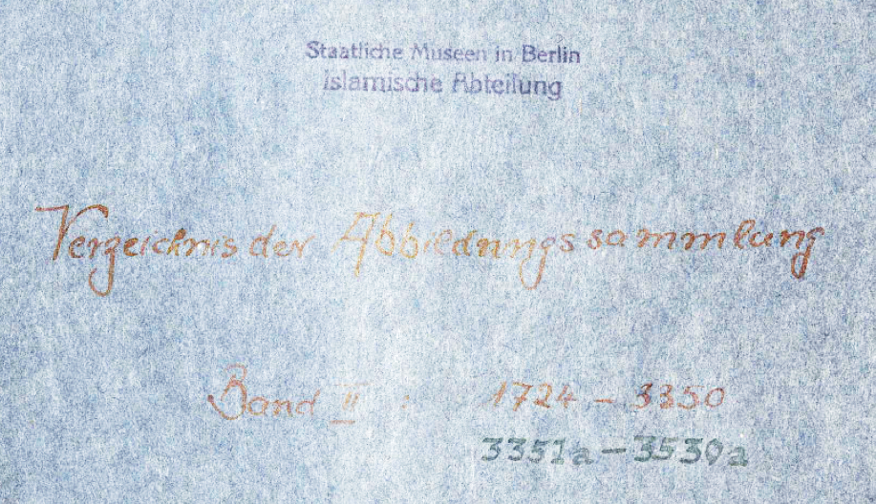

Collection of photographs in the Museum of Islamic Art

Slide 19
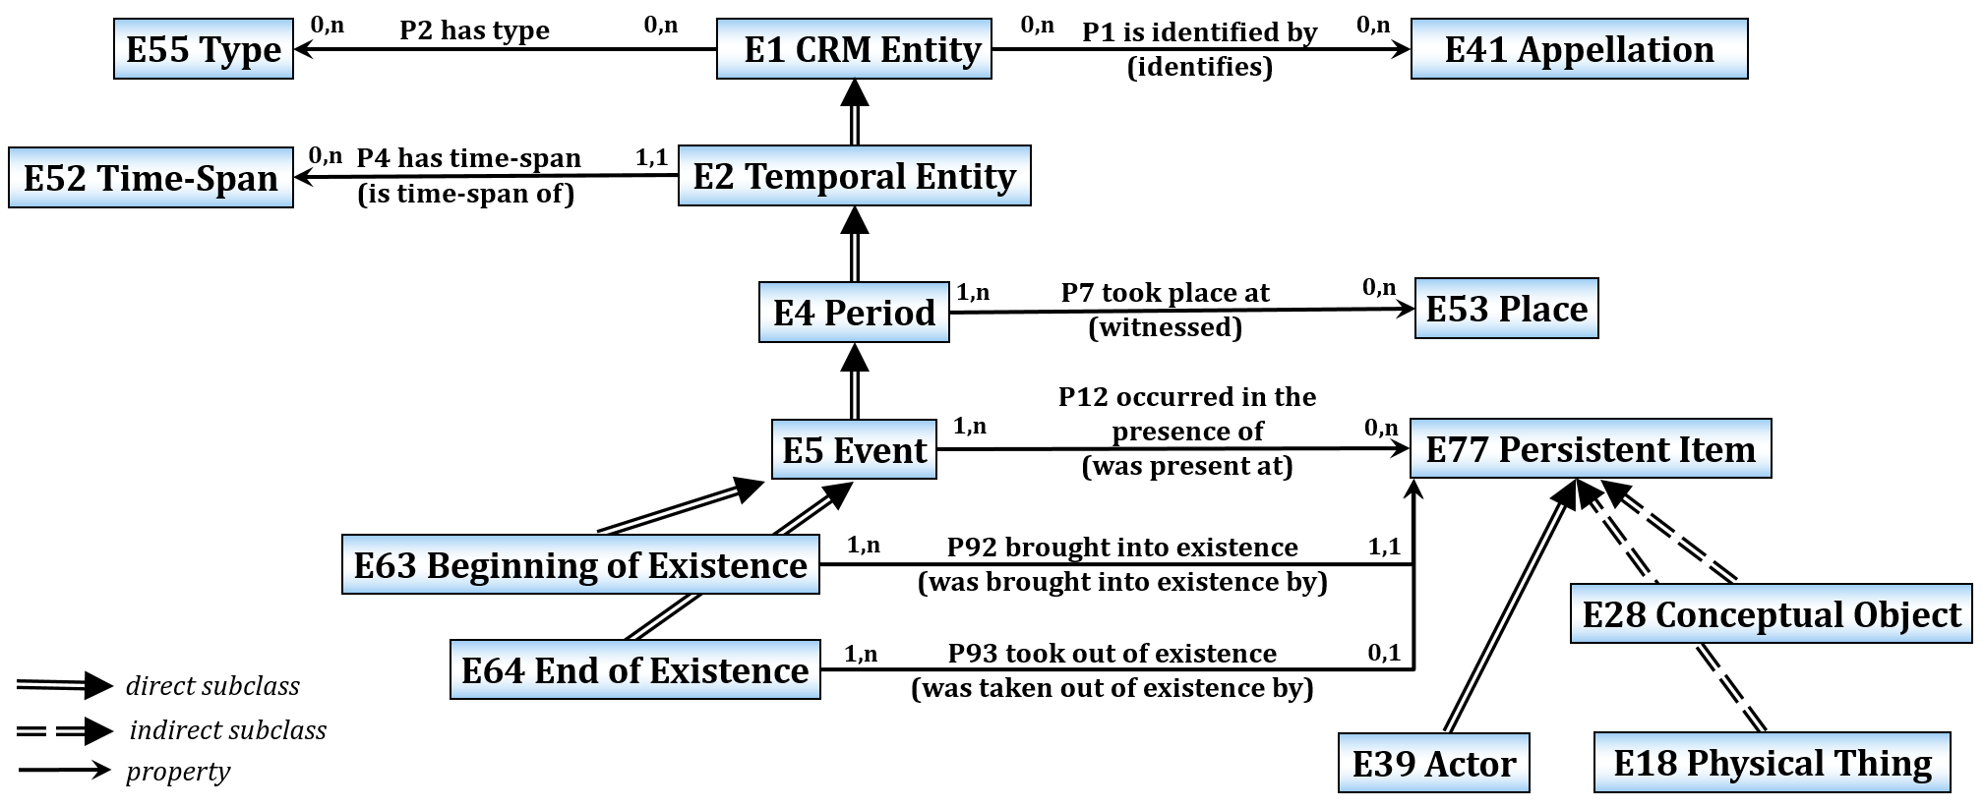
CIDOC-CRM: Event

Slide 20
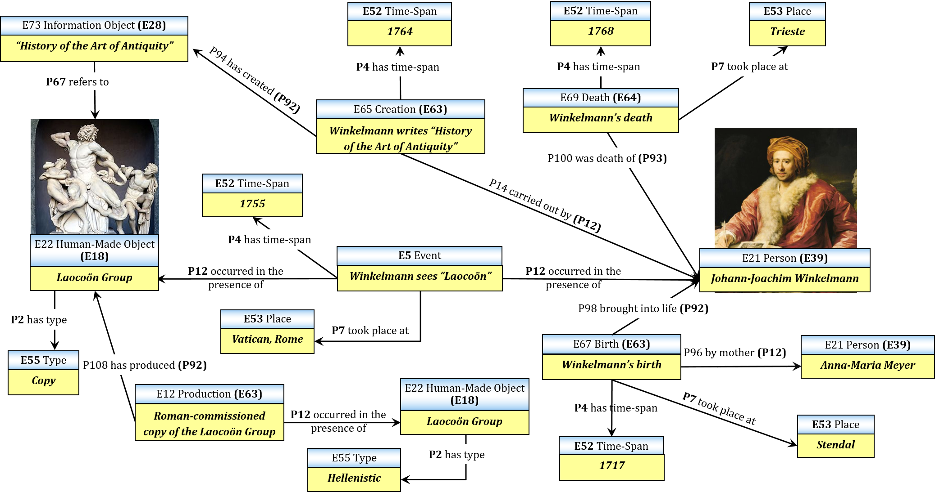
Object description
→ Records of acting persons

Slide 21
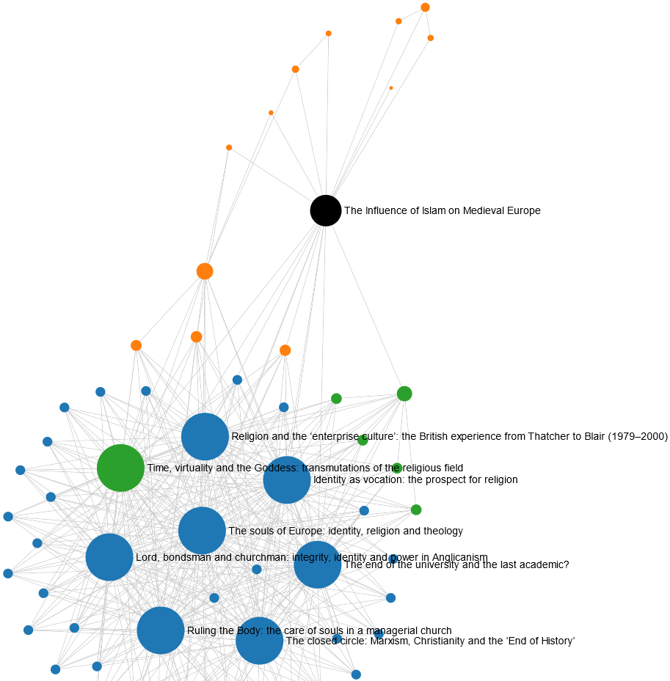
Change of perspective 1: Citation networks

Slide 22
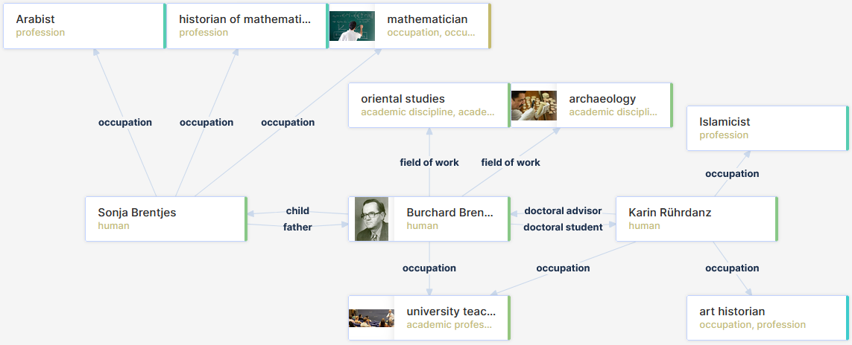
Change of perspective 2:
Sociology of research

Slide 23
Today = Research history of tomorrow
1.0: People publish information about themselves and others
2.0: Collaboration between people
  ↳ Alternating between “sender” and “receiver”
3.0: Semantic methods and tools
  ↳ Machine processing
Digital twins of museum objects + “digital twins of people” = Research
  Interaction between people
  Activities in relation to museum objects

Slide 24
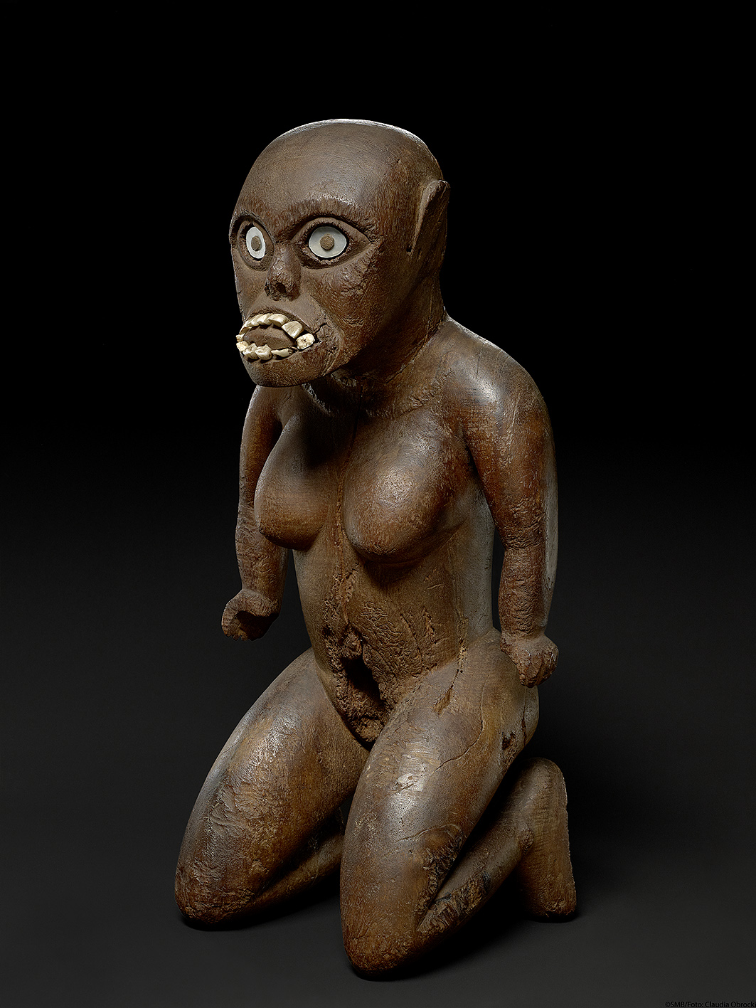
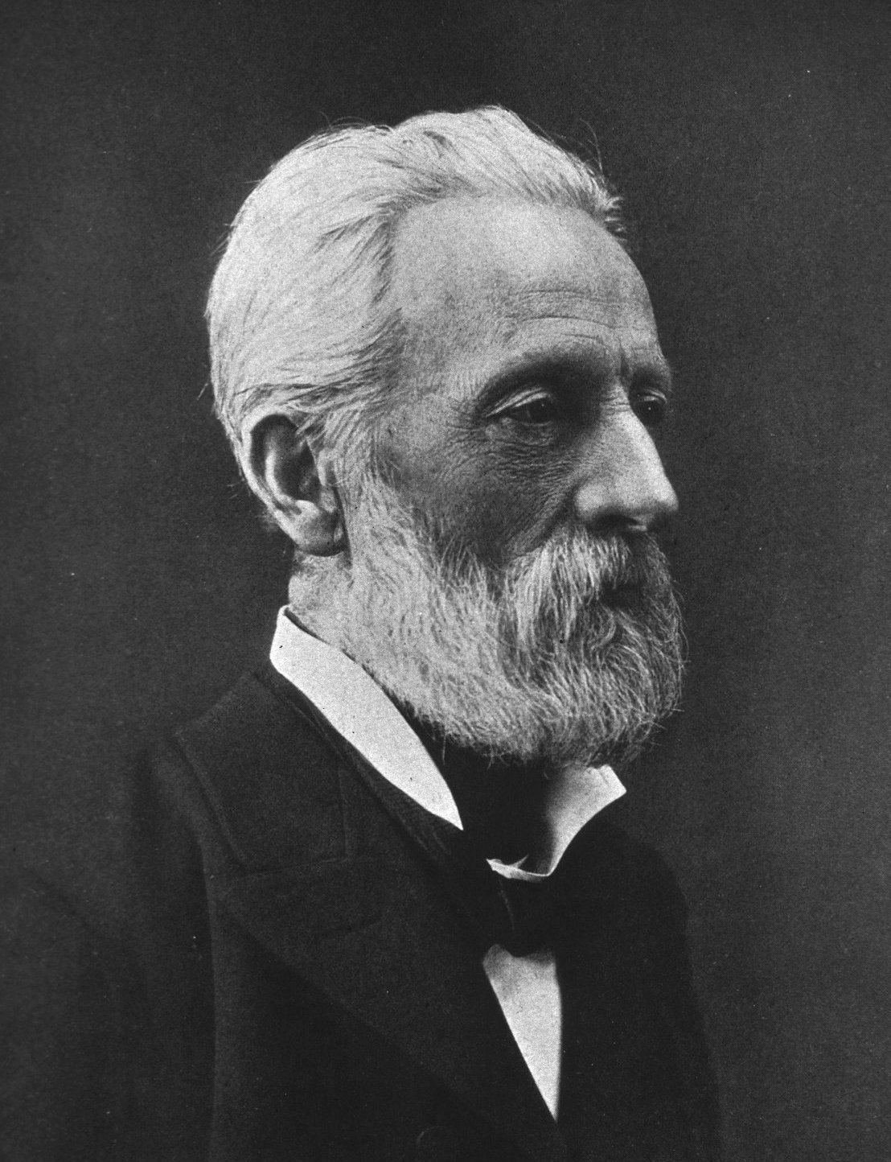
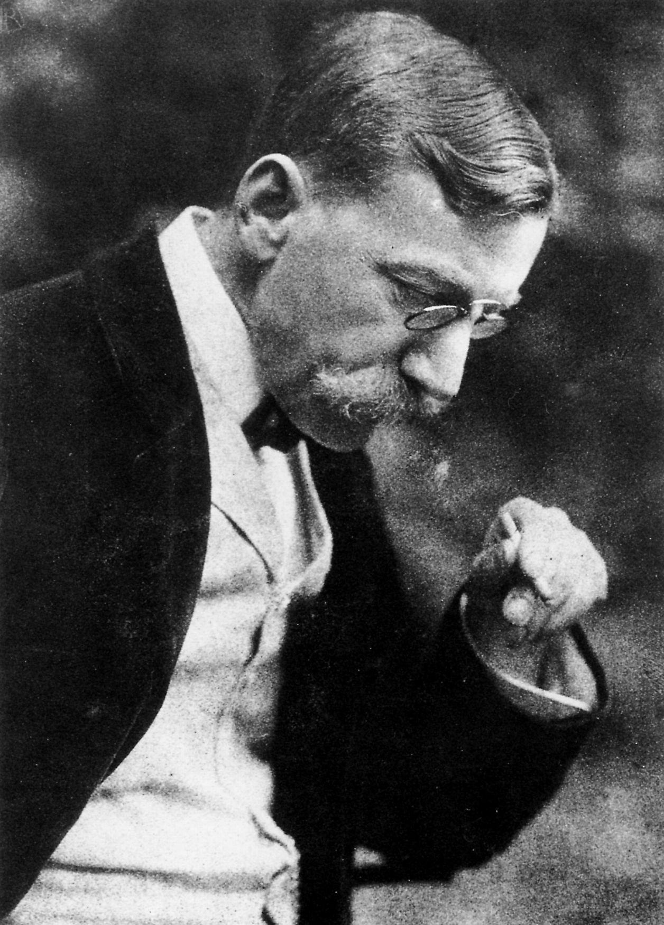
People and intangible cultural heritage: narrative tradition
“[...] now a ‘too late’ echoes back to us on all sides, as the keepers of pristine traditions are already rapidly dying out [...]“
(Adolf Bastian, 1881)
  “The all-leveling influence of our modern culture had [...] wiped out the traditional customs so rapidly that [...] old Hawaii could be considered to have disappeared forever.”
  (Eduard Arning, 1887)
“The return of powerful goddess Kihawahine could have significant impact on Lāhainā Community”
(Hawaii Public Radio, 2023)
Kiʻi Kihawahine
https://id.smb.museum/object/996611
(Ethnological Museum in the Humboldt Forum, Berlin)

Slide 25
Restitution
“[...] when I was in Berlin, it was like this:
the Africans in the room shuddered when they encountered the items [...].
You study, you perceive the outside [...]. But it‘s the inside that shakes us and that you can’t see.”
(Josephine Ebiuwa Abbe, University of Benin City)
Perspectives
  Re-spiritualization
  “Subjects” only within the context of the cultures of origin
  Restitution of cultural heritage and sharing of all information as “Linked Open Data”
  Exhibition & interpretation:
  with “digital twins” + replicas
01.09.2023

Slide 26
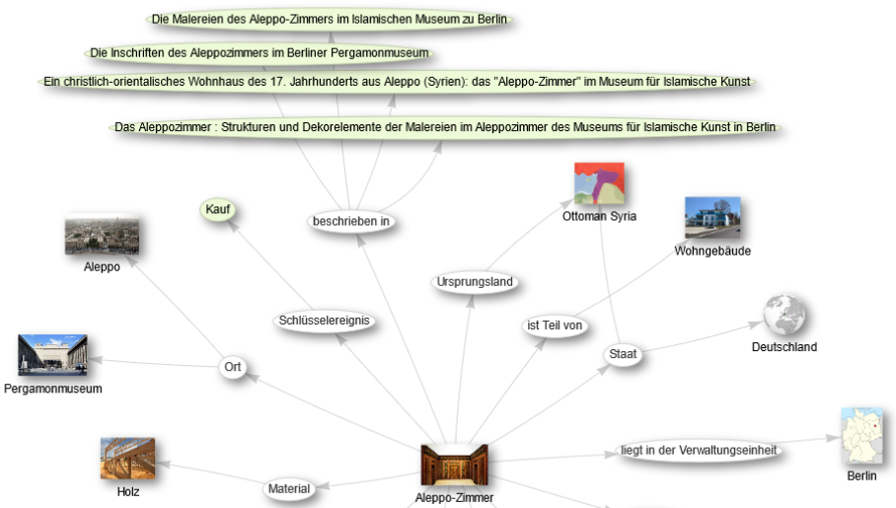
Aleppo-Room: Authors (1)

Slide 27
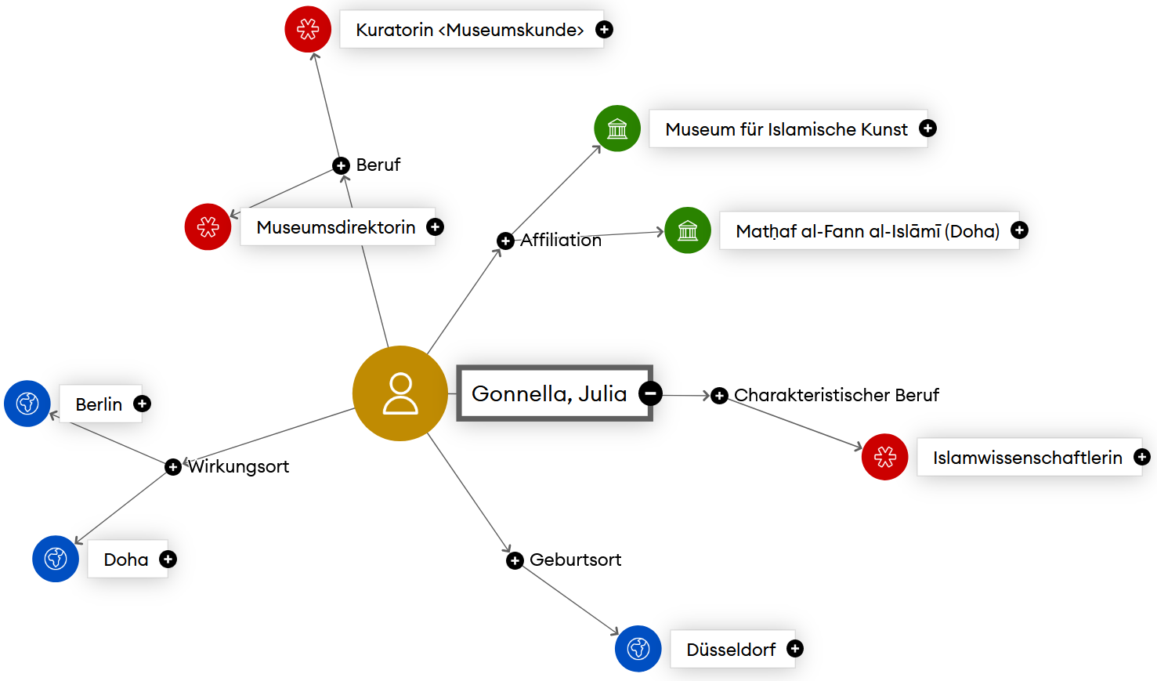
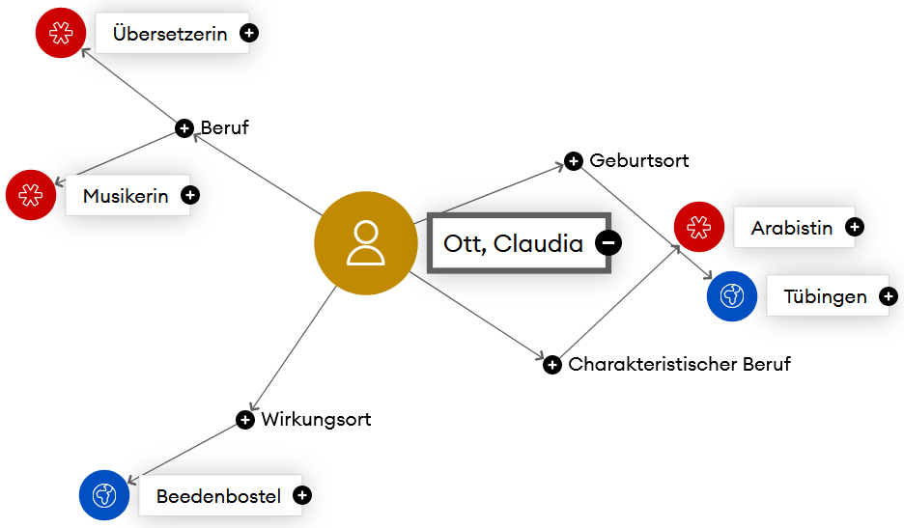
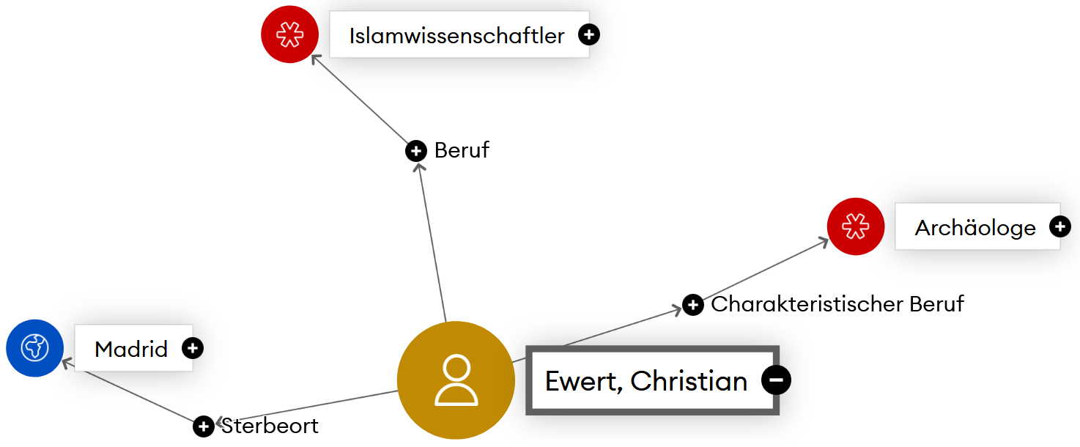
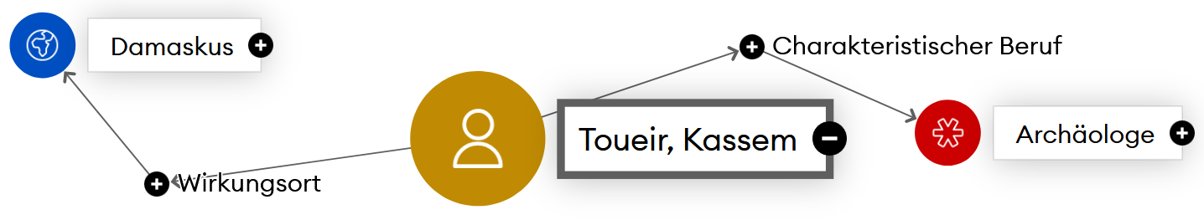
Aleppo-Room: Authors (2)

Slide 28
Conclusions …
… and a summary

Slide 29
Conclusions
Museums as memory organizations
  ≠ Originals as a means of social distinction
  ≠“Cultural capital“
  ≠ Distancing from less privileged groups
  ↳ New perspectives and opportunities for all museum tasks
Releasing museum objects from existing ownership (decolonization) → no loss
  (Re-)contextualization using digital transformation
    In-house analog and digital information collections (e.g. archives, photo archives, replicas or models)
    External sources
    Highest digitization class in each case
    Sharing as “Linked Open Data“
Focus on information + integration into globally linked information structures
  Creating staff and financial capacities
  Putting an end to unnecessary competition between museum and university scholarship

Slide 30

Summary
A museum without objects is possible and makes sense.
Pug
Ideal-typical after Bernhard-Viktor „Vicco“ Christoph-Carl von Bülow, 1923-2011
Zurich, 1993
In the work of the German humorist “Loriot” the pug motif first appeared in the 8th episode of the "Cartoon" magazine show on March 23rd, 1969, in the (fictional) short report “Pugs at the Pole”.
The pseudo-zoological figure of the wild forest pug goes back to the 19th episode of the same show on March 8, 1972. It later served as a model for various bronze sculptures that commemorate the humorist at the “Wild Forest Pug Center” in Brandenburg upon Havel.
The subject was dealt with in literature, including in “Pugs & People” (Zurich 1983). The sentence first recorded in 1993 (in “Very distinguished ladies and gentlemen: speeches and other such things”)
“Life without a pug is possible, but meaningless”
has become a popular quote.
Selected reading
"Loriot". In: Wikipedia, The Free Encyclopedia. Page Version ID: 1184582947 (11 November 2023 09:10 UTC).
„Waldmöpse“. In: Wikipedia – Die freie Enzyklopädie. Versions-ID: 228339304 (27.11.2022, 11:02 UTC).

Slide 31

Thank you.
Comments and collaboration
(MuseumsWiki)
https://0cn.de/MuseumDingeMenschen

Slide 32
Contents
”Maybe this is the end […] and the beginning of something else.” (Benedicte Savoy)
Conservative memory organization “Museum”
  Conservative memory organization “Museum”
  Wikidata: Potential for cultural heritage
  Salvation paradigm, collecting hype and overload
    An overload for the museum
    Objects in the museum documentation system (Museum of Islamic Art, Berlin)
  Overload: Green Museum?
Challenges
  Re-auratization or contextualization?
    From object space to information space
    Contextualization requires
    information system “Museum”
    “Aura of the original”?
    Information space and digital twin
  Provenance, decolonization and restitution
Persons not objects
  Demasking the museum by registering its shamans
    Felix Graf von Luckner (Q215804)
    Collection of photographs in the Museum of Islamic Art
    CIDOC-CRM: Event
  People as actors and network nodes
    Object description
    → Records of acting persons
    Change of perspective 1: Citation networks
    Change of perspective 2: Sociology of research
    Today = Research history of tomorrow
  People and intangible cultural heritage: narrative tradition
  Kiʻi Kihawahine
    Restitution
  Aleppo-Room
    Aleppo-Room: Authors (1)
    Aleppo-Room: Authors (2)
Conclusions …
  Conclusions
  Summary

Slide 33
Figure credits
https://commons.wikimedia.org/wiki/File:Emojione1_1F631.svg
https://commons.wikimedia.org/wiki/File:Emojione_1F914.svg
https://commons.wikimedia.org/wiki/File:Emojione1_1F609.svg
Emoji One, CC BY-SA 4.0 <https://creativecommons.org/licenses/by-sa/4.0>, via Wikimedia Commons
https://www.wikidata.org/wiki/Q2013#/media/File:Wikidata-logo-en.svg
„Stand der Dinge“, von Jacqueline Neuner [CC BY-SA 3.0 (https://creativecommons.org/licenses/by-sa/3.0/)]
https://commons.wikimedia.org/wiki/File:Organic_museum_and_center_in_Namyangju_City_(4444965824).jpg
Korea.net / Korean Culture and Information Service (Photographer name), CC BY-SA 2.0 <https://creativecommons.org/licenses/by-sa/2.0>, via Wikimedia Commons
https://www.transcript-verlag.de/978-3-8376-4820-1/die-aura-des-originals-im-museum/
Roman Weindl: Die »Aura« des Originals im Museum
https://commons.wikimedia.org/wiki/File:Fire_at_Museu_Nacional_05.jpg
By Felipe Milanez [CC BY-SA 4.0 (https://creativecommons.org/licenses/by-sa/4.0)], via Wikimedia Commons
https://commons.wikimedia.org/wiki/File:Luckner.png
DanielDemaret, CC BY-SA 3.0 <https://creativecommons.org/licenses/by-sa/3.0>, via Wikimedia Commons
https://commons.wikimedia.org/wiki/File:SMSSeeadlerFront.PNG
National Library of New Zealand, After Christopher Rave, Public domain, via Wikimedia Commons
https://commons.wikimedia.org/wiki/File:Auxiliary_Cruiser_Seeadler_1916-17.png
Chrischerf, CC BY-SA 3.0 <https://creativecommons.org/licenses/by-sa/3.0>, via Wikimedia Commons
„Figures and Diagrams“, CIDOC CRM, zugegriffen 30. Oktober 2023, https://cidoc-crm.org/figures, Fig. 1, 2 (Version 7.2.2)
„Kihawahine“, von Claudia Obrocki [CC BY-SA 4.0 (https://creativecommons.org/licenses/by-sa/4.0)]
https://id.smb.museum/object/996611
https://commons.wikimedia.org/wiki/File:Adolf_Bastian2.jpg, Public domain, via Wikimedia Commons
https://commons.wikimedia.org/wiki/File:Eduard_Arning_1903_001.jpg, Rudolf Dührkoop, Public domain, via Wikimedia Commons
Screenshots:
  https://wikidata.metaphacts.com/resource/wd:Q20856036
  metaphactory. „Josephine Tilden“. Zugegriffen 6. November 2023
  Citation Graph, https://citationgraph.org/graph/8f19d0fa7d74aace; GND Explorer, https://explore.gnd.network/
  https://wikidata.metaphacts.com/resource/wd:Q1010297
  metaphactory. „Burchard Brentjes“. Zugegriffen 31. Oktober 2023
  „Aleppo Room (Q1240477)“, Wikidata Query Service [CC BY-SA 4.0 (https://creativecommons.org/licenses/by-sa/4.0)], https://scholia.toolforge.org/topic/Q1240477
https://vectorportal.com/de/vector/mops-pies-rasa-wektorowa/23745
By Vectorportal.com [CC BY 4.0 (https://creativecommons.org/licenses/by/4.0)]
Alle anderen Abbildungen und Bearbeitungen: © CC BY-SA Thomas Tunsch (ThT)
Lizenz: Namensnennung - Weitergabe unter gleichen Bedingungen 4.0 International (CC BY-SA 4.0)

Slide 34
Lizenz / License
Namensnennung - Weitergabe unter gleichen Bedingungen 4.0 International (CC BY-SA 4.0)
  https://creativecommons.org/licenses/by-sa/4.0/deed.de
Diese Datei ist nicht gemeinfrei und die Verwendung über die Lizenzbedingungen hinaus ist eine Urheberrechtsverletzung.
Als Rechtenachweis ist anzugeben:
© CC BY-SA Thomas Tunsch (ThT)
Attribution-ShareAlike 4.0 International (CC BY-SA 4.0)
  https://creativecommons.org/licenses/by-sa/4.0/
This file is not in the public domain and use of this file outside of the licensing terms is a copyright violation.
Please credit authorship as follows:
© CC BY-SA Thomas Tunsch (ThT)

