Slide 1
Lexicalization of negative senses: a cross-linguistic study
10th Biennal Conference of the Association for Linguistic Typology (ALT 10)
Leipzig University/Max Plank Institute for Evolutionary Anthropology, Leipzig, Germany
Ljuba Veselinova, Stockholm University
ljuba@ling.su.se
August 16, 2013

Slide 2
Background (1)
Jespersen (1917: 12-13) presents a list of verbs which tend to merge together with their negator. This list includes verbs such as ’be’, ’want’, ’can’, ’know’, ’mind’.
(1) Some of Jespersen’s examples
a. Middle English
am nam < ne + am ’am not’ etc. the paradigm of the verb be
b. Early Modern English
will I, nill I, will ye, nill ye
nill < ne + will ’will not’
Forms such as nam and nill can be seen as lexicalizations of negation following Brinton & Traugott (2005) because they are obviously results from fusion and can be semantically decomposed into a negative element and a positive sense. They are also part of the lexicon in that they are learned by rote, rather then by rule. Their diachronic stability is a different matter.

Slide 3
Background (2)
Informal discussions of lexicalized negative senses are also found in the work of
  Payne (1985)
  Croft (1991)
  van Gelderen (2008)
  For instance, Croft (1991: 14-15) mentions non-segmentable forms to express senses such as ’not.want’ and ’not.like’ in Mam, Tagalog, Yapese, Wintu and Latin.
Lexicalization of modal senses such as ’not be able to’, ’need not’, ’must not’ is the subject of works by
  Palmer (1995)
  De Haan (1997)
  Van der Auwera (2001)
Lexicalization of ’not be’ is part of Erikssen’s (2011) work
Zeshan (2004) offers a detailed discussion of lexicalized negative senses in sign languages

Slide 4
Background (3)
  The questions triggered by the studies above are:
  are these observations cross-linguistically valid?
  are there any other senses, in other languages, that tend to merge with their negator or that tend to be expressed by unique lexemes?
  do any of these lexemes develop into markers of negation?

Slide 5
Method (1)
I look to identify predicative items in main declarative clauses that are either fused with the marker of of standard negation (SN) or are negated by some other means.
(2) English
A: Where is Snape?
B: Dunno < [I don’t know]

Slide 6
Method (2)
(3) Nganasan (Uralic, Samoyed)
Standard negation: auxiliary n’i-
a. kiriba nʼi -sɨə -mə nʼakələ -Ɂ
bread NEG-PST-1SG.O take-CNEG
tʼaj nʼakələ -sɨə -m
tea take-PST-1SG.S
’I did not buy bread but did buy tea’
(Laakso et al. 2001)

Slide 7
Method (3)
(3) Nganasan (Uralic, Samoyed)
Negation of the verb čenɨd’i ‘know’ is done by d’erusa ‘not.know’
b. sɨlɨ maa čenɨ-biʔ tərəďi
who what know-GER such.ACC
mɨŋkəľčənə ďeru-suə-mə
even.I not.know-PST-1SG.O
(Wagner-Nagy 2011: 129-131)

Slide 8
Method (4)
My starting point has been the lists of lexemes found in Jespersen and the other works cited above.
However, I have taken in any additional meanings offered in the materials I consulted

Slide 9
The data
A variety sample of 105 languages from around the globe
Family-based samples where three families were studied in depth
  Slavonic
  Polynesian
  Uralic

Slide 10
General results (1)
There are 191 lexemes in my database. They express 62 senses which are semantically analyzed as ’not Y’.
Most of these senses occur in 1 language only
Only a handful of them recur in many different languages

Slide 11
General results (2)
Quantitative distribution of negative lexicalization in the variety sample=105 languages
Example | Sense | Nr of langs
Turkish yok | not.exist | 71
Lezgian tuš | not.be of identity | 38
Ecuadorian Siona wehsë | not.know | 27
Ojibwe gwiinawi- | cannot, be unable | 18
Kwaza heɁai | not.want | 17
Anejom̃ emrin | not.talk | 8
Tetun lalika | not.need | 4
Nganasan məčid’i | not.enough | 3
Mele Fila mustakina | not.like | 3
Nunggubuyu =ariba | not.see | 3

Slide 12
General results (3)
Each of the identified lexicalizations was described in terms of
  Its cross-linguistic distribution
  Semantics
  Use
    specifically whether it has to be used for the negation of the supposed corresponding positive sense
    if it is used as a negator in other domains
  Form, in particular whether the lexeme in question is an idenfiable fusion between a negator and another word or not.

Slide 13
General results (2)
Quantitative distribution of negative lexicalization in the variety sample=105 languages
Example | Sense | Nr of langs
Turkish yok | not.exist | 71
Lezgian tuš | not.be of identity | 38
Ecuadorian Siona wehsë | not.know | 27
Ojibwe gwiinawi- | cannot, be unable | 18
Kwaza heɁai | not.want | 17
Anejom̃ emrin | not.talk | 8
Tetun lalika | not.need | 4
Nganasan məčid’i | not.enough | 3
Mele Fila mustakina | not.like | 3
Nunggubuyu =ariba | not.see | 3

Slide 14
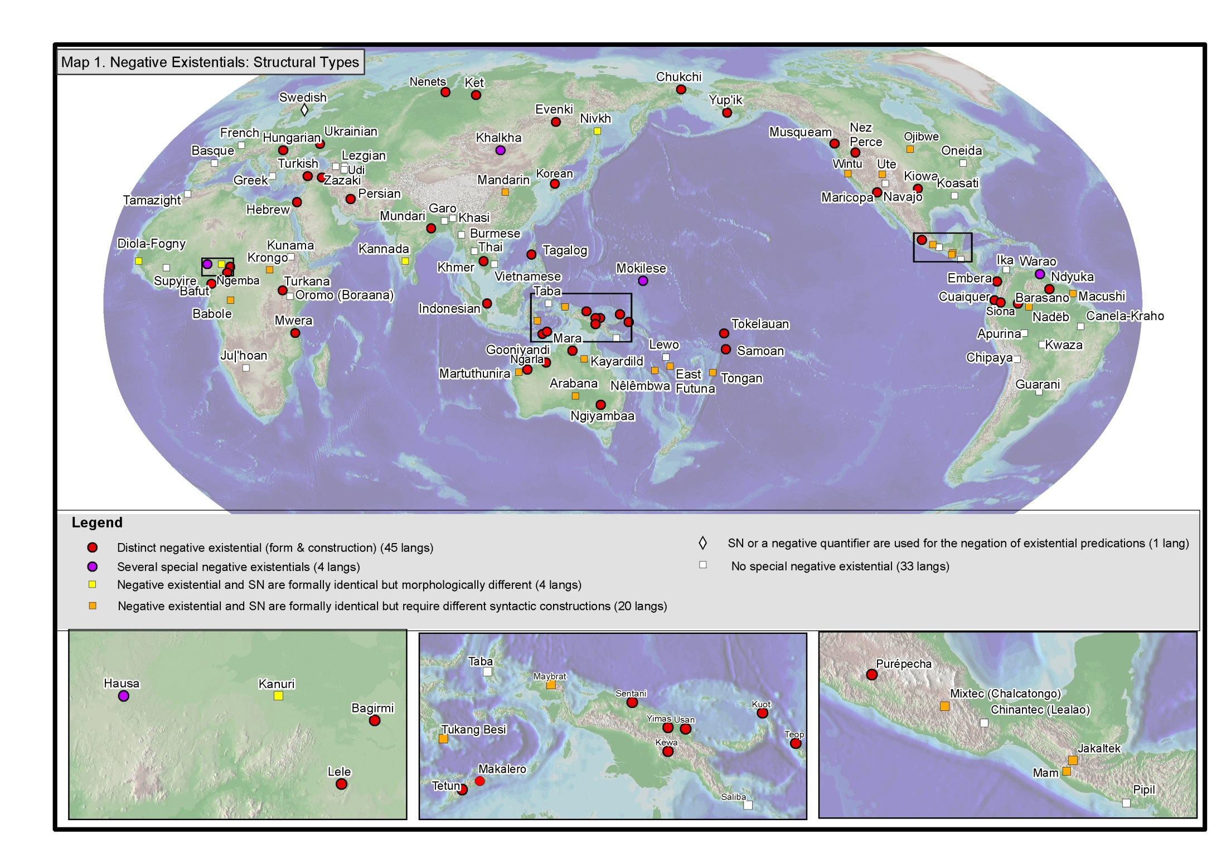
Cf. Veselinova Forthcoming

Slide 15
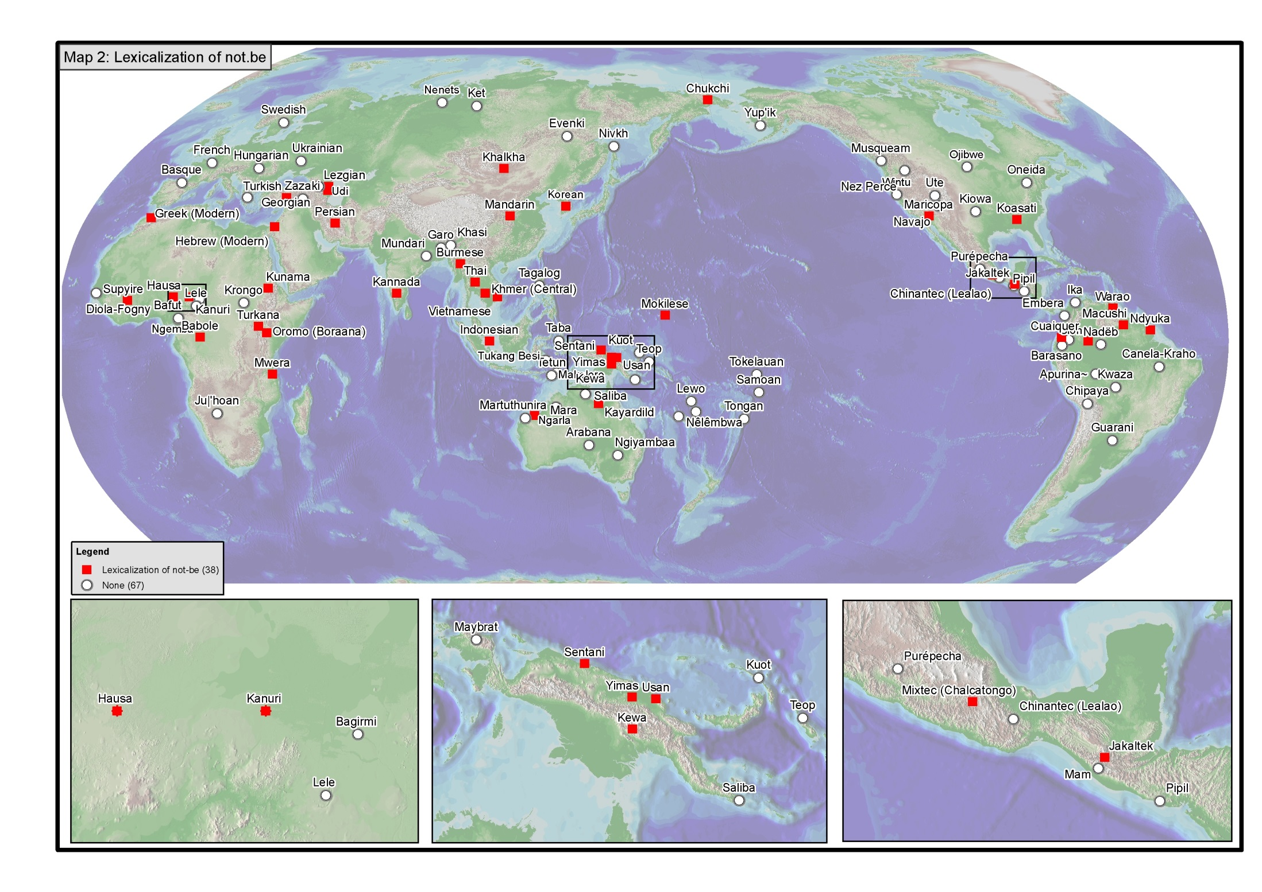
Cf. also Eriksen 2011

Slide 16
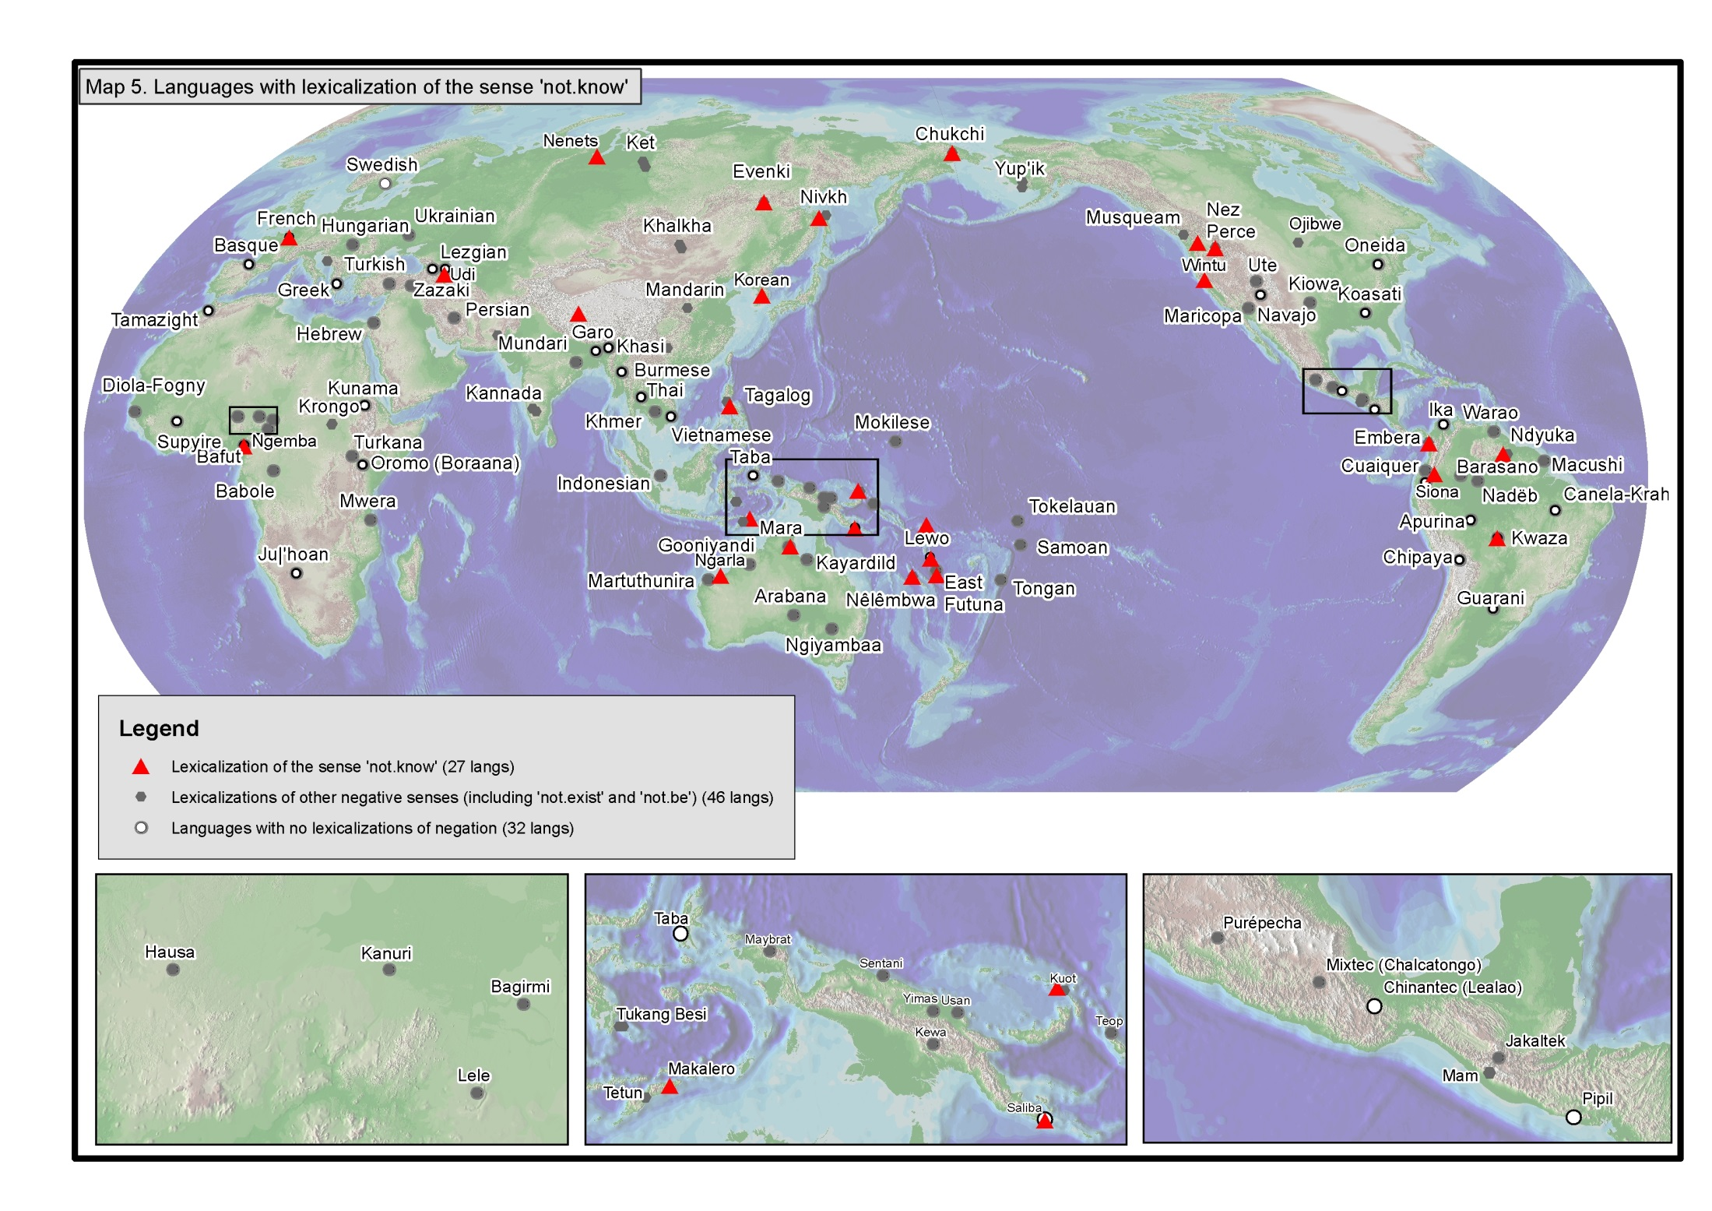

Slide 17
Semantics of ’not.know’ verbs (1)
’lack of information/awareness’, ’not recognize, not feel X’
’not able’
Distinction between ’not.know’ and ’I don’t know’
More lexemes in the negative than in the positive. The semantic distinctions between the negative lexemes are not always clear

Slide 18
Semantics of ’not.know’ verbs (2)
’lack of information/awareness’, ’not recognize, not feel X’
(4) Tundra Nenets (Uralic, Samoyed)
a. Ťuku sʲer-mʔ jexera-waʔ
this thing-ACC not.know-1PL
‘We do not know this matter.’
b. pʲinwa-xad jexera-sʲeti
fear-EL not.know-HAB.3SG
‘(S)he does not know fear.’
(Wagner-Nagy 2011: 129-131)

Slide 19
Semantics of ’not.know’ verbs
’not able’, ’not aware’
(5) Vaeakau-Taumako (Austronesian, [...] Polynesian, Outlier, Futunic)
a. Kholua e vale kholu-na ki-na la
2DU GENR not.know 2DU-IRR eat-TR DEM:3
'You cannot eat this' (Åshild Næss, p.c.)
b. Iau ko vale~vale-a po lhatu=ne kave ala
1SG INCP RED~not.know-TR COMP 3PL=PFV bring HYP
ki hea
to where
‘I don’t know where they took him.’

Slide 20
Semantics of ’not.know’ verbs (2)
Distinction between ’not.know’ and ’I don’t know’
(6) Tundra Nenets (Uralic, Samoyed)
a. ńisʲa-r merʔ tuu-ta –jekarʔ
brother-2SGPX soon come-IPF.3SG not.know
‘Is your brother coming soon? ‘I don’t know.’
b. jekarʔ, xibʲa tonda-mt sedaŋgop-ta
not.know who parka-ACC.2SGPX sew-3SG.O
‘I don’t know who is sewing your parka.’
(Wagner-Nagy 2011: 129-131)

Slide 21
Semantics of ’not.know’ verbs
Distinct forms for ’not.know’ vs. ’I don’t know’ are also observed in Chukcki, French, Evenki and Lewo
There are also languages such as Ngemba and Udi where the lexicalized form is restricted to 1SG

Slide 22
Semantics of ’not.know’ verbs
More lexemes/distinctions in the negative than in the affirmative
(7) Tundra Nenets
jexeras^{j} ‘not.know’
jarmjes^{j} ‘not.know’
jekarɁ ’I don’t know’
vs.
ténewas^{j} ‘know’

Slide 23
Use of ’not.know’ verbs as negators
Most ’not.know’ verbs are described as the only possible negators for the positive content ’know’ in their languages.
However, the situation appears to be more complex than that
(8) Vaeakau-Taumako
  vale ’not.know’ is said to be the default negator of iloa ’know’ (Næss and Hovdhaugen 2011: 402)
Lhatou siai ne ilo po ni ā ne hai
3PL NEG PFV know COMP PL.NSP what PFV do
‘They did not know what had happened.’ (ibid: 406)

Slide 24
(9) Vaeakau-Taumako (Austronesian, [...] Polynesian, Outlier, Futunic)
a. Kholua e vale kholu-na ki-na la
2DU GENR not.know 2DU-IRR eat-TR DEM:3
'You cannot eat this' (Åshild Næss, p.c.)
b. Iau ko vale~vale-a po lhatu=ne kave ala
1SG INCP RED~not.know-TR COMP 3PL=PFV bring HYP
ki hea
to where
‘I don’t know where they took him.’

Slide 25
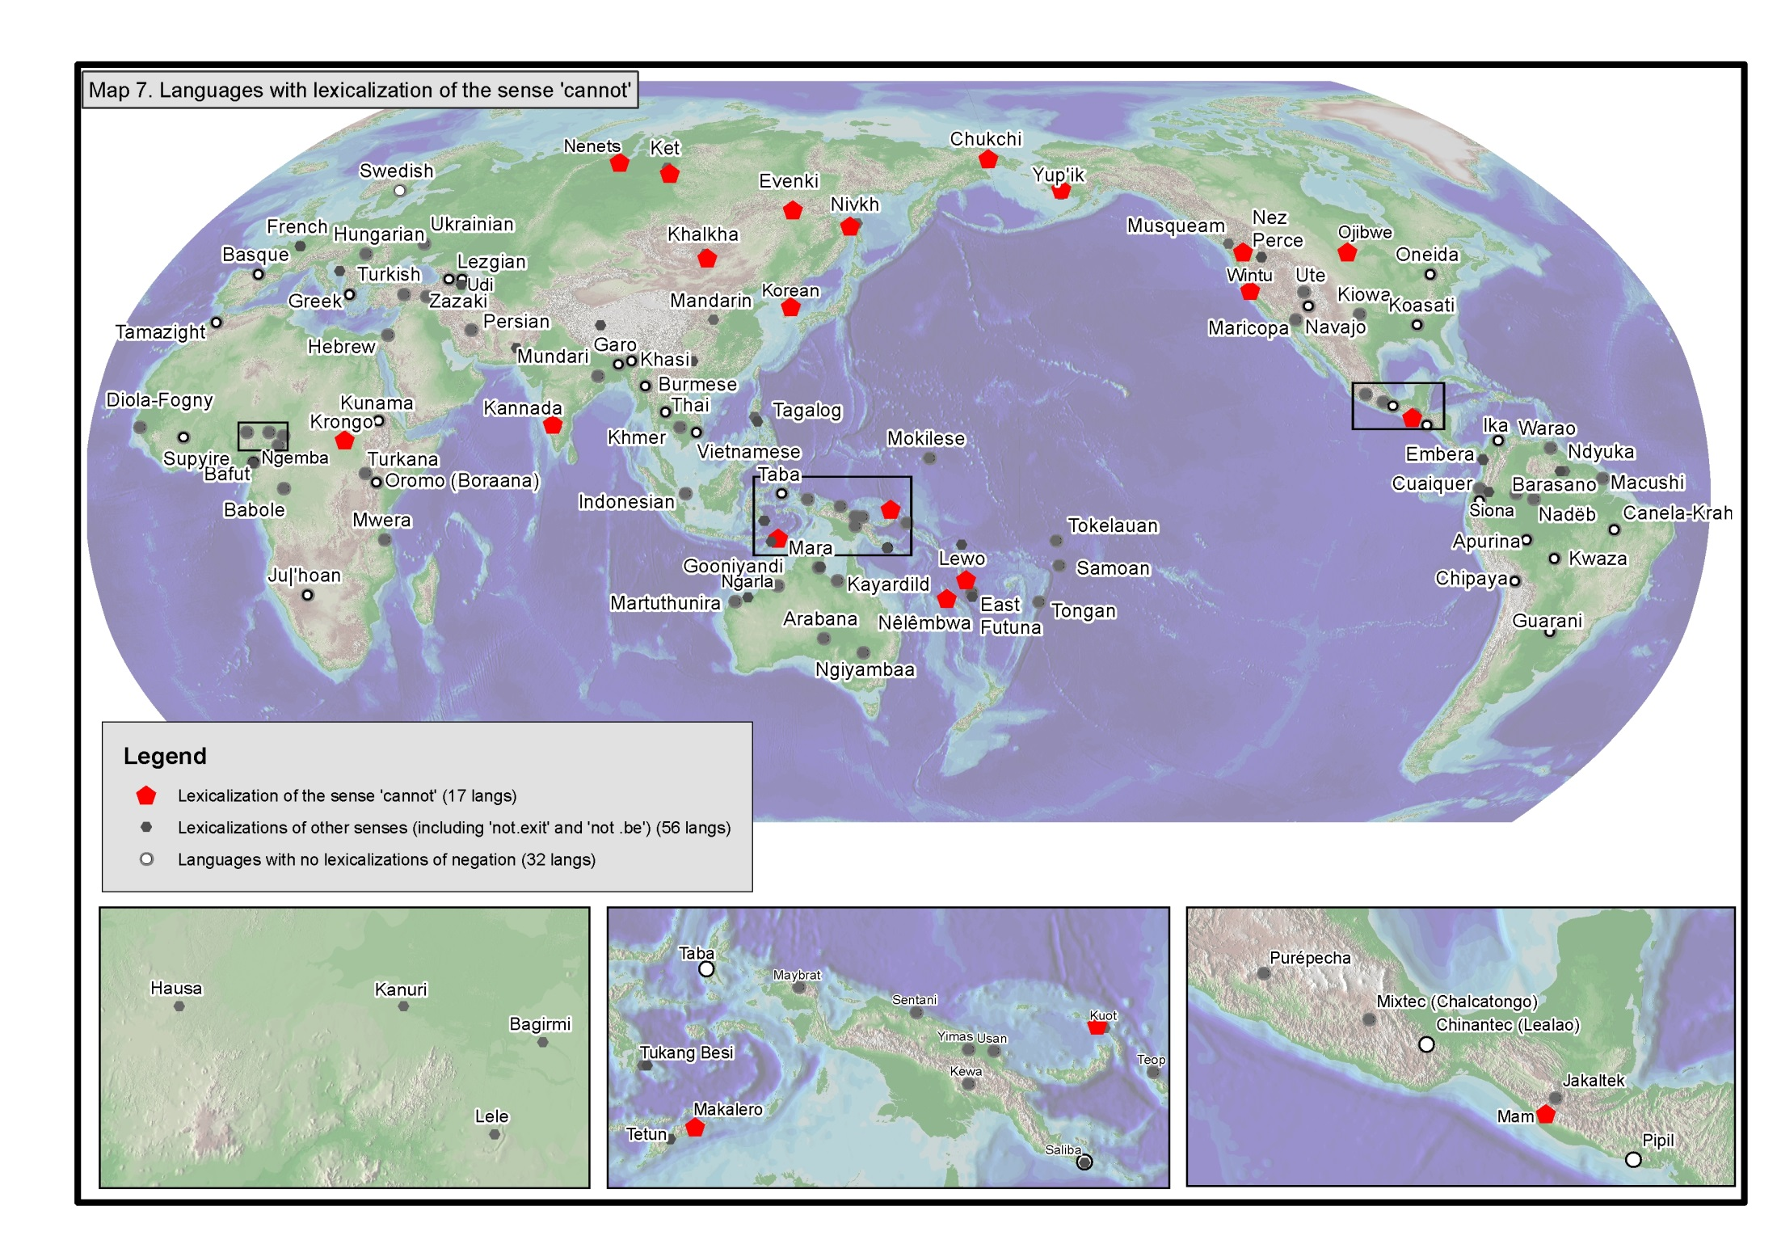

Slide 26
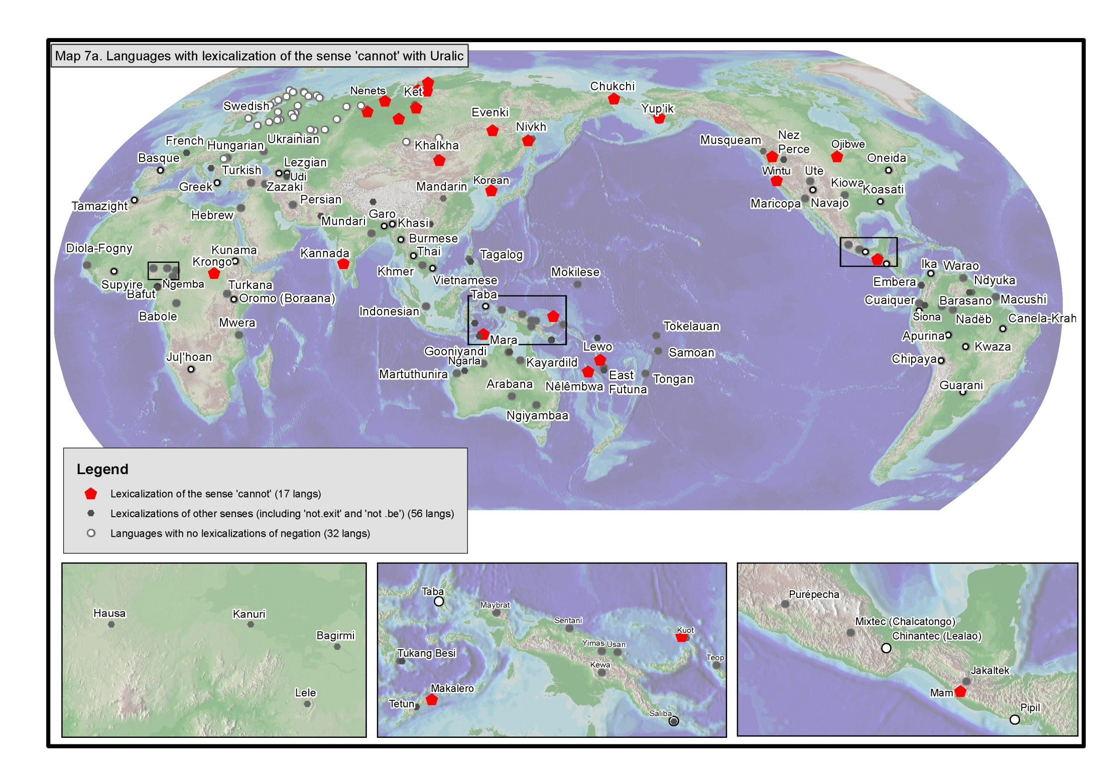

Slide 27
Semantics of ’cannot’ verbs (1)
’inability’
’impossibility’
’not.allowed, not.permitted’

Slide 28
Semantics of ’cannot’ verbs
(10) Lewo (Austronesian, Malayo-Polynesian [...] Oceanic, Central-Eastern [...] Vanuatu, Northeast Vanuatu Banks Islands)
Abilitive constuction with killa ’can’
a. To-m-ninuwe-ga po-na Ø-p̃isl na
1pis-r-not.know-just or-emph 3sS-finish emph
Ø-killa a-kla-ruru si-na
3sS-can 3pS-do-well again-emph
‘and we don’t know whether after this/later they will be able to fix it up again’, (Early 1994: 384)

Slide 29
Semantics of ’cannot’ verbs
Inabilitive construction with tete ‘unable’
b. Ø-tap̃a-tete o-were-lua-nu ne-va e
3sS-make-unable 2sS-pull-out-1sO 1sS-1.go
e yo-mema
loc place-dry
‘it’s not possible/there is no way/you can’t drag me out to the dry land’

Slide 30
Semantics of ’cannot’ verbs
’inability’ vs. ’not. allowed’
(11) Makalero (Trans-New Guinea West, Timor-Alor-Pantar) (Huber 2011: 423, 446)
a. Ani [uere’ me’e] -mi-kerek.
1s 2DEM.V able-along:RED-write
‘I could write that along.’
b. Fi [ueir e’ ere nopa’e] -seti-la’a.
1pi river V1DEM cannot-pass-move
‘We cannot cross the river here.’
c. Ei urau rei-la’a.
2s not.allowed outwards-move
‘You don’t go out! / You are not allowed to go out.’

Slide 31
’cannot’ verbs as negators
In 10 languages, the verbs translated as cannot are said to be the sole means for the negation of positive expressions for ability/possibility
In 5 languages (Chukchi, Evenki, Kannada, Northern Khanty, Ojibwe) the word ’unable’ does not seem to have a corresponding lexicalized affirmative
In 4 languages (Khalkha, Makalero, Nêlêmbwa and Ngemba) the lexicalized cannot is not obligatory for the negation of ability or possibility.

Slide 32
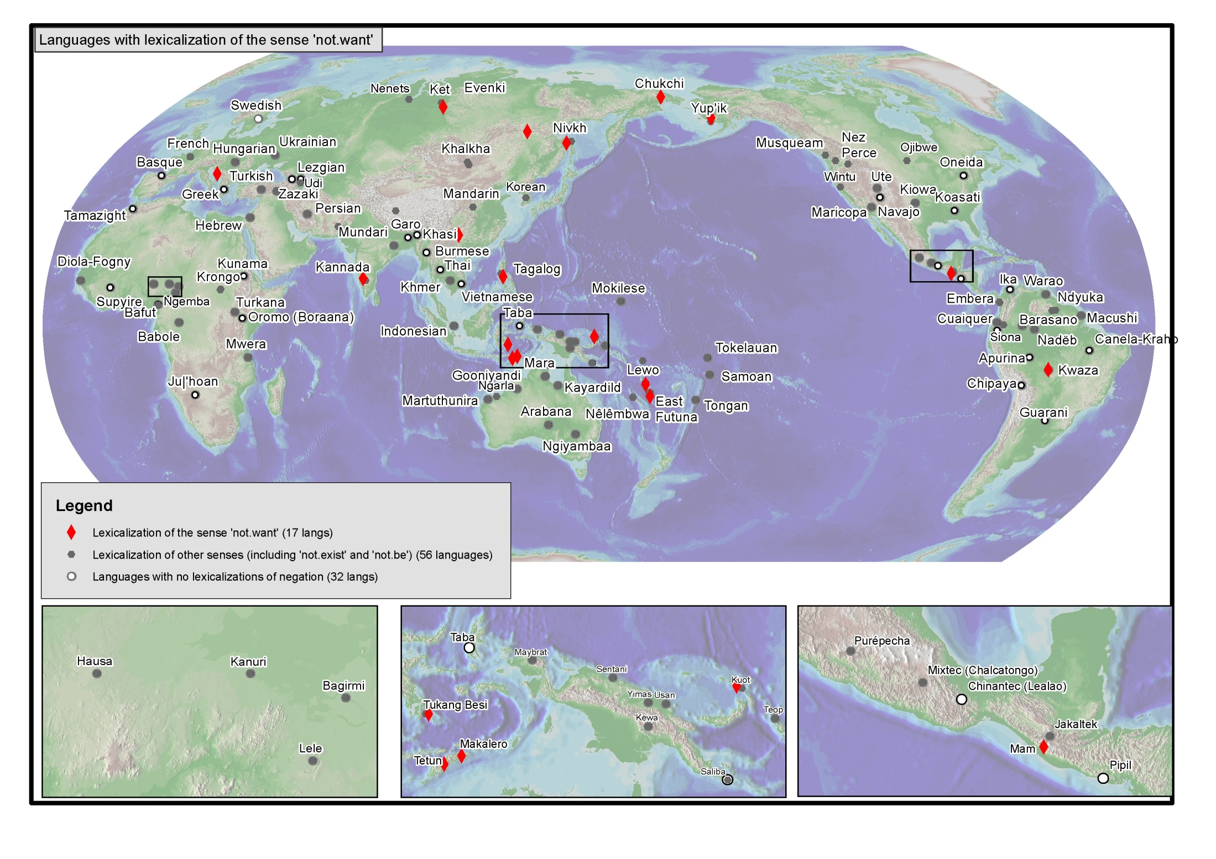

Slide 33
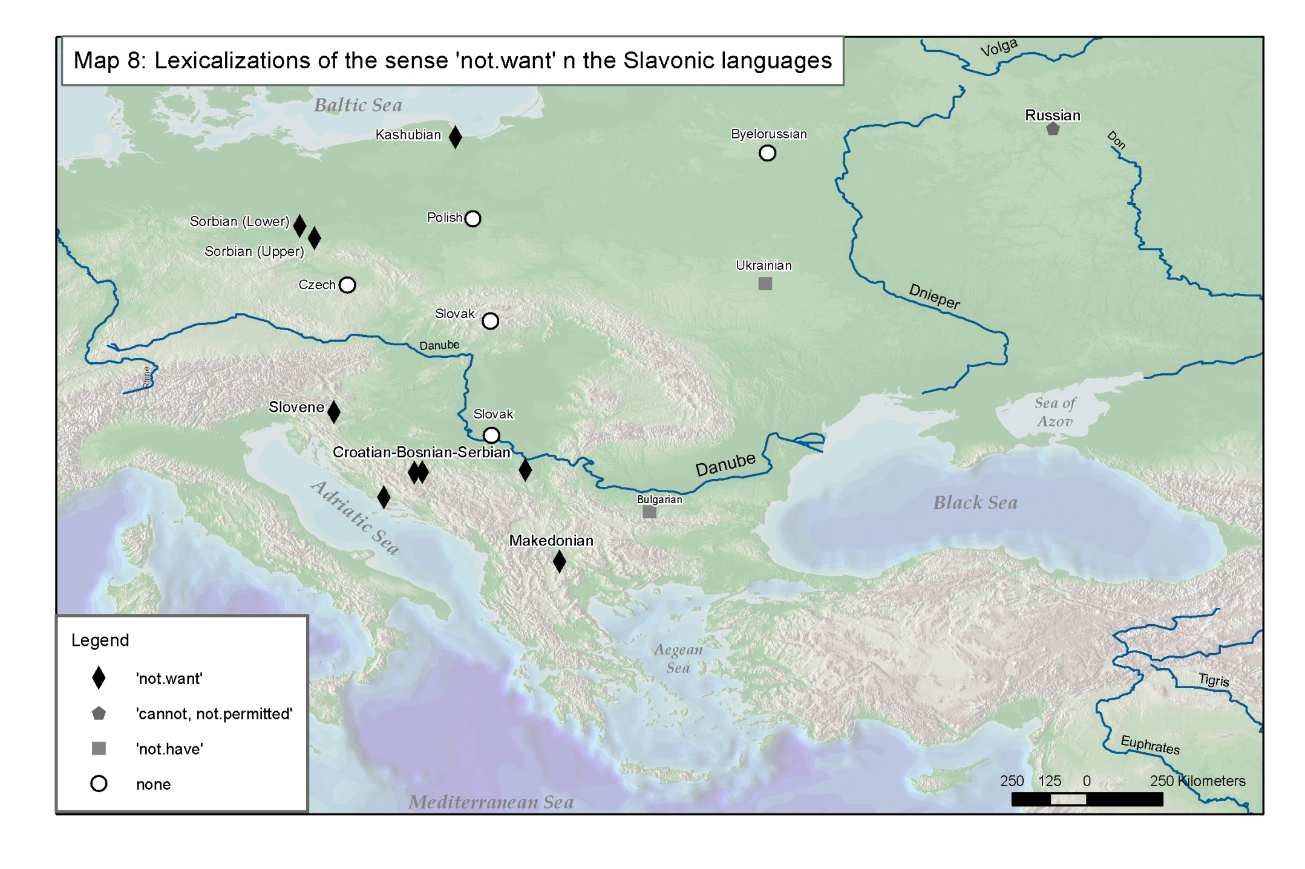

Slide 34
Semantics of ’not.want’ verbs
Least polysemic among the verbs under study here (cf. also Goddard 2001/NSM claim on ’not.want’ being a semantic prime)
(12) Serbian (Indo-European, South Slavic)
a. to je hladno ali hoču
it is cool but want.1SG.PRS
da jedem sladoled
to eat.1SG.PRS ice-cream
’It is cool but I feel like/want to have an ice-cream’
b. to je hladno, neču
it is cool, not.want.1sg.PRS
da jedem sladoled
to eat.1SG.PRS ice-cream
’It is cool, I don’t want any ice-cream’

Slide 35
’not.want’ verbs as negators (1)
’not.want’ verbs are obligatory for the negation of the sense ’want’ in 8 languages
’not.want’ verbs are listed as alternatives for the negation of the sense ’want’ in 9 languages. In some cases, there is a specification that the lexicalized forms belong to the spoken register.

Slide 36
’not.want’ verbs as negators (2)
In Serbian/Bosnian/Croatian, the lexicalized forms of ’not.want’ are used as standard negators in predications with future time reference
(13) Serbian
a. Maria će pevati
Maria FUT sing.INF
‘Maria will sing’
b. Maria neće pevati
Maria NEG.FUT sing.INF
‘Maria will not sing’

Slide 37
Lexicalized negative verbs: fusions with a negator or unsegmentable morphemes
The proportions are calculated based on the number of attested forms
 | Nr of forms | Fusion with SN/other negation marker | Unsegmentable morpheme
not.know | 41 | 5 (13%) | 36 (87%)
cannot | 29 | 5 (17%) | 24 (83%)
not.want | 25 | 7 (28%) | 18 (72%)

Slide 38
Semantic Domains of negative lexicalizations
Cognition
Emotional
attitude
Evaluative judgment
Non-
utterance
’not.know’
’not.understand
’not.want’
’not.like’
’not.right’
’not.enough’
’not.talk’
’not.inform’
Possession
Existence
Not-be
Modals
Tense-
Aspect
’not.have’
’not.exist’
’not.be’
’cannot’
’need.not’
’must.not’
’did.not’
’not.finished’
’not.yet’
Zeshan (2004)

Slide 39
Conclutions
The lexicalization of negative senses is not random but is rather organized around a limited number of cognitively salient categories (cf. Zeshan 2004)
An (weak) implicational universal can be postulated,
Not.exist > Not.know > not.speak
Not.be cannot not.like
not. want

Slide 40
References (1)
Brinton, Laurel J., and Traugott, Elizabeth Closs. 2005. Lexicalization and Language Change. Cambridge: Cambridge University Press.
Clark, Ross. 2002. Ifira-Mele. In The Oceanic Languages, eds. John Lynch, Malcolm Ross and Terry Crowley, 681-693. Richmond, Surrey: Curzon.
Croft, William. 1991. The Evolution of Negation. Journal of Linguistics 27:1-39.
de Haan, Ferdinand. 1997. The Interaction of Negation and Modality: A Typological Study: Outstanding Dissertations in Linguistics Series: Garland Publishers.
Early, Robert. 1994. A Grammar of Lewo, Vanuatu, Australian National University: Ph.D.
Eriksen, Pål Kristian. 2011. 'To Not Be' or not 'to not be': The typology of negation of non-verbal predicates. Studies in Language 35:275-310.
Evans, Nicholas D. 2010. Semantic Typology. In The Oxford Handbook of Linguistic Typology, ed. Jae-Jung Song, 504-533. Oxford: Oxford University Press.
Goddard, Cliff. 2001. Lexico-semantic universals: A critical overview. Linguistic Typology 5:1-65.
Huber, Juliette. 2011. A Grammar of Makalero, A Papuan language from East Timor. Utrecht: LOT.
Jacobson, Steven A., and Jacobson, Anna W. 1995. A Practical Grammar of the Central Alaskan Yup'ik Eskimo Language. Fairbanks: Alaska Native Language Center and Program, University of Alaska Fairbanks.

Slide 41
References (2)
Jespersen, Otto. 1917. Negation in English and other languages. København: Hovedkommissionær: Andr, Fred, Høst & Søn, KGL. Hof-boghandel, Bianco Lunos Bogtrykkeri.
Koch, Peter. 2001. Lexical typology. In Language Typology and Language Universals, eds. Martin Haspelmath, Ekkehard König, Wulf Oesterreicher and Wolfgang Raible, 1142-1179. Berlin/New York: Walter de Gruyter.
Koptjevskaja-Tamm, Maria. 2008. Approaching lexical typology. In From Polysemy to Semantic Change, ed. Martine Vanhove, 3-52. Amsterdam/Philadelphia: John Benjamins Publishing Company.
Moreno-Cabrera, Juan C. 1998. On the relationships between grammaticalization and lexicalization. In The Limits of Grammaticalization, eds. Anna Giacalone Ramat and Paul Hopper, 211-227. Amsterdam: John Benjamins.
Næss, Åshild, and Hovdhaugen, Even. 2011. A grammar of Vaeakau-Taumako: Mouton Grammar Library. Berlin: Mouton de Gruyter
Palmer, F. R. 1995. Negation and the Modals of Possibility and Necessity. In Modality in Grammar and Discourse, eds. J. Bybee and S. Fleischman, 453-471. Amsterdam: John Benjamins Publishing Company.
Payne, John R. 1985. Negation. In Language Typology and Syntactic Description, vol I: Clause Structure, ed. Timothy Shopen, 197-242. Cambridge: Cambridge University Press.

Slide 42
References (2)
Wagner-Nagy, Beáta. 2011. On the typology of negation in Ob-Ugric and Samoyedic Languages. Helsinki: Suomalais-Ugrilainen Seura -- Société Finno-Ougrienne -- Finno-Ugrian Society.
van der Auwera, Johan. 2001. On the typology of negative modals. In Perspectives on Negation and Polarity Items, eds. Jack Hoeksema, Hotze Rullmann, Victor Sanchez-Valencia and Ton van der Wouden, 23-48. Amsterdam: John Benjamins Publishing Company.
van Gelderen, Elly. 2008. Negative Cycles. Linguistic Typology 12:195-243.
Zeshan, Ulrike. 2004. Hand,head,and face: Negative constructions in sign languages. Linguistic Typology 8:1-58.

