Slide 1



What is Research Software?
And why is it critical to the research endeavour?
Professor Carole Goble CBE FREng FBCS
Software Sustainability Institute UK
ELIXIR, ELIXIR-UK Head of Node
The University of Manchester, UK
carole.goble@manchester.ac.uk
2nd International Funders Workshop:
The Future of Research Software 18-20 Sept 2023
Montreal, Canada (hybrid)

Slide 2
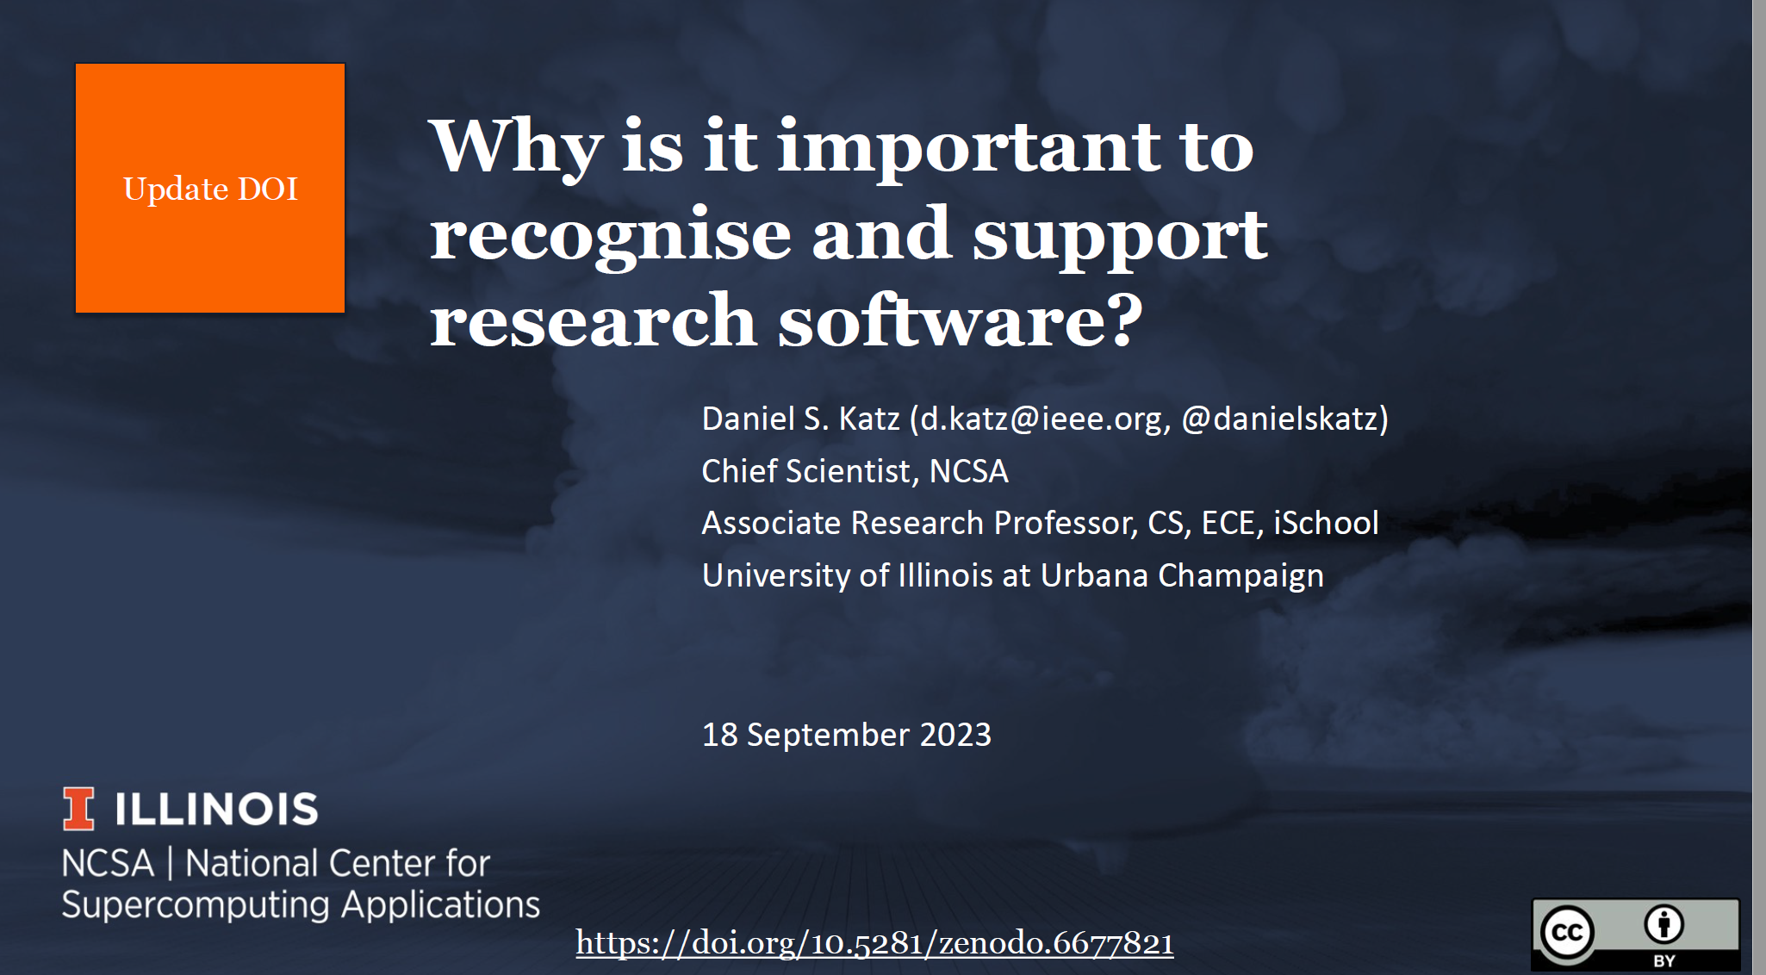

Acknowledgement: Dan Katz
Dan Katz
https://doi.org/10.5281/zenodo.6677821

Slide 3

Software is critical to every step of the research endeavour just like it is critical to every other endeavour in our lives.
https://research.com/research/definition-of-academic-research
Notes:
• Intended to advance knowledge
• Often collaborative
• Can be exploratory
• Can be hypothesis-driven
• Has inputs
• Has outputs
• Research software can be part of all above points in an increasing number of cases

Slide 4
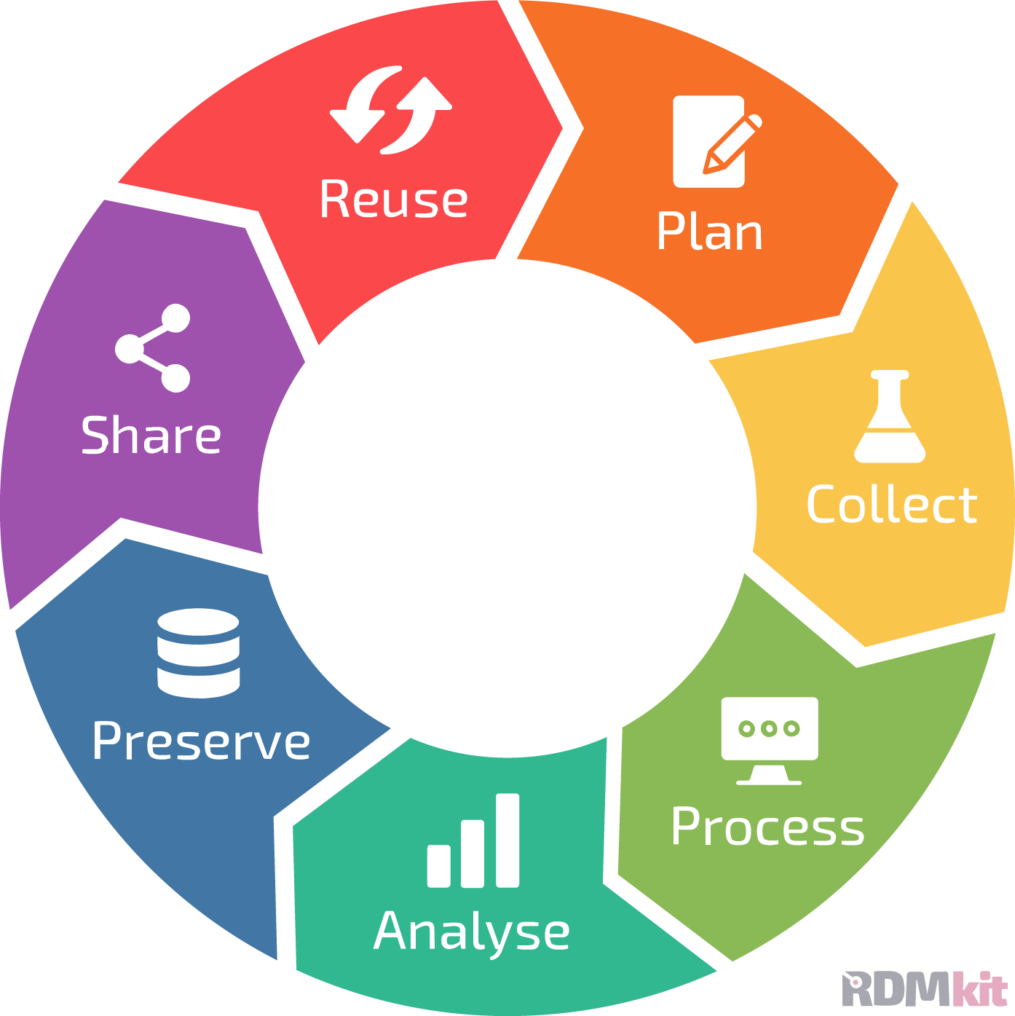

Software is critical to every step of the research endeavour
often
  team science
  data driven
  hypothesis driven
  exploratory
  pooled curated knowledge
Notes:
• Intended to advance knowledge
• Often collaborative
• Can be exploratory
• Can be hypothesis-driven
• Has inputs
• Has outputs
• Research software can be part of all above points in an increasing number of cases

Slide 5
The research community relies on software
>90%
say scientific software is important for their own research
~65%
say they would not be able to do their research without software
~50%
say they develop software as part of their research
S. Hettrick; https://www.software.ac.uk/blog/2016-09-12-its-impossibleconduct-research-without-software-say-7-out-10-uk-researchers
S.J. Hettrick, et al,; 10.5281/zenodo.14809
U. Nangia and D. S. Katz; 10.6084/m9.figshare.5328442.v1
J.E. Hannay et al., “How Do Scientists Develop and Use Scientific Software?” Proc. ICSE Workshop Software Eng. for Computational Science and Eng., 2009, pp. 1–8.
Notes:
Survey of researchers from 15 UK Russell Group universities conducted by SSI between August - October 2014.
406 respondents covering representative range of funders, discipline and seniority.
KEY POINT: The UK research community relies on specialist software
In the last four years, we have investigated and understood the challenges of the UK research community.
What is clear is that all of these different groups rely on software to do their research, with 69% of researchers from the research-intensive Russell Group saying it would be impossible to conduct their research without specialist software. This is more than just a reliance on Word or web browsers – specialist software is written into the research workflows of people from psychology to physics, from the life sciences to literature. The reliance isn’t confined to the “traditionally” computationally intensive subjects, it’s a feature of all disciplines.

Slide 6



Software is crucial to the Research Endeavour
Publishing
Funding
~20% of NSF projects over 11 years discuss software in abstracts ($10b)
2/3 main DOE ECP areas are research software (~$4b)
$300m of FY2021 NIH projects include “software development”
£840m UK Investment in 2013-2014
Software intensive projects are a majority of current publications
Most-cited papers are methods and software
65% of UK university preprints paper reference software (2017)
PLoS 40-50% articles generate code
Nangia and Katz; 10.1109/eScience.2017.78
“Top 100-cited papers of all time,” Nature, 2014
10.1038/514550a, PLoS: https://doi.org/10.6084/m9.figshare.21687686.v3
Collected from http://www.dia2.org in 2017
Collected from https://reporter.nih.gov in 2022
SSI Analysis of data from 49,650 grant titles and abstracts published on Gateway to Research covering 2010-2014
Notes:
30% Of total research investment has been spent on research which relies on software over the last four financial years
Lauren Cadwallader PLoS

Slide 7
What is Research Software? An intent perspective
Gruenpeter et al., “Defining Research Software: a controversial discussion,” 2021 https://doi.org/10.5281/zenodo.5504016
Research Software
created during the research process or for a research purpose
source code files, algorithms, scripts, computational workflows and executables, applications, tools, packages, modules etc.
Software in Research
used for research but not created during or with research intent
software components including operating systems, libraries, utilities, dependencies, packages, scripts, frameworks etc.
Warning: Differentiation may vary between disciplines

Slide 8








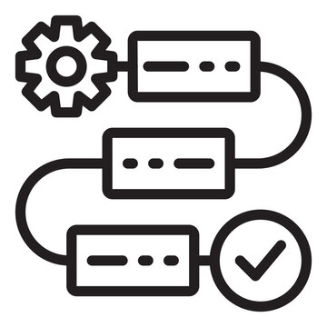



What is Research Software? A role perspective
Rob van Nieuwpoort and Dan Katz, “Defining the roles of research software,” https://doi.org/10.54900/9akm9y5-5ject5y from 1st Funders Workshop, 2022
a component of instruments
including pipelines
is the instrument
including curation
analyses research data
presents research results
Roles of research software
assembles or integrates existing components into a working whole
infrastructure or an underlying tool
facilitates distinctively research-oriented collaboration
including knowledge resources
Notes:
microscopes
Datascopes
Once piece of software can take on many and all these roles

Slide 9
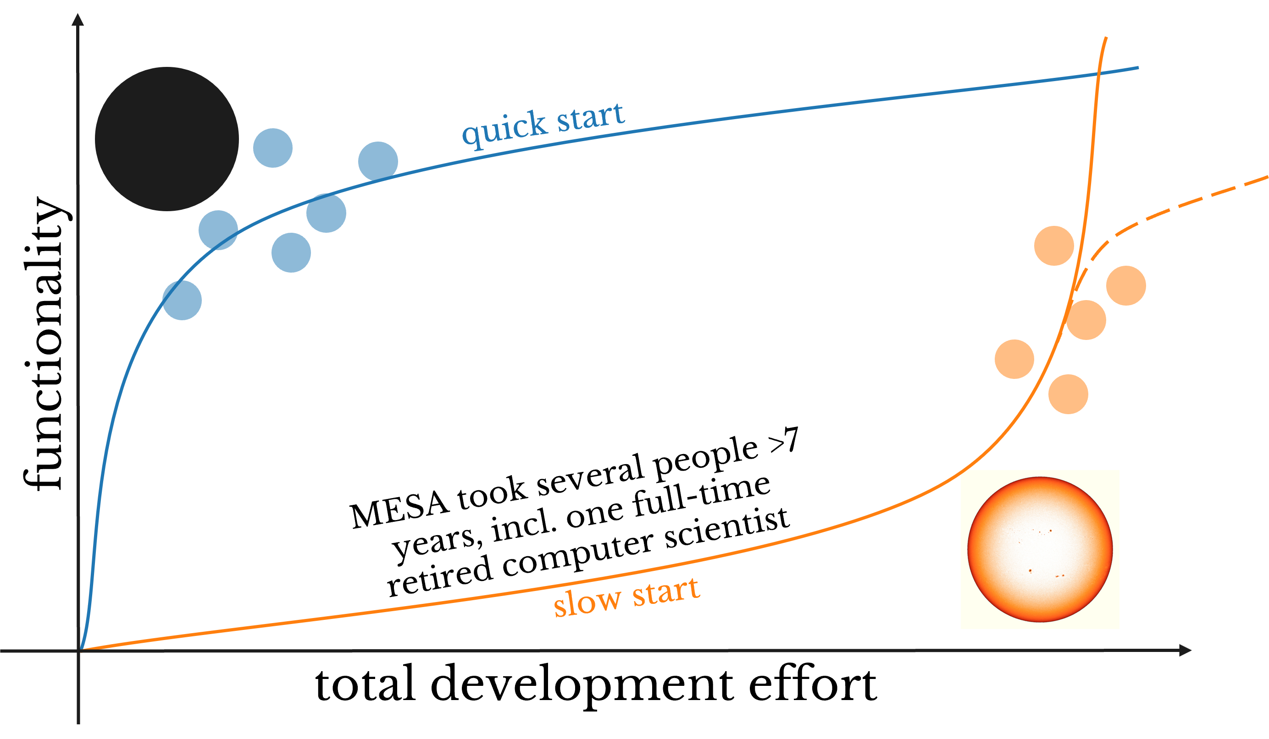
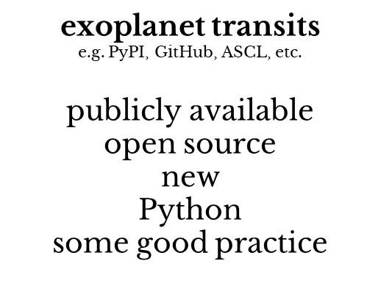
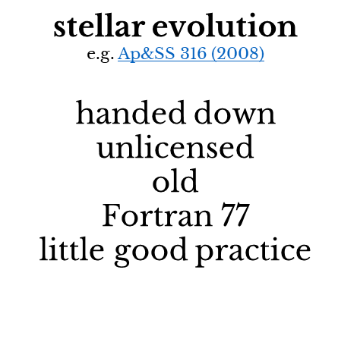
What is Research Software? An owner perspective
Warrick Ball, University of Birmingham. Astronomers re-invent small programs instead of collaborate to sustain and improve big ones
it is easier and more rewarding
to create one’s own new software
than to extend existing software
https://virtual.oxfordabstracts.com/#/event/4430/submission/31
https://danielskatzblog.wordpress.com/2021/05/14/software-development-curve/
Notes:
Astronomy software development curve

Slide 10


What is Research Software? A maturity perspective
Tom Honeyman, ARDC
Researchers
Analysis Code
one-off “me” research,
side effect software
Researchers who code
Researcher Developer
Prototype Tools
research need “professorware”
transition
Research Software Infrastructure
professionalised product
Research Software Engineer
Notes:
Dependencies, migration between the levels

Slide 11
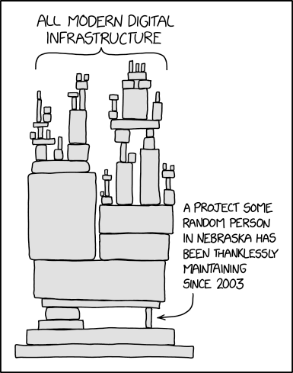

What is Research Software? A stack perspective
Dependencies, Roles, Visibility
User facing shiny thing
Applications, tools, scripts …
Discipline or project specific
Immediate visibility
Underware
Scientific & non-scientific infrastructure
Some discipline specific, some general
Platforms, libraries, utilities, frameworks…
Cross-domain generic reusability
Overly familiar, invisibility
https://xkcd.com/2347/
Notes:
Rocket and rocket launcher
Licensed Open Source
Licensed Binaries
Proprietary scripts
Licensed binaries and source codes
Audit it, run it
Communities can get disconnected from each other and their software.
Their own software vs some third party software
No credit no sustainability.

Slide 12
What is Research Software? A stack perspective
Dependencies, Roles, Visibility
User facing Software
Applications, tools, scripts …
Domain or project specific
Immediate visibility
Underpinning Software
Scientific & non-scientific infrastructure
Some discipline specific, some general
Platforms, libraries, utilities, frameworks…
Cross-domain generic reusability
Overly familiar, invisibility
https://xkcd.com/2347/
Notes:
Rocket and rocket launcher
Licensed Open Source
Licensed Binaries
Proprietary scripts
Licensed binaries and source codes
Audit it, run it
Communities can get disconnected from each other and their software.
Their own software vs some third party software
No credit no sustainability.

Slide 13
Software needs active nurturing to be sustained like machines/puppies, software will break/die if not maintained
All levels of software stack - stack collapse!
Keeping the Show on the Road
  Corrective -fixing faults
  Preventative - increasing maintainability
  Supportive – user and contributing developer support
Dealing with change
  Adaptive - adapting to changes in environment, porting, new versions of underlying layers
  Perfective - meeting new/different user requirements and achieve new capabilities
https://xkcd.com/2347/
Michael Feathers Working Effectively with Legacy Code, 2004
Notes:
1. Project-specific software (developed by researchers): software to do a computation using building
blocks from the lower levels: scripts, workflows, computational notebooks, small special-purpose
libraries & utilities
2. Discipline-specific software (developed by developers & researchers): tools & libraries that
implement disciplinary models & methods
3. Scientific infrastructure (developed by developers): libraries & utilities used for research in many
disciplines
4. Non-scientific infrastructure (developed by developers): operating systems, compilers, and support
code for I/O, user interfaces, etc.

Slide 14
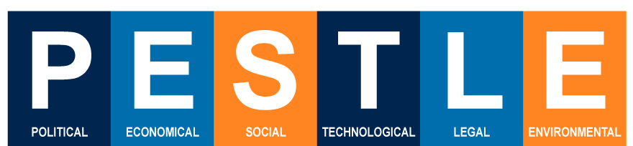
People make, use and resource software
They are at the heart of software sustainability
Domain researchers are often not software experts
Researchers, funders: Can’t pay, won’t pay, don’t pay
Community Open Source is not Free labour
Software development, maintenance and reuse is not rewarded and is even penalised
Underpinning infrastructure & seamless integration is under valued in favour of innovation
All software needs dedicated supported core and can’t rely on volunteers.
The Amsterdam Declaration on Funding Research Software Sustainability

Slide 15
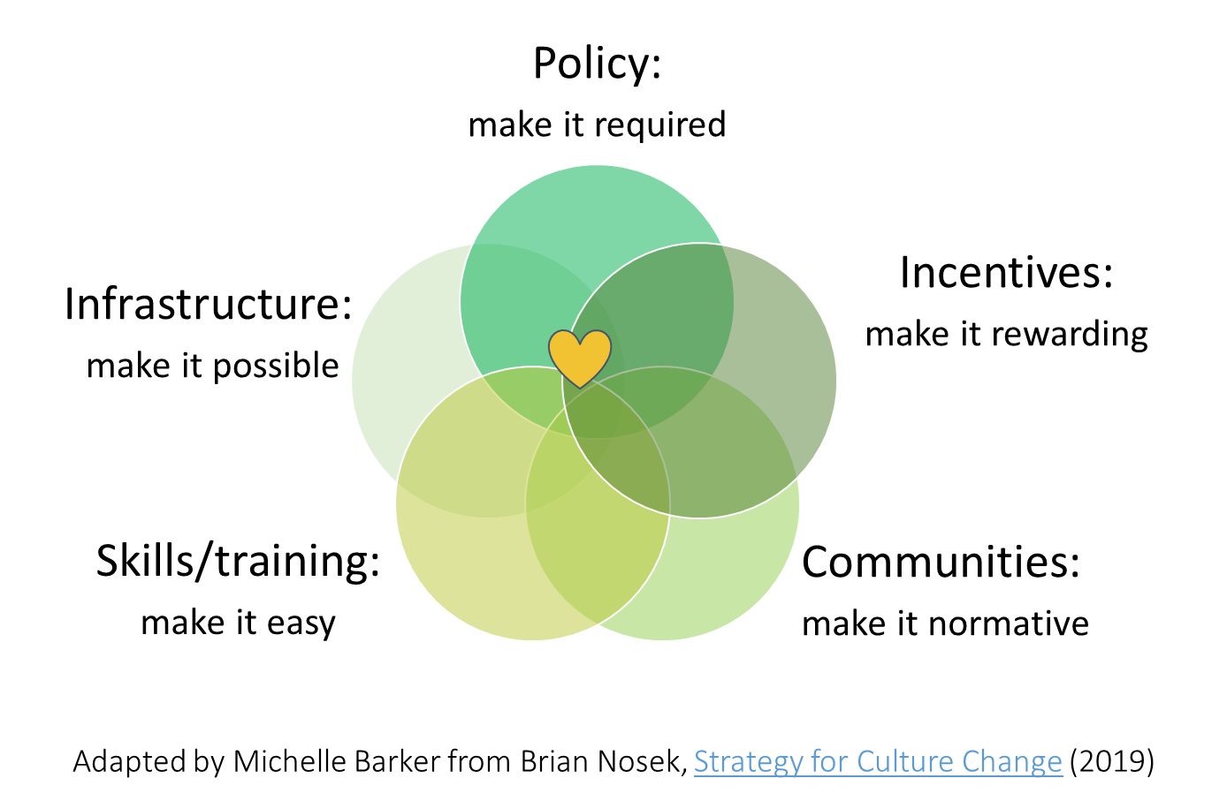
Summary – Research Software
Software is critical to the research endeavour
What Research Software is has many perspectives: Intent, Role, Maturity, Owner, Stack …. more!
Sustainability is hard but essential, especially for underpinning software.
Needs resources and mixed, multiple streams: direct (money) and indirect (community, reward, recognition, open source support etc).

