Slide 1
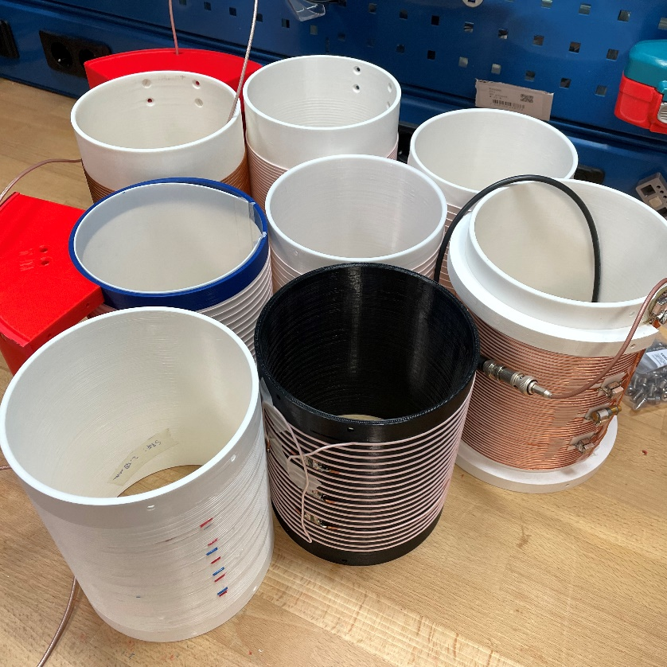
RF coil optimization 101
Tom O’Reilly

Slide 2
Introduction
What makes a good coil?
    Tx/Rx difference?
    High/low field difference?
How do you build a good coil?
    What can you ‘optimise’?
    Practical limits
With the good comes the bad
    Scanning with ‘good coils’

Slide 3
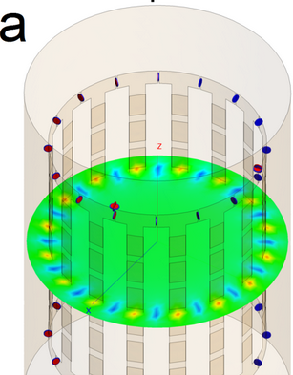
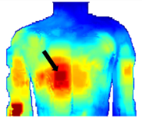
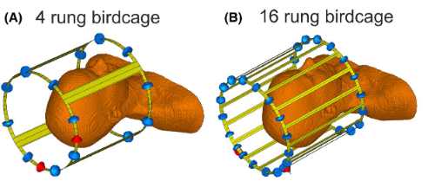
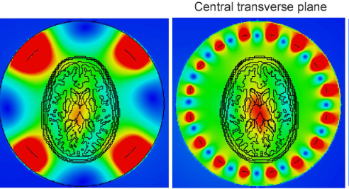
What makes a good transmit coil?
Homogenous
B₁⁺ field
High SAR efficiency
(B₁⁺ per SAR)
High Efficiency
(B₁⁺ per input power)

Slide 4
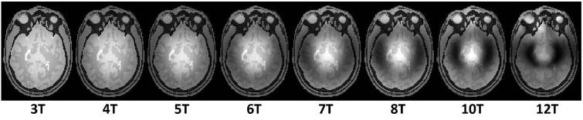
What makes a good HIGH FIELD transmit coil?
Homogenous
B₁⁺ field
High SAR efficiency
(B₁⁺ per SAR)
High Efficiency
(B₁⁺ per input power)
Wavelength can be an issue
At high field SAR is often limiting
Large RF amps

Slide 5
What makes a good LOW FIELD transmit coil?
Homogenous
B₁⁺ field
High SAR efficiency
(B₁⁺ per SAR)
High Efficiency
(B₁⁺ per input power)
No wavelength issues
(virtually) no SAR
Usually OK

Slide 6
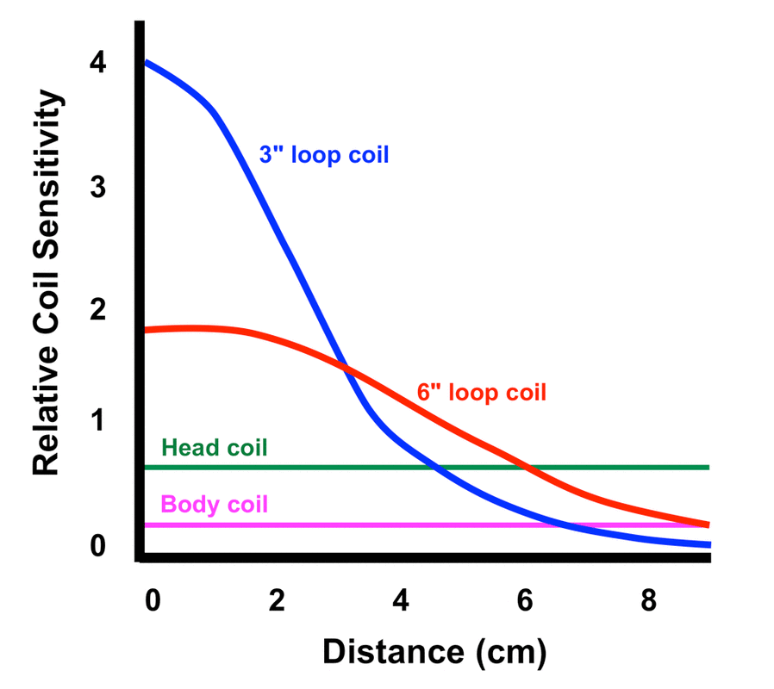
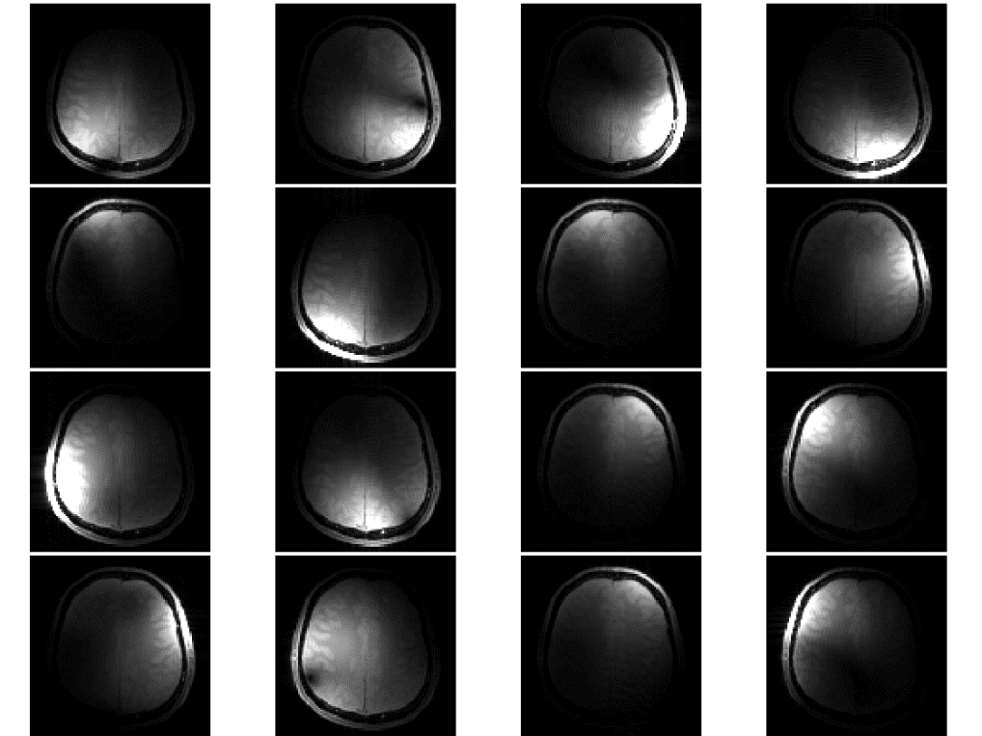
What makes a good receive coil?
High B₁⁻
(sensitivity)
Unique sensitivity profiles
(parallel imaging)

Slide 7
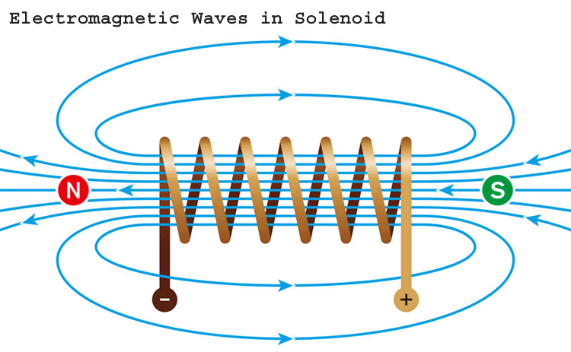
What makes a good Tx/Rx coil?
Maximise B field
Coil type
    Depends on B₀ direction
Coil size
    Smaller = Better
Minimise losses
Looooong story
    Different for different frequencies

Slide 8
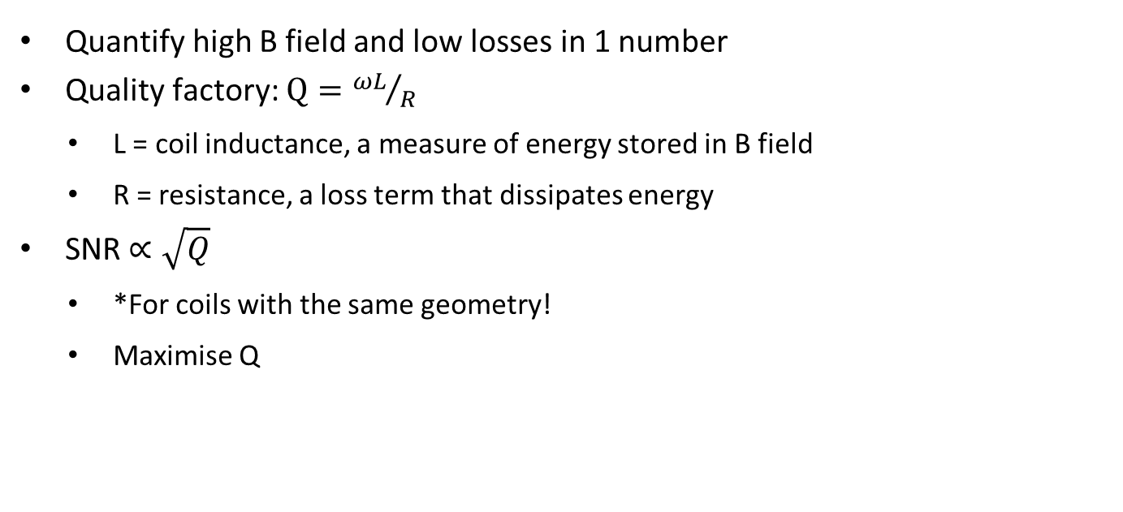
Q-uantify the Q-uality of the coil
Quantify high B field and low losses in 1 number
Quality factory: $Q={ωL}/R$
    L = coil inductance, a measure of energy stored in B field
    R = resistance, a loss term that dissipates energy
SNR $∝\sqrt{Q}$
    *For coils with the same geometry!
    Maximise Q

Slide 9
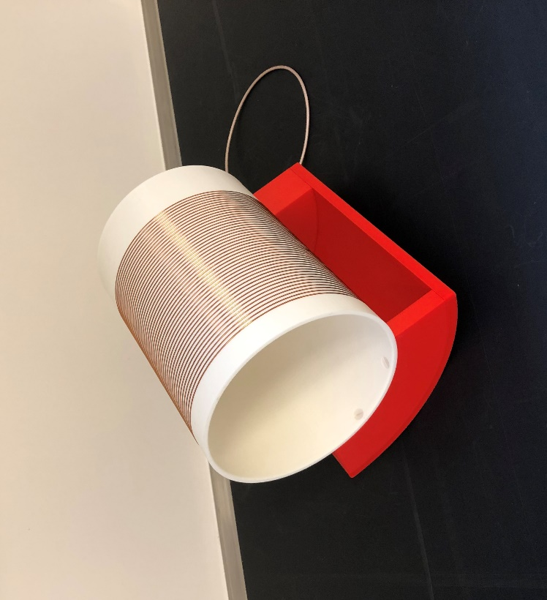
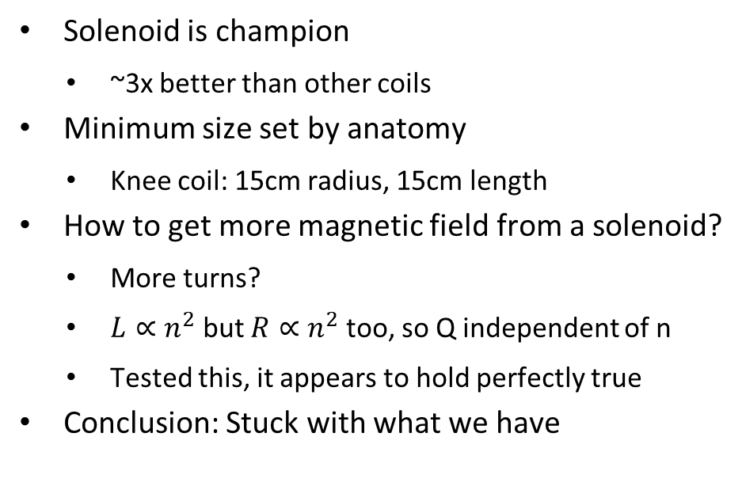
Maximise B-field
Solenoid is champion
    ~3x better than other coils
Minimum size set by anatomy
    Knee coil: 15cm radius, 15cm length
How to get more magnetic field from a solenoid?
    More turns?
    $L∝n^{2}$ but $R∝n^{2}$ too, so Q independent of n
    Tested this, it appears to hold perfectly true
Conclusion: Stuck with what we have

Slide 10
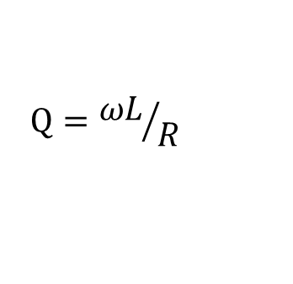
Minimise R
$$Q={ωL}/R$$
  Address the loss terms instead:
    R = total losses in the coil, many terms contribute
    Two predominant loss term categories:
      R_{coil}: losses in the coil itself
      R_{sample}: losses due to a conductive sample in the coil
  Huge difference between low and high field
    At high field R_{sample} dominant
      Small coils are better, R_{sample} lower, SNR higher
    At low field R_{coil} dominant*
      Large coils are better, R_{coil} lower, SNR higher

Slide 11

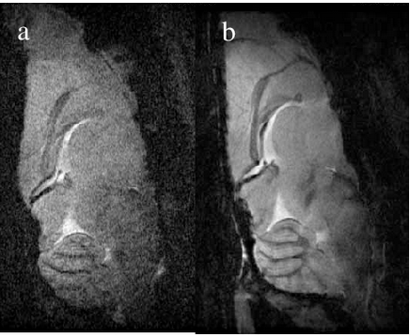
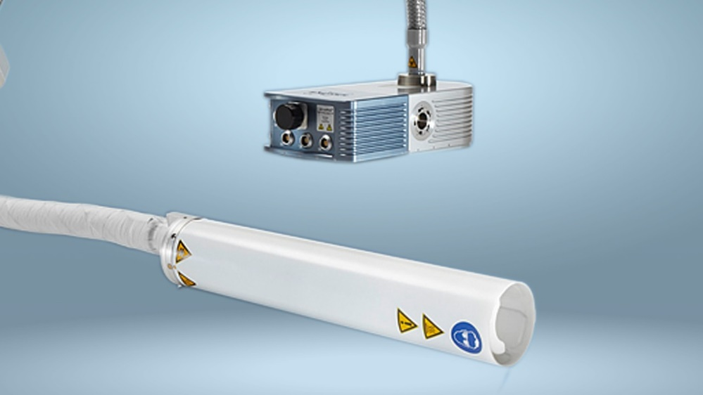
Minimise R – Cryogenic coils

Slide 12
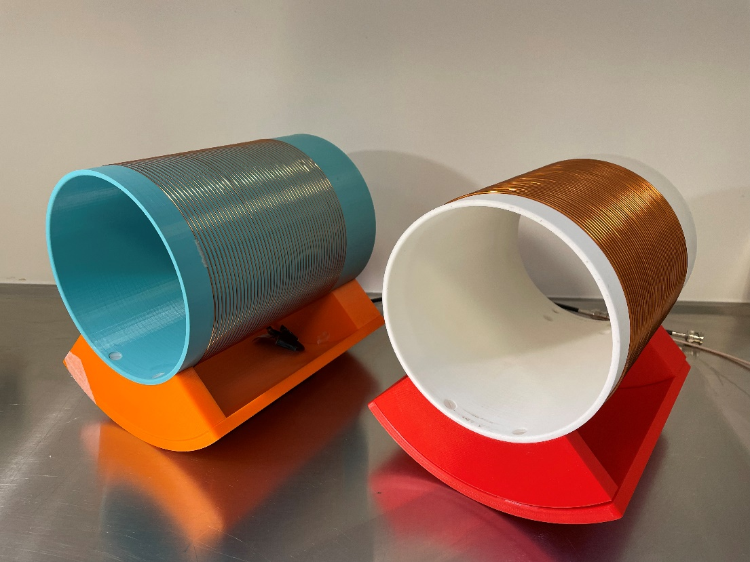
Optimisation - Reference coil
All experiments are done on the same coil base:
    156 mm diameter, 150 mm long solenoid
    Wound on a 3D printed PLA former

Slide 13
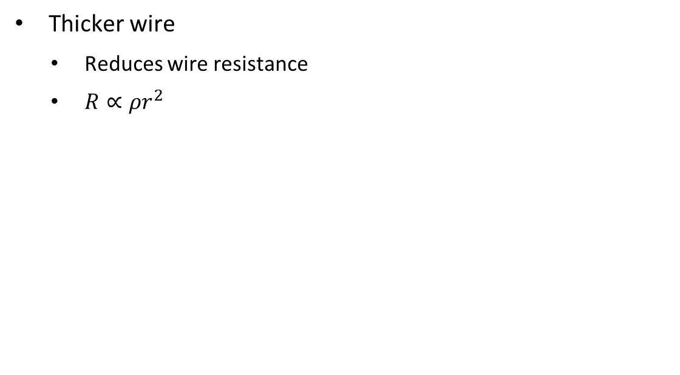
Addressing R_{coil}
Thicker wire
    Reduces wire resistance
    $R∝ρr^{2}$
r
Wire diameter (mm) | Q factor
0,8 | 130
1,5 | 280
Expected ~4x improvement

Slide 14
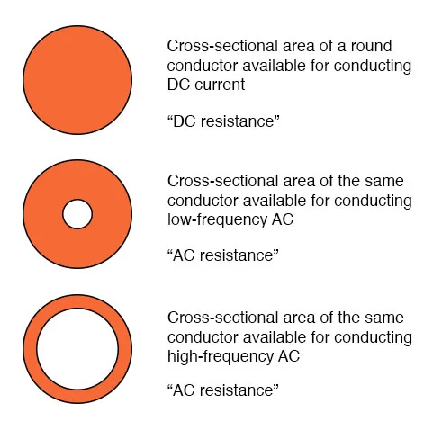
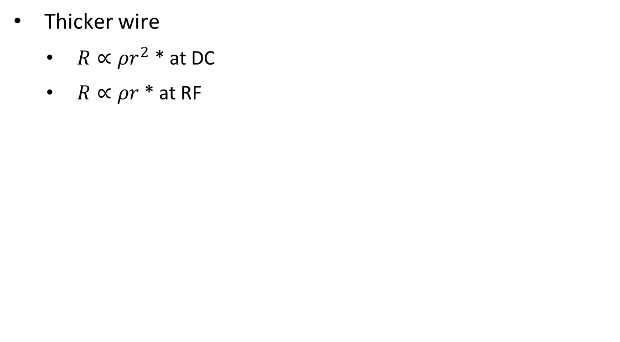
Addressing R_{coil}
Thicker wire
    $R∝ρr^{2}$ * at DC
    $R∝ρr$ * at RF
Wire diameter (mm) | Q factor
0,8 | 130
1,5 | 280

Slide 15
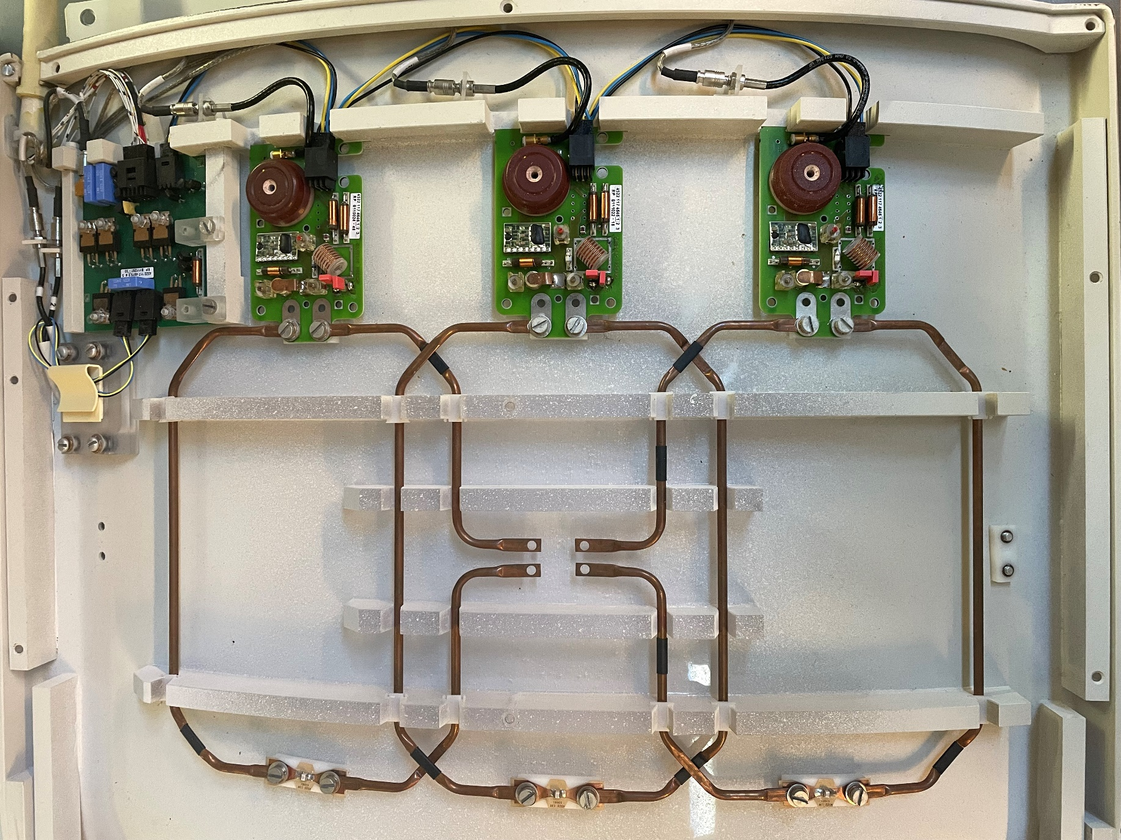
Skin depth – 1.5 Tesla body coil

Slide 16
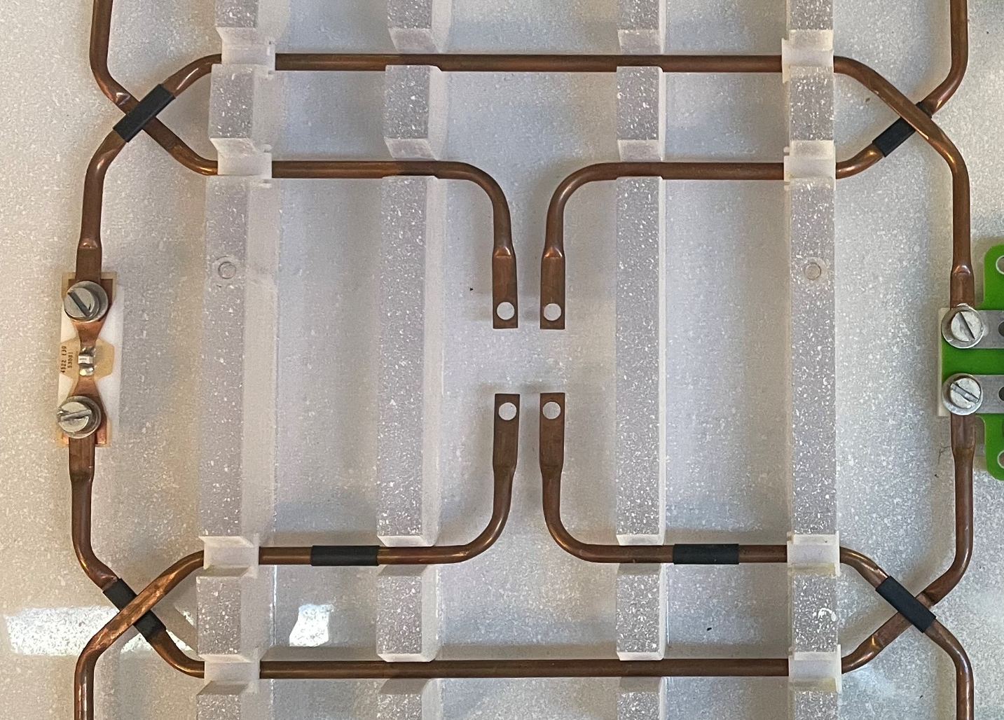
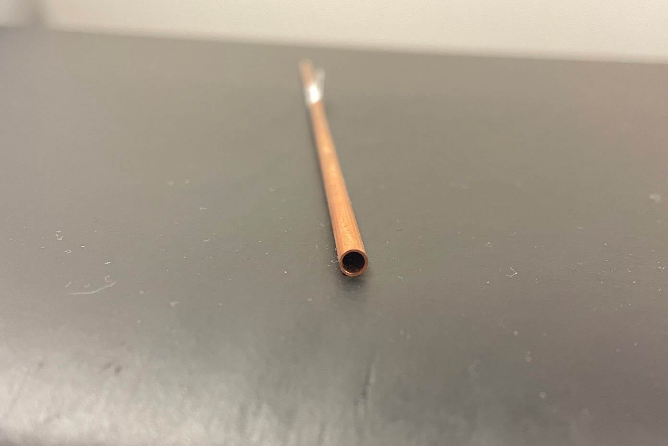
Skin depth – 1.5 Tesla body coil

Slide 17
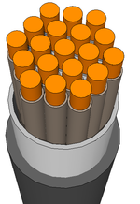
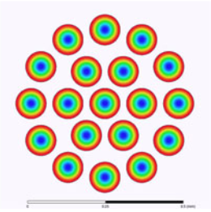
Litz wire
Many thin insulated strands together
Skin effect still present
    More surface area for current
Reduced conductor mass per meter
    Higher resistance at low F
Loses effectivity at higher f
Current distribution purely due to skin effect

Slide 18
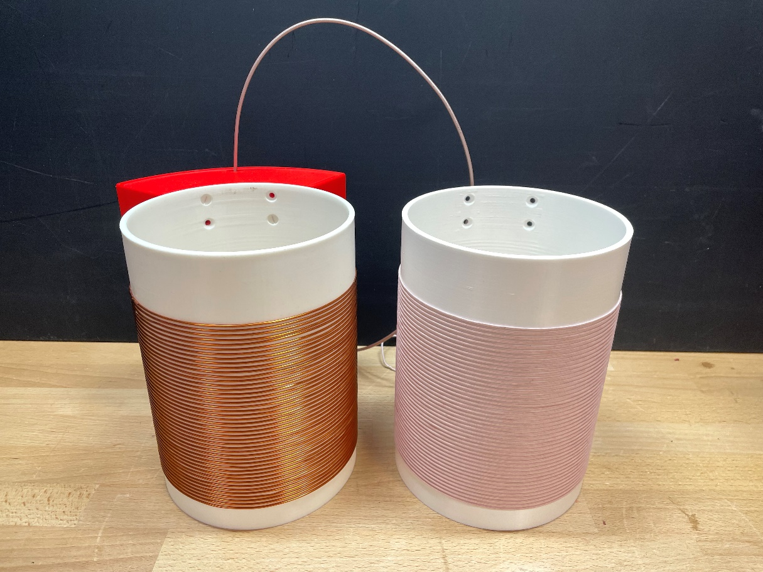
Litz wire coil
Wire type | Q factor
Solid copper | 280
Litz | 424
Close to the limit

Slide 19
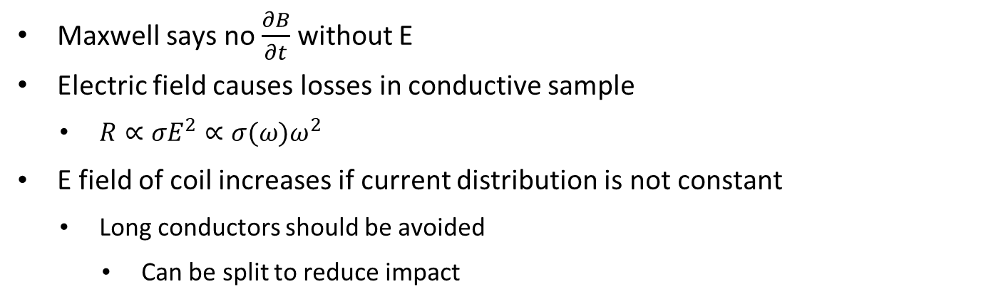
Addressing R_{sample}
Maxwell says no $\frac{∂B}{∂t}$ without E
Electric field causes losses in conductive sample
    $R∝σE^{2}∝σ(ω)ω^{2}$
  E field of coil increases if current distribution is not constant
    Long conductors should be avoided
      Can be split to reduce impact

Slide 20
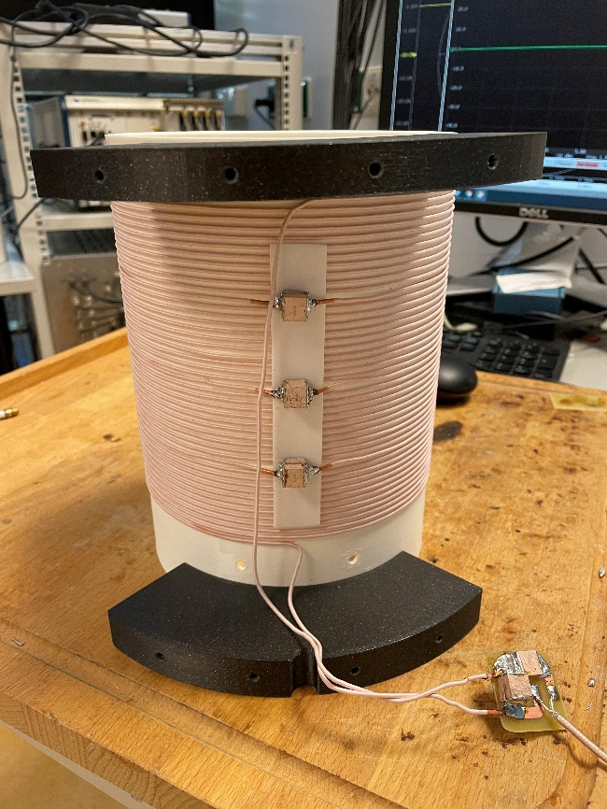
Addressing R_{sample}
    45 turn solenoid: 22 meters of wire
      150 m wavelength: 52 degrees of phase
    Testing number of segmentations
    Number of turns reduced
      Performance unchanged
      Sample noise ‘dominated’ coil!
Segmentations | Q unloaded | Q loaded | Ratio
1 | 305 | 91 | 3,4
3 | 427 | 177 | 2,4

Slide 21
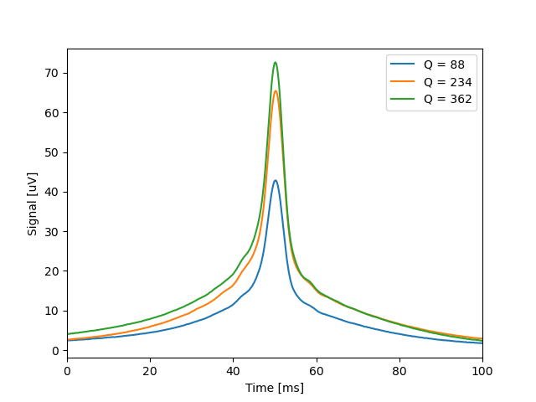
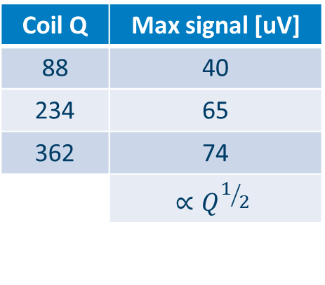
Signal (to-noise) improvement: Spin echo
Coil Q | Max signal [uV]
88 | 40
234 | 65
362 | 74
 | $$∝Q^{1/2}$$

Slide 22
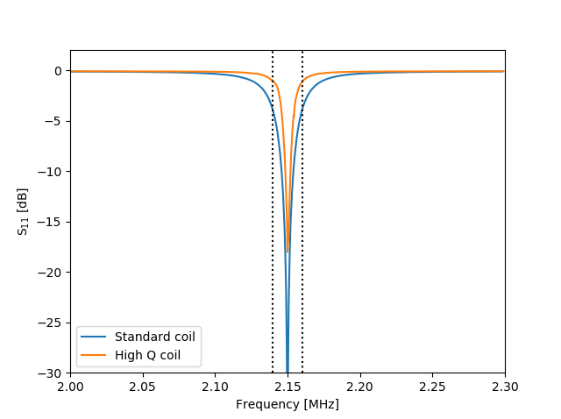
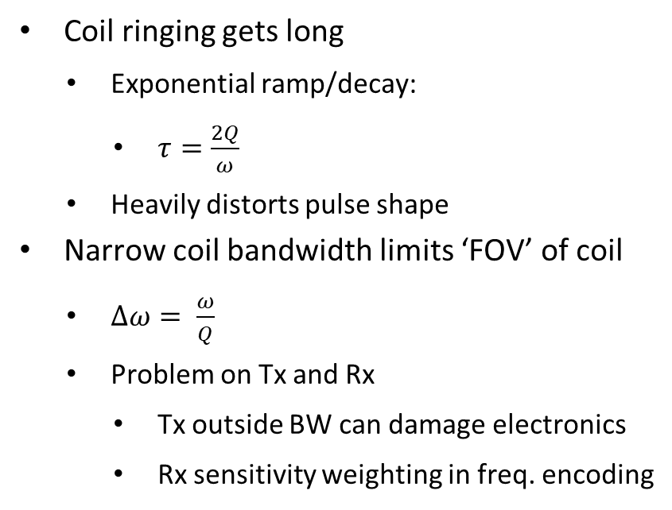
Why do we NOT want high Qs
Coil ringing gets long
    Exponential ramp/decay:
      $τ=\frac{2Q}{ω}$
    Heavily distorts pulse shape
Narrow coil bandwidth limits ‘FOV’ of coil
    $∆ω= \frac{ω}{Q}$
    Problem on Tx and Rx
      Tx outside BW can damage electronics
      Rx sensitivity weighting in freq. encoding

Slide 23
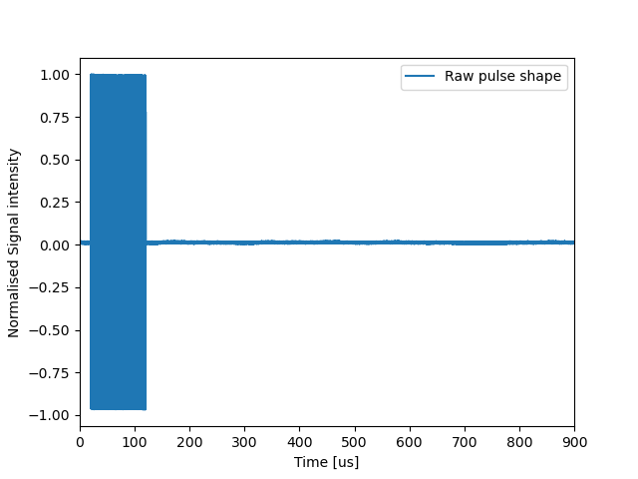
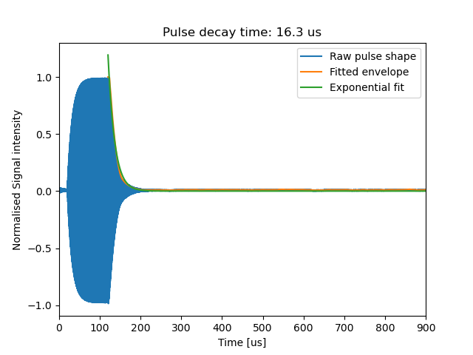
Coil ringing

Slide 24
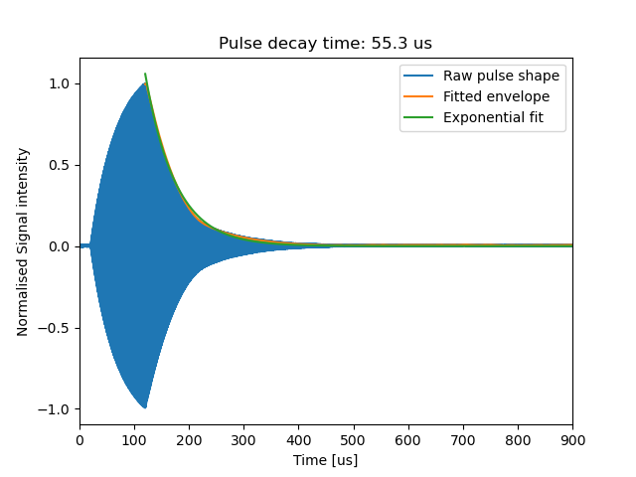
Coil ringing

Slide 25
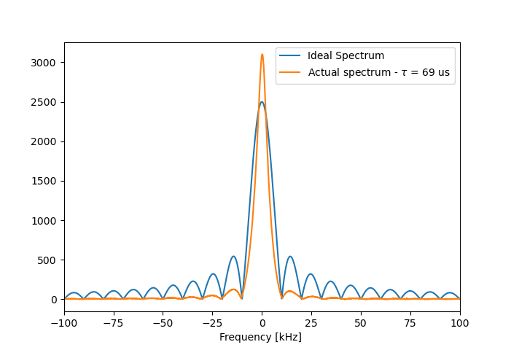
Coil ringing
100 us hard RF pulse

Slide 26
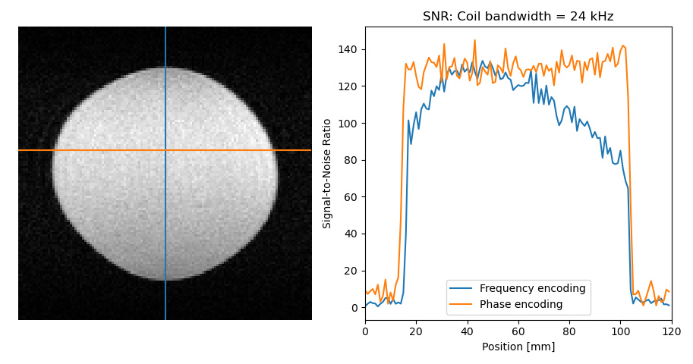
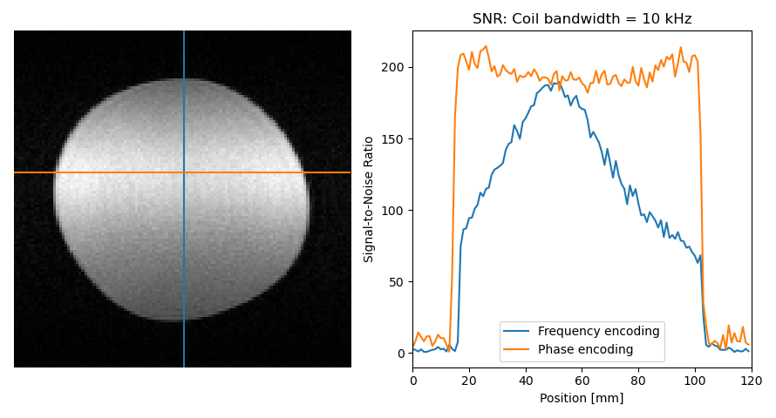
Coil Bandwidth – Frequency dependent signal

Slide 27
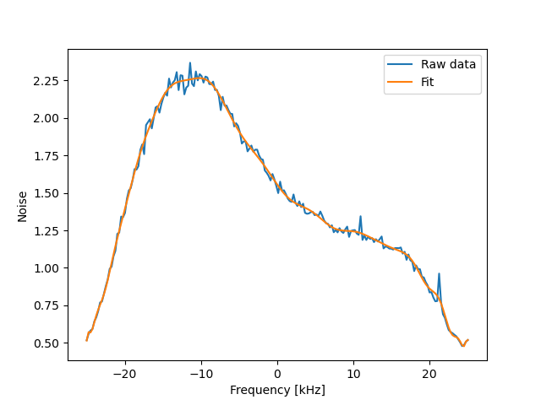
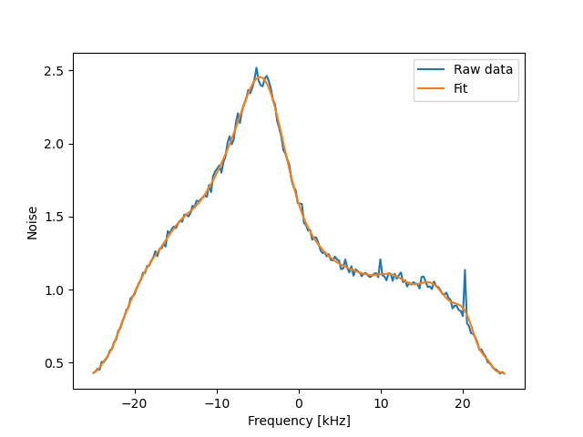
Coil bandwidth - Noise
Low Q coil
High Q coil

Slide 28
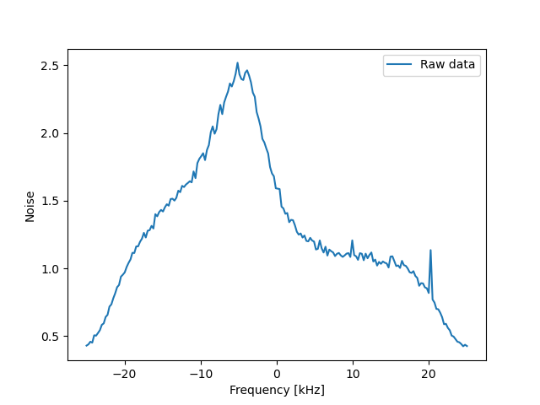
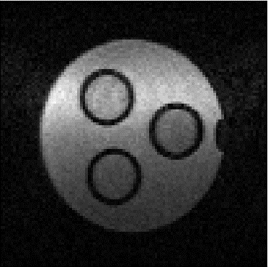
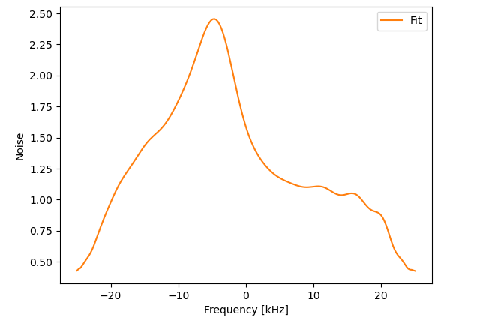
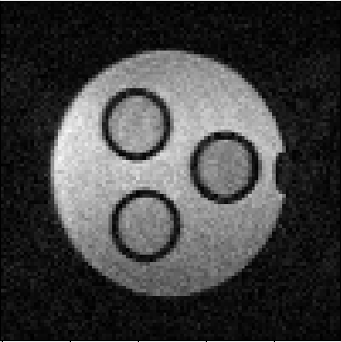
Coil Bandwidth: Correction
÷
=

Slide 29
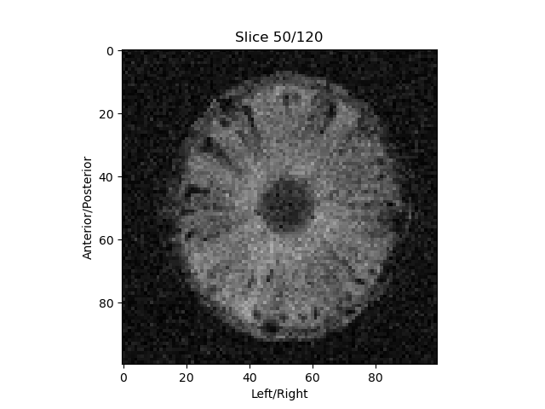
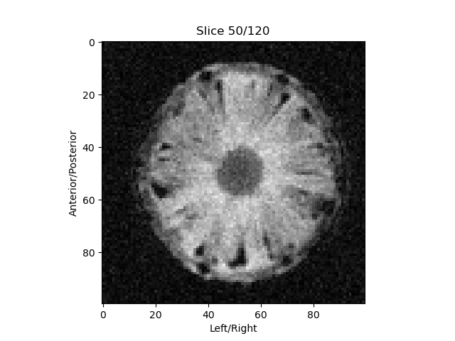
Imaging performance

Slide 30
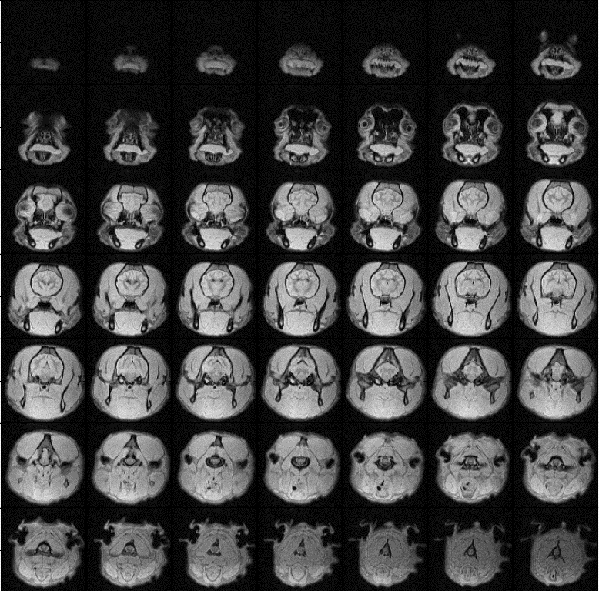
Vetinary scanning – Post mortem
PD 3D TSE sequence
FoV: 150 × 150 × 180 mm³
Acq. Mat.: 100 × 100 × 60
TR/TE: 600 ms/18 ms
ETL: 5
No averaging
Circular k-space window
Acq. BW: 20 kHz
Acq. time: 7 min 39 sec

Slide 31
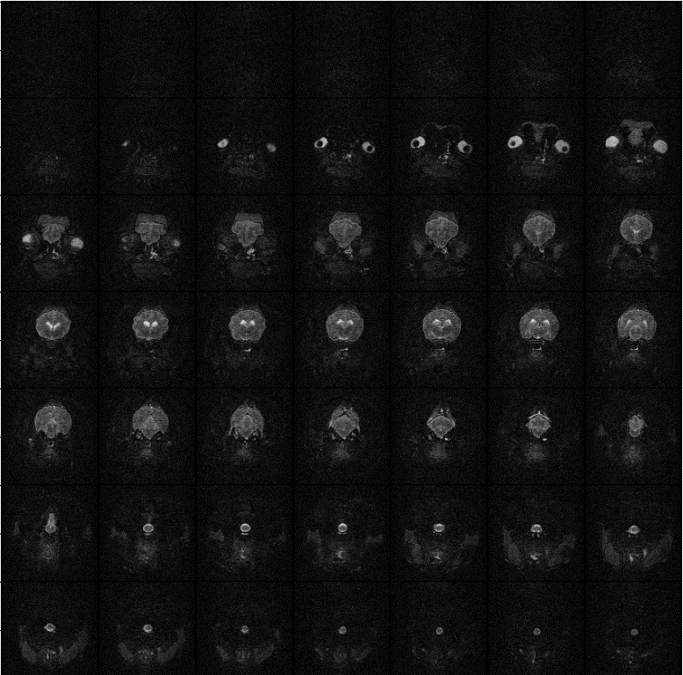
Vetinary scanning – Post mortem
T2w 3D TSE sequence
FoV: 150 × 150 × 180 mm³
Acq. Mat.: 100 × 100 × 60
TR/TE/TE_{eff}: 2000 ms/18 ms
ETL: 20
No averaging
Circular k-space window
Acq. BW: 20 kHz
Acq. time: 7 min 42 sec

Slide 32
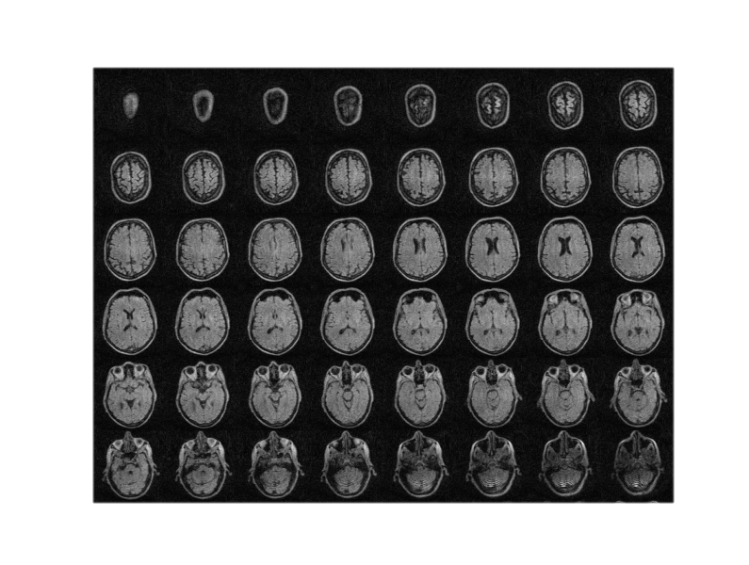
In-vivo imaging - 3D TSE
FoV: 220 × 220 × 225 mm³
Acq. Mat.: 110 × 110 × 75
TR/TE: 600 ms/15 ms
ETL: 7
Elliptical k-space mask
No averaging
Acq. BW: 20 kHz
Acq. time: 9 min 2 sec
CPR reconstruction
No denoising

Slide 33
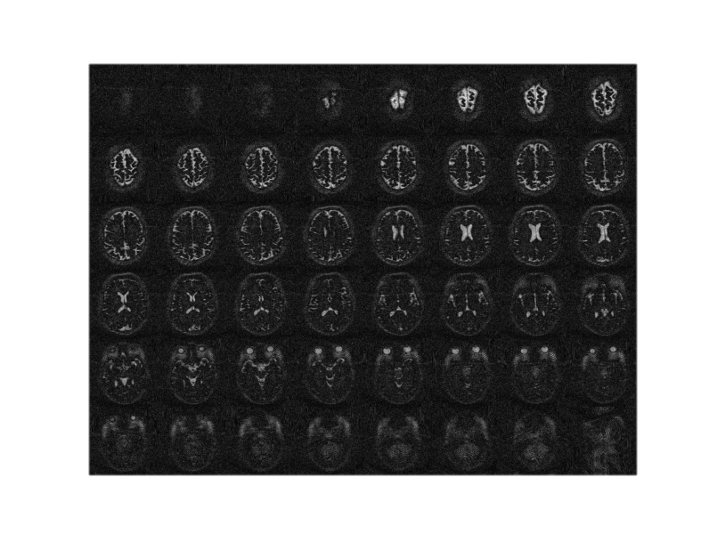
In-vivo imaging – 3D IR-TSE
FoV: 220 × 220 × 180 mm³
Acq. Mat.: 110 × 110 × 60
TR/TI/TE: 6000 ms/200 ms/18 ms
ETL: 110
No averaging
Acq. BW: 20 kHz
Acq. time: 6 min 12 sec
CPR reconstruction
No denoising

Slide 34
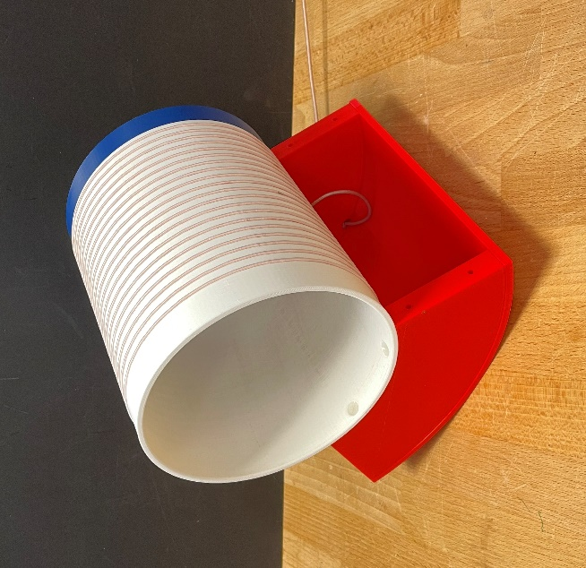

Summary
Coil optimization is field dependent
    Coil materials plays huge role at low field
Body loss dominance can be achieved at low field
    Comes from B field, not E field
Simple correction for BW related shading
Coil optimization yields improved SNR
    2x in phantoms, 2> in-vivo >2^{½}

Slide 35
Thanks!
“The project (22HLT02 A4IM) has received funding from the European Partnership on Metrology, co-financed from the European Union’s Horizon Europe Research and Innovation Programme and by the Participating States.”
Funder name: European Partnership on Metrology
Funder ID: 10.13039/100019599
Grant number: 22HLT02 A4IM

Slide 36


RF power
Coil Q | 90° pulse (V_{pp}) | 90° power (W)
88 | 77,7 | 15,1
234 | 45,6 | 5,2
362 | 37,4 | 3,5
 | $$∝Q^{−1/2}$$ | $$∝Q$$

