Slide 1
(Py)Pulseq:
Open Source Pulse Sequence Programming
Patrick Schünke, PTB

Slide 2
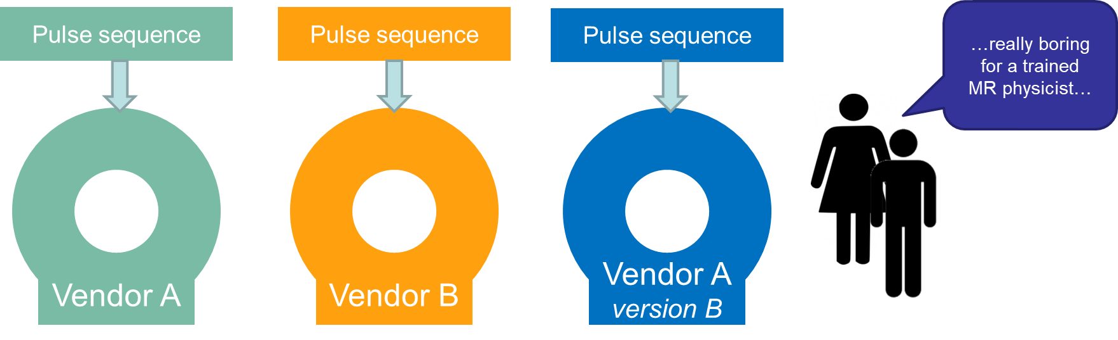
Pulse Sequence Dev: State-of-the-art
  Very complex and especially extremely time consuming
  Huge burden for multi-site, multi-vendor studies
*slide courtesy of Maxim Zaitsev,

Slide 3
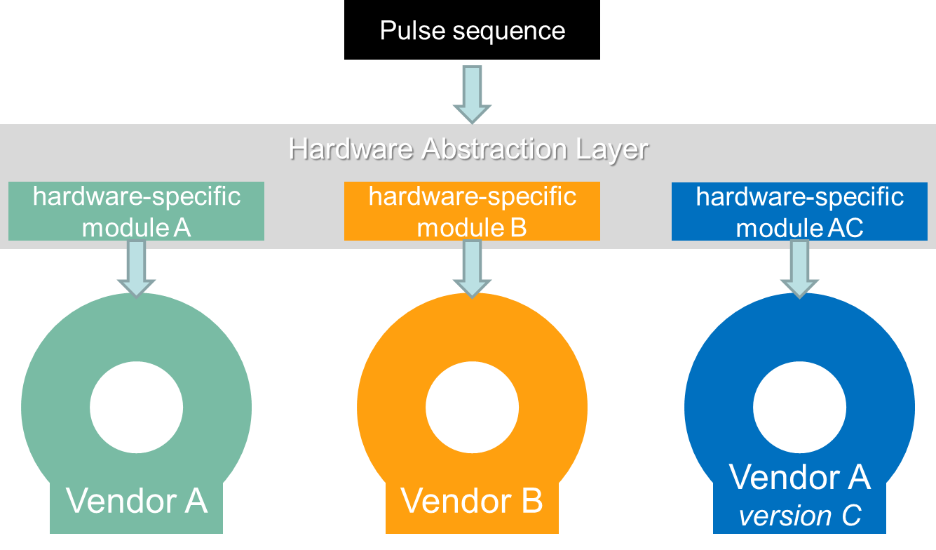
Pulse Sequence Dev: the Pulseq way ☺
*slide courtesy of Maxim Zaitsev,

Slide 4
Pulse Sequences in General
RF
Gs
Gp
Gr
TR
MR pulse sequences are simple and repetitive !
*slide courtesy of Maxim Zaitsev,

Slide 5
Pulseq Goals
Remove the initial threshold in sequence programming
  Turn simple things really simple
Make researcher-oriented features easily accessible
  Arbitrary gradients, arbitrary RF, flexible reordering, X-nuclei, …
Prevent typical sources of (human) errors
  Avoid timing errors with overlapping gradients
  Make data flag and counter setting optional/unnecessary
Minimize effort for implementation and support on hardware
  Lean sequence-to-hardware interface
*slide courtesy of Maxim Zaitsev,

Slide 6
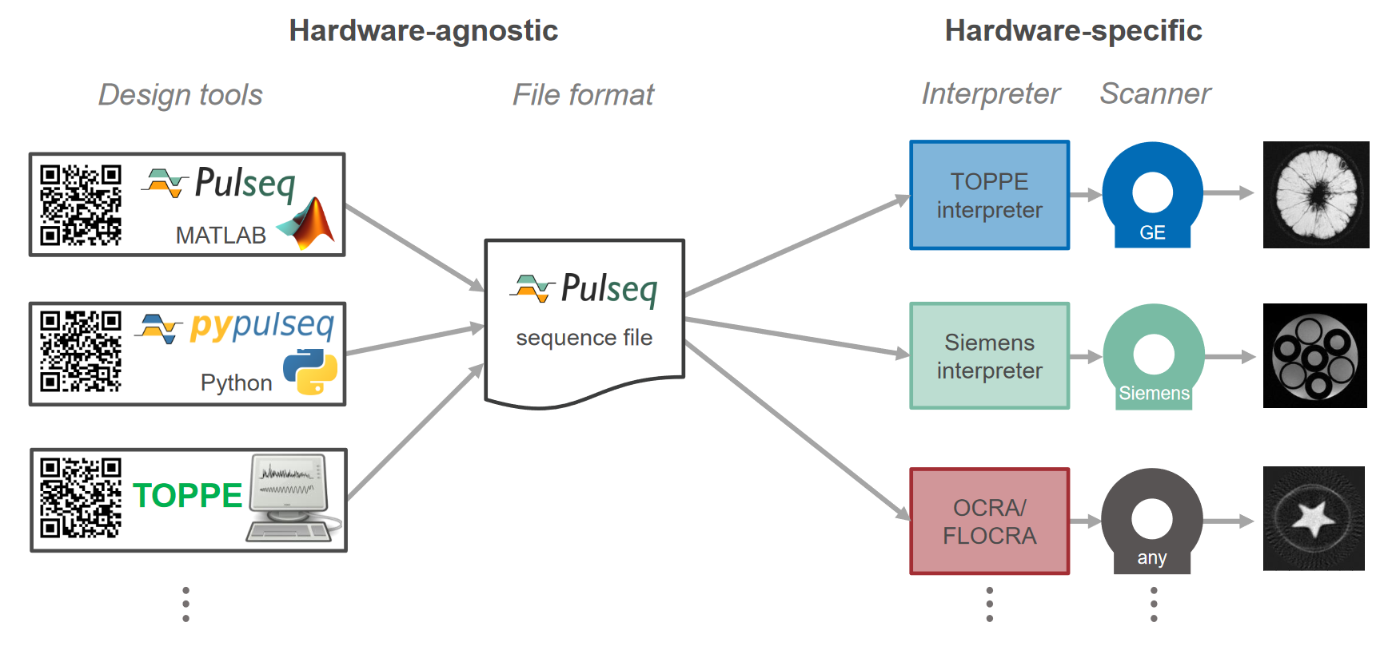
Pulseq Framework Overview
Layton et al., A rapid and hardware-independent pulse sequence prototyping framework. Magn. Reson. Med. 2017;77:1544–1552
Ravi et al., PyPulseq: A Python Package for MRI Pulse Sequence Design. J. Open Source Softw. 2019;4:1725

Slide 7
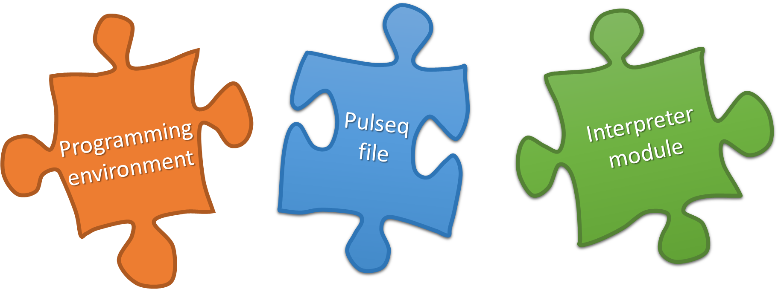
Pulseq Framework Overview

Slide 8
Pulseq Sequence Definition
Concatenation of non-overlapping blocks
block 1:
gradient and RF
block 2:
only gradients
block 3:
gradient and ADC
block 4:
only gradients
block 5:
gradient and RF …
RF
Gs
Gp
Gr
Gradients do not have to start or end at 0 at the block boundaries
*slide courtesy of Maxim Zaitsev,

Slide 9
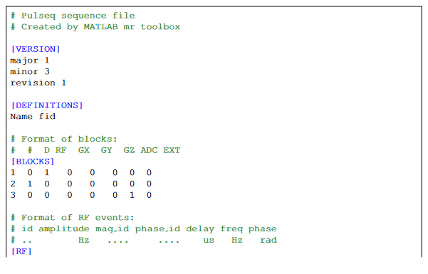

Pulseq *.seq Files

Slide 10
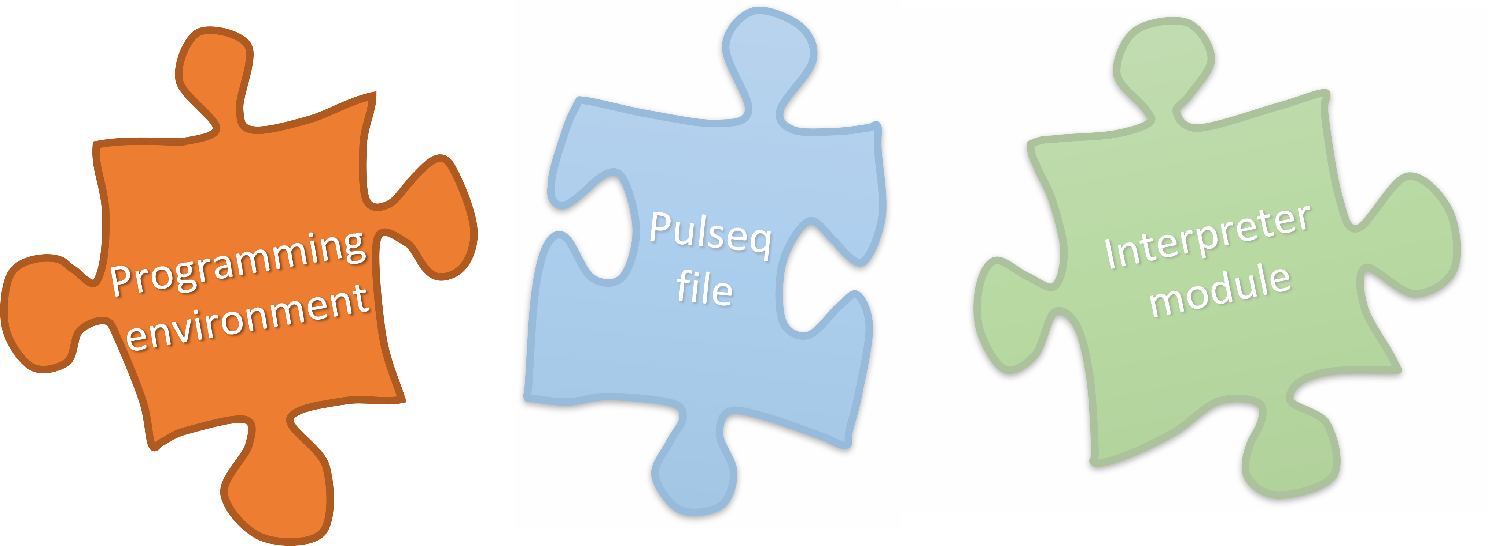
Pulseq Framework Overview

Slide 11


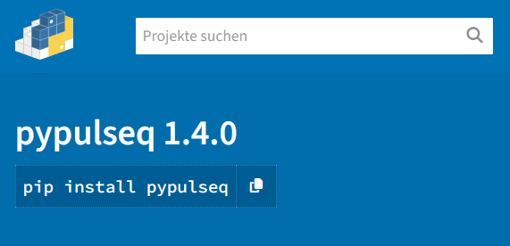
PyPulseq Design Tool
https://pypi.org/project/pypulseq/
https://github.com/imr-framework/pypulseq
Ravi et al., PyPulseq: A Python Package for MRI Pulse Sequence Design. J. Open Source Softw. 2019;4:1725

Slide 12
PyPulseq: Current Issues
`np.float` was a deprecated alias for the builtin `float`. To avoid this error in existing code, use `float` by itself.
Doing this will not modify any behavior and is safe. If you specifically wanted the numpy scalar type, use `np.float64` here.
The aliases was originally deprecated in NumPy 1.20; for more details and guidance see the original release note at:
https://numpy.org/devdocs/release/1.20.0-notes.html#deprecations.
fixed in sigpy GitHub repository, but not released yet ☹
pip install git+https://github.com/imr-framework/pypulseq@dev

Slide 13

PyPulseq: Current Developments
As a community, we are currently working on:
performance improvements
transition to „modern“ python package
  SimpleNamespace -> dataclass
  comprehensive CI/CD
  automated testing and reporting
  …

Slide 14
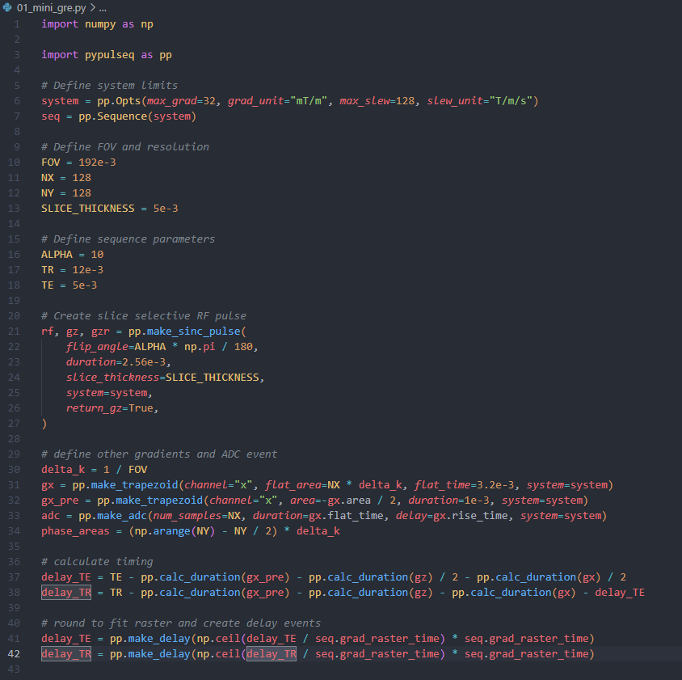
PyPulseq: Example Sequence

Slide 15
PyPulseq: Example Sequence

Slide 16
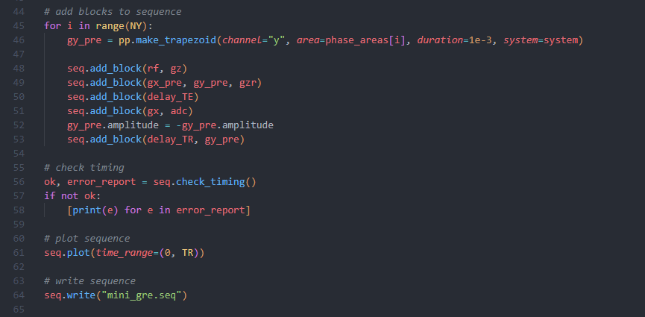
PyPulseq: Example Sequence

Slide 17
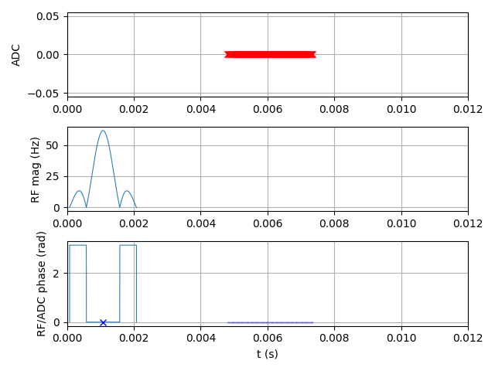
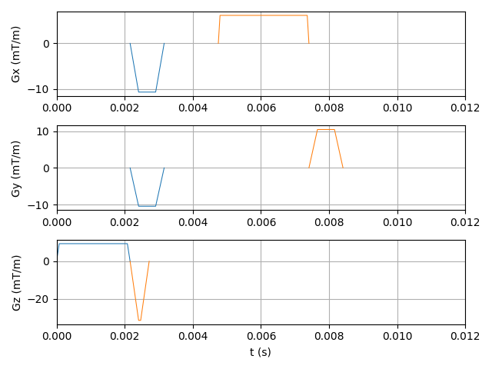
PyPulseq: Example Sequence

Slide 18

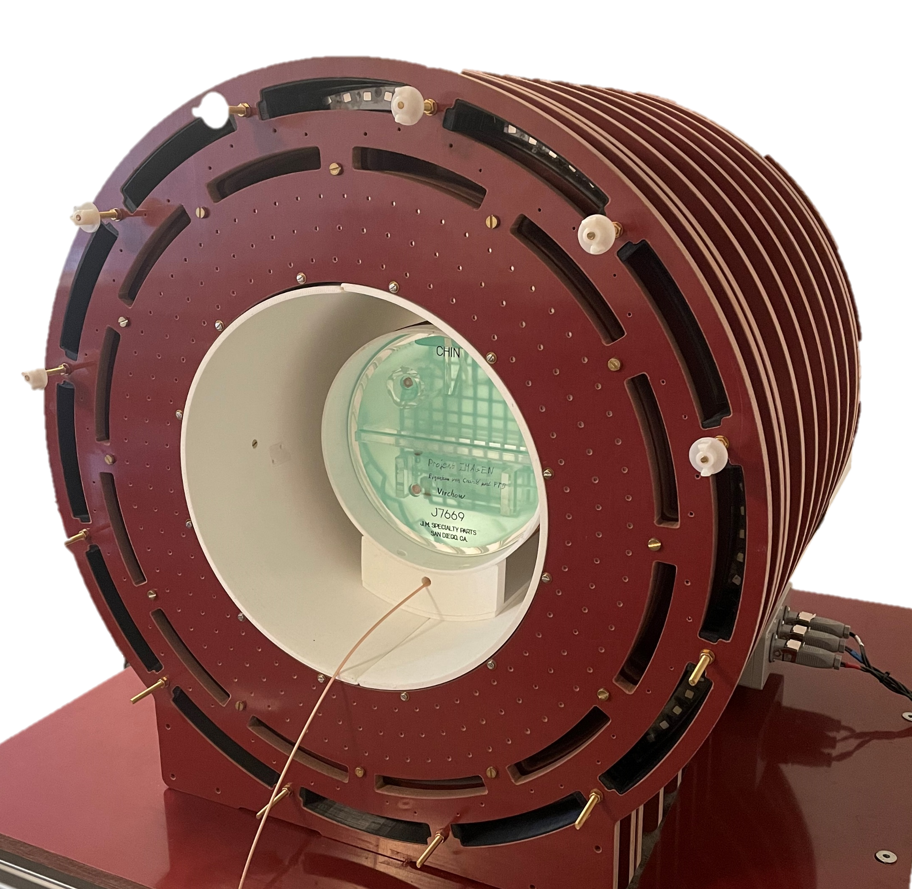
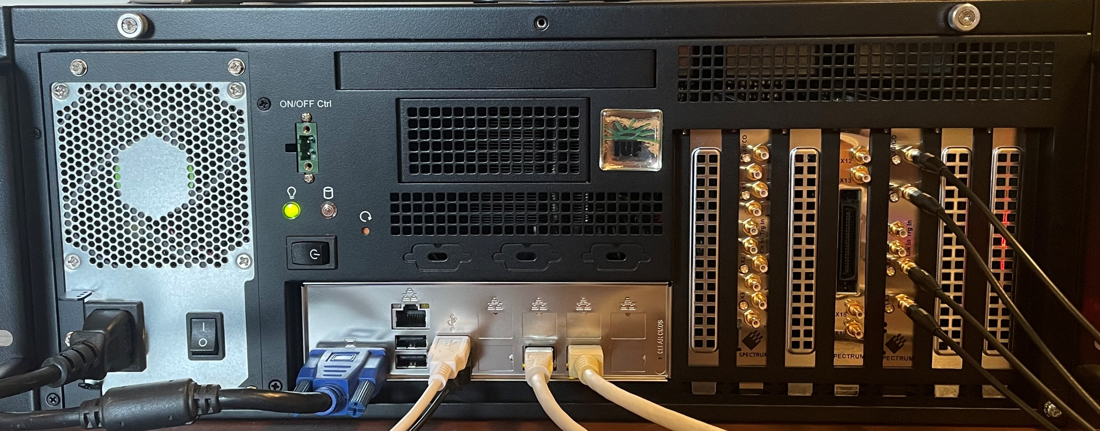
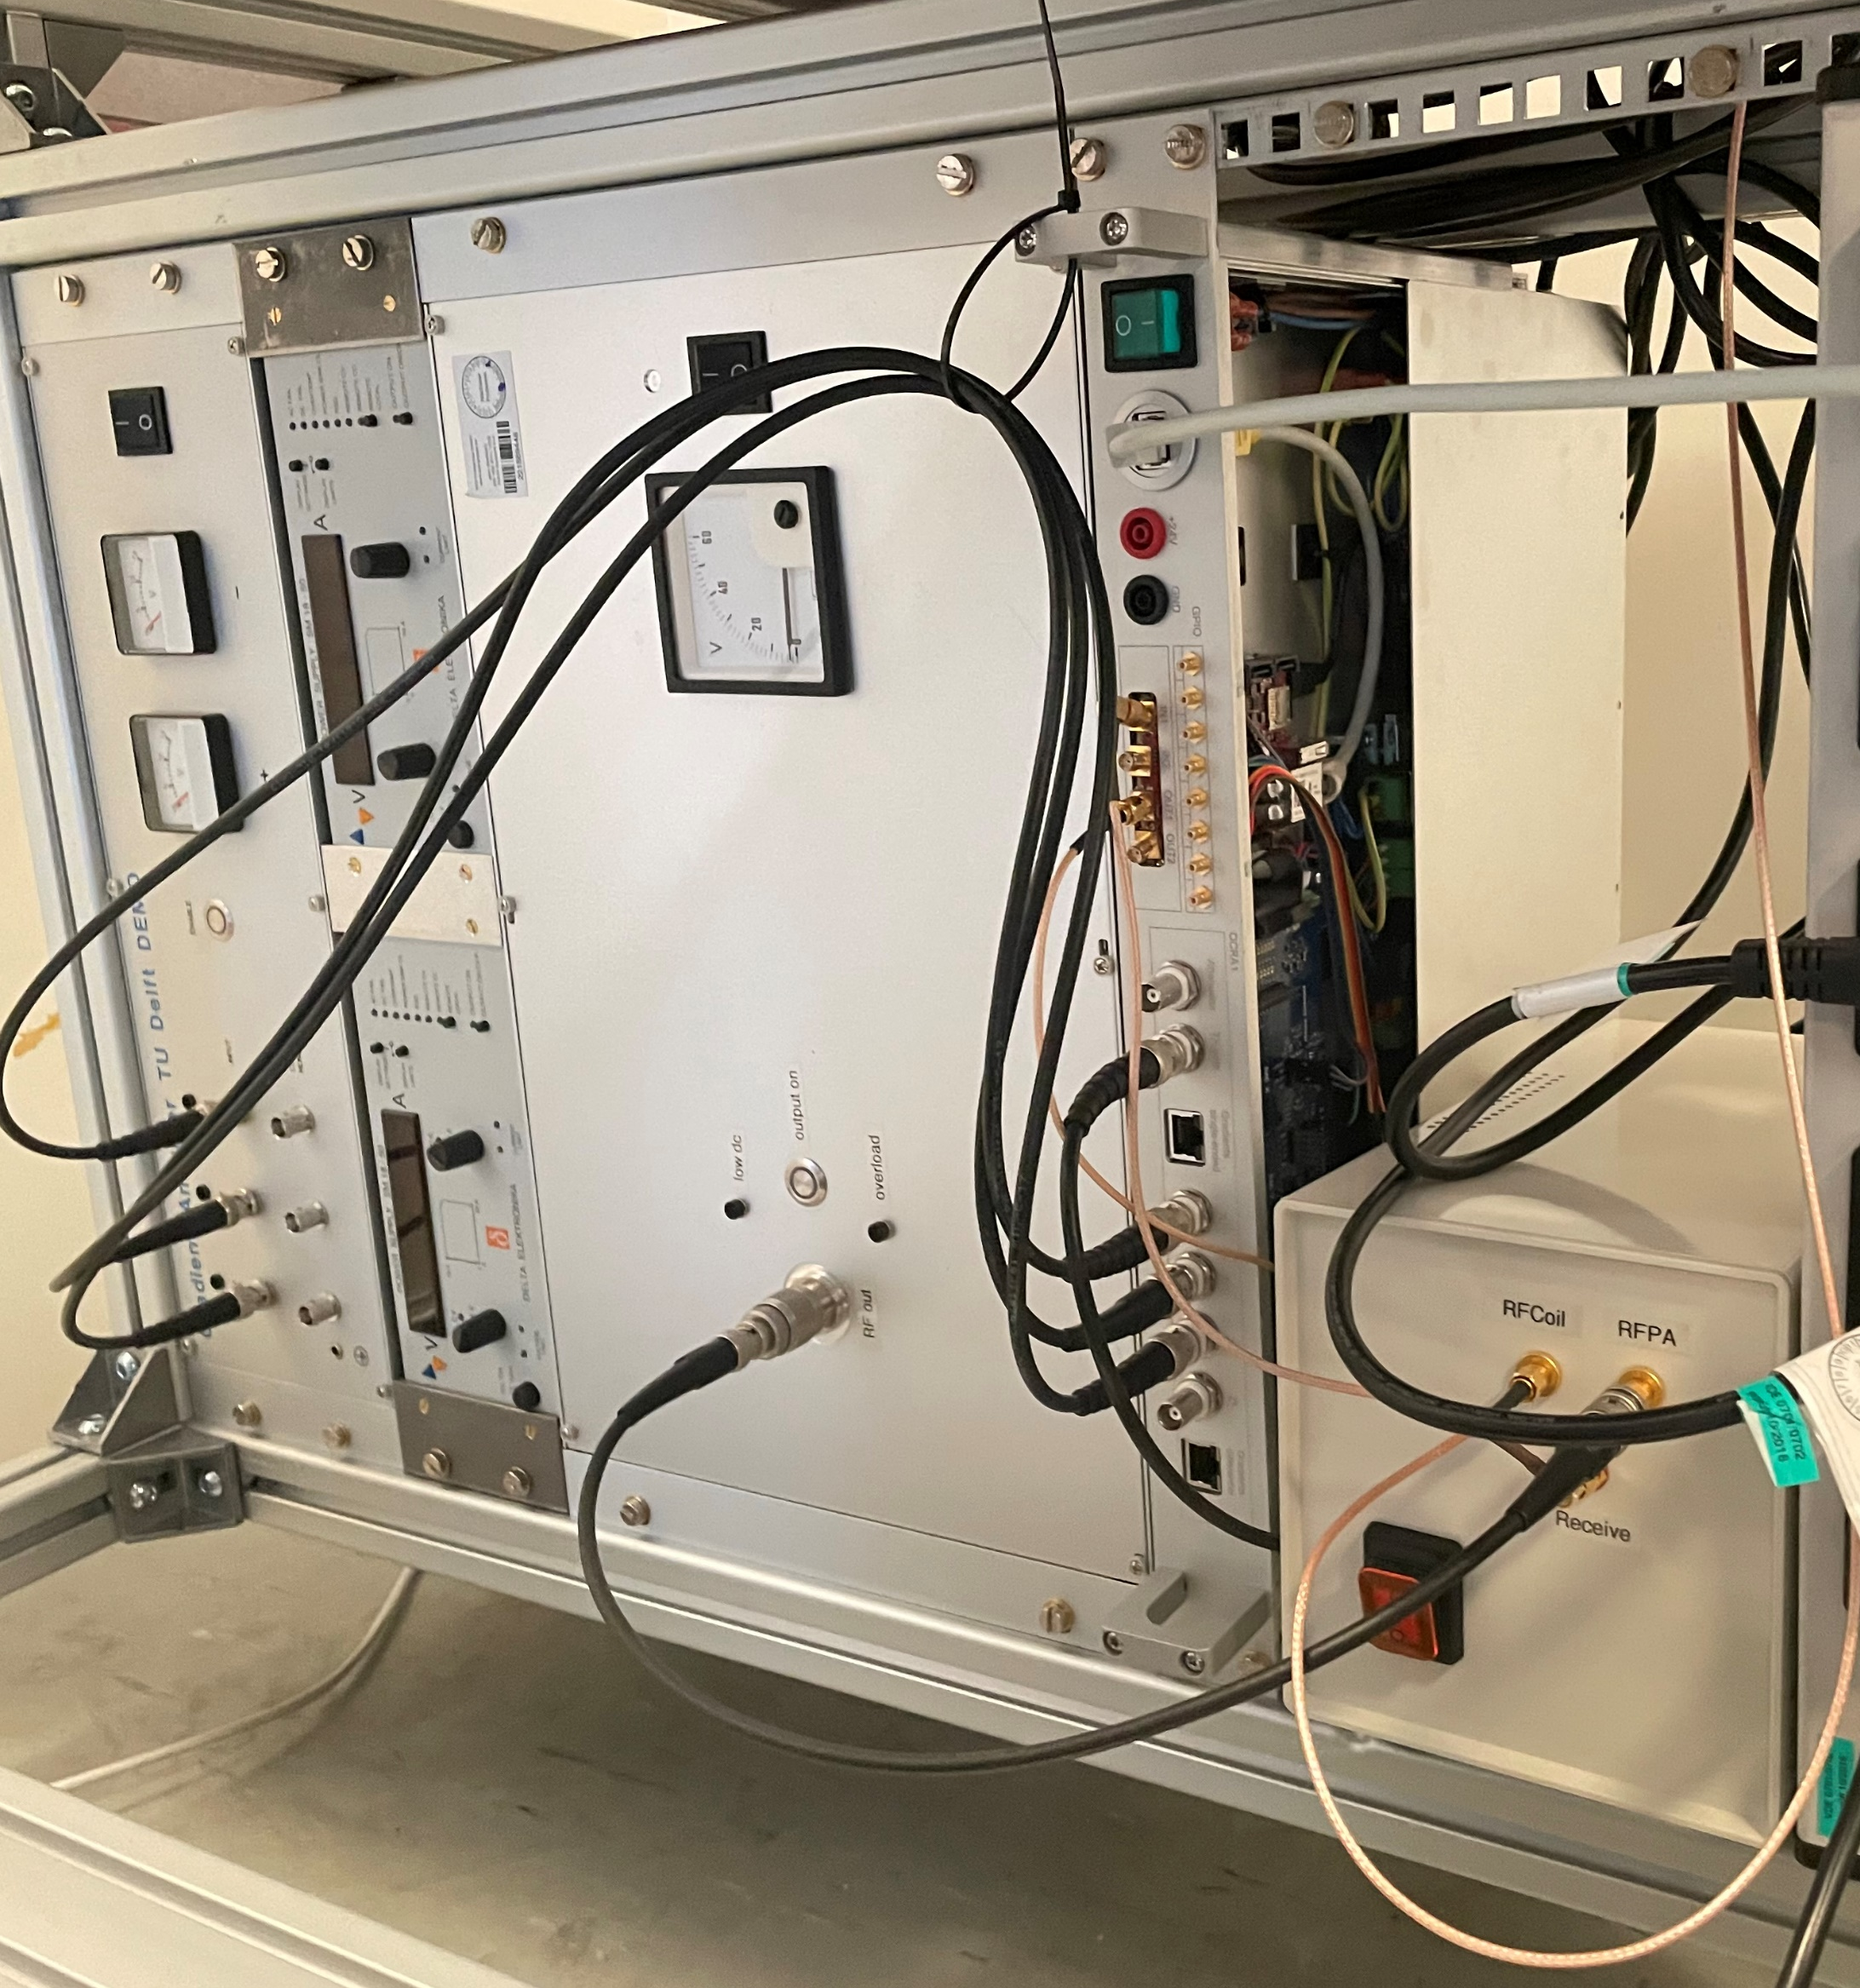


Introduction: System Overview
OSI²One: Affordable open-source permanent magnet
Magnetic field strength of 48 mT
Weight < 50 kg
Material cost ~20.000€
Ultralow-field MRI Console
Acquisition
Control
Sequence Provider: Compute samples
RX Signal
Amplification Hardware
Gradient amplifier
RFPA
Power supply
Preamp
TR-Switch
Transmit (TX) Card
RF, Gradients
Receive (RX) Card
Spectrum-Instrumentation, Measurement Cards
RX-Card: M2p5933-x4
TX-Card: M2p6546-x4
*slide courtesy of David Schote

Slide 19
(Py)Pulseq: Useful Links
General Pulseq homepage:
https://pulseq.github.io/
Pulseq (Matlab) GitHub repo:
https://github.com/pulseq/pulseq
PyPulseq (Python) GitHub repo:
https://github.com/imr-framework/pypulseq
Pulseq Tutorials (Matlab):
https://github.com/pulseq/tutorials

Slide 20




Acknowledgments
Keerthi S. Ravi
Sairam Geethanath
Bilal Taşdelen
…
Prof. Maxim Zaitsev
Dr. Kelvin J. Layton
...
Dr. Christoph Kolbitsch
Dr. Hannes Dillinger
Dr. Lukas Winter
David Schote
Felix Zimmermann
…
Prof. Moritz Zaiss
contributors

