Slide 1
Shimming
Tom O’Reilly
Leiden University Medical Center

Slide 2
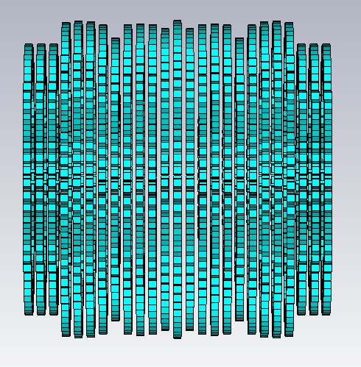
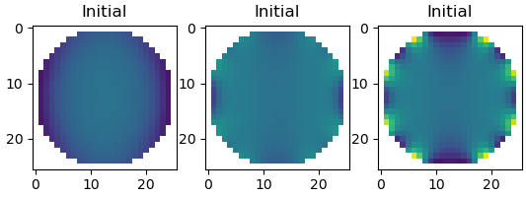
Diameter optimisation
25cm DSV: B₀ = 46.35 mT
ΔB₀ = 3000 ppm

Slide 3
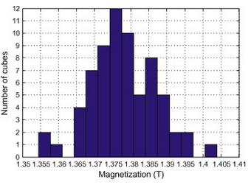
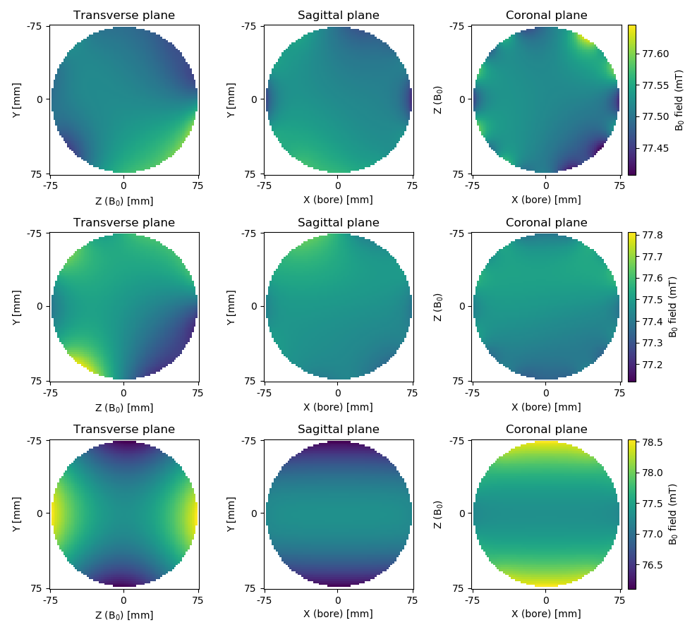
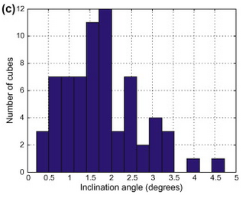
Construction: Magnet imperfections
3000 ppm
±2 %
9000 ppm
±2 degrees
Hugon et al, JMR, 2010

Slide 4
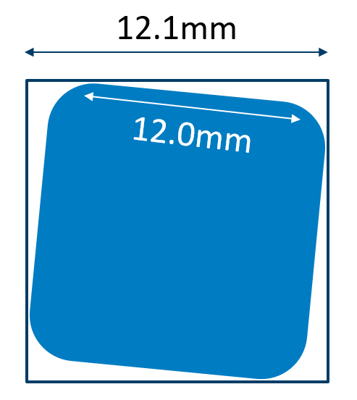
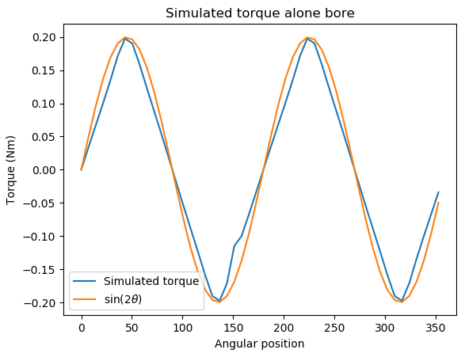
Construction: Torque induced errors
33000 ppm
±1.5 degrees

Slide 5
Torque induced errors: Compensation
Augment magnet rotations
Prior to cutting of rings!

Slide 6
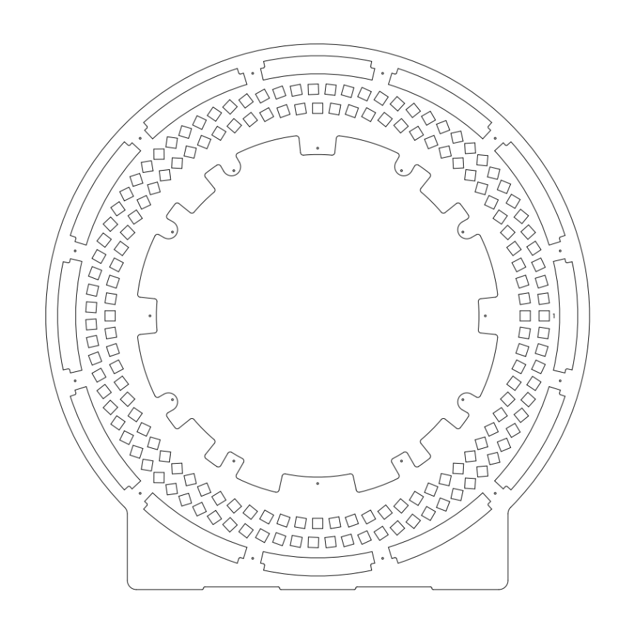
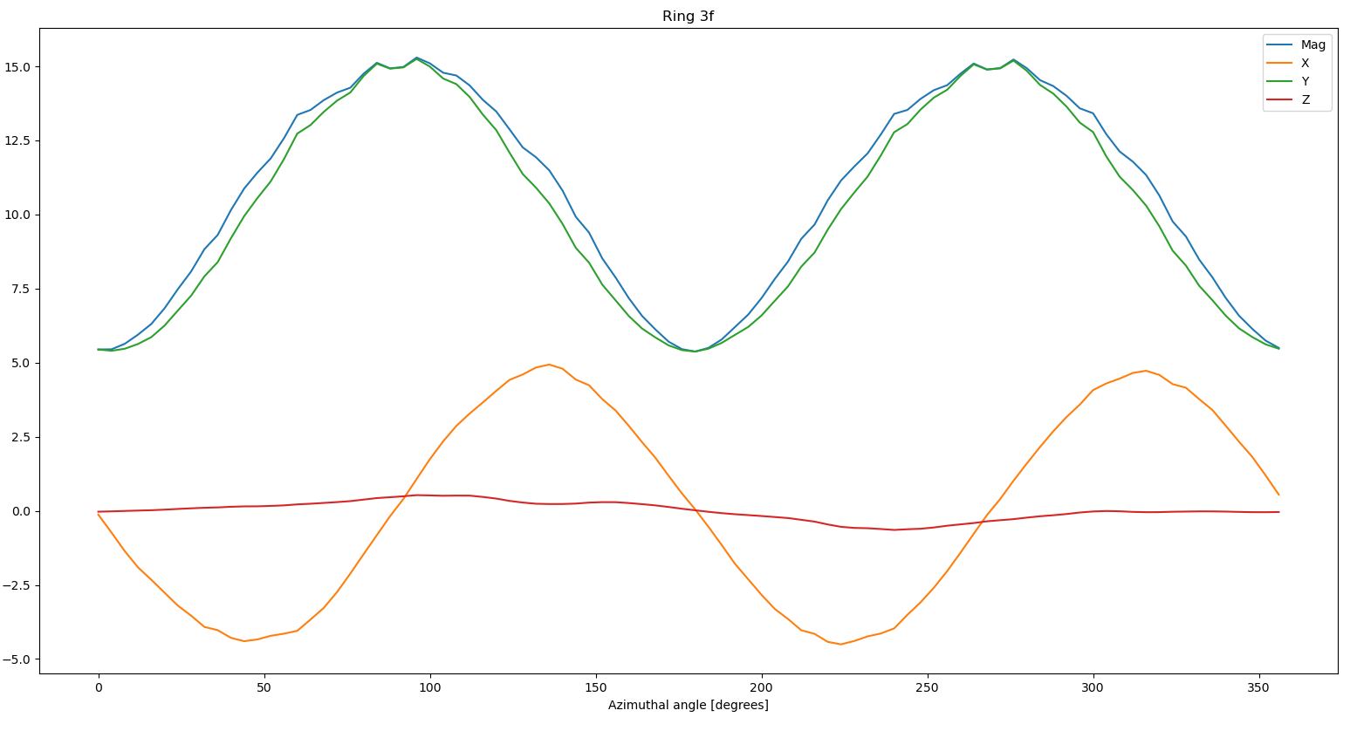
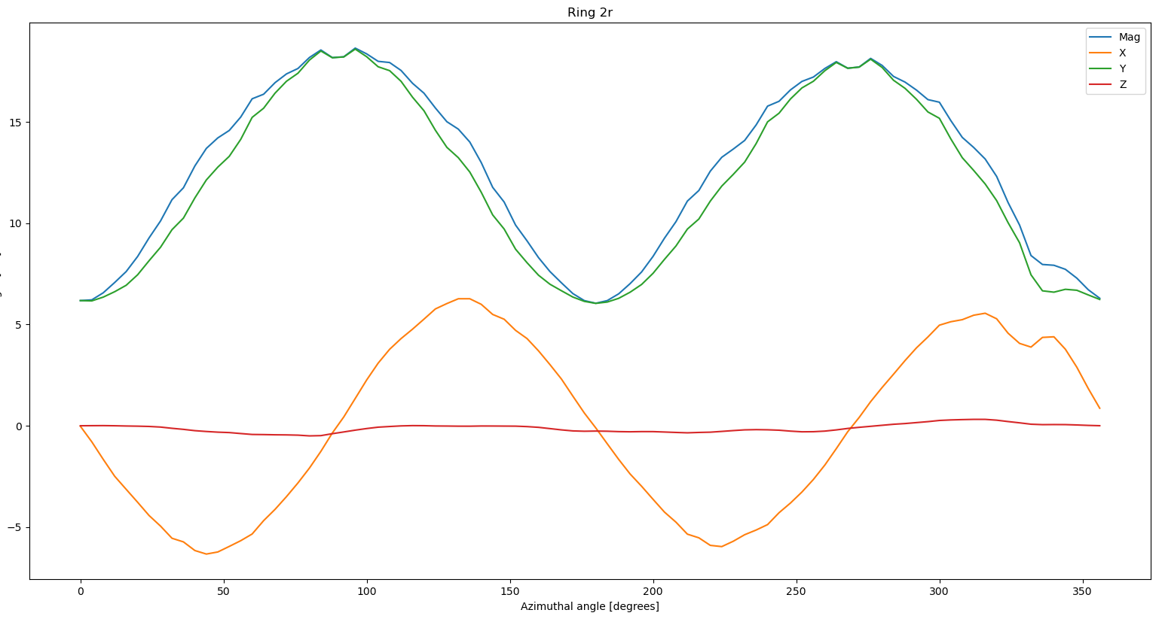
Construction: Dud magnets

Slide 7
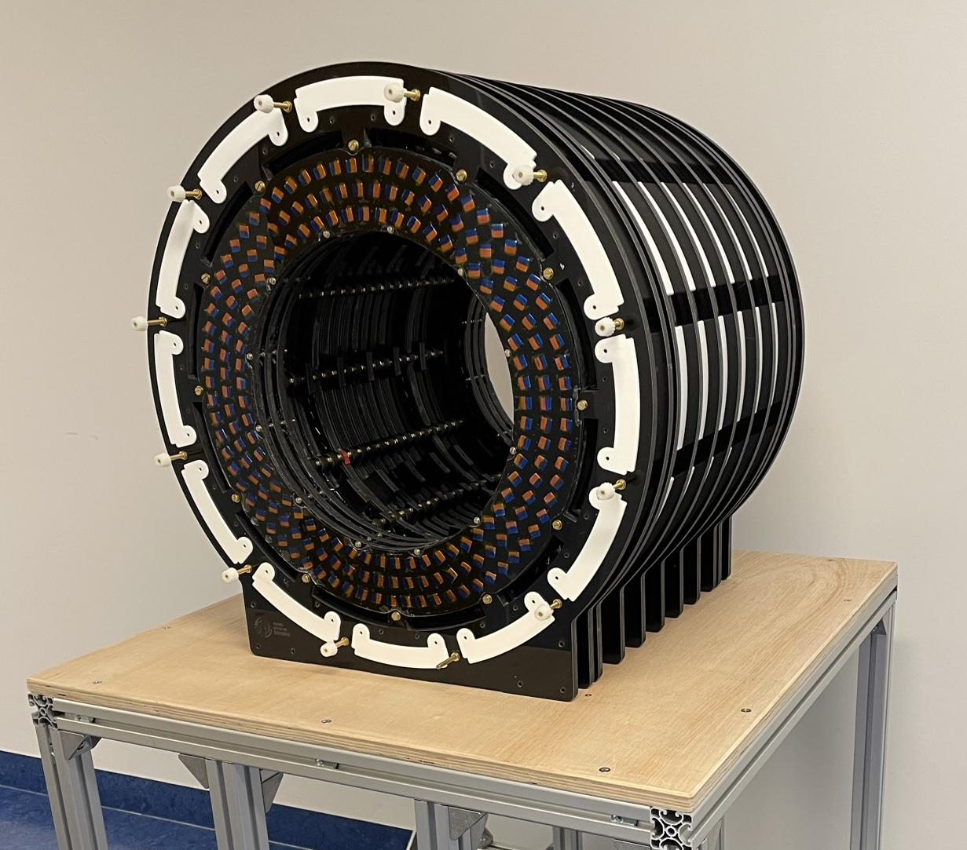
Construction: The finished magnet!

Slide 8
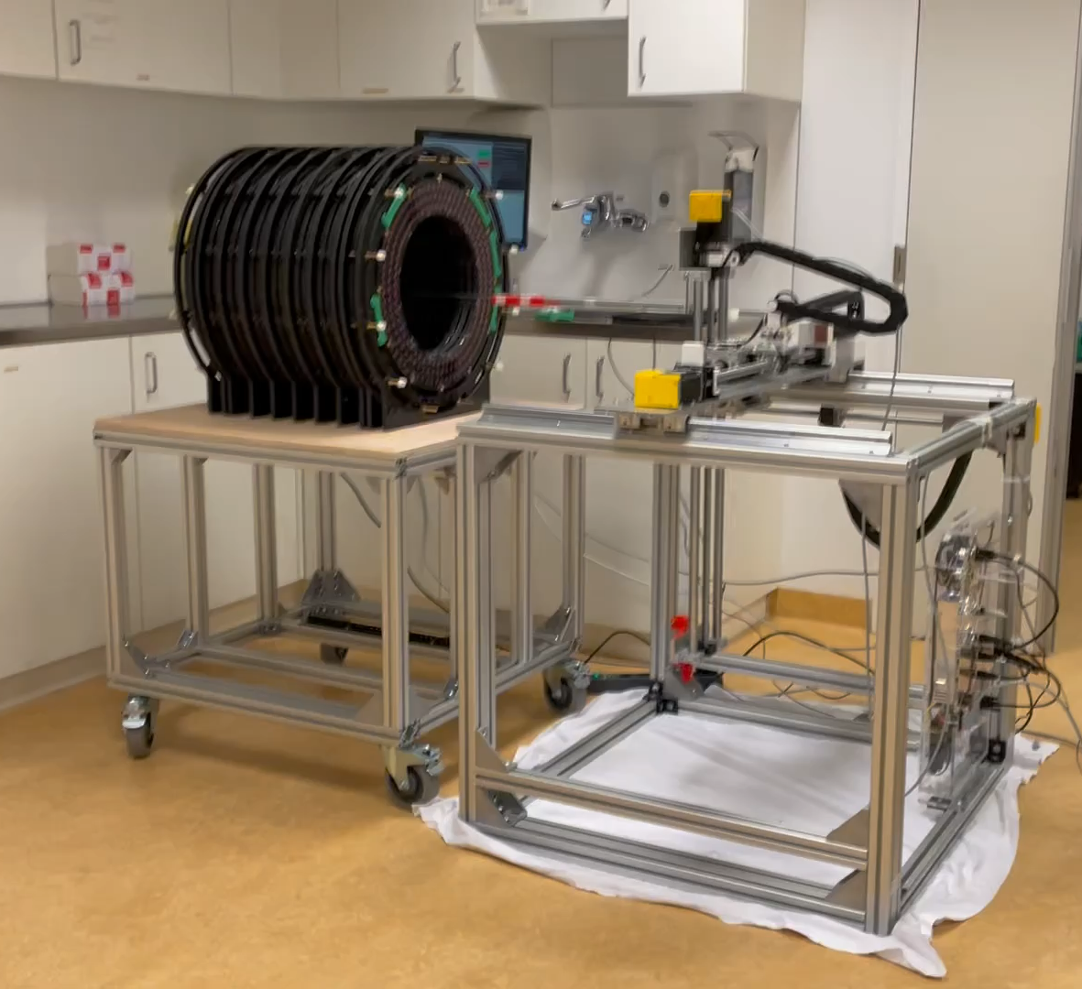
Shimming: Mapping
3D positioning system
    COSI Measure¹ (open source)
Hall effect sensors
    LakeShore Cryotronics F71
    AlphaLab Inc, High precision probe
Fit spherical harmonics
    Helps reduce noise
Temperature stable environment
    !!!!!!!!!!!
Consider background field
1. https://github.com/opensourceimaging/cosi-measure

Slide 9
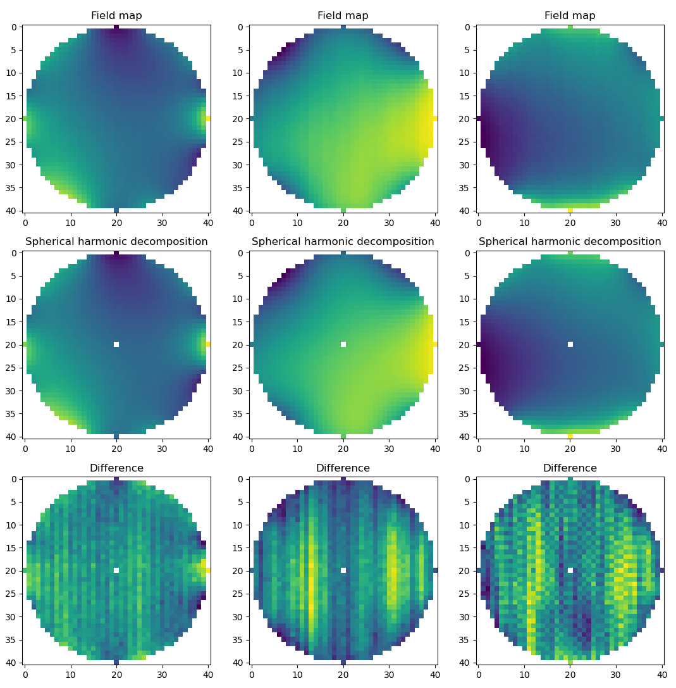
Spherical harmonic decomposition

Slide 10
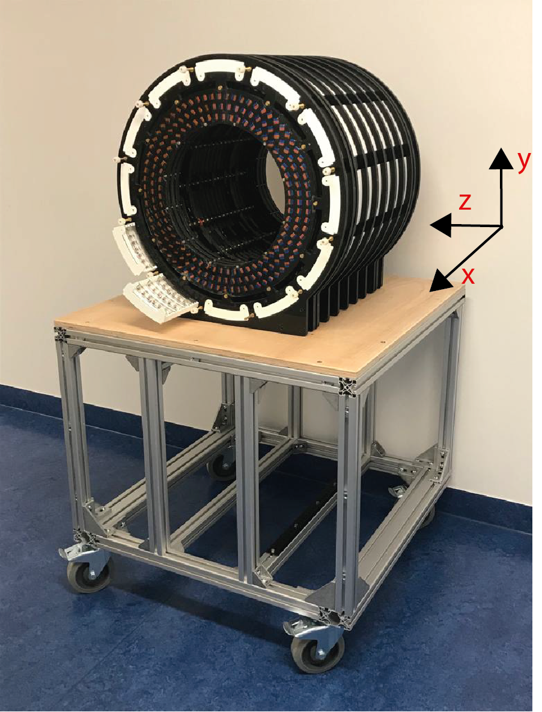
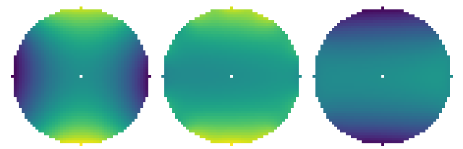
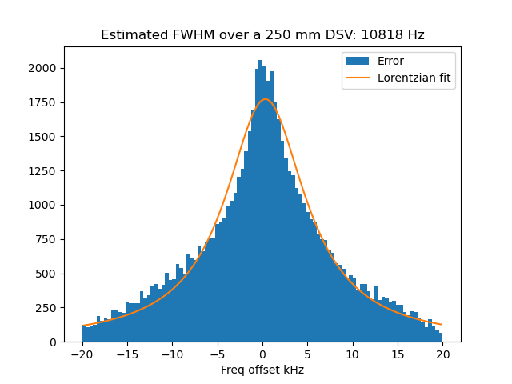
Field maps
Homogeneity: Simulated Measured
250 mm DSV: 3000 ppm 24795 ppm

Slide 11
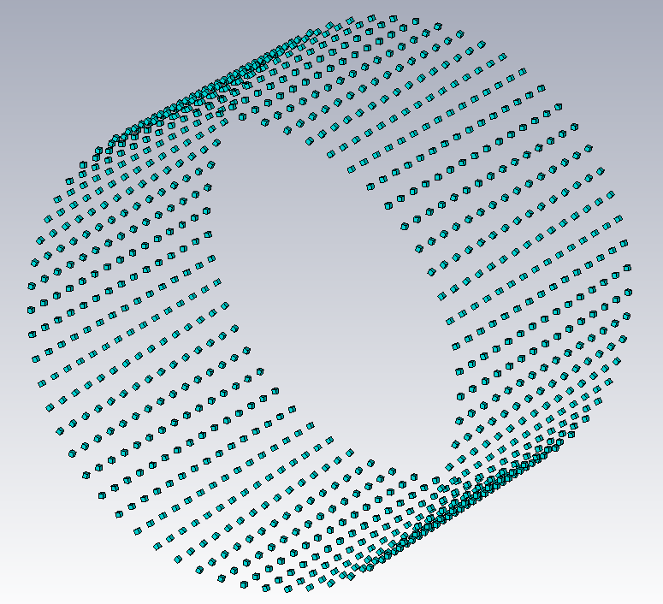
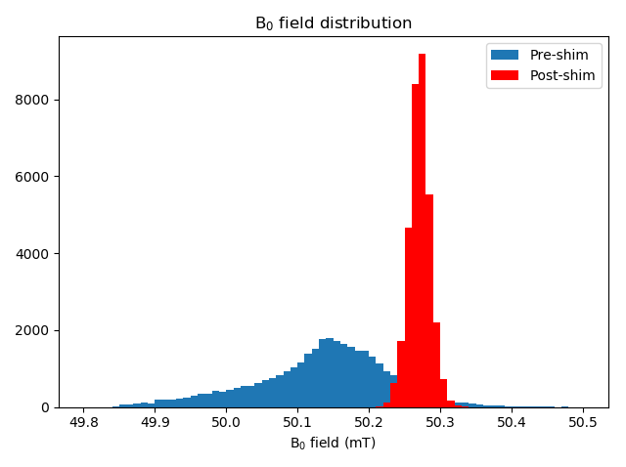
Shimming:
Use (small) magnets to correct inhomogeneity
    Iron shims less suitable
Perform optimisation on measured field
    Cannot be pre-computed
    Be flexible in shim system design
Typically an iterative process
    Consider when designing shim system

Slide 12
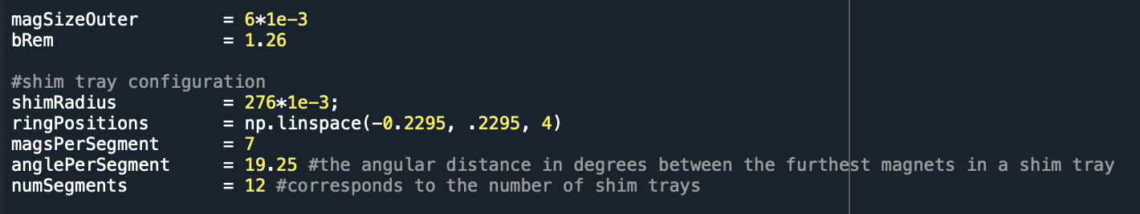
Shim calculations
Python based optimisation
    (will be) open source
Define properties/location of magnets
Read in measuerd B0 map
Calculates optimal shim configuration

Slide 13
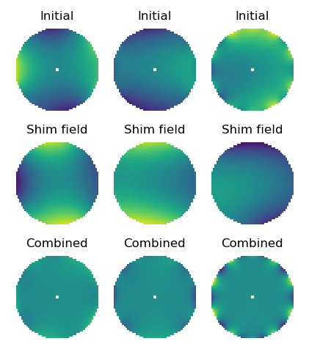
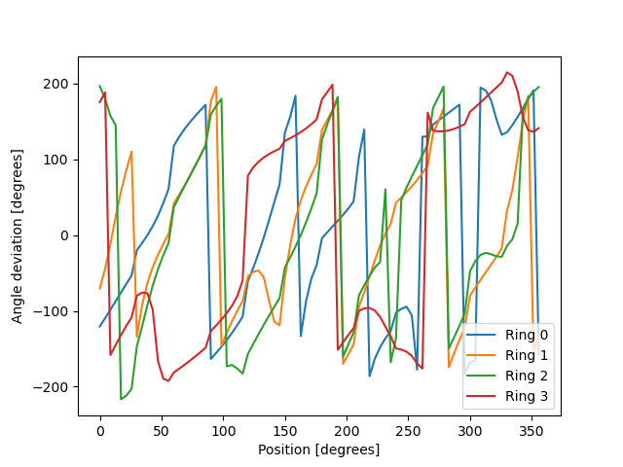
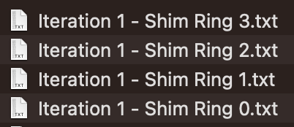

Algrotihm outputs

Slide 14

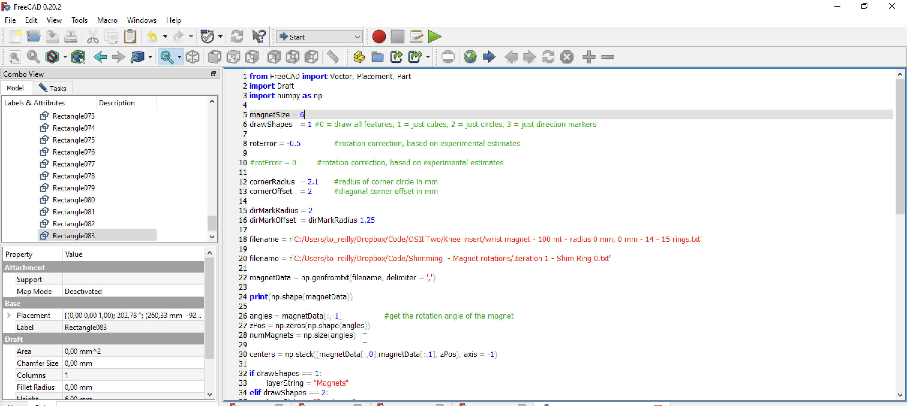
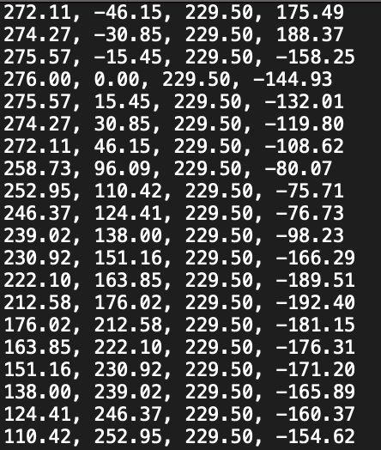
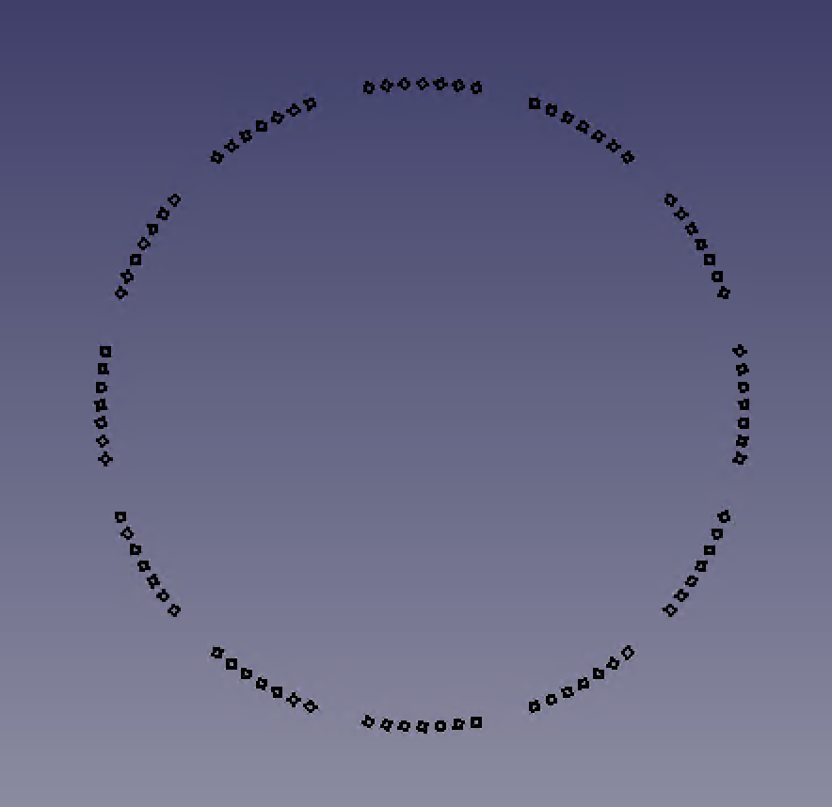
Construction
Txt file: x,y,z, angle

Slide 15
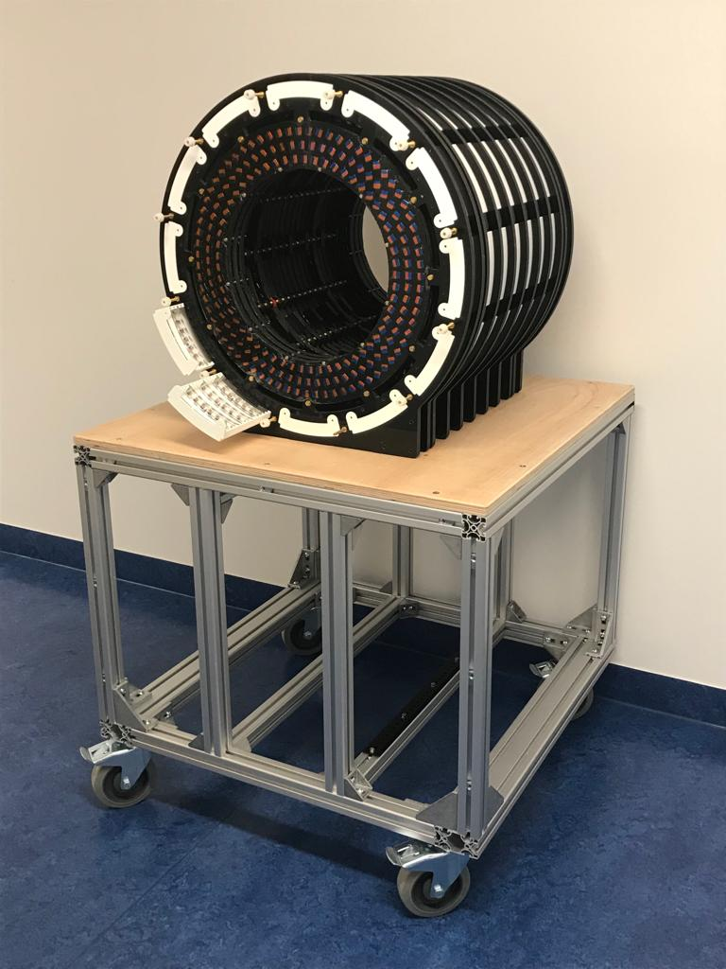
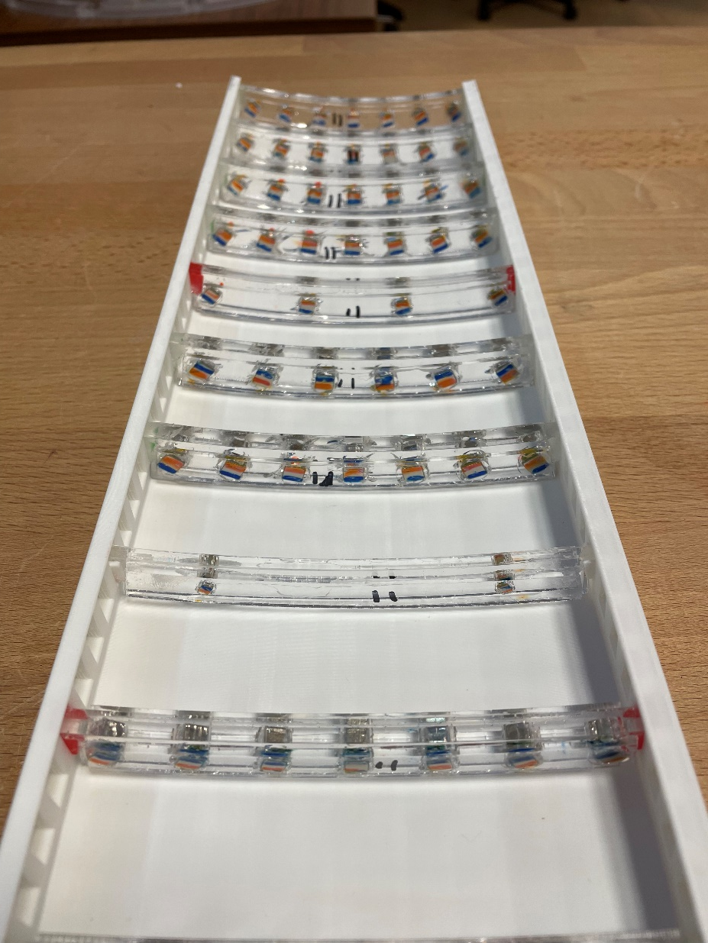
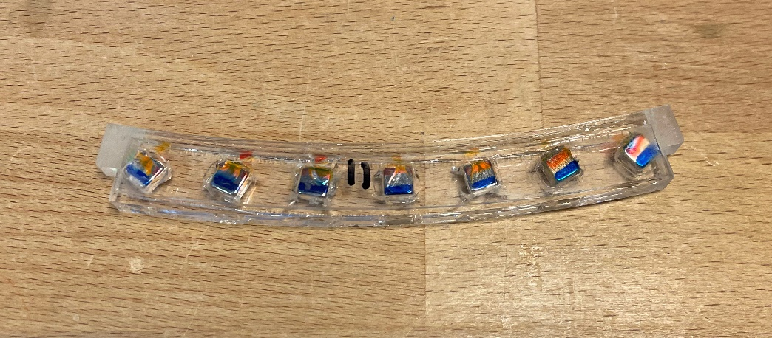
Construction

Slide 16
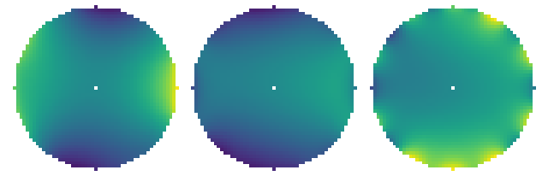
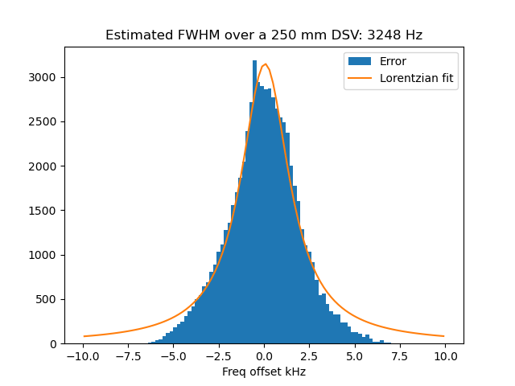
Mapping: 24795 ppm to 6806 ppm

Slide 17
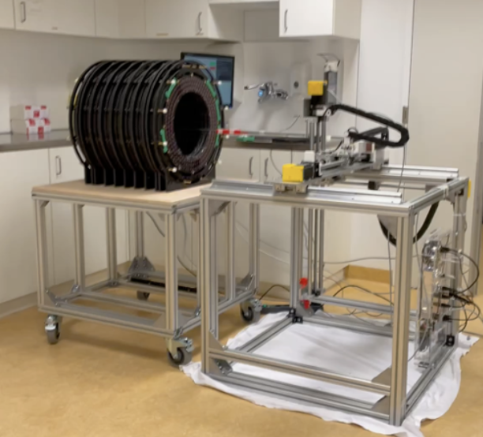
Repeat process

Slide 18

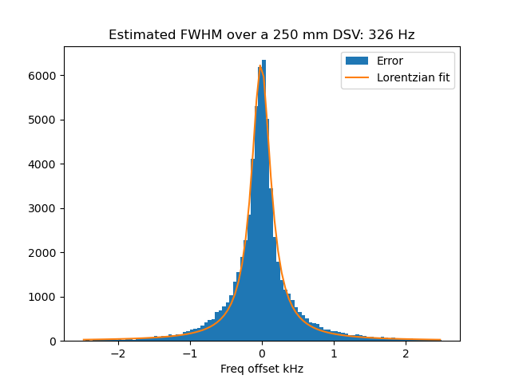
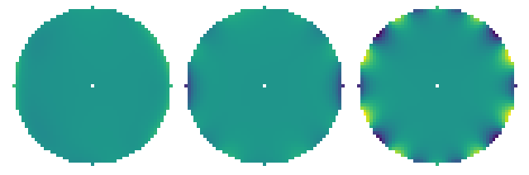
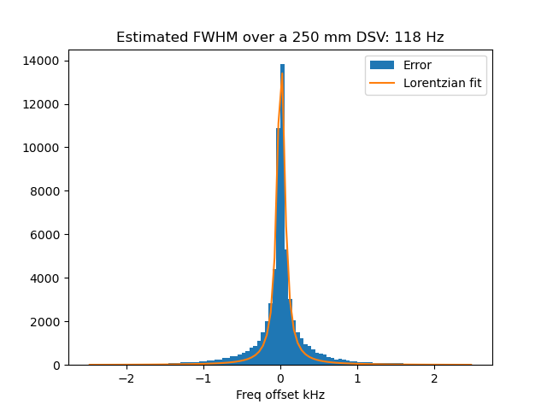
Iteration 2 and 3 – Full shimming
3889 ppm
3383 ppm

Slide 19
General notes
Limits to how good the shim can be
    Typically equal to initial simulations
Shim is very flexible
    Strength and size of magnets
Don’t try to get it perfect first time
    3 or 4 iterations typically needed
Try to adjust number of magnets
    Decreasing returns on investment

