Slide 1
OSI² One build workshop
Gradient Coils
Sebastian Littin
Medical Physics, University Medical Center Freiburg, Germany
Berlin, September 22th, 2023

Slide 2
Overview
Gradient Coils in MRI
Gradient Coil Design
Gradient Coil Manufacturing

Slide 3
Overview
Gradient Coils in MRI
Gradient Coil Design
Gradient Coil Manufacturing

Slide 4
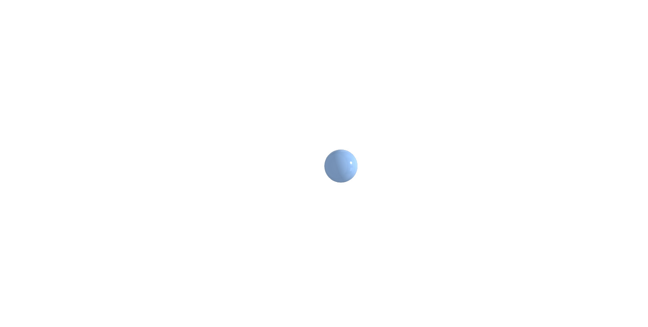
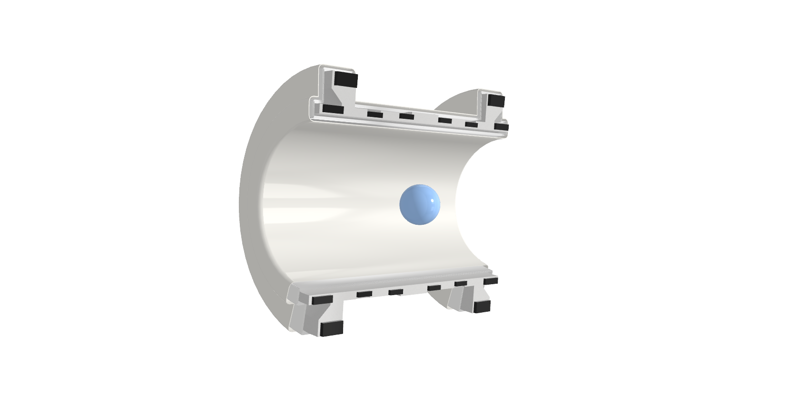
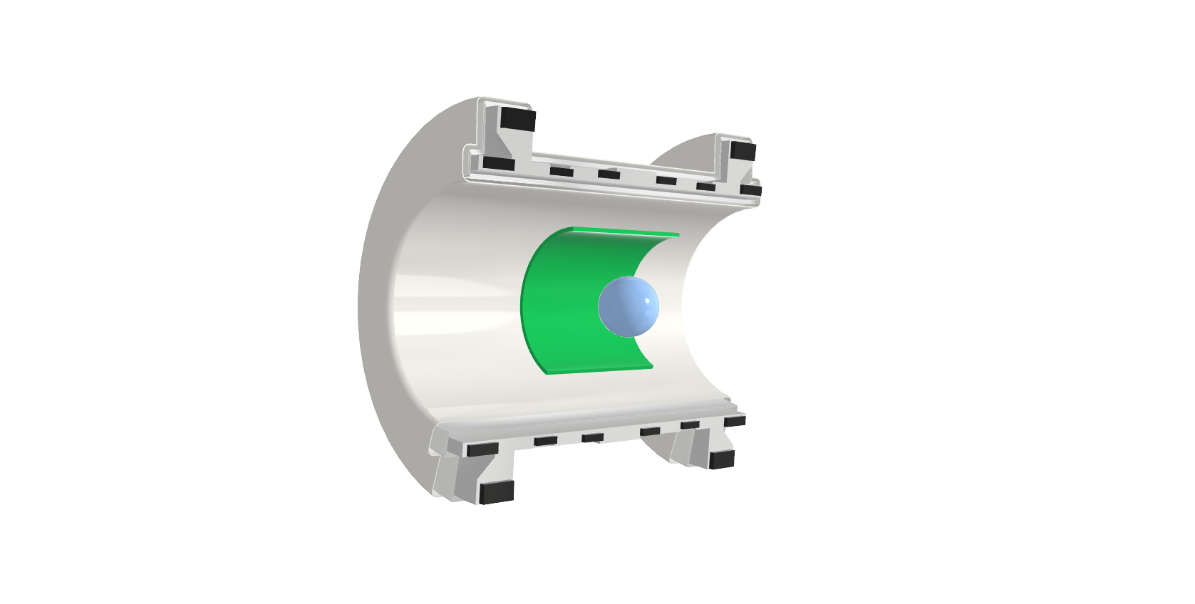
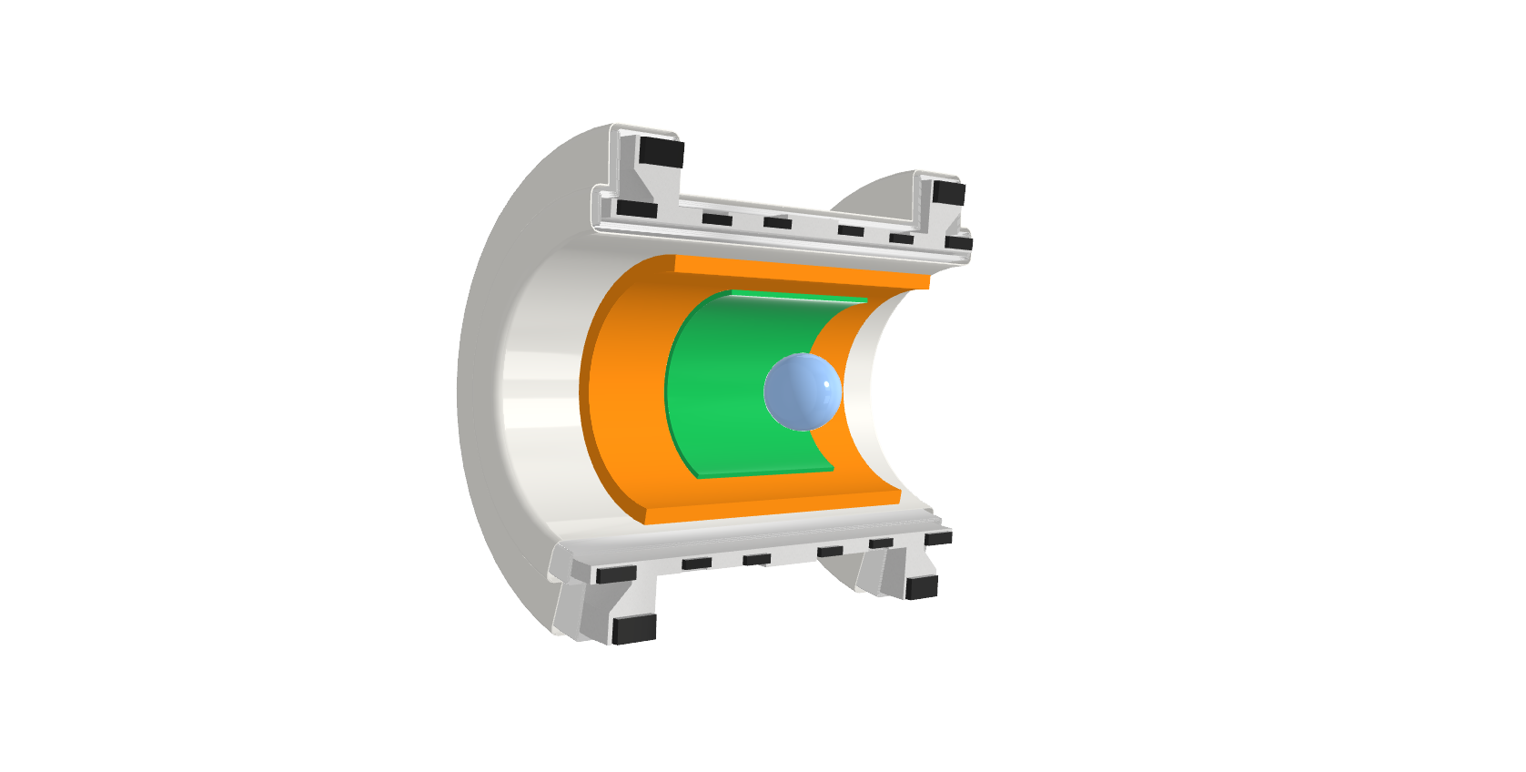
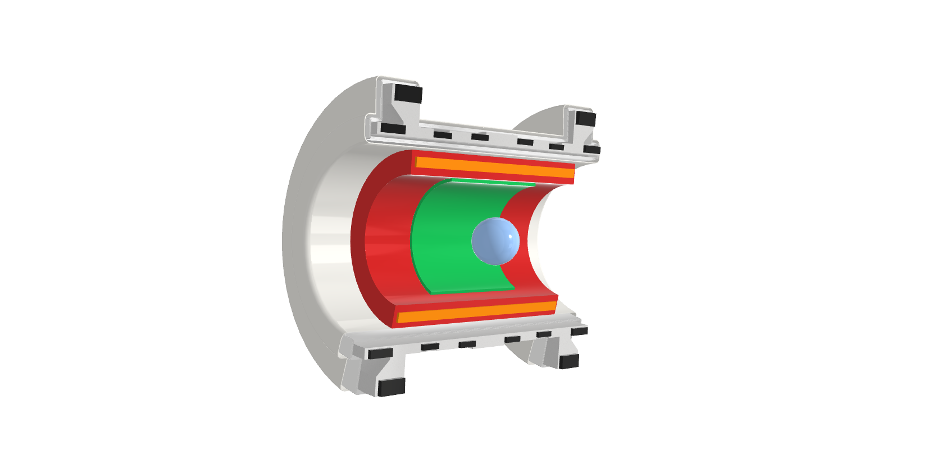
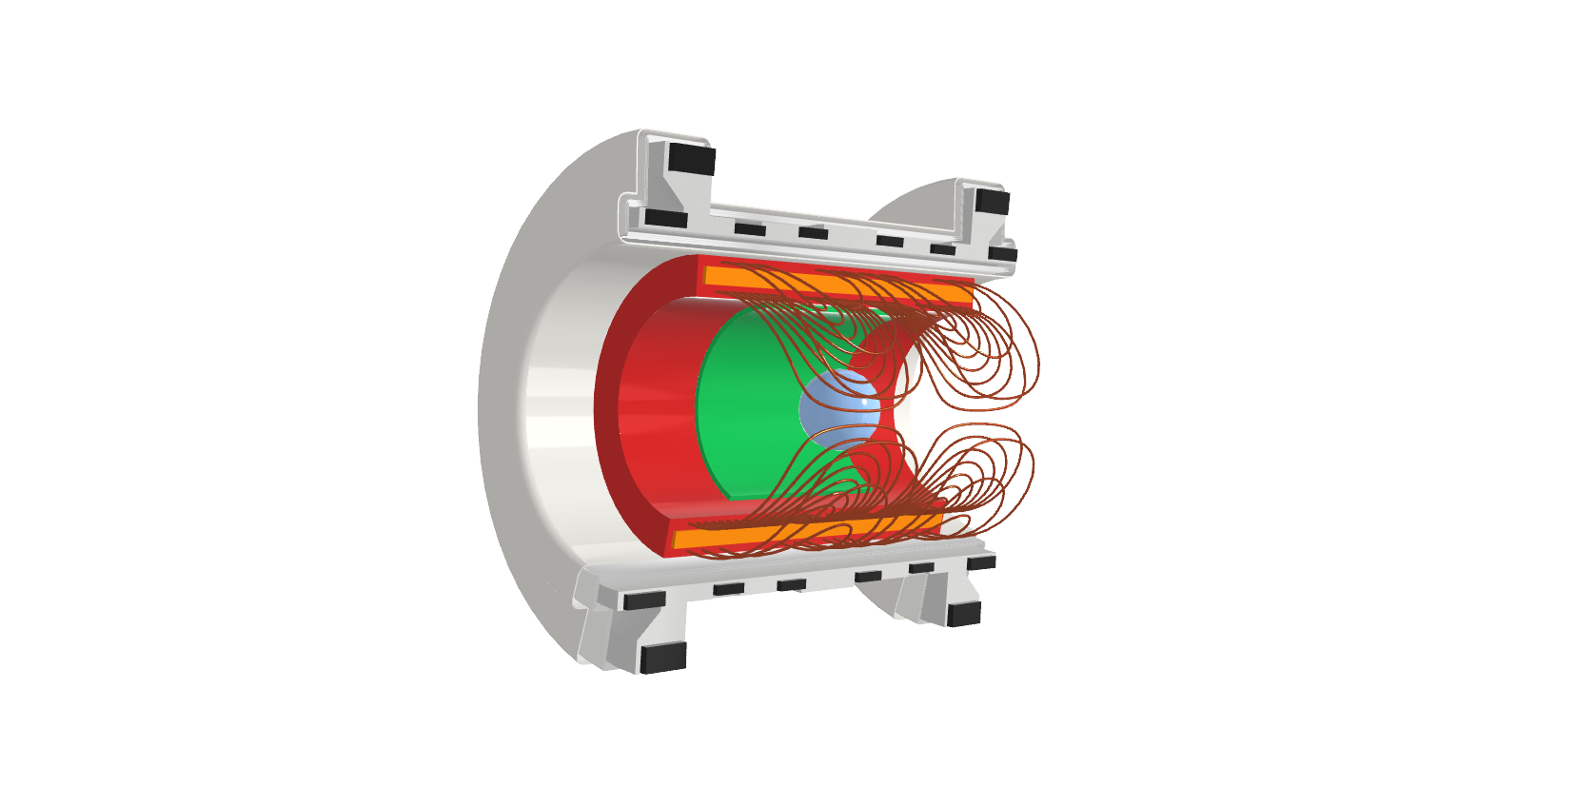
Gradient Coils in MRI: NMR vs MRI
What is necessary for the NMR Signal?
Sample => Signal source (¹H, ¹³C, ¹⁷O, …)
Magnet => Polarization (T; static (0Hz))
RF coil => Excitation/ Acquisition (µT; MHz)
Shims => Field Homogenization
NMR Spectrometer
Gradient Coils => Signal Localization
Gradients enable imaging
NMR => MRI
up to ~300mT/m; up to ~5 kHz

Slide 5






Spatially Varying Magnetic Fields - a.k.a. “Gradients”
Spatial variation of B₀-field: Linearly varying magnetic field (B_{z})
Local variation of the Larmor frequency
Linear relation between object and frequency space
Homogeneous slice profiles
Straight-forward Fourier Transform (FFT)
Usually three orthogonal magnetic (B_{z}) field gradients along spatial directions x,y and z
Extends beyond imaging region
Constant Gradient
$$B_{z}$$
$$ω_{2}$$
$$x$$
$$ω_{1}$$
Object
$$x_{1}$$
$$x_{2}$$

Slide 6
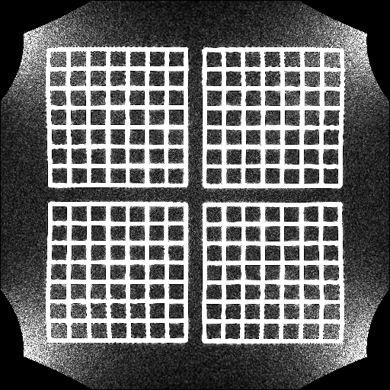
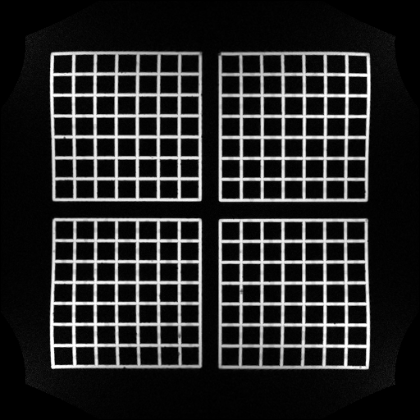
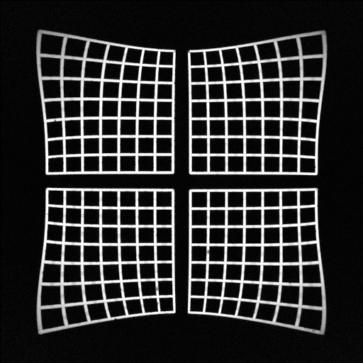
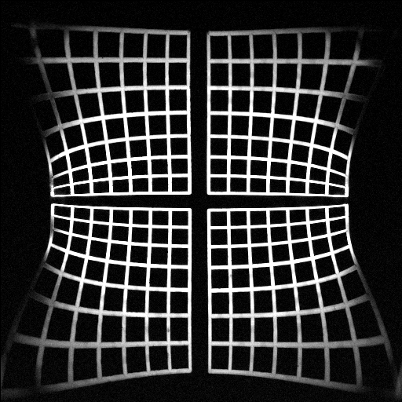
How linear are our encoding fields?
375 mm
clinical scanner, XZ (coronal) slice
FOV=50cm, iso-center
FOV=50cm, iso-center
no gradient distortion correction
FOV=50cm, 20cm above iso-center
no gradient distortion correction
All gradients are non-constant to some degree

Slide 7

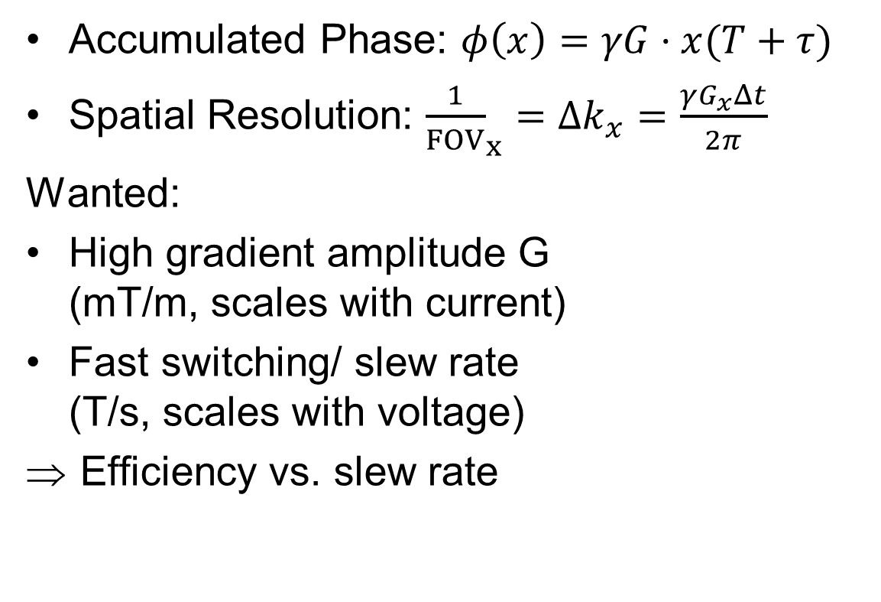

Gradient Coils in MRI: Image Encoding
Accumulated Phase: $φ\left(x\right)=γG⋅x(T+τ)$
Spatial Resolution: ${\frac{1}{FOV}}_{x}=Δk_{x}=\frac{γG_{x}Δt}{2π}$
Wanted:
High gradient amplitude G (mT/m, scales with current)
Fast switching/ slew rate (T/s, scales with voltage)
Efficiency vs. slew rate
Area =
Gradient Moment
Amplitude (G)
$$τ$$
T
$$τ$$
Time (t)
Imaging: Gradient Moment

Slide 8
Overview
Gradient Coils in MRI
Gradient Coil Design
Gradient Coil Manufacturing

Slide 9
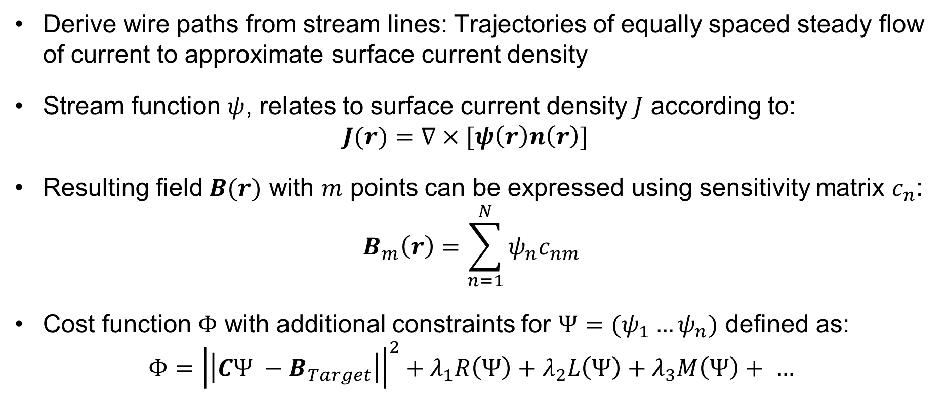
Gradient Coil Design: Boundary Element Method
Derive wire paths from stream lines: Trajectories of equally spaced steady flow of current to approximate surface current density
Stream function $ψ$, relates to surface current density $J$ according to:
$$J(r)=∇×[ψ\left(r\right)n\left(r\right)]$$
Resulting field $B(r)$ with $m$ points can be expressed using sensitivity matrix $c_{n}$:
$$B_{m}\left(r\right)=\sum_{n=1}^{N}{ψ_{n}c_{nm}}$$
Cost function $Φ$ with additional constraints for $Ψ=(ψ_{1}…ψ_{n})$ defined as:
$$Φ={\left|\left|CΨ −B_{Target}\right|\right|}^{2}+λ_{1}R\left(Ψ\right)+λ_{2}L\left(Ψ\right)+λ_{3}M\left(Ψ\right)+ …$$

Slide 10
Openly Available Software Repositories
Fully flexible design and post processing “CoilGen: Open Source MR Coil Layout Generator“ [1]
https://github.com/Philipp-MR/CoilGen
Educational “Thin-wire approximation” [2]
https://github.com/Sebastian-MR/ThinWire_MRIGradientCoilDesign
Python based “GradientDesignTool” (Patrick Fuchs)
https://github.com/LUMC-LowFieldMRI/GradientDesignTool
Matlab based “CoilDesign” (Gale Bringout)
https://github.com/gBringout/CoilDesign/
[3] Amrein P et al CoilGen: Open-source MR coil layout generator. Magn Reson Med. 2022; 88( 3): 1465- 1479. doi:10.1002/mrm.29294
[4] Littin S et al (2021) Methods: Of Stream Functions and Thin Wires: An Intuitive Approach to Gradient Coil Design. Front. Phys. 9:699468. doi:10.3389/fphy.2021.699468

Slide 11
How to design a gradient coil?
Define basic properties:
  Current carrying surface(s)
    Size/ Shape/ Resolution
  Target (main (&shield))
    Size/ Shape/ Resolution
  Main field (B₀) direction
    B_{z} || B₀
    Transverse components B_{x}/B_{y} ?
  Additional Constraints
    Torque/ force balance
    Minimum wire distance
    …
=> Fully flexible design and postprocessing “CoilGen: Open Source MR Coil Layout Generator“ [4]
https://github.com/Philipp-MR/CoilGen
[4] Amrein P et al CoilGen: Open-source MR coil layout generator. Magn Reson Med. 2022; 88( 3): 1465- 1479. doi:10.1002/mrm.29294

Slide 12
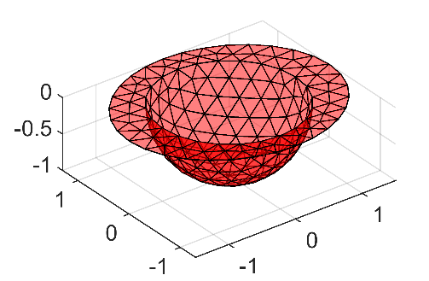
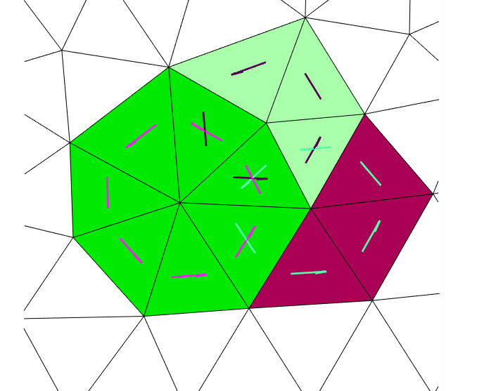
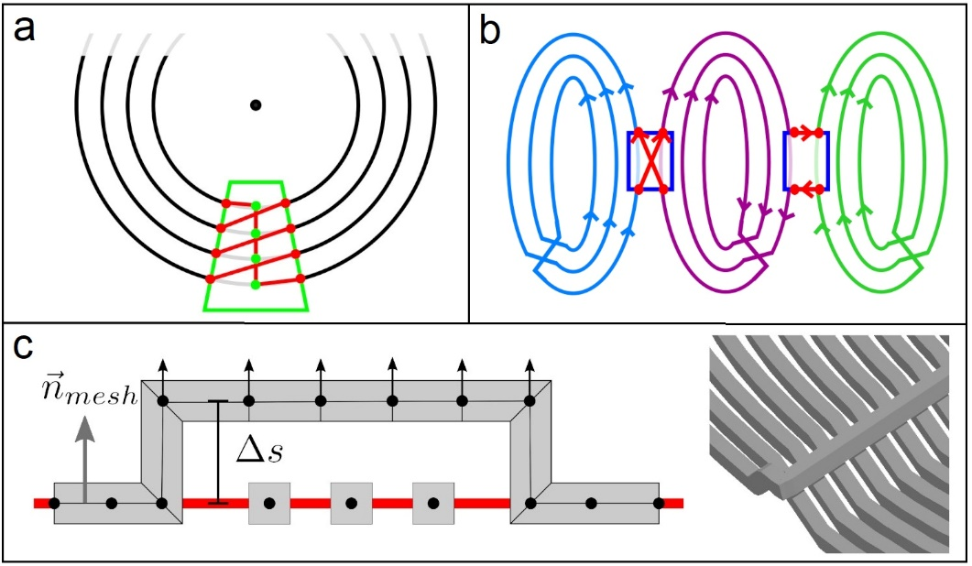
Boundary Element Method: CoilGen
Generate triangular surface mesh
Design on arbitrary surfaces
Optimize the stream function on boundary elements of a mesh [7,8]
Advanced post-processing options
Output: Non-overlapping, interconnected coil layout.
[7] Peeren G N. Stream function approach for determining optimal surface currents Journal of Computational Physics. 2003;191:305–321.
[8] Lemdiasov et al. A stream function method for gradient coil design Concepts in Magnetic Resonance Part B: Magnetic Resonance Engineering. 2005;26B:67–80.

Slide 13
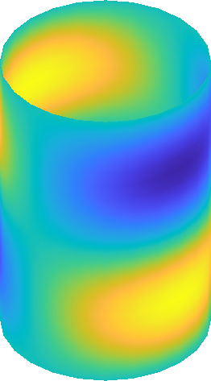
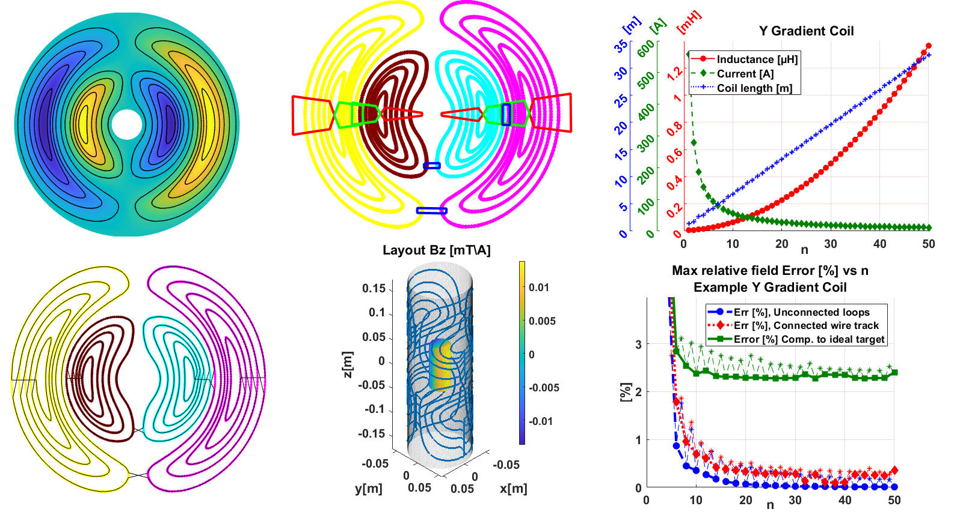
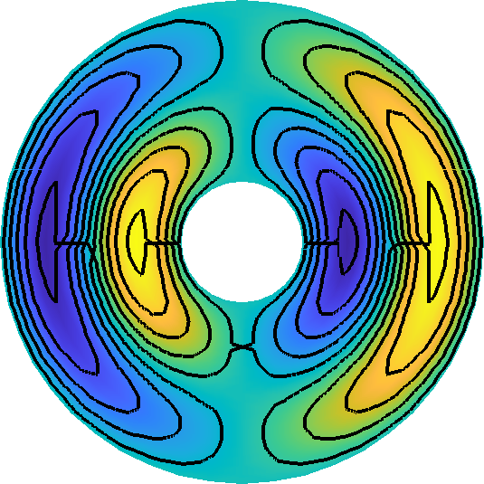
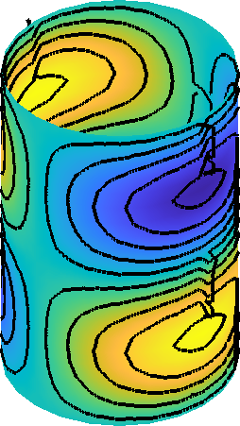
CoilGen: Beyond Stream Functions
Project on 2D surface, discretize
Analyze topology, define path
Interconnect in & between groups
Project back, manage overlaps

Slide 14
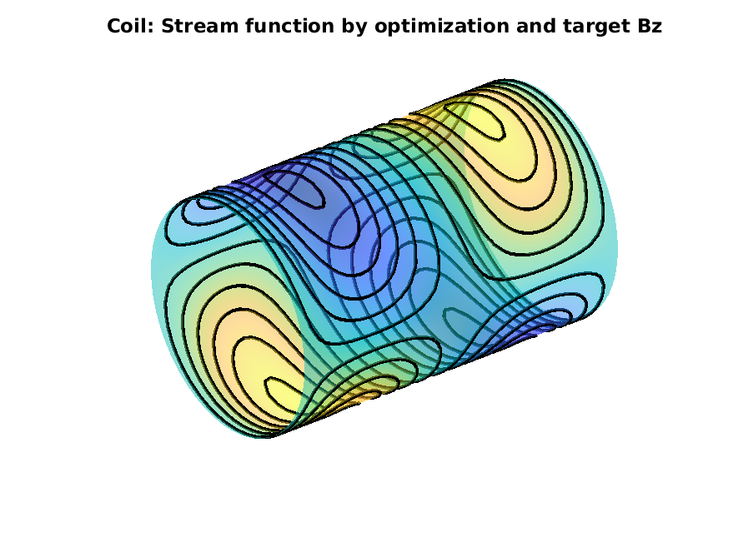
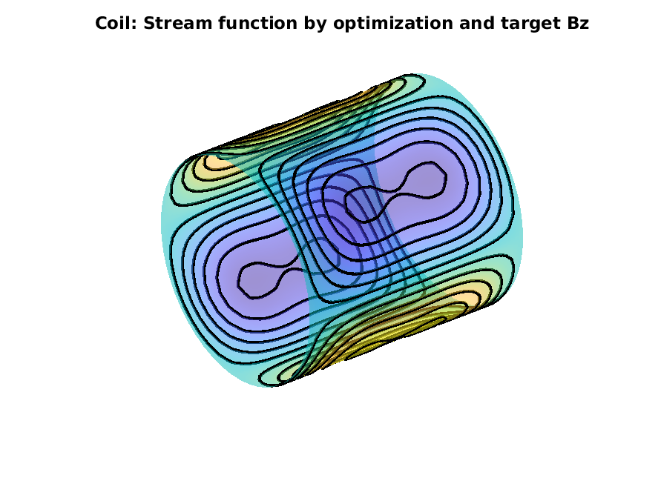
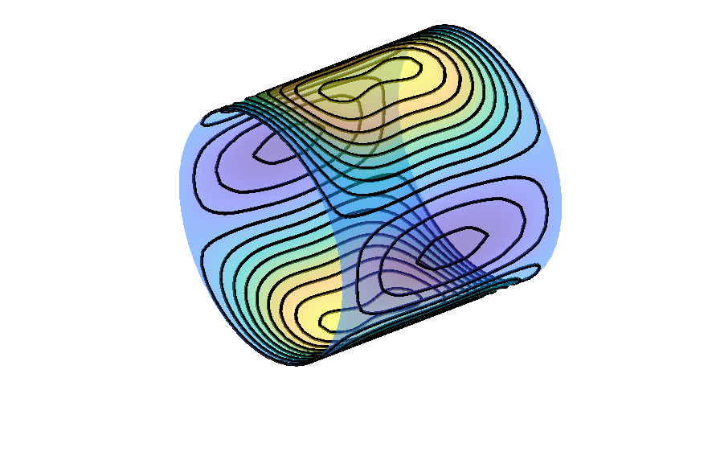
CoilGen: Coil Designs for Halbach Systems
x-Gradient
y-Gradient
z-Gradient

Slide 15
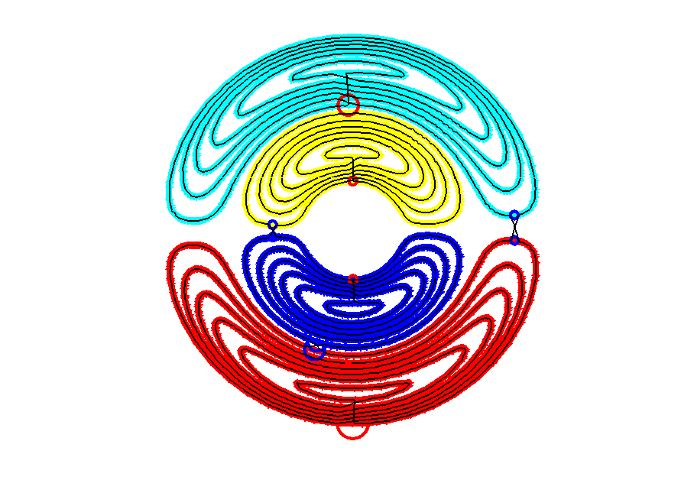
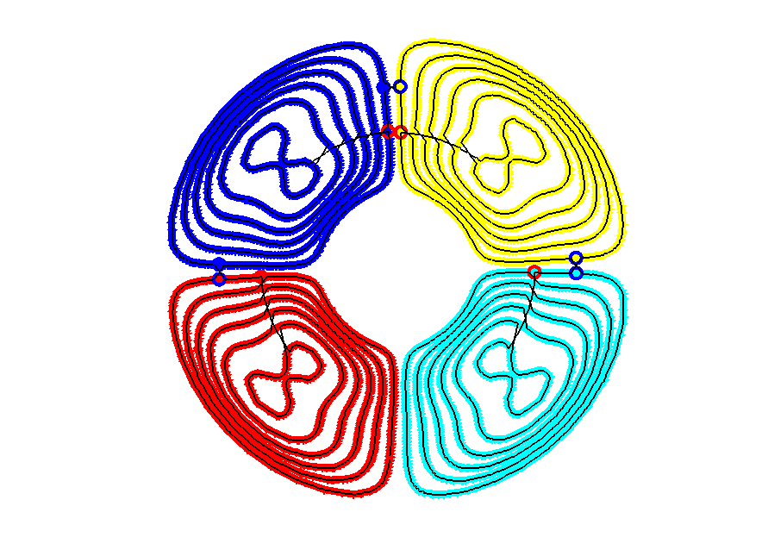
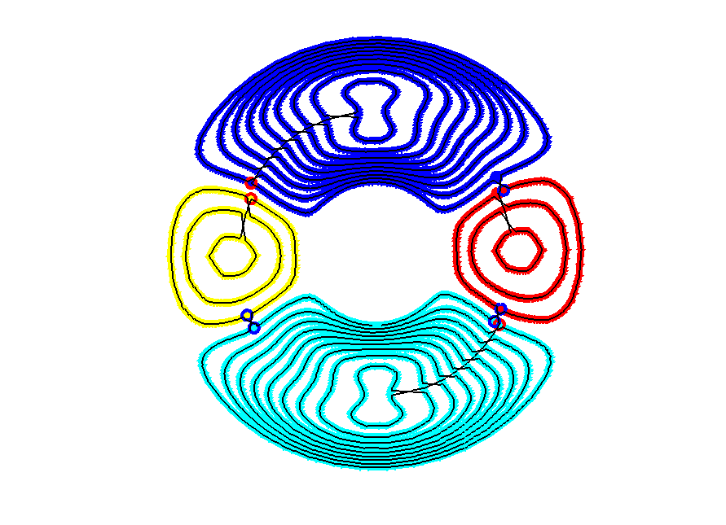
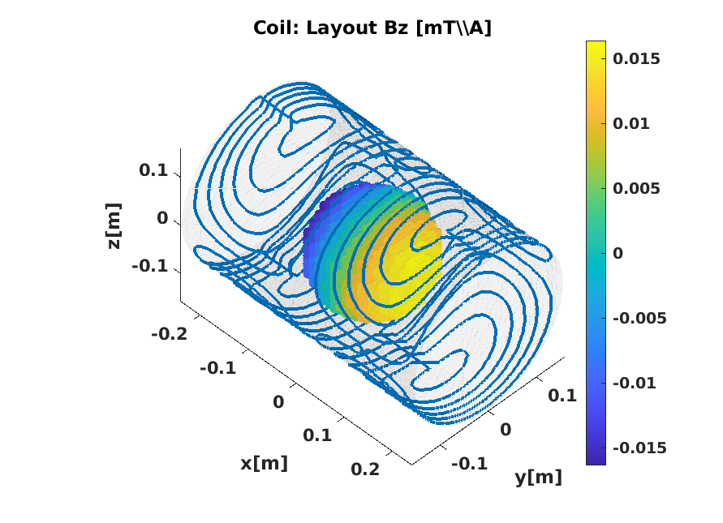
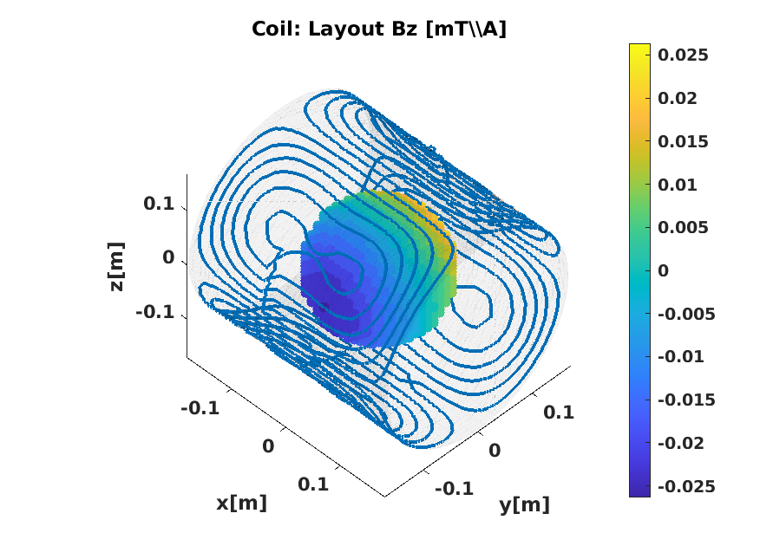
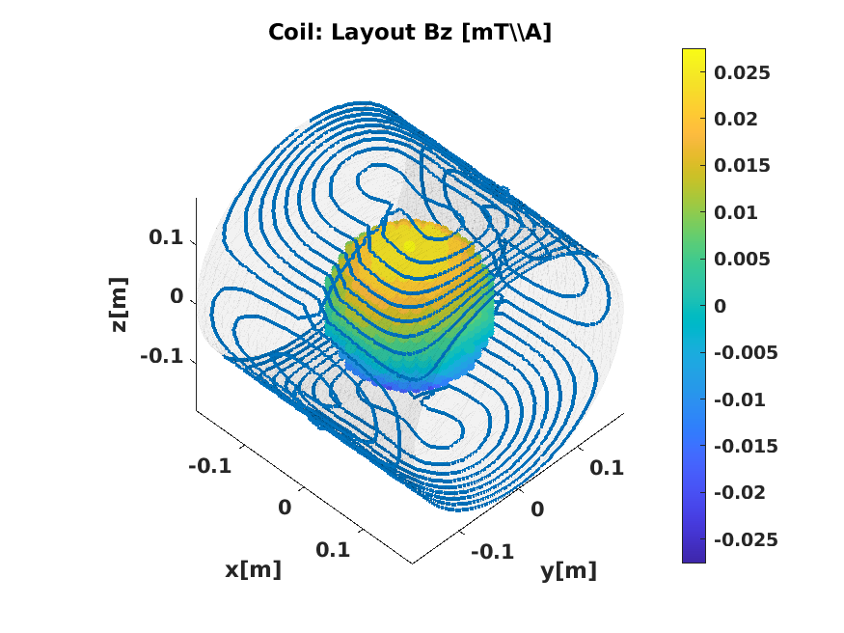
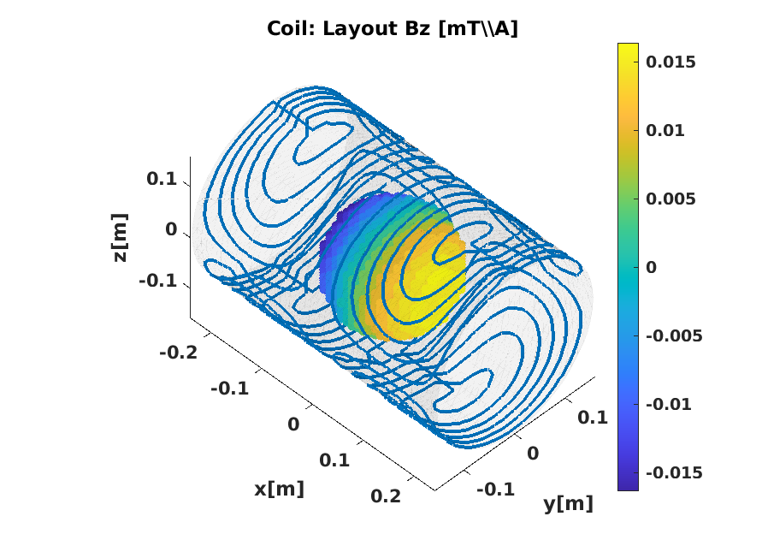
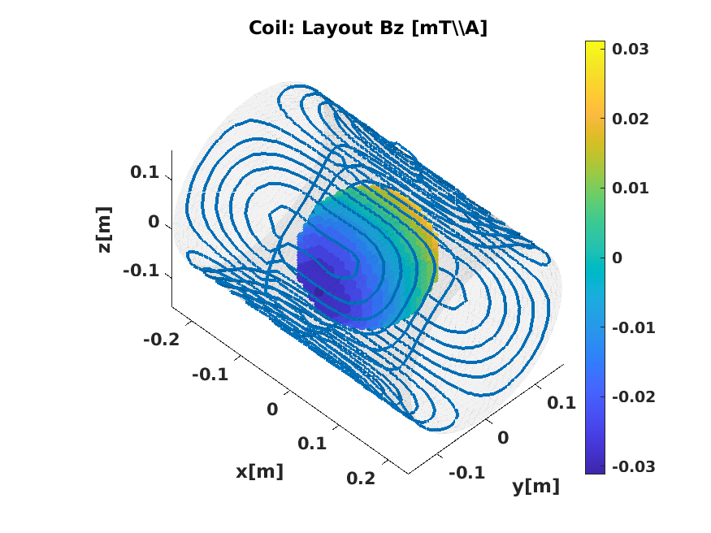
CoilGen: Coil Designs for Halbach Systems
x-Gradient
y-Gradient
z-Gradient

Slide 16
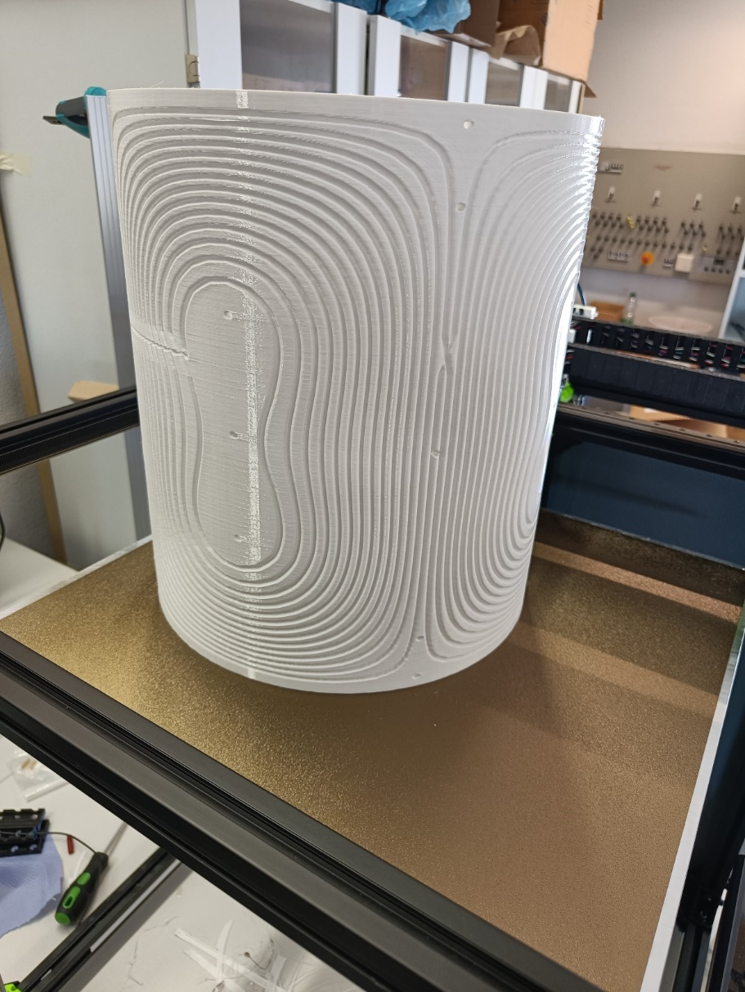
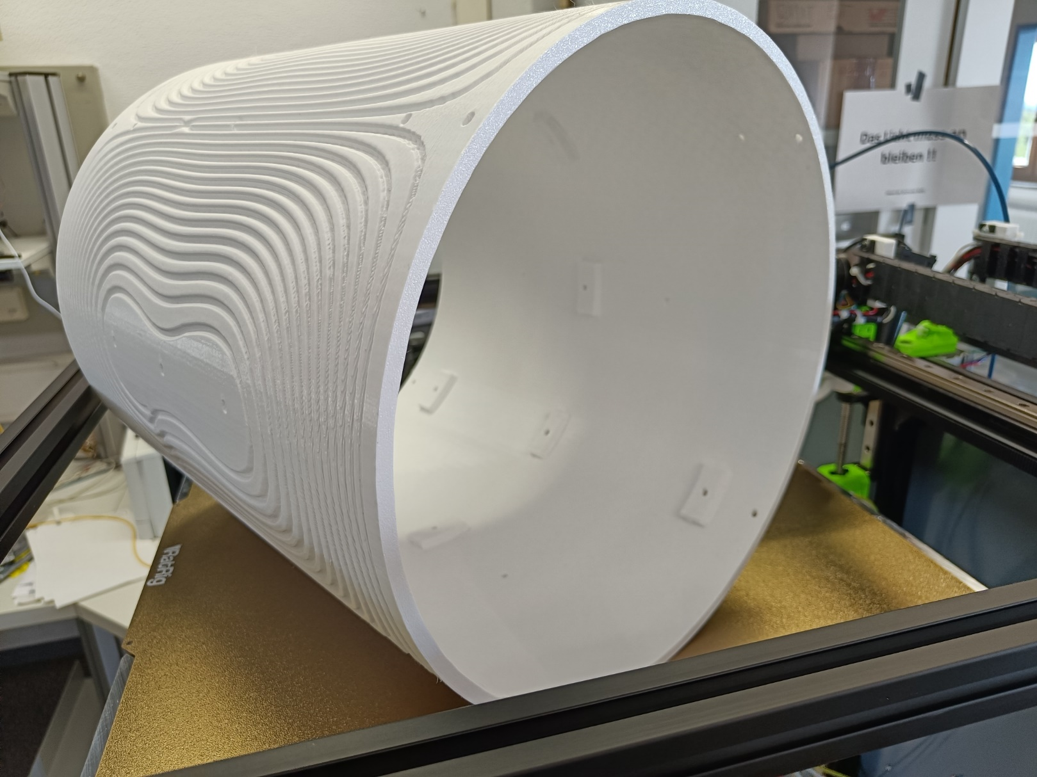
CoilGen: 3D printed carrier (FH Dortmund)
Images courtesy of Nils Allek (FH Dortmund)

Slide 17
Overview
Gradient Coils in MRI
Gradient Coil Design
Gradient Coil Manufacturing

Slide 18
Gradient Coil Manufacturing
How to realize a complex wire path?
Different approaches feasible:
Printed circuit boards (PCBs)
Wind on carrier structure (3D printed or milled)
Wind from copper wire
Directly cooled hollow wire
Remove material from solid sheet material (milling machine/ laser-cutter/ water-jet)

Slide 19
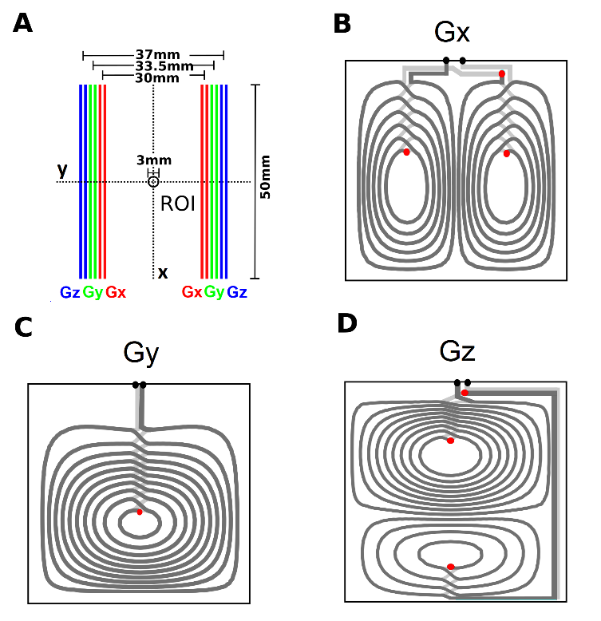
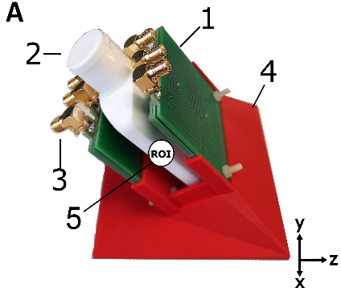
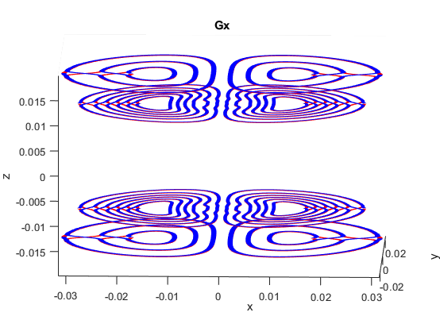
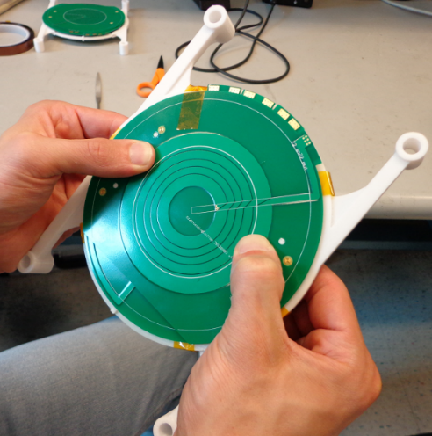
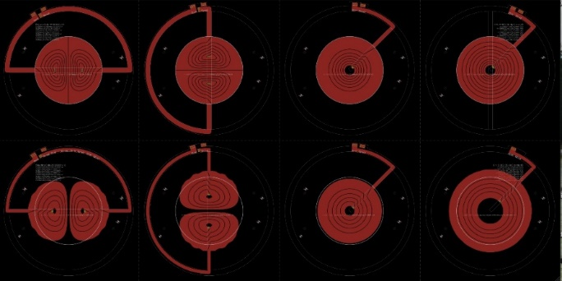

Printed Circuit Boards (PCBs)
Established manufacturing technique
Simple, cheap and precise from experienced companies
Limited cross section of conductor
[12]
[11]
[10]
[10] Zimmerman Cooley et al. Design and implementation of a low-cost, tabletop MRI scanner for education and research prototyping JMR Vol. 317, p. 106764
[11] OCRA Gradients, Images courtesy of M. Prier and P. Amrein
[12] Amrein et al. Optimal bi-planar gradient coil configurations for diamnond nitrogen-vacancy based diffusion-weighted NMR experiments, MagnResonMaterPhy (under review)

Slide 20
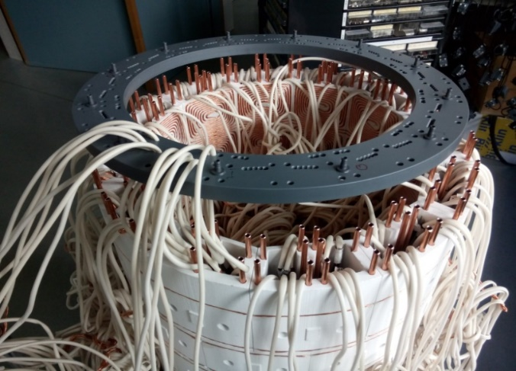
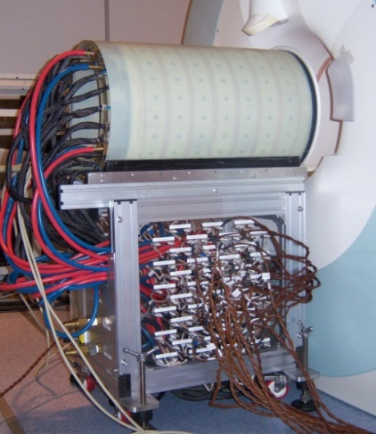
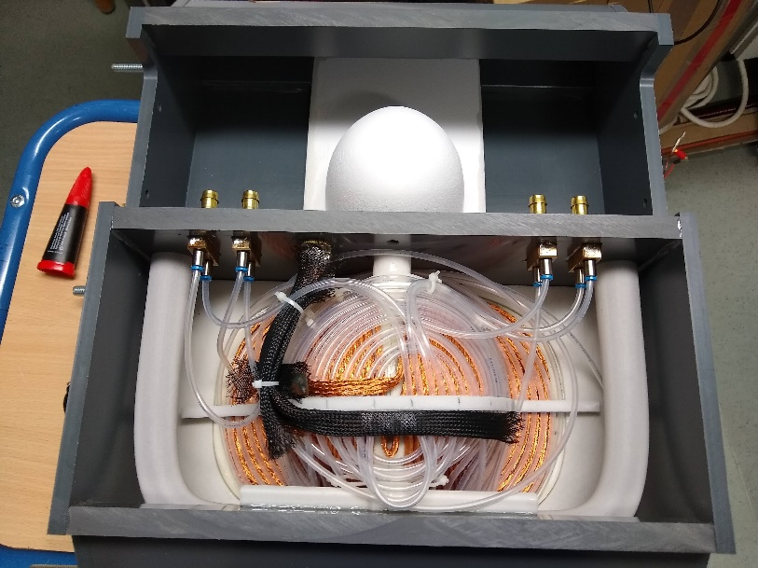
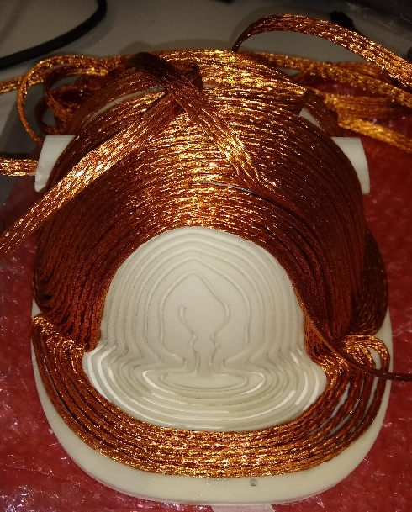
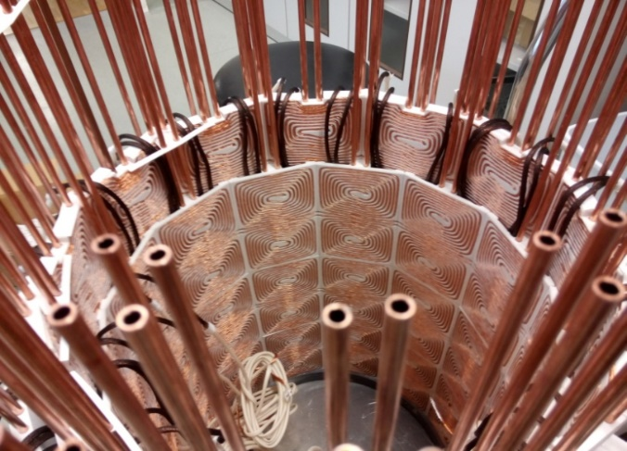
3D Printed Carrier Structures
3D printed coil carrier [16,17]
  Powder bed and inkjet head 3D printer
Individually insulated Litz wire
Vacuum infusion with epoxy resin
[17] Littin, S., et al. (2018), Development and implementation of an 84-channel matrix gradient coil. Magn. Reson. Med., 79: 1181-1191. https://doi.org/10.1002/mrm.26700
[16] Littin, S., et al. (2021), Approaching order of magnitude increase of gradient strength: Non-linear breast gradient coil for diffusion encoding, Proc. ISMRM 3096, 2021

Slide 21
Manufacturing Take Home Message(s)
Building hardware is:
  Fun and rewarding
  Tedious and exhausting: Plan for a “second first try”…
Use established connectors, methods, etc.
Question established practices
Check and double check for ferromagnetic parts
Measure before casting

Slide 22
Summary
Gradients enable for imaging: NMR => MRI
All gradients are non-constant to some degree
Stream function to approximate surface current density
BEM-methods mostly used
CoilGen: Pipeline for coil design established
Translation of CoilGen to Python in progress
Post processing necessary
Variety of manufacturing methods for implementing gradient coils within a research environment

Slide 23
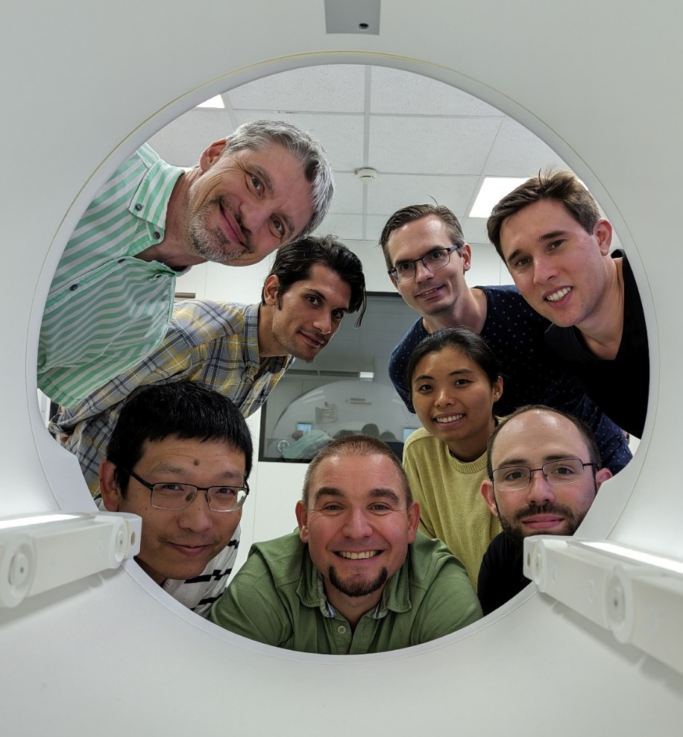
Acknowledgements
Philipp Amrein
Feng Jia
Ben Wilhelm
Maxim Zaitsev
All current and previous colleagues and collaboration partners
This work is part of the A4IM project.
This project (22HLT02 A4IM) has received funding from the European Partnership on Metrology, co-financed from the European Union‘s Horizon Europe Research and Innovation Programme and by the Participating States.
Further reading on gradient coils
[21] Hidalgo-Tobon, S.S. (2010), Theory of gradient coil design methods for magnetic resonance imaging. Concepts Magn. Reson., 36A: 223-242. https://doi.org/10.1002/cmr.a.20163
[23] Gudino, N. and Littin, S. (2023), Advancements in Gradient System Performance for Clinical and Research MRI. J Magn Reson Imaging, 57: 57-70. https://doi.org/10.1002/jmri.28421

