Slide 1
Gradient Coil Construction and Mounting
Wouter Teeuwisse, Tom O’Reilly
C.J. Gorter MRI Center
Leiden, The Netherlands

Slide 2
Gradient Construction, constraints
Available space
How to get gradient coils in/out of the magnet
Mechanical stress
Solid positioning
Wire connections

Slide 3
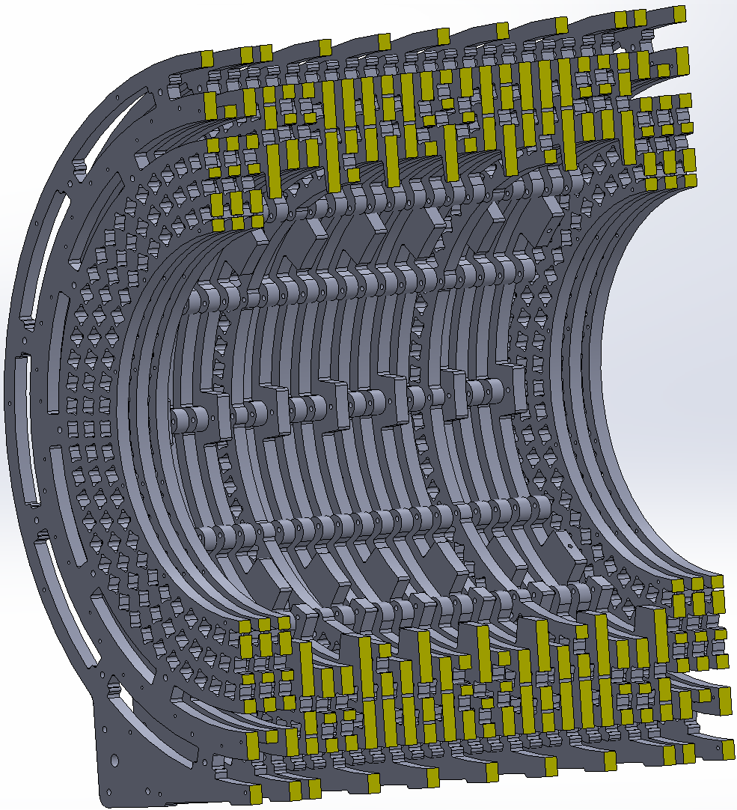
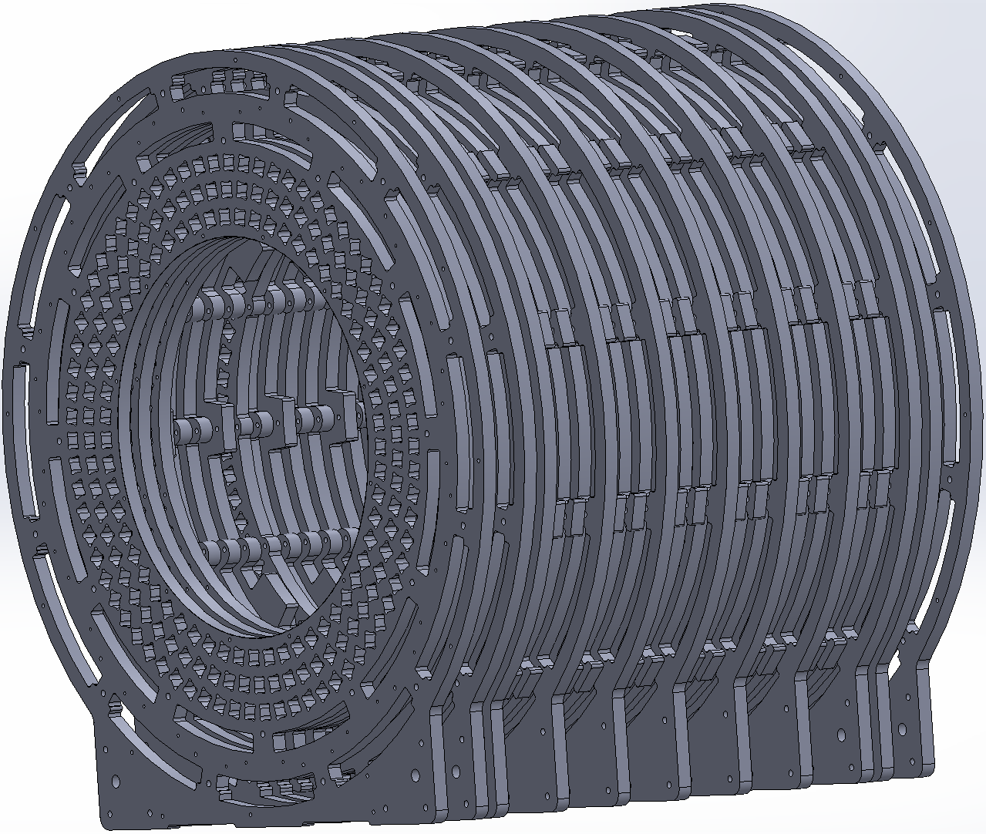
Constraints
1. Available space

Slide 4
Available space
Requirements:
X-gradient as long as possible
Keep bore as wide as possible

Slide 5
Constraints
2. How to get gradients in or out
Good: Coils can be joined and wired before insertion
Bad: Magnet split required

Slide 6
How to get gradients in or out
More complex (?)
Z- and Y-gradient divided into 4 quadrants each
X gradient split into 2 halves
Final wire connections with gradients in place

Slide 7
Constraints
3. Mechanical load and Heat
Mechanical load
Rigid, no deformations
    Shell 6mm thick
  Transfer forces to magnet construction
    Building pillars
  Tight fit in magnet
    Check tolerances and correct drawings
Heat
Little heat expected
    Ventilation holes in Z- and Y-gradient
    Distance between gradient shells

Slide 8
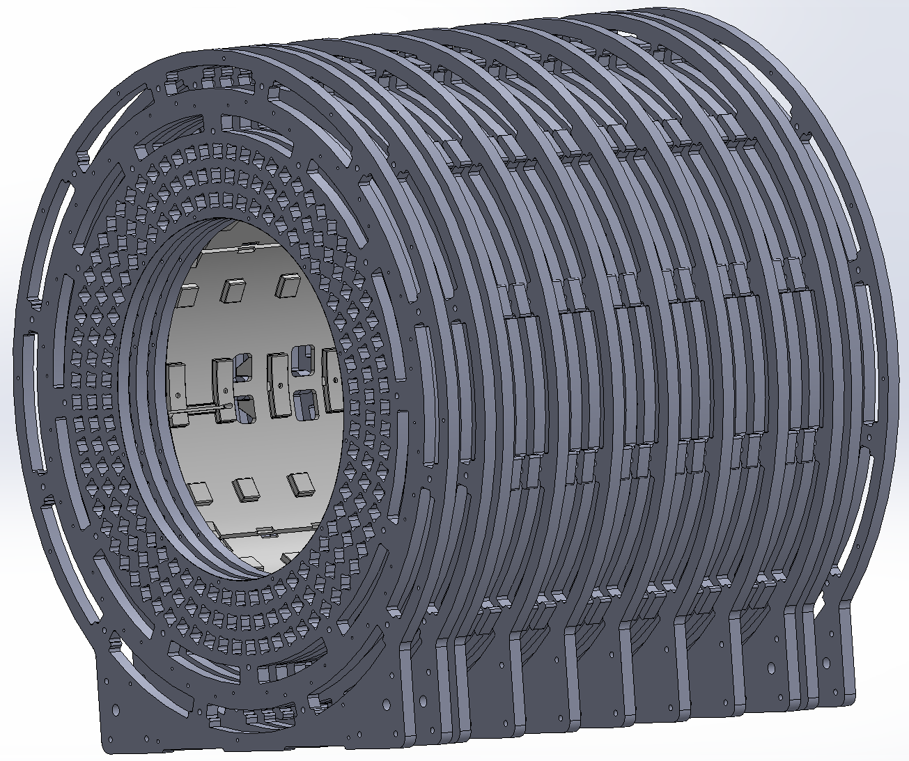
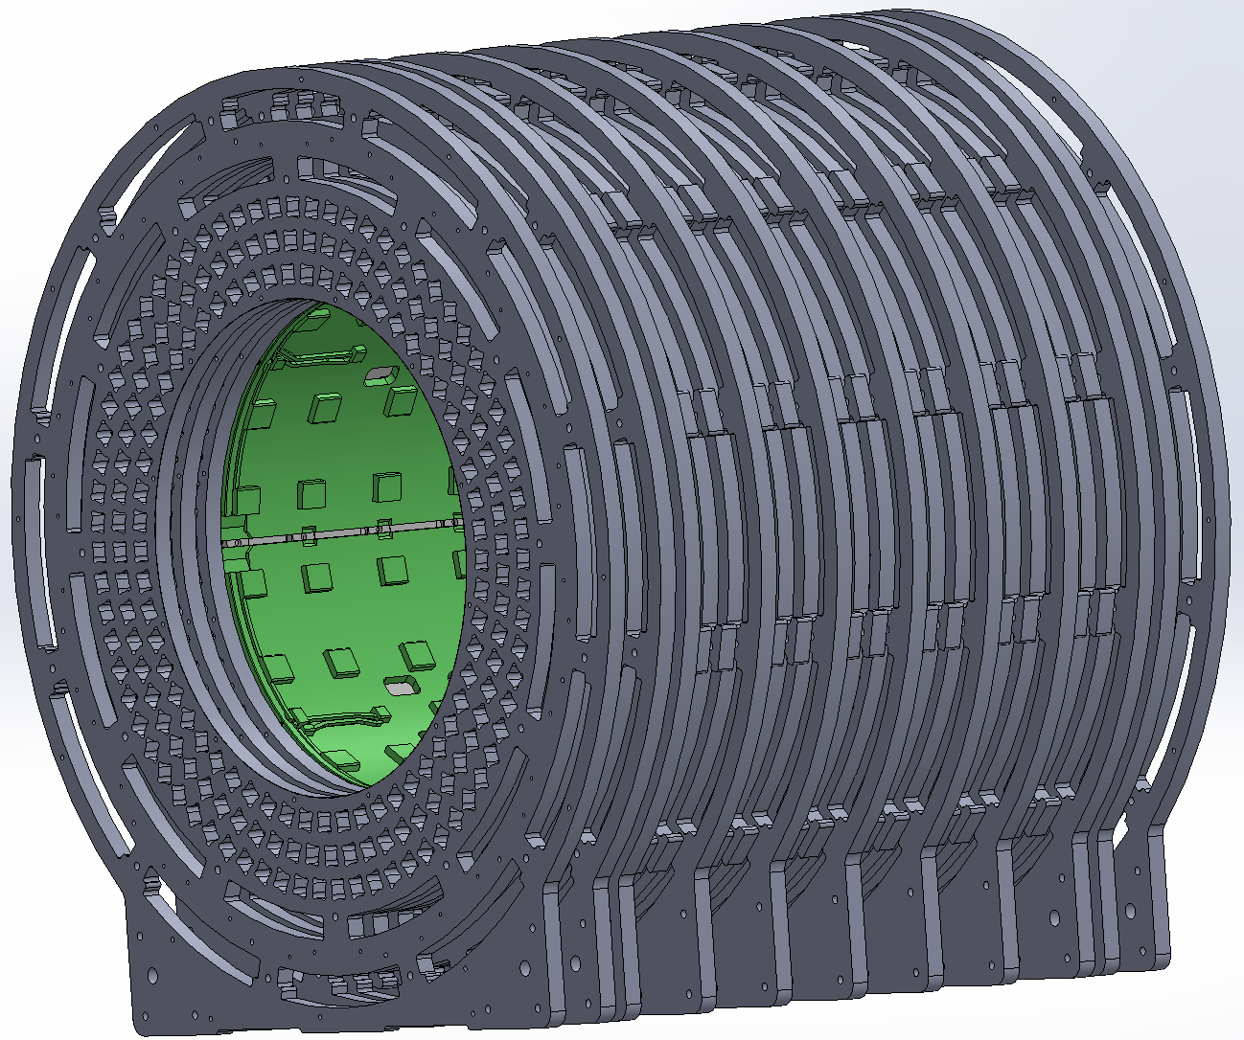
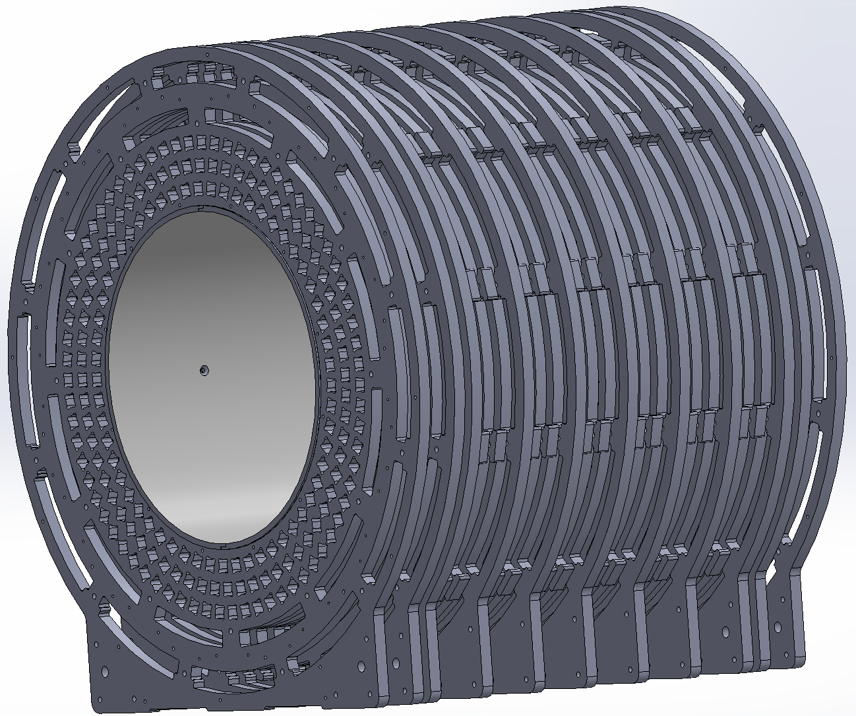
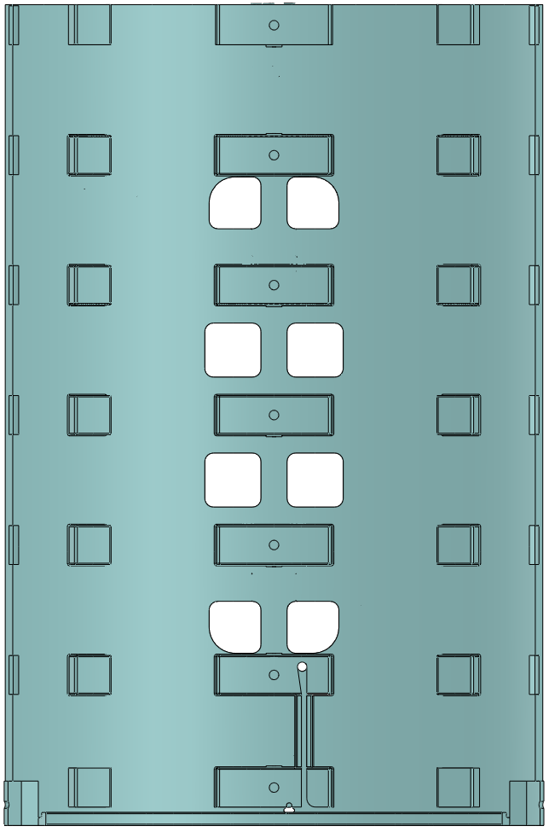
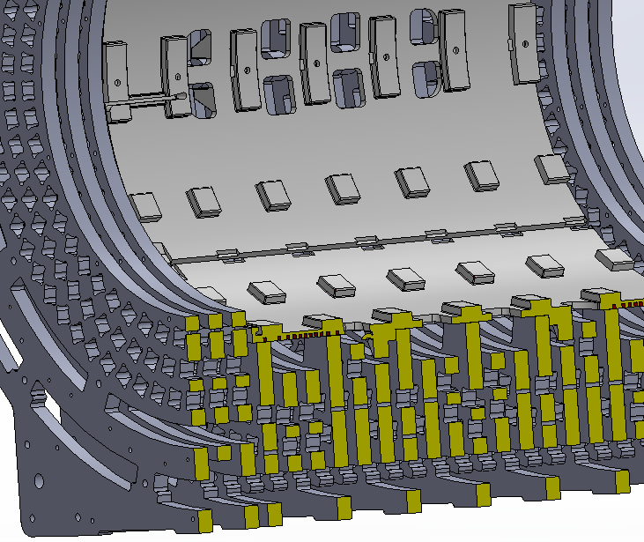
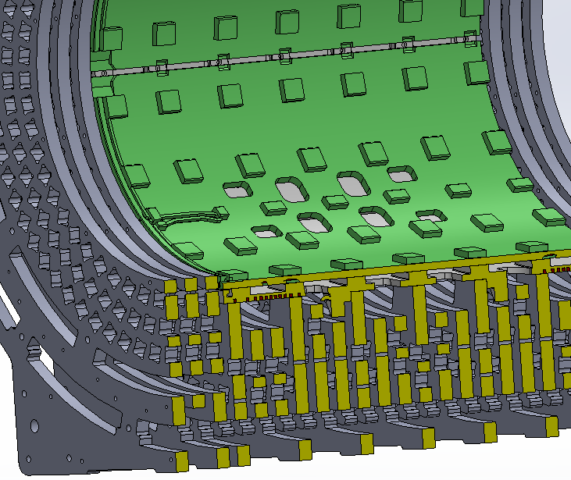
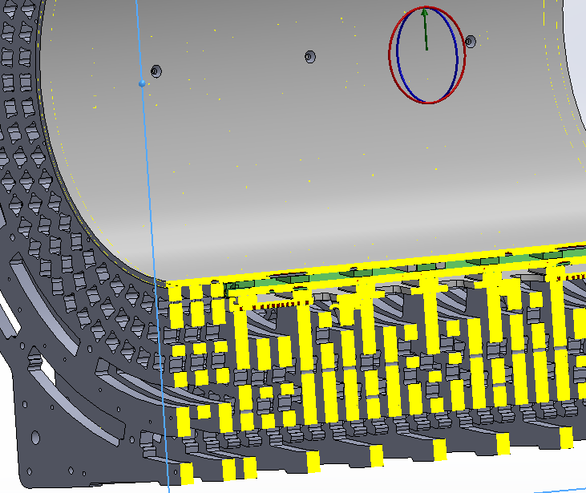
Mechanical load, building pillars
Z
Y
X

Slide 9
Constraints
4. Solid positioning
Not allowed:
Translations
Rotations
Play
Bending
This is relative to magnet nor between gradient coils
Why?
Rotations or translations lead to image distortion
Mutual influence between gradient channels
May affect eddy current correction
For reliable and reproducible K-space trajectories

Slide 10
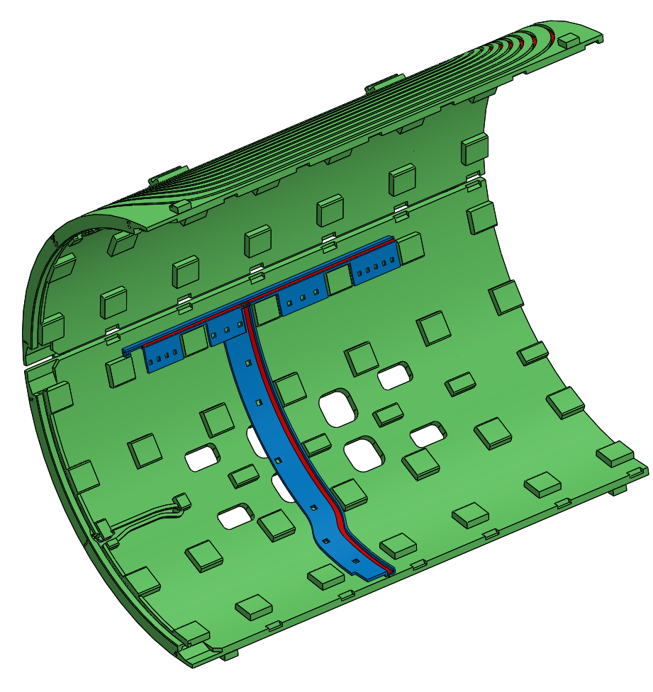
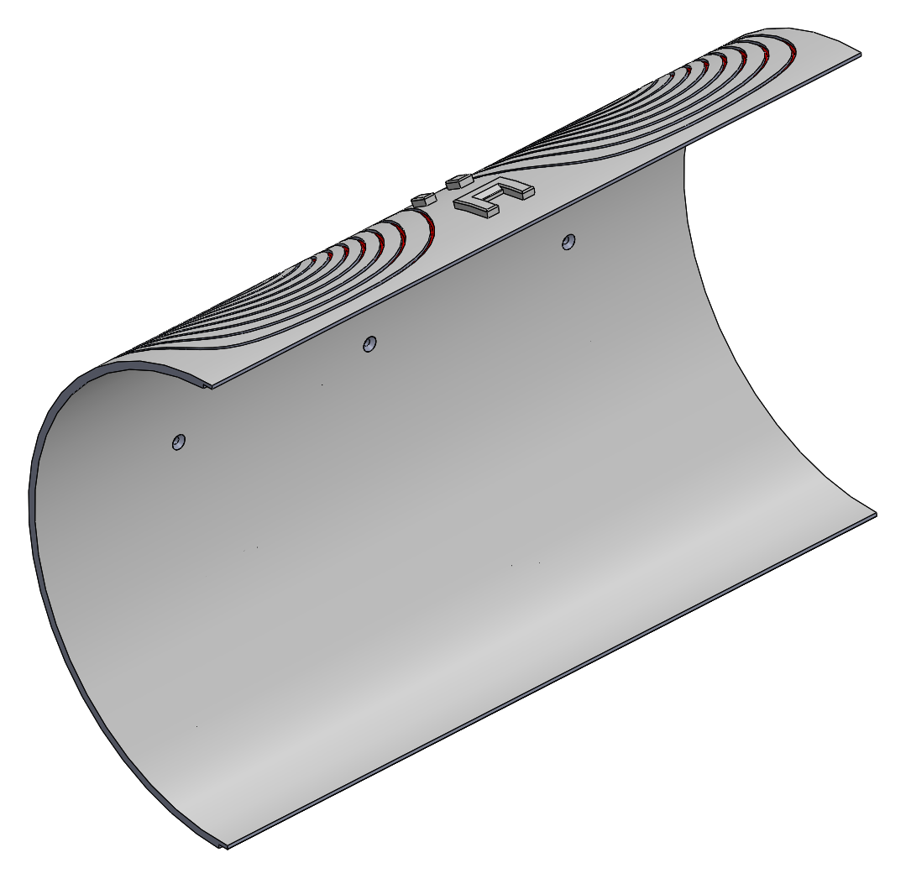
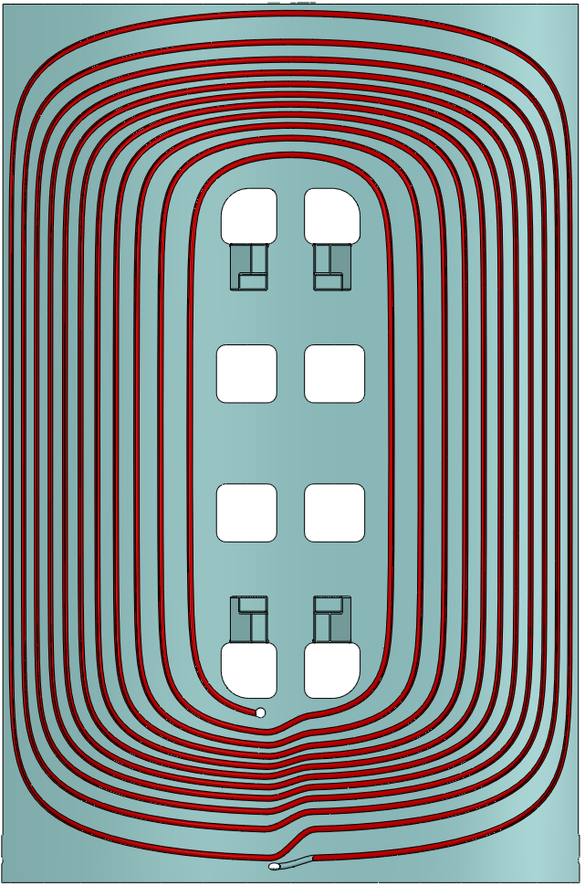
Robust positioning, check your cams
Single Z quadrant, viewed from outside
Two Y quadrant, viewed from inside
Single X half,
viewed from inside
Rotation cam
Translation cam
Rotation cam

Slide 11
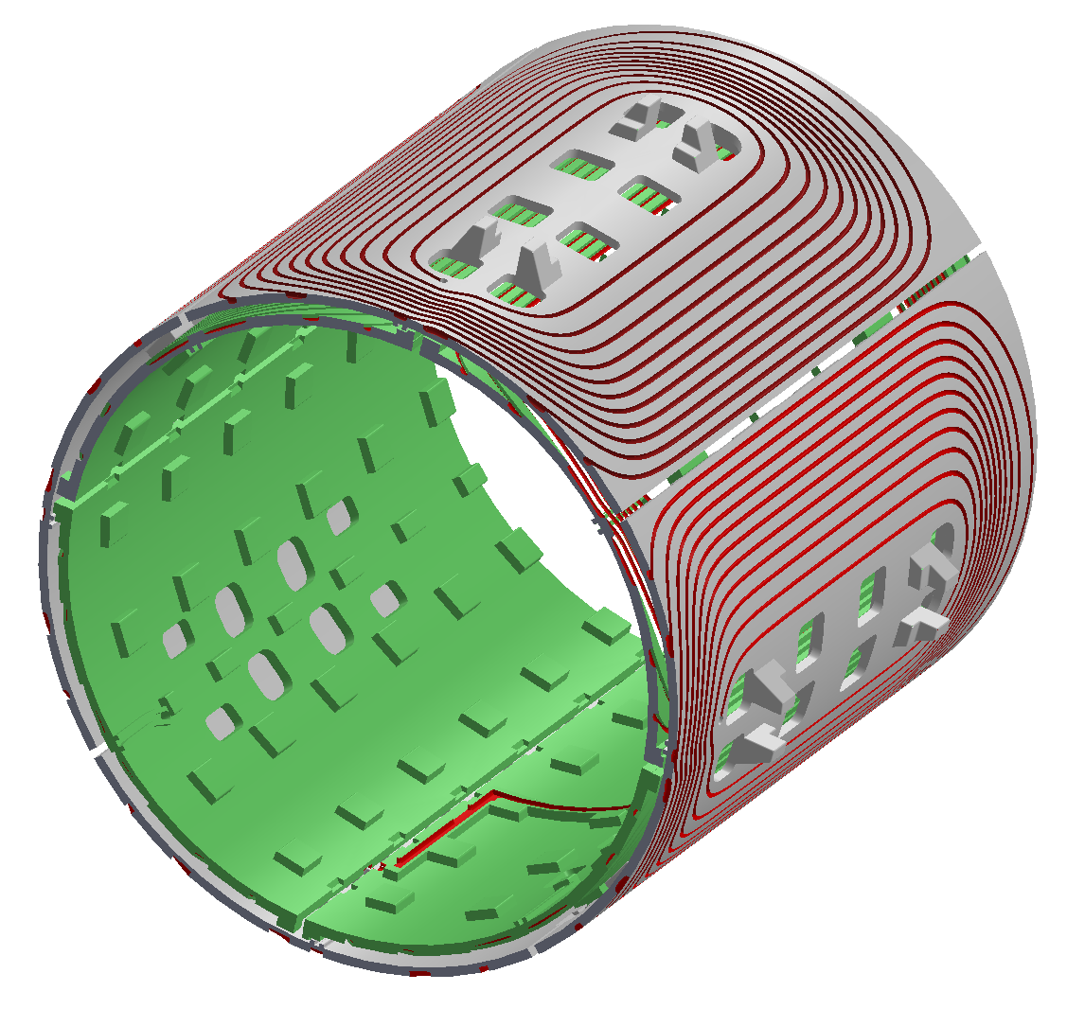
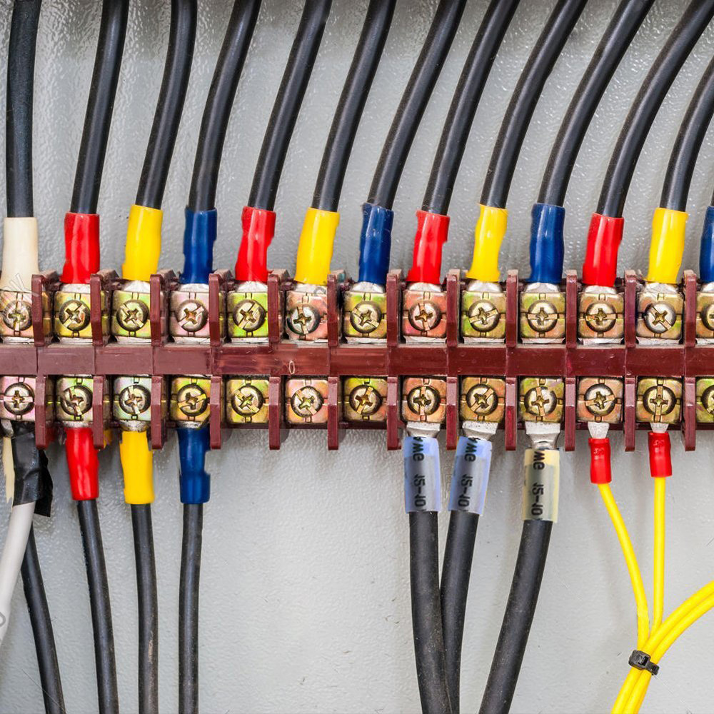

Constraints
5. Wire connections

Slide 12
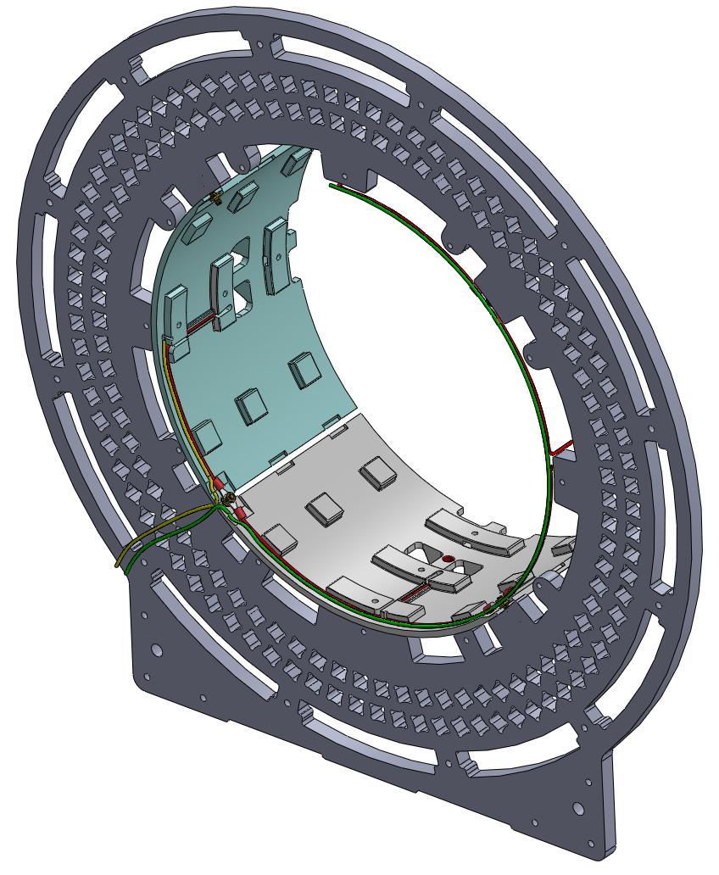
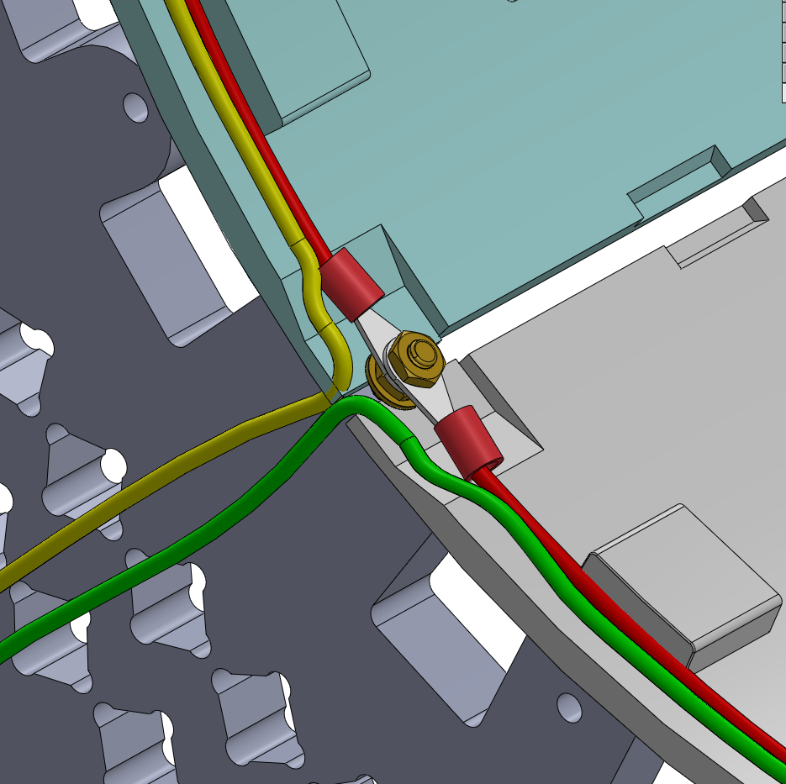
Z-gradient connections
Ring # 10
(rear)
East
South
West
North
Central port
Central port
Central port
Central port
Exit wire from
East periferal
Periferal port
Periferal port
Periferal port
Periferal port
To gradient
amplifier
Exit wire from
North periferal
View from rear of magnet

Slide 13
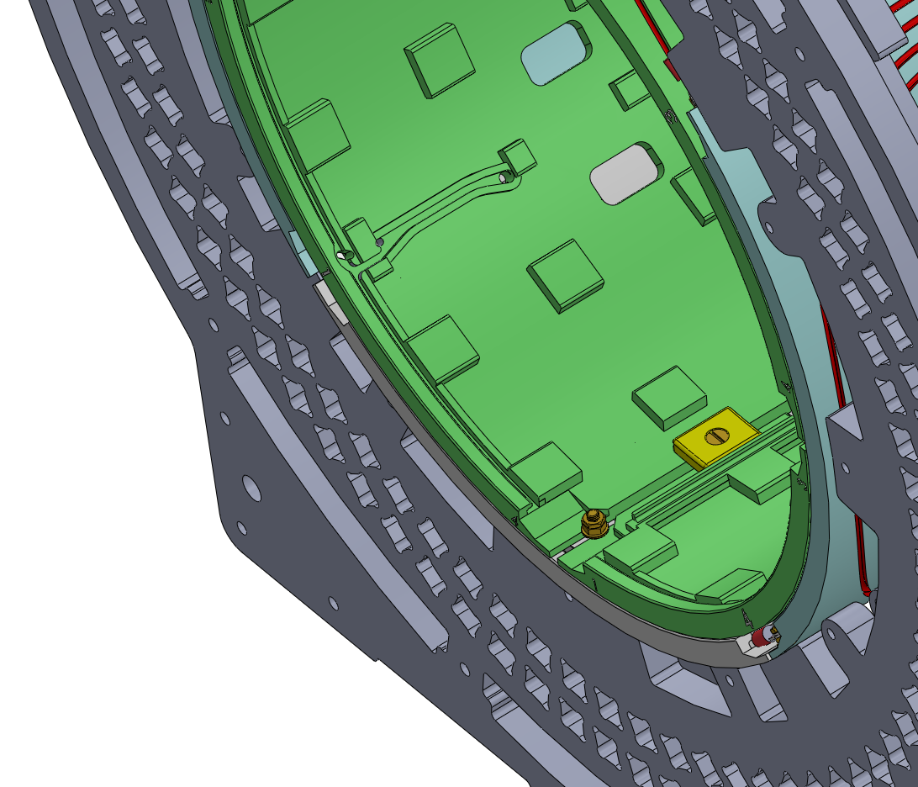
Y-gradient connections
Exit port to
gradient amp
Central port
Central port
Central port
Central port
a
Periferal port
Periferal port
Periferal port
Periferal port
a
b
b
3
2
1
2
1
4
1
4
3
4
3
2
Exit Port for wires to
gradient amplifier
View from rear of magnet

Slide 14
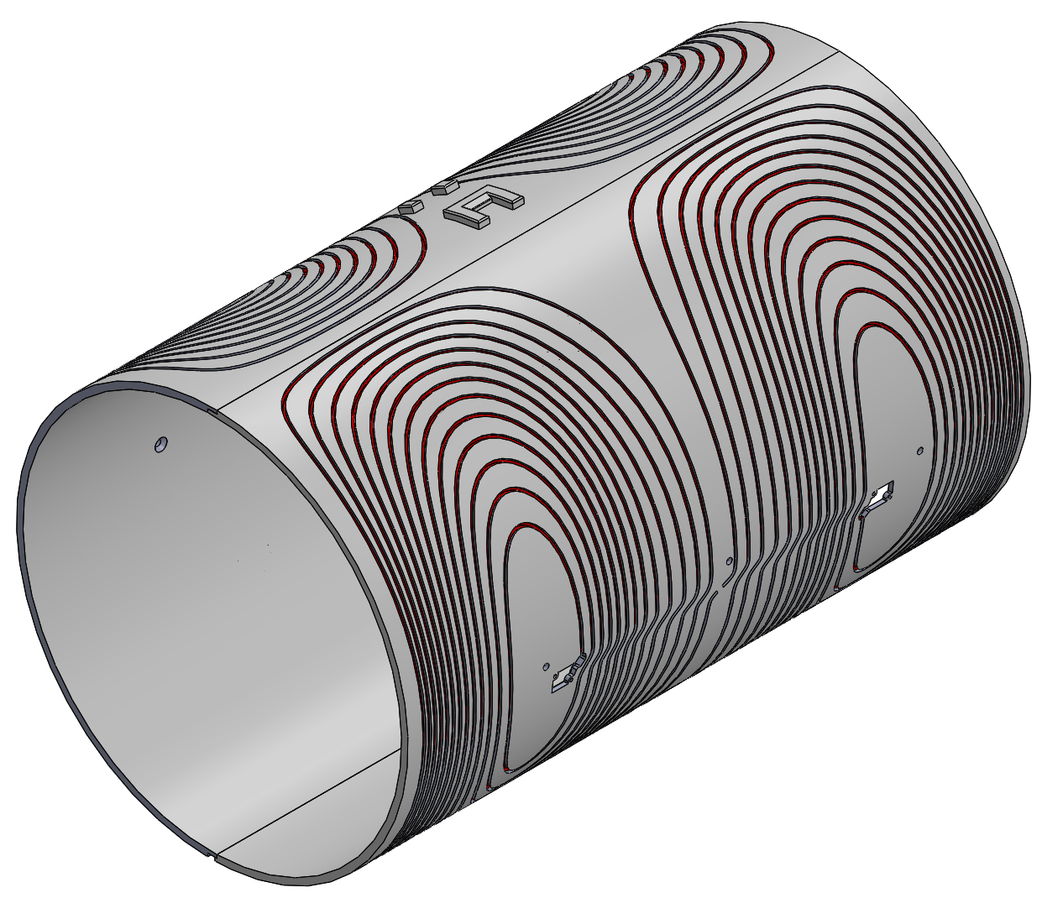
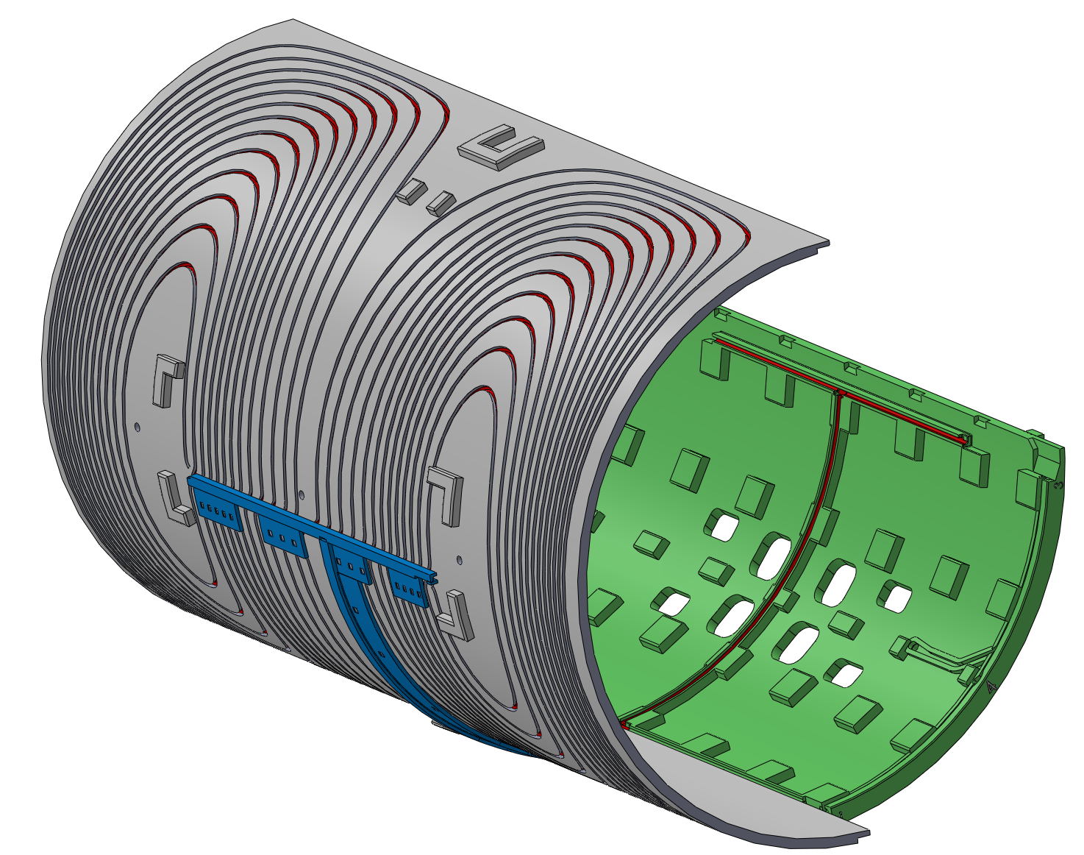
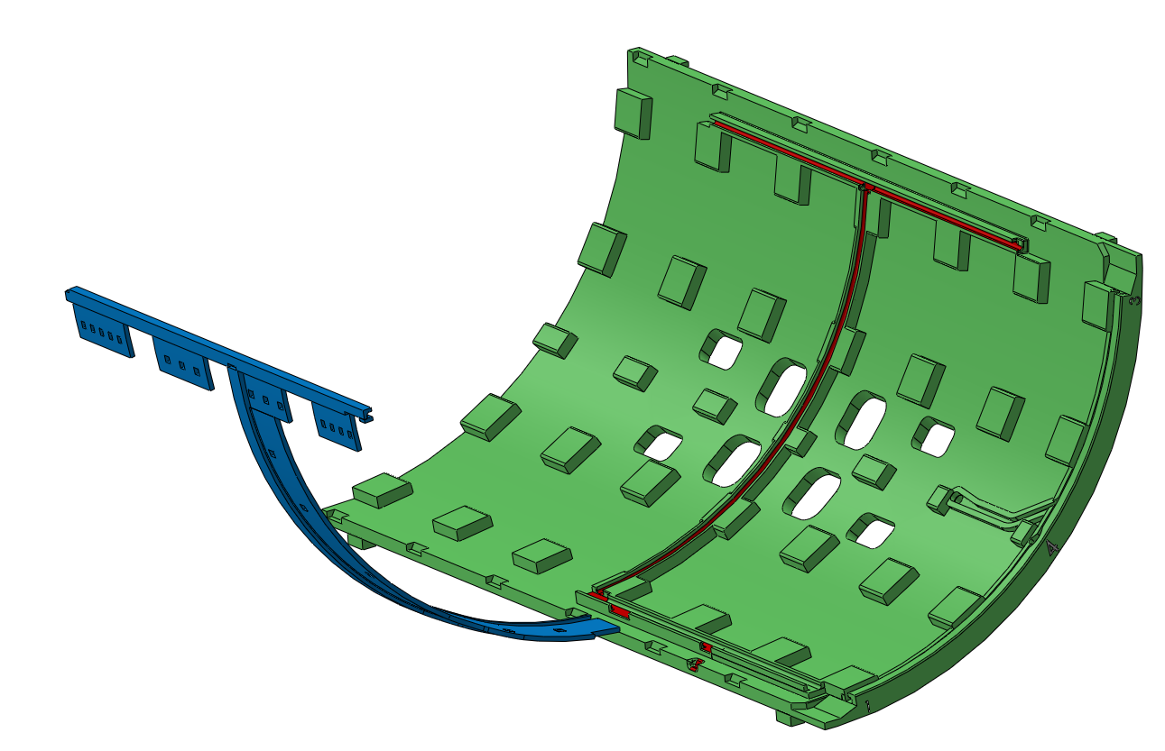
Challenge
Wiring the X-gradient
Front
East half
East half
Rear
Front
West half
Rear
To grad amp
West half

Slide 15
What’s next?
The design shown here is version 1.x
Possible improvements:
    3D printer optimization to reduce postprocessing of the prints
    More compact carriers to reduce thickness of the gradient coils
    More windings to increase efficiency
    Alternative for wire in a groove
    Your ideas?

Slide 16
?
?
?
?
?
?
?
?
?
?
?
?
?
?
?
?
?
?
?
?
?
?

Slide 19
Z-gradient, schematic wire plan
Please note:
Loop wire patterns are shown as viewed from the inside.
Colors correspond with those in following slides.
depicts a 25mm threaded rod + cable lugs
Wire ends that interconnect quadrants are shown in red.
Wire ends that connect to the gradient amp are in yellow and green.
East
South
West
North
Central port
Central port
Central port
Central port
Periferal port
Periferal port
Periferal port
Periferal port
To gradient
amplifier

Slide 20
Available space

