Slide 1
Red-Pitaya Console
https://gitlab.com/osii/console/red-pitaya/red-pitaya
Jan Gregor Frintz

Slide 2
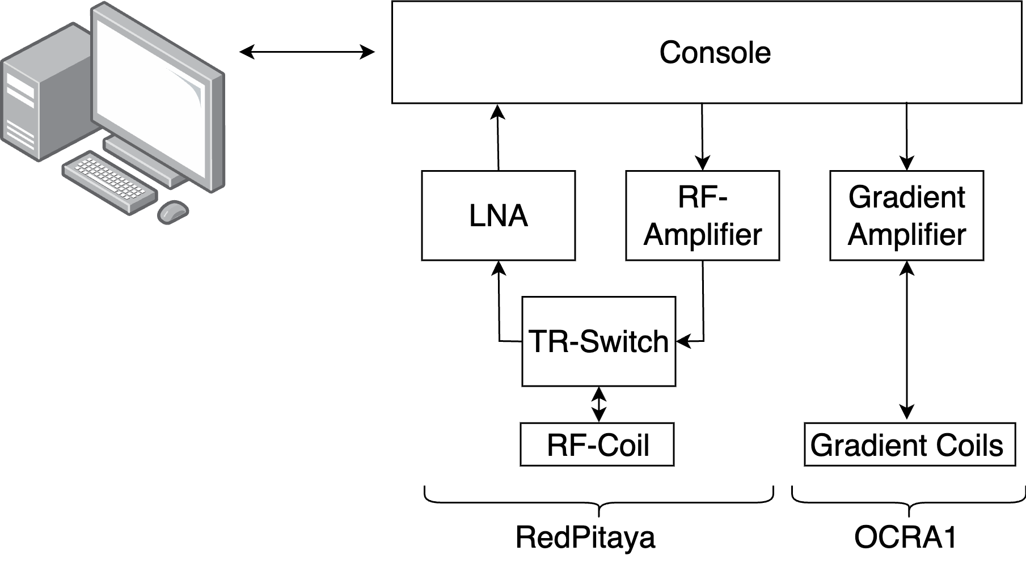
Red-Pitaya Console

Slide 3
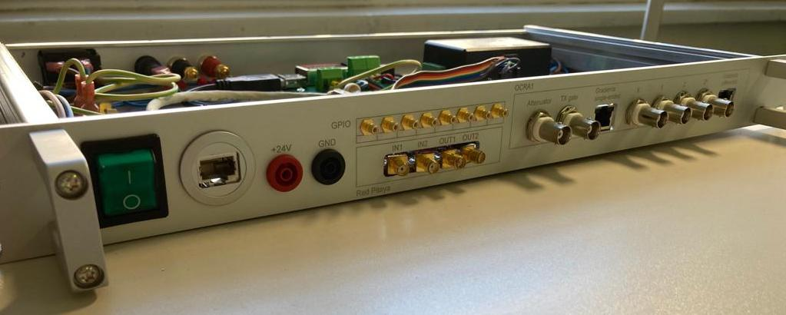
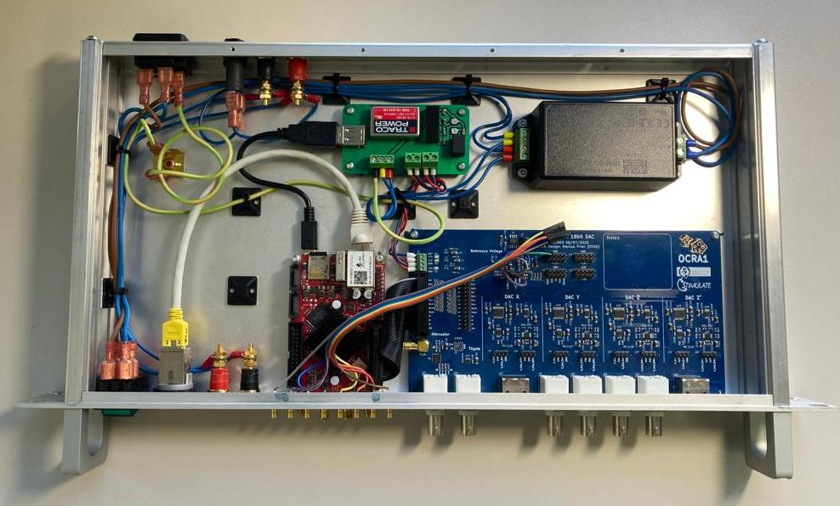
Red-Pitaya Console
Con

Slide 4
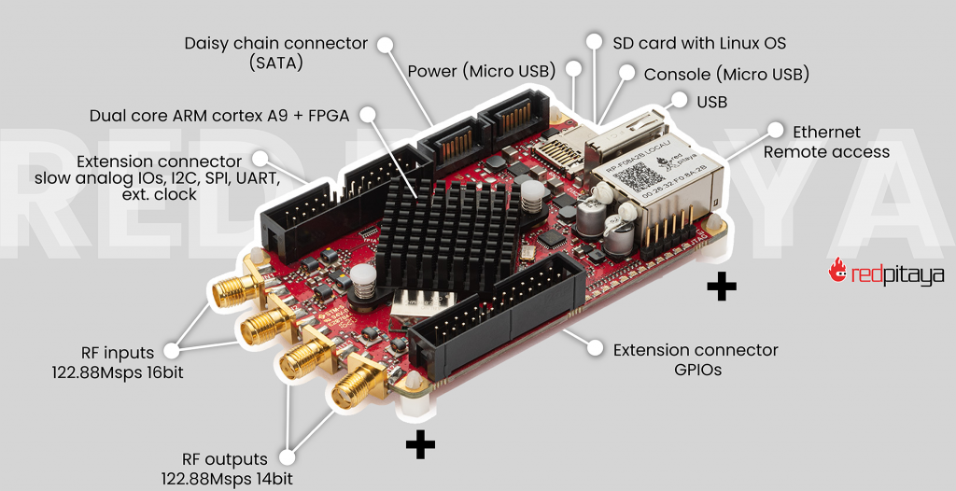
Red-Pitaya SDRlab 122-16
Closed Source Hardware
Open Source Software
Large & vivid community
767€
Notes:
SOC with FPGA
Onboard RF Inputs and Outputs
All GPIOs zou can think of
Software: Linux-Server and HDL

Slide 5
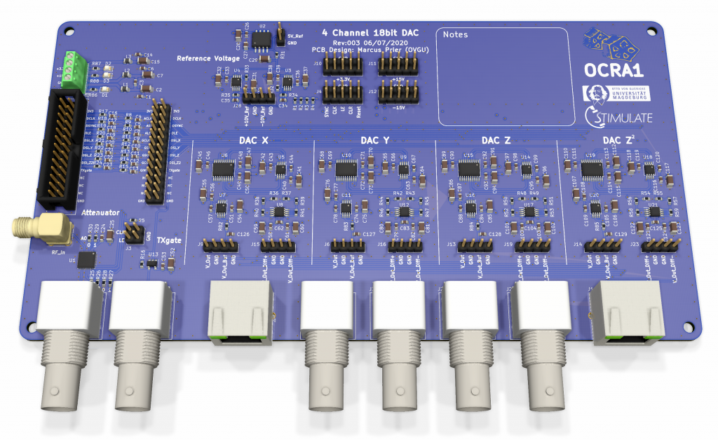
OCRA1 Gradient DAC
18 Bit DAC
TX Gate Buffer
RF Atttenuator
Designed by Marcus Prier,
Forschungscampus STIMULATE,
OVGU MAgdeburg
Notes:
Controlled by RedPitaya via SPI

Slide 6
Power Supply
Mains → 24 VDC
Custom PCB
Notes:
Custom PCB for
- 5V → RedPitaya
- 3V3
- +-15V

Slide 7


Documentation
Bill of Materials
Building Instructions
CAD Files (FreeCAD)
PCB project, GERBERs
Software Getting Started
https://gitlab.com/osii/console/red-pitaya/red-pitaya

Slide 8
Progress and Pitfalls
SD-Card on Frontpanel
Notes:
Changes already made in gitlab (CAD Files, BOM)
But: issue: wrong cable or panelmount

Slide 9
Progress and Pitfalls
Dust Cover
Notes:
Proposals:
- 3D printed Cover Plate
- screwed panelmount connectors
Please make it better and share your improvements.

Slide 10

Progress and Pitfalls
Be careful with PCB Models (Snap-EDA etc)
Better:
  https://gitlab.com/osii/kicad-library

Slide 11

Discussion: License
OCRA1
Thank you Marcus!
https://zeugmatographix.org/ocra/2020/11/27/ocra1-spi-controlled-4-channel-18bit-dac-and-rf-attenutator/
Notes:
I got confused

Slide 12
Discussion: License
When downloading the files, you declare to cite us as creator of the OCRA1 when using in your projects or publications (Marcus Prier, Forschungscampus STIMULATE, Otto-von-Guericke University Magdeburg). You are not allowed to remove logos or references.
What are we allowed?
No source files?
Notes:
Can we change it to CERN OHL etc?

Slide 13
About
Physikalisch-Technische Bundesanstalt
Braunschweig and Berlin
Abbestraße 2-12
10587 Berlin-Charlottenburg
Jan Gregor Frintz
Department 8.1 Biomedical Magnetic Resonance
E-Mail: jan.frintz@ptb.de
www.ptb.de
https://www.opensourceimaging.org/

