Slide 1
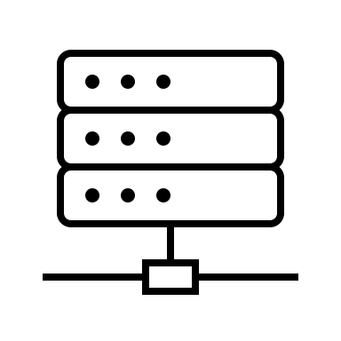














Operational Opportunities for Metadata Enrichment and Data Retention or Disposal Decision
ACCESS &
REUSE
PLAN &
DESIGN
SHARE &
DISSEMINATE
STORE &
MANAGE
Adapted from: ARDC. (2023). Research data management framework for institutions (Version 2). Zenodo. https://doi.org/10.5281/zenodo.8433246
Administrative processes
COLLECT &
CREATE
New infrastructure
Infrastructure EOL
Onboarding
Offboarding
EVALUATE &
ARCHIVE
ANALYSE &
COLLABORATE
Research project lifecycle stages
Start of
Funding
Facilities / Instruments
End of
Funding
Ethics
Application
Data
Collection
New Collaboration
Regular
Audit
Research Output Publication
Orphaned Data Review
RDMP
Project
Closure
External Data Use
Data Cleaning
Research Data
Publication
Reuse Review
Storage Provision
End of Retention Schedule
Trial & Error
Replan
Rework
Plan & Design
Collect & Create
Analyse &
Collaborate
Evaluate &
Archive
Share &
Disseminate
Access &
Reuse
Retained data volume
Indicative – Not Drawn To Scale
Volume of
retained data
changes with
“lifecycle” stages
Research data “lifecycle” stages

