Slide 1
Faceted classification
Exploring the boundaries between theory and methodology

Slide 2
The place of faceted classification:
faceted classification is a well recognized approach to the construction of knowledge organization systems (KOS)
it has been described as the dominant approach to knowledge organization in the late twentieth century
originally developed as a means of logical physical arrangement of documents
it has certainly influenced many different kinds of subject organization and retrieval tools
there is a parallel corpus of information on the faceted approach to web organization and retrieval

Slide 3
Faceted classification as theory:
facet analysis is usually referred to as a ‘theory’
it is regarded as having logical principles and it has a body of theoretical writing
its nature makes it very amenable to automated information management using database
but it has been suggested that it doesn’t meet some of the criteria necessary to a ‘proper’ scientific theory
should we therefore regard it simply as a useful methodology for constructing subject tools
i.e. a recipe for making a cake rather than an understanding of the chemistry of baking

Slide 4
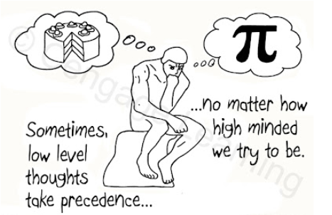
The tension between theory and method

Slide 5
What constitutes a theory?
The Oxford English Dictionary defines a theory as:
A scheme or system of ideas or statements held as an explanation or account of a group of facts or phenomena; a hypothesis that has been confirmed or established by observation or experiment, and is propounded or accepted as accounting for the known facts; a statement of what are held to be the general laws, principles, or causes of something known or observed. (OED online)

Slide 6
Characteristics of a theory:
a theory may consist of a model which explains a phenomenon or which attempts to represent some aspect of reality
ideally, it allows some extension of the model to make predictions
if the model can be represented formally it should support reasoning about the phenomenon
a theory ought to be put to test by scientific observation to confirm its validity
a test of theory is that it should be falsifiable
but it need not be accurate in every respect

Slide 7
Modelling and conceptual models:
a model is a way of representing some area or field in a formal manner
the model should include all entities, attributes, processes, and relationships in the field
it should show how these are connected
models are used in philosophy, science, social sciences, statistics, economics, and particularly in information systems design and systems architecture
they help us to identify the different factors in situations and to understand how systems function
in some kinds of models the model can be used to draw inferences about the system, i.e., to perform some kind of computation or calculation

Slide 8
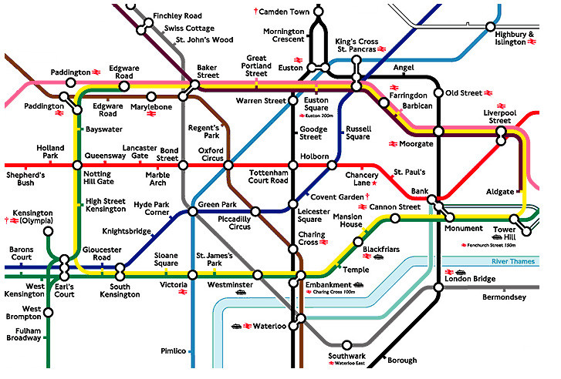
A good example of a model:

Slide 9
Classifications as theories:
many classification schemes (not just faceted ones) fulfil some of the criteria of theories as described above
they can provide models of the information universe or domain
it can provide an ‘explanation’ of the structure of a subject field
in common with some other kinds of models it creates a map of the subject
they can allow gaps to be filled in on logical principles
they can be verified by reference to documentation (or information) itself through literary warrant
more usually the last feature has been used to challenge the veracity of the classification model

Slide 10
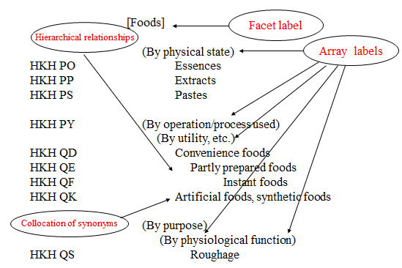
Basic faceted classification structure:

Slide 11
How to construct a theory 1:
traditionally, theories are based on deductive reasoning using logical principles
some propositions are regarded as axiomatic, i.e. self-evident and not susceptible of proof
this philosophical attitude can also be described as rationalist since it is worked on the basis of rational argument
it does not normally make reference to external criteria (such as empirical evidence)
much of Ranganathan’s theory is of this kind, and in fact he describes himself as having a ‘positivistic’ point of view which would align him with the logical positivists who take this approach to theory

Slide 12
How to construct a theory 2:
inductive reasoning aims to build theory from observation through a process of analysing and interpreting data
it may also be aligned with a post-positivist, or relativist, view of the world
much scientific theory building is a hybrid of deductive and inductive methods – developing hypotheses and testing them against empirical evidence
social science methodologies are often more dependent on theory building solely from data
‘second generation’ facet analysis, of the kind practised by the UK Classification Research Group, may have more in common with research methodologies of the inductive kind, meaning that the relationship between method and theory is different from the Ranganathanian model.

Slide 13
Theoretical foundations of LIS:
Berwick Sayers’ canons
  lay down some generally desirable features of classifications that act as principles in their construction
Bliss’s Organization of Knowledge
  a philosophic approach very much concerned with the order of and between classes; essentially humanistic; much influenced by Dewey (John not Melvil); speaks of authority and consensus in establishing it
Ranganathan’s Prolegomena
  the first attempt (bar Otlet) to take a scientific view of information; much of Ranganathan’s thinking is mathematical, and his ideas about class membership are related to set theory and theory of groups; Ranganathan is concerned with representing subject content as well as ordering it
  All of these theorists take a primarily deductive view
  Their ideas are theoretical in the sense of being abstract

Slide 14
Top-down and bottom-up-ness:
enumerative classifications are often referred to as top-down, because they deal with successive subdivision of a unified information domain
social classifications (folksonomies) are bottom-up in that they start with no assumptions about the structure of the domain
the status of faceted classifications in this respect is often not clear
the literature speaks of division using single principles which creates a ‘top-down’ impression
in practice, facets are normally assembled from concepts which meet the category criteria
an interesting parallel is that deductive and inductive methodologies are also referred to as ‘top-down’ and ‘bottom-up’

Slide 15
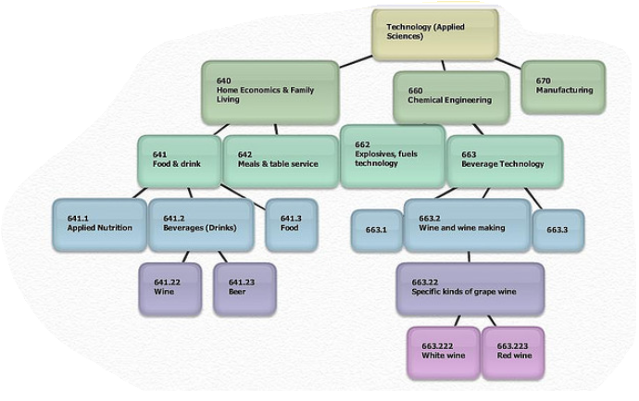
Top-down classification structure:

Slide 16
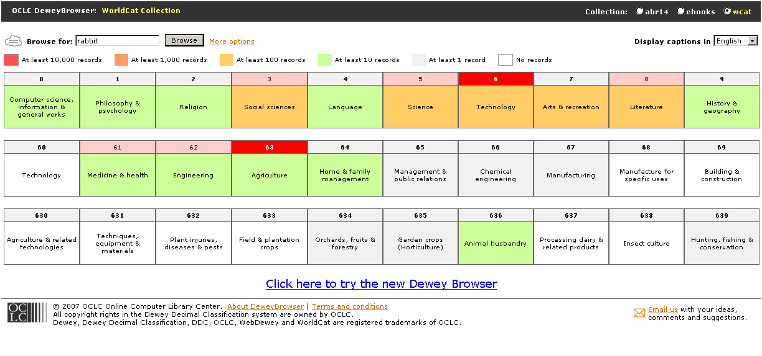
Dewey browser used to search WorldCat:

Slide 17
Concepts as particles:
molecular model is one I have used before
interesting work by van den Heuvel and Smiraglia on the universe of concepts
it fits very well with the idea of a faceted classification as consisting of ‘elementary’ particles, or building blocks
it’s susceptible to other analogies such as the parallel between bond types or intra-molecular forces and relationships; the dynamics of the molecule is like the syntax of a KOS

Slide 18
Assembling the facet from the bottom up:
we need to determine how the process can be inductive rather than deductive
depends on a close reading and analysis of the vocabulary of the domain
that should be derived from the language used in the documentation itself
the categorical status of each concept needs to be determined without pre-suppositions
care should be take to identify new categories where these arise
there is also an iterative process in examining and re-examining (particularly) compound concepts to determine how exactly they may be understood

Slide 19
Comparison with other inductive methodologies:
viewed in this way, facet analysis is comparable with other generally recognized inductive methodologies
it has value as general methodology beyond LIS
it is essentially a particular form of content analysis
it bears comparison with soft systems methodology in its identification of key concepts and root definitions
  the CATWOE (clients, actors, transformation, worldview, owner, environment) formula is not unlike fundamental categories
it is very similar in process to grounded theory
  coding
  categorization

Slide 20
Grounded theory:
grounded theory method (GTM) is a way of generating a theoretical product, “a grounded theory”, which emerges from the data
original purpose of GTM was to provide a systematic basis for qualitative research
  it seeks reliability and validity
  it has a solid core of data analysis and theory construction
  it attempts to put qualitative research on a footing with quantitative work
  it makes the research process visible, comprehensible, and replicable
it formalises well-established analytic methods ‘long practiced, but seldom articulated, by theoretically oriented … field researchers’

Slide 21
Facet analysis and grounded theory:
facet analysis and grounded theory have been compared in the past
they were both regarded as reform movements challenging a traditional view of research methods
they were seen as methods of dealing with large corpora of text
the facet analysis examined was that of Ranganathan and the Prolegomena
more recent understandings of facet analysis show even closer links in terms of process and interpretation

Slide 22
‘Second-generation’ facet analysis on the CRG model:
facet analysis as understood by the CRG is more fluid and less rigorous than Ranganathan’s theory
there are more potential categories
the categories are less ‘fundamental’ , in some sense hybrid categories/role indicators
the citation order is variable
the whole operation is much more context dependent
although this isn’t very well articulated, there is a powerful iterative element in the analysis (notable in Chemistry)
on that basis we might reasonable consider facet analysis an inductive method

Slide 23
Facet analysis as a theory building tool:
there has been some published work already regarding the value of classifications as theory building tools
if FA is regarded as a type of inductive tool, then it inherits those characteristics of theory building associated with GTM
theories in the form of models are built for individual domains through the process of analysis
at the same time the facet theory itself may be confirmed and/or developed along new lines
such inductive methods do consider themselves to have the status of theory (methodological theories?)

Slide 24
Attributes of theories which are shown by facet analysis:
it is built on logical principles
it provides conceptual models of subject domains
these can be represented (to some extent) in formal languages
as an inductive methodology it shares the theory building characteristics of other social science research theories
  theory emergent from data
  close reading and analysis
  iterative techniques
  results are replicable
facet analysis marries robust methodology with sound theory

