Slide 1

Opening up your scientific contributions thanks to licenses
Floriane Muller and Dimitri Donzé
26 October 2023
DOI: 10.5281/zenodo.7649204

Slide 2
Copyright basics
Copyright protects works
  which are intellectual creations
  with an individual character
  expressed in one form or another.
  → art. 2, al. 1 CopA
Works protected by copyright may only be used
  with the consent of the author / copyright holder
  or thanks to a legal exception to copyright.
→ art. 10, al. 1 CopA & chap. 5 CopA
Protection ends 50 to 70 years after the author’s death, depending on the type of work
→ chap. 6 CopA

Slide 3
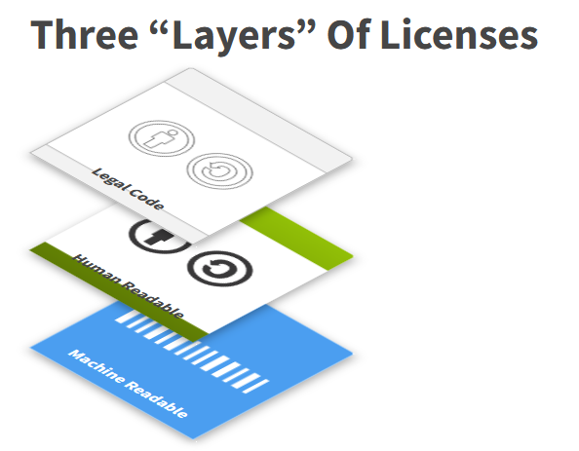





What ?
« [The Creative Commons copyright licenses] give everyone from individual creators to large companies and institutions a simple, standardized way to grant copyright permissions to their creative work. »
https://creativecommons.org/licenses/
A start and 4 combinables elements
Attribution (BY)
Share-Alike (SA)
Non-Commercial (NC)
Non-Derivatives (ND)
Image: https://creativecommons.org/licenses/
under CC BY 4.0 licence

Slide 4
Why assign a CC License ?
From «all rights reserved» to «some rights reserved»
Retain your rights
To ensure that your work will be attributed to you, even if they are later distributed
Share
To immediately indicate that it is allowed to re-use the work
(= distribute/reproduce/share) and indicate restrictions that apply (if you want)
Do not modify or translate
Do not commercialize
Share under the same conditions
legally binding
irrevocable, for the entire term of copyright protection
does not affect the rights of the copyright owners (dual licensing possible)

Slide 5

Who ?
Only copyright owners can license a work.
→ all co-authors together,
unless they have transferred their copyright to the publisher*
→ the publishing house, if the copyright has been assigned*
*
(publishing contract, copyright transfert agreement, or terms and conditions of use of the manuscript submission system of the publisher)
Photo by Andrea Piacquadio from Pexels.
Licence: Free of use

Slide 6
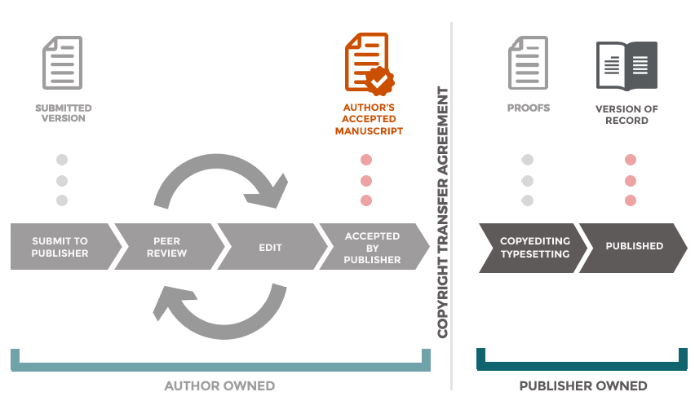

When ?
Original Image credit: CC BY <Claire Sewell & University of Cambridge, 2017
https://www.slideshare.net/ClaireSewell/open-access-webinar
The author may assign a CC licence to his/her texts and figures
Only the publisher can grant licences
Rights Retention Strategy (information webpage, 15’ webinar)

Slide 7

How ?
By indicating the licence in the document and/or on the web page
Mention
  (the CC logo)
  the name of the licence, abbreviated or in full
  the link to the licence
  the name of the author(s) and, if applicable, the copyright holder
  the year of creation
  For example, this material is distributed in
Other examples on: https://wiki.creativecommons.org/wiki/Marking_your_work_with_a_CC_license

Slide 8
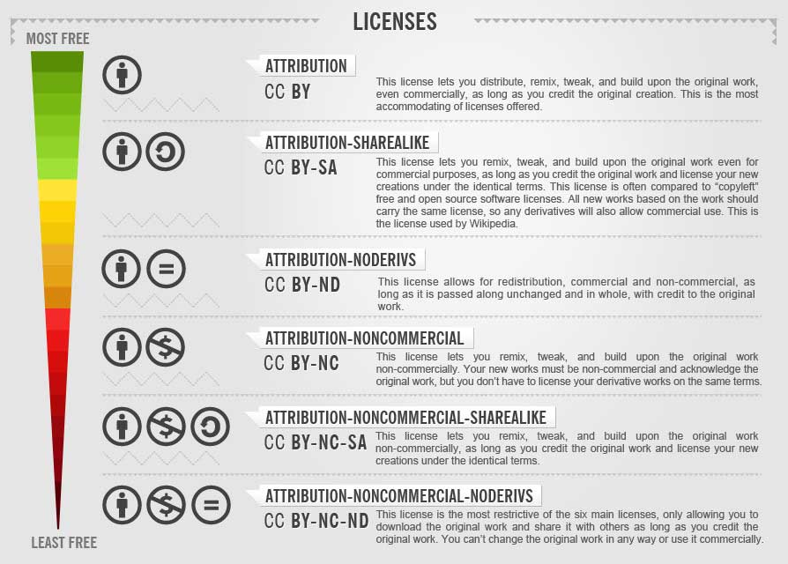
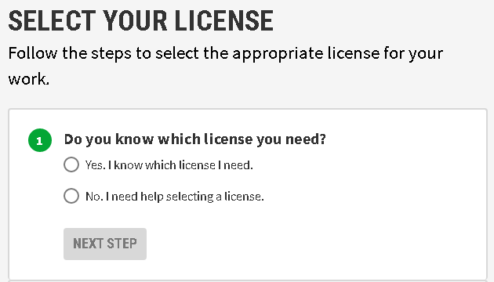
Which CC licence ?
For publications,
the UNIGE Open Access Policy requires choosing the most open licence possible, among the choices offered by the publishing house
Image credit: Creative commons: free photos For Bloggers – the ultimate guide by foter.com, (CC BY-SA 3.0)
For the rest, you can use the CC License Chooser to identify the right license for your needs:
https://chooser-beta.creativecommons.org/

Slide 9
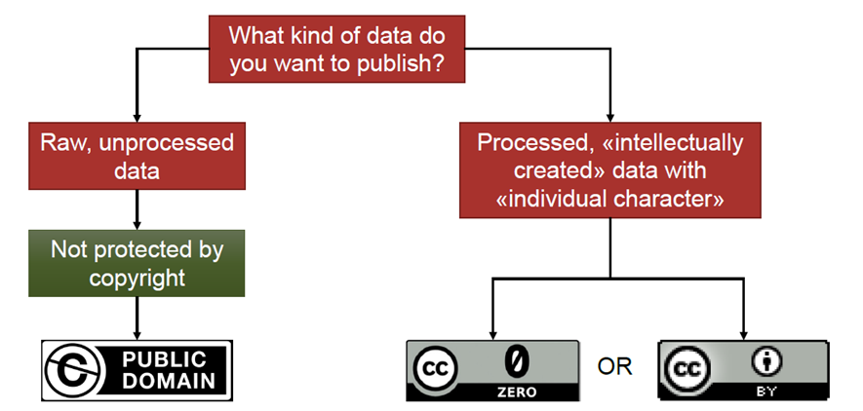
For research data ?
See dedicated 15’ training session: Dec 2022 & Feb 2023
(information & registration here)
Adapted, with permission, from B. Hirschmann. Creative Commons. How to licence your publications and research data for reuse, 2020

Slide 10


Questions ?
openaccess@unige.ch
Dimitri Donzé & Floriane Muller, University of Geneva Library, 2023
This work is licensed under a Creative Commons Attribution – ShareAlike 4.0 International licence:
http://creativecommons.org/licenses/by-sa/4.0/deed.en.

Slide 11
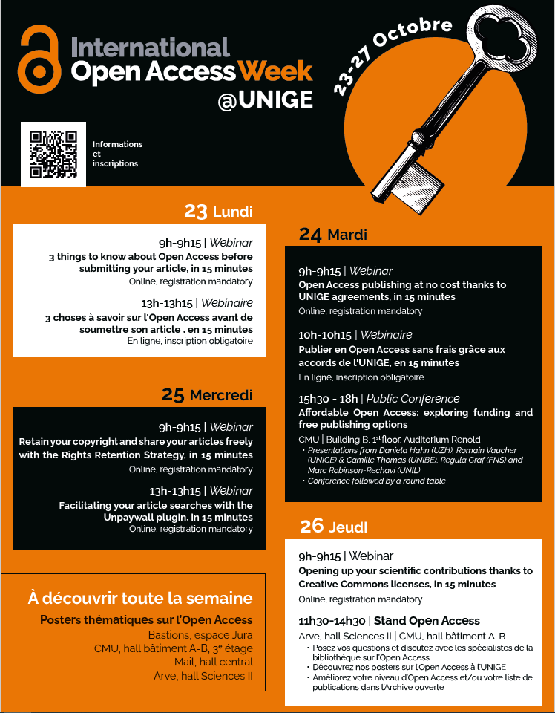
Come and join us
in person
at the Open Access Booths
today !

Slide 12

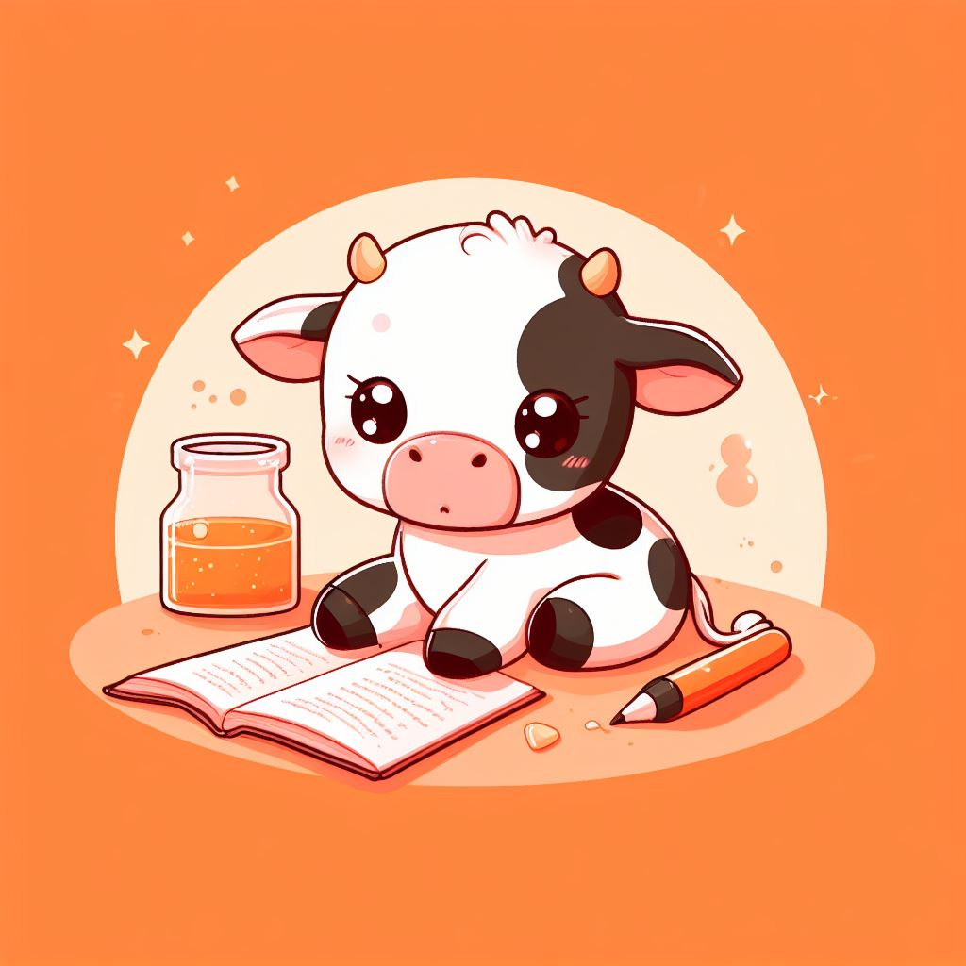


Open Access
where do we go from here?
Closing event
Friday October 27
12:00h
#OAWEEKCH23
A MOOE
massive online opinion event

