Slide 1




Growing awareness of the importance of research software and the people who develop it
Anelda van der Walt
Director
Talarify
anelda@talarify.co.za
Michelle Barker
Director
Research Software Alliance
barkermd@outlook.com
ZA·REN Week '23
Cape Town
South Africa
https://chpcconf.co.za/

Slide 2


Why should we care about research software and the people who develop it?
Answer at Slido.com code #3906946
https://talarify.co.za
https://rsse.africa/
https://researchsoft.org/

Slide 3


Why do you think research software is important?
ⓘ
Click Present with Slido or install our Chrome extension to activate this poll while presenting.
Notes:
📣 This is Slido interaction slide, please don't delete it.
✅ Click on 'Present with Slido' and the poll will launch automatically when you get to this slide.

Slide 4

Defining research software
Research software includes source code files, algorithms, scripts, computational workflows, and executables that were created during the research process or for a research purpose.
Different from “software in research” e.g. operating systems, libraries, dependencies, etc.
Gruenpeter, Morane, et al. (2021) doi.org/10.5281/zenodo.5504016z
https://talarify.co.za
https://rsse.africa/
https://researchsoft.org/

Slide 5
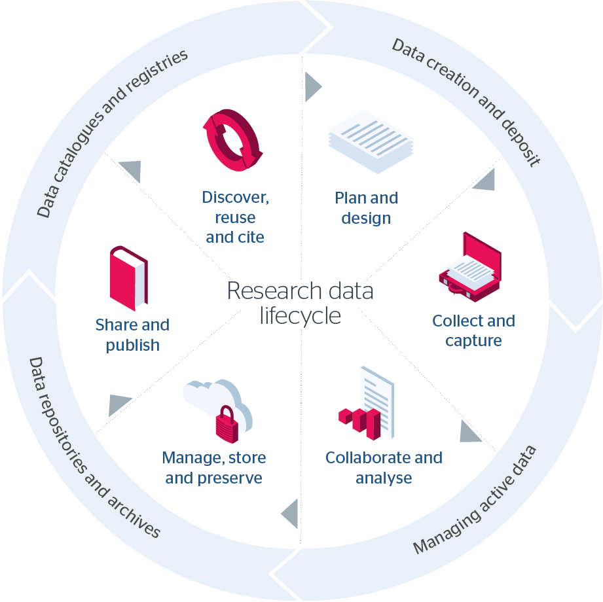
When is research software used?
Image from the Jisc RDM toolkit. Available at link published under CC BY-NC-ND
https://talarify.co.za
https://rsse.africa/
https://researchsoft.org/

Slide 6
Some statistics about research software
“Between 1995 and 2016, the National Science Foundation awarded $9.6 billion in funding to projects that included software in their abstracts.[1]
80% of articles published in Science and Nature explicitly mention research software.[2]
95% of researchers report using research software, and 2/3 could not do their research without it.[3]
On average, scientists spend 30% of their time developing research software and 40% of their time using research software.[4]”
Christina Maimone. (2019). North Western Research Computing and Data Services Updates, Events, and Resources. (link)
https://talarify.co.za
https://rsse.africa/
https://researchsoft.org/

Slide 7
25%
International research produces new code!
OECD International Survey of Science 2018 https://www.oecd-ilibrary.org/docserver/1b06c47c-en.pdf
https://talarify.co.za
https://rsse.africa/
https://researchsoft.org/

Slide 8


>57% of projects: bus factor <= 1
“Bus factor: A measure of the number of developers who understand a specific software project and could, with only a cursory review of the project, maintain or extend the code.
BF = 1 : project is completely reliant on only one developer.
If this developer finds new employment, becomes ill or is hit by the proverbial bus, the project will fail.”
RSE International Survey , 2022
https://softwaresaved.github.io/international-survey-2022/
https://talarify.co.za
https://rsse.africa/
https://researchsoft.org/

Slide 9

Who are the people developing research software?
> 55% PhD
> 40% not professional software developers
> 20% previously in industry job
> 50% part of a dedicated research software group in institution
> 53% work as sole software developer or in a team of two
~ 49% use open source licenses for their code all the time
RSE International Survey , 2022
https://softwaresaved.github.io/international-survey-2022/
https://talarify.co.za
https://rsse.africa/
https://researchsoft.org/

Slide 10



What do we know about the state of South African or African research software and the people who develops it?
https://talarify.co.za
https://rsse.africa/
https://researchsoft.org/

Slide 11


We have a growing repertoire of software-producing research projects on the continent including
astronomy
genomics/bioinformatics
machine learning applications
health and public health
geospatial
physics
computational social sciences
digital humanities
and more…
https://talarify.co.za
https://rsse.africa/
https://researchsoft.org/

Slide 12
African respondents in SSI surveys since 2017
2017
South Africa: 22
2018
South Africa: 23
Botswana: 2
Malawi: 1
Nigeria: 1
Mauritius: 1
Ethiopia: 1
2022
South Africa: 2
2017 & 2018 survey: https://github.com/softwaresaved/international-survey
2022 survey: https://github.com/softwaresaved/international-survey-2022
https://talarify.co.za
https://rsse.africa/
https://researchsoft.org/

Slide 13
African research software stakeholders mapped
ReSA 2022: Benin, Botswana, Cameroon, Democratic Republic of the Congo (DRC), Ghana, Kenya, Namibia, Nigeria, and South Africa.
39 Communities or organisations involved in Research Software
In South Africa:
South African National Bioinformatics Institute
Council for Scientific and Industrial Research
UCT eResearch
RSE at SUN
Martinez, Paula Andrea. (2022) doi.org/10.5281/zenodo.7179892
https://talarify.co.za
https://rsse.africa/
https://researchsoft.org/

Slide 14
African research software stakeholders map v2.0
Talarify 2023: 26 African countries (67 in South Africa)
Type | Number mapped
Community | 78
Research organisation | 52
Research group | 19
Training provider | 7
Research infrastructure | 5
Research software project | 2
National Research and Education Network | 1
Civic Tech organisation | 1
Advisory body | 1
Nomalungelo Maphanga, & Anelda Van der Walt. (2023). doi.org/10.5281/zenodo.7594454
https://talarify.co.za
https://rsse.africa/
https://researchsoft.org/

Slide 15
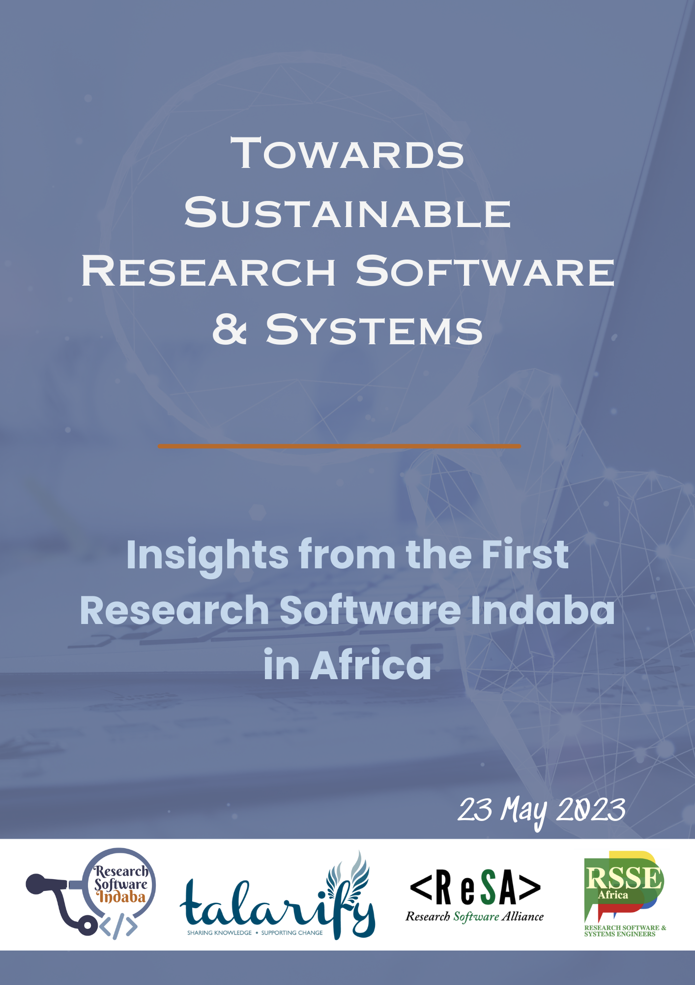
Research Software Indaba - South Africa 2023
Is your organisation involved in… | Responses
Research software or systems (data/compute) development and/or maintenance for in-house research | 16
Employ research software or infrastructure developers | 13
Training in research software or infrastructure development, maintenance, etc. | 13
Research software or systems (data/compute) development and/or maintenance as a service to others | 11
Provide access to specialised infrastructure on which research software runs (cloud/HPC) | 10
Develop policies related to the research software ecosystem | 9
Provide funding for research software projects, infrastructure, research, training, etc | 8
Research software project management | 8
Other | 8
Anelda Van der Walt, & Noxolo Chalale. (2023). doi.org/10.5281/zenodo.7980636
https://talarify.co.za
https://rsse.africa/
https://researchsoft.org/

Slide 16

International Research Funders Workshop ‘23
Amsterdam Declaration on Funding Research Software Sustainability (1.0). https://doi.org/10.5281/zenodo.8325436
https://adore.software/
https://talarify.co.za
https://rsse.africa/
https://researchsoft.org/

Slide 17

Huge opportunities to benefit from work done globally since 2010 for
individuals
research groups
institutions
funders
https://talarify.co.za
https://rsse.africa/
https://researchsoft.org/

Slide 18
1
https://talarify.co.za
https://rsse.africa/
https://researchsoft.org/

Slide 19

An invitation to join the RSE movement in
Africa and beyond
https://talarify.co.za
https://rsse.africa/
https://researchsoft.org/

Slide 20

Join the African research software community
RSSE-Africa
Uniquely African forum for African RSSEs
Explicitly includes research system engineers
e.g. data storage and computational infrastructure designers/developers (the extra “S”)
Founded in 2019
No membership fees
https://rsse.africa
https://talarify.co.za
https://rsse.africa/
https://researchsoft.org/

Slide 21




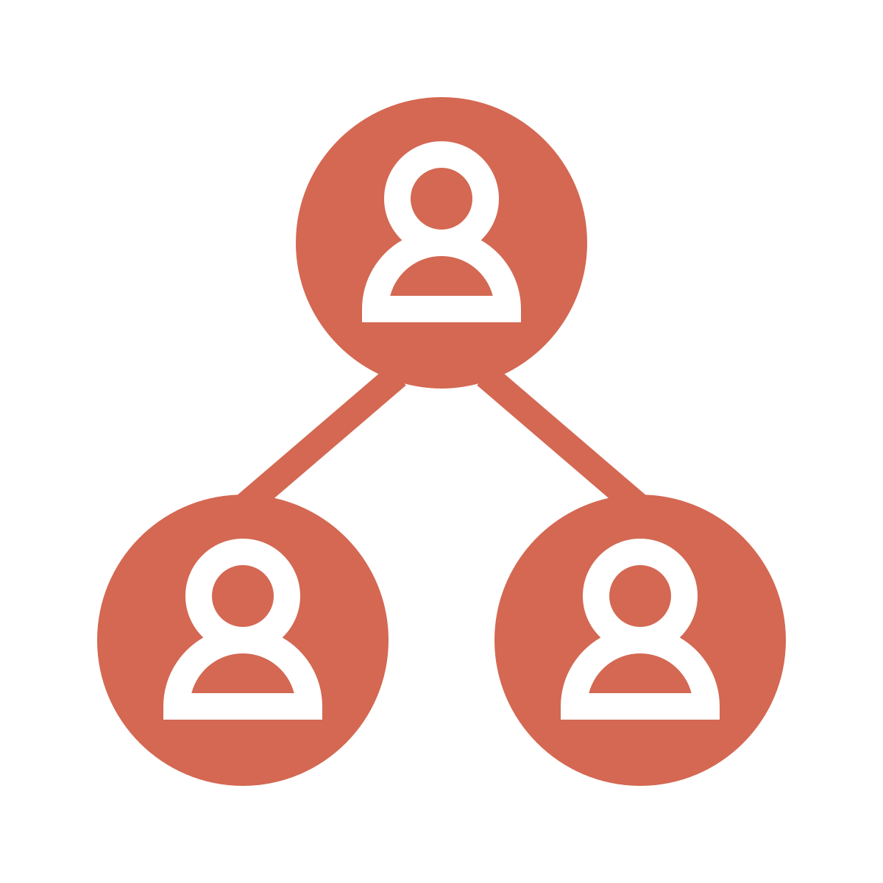
What we do in this community
Raise awareness of RSE
Share knowledge and resources
Share our work and collaborate
Showcase African expertise
Help to connect African RSEs and the global community
https://talarify.co.za
https://rsse.africa/
https://researchsoft.org/

Slide 22




RSSE-Africa
Online forum
Ask questions, share info, and meet peers.
Slack channel
We host a channel on the international RSE Slack workspace.
Meetups
Join our monthly meetups. Showcase your work. Learn about resources and opportunities.
Newsletter
Stay up to date with community news. Subscribe to our monthly newsletter.
https://talarify.co.za
https://rsse.africa/
https://researchsoft.org/

Slide 23
2
https://talarify.co.za
https://rsse.africa/
https://researchsoft.org/

Slide 24


Share this info
Please tell your students, colleagues, employers, and funders about resources and opportunities shared in this presentation.
https://talarify.co.za
https://rsse.africa/
https://researchsoft.org/

Slide 25
3
https://talarify.co.za
https://rsse.africa/
https://researchsoft.org/

Slide 26

Make your voice heard
Help shape policy, funding, and research by sharing information
about your research software work through a variety of surveys:
What to fund: https://bit.ly/what-to-fund
Usability and Design in Scientific Open Source Software Projects: https://bit.ly/usability-and-design
International RSE survey: Next iteration coming soon…
https://talarify.co.za
https://rsse.africa/
https://researchsoft.org/
Notes:
What to fund: A group of funding agencies from various countries around the world (https://www.researchsoft.org/funders-forum) is discussing the possibility of issuing a joint multilateral call to fund projects related to Research Software. The goal is to strengthen the software infrastructure aimed specifically at supporting research.
Usability & Design: Fill in Superbloom’s survey to contribute to research on how scientific open source software teams understand, consider, and undertake usability and design initiatives. An optional $15 USD Tremendous gift card is offered for your time.

Slide 27
Acknowledgements
We’d like to thank the following people for their support, contributions and collaboration
Peter van Heusden (SANBI, South Africa)
Kim Martin (RSE @ SUN founder and RSE advocate)
ReSA community managers (Saranjeet, Paula, and Kim)
Members of the UK RSE community who joined our community meetups
Member of RSSE-Africa for being part of the community
The global community for being open and collaborative!
https://talarify.co.za
https://rsse.africa/
https://researchsoft.org/

Slide 28
Thank you for your time!
We look forward to seeing you in the community!!
Questions?
https://talarify.co.za
https://rsse.africa/
https://researchsoft.org/

Slide 29
A selection of fantastic resources and events
Annual RSECon - https://rsecon23.society-rse.org/
Research Software Funders Forum - https://www.researchsoft.org/funders-forum/
Collaborations Workshop - https://www.software.ac.uk/programmes-and-events/collaborations-workshops
RSE Fellows - https://society-rse.org/community/rse-fellows/
SSI Fellows - https://software.ac.uk/programmes-and-events/fellowship-programme
Mentorship - https://openlifesci.org/
Research software community forum - https://www.researchsoft.org/events/2022-06/
Did you know that there’s an International RSE Day (12 OCT 2023)?
Research software directory - https://research-software.dev/
Practical guide to software management plans - https://doi.org/10.5281/zenodo.7038280
Job descriptions: https://www.software.ac.uk/blog/2022-08-12-how-do-we-assess-candidates-rse-jobs
Loads of other resources: https://www.software.ac.uk/resources/guides
Research software studies in Zenodo: https://zenodo.org/communities/researchsoftwarestudies/
Links to work done by Dr Kim Martin around RSE@SUN through collaboration with SSI: https://www.software.ac.uk/blog/2023-04-27-presenting-rsecon22-and-starting-rse-group-south-africa
https://talarify.co.za
https://rsse.africa/
https://researchsoft.org/

Slide 30
Overview of organisations
ReSA - https://www.researchsoft.org/
Society of Research Software Engineering - https://society-rse.org/
Research Software Funders Forum - https://www.researchsoft.org/funders-forum/
Software Sustainability Institute - https://www.software.ac.uk/
RSSE-Africa - https://rsse.africa/
South African National Bioinformatics Institute (SANBI) - https://www.sanbi.ac.za/
Talarify - https://talarify.co.za
https://talarify.co.za
https://rsse.africa/
https://researchsoft.org/

Slide 31
This presentation is available under
the CC-BY 4.0 international license.
Please cite it as follows:
Anelda van der Walt & Michelle Barker. (2023). Growing awareness of the importance of research software and the people who develop it. ZA-REN Week 2023. https://doi.org/10.5281/zenodo.10013668
https://talarify.co.za
https://rsse.africa/
https://researchsoft.org/

Slide 32
References for slide 5
[1] Katz, D. S., McHenry, K., Reinking, C. & Haines, R. Research Software Development Management in Universities: Case Studies from Manchester’s RSDS Group, Illinois’ NCSA, and Notre Dame’s CRC. in 2019 IEEE/ACM 14th International Workshop on Software Engineering for Science (SE4Science) 17–24 (2019). doi:10.1109/SE4Science.2019.00009
[2] Nangia, U. & Katz, D. S. Understanding Software in Research: Initial Results from Examining Nature and a Call for Collaboration. in 2017 IEEE 13th International Conference on e-Science (e-Science) 486–487 (2017). doi:10.1109/eScience.2017.78
[3] Nangia, U. & Katz, D. S. Track 1 Paper: Surveying the U.S. National Postdoctoral Association Regarding Software Use and Training in Research. (2017). doi:10.6084/m9.figshare.5328442.v3
[4] Hannay, J. E. et al. How do scientists develop and use scientific software? in 2009 ICSE Workshop on Software Engineering for Computational Science and Engineering 1–8 (2009). doi:10.1109/SECSE.2009.5069155
Original source: Christina Maimone. (2019). North Western Research Computing and Data Services Updates, Events, and Resources. (link)
https://talarify.co.za
https://rsse.africa/
https://researchsoft.org/

