Slide 1
Topic Modeling for Exploratory Fanfiction Analysis
October 12, 2023
FSNNA2023
Julia Neugarten
PhD Candidate in Cultural Studies
Radboud University, the Netherlands

Slide 2
Schedule
Presentation (20 minutes)
- My project: Anchoring and Innovating Classical Motifs in Contemporary Online Fanfiction
- Introducing the MythFic corpus and MythFic Metadata
- Topic Modeling: Techniques and Problems
Hands-On Part: Exploring the Topic Model (30 minutes)
Plenary Discussion: what did you find? (20 minutes)
Questions (20 minutes)

Slide 3

Anchoring and Innovating Classical Motifs in Contemporary Online Fanfiction
PhD-project (2022-2026)
Research question:
How is source material from Greco-Roman Antiquity transformed in contemporary online fanfiction?
  Part of Anchoring Innovation
  Combining digital humanities with more traditional humanities methods

Slide 4

The MythFic Corpus
5.154 works of fanfiction from Archive of Our Own
Fandom: Ancient Greek Religion & Lore
In English
Around 29 million words
Notes:
Note: at a rate of 52 novels a year or one novel a week, considering the average novel is 80.000 words, this corpus would take me almost seven years to read with my eyeballs, so distant reading seemed like a good idea.

Slide 5
MythFic Metadata
1.422 fandoms
5.455 characters
3.297 relationships
13.936 additional tags
Anonymized dataset available for reuse!
Notes:
Note: MythFic Metadata can be downloaded here: https://data.ru.nl/collections/ru/rich/mythfic_metadata_dsc_550?0

Slide 6
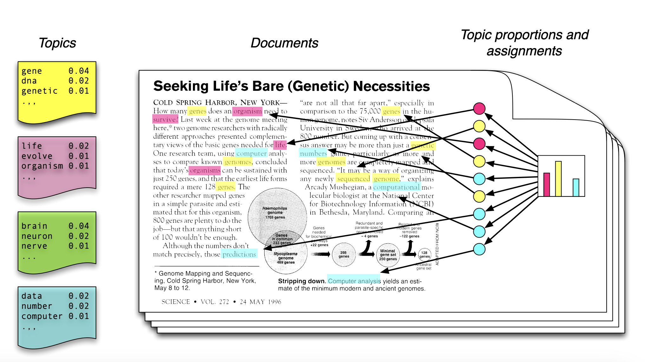
What is Topic Modeling
Identifies ‘topics’ or clusters of word usage in a set of texts
Assumptions (Blei 2012)
1. Each topic is a distribution over words
2. Each document is a mixture of corpus-wide topics
3. Each word is drawn from one of those topics
Reflects ‘the order of things’ in literary text (Uglanova & Gius 2020)
Or: reflects the ‘aboutness’ of a corpus (Murakami et. al. 2017).
Image from Blei (2012)
Notes:
The assumptions underlying topic modeling can cause problems, because:
- especially in literary text, it is very possible for a topic (like revenge or love or tragedy) to be subtextual, i.e. not expressed in the actual words
- some words (like ‘a’, ‘and’, ’the’ and ‘is’) are very frequent in textual date but arguably don’t relate to any topics

Slide 7
Problems of Topic Modeling
Some approaches depend heavily on the parameters you set (Egger & Yu 2022)
Difficult to interpret, like ‘reading tea leaves’ (Chang et. al. 2009)
Contextual factors like story setting or author strongly influence topics (van Zundert et. al. 2022)
The presence of names in your texts complicates matters (Jockers 2013)
Example
climate
carbon
emissions
skepticism
Notes:
Relevant parameters include text length
In the example, word 4 probably changes your understanding of the topic
A topic model will cluster together texts set in the same location, for example, because place names will ‘tie’ them together.
If this corpus contains references to both John Watson and John Winchester, the topic model obviously won’t distinguish between the Johns.

Slide 8
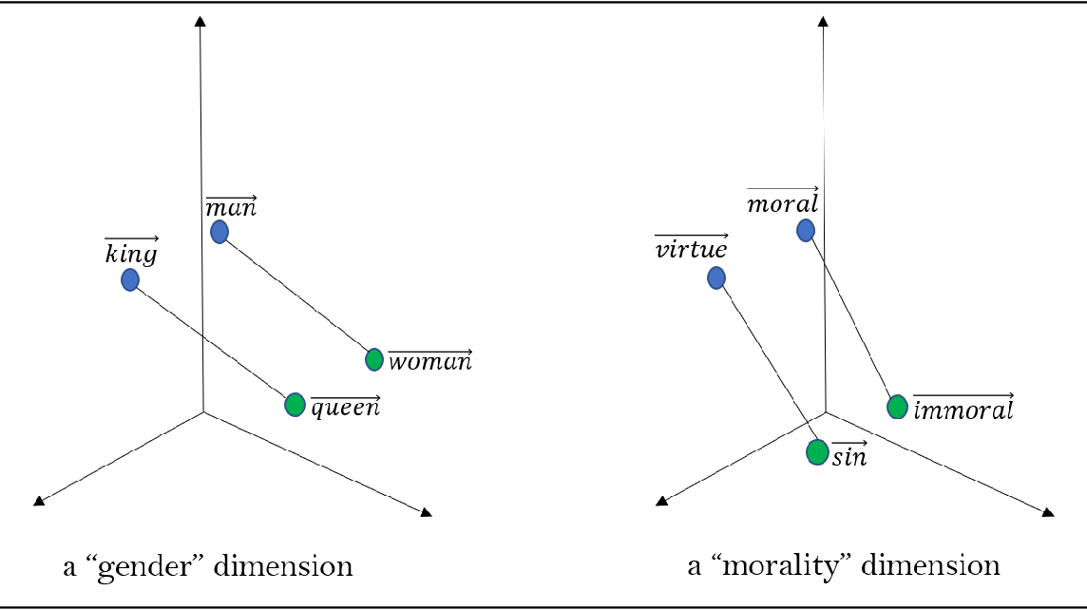
Top2Vec (Angelov 2020)
Uses vector-space model of words and documents, image from Arseniev-Koehler (2021)
Notes:
In a multidimensional vector space, words, documents and topics are plotted based on words and the words that surround them.

Slide 9
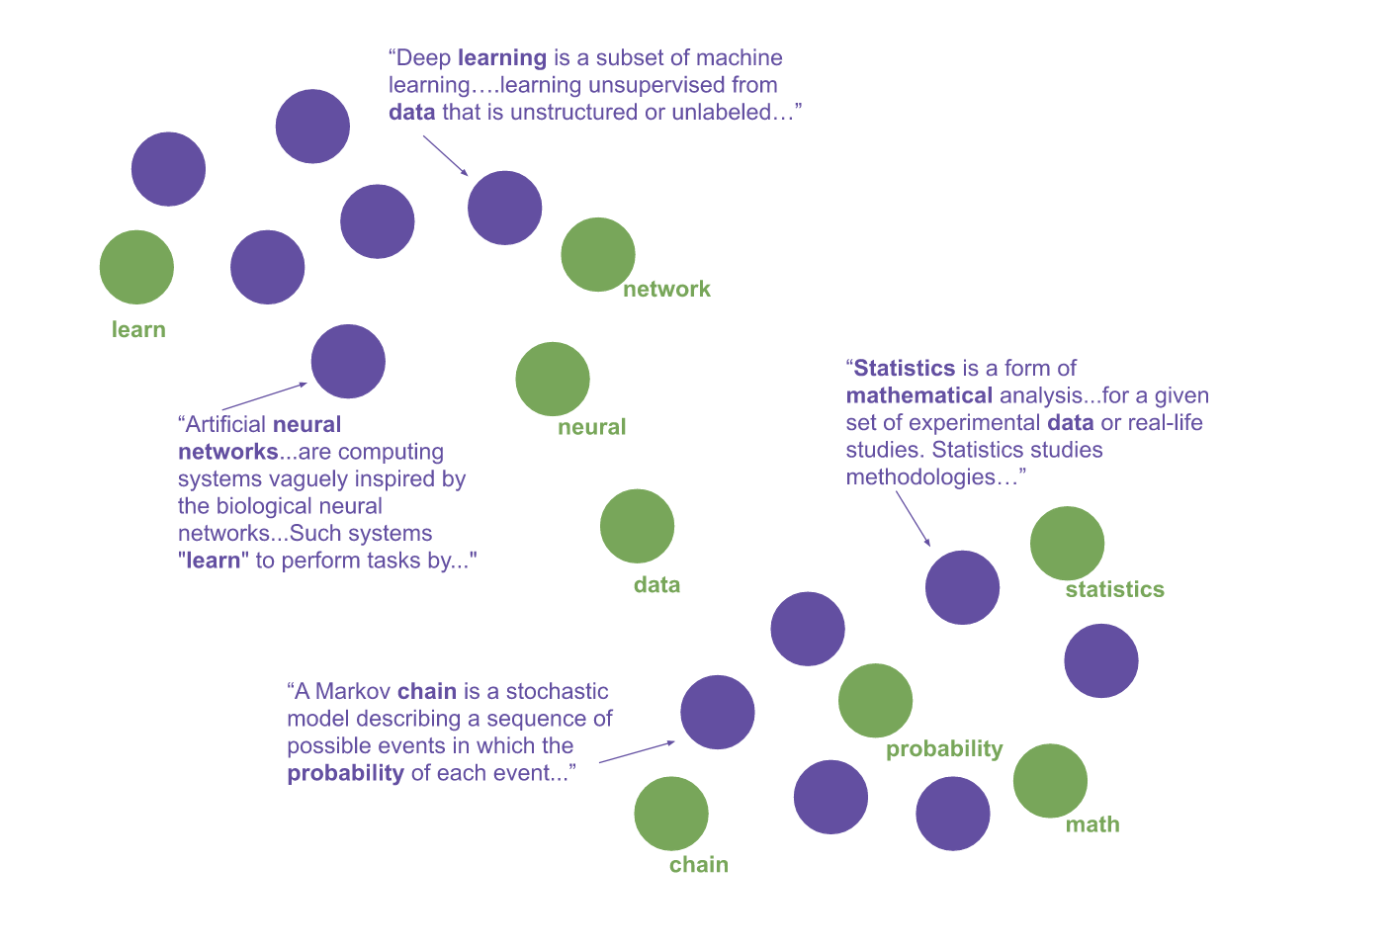
Top2Vec (Angelov 2020)
In the Top2Vec vector space, documents are placed close to other similar documents and close to the most distinguishing words.

Slide 10
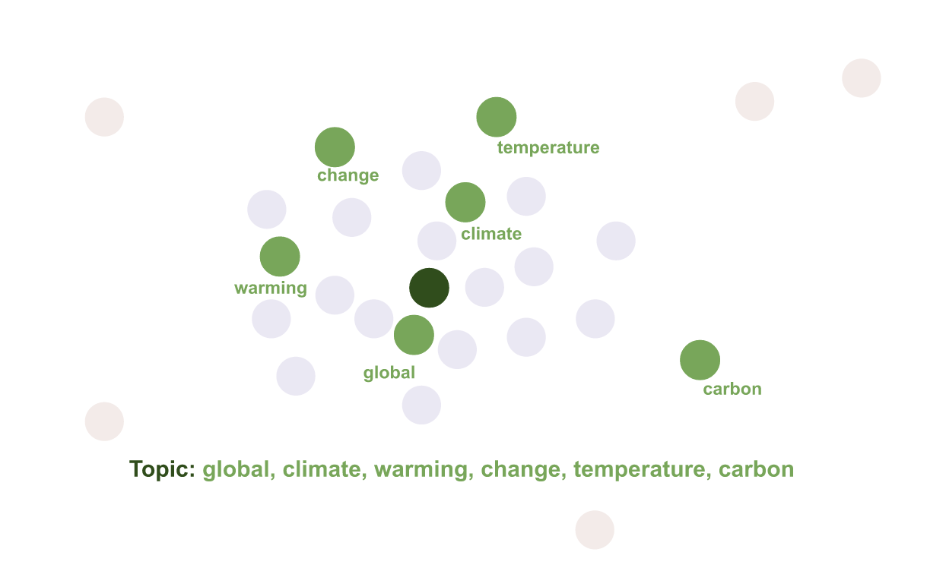
Top2Vec (Angelov 2020)
The closest word vectors in order of proximity become the topic words.

Slide 11
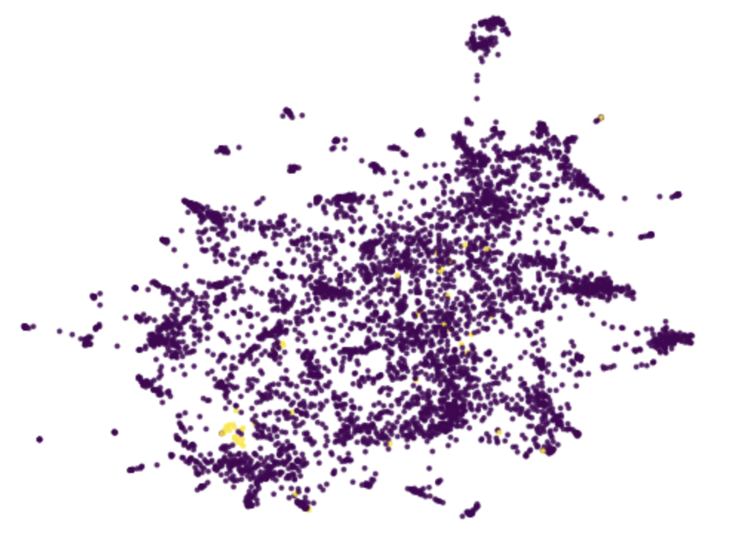
Dimensionality Reduction of the MythFic Topic Model
Notes:
This is what the topic model looks like if you flatten or reduce all these dimensions. The yellow dots are a single topic.

Slide 12
The Fun Stuff!
  Coding Path
  - a Google Colab Notebook to explore the Top2Vec topic model of MythFic
  - How many topics are there?
  - How many documents relate to each topic?
  - Which words are in each topic? Do they seem to have internal coherence?
  - Create visualizations
  - Find topics most closely related to specific keywords, i.e. ‘man’ versus ‘woman’

Slide 13
The Fun Stuff!
  No Coding? No Problem!
  - a folder containing word cloud visualizations of each topic
  - an overview of how many documents relate to each topic
  - Which words are in each topic? Do they seem to have internal coherence?
  - Ask me to find the topics most closely related to specific keywords for you!

Slide 14
Accessing and exploring the topic model
For attendees of the conference, I’ve shared the material via Discord.
For others, keep an eye on my Github -- https://github.com/julianeugarten --
because a repo with all the materials you need is currently under construction.

Slide 15
Discussion
What did you find?
What kinds of analysis or insight do these topics support?
What kinds of analysis or insight do these topics obscure?
  Could you apply topic models in your own research?
Notes:
Note: we concluded that it would be fruitful to create a second topic model with character names removed.

Slide 16




Contact Me
Do you want to apply Top2Vec topic modeling or use MythFic Metadata in your own research? Let me know!
https://github.com/julianeugarten
julia.neugarten@ru.nl
@julia_neugarten
https://julianeugarten.github.io/julianeugarten/

Slide 17
Questions?

Slide 18
References
Angelov, Dimo. Top2Vec: Distributed Representations of Topics. arXiv:2008.09470, arXiv, 19 Aug. 2020, https://doi.org/10.48550/arXiv.2008.09470.
Arseniev-Koehler, Alina. Theoretical Foundations and Limits of Word Embeddings: What Types of Meaning Can They Capture? July 2021, https://doi.org/10.31235/osf.io/vrwk3.
Blei, David M. Probabilistic Topic Models. 2012, http://www.cs.columbia.edu/~blei/talks/Blei_ICML_2012.pdf.
Chang, Jonathan, et al. “Reading Tea Leaves: How Humans Interpret Topic Models.” Advances in Neural Information Processing Systems 22, 2009.
Egger, Roman, and Joanne Yu. “A Topic Modeling Comparison Between LDA, NMF, Top2Vec, and BERTopic to Demystify Twitter Posts.” Frontiers in Sociology, vol. 7, May 2022, p. 886498, https://doi.org/10.3389/fsoc.2022.886498.
Firth, John Rupert. Studies in Linguistic Analysis. Wiley-Blackwell, 1957, https://cs.brown.edu/courses/csci2952d/readings/lecture1-firth.pdf.
Jockers, Matthew Lee. Macroanalysis: Digital Methods and Literary History. University of Illinois Press, 2013.
Murakami, Akira, et al. “‘What Is This Corpus about?’: Using Topic Modelling to Explore a Specialised Corpus.” Corpora, vol. 12, no. 2, 2017, pp. 243–77, https://doi.org/10.3366/cor.2017.0118.
Neugarten, Julia, and Roel Smeets. MythFic Metadata: Exploring Gendered Violence in Fanfiction about Greek Mythology. 1.0, Radboud University, 28 Apr. 2023, https://doi.org/10.34973/2MYE-8468.
Uglanova, Inna, and Evelyn Gius. The Order of Things. A Study on Topic Modelling of Literary Texts. 2020, http://ceur-ws.org/Vol-2723/long7.pdf.
van Zundert, Joris J., et al. “What Do We Talk About When We Talk About Topic?” CHR 2022: Computational Humanities Research Conference, 2022, https://ceur-ws.org/Vol-3290/short_paper5533.pdf.

